Slide 1
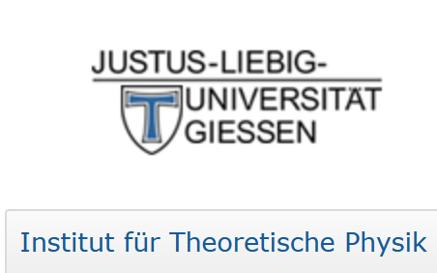
Reaction Approach to Lepton Number Violating Processes
Horst Lenske
Institut für Theoretische Physik, U. Giessen (Germany)
and
NUMEN Collaboration, LNS Catania (Italy)

Slide 2
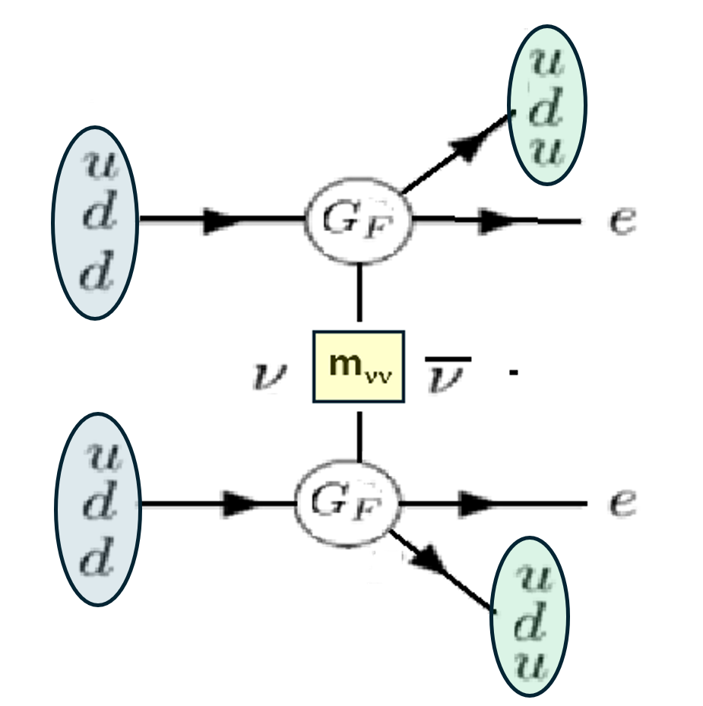
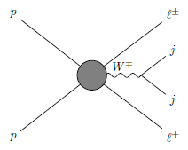
Lepton Number Violation from MeV to TeV Scale
LDCE
Nuclear 0ν2β (DBD) Decay
A(Z,N) → B(Z-2,N+2)
pre-defined, fixed energies
E ̴ MeV
Lepton pair of like-charge plus hadron jet-jet production
in pp/AA collisions
E ̴ TeV

Slide 3
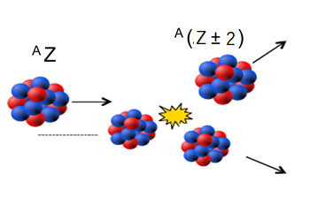
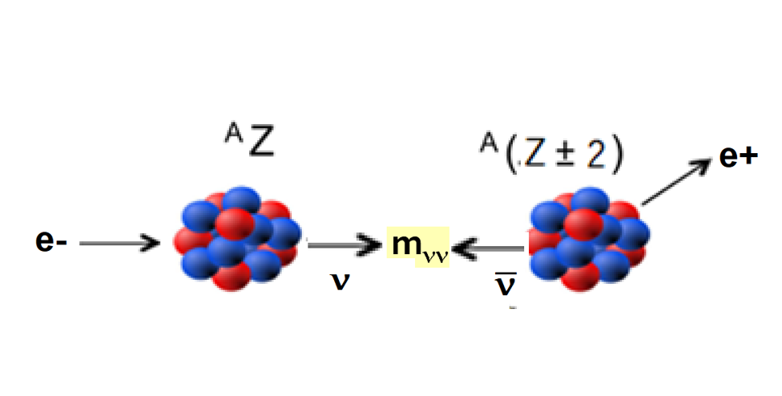
Bridging the Gap with… DCE Reaction Studies on Nuclei
Hadron and Nuclear Beams:
Lepton Beams:
(μ+)
(μ-)
A(π+,π-)B reactions: LAMPF ̴1980 - 1995
A(a,b)B |ΔZ| = 2 reactions: NUMEN@LNS
Lepton number violation: |ΔL| = 2
LNV under laboratory conditions
DSCE NME ( ≈2ν2β) and MDCE NME (≈ 0ν2β) @ MeV
New access to LNV in nuclear systems @ GeV to TeV

Slide 4
Probing Nuclear Isotensor Response in Heavy Ion Double Charge Exchange Reactions
Peripheral Direct Reactions of Heavy Ions
DCE Dynamics by Collisional NN and πN Interactions
Probes for 2p2h Nuclear Isotensor Spectroscopy
The NUMEN Multi-Methods Approach – Pair Transfer and DCE:
F. Cappuzzello, H.L. et al., Prog.Part.Nucl.Phys. 128 (2023) 103999

Slide 5
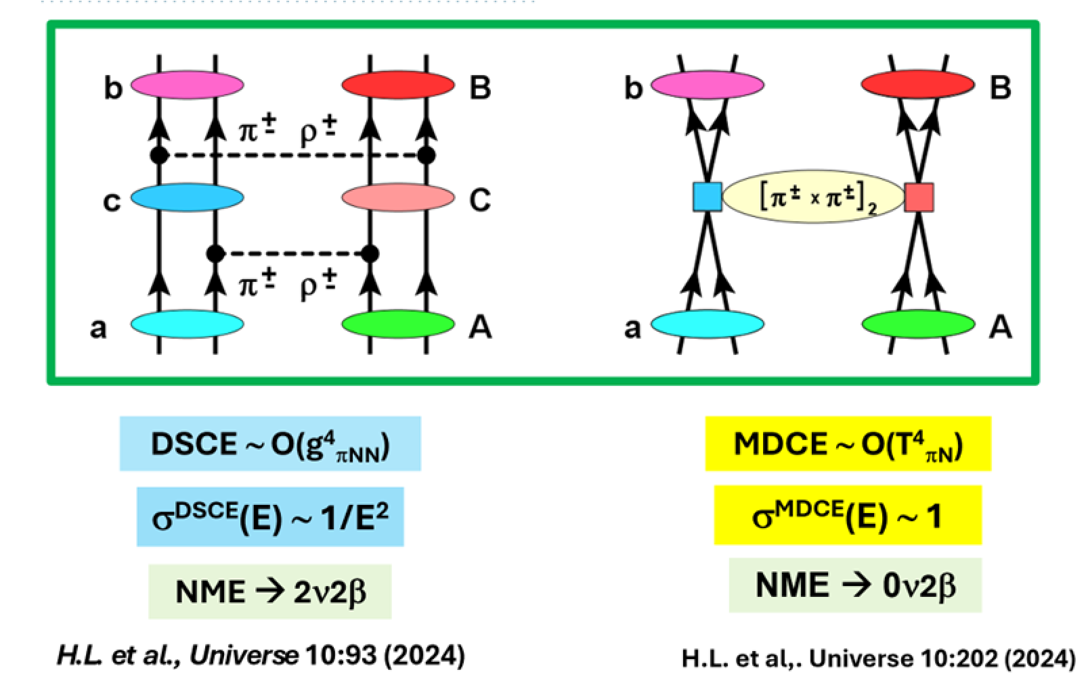
DCE Reactions on Nuclei with Hadron and Nuclear Beams
Double Single CE (DSCE)
„Majorana“ DCE (MDCE)

Slide 6
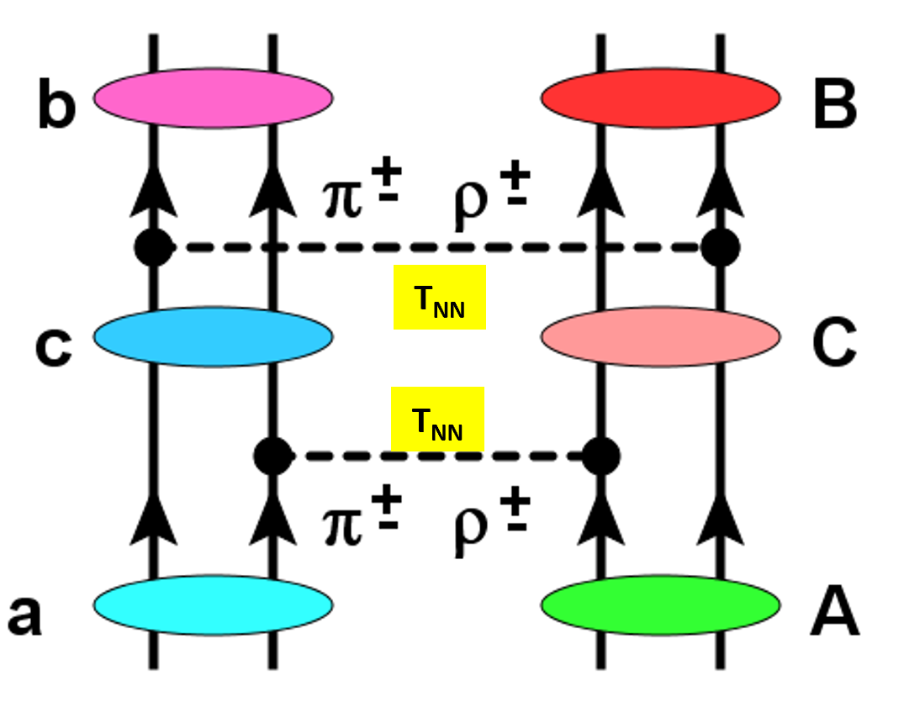
Double Single Charge Exchange Reactions n DCE by 2nd Order NN Isovector Interactions ~T²_{NN}
FSI
Rank-2 Isotensor Op.
ISI
H.L. et al., Universe 10:93 (2024)

Slide 7
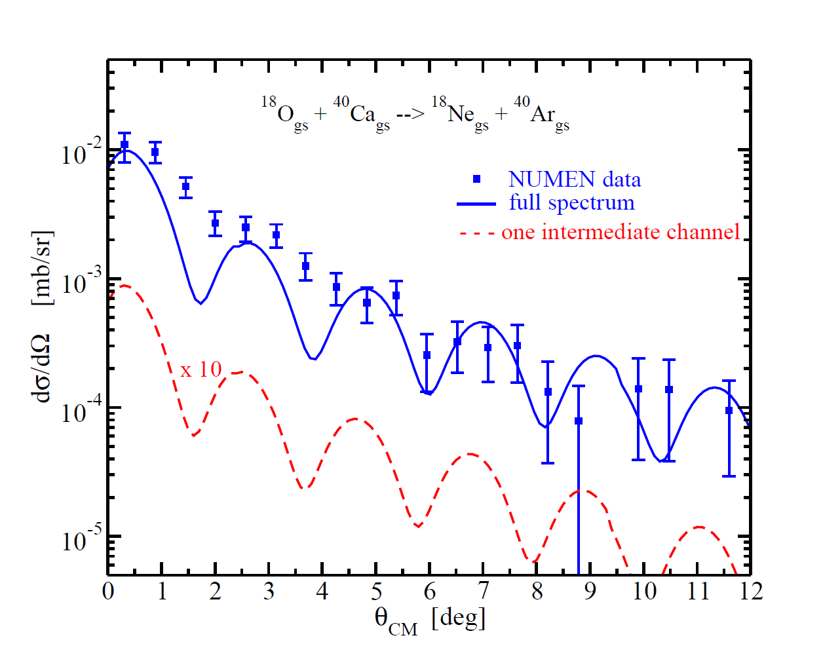
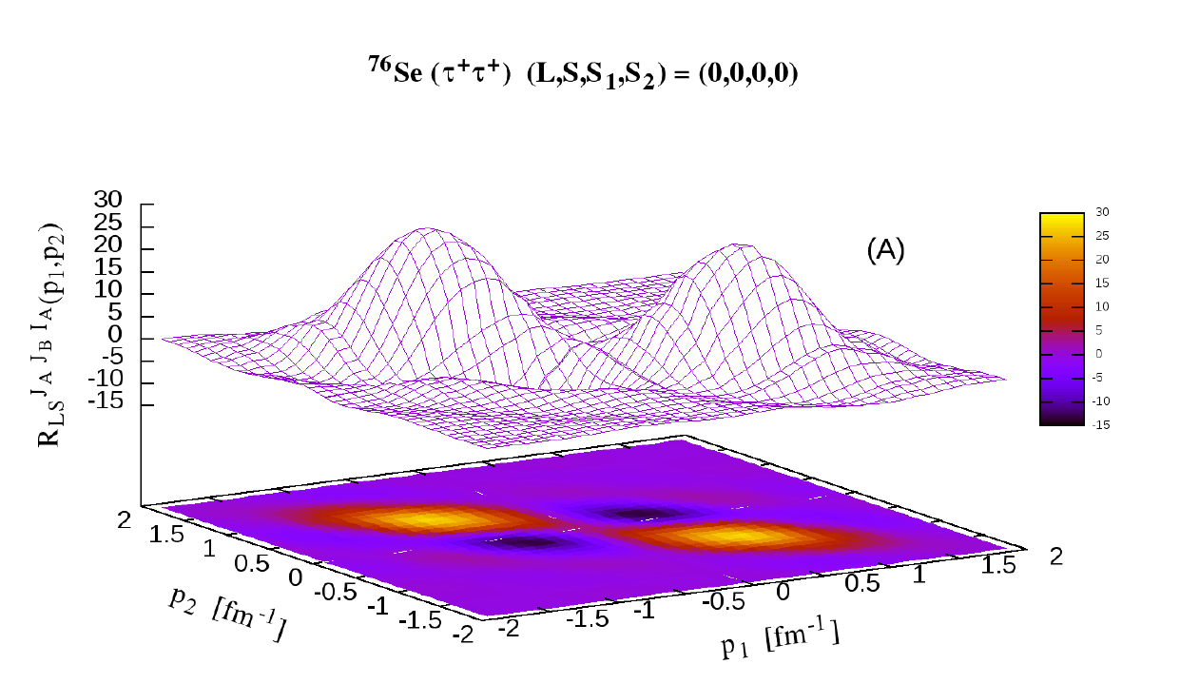
DSCE Theory: 2nd Order DWA and QRPA Nuclear Spectroscopy
¹⁸O+⁴⁰Ca →¹⁸Ne+⁴⁰Ar @ T_{lab}=15 MeV/A
More about DSCE → Maria Colonna
⁴⁰K(1⁺)
PRC (2025) in print
Theory: Jessica Bellone et al., PLB 807 (2020), Data: F. Cappuzzello et al., EPJ A51 (2015)

Slide 8
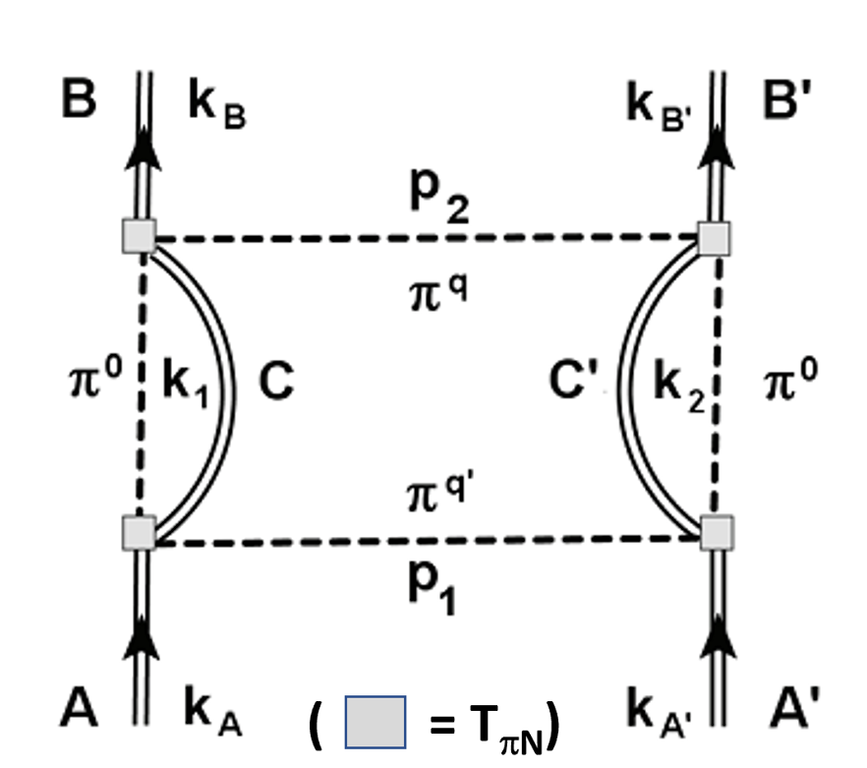
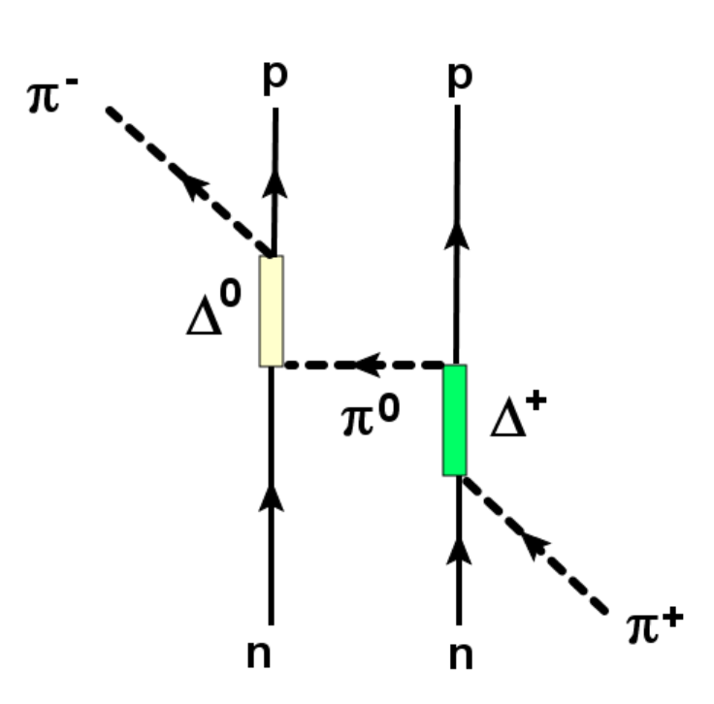
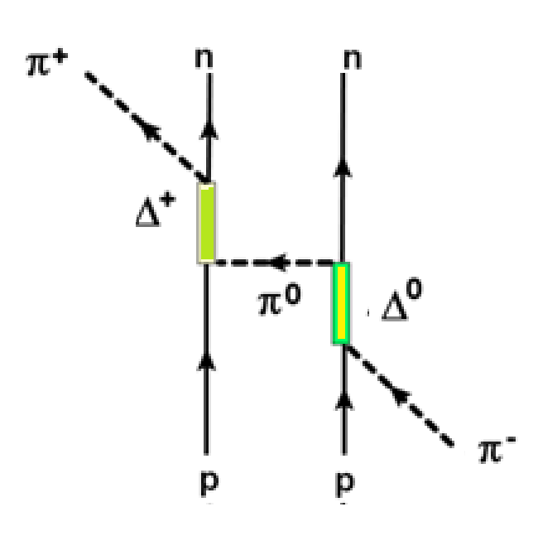
Majorana DCE (MDCE) Scenario
DCE via 2nd Order (off-shell) πN Isovector Interactions
On-shell counterpart:
(π⁺,π⁻) DCE reaction
On-shell counterpart:
(π⁻,π⁺) DCE reaction
H.L. et al,. Universe 10:202 (2024)
I_{2 ± 2}
I₂ ₂

Slide 9
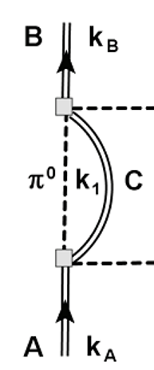
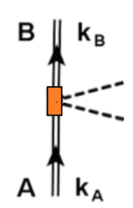
MDCE rank-2 Isotensor Nuclear Transition Matrix Elements
Natural Separation Scale = m_{π} → Closure Approximation
Caterina Garofalo
M.Sc. Thesis 2024
Pion Potentials

Slide 10
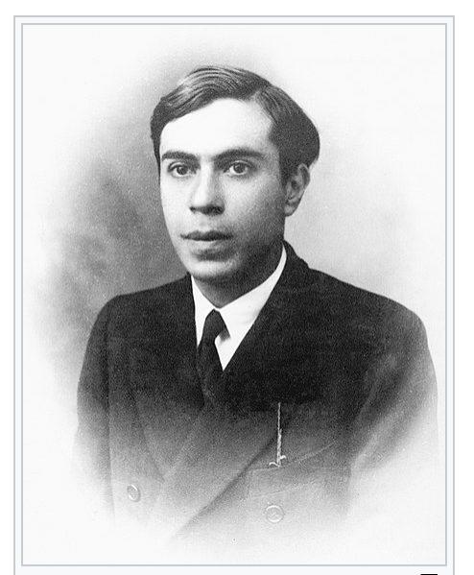
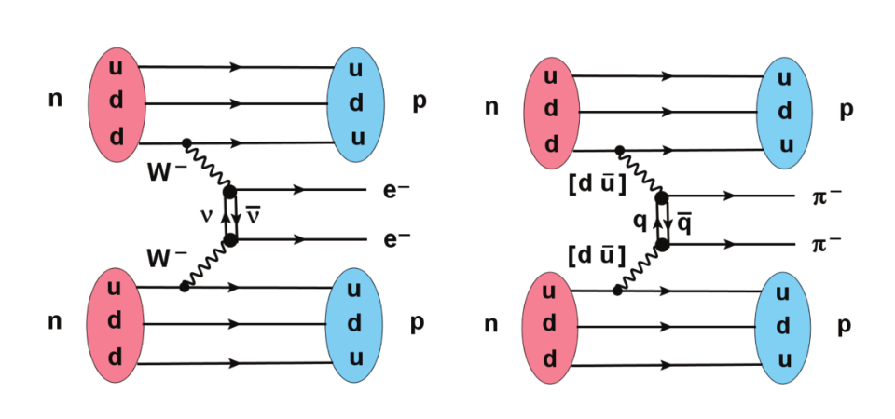
MDCE and 0ν2β Decay
The Majorana Aspect of MDCE Physics
ρ⁻∼
Ettore Majoran
*Aug., 5, 1906, at Catania
disappeared, Mar, 1938
+ 1959 in Venezuela?
+ in a Sicilian monastery?
ρ⁻∼
MDCE ≡ dynamically induced virtual Double Pion Decay
Strong-Interaction Counterpart of 0ν2β DBD
Probing 0ν2β Nuclear Wave Functions

Slide 11
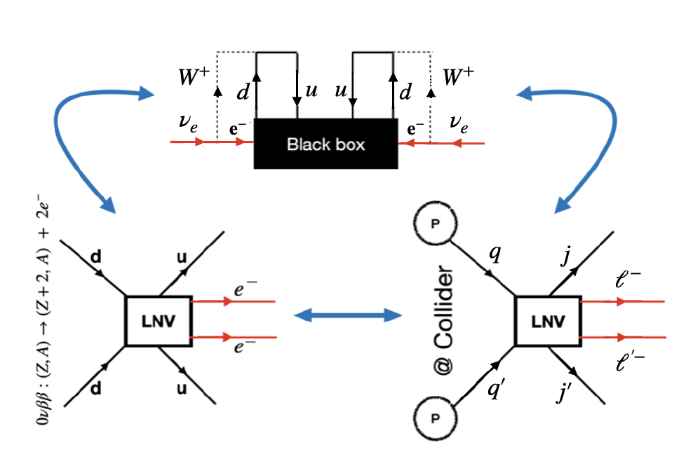
Double Beta Decay, LNV at Accelerators and the Black Box Theorem^{*)}
“If by whatsoever reason 0ν DBD exists, then the same mchanism will also cause LNV - and vice versa.“
^{*)}J. Schechter and J.W.F. Valle, Phys.Rev. D 25 (1982) 295
Babu et al., JHEP 06:132 (2024)

Slide 12
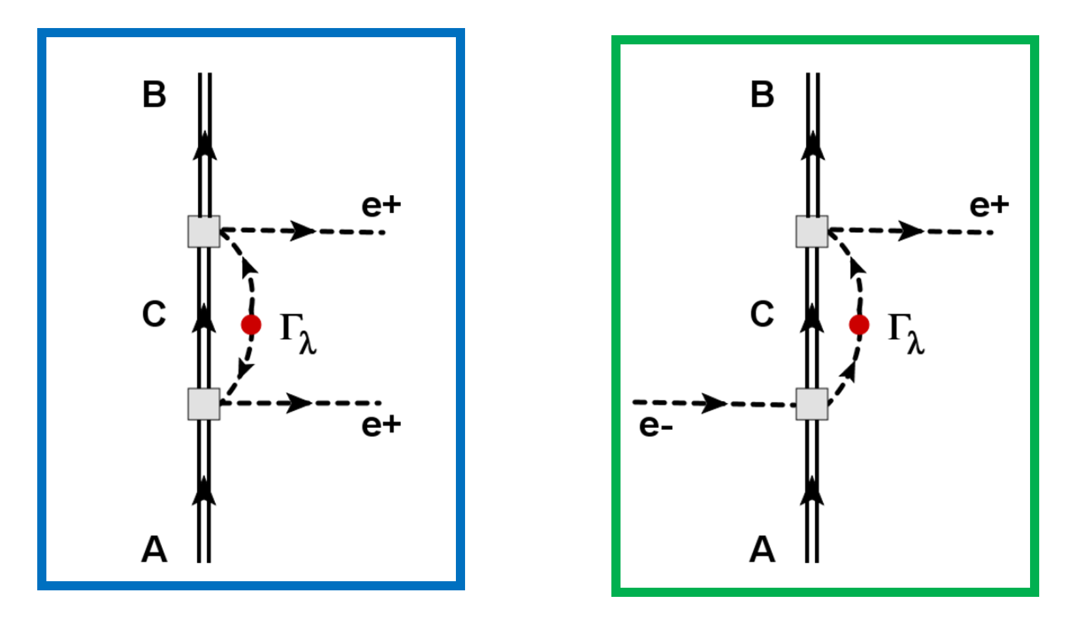
Lepton DCE Reactions on Nuclei
Majorana DBD vs. Majorana DCC
fixed energy vs. variable energy

Slide 13
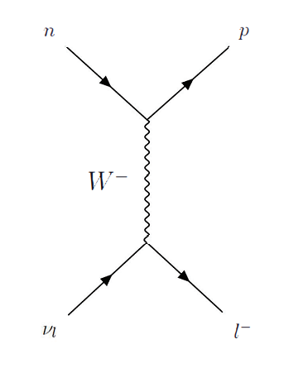
The LDCE Matrix Element
2nd Order CC (DCC) Reaction Amplitude
E_{ℓ}
0
1st Order (e-,ν_{e}) CC Amplitude
1st Order (ν_{e},e+) CC Amplitude
Half off-shell!

Slide 14
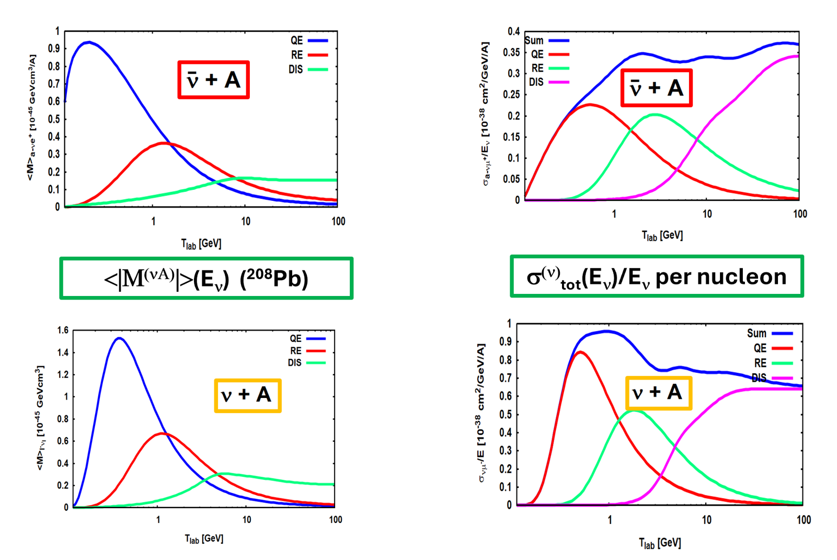
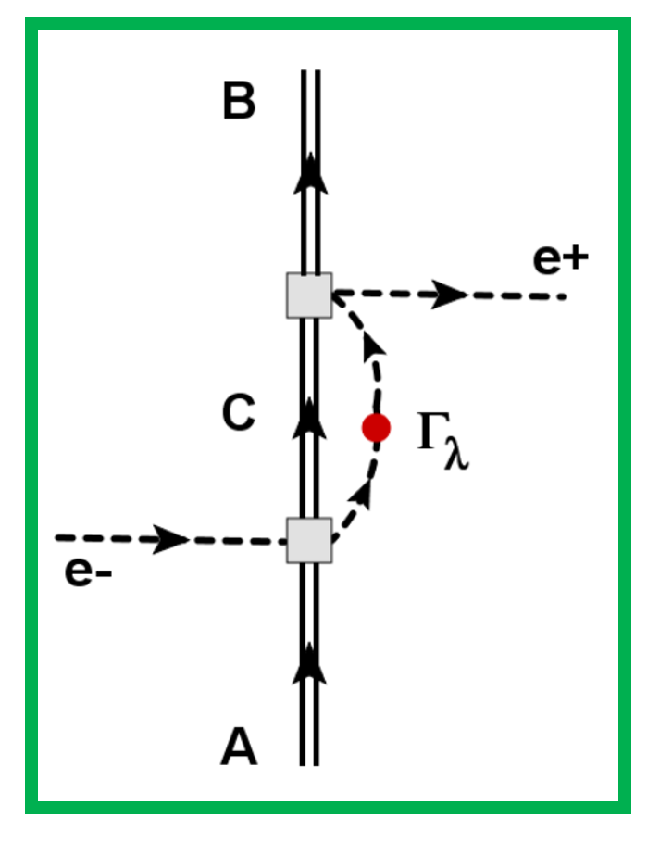
(e-,e+) Lepton DCE (LDCE) Reactions as a LNV Probe
ΔL=-2

Slide 15
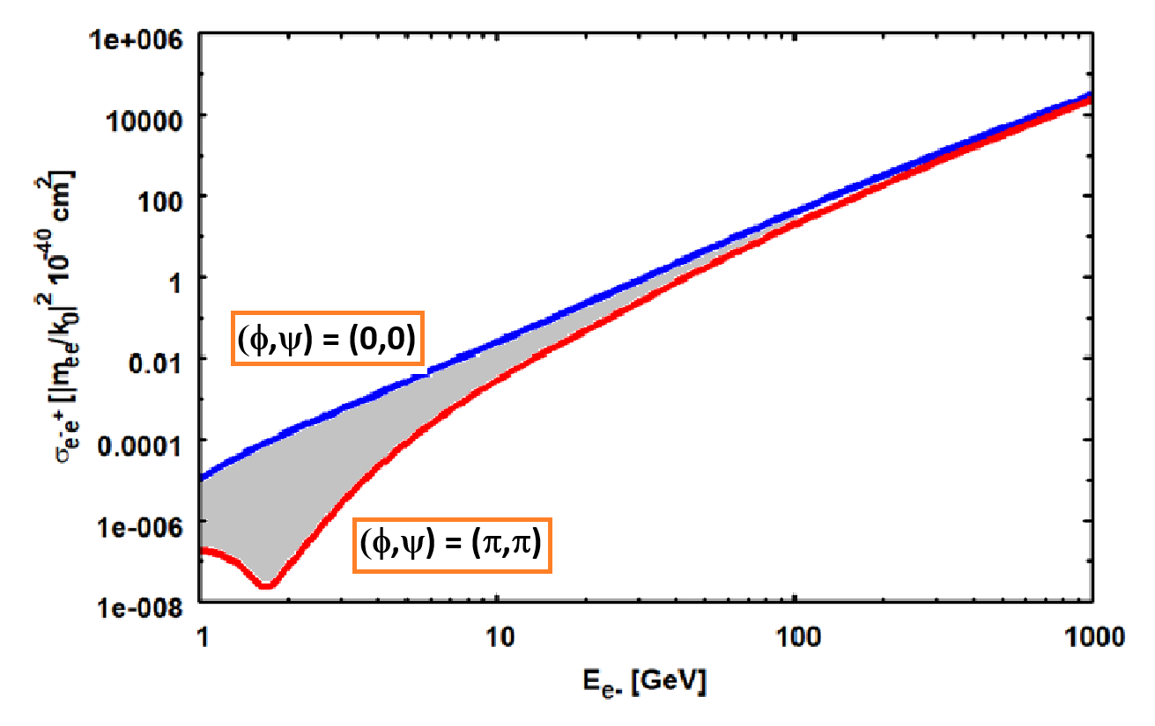
Estimating LDCE Cross section
σ_{e-e+}(²⁰⁸Pb →²⁰⁸Hg)
EIC
(eA @ 20-140 GeV)
HERA@DESY
(ep @ 320 GeV)
≈10⁻¹⁰ !!
Jlab
(e @12GeV)
Exp. simulations in progress:
Alessandro Spatafora

Slide 16
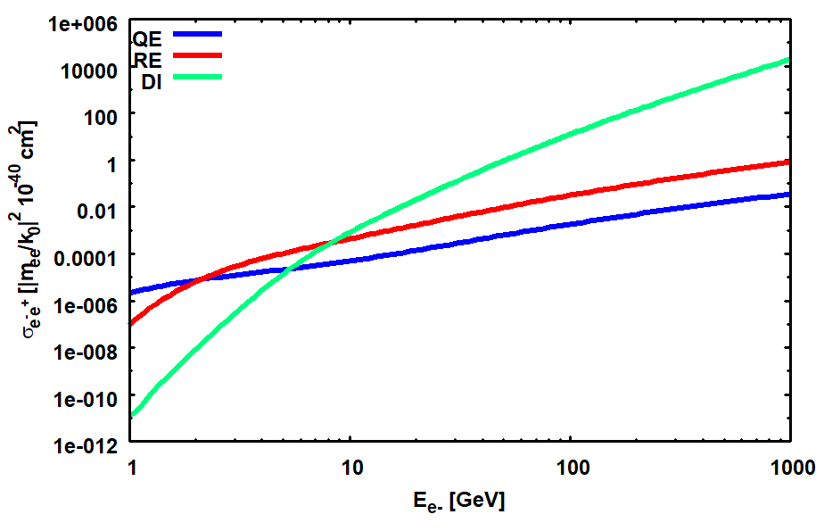
Challenges and Demands
LDCE Key Messages
Sizable x-sections in deep inelastic region
High yields at high energy at eA colliders
At 10 GeV region → Resonance-DIS competition
Half-off shell amplitudes for QE, RE, and DIS (→ PDF)
Transitional of light and heavy neutrino physics
|ΔL|=2 LEFT/SMEFT interactions of higher dimension

Slide 17
Summary
Double Single Charge Exchange (DSCE) by 2nd order NN interactions
„Majorana“ DCE (MDCE) by induced virtual Double Pion Decay
New perspective: DCE reactions for Nuclear 2p2h Isotensor Spectroscopy
Lepton DCE as an independent Probe for LNV and DBD
…with the NUMEN theory group:
J. Bellone, M. Colonna, D. Gambacurta (INFN/LNS Catania),
and C. Garofalo, A. Spatafora (INFN/LNS Catania)
Supported by DFG, grants Le439/17 Le439/16 , and INFN

Slide 18
Backups

Slide 19
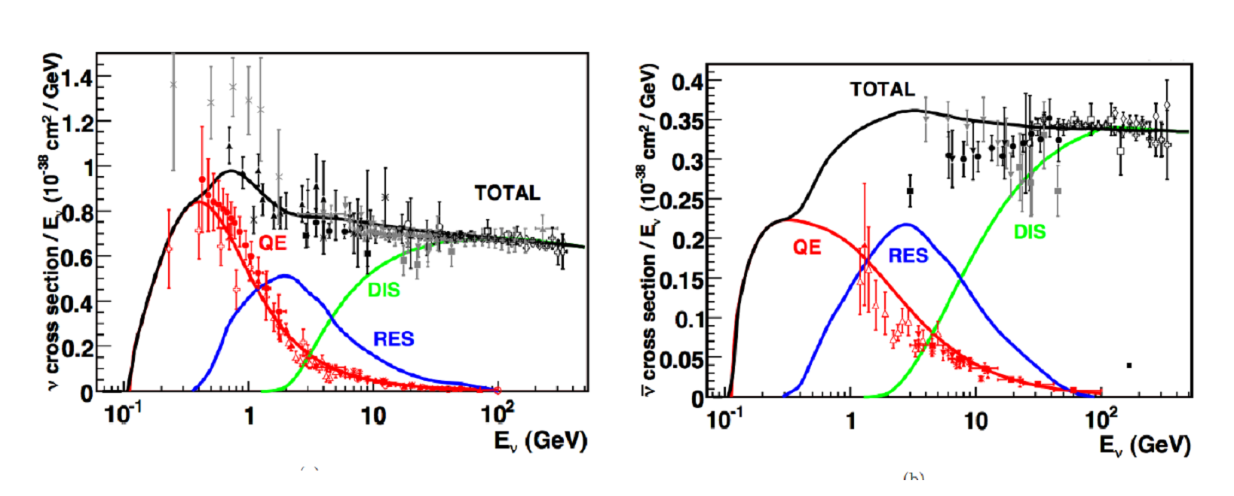
Neutrino-Nucleus Single Charged Current Cross Section
(ν_{μ},μ⁻) and (ν_{μ},μ⁺) Reactions per Energy and per Nucleon

Slide 20
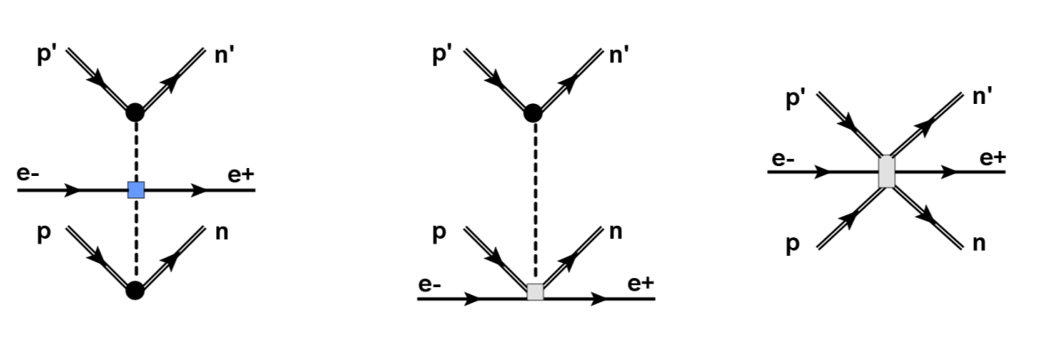
Structure of the LNV EFT-Lagrangian
The Δe=0 Majorana Part (MeV to GeV)
Sample Diagrams for Δe=2 (GeV to TeV)

Slide 21
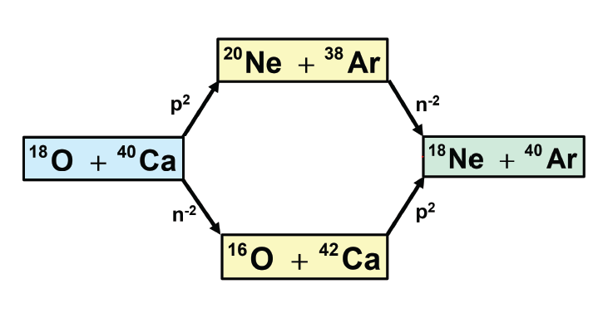
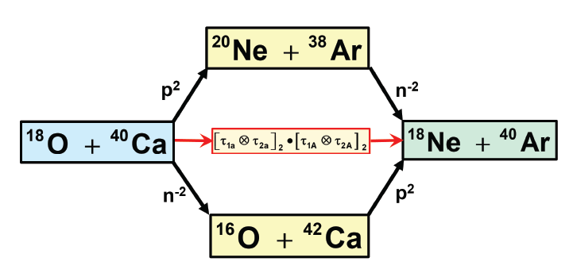
Heavy Ion DCE Reaction Mechanism
The Complete Picture: Direct and Transfer DCE
The NUMEN Multi-Methods Approach:
F. Cappuzzello, H.L. et al., Prog.Part.Nucl.Phys. 128 (2023) 103999

Slide 22
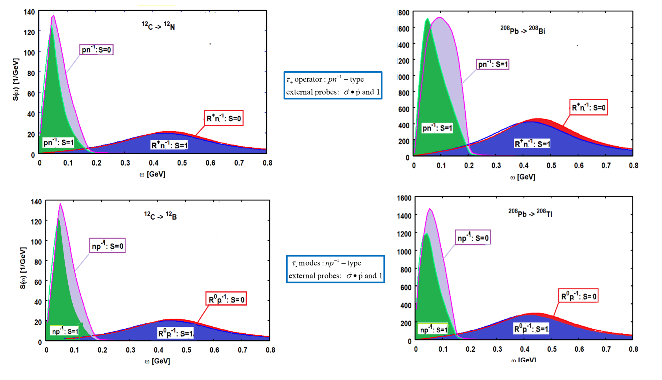
Nuclear Response Functions of Fermi and Gamow-Teller Operators
(Nucleons, Δ₃₃(1232), P₁₁(1440))
Phys.Rev.C 106 (2022) 1, 014618; Phys.Lett.B 807 (2020) 135565,

Slide 23
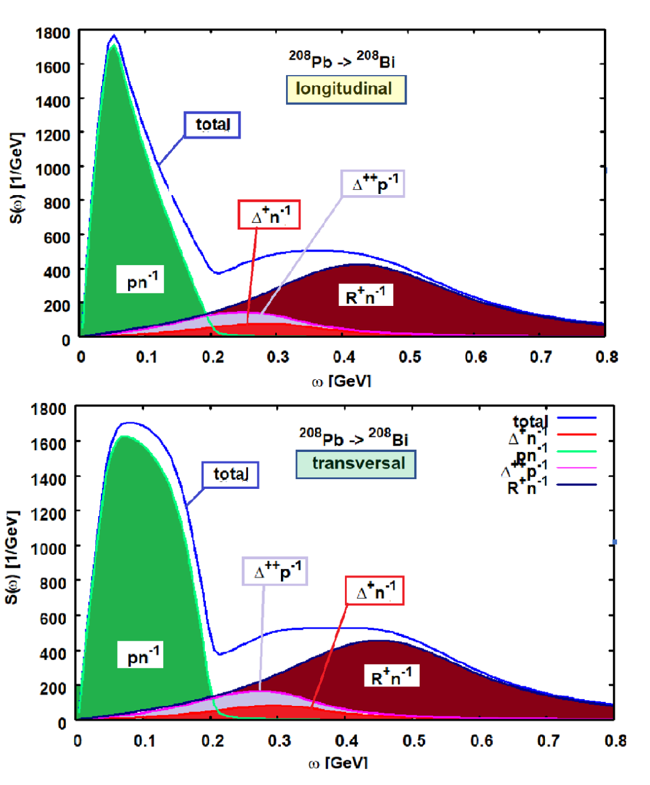
Longitudinal and Transversal Response Functions
(Nucleons, Δ₃₃(1232), P₁₁(1440))

Slide 24
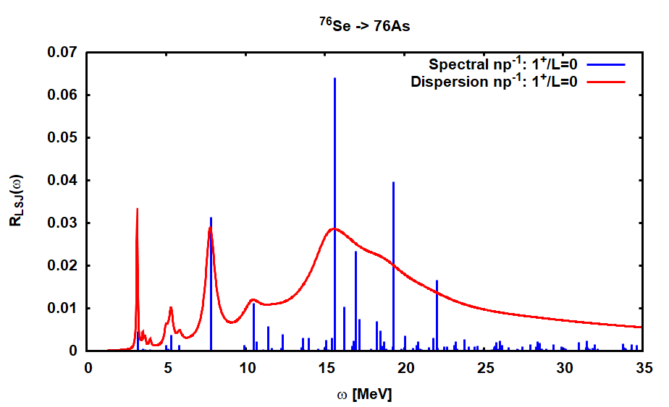
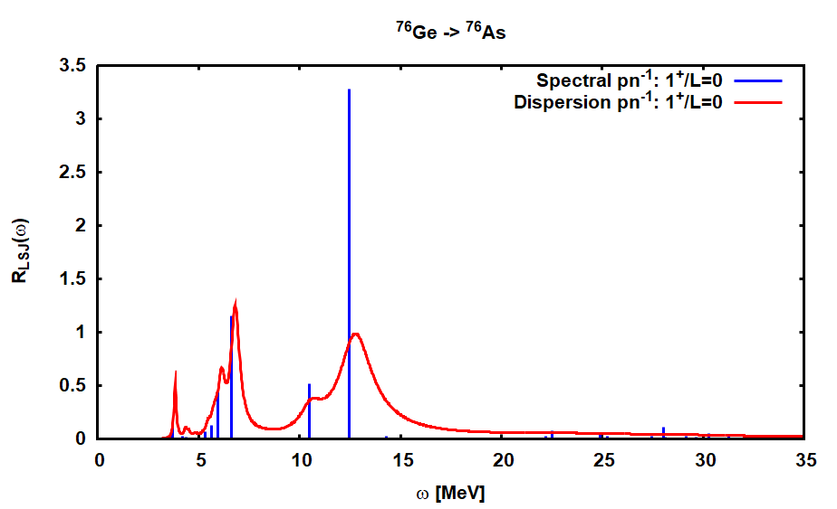
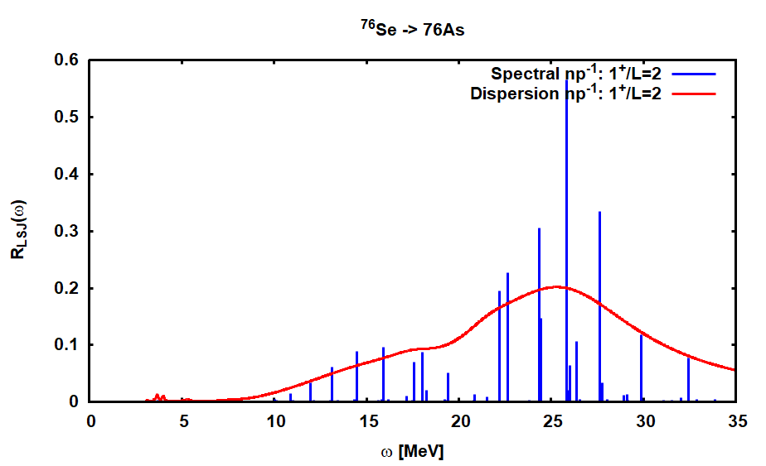
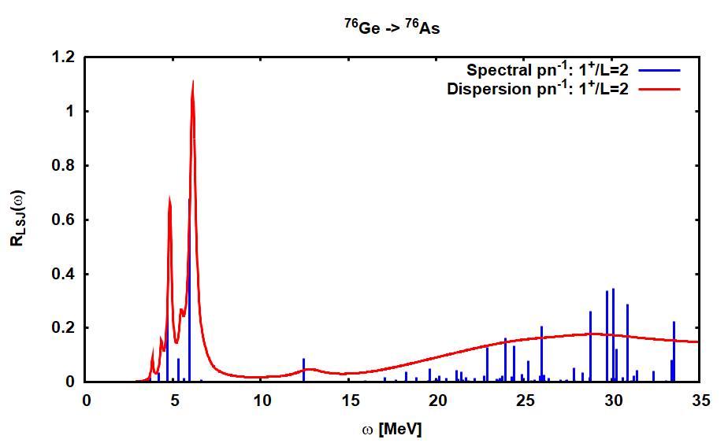
Ikeda Spin Sumrule – ω ≤ 60 MeV:
S_{GT}(-)-S_{GT}(+) = 33.96 ≤ 3(N-Z) = 36
np⁻¹
pn⁻¹
J^{π} = 1⁺
L=J-1
GiEDF+HFB+ccQRPA
e.g. Eur.Phys.J.A 57 (2021) 3, 89
⁷⁶Se → ⁷⁶As
⁷⁶Ge → ⁷⁶As
pn⁻¹
np⁻¹
J^{π} = 1⁺
L=J+1

