Slide 1
Double Beta Decay in the Context of EMPM and STDA Methods
Daria Denisova, Petr Veselý
Nuclear Physics Institute of the Czech Academy of Sciences, Řež, Czechia

Slide 2
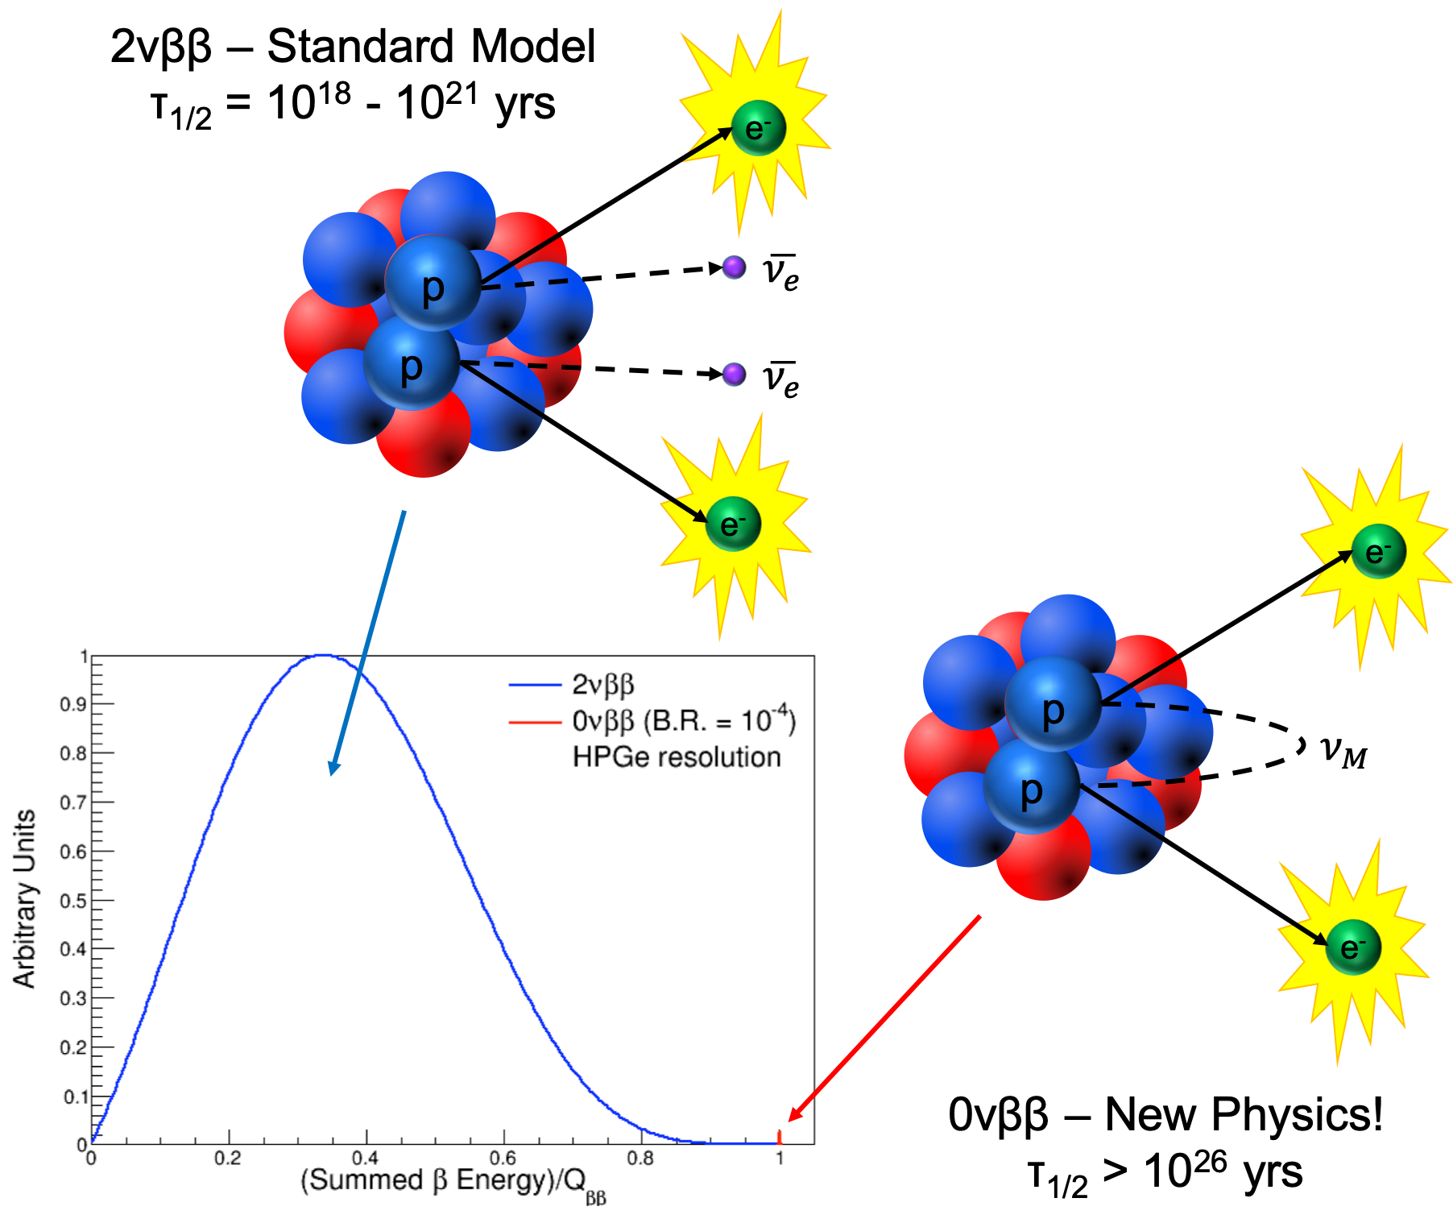
Motivation
Double beta decay is a rare nuclear process where particle, nuclear, and atomic physics intersect.
It provides a testing ground for the Standard Model through two-neutrino double beta decay (2νββ).
It also offers a pathway to physics beyond the Standard Model via neutrinoless double beta decay (0νββ).
This decay may uncover properties of the neutrino, one of the least understood particles.
It presents a significant experimental challenge, being among the slowest known decay processes in nature.
We focus our effort on the calculations of Nuclear Matrix Elements (NMEs).

Slide 3
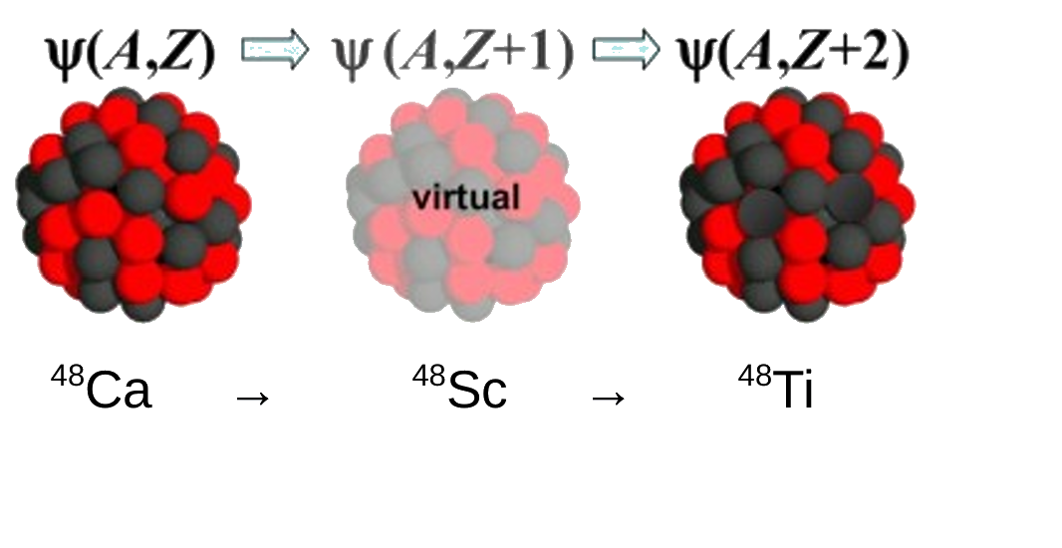
Theoretical framework
Models Employed
Mean-Field Approximation
Hartree-Fock (HF)
Wood-Saxon (WS)
1p–1h Excitations
Tamm-Dancoff Approximation (TDA)
Proton-Neutron TDA (pnTDA)
2p–2h Excitations
Second Tamm-Dancoff Approximation (STDA)
Equation of Motion Phonon Method (EMPM)
Objective
Accurate computation of Nuclear Matrix Elements (NMEs) for:
Two-neutrino double beta decay (2νββ)Neutrinoless double beta decay (0νββ)

Slide 4
Nuclear Matrix Element Results for ⁴⁸Ca
Transition chain:
⁴⁸Ca → ⁴⁸Sc → ⁴⁸Ti
$${(T_{\frac{1}{2}}^{2ν})}^{−1}=g_{A}^{4}m_{e}^{2}{|M_{GT}−\frac{M_{F}}{g_{A}^{2}}|}^{2}G^{2ν}$$
$$M_{F, GT }^{2ν}=\sum_{n}{\frac{〈f{||O}_{F, GT}||J_{n}^{+}〉〈J_{n}^{+}{||O}_{F, GT}||i〉}{E_{n}−(E_{i}+E_{f})/2}}$$
$$NME (total)=g_{A}^{2}m_{e}|M_{GT}−\frac{M_{F}}{g_{A}^{2}}|$$
$$q=\sqrt{\frac{M_{F}+\sqrt{\frac{1}{T_{\frac{1}{2}}^{2ν}G^{2ν}m_{e}^{2}}}}{g_{A}^{2}M_{GT}}}$$
Implication: Theoretical NME values are too high — suggests quenching (q) of gA to ~0.46.

Slide 5
Summary & Outlook
EMPM and STDA possibly offer consistent NME predictions but require CM correction, inclusion of 2p-2h configurations to calculation of ⁴⁸Sc.
Potentially gₐ quenching can be, to large extend, explained by EMPM or STDA if they are consistently used in calculations of ⁴⁸Sc and ⁴⁸Ti.
Next steps:
Generalize to quasiparticle formalism (e.g., ⁷⁶Ge, ⁸²Se).
Apply CM correction to STDA.
Study effect of 2p-2h or more-p-h on NMEs.

Slide 6
Thank you

