Slide 1
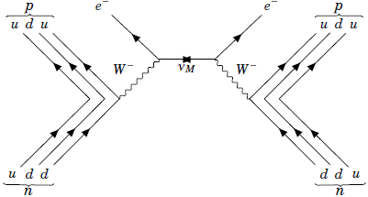
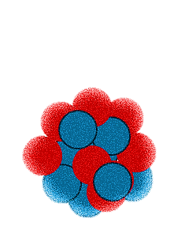
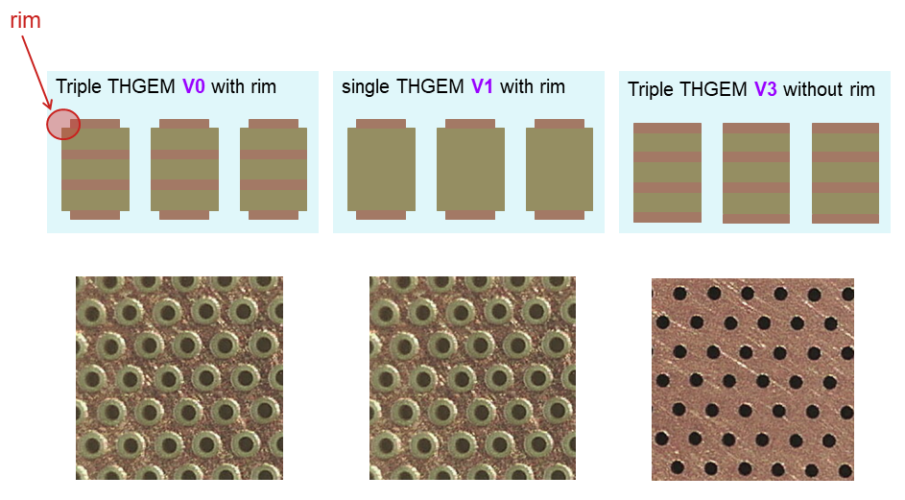
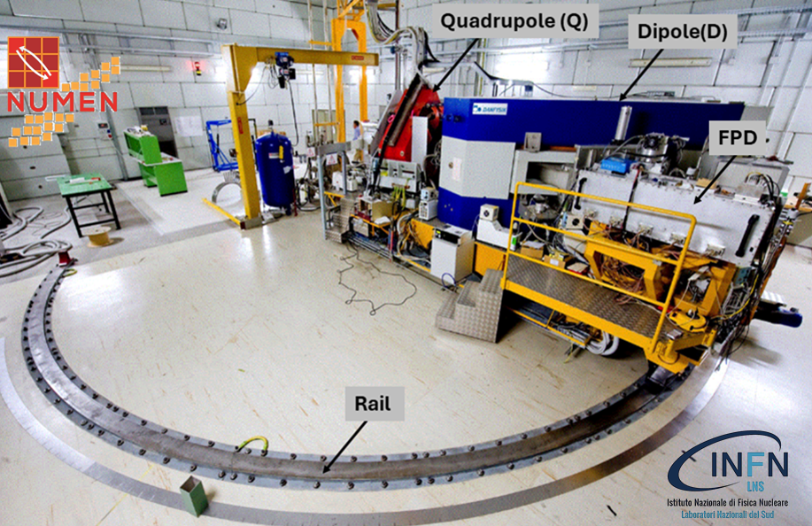
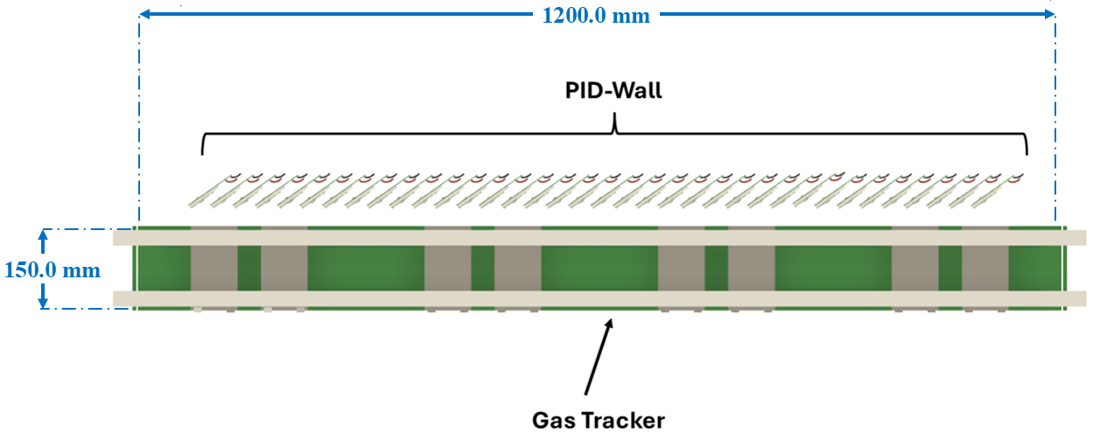
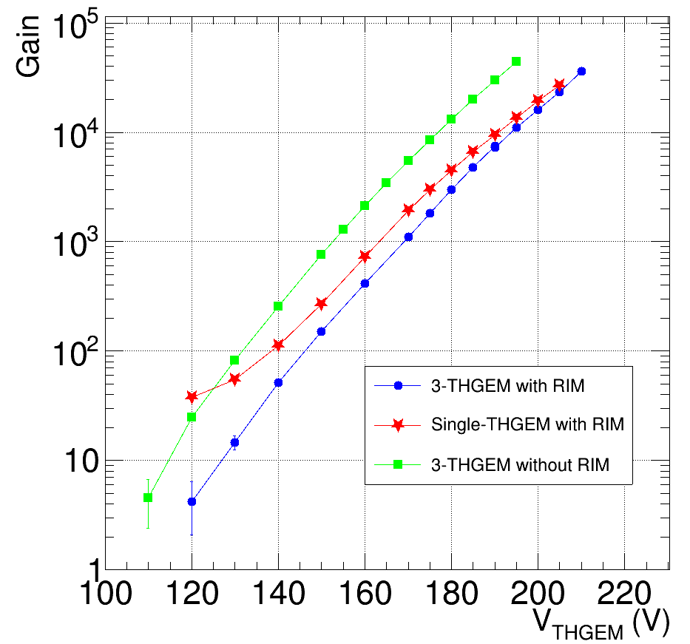
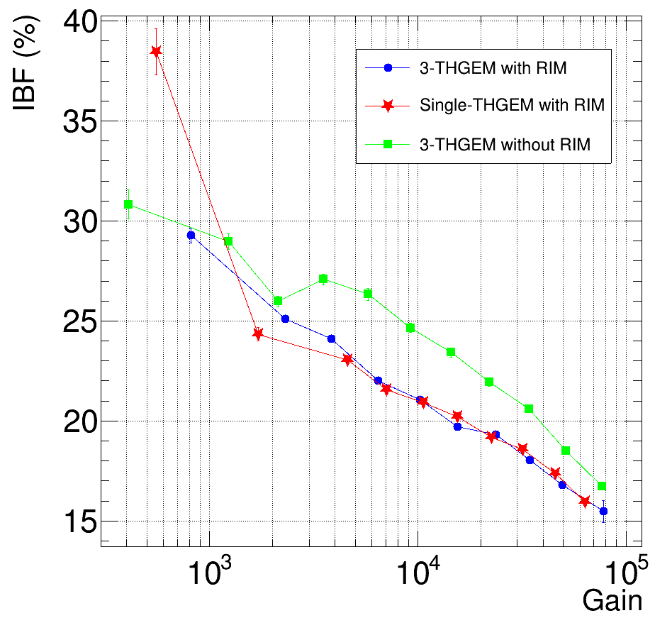
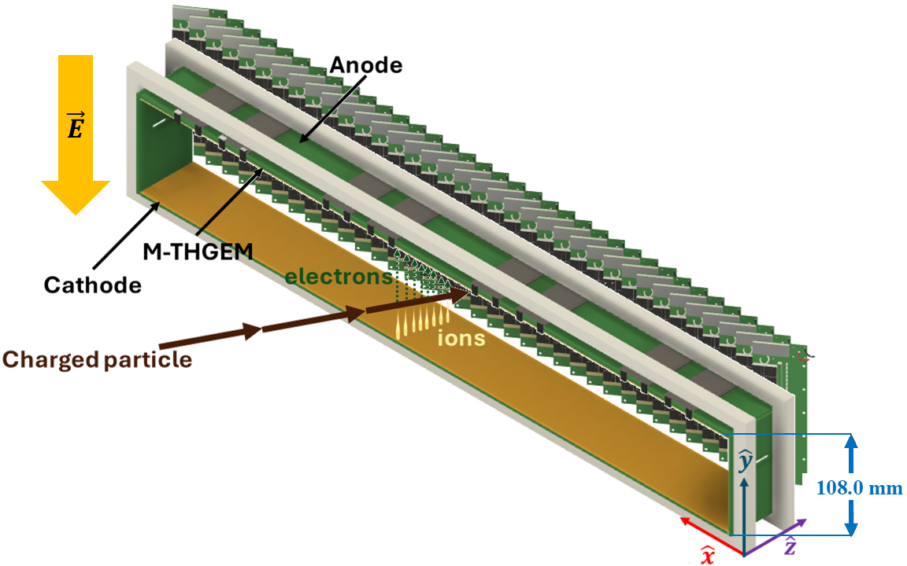
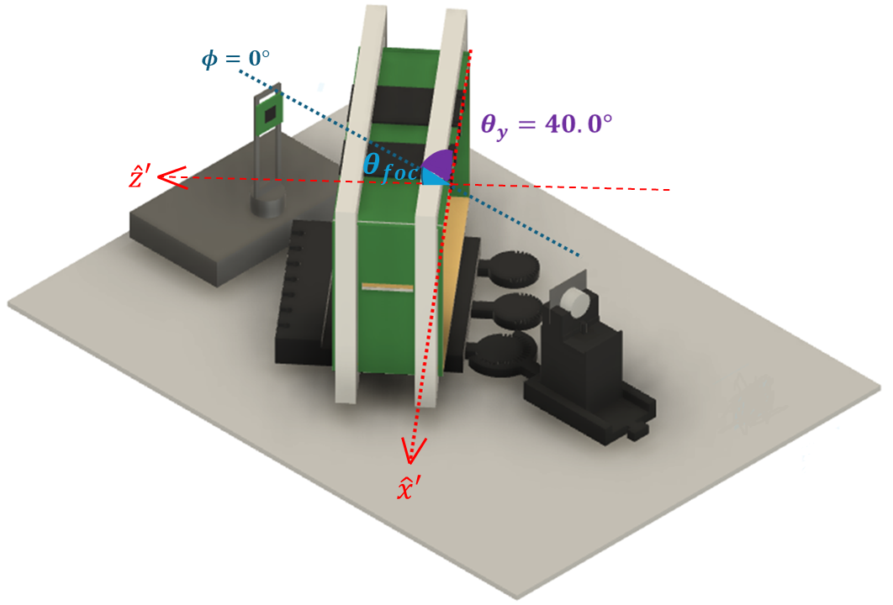
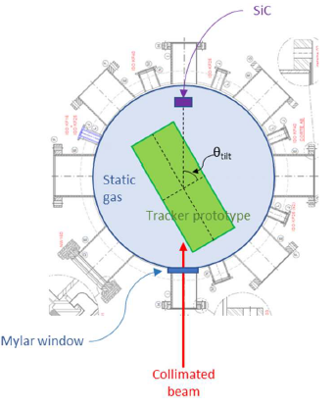
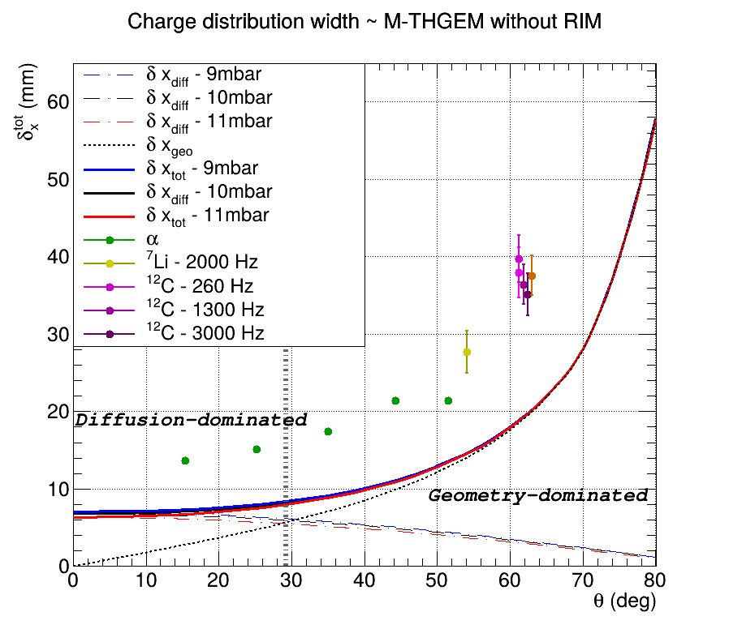
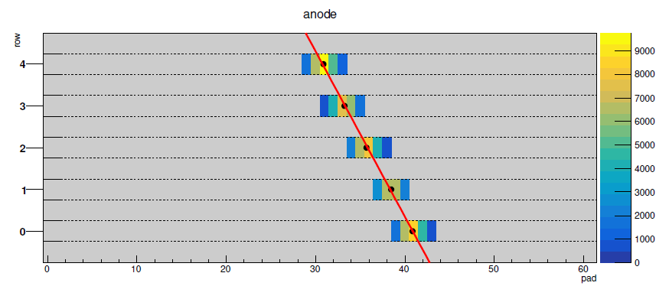
The new gas tracker of the MAGNEX spectrometer for high-rate ion detection: an experimental challenge for the NUMEN project
A. Pitronaci^{a,b*}, A. Boiano^{c}, G. Brischetto^{b}, D. Calvo^{d}, F. Cappuzzello^{a,b}, M. Cavallaro^{b}, I. Ciraldo^{b}, K. Palli^{e,f}, D. Pierroutsaku^{c}, D. Sartirana^{d}, O. Sgouros^{b}, V. Soukeras^{b}, D. Torresi^{b} for the NUMEN Collaboration
ªDepartment of Physics “E. Majorana”, UniCT, Via S. Sofia, 64, 95123 Catania, Italy
^{b}INFN, Laboratori Nazionali del Sud, via S. Sofia, 62, 95125 Catania, Italy
^{c}INFN – Sezione di Napoli, Via Cintia, 80126, Napoli, Italy
^{d}INFN - Sezione di Torino, Via Pietro Giuria, 1, 10125 Torino, Italy
^{e}Department of Physics and HINP, The University of Ioannina, 45110 Ioannina, Greece
^{f}Department of Chemistry, National and Kapodistrian University of Athens and HINP, 15771 Athens, Greece
Abstract
0$νββ$-decay & HI-DCE reactions
The NUMEN (NUclear Matrix Elements for Neutrinoless double beta decay) and NURE (NUclear REactions for neutrinoless double beta decay) projects have recently been proposed at the INFN-LNS laboratory to study Heavy-Ion-induced Double Charge Exchange (HI-DCE) reactions to provide data-driven information on the neutrinoless double beta ($0νββ$)-decay nuclear matrix elements. To access the small HI-DCE reaction cross sections (tens of nb), the use of high-intensity beams is a key feature; the MAGNEX facility at INFN-LNS needs a substantial upgrade, requiring a new focal plane detector (a low-pressure gas tracker based on a micropattern gas detector and a telescope array of SiC – CsI(Tl) for particle identification) and a scintillator array of LaBr₃(Ce). These new devices must cope with extremely high fluxes of reaction products (up to MHz of ions) and should be sufficiently radiation-hard (up to fluencies of 10¹³ ions/cm²) while guaranteeing the good performance of the previous detection systems ($ΔA/A∼$1/300, $Δθ/θ∼$0.2° and $ΔE/E\sim 1/1000$).
$${}_{Z^{′}}^{A^{′}}{a_{N}}+{}_{Z}^{A}{X_{N}}→{}_{Z^{′}−2}^{A^{′}}{b_{N+2}}+{}_{Z+2}^{A}{Y_{N−2}}$$
$${}_{Z}^{A}{X_{N}}→{}_{Z+2}^{A}{Y_{N−2}}+2e^{−}$$
$${\left[T_{1/2}\right]}^{−1}=G_{0ν}{\left|M_{0ν}\right|}^{2}{\left|f\left(m_{i},U_{ei},ξ_{i}\right)\right|}^{2}$$
Common properties:
same mother/daughter nuclei;
short-range Fermi, Gamow-Teller and rank-2 tensor operators;
DCE-reactions advantages:
No Q_{value} dependence;
higher yield due to the nuclear interaction;
(i) Characterization with $α$-source at INFN-LNS
MAGNEX and its Focal Plane Detector: upgrade in progress
M-THGEM advantages:
High achievable gain, stability, robustness, ideal for heavy-ions detection;
Consistent with NUMEN requirements!
${\hat{G}}^{−1}\left(\begin{matrix}x_{f} \\ θ_{φ} \\ y_{f} \\ φ_{f}\end{matrix}\right)=$ $\left(\begin{matrix}θ_{i} \\ y_{i} \\ φ_{i} \\ δ\end{matrix}\right), δ=\frac{p−p_{0}}{p_{0}}$
Gain: electron-amplification factor:
\
$$Δx_{foc}$$ | $$Δθ_{foc}$$ | $$Δφ_{foc}$$ | $$\frac{ΔZ}{Z}$$ | $$\frac{ΔA}{A}$$
0.6 mm | 0.3°FWHM | 0.5°FWHM | 1/48 | 1/300
$$G=\frac{I_{an}+I_{top}}{I_{prim}}$$
Magnetic field mapping: MAGNEX peculiarity;
COSY infinity: algebraic methods-based software that solves the transport equation at high order.
IBF: fraction of ions reaching the cathode:
(ii) First in-beam characterization at IFUSP
References
$$IBF=\frac{I_{cath}}{I_{an}+I_{top}}$$
Tracker performances as a function of the angle wrt incident ion beam;
$α$-source & Pelletron beams: ${}_{}^{7}Li,{}_{}^{12}C$ and ${}_{}^{16}O$;
Safiira setup: Beam spot: 300 $μ$m & Angular divergency: 0.2° FWHM
F. Cappuzzello et al., Shedding light on nuclear aspects of neutrinoless double beta decay by heavy-ion double charge exchange reactions, Prog. Part. Nucl. Phys. 128 (2023) 103999.
H. Lenske, F. Cappuzzello, M. Cavallaro and M. Colonna, Heavy ion charge exchange reactions as probes for nuclear 𝛽-decay, Prog. Part. Nucl. Phys. 109 (2019) 103716.
F. Cappuzzello et al., The NUMEN Technical Design Report, Int. J. Mod. Phys. A 36 (2021) 2130018.
M. Cavallaro et al., NURE: An ERC project to study nuclear reactions for neutrinoless double beta decay, PoS BORMIO2017 (2017) 015 [2002.02761].
I. Ciraldo et al., Characterization of a gas detector prototype based on Thick-GEM for the MAGNEX focal plane detector, Nucl. Instrum. Meth. A 1048 (2023) 167893 [2304.02390].
M. Cortesi, S. Rost, W. Mittig, Y. Ayyad-Limonge, D. Bazin, J. Yurkon et al., Multi-layer thick gas electron multiplier (M-THGEM): A new MPGD structure for high-gain operation at low-pressure, Rev. Sci. Instrum. 88 (2017) 013303 [1606.07314].
E.M. Gandolfo, J.R.B. Oliveira, L. Campajola, D. Pierroutsakou, A. Boiano, C. Agodi et al., Response of g-numen labr3(ce) detectors to high counting rates, Instruments 7 (2023).
Y. Assran, A. Sharma Transport properties of operational gas mixtures used at LHC,
https: // doi. org/ 10. 48550/ arXiv. 1110. 6761.
Centre of gravity method
$$x_{j}=\frac{\sum_{i=0}^{N Pads}{x_{i}w_{j}^{i}}}{\sum_{i=0}^{N}{w_{j}^{i} }}$$
$$δx=\sqrt{δx_{diff}^{2}+δx_{geo}^{2}}$$
2 contributions:
$δx_{diff}$: $e^{−}$diffusion-contribution;
$δx_{geo}$: geometrical effect
Conclusions and future perspectives:
Characterization at INFN-LNS: the Gain and the IBF obtained experimentally are consistent with the NUMEN requirements. The $θ$- and $φ$- distributions return angle compatible with the set geometry;
First in-beam characterization at IFUSP: the experimental charge distribution width follows quite well the predicted trend at both ion species and rate changes;
Future perspectives: single-track analysis to improve the quality of the reconstruction algorithm and subsequent resolution studies;
*Corresppnding author: A. Pitronaci - antonino.pitronaci@dfa.unict.it

