Slide 1
The new MAGNEX gas tracker for the NUMEN project
Antonino Pitronaci
The new gas tracker of the MAGNEX spectrometer for
high-rate ion detection: an experimental challenge for
the NUMEN project
Introductory concepts
First coupling tracker-SiC
First in-beam test at IFUSP
Conclusions
Antonino Pitronaci
June, 19th - 25th, 2025
UniCT DFA ”E. Majorana”
INFN - Laboratori Nazionali del Sud
Antonino Pitronaci
MAYORANA - June 19-25, 2025

Slide 2
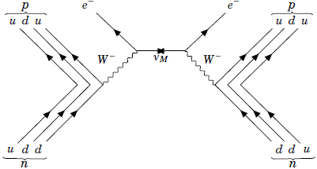
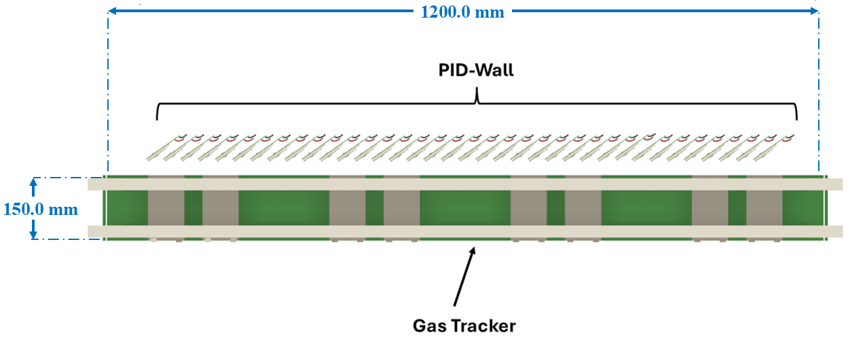
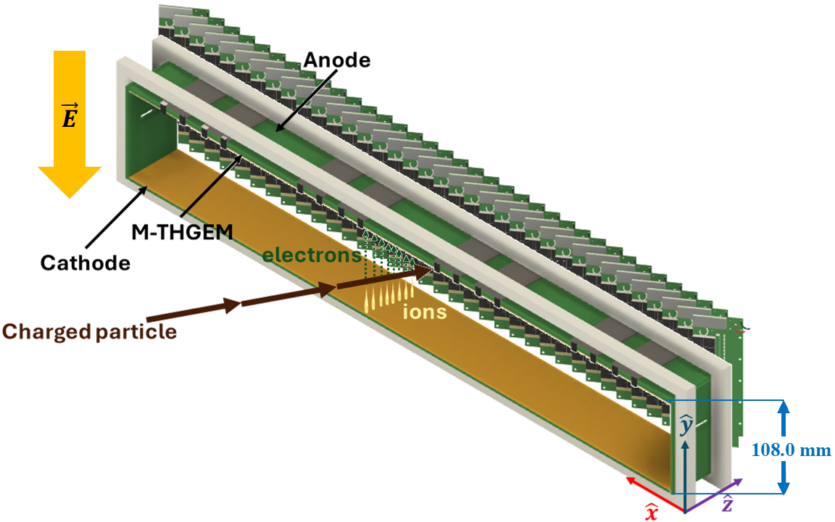
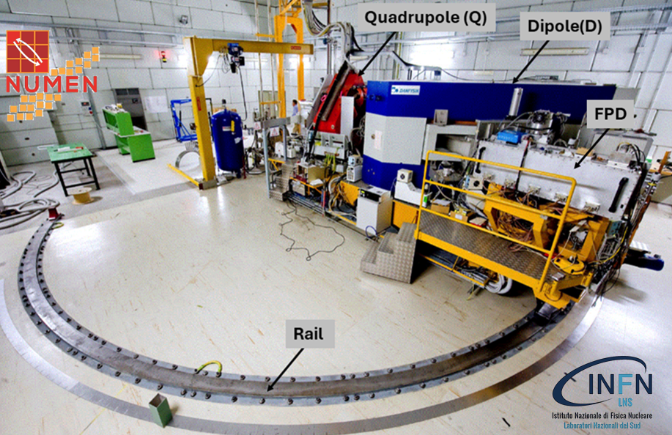
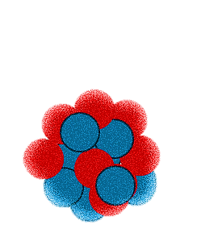
NUclear Matrix Element for Neutrinoless double-beta decay
The new MAGNEX gas tracker for the NUMEN project
Antonino Pitronaci
Experimental challenges
Aims of the project:
high tracking performances:
$Δx_{foc}=Δy_{foc}=0. 6mm$ (FWHM)
$Δθ_{foc}=0.3°$(FWHM) $− Δφ_{foc}0.5°$(FWHM)
Introductory concepts
First coupling tracker-SiC
First in-beam test at IFUSP
Conclusions
Objectives: getting data-driven information on neutrinoless double-beta (0νββ) Nuclear Matrix Elements (NMEs);
Methods: measurements of Heavy-Ion induced Double Charge Exchange reaction cross-section;
high identification power:
$\frac{ΔZ}{Z}=\frac{1}{48} − \frac{ΔA}{A}=\frac{1}{300}$
$${\left[T_{1/2}\right]}^{−1}=G_{0ν}{\left|M_{0ν}\right|}^{2}{\left|f\left(m_{i},U_{ei},ξ_{i}\right)\right|}^{2}$$
Bearing unprecedented high-intensity beams (10¹³ pps at the target);
Radiation hardness;
$${}_{Z^{′}}^{A^{′}}{a_{N}}+{}_{Z}^{A}{X_{N}}→{}_{Z^{′}−2}^{A^{′}}{b_{N+2}}+{}_{Z+2}^{A}{Y_{N−2}}$$
$0νββ$ & HI-DCE reactions
same mother/daughter nuclei;
short-range Fermi, Gamow-Teller and rank-2 tensor operators;
No Q_{value} dependence;
higher yield due to the nuclear interaction;
MAGNEX spectrometer
Antonino Pitronaci
MAYORANA - June 19-25, 2025 1/5

Slide 3
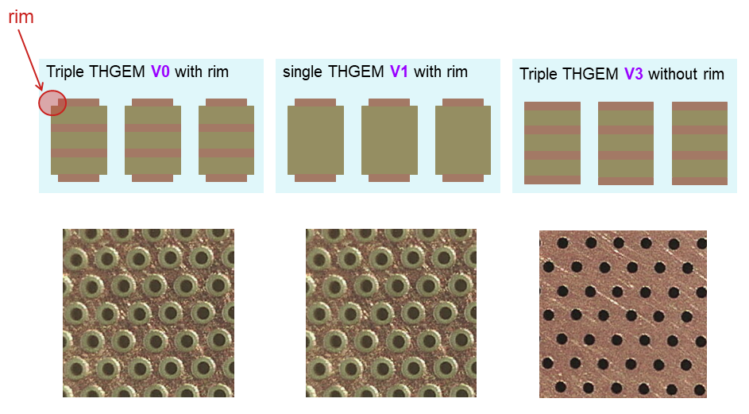
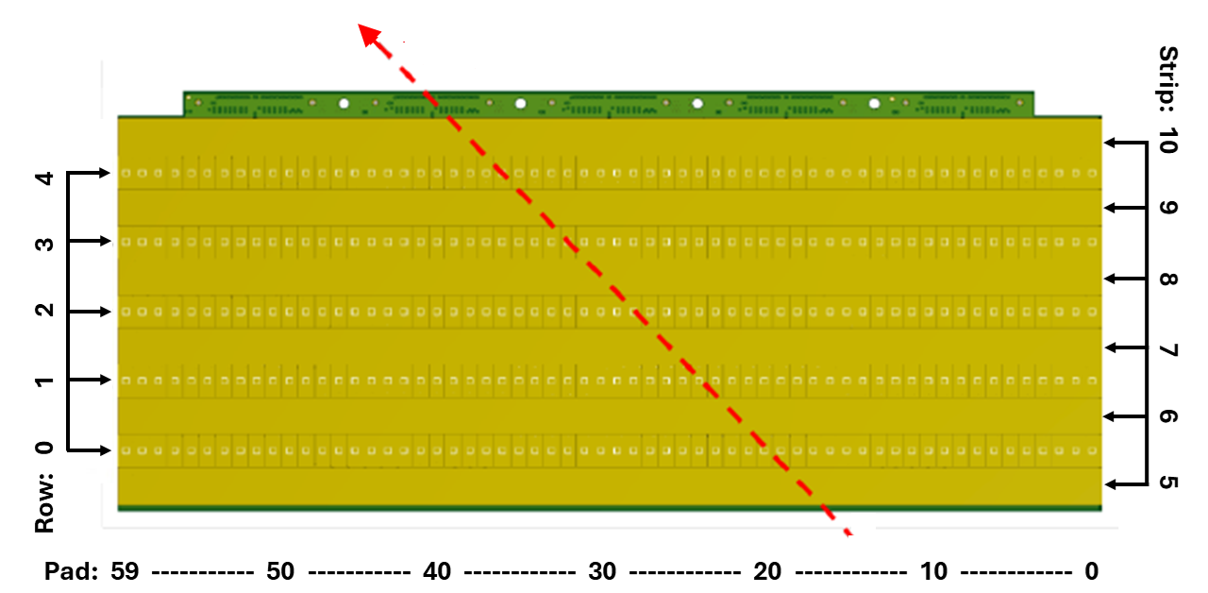
First coupling gas tracker & SiC detector at INFN-LNS Catania
The new MAGNEX gas tracker for the NUMEN project
Antonino Pitronaci
Experimental setup
Probe: collimated α by ²⁴¹Am α-source;
Working regime: i-C₄H₁₀ @ [10-30] mbar;
M-THGEM: ideal for high-rate ion detection;
Segmented anode: to get hit-map of the crossing ion;
Introductory concepts
First coupling tracker-SiC
First in-beam test at IFUSP
Conclusions
Antonino Pitronaci
MAYORANA - June 19-25, 2025 2/5

Slide 4
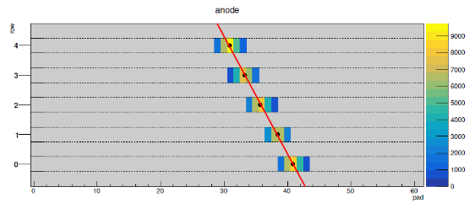
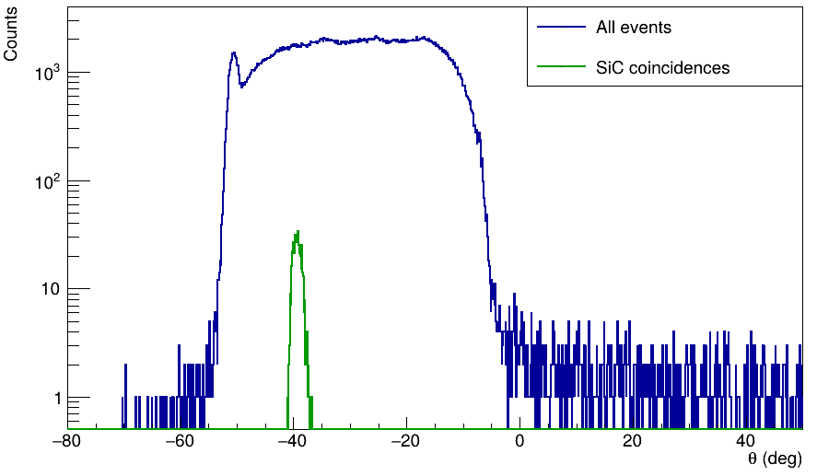
First coupling gas tracker & SiC detector at INFN-LNS Catania
The new MAGNEX gas tracker for the NUMEN project
Antonino Pitronaci
Experimental setup
$$x_{j}=\frac{\sum_{i=0}^{N Pads}{x_{i}w_{j}^{i}}}{\sum_{i=0}^{N}{w_{j}^{i} }}$$
Probe: collimated α by ²⁴¹Am α-source;
Working regime: i-C₄H₁₀ @ [10-30] mbar;
M-THGEM: ideal for high-rate ion detection;
Segmented anode: to get hit-map of the crossing ion;
Introductory concepts
First coupling tracker-SiC
First in-beam test at IFUSP
Conclusions
Remarks
Good quality track reconstruction;
Angles compatible with the set geometry
Antonino Pitronaci
MAYORANA - June 19-25, 2025 3/5

Slide 5
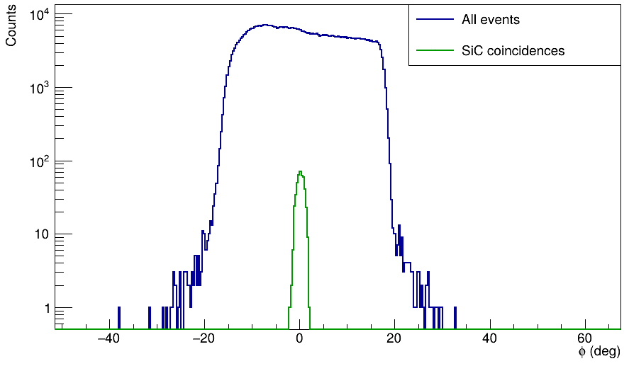
First coupling gas tracker & SiC detector at INFN-LNS Catania
The new MAGNEX gas tracker for the NUMEN project
Antonino Pitronaci
Experimental setup
$$x_{j}=\frac{\sum_{i=0}^{N Pads}{x_{i}w_{j}^{i}}}{\sum_{i=0}^{N}{w_{j}^{i} }}$$
Probe: collimated α by ²⁴¹Am α-source;
Working regime: i-C₄H₁₀ @ [10-30] mbar;
M-THGEM: ideal for high-rate ion detection;
Segmented anode: to get hit-map of the crossing ion;
Introductory concepts
First coupling tracker-SiC
First in-beam test at IFUSP
Conclusions
Remarks
Good quality track reconstruction;
Angles compatible with the set geometry
Antonino Pitronaci
MAYORANA - June 19-25, 2025 3/5

Slide 6
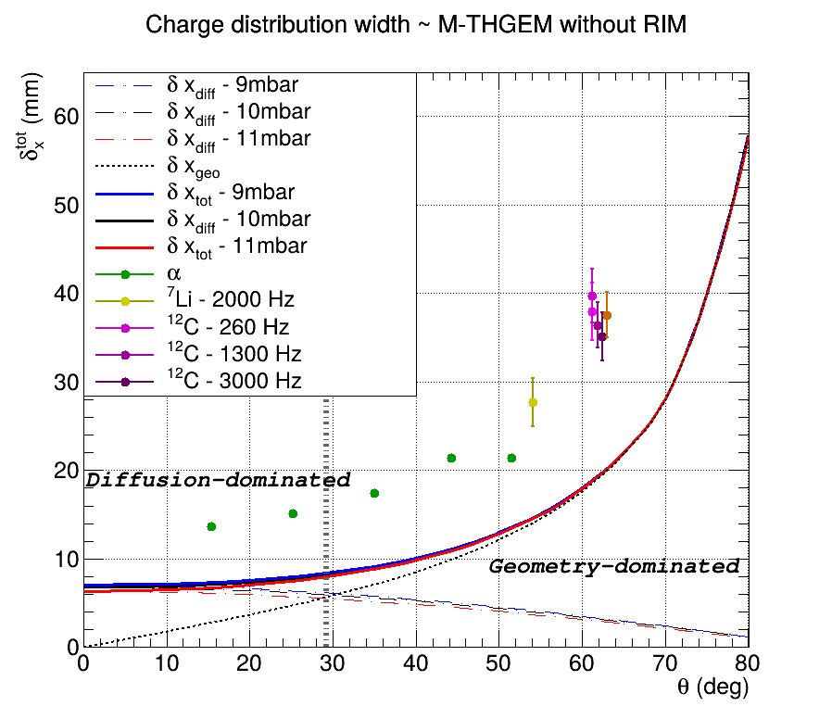
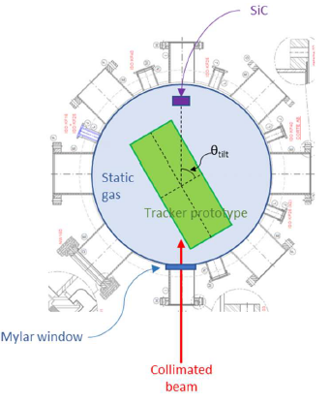
First in-beam characterization at IFUSP – São Paulo (Br)
The new MAGNEX gas tracker for the NUMEN project
Antonino Pitronaci
Experimental setup
$α$-particles & Pelletron beams:
${}_{}^{7}Li,{}_{}^{12}C$ and ${}_{}^{16}O$;
Safiira setup:
Beam spot: 300 $μ$m;
Angular divergency: 0.2° FWHM
Introductory concepts
First coupling tracker-SiC
First in-beam test at IFUSP
Conclusions
$$δx=\sqrt{δx_{diff}^{2}+δx_{geo}^{2}}$$
Remarks
Experimental dots roughly follow the predicted behavior;
Agreement between predictions and experiment could be affected by non linearities;
Antonino Pitronaci
MAYORANA - June 19-25, 2025 4/5

Slide 7
Conclusions
The new MAGNEX gas tracker for the NUMEN project
Antonino Pitronaci
Introductory concepts
First coupling tracker-SiC
First in-beam test at IFUSP
Conclusions
Characterization at INFN-LNS: The $θ$- and $φ$- distributions return angle compatible with the set geometry;
First in-beam characterization at IFUSP: the experimental charge distribution width qualitatively follows the predicted trend at both ion species and rate changes;
Perspectives: single-track analysis to improve the quality of the reconstruction algorithm and subsequent resolution studies;
Antonino Pitronaci
MAYORANA - June 19-25, 2025 5/5

Slide 8
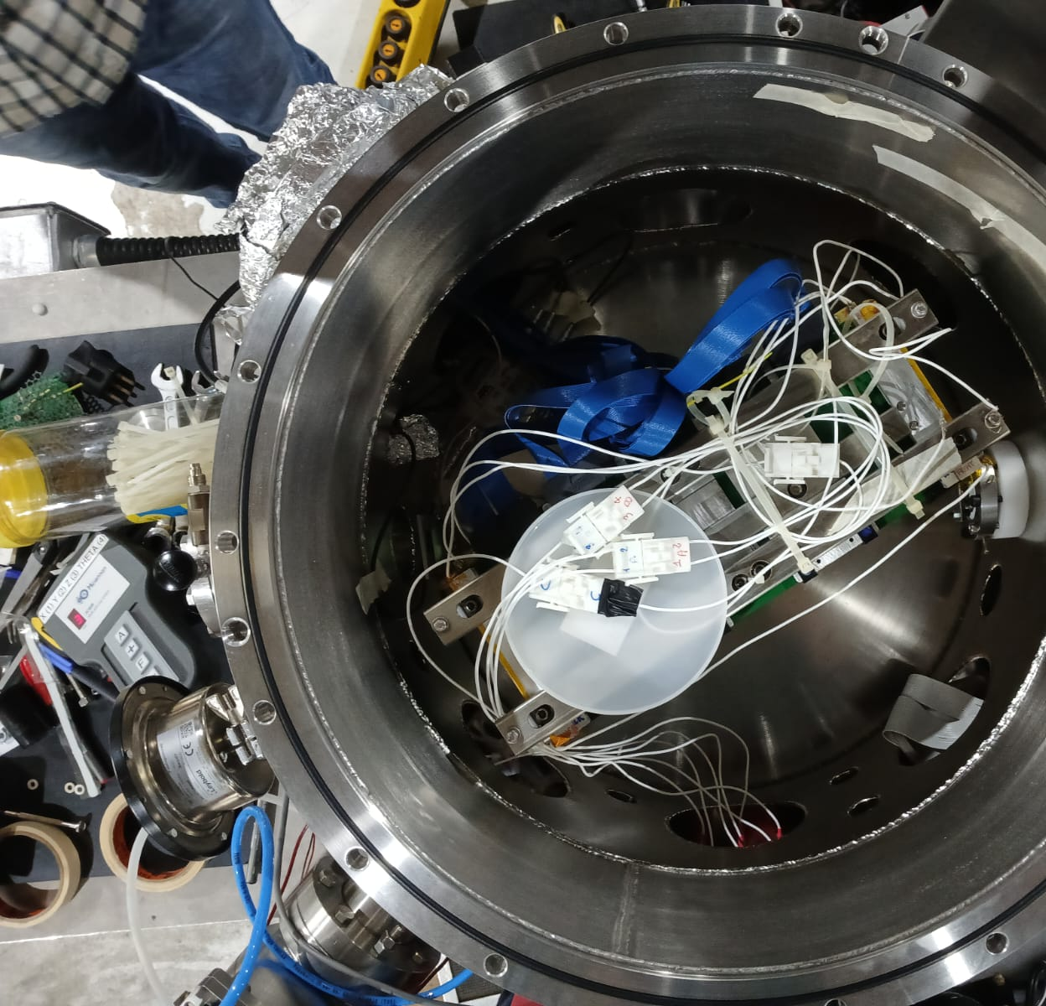
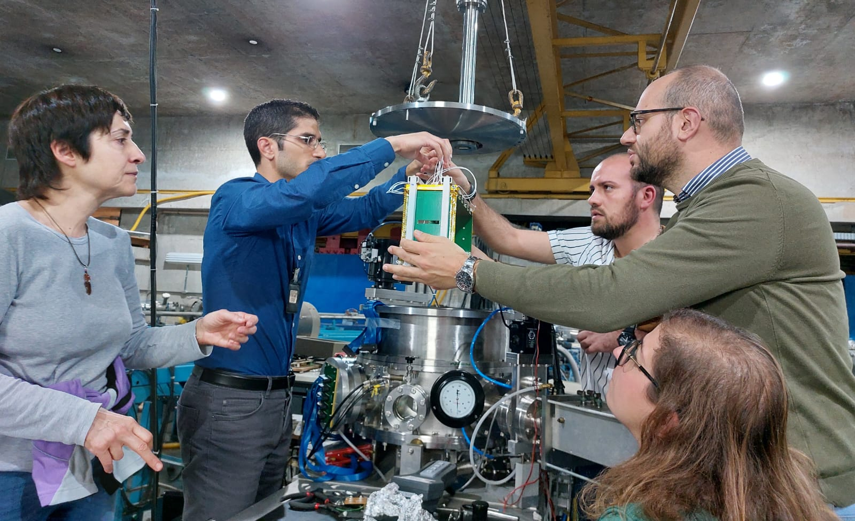
The new MAGNEX gas tracker for the NUMEN project
Antonino Pitronaci
Introductory concepts
First coupling tracker-SiC
First in-beam test at IFUSP
Conclusions
Thanks for Your attention!
Antonino Pitronaci
MAYORANA - June. 19-25, 2025

Slide 9
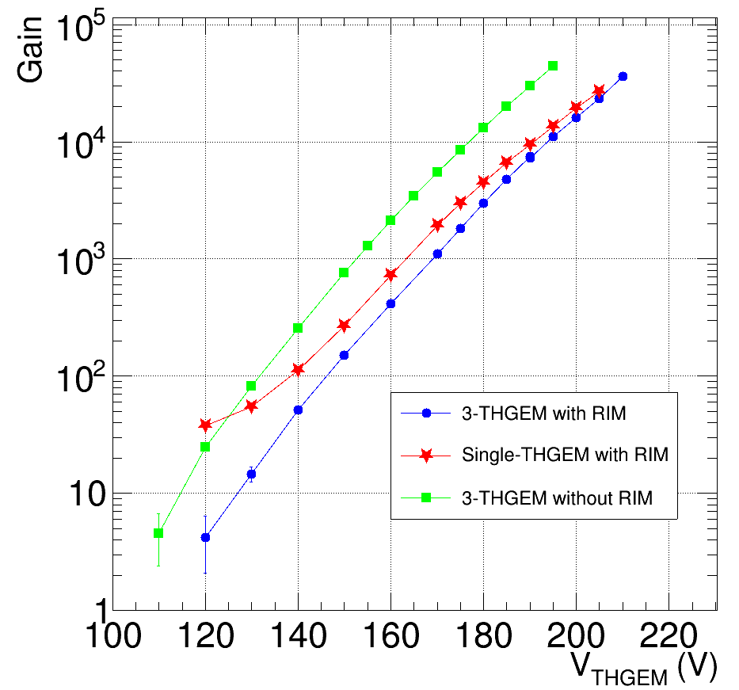
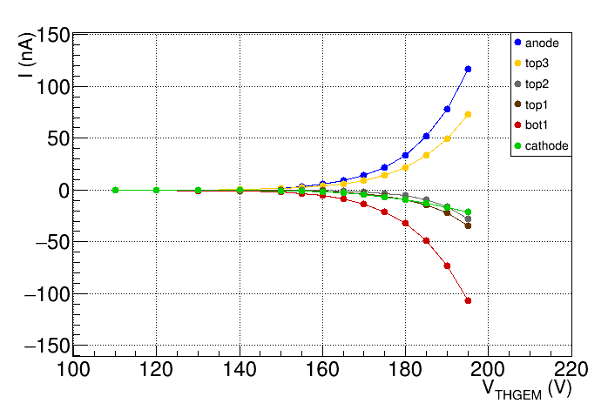
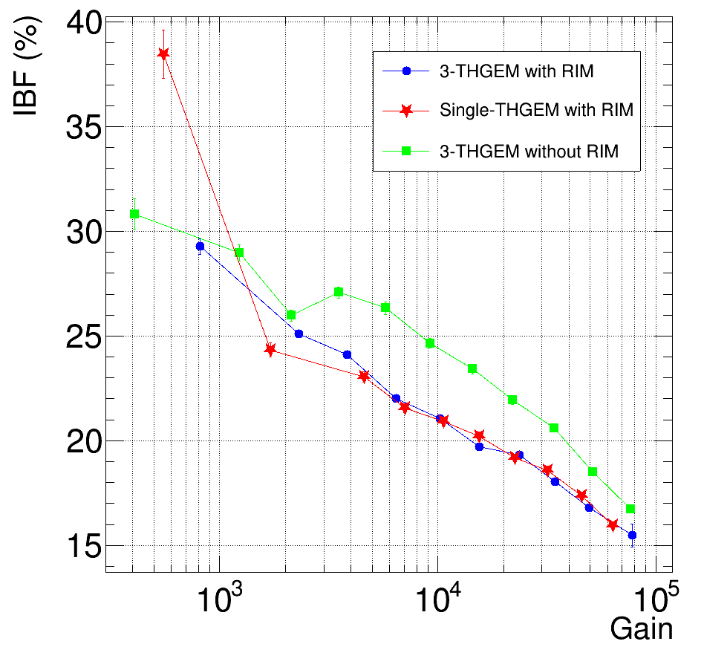
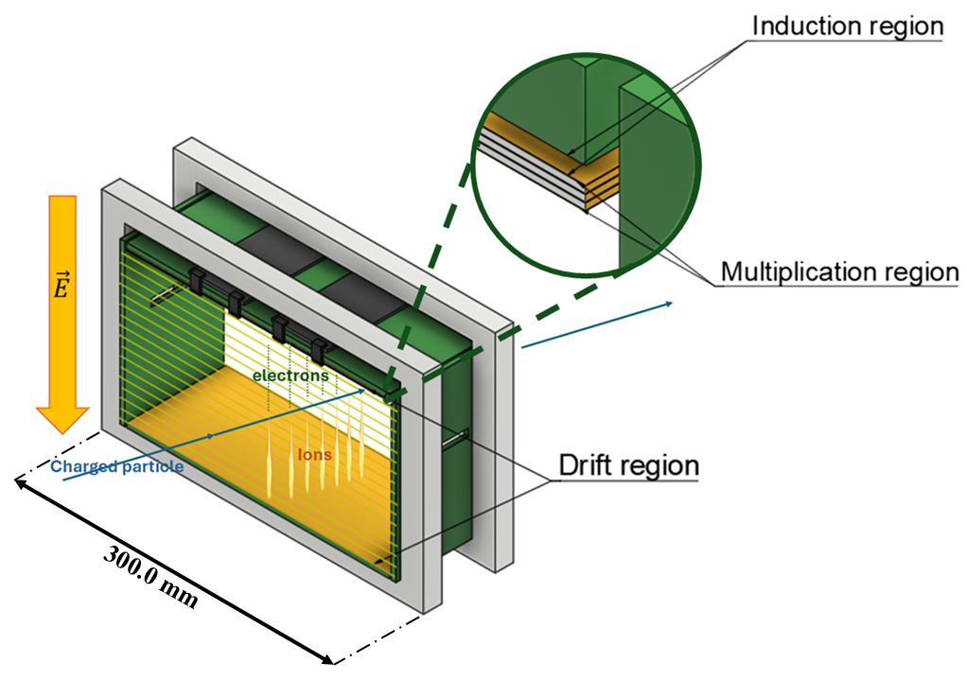
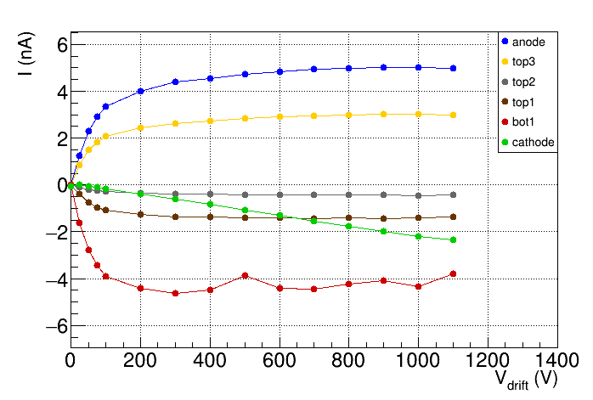
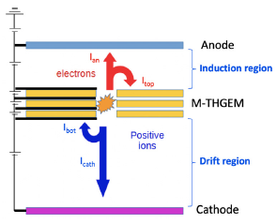
Backup: I-V characterization with $α$-source at INFN-LNS
The new MAGNEX gas tracker for the NUMEN project
Antonino Pitronaci
Observations
Observations
Currents measurements performed:
- changing $V_{THGEM}$;
- changing $V_{drift}$;
Observations:
- $I(V_{THGEM})$ follows an exponential trend;
- saturation of $I\left(V_{drift}\right)$ up to 800 V;
Gain: amplification factor for electrons
Gain (${10}^{4}$) and IBF (20 - 25)% consistent with the NUMEN requirements.
Introductory concepts
First coupling tracker-SiC
First in-beam test at IFUSP
Conclusions
$$G=\frac{I_{an}+I_{top}}{I_{prim}}$$
IBF: fraction of the produced ions reaching the cathode
$$IBF=\frac{I_{cath}}{I_{an}+I_{top}}$$
Antonino Pitronaci
MAYORANA - June 19-25, 2025

Slide 10
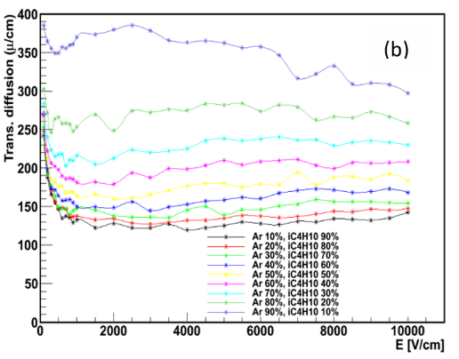
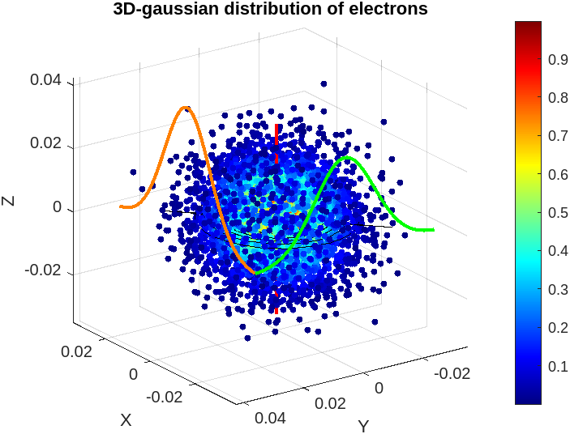
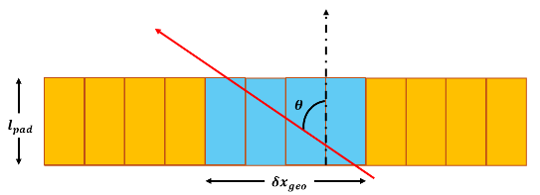
On the contributions $δx_{diff}$ & $δx_{geo}$
The new MAGNEX gas tracker for the NUMEN project
Antonino Pitronaci
Theoretical predictions:
Additional boundary condition (i):
Microscopic picture of $e^{−}$- drift:
$$δx_{diff}=σ_{L\left(T\right)}⋅cos⁡(θ)$$
Geometrical effect:
increases as $θ$ increases;
$$δx_{geo}=l_{pad}⋅\tan\left(θ\right)$$
Introductory concepts
First coupling tracker-SiC
First in-beam test at IFUSP
Conclusions
Additional boundary condition (ii):
Threshold effect:
FWAB-evaluation for $δx_{diff}$;
Credits: Y. Assran, A. Sharma "Transport properties of operational gas mixtures used at LHC" - https: // doi. org/ 10. 48550/ arXiv. 1110. 6761
Antonino Pitronaci
MAYORANA - June 19-25, 2025

Slide 11
On the design of mechanical supports (Fusion360 – Edu. License)
The new MAGNEX gas tracker for the NUMEN project
Antonino Pitronaci
Introductory concepts
First coupling tracker-SiC
First in-beam test at IFUSP
Conclusions
Antonino Pitronaci
MAYORANA - June 19-25, 2025

Slide 12
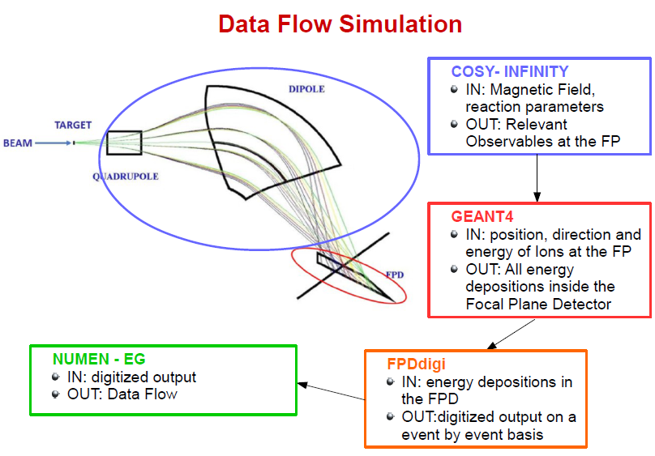
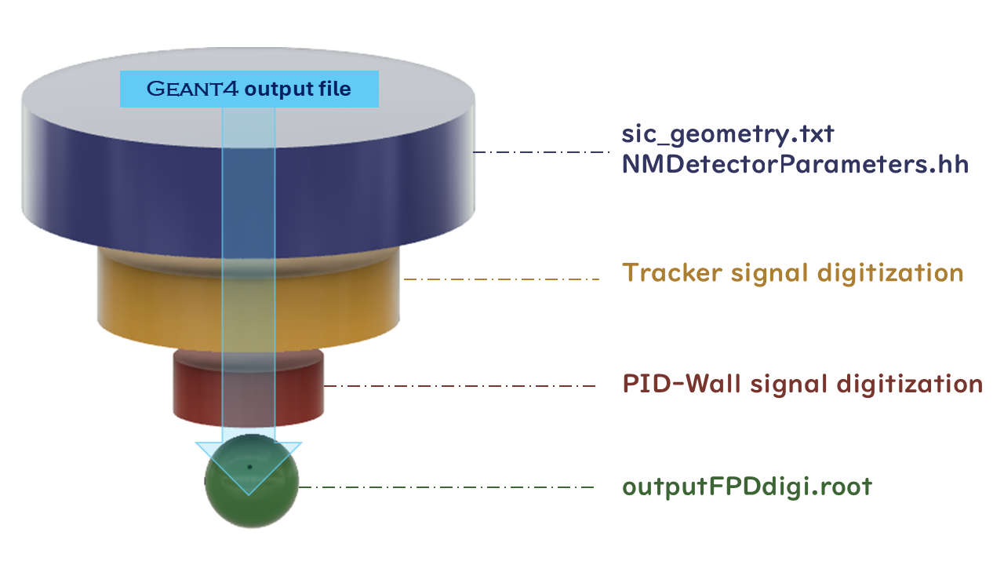
On the NUMEN Event generator: numenEG
The new MAGNEX gas tracker for the NUMEN project
Antonino Pitronaci
Introductory concepts
First coupling tracker-SiC
First in-beam test at IFUSP
Conclusions
Antonino Pitronaci
MAYORANA - June 19-25, 2025

