Slide 1
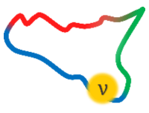
MAYORANA
(Multi-Aspect Young ORiented Advanced Neutrino Academy)
19–25 Jun 2025, Modica
Towards uniform
detector response
in large-scale KID arrays
for Dark Matter searches
with BULLKID-DM
Davide Quaranta,
24 June 2025

Slide 2
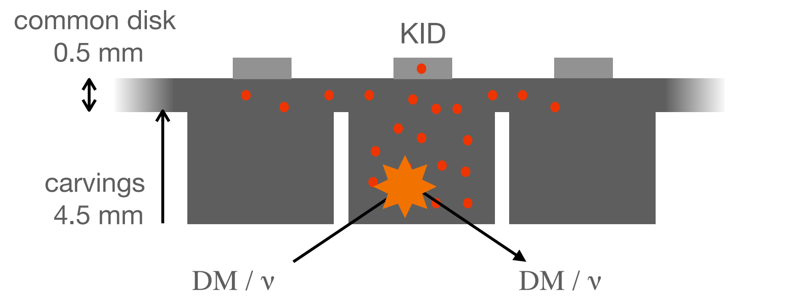
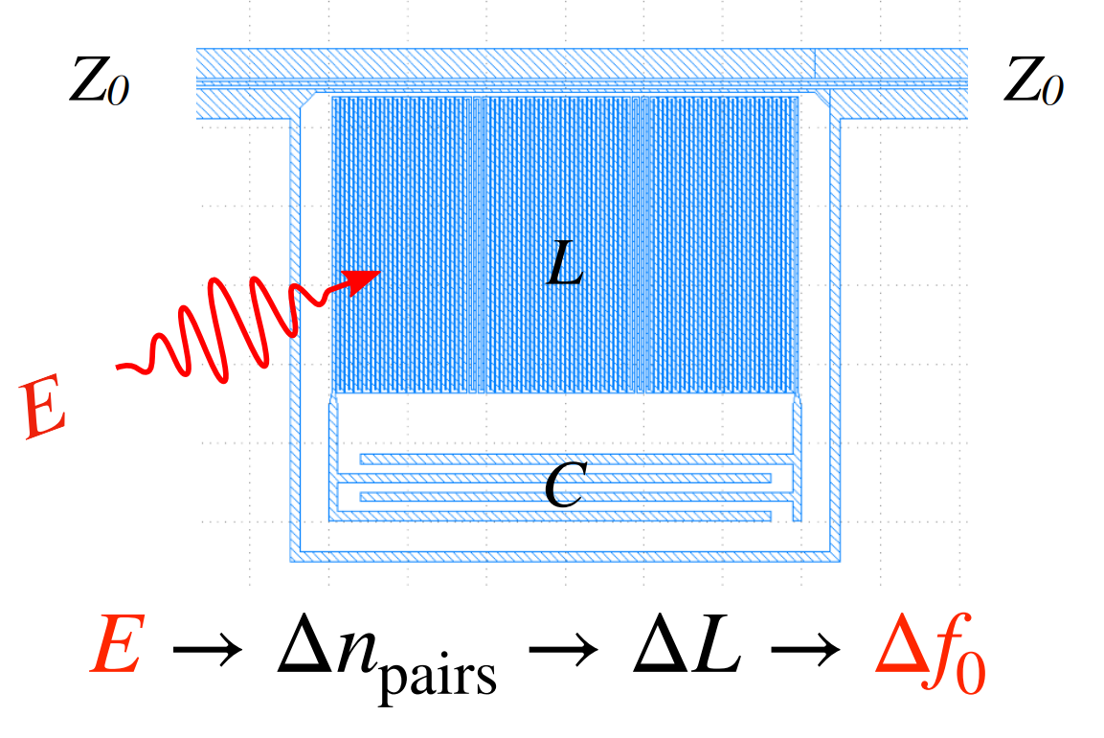
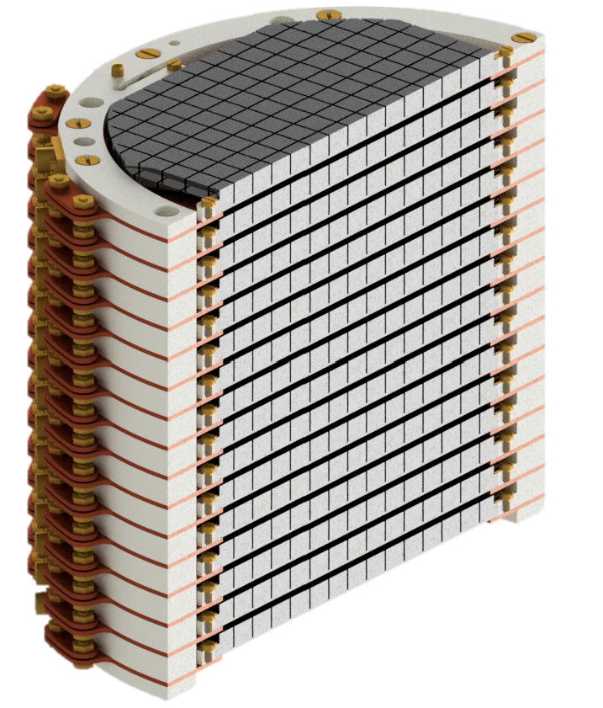
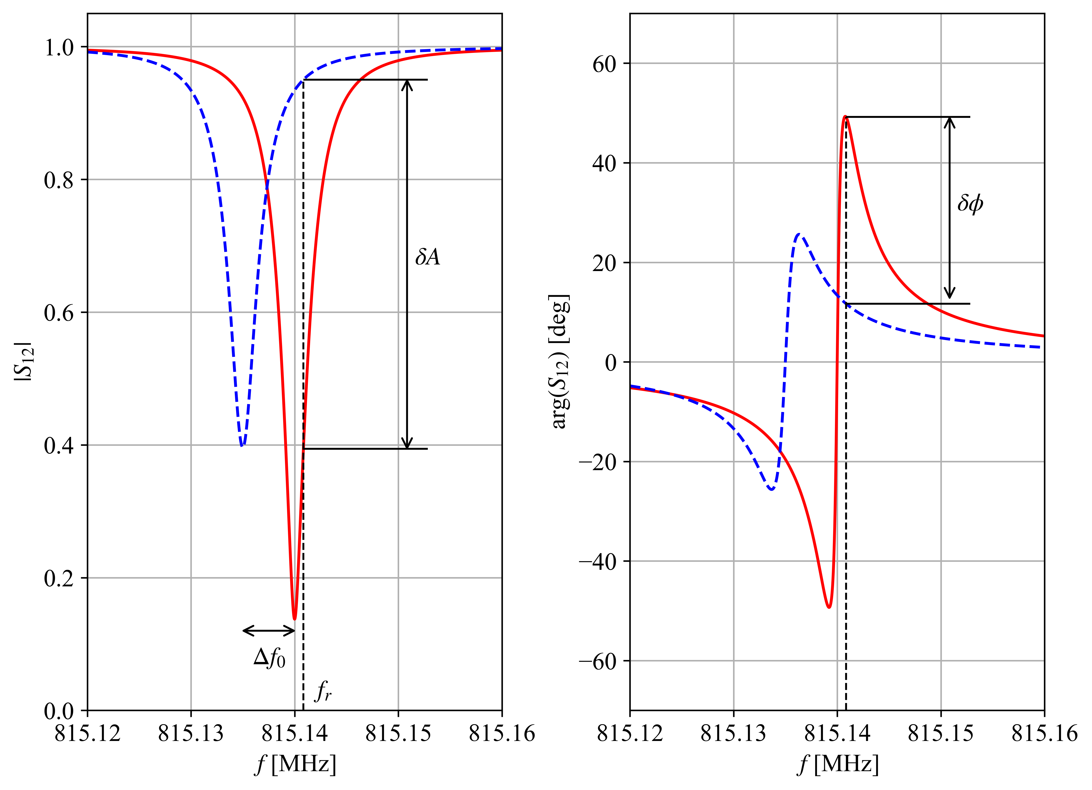
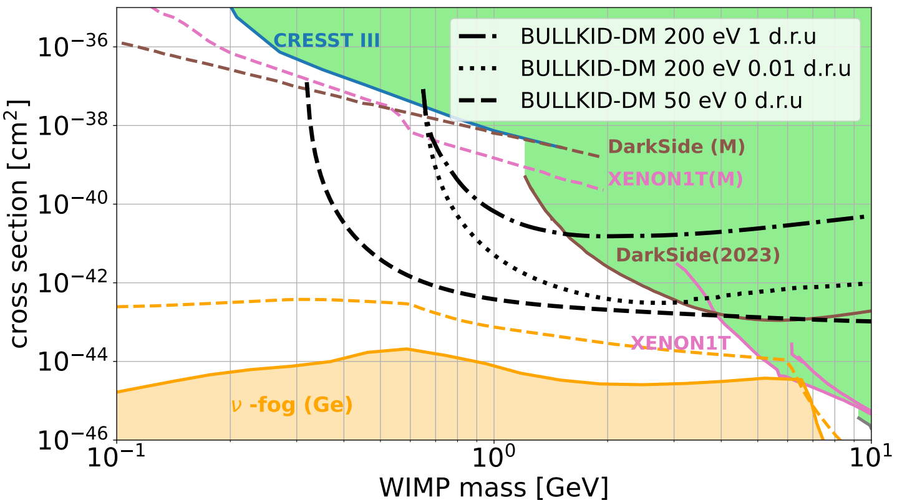
Turbocharged BULLKID-DM primer
BULLKID is an R&D project targeting at the development of a detector for :
16 diced silicon wafers
100 mm diameter
600 g active mass
More than 2500 dice
1 KID per die
SC RLC resonant circuit
Measure shift of resonant frequency
direct light dark matter detection
coherent neutrino-nucleus scattering
$$DM/ν$$
$$DM/ν$$
Installation @ LNGS 2027!
$$target nucleus$$

Slide 3
Turbocharged BULLKID-DM primer
BULLKID is an R&D project targeting at the development of a detector for :
16 diced silicon wafers
100 mm diameter
600 g active mass
More than 2500 dice
1 KID per die
SC RLC resonant circuit
Measure shift of resonant frequency
direct light dark matter detection
coherent neutrino-nucleus scattering
$$DM/ν$$
$$DM/ν$$
Installation @ LNGS 2027!
$$target nucleus$$

Slide 4
Turbocharged BULLKID-DM primer
BULLKID is an R&D project targeting at the development of a detector for :
16 diced silicon wafers
100 mm diameter
600 g active mass
More than 2500 dice
1 KID per die
SC RLC resonant circuit
Measure shift of resonant frequency
direct light dark matter detection
coherent neutrino-nucleus scattering
$$DM/ν$$
$$DM/ν$$
Installation @ LNGS 2027!
$$target nucleus$$

Slide 5
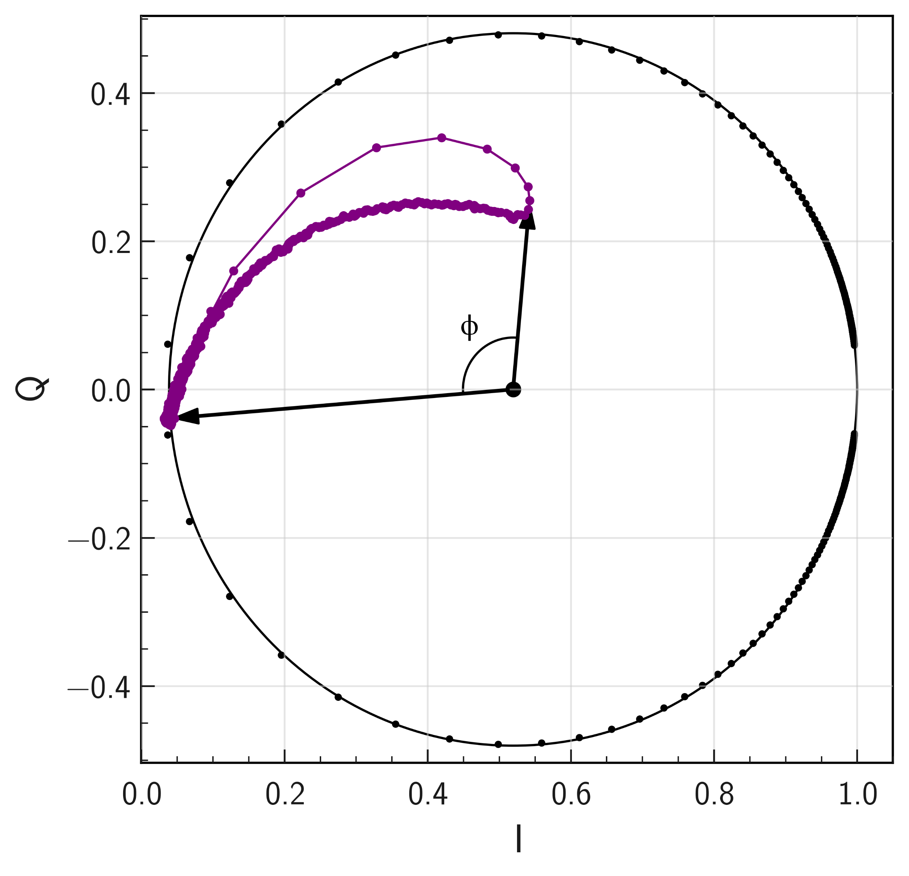
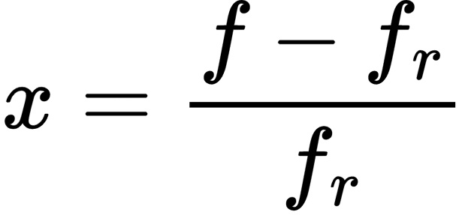
KID Signal Reconstruction
Energy of an event is measured from the change of the complex transmission function of the KID resonator:
$$S_{21}$$
Event
Keep this
in mind
The phase signal depends on:
the resonator quality factor Q
its working point (non-linearity)
the bias power
Key-Problem
Response can be very different across resonators! (and we will have many)
Calibrated Phase

Slide 6
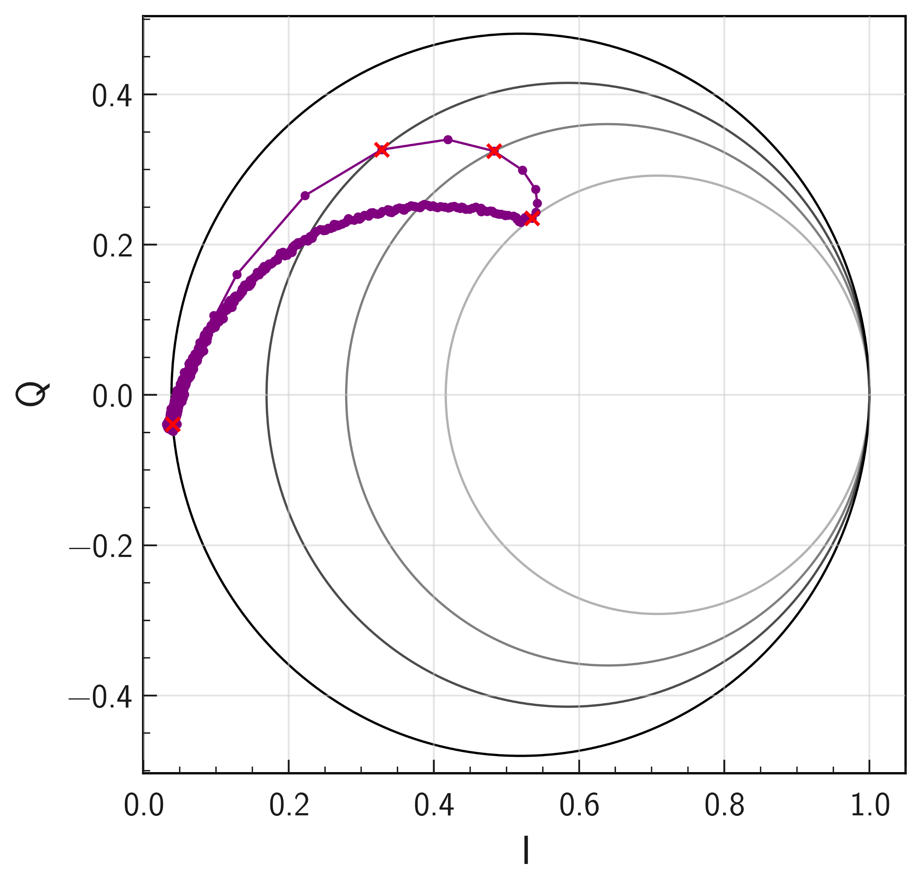
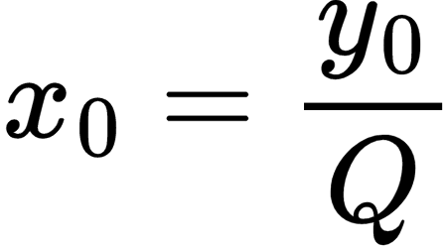
KID Signal Reconstruction
We developed a new reconstruction algorithm to extract the Fractional Frequency Shift (x) signal, which should be equal for all KIDs (and linear):
$$S_{21}$$
Event
We follow the evolution of the resonance circle during an event
At each step we compute the shift of the resonant frequency
Fractional Frequency Shift
Residual dependance on KID temperature due to is being currently investigated

Slide 7
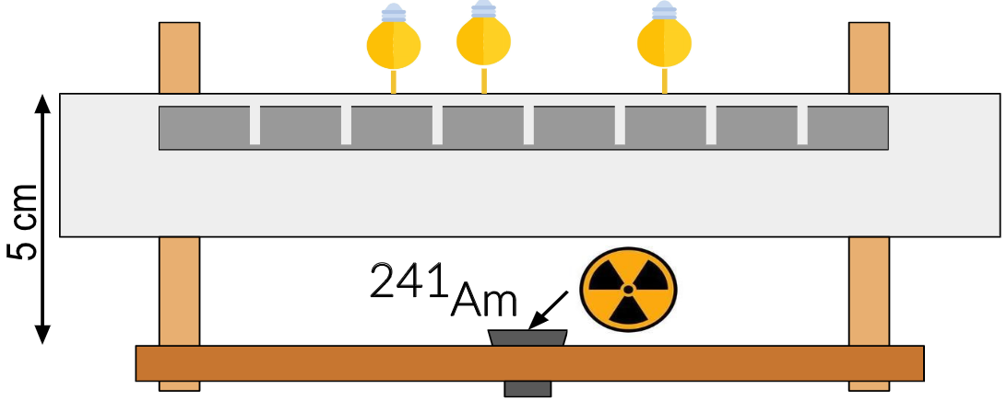
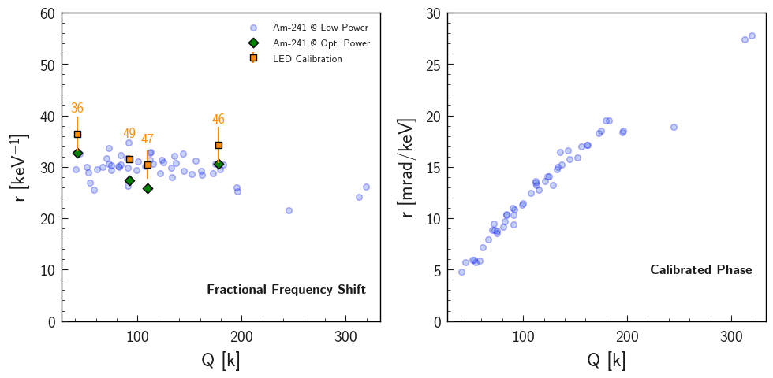
Whole Wafer Test with Am-241
Test using 60 keV peak of Am-241 for calibrating all the KIDs of a wafer at once.
The calibration was repeated in two bias-power configurations (low and high power).
Additional cross-check done with usual LED calibration.
Efficient KID response equalization was observed among all 50 dice under test:
average responsivity : 29.7 keV⁻¹
better then 10% agreement

Slide 8
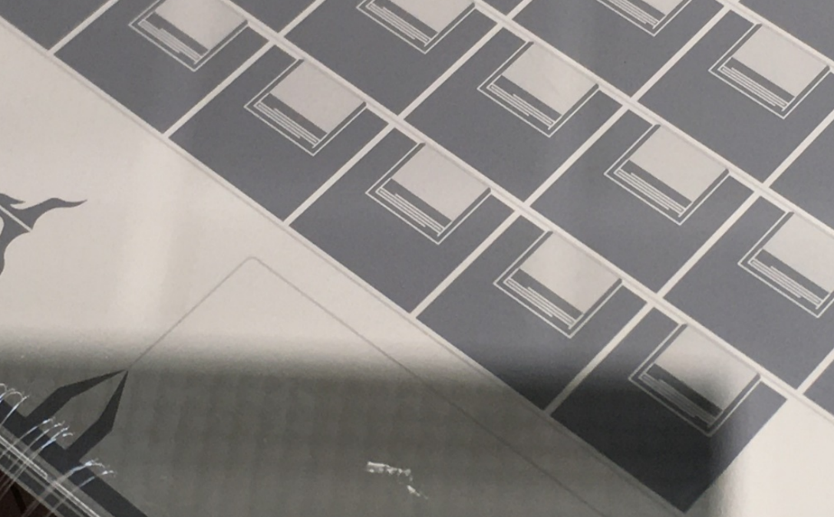
Thanks for the attention
*This work was partially supported through the European Research Council through the Consolidator Grant DANAE number 101087663

Slide 9
Backup Slides

Slide 10
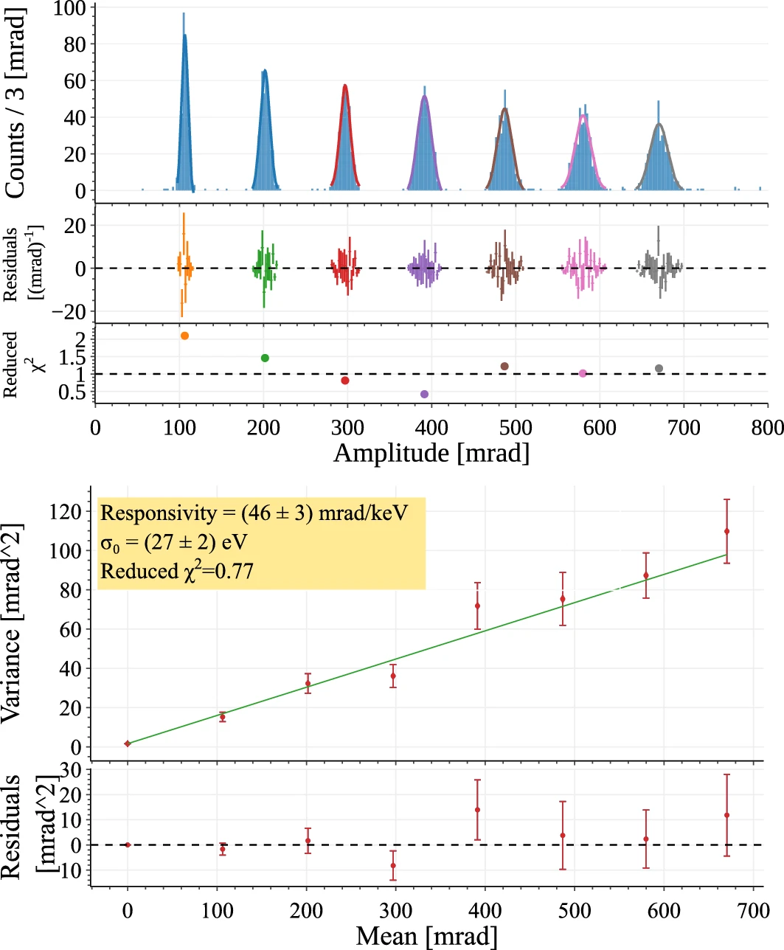
Calibration
The die under test is excited with LED pulses of increasing energy.
For Poisson's statistics
$$μ=k⋅ N_{ph}$$
$$σ^{2}=k⋅N_{ph}+σ_{0}^{2}$$
Introducing the responsivity R:
$R=k/ε_{ph}$ [mrad/keV]
$$σ^{2}=R⋅μ+σ_{0}^{2}$$
$R$and $σ_{0}$extracted by linear fit

Slide 11
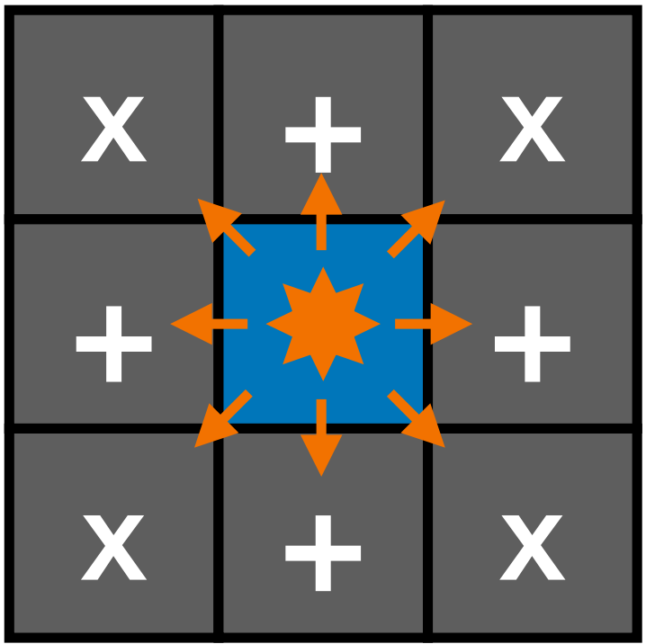
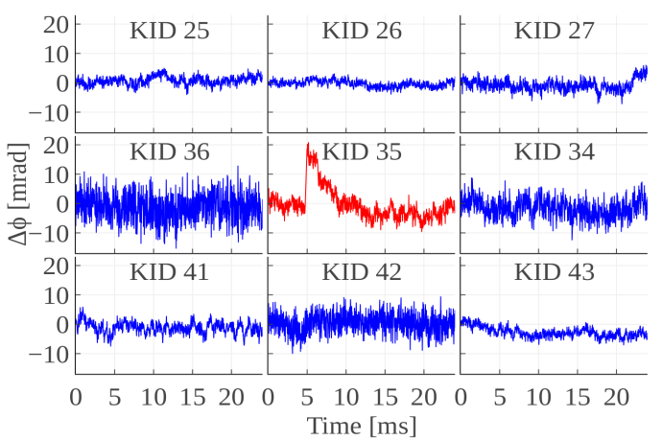
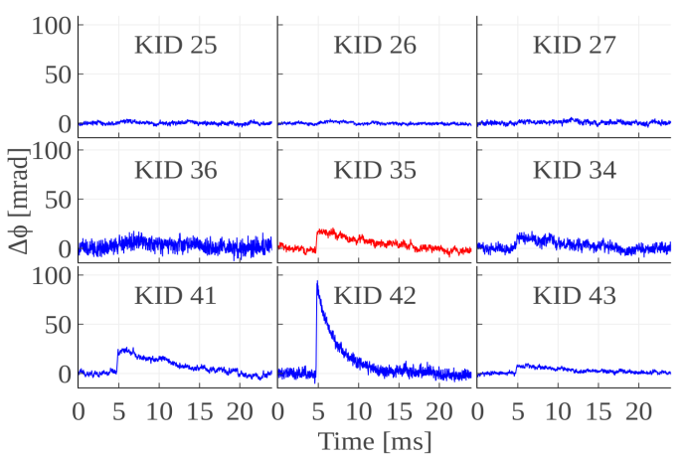
Phonon Leakage
Half of the phonons produced in a die escape to neighboring dice:
(14 ± 3) % in ogni cubo “+”
(5 ± 1) % in ogni “x”
Kept
Discarded
This effect reduces the efficiency of phonon collection
But it allows to identify the die where the interaction takes place

Slide 12
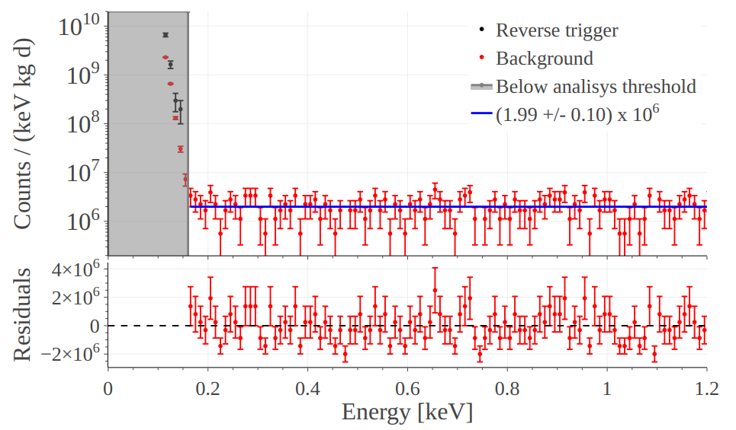
Background @ Sapienza
D. Delicato et al, Eur. Phys. J. C 84, 353 (2024)
Energy spectrum after 39 hours of exposure of a single 0.34 g die to background environmental conditions

Slide 13
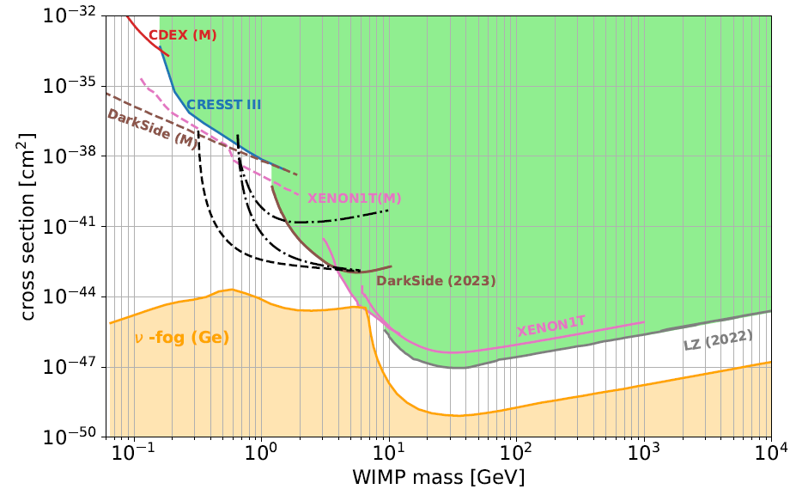
Sensitivity projections
1 d.r.u. = 1 count/keV/kg/year

Slide 14
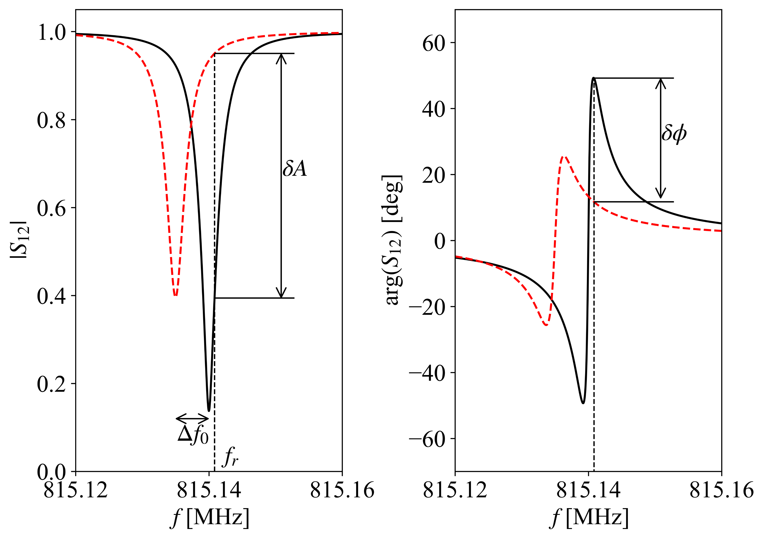
Kinetic Inductance Detectors
Quasiparticles
In a superconductor at T<T_c, the current flow is due to the Cooper Pairs:
${ e}^{−}e^{−}$ bound states
Bounding Energy $2Δ_{0}=3.53{k_{B}T}_{c}$
$$ℏω$$
Cooper pairs contribute to the inductance of the superconducting metal (Kinetic inductance)
$$2Δ_{0}$$
Cooper Pairs
KID starter pack
Superconducting LC Resonator
Energy releases break pairs of Coopers
Resonant frequency shifts
$$f_{0}=\frac{1}{2π\sqrt{LC}}$$

Slide 15
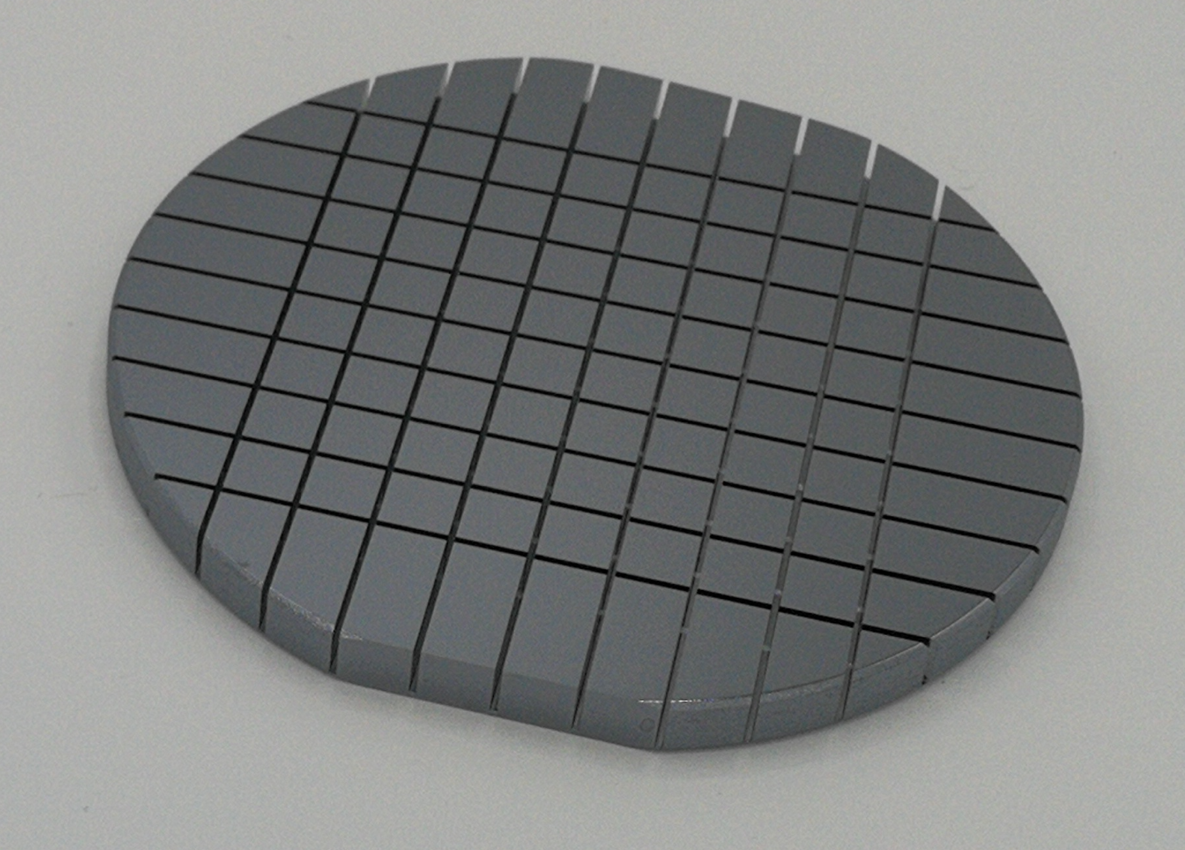
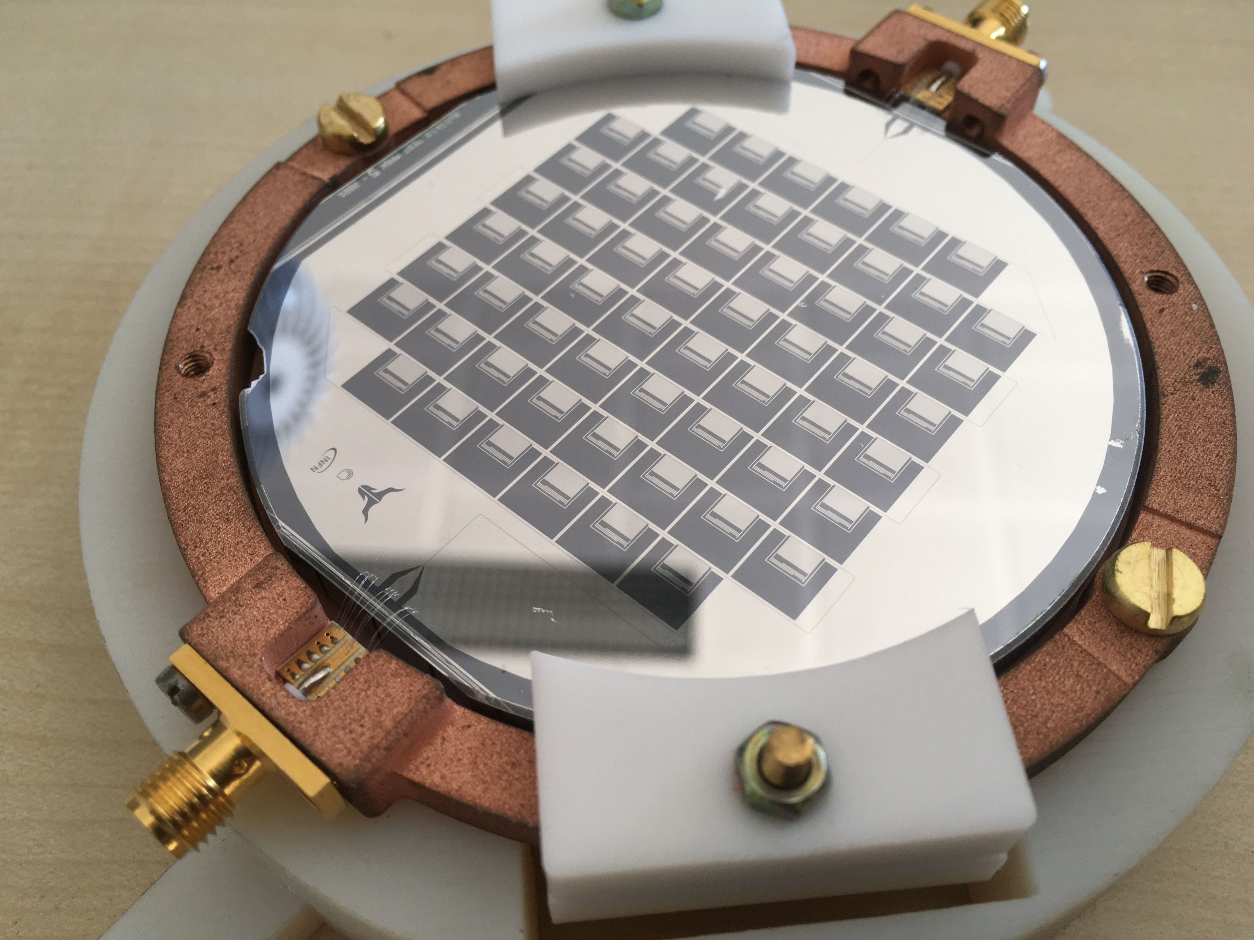
The BULLKID project
Bottom view
Basic idea
Detect phonons produced by particle interactions in a target detected by KIDs detectors
Monolithic silicon wafer:
Carved into diced ( $5×5×4.5$ mm³ )
0.3 g for die
0.5 mm commond base
Top view
60 KIDs array:
60nm Aluminum Film
1 KID for each die
Single readout line
$$f_{0}^{1}$$
$$f_{0}^{2}$$
$$f_{0}^{3}$$
$$f_{0}^{3}$$
$$f_{0}^{4}$$
$$…$$
$$f_{0}^{n}$$
$$f$$

Slide 16
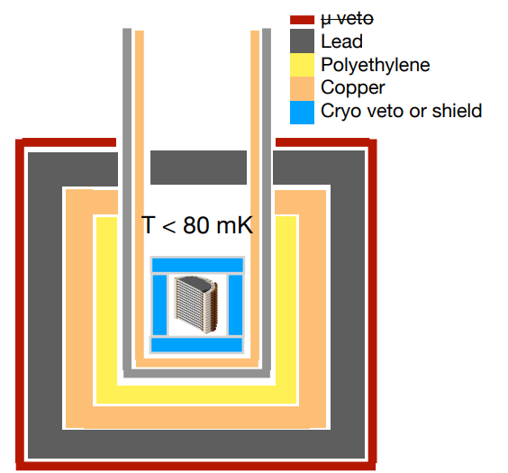
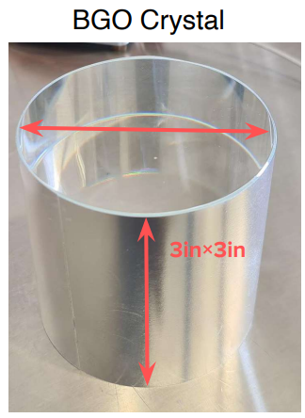
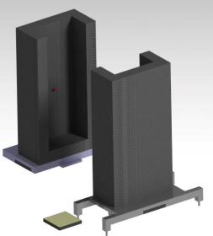
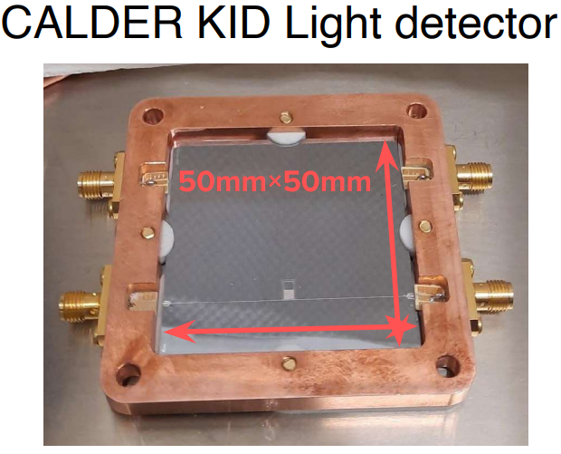
BULLKID @ LNGS
Shields & Vetoes
Additional Shields
5 cm Lead shield
10 cm Copper shield
Room T Shields
Lead $γ$-Shield
Cu Shield
PE n-shield
Cryo-schermo/veto
BGO crystal
KID light detector

Slide 17
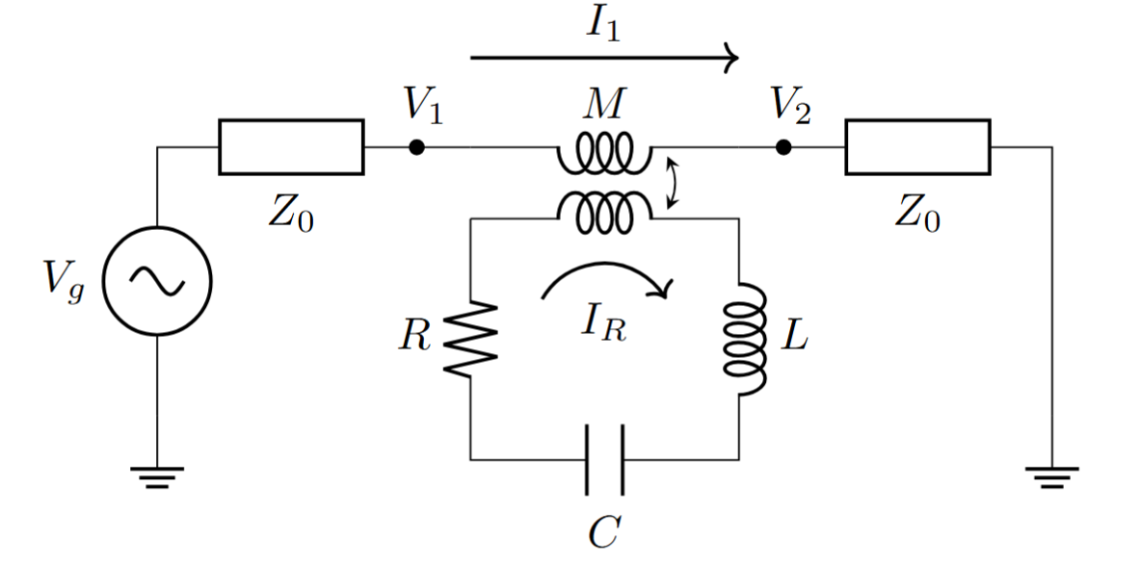
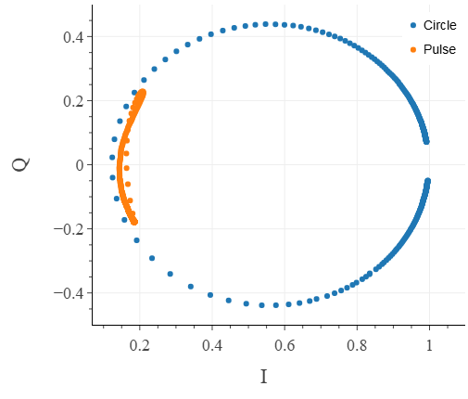
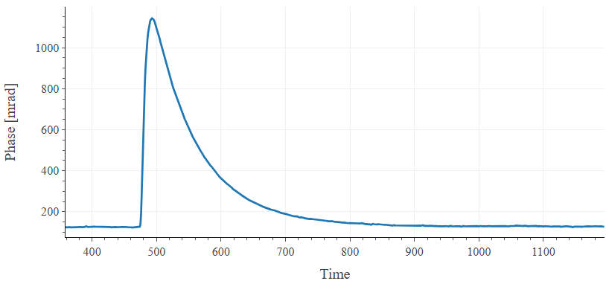
KIDs Readout
KID
Transmission function
$$S_{21}\left(ω\right)=1 − \frac{Q}{Q_{c}}\frac{1}{1+2jQx}$$
$$φ$$

Slide 18
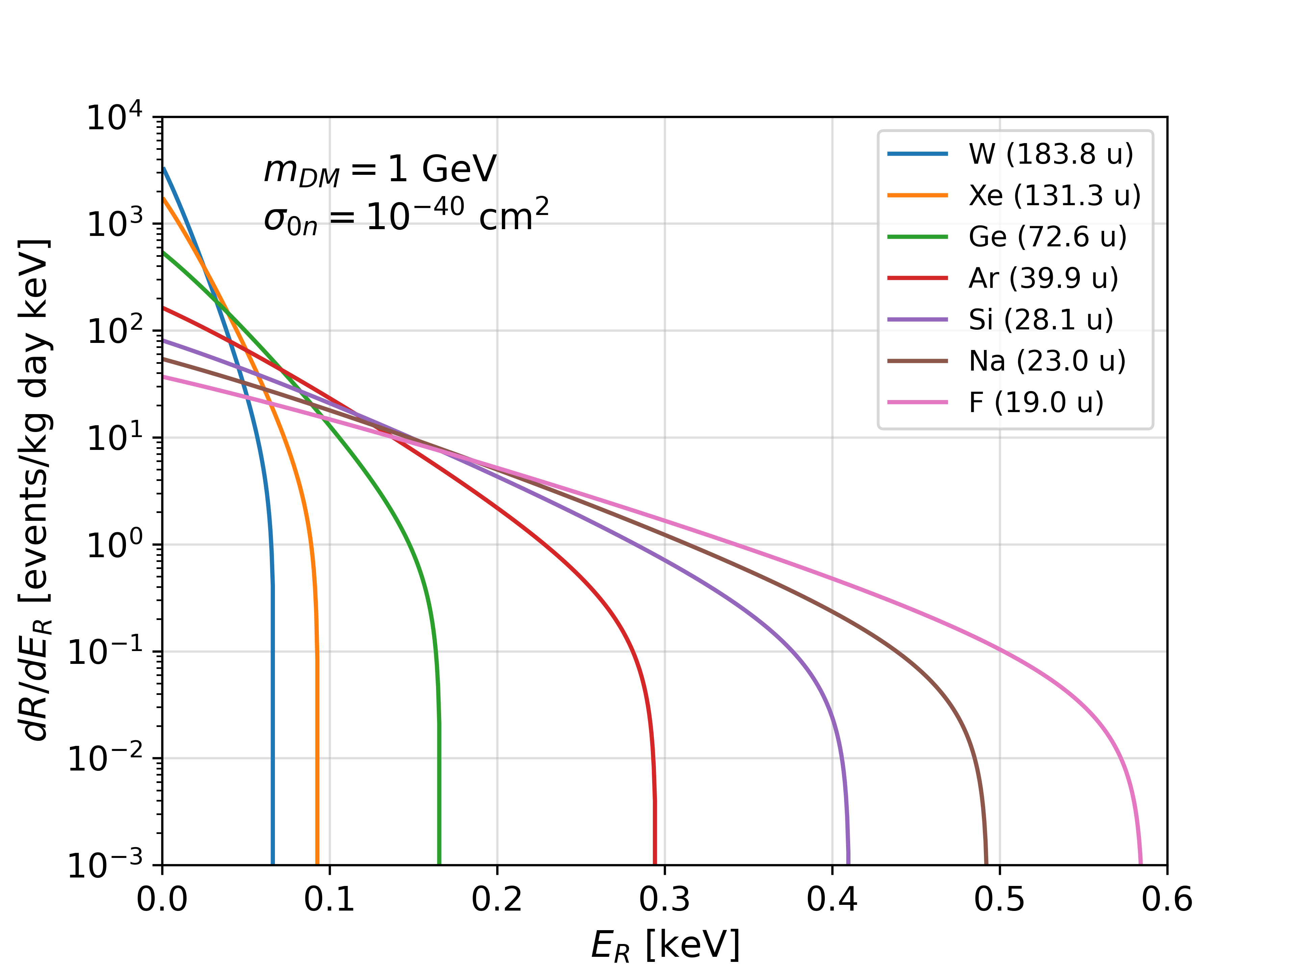
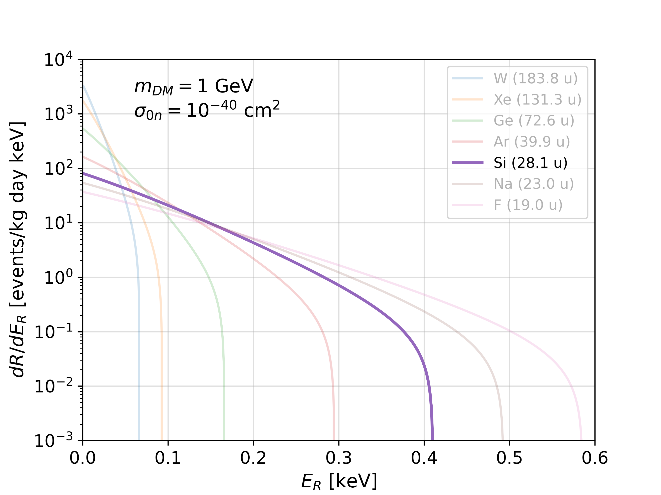
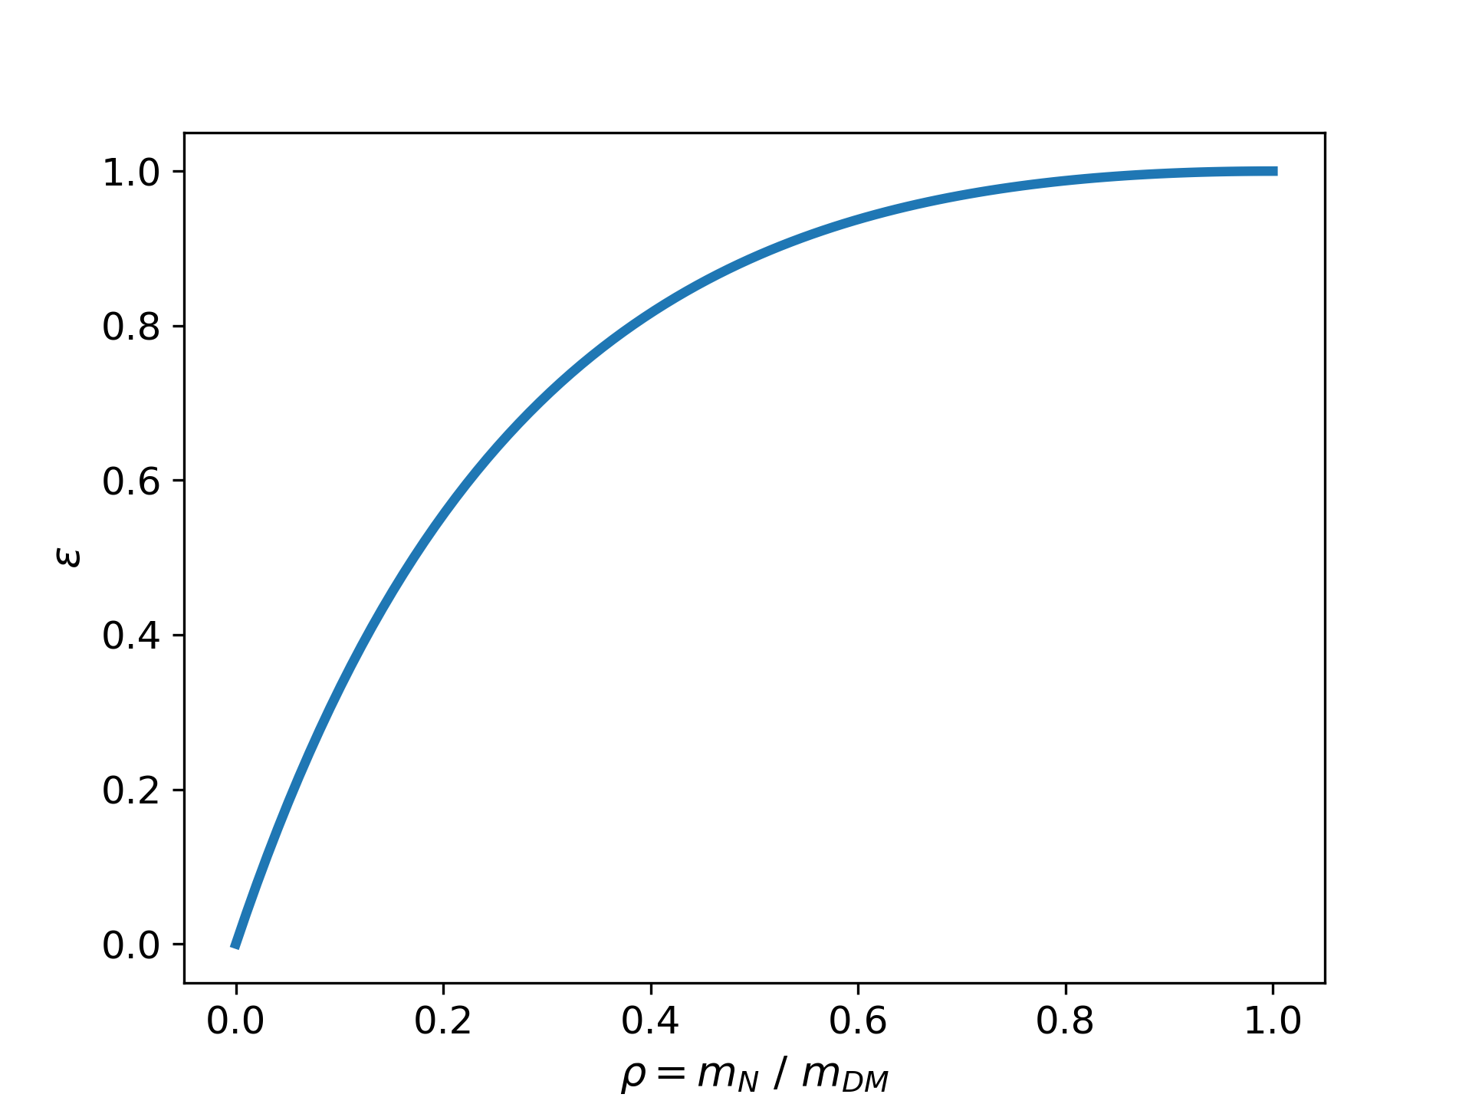
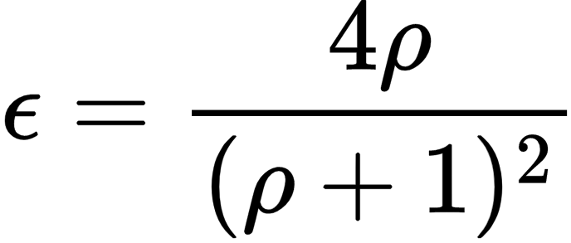
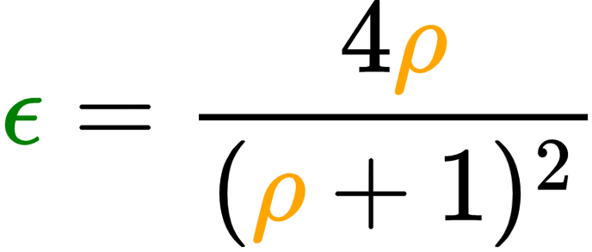
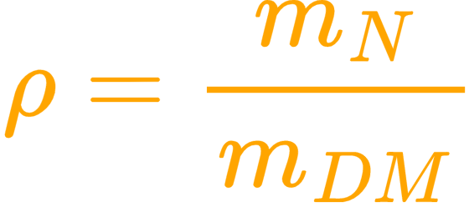
Dark Matter – Direct Search
Nuclear Recoil
$$DM/ν$$
$$DM/ν$$
$$target nucleus$$
Observable is recoil energy
Being an elastic scattering:
Fraction of energy transferred to the nucleus

Slide 19
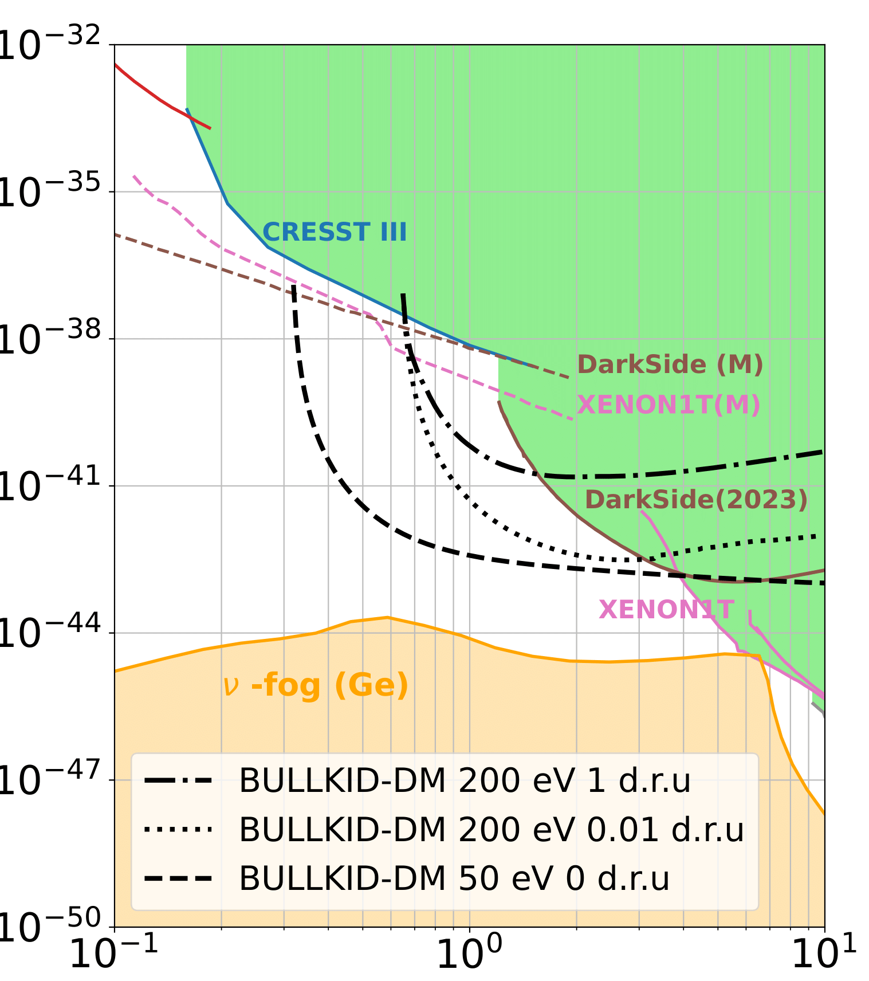
The BULLKID-DM Experiment
BULLKID is an R&D project targeting at the development of a detector for direct light dark matter detection and coherent neutrino-nucleus scattering.
Installation @ LNGS 2027!
$$DM/ν$$
$$DM/ν$$
$$target nucleus$$
16-layer stack of 100 mm diced silicon wafers:
600 g active mass
More than 2500 dice
Each die is sensed by a Kinetic inductance Detector
60 nm aluminum litography
Single readout line for each wafer
Cross section [cm$^{−2}$]
WIMP mass [GeV]

Slide 20
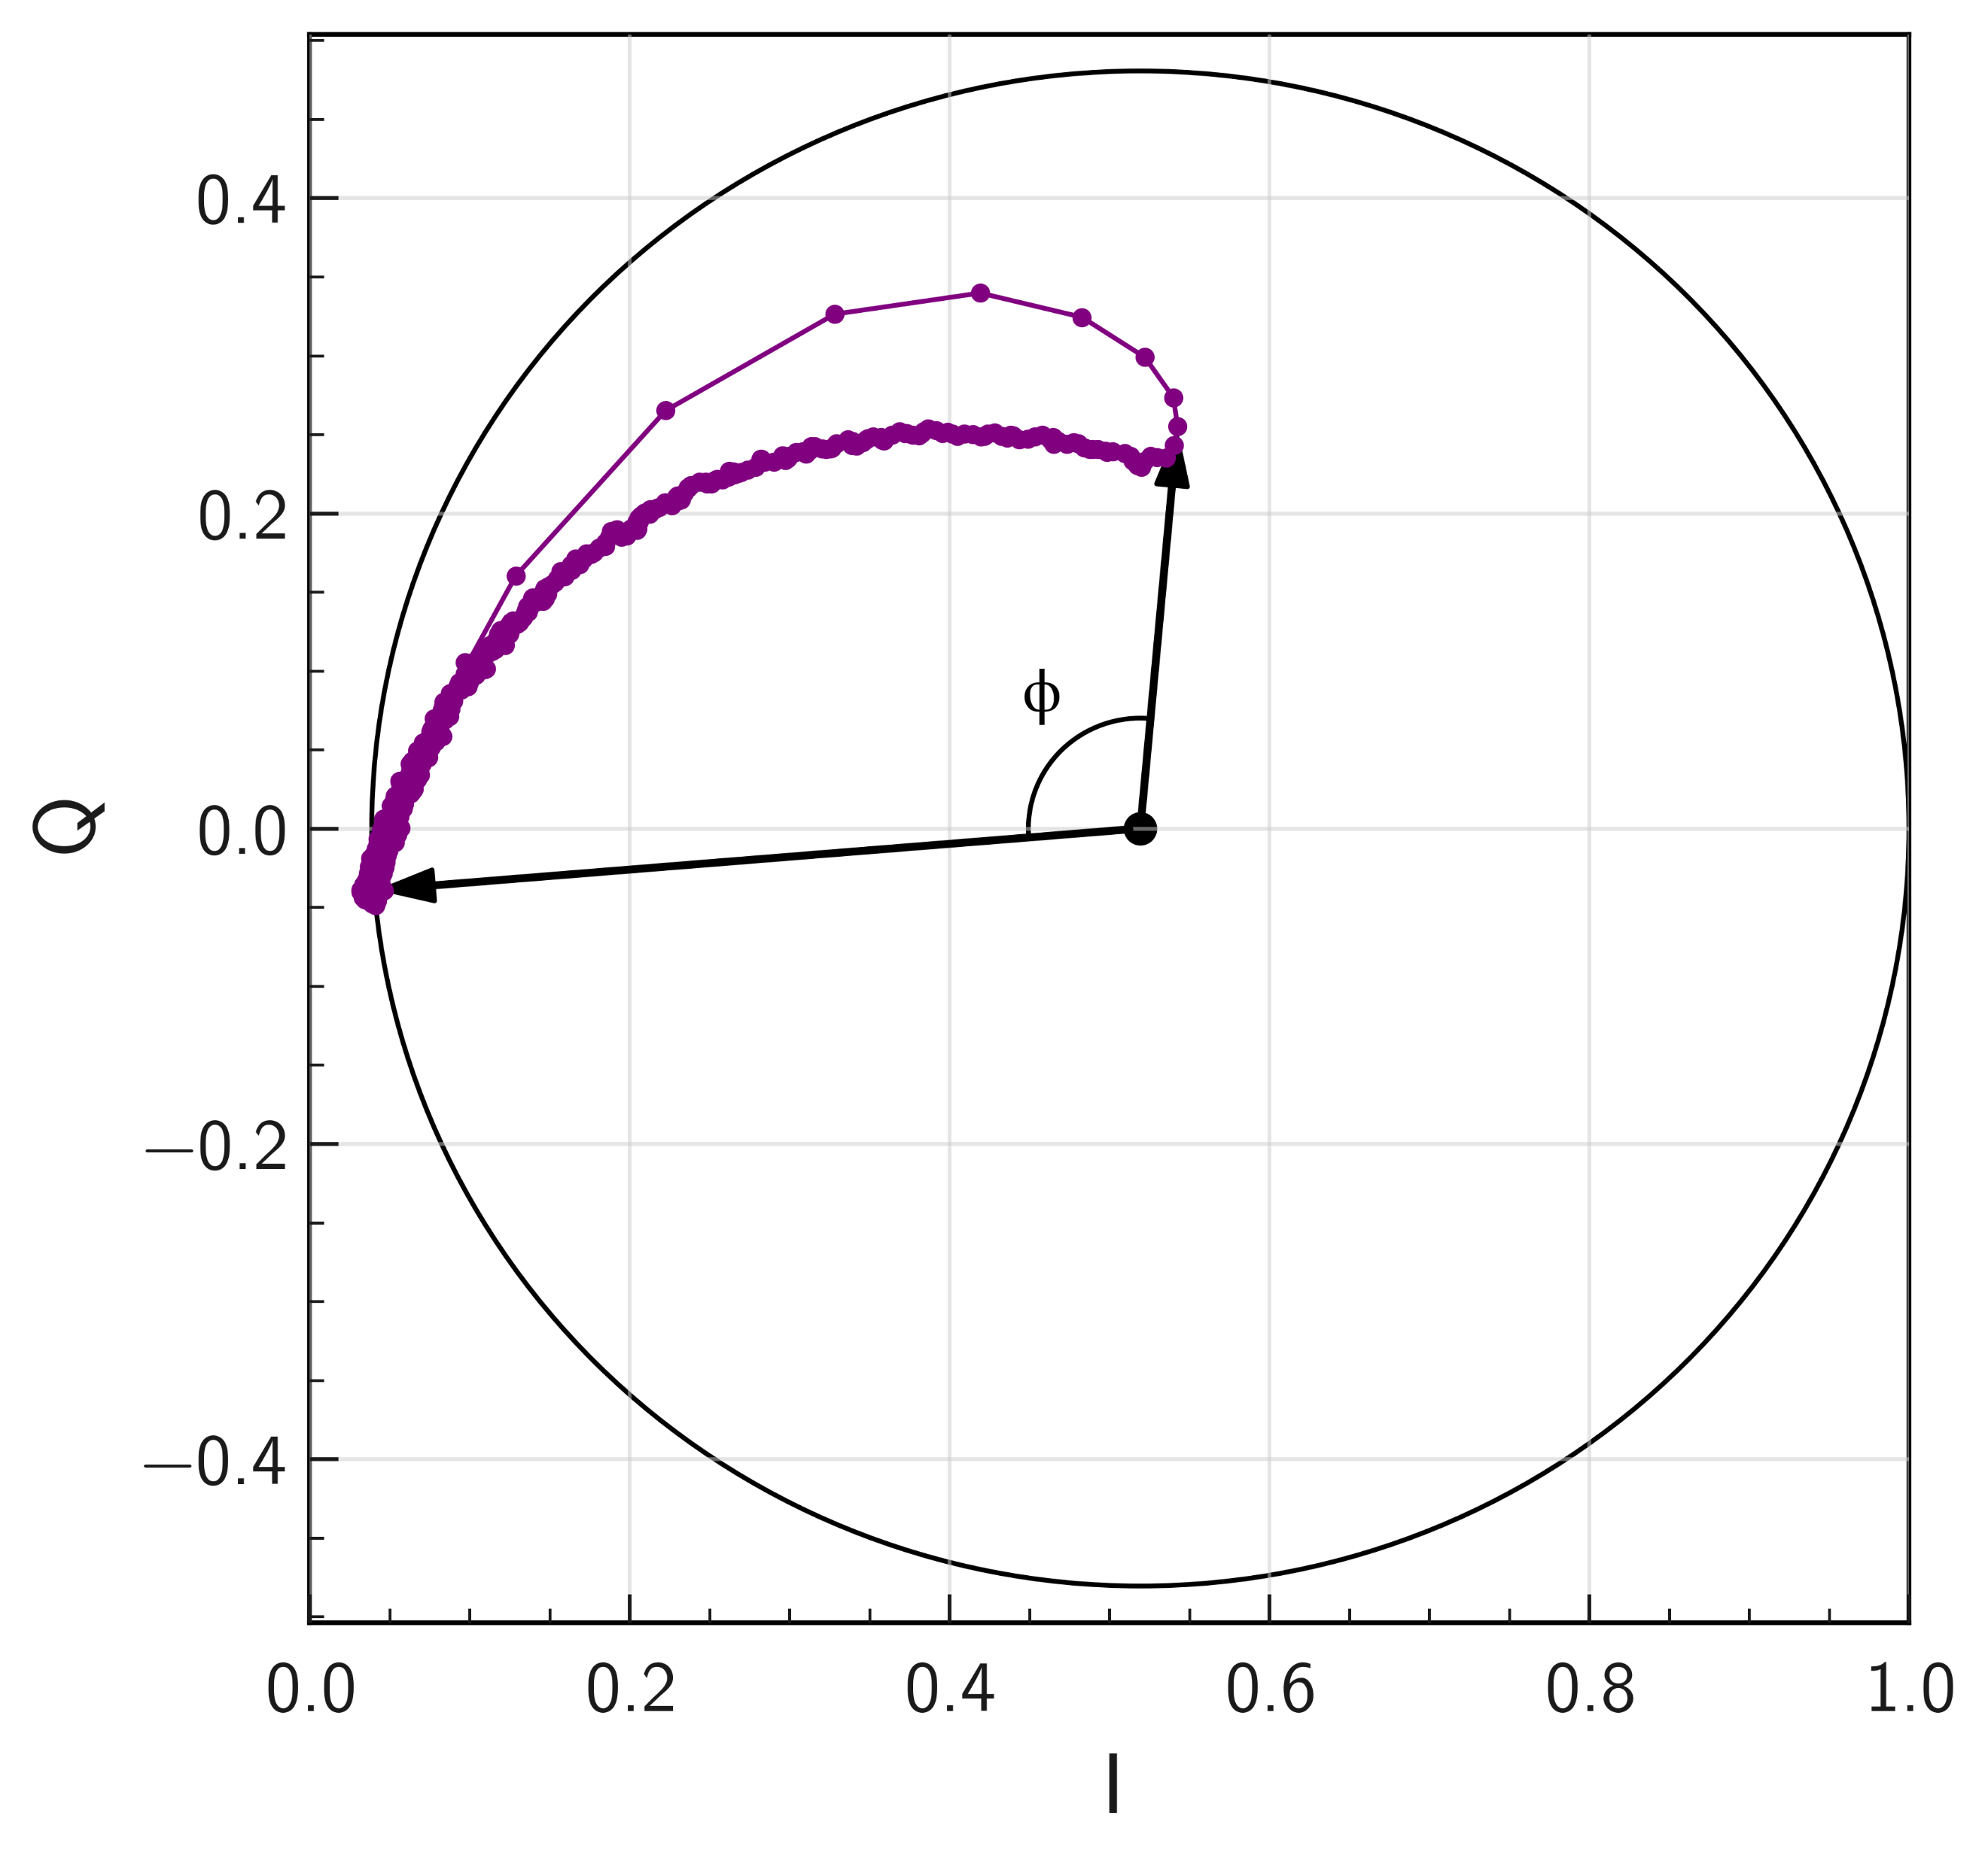
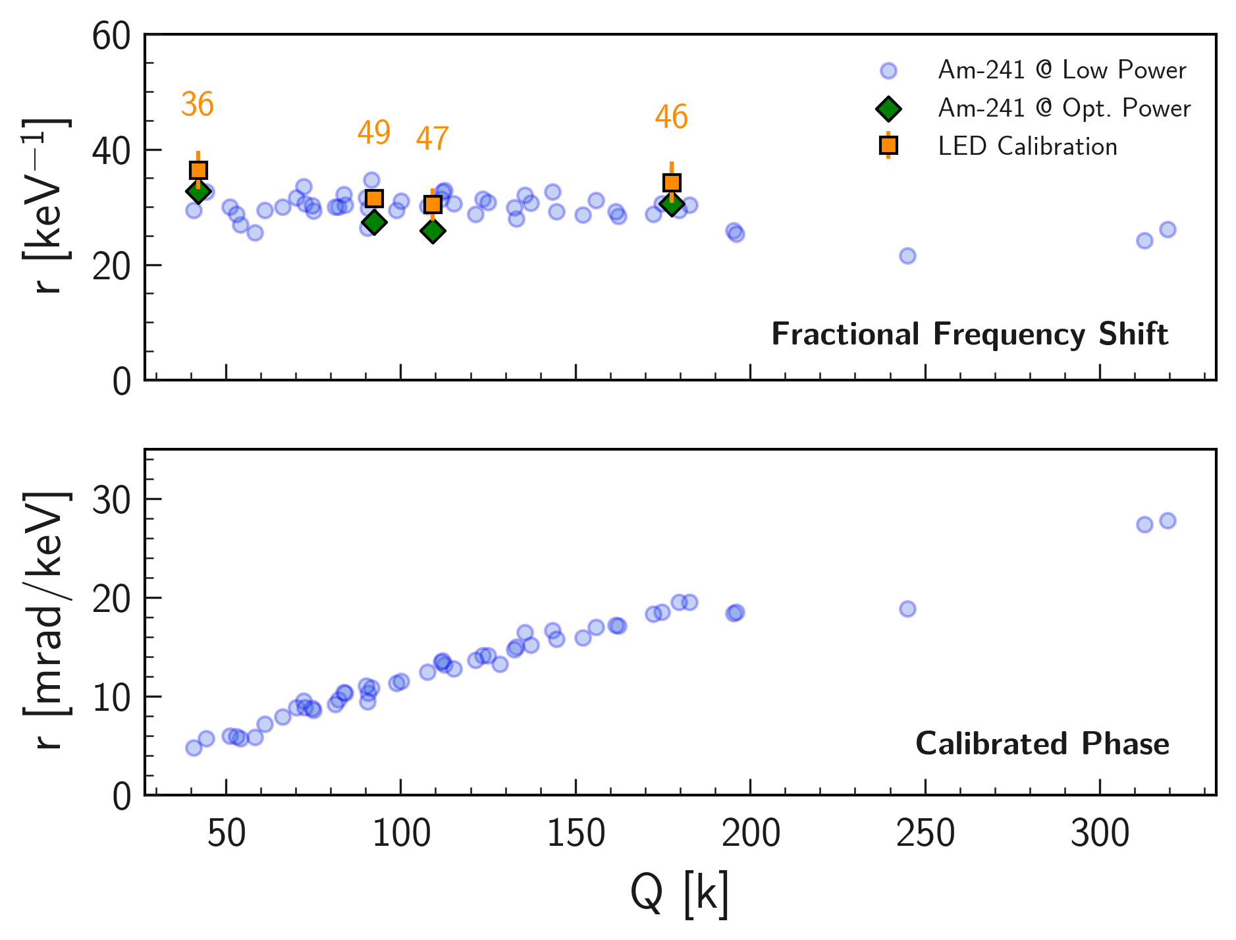
Towards uniform detector response in large-scale KID arrays
for Dark Matter searches with BULLKID-DM
Davide Quaranta^{1,2} on behalf of the BULLKID collaboration
¹Università di Roma ‘La Sapienza’
Project Goal
²Istituto Nazionale di Fisica Nucleare, Sezione di Roma
The BULLKID-DM Experiment
BULLKID is an R&D project targeting at the development of a detector for direct light dark matter detection and coherent neutrino-nucleus scattering.
The BULLKID-DM experiment will consist of a 16-layers stack of 100 mm silicon wafers.
Commissioning of the detector at the Gran Sasso National Laboratories of INFN is planned for 2027.
The idea is to sense phonons produced by the nuclear recoil of such particles on a diced silicon target with a large array of kinetic inductance detectors (KIDs).
Cross section [cm$^{−2}$]
It will have more than 2500 dice, with one KID detector each.
Calibration of such a large number of single detectors is therefore a challenge.
$$DM/ν$$
$$DM/ν$$
$$target nucleus$$
WIMP mass [GeV]
KID Signal Reconstruction
Energy of an event is measured from the change of the complex transmission function of the KID resonator:
We developed a new reconstruction algorithm to extract the Fractional Frequency Shift (x) signal, which should be equal for all KIDs:
The phase signal depends on the resonator quality factor Q , on its working point and on the bias power. Therefore the response is different from KID to KID.
Calibrated Phase
Fractional Frequency Shift
Whole-wafer test with Am-241
The performance of this new variable were tested using the 60 keV peak of Am-241 for calibrating all the KID of a wafer at once.
The calibration was repeated in two bias power configurations (low and high power).
Fractional Frequency Shift
Additional cross-check done with usual LED calibration.
Efficient KID response equalization was observed with the new variable, obtaining an average responsivity of 29.7 keV⁻¹ with better than 10% agreement between all 50 dice under test.
Calibrated Phase
Bibliography
¹ Jonas Zmuidzinas. “Superconducting Microresonators: Physics and Applications”(2012).
² A. Cruciani et al. “BULLKID: Monolithic array of particle absorbers sensed by kinetic inductance detectors” (2022).
³ L. J. Swenson et al. “Operation of a titanium nitride superconducting microresonator detector in the nonlinear regime” (2013).
⁴ M. S. Khalil et al. “An analysis method for asymmetric resonator transmission applied to superconducting devices” (2012).
⁵ M. Vignati et al. “Non-linearity in the system of quasiparticles of a superconducting resonator” (2021).

