Slide 1
Software and Analysis for FDIRC Prototype
Doug Roberts
Ellie Twedt
University of Maryland

Slide 2
Goal
The prototype will be taking data soon (hopefully!)
We want to be ready to analyze, understand and debug data right away.
There is a lot of preparation that can begin now.
At the moment, I would say that we have lots of bits and pieces of things but no overarching organization structure
On the other hand, we shouldn’t build a monster
Ease and clarity of use is key
  Read “Documentation”

Slide 3
Flow of Data
Currently have a mix of ASCII, ROOT, FORTRAN, C++
That’s probably ok at the top level of this tree
  Use the best tool
But further down, we should converge on a format
Would like to treat MC and Data with same tools
Ideally, could apply this to 1st prototype data
  Probably scope creep

Slide 4
Where To Put Things?
Communication:
  Nicolas has created an e-mail reflector. Please use to keep everyone in the loop. Also helps to keep a record.
  Would HyperNews or something similar be useful?
  Regular or semi-regular meetings?
Documentation
  Where? SuperB Wiki? Alfresco?
  Need to agree on conventions, numbering, coordinates, etc.
    Jerry has already started “Critical Dimensions” document.
Software
  Everything should be in SuperB svn. I think this is the only way that we can easily share and collaboratively develop code. But you have to be a SuperB member.
  Now would be a good time to start thinking about how to organize code and packages

Slide 5
Converting Some CRT FORTRAN/HBOOK to
C++/ROOT
On behalf of Ellie Twedt
University of Maryland

Slide 6
CRT1 Data format
Ascii file from Kurtis (Hawii)
Event
44 line Header
(date/time, hodoscopes, stack PMTs, trigger hits, etc.)
224 lines of fDIRC PMT data
(8 lines per BLAB2, 4 BLABs per tube, 7 tubes total)

Slide 7
Current status and goal
ascii data file
Compiled ROOT code that creates root tree with “events” of track direction, energy, PMT hits
✔
This is all currently done by FORTRAN code that creates PAW plots
root data file
Calculate Cherenkov angle
root data file
Customizable compiled ROOT analysis code (skeleton)
✔
plots

Slide 8
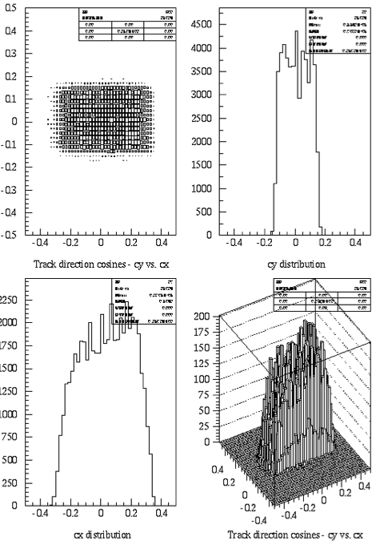
Comparison of some “old” and “new” plots
K_x
K_z
Track direction:
✖
K_y
k
old
New
(small subset of data used in “old”)

Slide 9
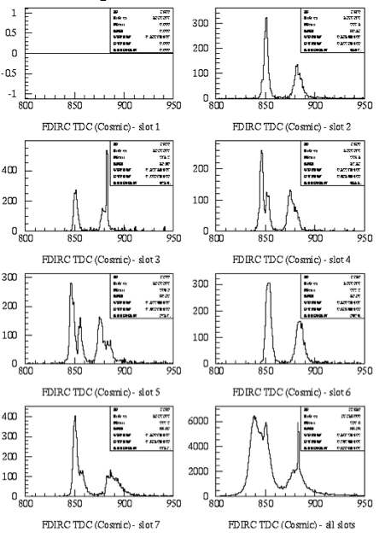
Comparison of some “old” and “new” plots
“time” of pulse in fDIRC PMTs
old
new
#2
Tube #1
#3
#4
#5
#6
#7
all

Slide 10
Still to be done
Implement dictionary / LUT to determine Cherenkov angle from PMT hits
Run on full dataset to validate against all “old” plots
Reformat output of old/new simulation to make identical root trees, so common analysis code can run on both MC and data

Slide 11
Some nagging questions
“pixel” (or channel) of PMT recorded in root tree. Should this be in electronics space or pad space?
Keep muons of all energies, or just those with E>1.6 GeV?
Currently “time” is absolute (unix) time. Change to be relative to first event in current file?
Common (well documented) axis/numbering system?

Slide 12
User Analysis
Could commit small(ish) data file (ascii) and all root code to svn. Where?
Common area for all CRT data, both old and new?
Accessibility of MC for old/new?
Format for soon-to-come CRT data same as last year? Need different root-tuple maker, but keep consistent analysis code?

