Slide 1
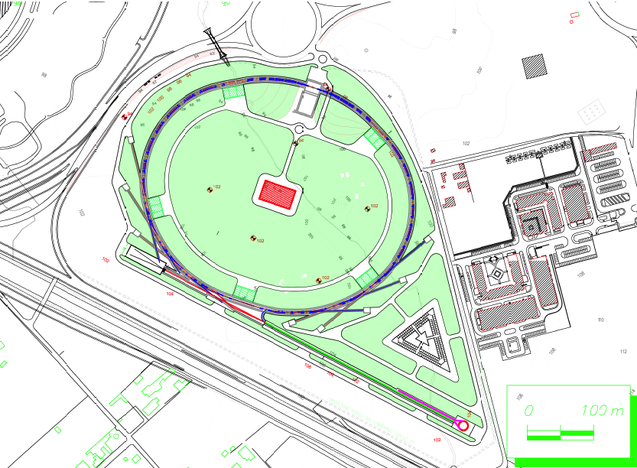

Detector Status
F.Forti, INFN and University, Pisa

Slide 2
Overview
Detector design is fairly advanced
  Progress report: arxiv.org/abs/1007.4241
R&D continuing in several areas
Most options are defined
Proto-collaboration organization is in place and working well
Transition to full collaboration well advanced
… but …
Significantly more physicists and engineers are needed
Need to define funding sources and committments
Need to baseline design/schedule and move on to construction
→ Plan to produce TDR even if not everything is clear

Slide 3
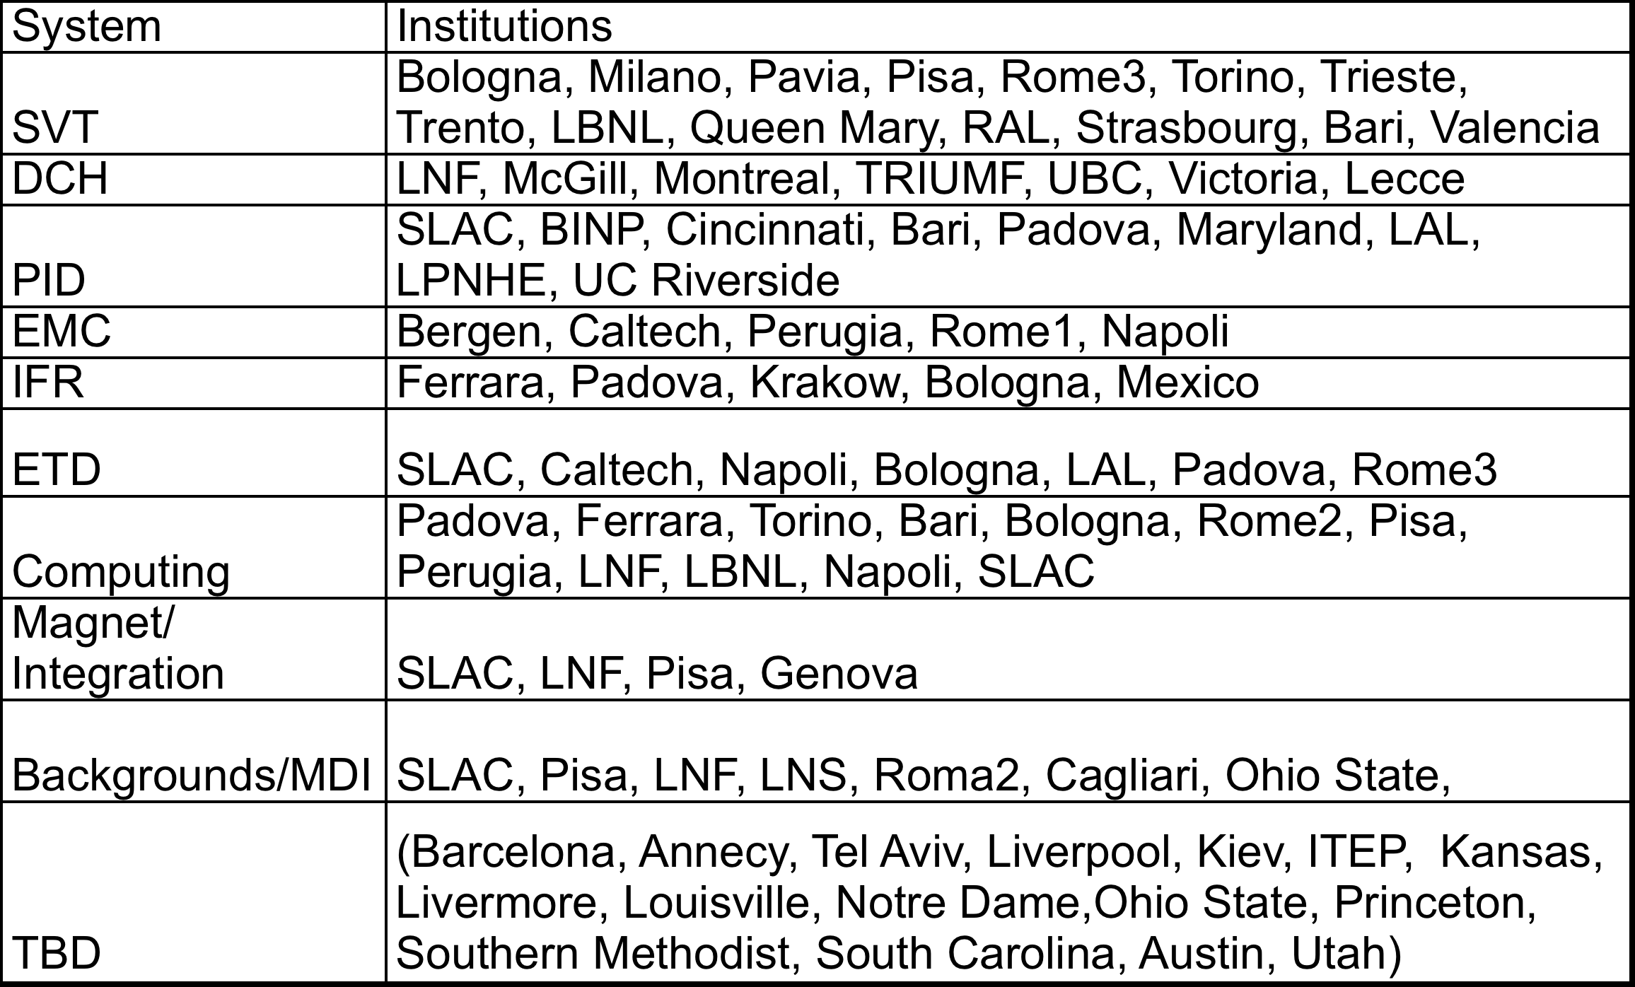
Institutions

Slide 4
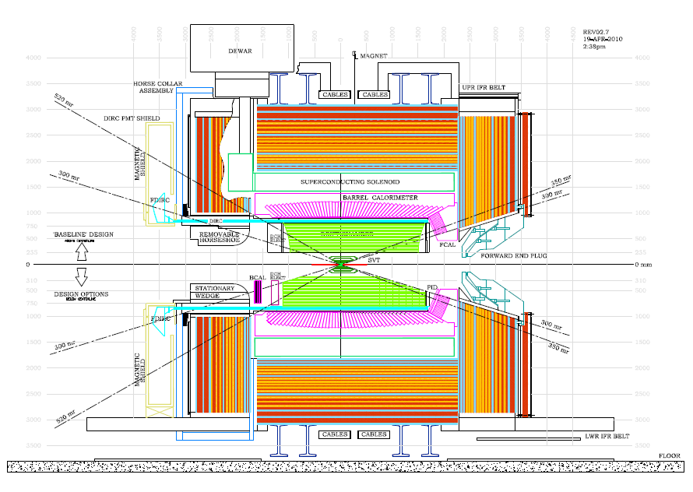
Detector Design (with fewer options)

Slide 5
Detector Design Issues
System | Baseline | Issues (technical OR manpower; R&D)
MDI | Initial IR designed | Magnetic elements and radiation masks. Design of tungsten shields. Cryostats radius Background simulations: global map, detector occupancy
SVT | 6-layer silicon | Technology for Layer 0: striplets or pixels. Thin pixels R&D. Readout chip for strips. Mechanical design.
DCH | Stereo-axial He-based | Dimensions (inner radius, length). Mechanical structure. Cluster counting option.
EMC | Barrel: CsI(Tl) Forw: LYSO | Electronics and trigger. Mechanical structure Forward EMC technology: LYSO / LYSO+CsI(Tl); Pure CsI. Backward EMC: cost/benefit analysis
PID | DIRC w/ FBLOCK | FBLOCK design. Photon detection. Mechanical structure Forward PID: cost/benefit analysis. Prove TOF technology.
IFR | Scintillator+ fibers | 8 vs 9 layers. SiPM radiation damage and location. Extra 10cm iron. Mechanical design and yoke reuse.
ETD | Synchronous const. latency | Fast link rad hardness. L1Trigger (jitter and rate). ROM design. Link to computing for HLT.

Slide 6
TDR process and timeline
The Technical Design Report is an essential step to get funding and get the detector built.
Conflicting requirements
  Essential to enlarge the collaboration, define institutional responsibilites and find resources for designing and building the detector
  Essential that collaboration members, institutions and countries take ownership of the design and fabrication
Funding and schedule
  The TDR must contain an initial definition of funding and resource availability
  Open question about how to incorporate funding agencies intentions and committments into the TDR:
    → Proposal to have a separate financial document to detail the agencies contributions
Timeline
June-July: setup SVN repository + initial outline
September 2011
  Detailed outline with page count + editorial responsibilities
  Tentative institutional matrix of responsibilities and money allocation
December 2011 → March 2012
  First (in)complete draft,
  Decision about what is in and what is out
  Updated budget and schedule for construction
February 2012 → June 2012
  Complete draft into final editing
  Final readers identified
July 2012
  Updated budget and schedule for construction
September 2012: Publish

Slide 7
MDI
Eugenio Paoloni

Slide 8
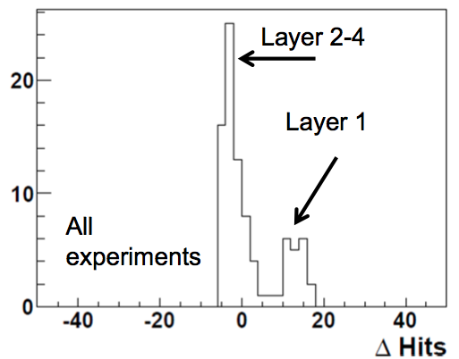


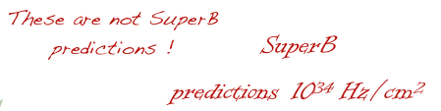

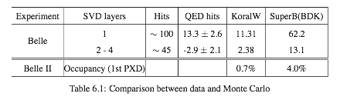



Background simulations
The SuperB - Belle II joint meeting was very fruitful
  Their rate measurements of pairs and our simulations are in fairly good agreement
  Consensus reached that radiative Bhabha backgrounds are not negligible in both experiments
  We learned from Belle-II the dangers of multi turn Radiative Bhabha losses: we plan to simulate it asap
Courtesy C. Kiesling
Courtesy C. Kiesling

Slide 9
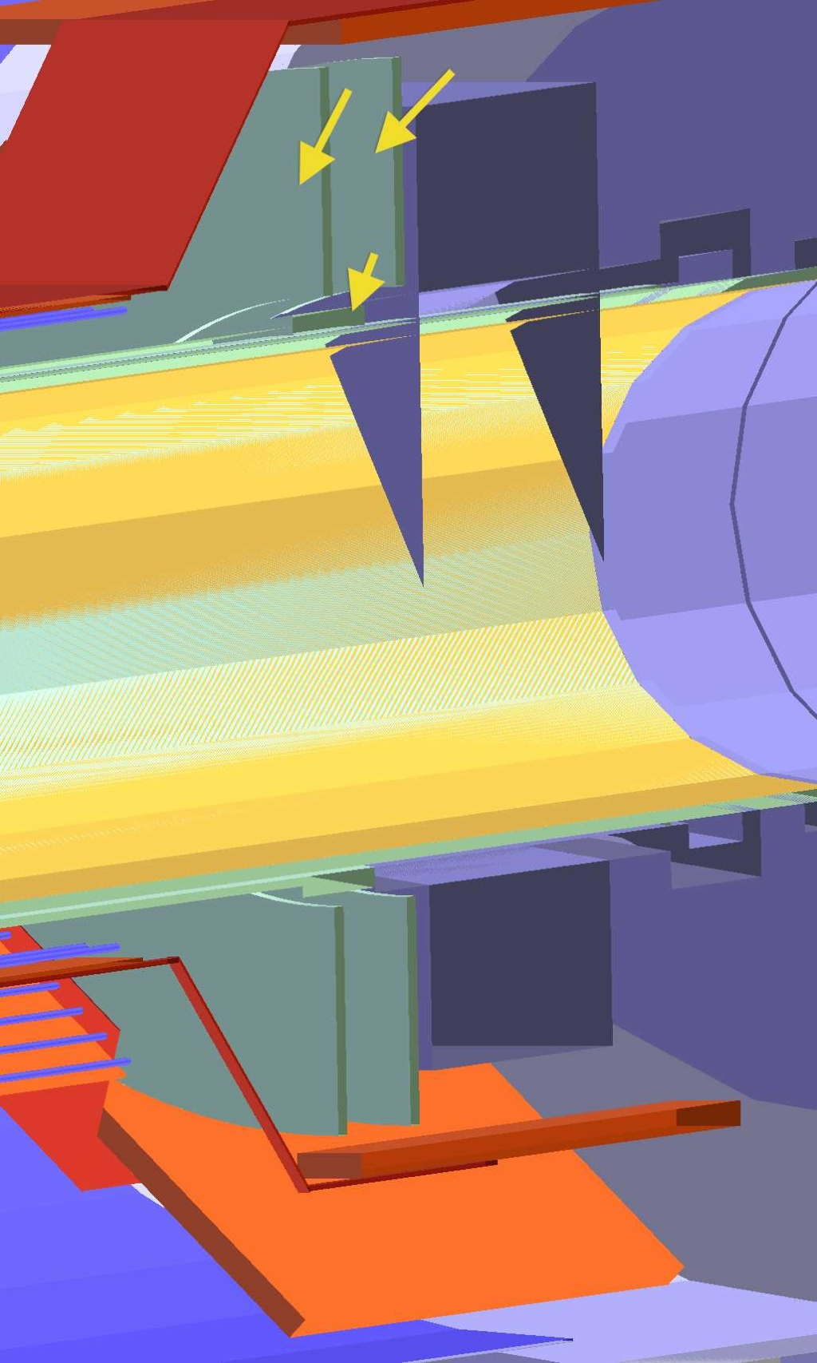
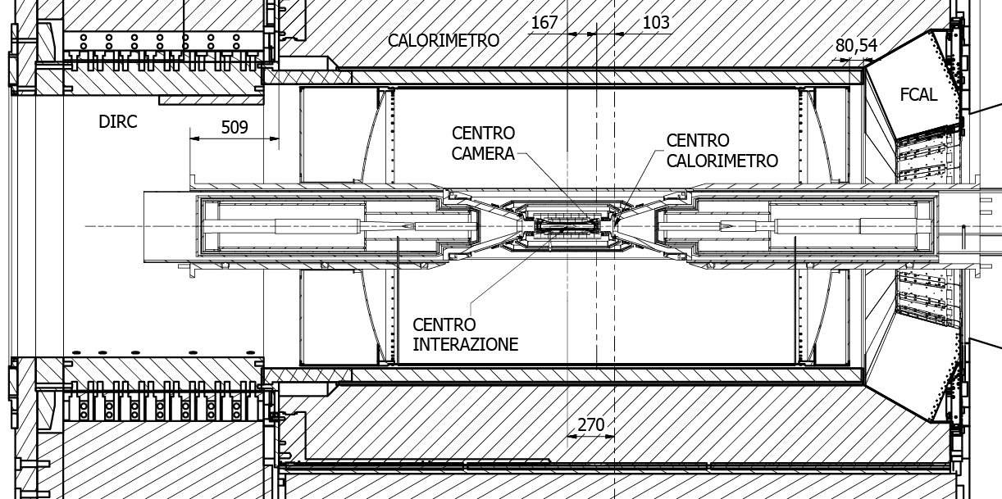
MDI & Bkg. Simulation
Progresses in the simulation:
  minor bug fixes in the geometry and magnetic field configuration
  Radiation Monitor put in the Bruno simulation
  Cherenkov light simulation for the FTOF (final checks)
  EMC energy deposits binned in time for a more accurate simulation of the system response
  Beam gas sample provided by Manuela simulated with Bruno
Progresses in the mechanical design:
  Filippo progressed in the design of the
  quick mounting/demounting procedures
  ( Parallel on Integration )
  Fabrizio Raffaelli is going to study the
  mechanical fixture of the W shields
Rad. Mon.
Be Pipe (r= 1cm)

Slide 10
SVT
Giuliana Rizzo

Slide 11
SVT – Some highligths since Dec.
Background simulation: many tests to understand new numbers from Dec.
Total rates from Dec. production (several sources included) too high for SVT!
Pairs increased a lot; some reasons understood and fixed, but rates still higher
  +20% in inner layers +80% in outer layers, where different material close to IP can count.
Touscheck as high as pair in L1-5. Rad Bhabha not negligible.
Some sources still to be included and new shielding configuration need to be studied
Joint Background Workshop with BelleII in Feb. very useful:
Discrepancy with BelleII pairs estimate has been solved and our result is still valid.
  The factor 15 was due to some “problems” in the initial BelleII value and to some misinterpretation of our results by Belle colleagues. The hit rates expected in Layer0 for both experiment is consistent. SuperB estimates also agrees with measurement performed with SVD Belle data.
Performance studies: high background deteriorates performance
low efficiency due to analog dead time (< 90 % in some layers)
  Impact will be evaluated with fastsim
High offline occupancy: ~4-6% in L0-L3 and ~2.5% in L4-5 (x5-x10 w.r.t. BaBar)
  Impact on resolution will be evaluated with fastsim
  Can affect reconstruction (difficult to evaluate the impact but need to face issue)
Many tests done to check discrepancy among fullsim and fastsim (for background studies); fastim tools to study SVT performance in high occupancy almost ready
R&D on pixel: INMAPS chips received and under test now
x5 safety included,
some source still missing

Slide 12
SVT-Detector Design and TDR status
Activities almost completed in all areas
Complete the work in ~1-2 months then concentrate on TDR writing
Silicon Sensors: geometry defined and detailed parameters provided noise evaluation.
Fanouts: Layer0 - some details still to be defined. Layer1-5 - prototypes in production at CERN
FE chip development: Readout architecture simulated (VHDL): 100% digital efficiency achievable even for high Layer0 rates (2 MHz/strip).
  “Analog” inefficiency and hit time resolution simulated with present FE design.
  Shaping time reduction for some layers under evaluation to mitigate background impact.
Peripheral Electronics: progress on definition of HDI components, connectors, copper bus & transition cards. Some work still needed
DAQ & FEboard: Electronics load reavaluated with new inputs (new geometry and back. rates)
Performance studies: some work still needed
Mechanics: Detailed procedure for quick demounting defined (presentation at the Integration session).
Insert a temporary cage to make SVT/Be pipe more rigid then slide criostats, W conical shields, cage + SVT+Be pipe w.r.t W cilindrical shields

Slide 13
DCH
Giuseppe Finocchiaro and Mike Roney

Slide 14
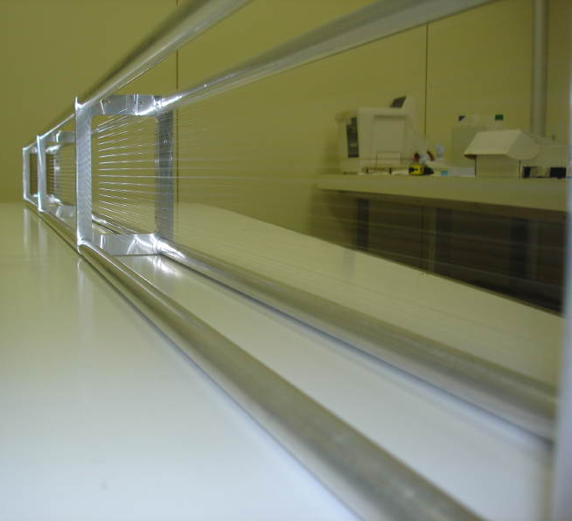
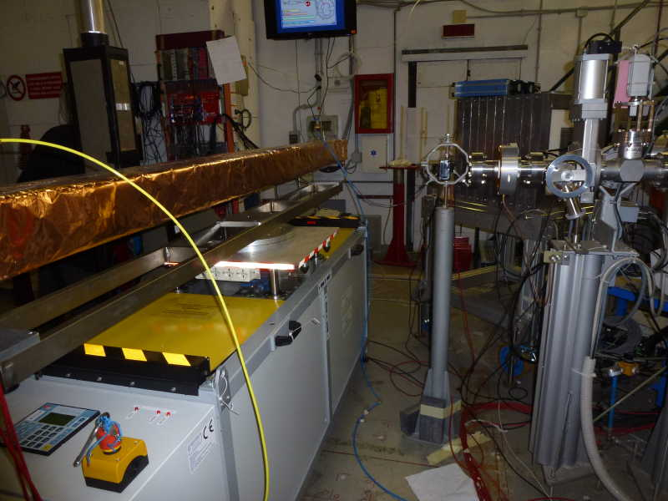
Beam test of Prototype2 at BTF
2.5m long prototype with 28 sense wires arranged in 8 layers
  Goal: study DCH response from single clusters in a realistic environment, and serve as a test bench for the final FEE and for test of DCH trigger implementation

Slide 15
Analysis of Proto2 data
Analysis status will be reviewed during the meeting. Examples:
Tracking
comparison of cluster counting and dE/dx performances
70% trunc. mean dE/dx - 10 samples
Counted clusters - 10 samples

Slide 16
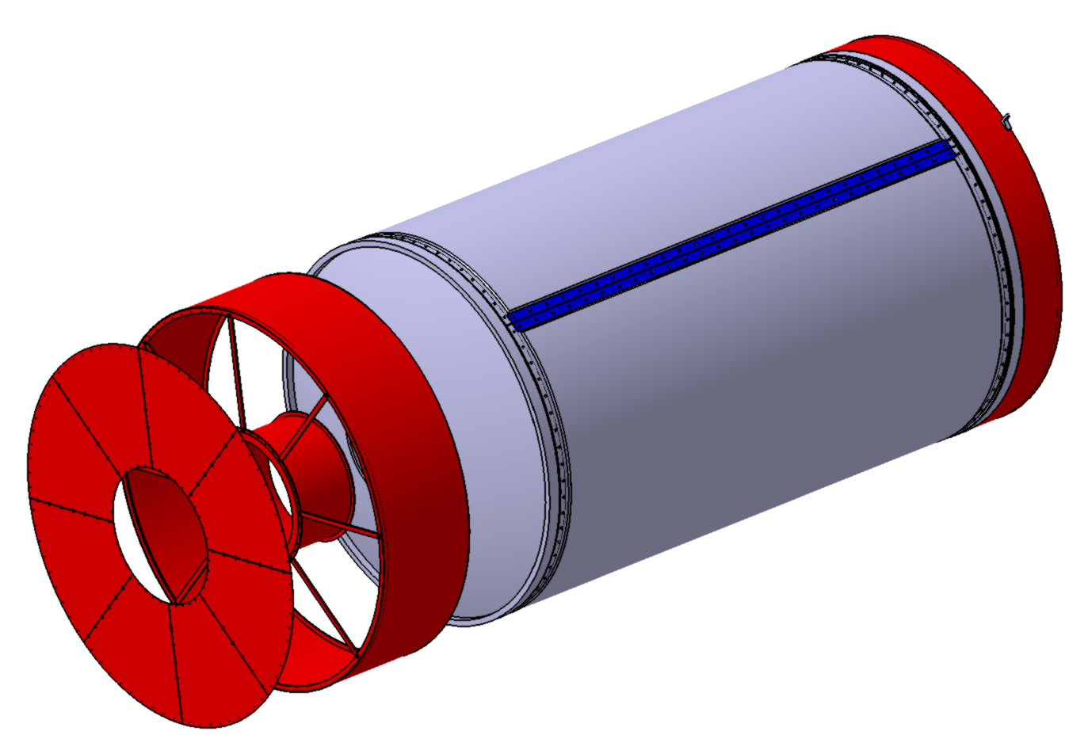
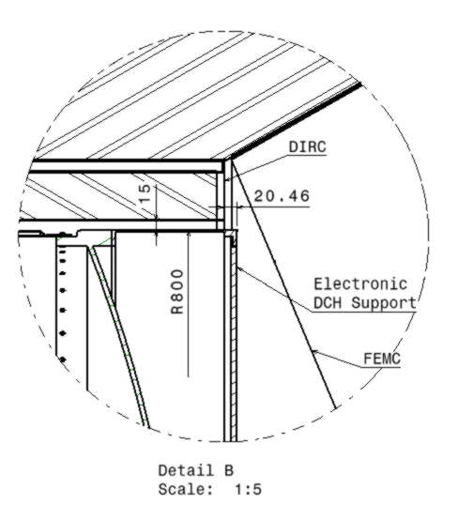
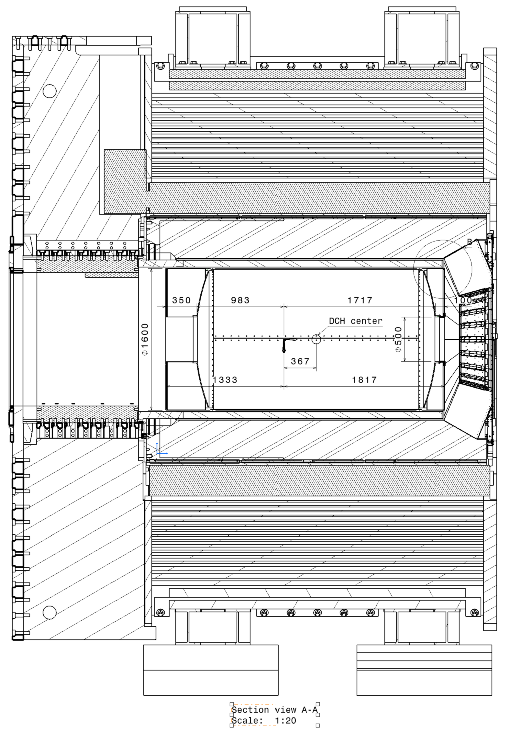
Mechanical Structure
More Progress on the DCH technical design, including:
  services (shielding, support for electronics)
  integration

Slide 17
TRIUMF DCH beam test dE/dx analysis
Study PID performance using standard readout for comparison to cluster counting.
Can perhaps do better than traditional truncated mean by looking at distribution of energies among the samples recorded by 40 layer DCH.
dE/dx plus cluster counting should give best performance
mean + shape
truncated mean only
Rocky So, UBC

Slide 18
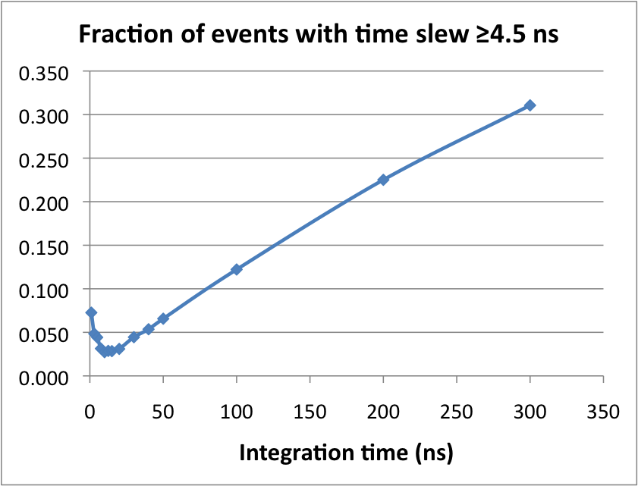
Amplifier properties: noise and bandwidth
Quantify impact of noise by slew: change in measured drift time for 1σ change in threshold.
  no TDC; time extracted from waveform.
  results are comparable to BaBar
One goal was to check whether Montreal amplifier prototype had adequate bandwidth for cluster counting.
Bandwidth limitation of readout limits usefulness of test. New data this summer.
FFT 140 MeV/c π/μ waveform
FFT of waveform with no beam
no information above ~250 MHz

Slide 19
PID
Nicolas Arnaud and Jerry Va’vra

Slide 20
PID status
a) FDIRC prototype
FDIRC optics (SLAC):
- QC of FBLOCK and Wedge completed.
- Fbox is being assembled around FBLOCK – expect to finish in April.
- Final assembly in CRT - expect to finish in May-June.
FDIRC electronics:
- Electronics for the FDIRC prototype is being built (SLAC & Hawaii).
- Expect to have the prototype’s electronics available in June
Software development:
- FDIRC prototype optics in MC simulation (Maryland)
- Continuing work to understand data from the 1st FDIRC prototype (SLAC).

Slide 21
PID status
    b) FDIRC at SuperB
FDIRC electronics:
- Final electronics motherboard for SuperB FDIRC designed (LAL & Padova)
- Work on the final SuperB FDIRC electronics continues (LAL):
(SCATS chips received, Test boards being finalized, Tests of the analog boards have started,
new 16-channel Wavecatcher board is ready for tests)
FDIRC shielding (SLAC, Padova):
- The 1st version of the SuperB FDIRC shield design completed
- It has been included in MC background simulation program (Alejandro).
Continuing work on H-8500 tube tests (Maryland, Bari, Padova, SLAC).
TDR: PID section is almost completed (~80%).

Slide 22
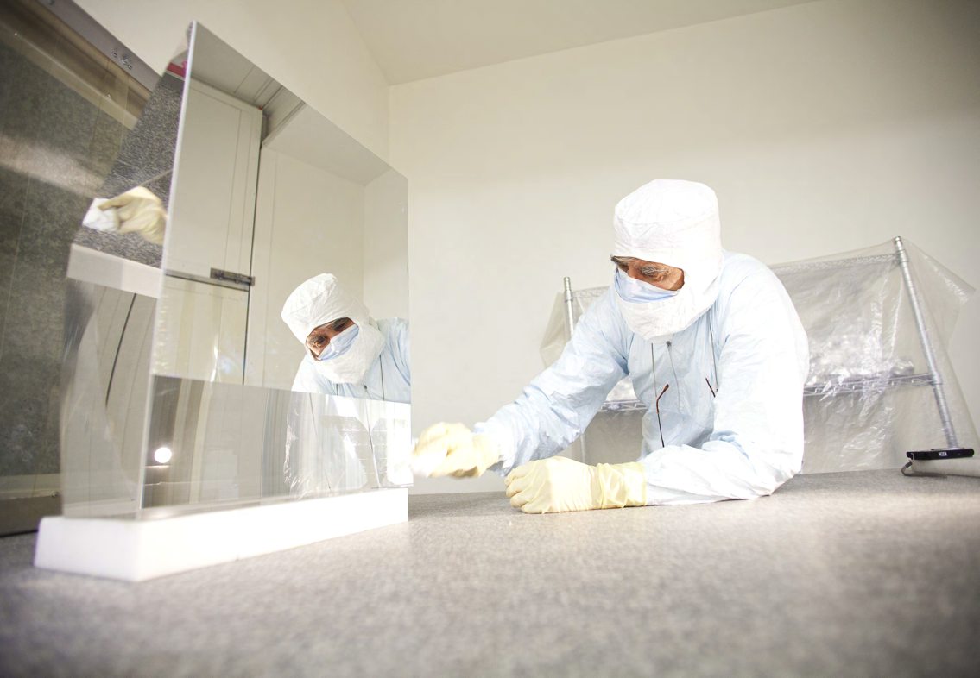
FDIRC optics was published in “SLAC Today” https://news.slac.stanford.edu/features/slac-physicists-build-prototype-particle-identification-detector
FBLOCK optics:
There is a short article describing highlights.

Slide 23
EMC
Claudia Cecchi and Frank Porter

Slide 24
EMC - Barrel
Babar Barrel will be reused replacing the preamps.
Background in Barrel (Radiative Bhabhas).
  Large effect of x5 safety factor with current shielding
Question: Do we disassemble barrel for move to Italy?
  Barrel not designed for long trips; risk of damage to crystals
  Disassembly and reassembly represents a substantial cost in schedule,labor, and facilities
  Subject of discussion at this meeting

Slide 25
EMC – Forward technology

Slide 26
IFR
Roberto Calabrese

Slide 27
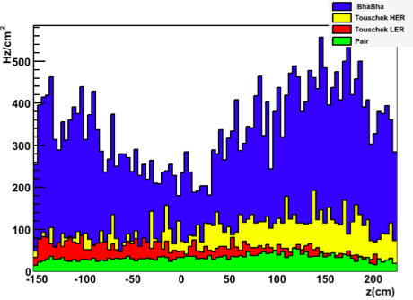
IFR overall status
BiRO module
Critical issues for final detector design
10cm
SiPM
Binary readout vs time readout for the barrel
Number of active layers: 8 vs 9
Amount of absorber and flux return configuration
Position of the photodetectors
Binary readout is now our baseline
5 cm
9 active layers is the baseline for the TDR, but the 8-layer option is not discharged
92cm of iron is the current baseline for the TDR. Under investigation the possibility to use less absorber. The BaBar iron will be reused with no major modification.
Neutron rate distribution
SiPM will be placed at the end of the scintillators inside the gaps. Neutron rate is high (up to some 100Hz/cm²) but with the binary readout it’s possible to rise the thresholds to reduce the increasing of the noise.

Slide 28
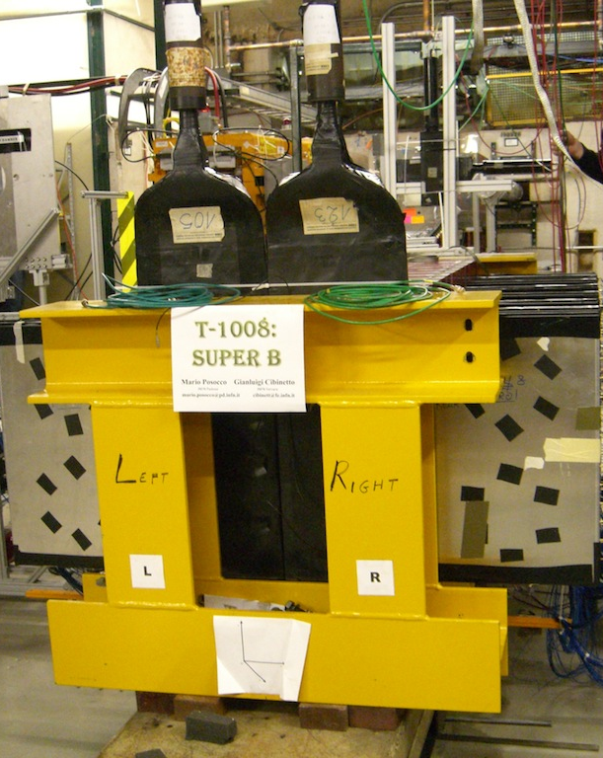
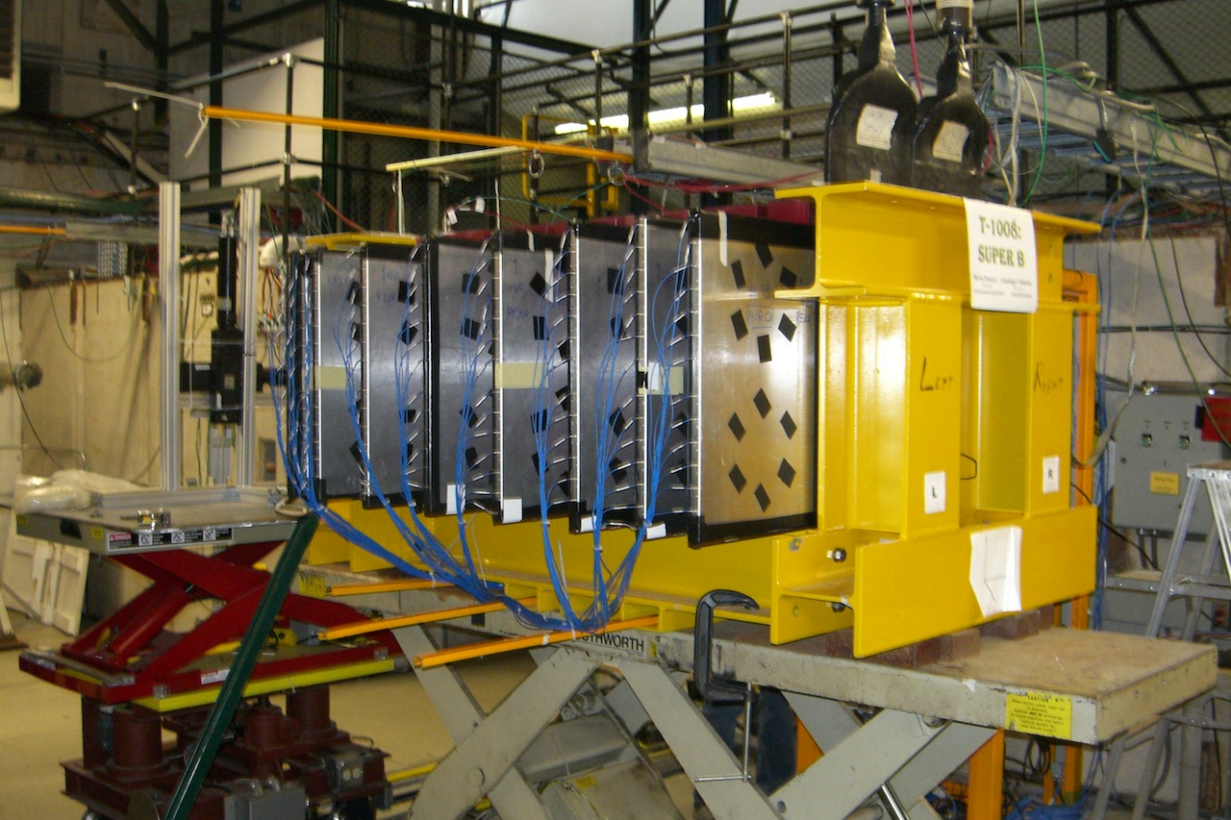
Beam Test
Our last beam test at Fermilab with muon/pion beam just done (end March 14th)
Main purpose: “calibration” run at high momenta (5-10 GeV) where the beam composition is well known and data are cleaner.
Experimental setup and trigger system improved.
New analysis strategy: tune Monte Carlo (Bruno) simulation based on high momenta test beam data.
Great reliability, operational stability and performances of the IFR prototype during all the beam test runs

Slide 29
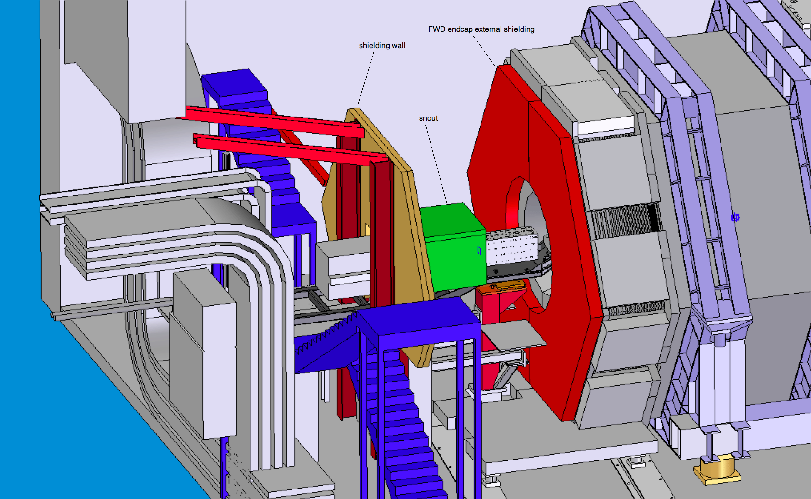
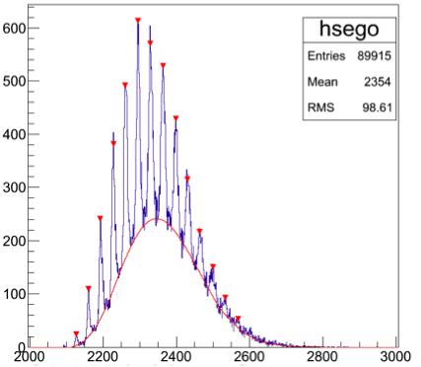
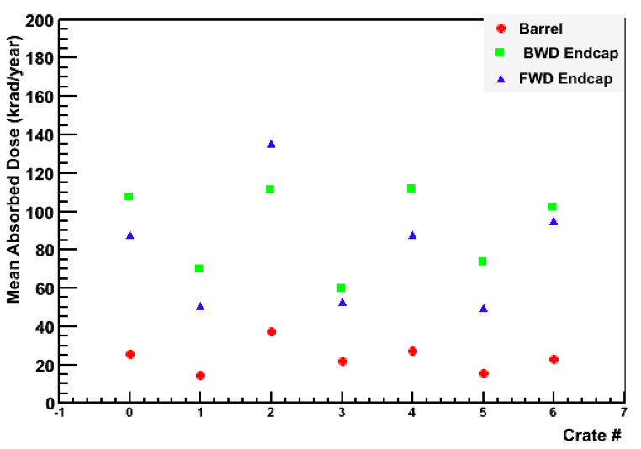
Other ongoing activities
Background simulation: external mechanical structures and other shielding studies.
Flux return and detection module mechanics.
R&D activities in Bologna, Ferrara and Padova to optimize/finalize the module design.
Preparation of the next irradiation tests for SiPM and electronics.
TDR preparation ongoing.
SiPM calibration
absorbed dose (krad/yr)

Slide 30
ETD/Online
Dominique Breton, Umberto Marconi, Steffen Luitz

Slide 31
ETD - 1
Since last meeting, progress on many different items
  Clock and control links:
    test beam at LNS of Virtex5 and Virtex6. Measurements of SEU cross-section with respect to memory configuration and link design (as a whole)
    test beam at LNS of National off-the-shelf serializer (TX only), AVAGO VCSEL transceivers and again Virtex5 at different dose rate and with different SEU mitigation strategies.
  Trigger:
    32 channels with clocked discriminators have been successfully integrated on DCH and readout with a TDC.
    2 different track elements have been implemented thanks to a look-up table.
    Cosmic and test beam results will be shown.
    Single LYSO crystal has been read out by PM on one side and SiPM on the other.
    Contact has been taken with BW to get a matrix in order to test an analog sum.
  ROM:
    10 GbE is in the hand of Bologna engineers team => should work in few months.
    PCIe solution as far as electronics is concerned is fine in principle.
    We have to design a low consumption mezzanine board, meant to be pluggable to a PC mother board to the PCIe bus.
    Linux driver needs instead additional work to achieve better performances.

Slide 32
ETD - 2
Progress was also made on outline and writing of the ETD/Online TDR chapters:
  ETD/Online introductory paragraph in the main introduction chapter.
  Then 2 dedicated chapters:
    ETD/Online (with 3 major sections)
      Requirements and design philosophy
      Event data chain: Trigger, DAQ, Event Builder, HLT and data logging
      Support services (ECS, DCS, monitoring, run control, etc.)
    Electronics
      description of the hardware implementation of electronics.
Have an event data chain design proposal. Will discuss during this meeting.
We will have 3 sessions during this workshop:
  one concerning common items => Wednesday 11:30
  one concerning front-end electronics=> Thursday 9:00
  one dedicated to hardware trigger => Thursday 11:30
During all sessions, we will focus on the following items:
  the writing of the TDR sections
  the answers given to the integration and power supplies questionnaires

Slide 33
Integration
F.Raffaelli, W.Wisniewski

Slide 34
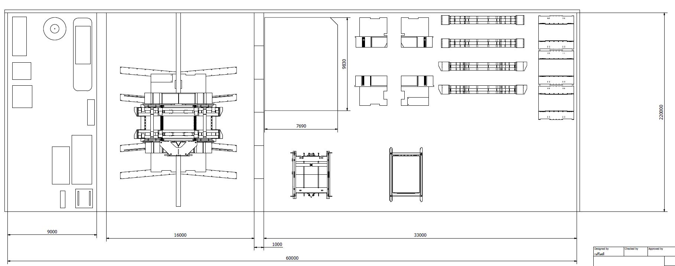
Integration issues
Mechanical integration group operational
  Integration and assembly of detector
  Experimental hall structure
  Transportation issue
  Refurbishing strategies
Gathering info from subsyst.
  Cables, services etc.
  Dimension and location of infrastructures
  Power, cooling, etc.

Slide 35
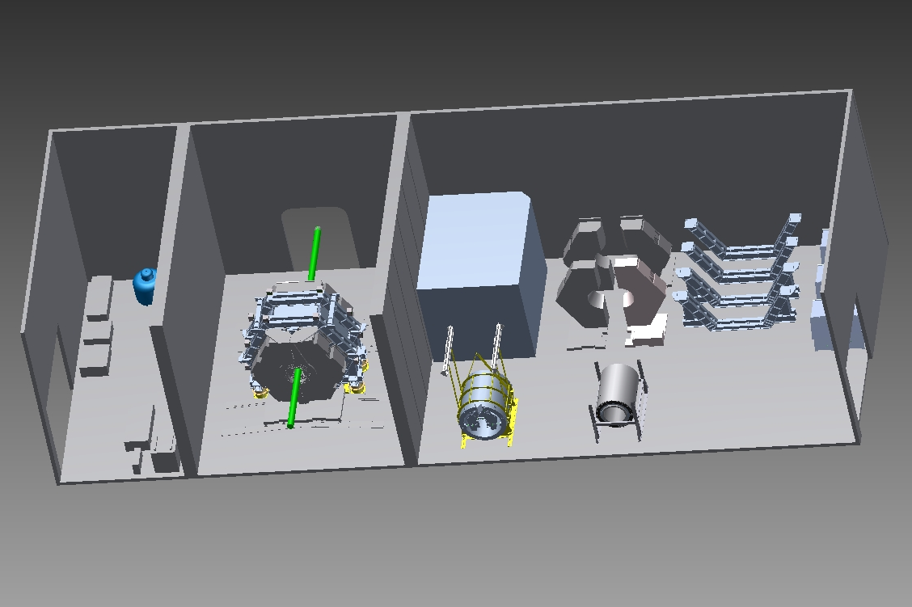
IR Hall Scheme

Slide 36
Interaction with accelerator team
Need to be boosted, with more regular technical contact
Started to look at common project management tools
  Session on Thursday morning
Large questions need to be addressed soon
  IR Hall: dimensions, layout, services, power, cooling, cryo, etc.
  Envelopes in Machine-Detector Interface. Strategies for mechanical integration between detector and machine
  Commissioning strategy: is the full 1.5T field needed for machine commissioning ? Big impact on detector assembly and commissioning strategy.
  Overall schedule: need to start laying down the overall integrated schedule for accelerator and detector construction

Slide 37
Agenda

Slide 39
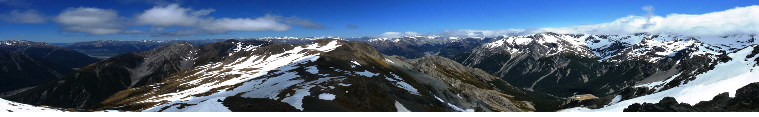


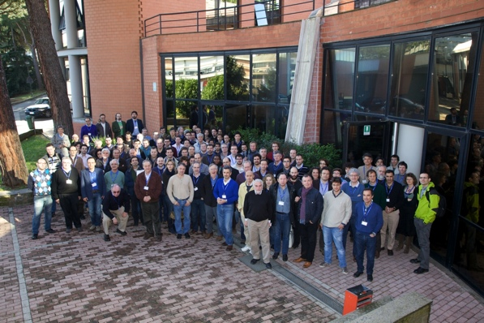
DETECTOR TIMELINE
CARTOON
2017
Data Taking
Bkgnd/Commissioning Detector
2016
Circulating Beams
Detector Commissioning
2015
IR Hall Available
Detector Assembly
Start
Transp.
of Babar pieces
2014
Detector Procurement
Civil Construction
Start
Start
2013
MDI
IR Hall
Services
Detector TDR
Design
2012
CabibboLab

Slide 40
BACKUP

Slide 41
Proto-Detector Organization
Detector Coordinators – B.Ratcliff, F. Forti
Technical Coordinator – W.Wisnieswki
SVT – G. Rizzo
DCH – G. Finocchiaro, M.Roney
PID – N.Arnaud, J.Va’vra
EMC – F.Porter, C.Cecchi
IFR – R.Calabrese
Magnet – W.Wisniewski
Electronics, Trigger, DAQ – D. Breton, U. Marconi
Online/DAQ – S.Luitz
Offline SW –
  Simulation coordinator – D.Brown
  Fast simulation – M. Rama
  Full Simulation – F. Bianchi
Background simulation – M.Boscolo, E.Paoloni
Machine Detector Interface –
  Rad monitor –
  Lumi monitor –
  Polarimeter –
Detector Geometry Working Group
Chairs M.Rama, A.Stocchi
Forward Task Force
Chair H.Jawahery
Backward Task Force
Chair W. Wisniewski
Mechanical integration team
F. Raffaelli
To be created:
Central electronics team

Slide 42
International Funding of Detector
Italy
  General agreement that will provide about 50% of funds needed for detector. Need to work on baseline and funding profile.
France
  Request will be presented in Fall 2011
Canada
  Request will be presented in Fall 2011
UK
  Ongoing negotiations. Desireable a larger participation of UK groups
Poland
  Request presented in 2011
US
  Request will be presented in late 2011 / early 2012
Russia
  Exchange contribution for IGNITOR to be understood. Bulk will be for accelerator work, but some could go to detector
China
  Ongoing negotiations.
Spain, Germany, Norway, Israel, …
For all it is essential to have a clear picture of the organization and schedule of infrastructure and accelerator

