Slide 1
Goals and scope of the Demonstrator
https://agenda.infn.it/event/44387/
R. Losito, CERN
Acknowledging contribution of many colleagues, among which D. Stratakis, D. Schulte,C. Rogers, L. Bottura, L.P. Krzempek

Slide 2
Outline
Motivation
The ideal Demonstrator
The reality (constraints related to budget, technology, safety etc…)
Propaedeutic R&D
What else can we do with a demonstrator ?

Slide 3
Motivations and Stakeholders
Picture from this source

Slide 4
Motivation and Stakeholders: Ideal Demonstrator
What:
We want to demonstrate 6D reduction of emittance by a factor 2 (C. Rogers)
We want to benchmark simulations to convince we understand all aspects of the cooling process.
We want to test the cooling cell technology in an operational environment.
We also want to have some physics!
How:
Using the cooling cell technology to be used in the real Muon Collider:
Magnets: HTS, 20K, cooled by LH₂
RF: Warm, multicell, High Gradient, High Efficiency Klystron
Absorbers: Hydrogen and LiH
When:
As soon as possible. If we want to start a MC before 2050, we should confirm the methodology and the technology at least 10÷15 years before

Slide 5
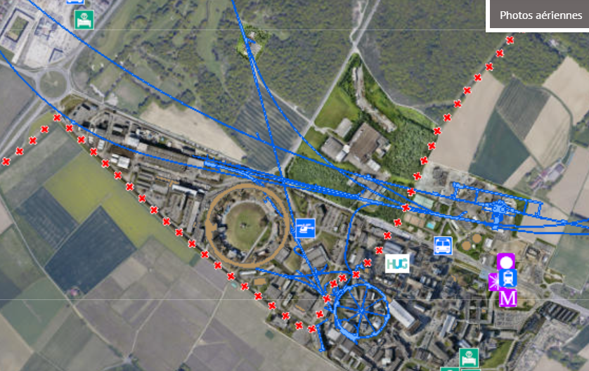
Demonstrator at CERN
80 kW/4 MW option
10 kW option

Slide 6
Present layout for the CERN option
Proton beam dump
Cooling cells
Target & Horn
Beam Instrumentation

Slide 7
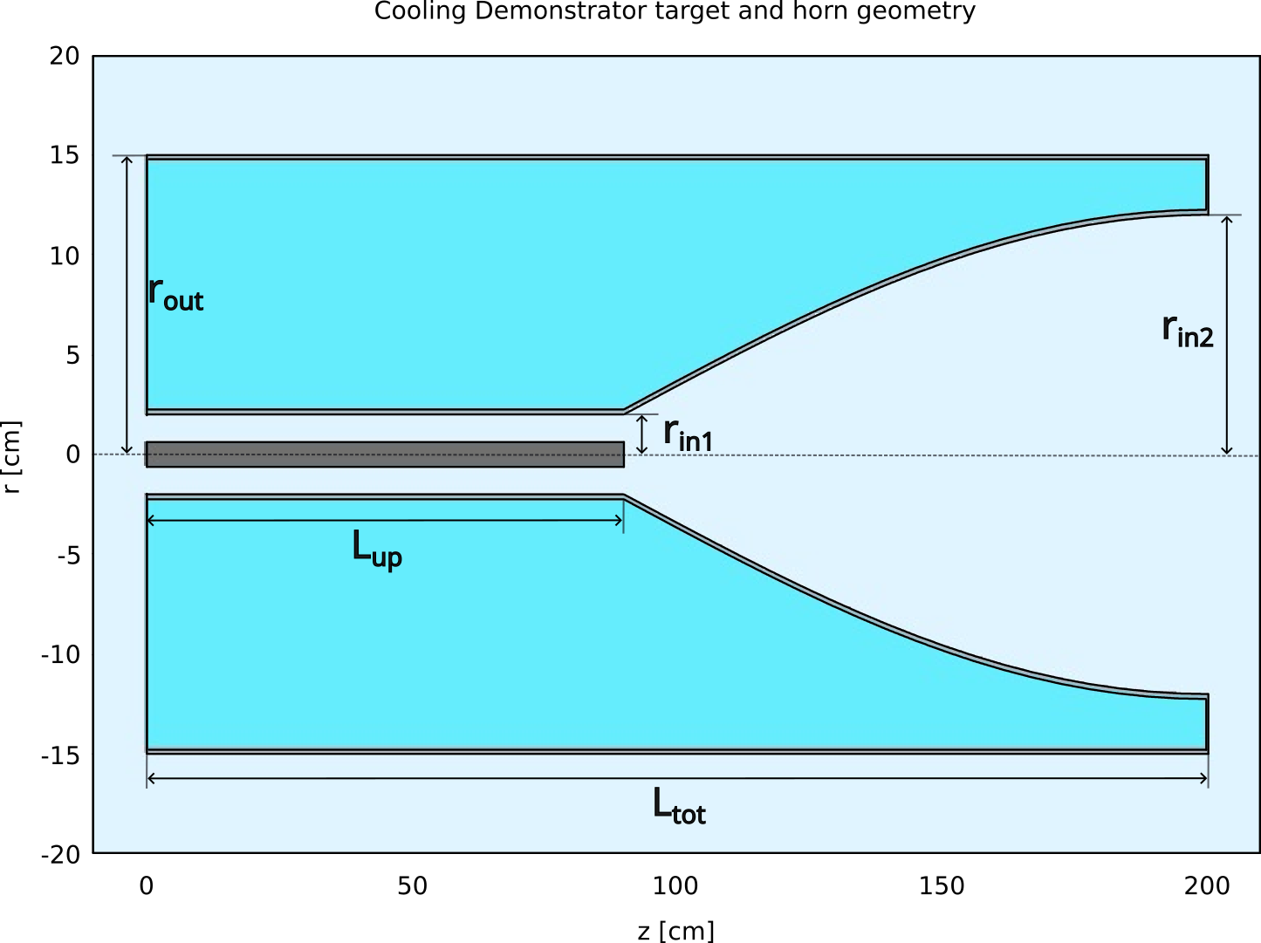
Beam Production and Transport (overview)
TT7 tunnel option adopted as the baseline at CERN
Proton beam extracted from the PS
Limited to ~ 10 kW averaged beam power
Design in progress
Influenced by the constraints of the tunnel
Target to be placed below the existing shaft
Preliminary muon bunch intensity estimate: ~ 10⁶ assuming 10¹³ protons per bunch
Beam
dump
Target & Horn capture
Pion decay section
Chicane
Beam preparation system

Slide 8
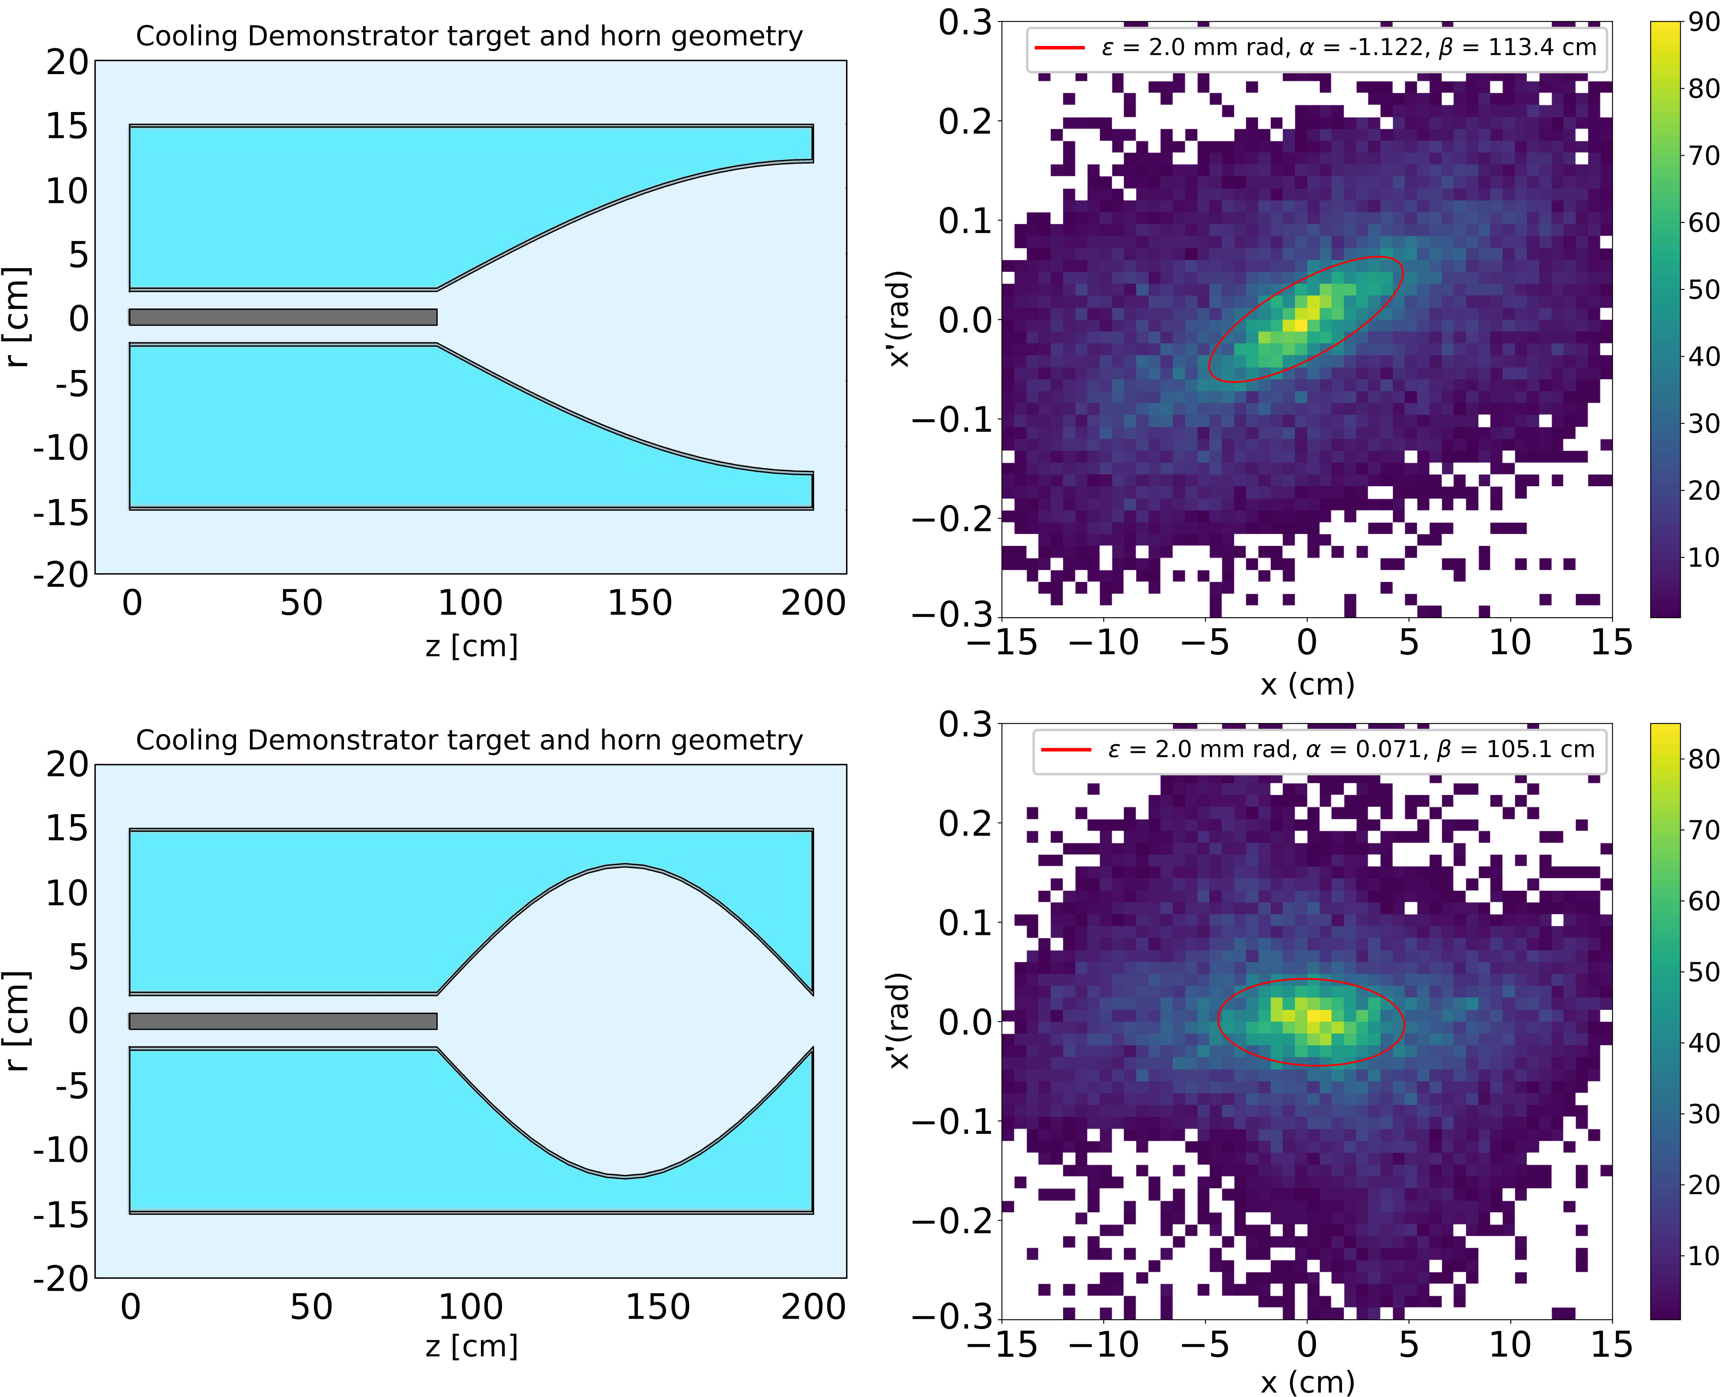
Target & Horn
First-pass design optimized for using 14 GeV proton beam to produce ~ 300 MeV/c pions
Note: does not include engineering constraints
Horn-based pion capture, graphite target (90 cm), current 220 kA
Parabolic and ellipsoidal horn profiles considered
Pion yield (in 210-330 MeV/c range and 2 mm rad transverse acceptance)
7.9 x 10⁻⁴ π⁺/POT
Further optimization required
More ambitious horn currents and target materials
Refine geometry

Slide 9
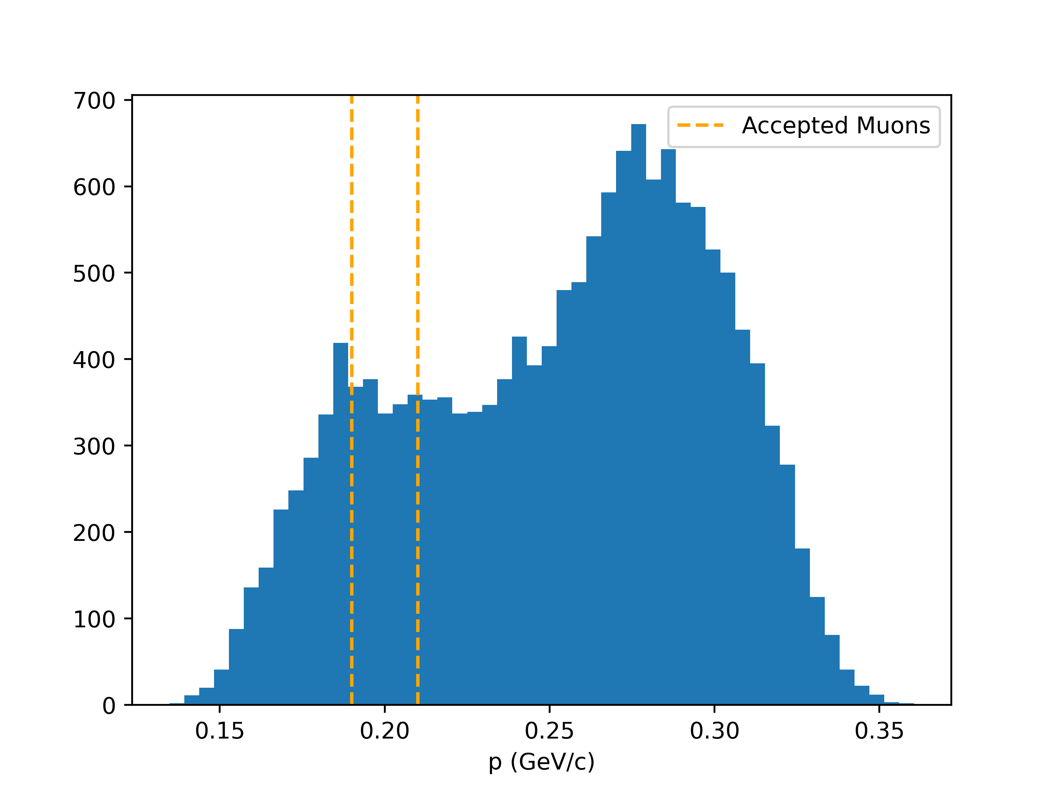
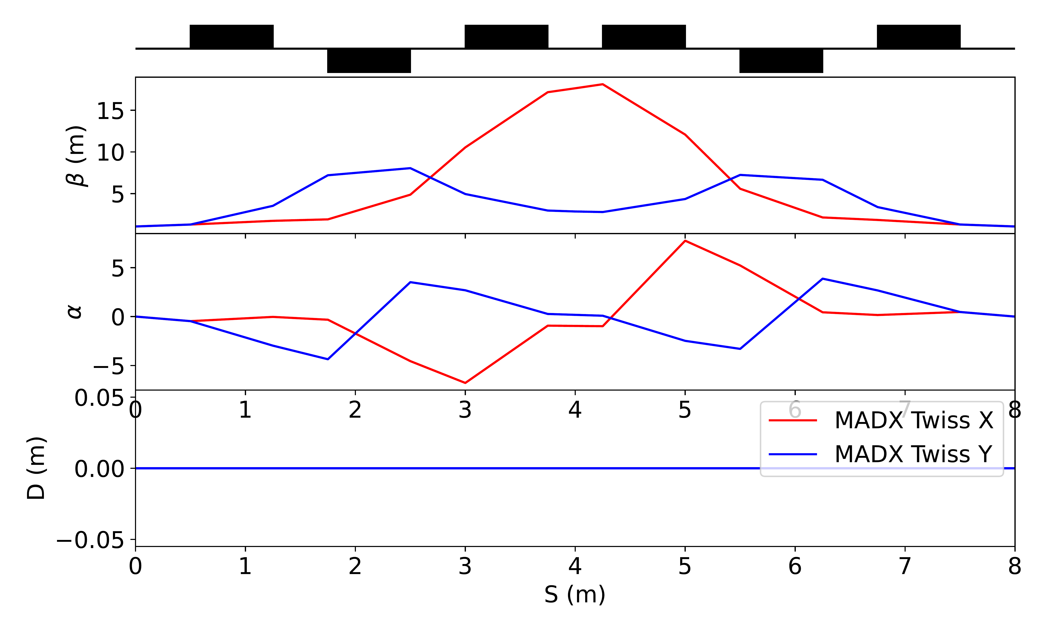
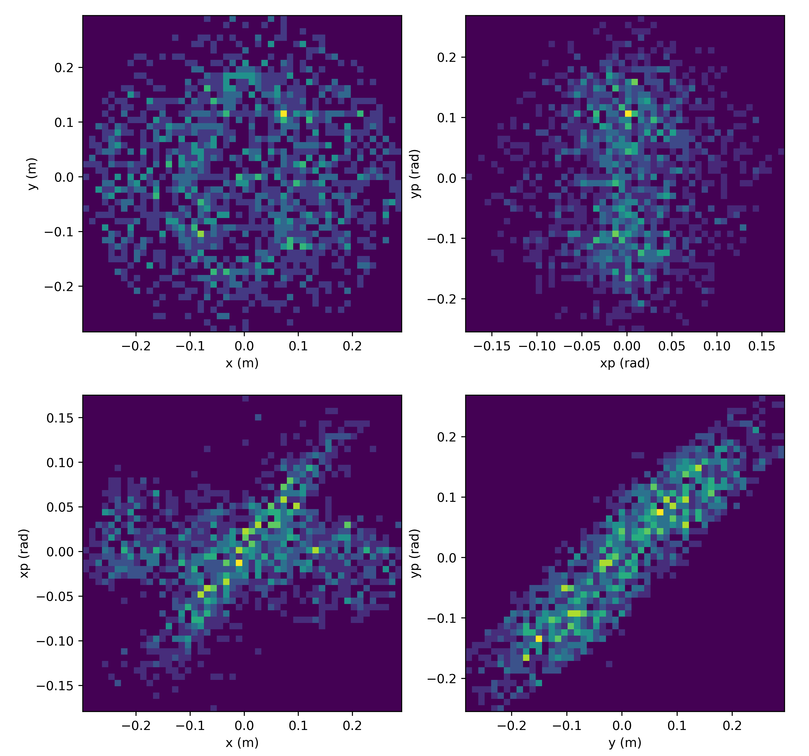
Pion Decay Channel
Need to allow pions to decay, and collect muons
~ 40% of pions decay within 8.5 m (at 300 MeV/c)
Space constraints in TT7
Civil engineering works required to enlarge the tunnel downstream of the TT7 cavern
Quadrupole-based lattices investigated
FODO and triplet configurations
Ongoing work on optimizing for muon capture efficiency
Phase space of muons with 190-210 MeV/c momentum

Slide 10
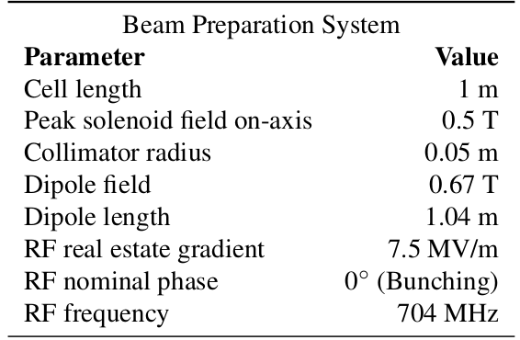
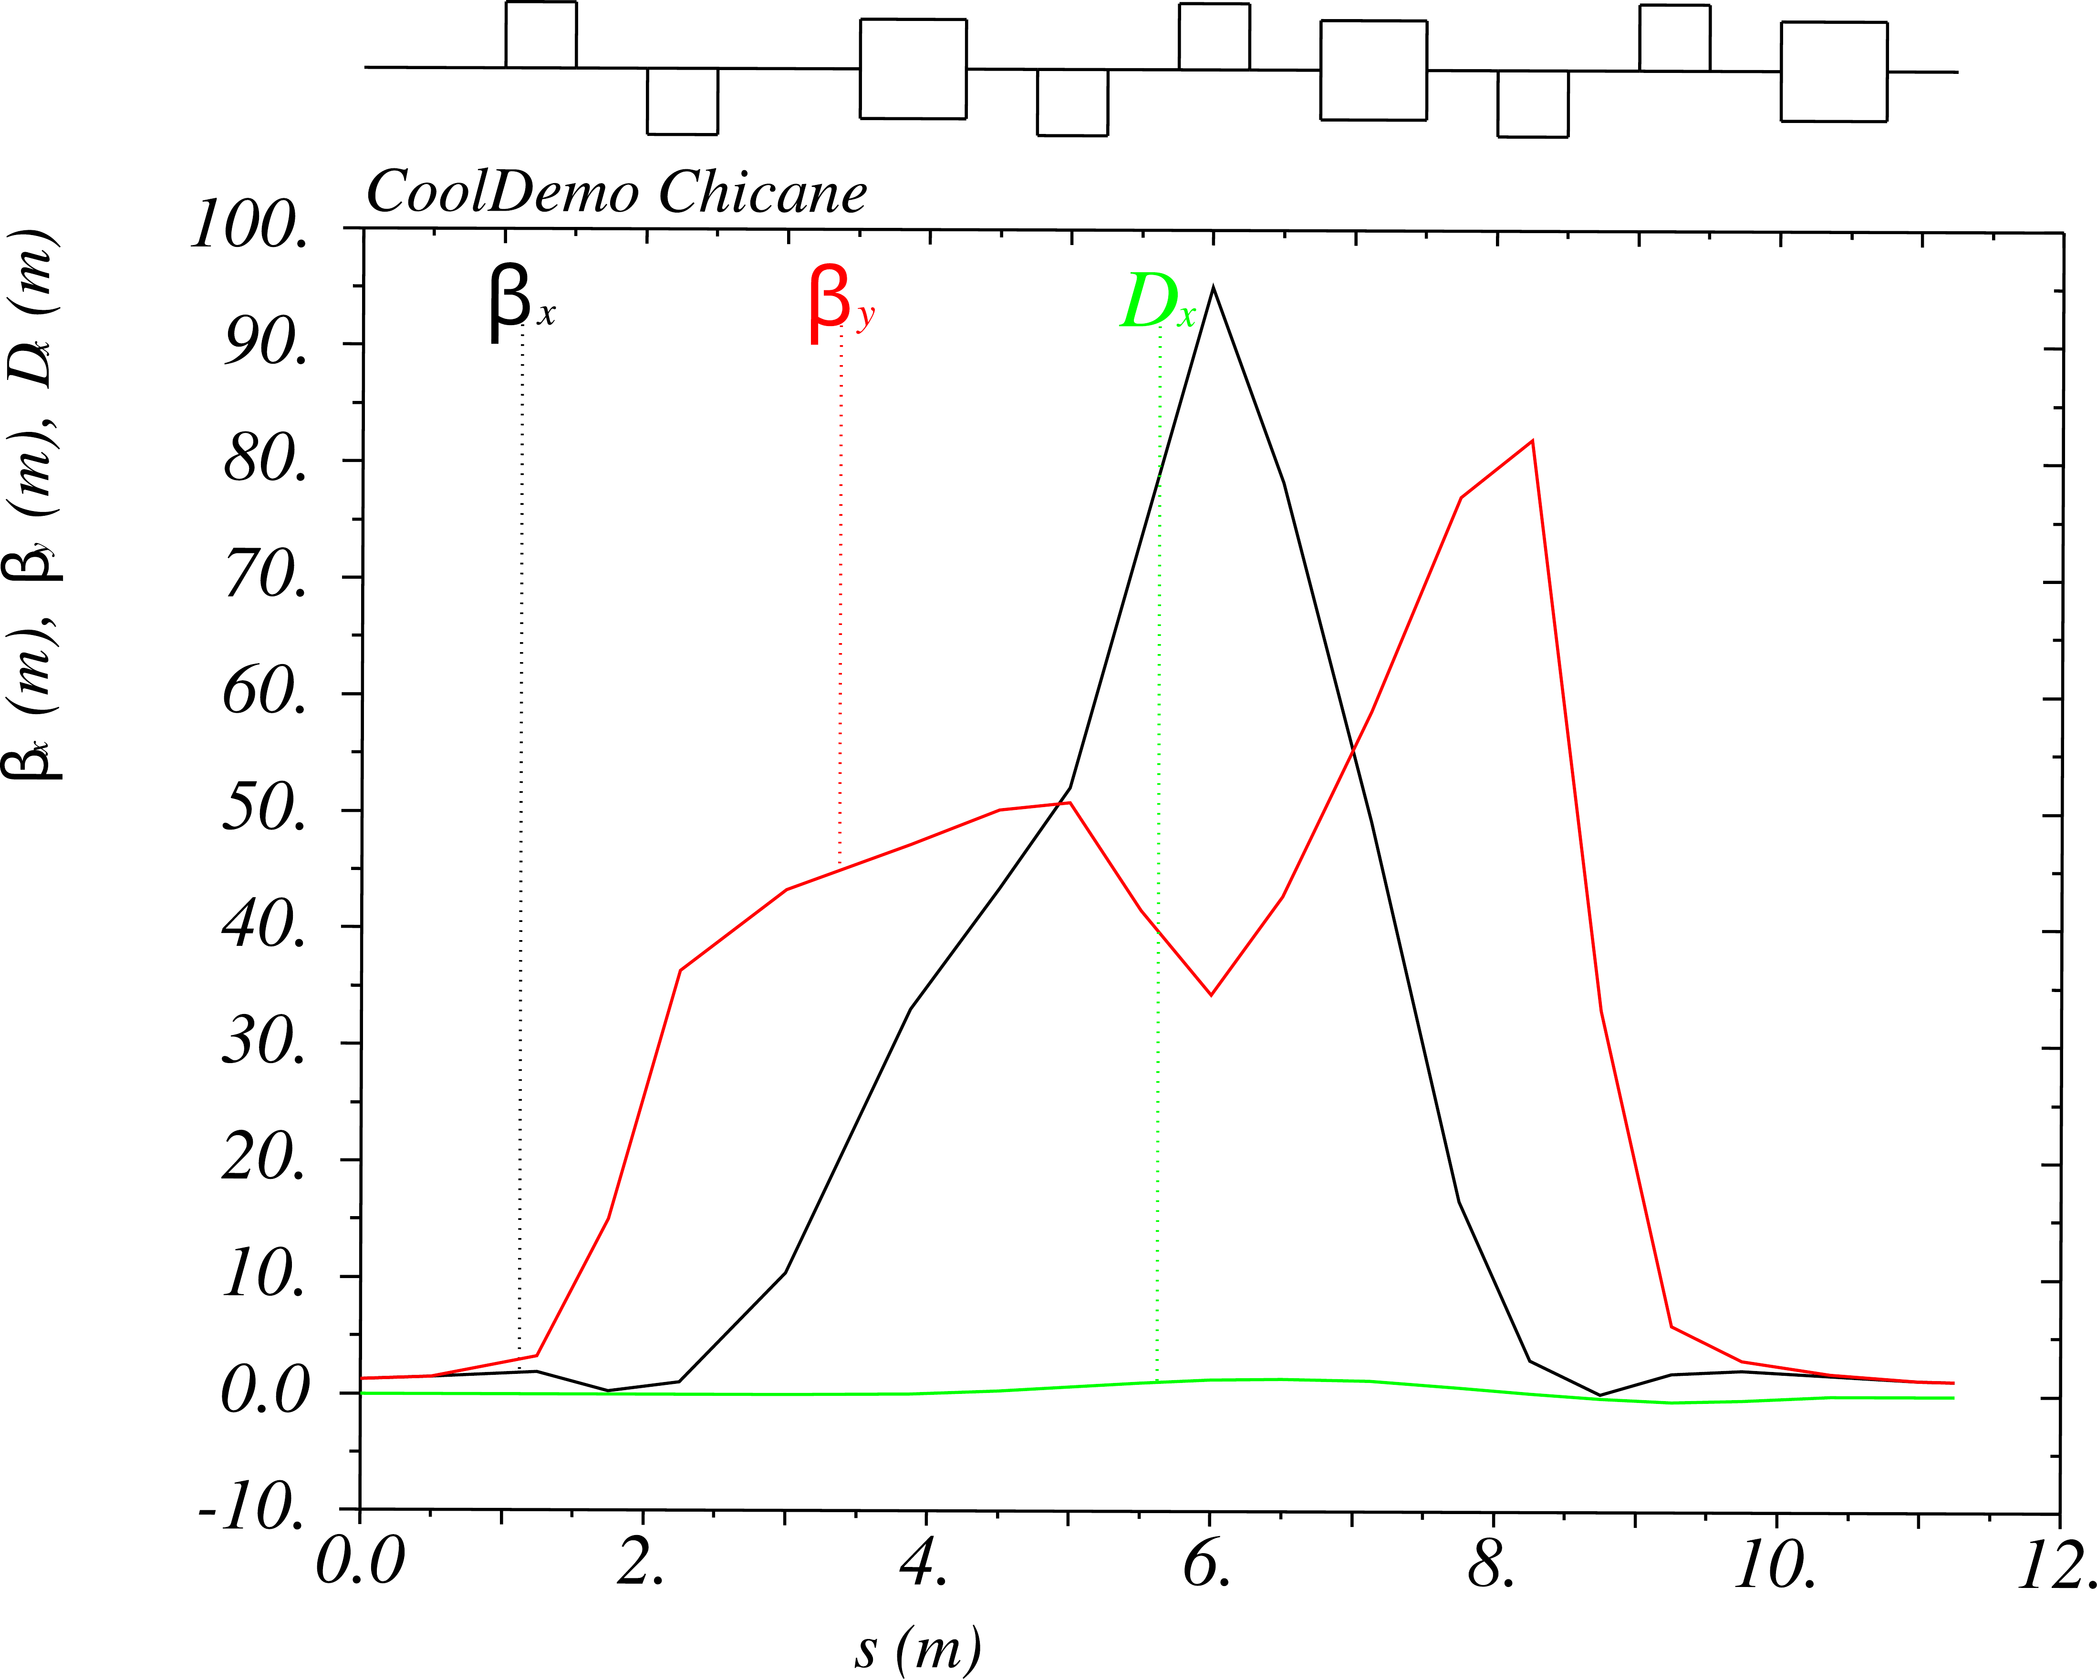
Chicane
Selects muons with 190-210 MeV/c momentum and transports them around the beam dump
Beam preparation system (BPS) integrated in the chicane lattice
To tune the muon beam both transversally and longitudinally
Transverse emittance ~ 1 - 2.5 mm (collimation)
In ~ 100 ps bunches (phase rotation)
Preliminary design done by C. Rogers
To finalise BPS integration within the chicane complex (linear optics matching and tracking studies), after first pass optimization of the pion decay section

Slide 11
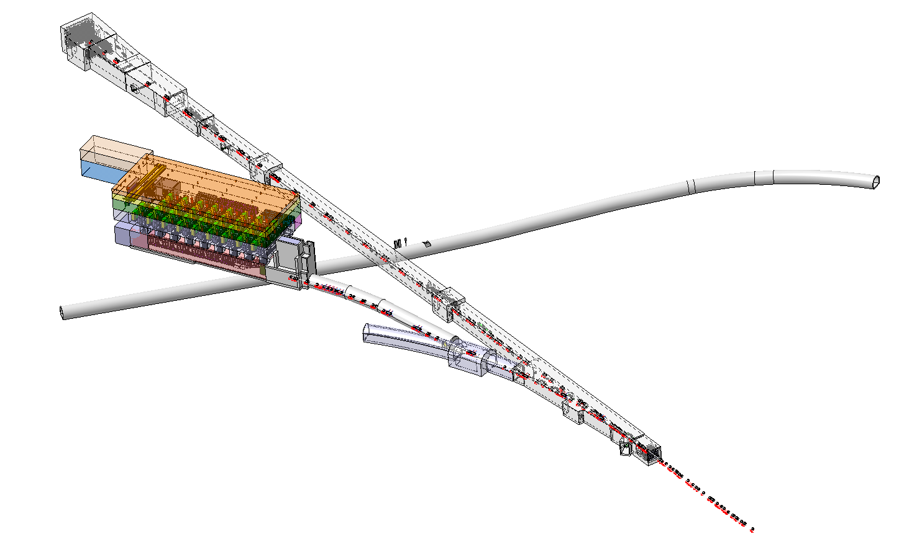
3D integration model
SPS
(downstream TT2)
Transfer line in TT7
Demonstrator in TT7
Service building
TT7
TT6
(for information)
Junction TT1/TT7
Transfer line in TT2
TT1
TT2
(upstream TT2)
PS

Slide 12
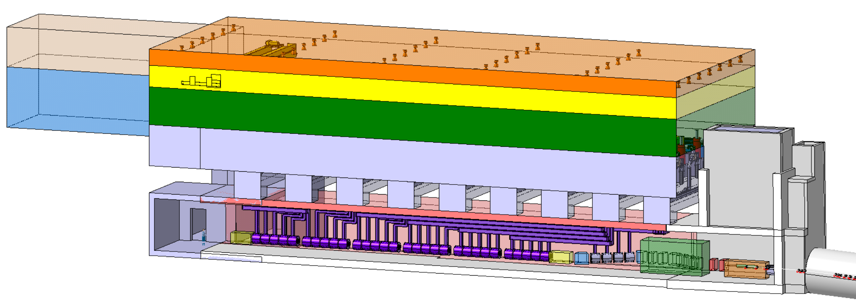
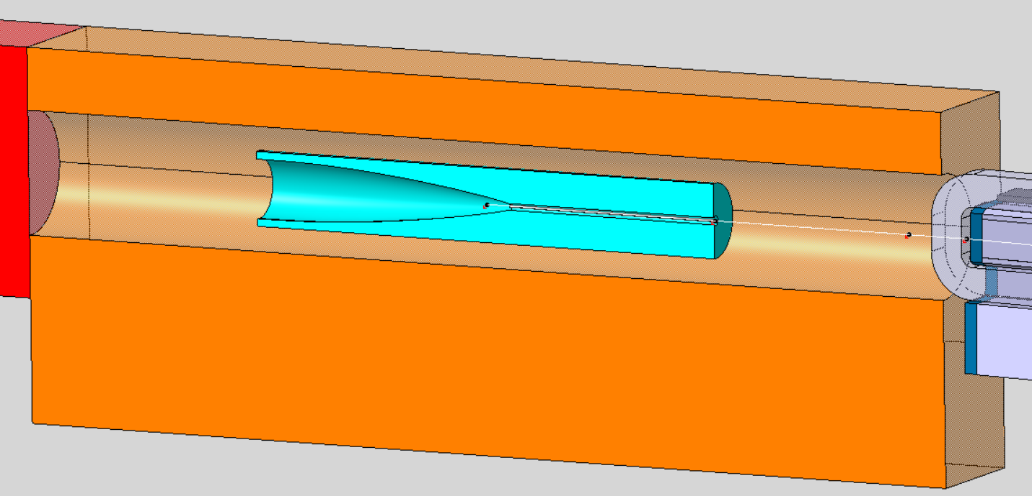
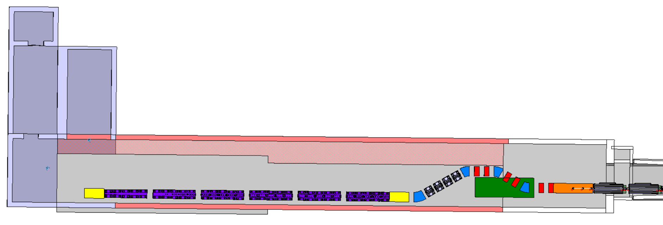
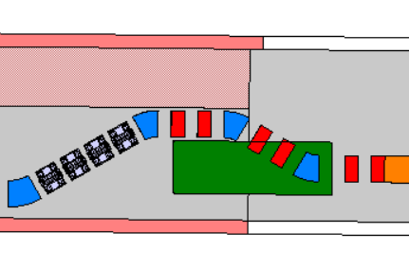
Integration – demonstrator in TT7
Downstream
Space envelope for cooling and ventilation
Space envelope for lightening
4m
Space envelope for crane
Shielded horn with target
Space envelope for transport
Ground level
Space envelope for klystrons
2m
29m
6x 5x cooling cells
2m
Beam dump
Optimization of transfer line components’ position is required or beam dump’s volume to solve interference
Downstream beam instrumentation
Upstream beam instrumentation
51.8m
14.3m
Part of new service building
(in grey)
Enlargement of TT7 (in red)
Imprint of current TT7 (in white)
Beam dump

Slide 13
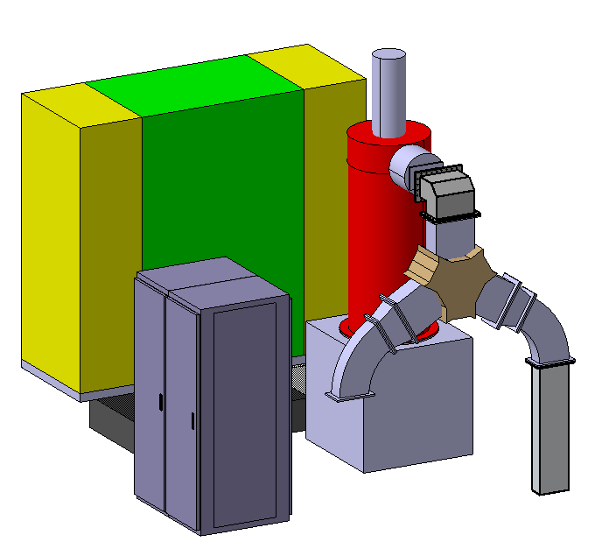
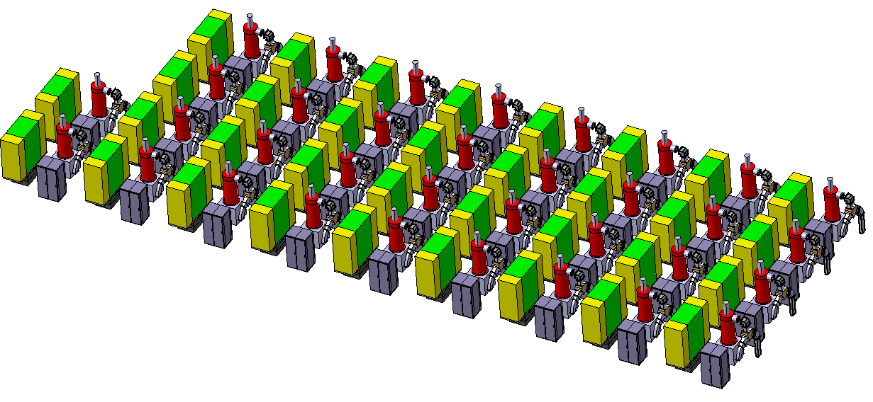
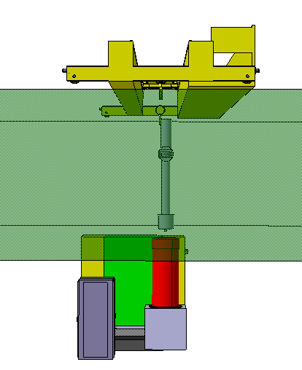
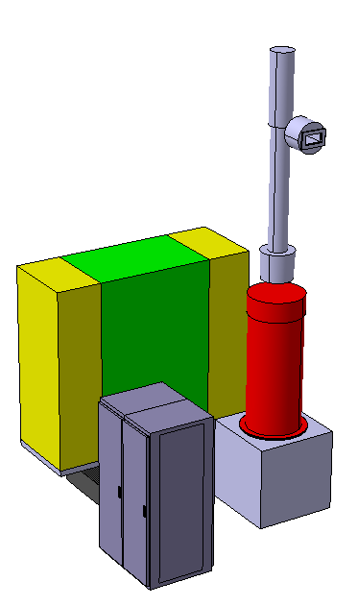
Integration – required service building
Modulator
Klystron
Integration study is based on CLIC RF L-band klystron (Canon E37503)
44m
Assembly of 34 klystrons
Parameters of integrated klystron | Units | CERN specification
RF frequency | MHz | 999.516
Peak RF power | MW | 20
Circulator
Associated components | Type
Modulator | CERN LINAC 4 type has been integrated (final size to be checked)
Circulator | Waveguide junction circulator 704.4 Mhz, 1.5 MW peak, 100kW average (CPR1150) – SPL test place at CERN
RF waveguide | WR1150 Waveguide Components On Microwave Techniques
Termination load
Termination load
15m
2x control rack
Required lifting range of 3.3m
Transport envelope height
3.5m
3.3m
Conclusions
Conservative approach has been applied in terms of space envelope
Quantity and space envelope required for klystrons assembly will depend on the final definition of RF frequency and power
Installation/maintenance scenario gives partial input on transport requirements of service building crane

Slide 14
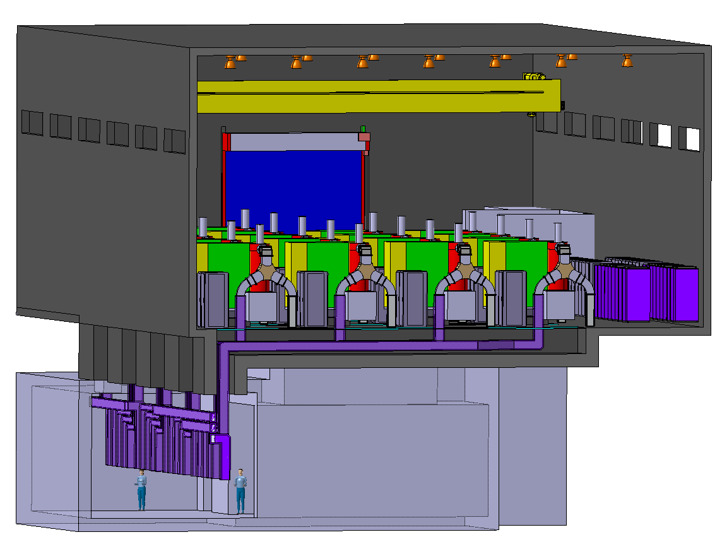
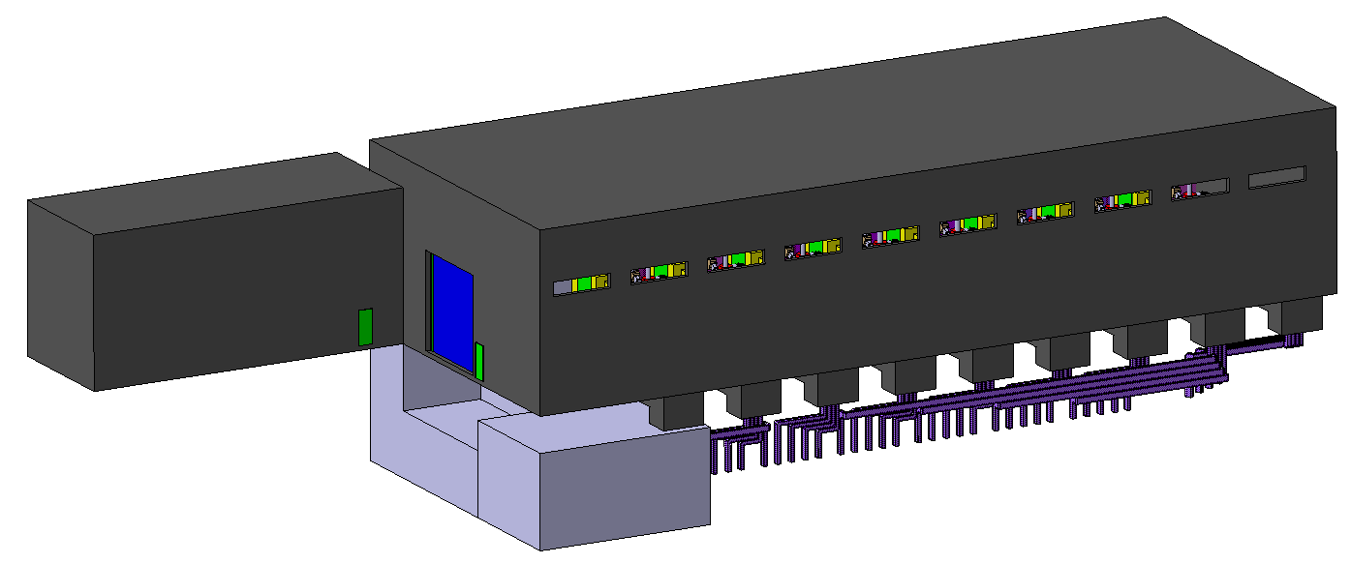
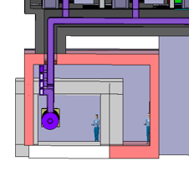
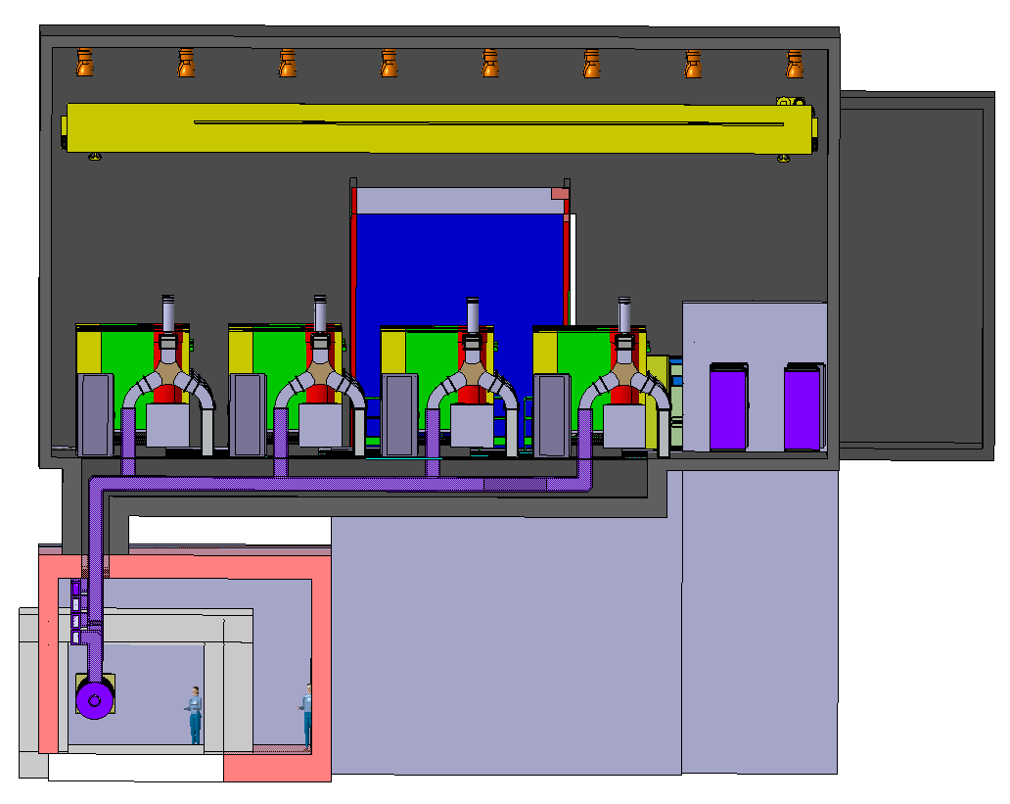
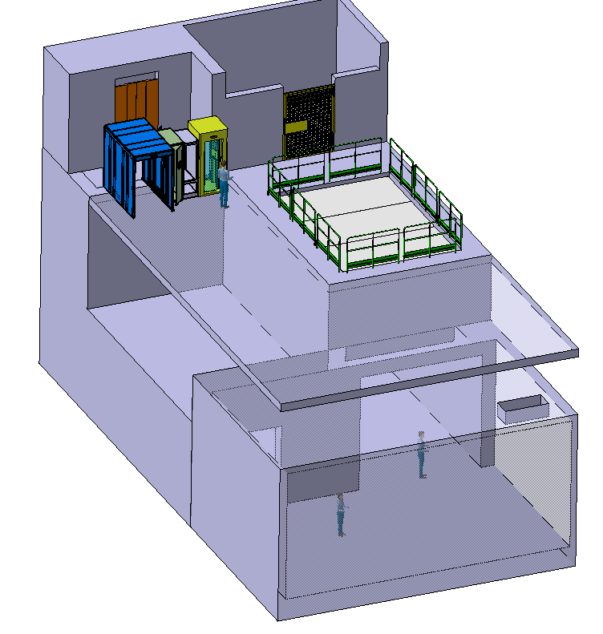
Integration – proposal of required service building
20m**
(constrain from adjacent 393 - AD/ELENA complex)
20m*
(installation on roof could be considered)
50m
Proposal of crane
(min 15.1t lifting capacity)
10m
2.5m
8m*
(installation on roof could be considered)
Proposal of waveguides routing in dedicated galleries
Ventilation duct cable trays lightening
Required standard services (distinguishers, AUGs, antipanic lightening )
Buffer zone (3.4x5.7m)
Surface
Personnel and small material access (PAD/MAD)
Material shaft (4x6m)
5x5m
Underground
Envelope proposal for power converters (3.8x4.0x40.5m)
Potential other services and/or shielding
Transport passage

Slide 15
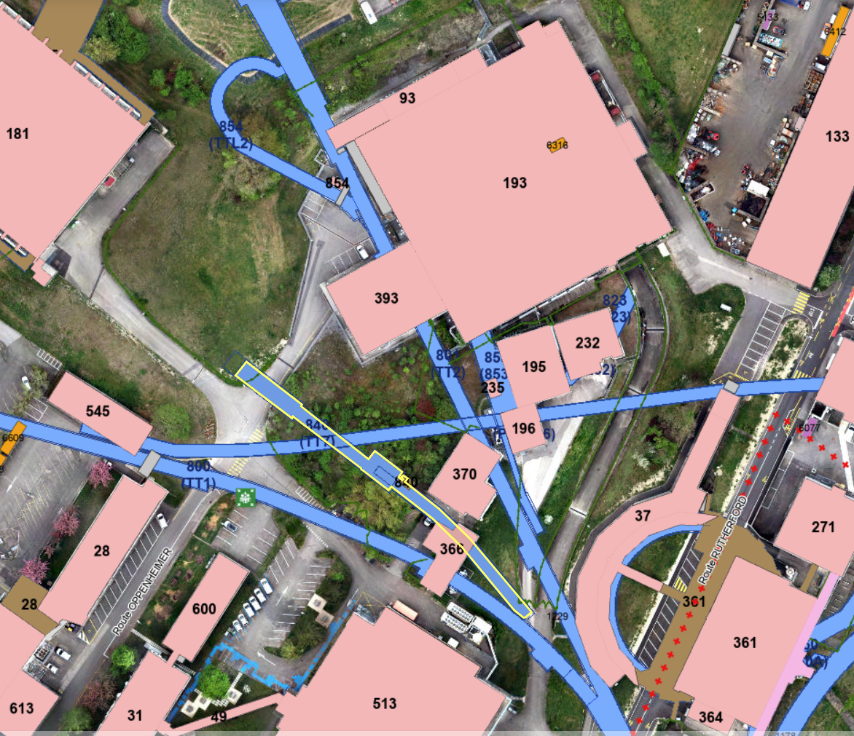
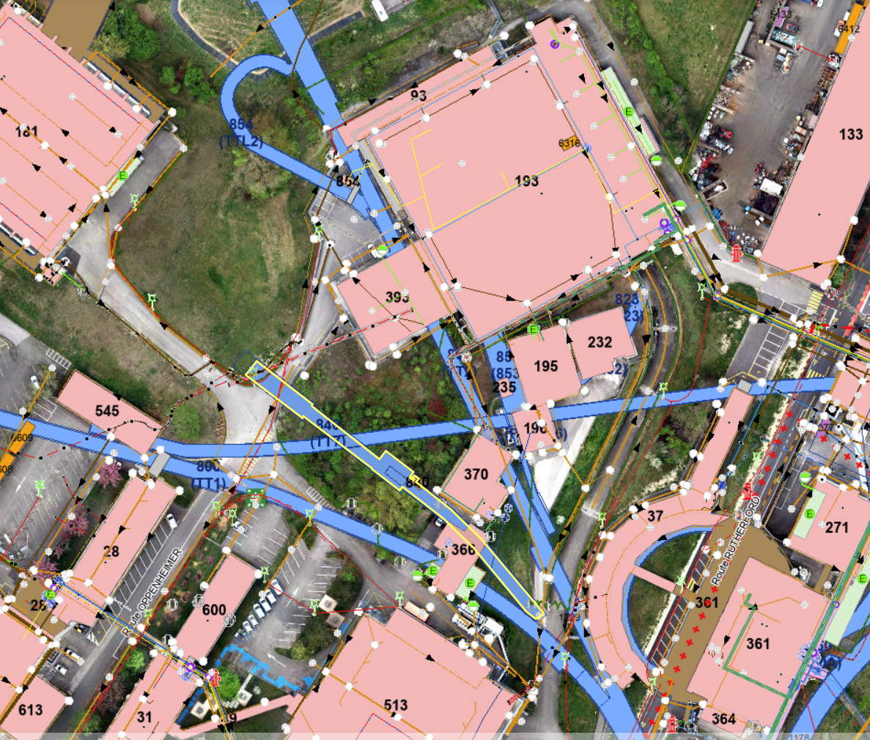
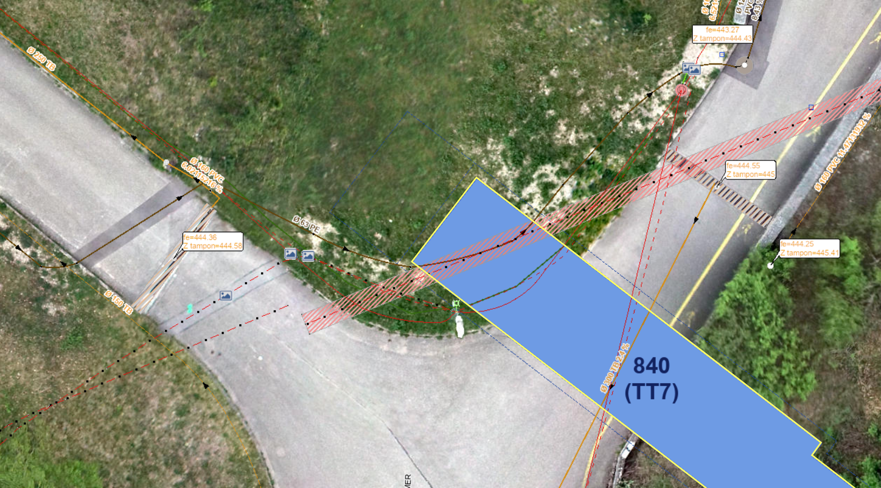
Impact on civil engineering
France
France
View of underground services at CERN
Access to adjacent 393
(AD/ELENA complex)
Jura side
Jura side
Rainwater
Electricity lines
Cable ducts in use (rerouting)
Cable ducts out of use (reuse or removal)
Wastewater
Access to new service building
Imprint of new service building
(approximate scale)
TT7
TT7

Slide 16
DRAFT R&D Programme
The Ionisation Cooling Demonstrator programme is phased into three main objectives
2026 – 2030
Build and test a single cooling cell as designed within the EU programme “MuCol”.
Cost estimated: ~15 MCHF, from 2026 to 2030
Possibly test it in CTF3, using Dewars or a cryocooler
Includes: 4 solenoids (2+2), one 3-cell cavity, development of a 704 MHZ, 24 MW klystron.
2028-2033
Build and Test a “cooling module”, made of 5 cells
Cost Estimated: ~50 MCHF , decision in 2028, execution from 2030 to 2034
Possibly test in CTF3 using eventually cryocoolers or a new plant
Procurement of 6 klystrons

Slide 17
DRAFT R&D Programme
2030 – 2035
Construction of an initial Demonstrator Facility (at CERN) .
Cost estimated: ~50 MCHF, from 2026 to 2030
Making use of the 5-cell module already tested in CTF3, klystrons and cryogenics
2034-2040
Use of the facility to test different types of cooling cells.
Cost: 15 MCHF/year

