Slide 1
Performance Limits of Dipole and Quadrupole for the Collider Ring
MuCol Italia – Torino
D. Novelli^{1,2}, L. Alfonso², A. Bersani², L. Bottura⁵, B. Caiffi²,
S. Farinon², F. Mariani¹, S. Mariotto³ , A. Pampaloni², T. Salmi⁴
¹Sapienza University of Rome, ²INFN – Genoa , ³INFN and University of Milan
⁴Tampere University, ⁵CERN
Funded by the European Union (EU). Views and opinions expressed are however those of the author only and do not necessarily reflect those of the EU or European Research Executive Agency (REA). Neither the EU nor the REA can be held responsible for them.
December 2024

Slide 2
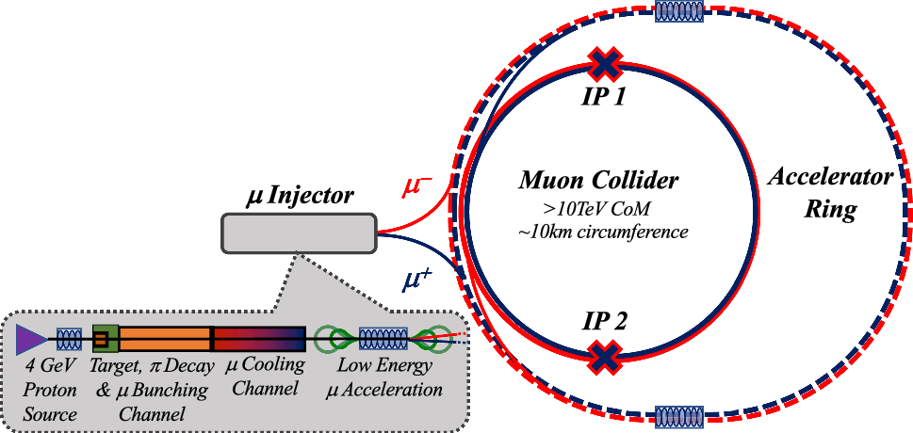
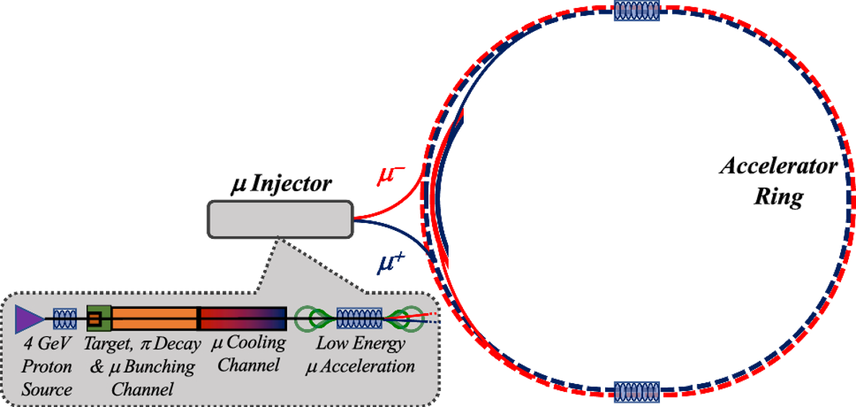
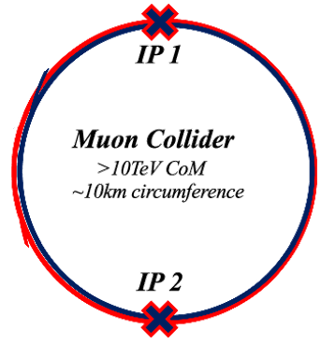
The Muon Collider Complex
Main stages of a muon collider complex
Magnets:
Dipoles
Quadrupoles
Sextupoles
Purpose:
Evaluate realistic performance targets for the collider magnets, in close collaboration with studies of beam physics, cryogenics, and energy storage.
Produce a credible and affordable design study (contain costs, energy efficiency, sustainable operation).
Task 7.4

Slide 3
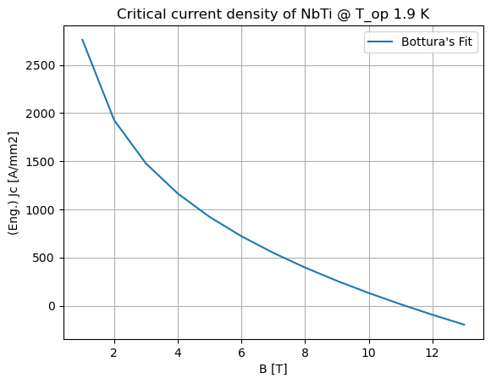
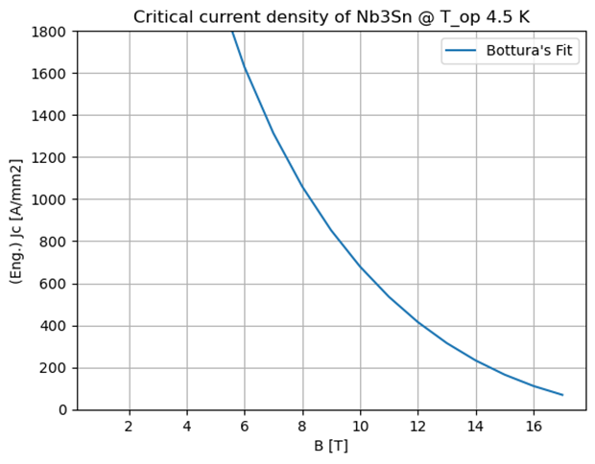
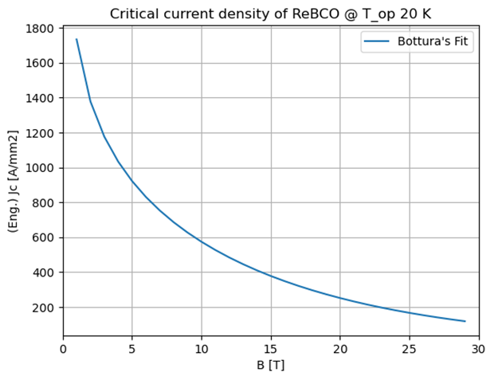
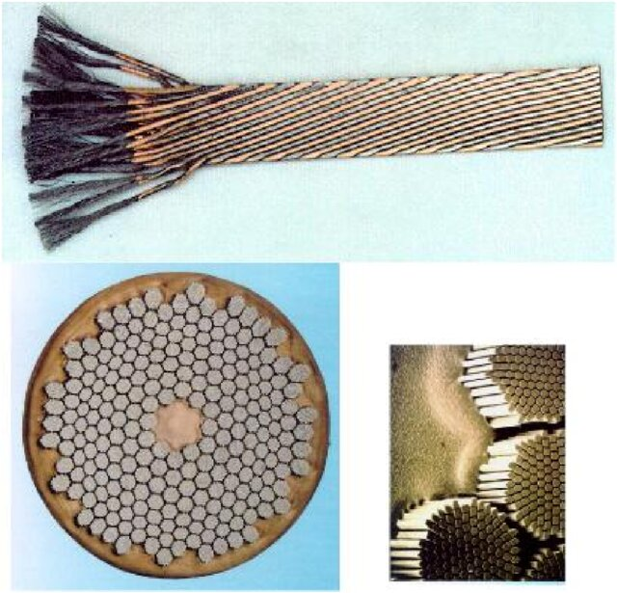
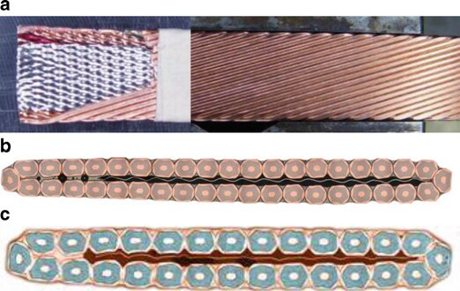
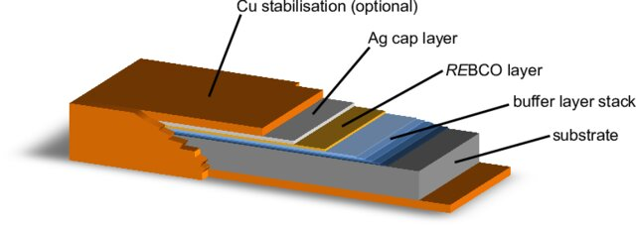
Introduction on SC magnets
[ref]
[ref]
[ref]
Nb₃Sn is a brittle intermetallic compound characterized by a strong propensity to fracture.
It was recently used for quadrupoles of Hi-Lumi project.
Can reach operating temperatures of 4.5 K with good em performance.
ReBCO can work at high operating temperatures, such as 20 K, preserving good em. performance.
It is difficult to protect from quench and it is complicated to produce large-sized tapes (so it is expensive).
It still requires a lot of R&D.
NbTi is used for the LHC’s magnets.
It is a ductile alloy with mechanical properties which make it easy to fabricate and use.
Typically works at 1.9 K with superfluid helium and produces B up to 8 T.

Slide 4
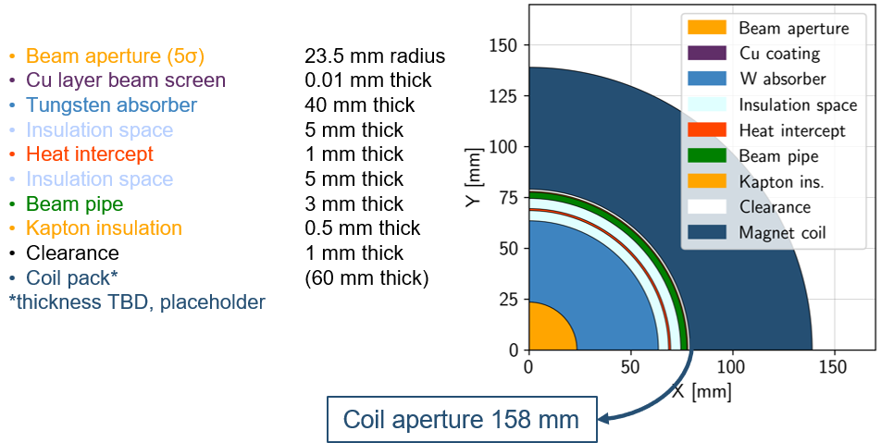
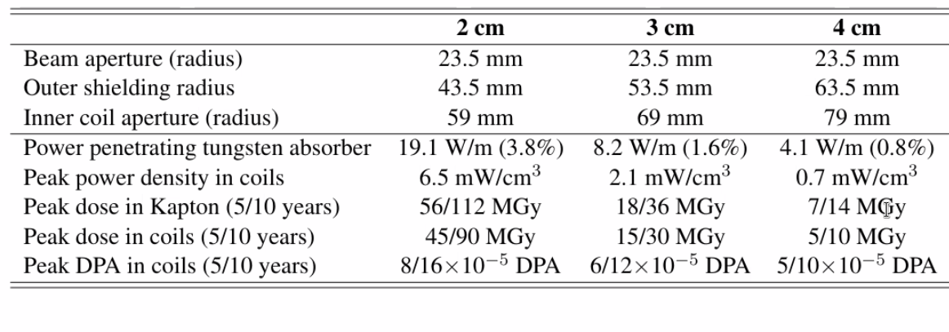
Collider Magnets Requirements
3 TeV collider (5 km ring):
Close to state of the art
$∼$11T/150mm (Nb₃Sn)
600 magnets, 5 m length
Operating temperature: 4.5 K
10+ TeV collider (10 km ring):
HTS magnets, R&D is required
$∼$15T/150mm (ReBCO, hybrid)
1200 magnets, 5 m length
Operating temperature: 4.5…20 K
Assuming 10 TeV machine and coil at 4.5 K
Courtesy of Patricia Borges de Sousa
https://indico.cern.ch/event/1250075/contributions/5357594/
with HTS @20K the absorber can be thinner (138 mm)
High field dipoles to minimize collider ring size and maximize luminosity.
Beam loss protection
High-energy electrons and positrons arising from muon decay and striking the collider ring magnets can cause radiation damage and unwanted heat load.
Shielding
Large aperture
Courtesy of Anton Lechner
P < 5 W/m working at 4.5 K
P < 10 W/m working at 20 K with HTS

Slide 5
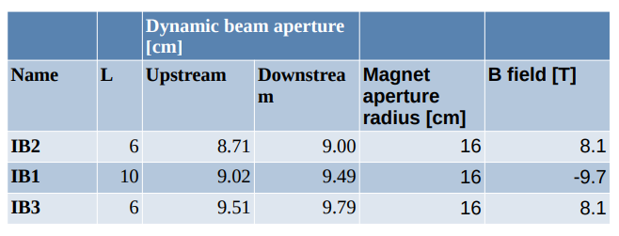
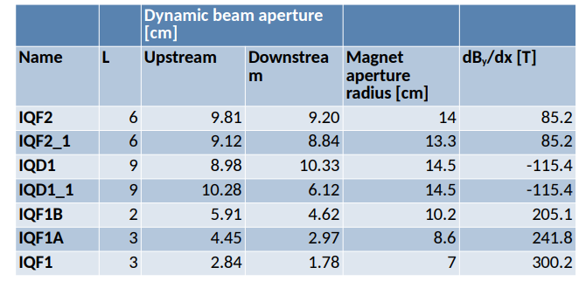
Collider Magnets Requirements
3 TeV collider (5 km ring):
Close to state of the art
$∼$11T/150mm (Nb₃Sn)
600 magnets, 5 m length
Operating temperature: 4.5 K
10+ TeV collider (10 km ring):
HTS magnets, R&D is required
$∼$15T/150mm (ReBCO, hybrid)
1200 magnets, 5 m length
Operating temperature: 4.5…20 K
Final Focusing Magnets
Courtesy of Daniele Calzolari
High field dipoles to minimize collider ring size and maximize luminosity.
Beam loss protection
High-energy electrons and positrons arising from muon decay and striking the collider ring magnets can cause radiation damage and unwanted heat load.
Difficult to define
a single magnet
specification
Shielding
Large aperture

Slide 6
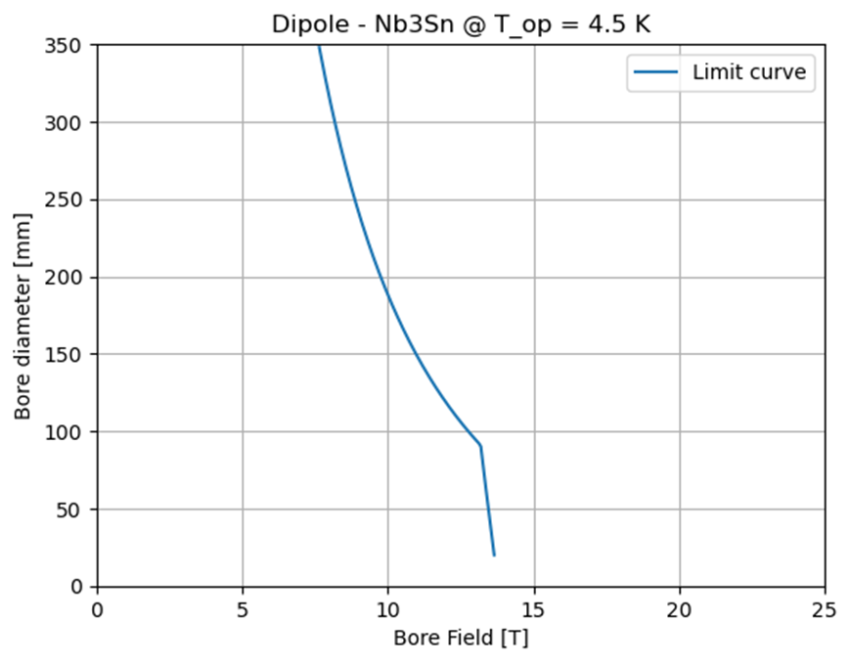
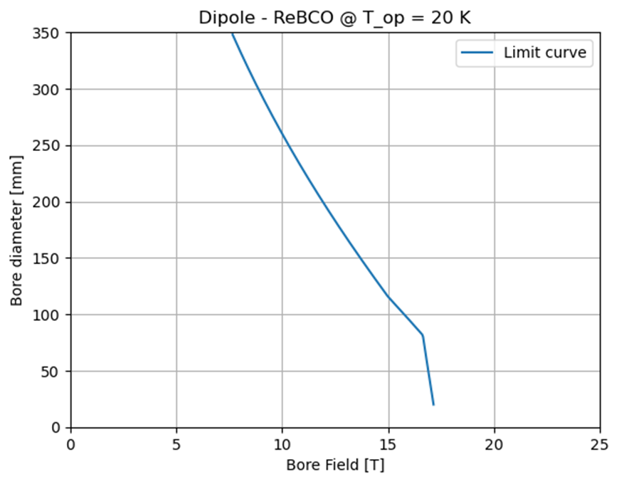
Introduction to A-B plots
Need for high fields in large apertures
We perform plots that can show the allowed area between aperture diameter (A) and bore field (B).
We consider Nb₃Sn for the 3 TeV machine and HTS (ReBCO) for the 10 TeV collider.
Innovative approach, useful for interfacing the needs of beam dynamics with the technological limits (of today and the near future) related to superconducting magnets.
Immediate feedback capable of analyzing many possible configurations in a single plot
Forbidden area
Forbidden area
Allowed area
Allowed area

Slide 7
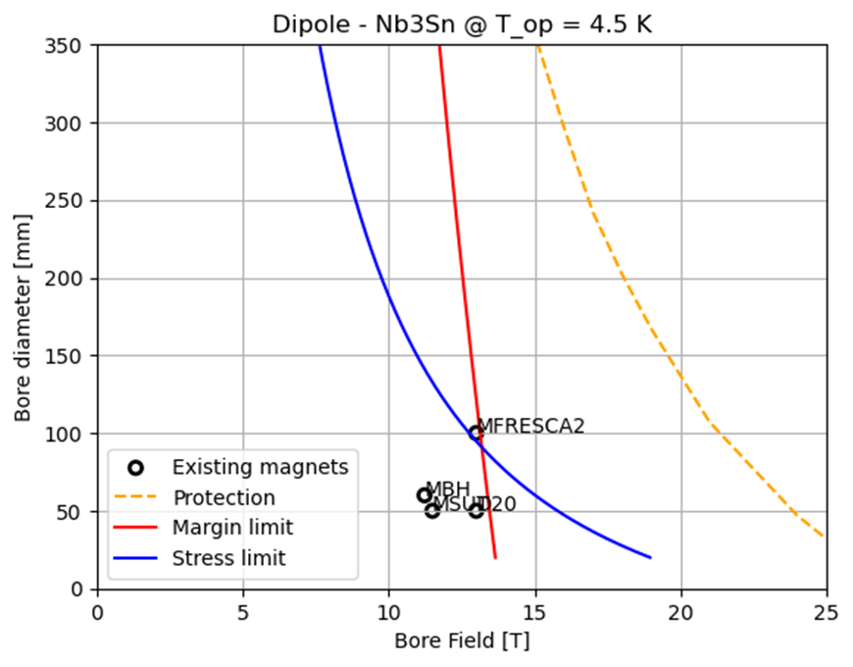
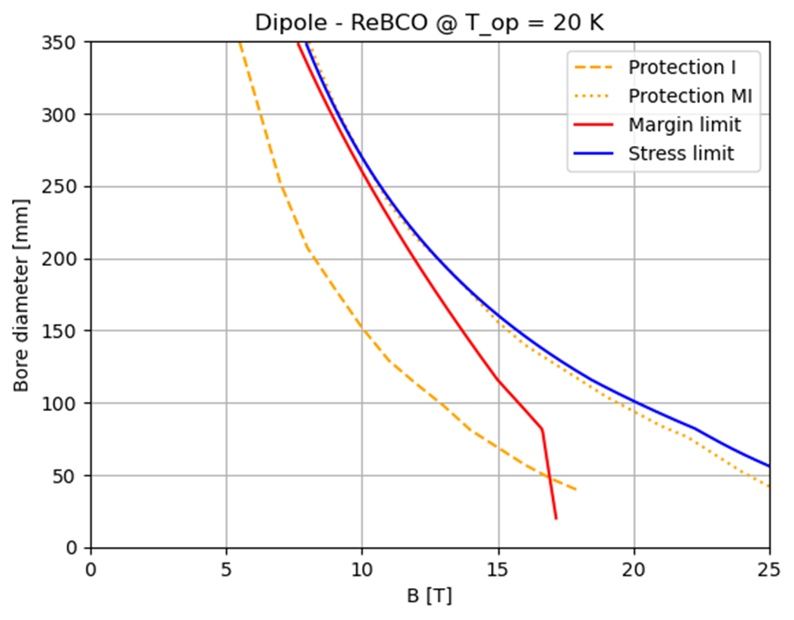
Introduction to A-B plots
Need for high fields in large apertures
We perform plots that can show the allowed area between aperture diameter (A) and bore field (B).
We consider Nb₃Sn for the 3 TeV machine and HTS (ReBCO) for the 10 TeV collider.
Limit curves are introduced by mechanical challenges (stress limit), critical current density (margin limit) and stored magnetic energy (quench protection), depending on the superconducting material.
Forbidden area
Forbidden area
Allowed area
Allowed area

Slide 8
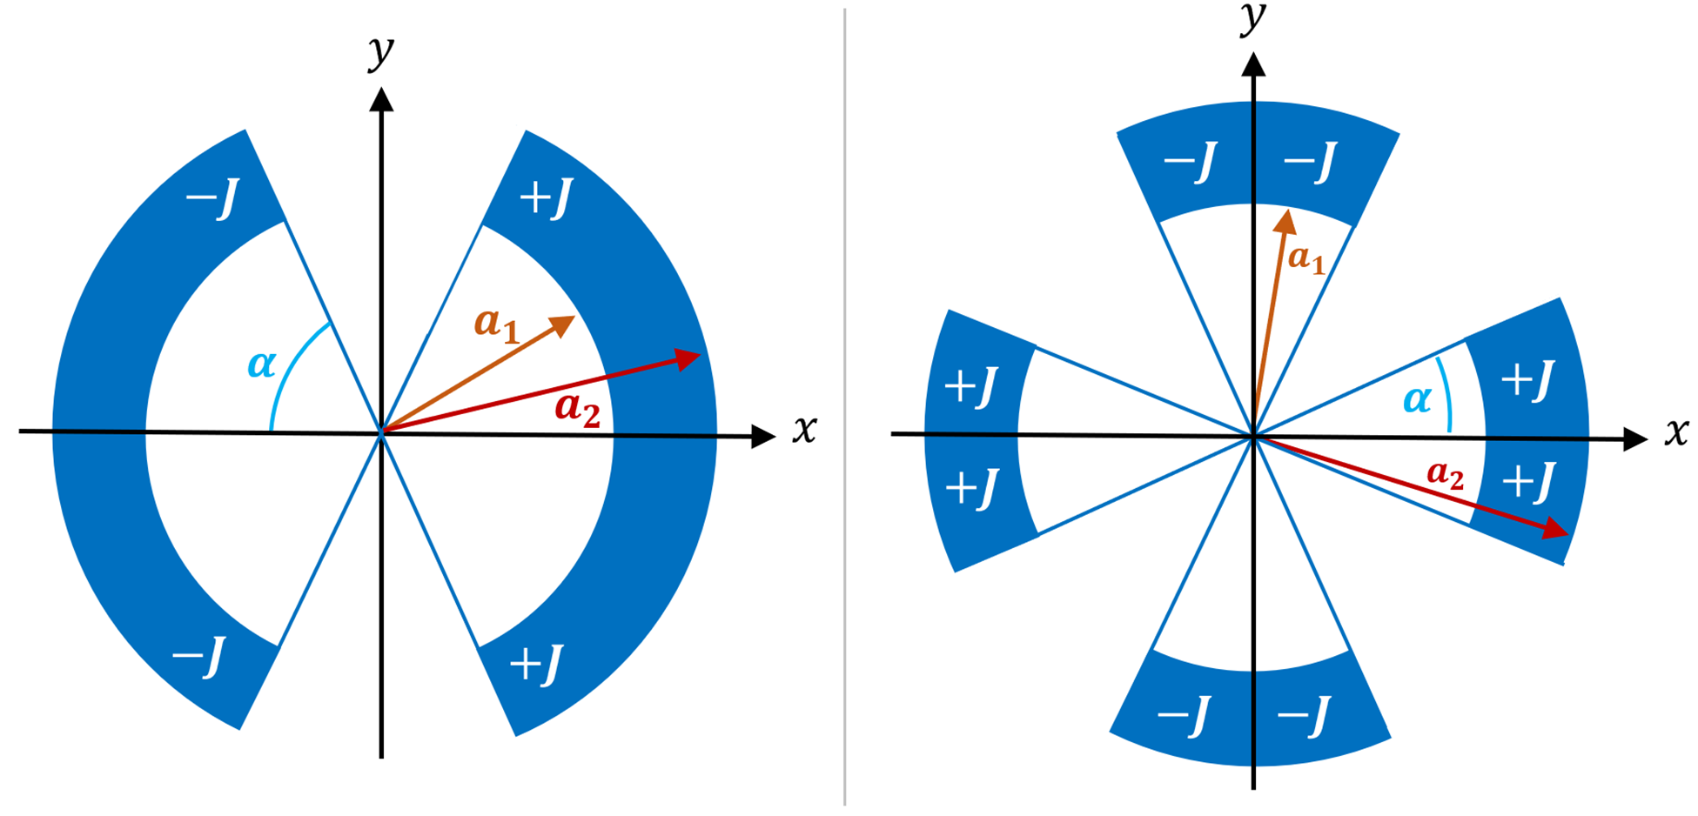
Method and Assumptions
A Python code is used to implement the analytic formulas for the cos-theta magnets in sector coil approximation.
($α$ is 60° for the dipole and 30° for the quadrupole)
Dipole
Quadrupole
$$B\left(w,J\right)=\frac{2μ_{0}J(a_{2}−a_{1})sinα}{π}$$
$$G\left(w,J\right)=\frac{2μ_{0}J}{π}\ln\left(\frac{a_{2}}{a_{1}}\right)sin⁡(2α)$$
($w=coil width )$

Slide 9
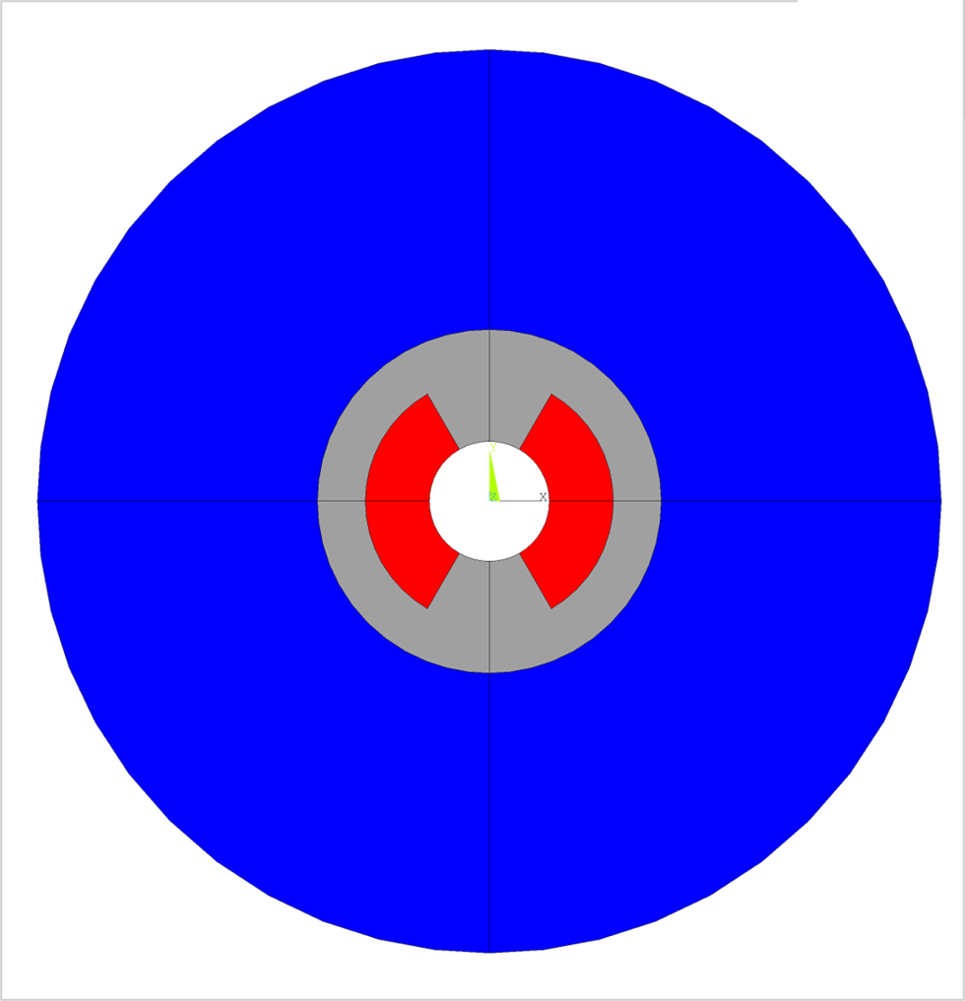
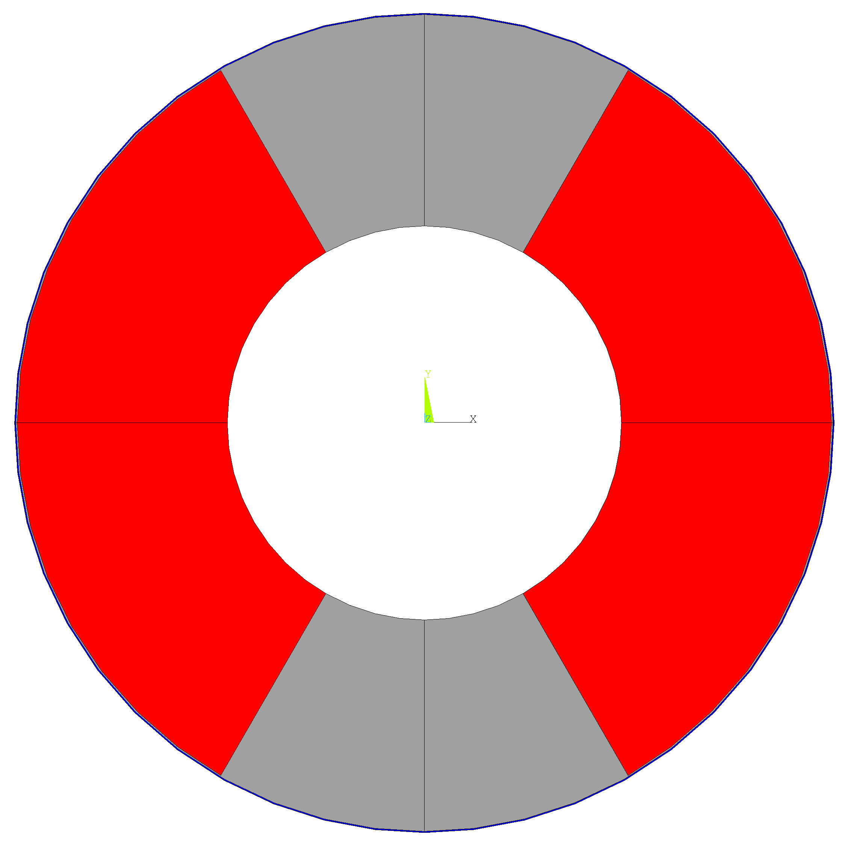
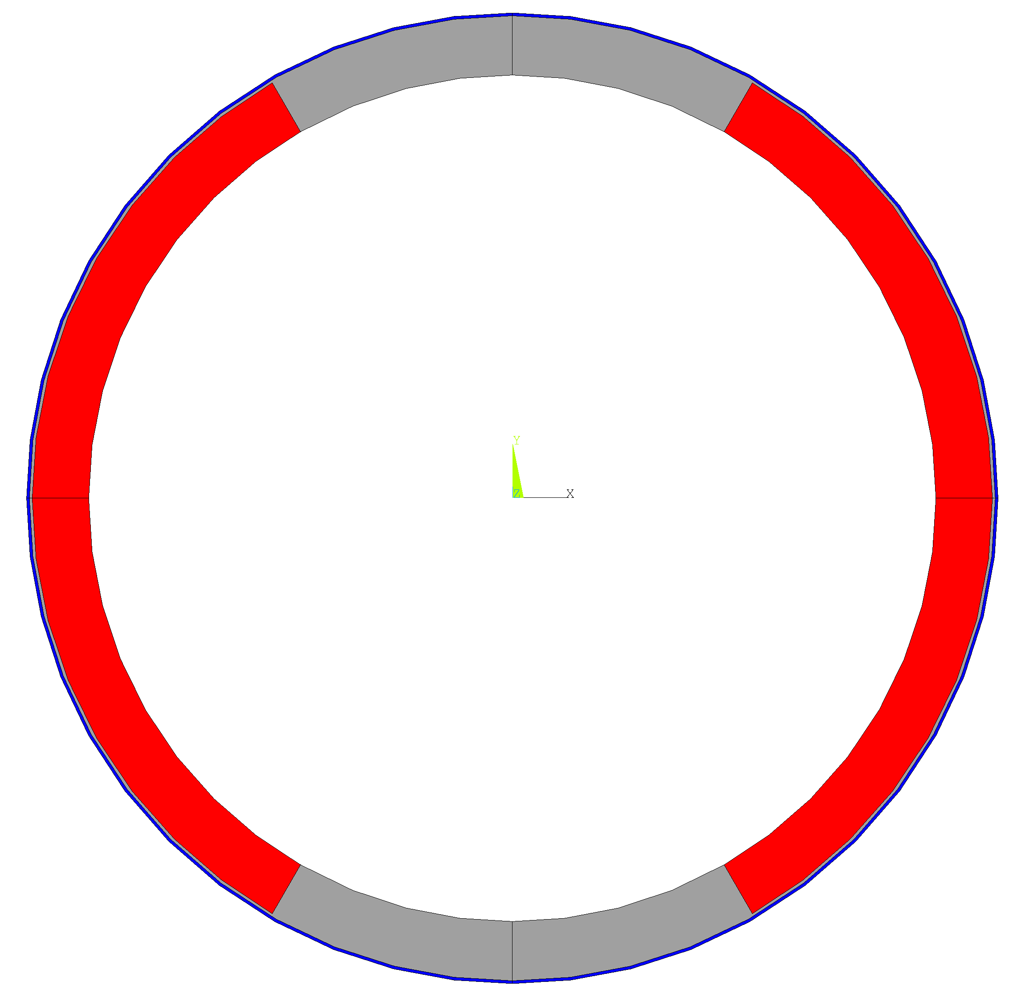
Method and Assumptions
A Python code is used to implement the analytic formulas for the cos-theta magnets in sector coil approximation.
Cost model: by setting an upper limit to the cost of the magnet, the maximum coil width can be calculated for each aperture, taking into account the other components.
Example diagram with bore aperture set at 150 mm.
Total cost of the magnet = 400 kEUR/m (FCC-hh $175 \text{k}\text{EUR}\text{/}\text{m}$ [ref])
Cost of the labour = 20 kEUR/m (LHC)
Aperture
150 mm
Aperture
150 mm
Materials | SC cost [EUR/kg] | Aspirational SC cost [EUR/kg]
Nb₃Sn | 2000 | 700 (FCC target)*
ReBCO | 8000 | 2500 (realistic projection)**
Coil width: $10 mm≤w_{c}≤80 mm$
$$ρ_{coil}=8000 kg/m^{3}$$
Structures: $w_{s}≤60 mm$
SS cost: 10 EUR/kg (HL-LHC)
$ρ_{ss}=7800 kg/m^{3}$
Iron yoke: $w_{i}≤350 mm$
Fe cost: 8 EUR/kg (HL-LHC)
$$ρ_{Fe}=7800 kg/m^{3}$$
Aperture
150 mm
* 7€/kAm, FCC target 5€/kAm
** 50 €/kAm: 1/3 of today prize (150€/kAm)
Also based on projection of ref
A. Molodyk and C. Larbalestier, Science, 2023
Bore
Coil
Structures
Iron
The maximum total cost of the magnet is the same for both materials.

Slide 10
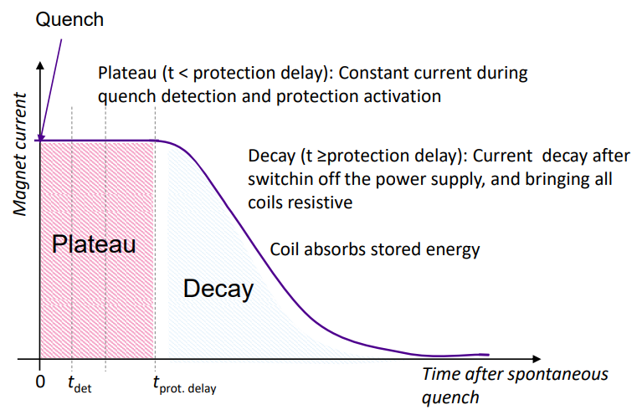
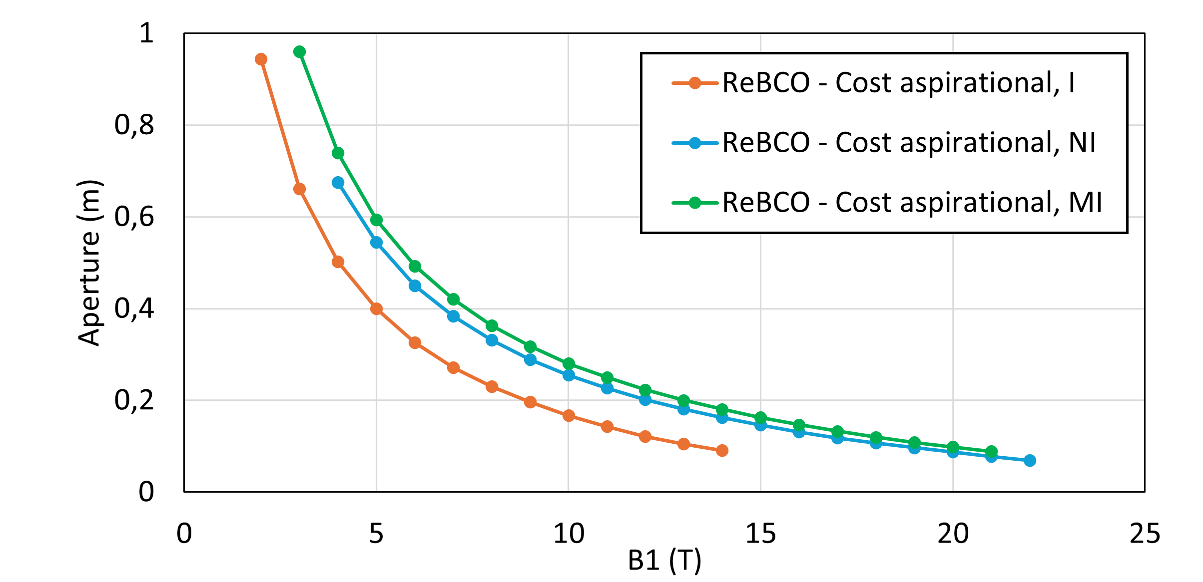
Method and Assumptions
A Python code is used to implement the analytic formulas for the cos-theta magnets in sector coil approximation.
Cost model: by setting an upper limit to the cost of the magnet, the maximum coil width can be calculated for each aperture, taking into account the other components.
The protection scheme consists in QH (or CLIQ) for classical insulated coils, limiting the hotspot temperature and the stored energy in the coils.
For the ReBCO, high cost requires small coil and very high current density → Protection will be a limiting factor
Need to devise alternative protection schemes!
→ Non-Insulated and Metal-Insulated coils
40 ms protection delay
Materials | Hotspot T [K]
Nb₃Sn | 350
ReBCO | 200
Courtesy of Tiina Salmi https://indico.cern.ch/event/1240045/

Slide 11
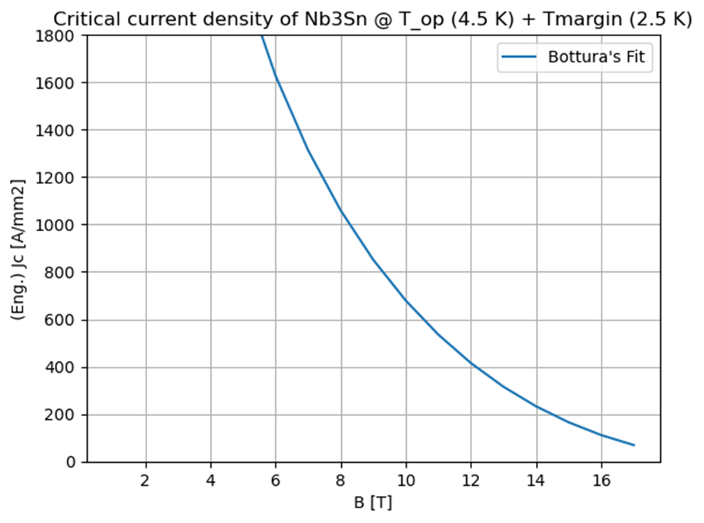
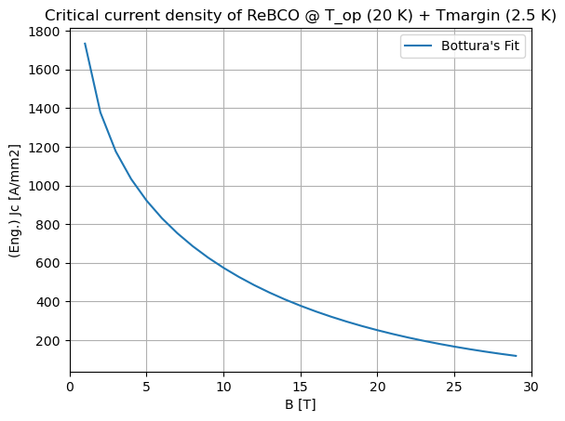
Method and Assumptions
A Python code is used to implement the analytic formulas for the cos-theta magnets in sector coil approximation.
Cost model: by setting an upper limit to the cost of the magnet, the maximum coil width can be calculated for each aperture, taking into account the other components.
The protection scheme consists in QH (or CLIQ) for classical insulated coils, limiting the hotspot temperature and the stored energy in the coils.
The margin limit is the limit due to the SC material itself, starting from the Bottura’s fit for the critical current density.
Materials | Operating T [K] | T margin [K]
Nb₃Sn | 4.5 | 2.5 (HL-LHC)
ReBCO | 20 | 2.5
J_{c} refers to:
Nb₃Sn: FCC cable target performance
ReBCO: Fujikura FESC-AP tape

Slide 12
Method and Assumptions
A Python code is used to implement the analytic formulas for the cos-theta magnets in sector coil approximation.
Cost model: by setting an upper limit to the cost of the magnet, the maximum coil width can be calculated for each aperture, taking into account the other components.
The protection scheme consists in QH (or CLIQ) for classical insulated coils, limiting the hotspot temperature and the stored energy in the coils.
The margin limit is the limit due to the SC material itself, starting from the Bottura’s fit for the critical current density.
The stress limit considers the maximum mechanical stress we can have on the coils, starting from the analytical formula for the midplane pressure of cos-theta magnet in sector coil approx. (Reference: https://doi.org/10.15161/oar.it/143359 )
Materials | Peak Stress [MPa]
Nb₃Sn | 150
ReBCO | 400
LARP TQ
(P. Ferracin)
Currently, only stresses generated by Lorentz forces are considered.
Tevatron dipole
(P. Ferracin)

Slide 13
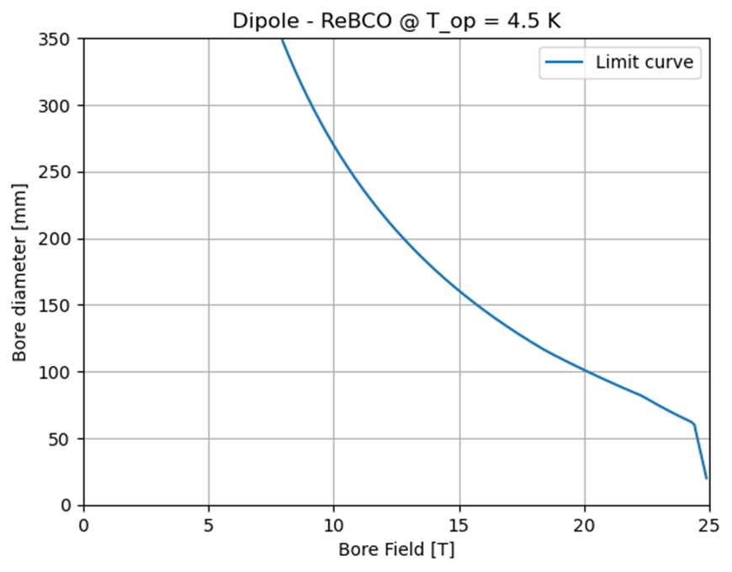
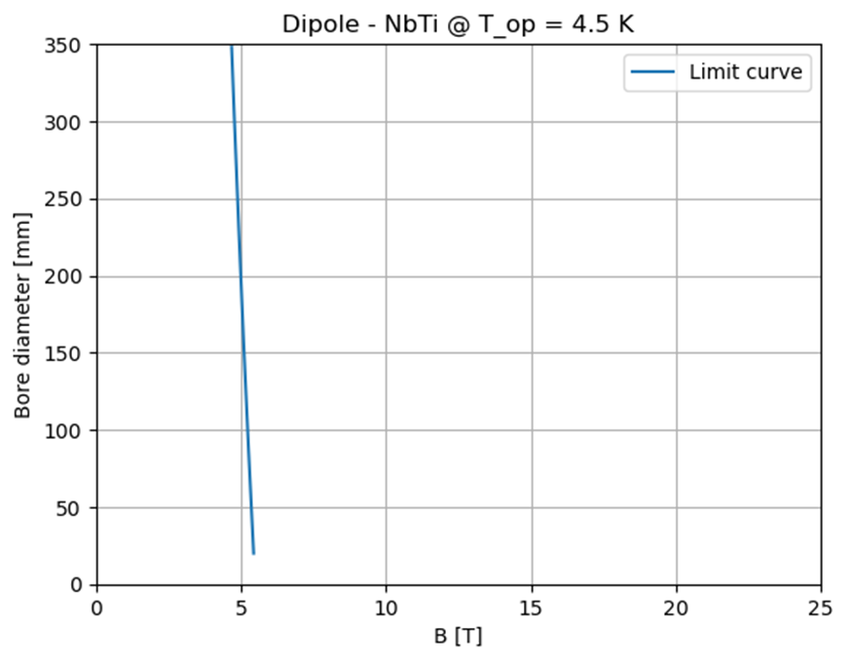
Dipoles A-B Plots
Forbidden area
Forbidden area
Forbidden area
Allowed area
Allowed area
Allowed area
Nb₃Sn is not considered for the 10 TeV as it falls short of the required performance.
It may be an option for the 3 TeV.
NbTi is a good reference for the study. It can be also an option for the 3 TeV with the same tunnel of the 10 TeV.
ReBCO is considered the baseline for 10 TeV.

Slide 14
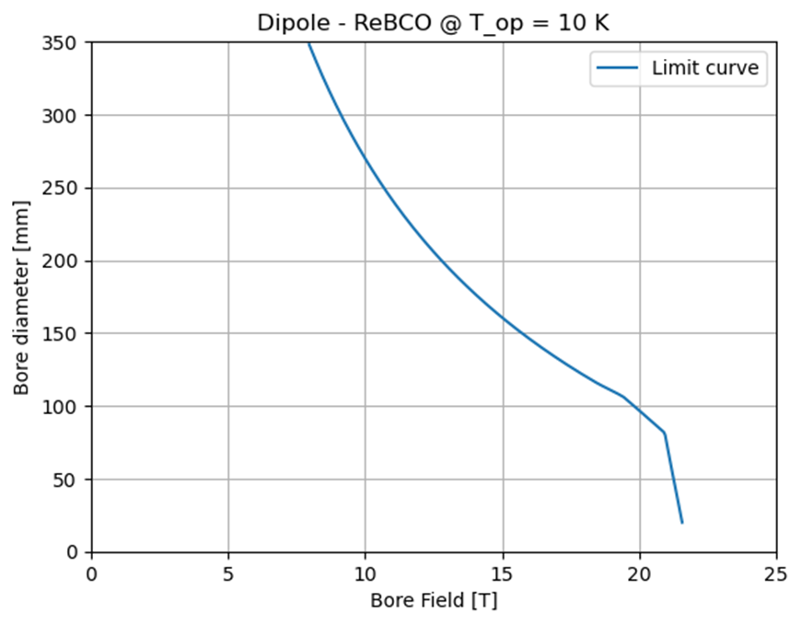
HTS ARC dipoles A-B plots
Forbidden area
Forbidden area
Forbidden area
Allowed area
Allowed area
Allowed area
Operating temperature: 4.5 K
→ tungsten shield with a radius of 4 cm
Operating temperature: 10 K
→ tungsten shield with a radius of 4 cm
Operating temperature: 20 K
→ tungsten shield with a radius of 3 cm
Budget: 400 kEUR/m for each magnet.
SC cost: 2500 EUR/kg (aspirational value).
These plots apply to ARC dipoles.
The Limit curve includes:
Cost model: including coils, iron, structures and labour
Protection: Non-insulated or Metal-insulated cable
Margin: Fujikura FESC AP Tape for the Jc fit
Maximum midplane stress: 400 MPa
ReBCO is considered the baseline for 10 TeV.

Slide 15
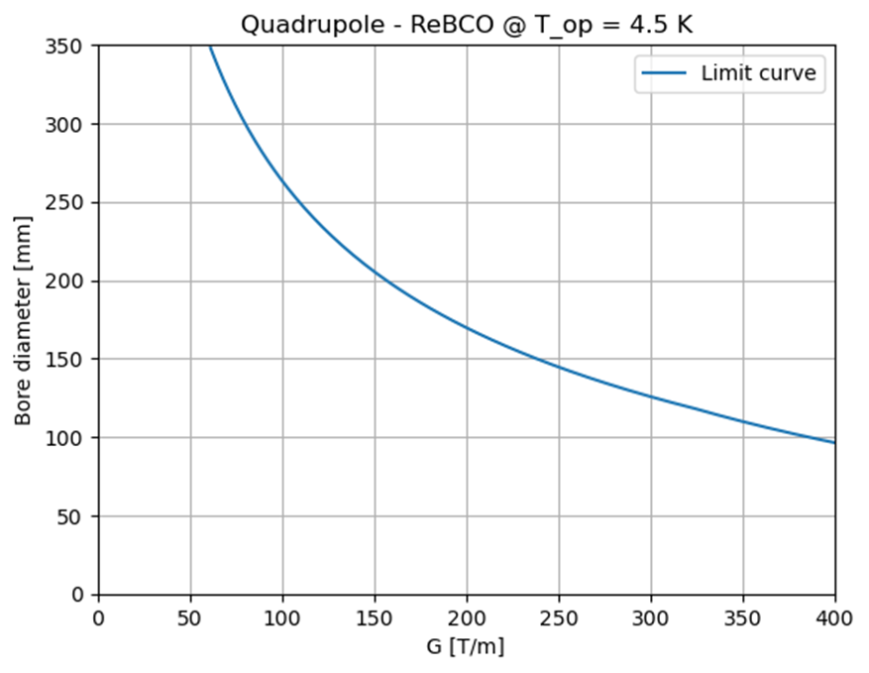
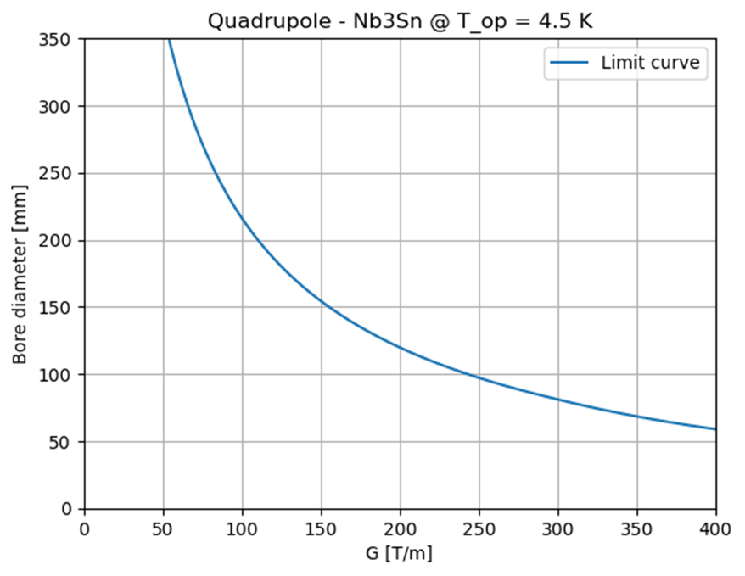
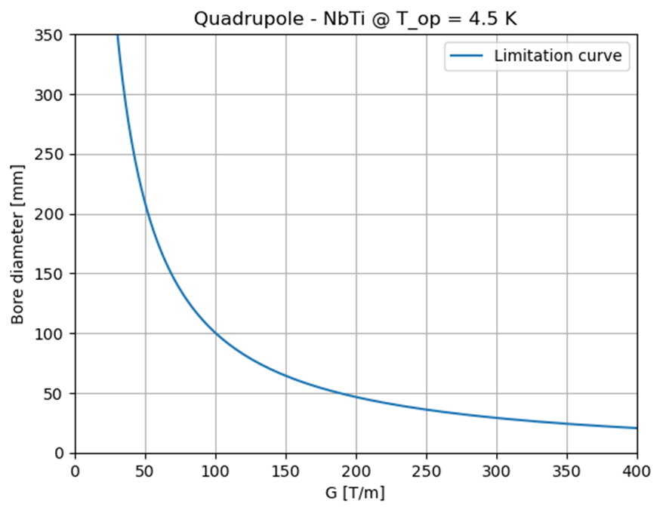
Quadrupoles A-G Plots
Forbidden area
Forbidden area
Forbidden area
Allowed area
Allowed area
Allowed area
Nb₃Sn is not considered for the 10 TeV as it falls short of the required performance.
It may be an option for the 3 TeV.
NbTi is a good reference for the study. It can be also an option for the 3 TeV with the same tunnel of the 10 TeV.
ReBCO is considered the baseline for 10 TeV.

Slide 16
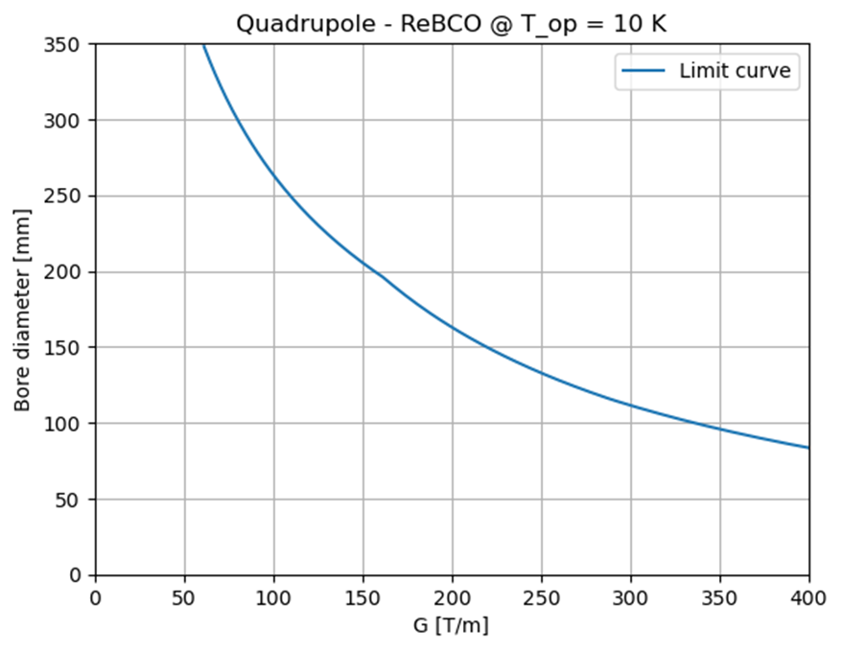
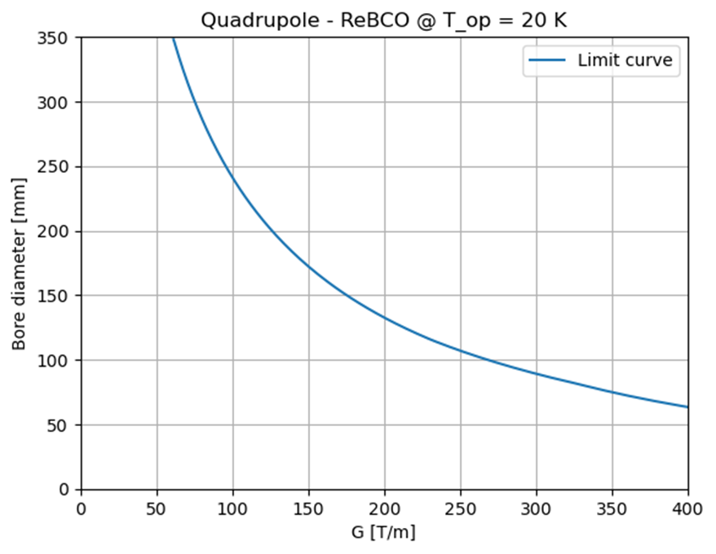
HTS ARC quadrupoles A-G Plots
Forbidden area
Forbidden area
Forbidden area
Allowed area
Allowed area
Allowed area
Operating temperature: 4.5 K
→ tungsten shield with a radius of 4 cm
Operating temperature: 10 K
→ tungsten shield with a radius of 4 cm
Operating temperature: 20 K
→ tungsten shield with a radius of 3 cm
Budget: 400 kEUR/m for each magnet.
SC cost: 2500 EUR/kg (aspirational value).
These plots apply to ARC quadrupoles.
The Limit curve includes:
Cost model: including coils, iron, structures and labour
Protection: Non-insulated or Metal-insulated cable
Margin: Fujikura FESC AP Tape for the Jc fit
Maximum midplane stress: 400 MPa
ReBCO is considered the baseline for 10 TeV.

Slide 17
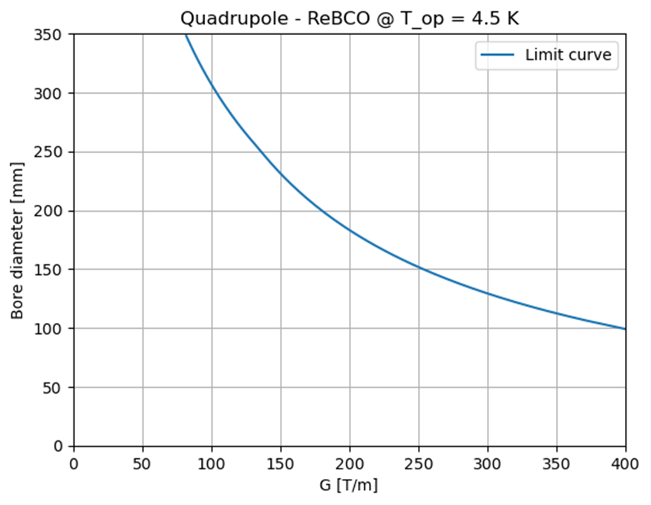
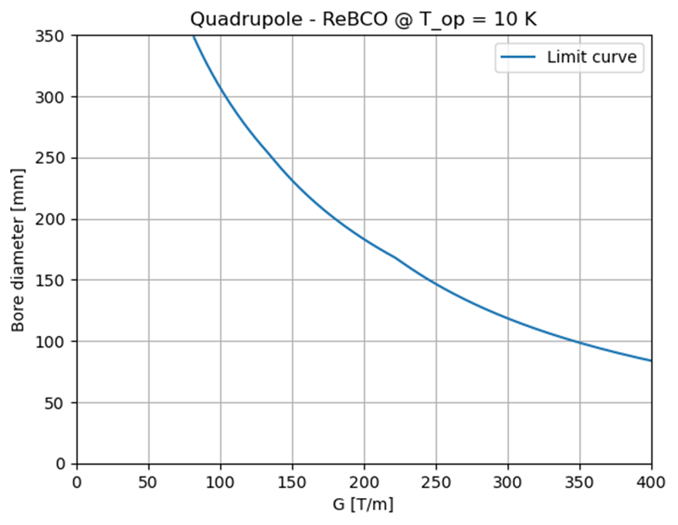
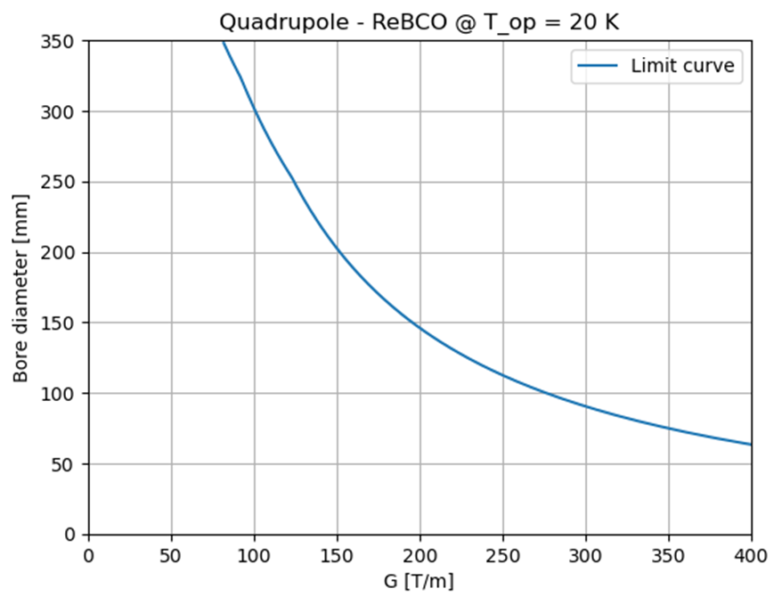
HTS FF quadrupoles A-G Plots
Forbidden area
Forbidden area
Forbidden area
Allowed area
Allowed area
Allowed area
Operating temperature: 4.5 K
→ tungsten shield with a radius of 4 cm
Operating temperature: 10 K
→ tungsten shield with a radius of 4 cm
Operating temperature: 20 K
→ tungsten shield with a radius of 3 cm
Budget: 800 kEUR/m for each magnet.
SC cost: 2500 EUR/kg (aspirational value).
These plots apply to FF quadrupoles.
The Limit curve includes:
Cost model: including coils, iron, structures and labour
Protection: Non-insulated or Metal-insulated cable
Margin: Fujikura FESC AP Tape for the Jc fit
Maximum midplane stress: 400 MPa
ReBCO is considered the baseline for 10 TeV.

Slide 18
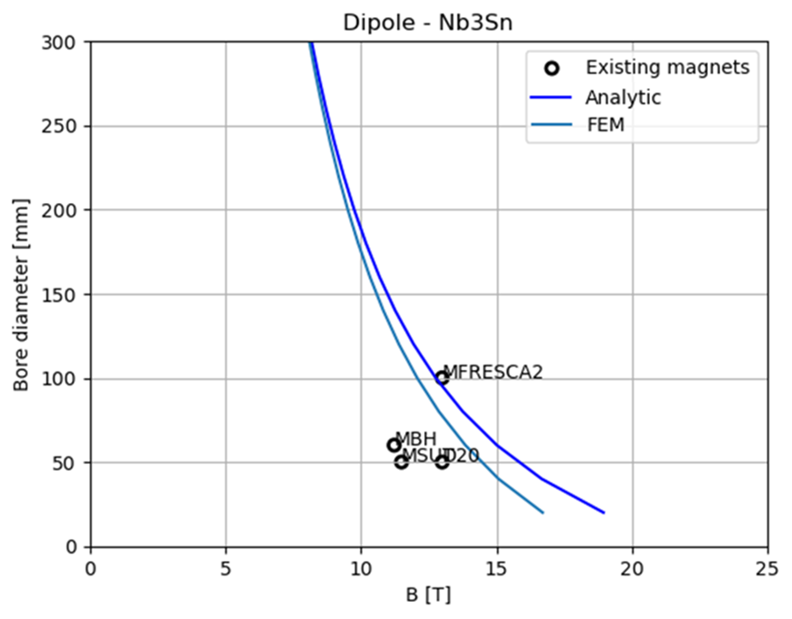
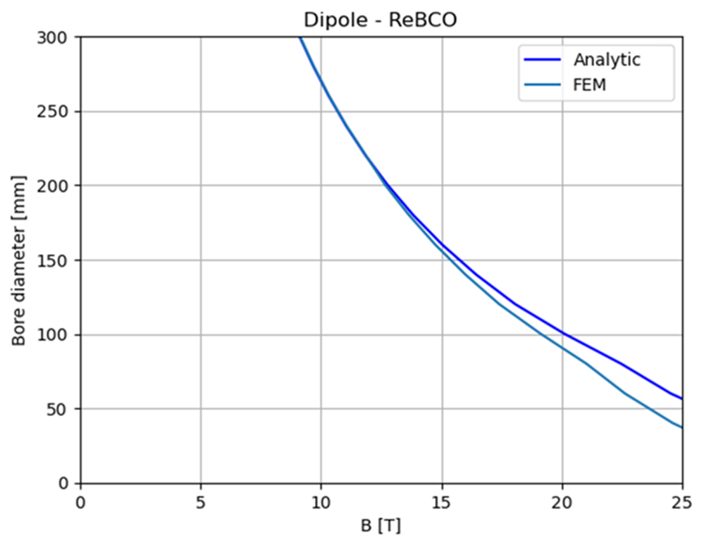
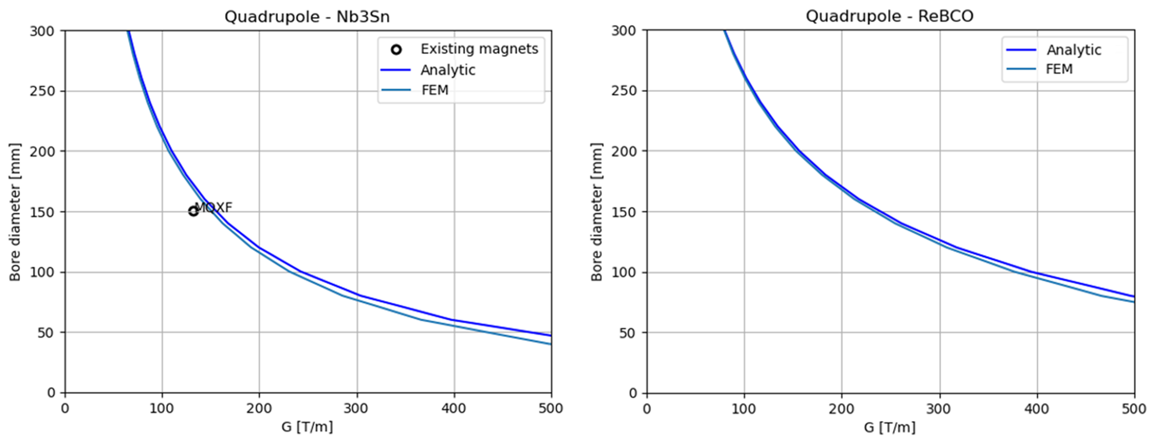
FEM Crosscheck for Stress Curves
FEM models for a sector dipole and quadrupole in ANSYS were implemented.
A Python code able to work with Ansys software was developed to run FEM simulations with the same inputs as the analytical study.
In the comparison, the FEM curves are always more restricting than the analytical ones since they take the maximum pressure on the midplane instead of an average over the coil width.

Slide 19
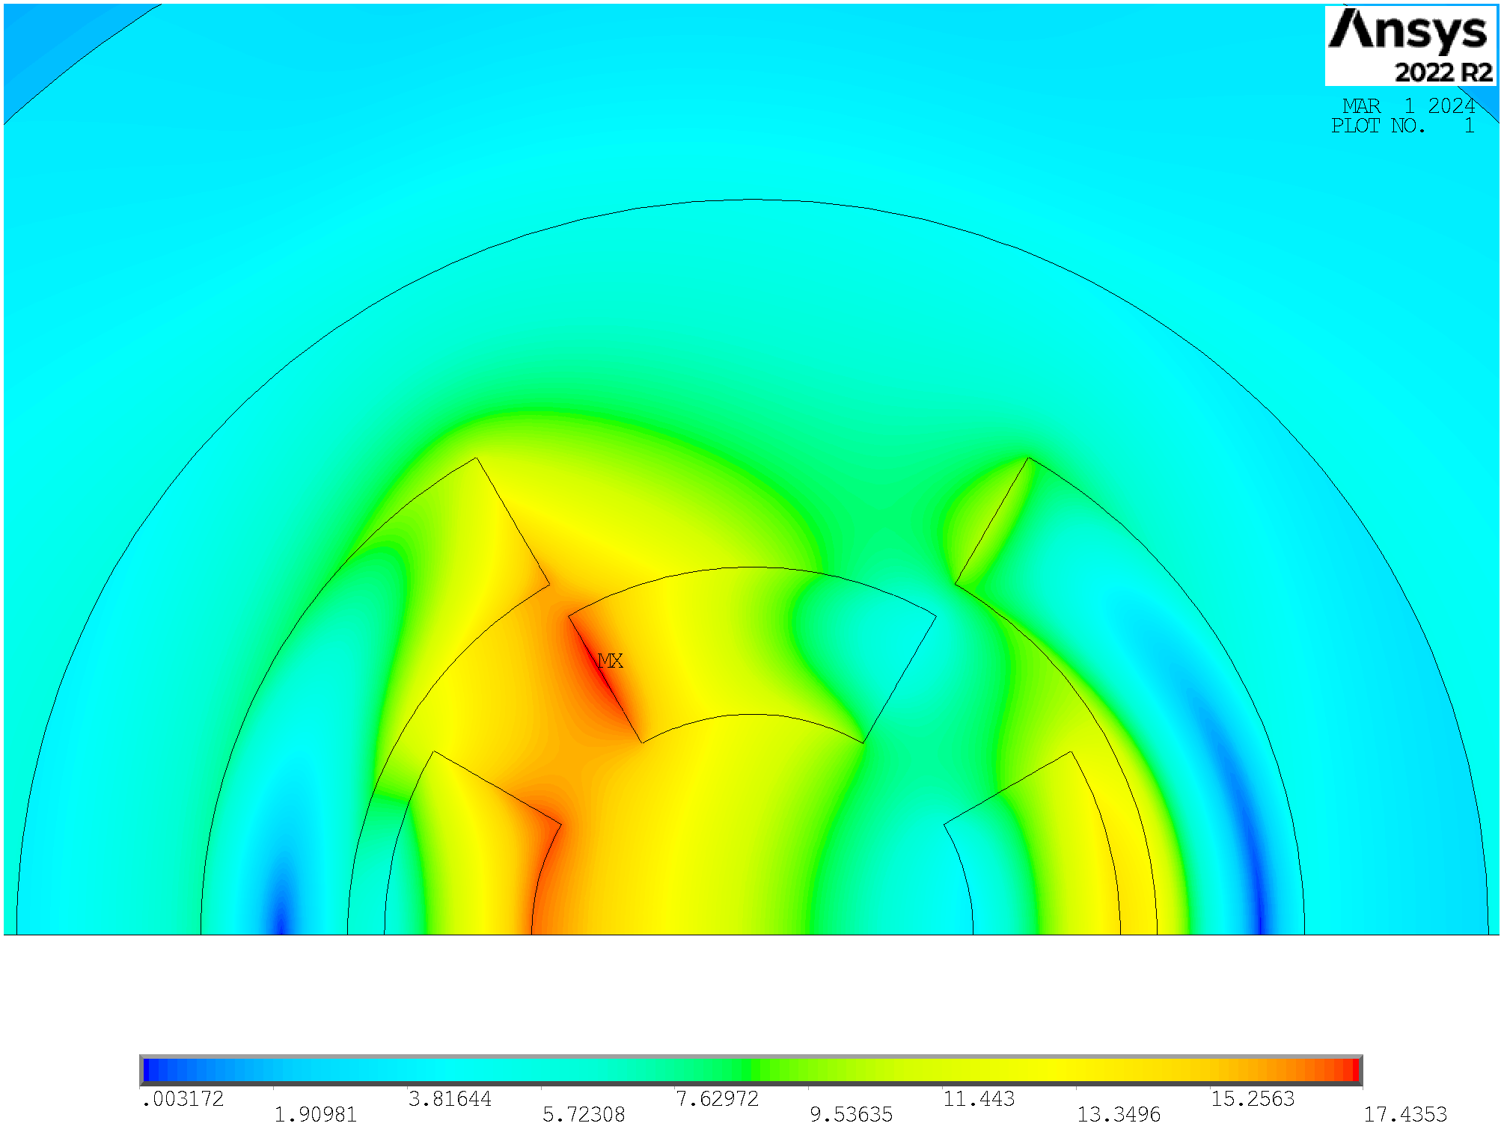
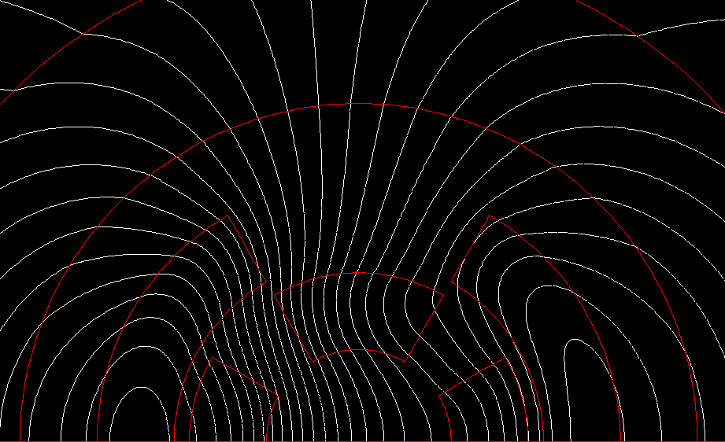
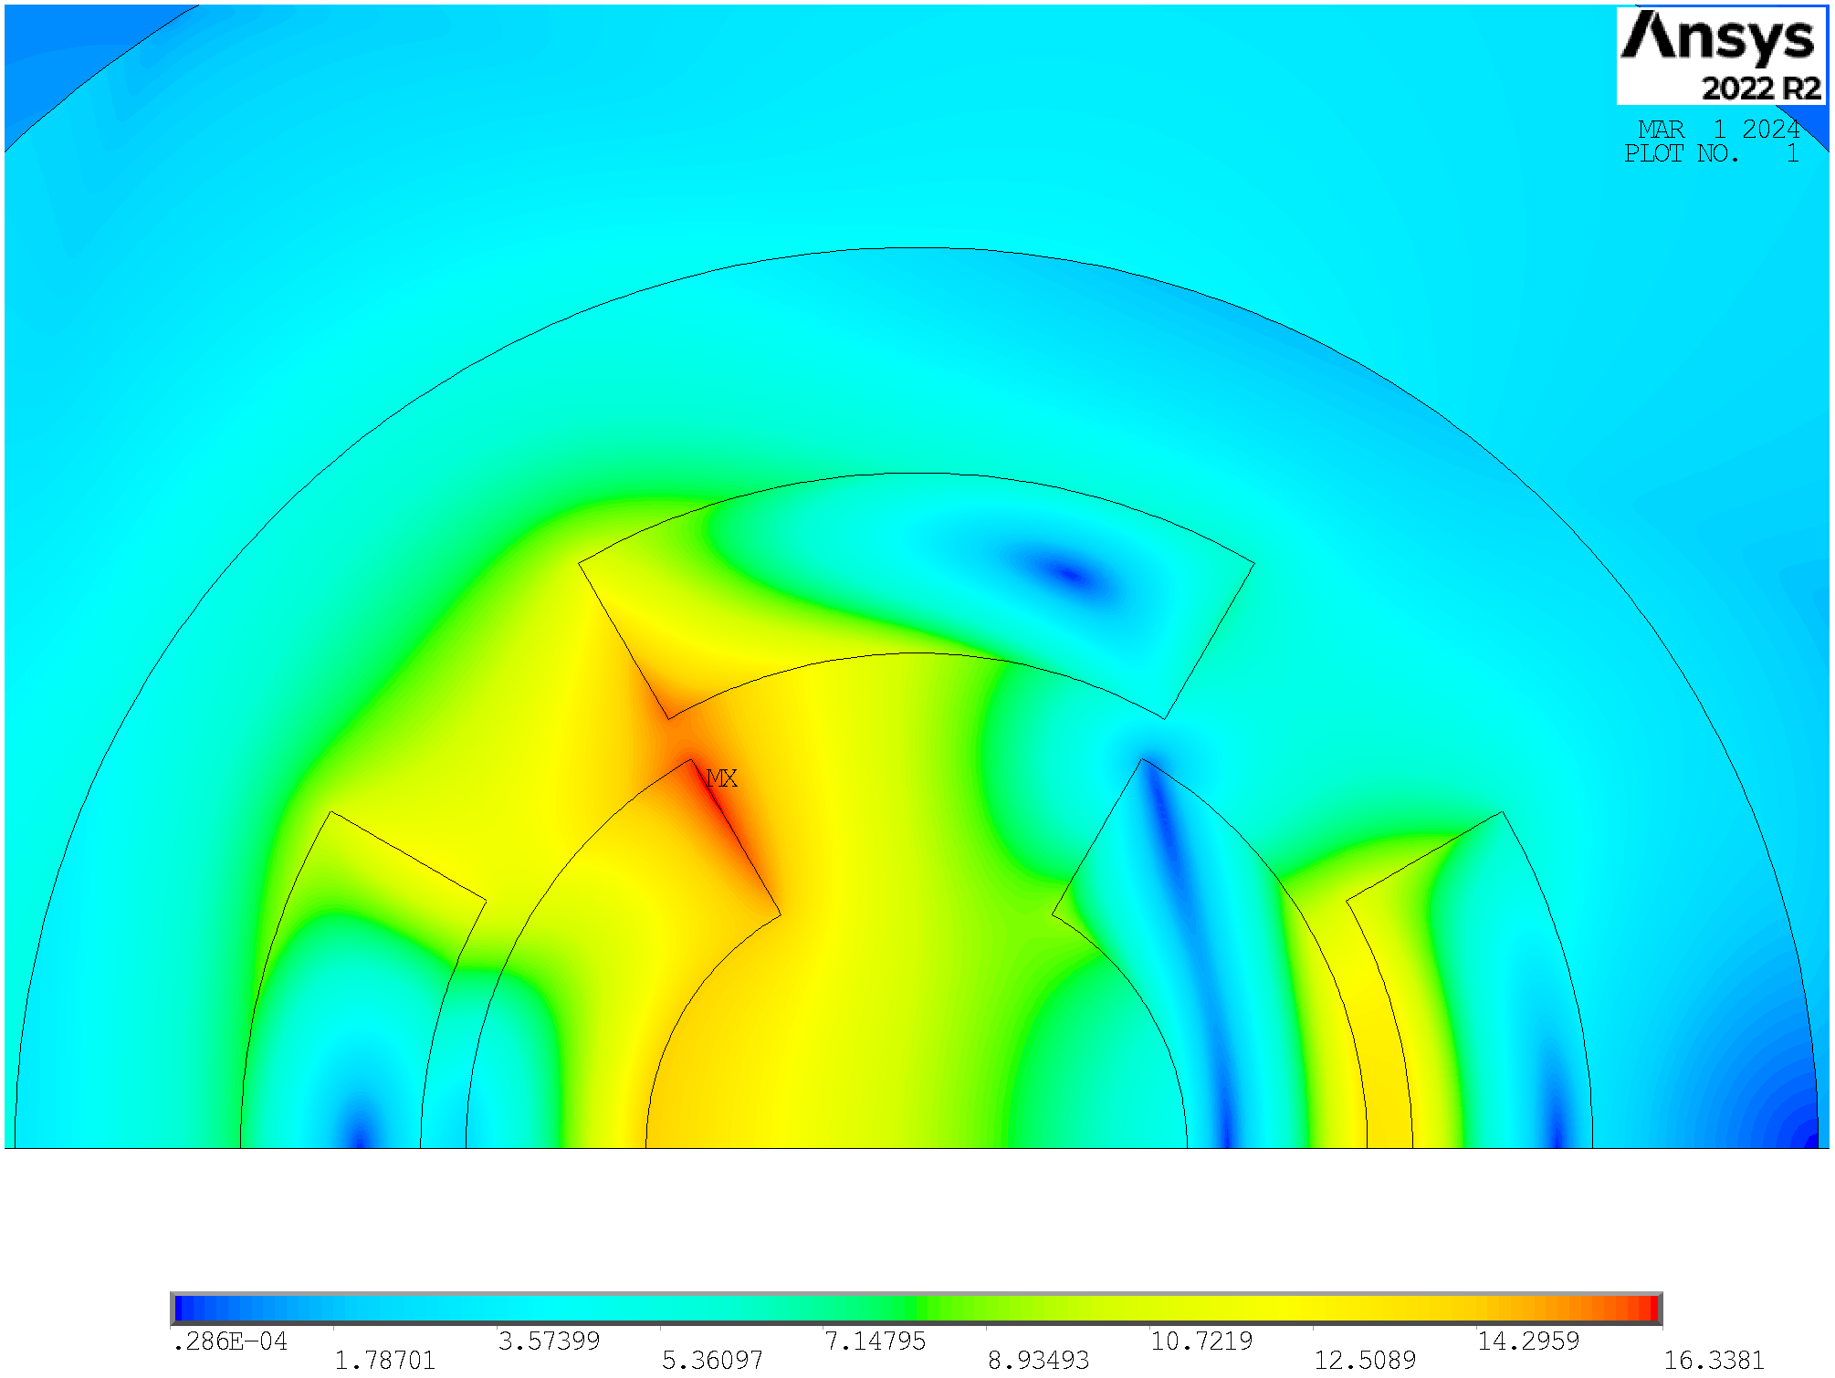
Combined Function Magnet
Arc:
Combined function magnets: B1, B1+B2 and B1+B3
B ≈ 8…16 T; G ≈ 320 T/m; G’ ≈ 7100 T/m²
Aperture ≈ 160 mm
Final focus:
Combined function magnets: B1, B2, B1+B2 , B1+B3
B ≈ 4…16 T; G ≈ 100…300 T/m; G’ ≈ 12000 T/m²
Aperture ≈ 120…300 mm
Preliminary results obtained with ANSYS in a sector coil approximation
Quad into dipole:
(ReBCO @20 K)
$J=3.5⋅{10}^{8}A/m^{2}$
$B_{ }∼11.7 T$
$G∼143.3 T/m$
$$r_{aperture}=70 mm$$
$$w_{coil}=80 mm$$
Dipole into quad:
(ReBCO @20 K)
$J=3.5⋅{10}^{8}A/m^{2}$
$B_{ }∼12.4 T$
$G∼90.4 T/m$
$$r_{aperture}=70 mm$$
$$w_{coil}=80 mm$$
Quadrupole inside dipole is more efficient, in agreement with US-MAP [ref]

Slide 20
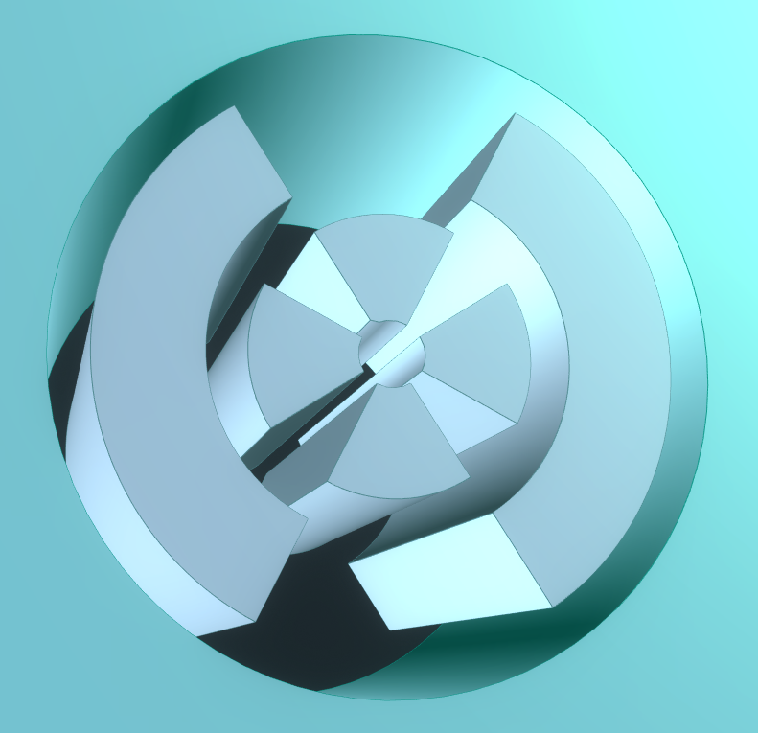
Combined Function Magnet
We would like to produce B-G plots in order to provide the allowed area for the combined function magnets.
Difficult to study analytically → Python-Ansys interface
$Bore Radius=25 mm$
$Bore Radius=50 mm$
$Bore Radius=75 mm$
$Bore Radius=100 mm$
30 mm
a1_quad
w_dip
30 mm
w_quad

Slide 21
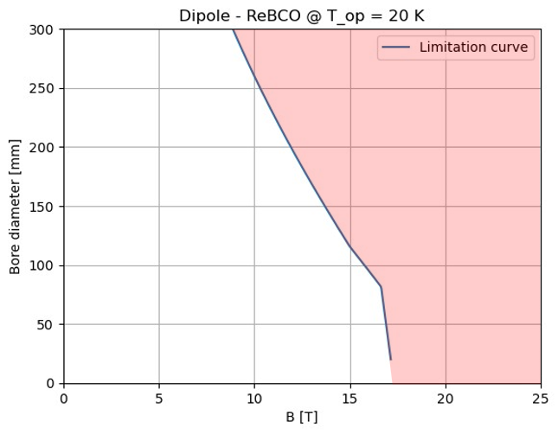
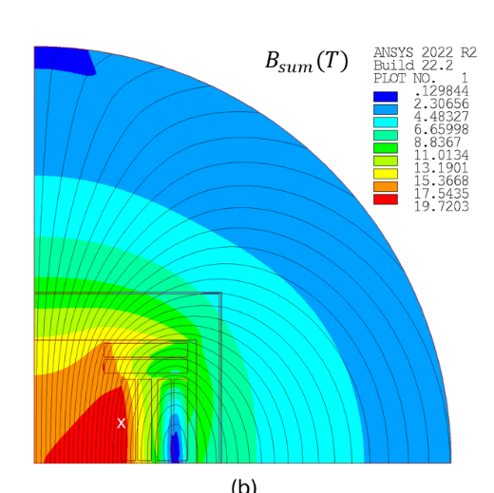
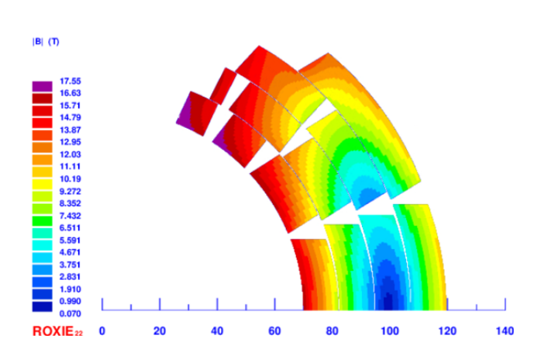
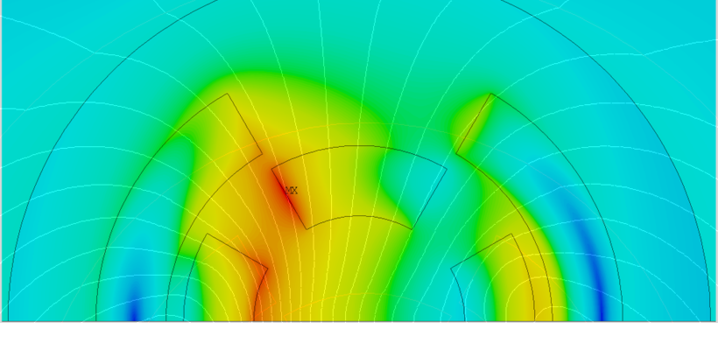
Conclusions
The allowed magnet aperture (A) - magnetic field (B) phase spaces are provided and discussed, representing the starting point to define possible beam optics which are also acceptable from a technological point of view.
To address the issue of neutrino flux in the straight sections, combined function magnets must be used in the Muon Collider. In this regard, we are working to identify realistic target designs from a technological point of view.
Courtesy of L. Alfonso
Courtesy of F. Mariani
Thanks to the A-B plots, we were able to identify a target design, allowing us to begin studying specific designs.
In particular, we are exploring a cos-theta design and a block coil design.

Slide 22
Thank you
for your attention
MuCol Italia – Torino
D. Novelli^{1,2}, L. Alfonso², A. Bersani², L. Bottura⁵, B. Caiffi²,
S. Farinon², F. Mariani¹, S. Mariotto³ , A. Pampaloni², T. Salmi⁴
¹Sapienza University of Rome, ²INFN – Genoa , ³INFN and University of Milan
⁴Tampere University, ⁵CERN
December 2024

Slide 23
Backup
slides
MuCol Italia – Torino
D. Novelli^{1,2}, L. Alfonso², A. Bersani², L. Bottura⁵, B. Caiffi²,
S. Farinon², F. Mariani¹, S. Mariotto³ , A. Pampaloni², T. Salmi⁴
¹Sapienza University of Rome, ²INFN – Genoa , ³INFN and University of Milan
⁴Tampere University, ⁵CERN
December 2024

Slide 24
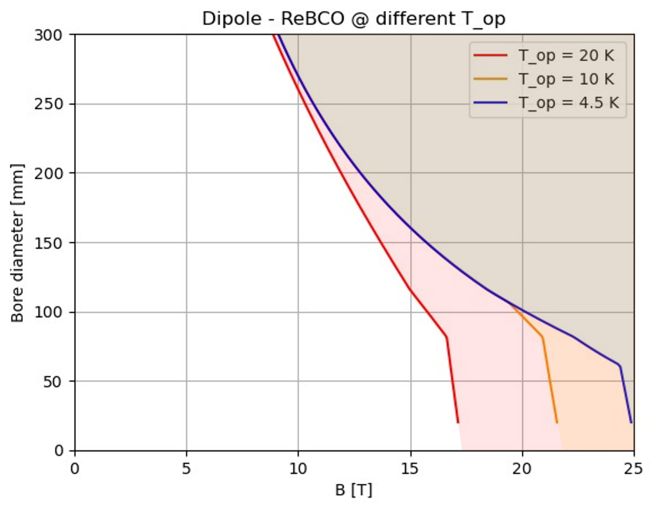
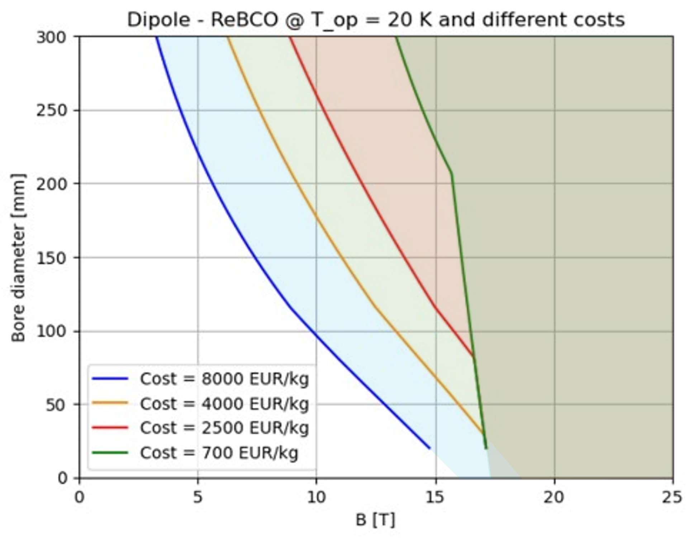
HTS dipole A-B Plots
IR [10T, 300 mm]
IR [10T, 300 mm]
Cost
reduction
ARC [16T, 140 mm]
ARC [16T, 140 mm]
$T_{op}$reduction
A reduction of operating temperature will result in wider design A-B range
The curves shown in the plots are the limit curves,
i.e., for each aperture value the strictest limit is taken, excluding the limit for insulated magnets.
A reduction of HTS cost will result in wider design A-B range

Slide 25
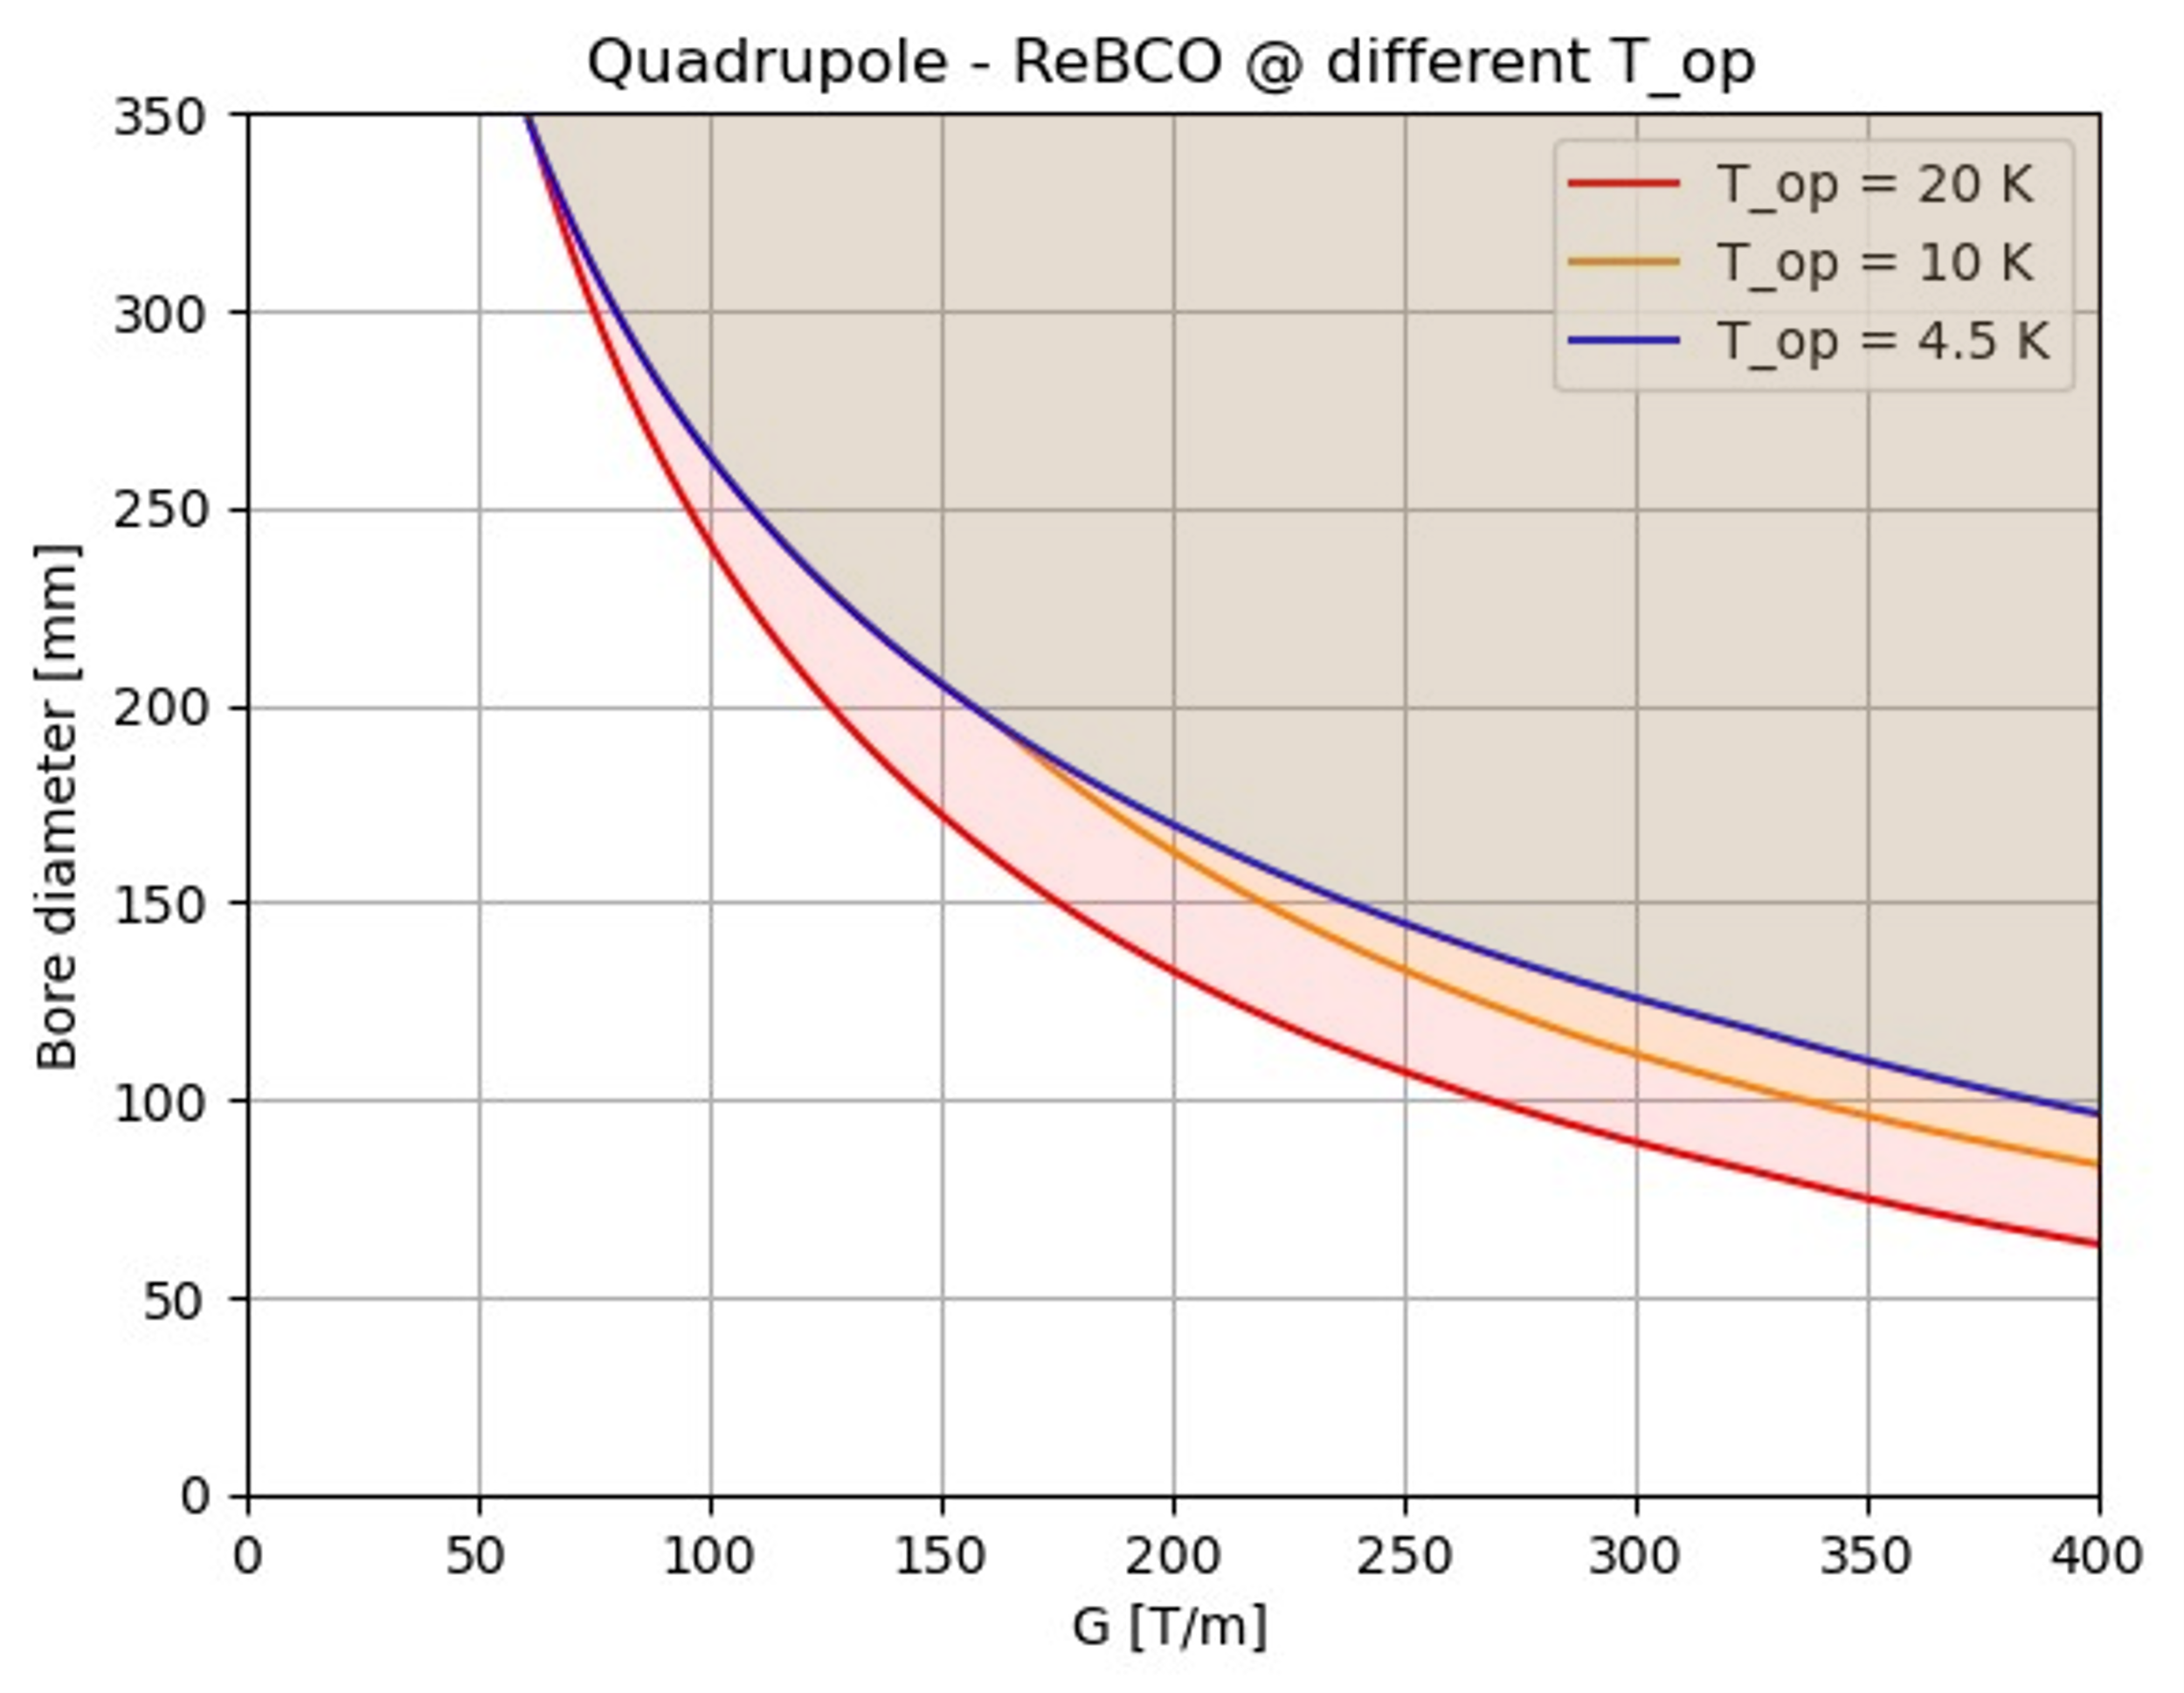
HTS quadrupole A-B Plots
IR [115T/m, 290 mm]
IR [115T/m, 290 mm]
Cost
reduction
ARC [240T/m, 170 mm]
ARC [240T/m, 170 mm]
ARC [330T/m, 130 mm]
ARC [330T/m, 130 mm]
$T_{op}$reduction
A reduction of operating temperature will result in wider design A-B range
A reduction of HTS cost will result in wider design A-B range
The curves shown in the plots are the limit curves,
i.e., for each aperture value the strictest limit is taken, excluding the limit for insulated magnets.

