Slide 1
Preliminary Design and Challenges of High Field Magnets for the Collider Ring

Slide 2
Outline
Overview of current work carried out by INFN – Genova/Milano
Dipole Magnet for Collider Ring
Cable Assumption
Electromagnetic Design
Hysteretic Losses
Evaluation of stresses in conductors due only to Lorentz Forces
Summary

Slide 3
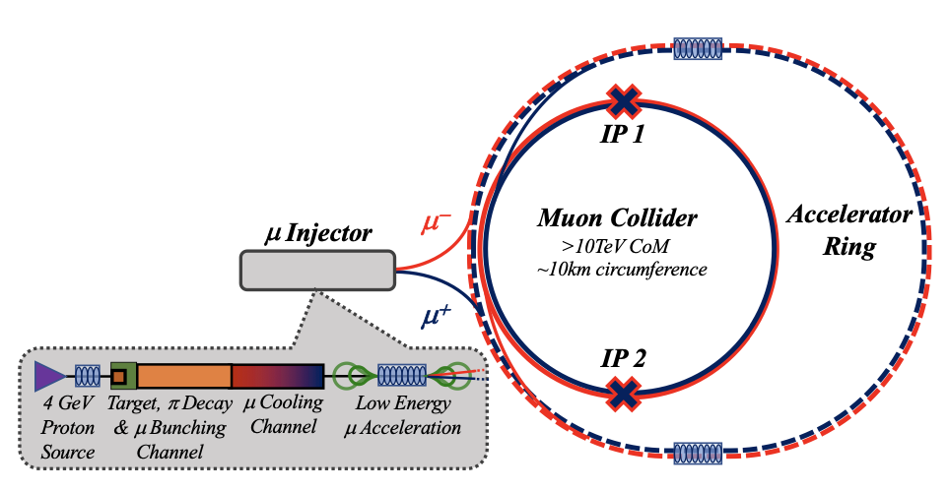
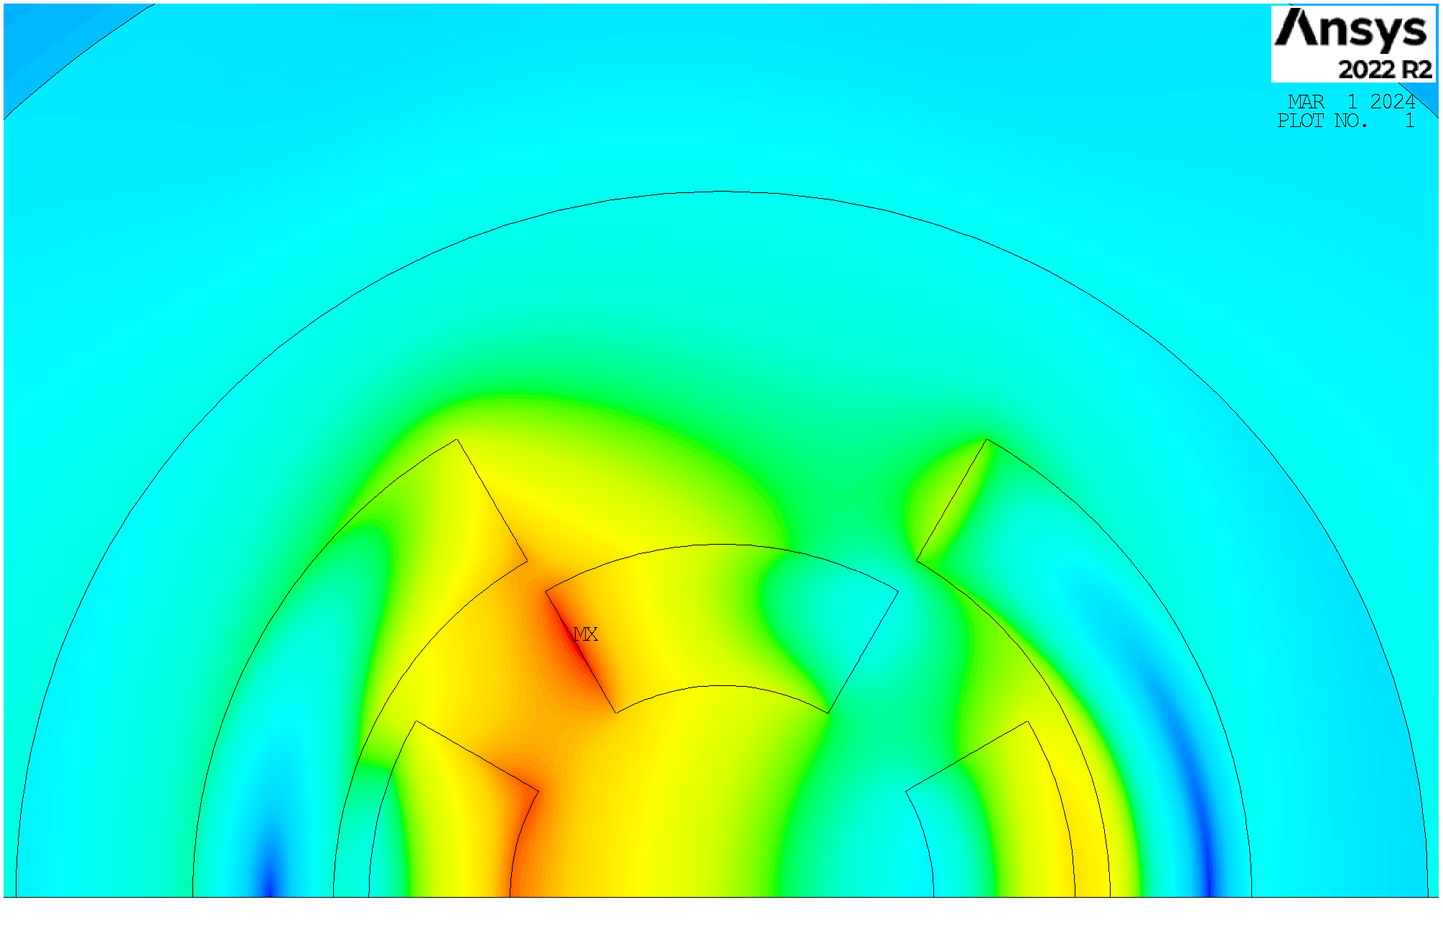
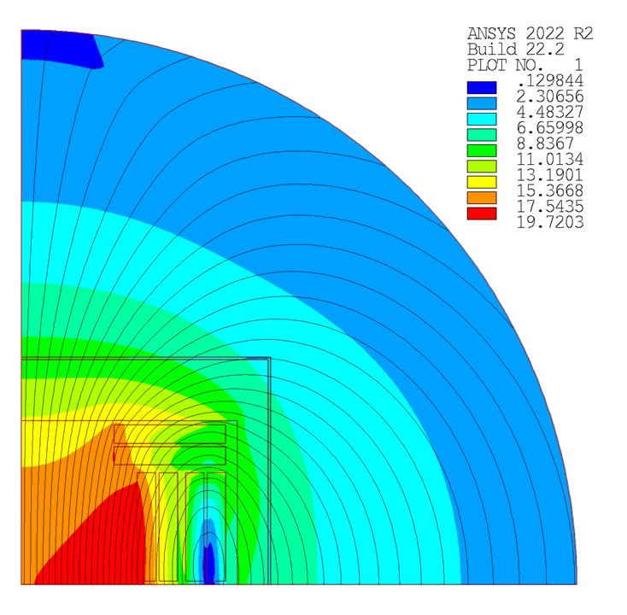
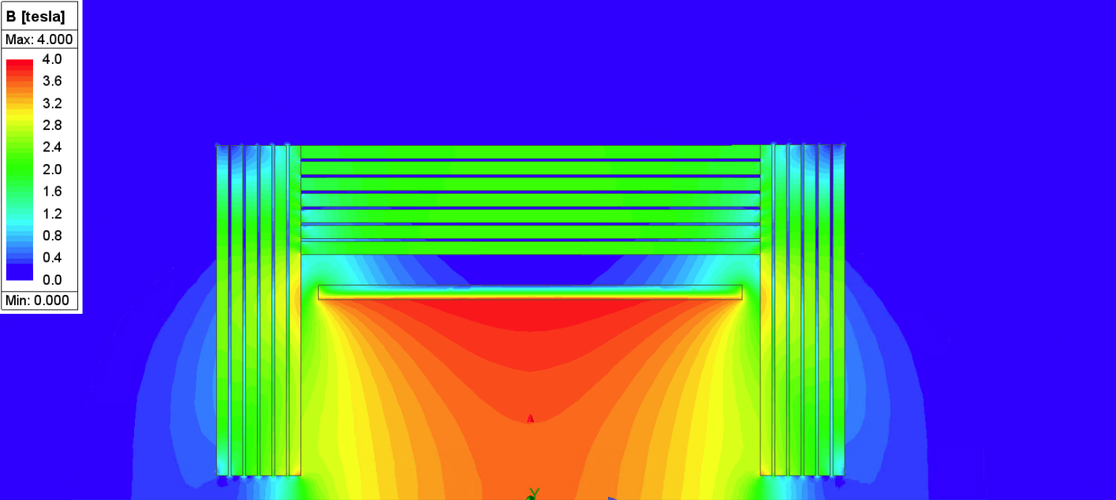
Magnets studied at INFN – Genova/Milano
Dipole Magnets for the Accelerator
Combined Function Magnets for the Collider Ring
Detector Magnet
Dipole Magnets for the Collider Ring
Overview of work
Dipole Magnet for Collider Ring
Cable Assumption
Electromagnetic Design
Hysteretic Losses
Evaluation of stresses
Summary
10 T
(30x100) mm
T_{op} = 20 K
(4 – 8) T + (100 – 330) T/m
Φ = (100-200) mm
T_{op} = 20 K
16 T
Φ = 140 mm
T_{op} = 20 K
See A. Bersani’s presentation
Only SC magnets non-ramped

Slide 4
Dipole Magnet for Collider Ring
Dipole Magnets for the Collider Ring
16 T
Φ = 140 mm
T_{op} = 20 K
Dipole Magnets for the Accelerator
Combined Function Magnets for the Collider Ring
Detector Magnet
Overview of work
Dipole Magnet for Collider Ring
Cable Assumption
Electromagnetic Design
Hysteretic Losses
Evaluation of stresses
Summary
10 T
(30x100) mm
T_{op} = 20 K
(4 – 8) T + (100 – 330) T/m
Φ = (100-200) mm
T_{op} = 20 K
See Bersani’s presentation

Slide 5
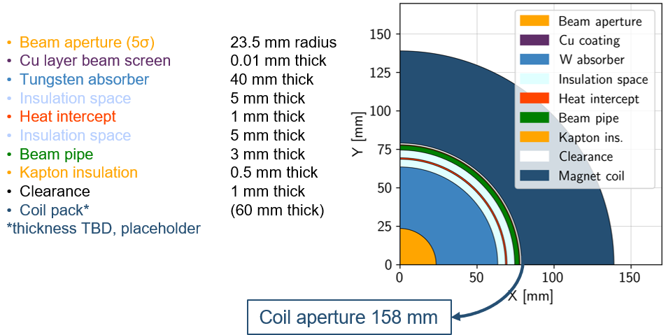
Dipole Requirements
Main challenges
High magnetic field for compactness
Large aperture to host radiation shielding for the muon decay product
Assuming 10 TeV machine and coil at 4.5 K
Overview of work
Dipole Magnet for Collider Ring
Cable Assumption
Electromagnetic Design
Hysteretic Losses
Evaluation of stresses
Summary
Parameter | Value | U.M.
φ | 140 | mm
Bore field | ≥16 | T
T_{op} | 20 | K
T_{margin} | 2.5 | K
Max. Budget | 400 | k€/m
Courtesy of Patricia Borges de Sousa
https://indico.cern.ch/event/1250075/contributions/5357594/
HTS cable

Slide 6
Objectives of the Study
Produce a preliminary conceptual design
Defining a cable geometry
Electromagnetic design optimization through a sensitivity study of geometrical parameters via F.E.M. software
Estimation of hysteretic losses
Mechanical stresses evaluation in the conductors due only to Lorentz Forces via F.E.M. software
Overview of work
Dipole Magnet for Collider Ring
Cable Assumption
Electromagnetic Design
Hysteretic Losses
Evaluation of stresses
Summary

Slide 7
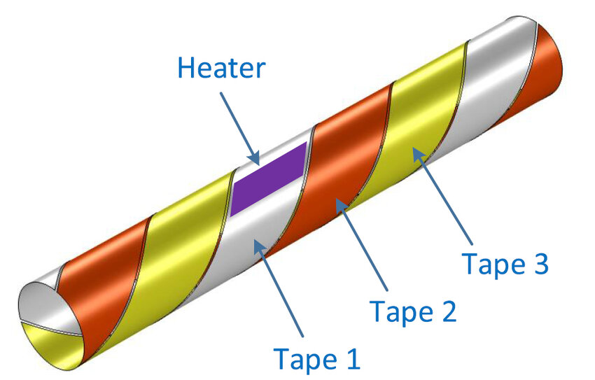
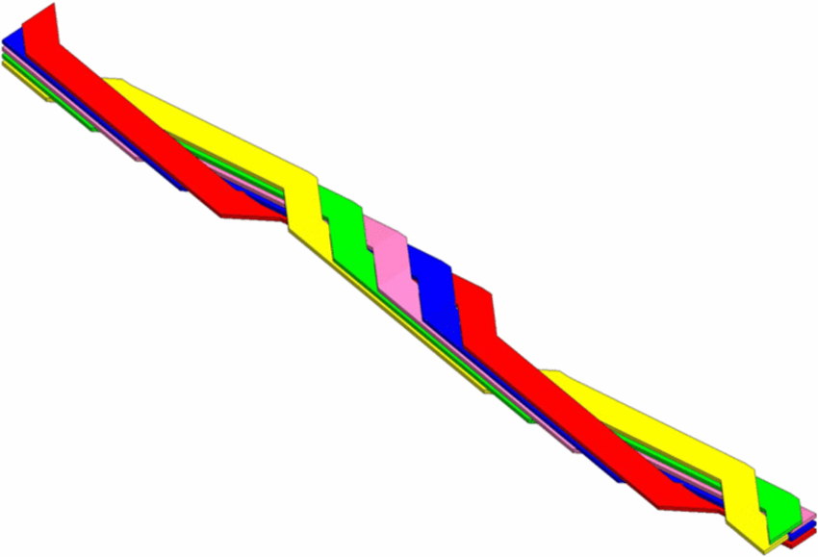
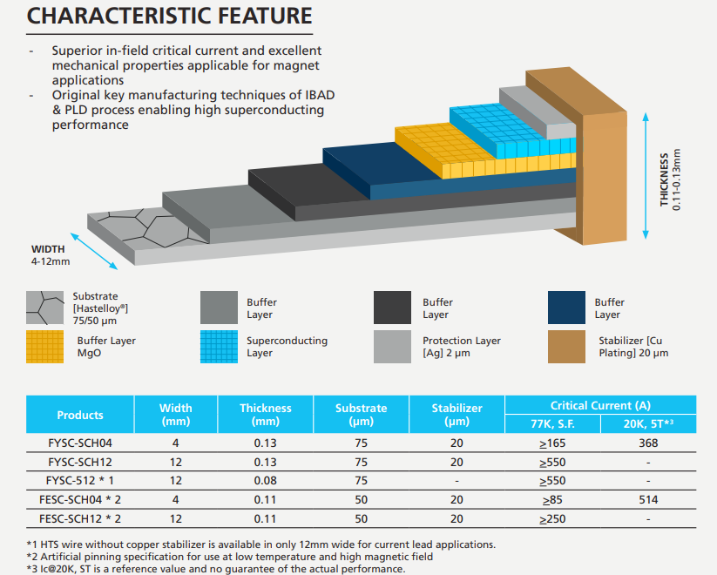
Cable Assumption
CORC cable
ROEBEL cable
Stacked cable
Fujikura FESC-SCH 12
Non-twisted stacked tapes cable co-wounded with a SS layer.
0.11 mm
Easy to scale to high current densities
Flexible
Easy to model
Overview of work
Dipole Magnet for Collider Ring
Cable Assumption
Electromagnetic Design
Hysteretic Losses
Evaluation of stresses
Summary
12 mm
For the same current, the engineering current density is lower due to the voids
Manufacturing complexity and sensitivity to mechanical stress
$50 μm$
$0,27 mm$
$$R_{Cu/SC}=\frac{A_{Cu}}{A_{SC}}=16.15$$
y
$$f_{f}=\frac{A_{SC}}{A_{tot}}=0.018$$
x
$12 mm$

Slide 8
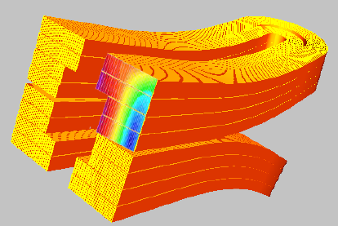
Electromagnetic Desing
Field map
Main results
Parameter | Value | U.M.
N° tape | 3640 | -
I_{op} | 1403 | $$A$$
J_{eng} | 433 | $$A/mm^{2}$$
B_{bore} | 17.5 | $$T$$
B_{peak_max} | 19.4 | $$T$$
Margin | 2.5 | $$K$$
E_{stored} | 6968 | $$kJ/m$$
L | 2.26 | $$mH/m$$
F_{x} | 15.56 | MN/m
F_{y} | -10.84 | MN/m
Optimization of blocks width and position
Overview of work
Dipole Magnet for Collider Ring
Cable Assumption
Electromagnetic Design
Hysteretic Losses
Evaluation of stresses
Summary
3D conceptual design

Slide 9
New Ends Winding Proposal
Hard-way
Easy-way
Overview of work
Dipole Magnet for Collider Ring
Cable Assumption
Electromagnetic Design
Hysteretic Losses
Evaluation of stresses
Summary

Slide 10
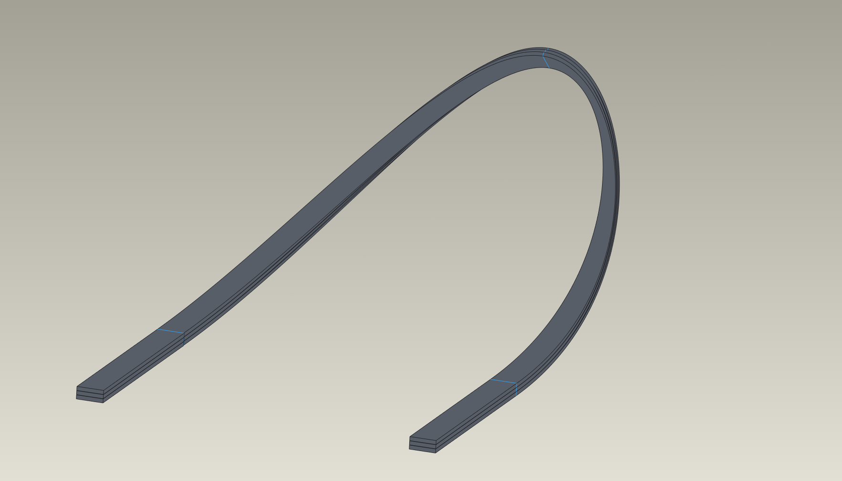
New Ends Winding Proposal
Hard-way
Easy-way
Overview of work
Dipole Magnet for Collider Ring
Cable Assumption
Electromagnetic Design
Hysteretic Losses
Evaluation of stresses
Summary

Slide 11
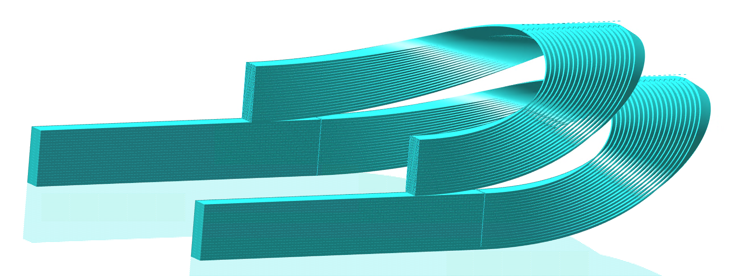
New Electromagnetic Design
Field map
Main results
$$B (T)$$
Parameter | Value | U.M.
N° tape | 3176 | -
$$I_{op}$$ | 2481 | $$A$$
$$J_{eng13}$$ | 386 | $$A/mm^{2}$$
$$J_{eng2}$$ | 766 | $$A/mm^{2}$$
$$B_{bore}$$ | 17.5 | $$T$$
$$B_{peak1}$$ | 19.7 | $$T$$
$$Margin$$ | 2.5 | $$K$$
E | 7575 | $$kJ/m$$
L | 2461 | $$mH/m$$
F_{x} | 16.03 | MN/m
F_{y} | -12.13 | MN/m
Optimization of blocks width and position
Overview of work
Dipole Magnet for Collider Ring
Cable Assumption
Electromagnetic Design
Hysteretic Losses
Evaluation of stresses
Summary
3
x
1
2
3D conceptual design

Slide 12
Innovative Approach of Grading
$J_{eng}=383 \left(A/{mm^{2}}\right)$
$$B (T)$$
Joined together and powered as single unit
Overview of work
Dipole Magnet for Collider Ring
Cable Assumption
Electromagnetic Design
Hysteretic Losses
Evaluation of stresses
Summary
3
x
1
2
$J_{eng}=766 \left(A/{mm^{2}}\right)$

Slide 13
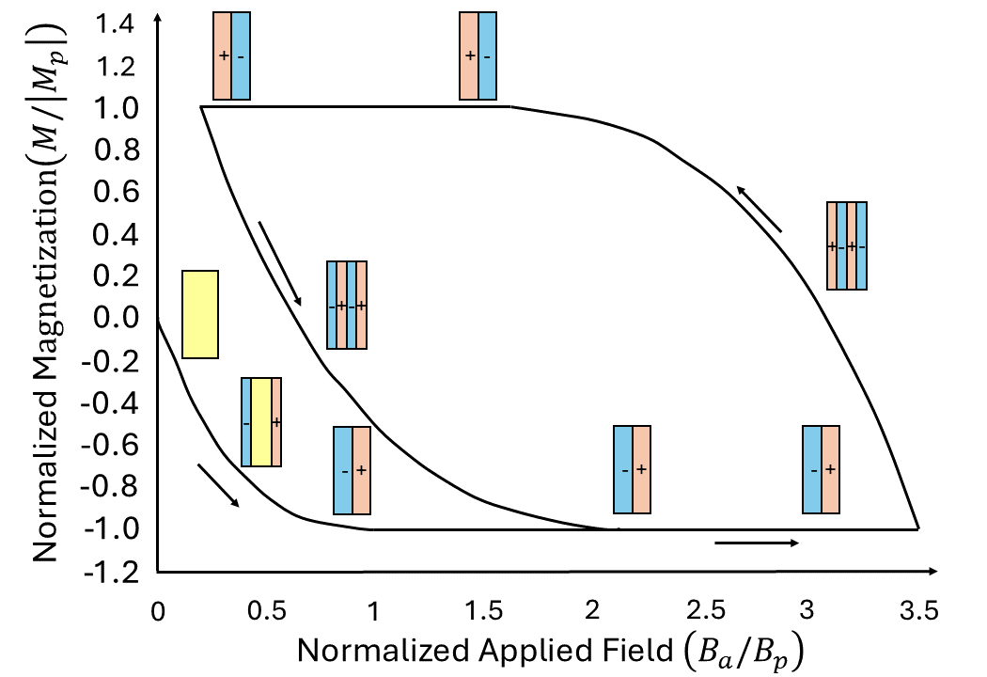
Hysteretic Losses
Intrinsic losses of SC materials independent of cycle time
Bean’s critical state model
Hard-way
Easy-way
Overview of work
Dipole Magnet for Collider Ring
Cable Assumption
Electromagnetic Design
Hysteretic Losses
Evaluation of stresses
Summary
$$\frac{Q_{sat}}{L}=2J_{c}B_{Avg}a^{2}b$$
x
2a
$$\frac{Q}{L}=432\frac{kJ}{m}$$
$$\frac{∆Q}{L}=18 \%$$
$$\frac{Q}{L}=527 \frac{kJ}{m}$$

Slide 14
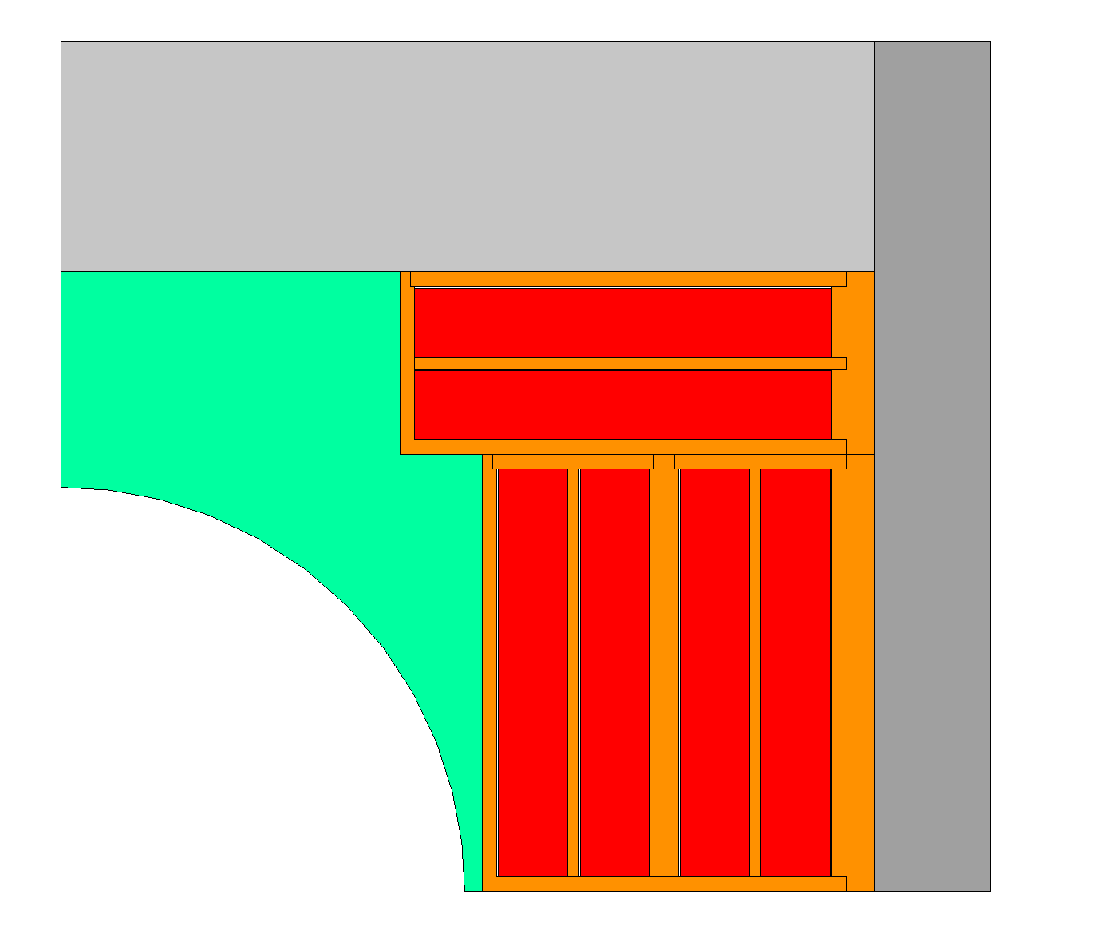
Evaluation of Stresses in Conductors
Assumption
Gap of 0.3 mm between all coils and case
Infinitely rigid structure (Nodal Displacement = 0)
Standard type contact without friction
E_{coil} = 174 GPa ¹
Ν_{coil} = 0.3
Overview of work
Dipole Magnet for Collider Ring
Cable Assumption
Electromagnetic Design
Hysteretic Losses
Evaluation of stresses
Summary
¹ C. Barth et al., Electro-mechanical properties of ReBCO coated conductors from various industrial manufactures at 77 K, self-field and 4.2 K, 19 T, 2015, Supercond. Sci. Technol. 28 045011

Slide 15
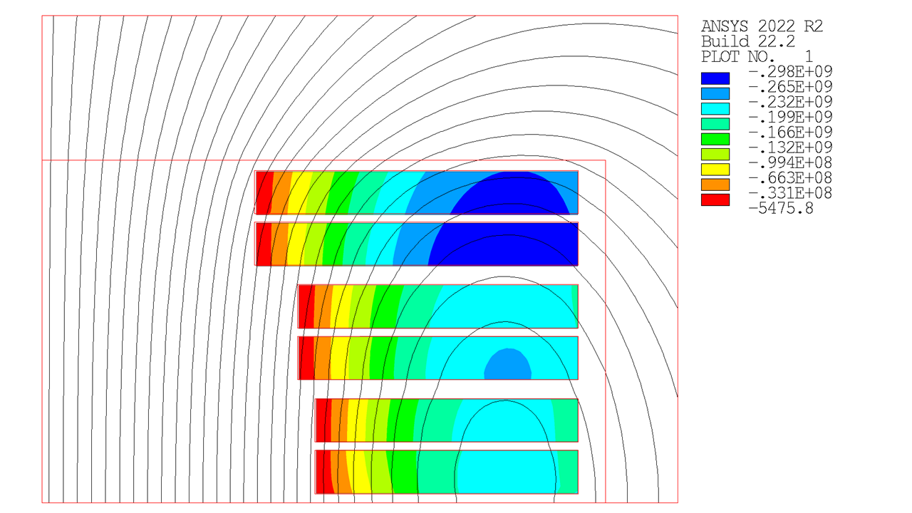
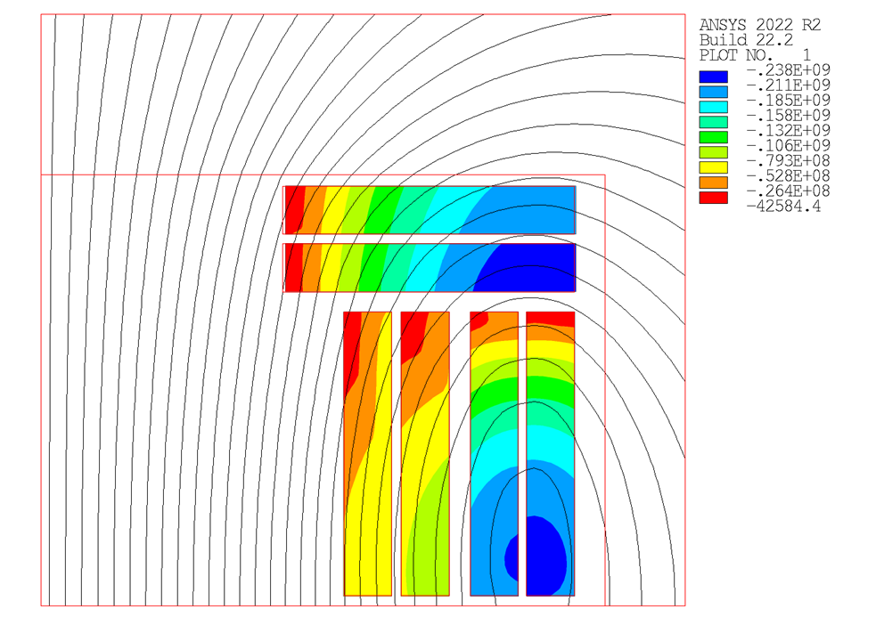
Evaluation of Stresses in Conductors
Hard-way
Easy-way
$$σ_{III} (Pa)$$
$$σ_{III} (Pa)$$
Overview of work
Dipole Magnet for Collider Ring
Cable Assumption
Electromagnetic Design
Hysteretic Losses
Evaluation of stresses
Summary
$$F_{Lorentz}∝B^{2}$$
$$σ_{max}$$ | Value | U.M.
$$σ_{x_max}$$ | -300 | MPa
$$σ_{y_max}$$ | -50 | MPa
$$σ_{max}$$ | Value | U.M.
$$σ_{x_max}$$ | -238 | MPa
$$σ_{y_max}$$ | -218 | MPa

Slide 16
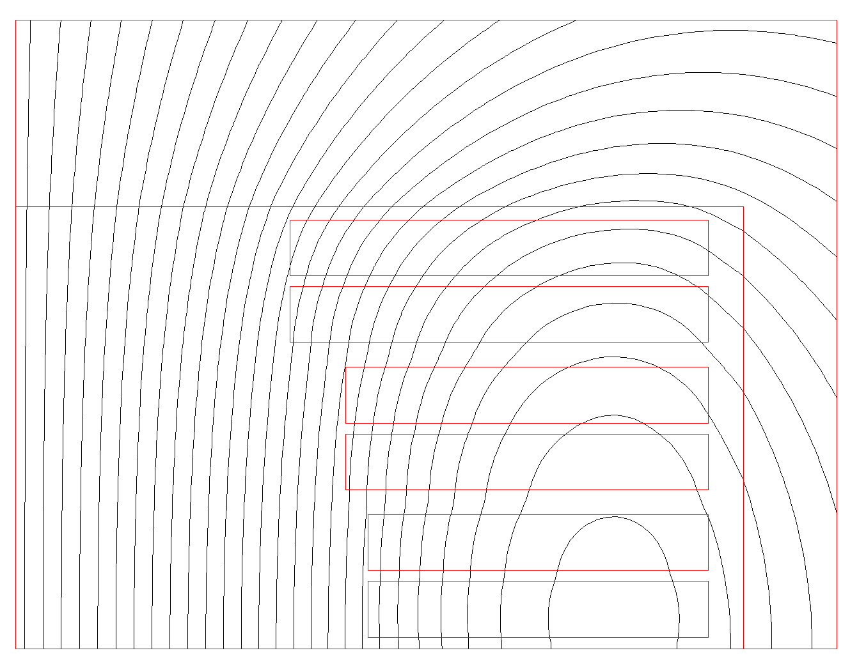
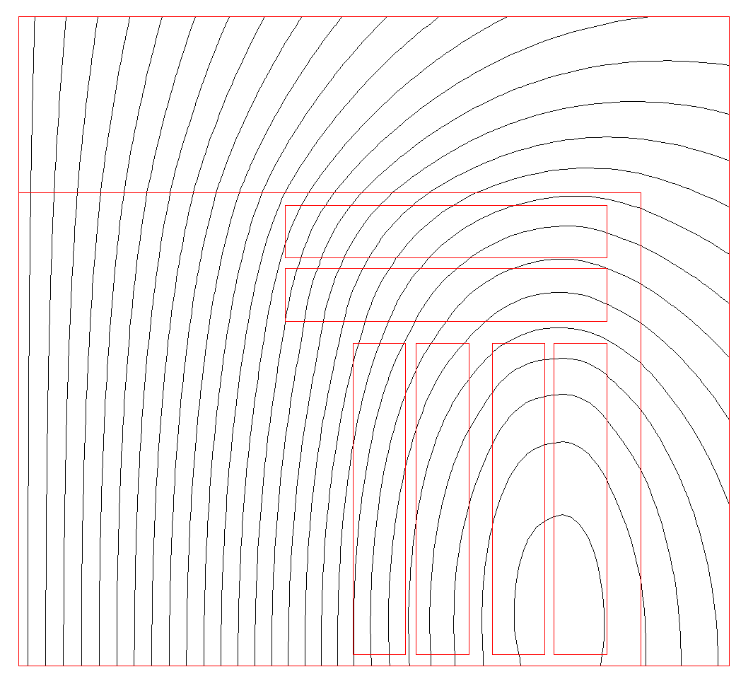
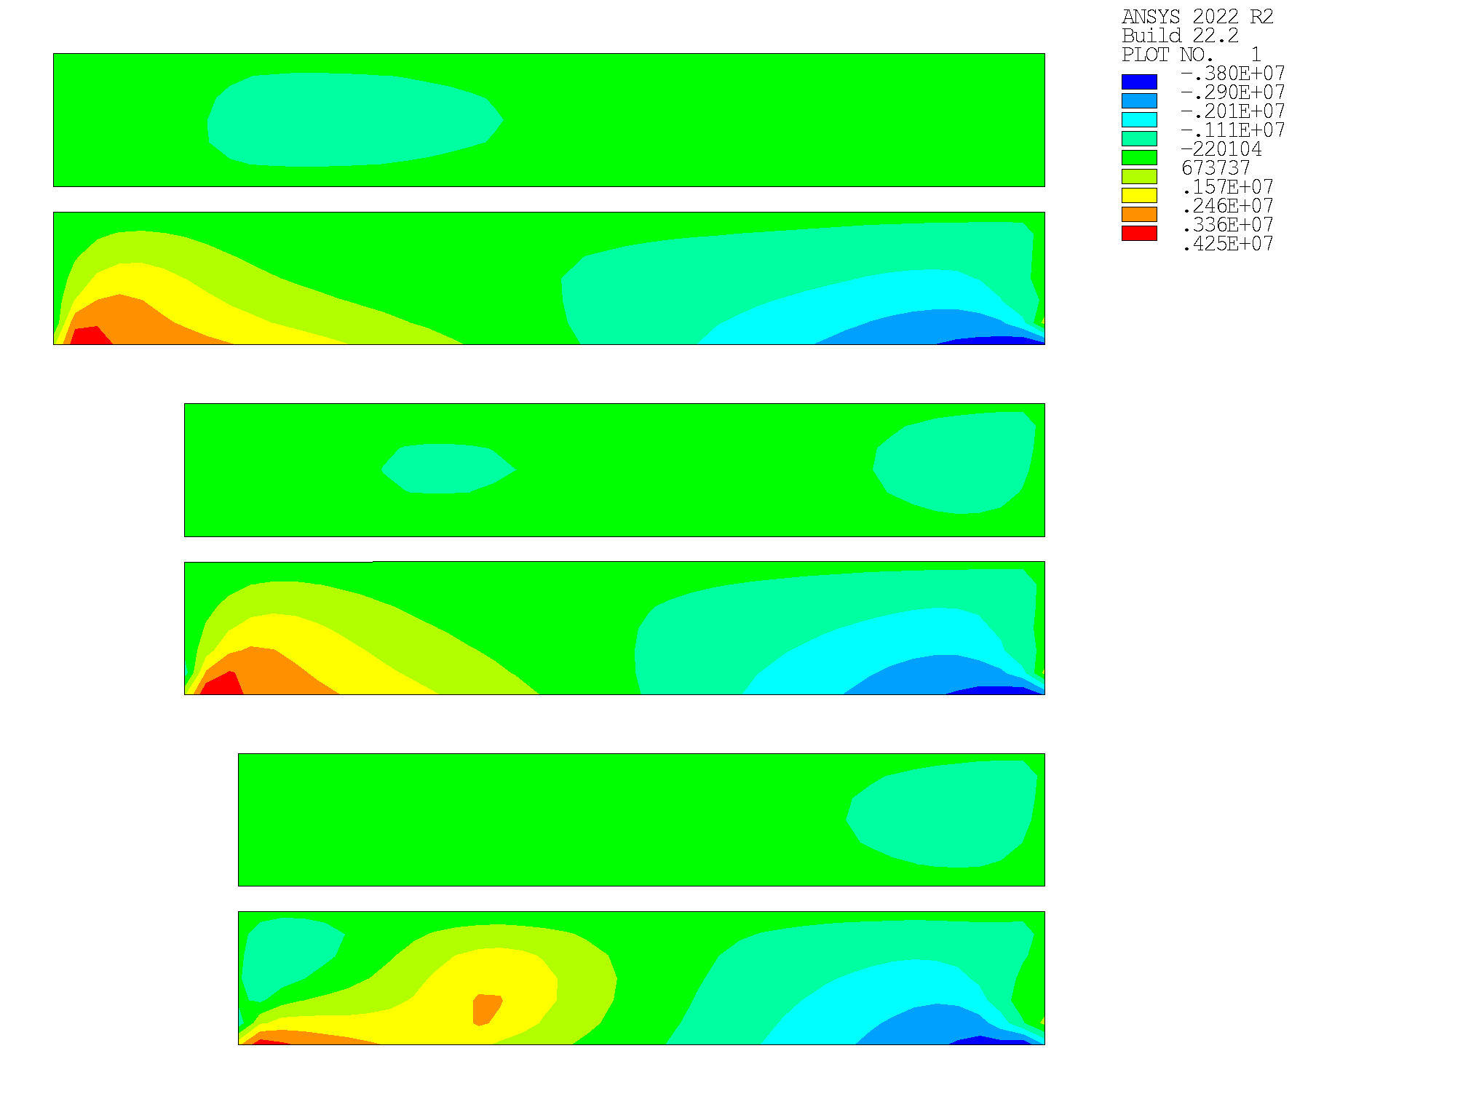
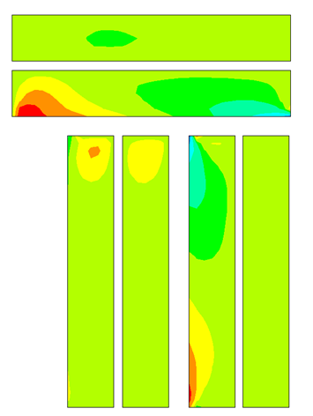
Evaluation of Stresses in Conductors
Hard-way
Easy-way
Overview of work
Dipole Magnet for Collider Ring
Cable Assumption
Electromagnetic Design
Hysteretic Losses
Evaluation of stresses
Summary
$$σ$$ | Value | U.M.
$$σ_{xy_max}$$ | 4.25 | MPa
$$σ_{xy_min}$$ | -3.8 | MPa
$$σ$$ | Value | U.M.
$$σ_{xy_max}$$ | 2.96 | MPa
$$σ_{xy_min}$$ | -4.48 | MPa

Slide 17
Maximum Allowable Stresses of Tape
Max. compressive stresses
$$σ_{max}$$ | Value | U.M.
$$σ_{x_max}$$ | -100^{1,2} | MPa
$$σ_{y_max}$$ | -400^{1,2} | MPa
¹ Value related to RT
y
x
Max. tensile stresses
Overview of work
Dipole Magnet for Collider Ring
Cable Assumption
Electromagnetic Design
Hysteretic Losses
Evaluation of stresses
Summary
$$σ_{max}$$ | Value | U.M.
$$σ_{x_max}$$ | - | MPa
$$σ_{y_max}$$ | - | MPa
$$σ_{z_max}$$ | 600² | MPa
$$σ_{xy_max}$$ | 11.27³ | MPa
All the stresses seen before are below the max. allowable stress
² Superconductor Business Development Division Fujikura Ltd., “Introduction of Fujikura re-based high temperature superconductor,” Fujikura Global, Tech. Rep., 2024
³ P. Gao, X. Geng, G. Man and X. Wang, "Measurement of Shear Delamination Strength of REBCO Coated Conductors," in IEEE Transactions on Applied Superconductivity, vol. 32, no. 4, pp. 1-5, June 2022, Art no. 6600305, doi: 10.1109/TASC.2021.3136831

Slide 18
Summary
INFN Genova – Milano: study of accelerator and collider dipoles
Non-twisted stacked tapes cable co-wounded with a SS layer
New ends winding always in easy way direction
Innovative approach of grading powering two cables joined together as a single unit
Hysteretic losses 18 % higher than in the first configuration
All mechanical stresses below the max. allowable stress of tape
Overview of work
Dipole Magnet for Collider Ring
Cable Assumption
Electromagnetic Design
Hysteretic Losses
Evaluation of stresses
Summary
Mucol Italia
Torino, 05/12/2024
luca.alfonso@ge.infn.it

Slide 19
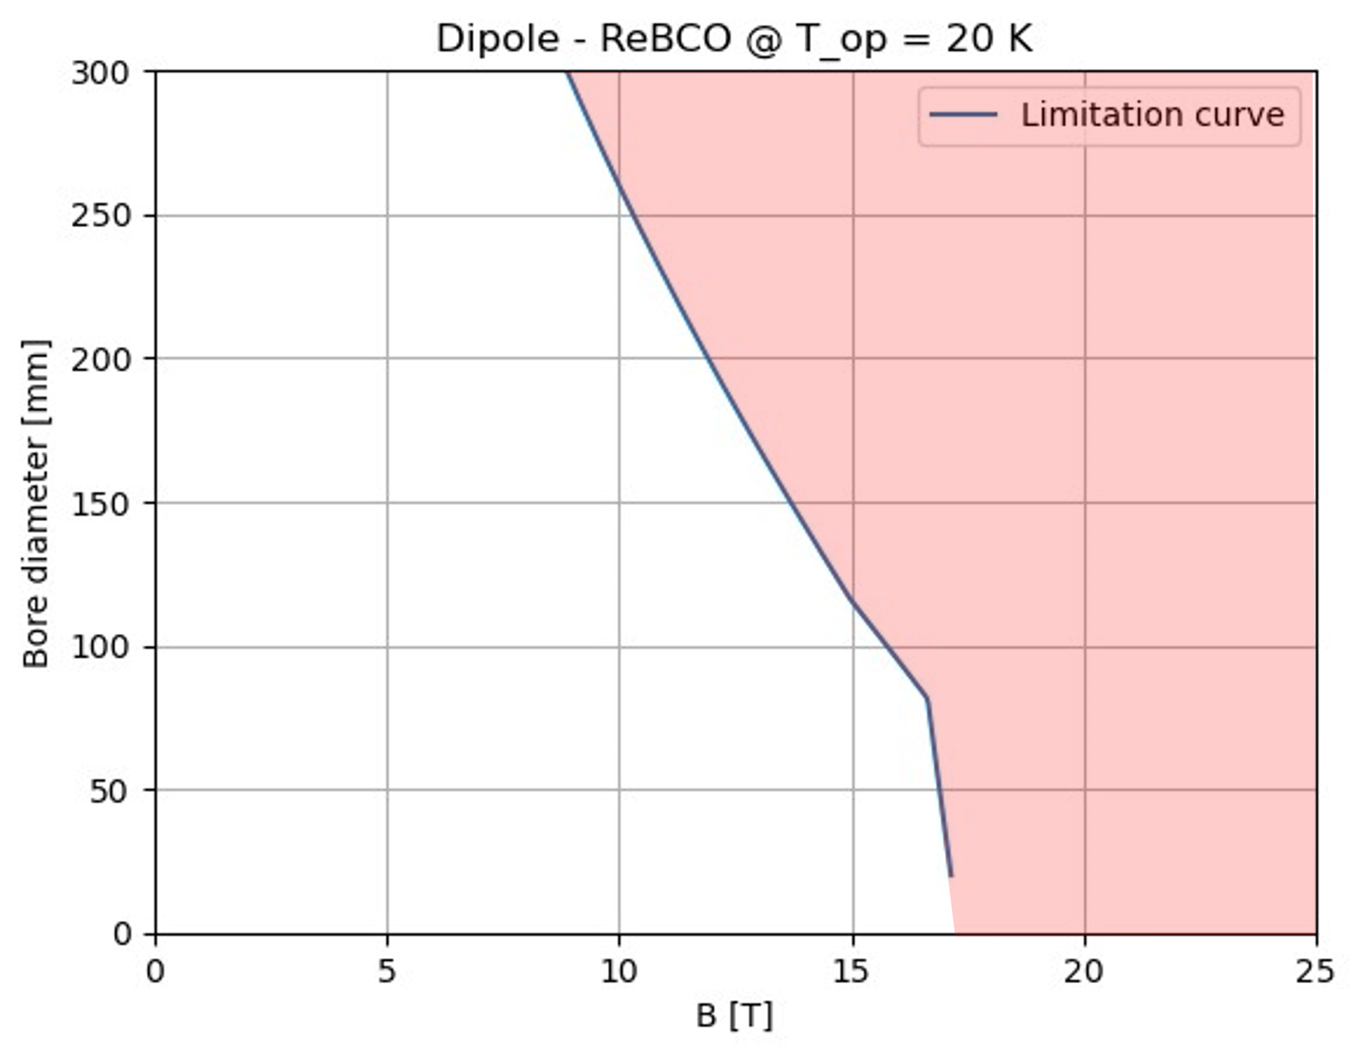
A(aperture)-B(bore field) plots
Overview of work
Dipole Magnet for Collider Ring
Cable Assumption
Electromagnetic Design
Hysteretic Losses
Evaluation of stresses
Summary
Innovative approach to instantly understand which magnets are feasible
Analytical evaluation of the bore field for a cos-theta magnets in sector coil approximation
The limit curve takes into account:
Maximum stress on conductors
Temperature margin on the loadline
Maximum T_{quench}
Forbidden region
Allowed region
$$B\left(w,J\right)=\frac{2μ_{0}J(a_{2}−a_{1})sinα}{π}$$
See Novelli’s presentation

