Slide 1
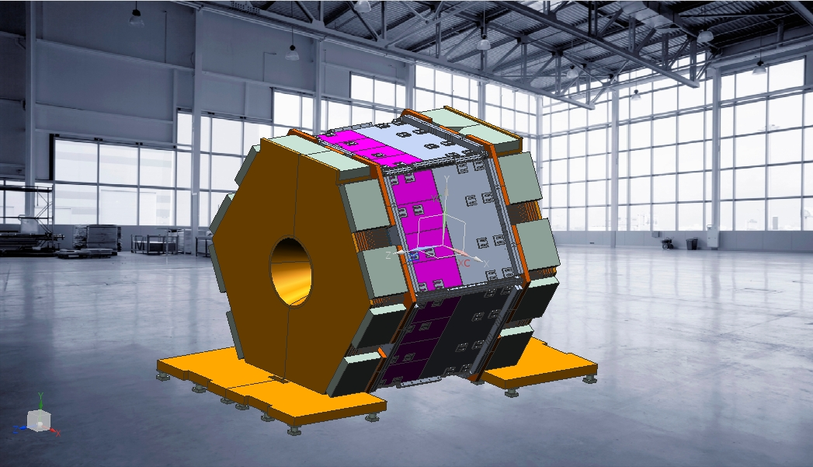
SuperB – IFR status of the detector & tooling development

Slide 2
OUTLINE
Detector
Status of the design
Tooling
Status of the development

Slide 3
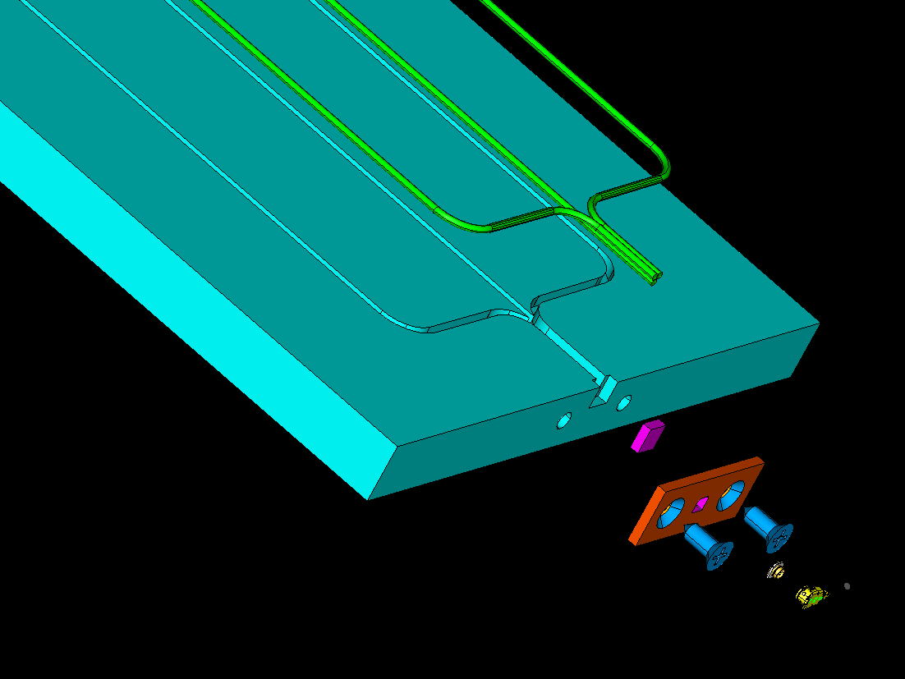
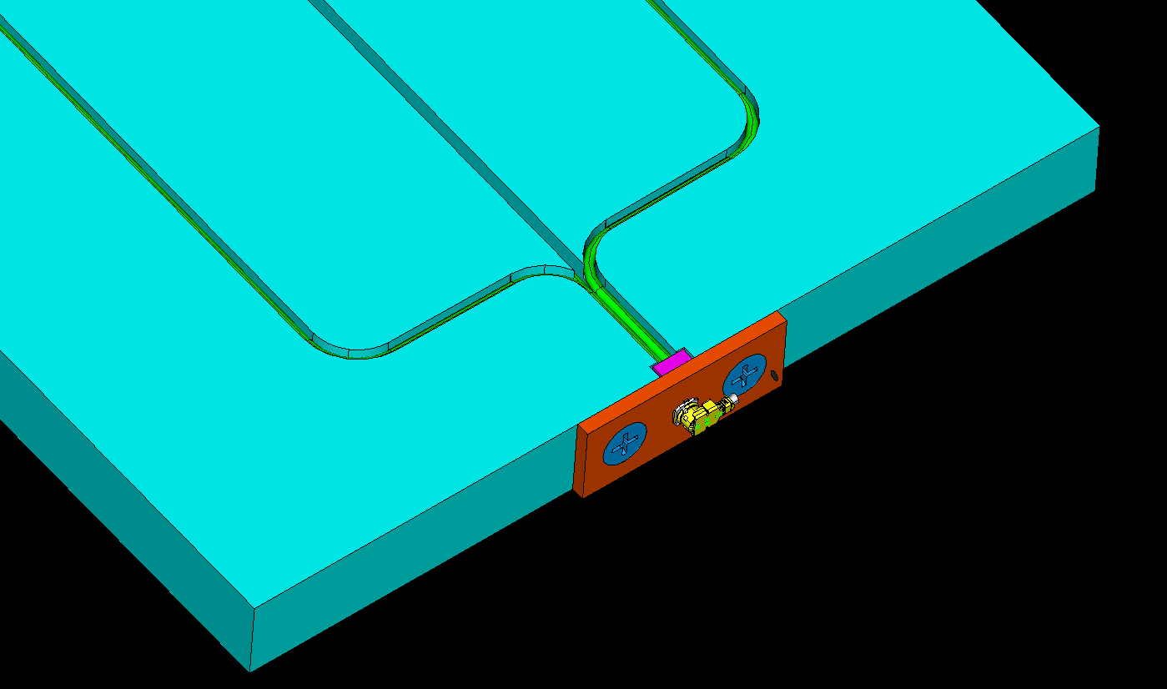
STATUS OF THE DETECTOR DESIGN- 1
DETECTOR BASELINE
Grooves in the scintillator accomodating the fibers
The fibers coming from the scintillator are joined to the PM
the signal coming from the PM is collected through a PCB and sent by an electrical wire
FIBER
GROOVE
PCB
PM
WIRE CONNECTOR

Slide 4
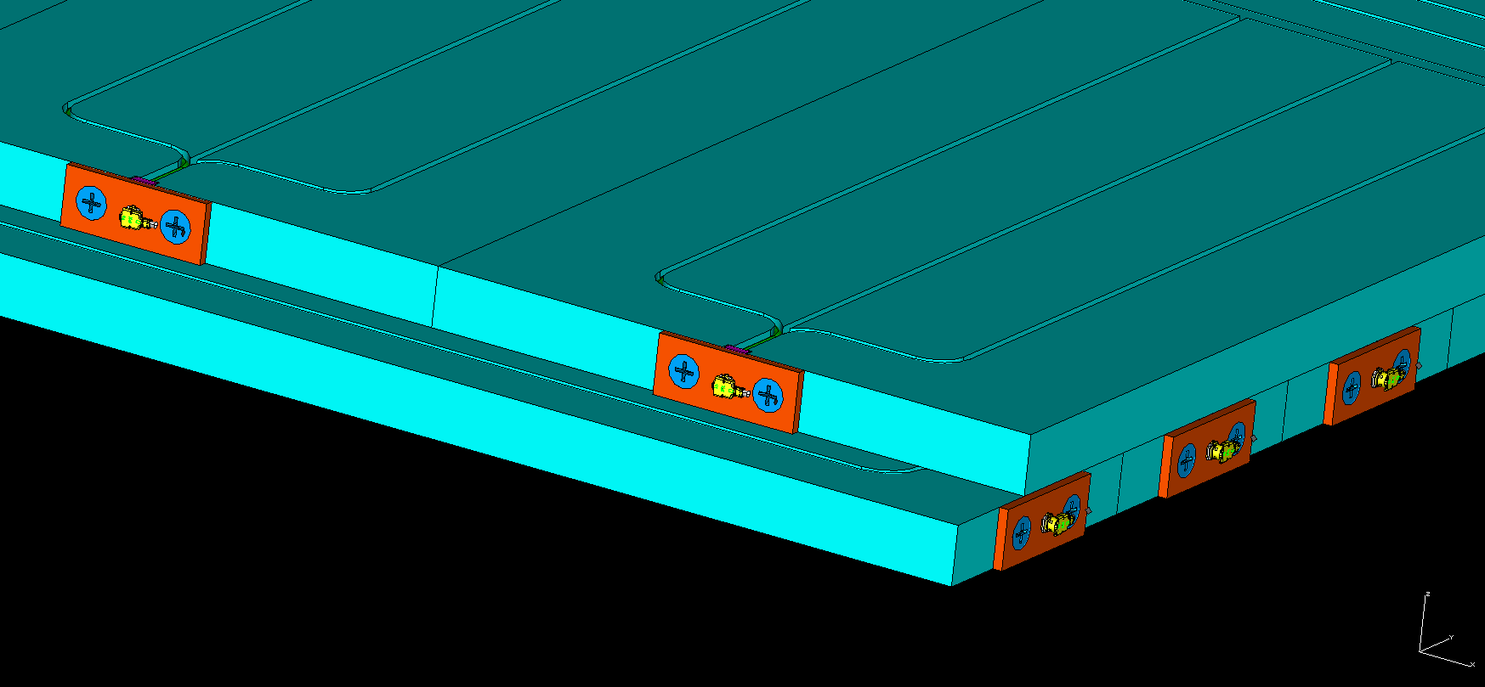
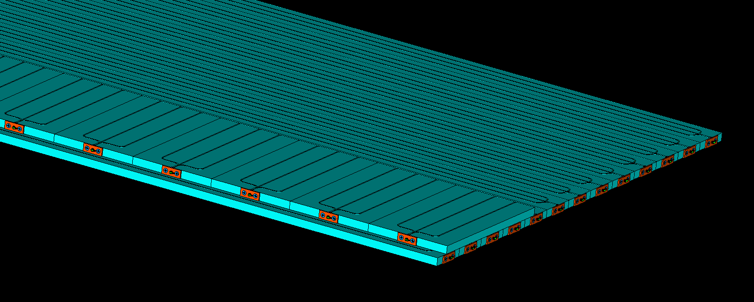
STATUS OF THE DETECTOR DESIGN- 2
DETECTOR LAYOUT
BARREL The longitudinal scintillators are 50 mm in width and 10 mm thick ; the transversal ones are 100 mm in width and 10 mm thick
END CAPS Both the longitudinal and transversal scintillators are 50 mm in width and 10 mm thick
BARREL BEAM AXIS

Slide 5
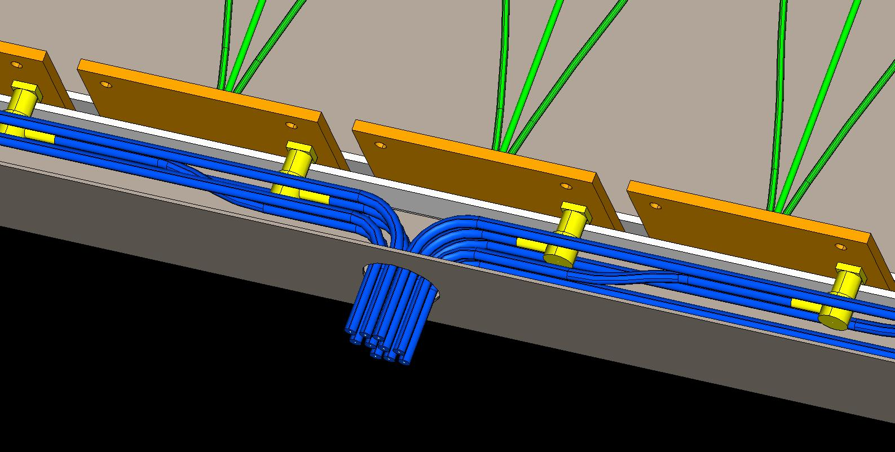
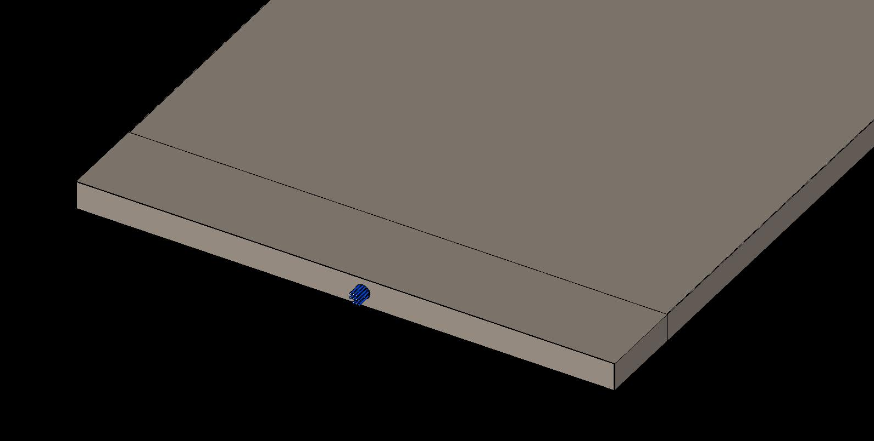
STATUS OF THE DETECTOR DESIGN- 3
DETECTOR LAYOUT
Scintillators, fibers & PM are inside a dark box
The PM wires are collected in a bunch coming out from the box
The dark box is made by foils of aluminum 1 mm thick
BUNCH OF WIRES
DARK BOX

Slide 6
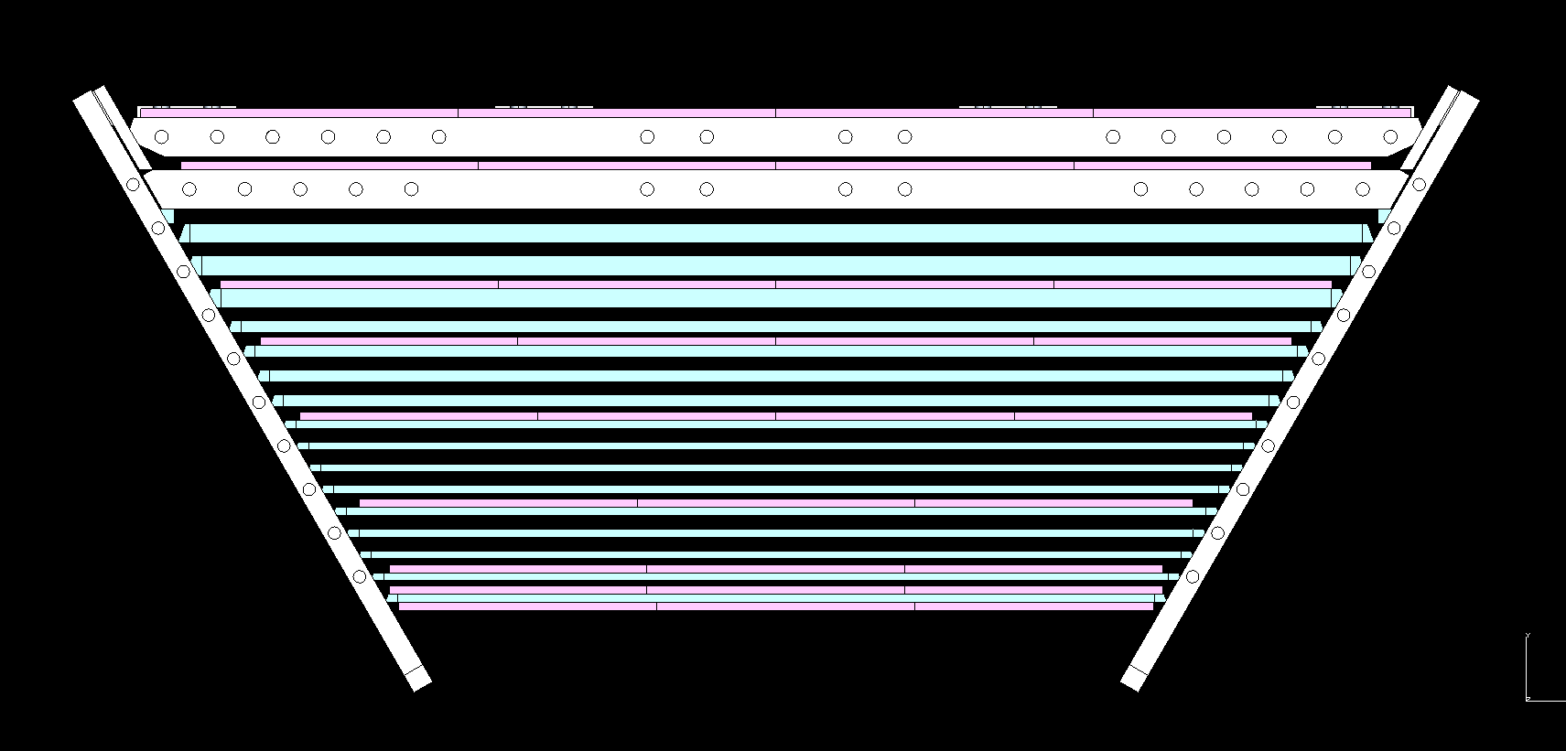
THE BARREL SEXTANT - 1
Since now 9 layers of detector each sextant are foreseen
Absorbers are foreseen into the gaps between the plates
EXTERNAL LAYER
STEEL PLATE
DETECTOR LAYER
GAP

Slide 7
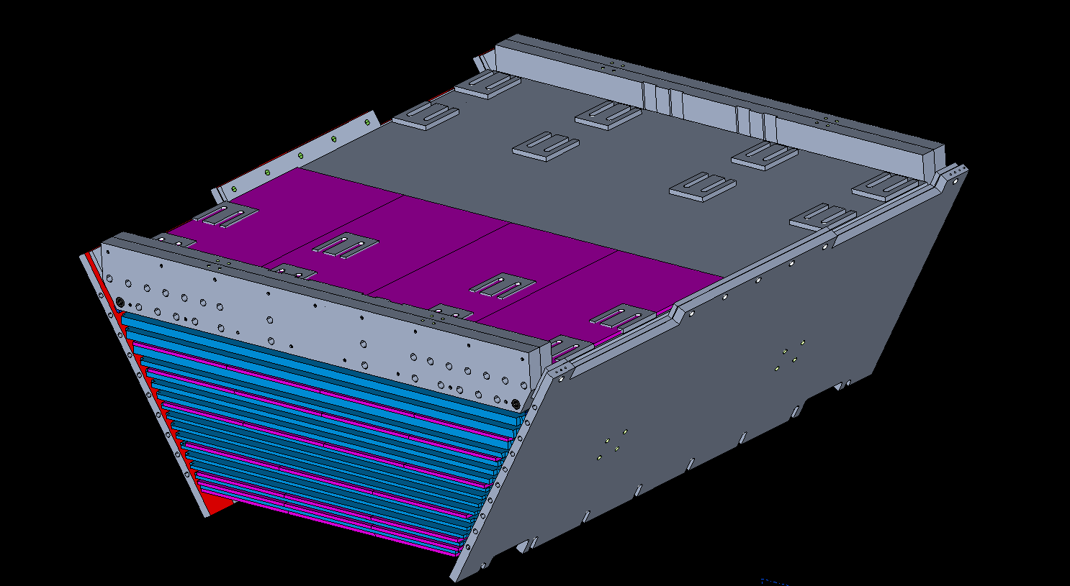
THE BARREL SEXTANT - 2
Is not yet clear how to accommodate the external layer
EXTERNAL LAYER

Slide 8
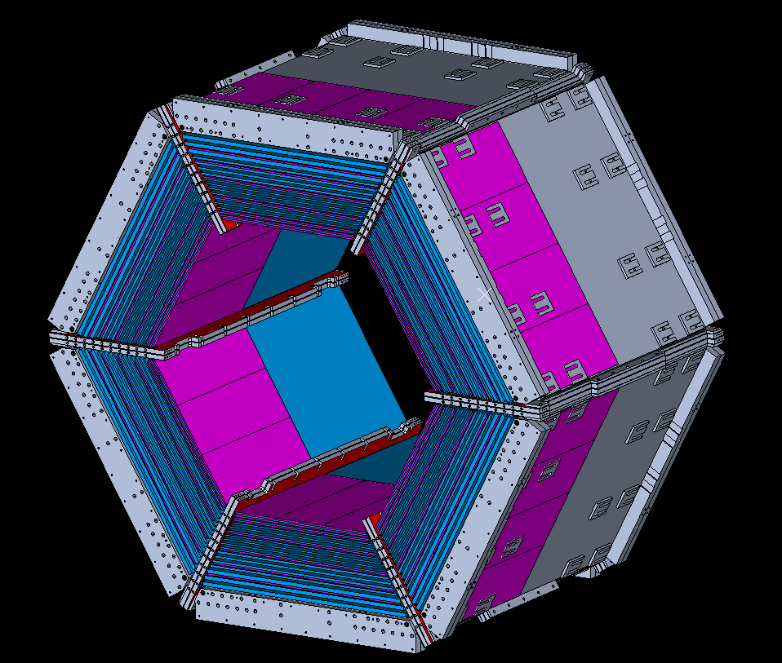
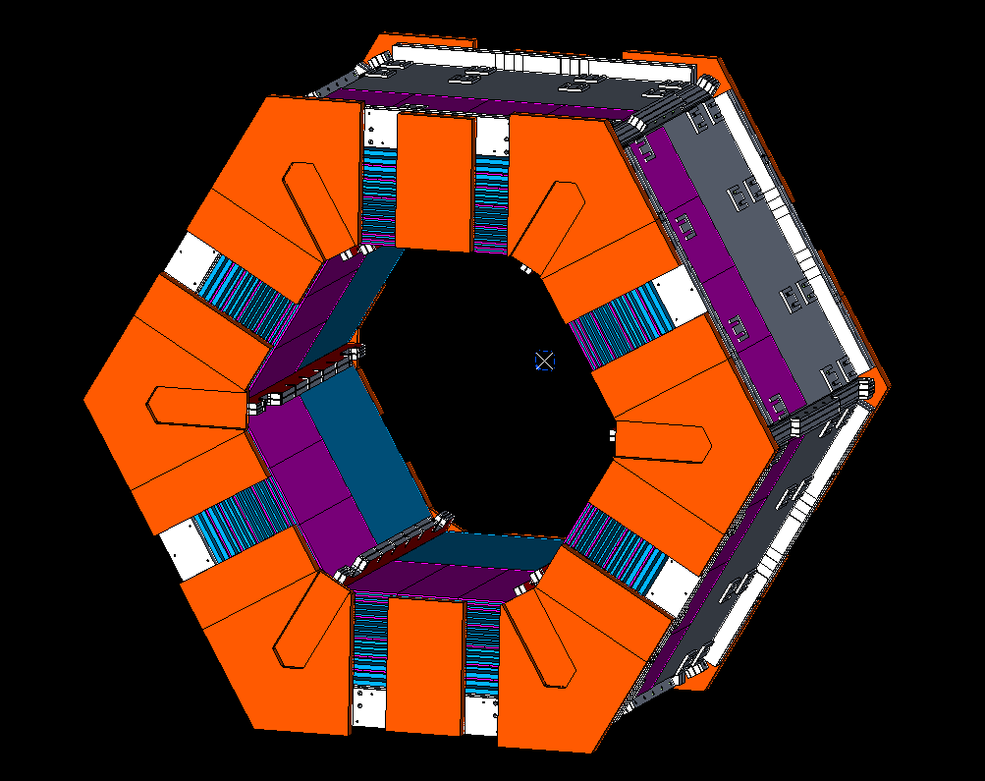
THE ASSEMBLED BARREL
CORNER PLATE

Slide 9
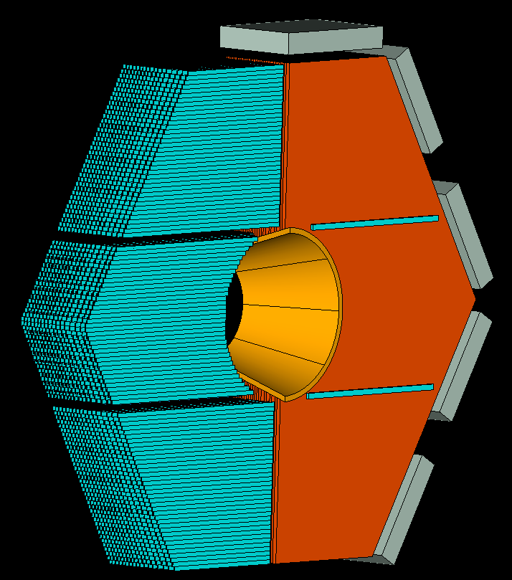
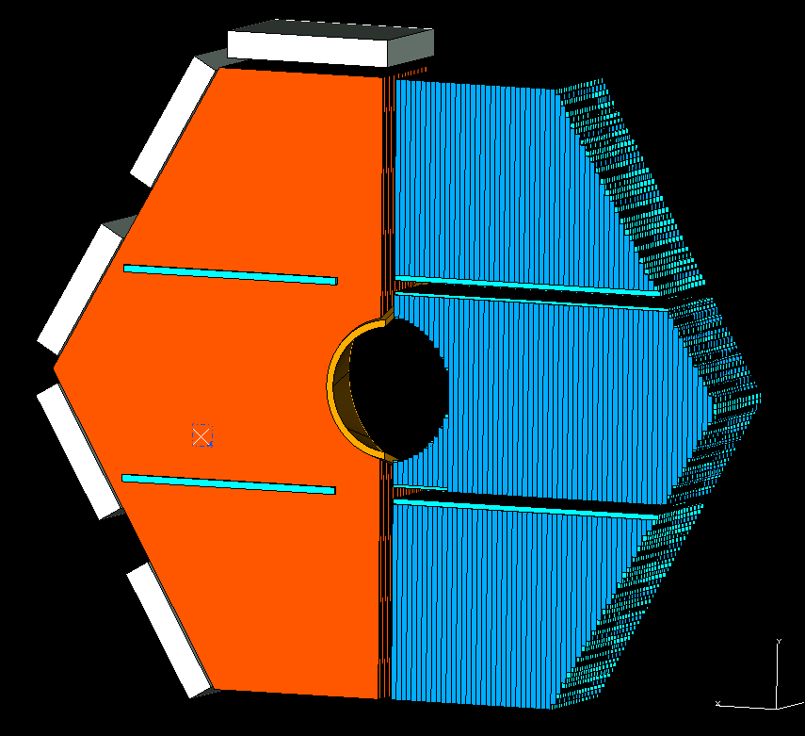
THE END CAPS - 1
17 detector layers are allowed ; number of layers TBD
The hole of the forward end cap is conical shaped ; the hole of the backward end cap is cylindrical shaped
The layers have to be splitted in three parts and follow the holes shape
DETECTOR LAYERS
SPACERS
DETECTOR LAYERS

Slide 10
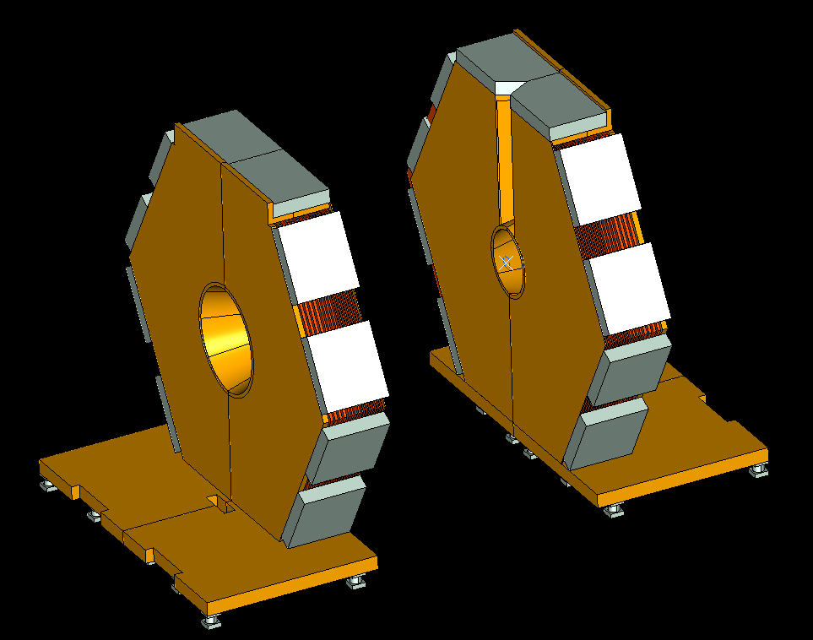
THE END CAPS - 2
The detector layers of the backward end cap have to be shaped also following the cut giving the space for the cooling circuit
COOLING
CONICAL HOLE
CYLINDRICAL HOLE

Slide 11
Status of the tooling development
The tooling development regards :
Machine making the grooves housing the fibers
Machine dispensing the resin fixing the fibers
A production plan is needed (space, timing, labor, …..) including the quality control ( and the tooling for it )
The toolings for the installation of the detector in the experimental area are also needed

Slide 12
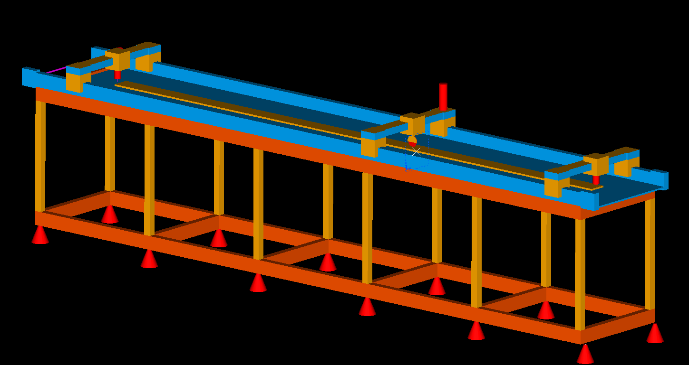
Machine making the grooves
The machine consist of :
A plane supporting the scintillator
An head equipped with a cutting disk making the linear groove
An head equipped with a cylindrical milling cutter making the curved grooves for the exit in place of the fibers
The machining time is approximately 8 min each scintillator corresponding to 3,5 weeks/1000 scinti (40 h/week)

Slide 13
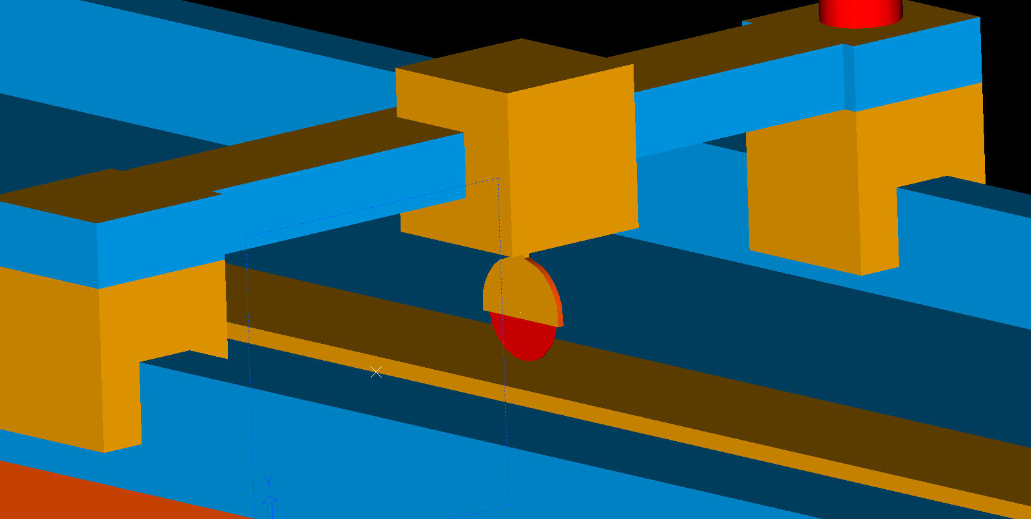
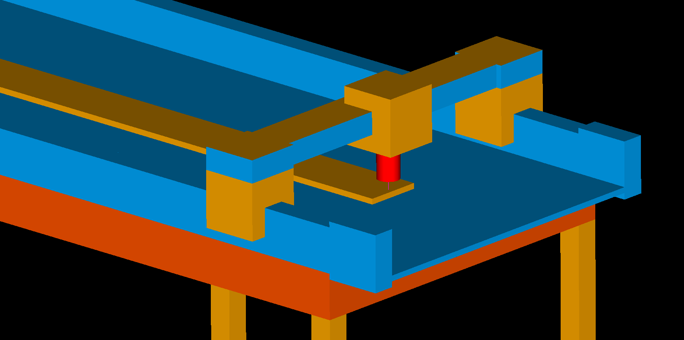
Groove machine sketches (I)
CUTTING DISK
CYLINDRICAL MILLING CUTTER

Slide 14
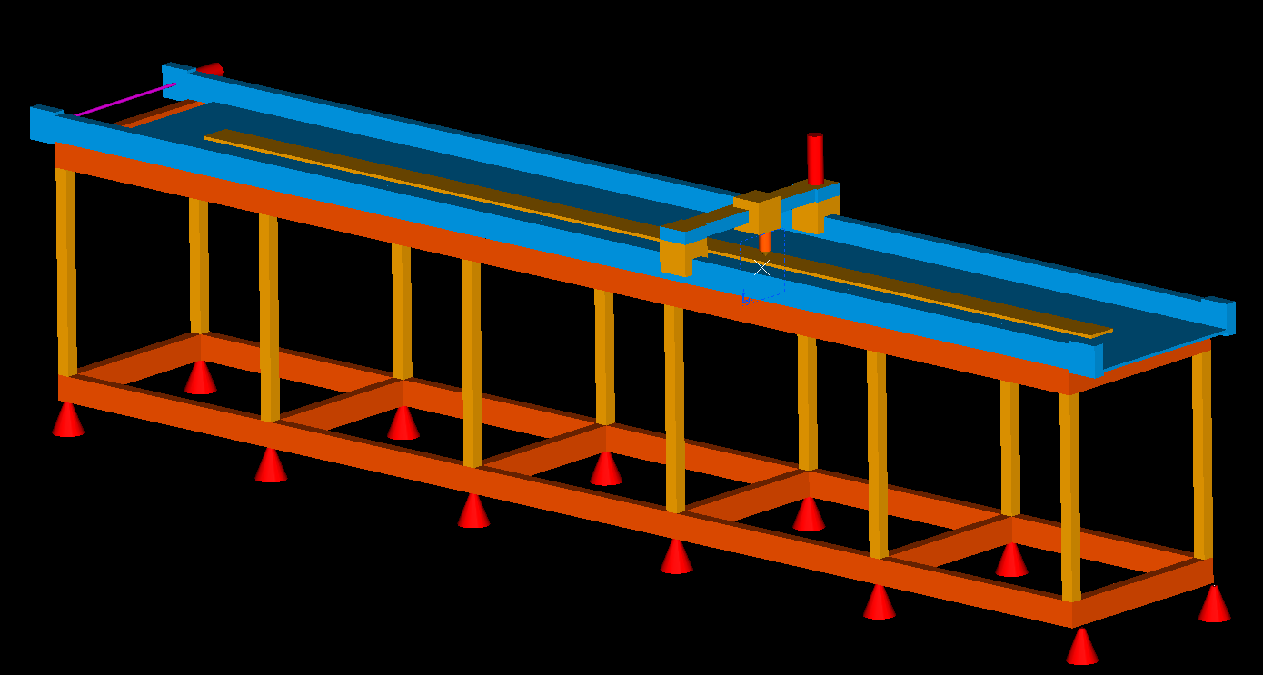
Machine dispensing the resin
The machine consist of :
A plane supporting the scintillator
An head equipped with a resin dispenser
The dispensing time has to be checked

Slide 15
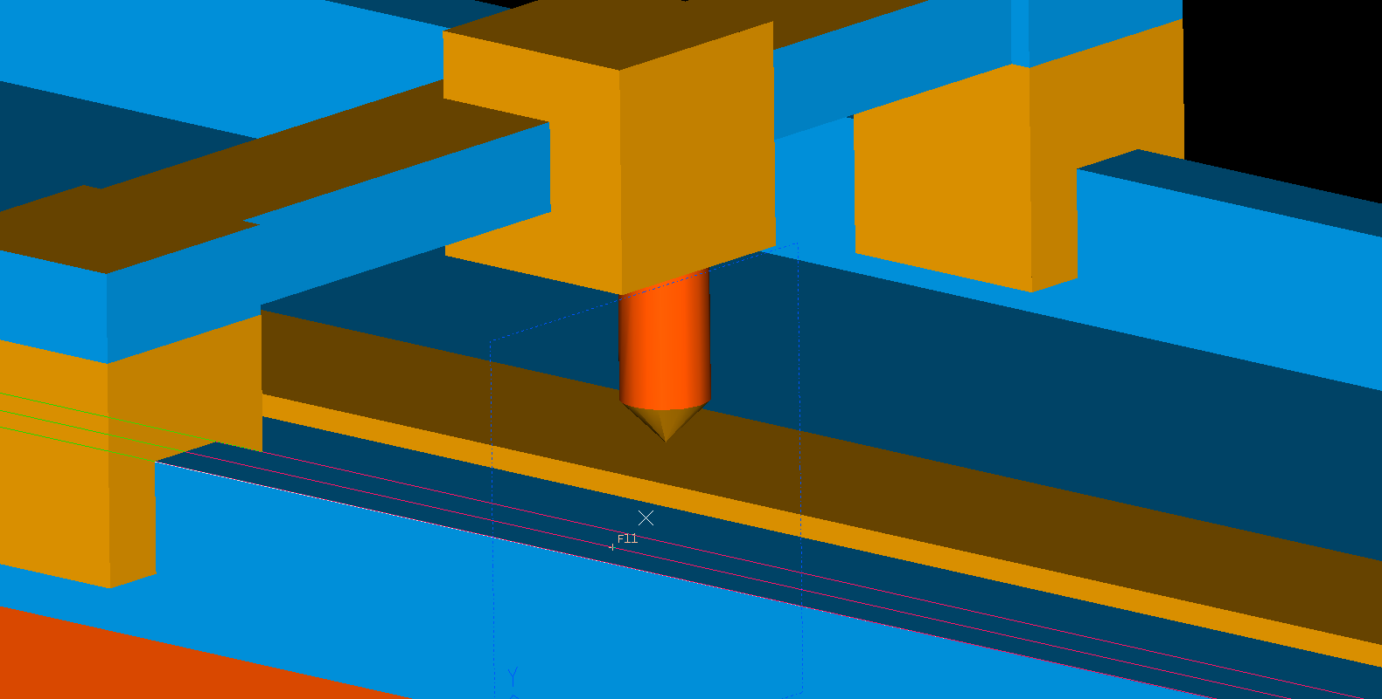
machine machine sketches (I)
RESIN DISPENSER

Slide 16
Conclusions
The detector design is in a good advanced status of development
The toolings needed for the construction of the detector are under way
The toolings for the assembly in the experimental area have to be developed

