Slide 1
EMC Barrel transportation (discussion about the two possibilities)
5th SuperB meeting Pisa, September 19-21, 2012 C.Sciacca, Naples

Slide 2
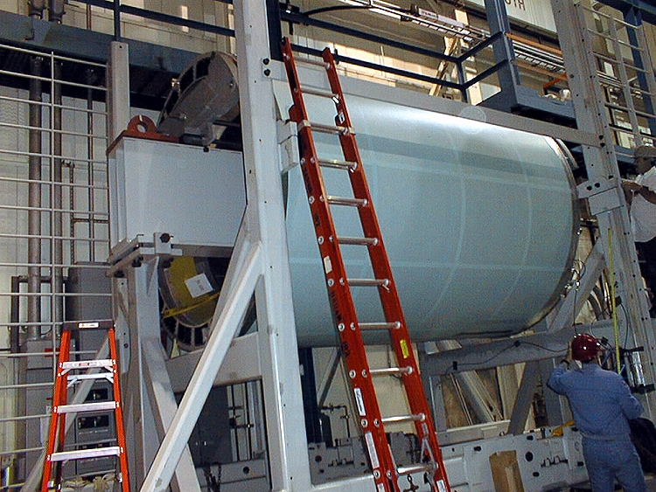
Barrel EMC
5th SuperB meeting Pisa, September 19-21, 2012 C.Sciacca, Naples

Slide 3
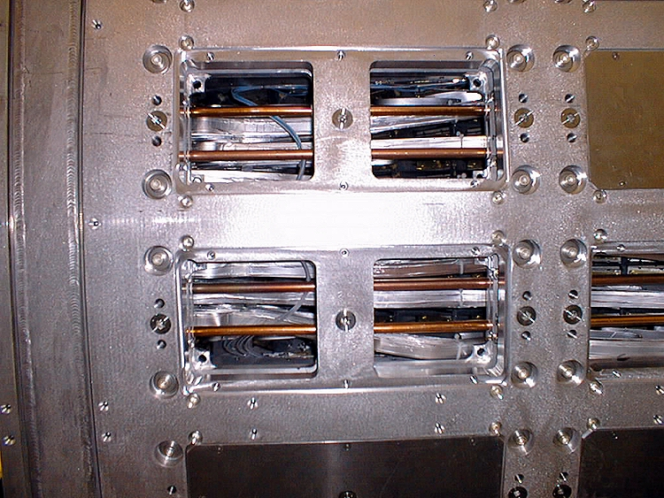
This how modules appear inside support cylinder. Cables and pipes to be removed in any case
5th SuperB meeting Pisa, September 19-21, 2012 C.Sciacca, Naples

Slide 4
For the EMC Barrel transportation from Slac to Cabibbo Lab, with refurbishing (new front end electronics) along the road, two scenarios are conceivable: A) No dismantling 1) transport SLAC-Naples 2) work in Naples around the entire structure 3) transport Naples-Cabibbo Lab B) Dismantling/remounting 1) dismantling at module level in SLAC, and shipment 2) work in Naples on the individual 280 “21-cristal” modules 3) transport of modules at Cabibbo Lab and remounting there
5th SuperB meeting Pisa, September 19-21, 2012 C.Sciacca, Naples

Slide 5
5th SuperB meeting Pisa, September 19-21, 2012 C.Sciacca, Naples

Slide 6
The two options have completely different implications : option A), no dismantling pros: limited work at Slac “compact” shipments no module remounting cons: preliminary complex engineering studies are necessary limited informations on component aging modules not accessible for tests big transport structure, with vibration damping significant risks in handling during transports difficulty in working around a big structure impossibility to make repairs (if different from front end change)
5th SuperB meeting Pisa, September 19-21, 2012 C.Sciacca, Naples

Slide 7
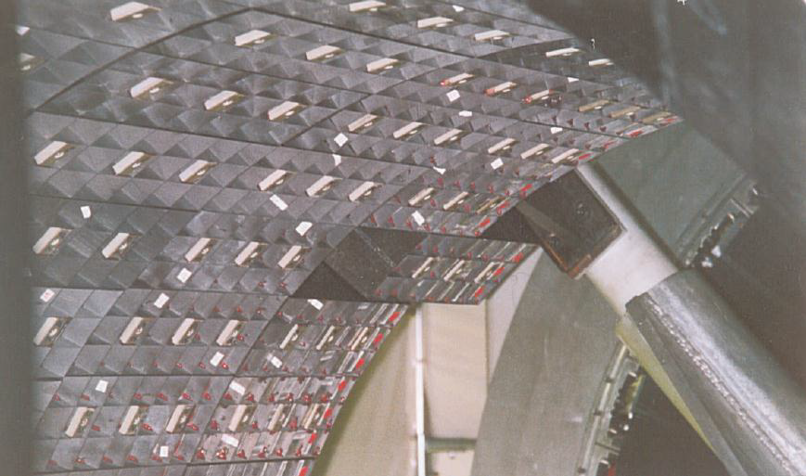
Last module insertion
5th SuperB meeting Pisa, September 19-21, 2012 C.Sciacca, Naples

Slide 8
option B), dismantling and remounting (see Kevin Flood talk in feb 2012 , http://tinyurl.com/cha3f8t) pros: easier shippings (no calculations, no damping structure to design and build) less “catastrophic” risks simpler handling in Naples (crane capacity: 10 tons) much, much easier refurbishing work (parallelization possible) testing individual modules (cosmic ray tracking telescope) possibility of “harder” repairs (i.e. sensors reglueing) well planned dismantling, under D&D framework (see S. Osier talk) cons: big work at SLAC
5th SuperB meeting Pisa, September 19-21, 2012 C.Sciacca, Naples

Slide 9
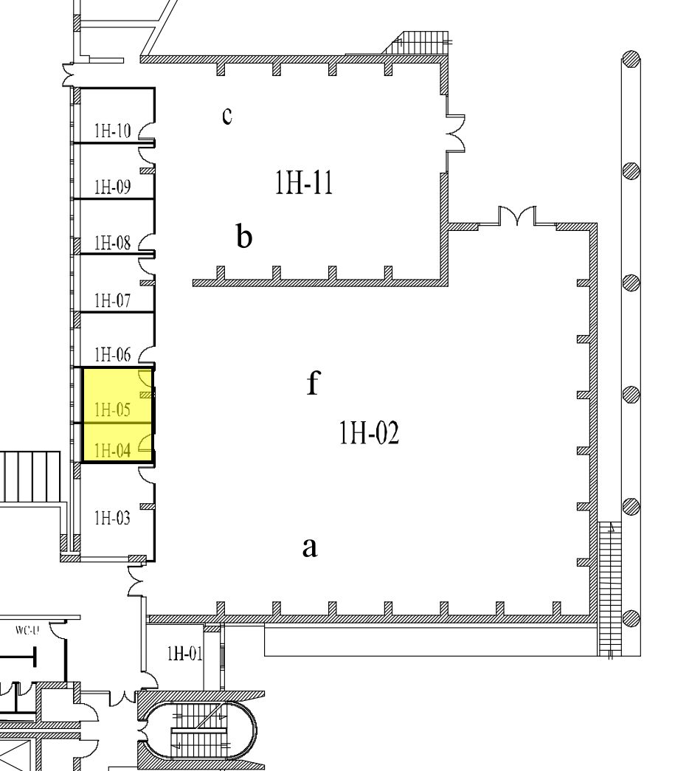
Hall 1H-02 in Naples (20 x 20 m2, 10 ton crane)
5th SuperB meeting Pisa, September 19-21, 2012 C.Sciacca, Naples

Slide 10
Choosing option B, in close collaboration with D&D program, timing in the next years would be: 2013 SLAC: tooling procurement, start dismantling (see S.Osier Mac Project) Naples : site preparation, tent, conditioning, transport planning and module containers design, work at SLAC 2014 SLAC: module extraction, packing Naples : work at SLAC, shipments, start modules refurbishing at home 2015 Naples: finish module refurbishing, module shipping to Cabibbo Lab Cabibbo Lab : site preparation, tent, conditioning, start remounting
5th SuperB meeting Pisa, September 19-21, 2012 C.Sciacca, Naples

