Slide 1
Physics Progress and Plans Adrian Bevan
Overview:
Summary of European Strategy Group contribution.
Planning for the December workshop
Updating sensitivity comparisons

Slide 2
Higgs like boson discovered at CERN
We should revisit old studies to see what we can learn about the Higgs:
We know it is relevant to NP dynamics in decays
The Higgs mass pins down the EW sector pretty well (much better than the LEP plot): sin²θ_{W} is now a NP search parameter.
arXiv:1207.7214,
arXiv:1207.7235
m_{H} ~125-126 GeV/c²

Slide 3
ESG Contribution
A number of people helped prepare a brief summary of the programme:
Brian Meadows also contributed to this, but is acknowledged by his request so as not to interfere with his sabbatical this year.

Slide 4
ESG Contribution
A number of people helped prepare a brief summary of the programme:
Brian Meadows also contributed to this, but is acknowledged by his request so as not to interfere with his sabbatical this year.
Many thanks for help from the contributors and comments from the community!

Slide 5
✔
S-Bfactory
✔
✔
✔
✔

Slide 6
My interpretation:
Complementarity between hadron, e+e- and kaon experiments.
To cover all eventualities, we need all areas supported.
✔
S-Bfactory
✔
✔
✔
✔

Slide 7
✔
✔
✔
✔
✔

Slide 8
Antonio Masiero

Slide 9
Antonio Masiero

Slide 11
B→D*τν
arXiv:1205.5442 (BaBar)
Measure a ratio of modes to reduce theoretical dependence of constraint.
2D fit, using E_{extra} in an MVA that has a loose cut on it to minimise systematic impact on result.
2HDM
Type II

Slide 12
B→τν, μν
Belle and BaBar updated τν results at ICHEP.
Belle consistent with SM
BaBar is not...
Longer term issue:
Are we using the most experimentally robust ways to measure this branching fraction?
Will E_{extra} ultimately limit our ability to do the measurement?
c.f. the D*τν result from BaBar.

Slide 13
T Violation
Wouldn't it be nice to actually test T violation using T-conjugate pairs?
Would be possible to compare CP violation with CPT tests to close the loop on testing T, CP and CPT.
Need to identify T conjugate pairs of decays to construct:

Slide 14
T Violation
BaBar showed results at FPCP
14σ significance for this result: SuperB should confirm this measurement with high precision.
Part of our symmetry testing programme.
Observed
T-conserving
Compatible with sin2β results on CPV and with CPT

Slide 15
Antonio Masiero

Slide 16
Ikaros Bigi has told us many times that we need to test CP violation in the up-quark sector.
LHCb have paved the way with a deviation from expectation (D⁰→KK/ππ).
Belle also see a CP effect (D⁺→K_{S}pi⁺).
These are direct CPV measurements. "Binary test of the SM"
The experimental community is slowly coming round to the fact that hadronic uncertainties are important.
We need to:
Do time-dependent measurements (indirect CPV is clean[ish])
Measure sets of channels to constrain hadronic uncertainties.
e.g. a long list of things to do here: D⁰→π⁺π⁰, ...

Slide 17
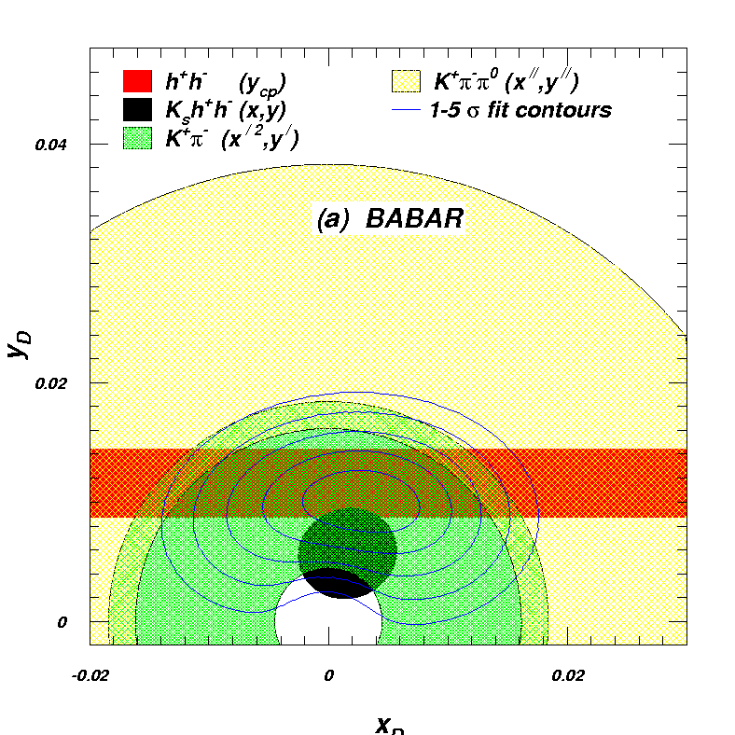
Charm Mixing Update
Now assume 1ab⁻¹ at ψ(3770).
Updated plots now available in the TDR.
K_{S}hh Dalitz plot contribution helps shrink overall syst. error
Brian Meadows

Slide 18
Other charm physics of interest
Many rare decays to explore:
Pretty good idea of how well we can measure a number of final states.
Need to look at multi-body states (i.e. amplitude analyses).
3 body modes should be explored in general: probably current configurations are good enough.
4 body states are a concern:
We expect that at charm threshold these will be problematic to reconstruct (based on discussion with CLEO-c and BES III collaborators).
Their solution was: 1T magnetic field, and remove detector X₀ at the centre of the detector.
Should be studied for the physics book.

Slide 22
Tau physics from a hadron machine
LHCb showed some nice preliminary results on
3 times worse limit than the B Factories using 1fb-1 of data.
Background plays a role, so one has to take care extrapolating limits.
Expect some improvement in method when extrapolating beyond this level.
See LHCb-CONF-2012-015
(personal opinion: Unfortunately LHCb succumbed to using CLs)

Slide 23
τ LFV
To evaluate
To evaluate

Slide 24
Precision EW programme
Mike Roney, ICHEP

Slide 25
Now we know the Higgs mass, reverse the precision EW constraint to predict weak angle running.
Measure this at the 4S to remove the need to worry about hadronization uncertainties.
Requires machine to have polarised electrons.
Mike Roney, ICHEP

Slide 26
Golden Measurements: General
This table concentrates on observables that SFFs can measure, with a few of the prime examples from hadron experiments to highlight that there are many things that need to be measured well.
Benefit from polarised e⁻ beam
very precise with improved detector
Statistically limited: Angular analysis with >75ab⁻¹
Right handed currents
SuperB measures many more modes
systematic error is main challenge
control systematic error with data
SuperB measures e mode well, LHCb does μ
Clean NP search
Theoretically clean
b fragmentation limits interpretation

Slide 27
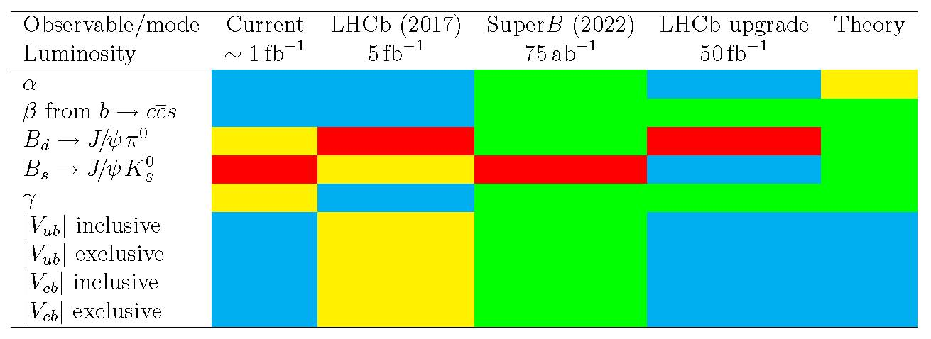
Golden Measurements: CKM
This table concentrates on observables that SFFs can measure, with a few of the prime examples from hadron experiments to highlight that there are many things that need to be measured well.
Comparison of relative benefits of SuperB (75ab⁻¹) vs. existing measurements and LHCb (5fb⁻¹) and the LHCb upgrade (50fb⁻¹).
LHCb can only use ρπ
βtheory error B_{d}
βtheory error B_{s}
Need an e⁺e⁻ environment to do a precision measurement using semi-leptonic B decays.

Slide 28
TDR
The European Strategy Group documentation consolidated our previous work.
Largely re-used this text for the TDR physics overview.
Charm mixing potential updated for 1ab⁻¹ at threshold.
A good snapshot of where we are today, and refers back to other documents that we have written in the past few years.

Slide 29
Updating comparisons
The complementarity of SuperB with other experiments assumes experimental sensitivities as stated at a given point in time.
We know a lot more about the potential of some of the complementary experiments now that we did last year.
After both ICHEP and the CKM workshop we expect that there will be a number of results that will need updating for our standard speaker material.
We will systematically update these expectations post-CKM.

Slide 30
December Meeting
We plan to have a physics workshop at the December meeting.
Details to be discussed over the next few days
Plan to follow the same format as the December 2011 meeting.
Will start to discuss the physics book timeline, once we have the approved schedule of the project in hand.
Will also take stock of areas that we have not thought much about: (e.g. multi-body charm decays at threshold and the 4S).

