Slide 1
DET. Integration
Inner detector envelope
Radial clearances.
Longitude clearances
Cable distribution
inner detectors.
Conclusions.

Slide 2
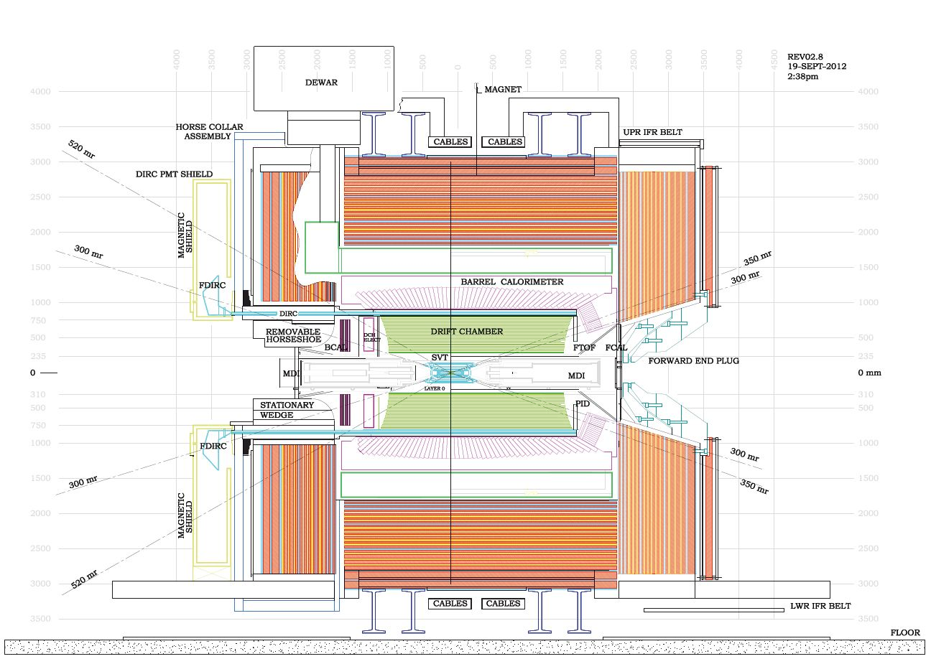
Mew SuperB Ref. drawing

Slide 3
Inner detector envelopes
The tungsten shielding thickness has increased to 45mm
The inner radius of the tungsten shielding is now 5mm larger. (requested by SVT)
The final dimensions are:
Inner diameter 440mm outer diameter 530mm.
We Leave 5mm radially of clearance between the DCH and the shielding
The inner diameter of the DCH is 540mm.

Slide 4
Survey was made and inspection was made after the meeting
Forward calorimeter service envelope
Wire chamber supports.
DIRCH inner tube measurements.

Slide 5
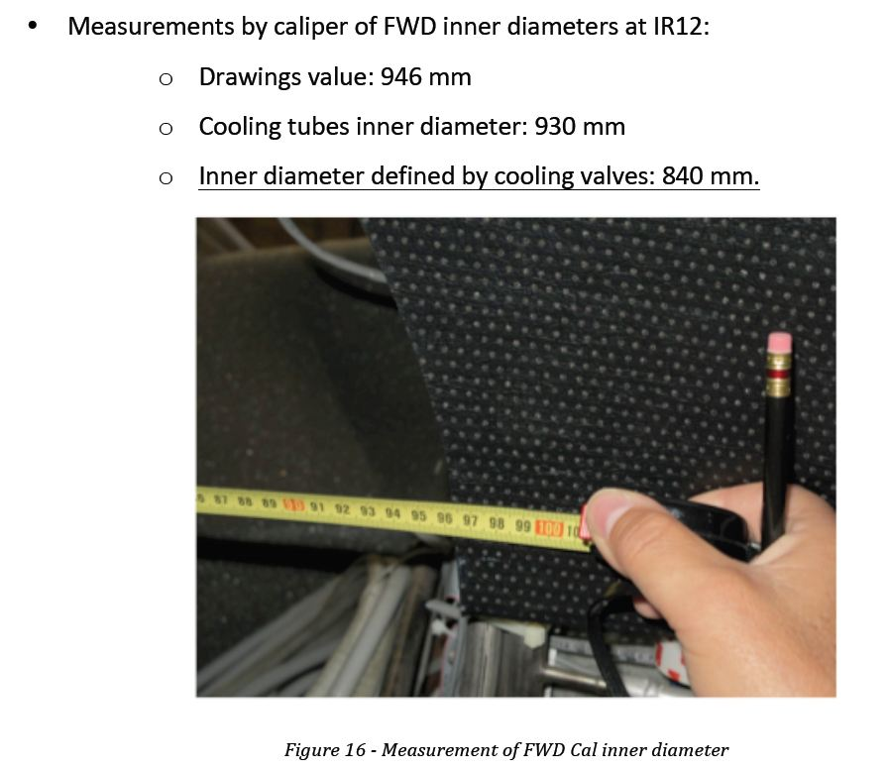
Survey was made and inspection was made after the meeting

Slide 6
Survey was made and inspection was made after the meeting
Wire chamber supports

Slide 7
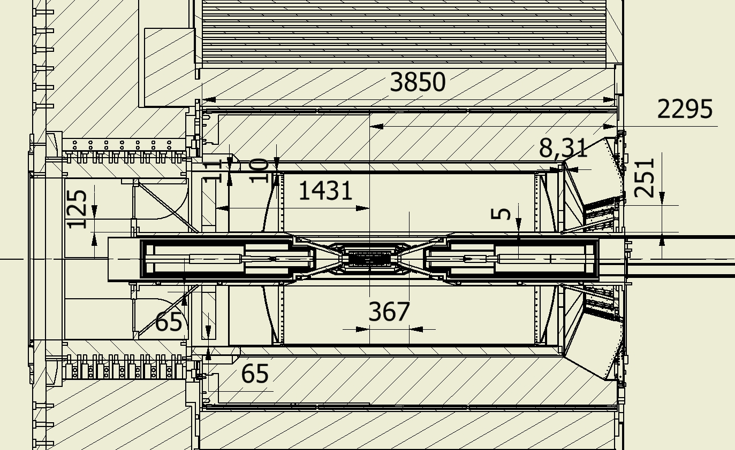
Envelope of the SuperB inner detectors
241
115

Slide 8
Inner detector Forward region service area
Considering the inner diameter of the tungsten shielding 530mm and the inner diameter of FCAL 840mm. The Total area of 325200mm2.
We have to subtract from this number the area of the four spokes that are supporting the shielding.
This area is reserved for the HV and gas pipes of DCH (12 cables diameter 9mm + gas supplies)
Services for the TOF must be considered in the same area.
The SVT Layer 0 and MDI have the services running inside the tungsten tube
Inner detector Backward region service area
The idea is to use 12 outer slots at the radius of the DIRCH strong tube
The SVT Layer 0 and MDI have the services running inside the tungsten tube

Slide 9
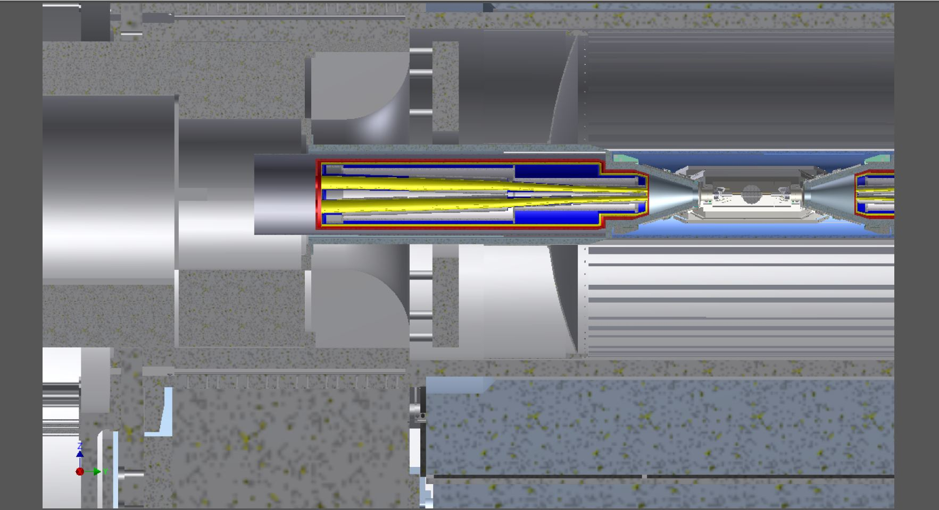
Supporting the SuperB detectors backward end
Two half removable shielding
Quadrant removable shielding
Stationary shielding

Slide 10
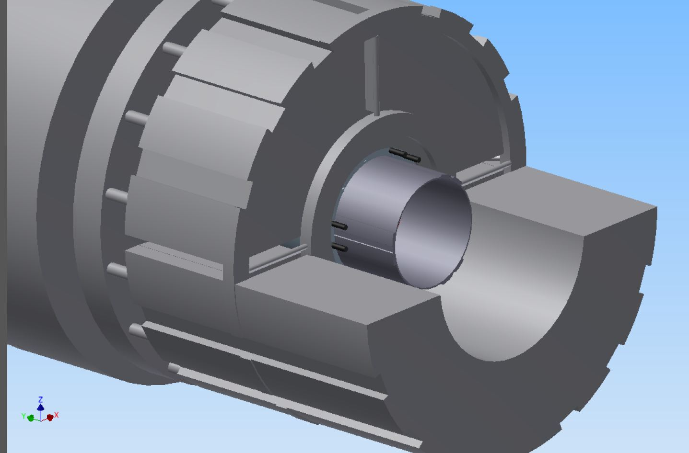
Supporting the SuperB detectors
Stationary shielding with groove for cable passage for the read-out DCH and BCAL
Backward end
QUADRANT REMOVABLE SHIELDING
Bcal support extension
LOWER EXTERNAL REMOVABLE SHIELDING

Slide 11
Supporting the SuperB detectors
Stationary shielding
Backward end
QUADRANT REMOVABLE SHIELDING
LOWER EXTERNAL REMOVABLE SHIELDING

Slide 12
Envelope of the SuperB inner detectors
DCH Backward services can be distribute uniformly around the DIRCH tube (radius 1630mm) The clearance between the BCAL and the DIRCH is 65mm but we need to have a supporting structure for it.
The scenario could be slots uniformly distribute of 30mm time 12 places
The slots are continuing thru the shielding.
In order to have access to DCH we have to dismount the shielding and remove BCAL. This implies cable protection like Cable Channel connected to the DIRCH
Service of BCAL can go on the inner tube of the DIRCH.
Otherwise going at lower radius on top of the Shielding can make the access operations very difficult. We have to remove al the service of BCAL to remove it.
The BCAL services must be disconnected at the BCAL END.

Slide 13
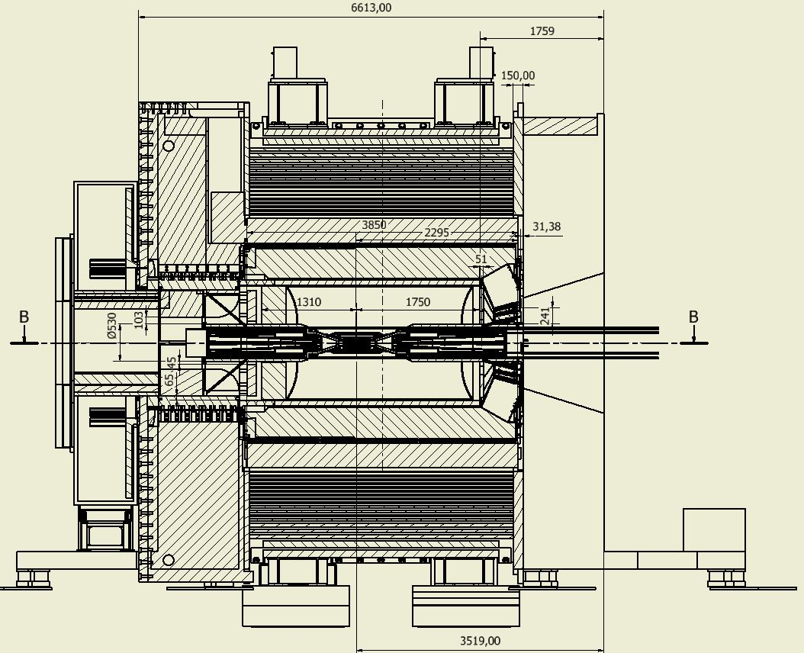

Slide 14
Envelope of the SuperB inner detectors
DCH longitudinal envelope z=-1310,z=1750
DCH diameter envelope 540mm ; – 1610mm
FTOF needs to reduce his outer diameter to the DCH outer diameter (1610mm) to fit inside the DIRCH. Inner diameter 900mm
(Zmax 1801 of FTOF)
Tungsten shielding inner diameter 440mm outer diameter 530mm

Slide 15
Mechanical Envelope and mass of the SuperB inner detectors after meeting 23-july 2012

Slide 16
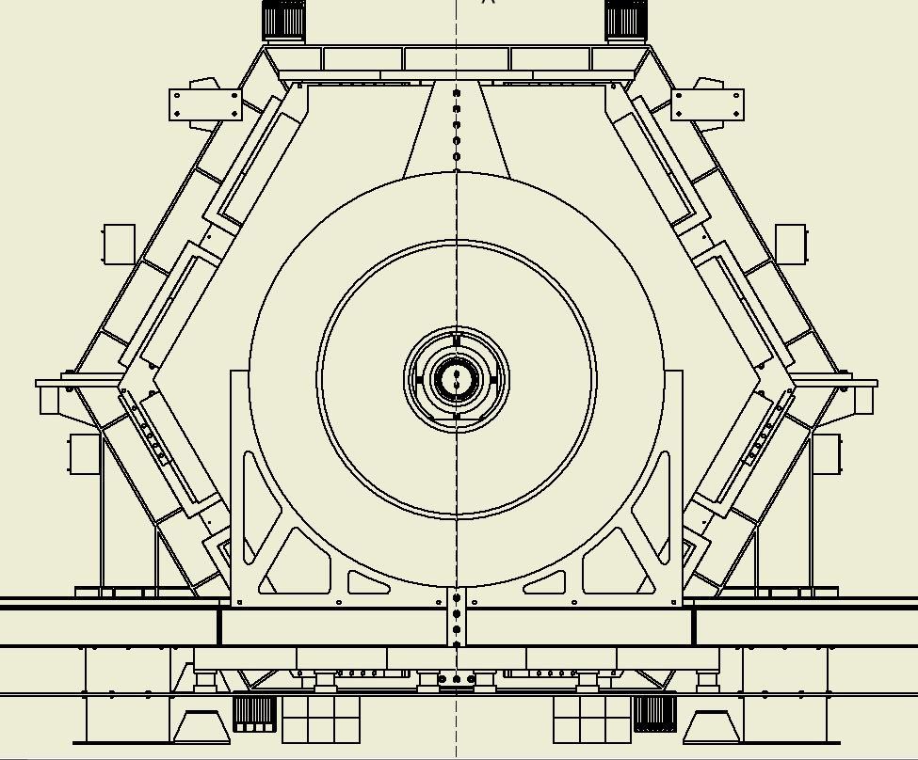
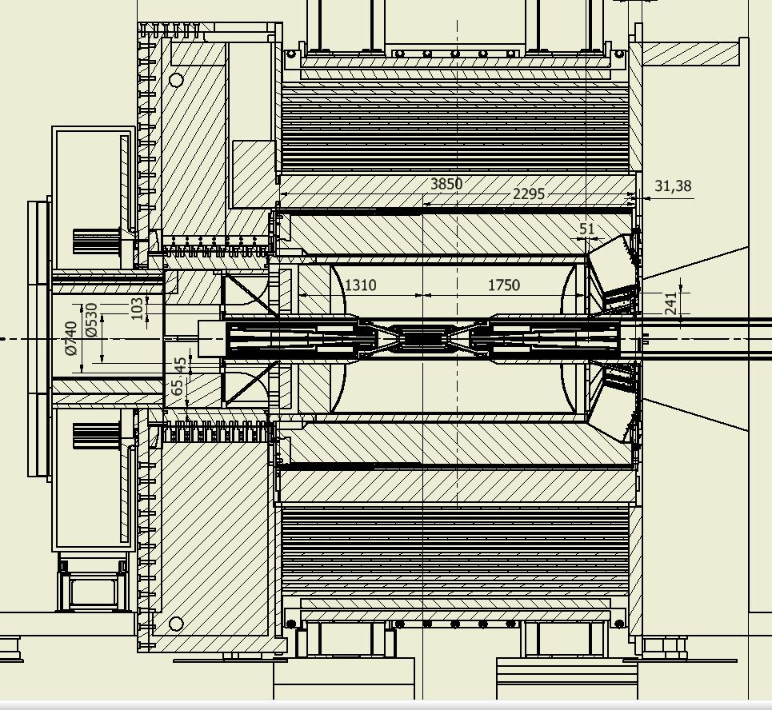
No access to the FTOF and Forward end of DCH.
Forward calorimeter access removing partially the forward support of the tungsten shielding

Slide 17
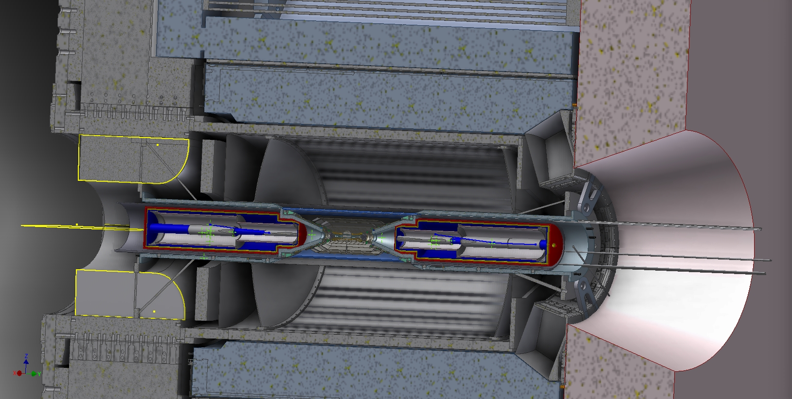

Slide 18
Advice on Magnet forces acting on Babar and SuperB components.
In particular analyzing the new proposed of the forward door and the backward new shielding iron on the Strong tube of the DIRC.
We need a support to analyzed the magnetic forces giving the right input to the analysts.
We need to setup the material distribution for that purpose.

Slide 19
Conclusions
This at the moment is the proposed configuration of SuperB.
We would like to get advices and approval from the superB community on the proposed scheme before going in developing detailed mechanical model.

