Slide 1
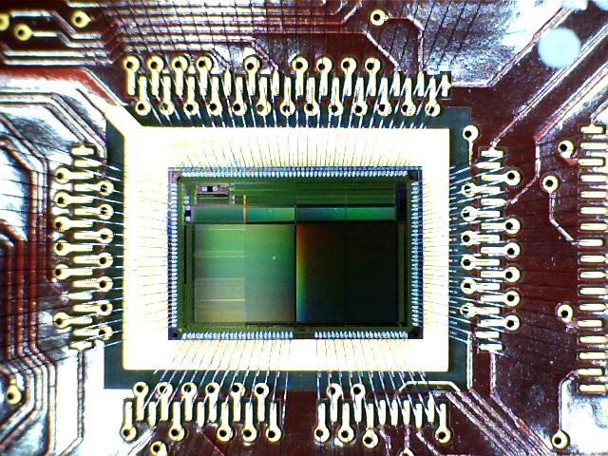
UK Programme
Outline:
Mechanics
Sensor Bench tests
2012 Test beam plans

Slide 2
Mechanics
Filippo visited before the summer break to discuss plans to make a prototype of the interaction region by the end of 2013.
Discussion mainly focussed on the support cones and space frame assembly.
Detailed problem:
Space frame
CFRP Rings, tubes, assembly jigs
alignment jigs
Cones
CFRP
Faraday cage
cooling rings (with mounting buttons)
N.B. for now we plan to use up our old stock of epoxy resin based CFRP, would want to use a more rad hard cyanite-ester resin for the real thing.
Fred, John, Jag & Filippo

Slide 3
Can we increase cooling for L1/L2?
Same profile from the detector point of view, larger x-sectional area for coolant.
Fred

Slide 4
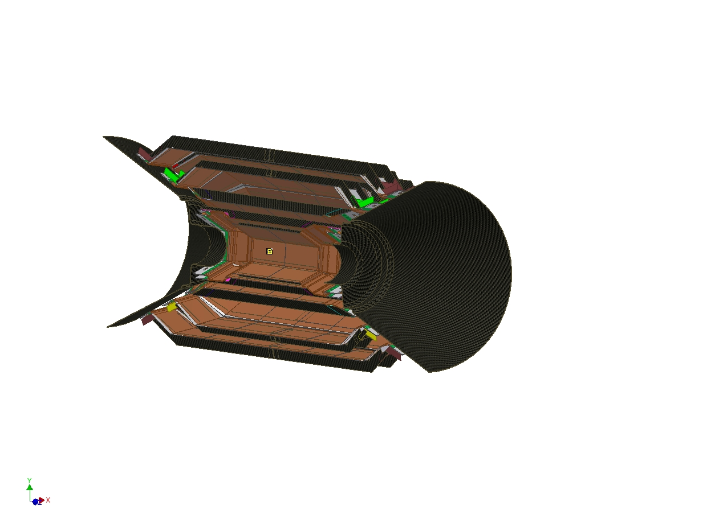
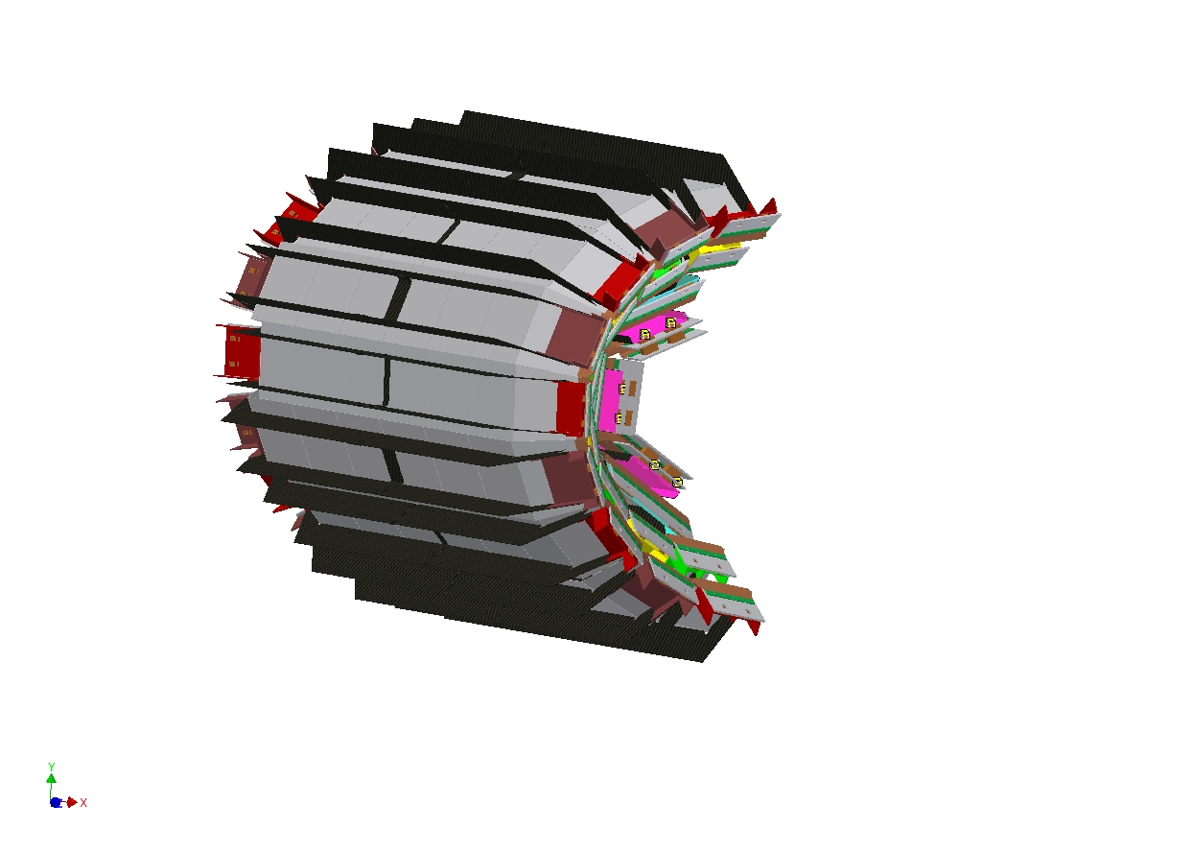
Splitting the support structure
Aim to use the logical split (vertically) through the SVT)
Started to think about assembly of the cones and support frame relative to parts. Can either
Fix the cooling rings and build around them (using buttons as datums).
Build up structure from the inside out (starting with cones).
Fred

Slide 5
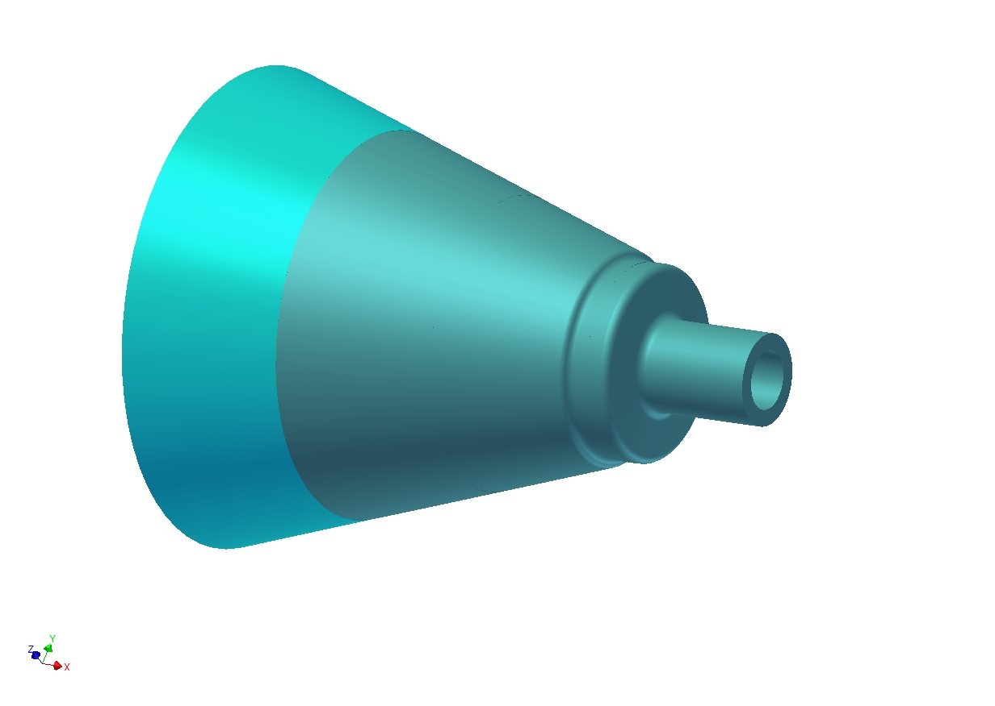
Working on mould design for cones: aim to co-cure copper mesh into the cone surface to provide the faraday cage in a natural way.
Have mould resin ready to machine. Aim is to finish producing mould by the end of the year.
Cooling rings shown are basic model from Filippo.
Co-curing copper mesh to main part of the mould shown to work well on test sample.
Aim to push forward to finalise basic cone design before making mould.
Fred

Slide 6
Prototyping space-frame
Looking at various materials: Foam Core or Solid?
Foam Core
Advantages: Light weight, less material (possibly!)
Disadvantages: Is core material rad hard? Would need to run tests.
Requires extra material (pads) at fixed points due to thin walls.
Requires inserts where rings fit together (as above).
Edges will need to be sealed.
Solid Profile
Advantages: Very strong – could be lightened by machining.
Good mechanical contact at fixed points.
Rad hard.
Disadvantages: Time consuming to build (approx 40 layers).
More material (possibly!)
Initial aim to try making a solid ring of CFRP to machine as required.
John & Jag

Slide 7
Foam Core (showing additional support pads)
Support
Pad
CF Tube Support
John

Slide 8
Solid Ring CF Lay-up Strategy (alternating layers)
Layer 1
Layer 2 etc
Final machined
profile
John

Slide 9
CF Lay-up Jig
John

Slide 10
Solid CF Ring
John

Slide 11
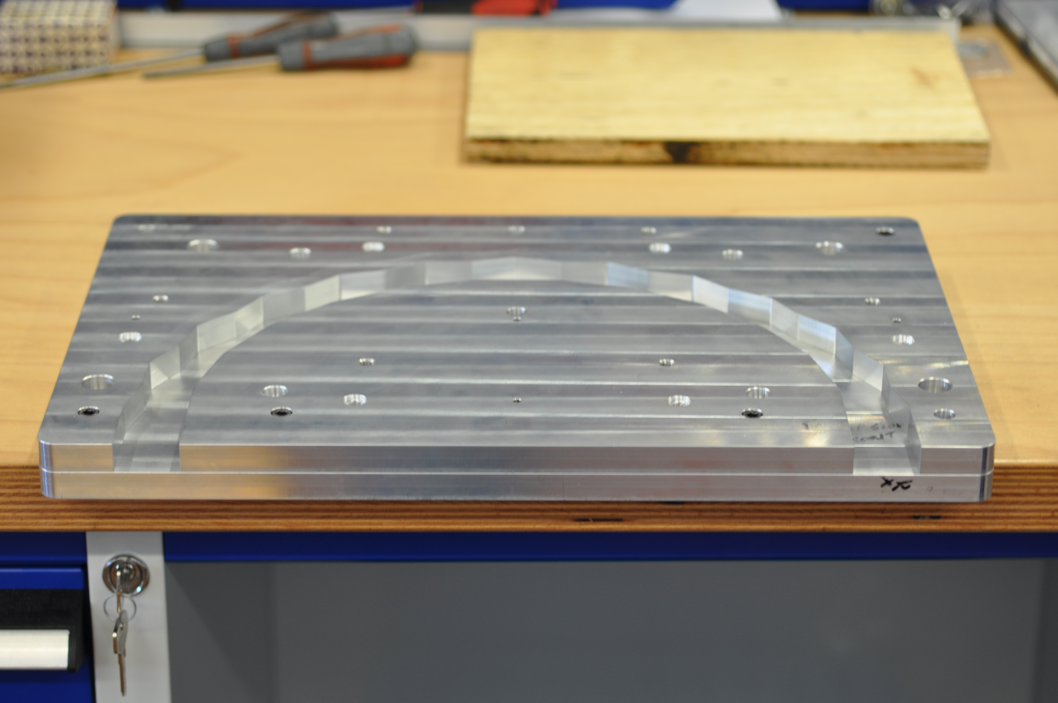
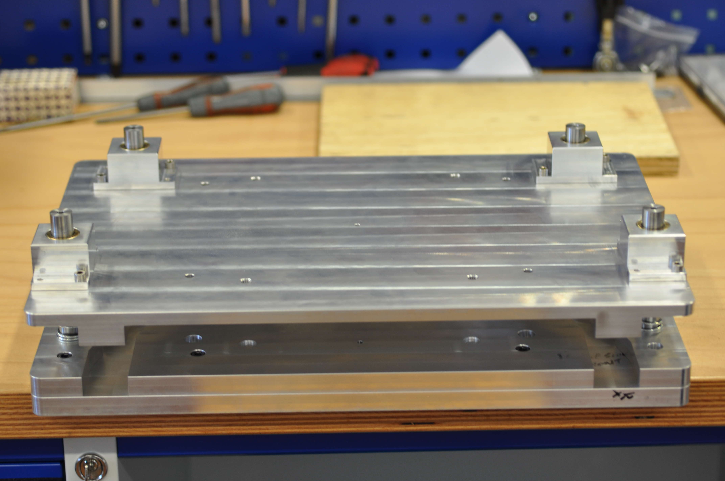
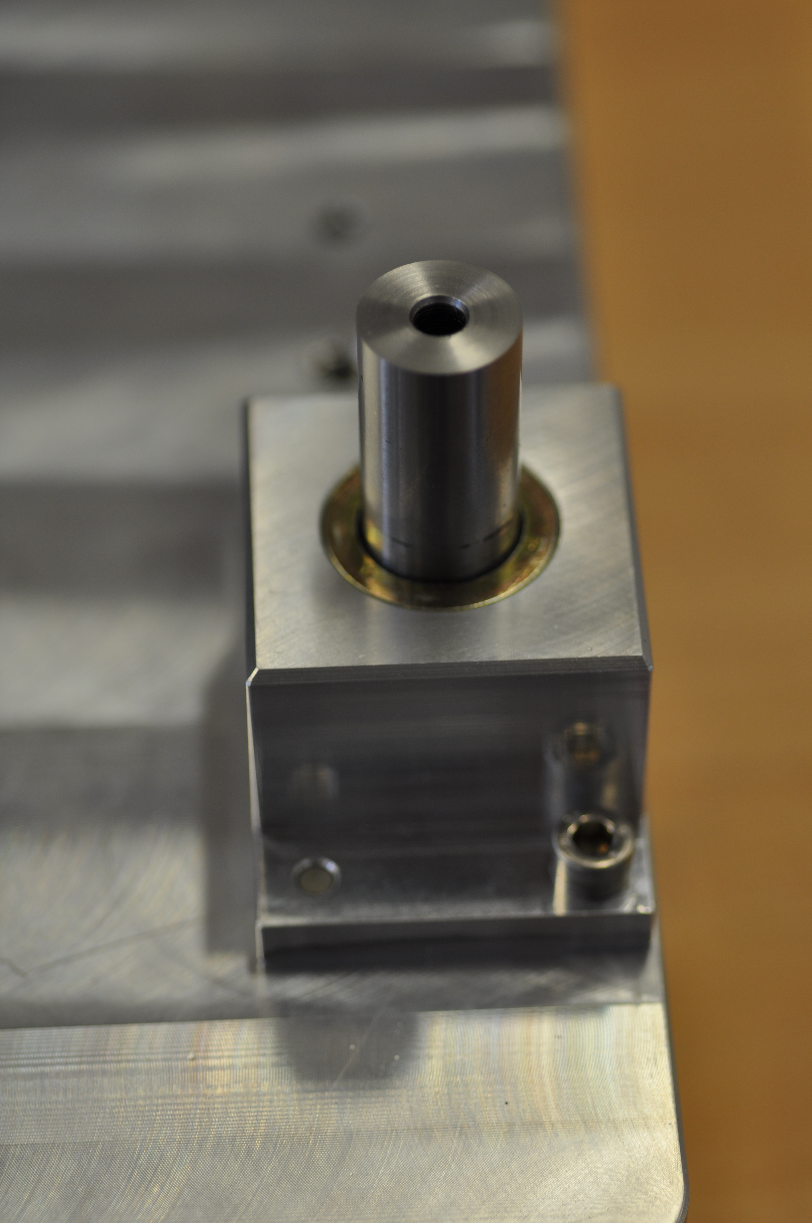
In the process of making jigs for the first solid ring prototypes
Will need to finish off a few parts, and coat with Teflon before we can try making some samples.
May require a bit of trial and error given we need to produce relatively thick CFRP parts & want uniform curing of the material.
Using Amber Composites E722 twill (200g/m²)
(our stock of prepreg is past its shelf life, so it is usable for prototypes, but not for a production part)
Jag

Slide 12
Support alignment frame
Initial rough concept for discussion:
Base the support around a long silver steel bar to form central axis of the detector for assembly purposes.
Will need to mount cones accurately onto this, and build the space-frame with a combination of alignment and assembly jigs.
Ideally would like to be able to put this all under our new CMM (will be a tight fit).
Fred, John, Jag

Slide 13
Sensor bench tests
Concentrating on reference pixel tests initially
Basic functionality tests:
pedestals, noise, Fe55 and LED response
Gain determined from Photon Transfer Curve (PTC)
Prepared laser stage scan using RAL setup.
In progress: Debugging on chip ADC "Strixel" firmware at the moment.
The following slides are based on results from the collaboration shown by James Mylroie-Smith at Pixel 2012.
with James, Gianluca, Fergus + our Arachnid collaborators at Bristol, RAL and Daresbury

Slide 14
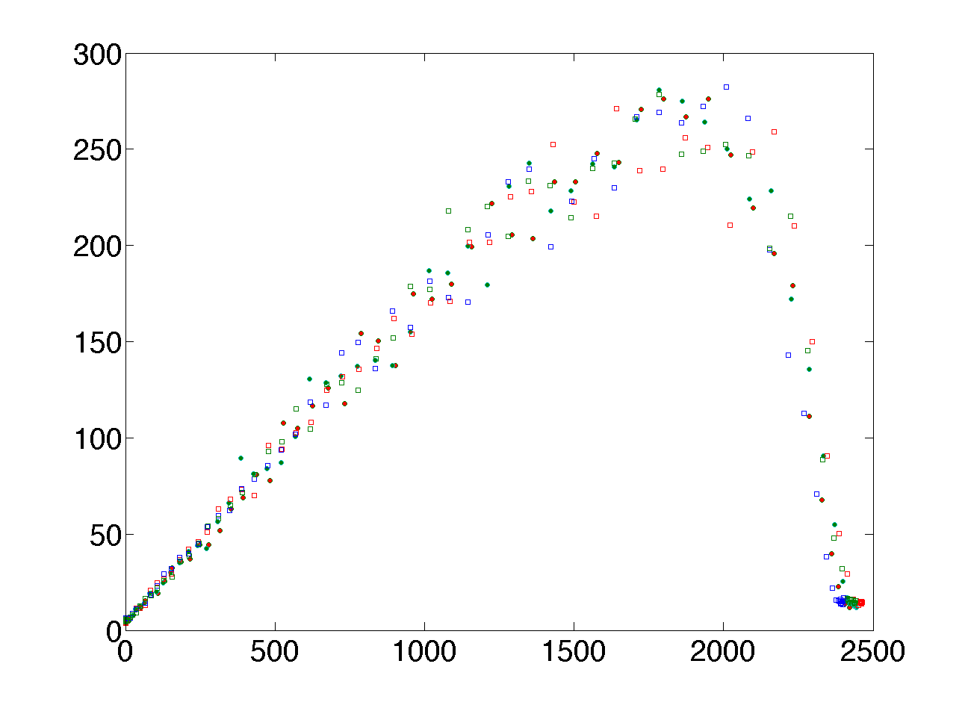
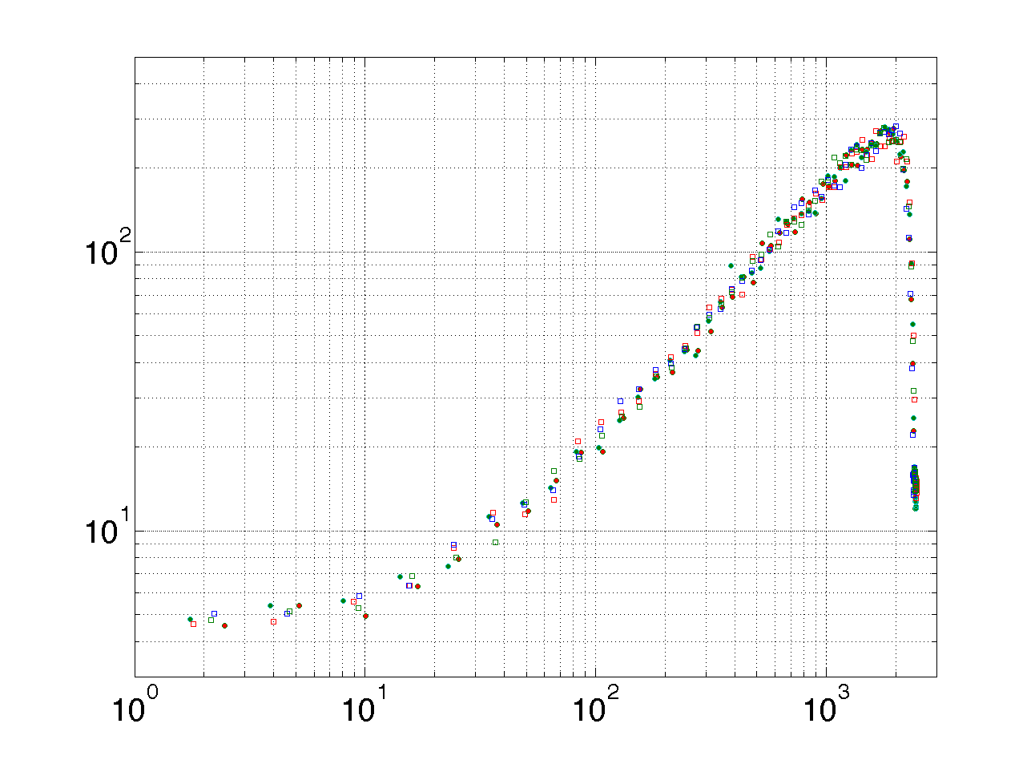
PTC Results
From James' talk at Pixel 2012
PTC performed using IR illumination
Results show good uniformity across the pixels
Gain ≈ 0.17 ADC/e
Noise ≈ 12e rms
Linear full well ≈ 11500e
Maximum full well ≈ 14700e
Noise²
Log(Noise²)
Signal
Log(Signal)
with James, Gianluca, Fergus + our Arachnid collaborators at Bristol, RAL and Daresbury

Slide 15
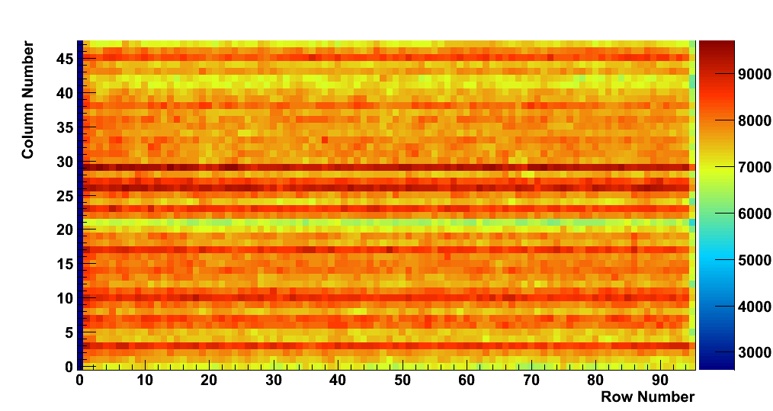
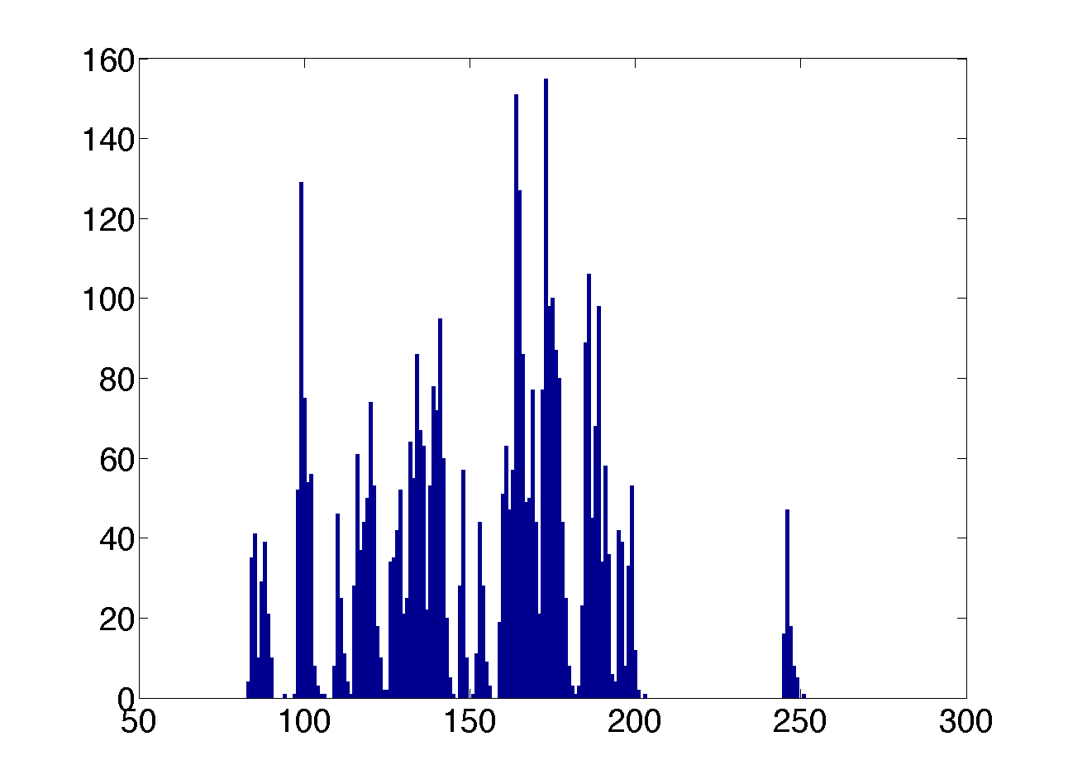
Pedestals
From James' talk at Pixel 2012
Readout is performed on a column by column basis
Shows common noise in columns
Pedestal Value (ADC counts)
with James, Gianluca, Fergus + our Arachnid collaborators at Bristol, RAL and Daresbury

Slide 16
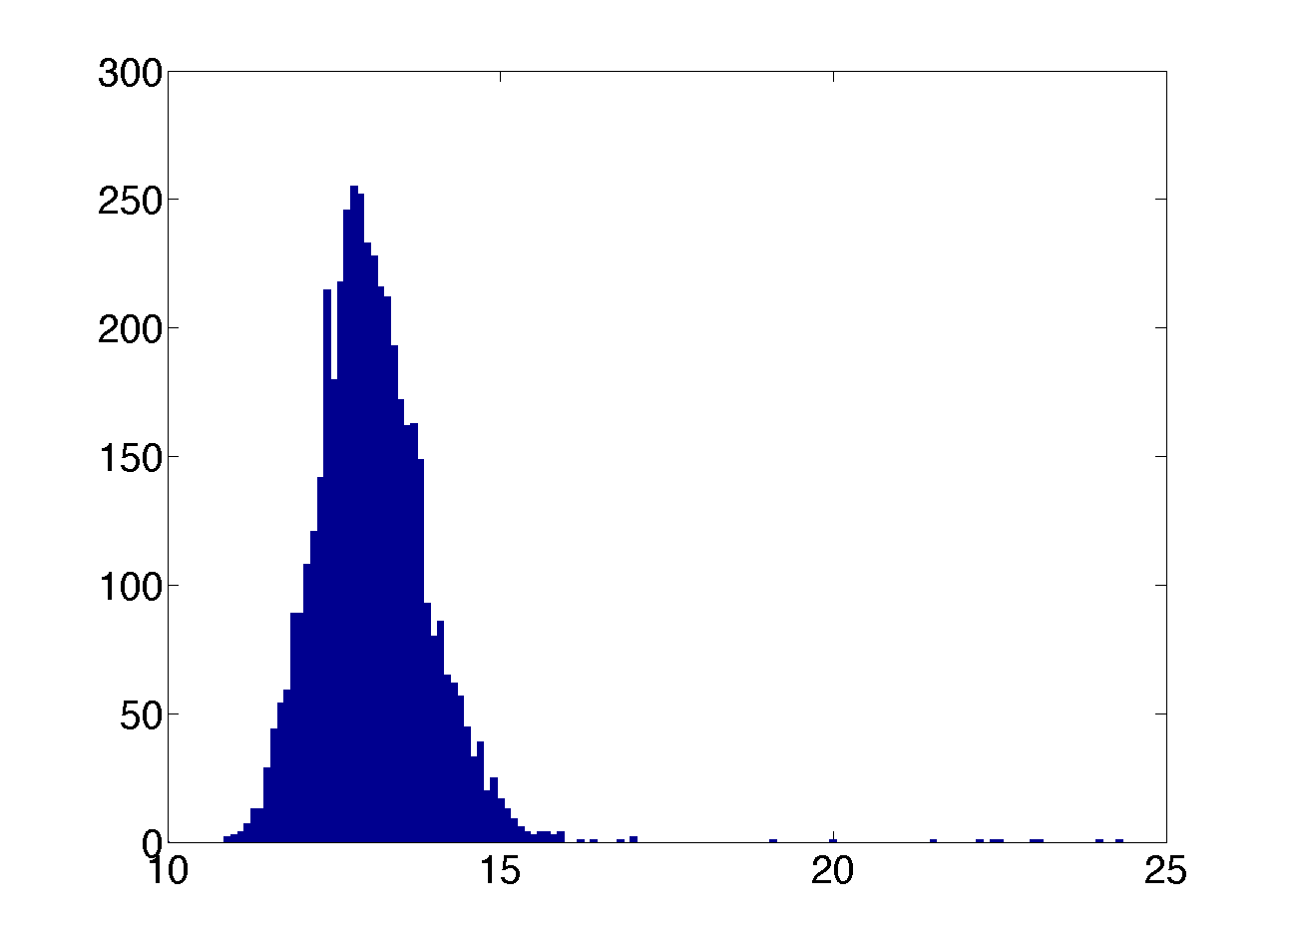
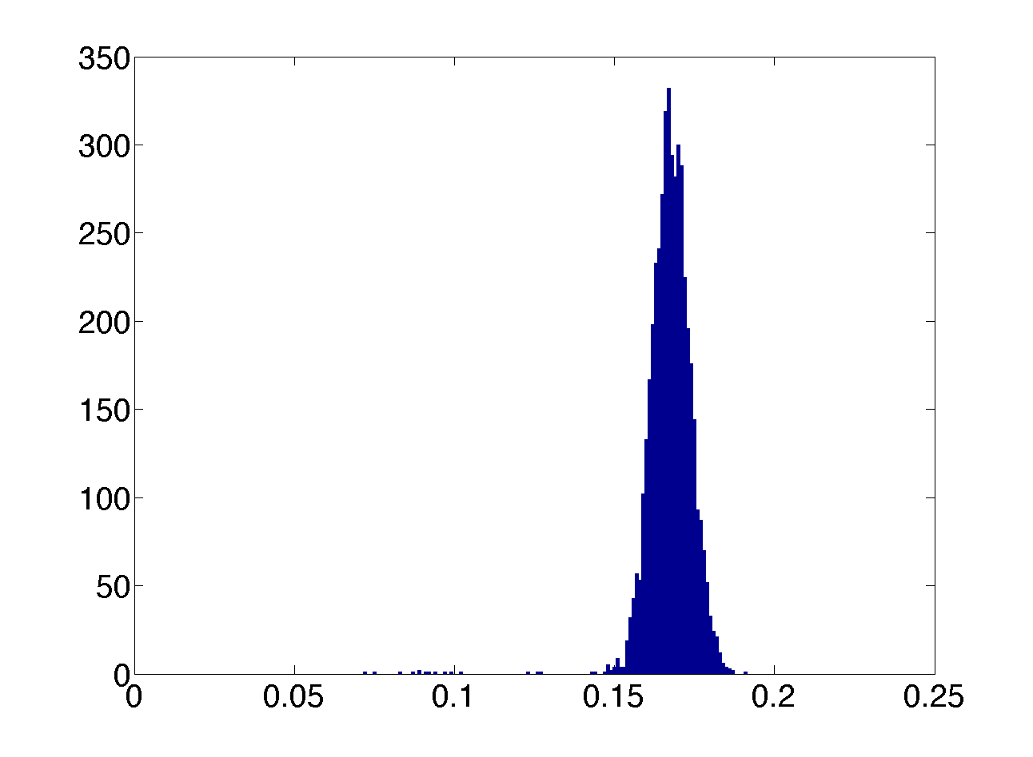
Noise and Gain
From James' talk at Pixel 2012
Noise and gain are uniform across the sensor
Average noise value ~12 e RMS
Average gain value 0.17 => 51𝜇V/e
Noise from each pixel
Gain from each pixel
RMS Noise(e)
Gain(ADCs)
with James, Gianluca, Fergus + our Arachnid collaborators at Bristol, RAL and Daresbury

Slide 17
Noise vs Temperature
From James' talk at Pixel 2012
^{Noise}
At 50C the noise becomes large.
Increase in noise at 20C
Noise (ADCs)
^{Pedestal}
ZOOM
Noise (ADCs)
Temperature (C)
Temperature (C)
with James, Gianluca, Fergus + our Arachnid collaborators at Bristol, RAL and Daresbury

Slide 18
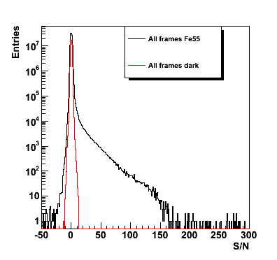
⁵⁵Fe
Reference pixel results
From James' talk at Pixel 2012
Fe55 spectrum shows a sharp cut-off at
Good S/N up to 150
Consistent with noise and gain from PTC
with James, Gianluca, Fergus + our Arachnid collaborators at Bristol, RAL and Daresbury

Slide 19
Test beam
CERN test beam at T4-H6 mid-November
Clarifying dates with regard to latest schedule.
Preparing for this: will have a stack of sensors with trigger in a stand alone system to simplify the setup.
Will perform pion beam irradiation of these sensors.
RAL group leading preparations for this.
Aim to have a lab based test of the setup in the coming month.

Slide 20
Summary
Clear plan forward on the mechanical side:
Some issues are well understood, and we can start prototyping.
Others: we're starting to try out ideas to determine the best way forward.
Sensor testing:
First results are now available from Cherwell.
Reference pixels are behaving as expected, and we hope to be in a position to study the other pixel types soon.
Test beam plans progressing well.

