Slide 1
Radiation Monitor:
Concepts, Simulation for an Advanced Read Out
R. Cardarelli, A. Di Ciaccio, L. Paolozzi
INFN-Roma Tor Vergata
Super-B Collaboration meeting 20/09/2012
Pisa

Slide 2
Outline
Location of the beam monitor in the Super-B detector.
Test of a mono c. v.s. poly c. diamond detector with SiGe amplifier.
Conclusions and future plans.

Slide 3
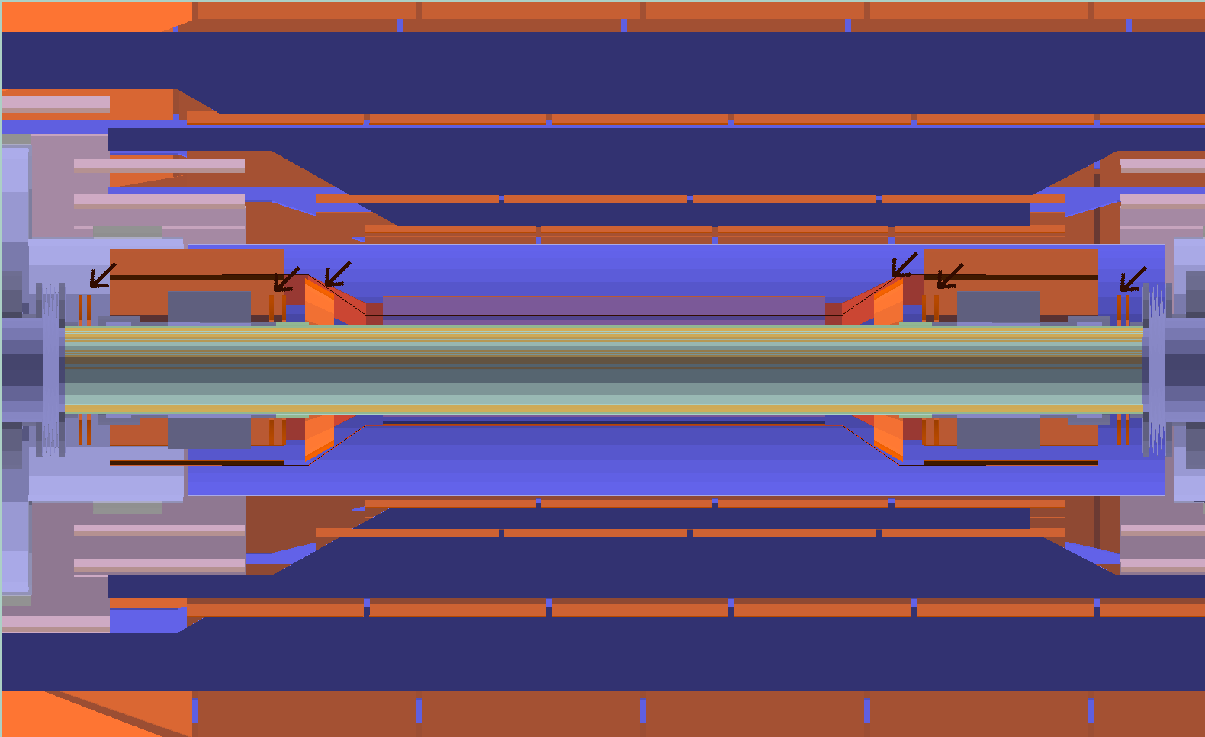
Location of the detectors

Slide 4
geometry of the detector
8 diamond detectors for each ring
feature
detector size | 8 X16 mm²
leakage current | 80x10⁻¹⁰ A
Ionization current | 6.7x10⁻¹⁰ A
hits rate | 130KHz
Transit time | 20 ns
Integration time | 30 ns
Electric resistance | 10¹¹ Ωcm
energy threshold | 150KeV
Diamond detectors 4mm x 4mm

Slide 5
Tentative electronics diagram
.
HV
500 Volt
Pico
Amp
100 kOhm
10m coax. Cable Ø = 0.7 mm
Diamond
detector
amp
digitizer
CPU
amp

Slide 6
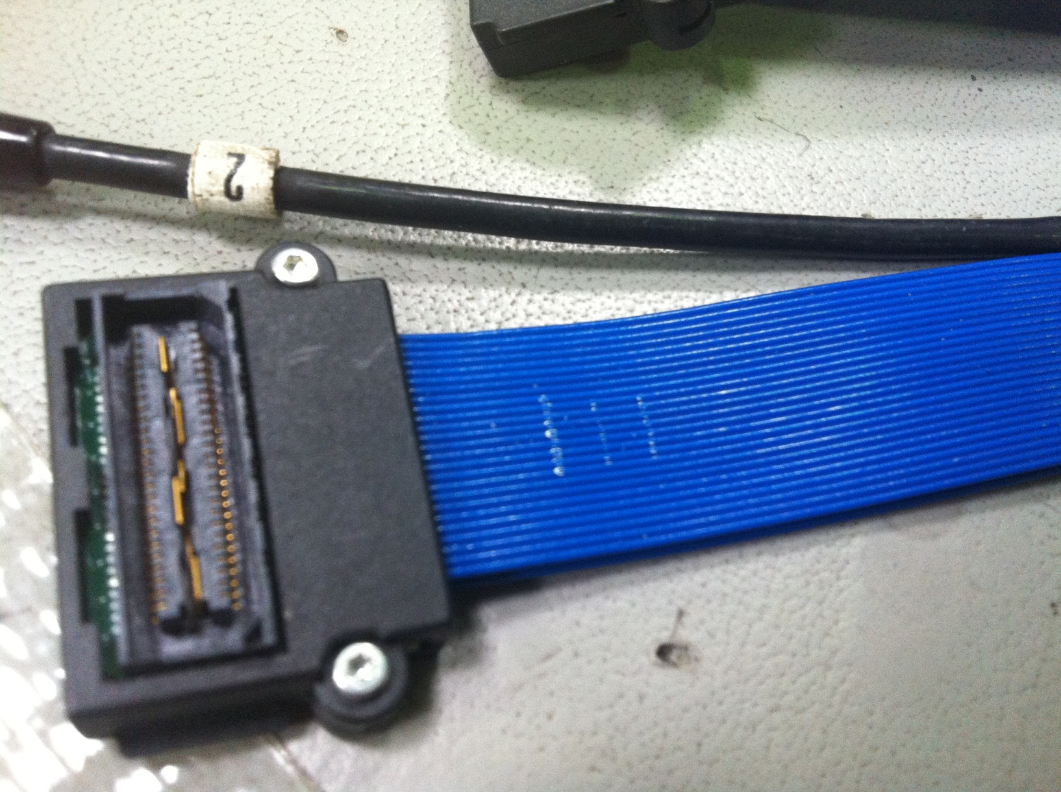
Multi-Coaxial Cable Ø = 0.7 mm

Slide 7
Amplifier, AC, (BJT SiGe, BFP740)
Voltage supply 5 Volt
Sensitivity 6 mV/fC
noise 500 e⁻ RMS
Input impedance 50 Ohm
B.W. 30 MHz
Power consumption 10 mW/ch
Low cost 2 – 3 eur./ch
Radiation hardness 50 Mrad, 10¹⁵ n cm⁻²

Slide 8
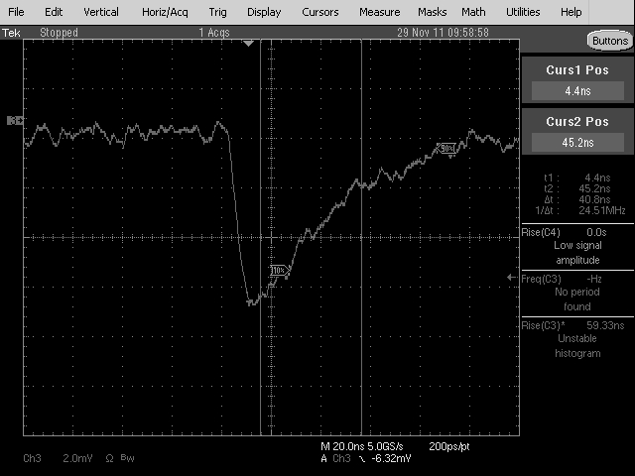
Signal from a minimum ionizing particle
20ns/div.
20ns/div.

Slide 9
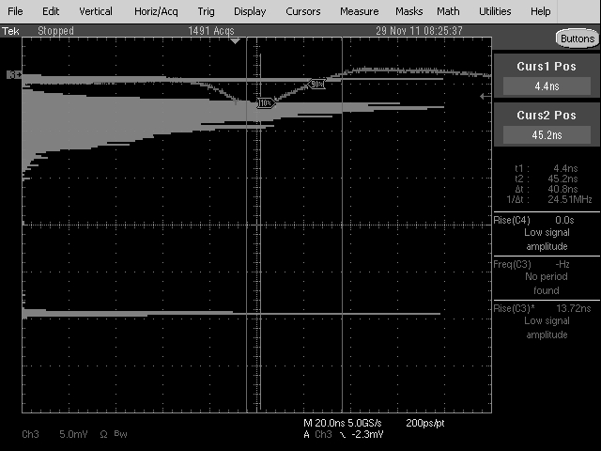
Americium-241 + Sr-90
Am-241
Sr-90
noise

Slide 10
Polycrystal diamond: alfa source
(log scale)

Slide 11
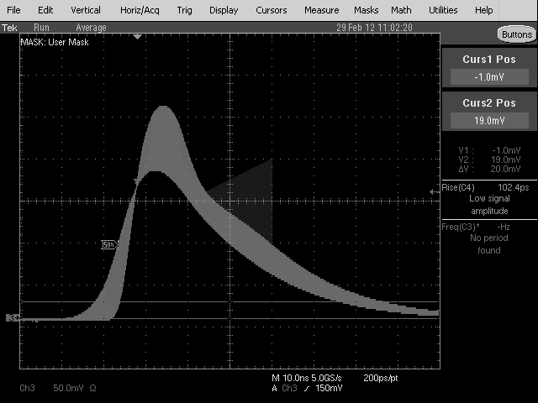
Drift of the monocrystal diamond

Slide 12
Problems of standard diamont detectors
Monocrystal is unstable.
Polycrystal has low charge collection efficiency.

Slide 13
Standard diamond detector

Slide 14
New detector concept
graphite
0.2 mm
Graphite+Al
P - Diamond

Slide 15
Conclusions
The background of the detector has been simulated.
The developement of FE electronics is in progress.
A new structure of diamond detector has been proposed to solve the main problems of the present ones.

Slide 16
Future plans for 2013
Test at H8 (CERN) with muon beam.
Test of the new detectors.
Test of the final layout.
Developement of a full custom FE electronics in SiGe technology.

