Slide 1
Summary of detector Integration Plenary
Inner detector envelope
Radial clearances.
Longitude clearances
Cables distribution
Issues that we must face in the future meetings.
Conclusions.

Slide 2
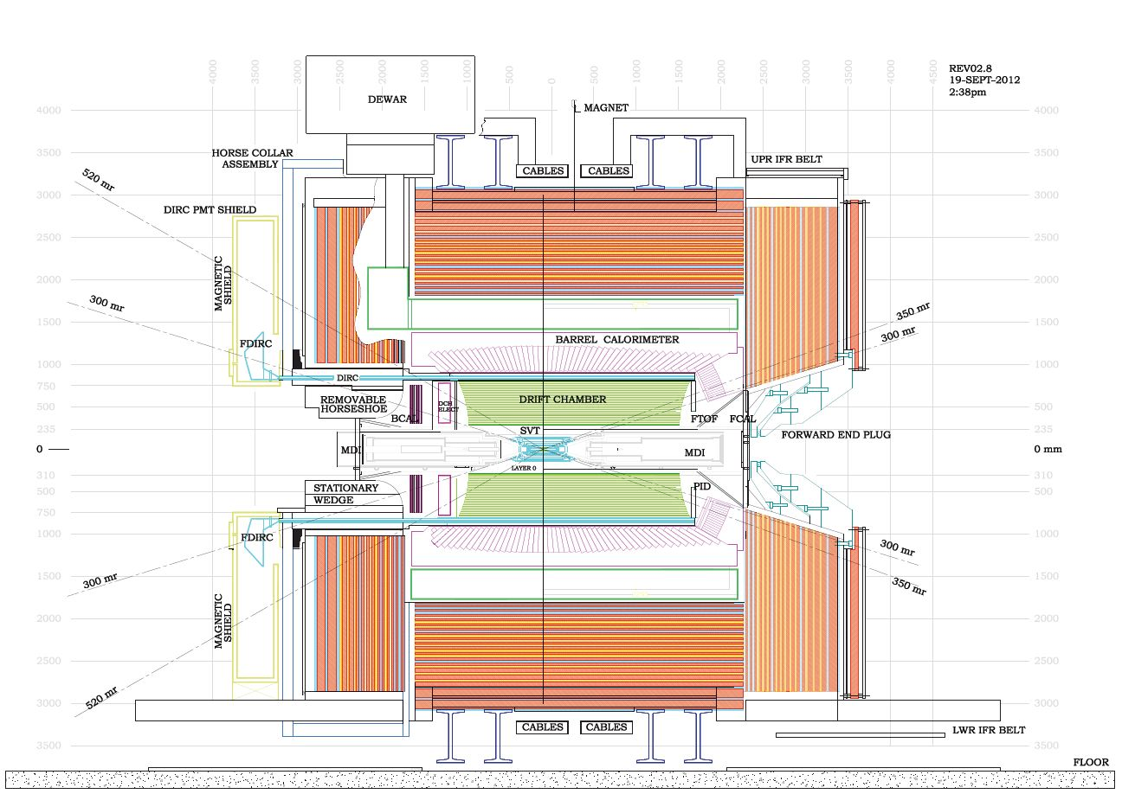
Mew SuperB Ref. drawing

Slide 3
We review the Inner detector envelopes
The tungsten shielding thickness has increased to 45mm
The inner radius of the tungsten shielding is now 5mm larger. (requested by SVT)
The final dimensions are:
Inner diameter 440mm outer diameter 530mm.
We Leave 5mm radially of clearance between the DCH and the shielding
The inner diameter of the DCH is 540mm.

Slide 4
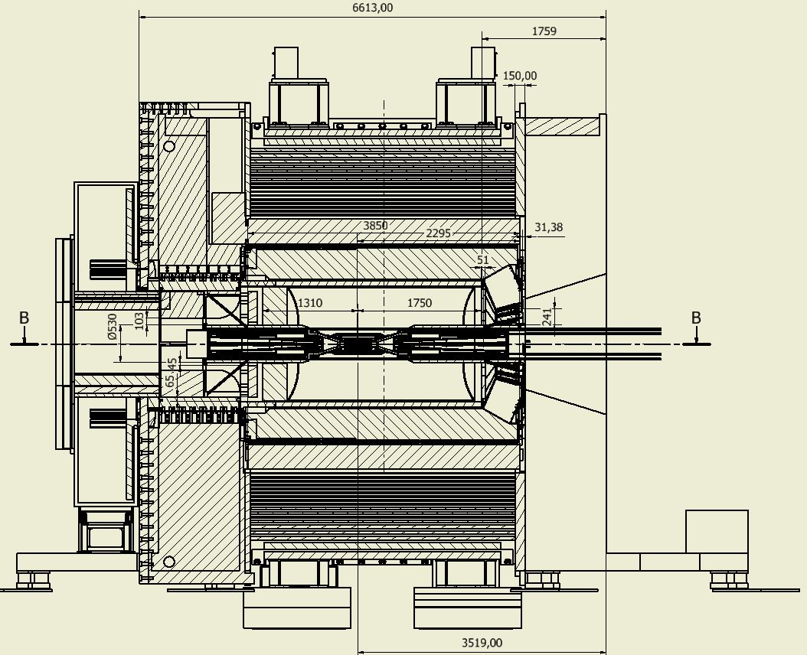

Slide 5
Survey was made and inspection was made after the meeting at SLAC in July 2012
Forward calorimeter service envelope
Wire chamber supports.
DIRCH inner tube measurements.

Slide 6
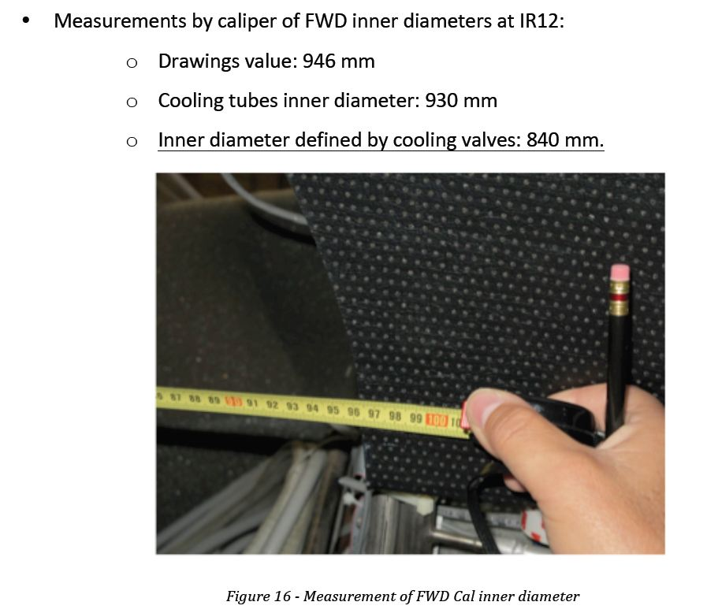
Survey was made and inspection was made after the meeting

Slide 7
Survey was made and inspection was made after the meeting
Wire chamber supports

Slide 8
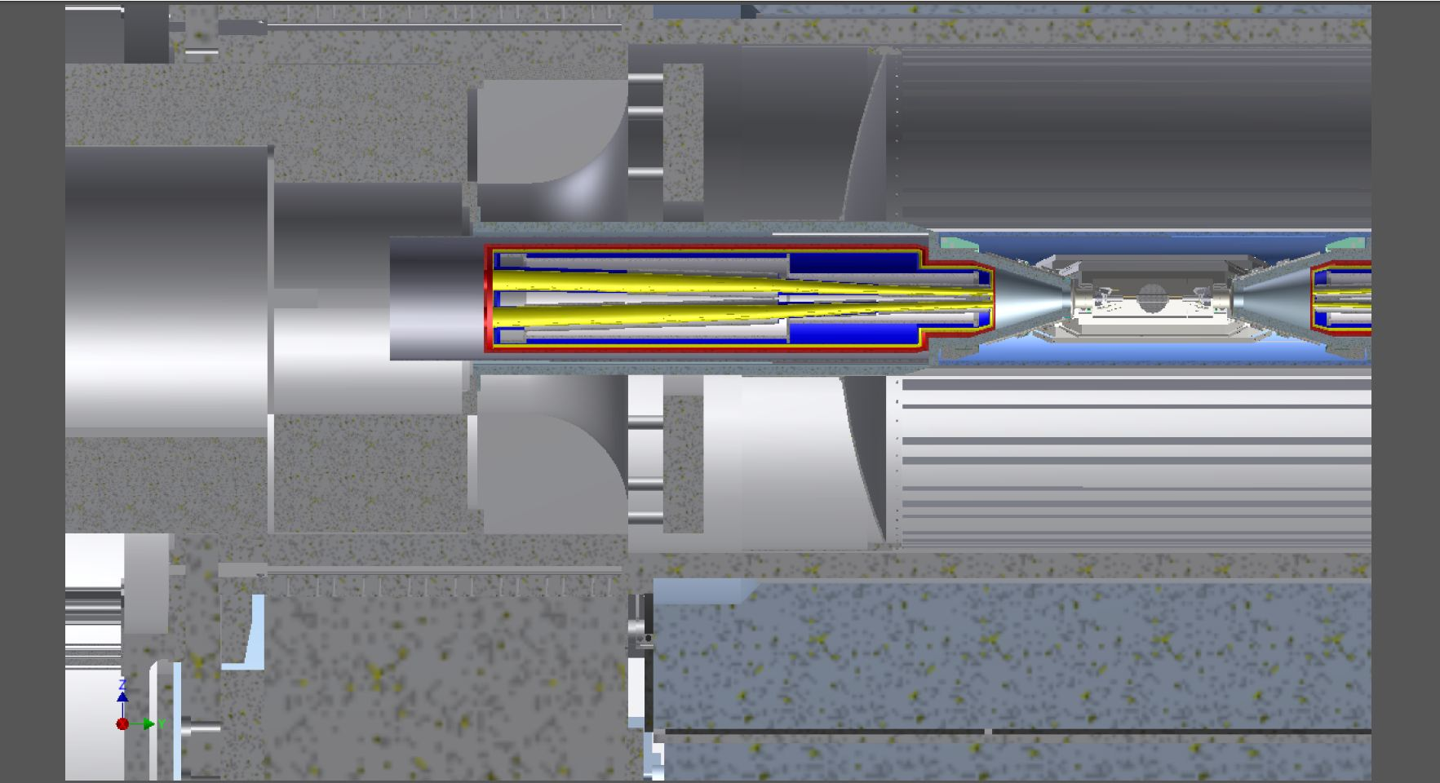
Supporting the SuperB detectors backward end
Two half removable shielding
Quadrant removable shielding
Stationary shielding

Slide 9
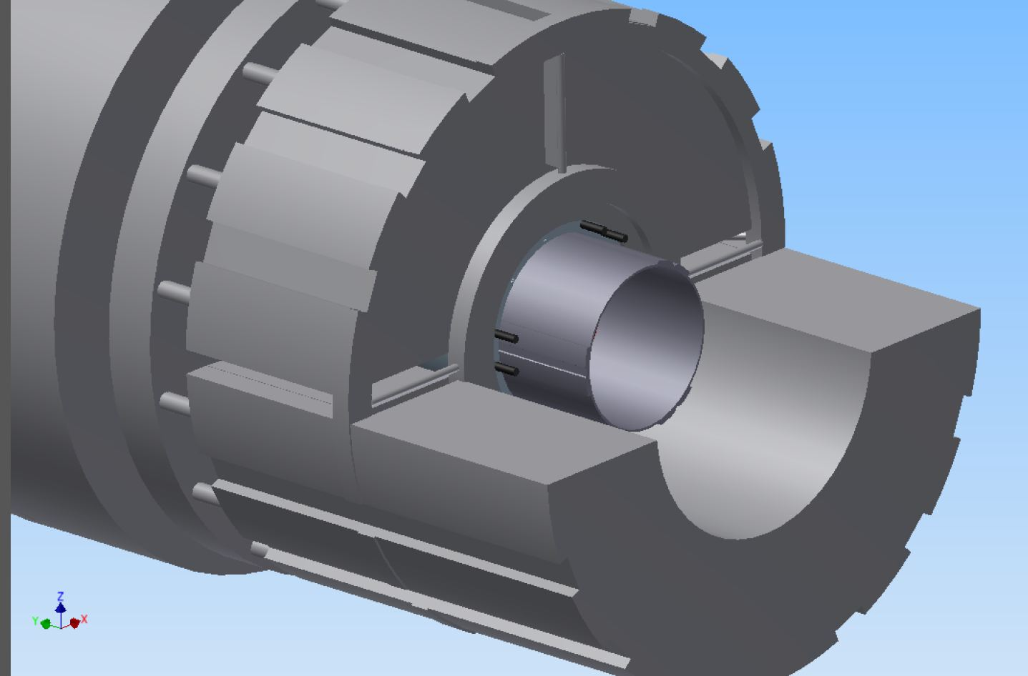
Supporting the SuperB detectors
Stationary shielding with groove for cable passage for the read-out DCH and BCAL
Backward end
QUADRANT REMOVABLE SHIELDING
Bcal support extension
LOWER EXTERNAL REMOVABLE SHIELDING

Slide 10
Supporting the SuperB detectors
Stationary shielding
Backward end
QUADRANT REMOVABLE SHIELDING
LOWER EXTERNAL REMOVABLE SHIELDING

Slide 11
Mechanical Envelope and mass of the SuperB inner detectors after meeting 10-Sept 2012

Slide 12
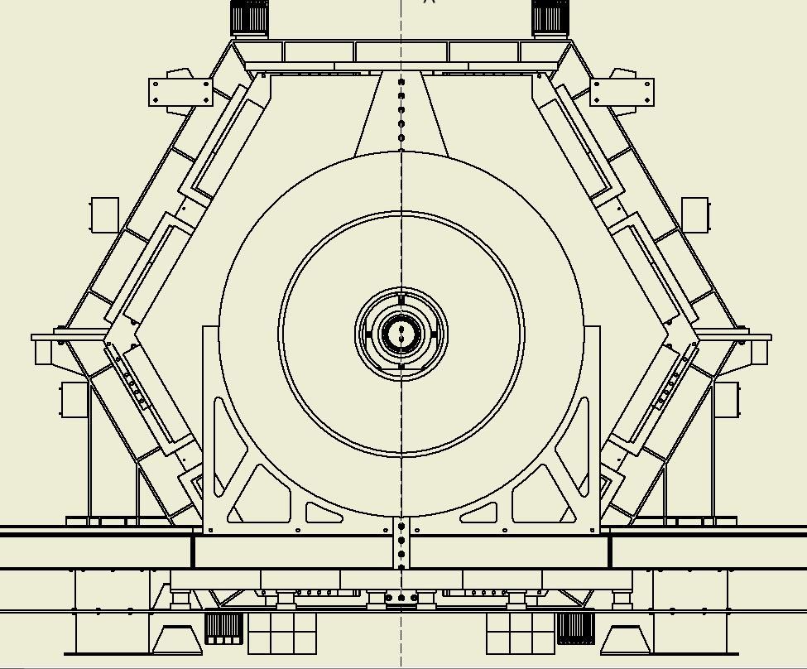
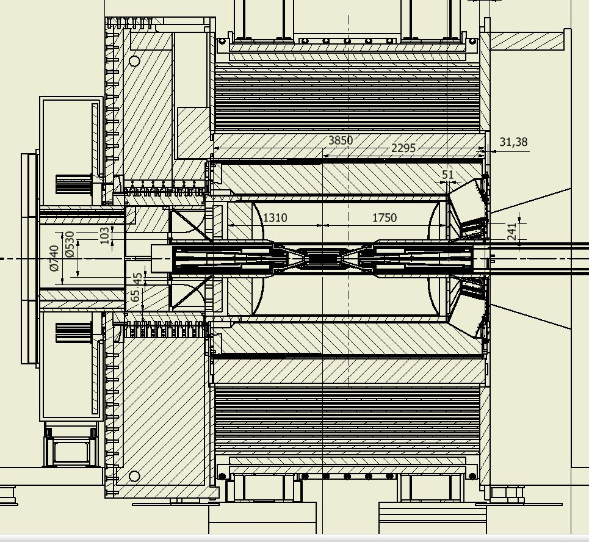
No access to the FTOF and Forward end of DCH.
Forward calorimeter access removing partially the forward support of the tungsten shielding

Slide 13
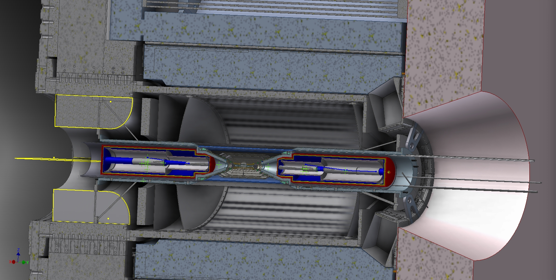

Slide 14
Issues that we must face in the future meetings
Advice on Magnet forces acting on Babar and SuperB components.
In particular analyzing the new proposed of the forward door and the backward new shielding iron on the Strong tube of the DIRC.
We need a support to analyzed the magnetic forces giving the right input to the analysts.
We need to setup the material distribution for that purpose.

Slide 15
Issues that we must face in the future meetings
A global shielding strategy must be considered and analyzed from all point of view.
We required a task force and a dedicated meeting to face this issue.

Slide 16
Issues that we must face in the future meetings
An assembly strategy of the detector must be study in agreement with the machine commissioning.
A detail analysis of the machine commissioning planning has an impact on the design and the assembly procedure of the SuperB detector.

Slide 17
Conclusions
This at the moment is the proposed configuration of SuperB.
We would like to get advices and approval from the superB community on the proposed scheme before going in developing detailed mechanical model.
New issues must be discussed and analyzing like:
Shielding, Magnet force and installation procedure.

