Slide 1
Accelerators Activity
SuperB collaboration meeting. Pisa 21/09/2012

Slide 2
Elba situation. Management focused
Accelerator project organization:
An organization structure has been set up.
This is based on one organigramme where the roles and the responsibilities are defined
The technical coordinator, the accelerator division and technical division leaders are identified
Possibility to hire experts or young researchers
Possibility to travel
Contacts for MoUs
Integration of a SASE FEL facility in the LINAC
Request to produce in a very short delay a preliminary costing based on the ‘frozen’ CDR design.

Slide 3
Evolution
The costing commission requests has a strong evolution with new constraints. Now we face more an ‘Audit’ mandate since we are expected to produce the costing and the spend profile together with the manpower and resources hiring plan, the risk analysis, the collaboration status …..
Unfortunately this exercise has focalized a lot of resources and expertise to produce a final document that will be soon ready to be provided to the commission.
At present we finalized the full WBS, the associated costing, the manpower requirements and its temporal profile.
Cost Estimation → including personnel, spare components, contingency and VAT;
To respect the challenge of the physics constraints we produced also a Master Schedule based on a success oriented planning not restricted by the personnel availability, neither by the flow of the financial resources. This very aggressive schedule impose well identified milestones in 2013.
HR plan → including the identification of the detailed profiles for the first phase of the project to fulfill the 2013 milestones.
Different scenarios are explored to provide a coherent plan for hiring, associating and organising the accelerator design team
At present we absolutely need to reinforce the expertise and the team to address the open questions in a short delay

Slide 4
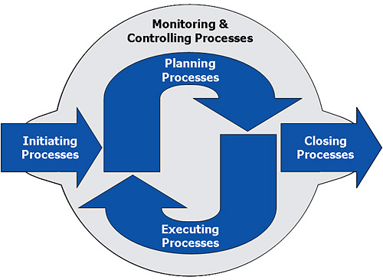
PM for the SuperB
accelerator project
PM process groups and knowledge areas map
L.Lari

Slide 5
Technical work
Divided in three parts : Main Rings, Injectors, SASE integration
MAIN rings : Thanks to our BINP,JAI, LNF and LAL colleagues
The V16 lattice polarization was estimated in ~70 %
STRATEGY:
Produce a new LER lattice to fit polarization
Adapt the HER
Adjust the parameters to maintain the emittances and the luminosity
Estimation of Impedances, Synchrotron fans and collective instabilities
Lifetime calculation
Introduce the ‘footprint constraints’ in the lattice (pumps, bellows, bpm….)
New lattice version : V01. 80 % polarization.
Now we have to face the energy acceptance and Dyn Aperture problems, it is possible that P can slightly decrease.
Injector. Produce a new version of the DR Lattice that fits the magnets technological constraints
Introduce the ‘footprint constraints in the lattice’ (pumps, bellows, bpm….)
SASE.
Produce the over-costing of the SASE configuration

Slide 6
Main Rings – In progress
Full review of the lattice and layout for both LER and HER
Change of dipole magnets field to increase depolarization time (760 → 1700 sec)
Circumference of rings changed → HER dipoles need to be changed to fit LER
Polarization degree 80% (Biagini, Koop, Sinyatkin, Bogomiagkov, Levichev)
Change in Final Focus layout (now symmetric wrt IP)
Layout of Interaction Region according to latest QD0/QF1 design from Sullivan, Paoloni, Fabbricatore
Inserted detector solenoid and anti-solenoids fields in the Interaction Region to start evaluation of non linear terms and influence on beam dynamics (Bartolini, Biagini, Malisheva, Seryi)
3D design of magnets (dipoles, quadrupoles, sextupoles) in progress to define realistic layout in order to install all needed hardware (vacuum, diagnostics, bellows…) (Okunev, Clozza, Bini, Serio, Stella, Drago, Tommassini, Prevost, Mercier, Demma). We started from a ‘guess’ vacuum chamber design. NEED OF A IMPEDANCE EXPERT
Change in LER injection cell position to better fit injection system (Linac) layout (Guiducci, Sinyatkin, Tommassini, Pellegrini)
Touschek lifetime evaluation. Required energy acceptance to provide the required lifetime (Boscolo)
Estimate the Collective instabilities, Synchrotron fans and Impedances (Demma)

Slide 7
V02
HER&LER
Separation – 2.15 m
Circumference
1183.057 m
Separation – 2 m
ID Cells
HER Inj.
LER Inj.
RF cav.

Slide 8
Preliminary MR parameters
* - rings with old V16 experimental section
Parameter | V02 LER* | V02 HER*
Energy, GeV | 4.18 | 6.7
Circumference, m | 1183.2028* | 1183.2028*
Bunch current, mA | 2.66 | 2.06
Number of particles | 6.56E+10 | 5.07E+10
Total RF volt, MV | 4.52 | 6.91
RF bucket, % | 2.64 | 2.06
Coupling, % | 0.25 | 0.25
Damping time (x), msec | 53 | 24.3
Emittance w/o IBS, nm*rad | 1.20 | 1.88
Emittance wh IBS, nm*rad | 2.29 | 2.00
Em_IBS/Em_w/o_IBS | 1.91 | 1.066
Long. Length_w/o_IBS, mm | 3.86 | 4.79
Long. Length_wh_IBS, mm | 5.01 | 4.93
Sigs_IBS / Sigs_w/o | 1.30 | 1.029
dP/P_limit = 1.0 %
Touschek lifetime wh IBS, sec | ~310 | ~995

Slide 9
NEW Dipoles
LER
Name | N | L, m | R, m | alf,rad | B,T | Comment
BLERSL0 | 24 | 1.2 | 48.95461 | 0.024513 | 0.285 | BLERSL0, L= 1.2 m, R = 49.0 m
BLERPI10 | 24 | 0.7 | 43.54913 | 0.016074 | 0.320 | BLERPI10, L= 0.7 m, R = 43.5 m
BLERJ0 | 4 | 1.2 | 40.98753 | 0.029277 | 0.340 | BLERJ0, L= 1.2 m, R = 41.0 m
DIP_LER | 80 | 1.2 | 38.71043 | 0.030999 | 0.360 | DIP_LER, L= 1.2 m, R = 38.7 m
DIP_LER1 | 78 | 0.7 | 35.86415 | 0.019518 | 0.389 | DIP_LER1, L= 0.7 m, R = 35.9 m
DIP_LERS | 8 | 0.7 | 28.55686 | 0.024513 | 0.488 | DIP_LERS, L= 0.7 m, R = 28.6 m
HER
Name | N | L, m | R, m | alf,rad | B,T | Comment
BHER2 | 24 | 1.48 | 92.0753 | 0.016074 | 0.243 | BHER2, L= 1.48 m, R = 92.1 m
BHERSL | 12 | 4.27 | 87.0986 | 0.049025 | 0.256 | BHERSL, L= 4.27 m, R = 87.1 m
BHERS | 4 | 4 | 81.59119 | 0.049025 | 0.274 | BHERS, L= 4 m, R = 81.6 m
BHER1 | 78 | 1.48 | 75.82705 | 0.019518 | 0.295 | BHER1, L= 1.48 m, R = 75.8 m
BHER | 40 | 4.7 | 75.80804 | 0.061999 | 0.295 | BHER, L= 4.7 m, R = 75.8 m
BHERJ | 2 | 4.1 | 70.02036 | 0.058554 | 0.319 | BHERJ, L= 4.1 m, R = 70.0 m

Slide 10
NEXT STEPS
Freeze lattice
Dynamic aperture (Piminov) and lifetime studies → correction of chromatic effects both in FF and arcs, maximization of energy acceptance for lifetime,…
Assessment of beam parameters (Bogomiagkov) for 10³⁶
Design of vacuum chamber
Evaluation of chamber impedance
LET for magnets and diags design

Slide 11
Injectors

Slide 12
DR new Lattice for engineering (Zhang, Guiducci)
Longer lattice to accommodate the magnets
Dynamical aperture optimization
New Beta at the injection
Injection start to end simulations (Guiducci, Pellegrini)
Magnets Design (Okunev)
Two Dipole versions (1.75 and 1.9 T)
e+ Source optimization (Demma, Brossard)
Reshuffling of the Capture session for engineering
TM020 Cavity Prototype (E.Ngo Mandag, P.Lepercq)
Aluminium proto design done.

Slide 13
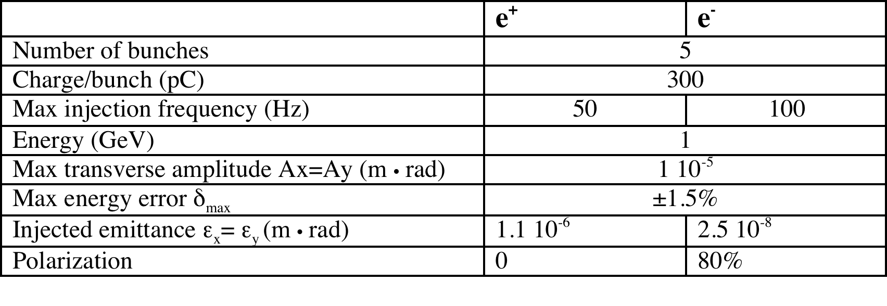
DR Specifications
Injection
Extraction

Slide 14
DR Main issue
the drift spaces in the lattice are not enough to accommodate the real magnet dimensions
More work is needed to achieve a lattice with realistic spaces for the magnets satisfying the requirements on beam emittances, damping times and dynamic aperture:
  Magnet Design
  Lattice Revision

Slide 15
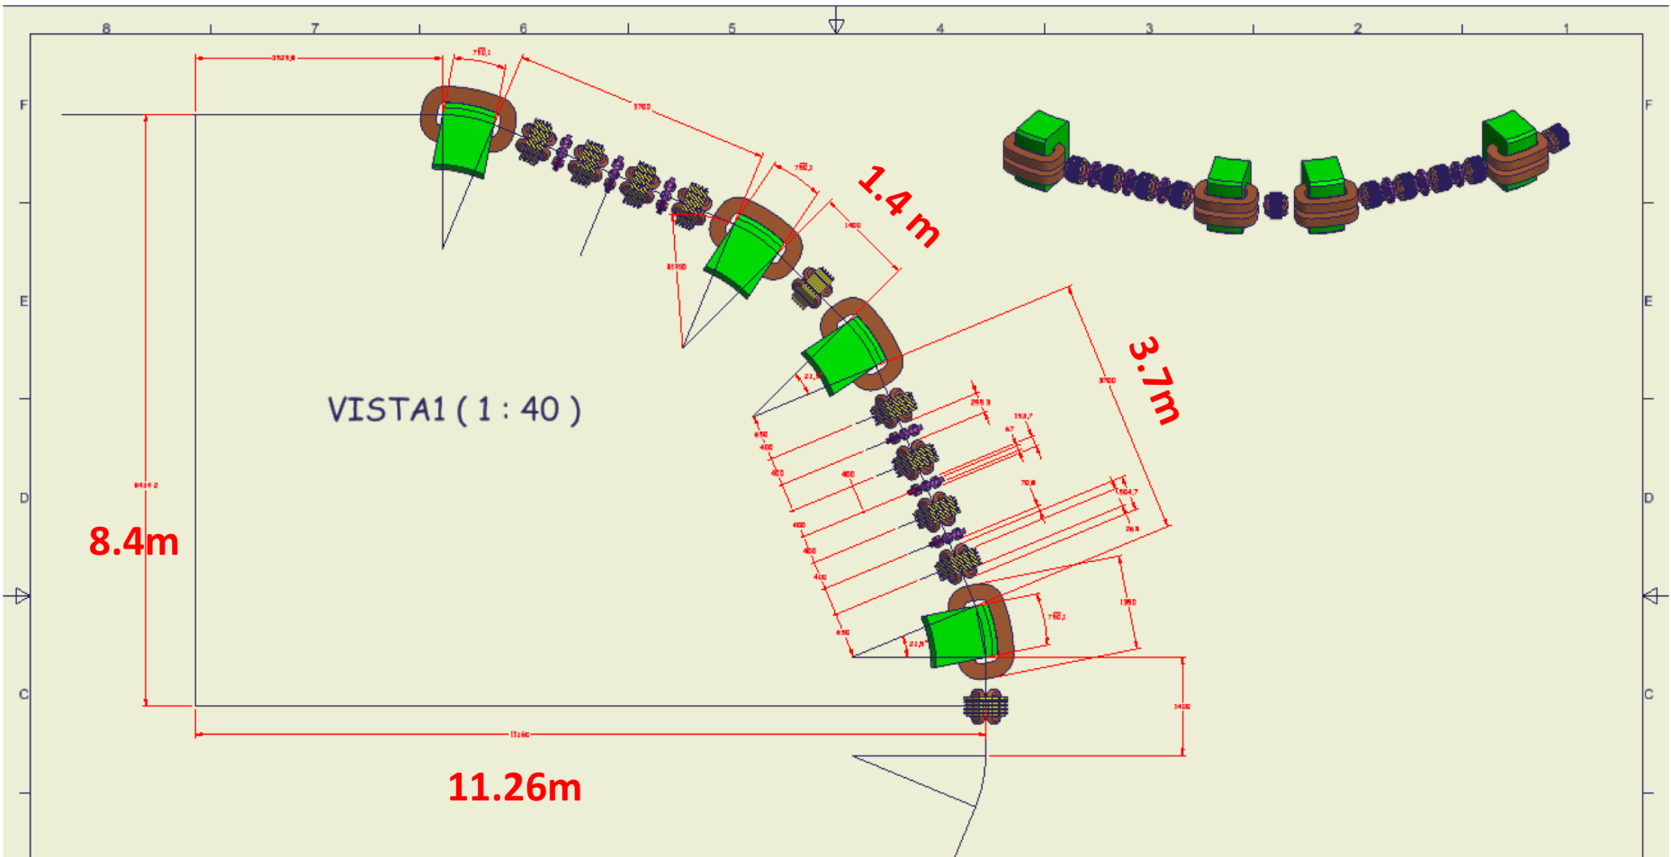
DR Present status
Drift spaces in the lattice have been modified to accommodate the real magnet dimensions as shown in the layout

Slide 16
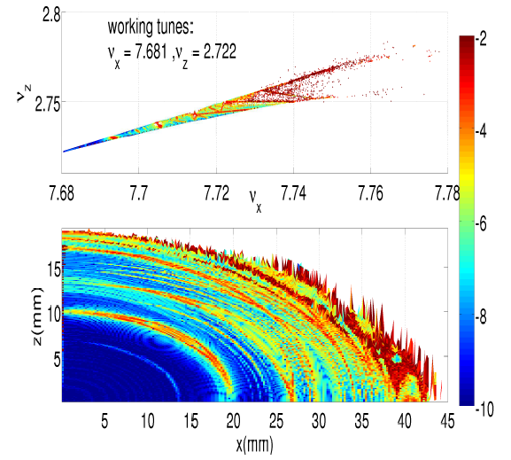
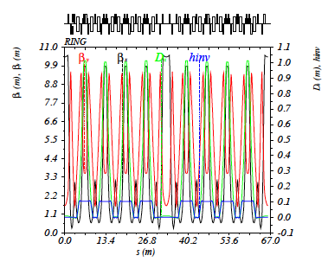
DR Present status
Circumference 51 m -> 66 m
Energy 1 GeV -> 1.1 GeV
Horizontal Emittance 23 nm > 33 nm
Horizontal damping time 7.3 ms -> 8.0 ms
DR optical funtions are very similar to the CDR2 lattice

Slide 17
Start-to-end simulation:
DR to Main Rings e+ sources
Parameters at DR exit (from CDR2 lattice)
Transfer lines DR to Linac, including bunch compressor (CDR2 lattice with minor updates)
Linac lattice calculated using 1 quadrupole each 2 accelerating sections
A short quadrupole section is used to match the optical functions to those of the main ring injection cell (V16).
The injection cell from the septum entrance to the Kicker position is used for the injection tracking simulations
The beam distribution is tracked from the DR exit to the main ring injection cell, just after the kicker.
Tracking is done using “Elegant” and taking into account of the main beam dynamics effects as wakefields in the cavities and CSR.

Slide 18
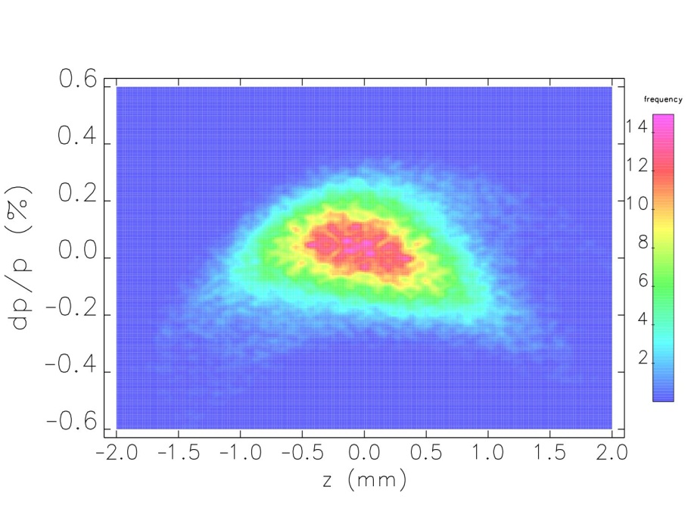
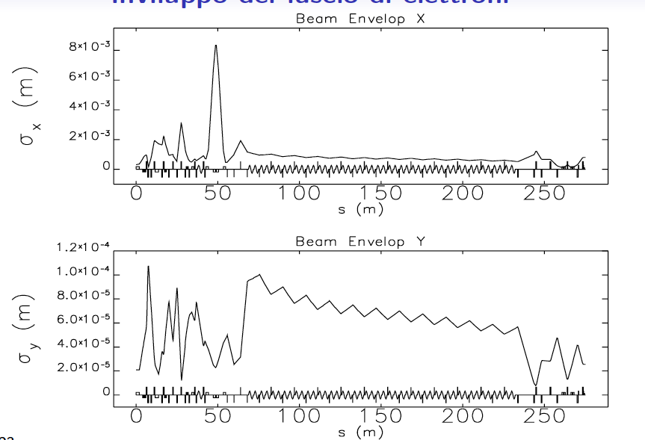
Long distribution after the linac - e⁻
e⁻ beam envelope: from DR exit to LER ring injection cell

Slide 19
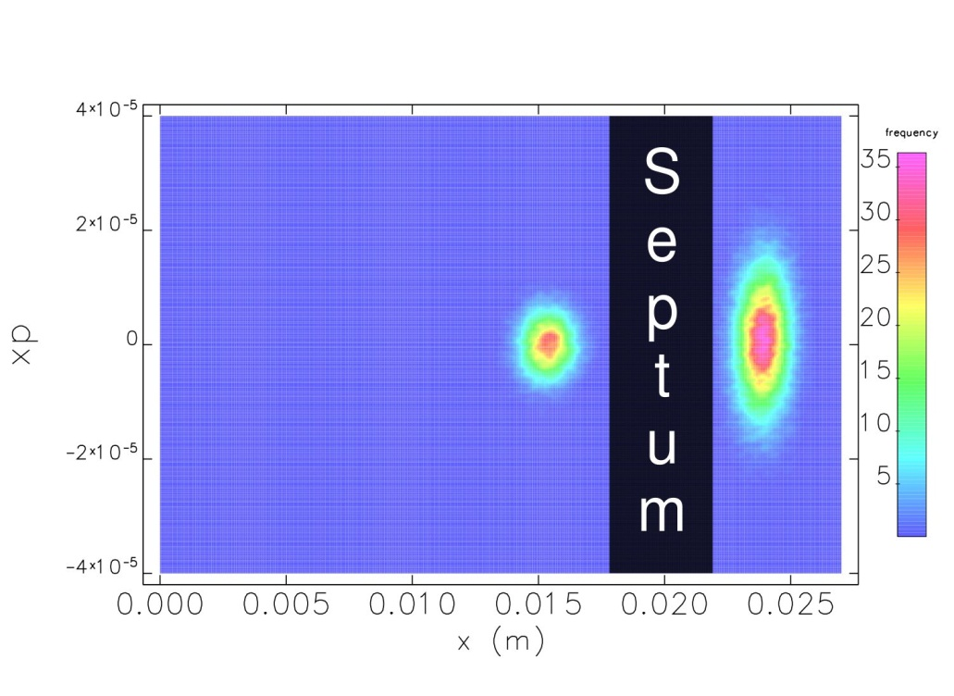
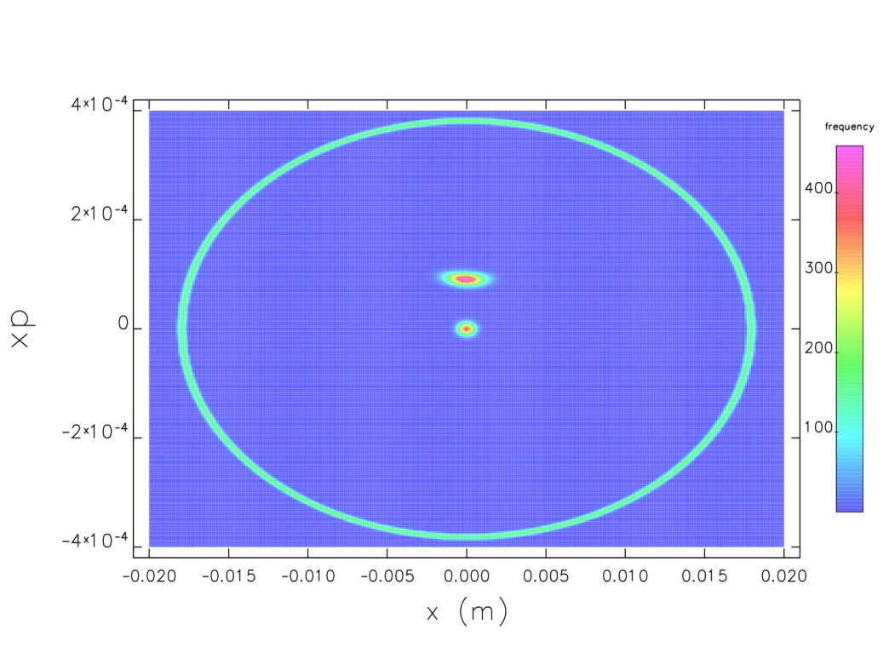
x distribution at septum
x Distribution at kicker
STORED AND INJECTED BEAM AFTER THE INJECTION KICKER AT LER
THE INJECTED BEAM IS WELL WITHIN THE RING STAY CLEAR ACCEPTANCE (GREEN ELLIPSE)

Slide 20
Next Steps
DR finalization and integration
- SASE Integration
Engineering constraints for everybody
Positron source drive linac to be designed (with electron source)
Study the possibility to have a multibunch injection

Slide 21
CONCLUSIONS
The Technical contributions for the Audit commission are basically provided. Costing, WBS, Maser Schedule, Hiring profiles for the project and for the crush program, manpower needed….
At present our mean goal is to produce a machine engineering footprint to allow the civil infrastructures to start
Main Ring => We started to increase the polarization. Now we will face the problems so Polarization will probably decrease
Lattice V0 is done
Magnets design is ongoing
Now we are integrating the main systems (Vacuum, diags…)
The DR has been changed to take into account the engineering constraints of the magnets. Vacuum and diags to be done
Injection system nearly to be finalized
A LOT HAS BEEN DONE FROM A VERY LITTLE TEAM (~ 10 FTE)…BUT A LOT HAS STILL TO BE DONE
We need manpower and missing expertise to provide a first acceptable footprint.

Slide 22
Thanks to all the colleagues for the work
Thanks to M.Biagini and S.Guiducci for the slides

