Slide 1
THEORY OF NUCLEAR STRUCTURE AND REACTIONS
Dalla struttura dei nuclei all’EOS
di materia nucleare
- Maria Colonna, LNS
e-mail:colonna@lns.infn.it
- Stefano Burrello, LNS
e-mail:burrello@lns.infn.it
- Danilo Gambacurta, LNS
e-mail:gambacurta@lns.infn.it
- Vincenzo Greco, LNS e Dip. di Fisica
e-mail:greco@lns.infn.it
PID@LNS 2025 3-4-2025

Slide 2
Why do we study
(Theoretical) Nuclear Physics?

Slide 3
… a bit of history
1912: Rutherford experiment
a tiny dense nucleus at the center of atoms
1932: neutron was discovered (Chadwick)
quantum mechanics was mature, particle accelerators started to be developed
1950: important properties of nuclear structure were understood
α-clusters, fission, liquid-drop model, shell model (Bohr & Mottelson, Wigner)
1960: Bardeen–Cooper–Schrieffer (BCS) model of superconductivity
nuclear pairing, BCS – Hartree Fock theory
1980: unveil the mysteries of the strong force (the nuclear force)
→ QCD - particle physics
What are the main motivations for the study of nuclear physics today ?

Slide 4
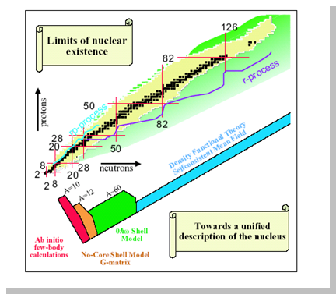
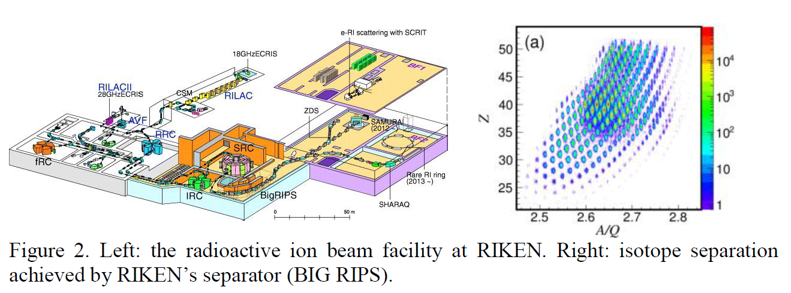
Current important science motivations
The availability of radioactive ion beams (RIB)
exploring the structure of «exotic» nuclei
through (low energy) nuclear reactions
→ a testbed for nuclear forces and their connections
to QCD principles
A world challenge!
→ A new facility, FRAISE, will be operational at LNS
(Japan)

Slide 5
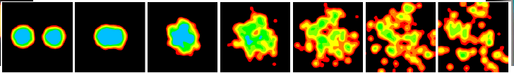
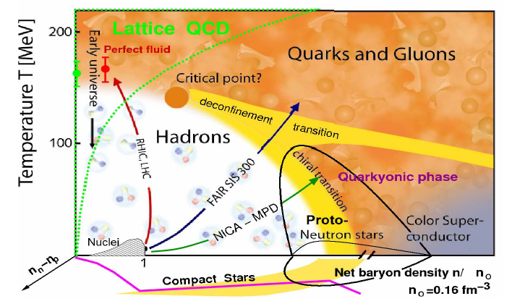
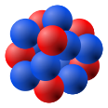
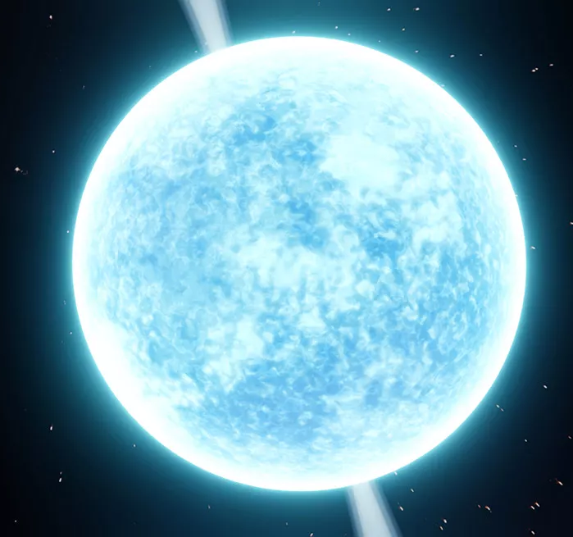
The nuclear Equation of State
exploring the behavior of nuclear matter under several conditions
of density, temperature and charge asymmetry
through dissipative nuclear reactions (Heavy Ion Collisions - HIC)
The Phase Diagram of
Strongly Interacting Matter
and
Tentative paths with
Nuclear Reactions
asymmetry axis

Slide 6
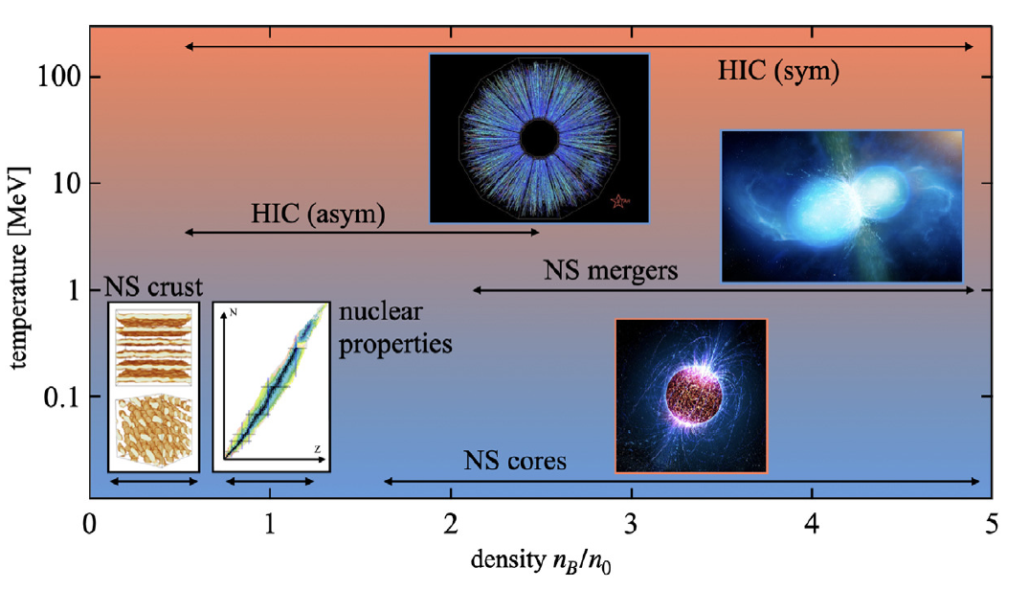
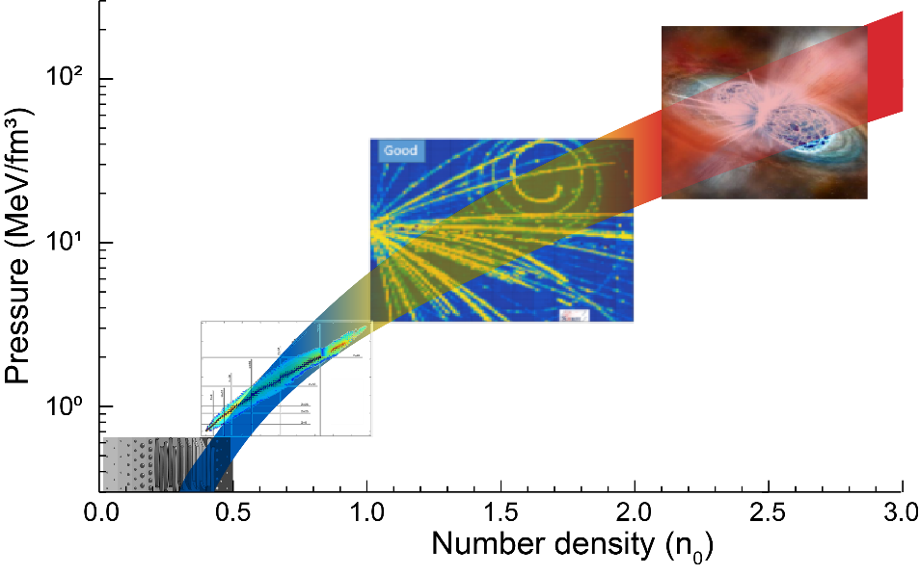
Important links with Astrophysics
stars, both during their lifetime and at their death, offer unique laboratories
to nuclear physics with conditions of temperature and density that cannot be
reproduced on Earth.
Schematic depiction of the ranges
of density and temperature probed in experiments
and astronomical observations sensitive to the EoS
Heavy ion collisions
Pure Neutron Matter
The neutron matter Equation of State
from combined experiments/observations
Astronomy
observations
Nuclear experiments
Moreover, nuclear reactions are important to understand
the (primordial) synthesis of elements and the life of stars
Crust
Nuclei properties

Slide 7
Reazioni nucleari:
Il problema della dinamica di un sistema quantistico a molti corpi …
iћ
stato a molti corpi
iћ
determinante di Slater
Densità ad un corpo ~ ρ(r,t)
campo medio
iћ

Slide 8


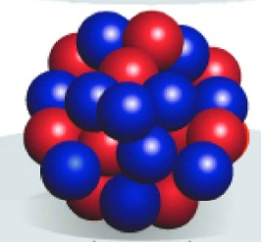
Direct Reactions
Reactions involving few or simple degrees of freedom, e.g. single particle or collective, e.g. ¹⁶O(d,p)¹⁷O, usually using light probes. Treated quantum-mechanically with scattering theory, e.g. optical model.
Nuclear structure
→ Today of interest to study structure of exotic, weakly bound nuclei

Slide 9
NUMEN at LNS: Charge Exchange reactions
⁴⁰Ca(¹⁸O,¹⁸Ne)⁴⁰Ar @ 270 MeV
¹⁸O⁷⁺ beam from Cyclotron at 270 MeV (10 pnA, 3300 μC in 10 days)
⁴⁰Ca target 300 μg/cm²
Ejectiles detected by the MAGNEX spectrometer 0° ≤ θ_{lab} ≤ 10° corresponding to a momentum transfer ranging from 0.17 fm⁻¹ to 2.2 fm⁻¹
Measured channels
DCE reaction ⁴⁰Ca(¹⁸O,¹⁸Ne)⁴⁰Ar
SCE reaction ⁴⁰Ca(¹⁸O,¹⁸F)⁴⁰K
2p-transfer ⁴⁰Ca(¹⁸O,²⁰Ne)³⁸Ar
2n-transfer ⁴⁰Ca(¹⁸O,¹⁶O)⁴²Ca
⁴⁰Ca | ⁴¹Ca | ⁴²Ca
³⁹K | ⁴⁰K | ⁴¹K
³⁸Ar | ³⁹Ar | ⁴⁰Ar
(¹⁸O,¹⁶O)
(¹⁸O,¹⁸F)
(¹⁸O,²⁰Ne)
Z
(¹⁸O,¹⁸Ne) and ββ+
N
D. Carbone -- CNNP2017 Conference on Neutrino and Nuclear Physics 15 - 21, 2017 Catania,Italia

Slide 10
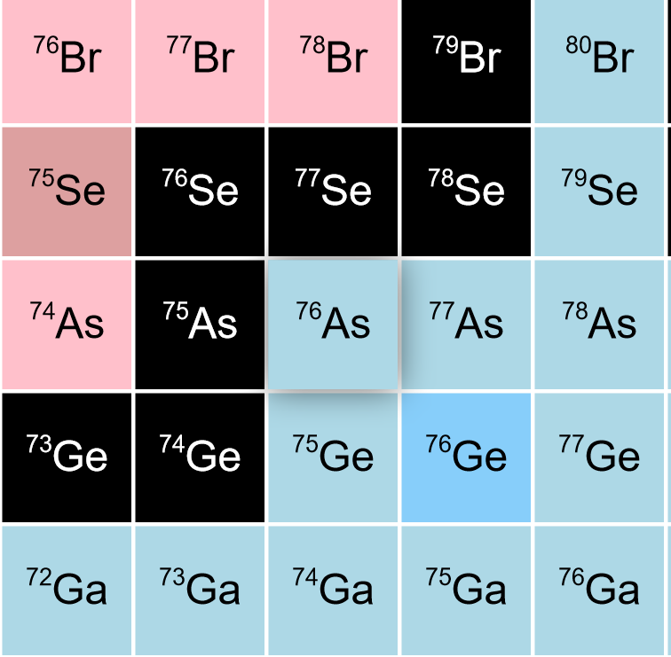
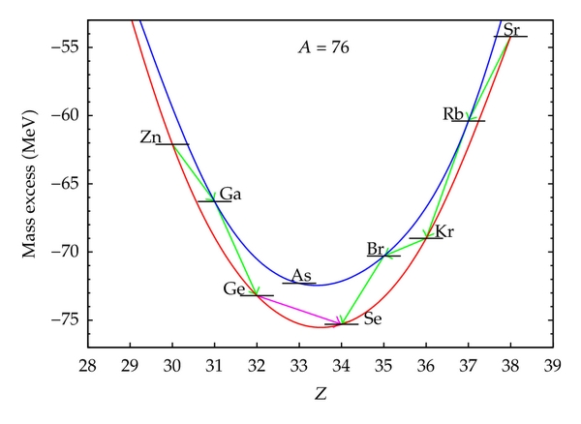
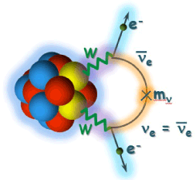

0νββ decay
Open problem in modern physics:
Neutrino absolute mass scale
Neutrino nature
  Still not observed
0νββ is considered the most promising approach
${{}_{Z}^{A}X}_{N}→$ ${{}_{Z+2}^{A}Y}_{N−2}+{2e}^{−}$
Beyond standard model
Process mediated by the weak interaction
Occurring in even-even nuclei where the single β-decay is energetically forbidden
D. Carbone -- CNNP2017 Conference on Neutrino and Nuclear Physics 15 - 21, 2017 Catania,Italia
D. Carbone -- CNNP2017 Conference on Neutrino and Nuclear Physics 15 - 21, 2017 Catania,Italia

Slide 11
Anche nel caso di meccanismo più dissipativi, ci si riduce ad un problema ad un corpo introducendo il concetto di
interazione efficace :
Lo stato many-body e’ rappresentato dal prodotto (antisimmetrizzato) di stati di particella singola (determinante di Slater)
L’interazione fra i nucleoni si esplica sotto forma di un “campo medio”
auto-consistente : ciascun nucleone risente del campo creato da tutti gli altri
- Il potenziale e’ un operatore ad un corpo, ma non e’ un campo esterno !!
Equazione di Stato (EoS)
di materia nucleare

Slide 12
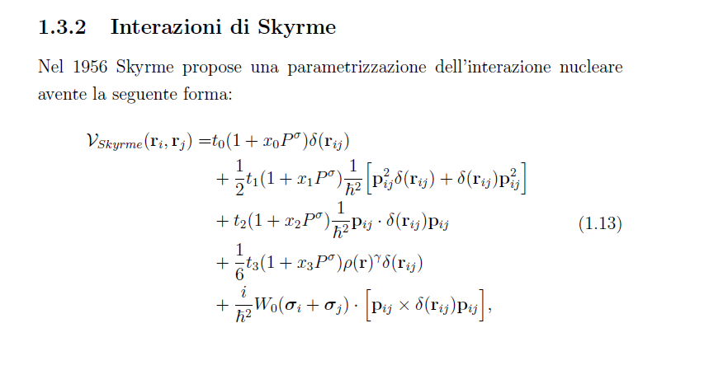
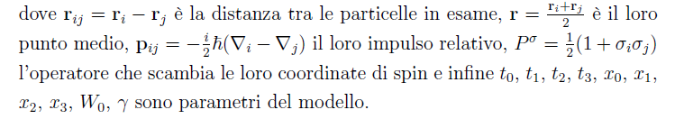
Un esempio di interazione efficace
Termine attrattivo
Termine repulsivo

Slide 13
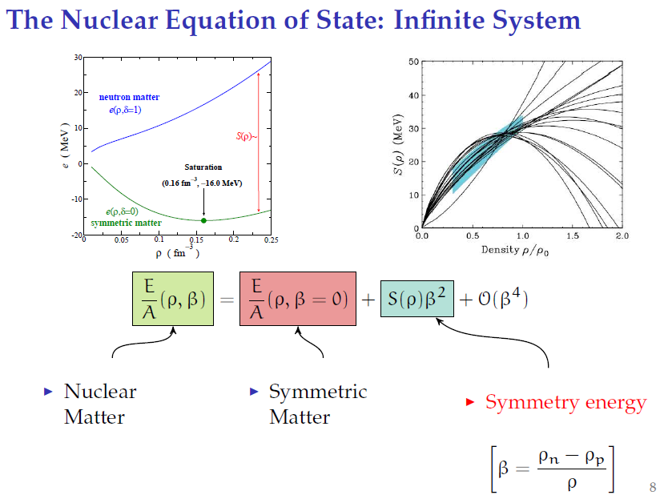
The nuclear Equation of State (T = 0)
analogy with Weizsacker
mass formula for nuclei (symmetry term) !
asymmetry parameter

Slide 14
Asymmetric matter : Symmetry Energy
Symmetric → Asymmetric
E/A (ρ) = E_{s}(ρ) + S(ρ)β²
Fermi
(T=0)
Asymmetry parameter
β = (ρ_{n} –ρ_{p} ) / ρ
k_{F}
x x x x
o o o o
N
Z
N
Z
≈ ε_{F}/3 ~ ρ^{2/3}
Nuclear interaction
at saturation density
ρ = ρ₀
a₄ term (~30MeV) of the Weiszäcker Mass Formula:
at saturation E_{sym}(Fermi) ≈ E_{sym}(Interaction)

Slide 15

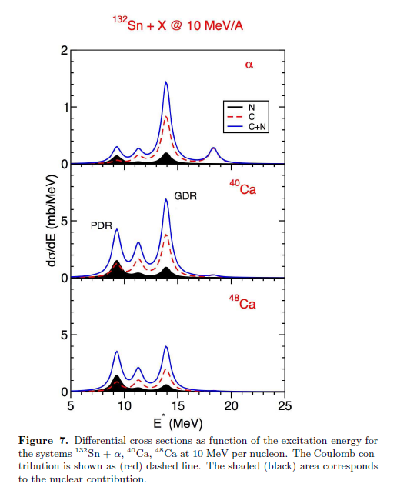

Nuclear structure and collectivity
Self-consistent MF calculations (and extensions) are a powerful framework to understand the structure of medium-heavy nuclei.
Nuclear levels, Nuclear collective motion (HF, TDHF and extensions)
Giant Dipole Resonance
Neutron center
of mass
Proton center
of mass
Pygmy Dipole Resonance
Isovector dipole response in neutron-rich nuclei
Symmetry energy
→ S(ρ)
E (MeV)
15
neutron-skin effect!
E/A (ρ) = E_{s}(ρ) + S(ρ) β²
β=(ρ_{n}-ρ_{p})/ρ
D. Gambacurta, Nuovo Cimento C 47, 22 (2024)

Slide 16
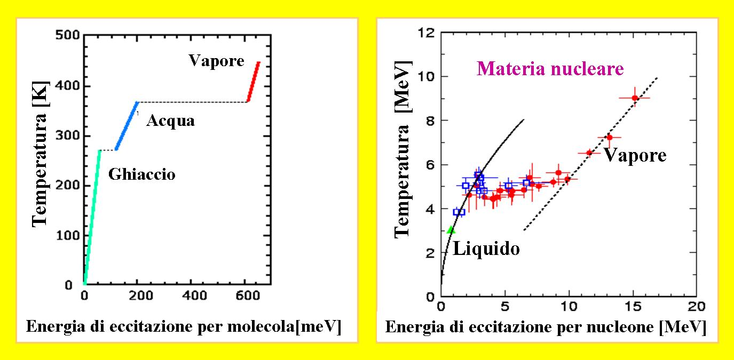
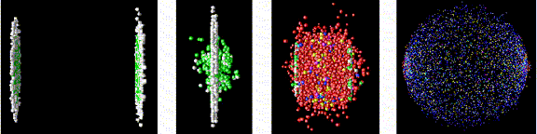
Le collisioni nucleari consentono di creare stati transienti di
materia nucleare in varie condizioni di densita’ e temperatura
Collisione fra ioni pesanti
Esplosione di supernova
Le diverse fasi della materia nucleare …
Liquido - gas
Nucleoni – plasma di quarks e gluoni

Slide 17
Tentative “Paths” with
Heavy Ion Collisions:
From dilute (liquid-gas)
phase to high baryon
and isospin density
The Phase Diagram of Strongly Interacting Matter
D.Blaschke
asymmetry
axis
Treatment of many-body dynamics
Kinetic theories EOS Phenomenology of Heavy Ion Collisions
low ρ, T high ρ, T
~ 0.05 GeV/A
~ 0.5-2 GeV/A
E_{beam}
ρ ~ 1.5-2 ρ₀

Slide 18

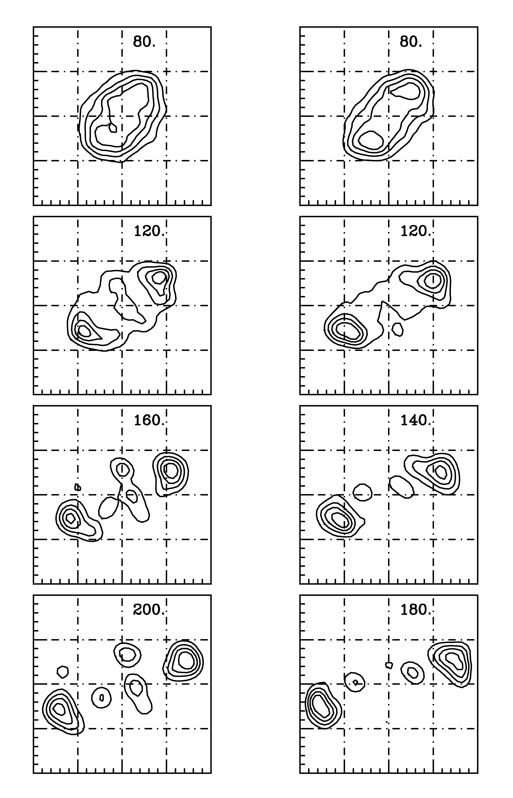
Mean-field calculations
(fluctuations projected on ordinary space)
b = 4 fm
b = 6 fm
Central collisions
Ni + Au, E/A = 45 MeV/A
Sn124 + Sn124, E/A = 50 MeV/A

Slide 19
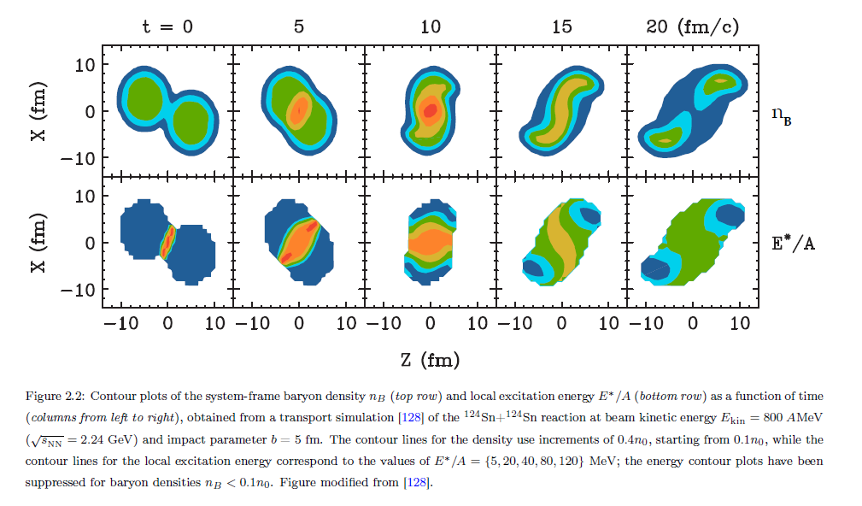
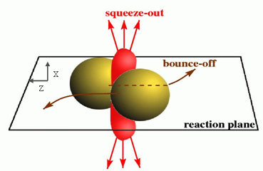
Heavy Ion Collisions: collective flows
¹²⁴Sn + ¹²⁴Sn,
0.8 GeV/A, b=5 fm
pBUU - Shi, Danielewicz, Lacey, PRC 64 (2001)
Transverse flow V₁
y = rapidity = v_{parallel} /v_{beam}
p_{t} = transverse momentum
ρ ~ 1.5-3 ρ₀
= − 1 full out
V₂ = 0 spherical
= + 1 full in
target
projectile
Out-of-plane (elliptic) flow:
anisotropy in transverse plane
of emitted particles

Slide 20
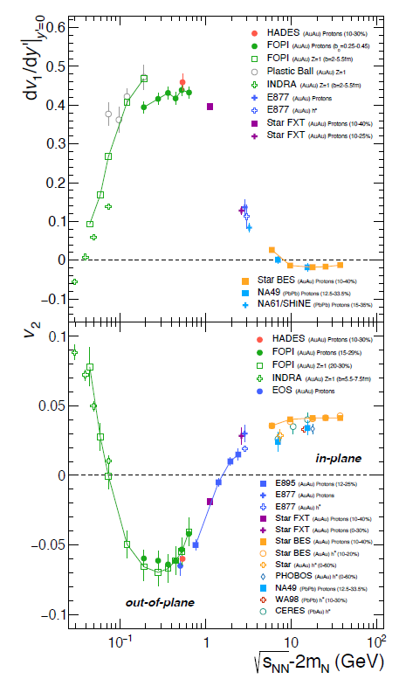
Collective flows data:
a systematics with energy
V₁
p_{x}
Transverse flow V₁
p_{z}
V₂
target
projectile
Elliptic flow V₂
A.Sorensen et al, PPNP 134 (2024)

Slide 21
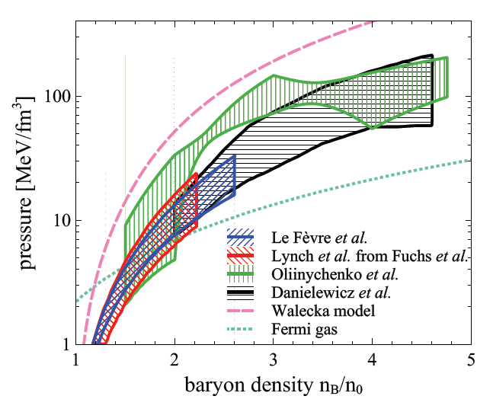
EoS constraints from Heavy Ion Collisions
(symmetric nuclear matter)
Au + Au collisions 0.15-10 AGeV
Danielewicz, Lacey, Lynch Science 298 (2002)
Kaon emission
C.Fuchs, PPNP 134 (2004)
FOPI – elliptic flow
A.Le Fèvre et al, NPA 945 (2016)
Constraints from new STAR data,
using a baryonic EoS
with varying speed of sound
D.Oliinychenko et al, PRC108 (2023)
A.Sorensen et al, PPNP 134 (2024)

Slide 22
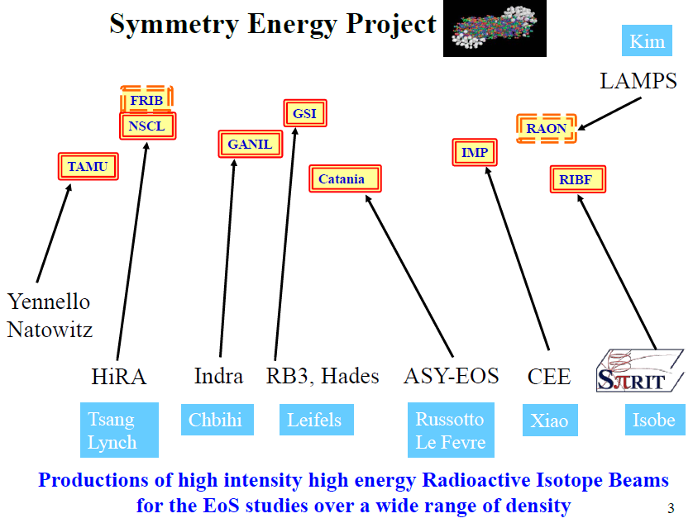
NIMROD
VAMOS
+ FAZIA, FARCOS, …
B.Tsang NuSym ‘23

Slide 23
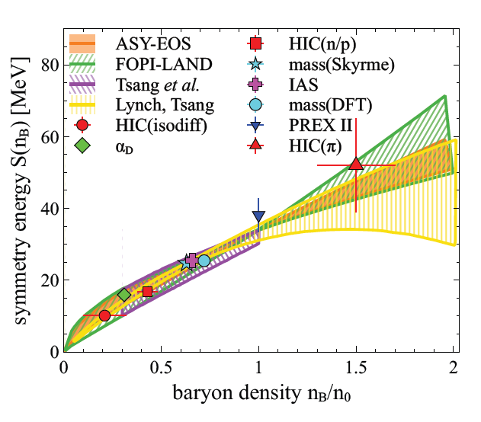
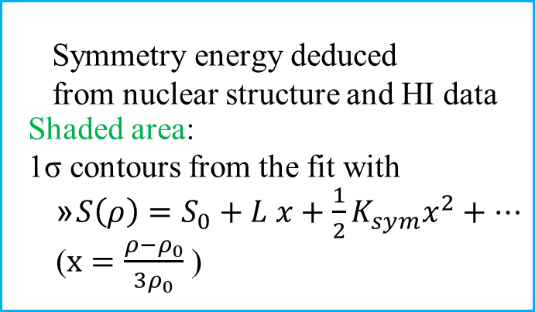
SE from structure and nuclear reactions
A.Sorensen et al, PPNP 134 (2024)
  Symmetry energy deduced
  from nuclear structure and HI data
  Shaded area:
  1σ contours from the fit with
    $S\left(ρ\right)=S_{0}+L x+\frac{1}{2}K_{sym}x^{2}+…$
    ($x=\frac{ρ−ρ_{0}}{3ρ_{0}}$ )
Lynch & Tsang PLB 137098 (2022)
B. Tsang et al., PRL 102 (2009)
Lynch & Tsang PLB 137098 (2022)

Slide 24
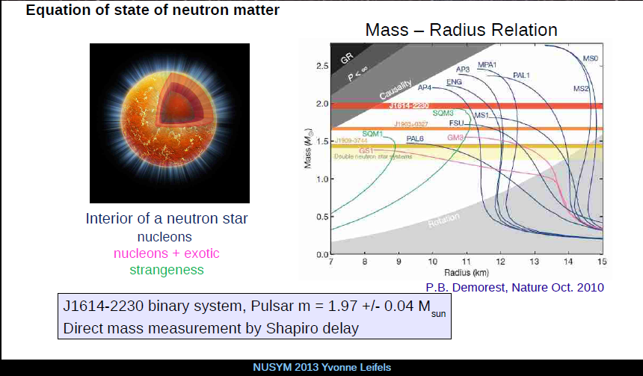
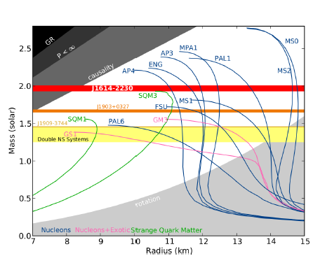

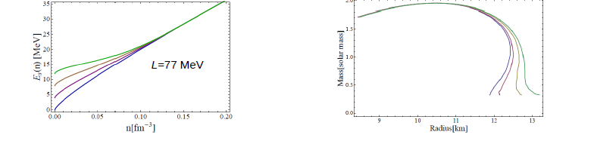
Neutron Stars (NS):
balance of Gravity (pulls in) and Symmetry energy pressure (pushes out) :
Masses vs. Radii
Maximum mass :
mainly determined by high density EOS ,
onset of strangeness, quark phase
Radius (for M ~ 1.4 M_{o} ) :
depends on low density
Symmetry Energy and slope L
Alvarez-Castillo & Kubis (2012)

Slide 25
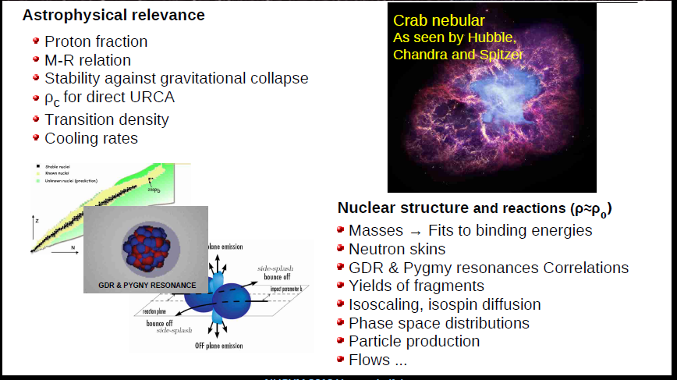
Astrofisica --- Struttura Nucleare --- Reazioni

Slide 26

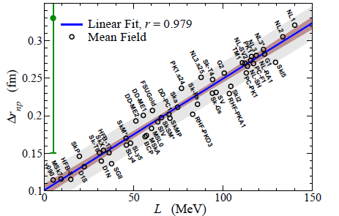
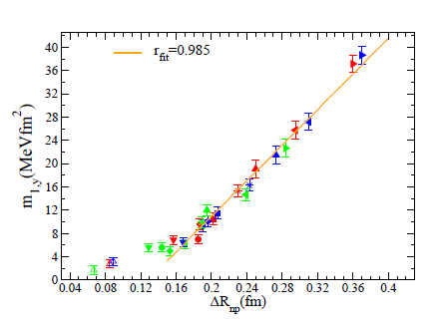

Correlations :
L – neutron skin
Correlations :
PDR strength – neutron skin
PREX point
Pb
SMF calculations
superstiff
stiff
soft
HF calculations
D. Gambacurta, Nuovo Cimento C 47, 22 (2024)
V.Baran et al., Physical Review C 88, 044610 (2013)
Symmetry energy
→ S(ρ)

Slide 27
Correlations :
L – neutron skin
Correlations :
PDR strength – neutron skin
PREX point
Pb
crust-core
SMF calculations
superstiff
²⁰⁸Pb
stiff
soft
HF calculations
Nuclei- neutron star
connection !
I.Vidana et al., PRC80(2009)

Slide 28
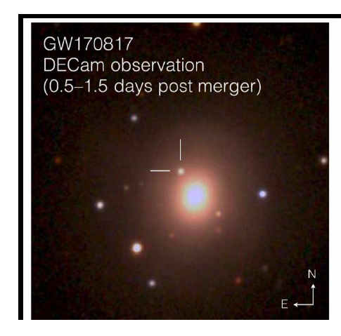
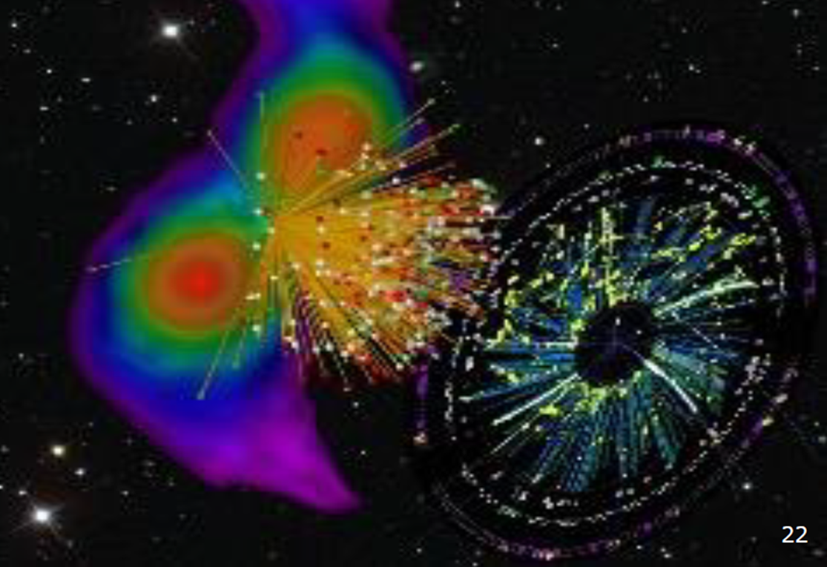
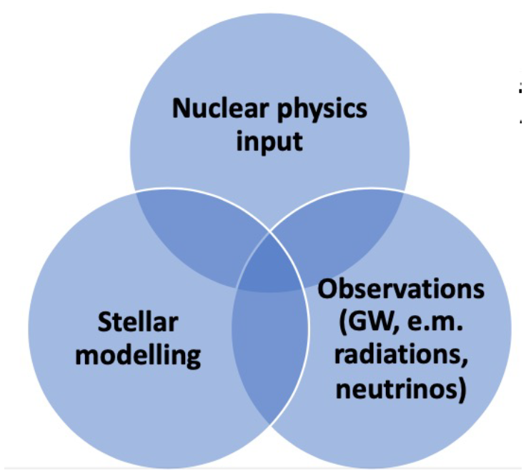
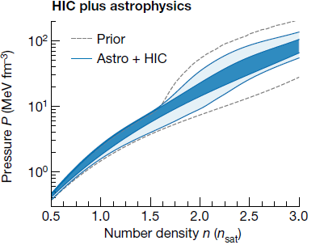
Multimessenger astronomy associated with the detection of GW waves:
heavy elements (r-process) are produced in neutron star mergers
the nuclear EoS has a strong impact on neutron star features
that influence the emission
Bayesian Inference on the EoS of
Neutron Star Matter
χEFT calculations
+ NS masses
and radii (NICER)
GW signals
NS mergers
+ collective flows from HIC
P.Russotto et al, PRC 94 (2016)
S. Huth et al., Nature 606, 276 (2022)
C.Y. Tsang et al., Nature Astron. 8 (2024) 328

Slide 29
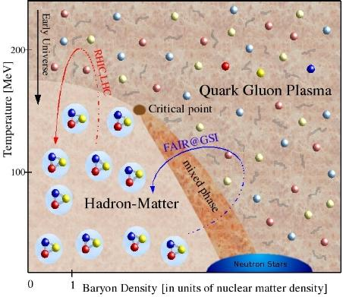
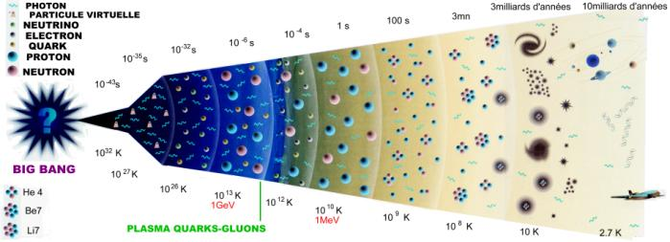
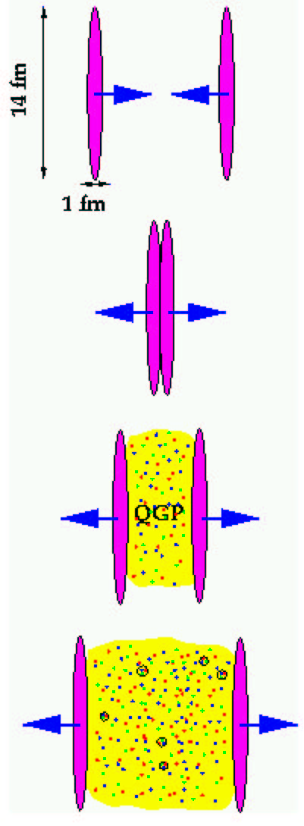
Dynamics of the Quark-Gluon Plasma:
Exploring QCD at high T by Ultra-Relativistic HIC
LHC
RHIC
10⁻⁵s
Quark-Gluon Plasma
nuclei
Facility | Lab. | Energy [A GeV] | Ene.density [GeV/fm³]
RHIC(00-…) | BNL | 200 | 15
LHC (09-...) | CERN | 5500 | 75-200
FAIR (20-…) | GSI | 2-20 | 1-4
new medium created from the energy deposited μ_{B}=0 (quark=antiquarks)
Hotter-denser-longer increasing E_{beam}
RHIC - T=2T_{c} −> τ_{QGP} ~5 fm/c
LHC - T=3-4T_{c} −> τ_{QGP}~15fm/c

Slide 30
Metodologia
more theoretical…
more phenomenological…
Resultati di lattice QCD, pQCD and effective lagrangians:
non direttamente confrontabili con i dati sperimentali
Teoria cinetica di partoni:
−> suggerisce e predice osservabili direttamente confrontabili con i dati
Interazione contenuta in m* ed F_{μν} studiata tramite Lagrangiane efficaci che riproducono i risultati della QCD risolta su reticolo
KEYS:
Relate theorethical studies on QCD to the experimental observables
Treatment of the various phenomena in a common framework:
collective flow, hadronization, jet-quenching and heavy quarks dynamics…
Initial Conditions
Quark-Gluon Plasma
Hadronization
BULK
(p_{T}~T)
Microscopic
Mechanism
Matters!
S.Plumari, V.Greco et al.,
NPA 941, 87 (2015)
CGC (x<<1)
Gluon saturation
MINIJETS
(p_{T}>>T,Λ_{QCD})
Heavy Quarks
(m_{q}>>T,Λ_{QCD})

Slide 31
Un esempio: Flusso Ellittico
(misura viscosità del mezzo)
p_{y}
v₂/ε misura l’efficienza di
conversione dell’eccentrictità dallo spazio xy a quello degli impulsi (p_{x},p_{y})
p_{x}
y
z
η/s viscosity
x
c²_{s}=dP/dε − EoS
più piccolo η/s mai osservato?!
η=0
RHIC
SPS
Transverse Density [fm⁻²]

Slide 32
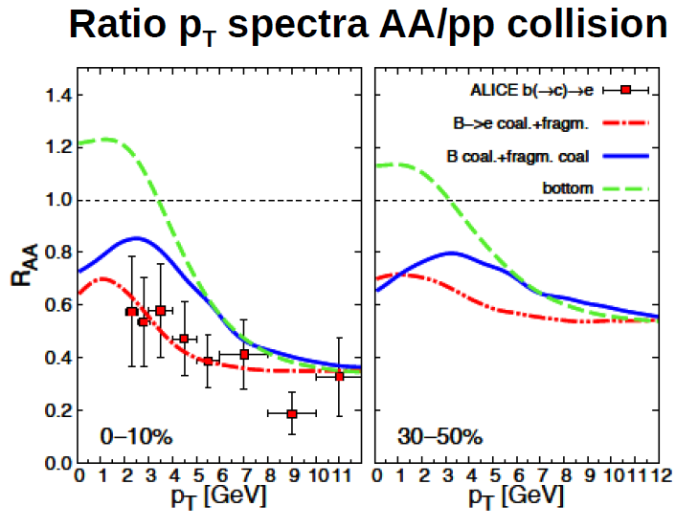

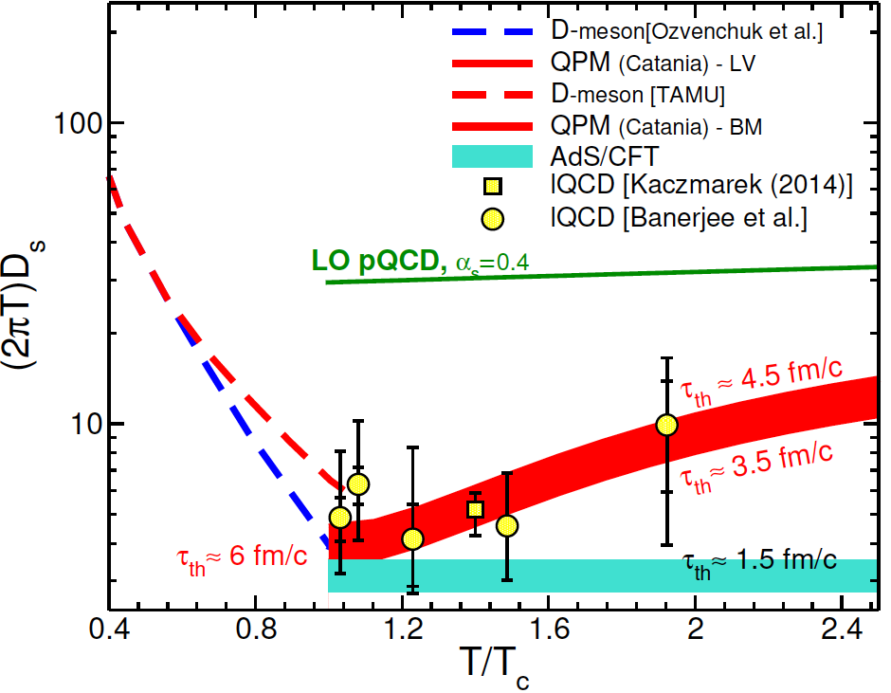
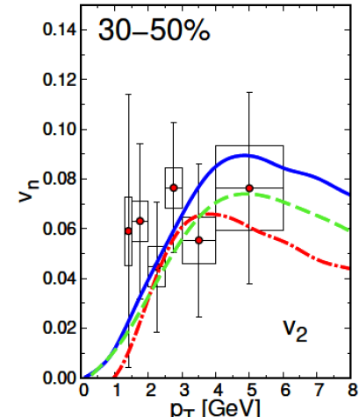
Quark dynamics: «charmed» and «bottom» meson production
Diffusion Coefficient of
Charm Quark
Asymptotic free regime
AdS/CFT
B mesons
X. Dong and V Greco, Prog.Part.Nucl.Phys. (2019)
A. Beraudo et al., JHEP 02 (2018) 043
Largely non-perturbative D_{s} (close AdS/CFT)
−> Γ_{coll} ≈ D_{s}⁻¹ ≈ 0.5-1 GeV
Agreement with lattice QCD
D_{s} ~ (100-500) × 10⁻⁵ cm²/s
Elliptic Flow v₂
LNS
ML. Sambataro et al., PLB 849 (2024)
Notes:
U shape typical of phase trnsition
As T→Tc ticuhe the AdS limit

Slide 33
Struttura Nucleare
Reazioni Nucleari
EoS e astrofisica
nucleare
Studio dell’interazione nucleare e di sistemi nucleari
in varie condizioni

Slide 34
Other fields connected to nuclear structure and reactions
Neutrino physics
Neutrino-nucleus cross sections are important for neutrino-oscillation experiments,
as neutrinos interact with nuclear targets in the detectors
Nuclear structure ingredients are crucial to the search of neutrino-less double β decay
Physics beyond the Standard Model
Dark particles are searched in (underground) experiments using detectors filled
with Ar or Xe
The knowledge of nuclear cross sections with «standard» particles is instrumental to the
search of physics beyond the SM
Multi-messenger physics
HIC help determining the nuclear EoS, a crucial ingredient to interpret signals emitted
from neutron stars and binary mergers → detection of gravitational waves
+ medical applications…

