Slide 1
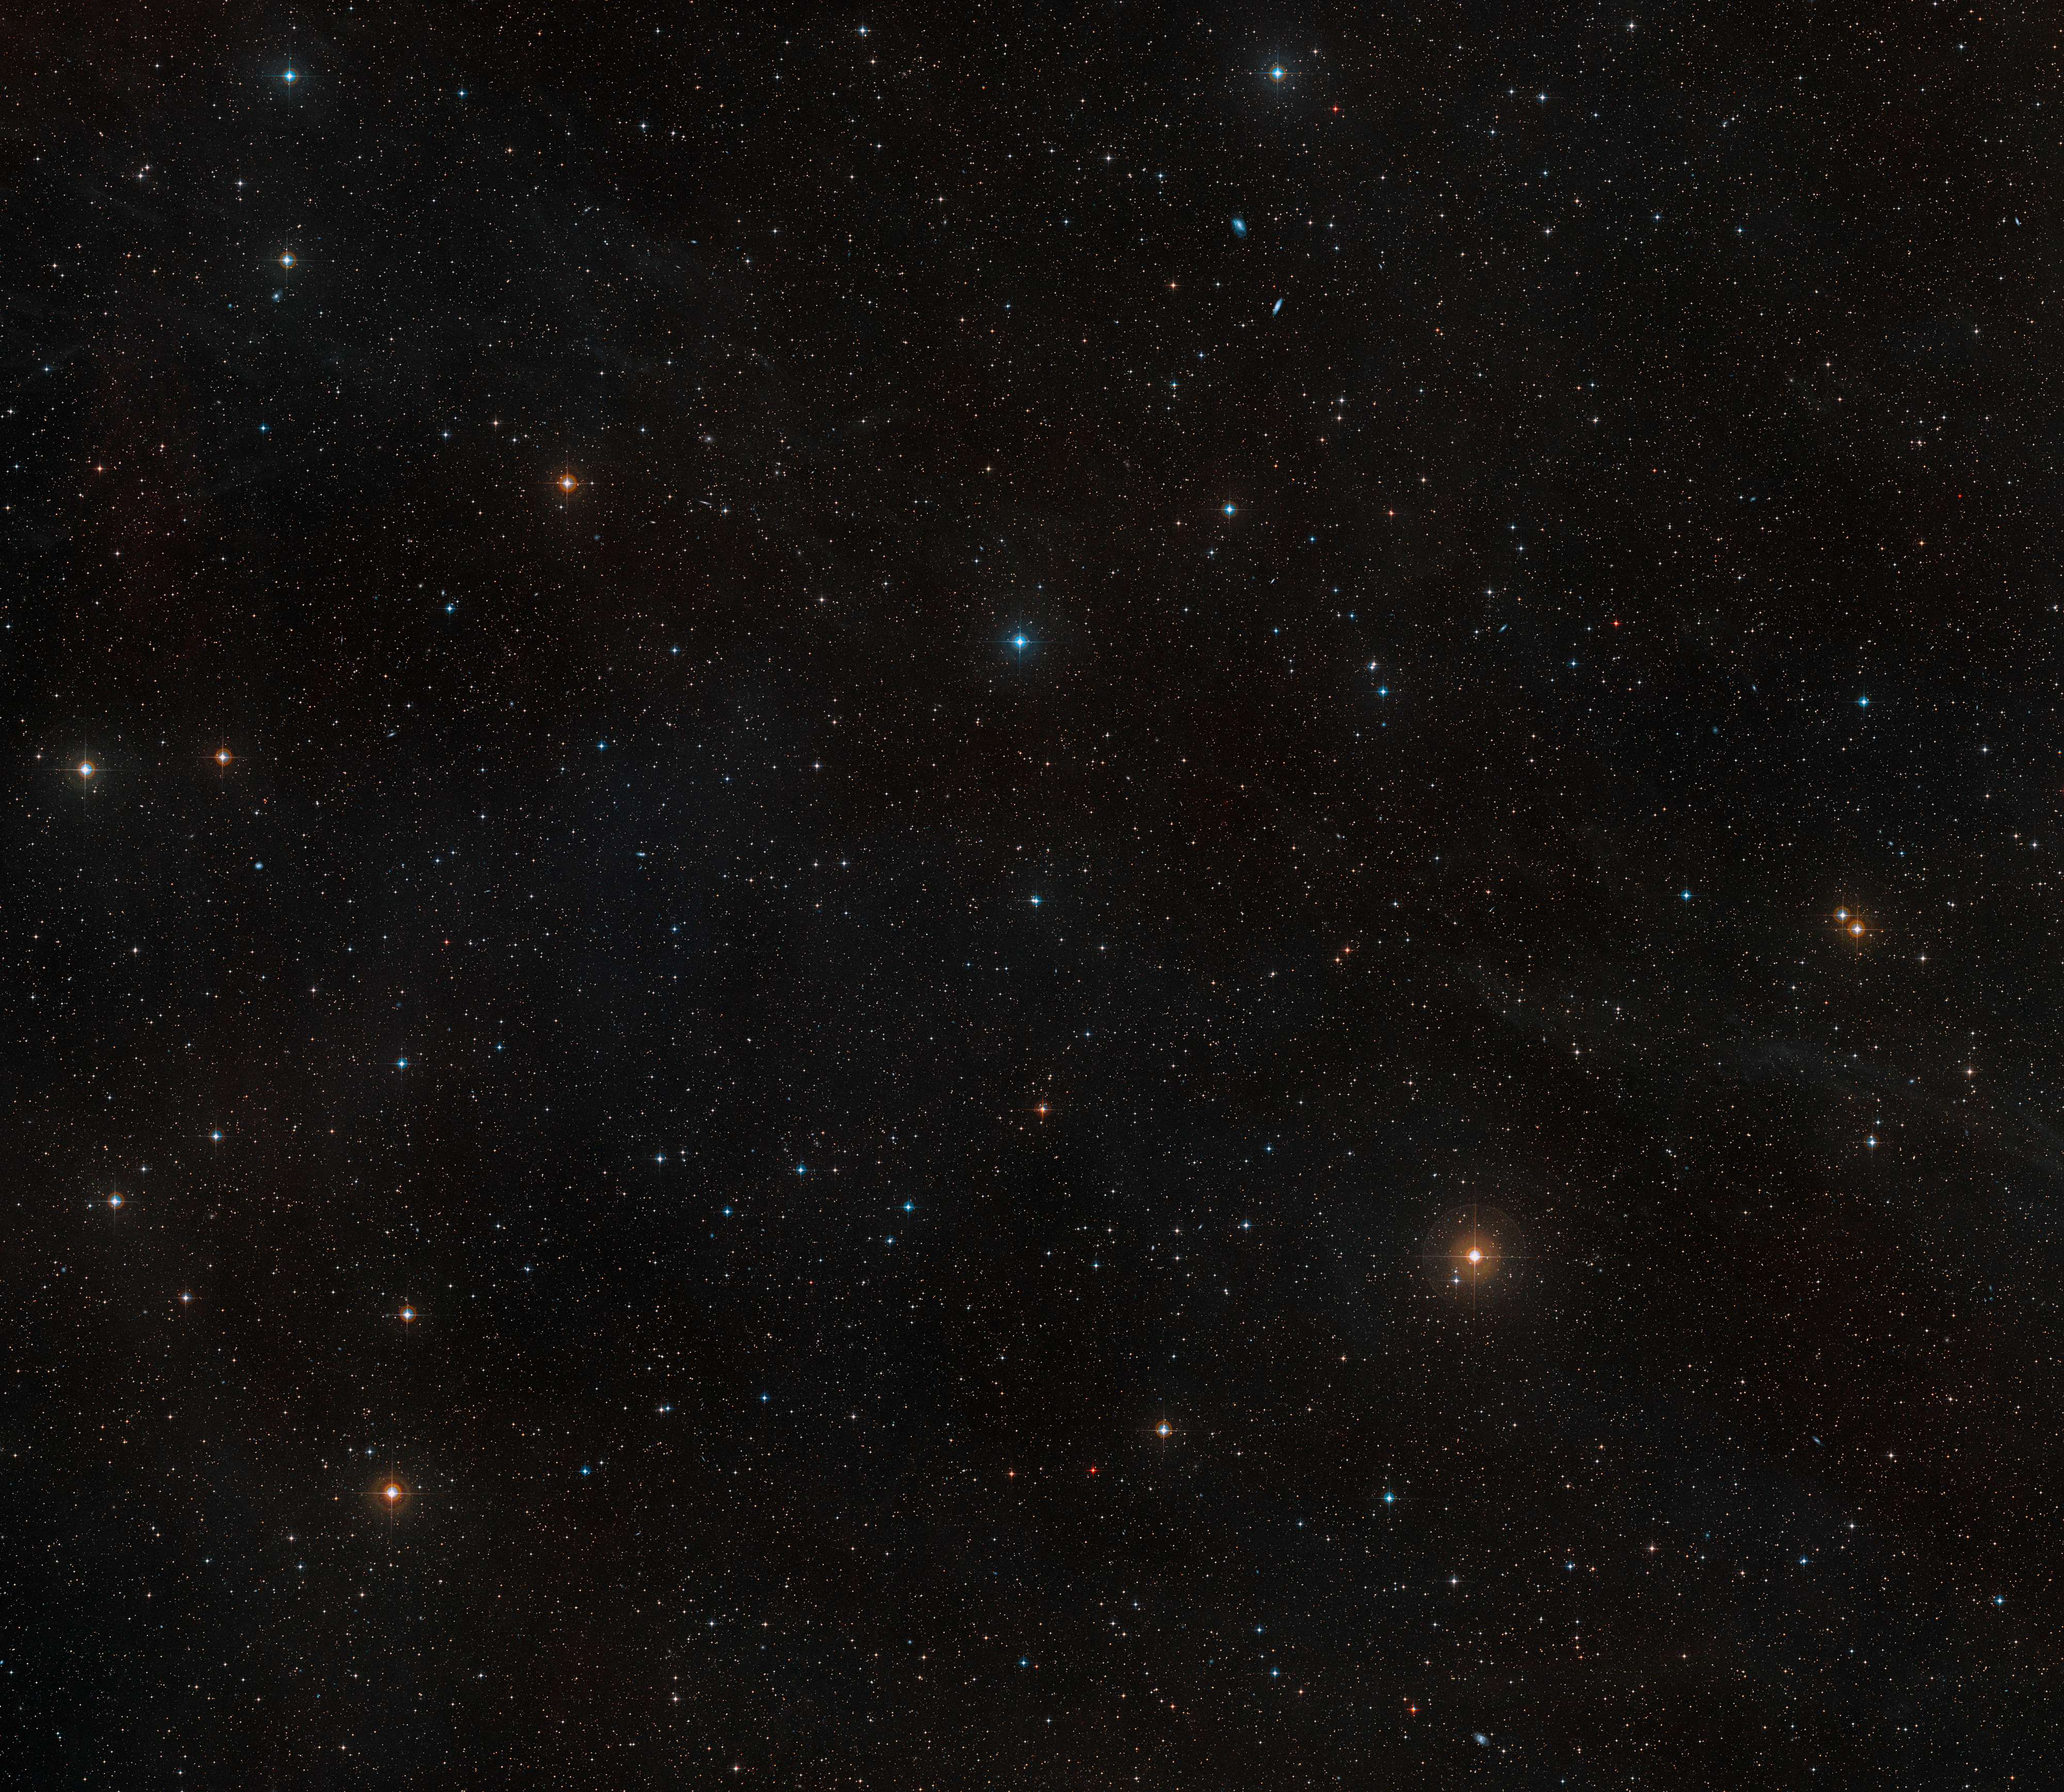
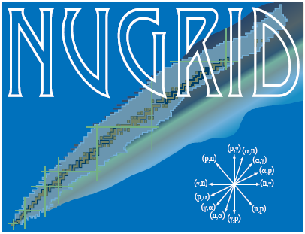





Carbon-Oxygen Shell Interactions in Massive Stars: Nucleosynthesis and Implications
Gruppi Italiani di Astrofisica Nucleare Teorica e Sperimentale XII
Catania, July 4, 2025
Lorenzo Roberti, INFN – Laboratori Nazionali del Sud, Catania, Italy
Main collaborations:
Pandora + AsFiN
Budapest group: M. Pignatari, M. Lugaro
Rome + Berkeley group: M. Limongi, A. Chieffi, A. Falla, L. Boccioli
NuGriD collaboration

Slide 2
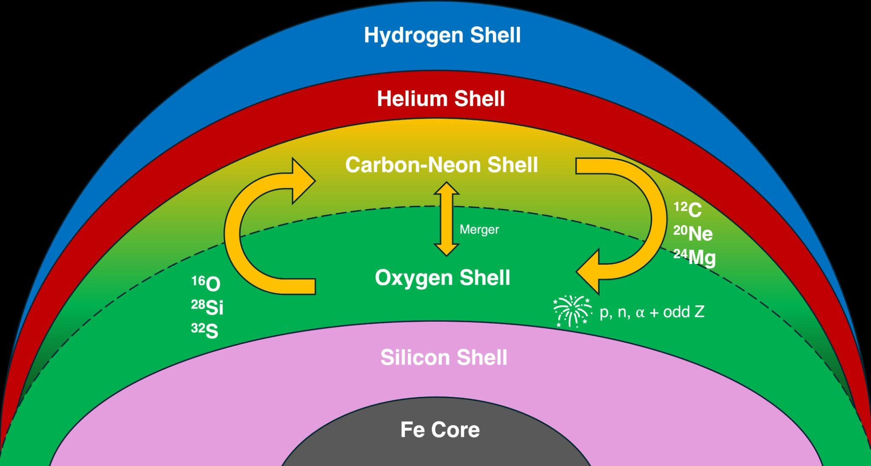

Carbon-oxygen shell mergers in massive stars
Ingestion of some C (and Ne) in the O burning shell during late stages of the evolution;
Convective-reactive event →Formation of an extended mixed convective zone;
Peculiar nucleosynthesis and impact on the explodability;
Found often in 1D stellar models with M_{ini}$≤$25 M$⊙$;
Confirmed by 3D simulations (e.g., Rizzuti+24).

Slide 3
Carbon-oxygen shell mergers in massive stars
Ingestion of some C (and Ne) in the O burning shell during late stages of the evolution;
Convective-reactive event →Formation of an extended mixed convective zone;
Peculiar nucleosynthesis and impact on the explodability;
Found often in 1D stellar models with M_{ini}$≤$25 M$⊙$;
Confirmed by 3D simulations (e.g., Rizzuti+24).
Production of a large number of unstable nuclei at high temperature and density (e.g. 37Ar)

Slide 4
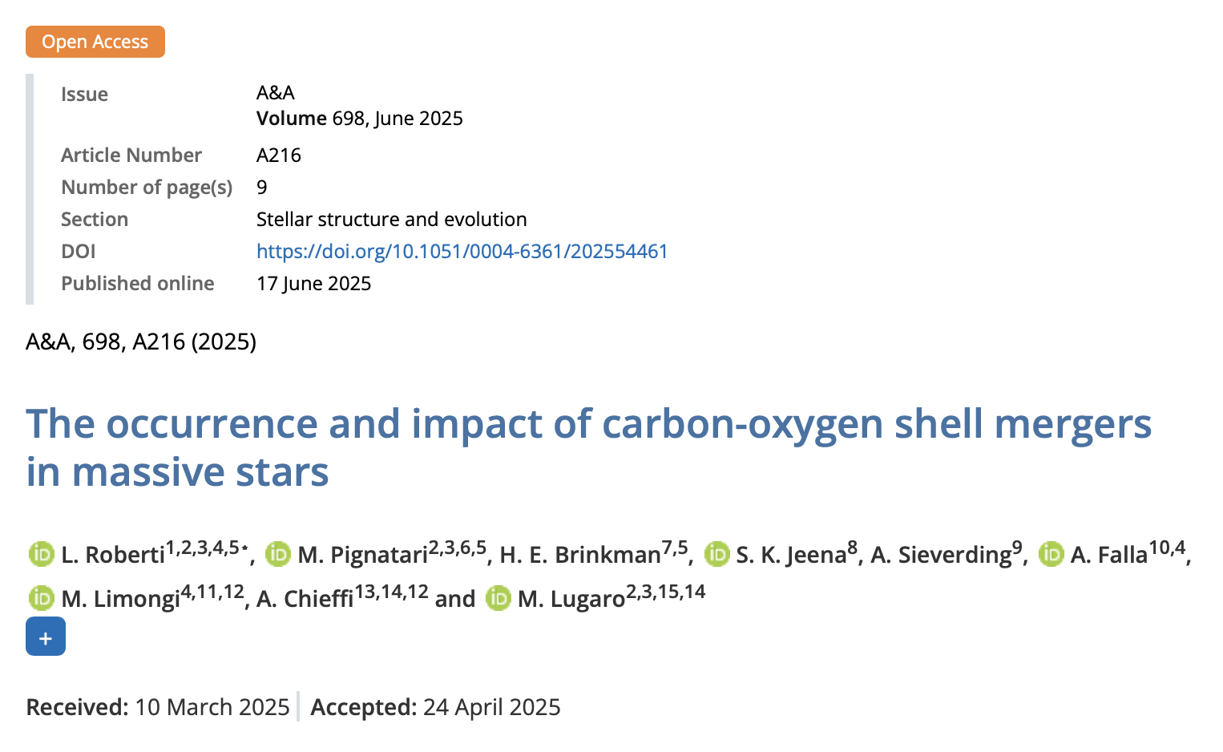

Carbon-oxygen shell mergers in massive stars
Link to the paper

Slide 5
Nucleosynthesis in a C-O shell merger
Enhanced O-burning products and production of odd-Z elements (P, Cl, K, Sc);
Efficient photodisintegration of heavy elements: production of the weak s-process and 𝜸-process nuclei.

Slide 6
Nucleosynthesis in a C-O shell merger
Enhanced O-burning products and production of odd-Z elements (P, Cl, K, Sc);
Efficient photodisintegration of heavy elements: production of the weak s-process and 𝜸-process nuclei.

Slide 7

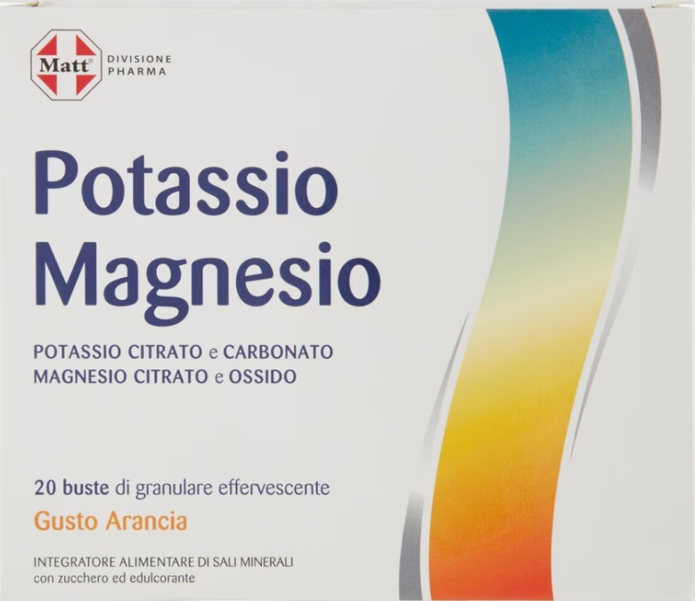
Nucleosynthesis in a C-O shell merger
Enhanced O-burning products and production of odd-Z elements (P, Cl, K, Sc);
Efficient photodisintegration of heavy elements: production of the weak s-process and 𝜸-process nuclei.

Slide 8
Nucleosynthesis: odd-Z element production

Slide 9
Nucleosynthesis: odd-Z element production
Odd-Z elements and O-burning products

Slide 10
Nucleosynthesis: odd-Z element production

Slide 11

Nucleosynthesis: odd-Z element production
$$Tshock∝R^{−3/4}$$

Slide 12
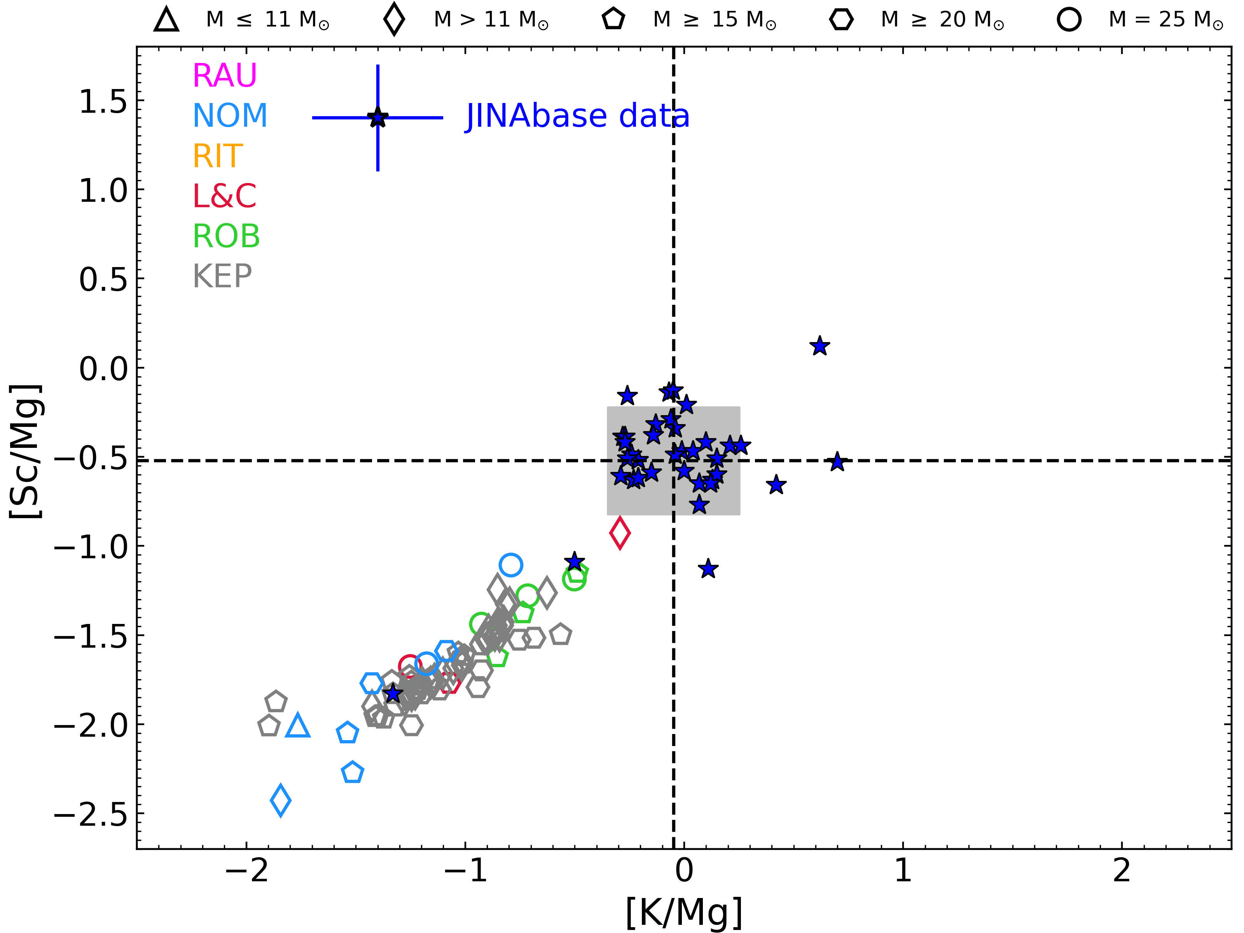
Stellar Archaeology: odd-Z elements
Comparisons between Pop III models and observations with [Fe/H]<-3 → one or few enrichment episodes;

Slide 13
Stellar Archaeology: odd-Z elements
Comparisons between Pop III models and observations with [Fe/H]<-3 → one or few enrichment episodes;
Mixing between more stars does not allow the ratios to move to the observations!
mix

Slide 14
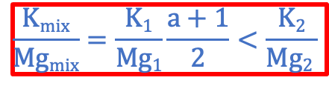
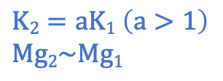

Stellar Archaeology: odd-Z elements
Comparisons between Pop III models and observations with [Fe/H]<-3 → one or few enrichment episodes;
Mixing between more stars does not allow the ratios to move to the observations!
$$K2=aK1 \left(a>1\right)$$
$$Mg2\sim Mg1$$
mix
$$K1$$
$$Mg1$$
$$\frac{Kmix}{Mgmix}=\frac{K1}{Mg1}\frac{a+1}{2}<\frac{K2}{Mg2 }$$

Slide 15
Stellar Archaeology: odd-Z elements
Comparisons between Pop III models and observations with [Fe/H]<-3 → one or few enrichment episodes;
Mixing between more stars does not allow the ratios to move to the observations!
An extra (super-solar) component is required;
mix

Slide 16
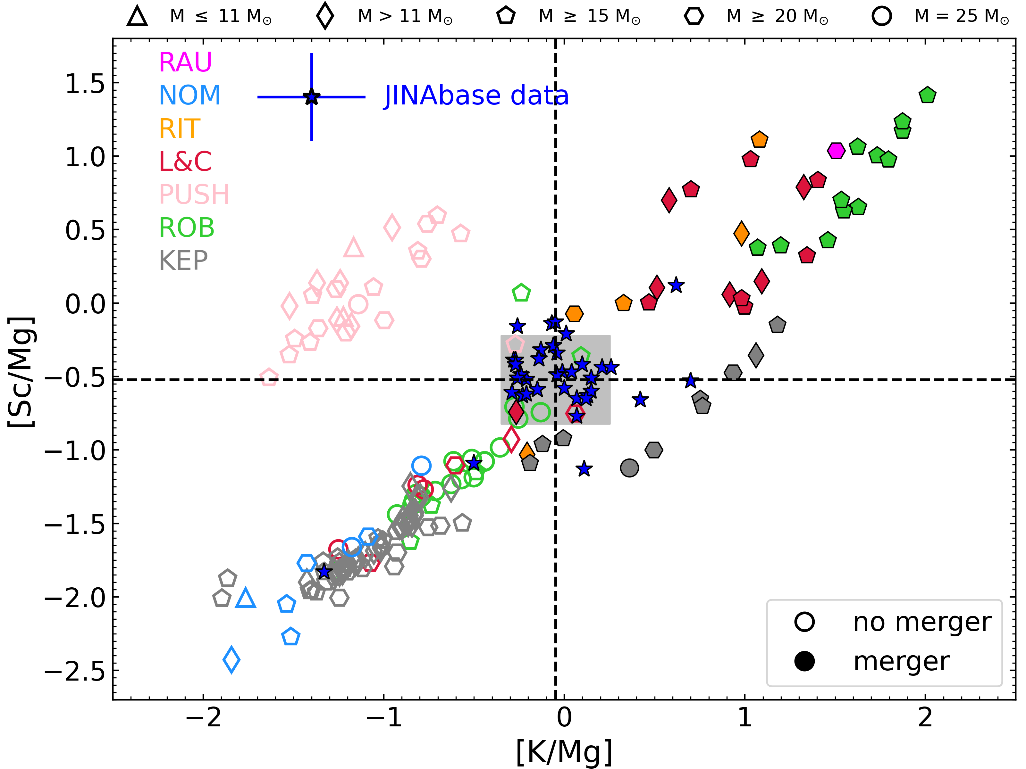
Stellar Archaeology: odd-Z elements
Comparisons between Pop III models and observations with [Fe/H]<-3 → one or few enrichment episodes;
Mixing between more stars does not allow the ratios to move to the observations!
An extra (super-solar) component is required;
Models with C-O shell mergers naturally populate the required quadrant!

Slide 17
Summary and conclusions
Carbon-oxygen (C-O) shell mergers in massive stars have a crucial impact on the explosion and on the ejecta composition of CCSNe;
Indications from 3D modeling seem to confirm their existence;
Production site for odd-Z elements: possible enrichment already in the early universe!
Large density jump at the Si/O interface because of the extended mixed convective region: easier explosion? In progress, stay tuned!
Questions: frequency? Trend with mass/metallicity/rotation? Nuclear physics?
THANK YOU!

