Slide 1
Preliminary Study of the ¹⁹F(p,𝛾)²⁰Ne at LUNA
R. Biasissi
Università degli Studi di Padova, Padova, Italy
Istituto Nazionale di Fisica Nucleare, Sezione di Padova, Padova, Italy
GIANTS Conference (Catania) — R. Biasissi
3-4/07/2025

Slide 2
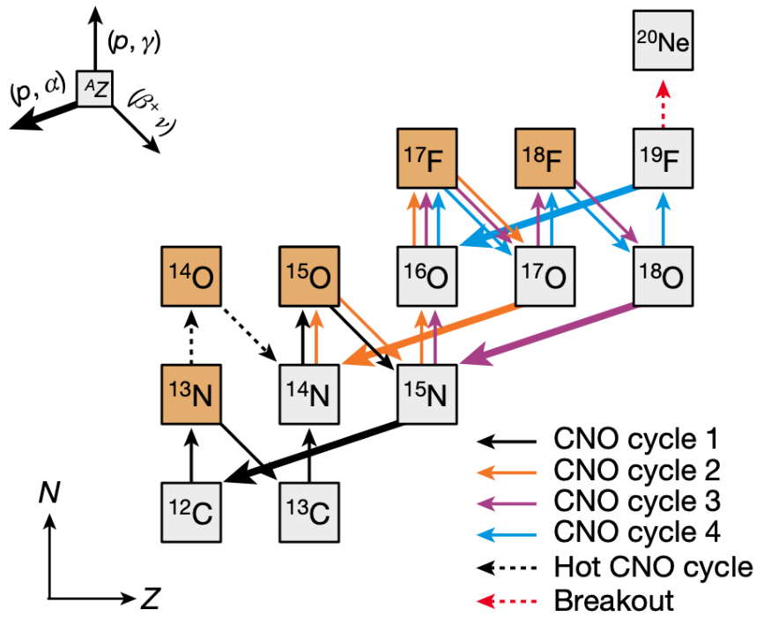
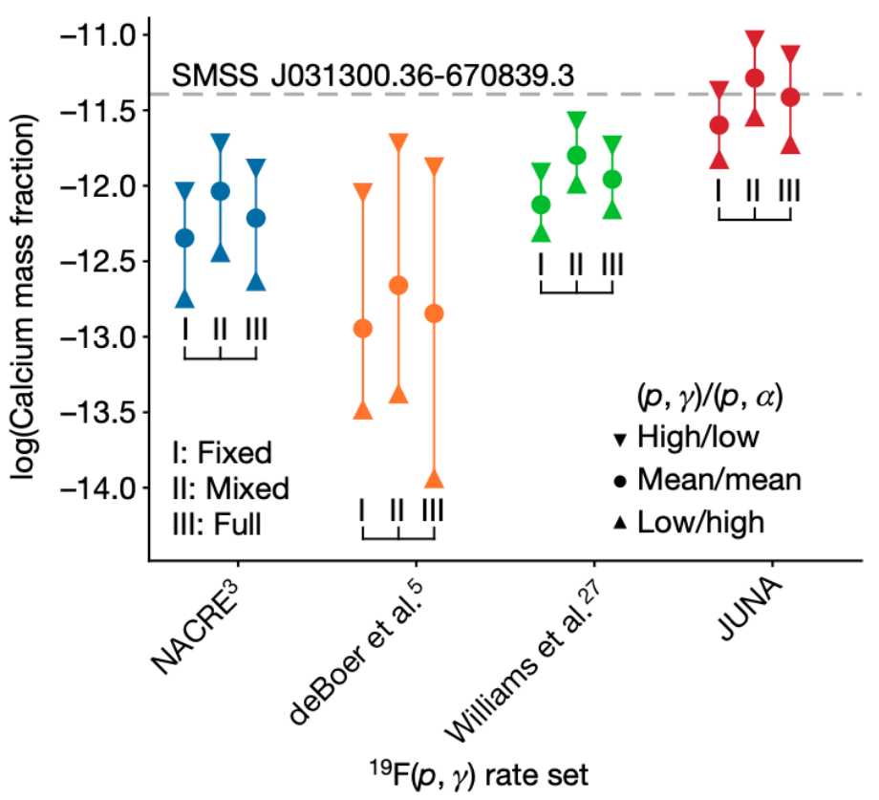
¹⁹F(p,𝛾)²⁰Ne Astrophysical Motivation
Link between CNO and NeNa cycles
Hot CNO breakout may play a key role in explaining the observed Ca abundance in metal-poor stars
¹⁹F(p,𝛾)²⁰Ne and ¹⁹F(p,𝛼𝛾)¹⁶O ratio defines the elements production of first stars
GIANTS Conference (Catania) — R. Biasissi
3-4/07/2025

Slide 3
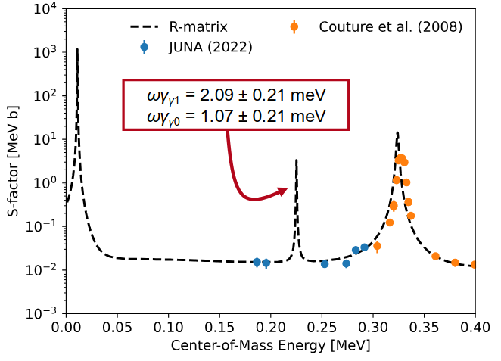
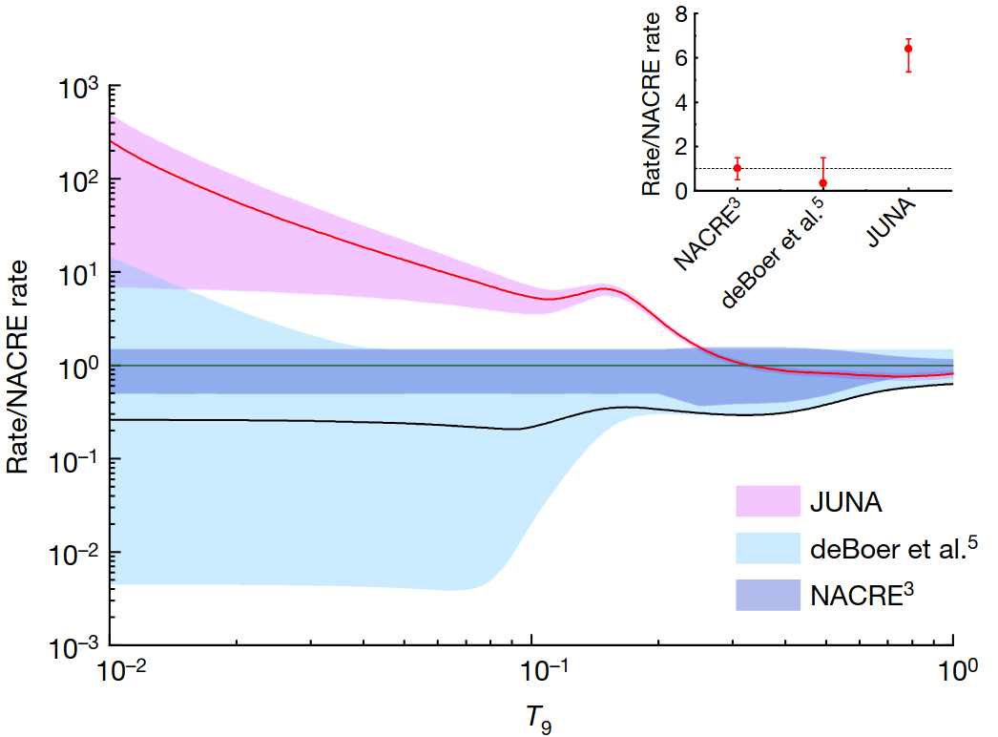
¹⁹F(p,𝛾)²⁰Ne State of the Art
Zheng et al. (2022) found the Elab = 240 keV resonance, drastically enhancing the reaction rate
No other literature data are available < 300 keV!
Factor 6 or higher!
GIANTS Conference (Catania) — R. Biasissi
3-4/07/2025

Slide 4
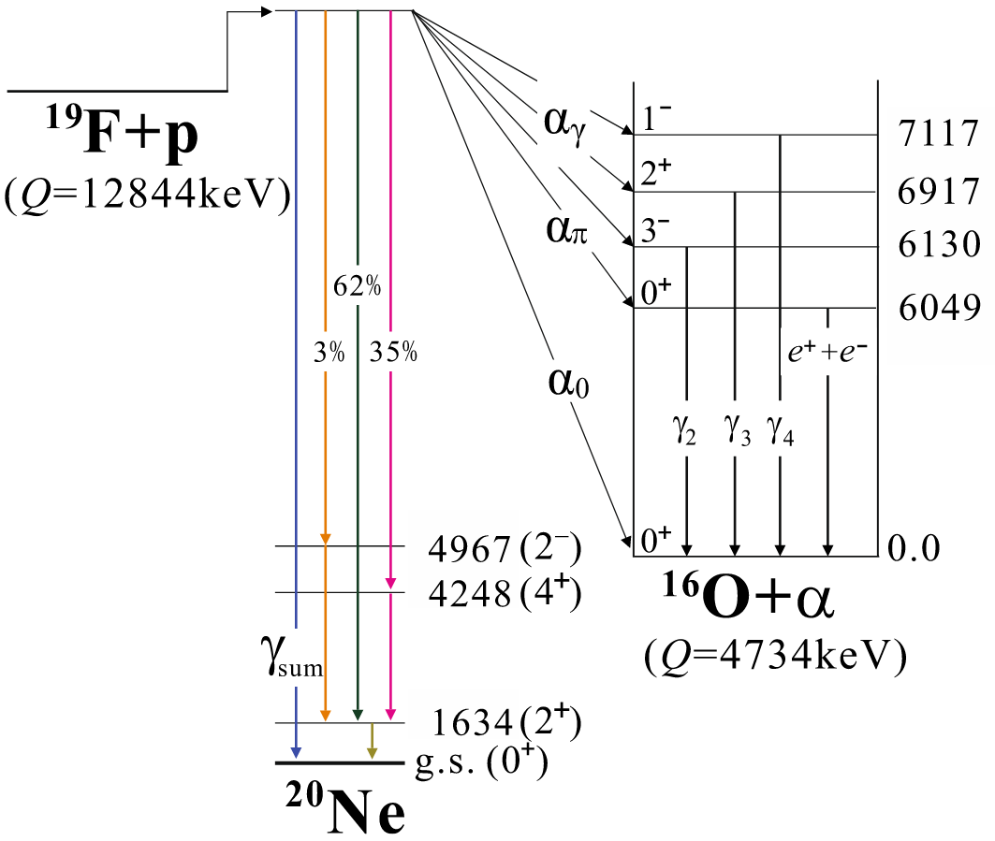
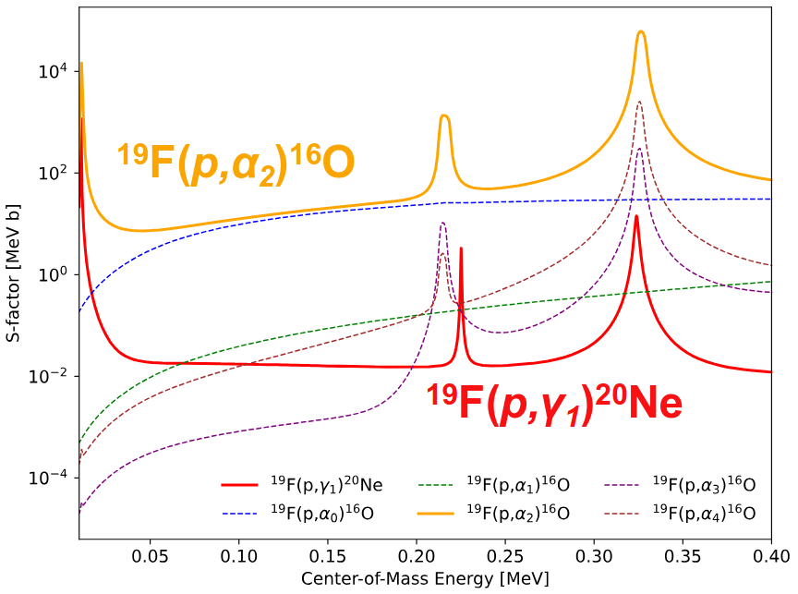
¹⁹F(p,𝛾)²⁰Ne and ¹⁹F(p,𝛼𝛾)¹⁶O Reactions Details
¹⁹F(p,𝛼𝛾)¹⁶O creates a huge pile-up background
Beam-induced background from contaminants like ¹¹B(p,𝛾)¹²C
GIANTS Conference (Catania) — R. Biasissi
3-4/07/2025

Slide 5
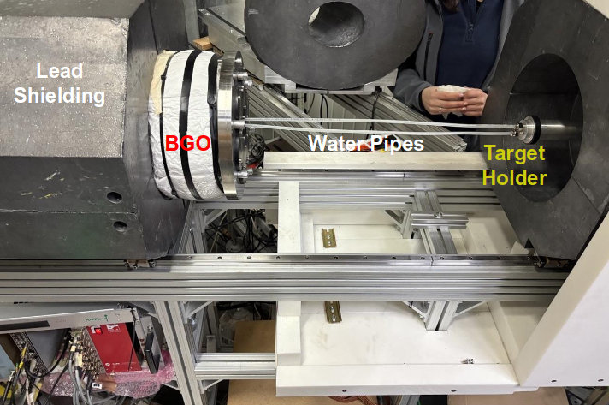
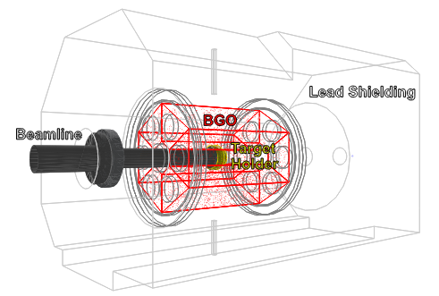
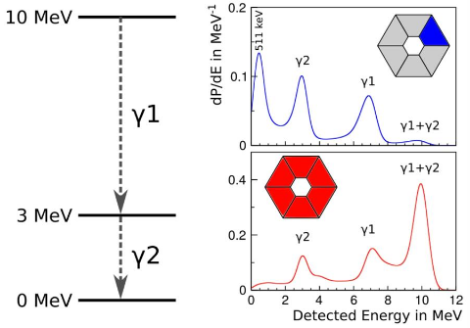
LUNA Experimental Setup
Total Absorption Spectroscopy
Low energy spread (<100 eV), excellent stability (<5 ev/h) and intense currents (up to 500 μA)
GIANTS Conference (Catania) — R. Biasissi
3-4/07/2025

Slide 6
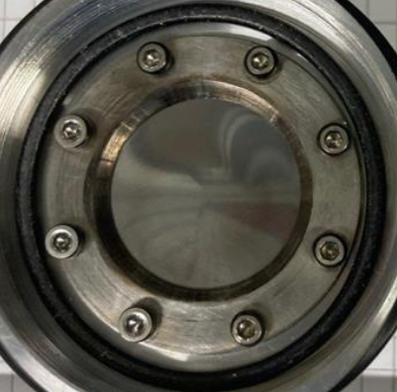
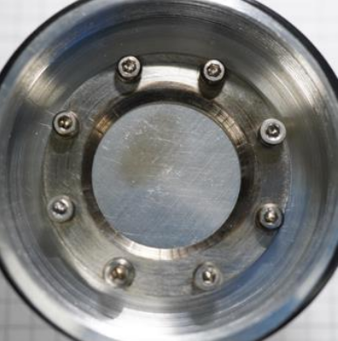
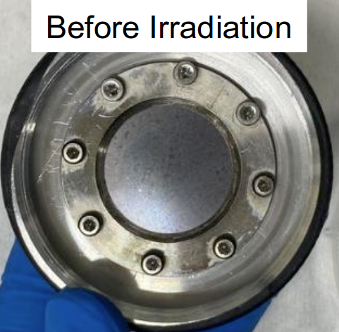
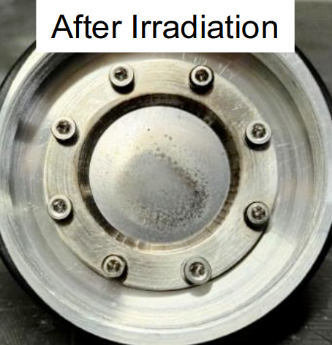
¹⁹F Targets
Sputtered:
Evaporated:
Implanted:
Fluorinated:
MgF₂, LiF – Not available
CaF₂ with Ta and W backing – 10% degradation/C
¹⁹F with Ta and Fe backing
Low-¹⁹F content with Fe backing
TaF₅ with Ta backing
Before Irradiation
Targets characterized
with the NRRA technique
and ¹⁹F(p,𝛼𝛾)¹⁶O reaction
After Irradiation
GIANTS Conference (Catania) — R. Biasissi
3-4/07/2025

Slide 7
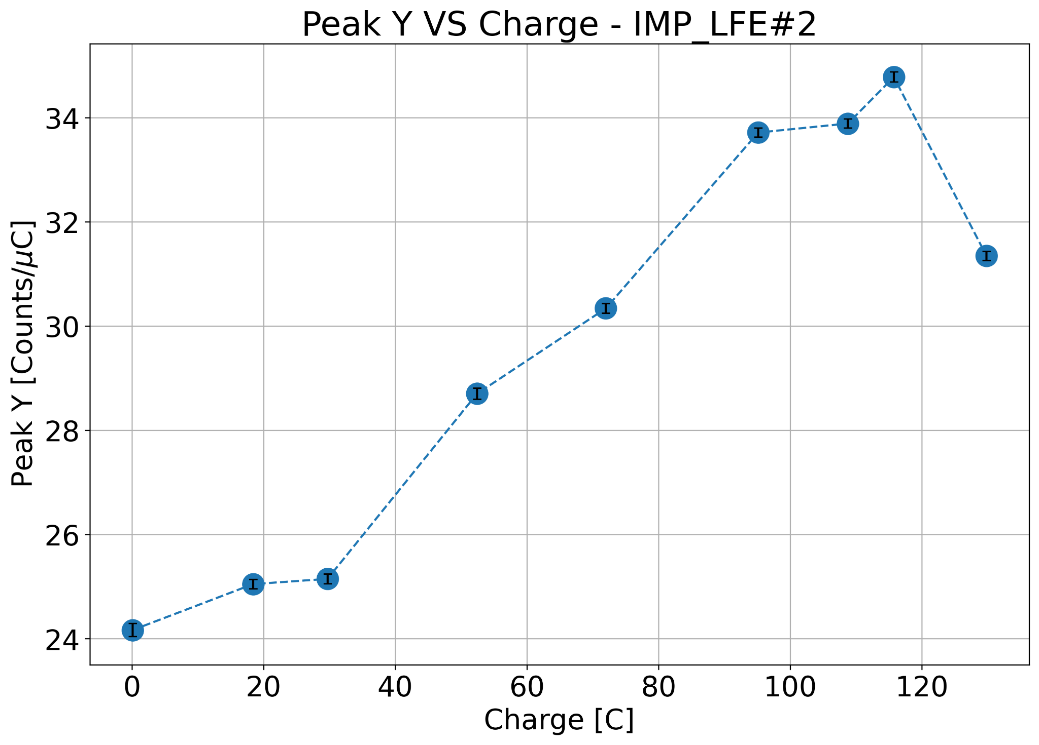
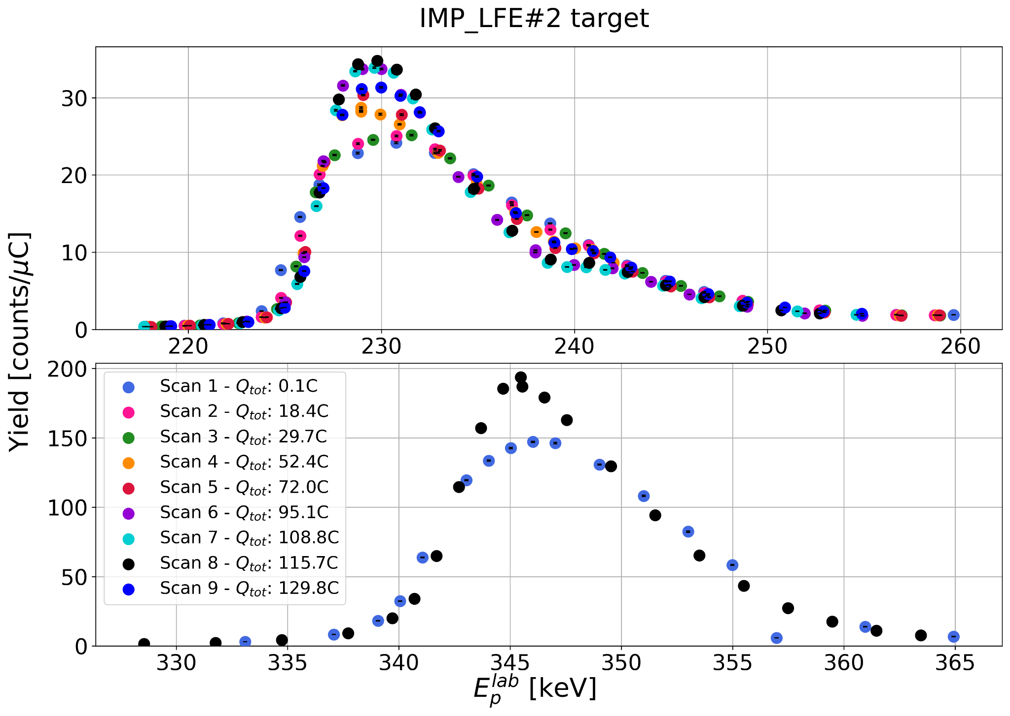
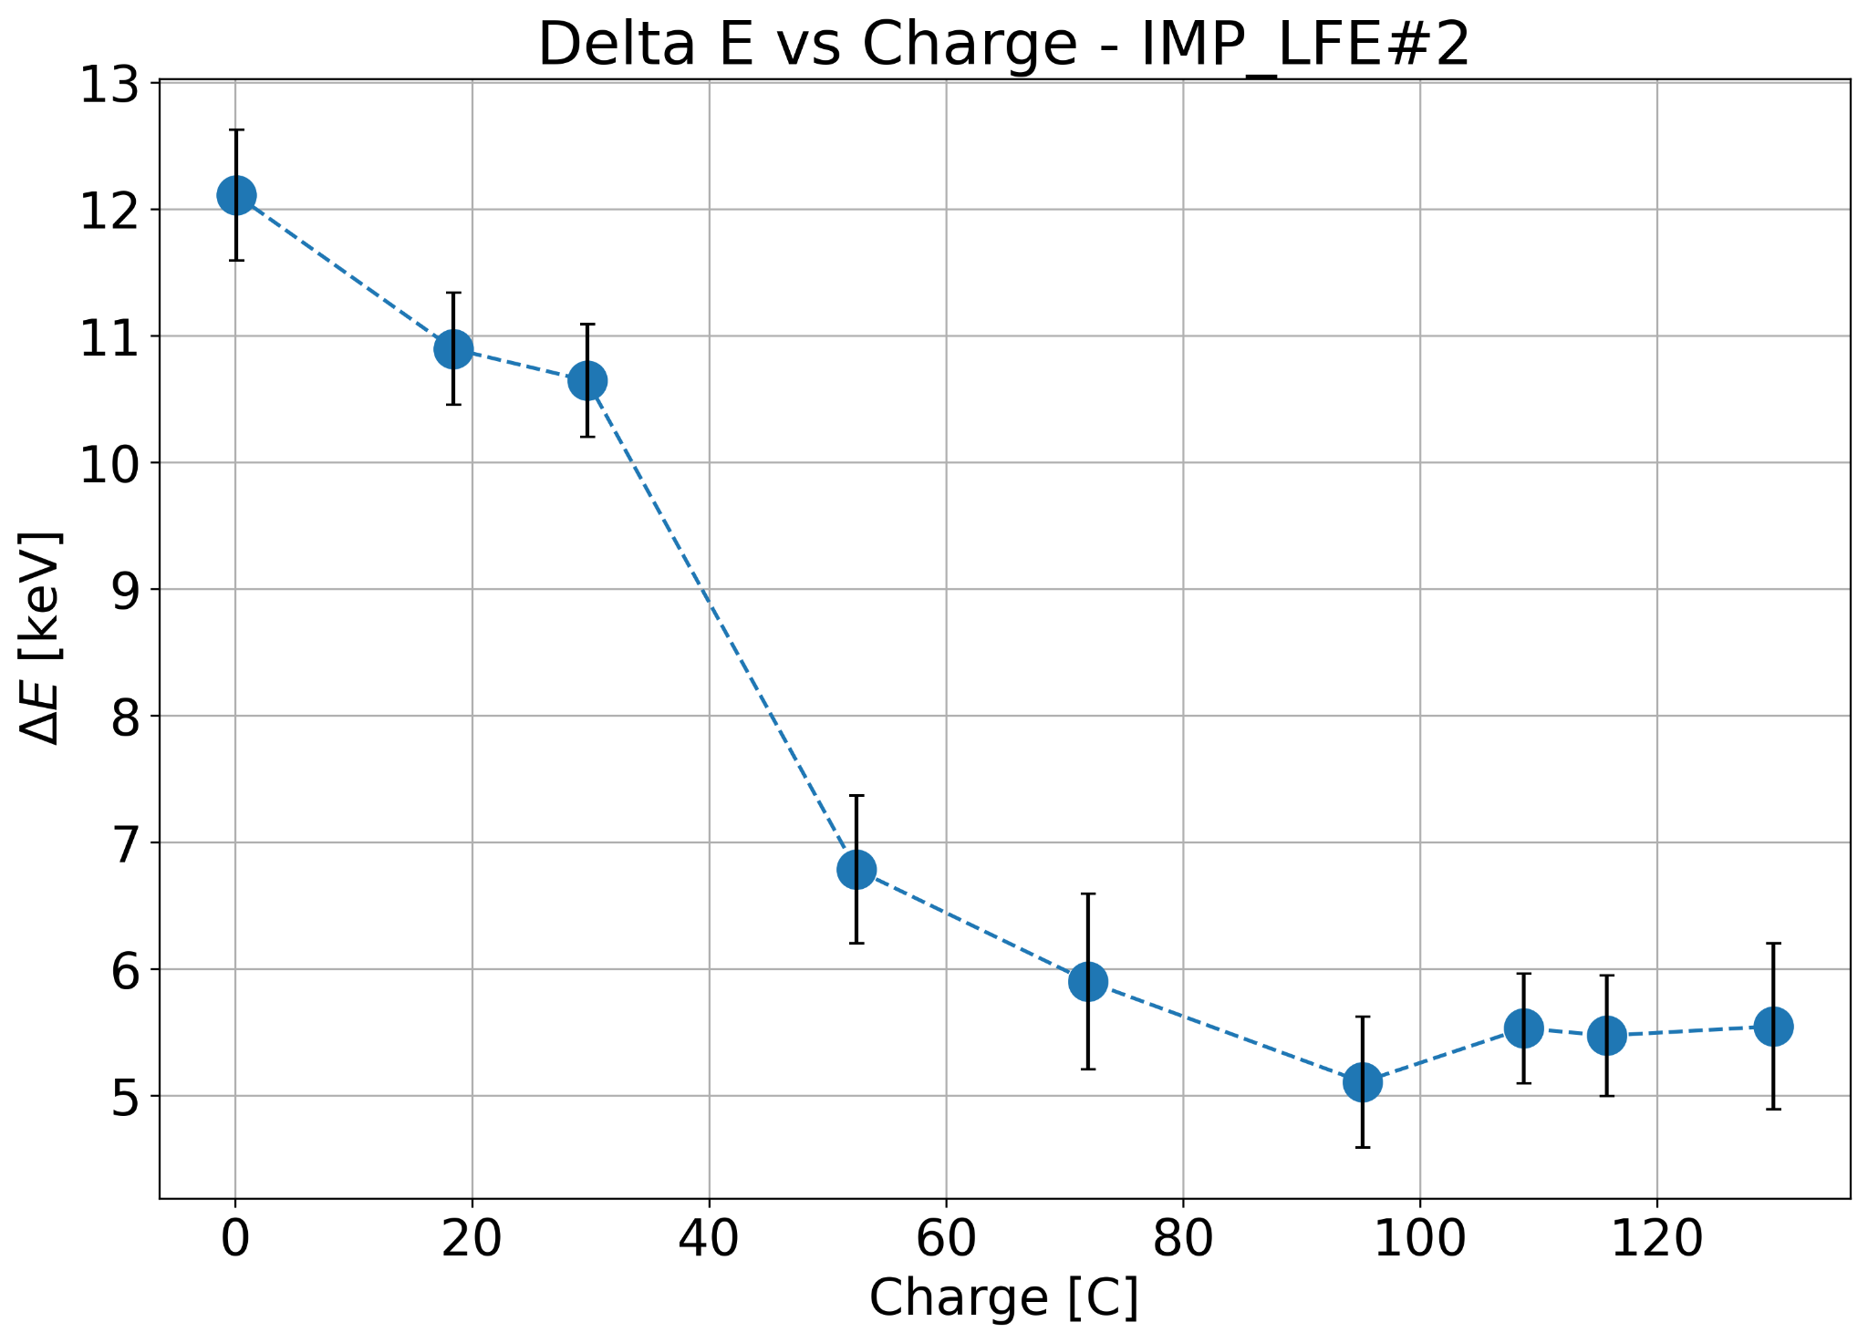
Implanted Targets – Fe backing
Good stability up to 30 C
No clear peak degradation
(about 0.6-0.9%/C, total still unknown precisely)
P R E L I M I N A R Y
P R E L I M I N A R Y
GIANTS Conference (Catania) — R. Biasissi
3-4/07/2025

Slide 8
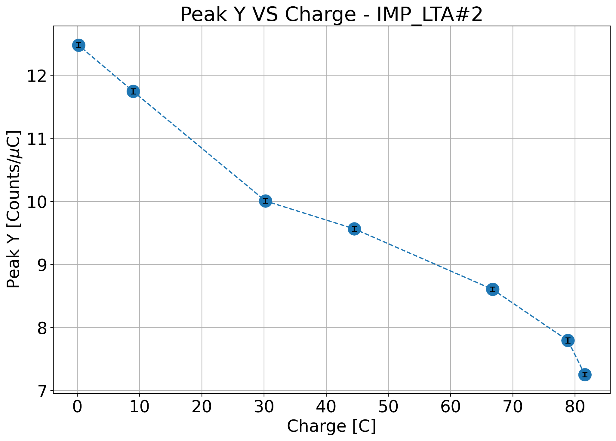
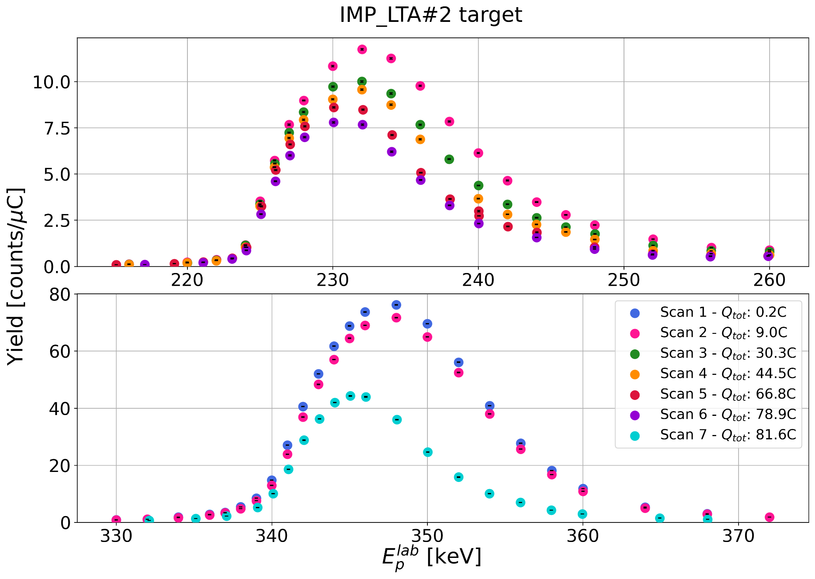
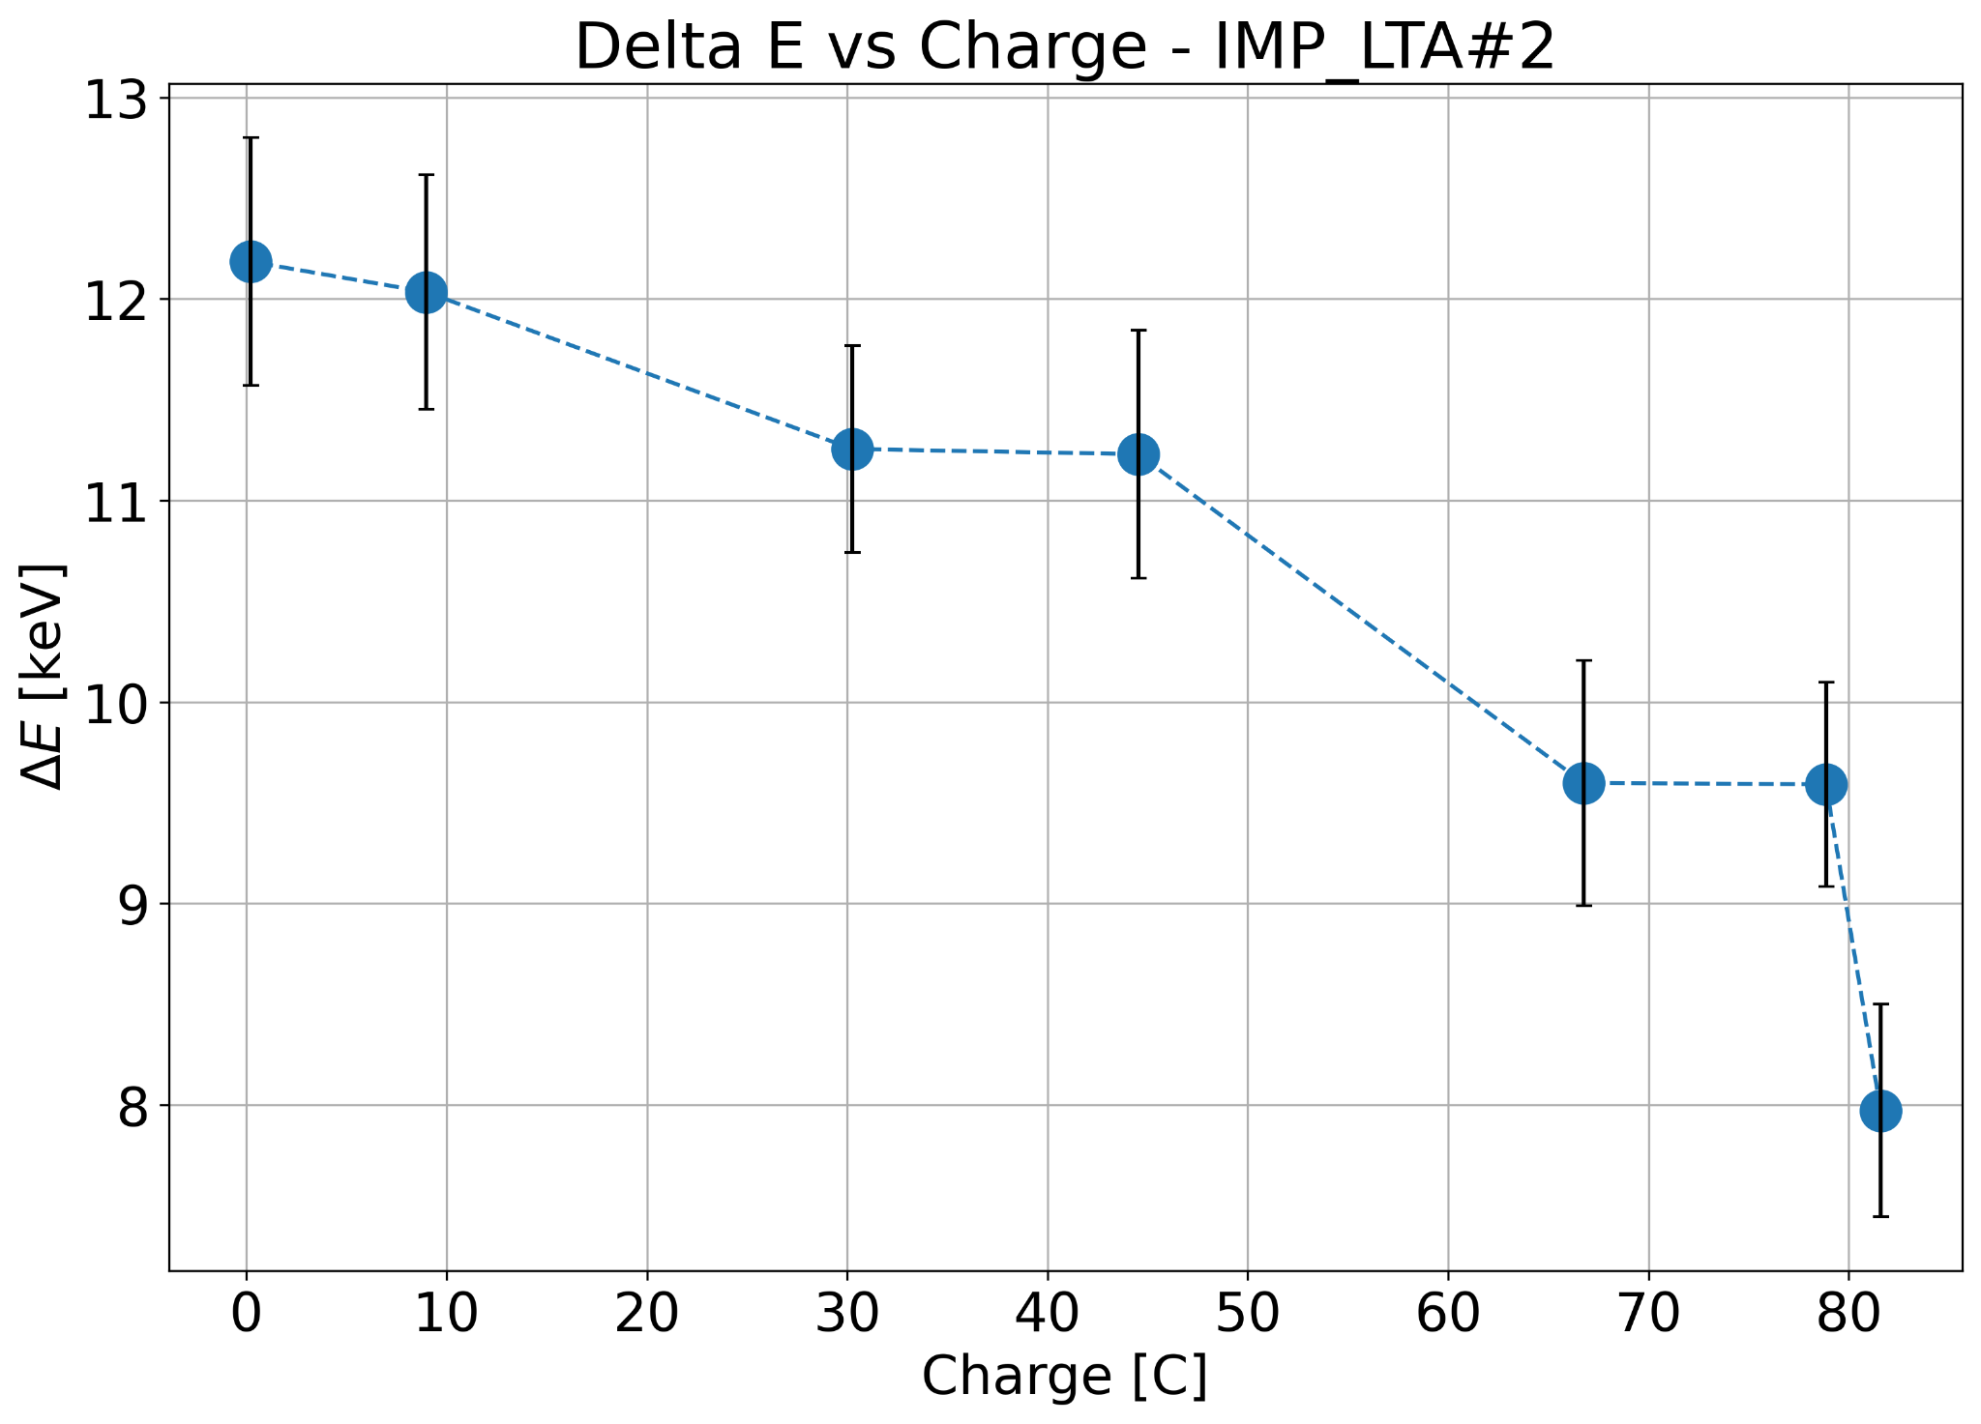
Implanted Targets – Ta backing
Good stability up to 10-15 C
Peak degradation of 0.5%/C (total ≈ 40%)
P R E L I M I N A R Y
P R E L I M I N A R Y
GIANTS Conference (Catania) — R. Biasissi
3-4/07/2025

Slide 9
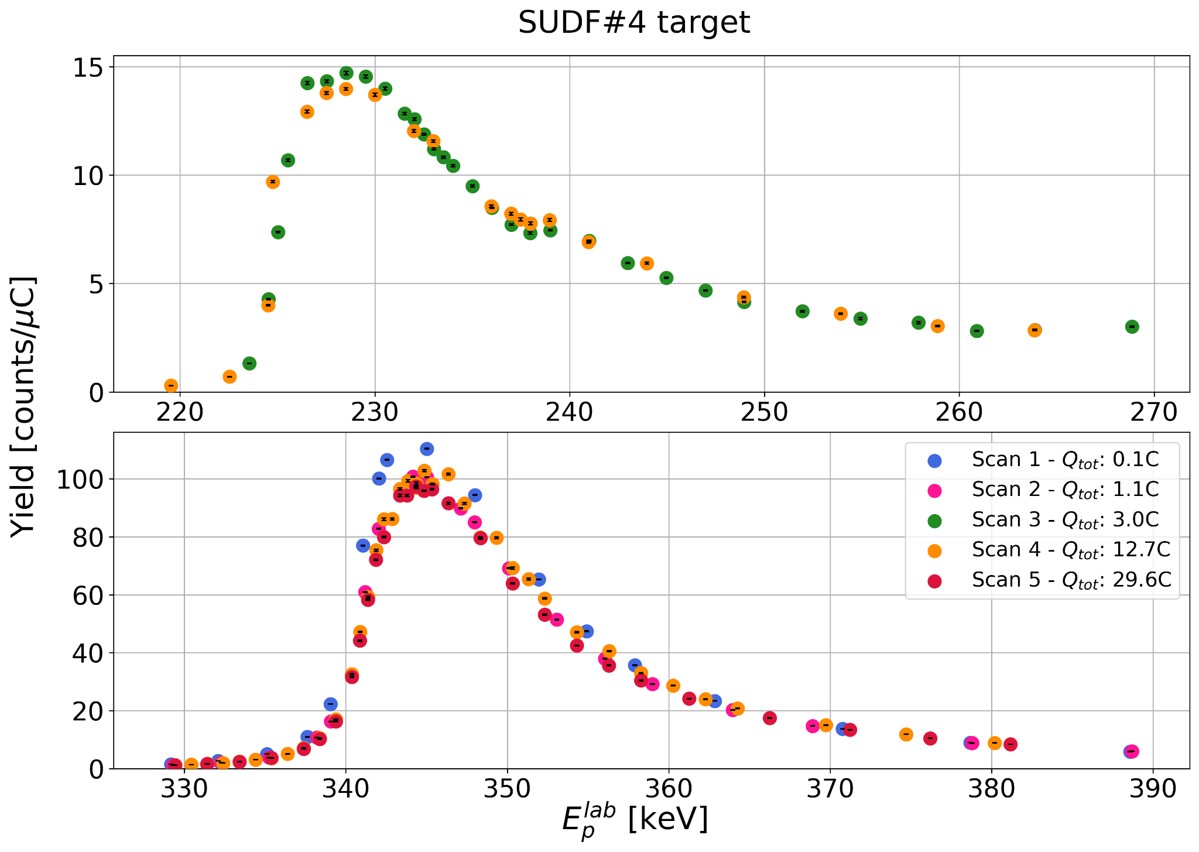
Fluorinated Targets
New type of target produced by SUDFLUOR company (France)
Produced by exposing Ta backing at different temperatures (20-100°C) to ¹⁹F atmosphere creating stable TaF₅ layer. Best results with higher temperature
Currently under analysis through
SEM and SIMS at Padova/LNL
Good stability up to 13 C
Peak degradation of 0.4%/C
(total ≈ 15%)
Drafting of technical paper will
commence shortly
GIANTS Conference (Catania) — R. Biasissi
3-4/07/2025

Slide 10
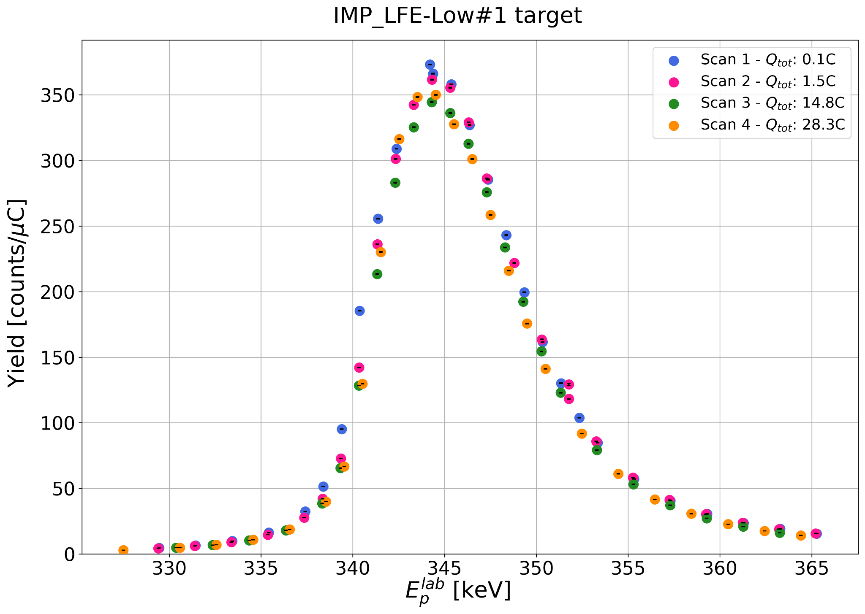
Implanted Low-¹⁹F Content Target
Low-¹⁹F content allowed to use it with BGO always in close-geometry exploring >300 keV (only 3 points around 340 keV resonance currently)
High stability up to 28 C
Peak degradation of 0.15%/C
(total ≈ 5%)
GIANTS Conference (Catania) — R. Biasissi
3-4/07/2025

Slide 11
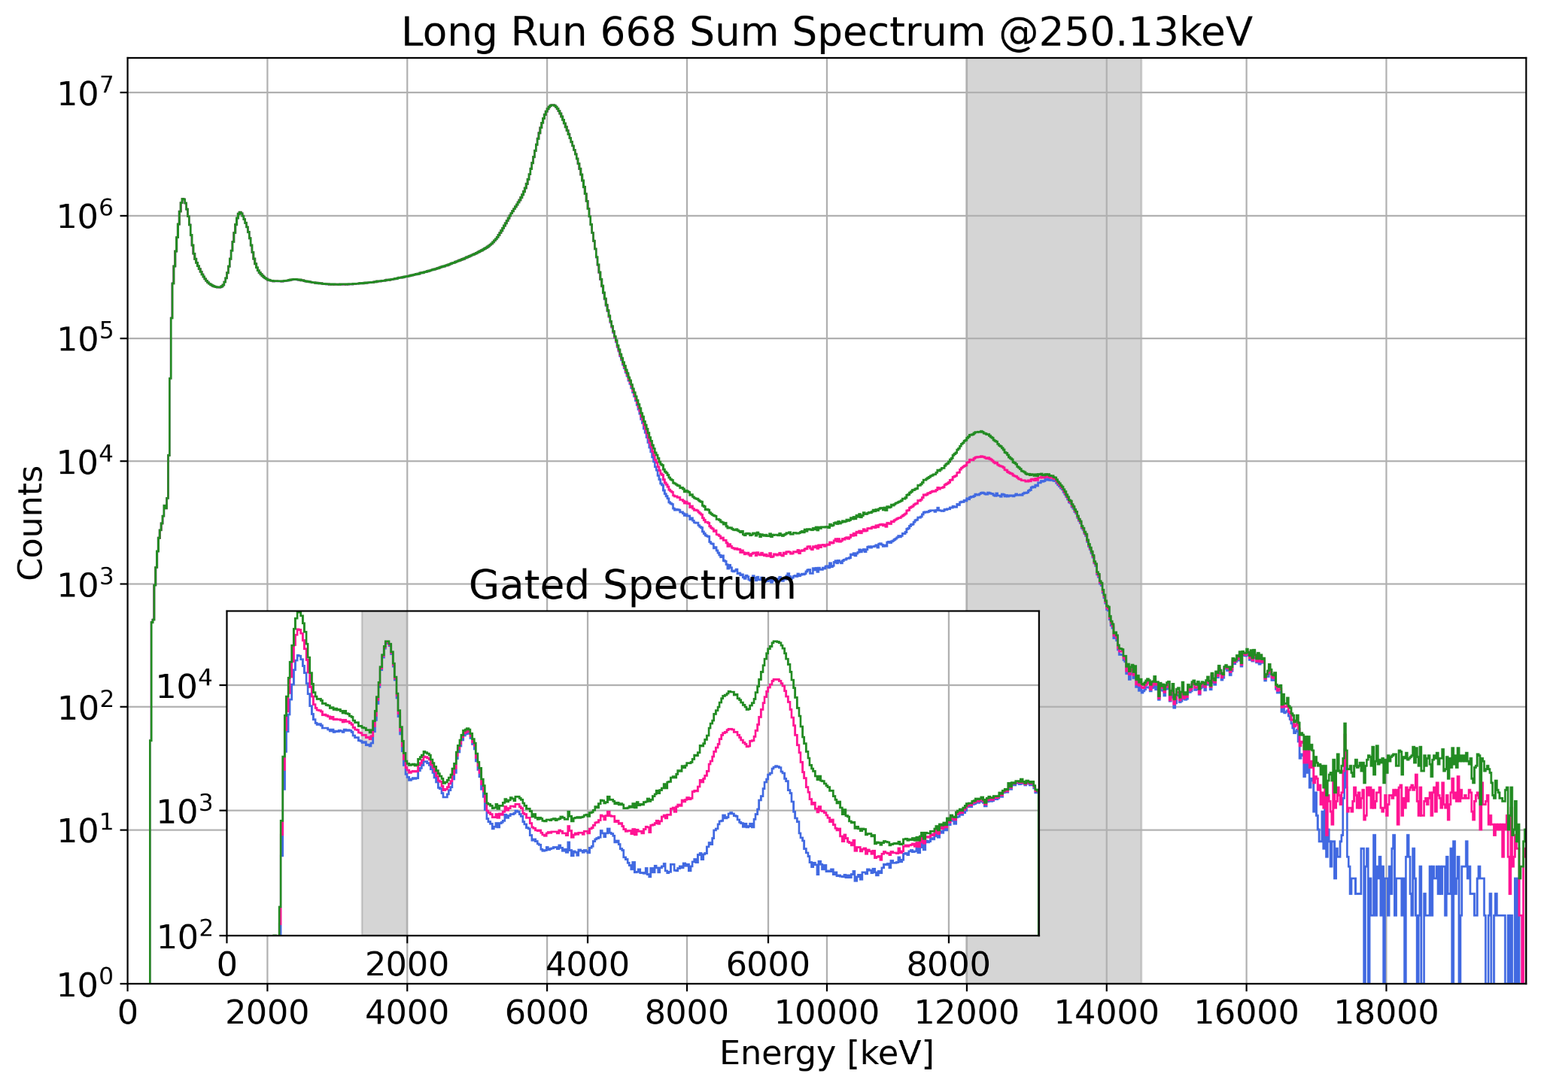
Methodology – Long-runs analysis
Time coincidence of 10-50-500 ns → Sum Spectrum
Focus: ¹⁹F(p,𝛾)²⁰Ne reaction
Gate region=[12.0;14.5] MeV
Δt: 10 ns
Peak of interest: 1.634 MeV
ROI=[1.5;2.0] MeV
Gate region
¹⁹F(p,𝛼𝛾)¹⁶O
¹⁹F(p,𝛼𝛾)¹⁶O pile-up
¹⁹F(p,𝛾)²⁰Ne
¹¹B(p,𝛾)¹²C
1634 keV ¹⁹F(p,𝛾)²⁰Ne
GIANTS Conference (Catania) — R. Biasissi
3-4/07/2025

Slide 12
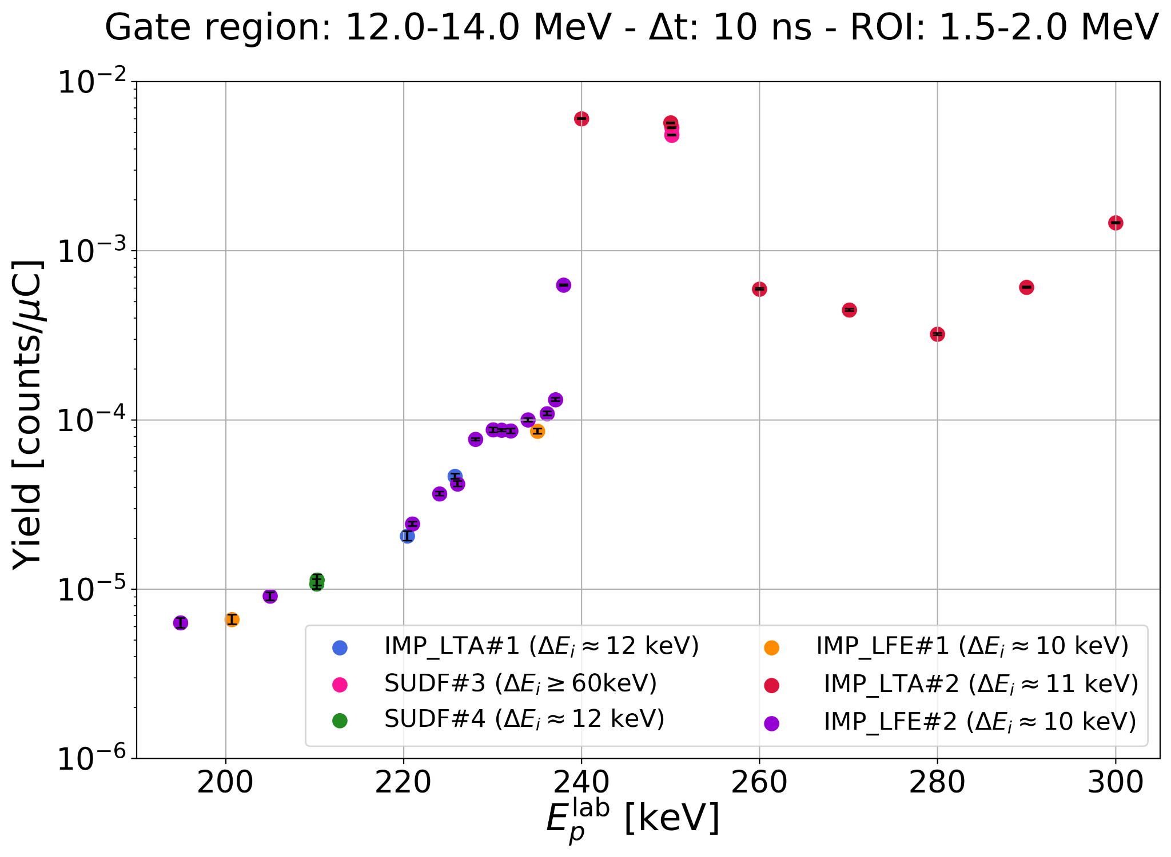
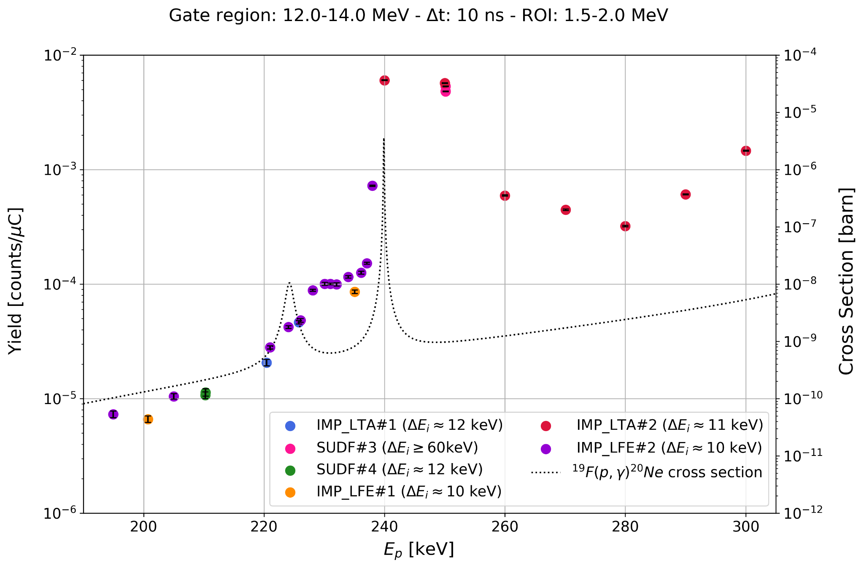
¹⁹F(p,𝛾)²⁰Ne April Campaign Results
Beam pre-focusing procedure with evaporated target
Explored energy range between
Elab = 190 and 300 keV
Results with respect to SUDF#4
(not accounting yet for target degradation and thickness)
225 keV
240 keV
P R E L I M I N A R Y
GIANTS Conference (Catania) — R. Biasissi
3-4/07/2025

Slide 13
Conclusions
Preliminary results shows great stability of the implanted targets
New fluorinated type target has been developed
— Upcoming Autumn Campaign —
Wider usage of fluorinated targets: reproducibility check and fill the gaps <300 keV
Deeper study of energy region >300 keV with implanted low-¹⁹F content target
HPGe detector: more precise estimation of branching ratios
GIANTS Conference (Catania) — R. Biasissi
3-4/07/2025

