Slide 1



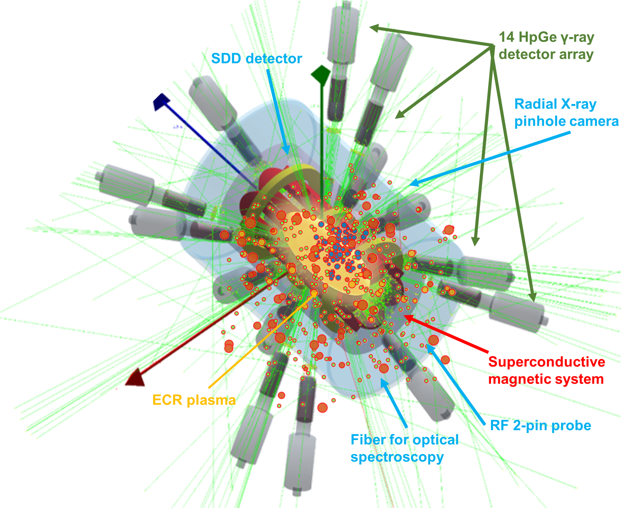
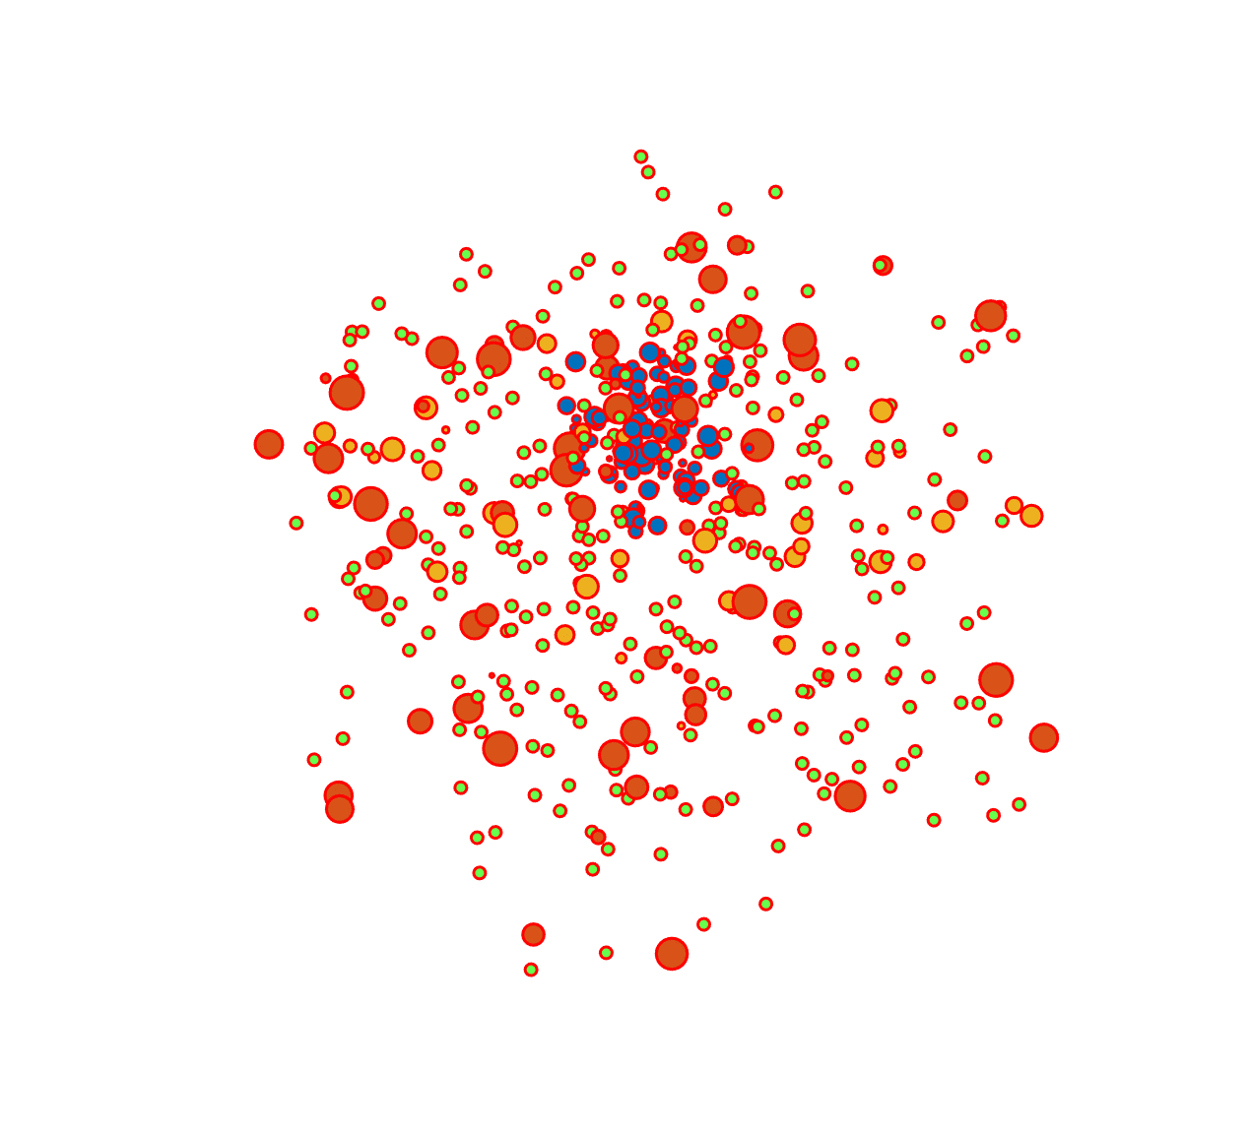
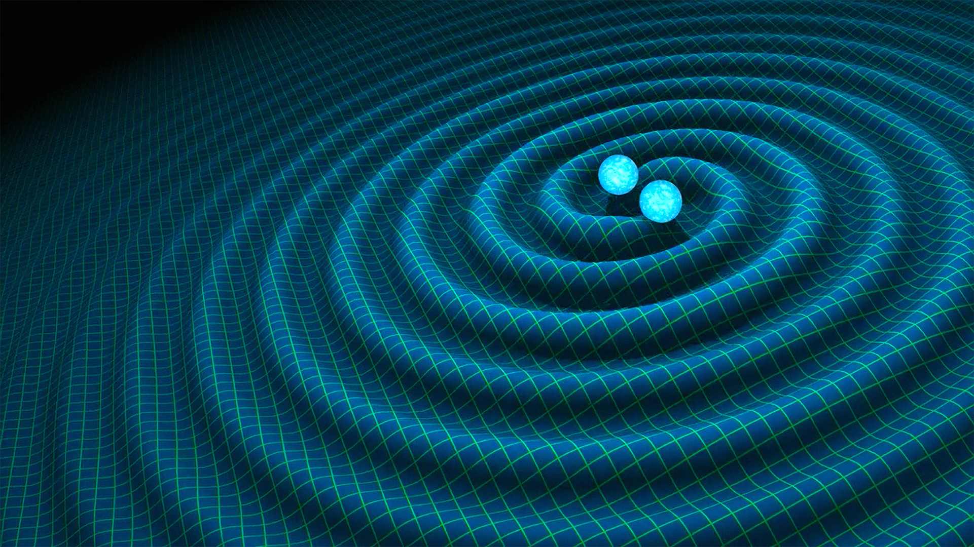
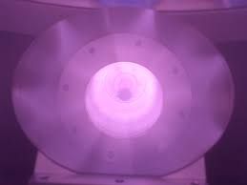
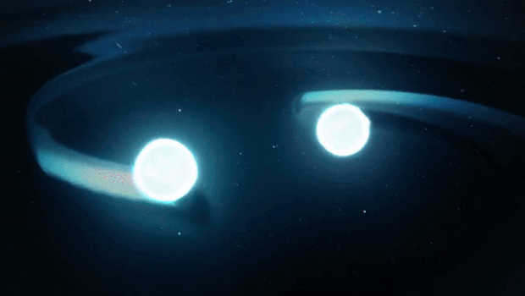

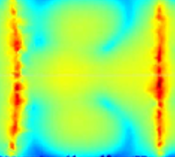
EXPERIMENTAL DESIGN OF OPACITY MEASUREMENTS IN THE PANDORA PLASMA TRAP RELEVANT FOR KILONOVAE SIGNALS
Angelo Pidatella
INFN-LNS
On behalf of the PANDORA collaboration
GIANTS XII INCONTRO – July 3-4, 2025 – Catania, INFN - LNS

Slide 2
OUTLINE
WHAT? - The kilonova in a nutshell: a recap on the physics case and state of the art
WHY? - The plasma opacity problem – the PANDORA experiment
HOW & WHERE ?
  First attempt of reproducing plasma conditions in laboratory
  The opacity experimental design: methods and setup
Summary
A. Pidatella – GIANTS XII INCONTRO – July 3-4, 2025

Slide 3
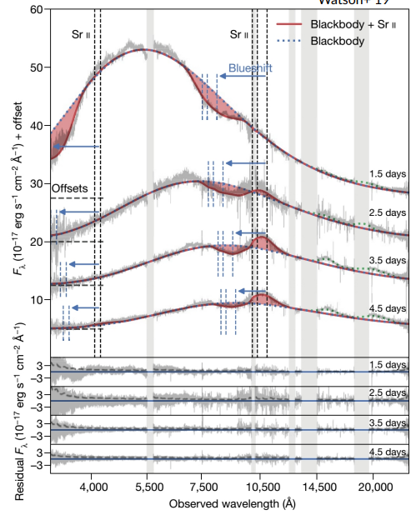

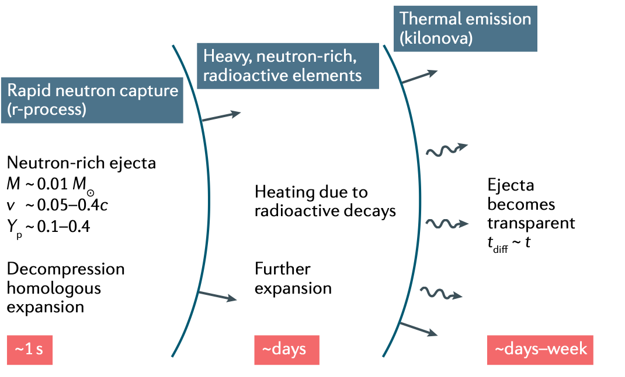
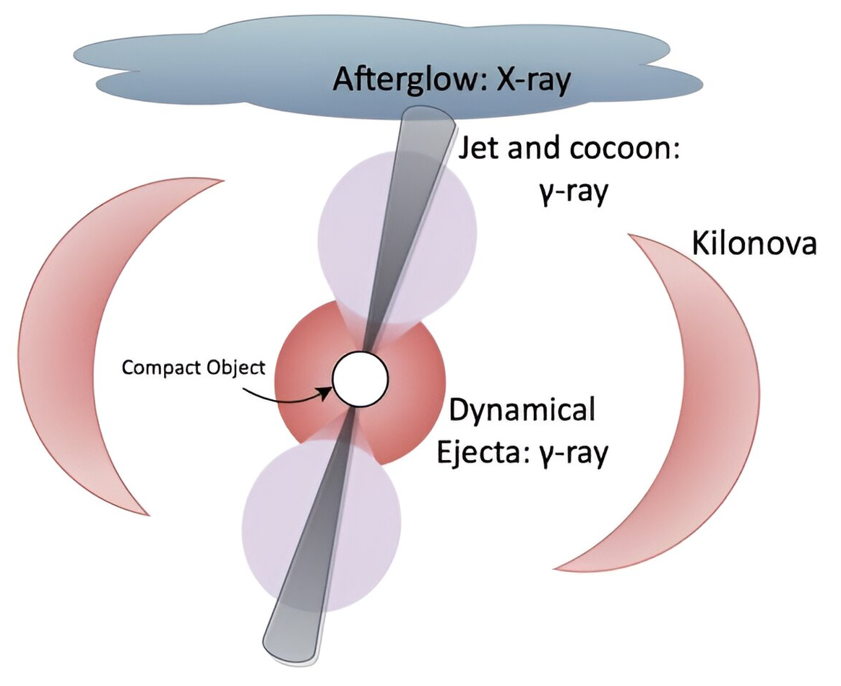
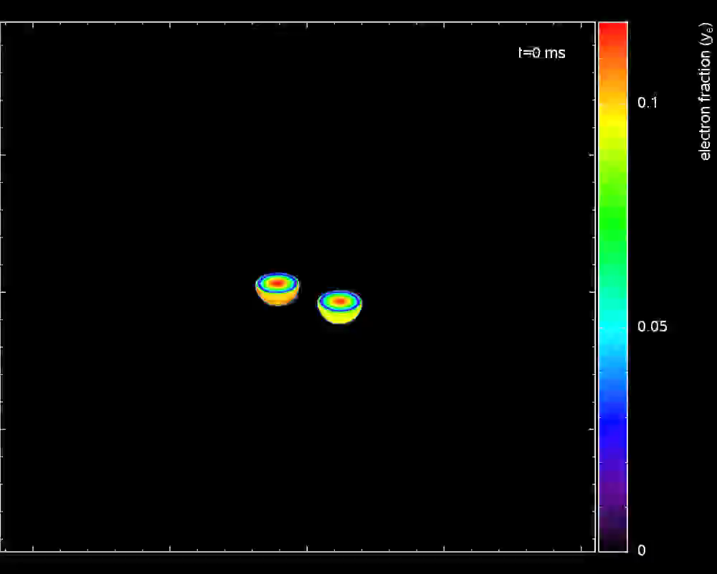
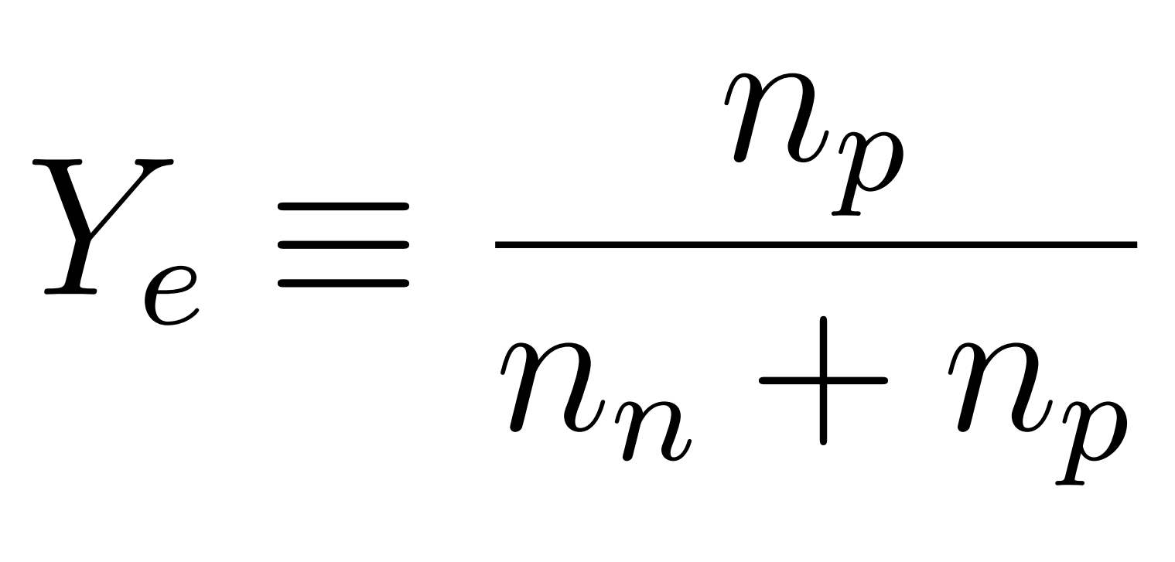



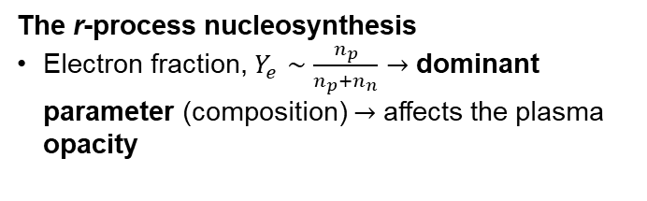
WHAT?
The kilonova in a nutshell: a recap on the physics case and state of the art
Merger of binary neutron stars: ejection of n-rich matter, rapid neutron capture (r-process) nucleosynthesis
Radioactive decay of synthesized r-process nuclei power electromagnetic transient: kilonovae (KN)
I. Arcavi et al. Nature, 551(7678):64,66, (2017)
First evidence of r-process elements in a NSM was
obtained from kilonova (KN) AT2017gfo, from
Gravitational Wave event GW170817.
KN light-curve, 2 fundamental inputs: (1) r-process nucleosynthesis yields (fixing the heating rate) (2) opacity (fixing the exchange of energy between plasma and radiation)
BLACKBODY SPECTRUM VS. OBSERVED KN SPECTRUM
Siegel D. M., Nat. Rev. Phys. 4, 306-318 (2022).
ABSORPTION SPECTRAL FEATURES
(2)
The r-process nucleosynthesis
Electron fraction, $Y_{e}∼\frac{n_{p}}{n_{p}+n_{n}}→$ dominant parameter (composition) $→$ affects the plasma opacity
(1)
BNS EJECTA OPACITY IS AN OPEN ISSUE TO BE FURTHER EXPLORED
https://compact-merger.astro.su.se/movies.html#rproc
A. Pidatella – GIANTS XII INCONTRO – July 3-4, 2025

Slide 4
WHY?
The plasma opacity problem – the PANDORA experiment
Critical OPACITY Challenges Identified (?)
Atomic Data Limitations: Incomplete transition-line databases and uncertain oscillator strengths remain critical bottlenecks.
Ionization State Modeling: Most studies focused on low ionization states (I–IV), while higher states (V–XI) dominate in early-phase ejecta (T > 25,000 K).
Ionization Dynamics: Higher ionization states (V–XI) dominate early phases but are understudied; time-dependent modeling is essential.
Ejecta Composition Heterogeneity: Opacity depends on localized elemental abundances, necessitating multi-element simulations rather than single-element approximations.
NLTE (Non-Local Thermodynamic Equilibrium) effects critically shape kilonova spectra evolution, with their influence growing substantially over time due to the ejecta's rapid expansion and cooling.
Tanaka, M., et al. MNRAS, 496, 2020;
Deprince, J. et al, A&A, 696, A32 (2025)
A&A, 685, A91 (2024)
Sneppen A., et al. A&A, 688 (2024) A95
Kato, D. et al., MNRAS 535, 2670–2686 (2024) ;
Banerjee S., et al., ApJ 934 117, 2022
Pognan, Q., A. Jerkstrand, et al. , MNRAS, 513, 4, 2022;
Pognan Q., et al., MNRAS, 526, 4, 2023
Tarumi, Y. et al., arXiv:2302.13061
A. Pidatella – GIANTS XII INCONTRO – July 3-4, 2025

Slide 5
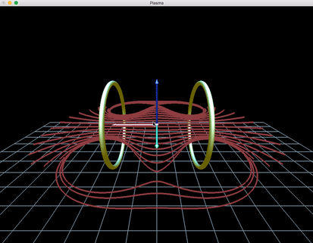
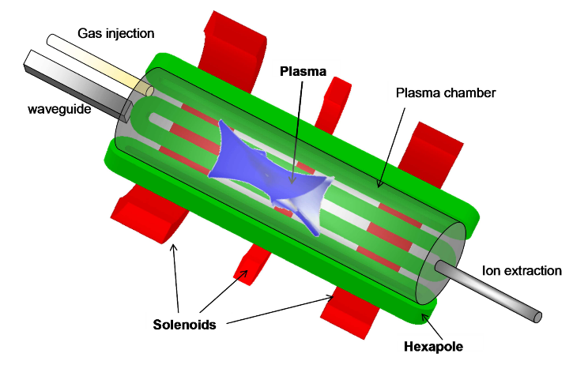

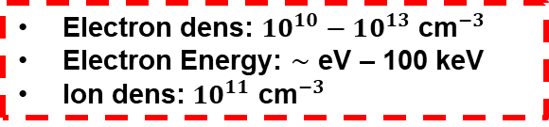
THE PANDORA EXPERIMENT
From an Electron Cyclotron Resonance (ECR) plasma historically used in particle accelerator as source for multi-charged ion beams to….
Electron dens: $10^{10}−10^{13}$ ${\text{cm}}^{−3}$
Electron Energy: $∼$ eV – 100 keV
Ion dens: $10^{11}$ ${\text{cm}}^{−3}$
…an interdisciplinary ECR plasma facility to perform fundamental studies in nuclear physics and nuclear astrophysics, taking advantage of an advanced multi-diagnostic system
See the talk by E. Naselli
Mascali D., et al, Eur. Phys. J. A (2017) 53: 145
Mascali D., et al, Universe 8 (2), 80 (2022)
PANDORA (Plasmas for Astrophysics Nuclear Decays Observation and Radiation for Archaeometry) plasma trap for inter-disciplinary studies: atomic physics, astrophysics, and nuclear astrophysics
  Nuclear bound-β decay rate in a high-energy content plasma for nuclei relevant in s-process branching
  Magneto-plasma opacity spectroscopic measurements relevant for KN light-curve and r-process nucleosynthesis yields
  Plasma kinetic turbulences and impact on astrophysics
See the talk by B. Mishra
Pidatella, A. et al., Plasma Phys. Control. Fusion 66 (3), 035016 (2024)
Mishra, B., et al., Front. in Physics, 10, 932448, (2022)
Galatà, A., et al., Front. in Physics, 10, 947194, (2022)
Pidatella, A., et al. Nuovo Cimento 44 C (2021) 65
Pidatella, A., et al. Frontiers in Astronomy and Space Sciences, 10.3389/fspas.2022.931744 (2022)
Mascali D., et al (2022) Plasma Phys. Control. Fusion 64 035020
A. Pidatella – GIANTS XII INCONTRO – July 3-4, 2025

Slide 6
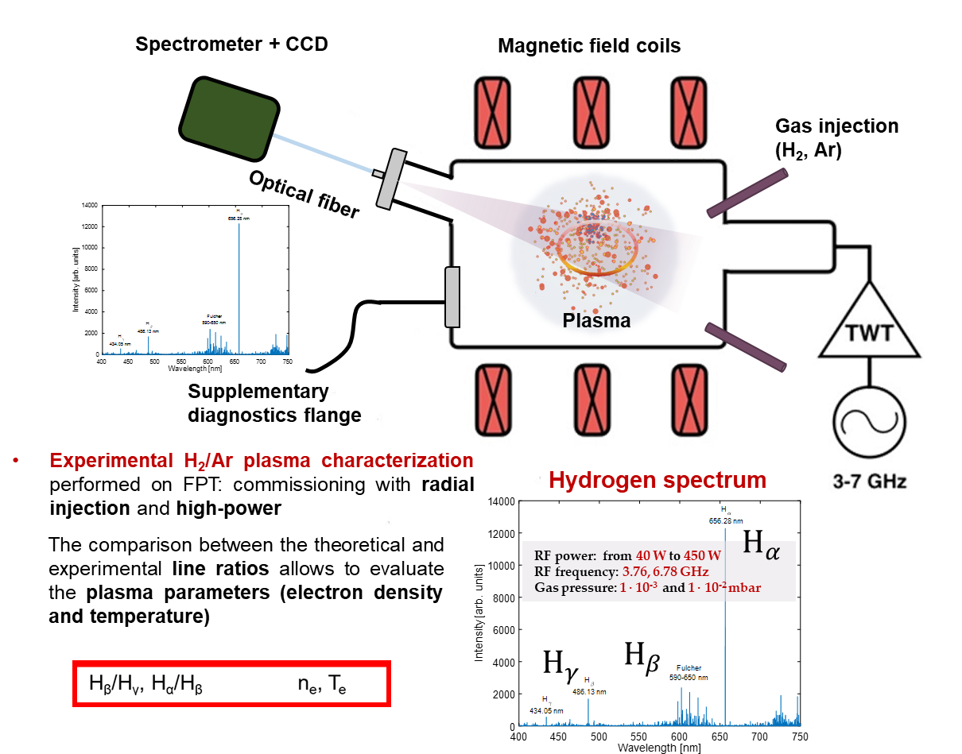
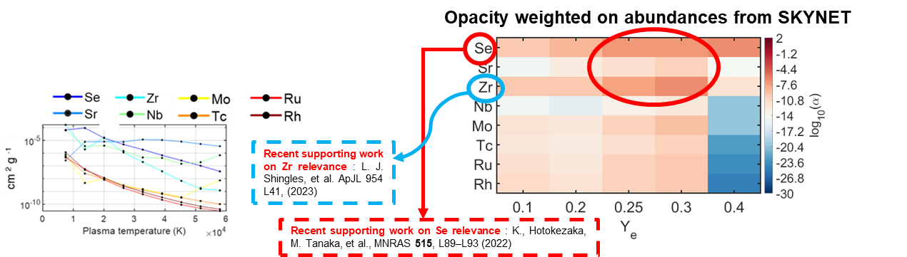
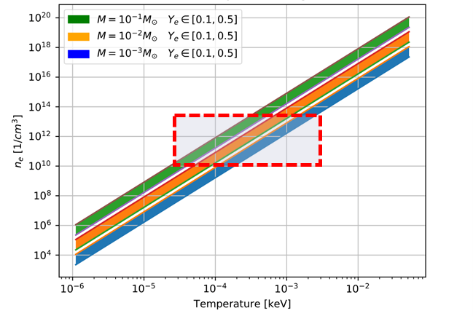
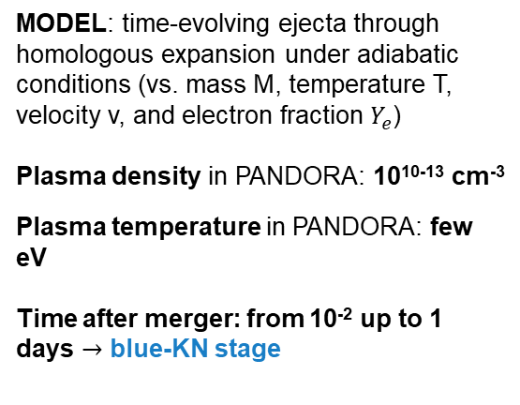
HOW & WHERE ?
First attempt of reproducing plasma conditions in laboratory
FROM THE MODEL (2020)…
…TO THE EXPERIMENT (2022- present)
MODEL: time-evolving ejecta through homologous expansion under adiabatic conditions (vs. mass M, temperature T, velocity v, and electron fraction $Y_{e}$)
Plasma density in PANDORA: 10¹⁰⁻¹³ cm⁻³
Plasma temperature in PANDORA: few eV
Time after merger: from 10⁻² up to 1 days $→$ blue-KN stage
Pidatella, A., et al. Nuovo Cimento 44 C (2021) 65
Pidatella, A.,et al. Frontiers in Astronomy and Space Sciences
10.3389/fspas.2022.931744 (2022)
A. Pidatella – GIANTS XII INCONTRO – July 3-4, 2025

Slide 7
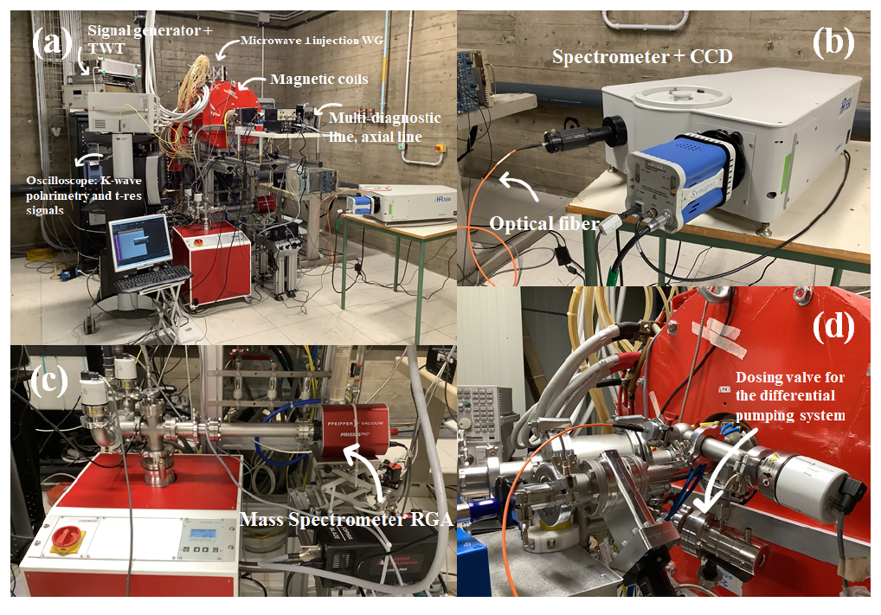
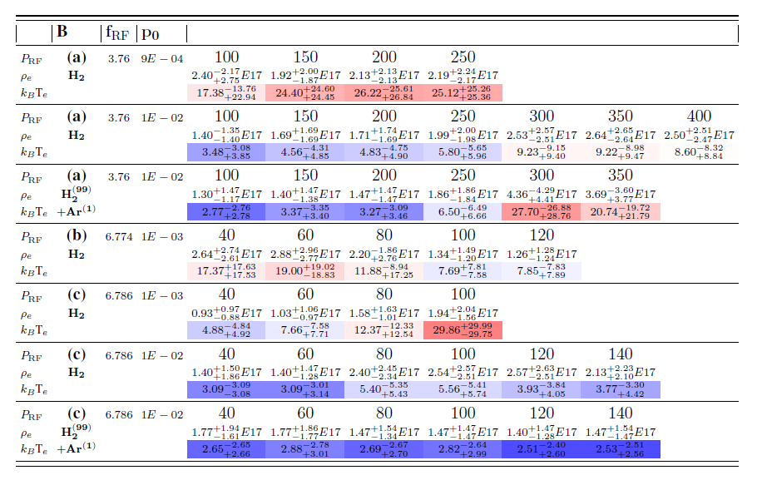
HOW & WHERE ?
First attempt of reproducing plasma conditions in laboratory
(2022) – First experimental setup and measurement campaign on the Flexible Plasma Trap (FPT@LNS): campaign of OES measurements, closely reproducing KN conditions – few eV, and 10¹¹ cm⁻³
High - T
Pidatella, A.,et al. Frontiers in Astronomy and Space Sciences
10.3389/fspas.2022.931744 (2022)
Low - T
A. Pidatella – GIANTS XII INCONTRO – July 3-4, 2025

Slide 8
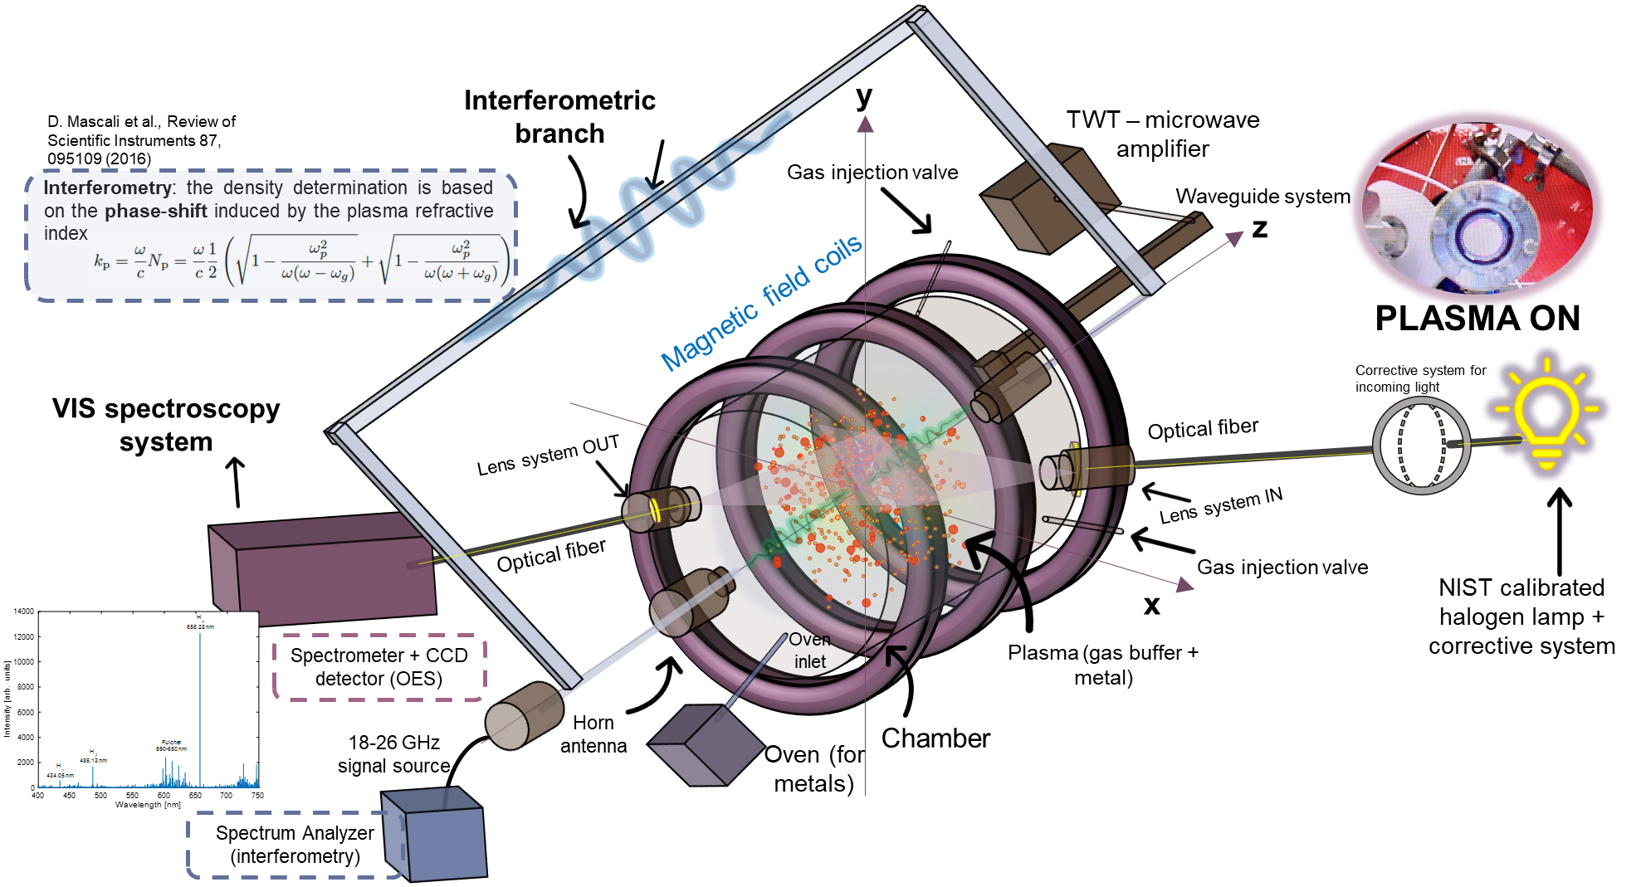

HOW & WHERE ?
The opacity experimental design: methods and setup
Opacity direct measurement: TRANSMITTANCE
A. Pidatella – GIANTS XII INCONTRO – July 3-4, 2025

Slide 9
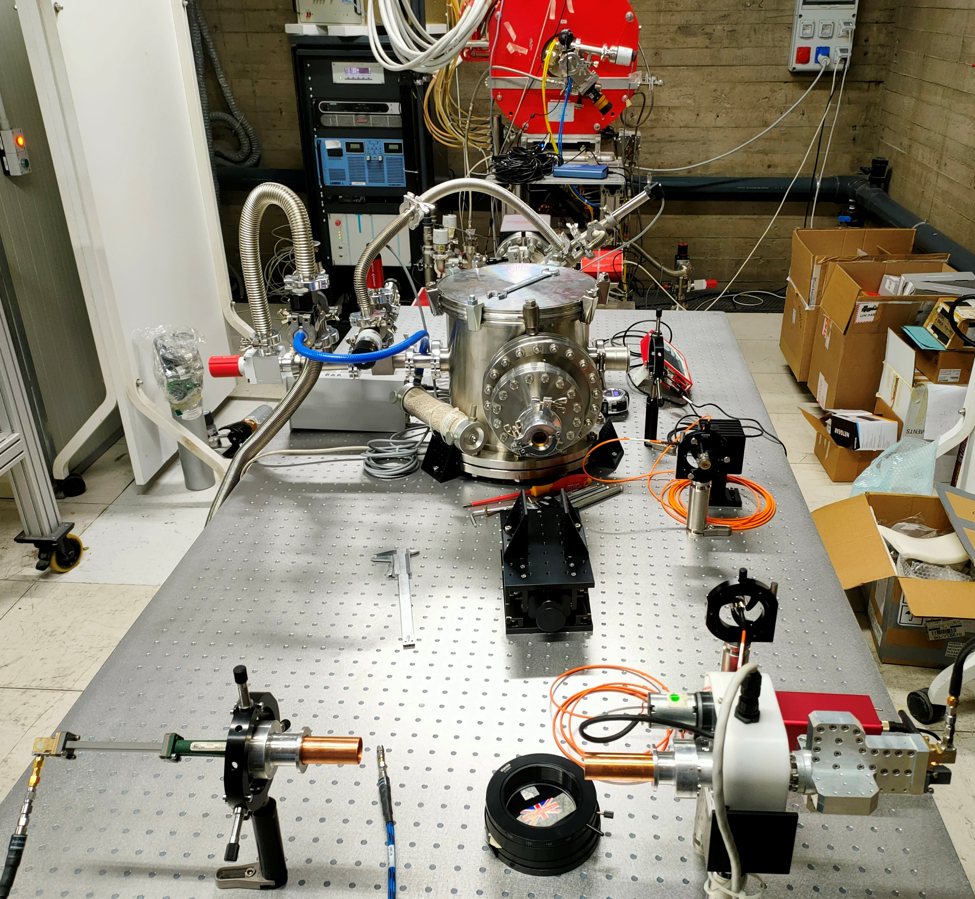
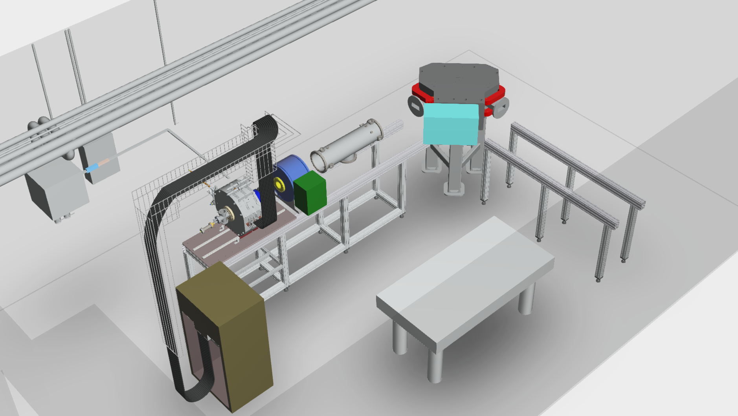
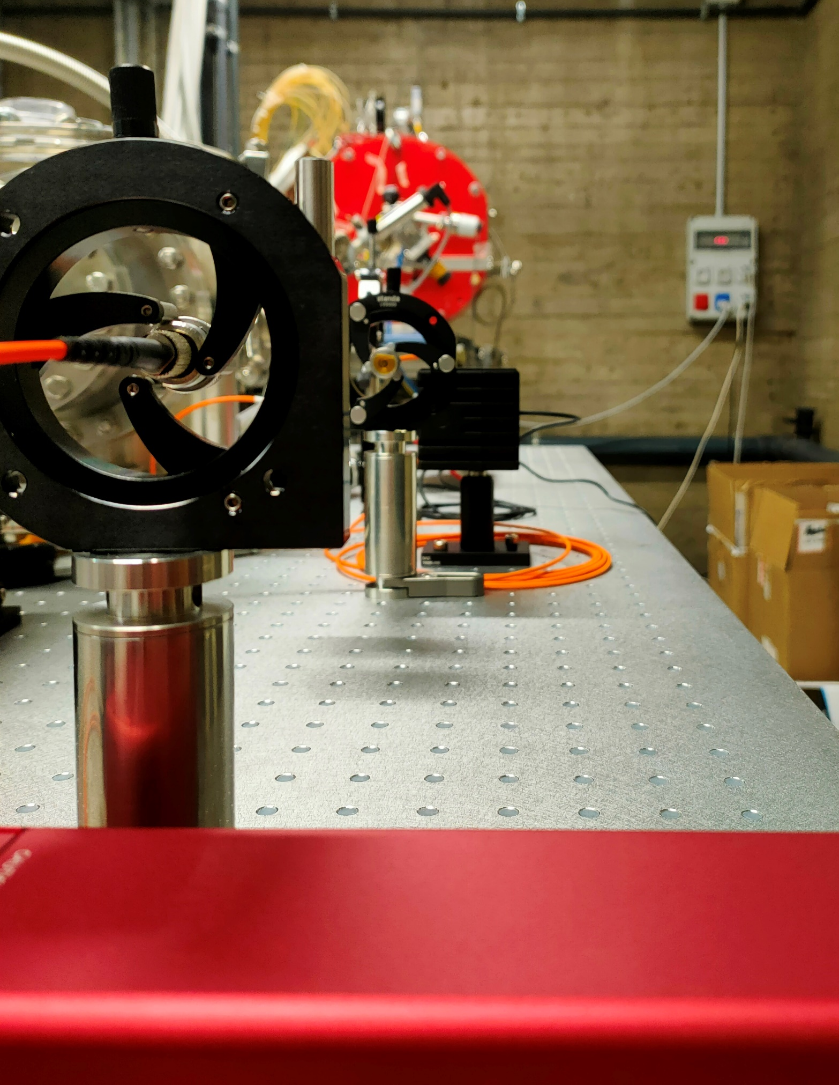
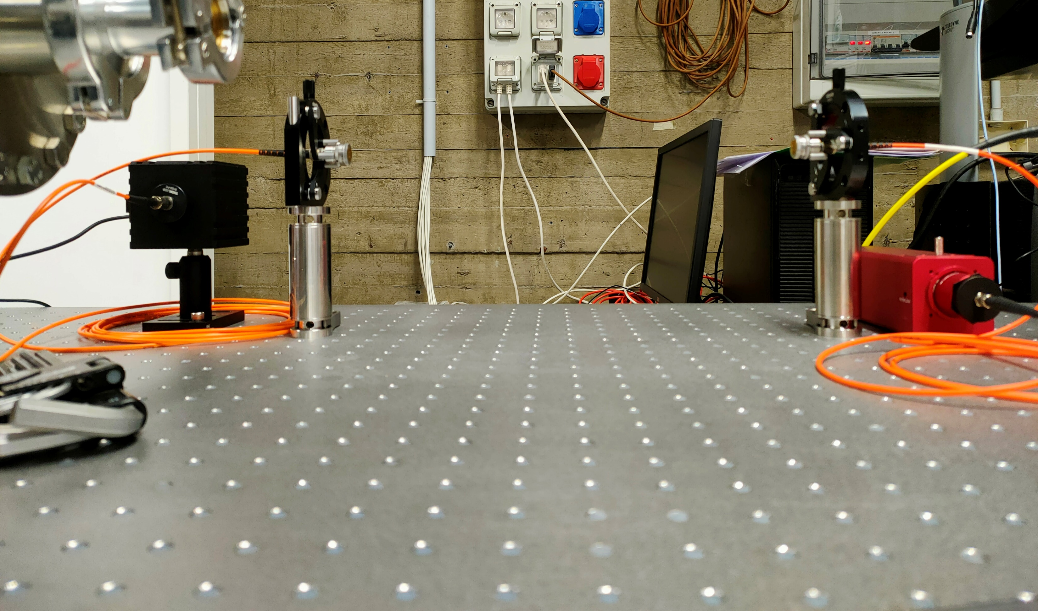
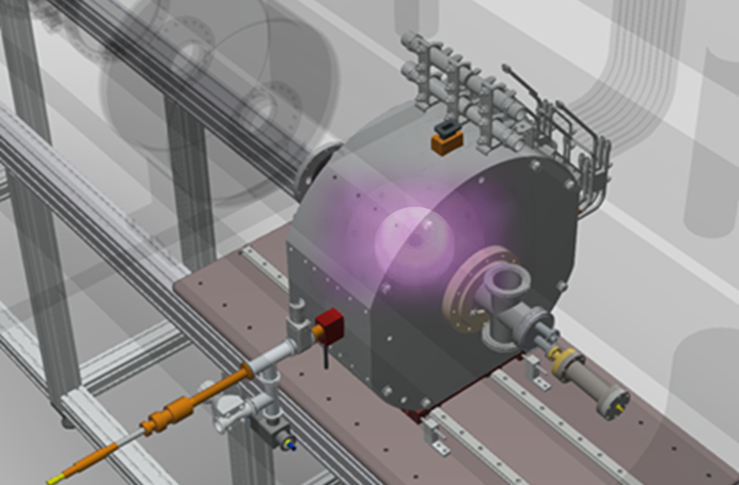
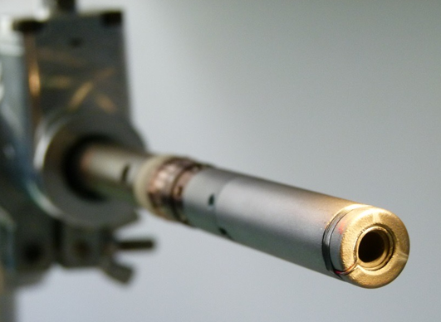
HOW & WHERE ?
The opacity experimental design: methods and setup
(Coming soon!) – First experimental test-bench on the FPT @ LNS
FPT
Mass spectrometer
Beam line
Multi-diagnostic test-bench on the FPT
Lens 1
Lens 2
Lens 2
Lens 1
Resistive oven for metals
Halogen lamp
Plasma trap
Calibrated power meter for calibration and alignement
Metallic evaporator
Halogen lamp
Plasma diagnostic box
A. Pidatella – GIANTS XII INCONTRO – July 3-4, 2025

Slide 10

SUMMARY
WHAT? - The kilonova plays a crucial role in the MM-astronomy era; modeling extremely sensitive on plasma ejecta opacity – correct reconstruction still debated!
WHY? - The opacity problem is hard to be tackled only via theory.
HOW & WHERE ?
  PANDORA@INFN: unique controlled experiments in laboratory plasmas reproducing KN conditions as well as for testing KN atomic models under NLTE regime, experimentally tackling the plasma opacity supporting KN modeling
WHAT’S NEXT?
First measurements @ FPT (exp. 2025) using He buffer (testing the protocol), no metallic species
Opacity measurements of a pool of metallic species ( Se, Sr, Zr ) @ FPT, PANDORA at INFN – LNS
A. Pidatella – GIANTS XII INCONTRO – July 3-4, 2025

Slide 11







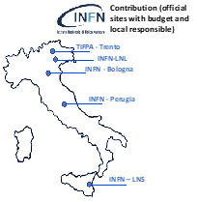
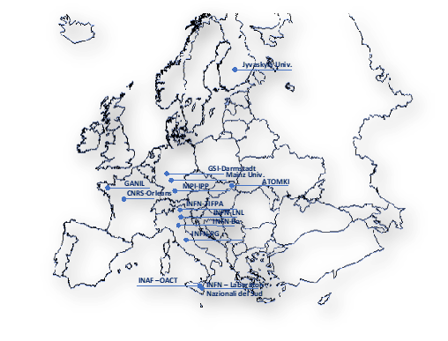

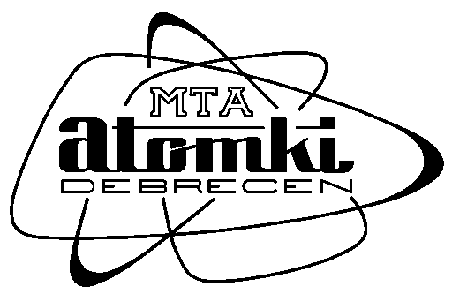







Thank you very much for your attention!!
Also collaborating in the nuclear fusion research programme for the Divertor Tokamak Test (DTT) project
A. Pidatella – GIANTS XII INCONTRO – July 3-4, 2025

Slide 12
BACKUP
A. Pidatella – GIANTS XII INCONTRO – July 3-4, 2025

Slide 13
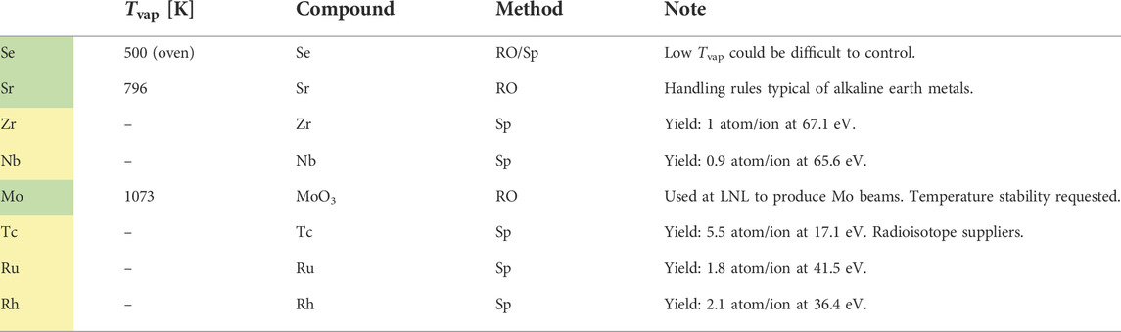

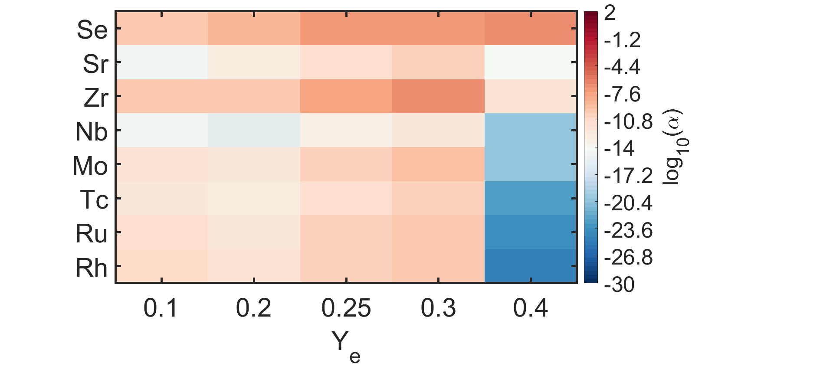
BACKUP
Se
Sr
Wishlist: day-1 measurements
Zr
Nb
Mo
Tc
Ru
Rh
  Why? → Relevant absorption feature in VIS spectrum to be compared with KN observation and theoretical calculations
  How? → Different techniques of metal injection in plasma;
  → Diagnostics of plasma parameters;
  → Diagnostics of relative charge state distribution of metal in the plasma;
  → Detection of VIS-NIR transmittance spectrum
Feasibility
  Two degrees of study:
  Single-specie plasma opacity @ KN plasma conditions under NLTE – only light-r process elements!
  Single-specie plasma opacity @≠ KN plasma conditions – both light- and heavy-r process elements – to extrapolate and test (N)LTE opacity models/atomic data at the state-of-the-art
A. Pidatella – GIANTS XII INCONTRO – July 3-4, 2025

Slide 14
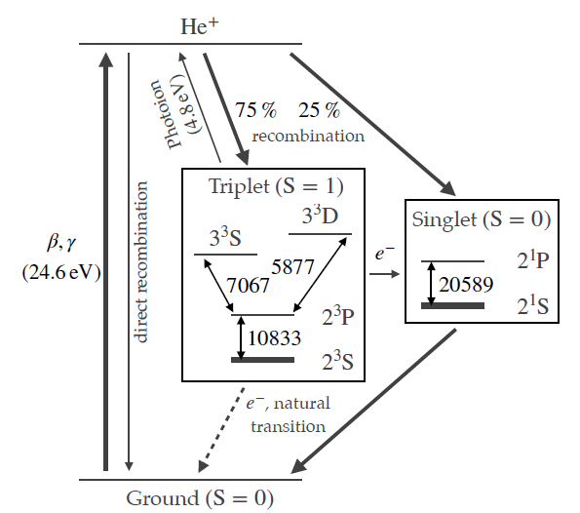
BACKUP
Testing the method and protocol: day-0 measurement
First transmittance measurements @ FPT using He buffer (not mixed), no metallic species
Why He? – relation to the KN scenario
    (2023) Helium 10833 Å line can be an alternative explanation of the feature of P-Cygni profile used to fit AT2017gfo
    Find that 0.2% (in mass) of Helium in the ejecta can reproduce the P-Cygni feature in the observed spectrum at 1.43 -- 4.40 days under non-LTE plasma conditions
    (2024) debated inconsistency of P-Cygni spectrum if using He-I: when NLTE conditions become important?
A. Pidatella – GIANTS XII INCONTRO – July 3-4, 2025

Slide 15
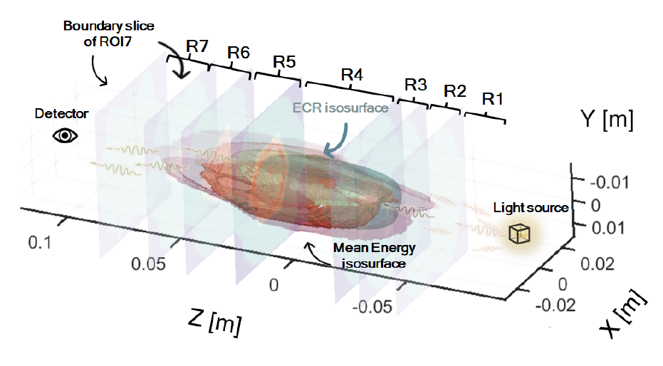

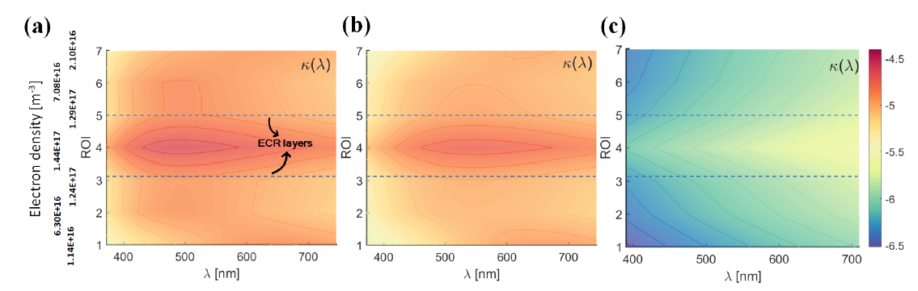
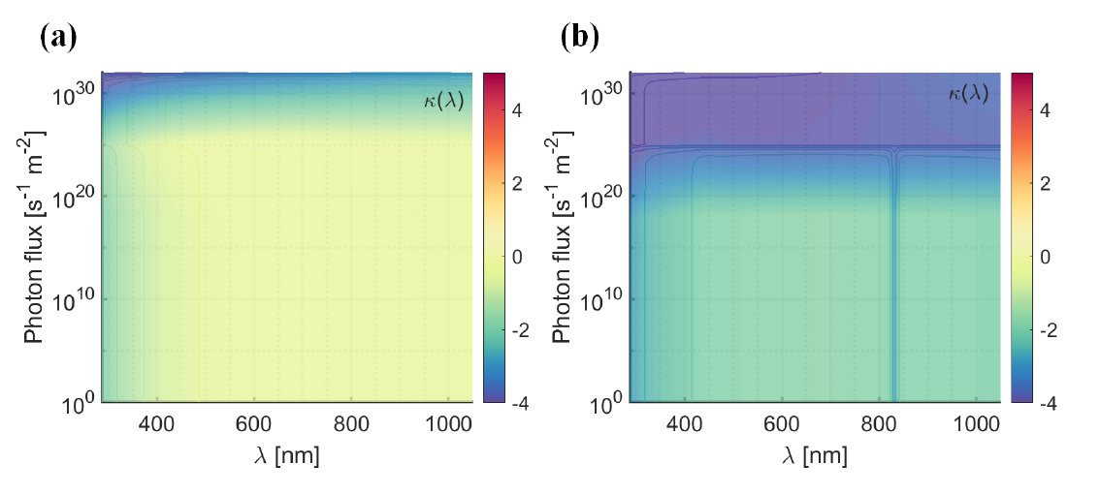
BACKUP
Simulated strong impact of external radiation field on the VIS plasma response
A. Pidatella – GIANTS XII INCONTRO – July 3-4, 2025

Slide 16
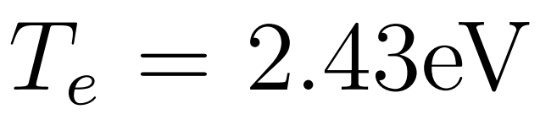
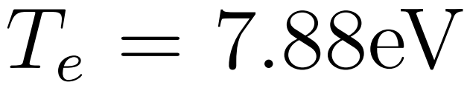
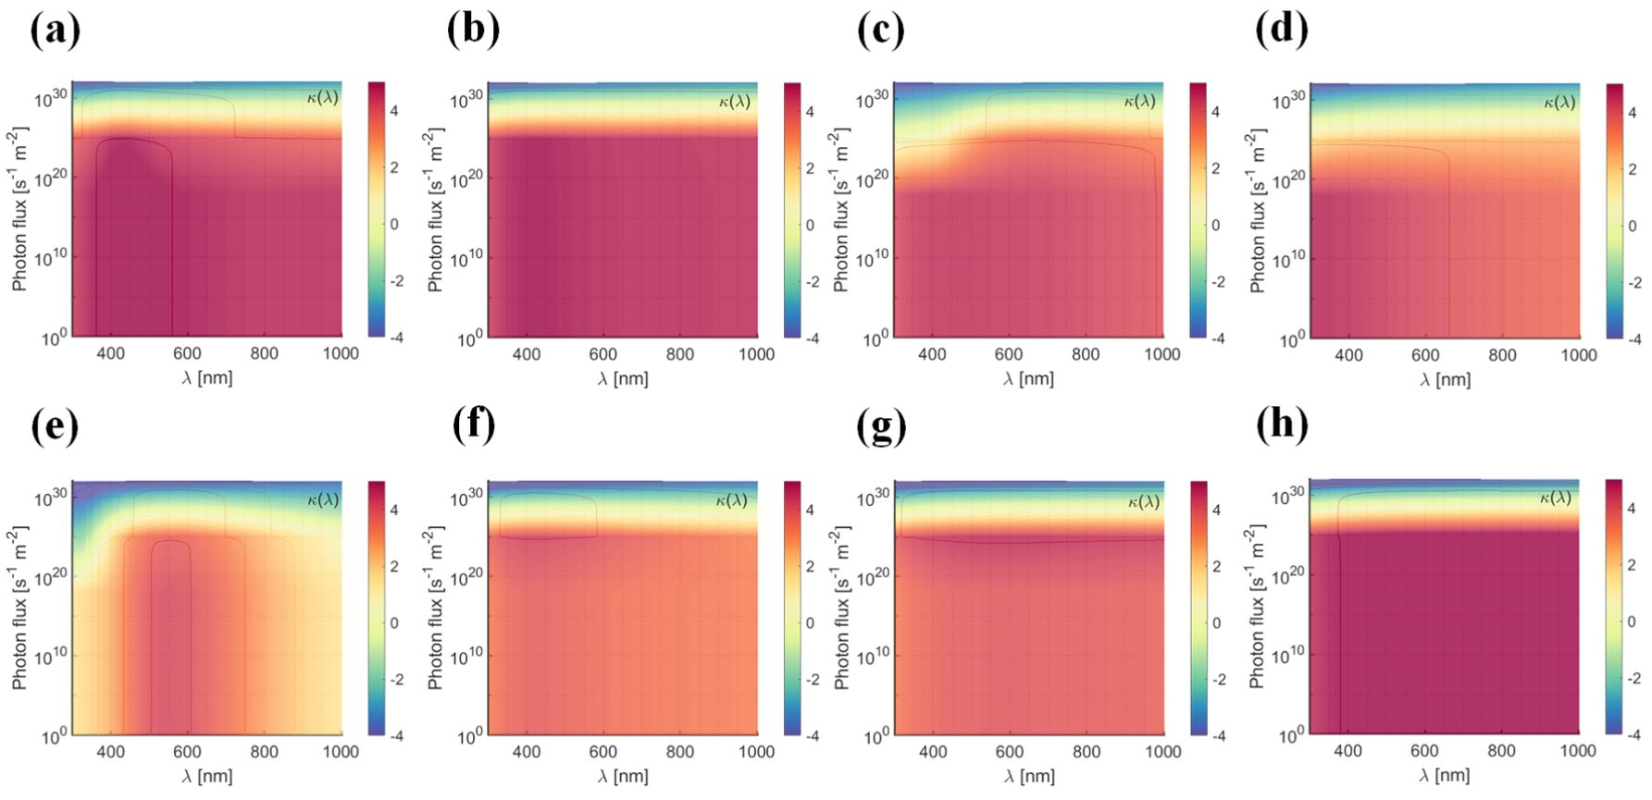
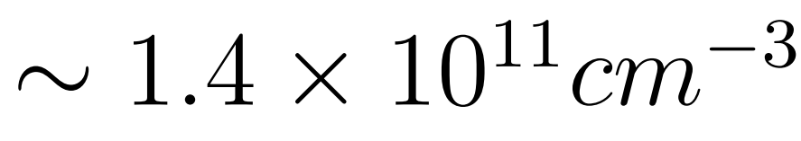
BACKUP
Numerical opacity vs. FPT experimental plasma parameters vs. external light source flux
SELENIUM
STRONTIUM
ZIRCONIUM
NIOBIUM
A. Pidatella – GIANTS XII INCONTRO – July 3-4, 2025

Slide 17
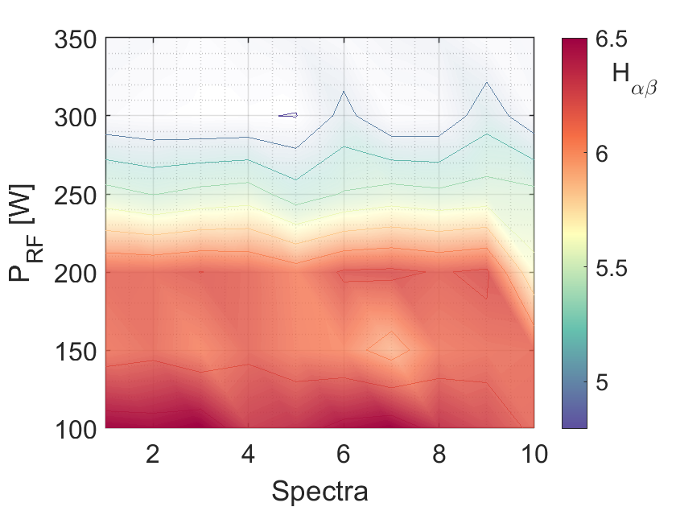
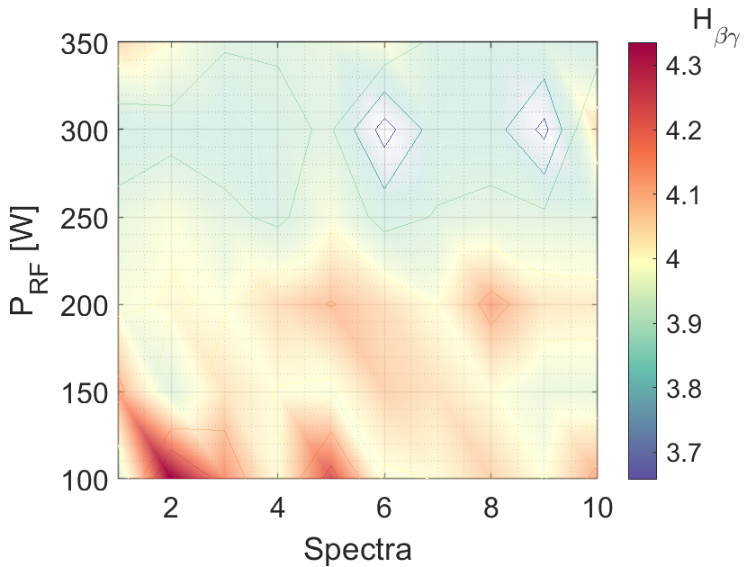
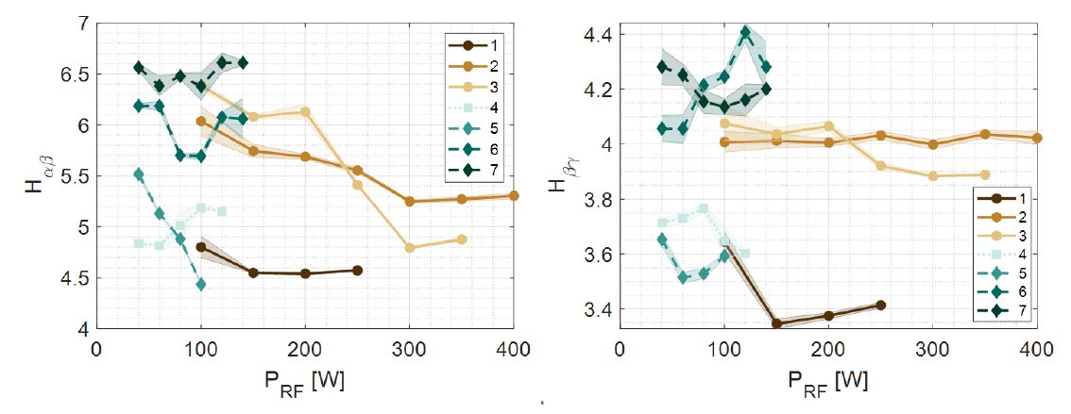





BACKUP
Monitoring plasma stability from emission line ratios
Characterizing plasma density and temperature from line ratios
  $$H_{αβ}$$
  $$H_{βγ}$$
7 exp. configurations, different pressures: many spectra per cfg.
  $$H_{α}$$
Lamp-calibrated (relative, not absolute) spectra
  $$H_{γ}$$
  $$H_{β}$$
A. Pidatella – GIANTS XII INCONTRO – July 3-4, 2025

Slide 18
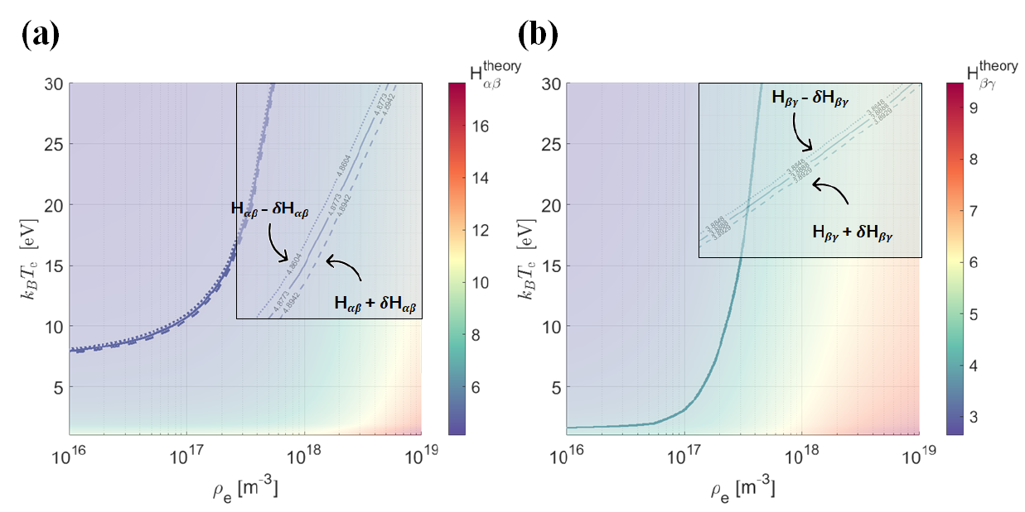


BACKUP
Monitoring plasma stability from emission line ratios
Characterizing plasma density and temperature from line ratios
ESTIMATES : Average density and temperature proportional to the effective emission coefficients $χ_{λ}$.
Solving non-linear two-variables equation system from two-lines integrated ratios → cross point! Unique solution for $\left\langle ρ\right\rangle ,⟨T⟩$
  $\frac{I_{α}}{I_{β}}=\frac{η_{α}}{η_{β}}\frac{χ_{α}\left(ρ,T\right)}{χ_{β}\left(ρ,T\right)}→\left\langle ρ\right\rangle ,⟨T⟩$
Thanks to the collaboration of colleagues from MPI für Plasmaphysik and UNI-Augsburg
Theory: YACORA CR model line ratios (n,T) isosurface
Collisional Radiative (CR) model
Balance eqs. are solved considering the different mechanisms of population and de-population of atomic levels (Rate eqs.)
Exp: measured line ratios, isoline on theoretical isosurface
Pidatella, A.,et al. Frontiers in Astronomy and Space Sciences
10.3389/fspas.2022.931744 (2022)
A. Pidatella – GIANTS XII INCONTRO – July 3-4, 2025

Slide 19
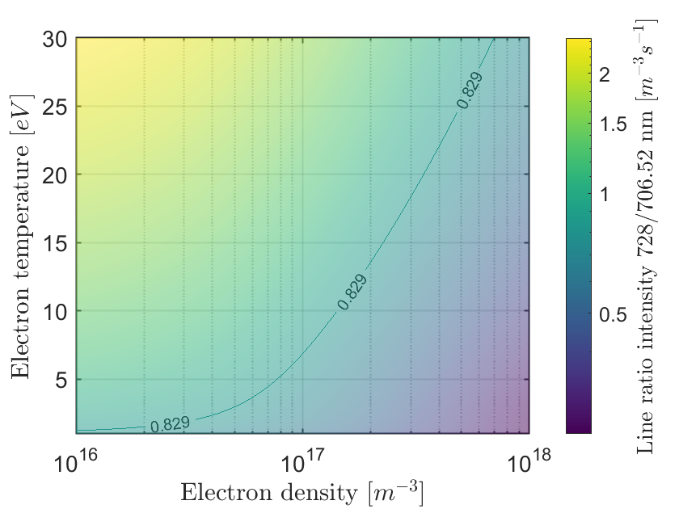
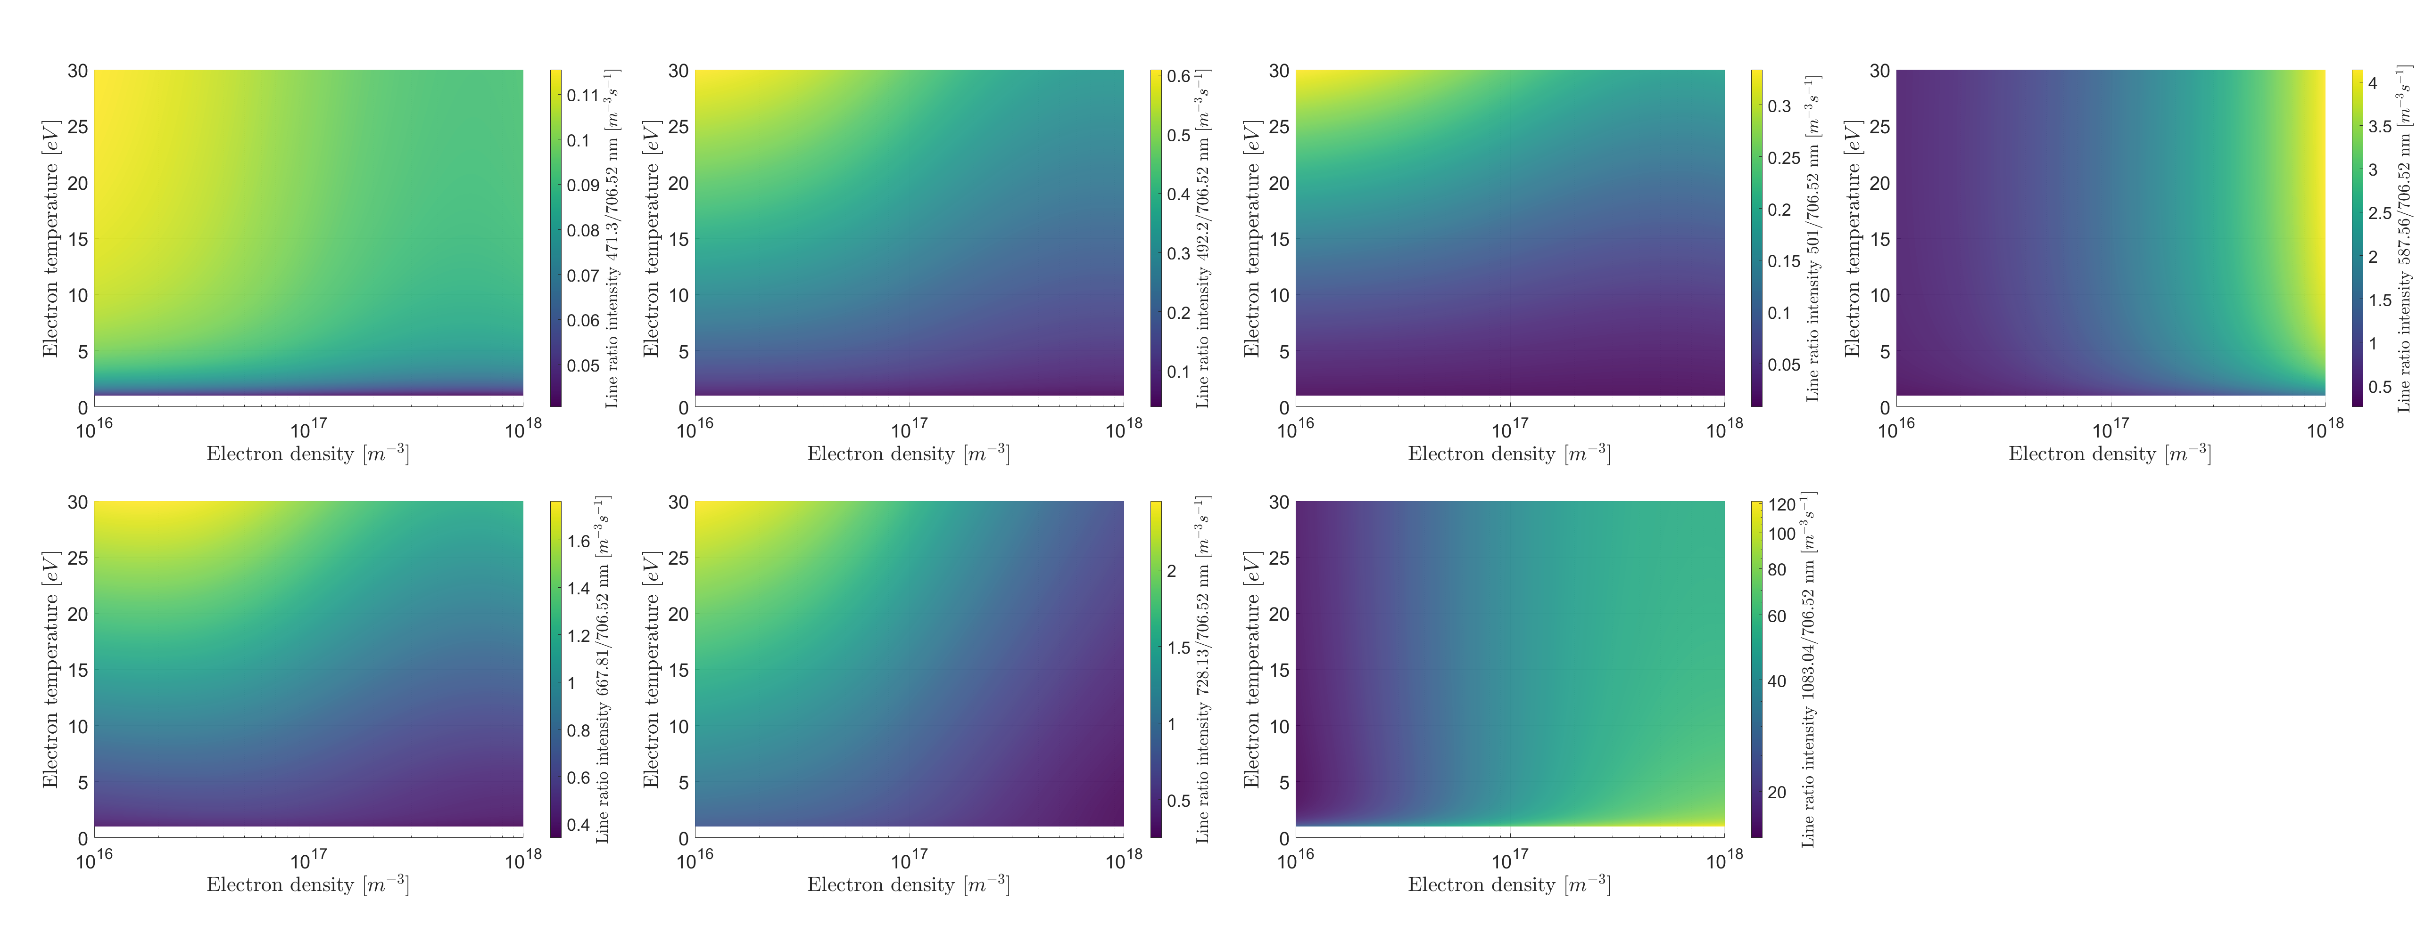
BACKUP
First transmittance measurements @ FPT using He buffer (not mixed), no metallic species
    Light transmission to spectrometer without plasma, but through the chamber – check for nominal spectral distribution;
    Self-emission spectrum from plasma without external light;
    Transmittance measurements with plasma and external light;
OES diagnostic from He? – we need plasma parameters
Plasma diagnostics: OES line ratios
CR model YACORA calculations of NLTE He-I line ratio
Helium theoretical emission line ratios vs. plasma (n, T)
OES plasma parameters: 6 of 7 lines ratio (absolute)
He Opacity: 1083/706 nm line
A. Pidatella – GIANTS XII INCONTRO – July 3-4, 2025

Slide 20





BACKUP
REQUIREMENTS
Opacity direct measurement: TRANSMITTANCE
Plasma reproducibility
Accurate transmittance measurements: absolute spectral radiance from OES
Independent plasma diagnostics
Light source: high-quality absolute intensity, broad, featureless spectrum, larger than SE
OES diagnostics
Profilometry/Secondary diagnostics
CHALLENGES & CRITICAL ASPECTS
Transmittance measurements: plasma active medium
Self-emission from plasma + radiation attenuation led by opacity
Spurious contribution: (i) reflection at chamber wall, etc
To be measured: independent measurements
Opacity of metal/buffer mixture: strongly dependent on density and temperature profile
Pidatella, A.,et al. Front. in Astr. Space Sci, 10.3389/fspas.2022.931744 (2022)
Pidatella, A., EPJ Web of Conferences 275, 02012 (2023)
Pidatella, A., Genova University Press, ISBN: 978-88-3618-218-3 (2023)
A. Pidatella – GIANTS XII INCONTRO – July 3-4, 2025

