Slide 1



Electron Capture and Bound-State β-Decays in Ions and Plasma
New calculations for s-process nucleosynthesis
B. Mishra, A. Pidatella, D. Mascali
INFN-LNS
S. Taioli, T. Morresi
ECT*-FBK
S. Simonucci, F. Triggiani
Università di Camerino
On behalf of the PANDORA collaboration

Slide 2
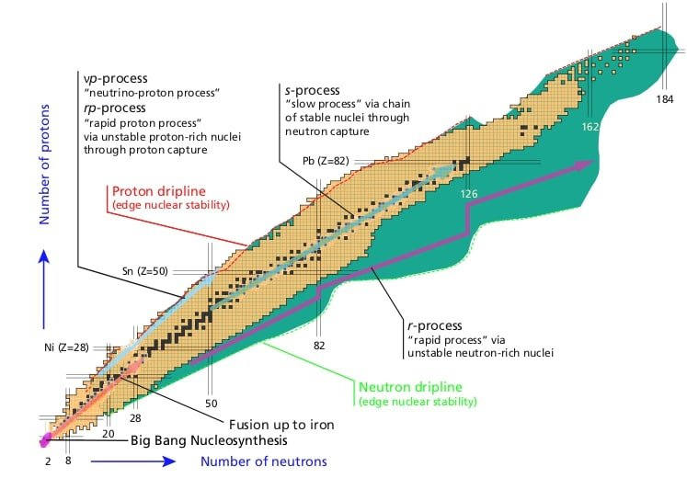
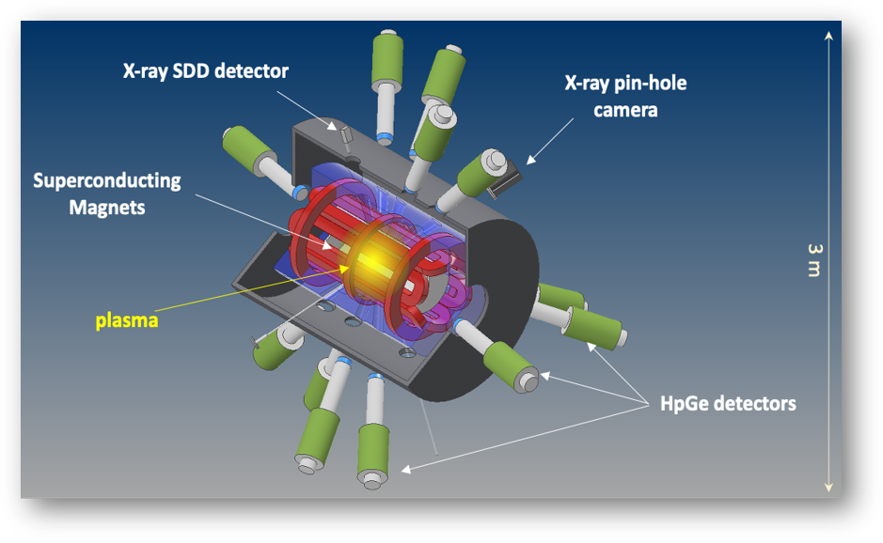
S-Process Nucleosynthesis and β-Decay
Plasmas for Astrophysics, Nuclear Decay Observations and Radiation for Archaeometry
n_{e} ~ 10¹¹⁻¹³ cm⁻³
kT_{e} ~ 0.1 - 100 keV
D. Mascali et al, Universe 8, 80 (2022)
D. Mascali et al, EPJ WoC 227, 01013 (2020)
T.R. Rodriguez, J. Phys. Conf. Ser. 503 (2014)
Model inputs:
For details on facility, diagnostics and experimental methodology, see talk by E. Naselli
Maxwell Average Cross Sections (MACS)
Plasma opacity for r-process
A. Pidatella et al, Front. Astron. Space Sci. 931744 (2022)
See flash talk by A. Pidatella
β-decay rate in plasma for s-process
Talks by R. Mucciola, N. Pieretti, M. Spelta
ϐ-Decay Rates (λ_{ϐ})
Bharat Mishra, 03/07/2025, GIANTS XII Incontro
2

Slide 3
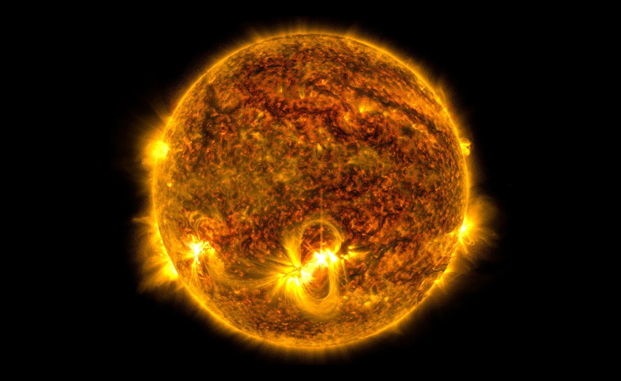
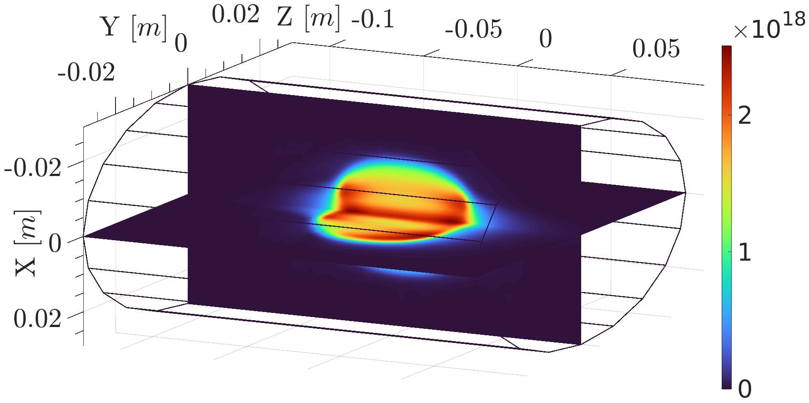
Modelling β-Decays in Plasmas
PANDORA can be a testbench for validating different models of in-plasma β-decay
n_{e} [m-3]
High density and temperature
n ~ 10²⁴⁻²⁶ cm⁻³, kT ~ 100 eV - 1 keV
LTE
CSD – Saha equation, LPD – Boltzmann equation, electrons – Maxwellian
Perfect confinement
Low density, high temperature
n_{e} ~ 10¹¹⁻¹³ cm⁻³, kT_{e} ~ 100 eV - 1 keV
NLTE
CSD and LPD described by collision-radiative model
Finite ion confinement
Ions are subject to transport, reactions are non-local
General model of in-plasma decay
Bharat Mishra, 03/07/2025, GIANTS XII Incontro
3

Slide 4
Modelling β-Decays in Plasmas
General model of in-plasma decay
Configuration-dependent rates
Plasma model
In-plasma rates
Decay rate for each charge state i and excited level j of the isotope
Updated atomic data taken from HULLAC, but can be substituted with other databases as well
A. Bar-Shalom, M. Klapisch and J. Oreg, J. Quant. Spectrosc. Ra. 71, 169 (2001)
Customised according to parameter space
FLYCHK for uniform plasmas, PIC-MC codes for PANDORA
H.-K. Chung et al, High Energy Density Phys. 1, 3 (2005)
B. Mishra et al, Front. Phys. 932448 (2022)
Generates more observables – can be tested in other facilities (ESR-FAIR@GSI, ERNA)
Can test different atomic databases
Bharat Mishra, 03/07/2025, GIANTS XII Incontro
4

Slide 5
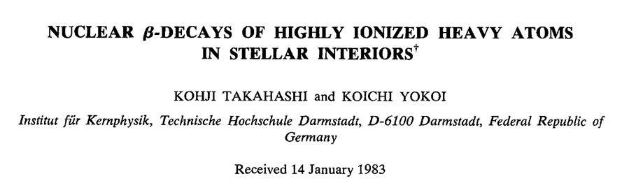
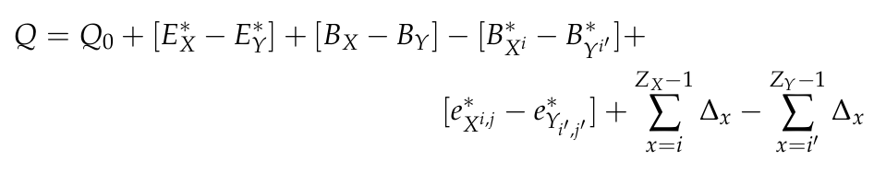
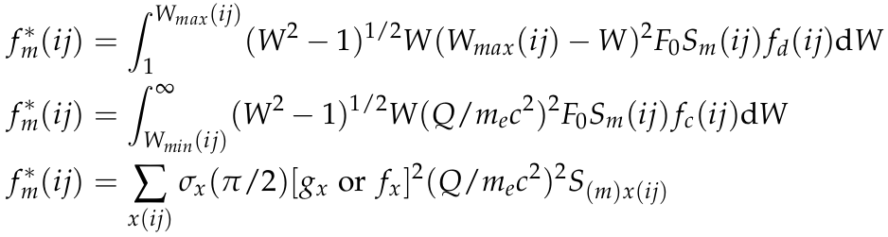
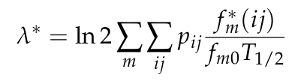
Takahashi-Yokoi Model: Systematics Based
A comprehensive model to predict β-decay rates of A>59 nuclei in LTE plasma
K. Takahashi and K. Yokoi, Nucl. Phys. A 404 (1983)
K. Takahashi and K. Yokoi, At. Data Nucl. Data Tables 36 (1987)
Decay Energy
Lepton Phase Volume
Difference in ionisation energy
Difference in nuclear level energy
Difference in excitation level energy
Difference in IPD
Orbital EC/ Bound state β-Decay
i = ionisation stage of the atom (follows charge conservation)
j = excitation state of parent system
j' = excitation state of daughter system
Decay rate
log ft of transition (known from terrestrial measurement or reliably calculated). Related to NME.
Bharat Mishra, 03/07/2025, GIANTS XII Incontro
5

Slide 6
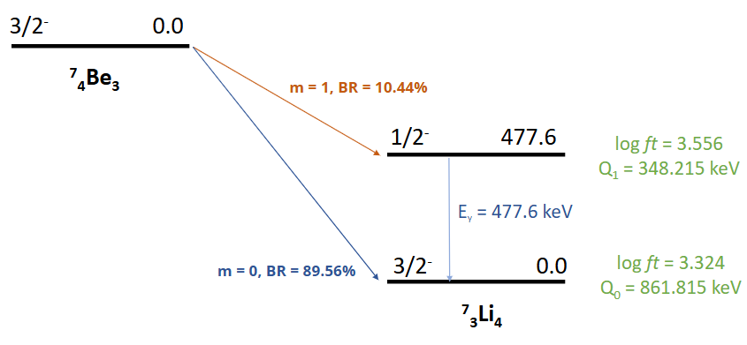

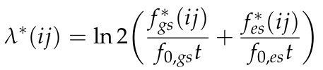

Generalised Takahashi-Yokoi Model: ⁷Be
Configuration-dependent rates
Orbital occupancy – taken from HULLAC
Hyperfine splitting – taken from Patyk et al
Z. Patyk et al, Phys. Rev. C 77, 1 (2008)
Coulomb amplitude – taken from LOGFT and Behrens-Janecke
H. Behrens and J. Janecke, Numerical Tables for beta decay and electron capture, Landolt-Bornstein (1969)
⁷Be undergoes EC decay to ⁷Li through 2 channels
Decay scheme taken from ENSDF database
In-plasma rates
Astrophysically relevant
Phase-2 isotope for PANDORA
Plasma model
Bharat Mishra, 03/07/2025, GIANTS XII Incontro
6

Slide 7
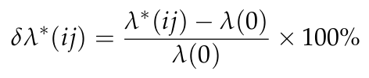
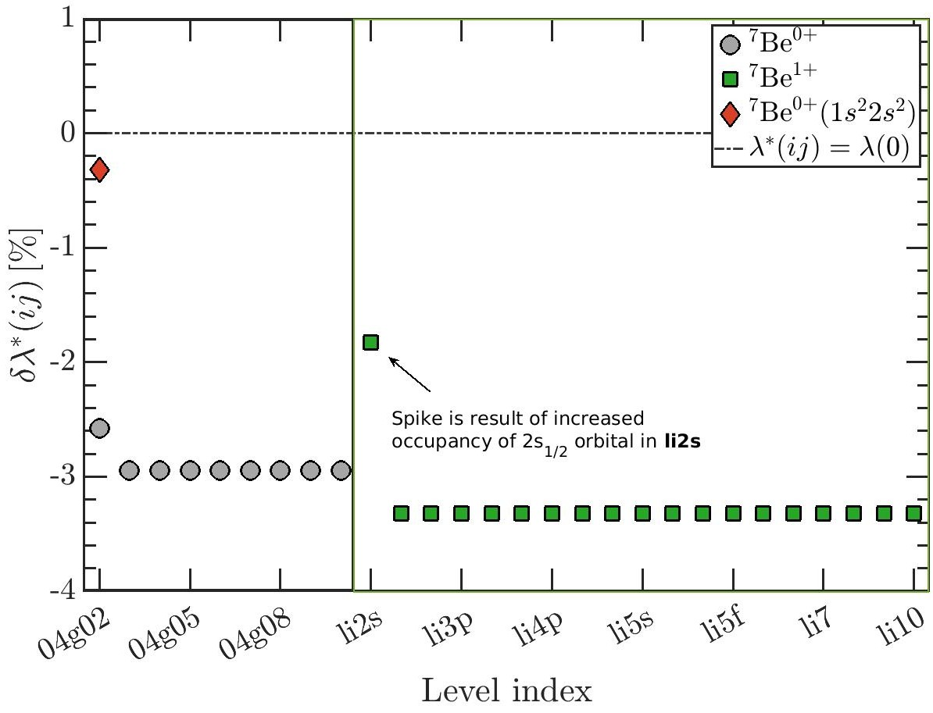
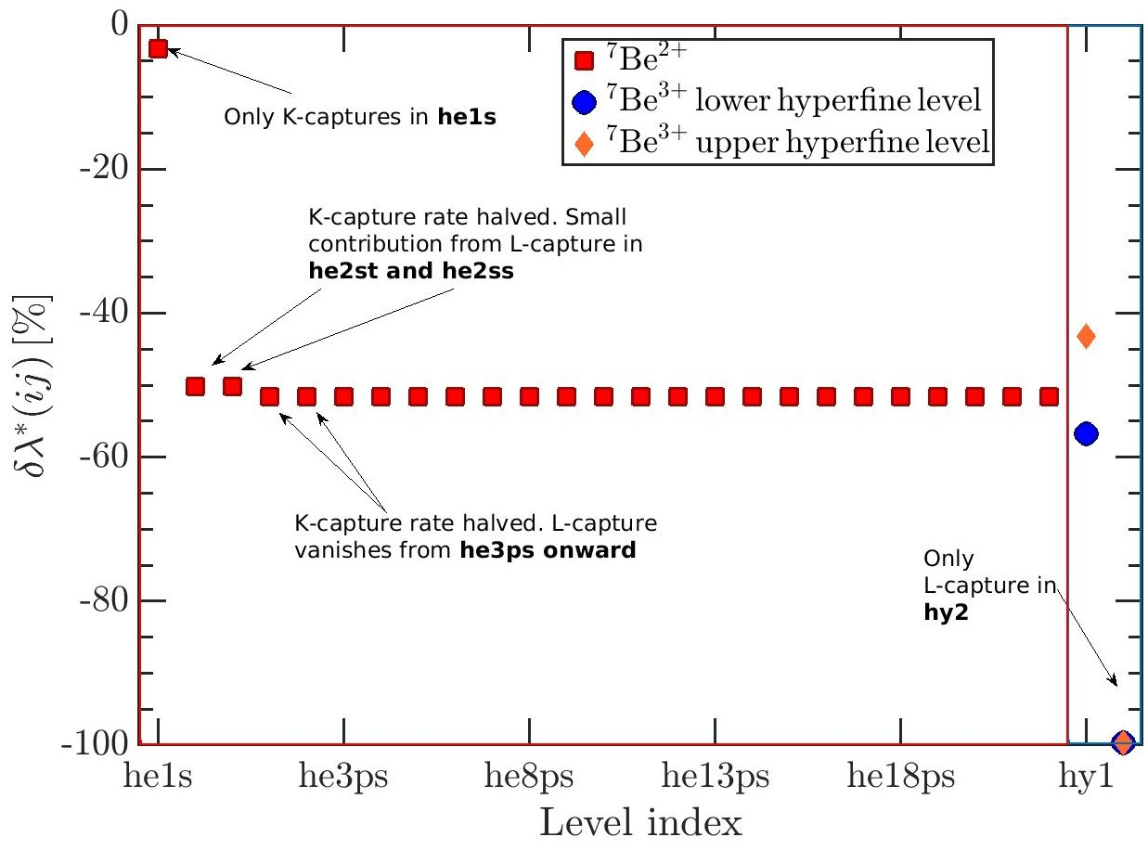
Electron Capture Rates in ⁷Be Ions
Complete analysis of decay rates in individual ions and atomic excitation levels
🗸
Bharat Mishra, 03/07/2025, GIANTS XII Incontro
7

Slide 8
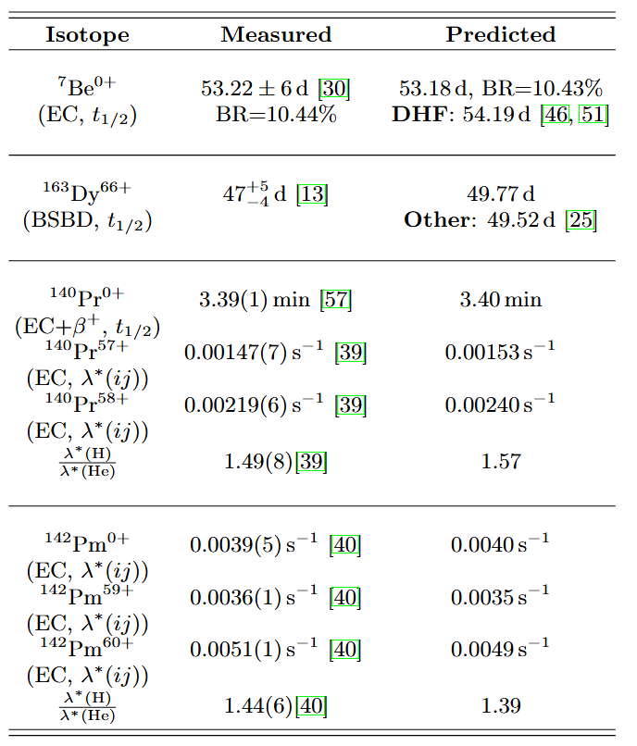
Electron Capture Rates in Other Ions
S Liu, C Gao, and C Xu, Phys. Rev. C 104, 024304 (2021)
M. Jung, F. Bosch et al, Phys. Rev. Lett 69, 2164 (1992)
🗸
Generates more observables – can be tested in other facilities (ESR-FAIR@GSI, ERNA)
Can test different atomic databases
Y. Litvinov et al, Phys. Rev. Lett 99, 262501 (2007)
N. Winckler et al, Phys. Lett. B 679, 36 (2009)
Bharat Mishra, 03/07/2025, GIANTS XII Incontro
8

Slide 9
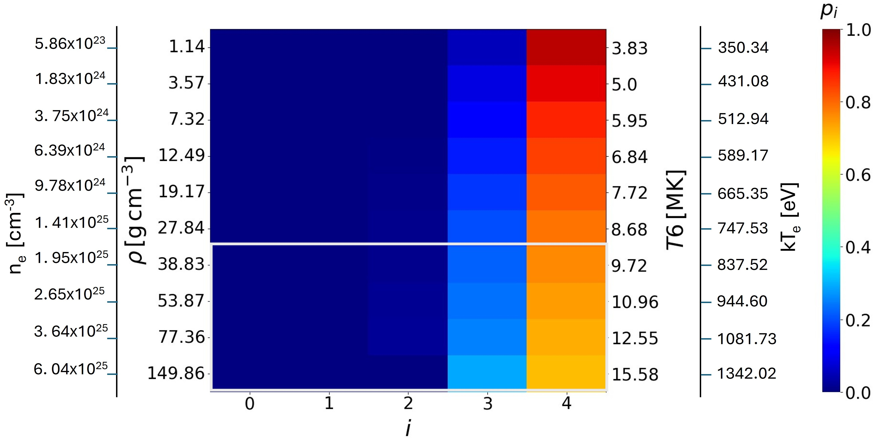
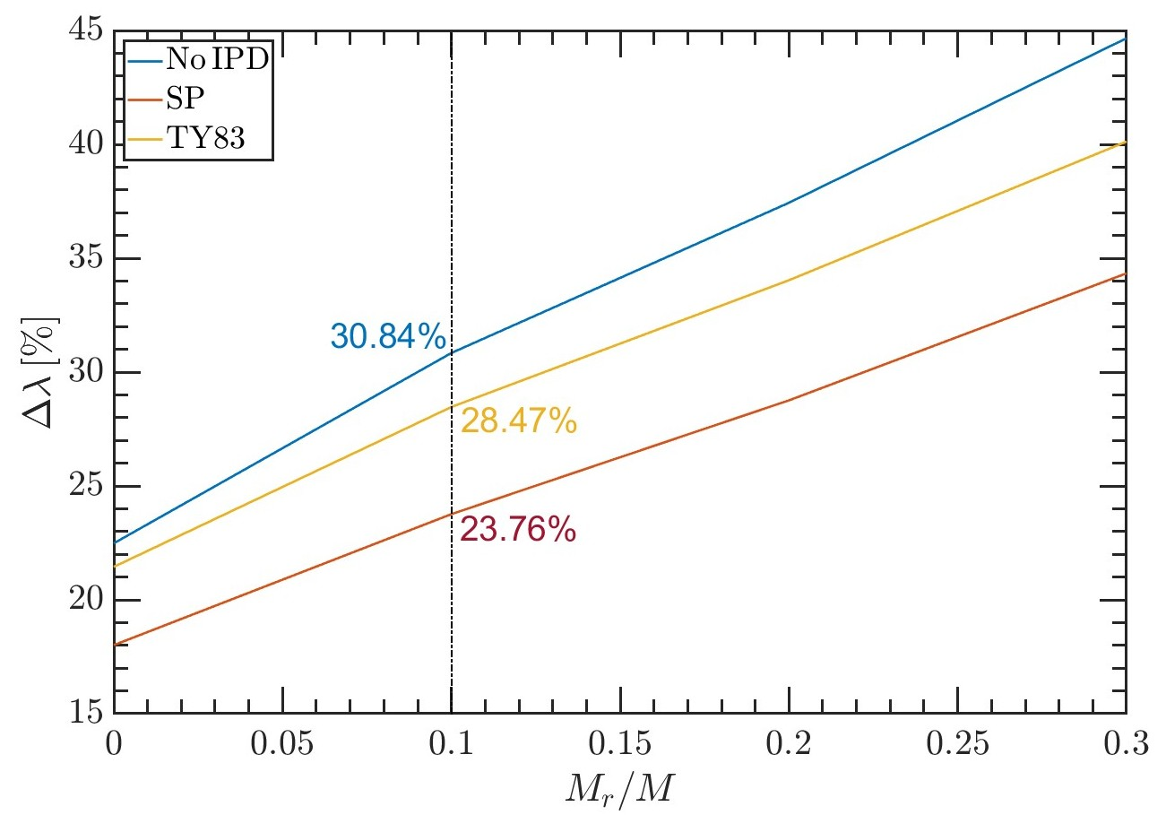
In-Plasma Electron Capture Rates: ⁷Be
Solar core
M_{r}/M=1
Model applicable to high density solar interior – reproduces expected decay rate enhancement (sanity check)
🗸
M_{r}/M=0
CSD of ⁷Be at different mass coordinates in the sun
Percentage enhancement of ⁷Be decay rate at M_{r}/M<0.3
Plasma model: Saha-Boltzmann equation
IPD: Stewart-Pyatt model
Composition: Solar Models ICE-2023/SF-III
Magg et al, A&A 661, A140 (2022) [Photospheric]
IPD: Stewart-Pyatt model
Free electron capture rate:
J.N. Bahcall and C.P Moeller, ApJ 155, 511 (1969)
Bharat Mishra, 03/07/2025, GIANTS XII Incontro
9

Slide 10
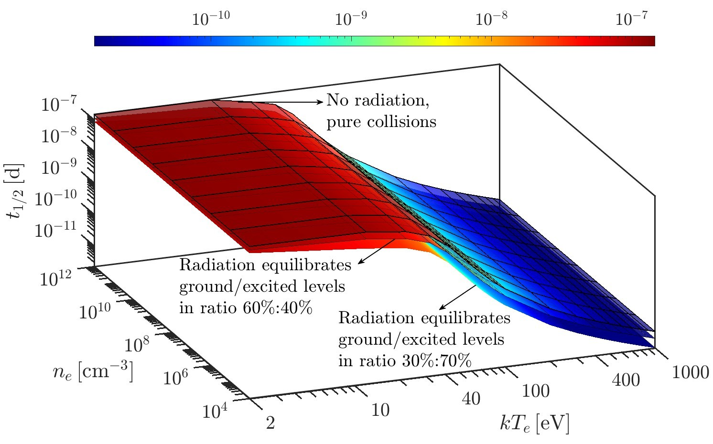
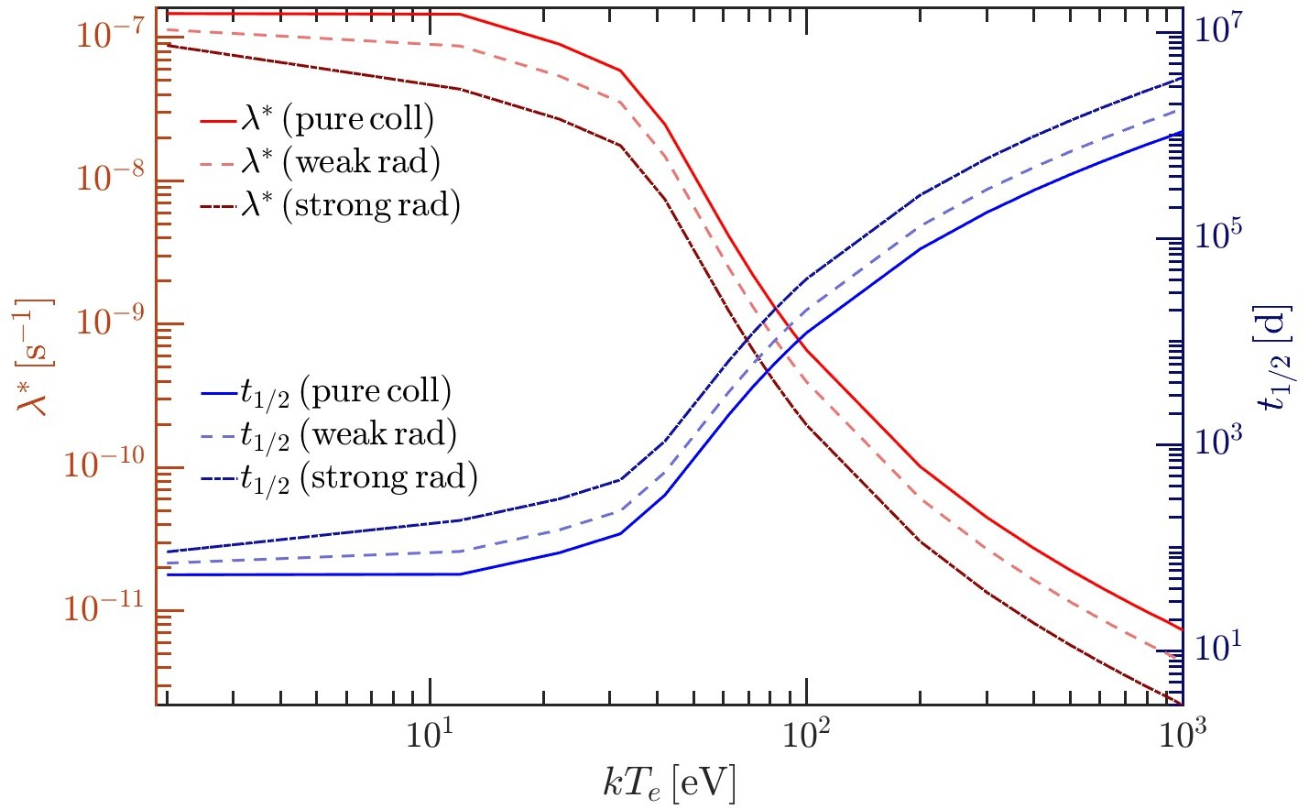
In-Plasma Electron Capture Rates: ⁷Be
Laboratory magnetoplasma
⁷Be decay rate as a function of n_{e} and kT_{e} under lab conditions
No dependence on density
Strong dependence on population of bound excited states, particularly in ⁷Be²⁺ and ⁷Be³⁺
⁷Be λ_{β} and t_{1/2} as a function of kT_{e} under lab conditions
Bharat Mishra, 03/07/2025, GIANTS XII Incontro
10

Slide 11
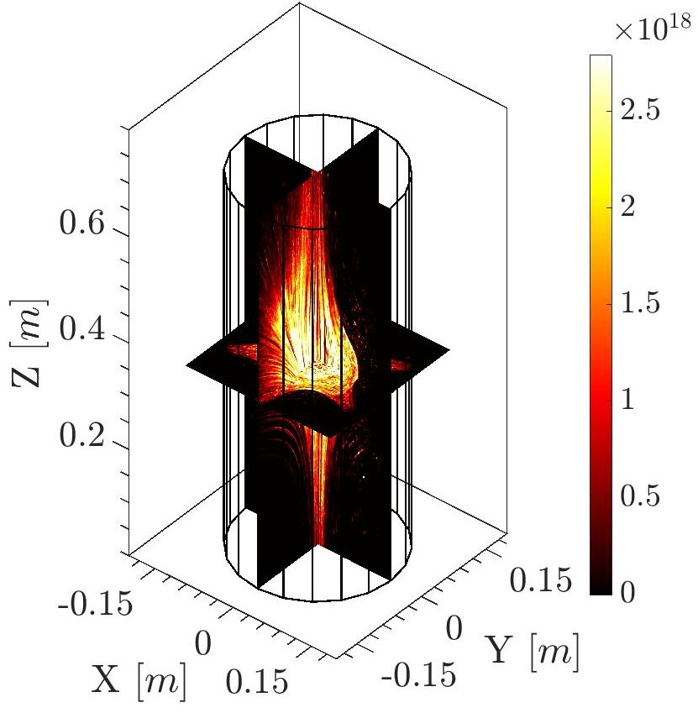
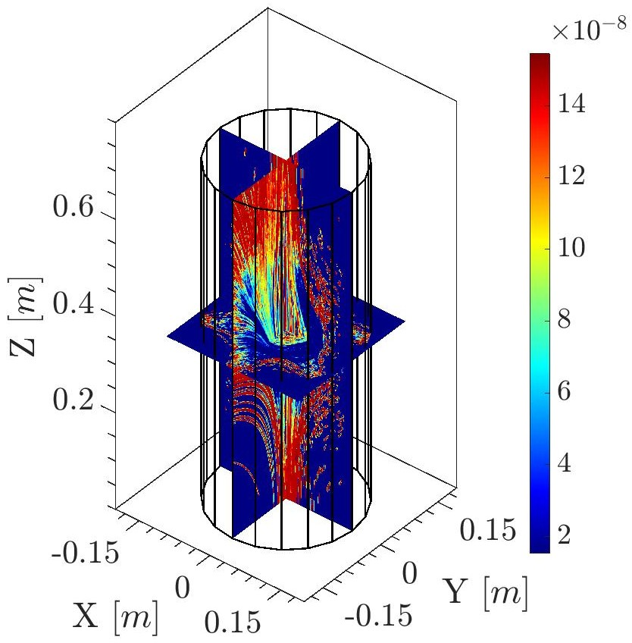
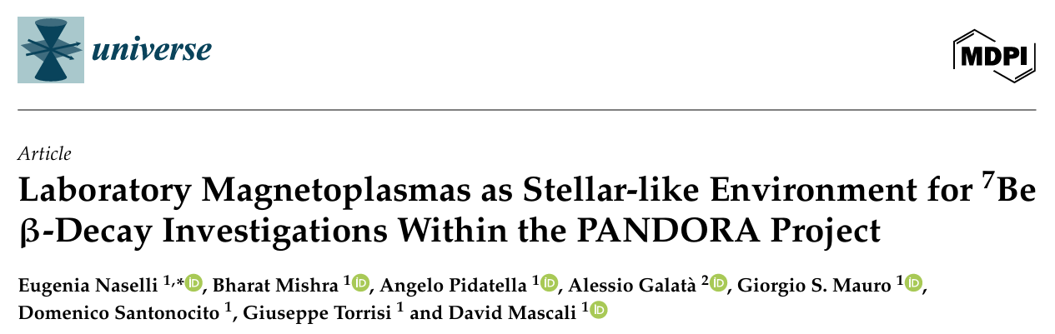
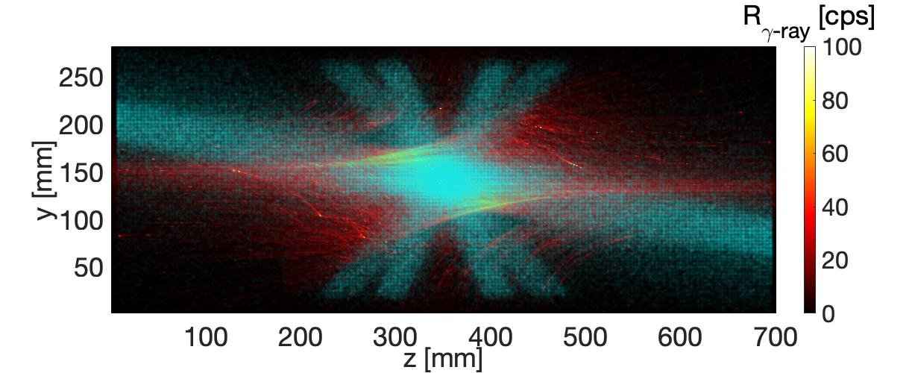
Application to PANDORA
The in-plasma decay model can be combined with Particle-in-Cell Monte Carlo (PIC-MC) codes to predict spatial distribution of λ_{β} in PANDORA.
B. Mishra et al, Front. Phys. 932448 (2022)
For data interpretation
For optimising isotope injection technique
For predicting decay rates
For assessing experimental feasibility
n_{e} [m⁻³]
λ_{β} [s⁻¹]
Lines of sight of HPGe detectors
λ_{β}*/ λ_{β}~10⁻²
3D distribution of n_{e} in PANDORA (preliminary simulation)
⁷Be EC rate in PANDORA (pure collision)
Bharat Mishra, 03/07/2025, GIANTS XII Incontro
11

Slide 12


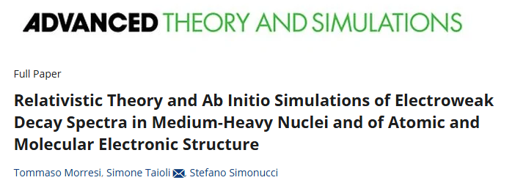
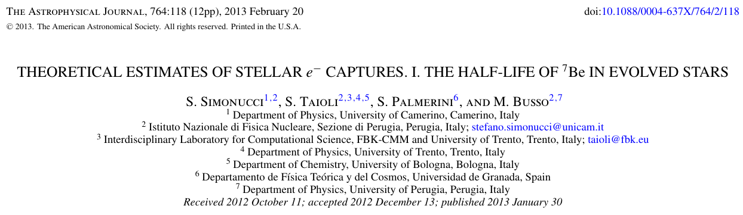
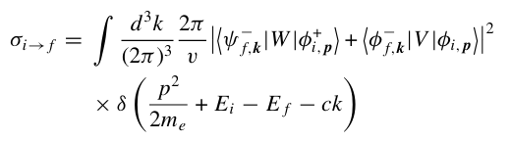
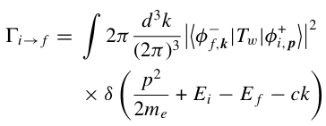
Hartree-Fock Model: Ab-Initio
Alternate model to predict in-plasma decay rates. Electron capture is modelled as a two-body scattering process under two potentials.
T. Morresi, S. Taioli and S. Simonucci, Adv. Th. Simul. 1 (2018)
Electron capture cross section
Electron capture rate
multiplied by electron current
Contains exchange and overlap corrections, Coulomb screening effects
Bharat Mishra, 03/07/2025, GIANTS XII Incontro
12

Slide 13
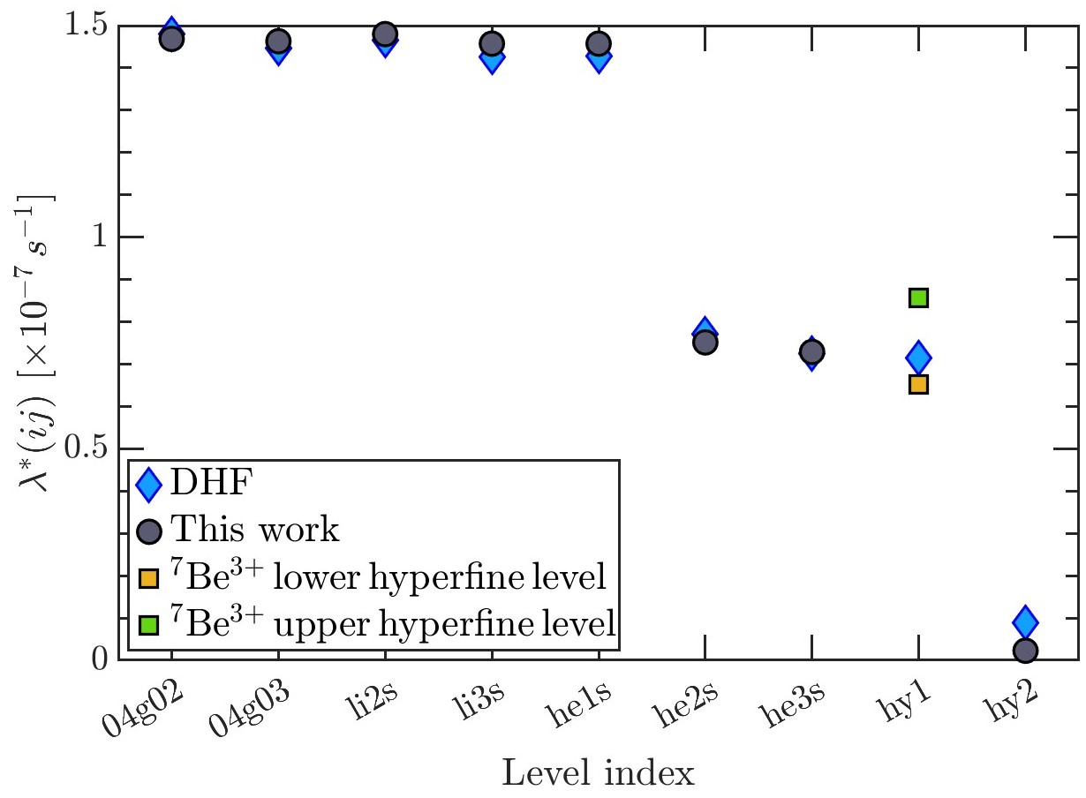
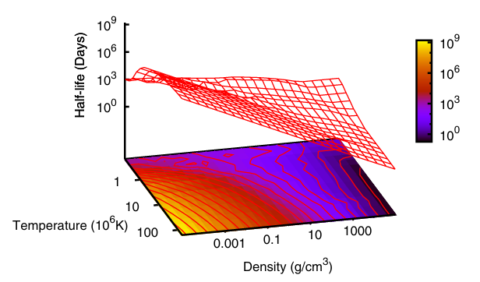
Hartree-Fock Model: Ab-Initio
Configuration-dependent capture rates: ⁷Be
In-plasma (solar) capture rates: ⁷Be
Alternate model to test in PANDORA, and applicable to stellar interiors as well
🗸
Comparison between HF- and TY83-predictions of EC rates in ⁷Be ions
Model predicts slightly lower capture rate of ⁷Be and ⁸B solar neutrino flux
D. Vescovi et al, A&A 623, A126 (2019)
Bharat Mishra, 03/07/2025, GIANTS XII Incontro
13

Slide 14
Synergies
Natural synergy with n_ToF
Complimentary inputs to MACS (see talks by R. Mucciola, N. Pieretti, M. Spelta)
Electron capture rate in ⁷Be ions: benchmark@ERNA
See talk by L. Gialanella/R. Buompane
Extension of PIC simulations for plasma opacity: collaboration with INAF
See next talk by M. Bezmalinovich and flash talk by A. Pidatella
Electron capture and bound state β-decay rates in highly charged ions @GSI
A⁻ score on 2025 G-PAC proposal to measure decay rates of ¹³⁴Cs
INFN-GSI collaboration proposal submitted to Ministero degli Affari Esteri e della Cooperazione Internazionale
Proposed (future) experiments at EuAPS facility to study s-process isomer thermalisation
Active collaboration with AsFIN
Sensitivity study of opacity on r-process nucleosynthesis (L. Roberti)
Possible studies on decay rate modification of ³⁷Ar
Bharat Mishra, 03/07/2025, GIANTS XII Incontro
14

Slide 15
Conclusions and Perspectives
PANDORA is an upcoming facility at INFN–LNS to study β-decays in a plasma
The facility can be a testbench of in-plasma decay models
We have developed a general approach to in-plasma decay modelling
Applicable to wider parameter space
Model can be tested in low density laboratory plasma and then applied to s-process nucleosynthesis sites
Uses updated atomic data → HULLAC database and FLYCHK
Model can be extended to light nuclei and include finer effects in multi-electron atoms such as exchange and overlap corrections, influence of excited levels and, hyperfine splitting
Can be coupled to Particle-in-Cell plasma kinetic codes
Numerous synergies with other Italian and international facilities/projects
Bharat Mishra, 03/07/2025, GIANTS XII Incontro
15

Slide 16







David Mascali
Domenico Santonocito
Angelo Pidatella
Eugenia Naselli
Giuseppe Torrisi
Giorgio Mauro
Giorgio Finocchiaro
THANK YOU FOR YOUR ATTENTION!
Alessio Galatà
Alberto Mengoni
Stefano Simonucci
Sara Palmerini
Maurizio Busso
Simone Taioli
...and the PANDORA collaboration

Slide 17
Additional Slides

Slide 18
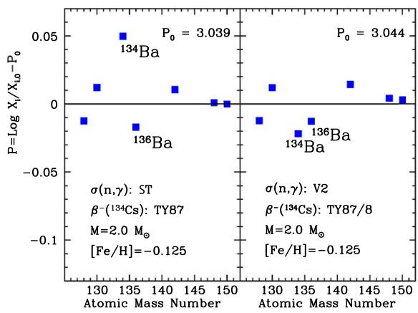
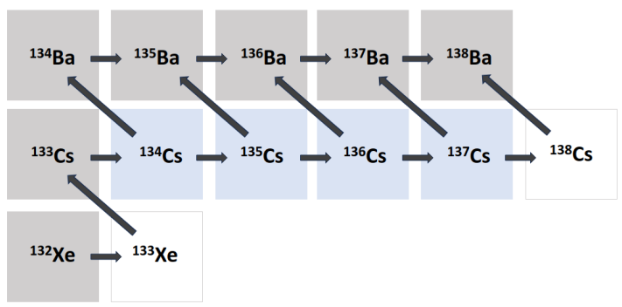
S-process: ¹³⁴Cs
Selected on basis of relevance in nuclear astrophysics and in-plasma measurability in PANDORA trap
Isotope​ | T_{1/2} [ yr ]​ | E_{γ} [ keV ]​
¹⁷⁶Lu​ | 3.78 · 10¹⁰​ | 202.88 & 306.78​
¹³⁴Cs​ | 2.06​ | 795.86​
⁹⁴Nb​ | 2.03 · 10⁴ | 871.09​
Phase 1 isotopes:
¹⁷⁶Lu
¹³⁴Cs
⁹⁴Nb
Phase 2 isotope:
⁷Be
S-process nucleosynthesis chain through Cs and Ba isotopes – competition between neutron capture vs β-decay
Difference between calculated and observed abundance of ¹³⁴Ba, considering different rates of in-plasma β-decay of ¹³⁴Cs
S. Palmerini et al, ApJ 921:7 (2021)

Slide 19
S-process: ¹³⁴Cs
Abundance of ¹³⁴Ba is sensitive to model-prediction of β-decay rate in ¹³⁴Cs
Palmerini et al (2021) and Taioli et al (2022) both find improvement in calculated abundance of ¹³⁴Ba on suppressing β-decay rate in ¹³⁴Cs compared to Takahashi-Yokoi model
Brings into question the accuracy of Takahashi-Yokoi predictions
There may be many other factors involved in reconstructing the
abundance of ¹³⁴Ba, but we choose to focus on the decay rate
Difference between calculated and observed abundance of ¹³⁴Ba, considering different rates of in-plasma β-decay of ¹³⁴Cs
S. Palmerini et al, ApJ 921:7 (2021)

Slide 20
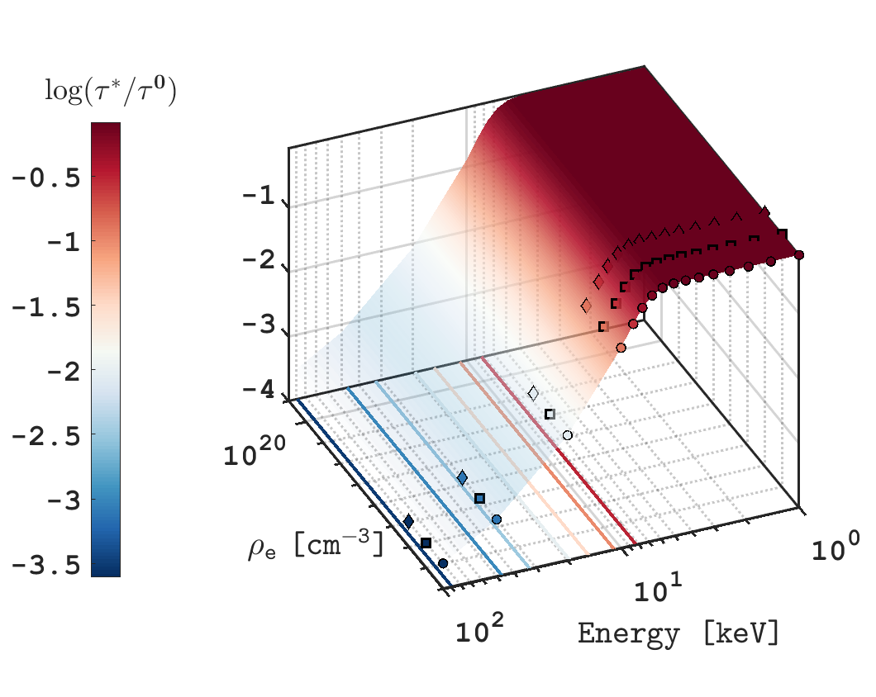
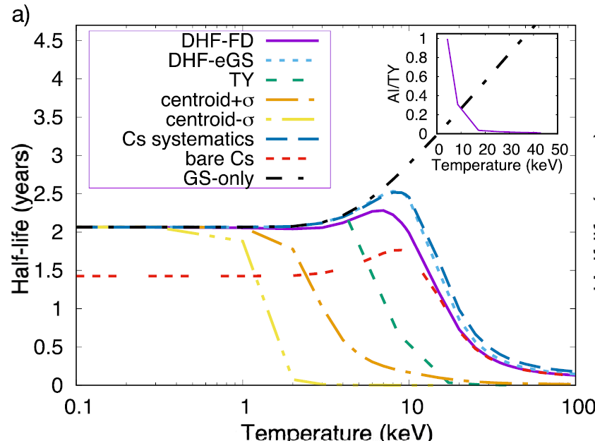
S-process: ¹³⁴Cs
Takahashi-Yokoi based prediction of variation of lifetime of ¹³⁴Cs as a function of plasma density n_{e} and temperature k_{B}T_{e}
Both models consider contribution of excited states in ¹³⁴Cs
Ground state: J^{π} = 4⁺ (0.0 keV)
First excited state: J^{π} = 5⁺ (11.2442 keV)
Second excited state: J^{π} = 3⁺ (60.0297 keV)
In-Plasma Decay Rate
β-Decay Rates of Individual Ions
“Configuration-dependent rate”
→ Bound state decay
→ Continuum decay
Same predictions using ab-initio DHF model and compared with Takahashi-Yokoi
S. Taioli et al, ApJ 933:158 (2022)
Ion Charge State Distribution
Plasma Model
Mismatch between DHF and Takahashi-Yokoi model could be due to:
Difference in predicted BSBD rates
Difference in predicted continuum decay rates
Difference in plasma model
Only GS of ¹³⁴Cs
Takahashi-Yokoi
GS + excited states

Slide 21
S-process: ¹³⁴Cs
To be measured by PANDORA and validated by suitable model before application to nucleosynthesis
In-Plasma Decay Rate
β-Decay Rates of Individual Ions
“Configuration-dependent rate”
→ Bound state decay
→ Continuum decay
Ion Charge State Distribution
Plasma Model
If the model predicted continuum and bound-state β-decay rates could be validated against measurements in some highly charged ions, the uncertainties could be narrowed down
Mismatch between DHF and Takahashi-Yokoi model could be due to:
Difference in predicted BSBD rates
Difference in predicted continuum decay rates
Difference in plasma model
Measurement of continuum decay rates in ¹³⁴Cs⁵²⁺ ⁻ ⁵⁵⁺
Measurement of bound-state decay rates in ¹³⁴Cs⁵²⁺ ⁻ ⁵⁵⁺
Comparison with respective predictions from DHF and Takahashi-Yokoi

Slide 22
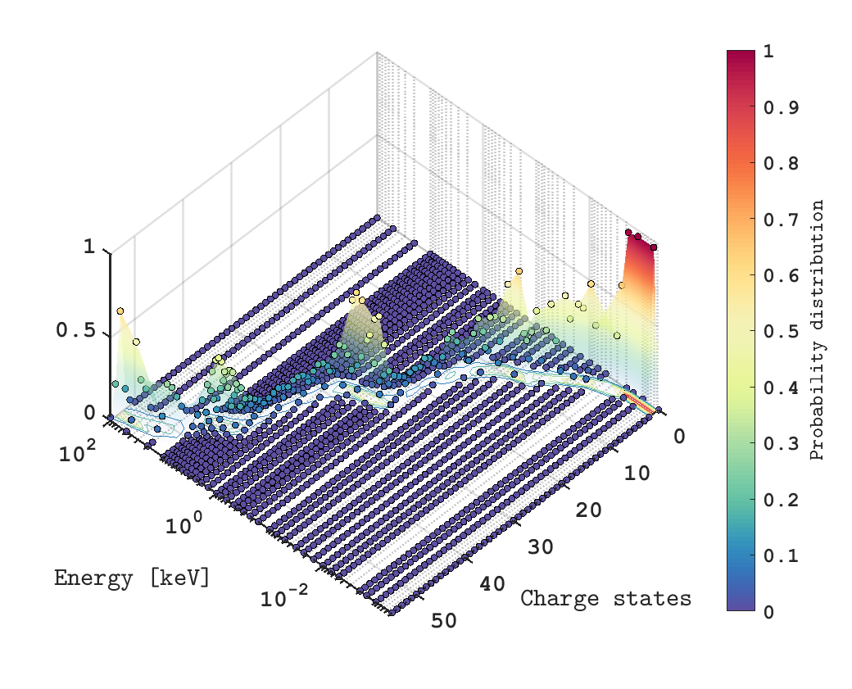
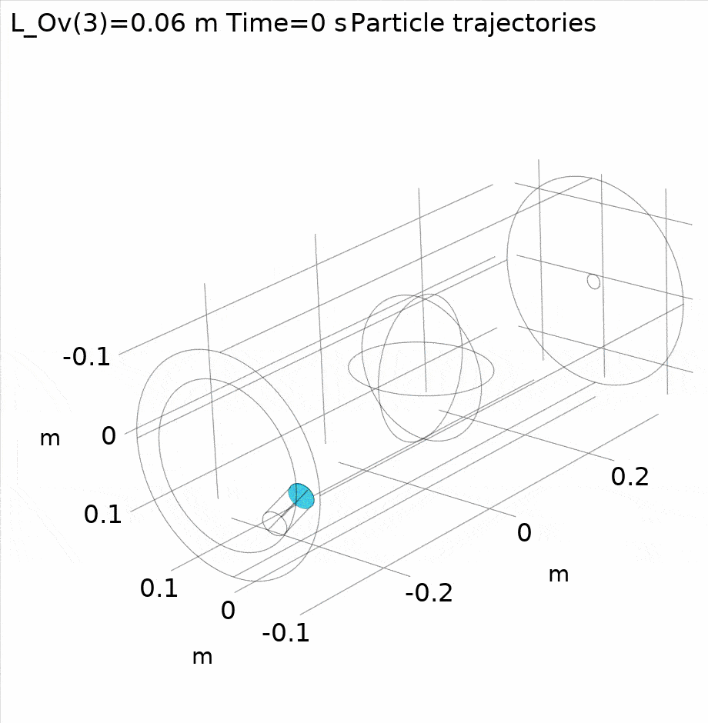
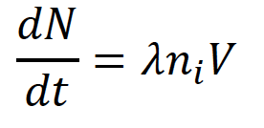
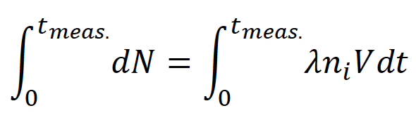
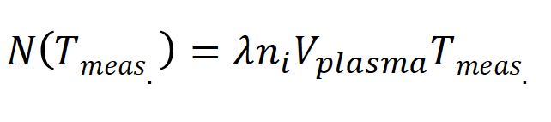
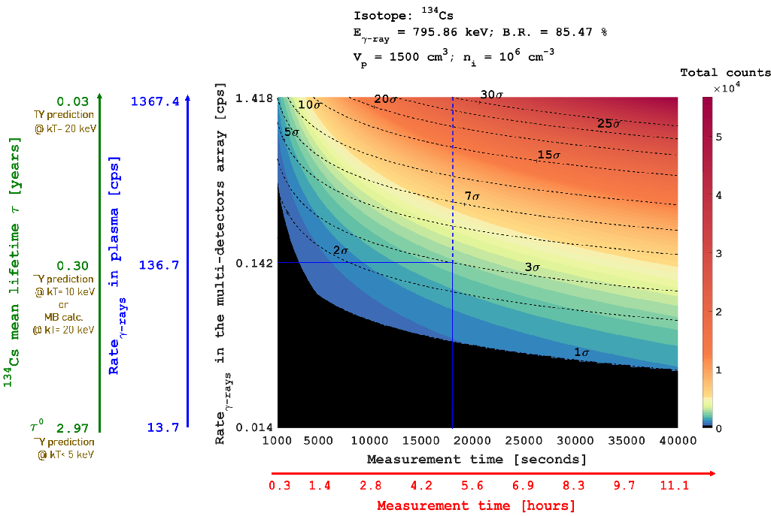
S-process: ¹³⁴Cs
E_{γ} [ keV ]​
202.88 & 306.78​
795.86​
871.09​
1. ¹³⁴Cs injection and diffusion in plasma chamber
2. ¹³⁴Cs CSD as a function of k_{B}T_{e}
METHOD: γ -rays tagging of decay-products energies between 200 keV and 1800 keV – correlated to stable plasma conditions
Mastering isotope density and plasma volume: estimate of measurement time for evidencing change in the decay rate
Naselli, E. et al., EPJ Web of Conf., 279 13006 (2023)
3. Expected decay rate ¹³⁴Cs change
4. Measurability plot
Pidatella, A. et al., Plasma Phys. Control. Fusion 66 (3), 035016 (2024)
Short-lived isotope: injection in plasma via metal vaporization through ovens
Isotope concentration: 10⁻⁵ times plasma electron density
Harsh plasma noise in the energy range of γ emission: study of detection efficiency

Slide 23
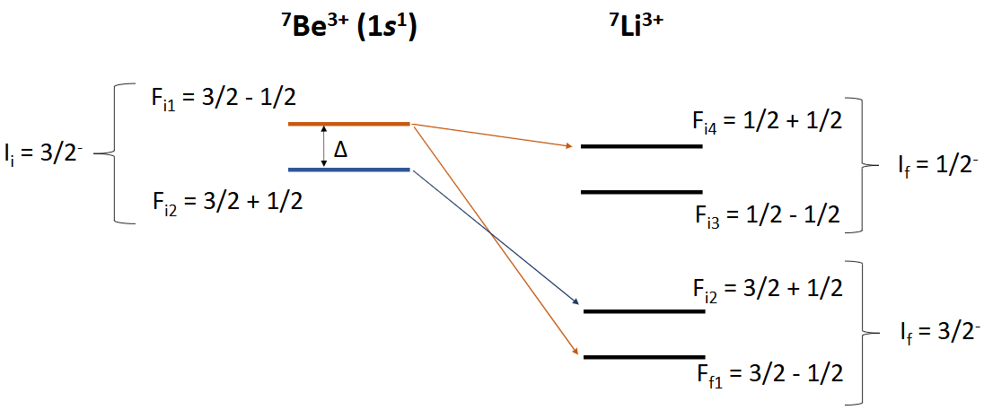

Hyperfine splitting in H-like ions
If ⁷Be³⁺ is in the upper hyperfine level, it can decay through both channels and its EC rate is enhanced
If ⁷Be³⁺ is in the lower hyperfine level, it can only decay through gs-> gs transition, and its total EC rate is suppressed

Slide 24
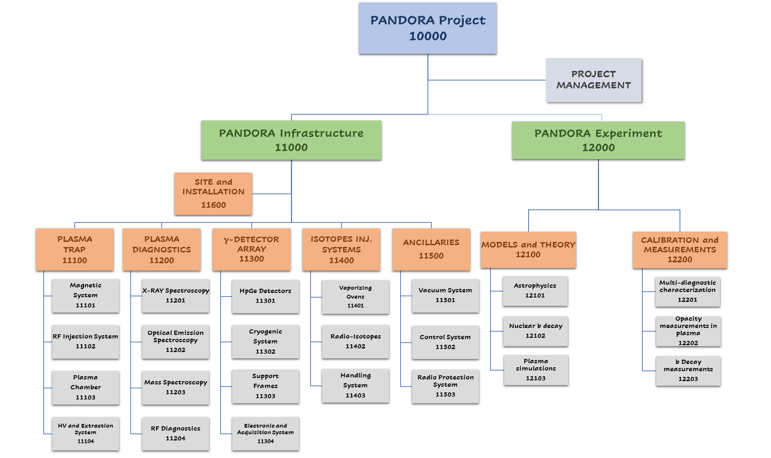
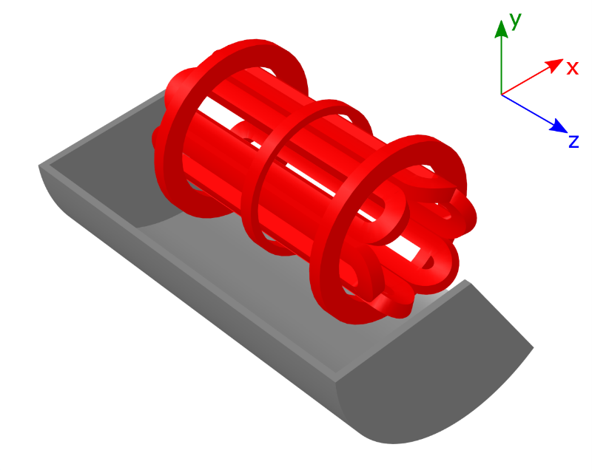
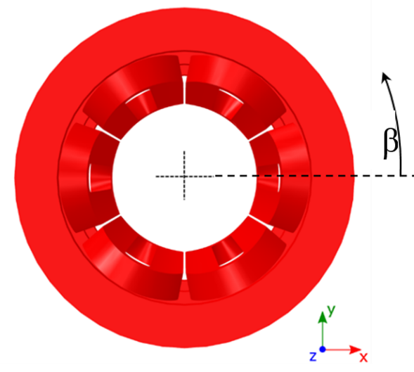
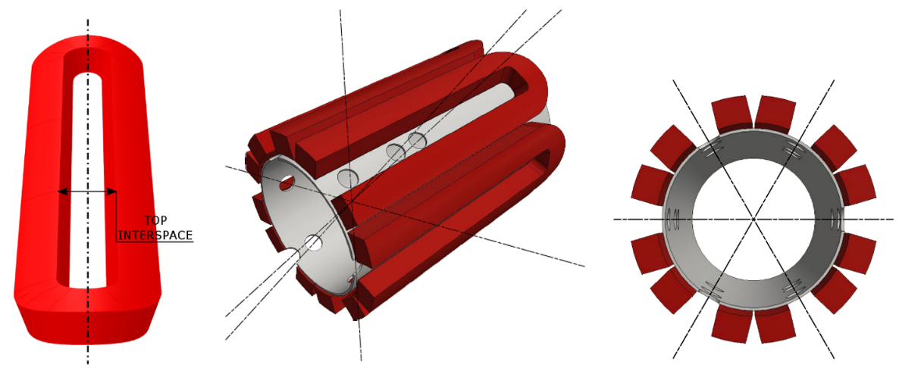
MAIN SUBSYSTEMS UPDATES: Trap procurement
(LNS ACTIVITY)
The magnetic system, fully superconductive, consists of:
#3 axial coils that generates the axial magnetic field;
#6 hexapole coils that generates the radial magnetic field.
It will enclose a plasma chamber with:
inner radius R_{CH_IN} = 140 mm
length L = 700 mm.
MAGNETIC FIELD REQUIREMENTS
B_{inj} max @ z = - 350 mm | 3 T
B_{inj} operative range | 1.7 T – 3 T
B_{ext} max @ z = 350 mm | 3 T
B_{ext} operative range | 1.7 T – 3 T
B_{min} @ z = 0 mm | 0.4 T
B_{hex} @ R_{CH_IN} = 140 mm | 1.6 T
Lhe | Free
Warm Bore radius | 150.5 mm
Distance between mirrors | 700 mm
Stray field (as above specified) | Less than 0.2 T
The PANDORA’s trap has been designed to operate at 18 + 21 GHz.

Slide 25
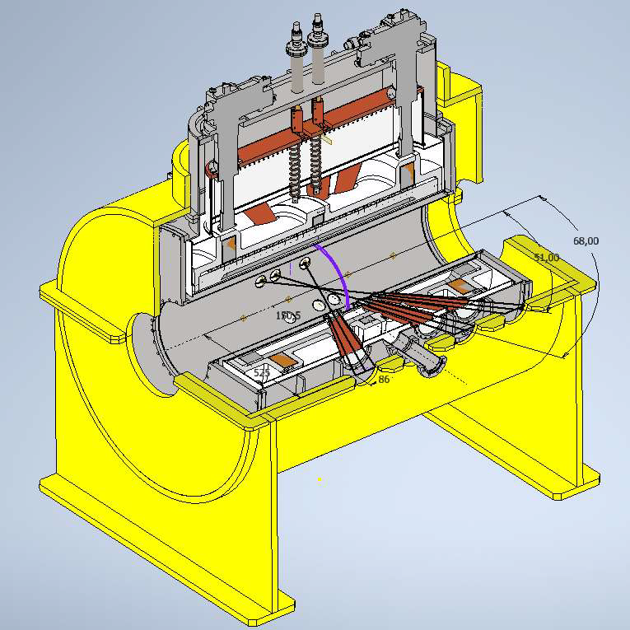
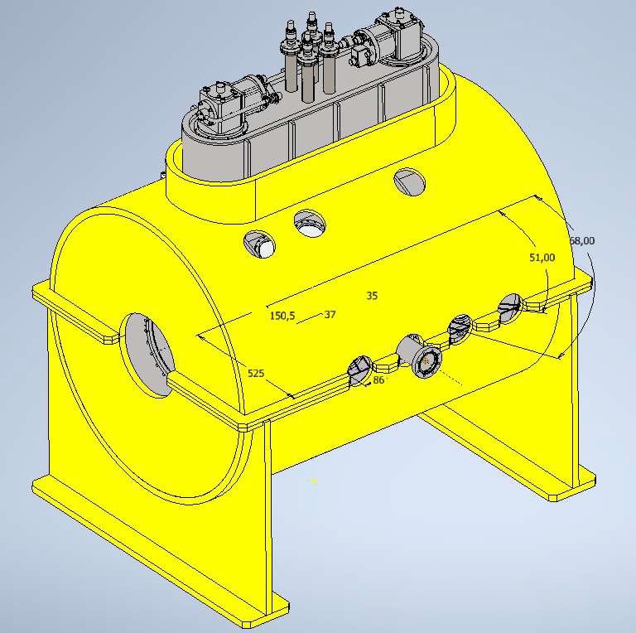
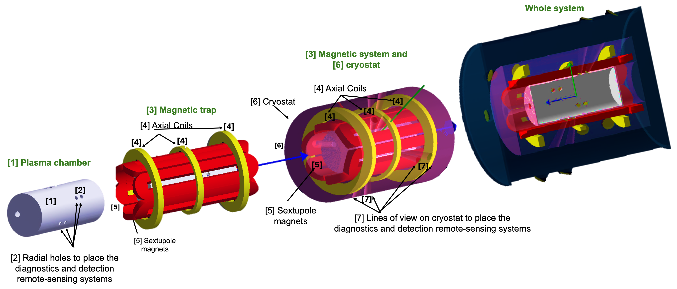
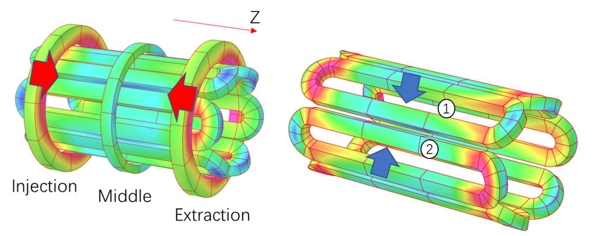
MAIN SUBSYSTEMS UPDATES: Trap procurement
Competitor #1-Executive Design
TENDER IS NOW COMPLETE AND THE COMPANY IS STARTΙΝG MANUFACTURING!!

Slide 26
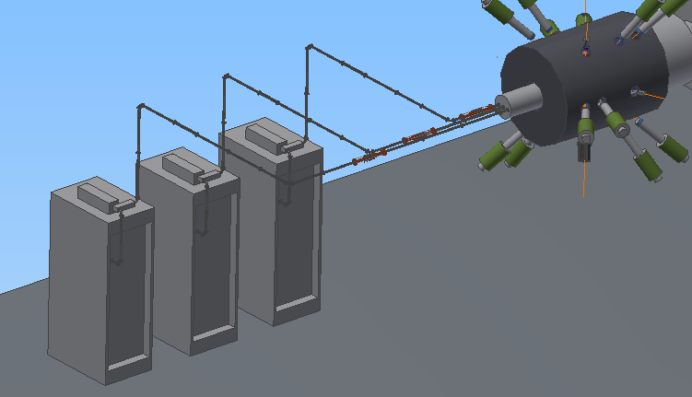
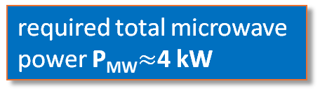
MAIN SUBSYSTEMS UPDATES: RF system
(LNS ACTIVITY)
GREEN: already purchased
YELLOW: planned to be procured in 2024
Silver plated low-losses
Waveguides branching
Target power density of 1.38 kW/l
PANDORA ECR plasmoid
volume ~ 3 l
required total microwave
power P_{MW}$≈$4 kW
Different microwave injection schemes:
“Single-Frequency” mode: only one amplifier is used.
“Two-Frequency Heating” (TFH) and “Two-Close-Frequency Heating” (TCFH) scheme mode, also with the possibility to vary the power ratio between two microwave amplifiers:.
“Three-Frequency-Heating” mode from the three Klystrons
“compliant” with the planned total amount of power delivered by the three klystrons 6 kW
to reach high charge states
Klystron 3
21 GHz
1.4 kW
Klystron 2
17.3-18.1 GHz
2.4 kW
Klystron 1
17.3-18.1 GHz
2.4 kW

Slide 27
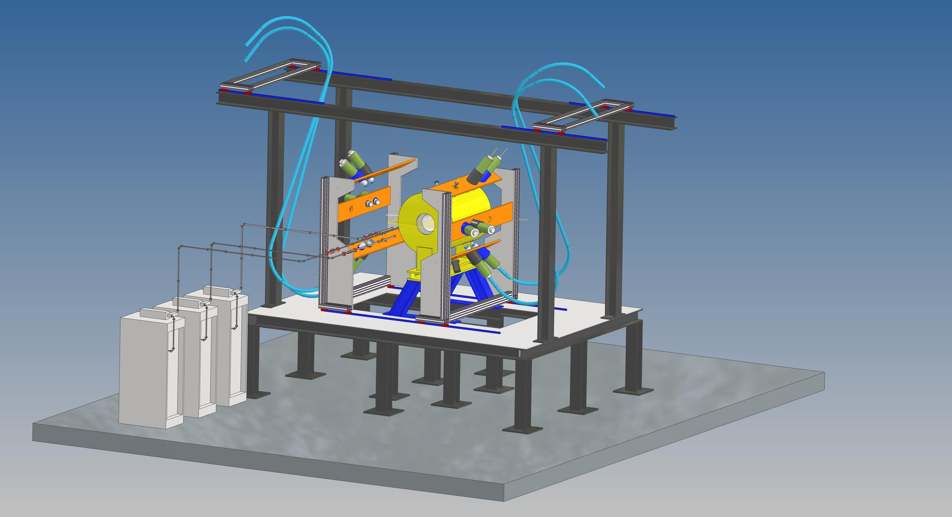

MAIN SUBSYSTEMS UPDATES: HPGE detection system
(LNS+ LNL activity)
PANDORA SETUP Mechanics

Slide 28
ECR Plasma Simulations: Pipeline
PIC SIMULATIONS FOR ELECTRONS
3D, steady-state maps of n_{e} and E_{e}
PIC-MC SIMULATIONS FOR PLASMA IONS
PIC-MC SIMULATIONS FOR ISOTOPE IONS
3D, steady-state maps of <Z> and n_{i}
3D, steady-state maps of <Z> and λ*
First level input to all codes and therefore precision needed
Observables: Soft X-ray spectroscopy, interferometry, polarimetry, profilometry, Thomson scattering
Second level input to in-plasma decay code
Observables: Faraday cup, optical emission spectroscopy, X-ray fluorescence
Observables: PANDORA

Slide 29


Particle-in-Cell Simulations
PIC is a technique to simulate plasma.
Self-consistent, steady-state solution
N macroparticles, each representing a certain number of real particles, are initialised and transported according to equations of motion
The simulation domain is divided into a grid, and particle trajectories leaves traces at grid points which leads to an occupation map
Occupation maps are scaled to density maps according to some physical law, and fields are calculated on grid points using FEM/FDM
(i-1,j-1)
(i-1,j)
(i-1,j+1)
(i-1,j-1)
(i-1,j)
(i-1,j+1)
(i-1,j-1)
(i-1,j)
(i-1,j+1)
(i,j-1)
(i,j)
(i,j+1)
(i,j-1)
(i,j)
(i,j+1)
(i,j-1)
(i,j)
(i,j+1)
(i+1,j-1)
(i+1,j)
(i+1,j+1)
(i+1,j-1)
(i+1,j)
(i+1,j+1)
(i+1,j-1)
(i+1,j)
(i+1,j+1)

Slide 30




ECR Plasma Electron Simulations
PIC simulation for ECR plasma electrons
Description: Vlasov-Maxwell equation
Scaling: Plasma cutoff density
Self-consistency: Microwave EM field
D. Mascali, G. Torrisi et al , Eur. Phys. J. D. 69, 27 (2015)
G. Torrisi, D. Mascali et al, JEWA 28, 9 (2014)
A. Galatà et al, Front. Phys. 10, 947194 (2022)
R = 29 mm
B-field distribution in A-HPC ion source. The ellipsoidal surface nestled in the middle represents the ECR surface
L = 210 mm
Electron density n_{e} (m⁻³) and mean energy E_{e} (keV) maps for A-HPC obtained from PIC simulations.

Slide 31


ECR Plasma Ion Simulations
PIC simulations for ECR plasma ions:
Description: Vlasov-Maxwell equations + Balance equation
Scaling: Quasineutrality with electron density
Self-consistency: Electron density and energy maps
B. Mishra et al, Front. Phys. 10, 932448 (2022)
B. Mishra, EPJ WoC 275, 02001 (2023)
Ion Transport
Transport in EM fields under Lorentz force
Collisions by Fokker-Planck equation
MC Sampling
3 core modules
Electron impact ionization (EI)
Ion impact charge exchange (CEX)
Density Scaling
Iterative scaling of ion occupation map

Slide 32


ECR Plasma Ion Simulations
Higher charge states tend to accumulate in the near-axis region
<Z> of argon plasma in A-HPC ECRIS as calculated using PIC-MC code
n_{i} of Ar²⁺ and Ar⁶⁺ in A-HPC ECRIS along the radius and axis in A-HPC

Slide 33










The PANDORA project – concept of spectroscopic plasma analysis
Hydrogen spectrum
Opacity direct measurement: TRANSMITTANCE
  $$H_{α}$$
RF power: from 40 W to 450 W
RF frequency: 3.76, 6.78 GHz
Gas pressure: 1 · 10⁻³ and 1 · 10⁻² mbar
Pidatella, A.,et al. Frontiers in Astronomy and Space Sciences, 10.3389/fspas.2022.931744 (2022)
  $$H_{γ}$$
  $$H_{β}$$
OES diagnostics
Profilometry/Secondary diagnostics
To be measured: independent measurements
Opacity of metal/buffer mixture: strongly dependent on density and temperature profile
angelo.pidatella@lns.infn.it

Slide 34



Orbital Electron Capture Decay in ⁷Be
Decay Energy
Average difference in excitation energy between parent and daughter ions
Atomic data (level index, energy and electronic configuration) taken from FLYCHK
H.-K. Chung, M.H. Chen, Y. Ralchenko et al, High Energy Density Phys. 1, 1 (2005)

Slide 35



Orbital Electron Capture Decay in ⁷Be
Shape Factor
Shell Occupancy
σ_{x} describes the occupancy of an orbital. In order to capture orbital electrons, the occupancy should be non-zero.
On ionising the atom, the number of electrons available in a shell decreases, and the capture phase volume decreases. Consequently, the EC decay rate goes down. Inversely, bound state decay rates increase because

Slide 36




Orbital Electron Capture Decay in ⁷Be
Radial Wavefunctions
The radial wavefunctions describe the degree of overlap between the atomic orbitals and the nuclear surface. The wavefunctions are obtained by solving the Dirac equation in the central Coulomb field
V.M. Burke and I.P Grant, Proc. Phys. Soc.90, 297 (1967)
Electrons from inner orbitals are more likely to be captured as compared to outer orbitals whose contribution decreases rapidly

