Slide 1
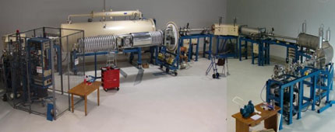

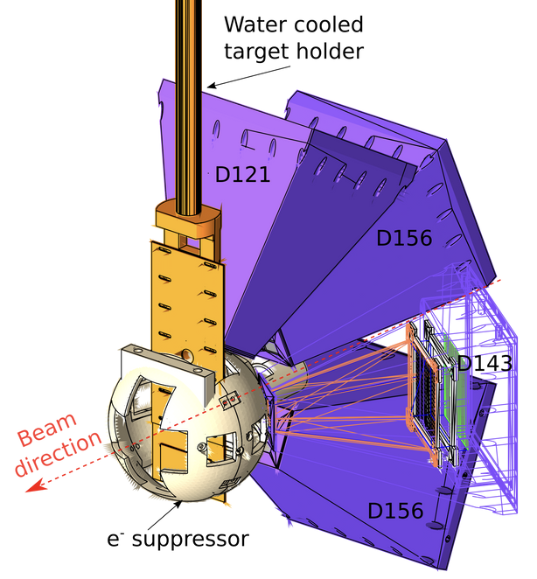


Direct measurement of ¹²C+¹²C towards astrophysical energy at ERNA
Catania 02-07-2025
Gianluca Imbriani
Physics Department of University of Naples Federico II,
Italian National Institute of Nuclear Physics (INFN)

Slide 2
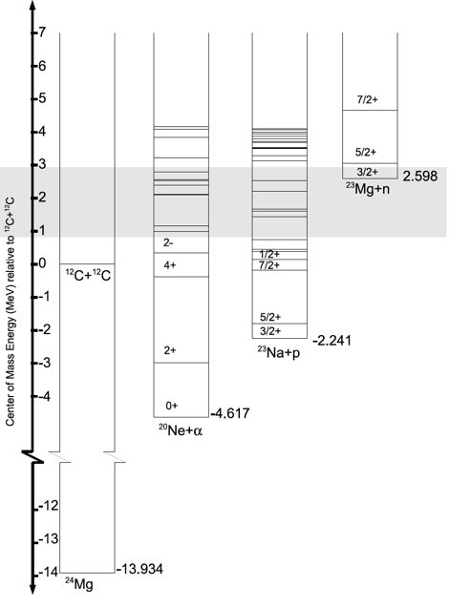
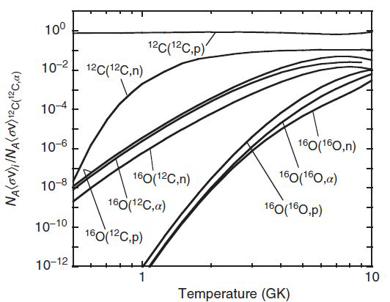
The ¹²C+¹²C reactions
¹²C+¹²C→ ²⁰Ne + α Q = 4.62 MeV
¹²C+¹²C→ ²³Na + p Q = 2.24 MeV
¹²C+¹²C→ ²⁴Mg + γ Q = 13.93 MeV
¹²C+¹²C→ ²³Mg + n Q = -2.62 MeV
Iliadis, C., Nuclear Physics of Stars, Wiley, 2015

Slide 3
The ¹²C+¹²C reactions
¹²C+¹²C→ ²⁰Ne + a Q = 4.62 MeV
γ-rays and α particles energies for excited states for ¹²C(¹²C, α)²⁰Ne (Q = 4.617 MeV)
E_{X} (MeV) | J^{p} | Main γ transitions (MeV) |  | ID | E_{α−max} (MeV) (E^{CM} = 2 MeV)
0.0 | 0⁺ |  |  | α₀ | 8.6
1.63 | 2⁺ | 1.63 → 0 1.63 |  | α₁ | 6.8
4.24 | 4⁺ | 4.24 → 1.63 2.61 |  | α₂ | 3.9
4.96 | 2⁻ | 4.96 → 1.63 3.33 |  | α₃ | 3.1
5.62 | 3⁻ | 5.62 → 1.63 3.98 |  | α₄ | 2.2
5.78 | 1⁻ | 5.78 → 1.63 4.15 | 5.78 → 0 5.78 | α₅ | 2.0
²⁴Mg*

Slide 4
The ¹²C+¹²C reactions
¹²C+¹²C→ ²³Na + p Q = 2.24 MeV
γ-rays and p particles energies for excited states for ¹²C(¹²C, p)²³Na (Q = 2.241 MeV)
E_{X} (MeV) | J^{p} | Main γ transitions (MeV) |  | ID | E_{p-max} (MeV) (E^{CM} = 2 MeV)
0.0 | 3/2⁺ |  |  | p₀ | 5.3
0.44 | 5/2⁺ | 0.44 → 0 0.44 |  | p₁ | 4.8
2.07 | 7/2⁺ | 2.07 → 0.44 1.63 (91%) | 2.07 → 0 2.07 (9%) | p₂ | 3
2.39 | 1/2⁺ | 2.39 → 0.44 1.95 | 2.39 → 0 2.39 | p₃ | 2.6
2.64 | 1/2⁻ | 2.64 → 0 2.64 |  | p₄ | 2.3
2.70 | 9/2⁺ | 2.70 → 2.07 0.62 | 2.70 → 0.44 2.26 | p₅ | 2.3
2.98 | 3/2⁺ | 2.98 → 0.44 2.54 | 2.98 → 0 2.98 | p₆ | 1.9
²⁴Mg*

Slide 5
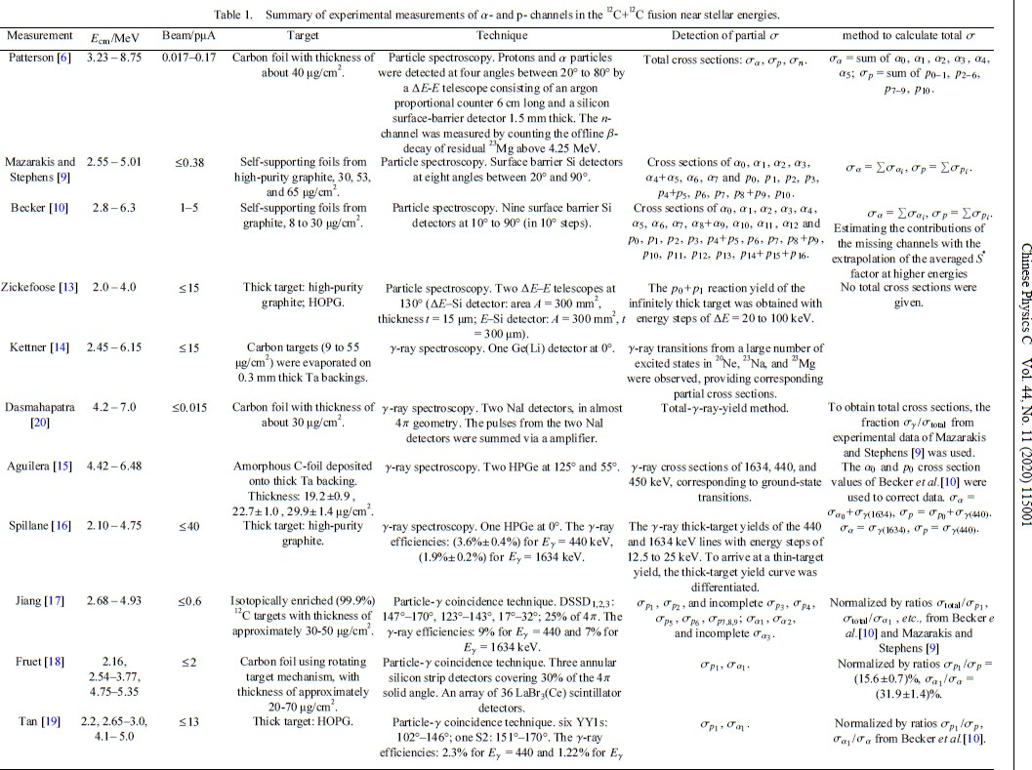
Summary table (as of 2020)

Slide 6
TARGETS
Summary table (as of 2020)

Slide 7
Technique
Summary table (as of 2020)

Slide 8
Total or
partial σ
Summary table (as of 2020)

Slide 9
Total or
partial σ
Summary table (as of 2020)

Slide 10
Minimum
energy
Summary table (as of 2020)

Slide 11
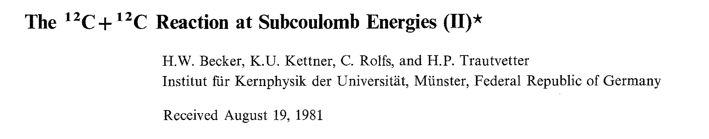

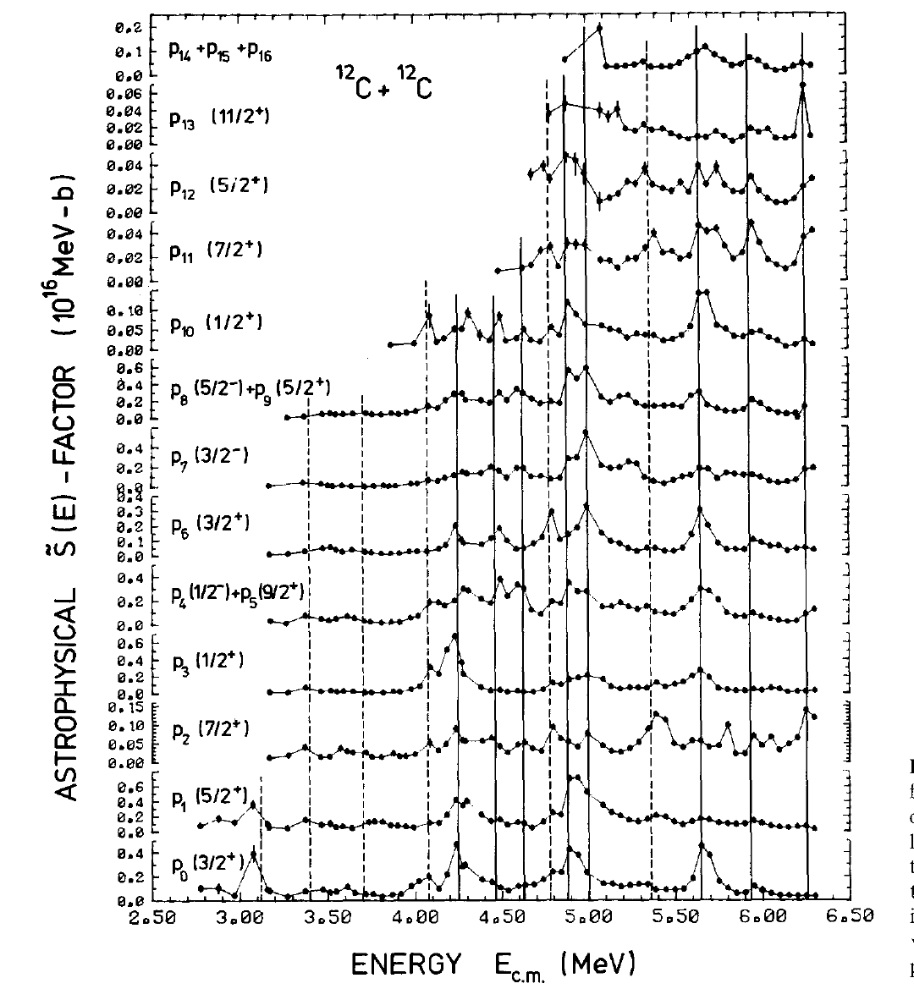
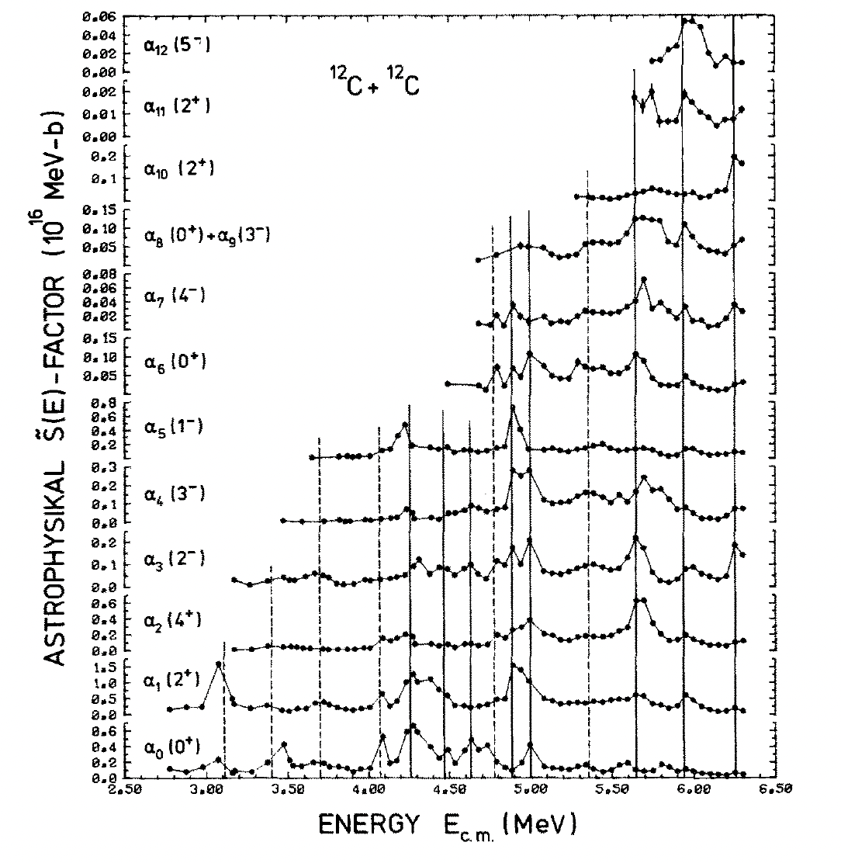
The Becker experiment

Slide 12
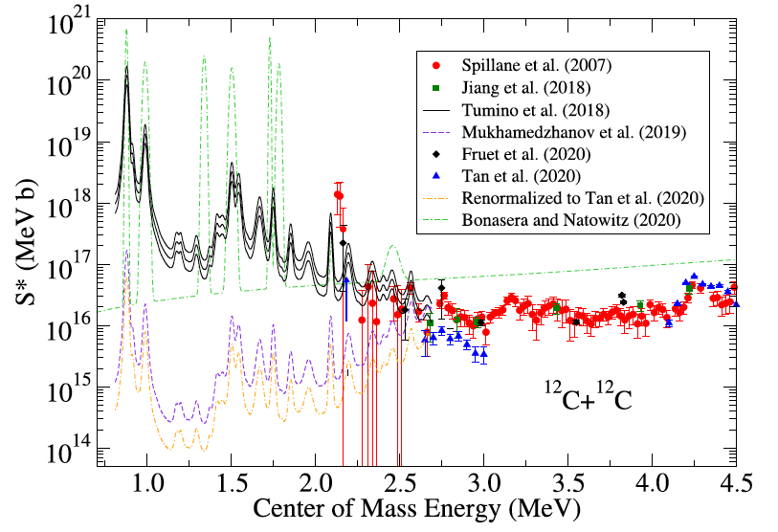
The ¹²C+¹²C state of the art
Several datasets and models
Direct measurements above 2.1 MeV (large scattering, large uncertainties)
Only indirect measurements below 2.1 MeV (problems with normalization and other discrepancies)
Very large uncertainty below 2.5 MeV
Presence of several states at low energies
Gamow peak

Slide 13
The ¹²C+¹²C state of the art
Several datasets and models
Direct measurements above 2.1 MeV (large scattering, large uncertainties)
Only indirect measurements below 2.1 MeV (problems with normalization and other discrepancies)
Very large uncertainty below 2.5 MeV
Presence of several states at low energies

Slide 14
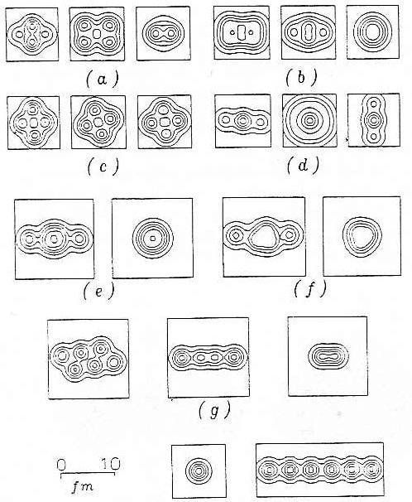
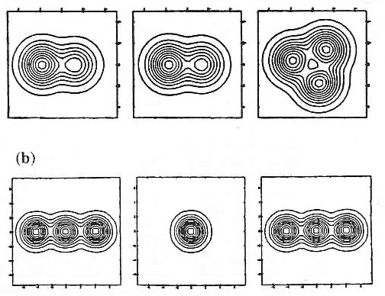
α-cluster configurations in ¹²C and ²⁴Mg
¹²C+ ¹²C nuclear motivation
²⁴Mg
¹²C
Cluster model predictions for
Cluster and shape configurations
For ¹²C and ²⁴Mg T=0 nuclei

Slide 15
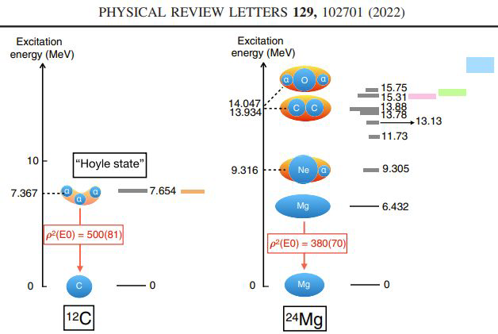
The ¹²C+¹²C possible cluster states
subset of the excited 24Mg 0⁺
states that are strongly
populated by ²⁴Mg(α,α’)²⁴Mg
Possible analogy between the Hoyle state in ¹²C as the driver of 3α fusion and
candidate cluster states in ²⁴Mg as fusion

Slide 16
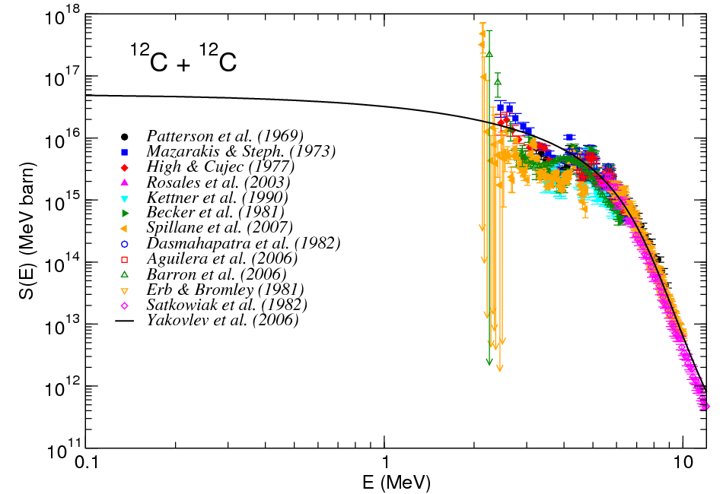
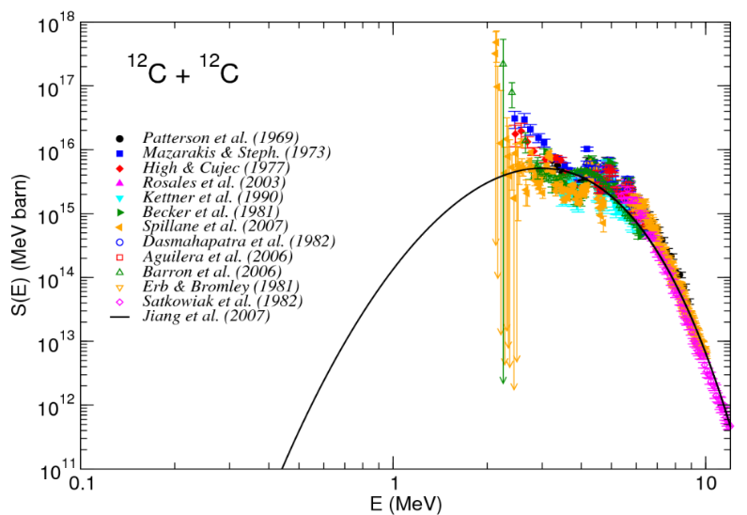
The ¹²C+¹²C potential model
standard potential model
hindrance potential model
Different potential models lead to different ways to extrapolate the low energy cross section (S-factor).
The only way to distinguish is to measure below 2 MeV.

Slide 17


Summary table (as of 2020)
Morales-Gallegos et al., Eur. Phys. J. A (2024)
E_{cm}=2.51-4.36 MeV
I_{beam}=10-50 μA
Target: 1 mm thick HOPG (99.99% pure) at high T Technique: charged particle spectroscopy with ΔE-E PID (ionization chamber + silicon strip detector)
Detection of partial σ: p₀, …, p₆, α₀, α₁

Slide 18
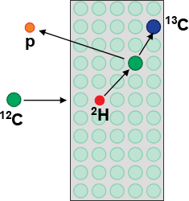
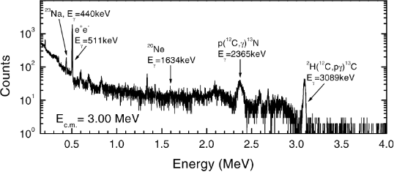
¹²C+¹²C background issues
Photon detection
²H(¹²C,pγ)¹³C
¹H(¹²C,γ)¹³N
Particle detection
²H(¹²C,¹²C)²H + ²H(¹²C,pγ)¹³C
(E_{γ}=3.09 MeV) (E_{γ}=2.36 MeV)
12_{C+}12_{C}
Beam-Induced Background Full energy peak
Beam Induced Background (BIB) due to ¹H and ²H in the target was a strong limitation in previous measurements based on particle detection
BIB affects mostly the measurements based on particle detection, as in photon detection measurements it only causes a moderate Compton background

Slide 19
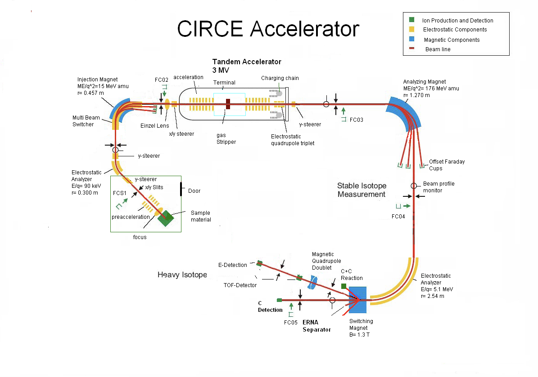
¹²C+¹²C @CIRCE laboratory first experiment: p detection
PHYSICAL REVIEW C 97, 065806 (2018)
J. Zickefoose, A. Di Leva, F. Strieder, L. Gialanella, G. Imbriani,
N. De Cesare, C. Rolfs, J. Schweitzer, T. Spillane, O. Straniero, and F. Terrasi

Slide 20
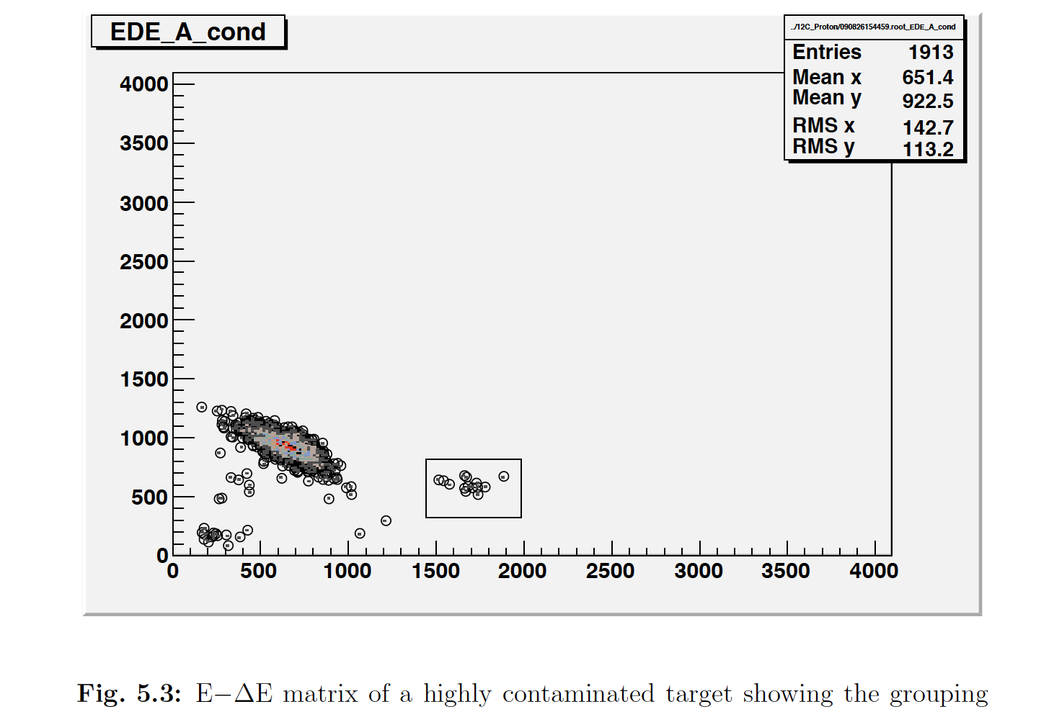
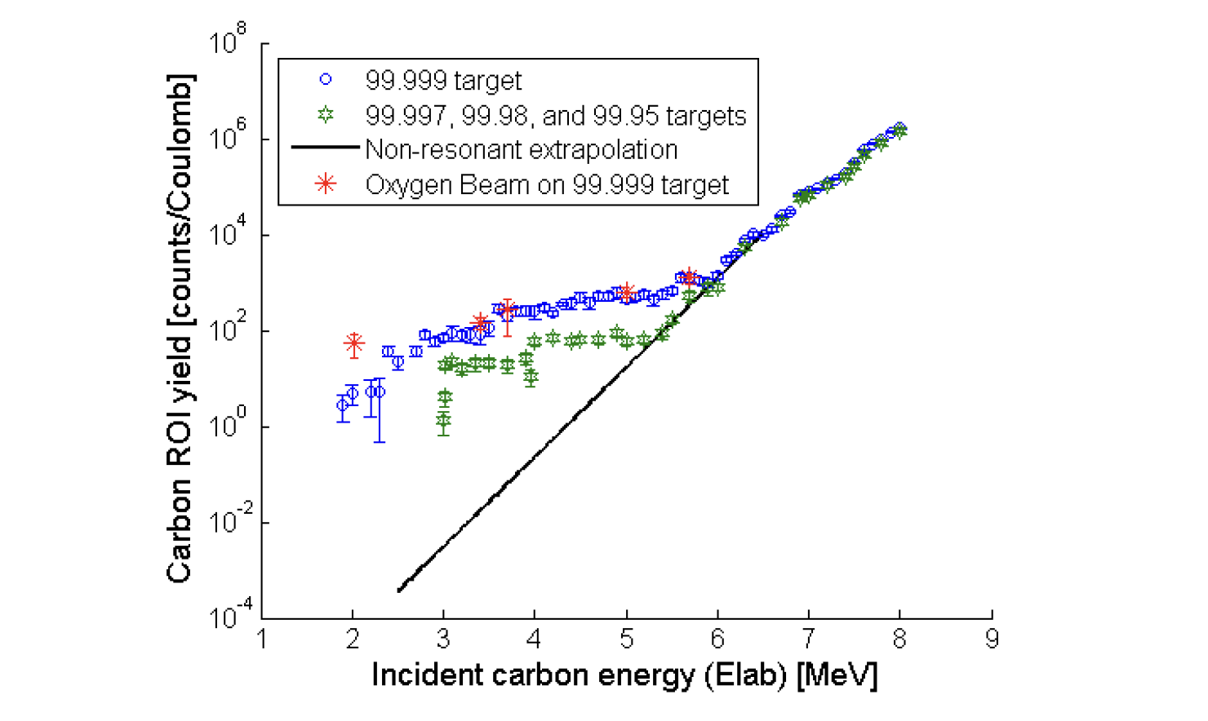
¹²C+¹²C @CIRCE laboratory first experiment: p detection

Slide 21
¹²C+¹²C @CIRCE laboratory first experiment: p detection
E = 2.6 MeV
PHYSICAL REVIEW C 97, 065806 (2018)
J. Zickefoose, A. Di Leva, F. Strieder, L. Gialanella, G. Imbriani,
N. De Cesare, C. Rolfs, J. Schweitzer, T. Spillane, O. Straniero, and F. Terrasi

Slide 22
¹²C+¹²C @CIRCE laboratory first experiment: p detection
PHYSICAL REVIEW C 97, 065806 (2018)
J. Zickefoose, A. Di Leva, F. Strieder, L. Gialanella, G. Imbriani,
N. De Cesare, C. Rolfs, J. Schweitzer, T. Spillane, O. Straniero, and F. Terrasi

Slide 23
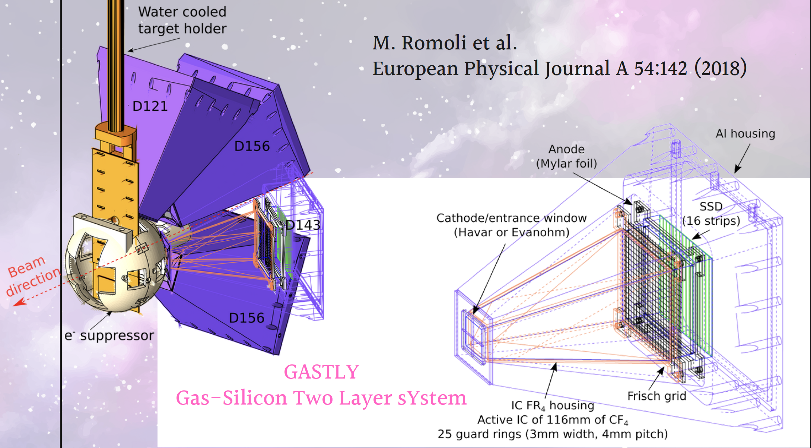
¹²C+¹²C @CIRCE laboratory second experiment:
double stage detector

Slide 24
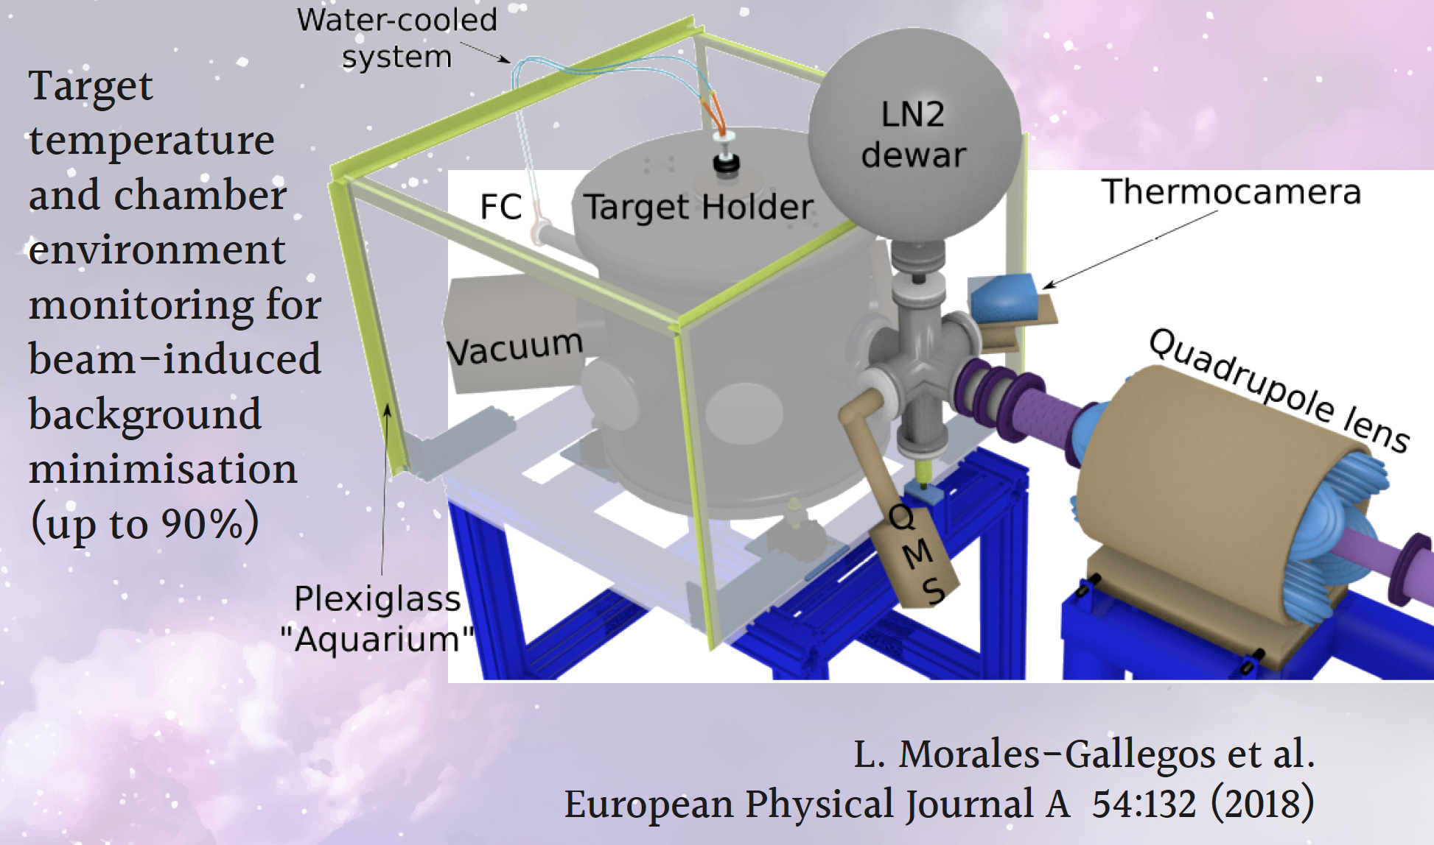
¹²C+¹²C @CIRCE laboratory second experiment:
double stage detector

Slide 25
¹²C+¹²C @CIRCE laboratory second experiment:
double stage detector
GASTLY detectors
GAs-Silicon Two-Layer sYstem
L. Morales-Gallegos et al.
Eropean Phisical Journal A 58:65 (2022)
Elab = 8.6 MeV
Detector at 121°

Slide 26
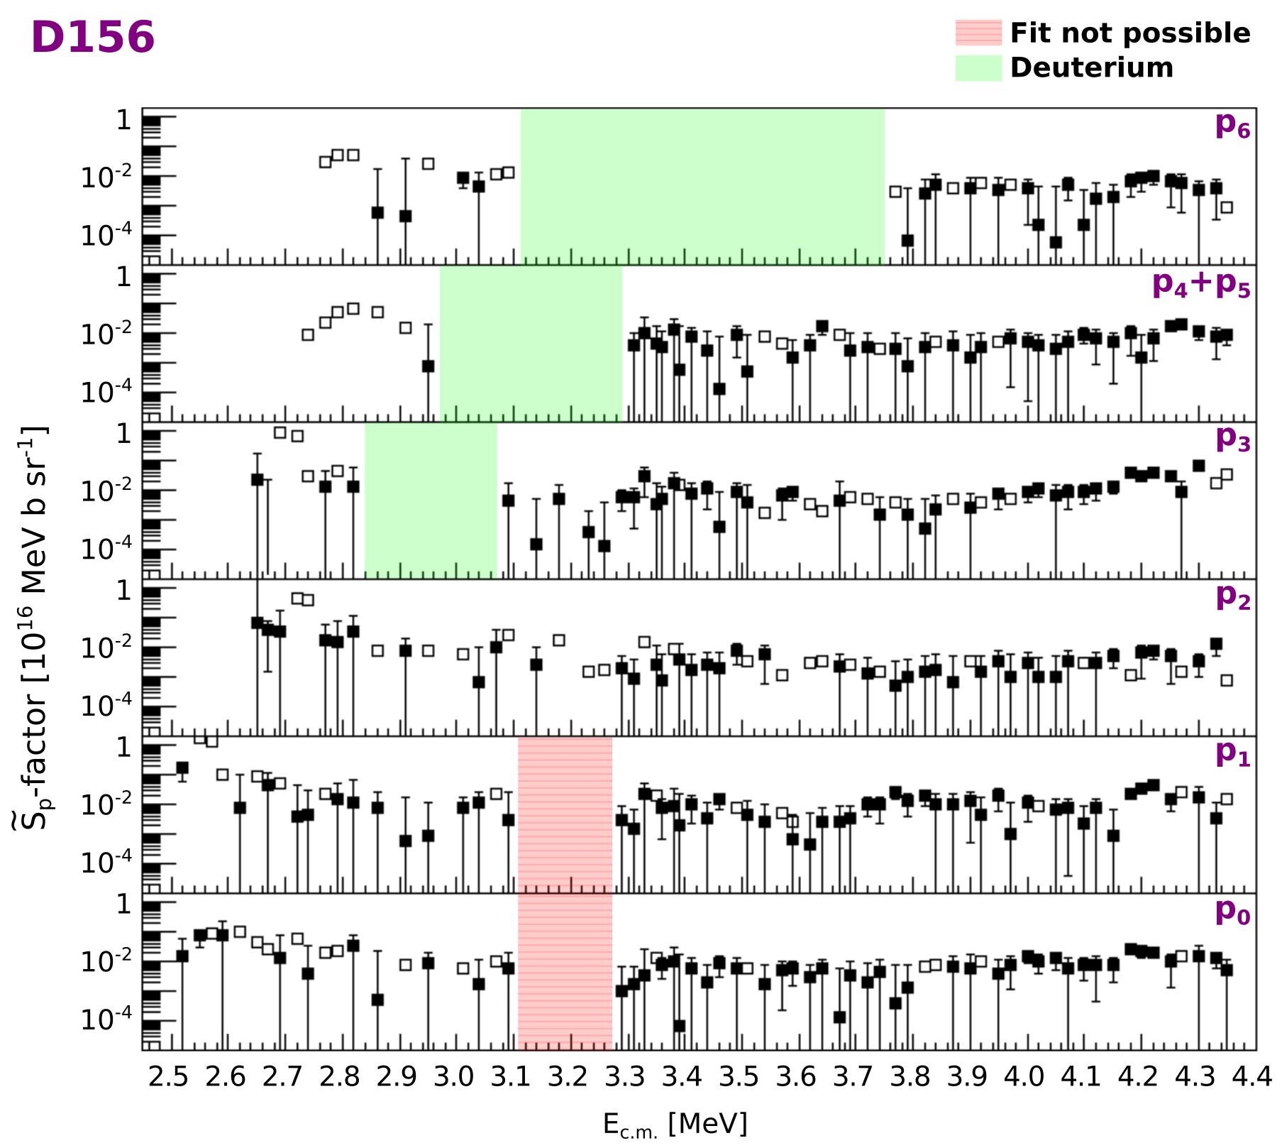
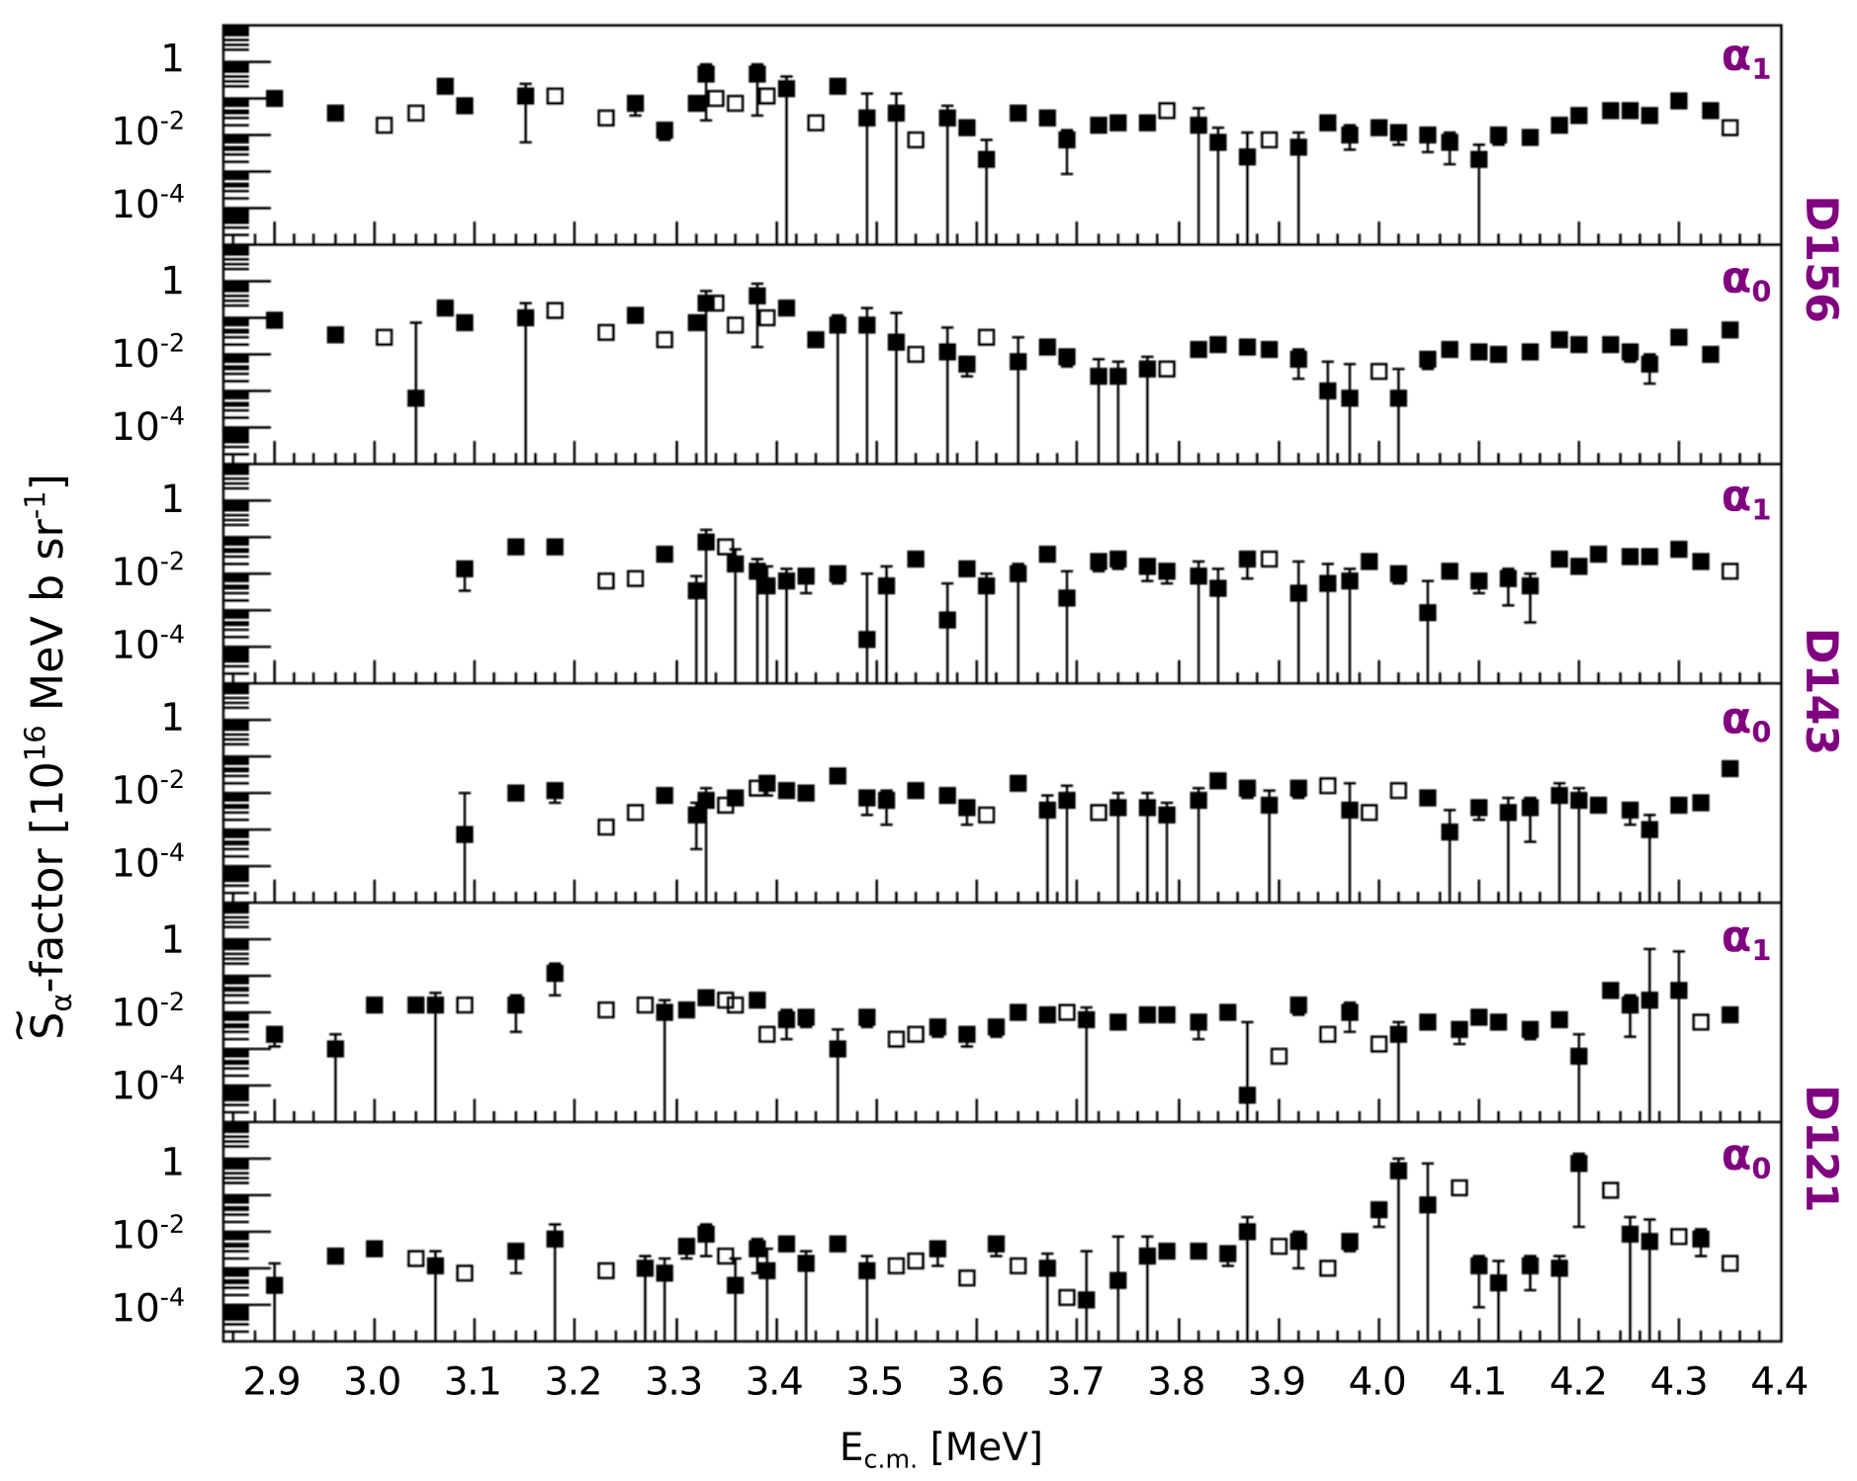
¹²C+¹²C @CIRCE laboratory second experiment:
results

Slide 27
The ¹²C+¹²C NEW state of the art

Slide 28
The ¹²C+¹²C NEW state of the art

Slide 29
Future activities

Slide 30
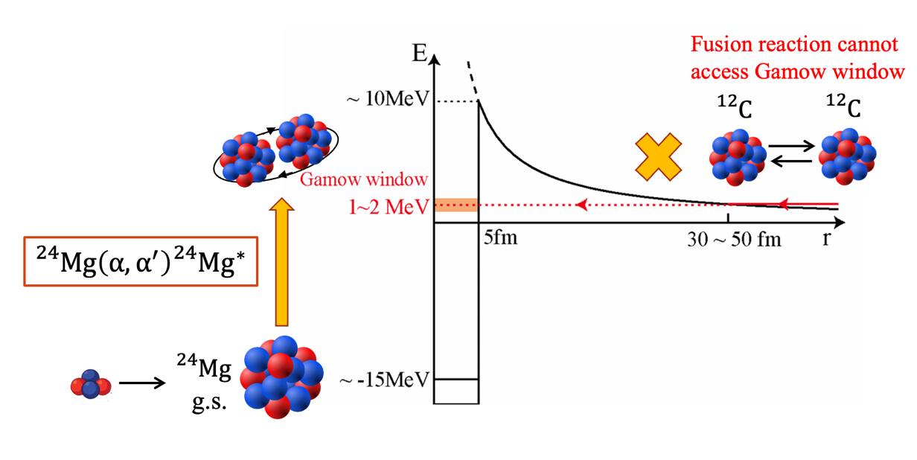
Method: α inelastic scattering on ${}_{}^{24}{Mg}$
Direct access to deep sub-barrier resonances

Slide 31
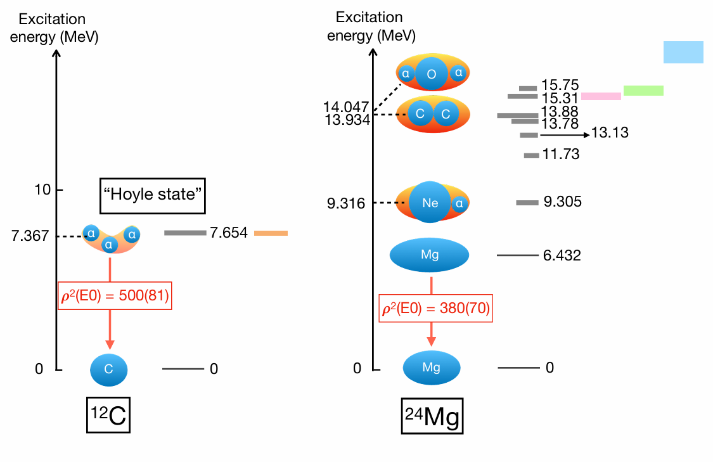

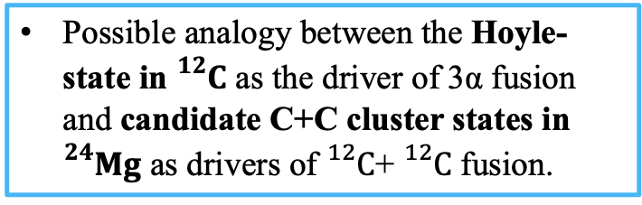
${}_{}^{12}C+{}_{}^{12}{C }$: monopole transition as novel probe for resonances
Plausible description of the resonances in the ${}_{}^{12}C+{}_{}^{12}C$ system by a full-microscopic nuclear model;
Experimental method to confirm the theoretical predictions.
type 1a supernovae
massive stars
superbursts
T. Yasutaka and
M. Kimura, PLB 823 (2021)
Possible analogy between the Hoyle-state in ${}_{}^{12}C$ as the driver of 3α fusion and candidate C+C cluster states in ${}_{}^{24}{Mg}$ as drivers of ${}_{}^{12}C$+ ${}_{}^{12}C$ fusion.
P. Adsley et al., PRL 129.10 (2022)

Slide 32
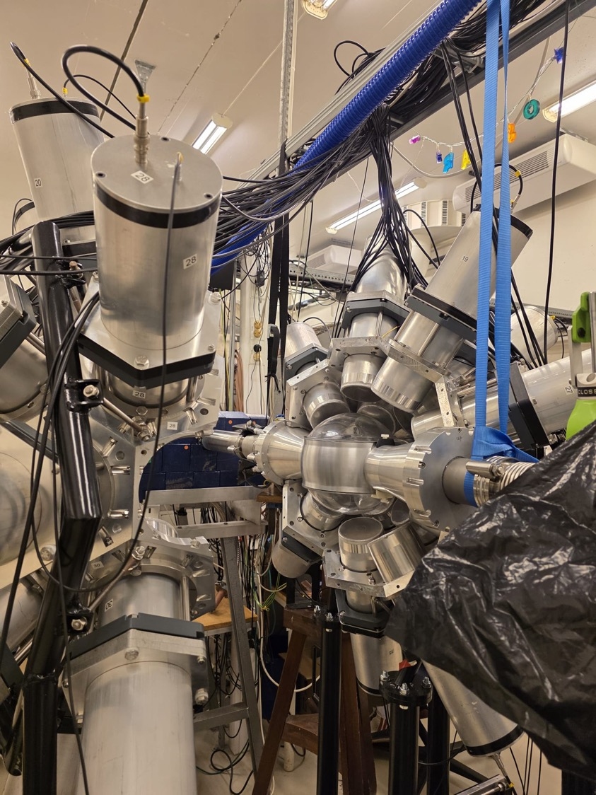
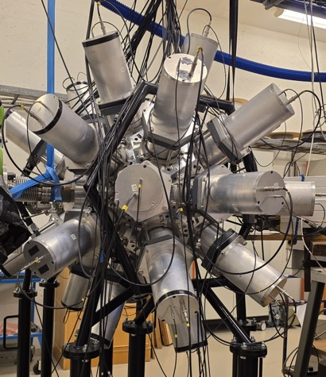
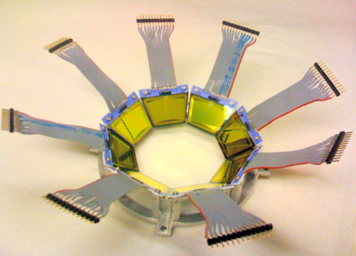

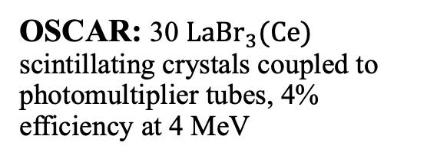
Experimental setup at
Oslo Cyclotron Laboratory (OCL)
beam: α particles @30 MeV;
target: self-supporting ${}_{}^{24}{Mg}.$
OSCAR: 30 ${LaBr}_{3}(Ce)$ scintillating crystals coupled to photomultiplier tubes, 4% efficiency at 4 MeV
SiRi: 8 trapezoidal ΔE-E silicon detectors; ΔE 130 µm thick, segmented into 8 annular strips

