Slide 1
Last Stage Suspension
Mechanics in
Virgo+MS
Piacciavi, generosa Erculea prole,
ornamento e splendor del secol nostro,
Ippolito, aggradir questo che vuole
e darvi sol può l'umil servo vostro.
Quel ch'io vi debbo, posso di parole
pagare in parte e d'opera d'inchiostro;
né che poco io vi dia da imputar sono,
che quanto io posso dar, tutto vi dono.
Paola Puppo

Slide 2
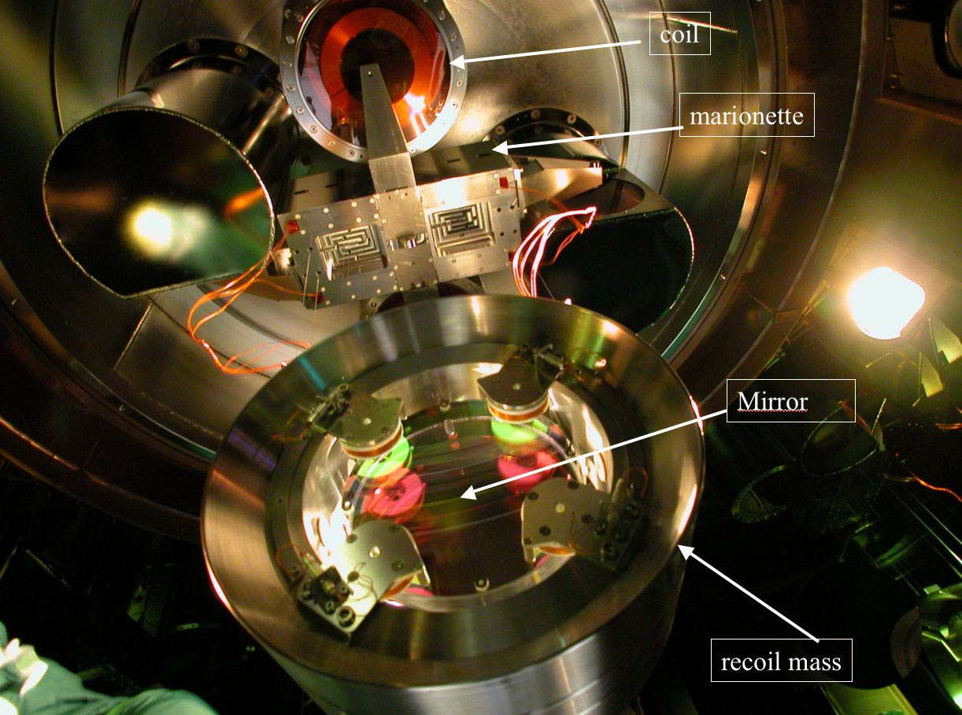
Last Stage Mirror Suspension
The role of the Last Stage Suspension is to compensate the residual seismic noise and to steer the optical components maintaining the relative position of the interferometer mirrors.
Virgo BS Payload
F7 Coil
Requirements:
- In Axis Suspension
- Materials:
UHV compatible;
Amagnetic;
No electrostatic charges;
Internal Frequencies above Virgo bandwidth;
Low frequencies of the system below Virgo bandwidth;
Compatibility with SuperAttenuator and lower part of the tower:
Weights
Shape
Pots
MARIONETTE:
Mirror control with coil-magnet actuators between F7 and marionette
RECOIL MASS
Mirror steering with coil-magnet actuators between RM and mirror; Mirror protection

Slide 3
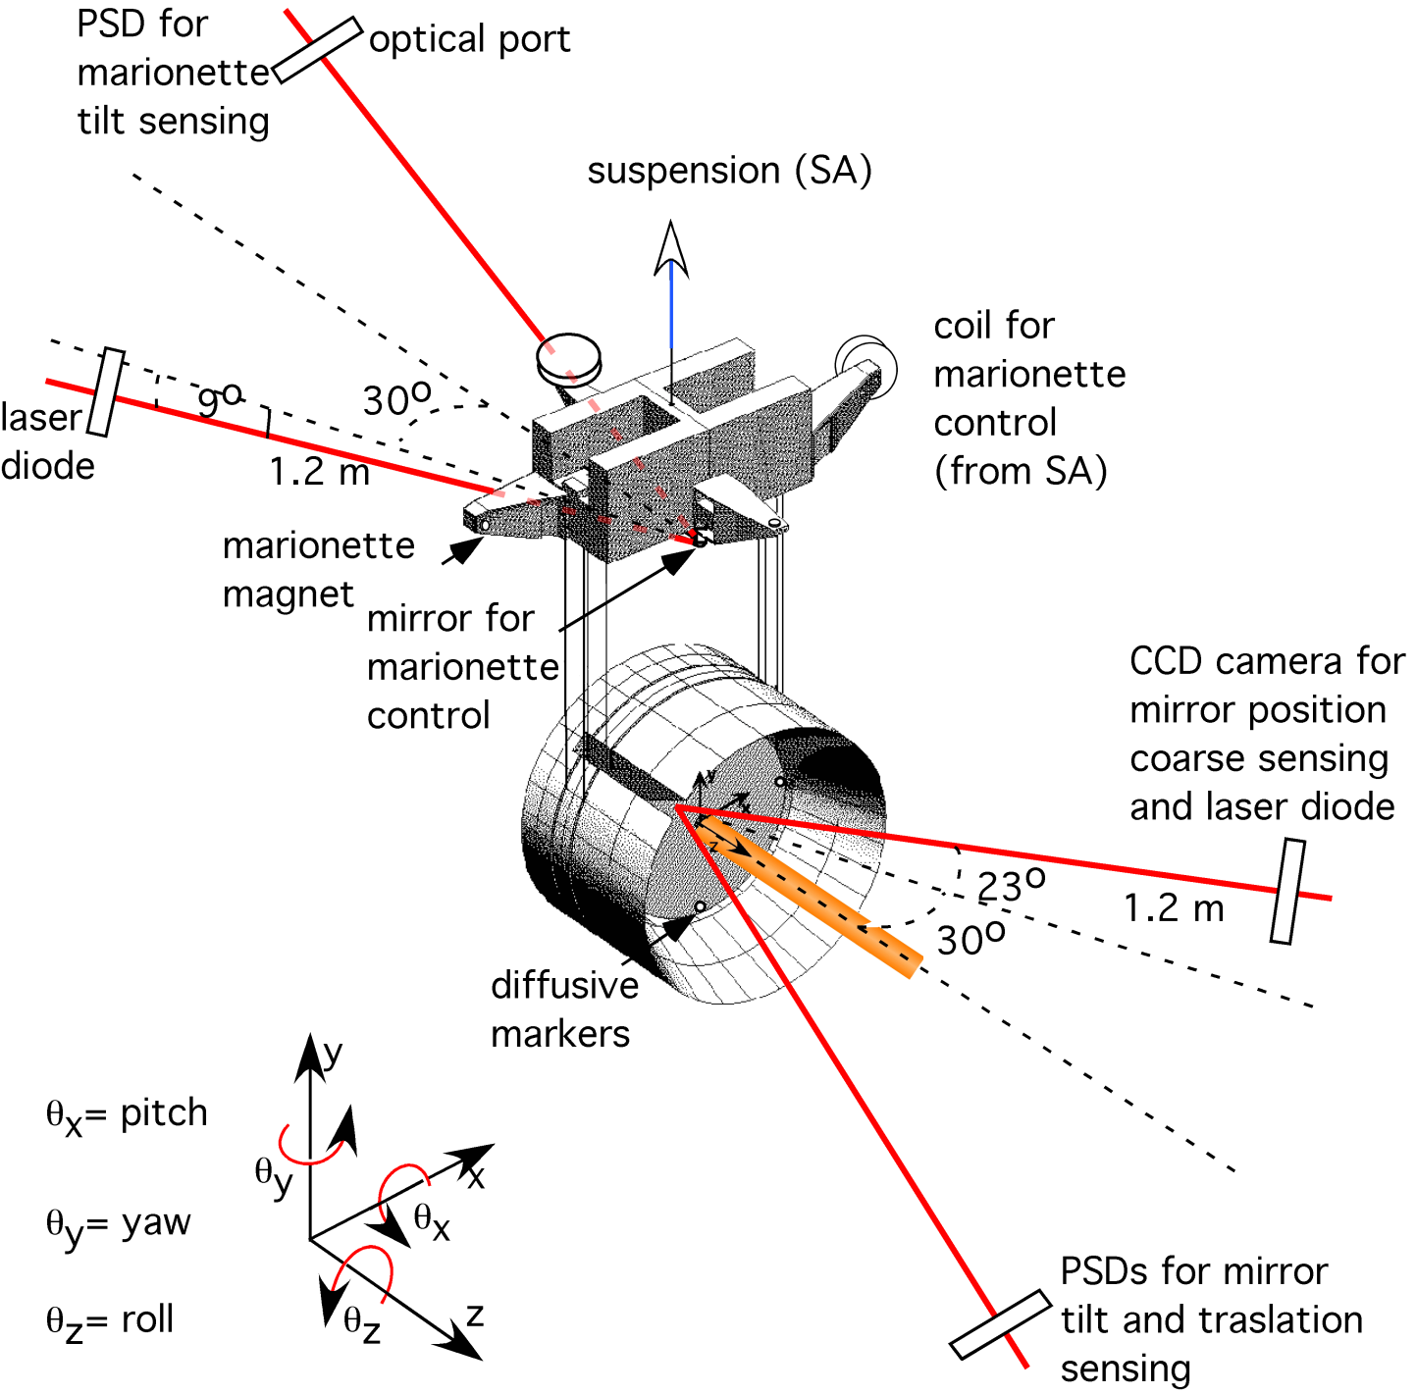
Scheme of the Local Control implementation /1

Slide 4
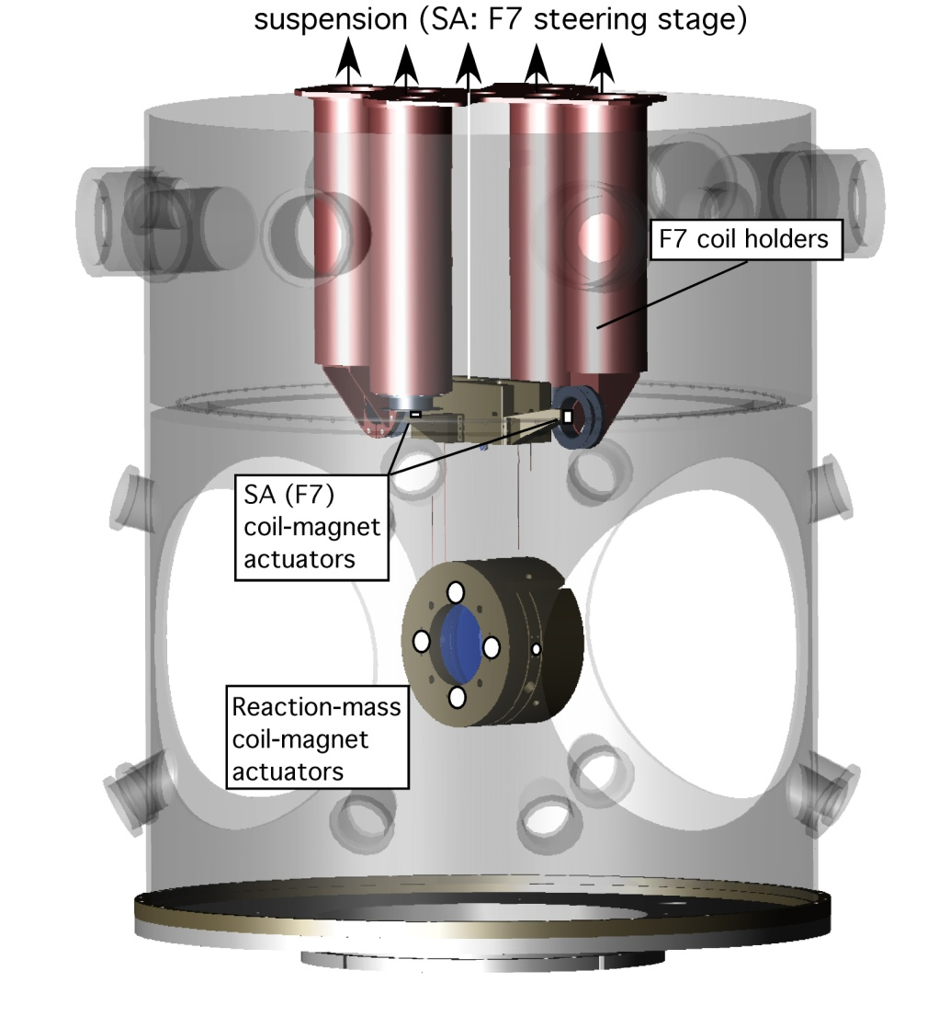
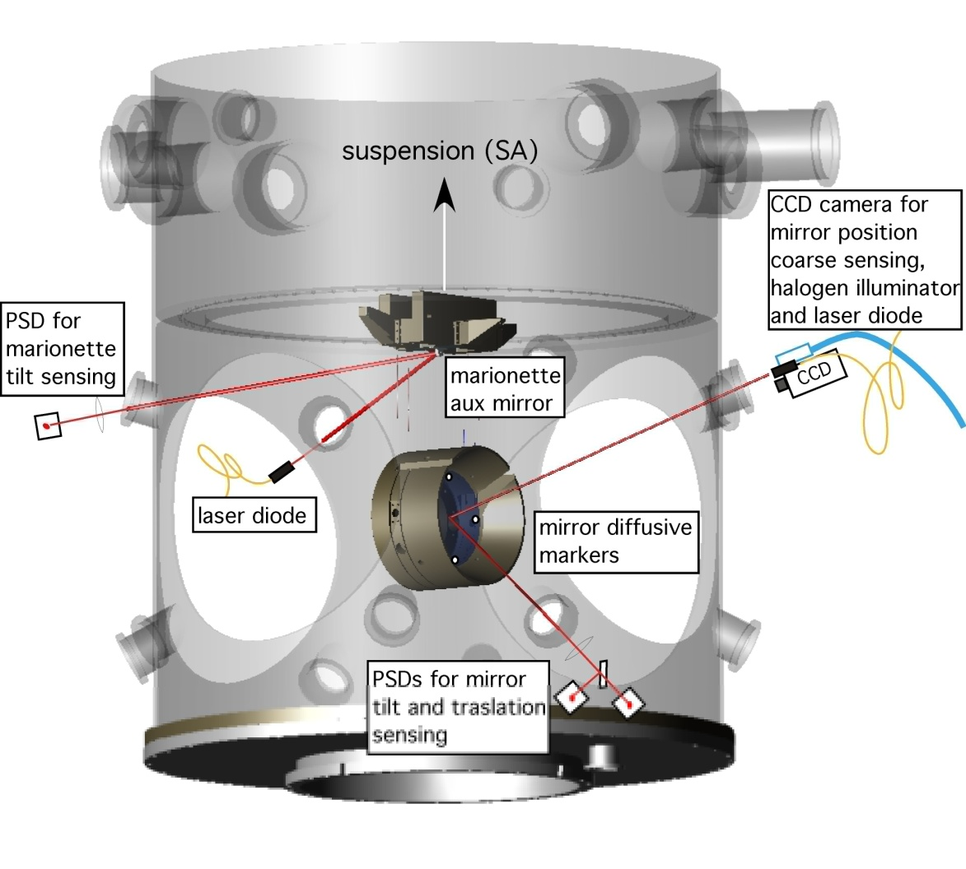
Scheme of the Local Control implementation /2
sensing
actuation

Slide 5
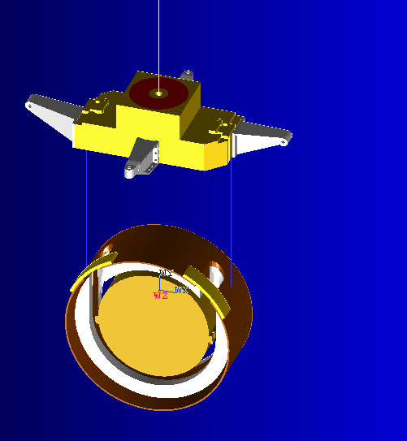
The Virgo+MS Payload
Virgo
Marionette (AISI316L): 100 kg
Reaction Mass(Al6063): 60 kg
Mirror (Suprasil): 21 kg
Overall payload weight: 181 kg
Virgo +MS
Marionette (AISI316L+CuW+Peek): 100 kg
Reaction Mass (AISI316L+Peek): 60 kg
Mirror (Suprasil): 21 kg
Overall payload weight: 181 kg

Slide 6
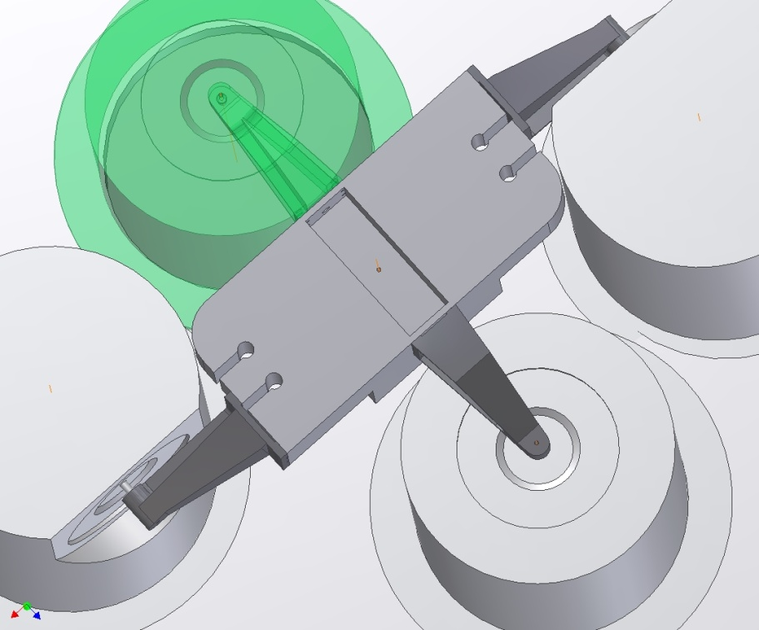
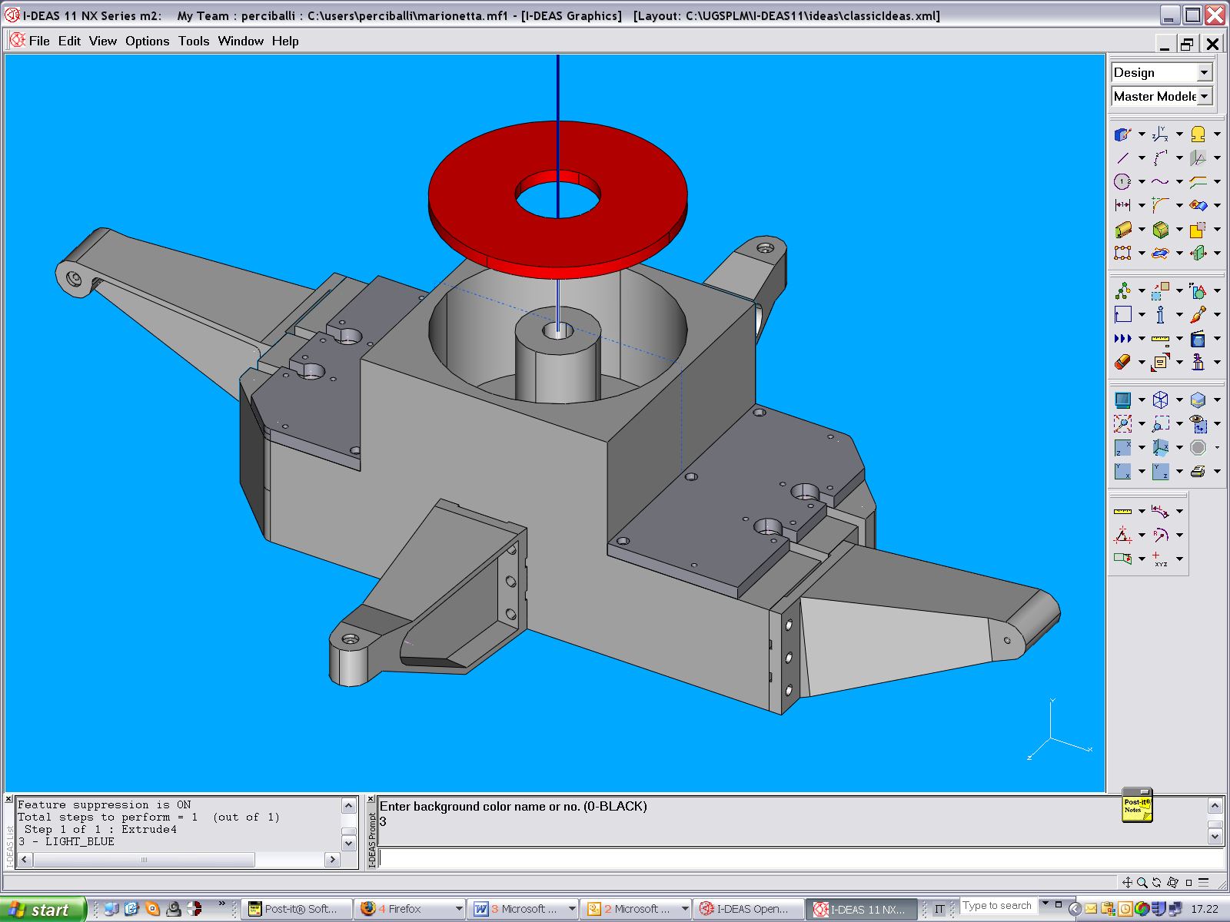
Marionette
shaped to gain space between the bechers
dielectric arms;
body in amagnetic Steel (AISI316L)
Flexible design
470 mm
CuW
More space between the bechers
Acting on counterweights, it is possible to reduce the mass of the marionetta by about 10 kg, keeping the same Center of Mass position
magnets
Peek
arms
We can change mirror suspension wires clamping mechanics according to necessity.

Slide 7
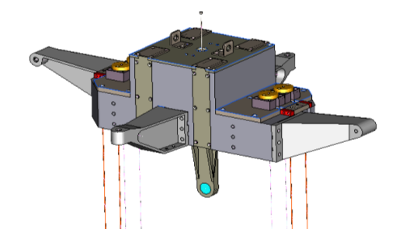
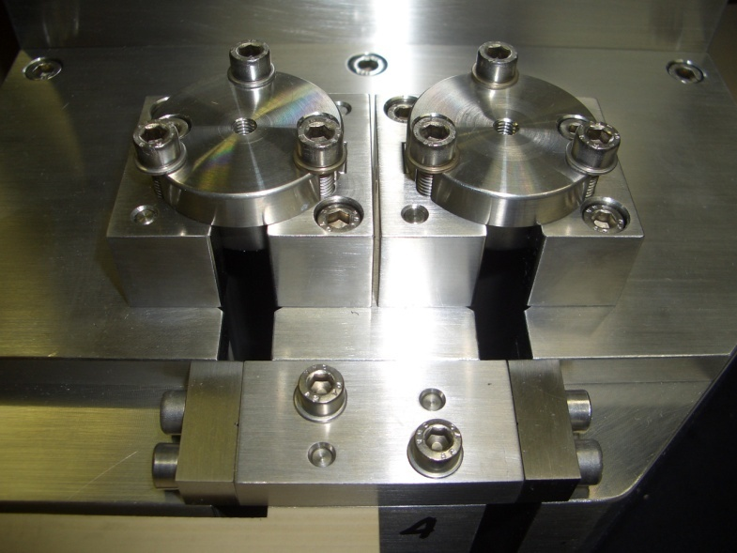
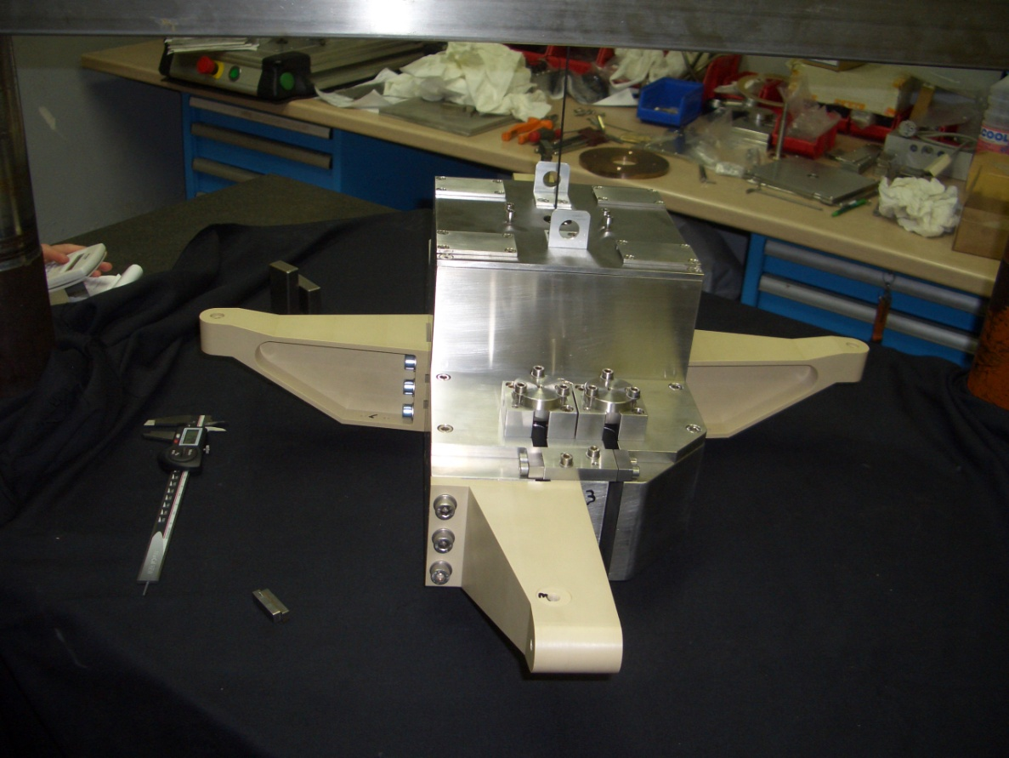
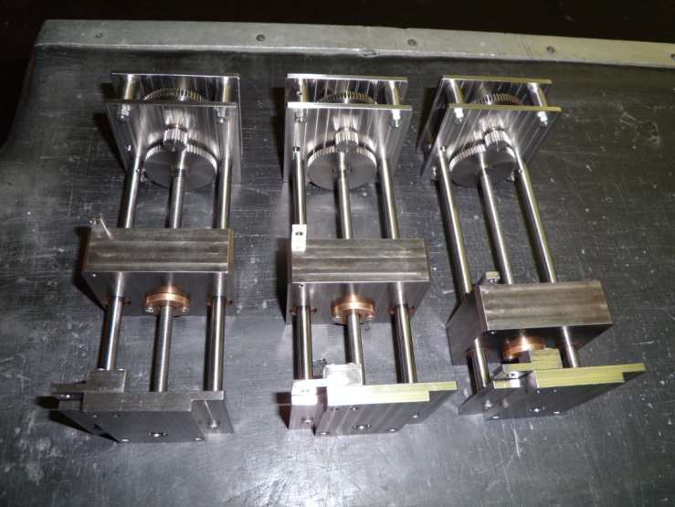
Marionette
Peek arms
RM steel wires clamps: Virgo-like
Mirror’s clamps box: stiffness implemented, other clamping screws added
Static Balance weight

Slide 8
4.85 kg steel inserts used to rise up artificially the baricentre
baricentre
+2. 7 mm
Maraging wire clamp and fibre λ
The clean way to drive pitch mode in the range 250-300 mHz, reducing z/φ coupling and improving pitch control accuracy, is to bring the bending point of marionette wire closer to the center of mass.
+5.85 mm
- 4.85 kg
+ 4.85 kg
+7.8 mm

Slide 9
However in such a case, payload assembly and commissioning has become more critical with respect to the balancing, (no remote adjustment of θ_{z} position in present marionetta).
Indeed, trying to tune the overall θ_{z} and θ_{x} motion of the payload changing the vertical position of the marionette CM could drive modes dangerously close to 0.198 Hz, the main pendulum mode of the chain.
A tradeoff tuning of the various mode frequencies was reached with some iteration on the payloads, (about 2 weeks for the first one)
Comparison of the main pendulum frequencies for the old and the new payload

Slide 10
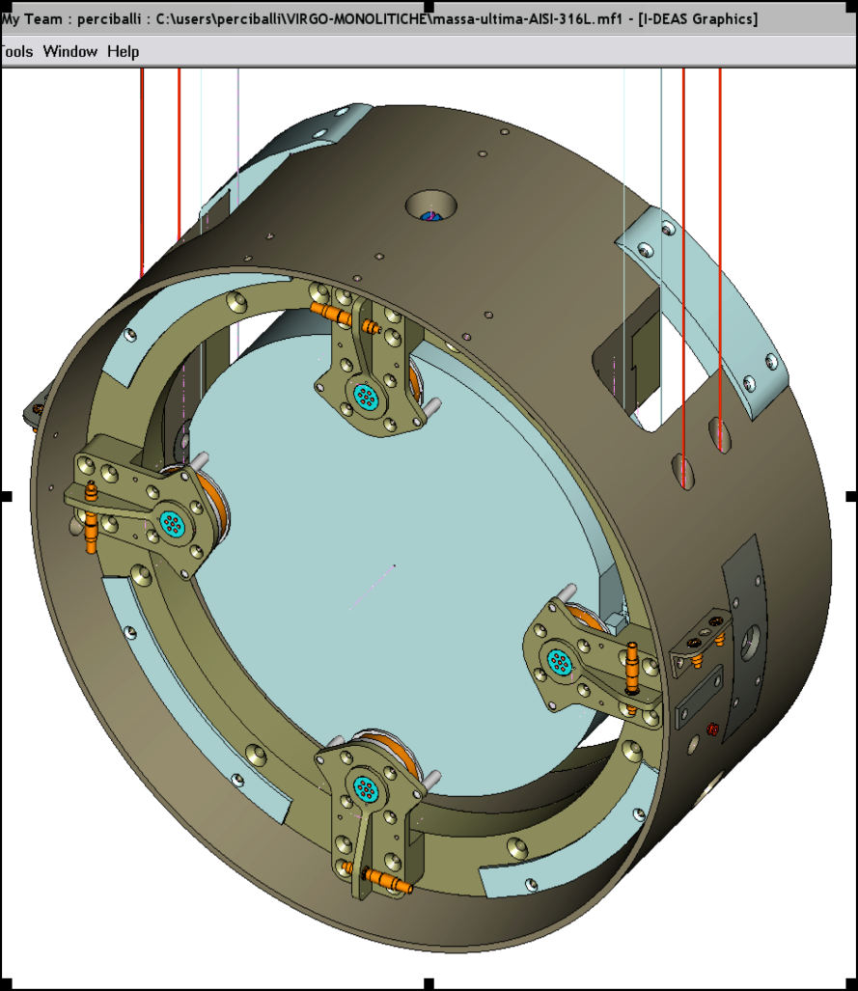
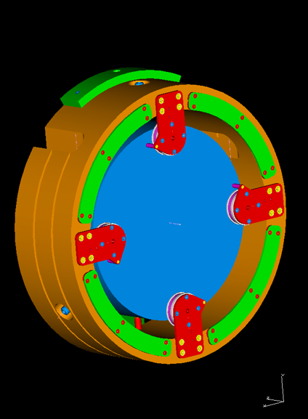
Recoil Mass
Function
To protect the mirror from pollution
To protect the mirror from shocks and wire breaks (expecially silicon wires);
To support the coils for mirror actuation
To support the Markers for Local Control
Requirements
Center of mass coincident with the mirror one;
Suspension plane passing through the center of mass;
4 back coils.
Lateral (one side) holes for mirror position monitoring;
Dielectric materials facing the magnets (no more eddy currents effects);

Slide 11
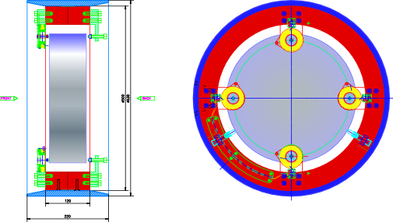
Recoil Mass
Outside : Steel AISI316L
Inside: Tecapeek CF30 (two pieces)
Coils: Virgo-like
Safety stops
3/11/2008

Slide 12
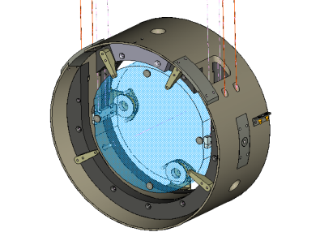
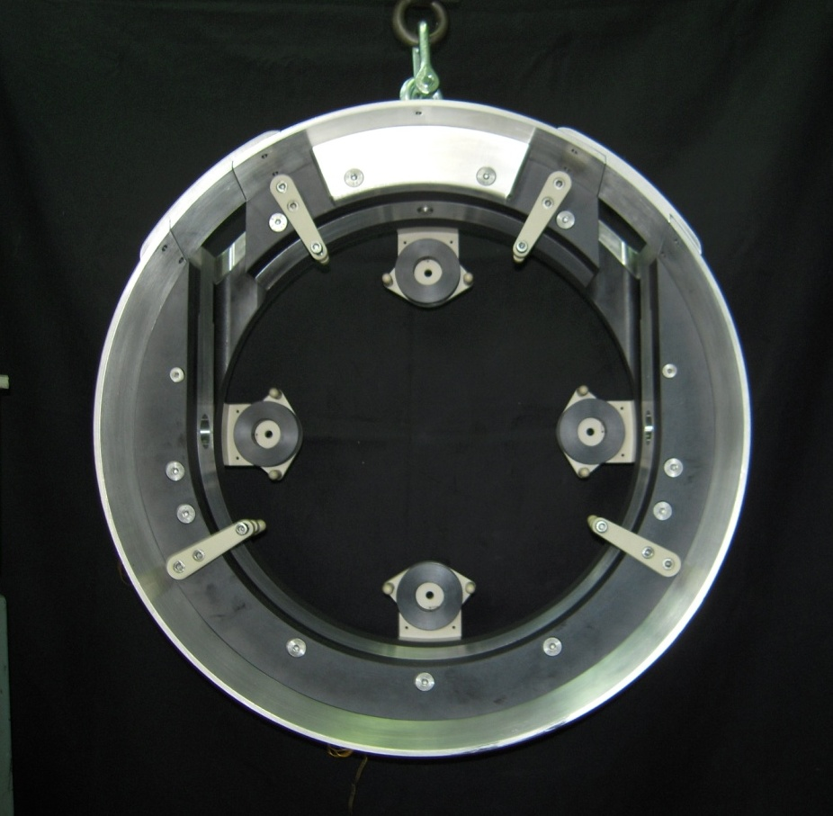
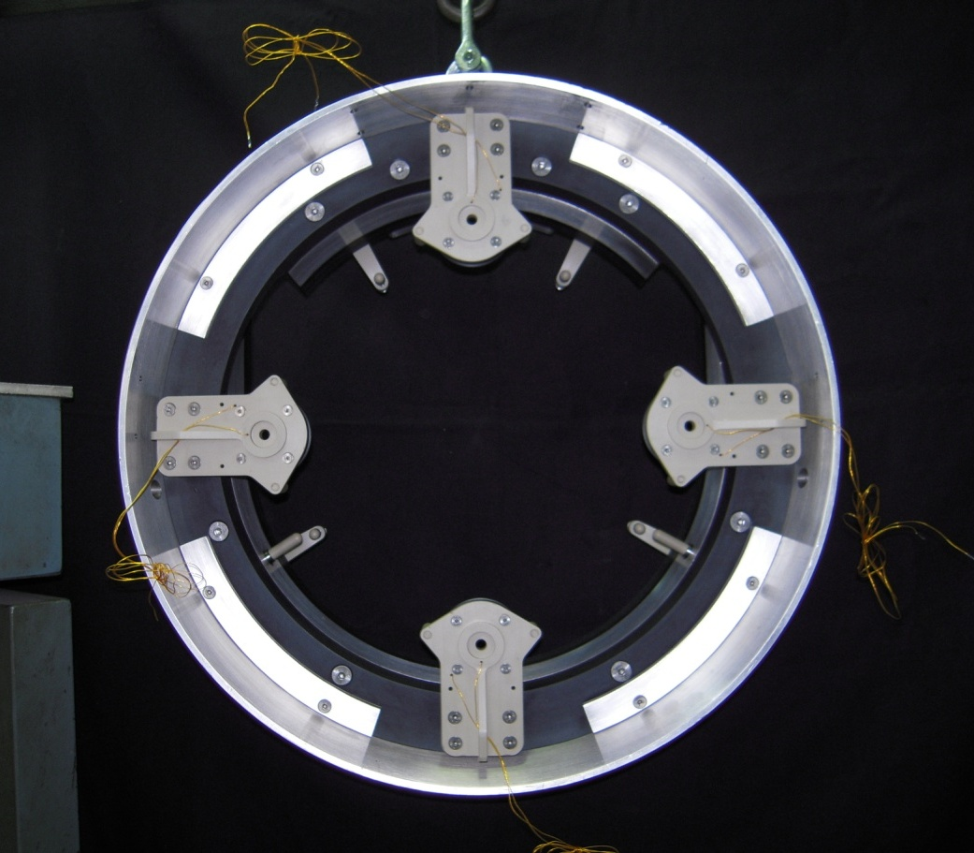
Payloads: Recoil Mass
Front
Back
Material: peek, peek CF30, Steel AISI316L
Coil supports: peek+peekCF30 (near mirror)
Markers mounted on the coils supports

Slide 13
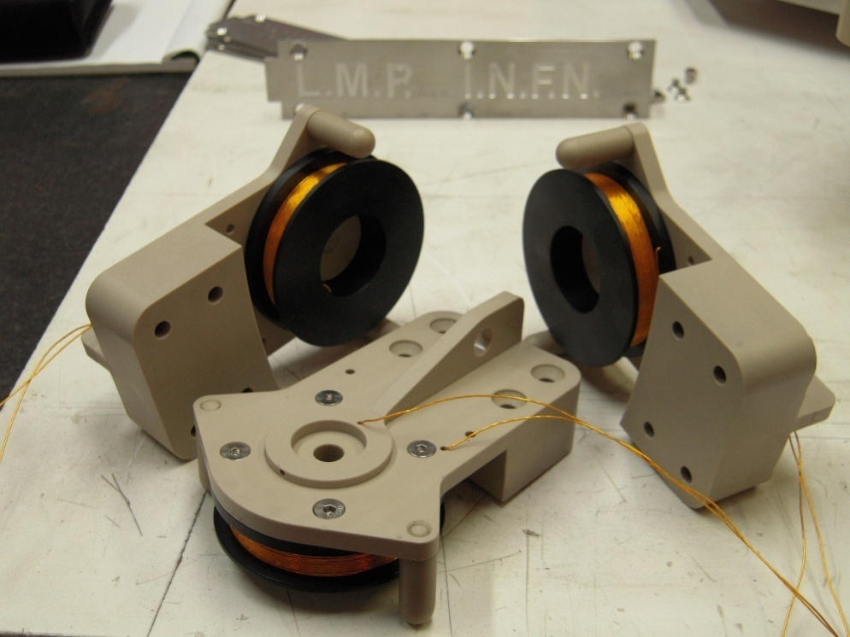
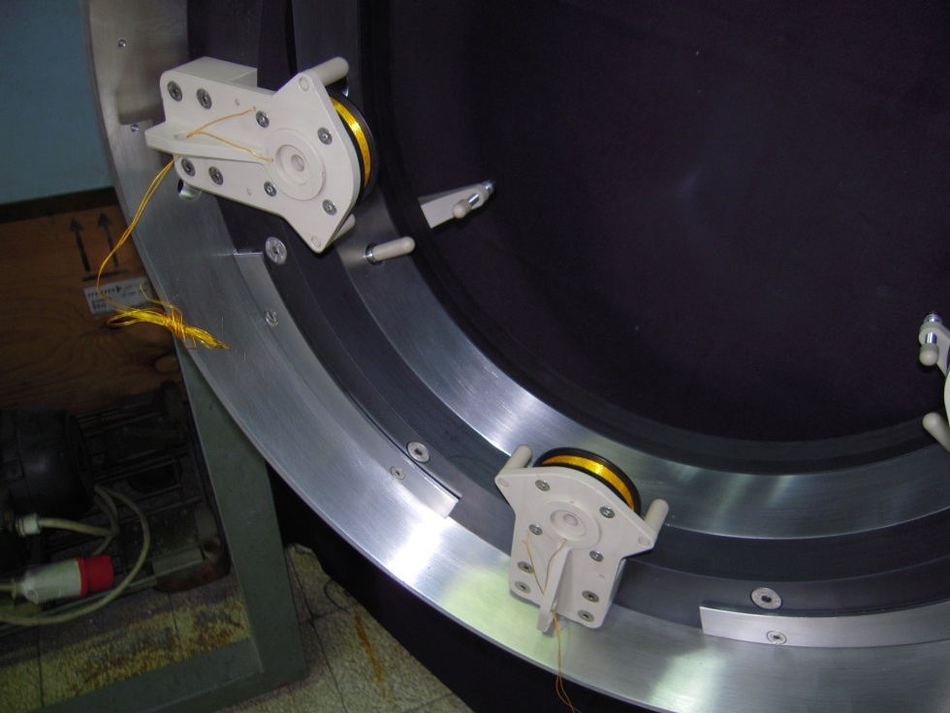
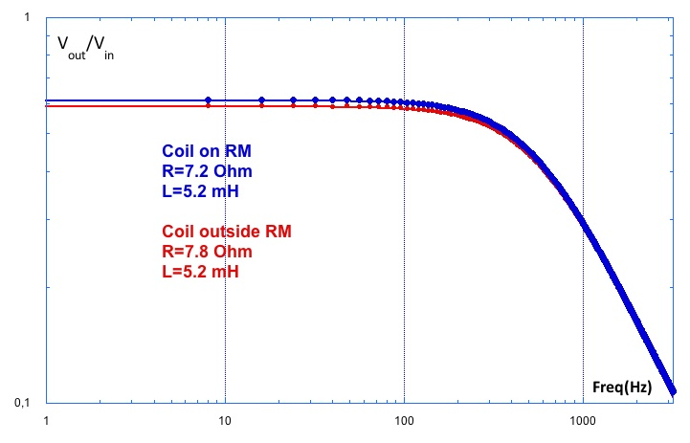
Mirror Coils
Non linear effects absent
Properties similar to Virgo coil ones:
289 turns R=7 Ohm L=5.2 mH
Magnets 2.5mm diamX2.5mm, 1 T
Force: about 2 mN/A

Slide 14
Virgo Mirrors Dimensions
345 mm
334 mm
50 mm
100 mm
Flat 100*50 mm
Flat 100*100 mm
Input Mirrors
End Mirrors

Slide 15
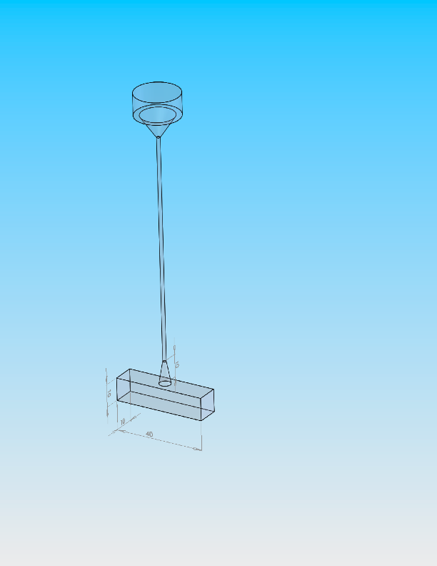
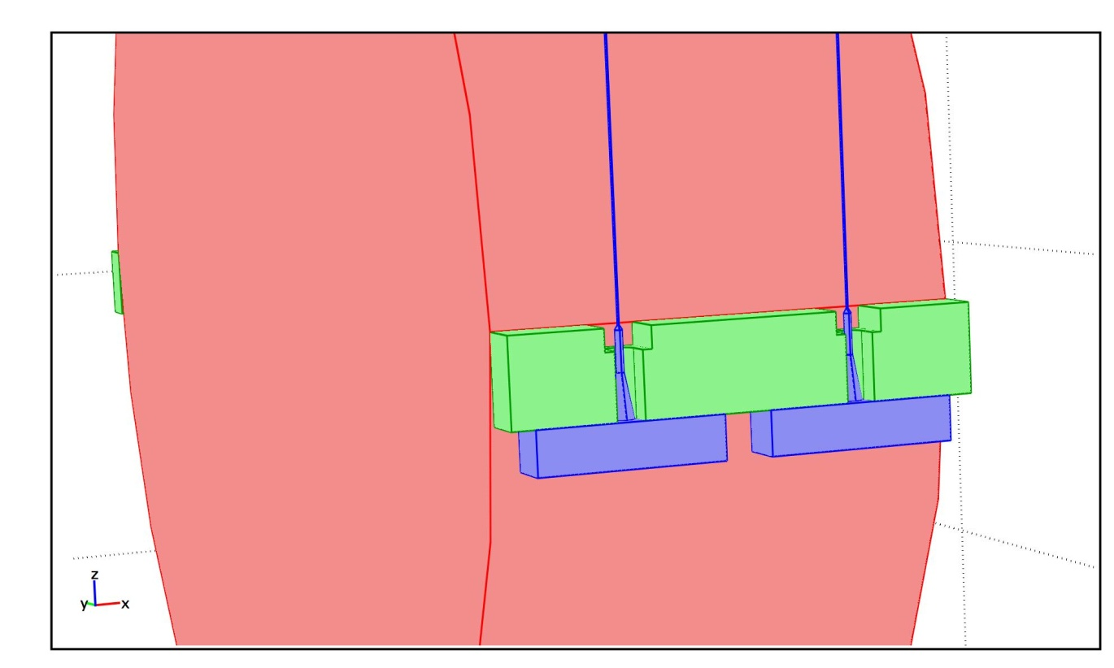
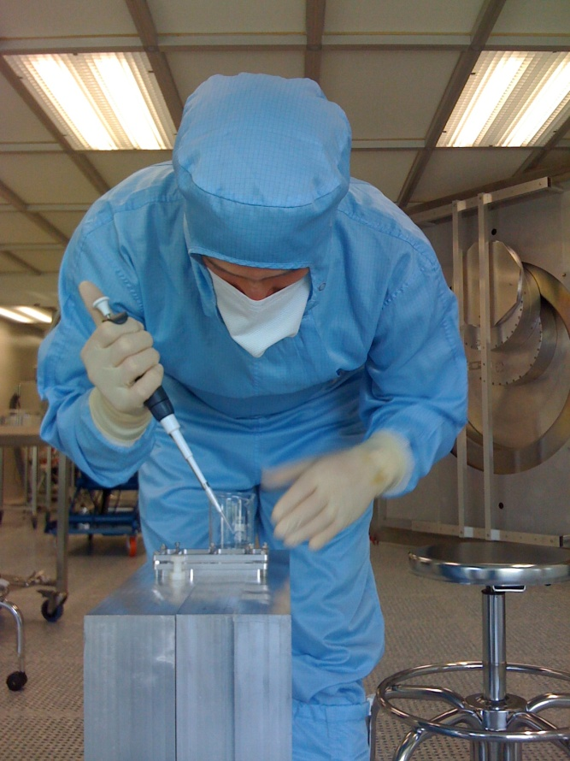
Mirror Monolithic Suspension
Fused silica fibres anchored to supporting ears, silica bonded to the mirrors
Fused Silica Fibre
Ø 0,28 mm
Length 700mm
Mirror lateral surface
Ears being bonded to a test mirror at LMA

Slide 16
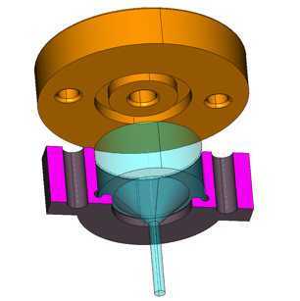
Upper Clamps
Steel box to host the upper silica clamp on the marionetta
Coupling to the mirror flats with New Ears
Silica Clamps
on the marionette
Silica anchors
Silicate bonding
Notes:
16

Slide 17
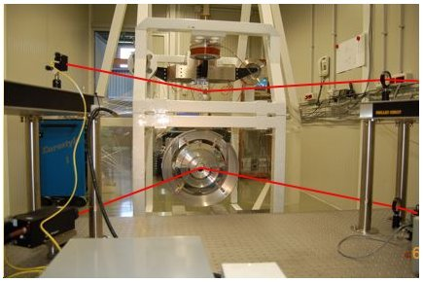
Payload Suspension and Control in a Test Facility
Marionetta and coils
Mechanical Assembling using a suspension frame done in 3 steps.
steel suspension (TF meas, control design, analytical and FEM model
silica wires susp. (assembly procedure, TF meas, model retuning (with FS) )
silica ear and wires susp.
Recoil Mass
Laser
Mirror and markers
Camera
y
lens
(and PSDs)
x
z
Tx TF in the various set-ups

Slide 18
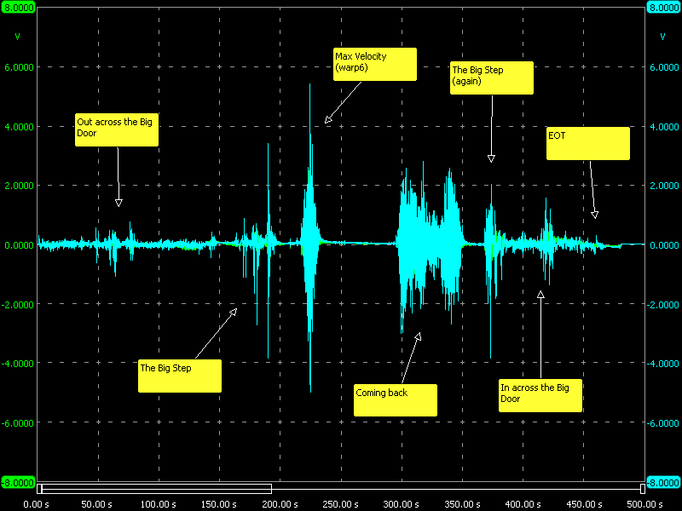
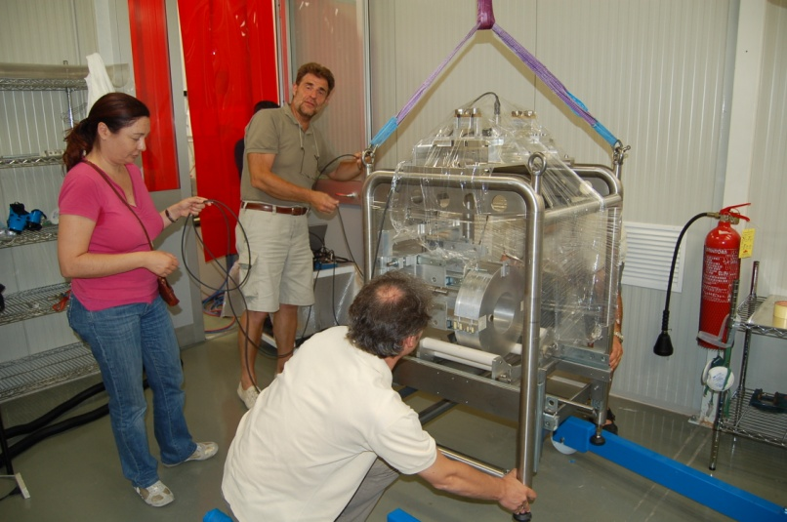
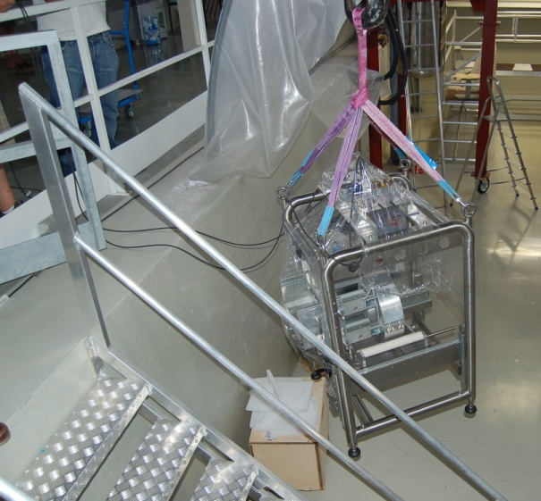
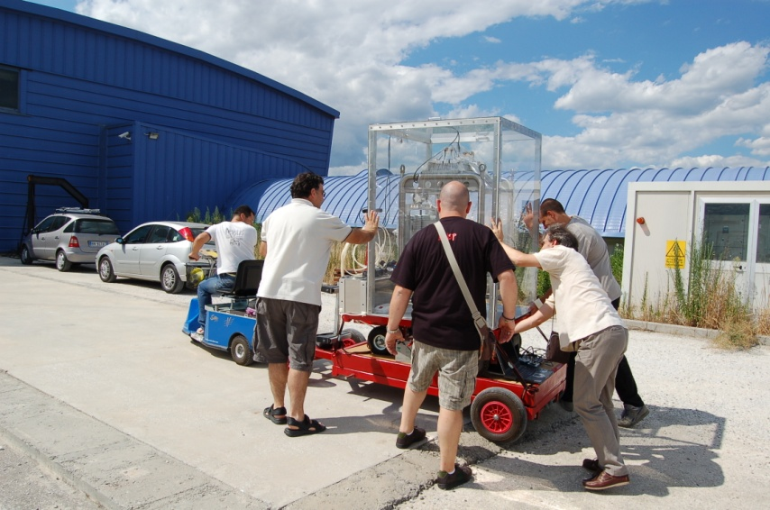
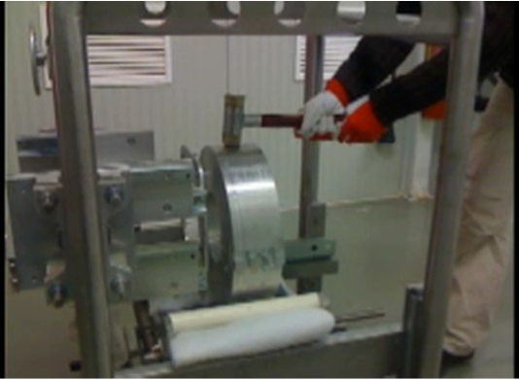
RESISTANCE TO SHOCKS, DUST POLLUTION, HUMIDITY
m/s²
Transportation test:
On the dummy payload
Mechanical vibration monitored with accelerometers
The test was successful (no broken fibers!
Crash Test : see movie on YouTube
(search monolithic crash), fiber robustness tested

Slide 19
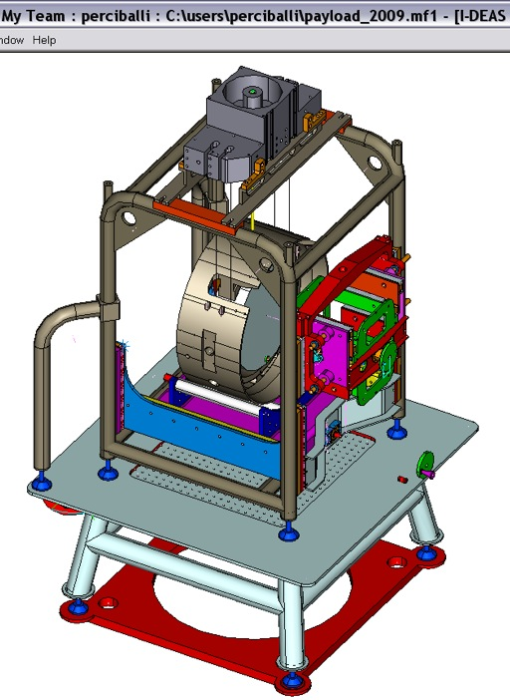
Assembly Frames
Special Assembly Structure for:
Payload Assembly
Payload Transport
Payload Integration with Super Attenuator

Slide 20
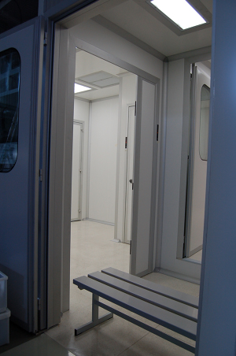
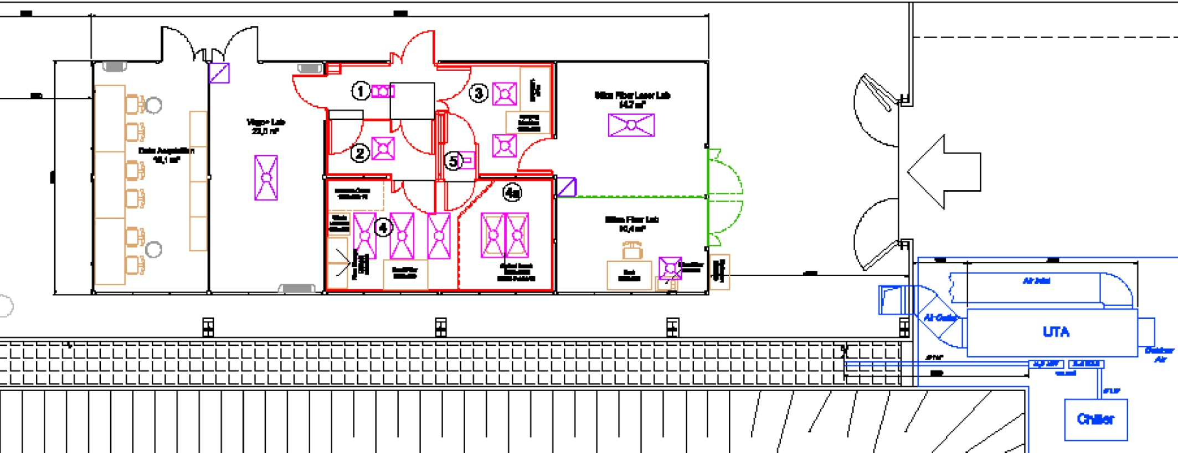
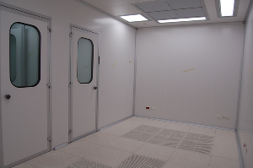
Clean Room at 1500 W
Payloads Parts assembly and storage
Fibres test zone
Fibres production
SAS
The new clean room is working:
Class 100 cleanliness reached
Virgo Document VIR-0435A-09
Payload assembly zone
Notes:
20

Slide 21
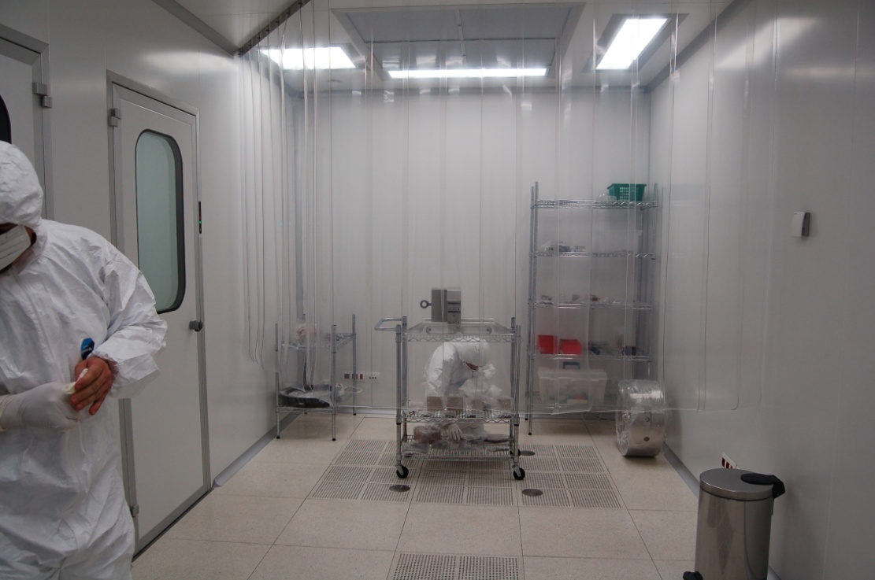
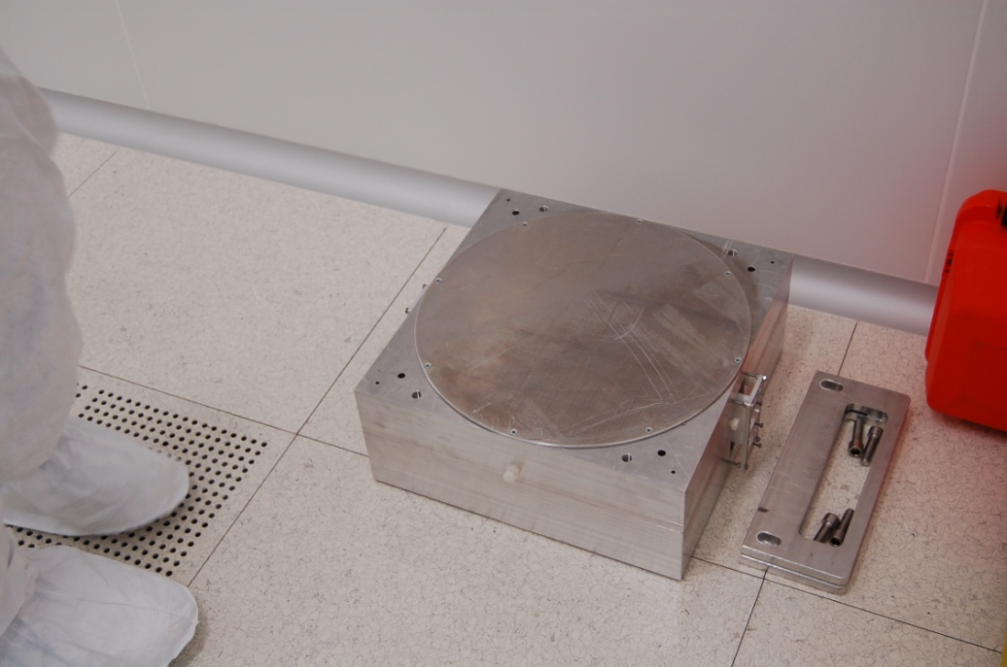
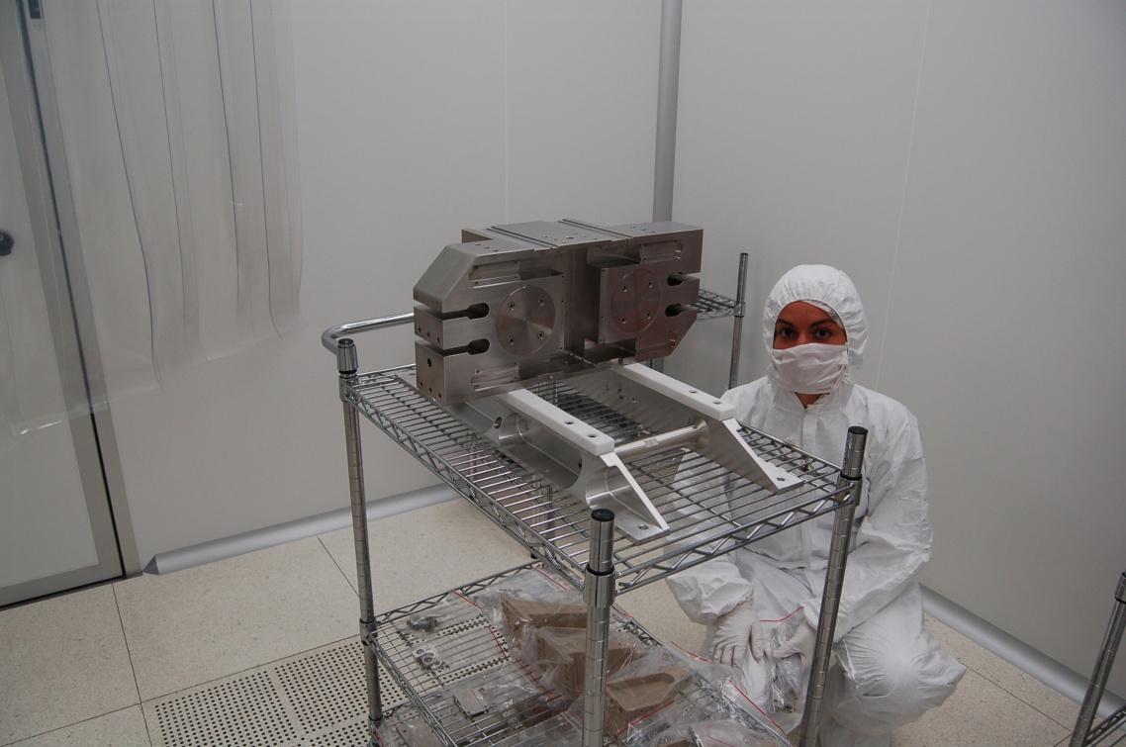
Clean room at 1500 W
Old NE Test Mirror in storage box
The clean room is working:
Class 100 cleanliness reached
Virgo Document VIR-0435A-09
Marionetta assembly

Slide 22
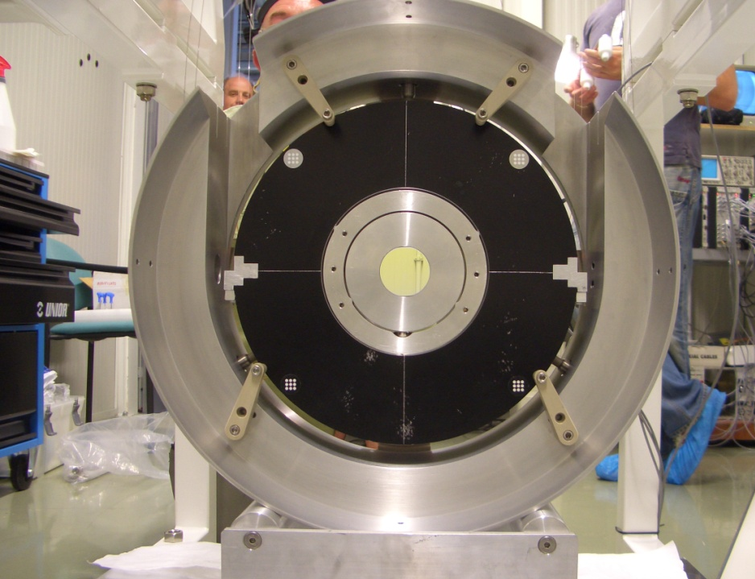
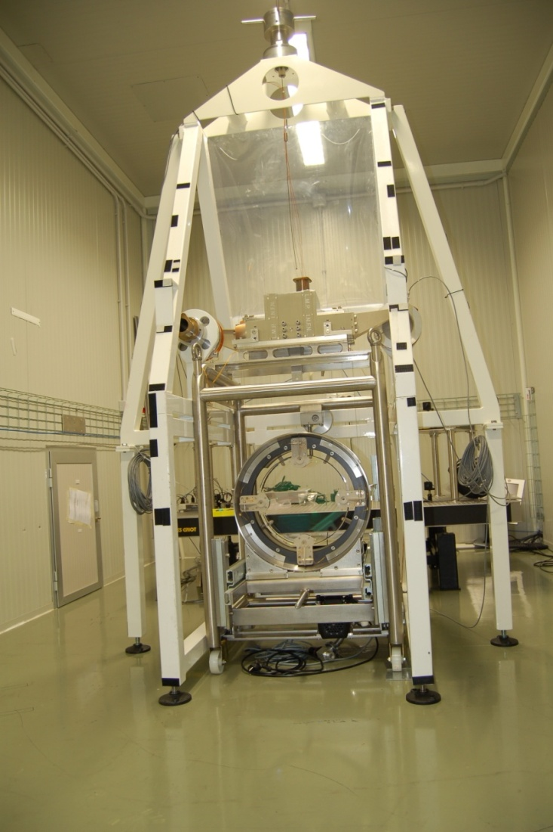
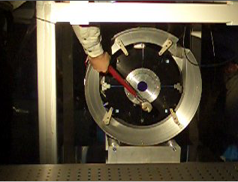
Validation of complete Monolithic Suspension Prototype
Payload prototype with dummy mirror
Payload prototype with old NE mirror
at the 1500 West Arm Test Facility
Safety, resistance and transport studies
Payload Production
8/2/2010
Piero Rapagnani

Slide 23
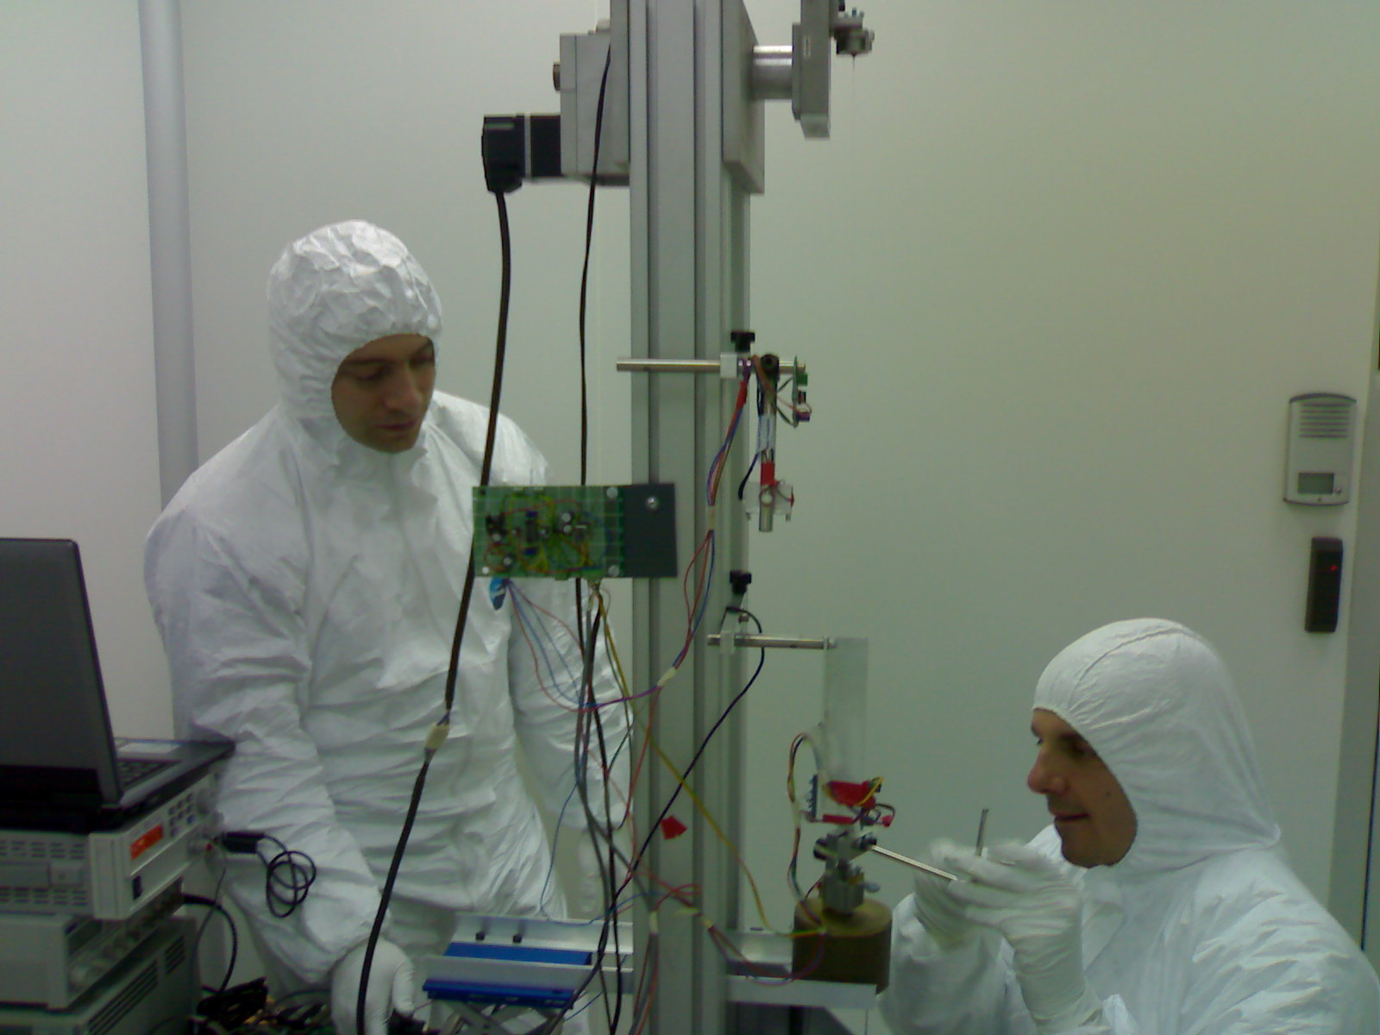
Payload Assembly
Fibres for the payload are prepared and tested
8/2/2010

Slide 24
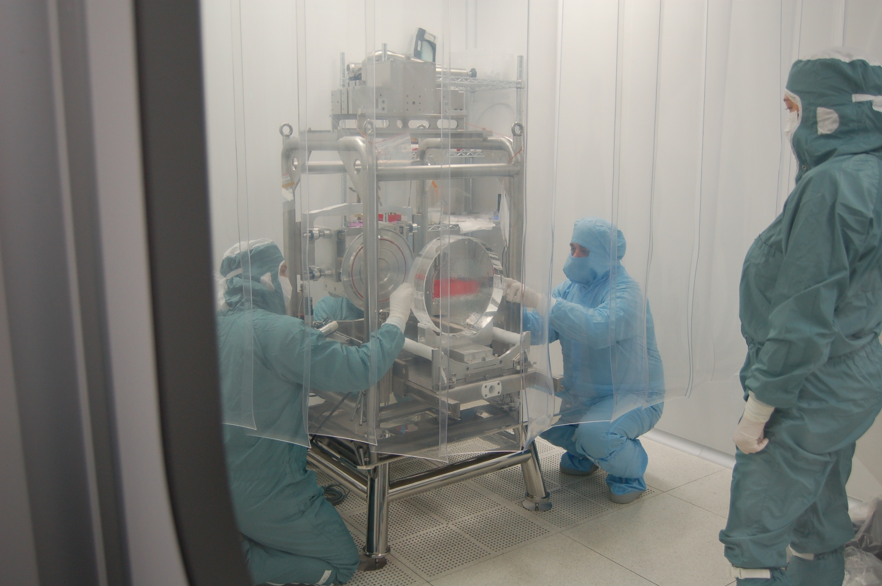
Payload Assembly
The NI Mirror is being inserted in the assembly frame
8/2/2010

Slide 25
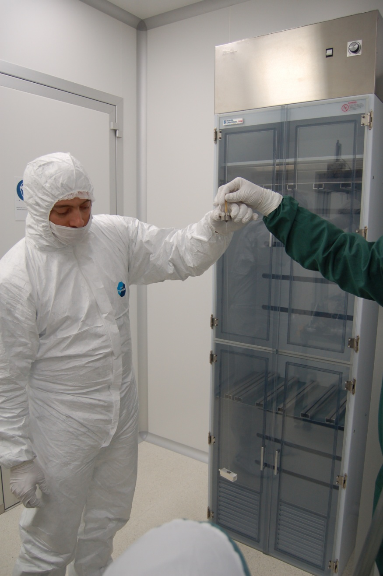
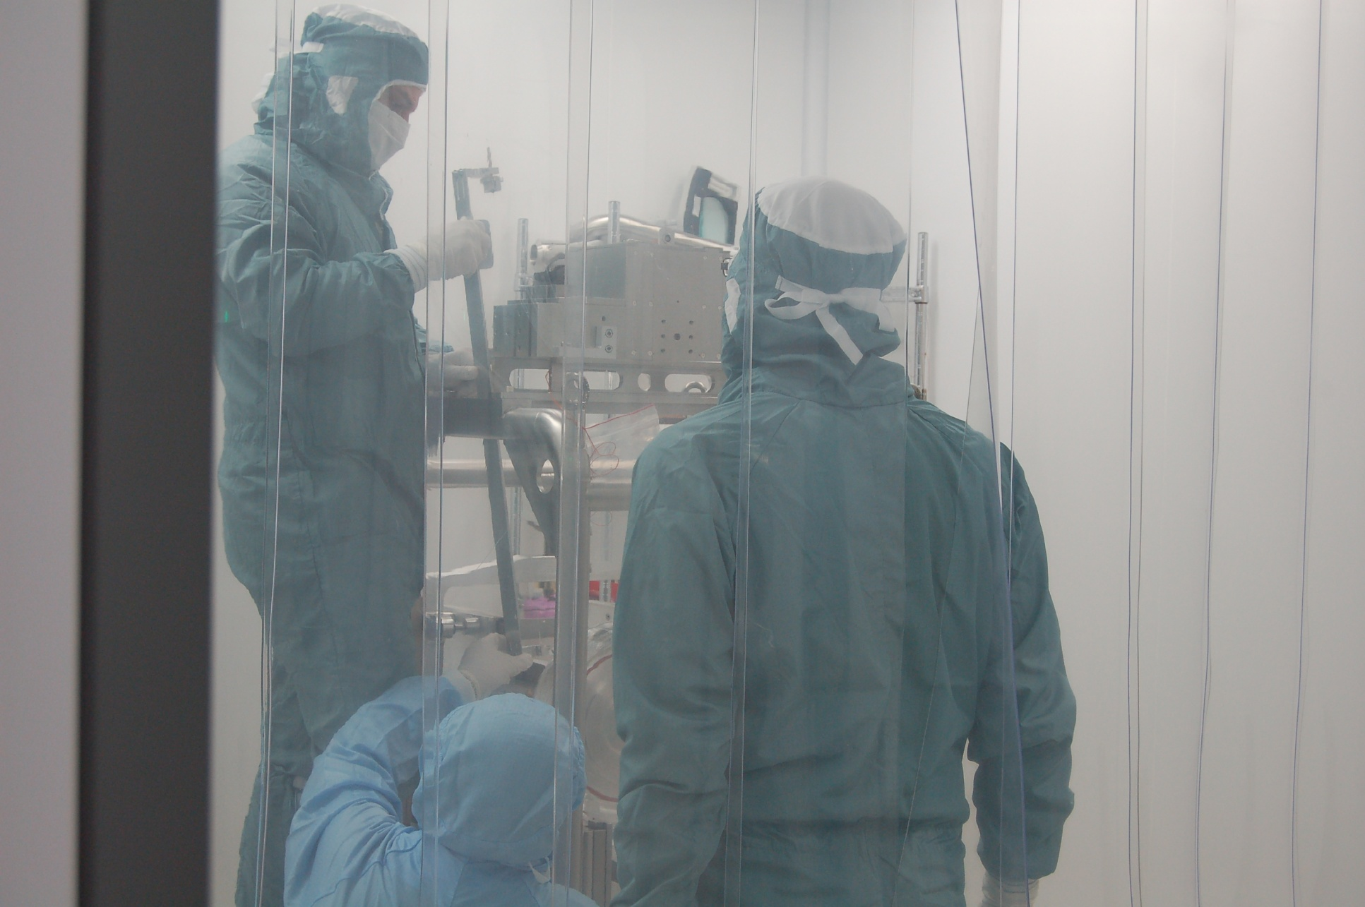
The first fibre is taken from the test lab and carefully put in place

Slide 26
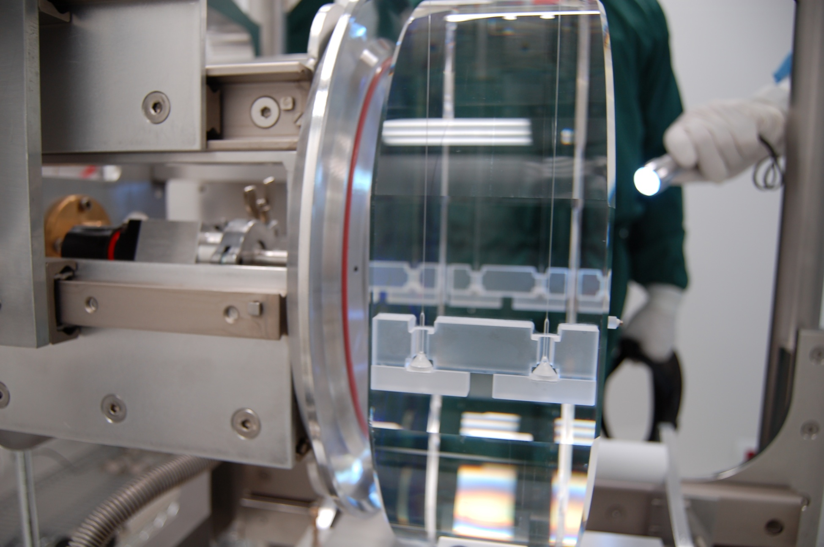
All fibres in position and bonded to the mirror

Slide 27
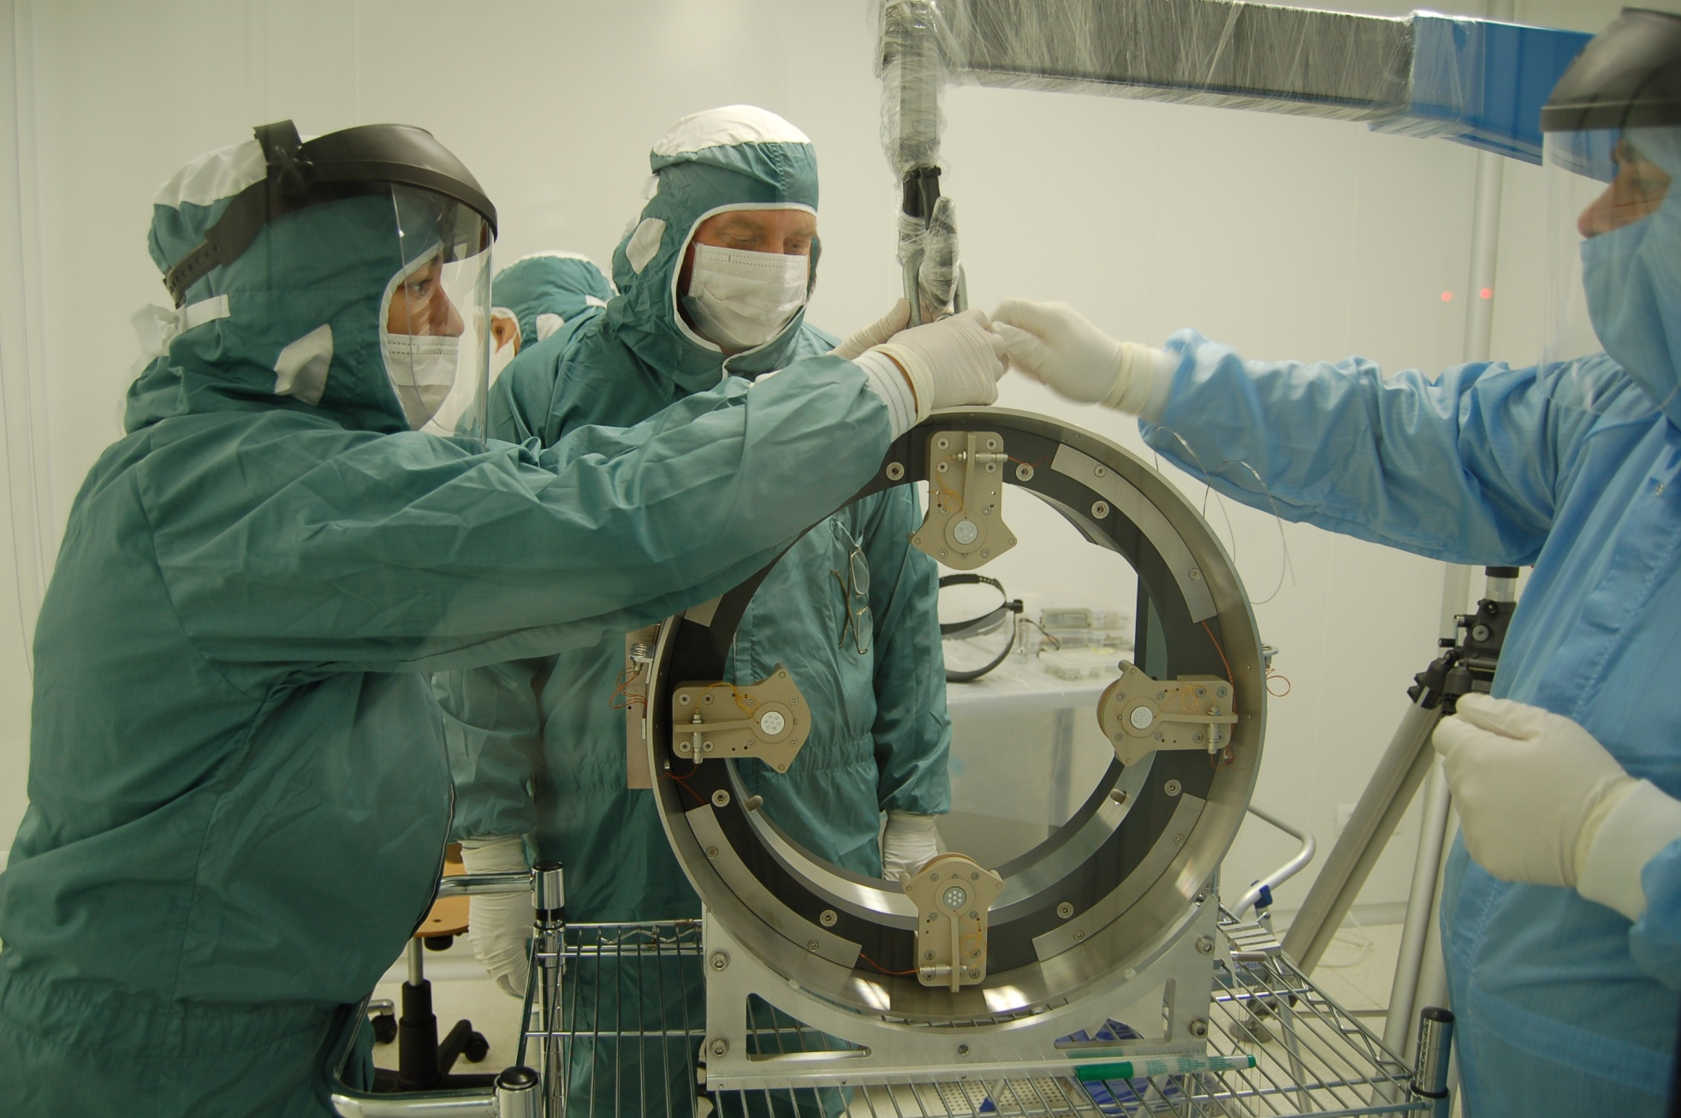
The Recoil Mass is suspended around the mirror

Slide 28
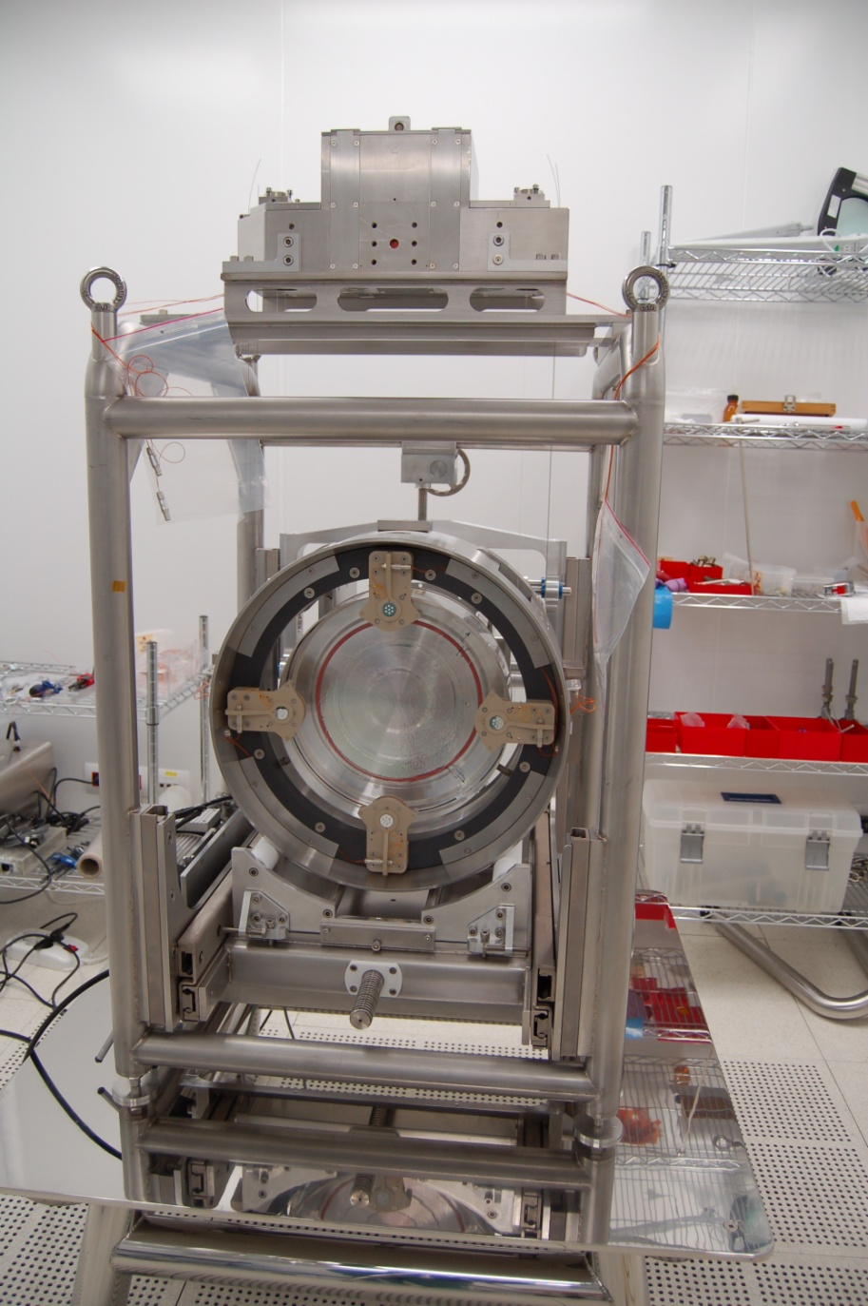
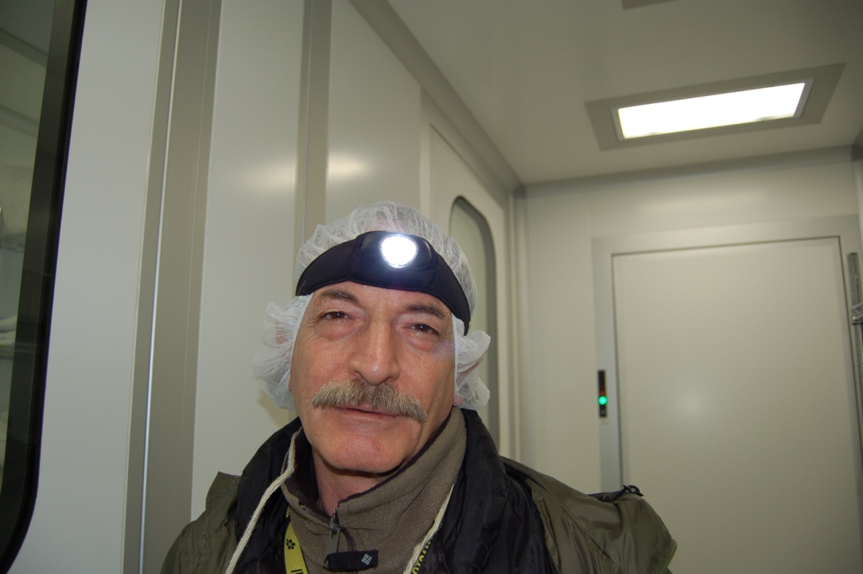
The payload is ready...
...after 7 hours of work and a lot of stress
Maurizio Perciballi

Slide 29
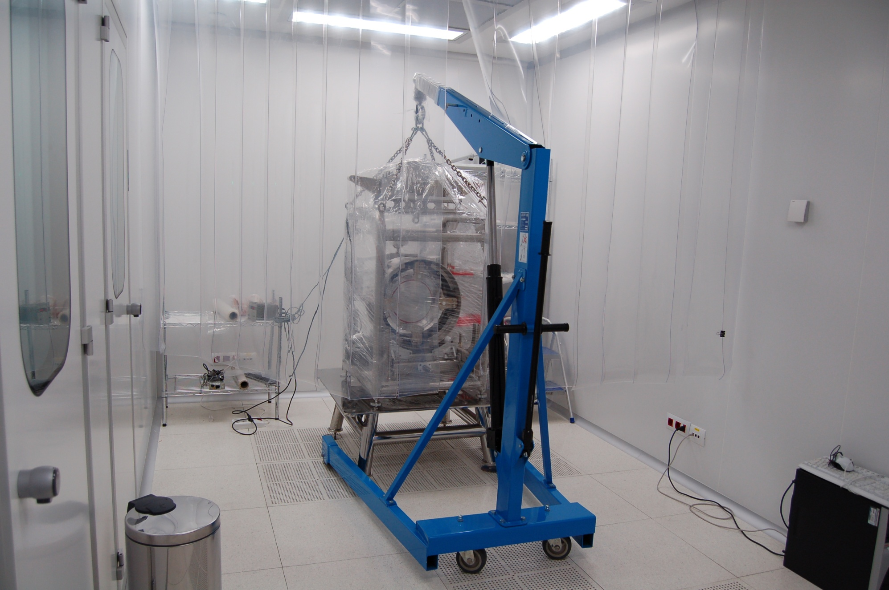
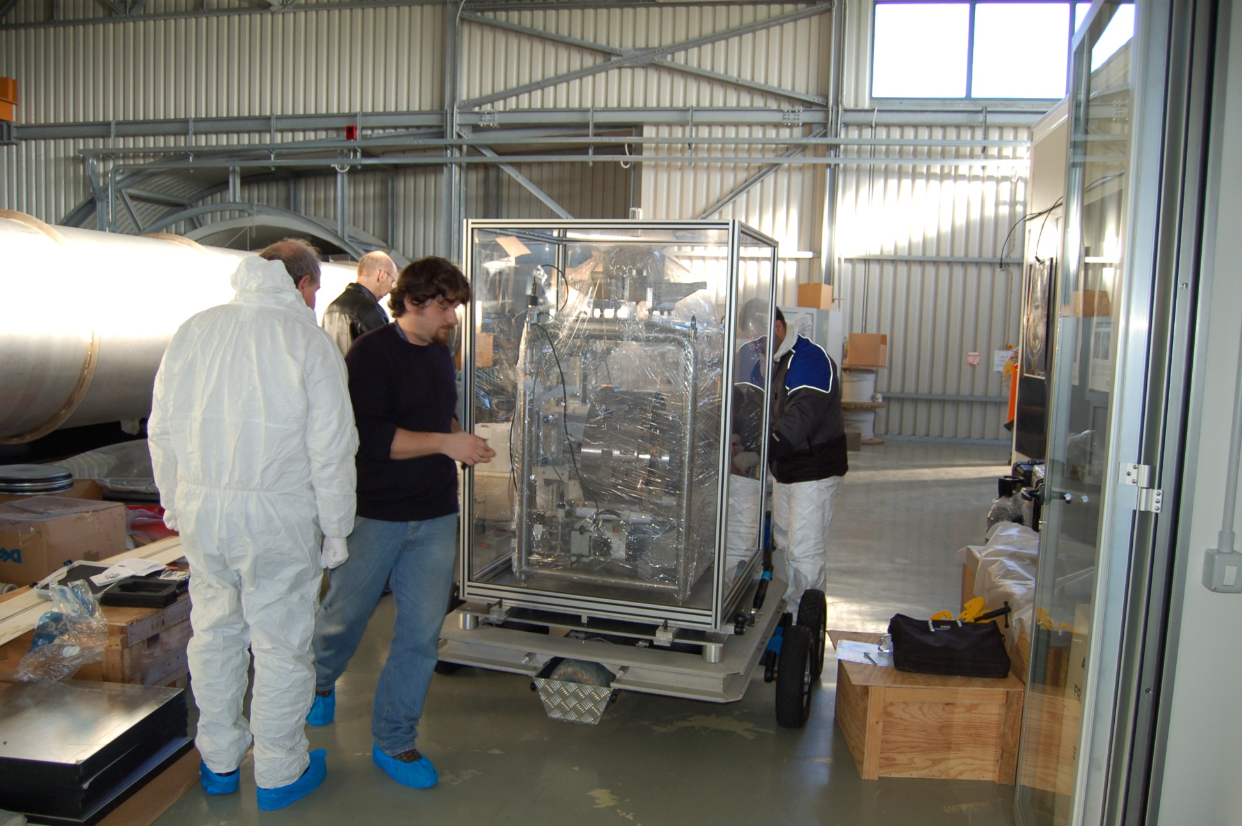
Payload Transfer to the Central Building.
Temperature, humidity, acceleration were monitored during the travel

Slide 30
NI Transport along the West Arm.

Slide 31
Payload insertion into NI tower
Insertion lasted about 4 hrs
The NI tower lower chamber ready to receive the payload
Payload suspended

Slide 32
The hanging, unpacking and unblocking procedure was devised on the spot: no tests were possible, before the real assembly.
Unpacking and unblocking: the most delicate actions

Slide 33
TCS optics remounted and aligned, with the help of a screen clamped to the Recoil Mass in front of the Mirror
Final payload balancing
Protective film removal
Final manual alignement
Tower closed
After that...

Slide 34
END

Slide 35
Spare Slides

Slide 36
Roll motion of the payload cannot be directly damped because there are no θz actuators: a small centering force on the θy actuators is usually used.
If these actuators are used for locking, the roll motion can be pumped up and the ITF unlocks.
To avoid this effect, a new control loop involving both suspension and payload was implemented

