Slide 1
Neutron cosmic ray

Slide 2
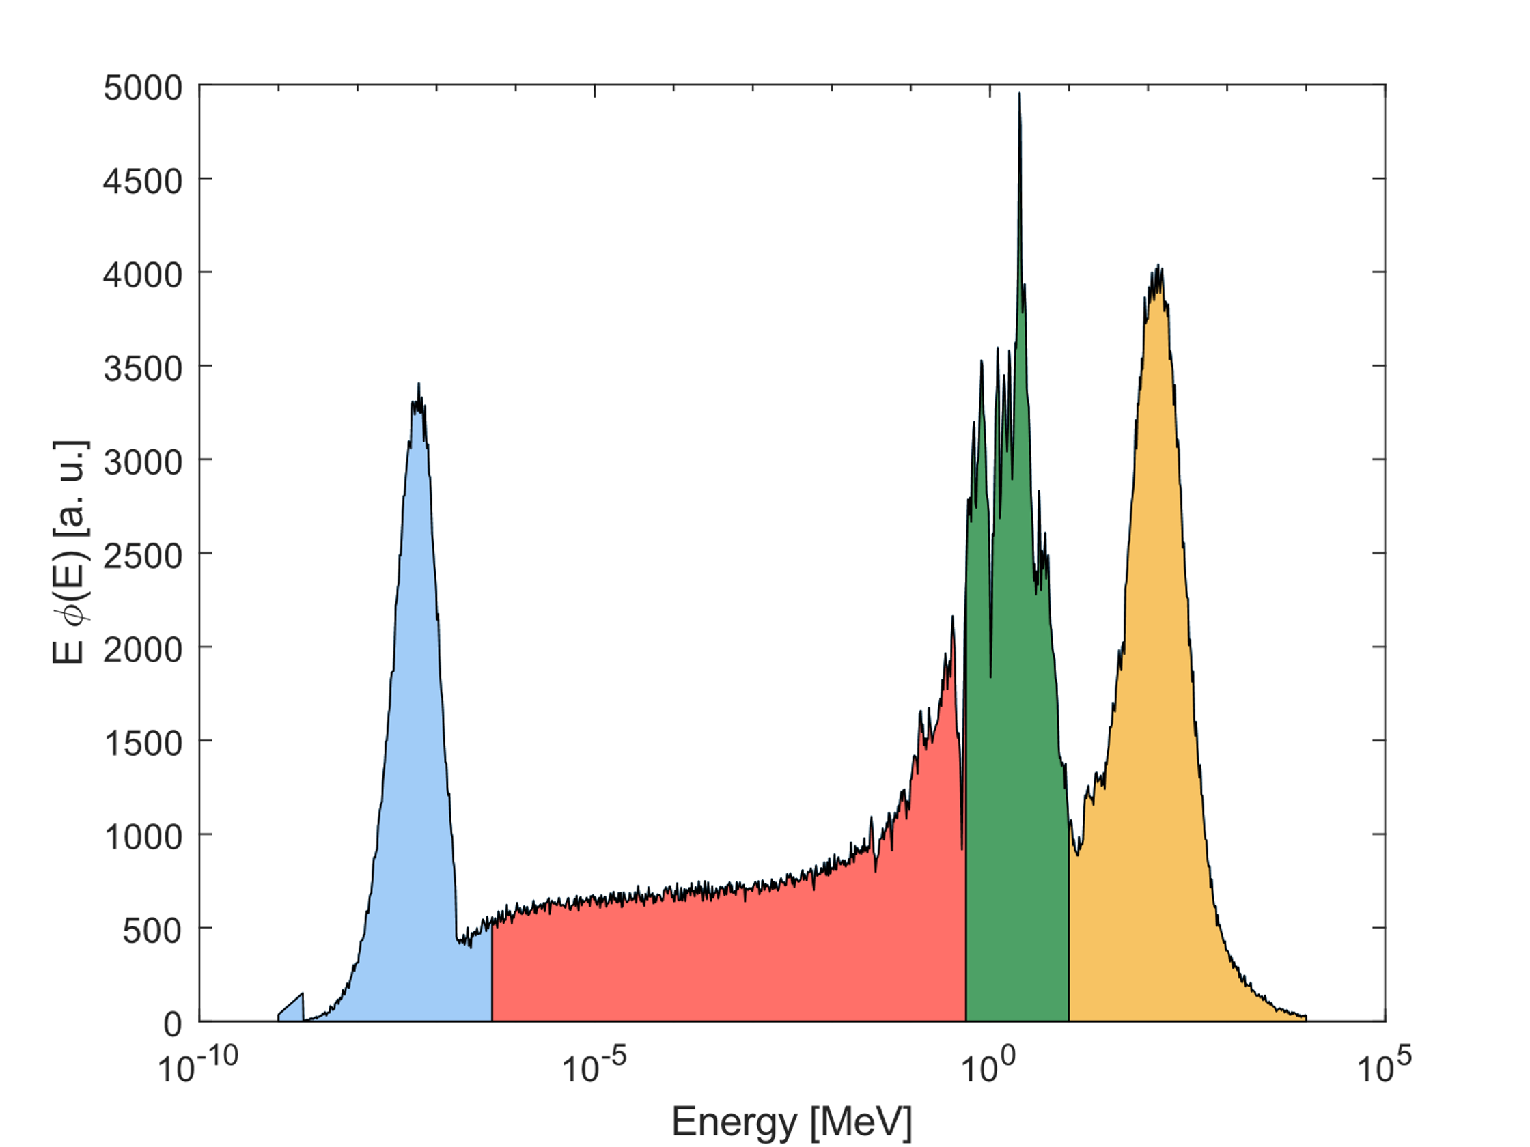
Cosmic Ray Neutrons
Earth is constantly irradiated by charged particles (mainly protons) coming from our galaxy. The interactions between these particles and the atmosphere generate a neutron field.
p
γ
Thermal
Epithermal
Fast
High Energy
N
n
μ
n
n
Soil
n
n
Soil

Slide 3
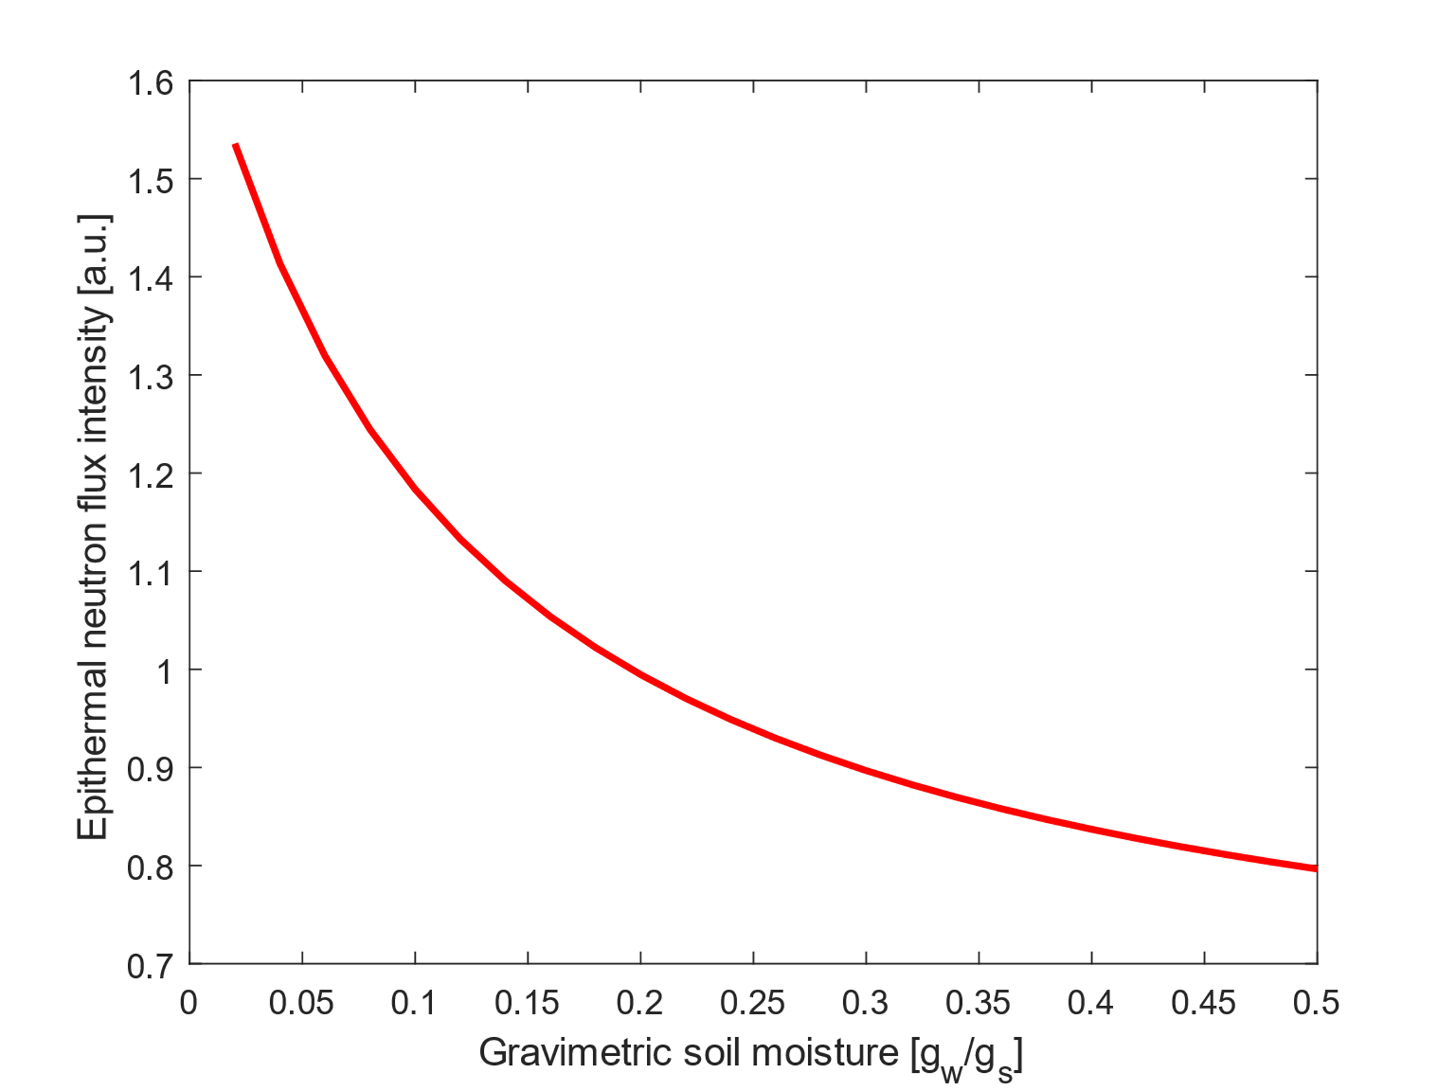
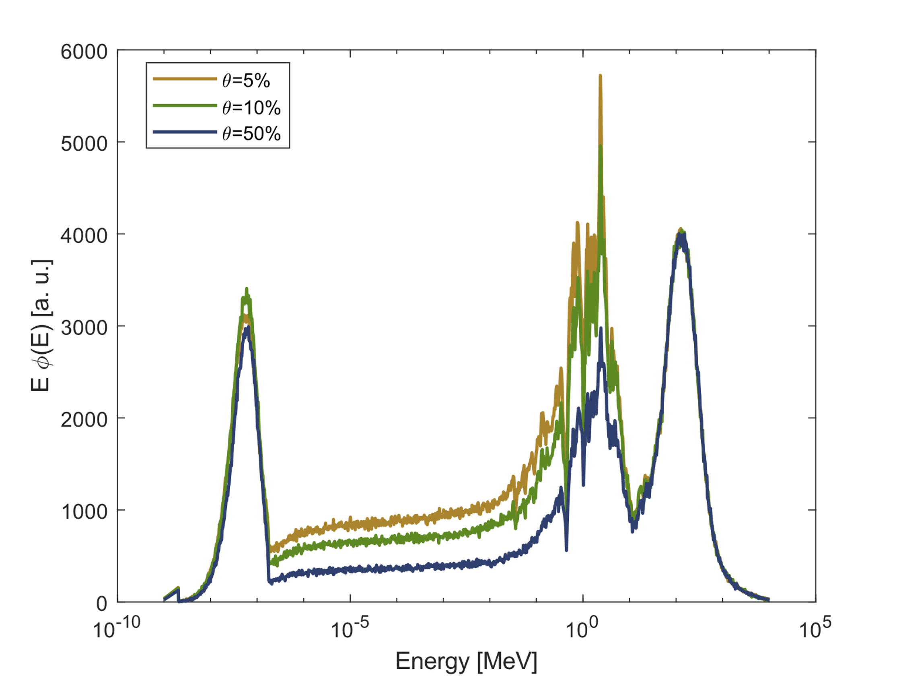
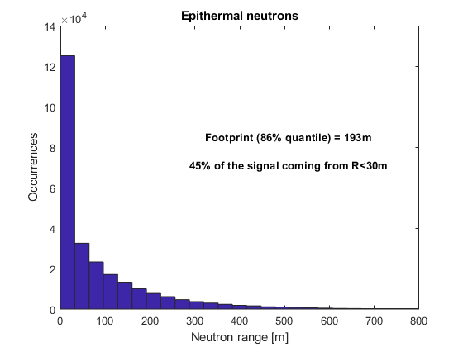
Cosmic Ray Neutron Sensing
Cosmic Ray Neutron Sensing
Changes in the water content in a field are assessed measuring the epithermal cosmic neutron flux.
An area of some hectares and depth of tens of centimeters are investigated.

Slide 4
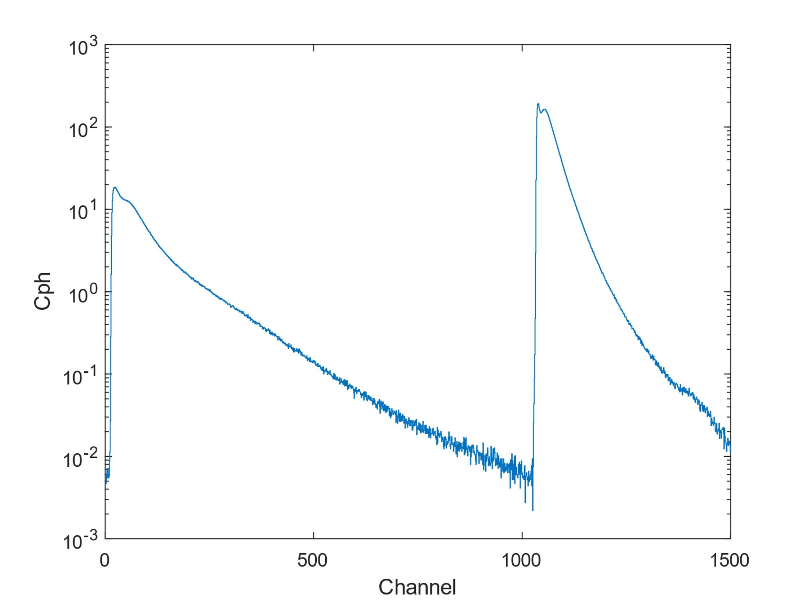
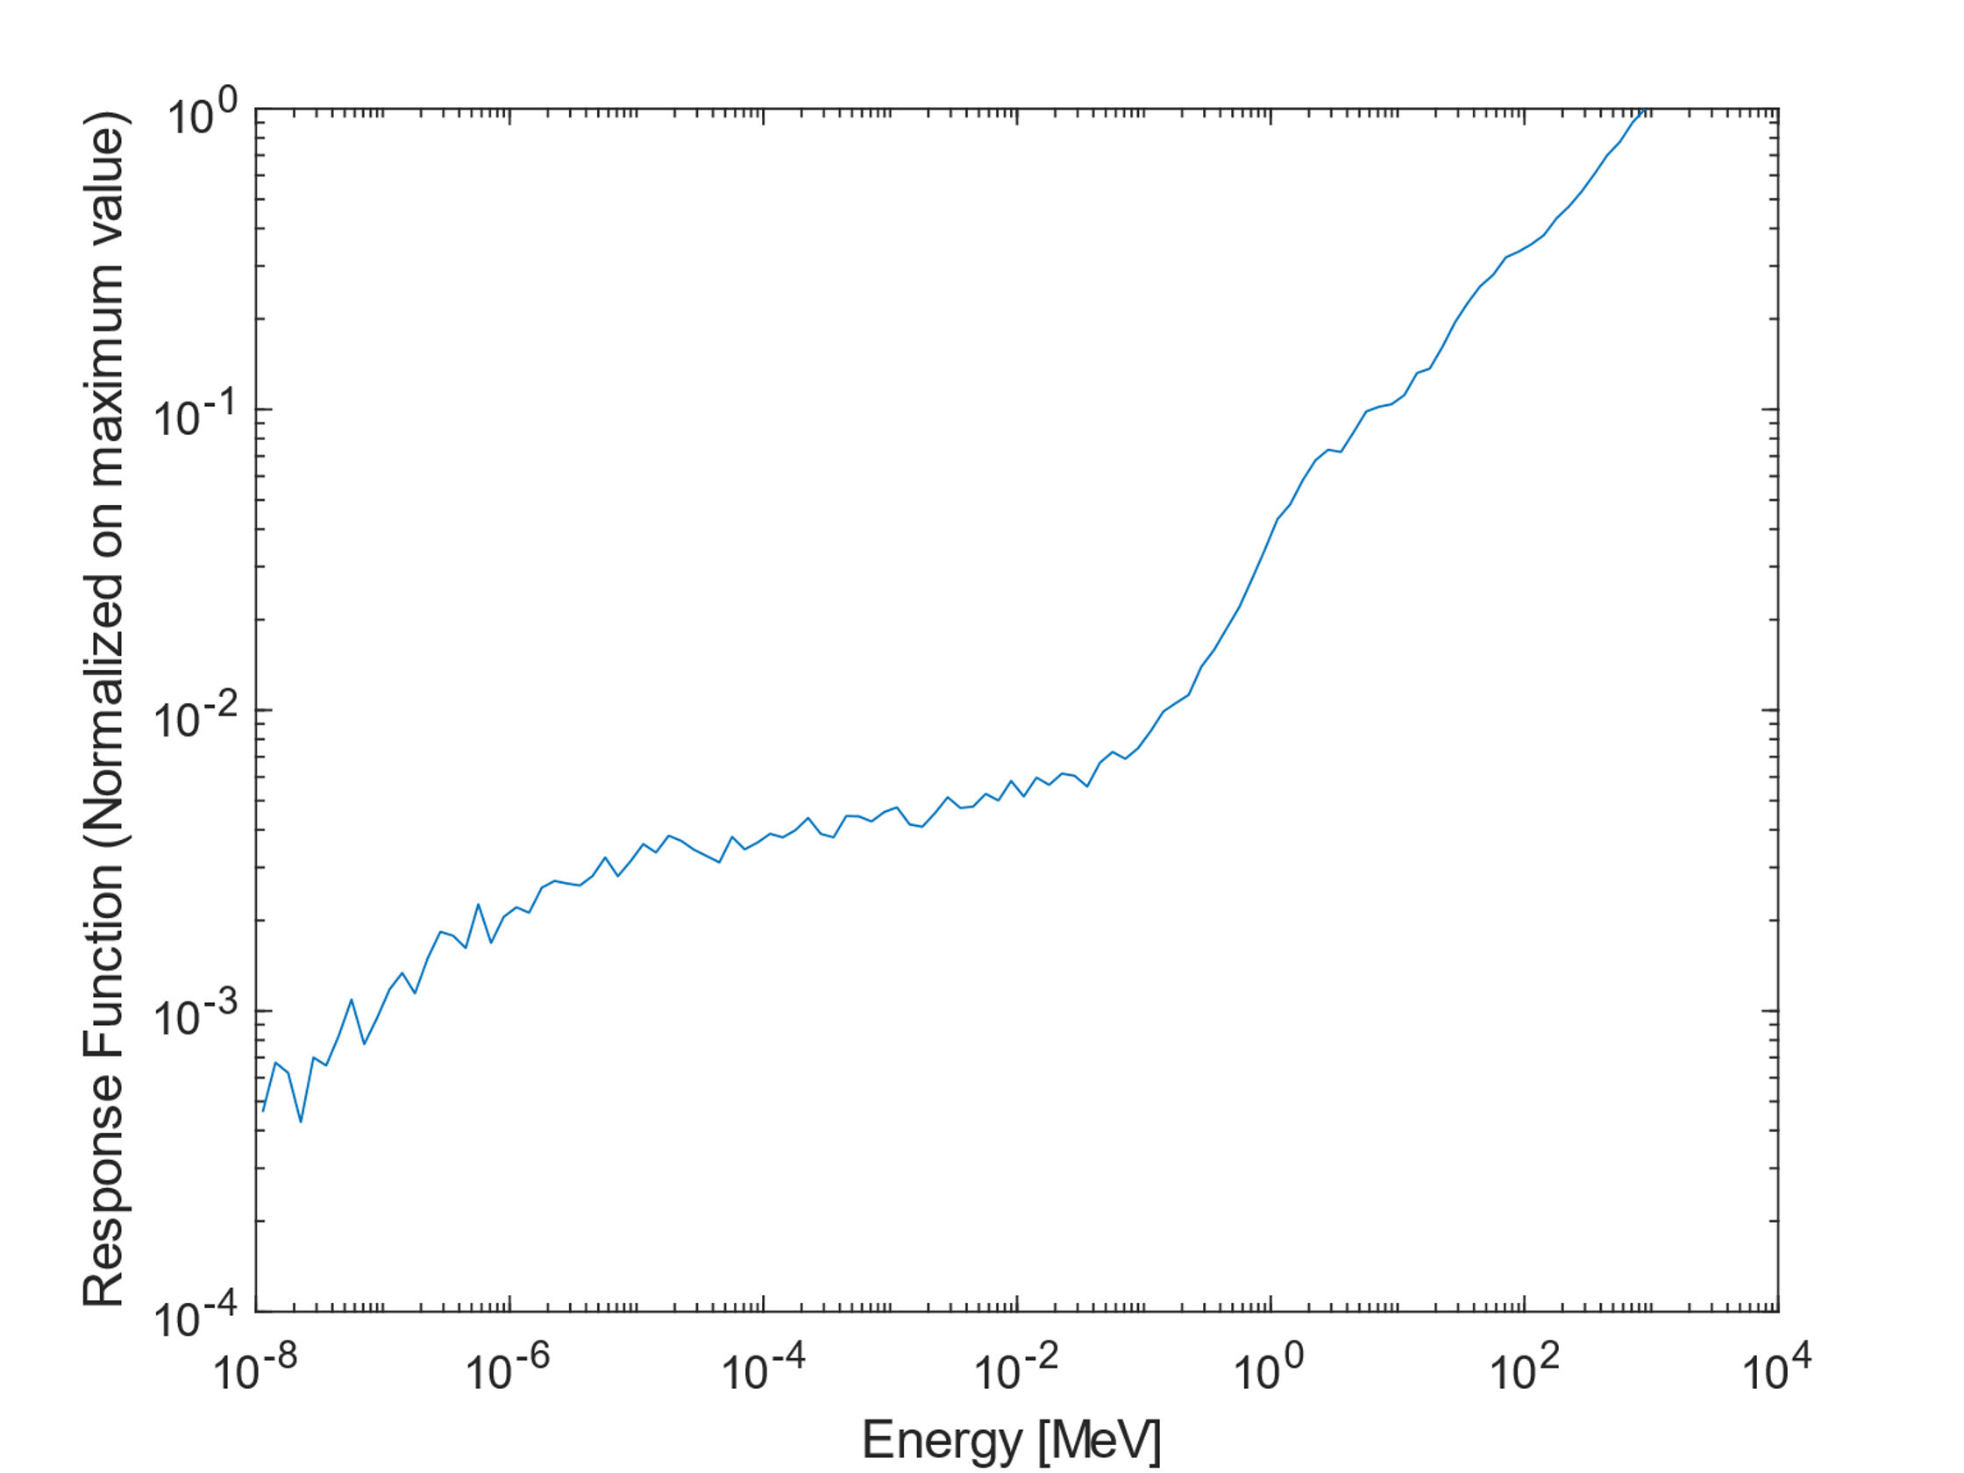
Bridgeport PMTN2k Detector
PMT
Acrylic Light Guide
¹⁰B + ZnS(Ag)
Simultaneous measurement of Cosmic Ray Neutrons and Muons
With proper moderating material (~300kg) sensitivity to high energy neutrons can be maximized
Neutrons
Muons

Slide 5
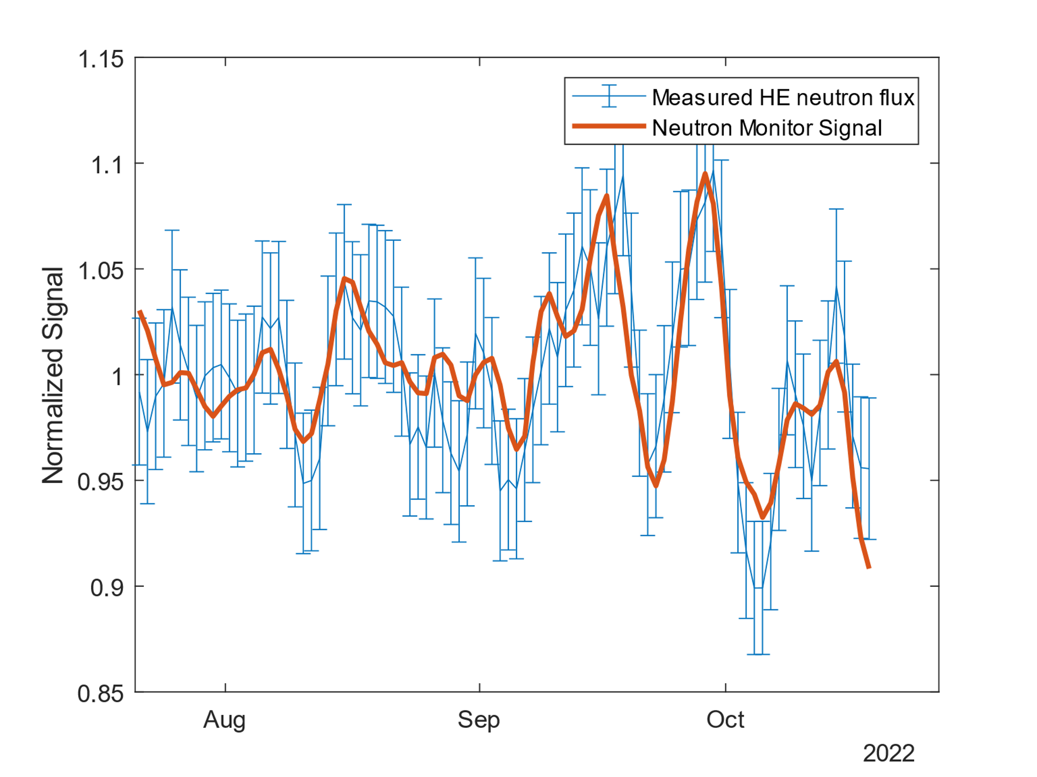
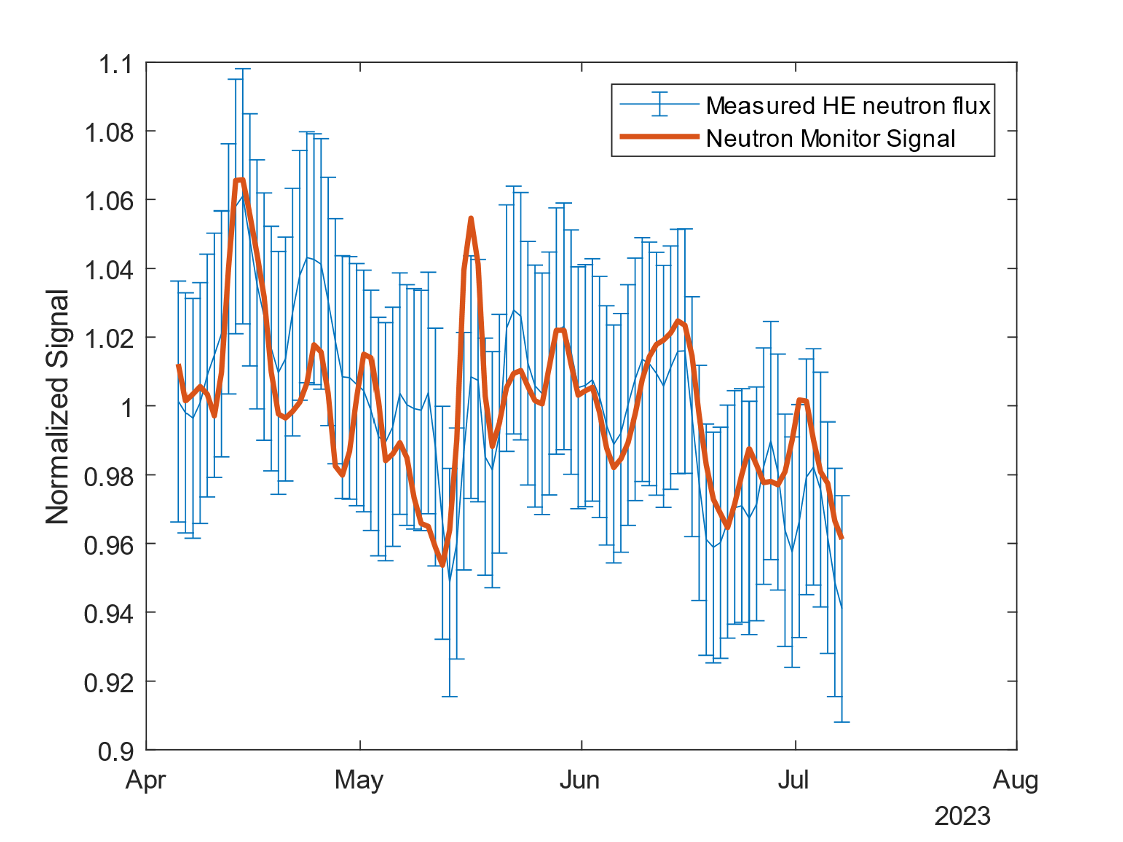
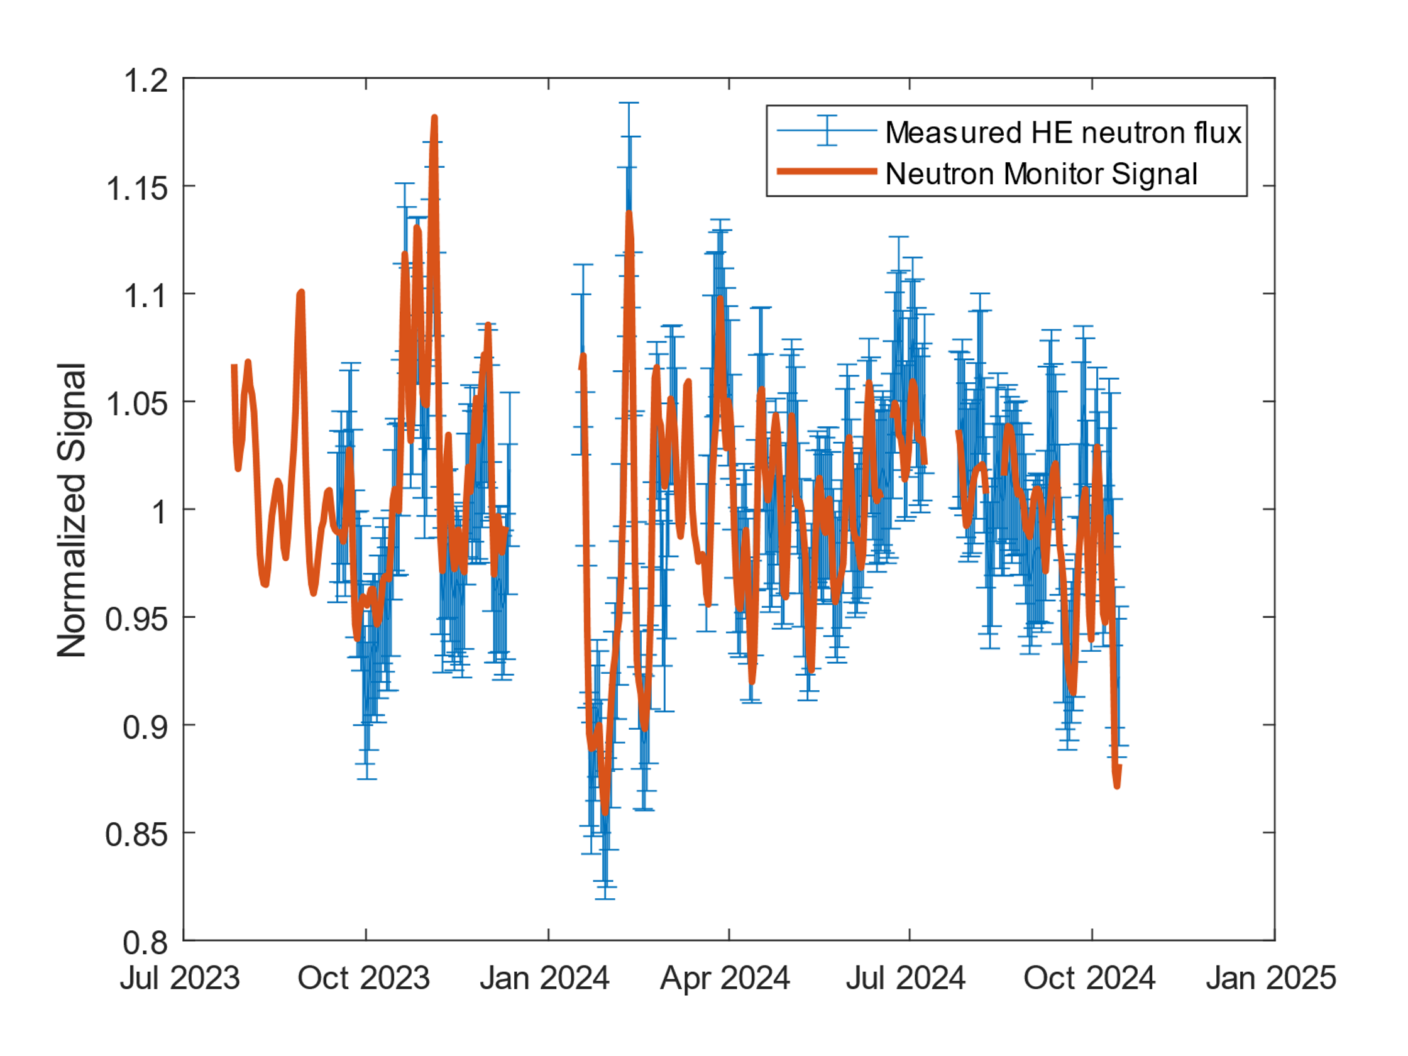
The W-PIE neutron spectrometer
Currently used for soil moisture measurements.
It measures the entire spectrum of high-energy neutrons.
Low counting rates with respect to a specific solution for high energy neutrons.
Output is a neutron flux (not just neutron counts)
Comparison with neutron monitors

