Slide 1
Introduction
Massimo Ferrario,
On behalf of the EuPRAXIA collaboration
VIII TDR Review Meeting – LNF - 25/11/2024

Slide 2
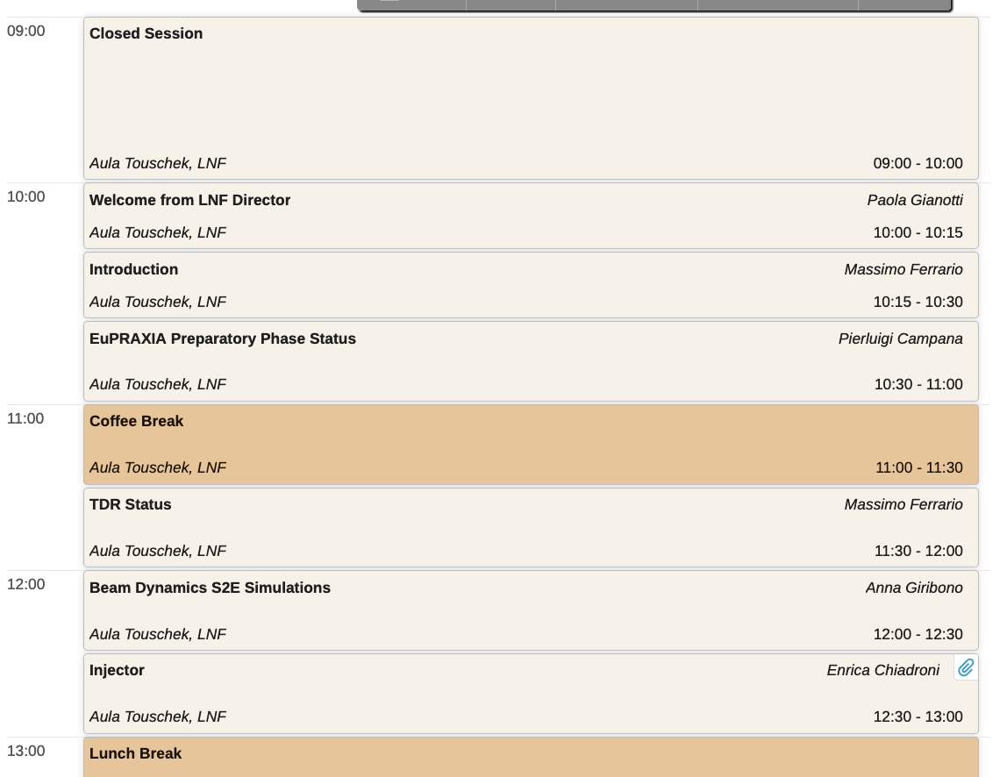
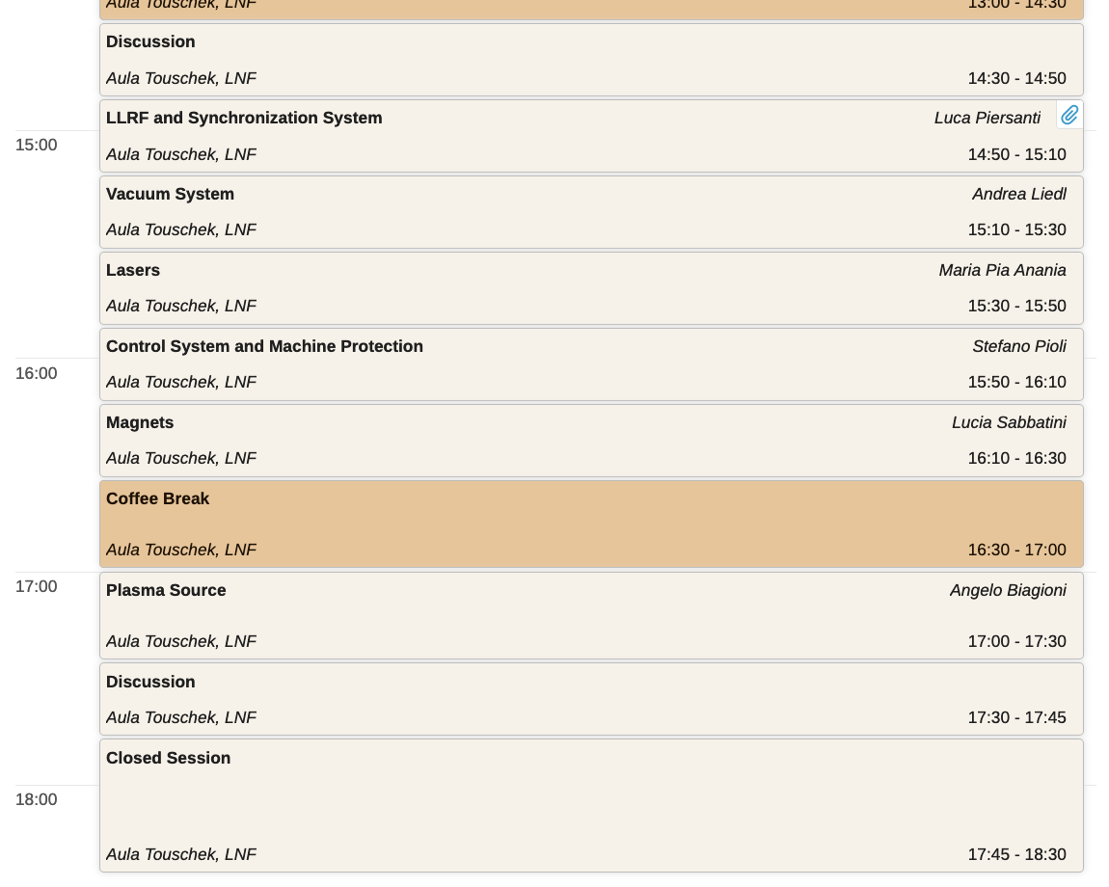
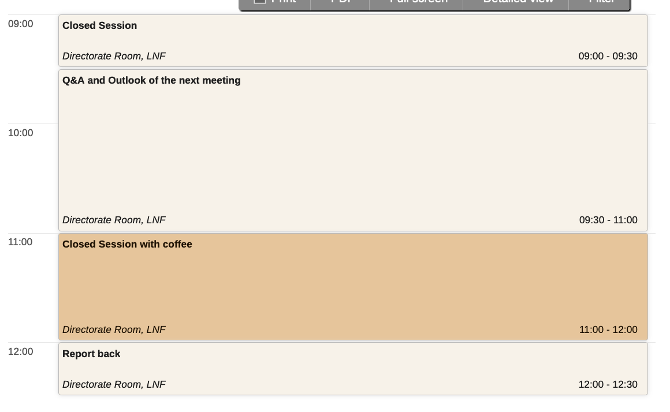
Agenda

Slide 3
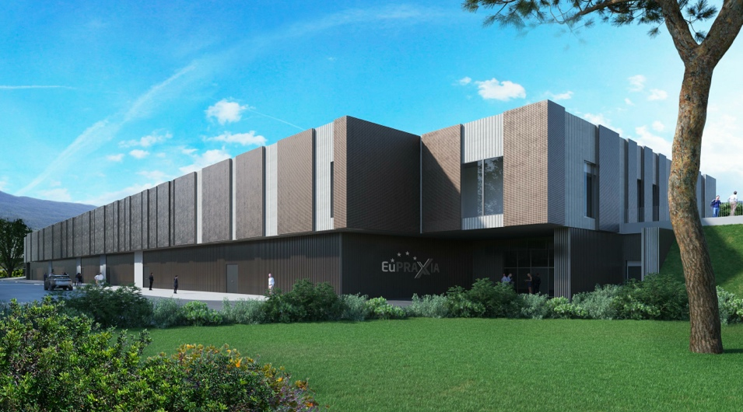
Building next steps
  Fire authorization received on April 2024
  Tender for Executive Project Verification:
  Provisional award on 06.21.2024
  Contract signature expected by the end of November 2024
  Completion of the executive design by the end of 2024
  The execution of the executive project verification should be completed by March 2025.
  Start of the tender procedure for the awarding of the works
  Construction site opening: September 2026

Slide 4
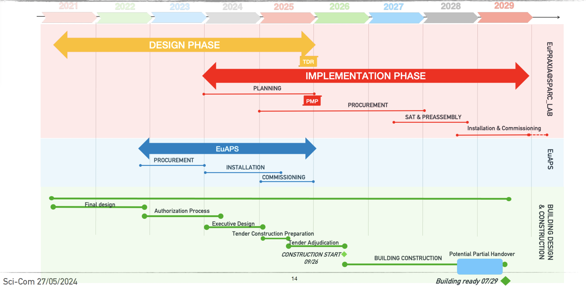
EuPRAXIA@SPARC_LAB baseline updating

Slide 5
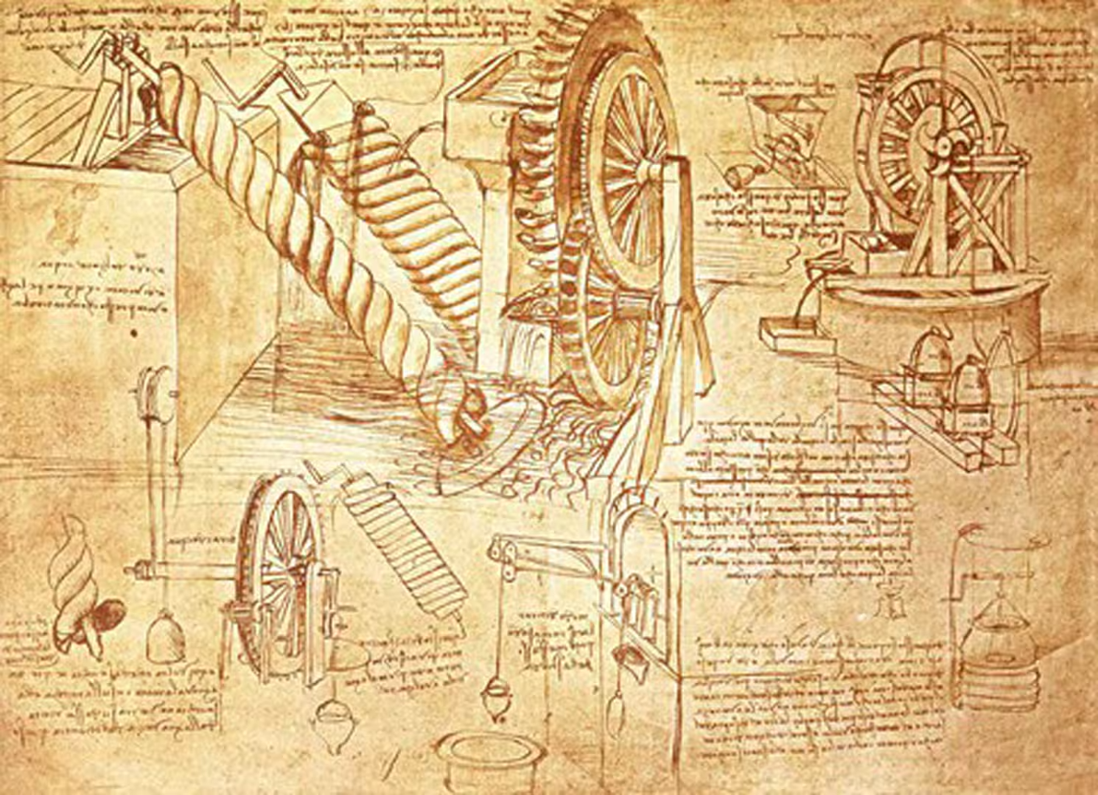
EuPRAXIA@SPARC_LAB TDR Status
Massimo Ferrario,
On behalf of the EuPRAXIA collaboration
VIII TDR Review Meeting – LNF - 25/11/2024

Slide 6


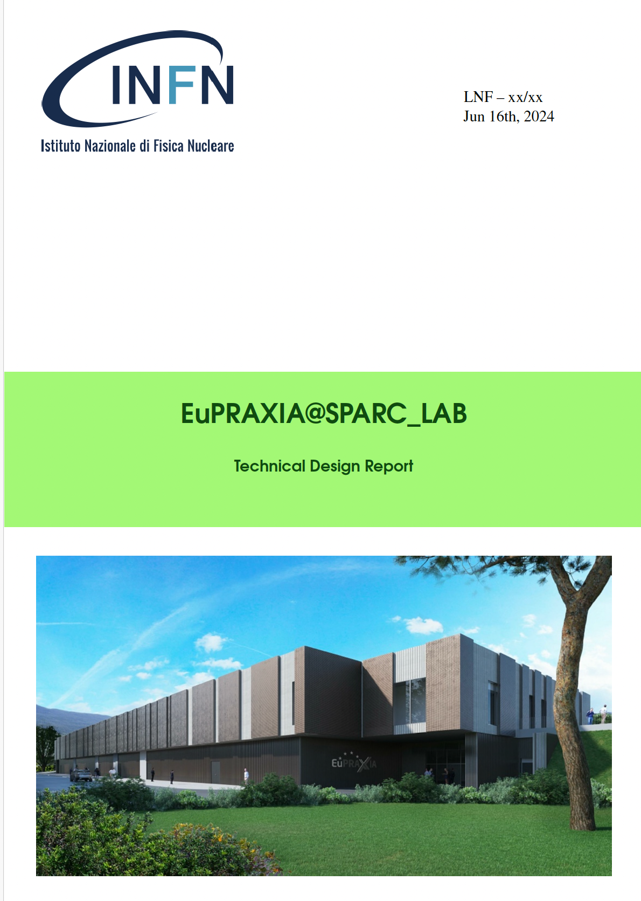
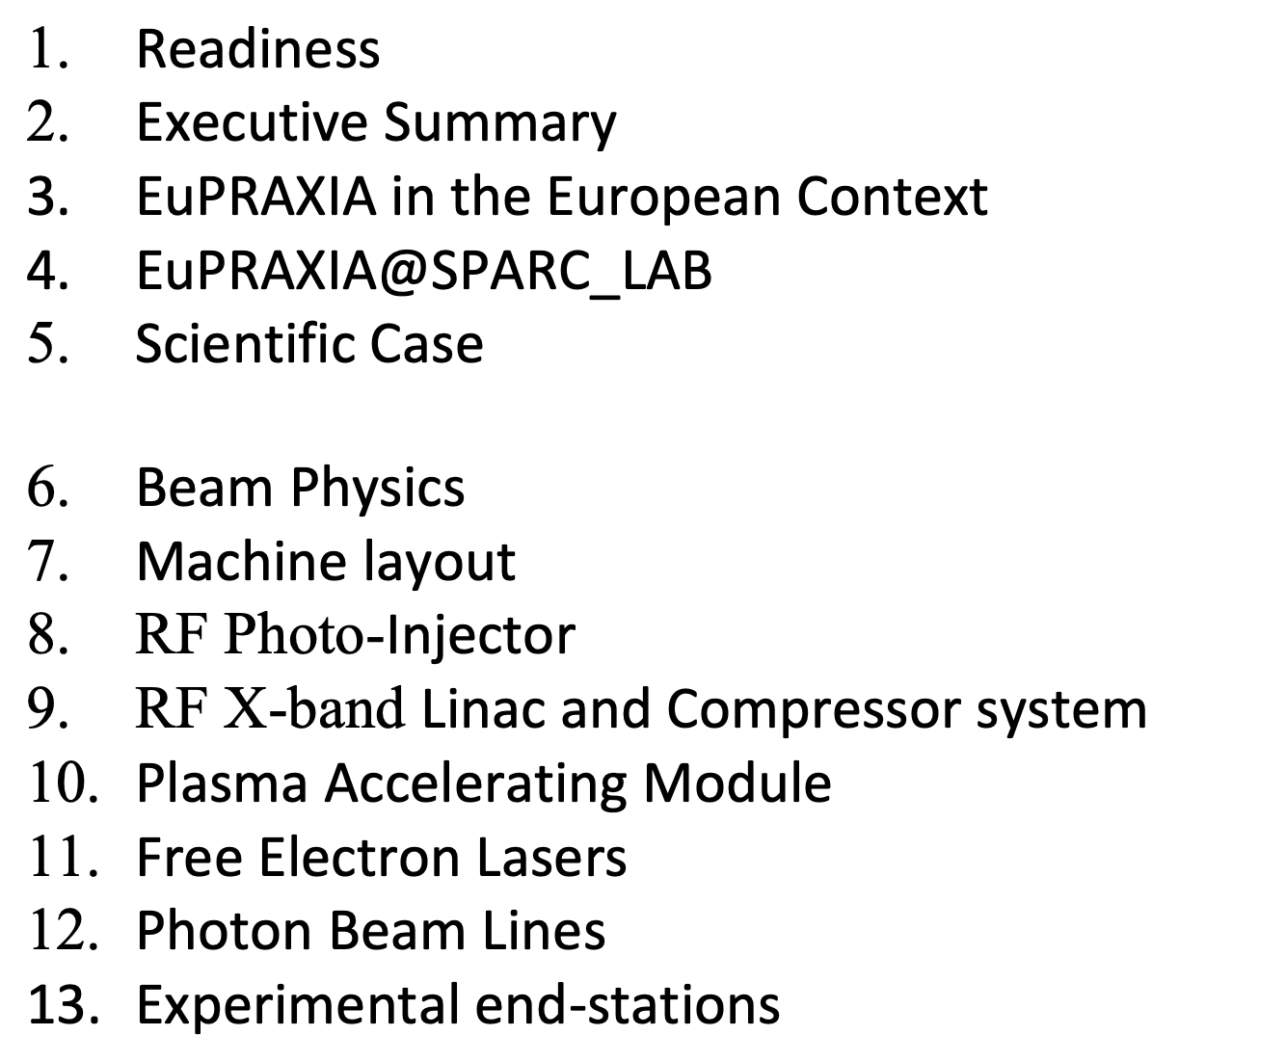
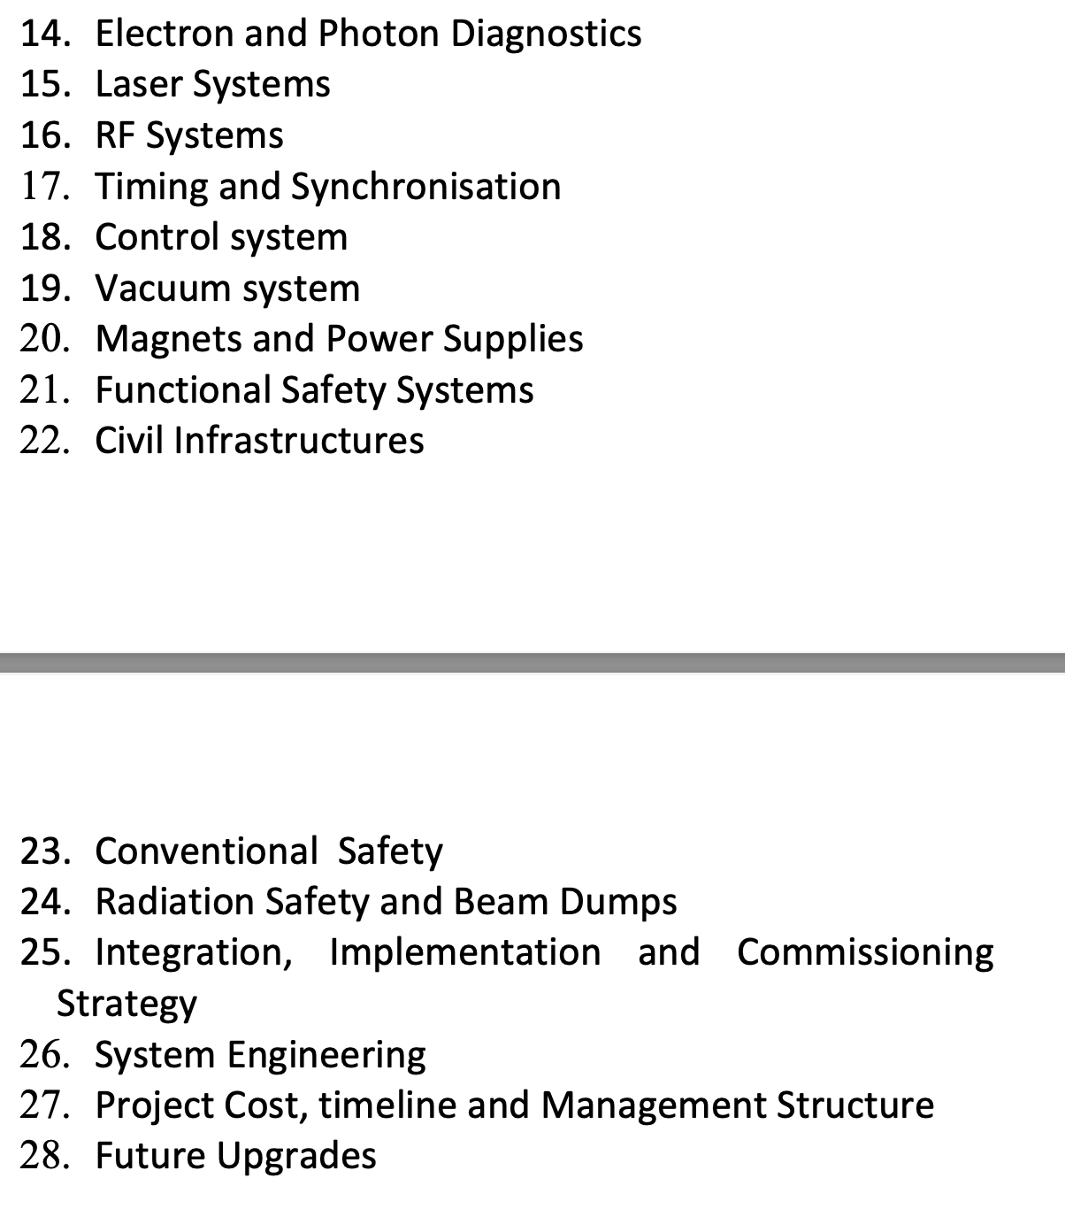
TDR Index
https://www.overleaf.com/6441975428vfsgmvpctmph#ebe5ff

Slide 7
TDR Writing Status [%]
Editorial Board
M. Ferrario
A. Gallo
A. Giribono
R. Pompili
F. Villa
X band linac | Civil infrastructures | Timing and synchronization | Free Electron Lasers | Plasma acc. module | Ele. and phot. diagnostics | Functionality saf. systems | Exp. end-stations | Laser systems | Control system | Photo-injector | Photon beamlines | System engineering | P. cost, time., management | Beam physics | EuPRAXIA in EU context | Scientific case | Machine layout | Magnets and power supp. | Int., impl., comm. strategy | Vacuum systems | Rad. saf. and beam dumps | Executive summary | EuPRAXIA@SPARC_LAB | RF systems | Conventional safety | Future upgrades
85 | 85 | 80 | 65 | 60 | 60 | 45 | 40 | 30 | 30 | 25 | 16 | 15 | 15 | 11 | 10 | 10 | 10 | 7 | 7 | 5 | 5 | 0 | 0 | 0 | 0 | 0
80 | 5 | 80 | 30 | 60 | 45 | 45 | 15 | 30 | 30 | 20 | 15 | 7 | 7 | 10 | 10 | 5 | 10 | 7 | 7 | 5 | 5 | 0 | 0 | 0 | 0 | 0
5 | 80 |  | 35 |  | 15 |  | 25 |  |  | 5 | 1 | 8 | 8 | 1 |  | 5
November 2024
June 2024
Progress
Warning: Writing status does not reflects the effective Project Design Advancement
Complete draft: April 2025 => Final version: October 2025 => INFN Approval: end 2025

Slide 8
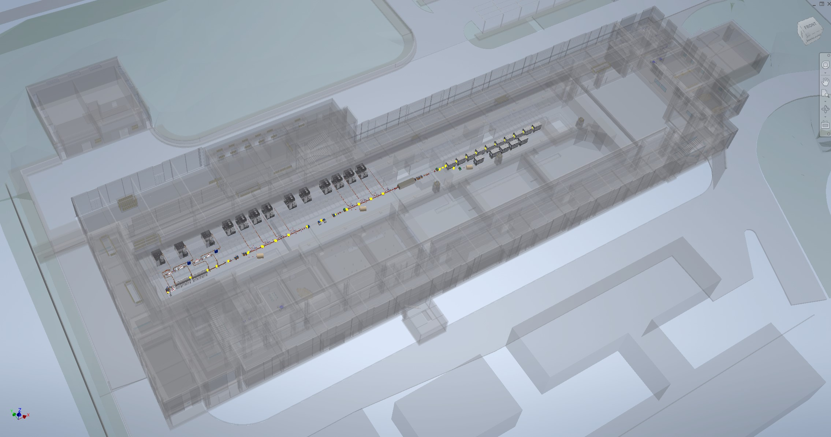
Machine Layout

Slide 9
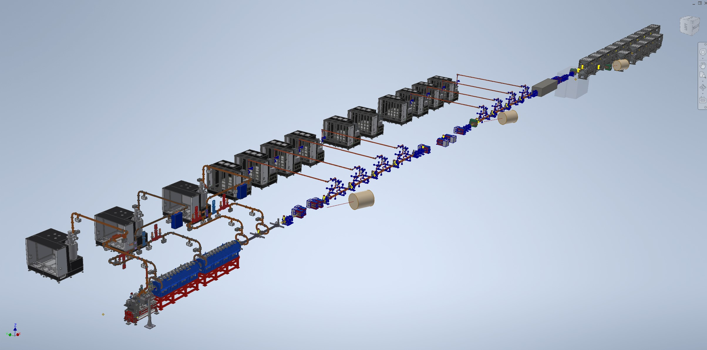
All Component included

Slide 10
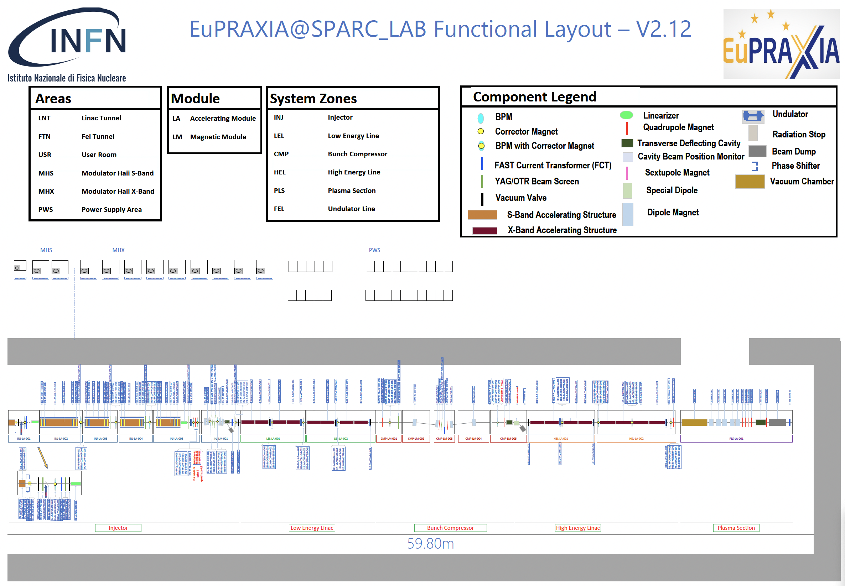
The RC noticed that communication between WP leaders needs substantial improvement.

Slide 11
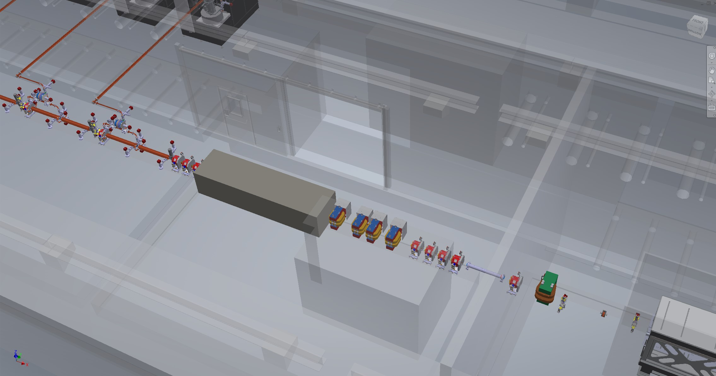
Driver/Witness Separator (Chicane)

Slide 12
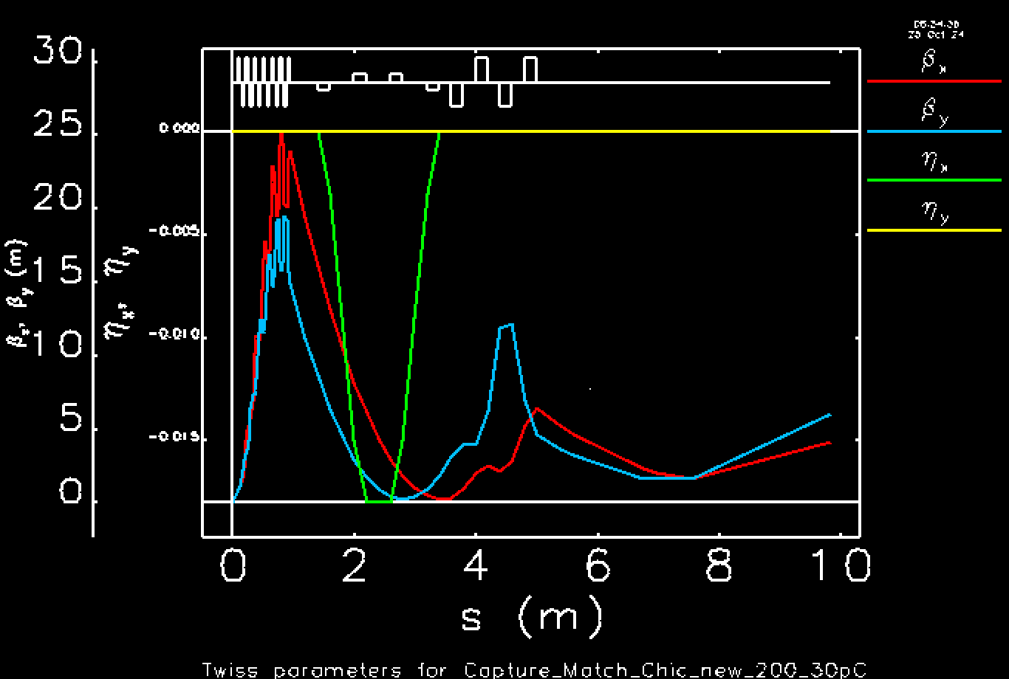
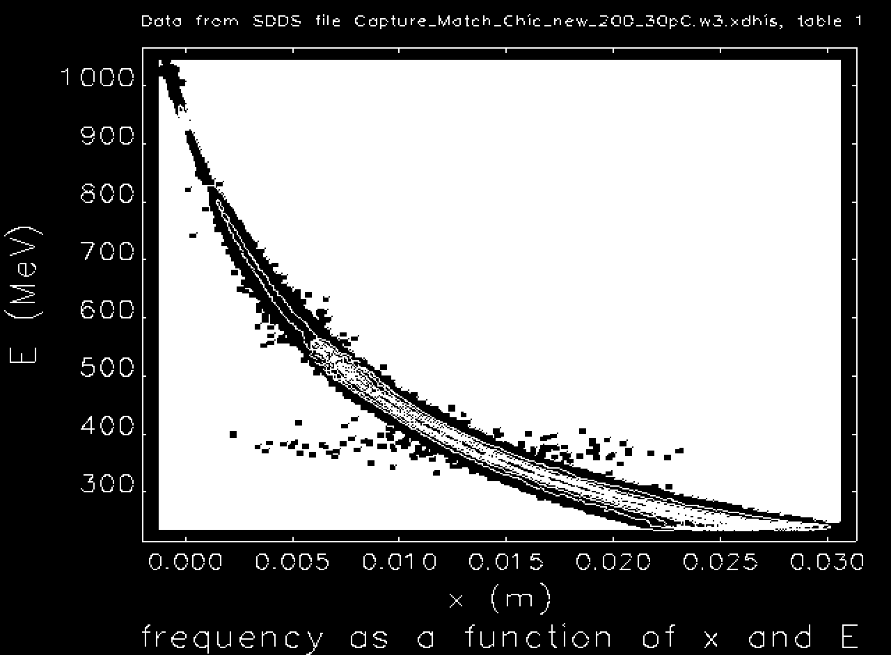
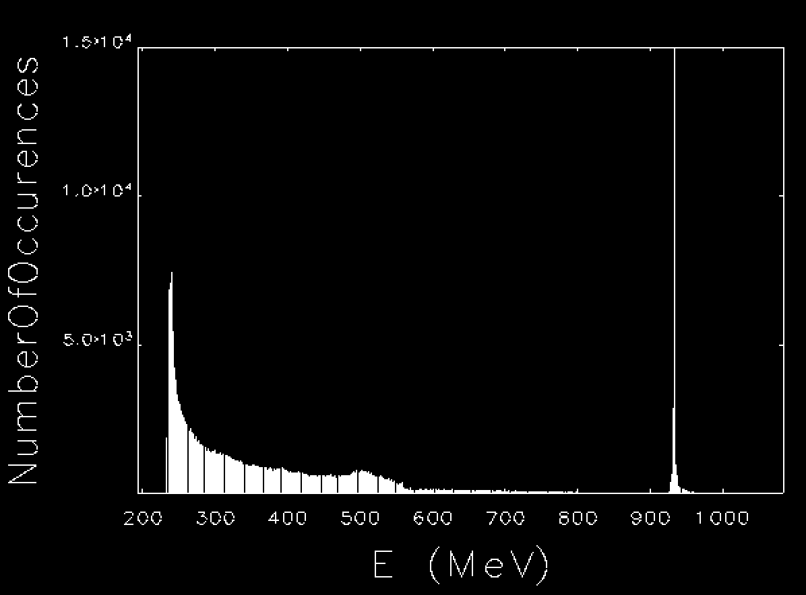
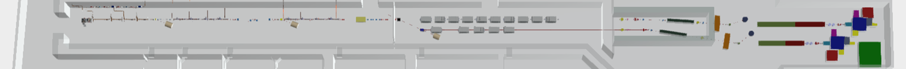
Driver Witness Separation in the final Extraction Chicane
Courtesy C. Vaccarezza and the BD team

Slide 13
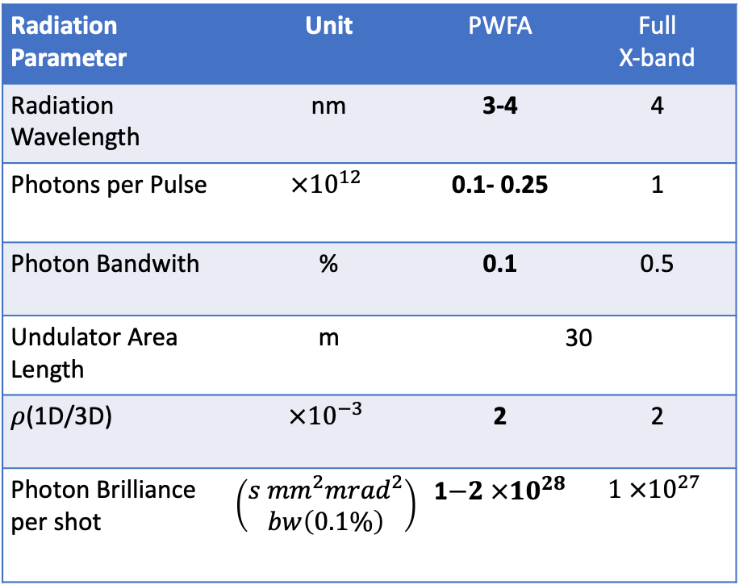
Goal parameters and design criteria (100 Hz)
The RC strongly recommends that the preparation of the list of the machine parameters is given priority as it is fundamental for the coherent preparation of the TDR.
Radiation Parameter | Unit | PWFA | Full X-band
Radiation Wavelength | nm | 3-4 | 4
Photons per Pulse | $$×{10}^{12}$$ | 0.1- 0.25 | 1
Photon Bandwith | % | 0.1 | 0.5
Undulator Area Length | m | 30 | 30
𝜌(1D/3D) | $$×{10}^{−3}$$ | 2 | 2
Photon Brilliance per shot | $$\left(\begin{aligned}s {mm}^{2}{mrad}^{2} \\ bw\left(0.1\%\right)\end{aligned}\right)$$ | 1$−2 ×{10}^{28}$ | $$1 ×{10}^{27}$$
Electron Beam Parameter | Unit | PWFA | Full X-band
Electron Energy | GeV | 1-1.2 | 1
Bunch Charge | pC | 30-50 | 200-500
Peak Current | kA | 1-2 | 1-2
RMS Energy Spread | % | 0.1 | 0.1
RMS Bunch Length | 𝜇m | 6-3 | 24-20
RMS norm. Emittance | 𝜇m | 1 | 1
Slice Energy Spread | % | ≤0.05 | ≤0.05
Slice norm Emittance | mm-mrad | 0.5 | 0.5
Energy jitter | % | ≤0.05 | ≤0.05
Driver-Witness Temporal jitter | fs | < 5 | -

Slide 14
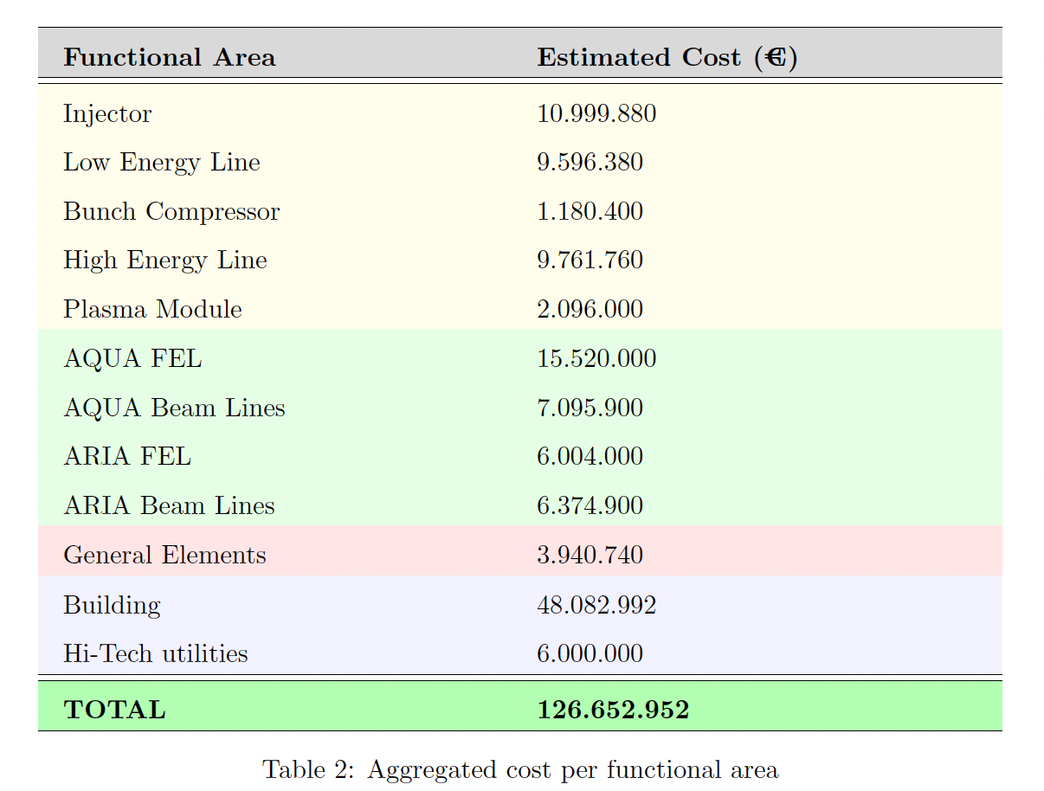
The TDR shall include a chapter on risk management that covers the risks, the eventual mitigating measures, and their associated cost.
The TDR shall include a chapter on environmental sustainability.

Slide 15
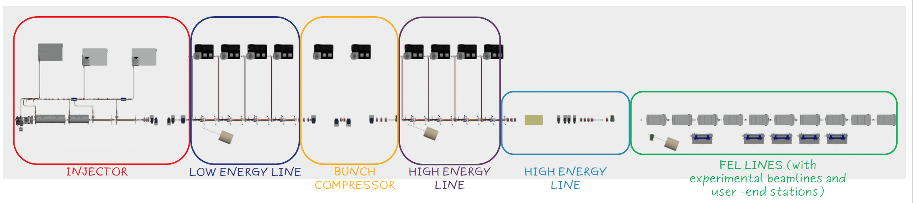
RF/Plasma - Cost Comparison
600 MeV (RF)
+500 MeV
(RF)
Assuming we have an RF injection system up to 600 MeV,
compare an upgrade of +500 MeV with:
X-ban RF structures only
Plasmamodule only
+500 MeV
(Plasma)

Slide 16
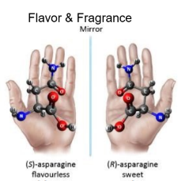
ARIA beamline scientific case
Not included in the TDR
Gas phase & Atmosphere
(Earth & Planets)
Aerosols
(Pollution, nanoparticles)
Molecules & gases
(spectroscopies, time-of-flight)
Proteins
(spectroscopies)
Surfaces
(ablation & deposition)
Photoemission
Spectroscopy
Photoelectron Circular
Dichroism
Raman spectroscopy
Photo-fragmentation of molecules
Time of Flight Spectroscopy
During the last weeks negotiations with local government (Reg.Lazio) have been intensified and we are close to finalize an agreement for an additional 10 M€ funding for the second beam line (ARIA).
This is a co-funding (10M€ Reg.Lazio + 10M€ INFN).
This is exclusively for an additional beam line (thus cannot be used for the original baseline) and has some constraints in terms of financial accounting.
The second beamline must be completed in 2029 (although is not mandatory to have it fully operational).
Courtesy F. Stellato

Slide 17
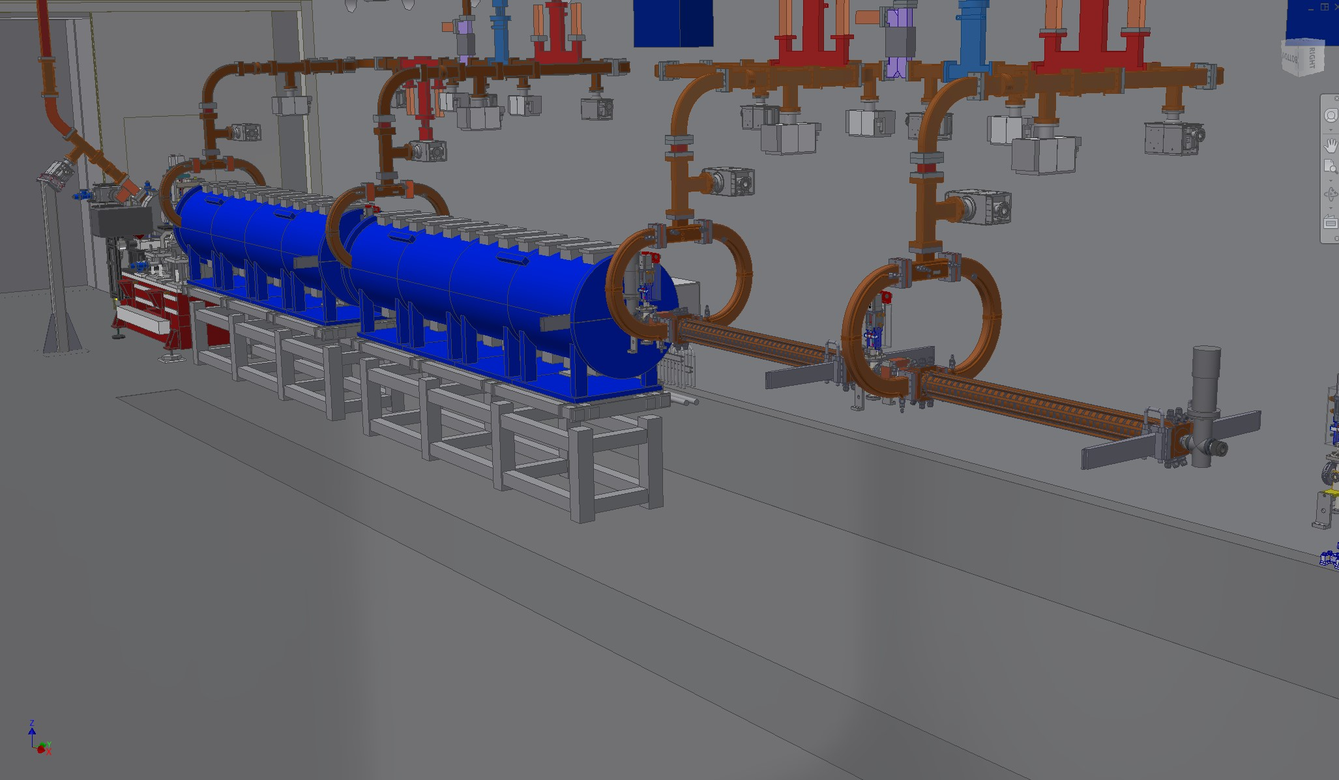
Injector

Slide 18
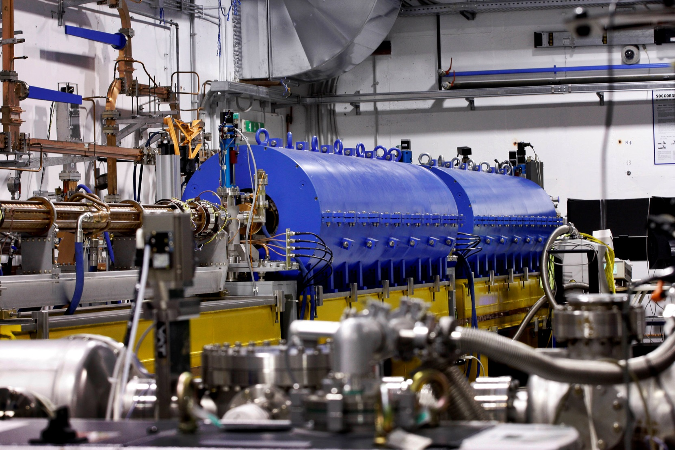
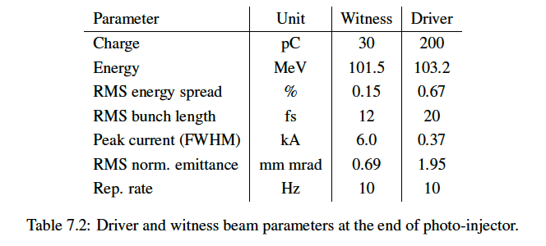
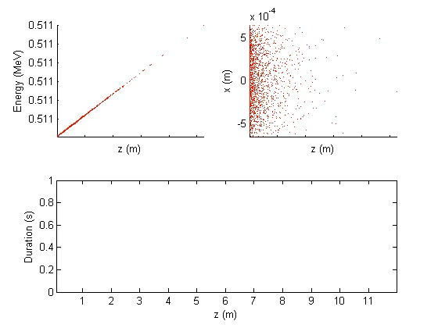
Injector test at SPARC_LAB planned (2025)
10 m
Courtesy E. Chiadroni

Slide 19
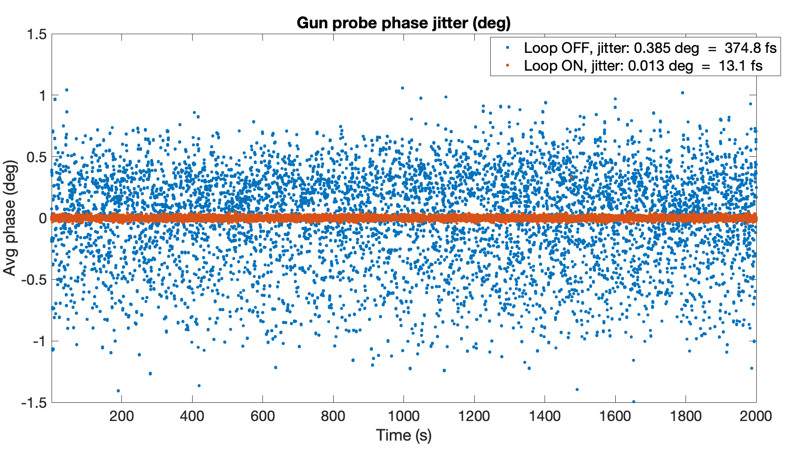
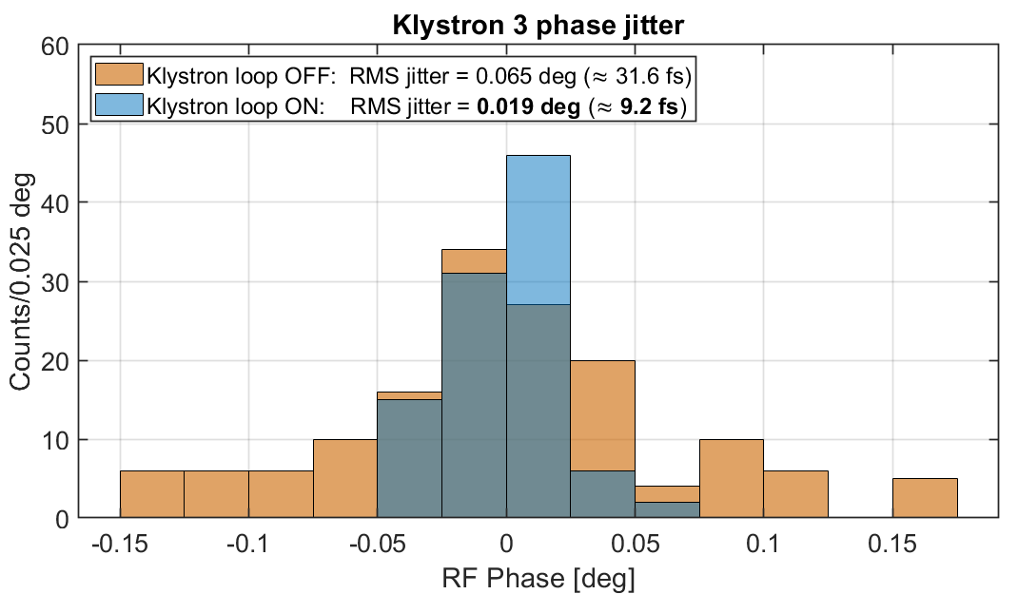
Preliminary results obtained at SPARC_LAB
In May 2023 we tested a preliminary version of the intra-pulse feedback on the C-band klystron with very good results
Preliminary data have been parasitically collected during machine restart in October 2024 for the S-band power plants
TO DO:
The performance achieved on both S and C band power plants are very promising but must be still optimized and consolidated:
  Reach the same stability of K1 also on K2
  Further optimize the intra-pulse feedback system (Xianghe Fang Ph.D. student from Eupraxia DN just started his activity with the RF group on this topic)
PC-laser locking electronics performance can be improved
Test of the intra-pulse feedback system on the X-band power plant at TEX
S-BAND
C-BAND
RF-Gun phase jitter compression
from 0.385 deg down to 0.013 deg (13.1 fs)
K3 phase jitter compression
from 0.065 deg down to 0.019 deg (9.2 fs)
.
.
PRELIMINARY
L. Piersanti et al. Photonics 2024, 11(5), 413

Slide 20
Thanks

Slide 21
