Slide 1
Plasma accelerating module
TDR Review committee
25-26 November 2024
Biagioni,
on behalf of the EuPRAXIA collaboration

Slide 2
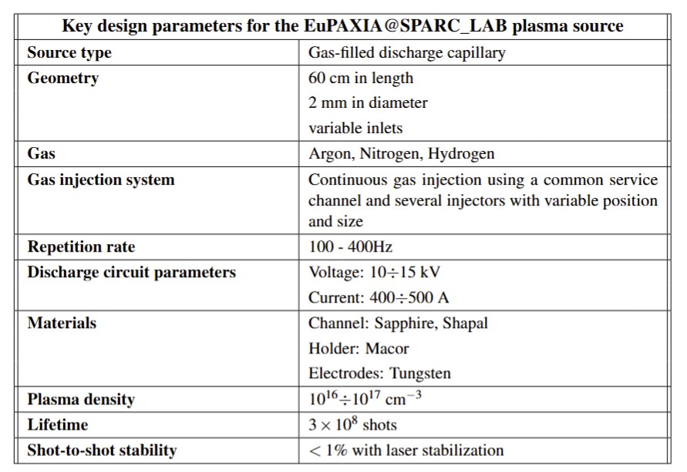
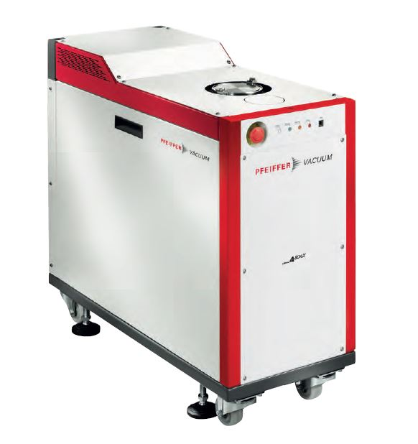
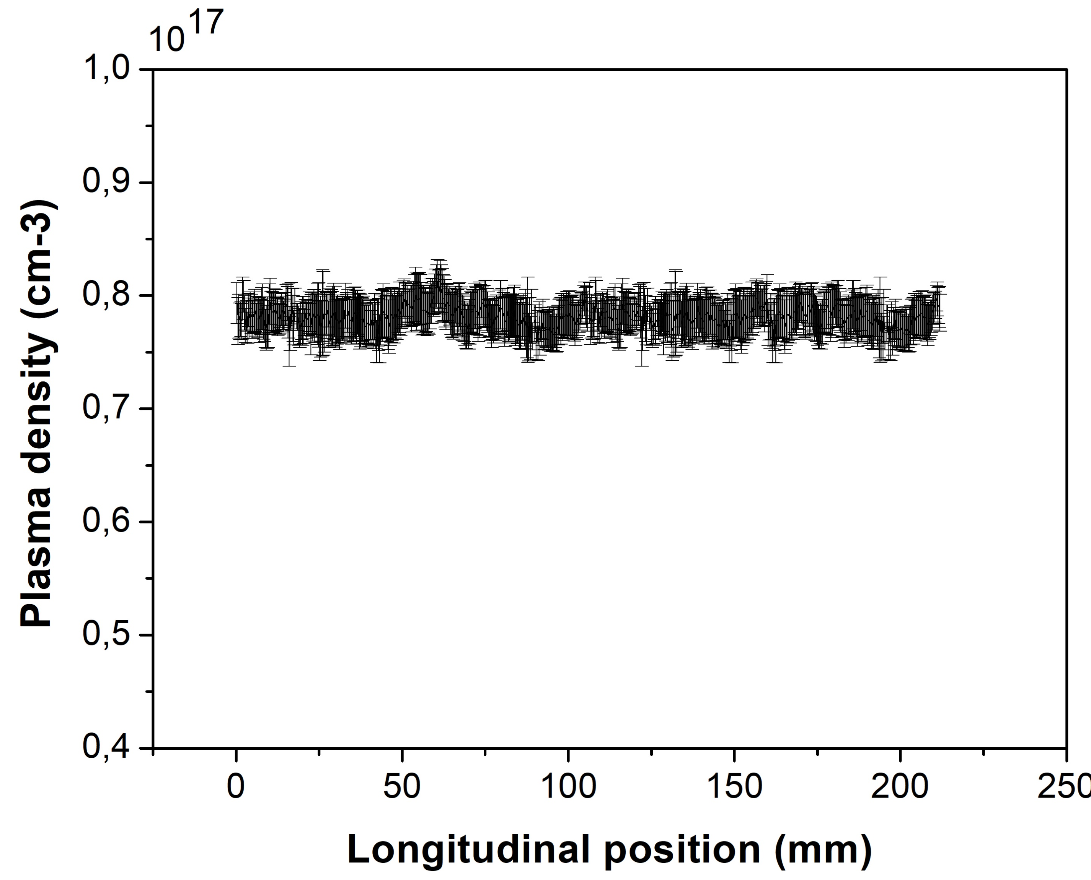
Plasma accelerating module – Key parameters

Slide 3
Plasma accelerating module – Key parameters

Slide 4
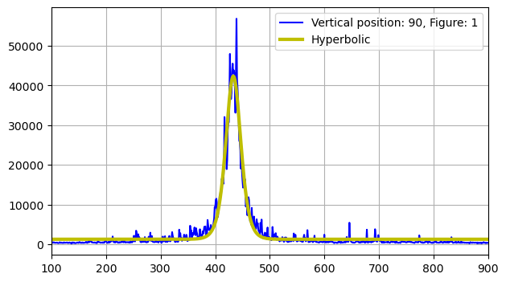
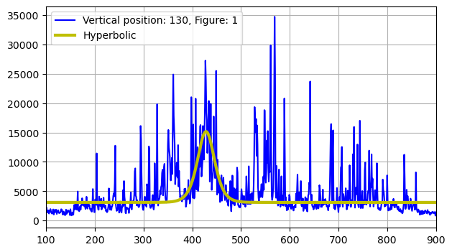
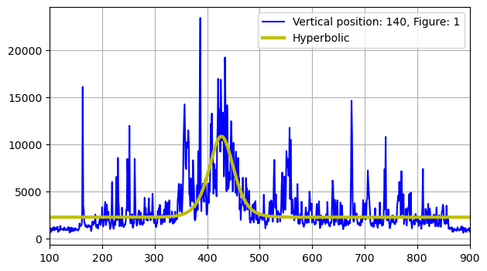
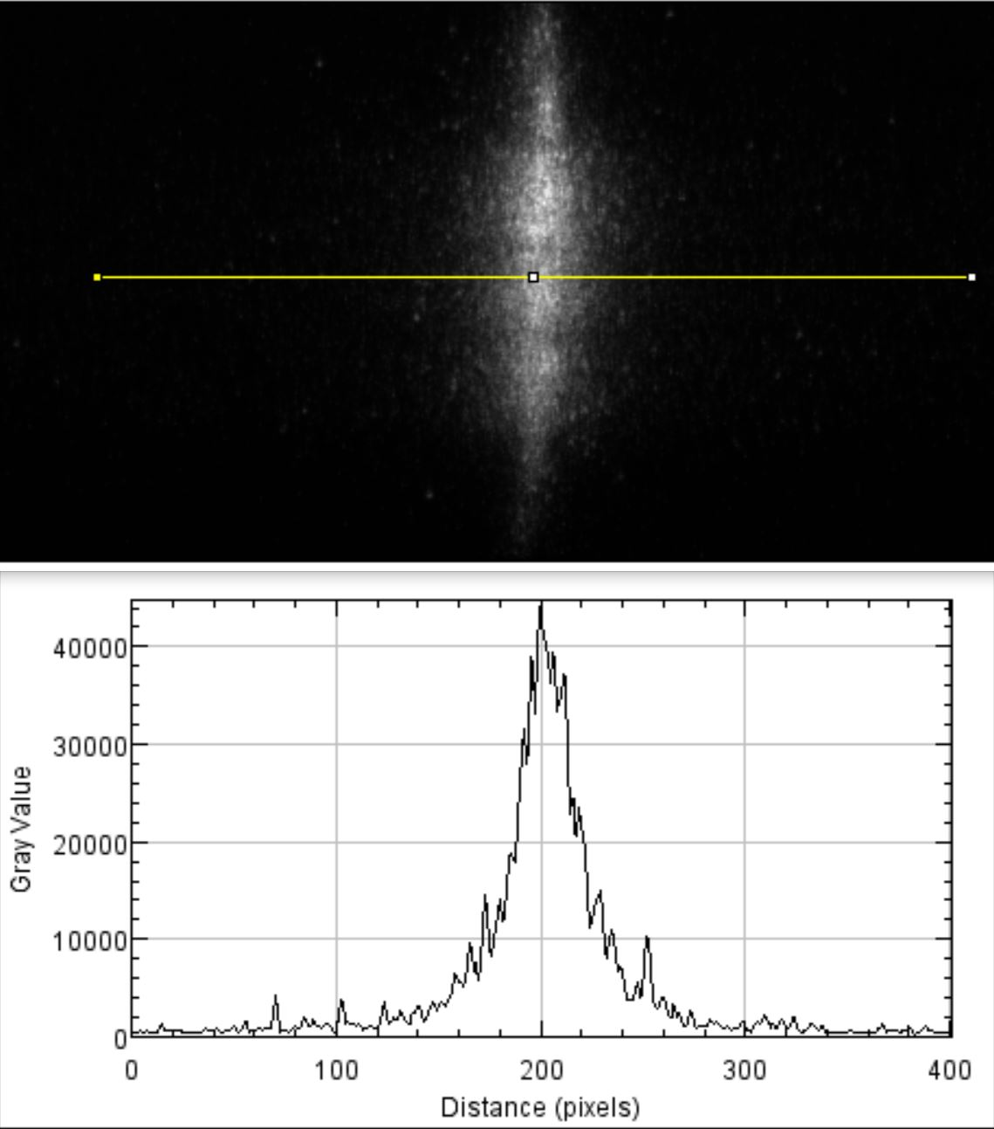
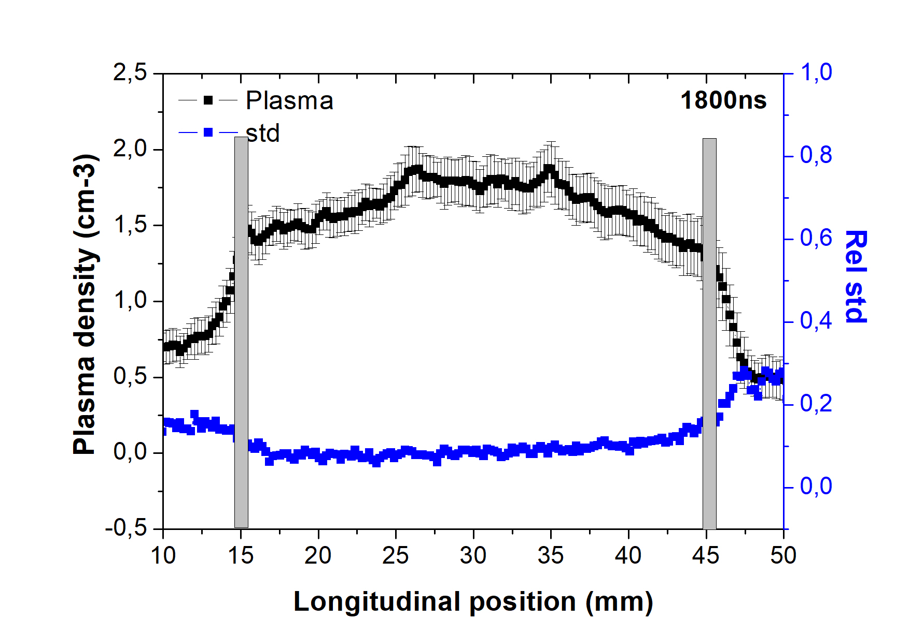
Plasma accelerating module – Stability analysis
averaged
Single shot 1500
Single shot 2500
superimposed noise causes a change in the fit curve and, in turn, an increasing of the error bars
to estimate the correct error bars, an average is taken over several images

Slide 5
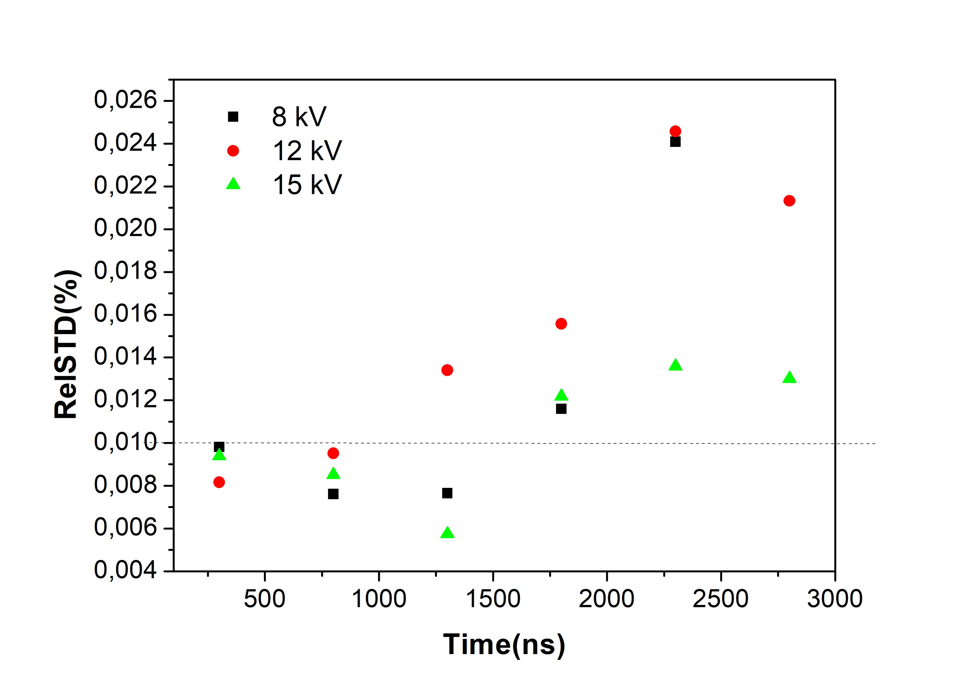
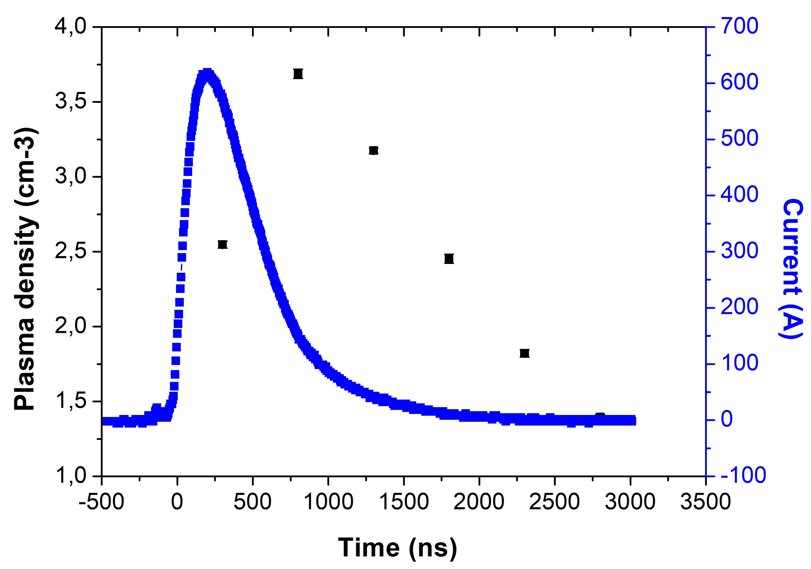
Plasma accelerating module – Stability analysis
10¹⁶
15 kV
During recombination, due to the worsening of the SNR, there is an increase of the instability
In the work delays, after discharge, error bars remains less than 1%

Slide 6
Plasma accelerating module – Plasma ramps control
The geometry allows the longitudinal plasma distribution to be controlled
In particular, internal ramps are an important tool for optimising the match between the input beam and plasma density.
10 injectors of constant diameter and progressively closer together
10 injectors progressively closer together and having progressively increasing diameters
20%
60cm
A. Biagioni | TDR Review committee 25-26 November 2024

Slide 7
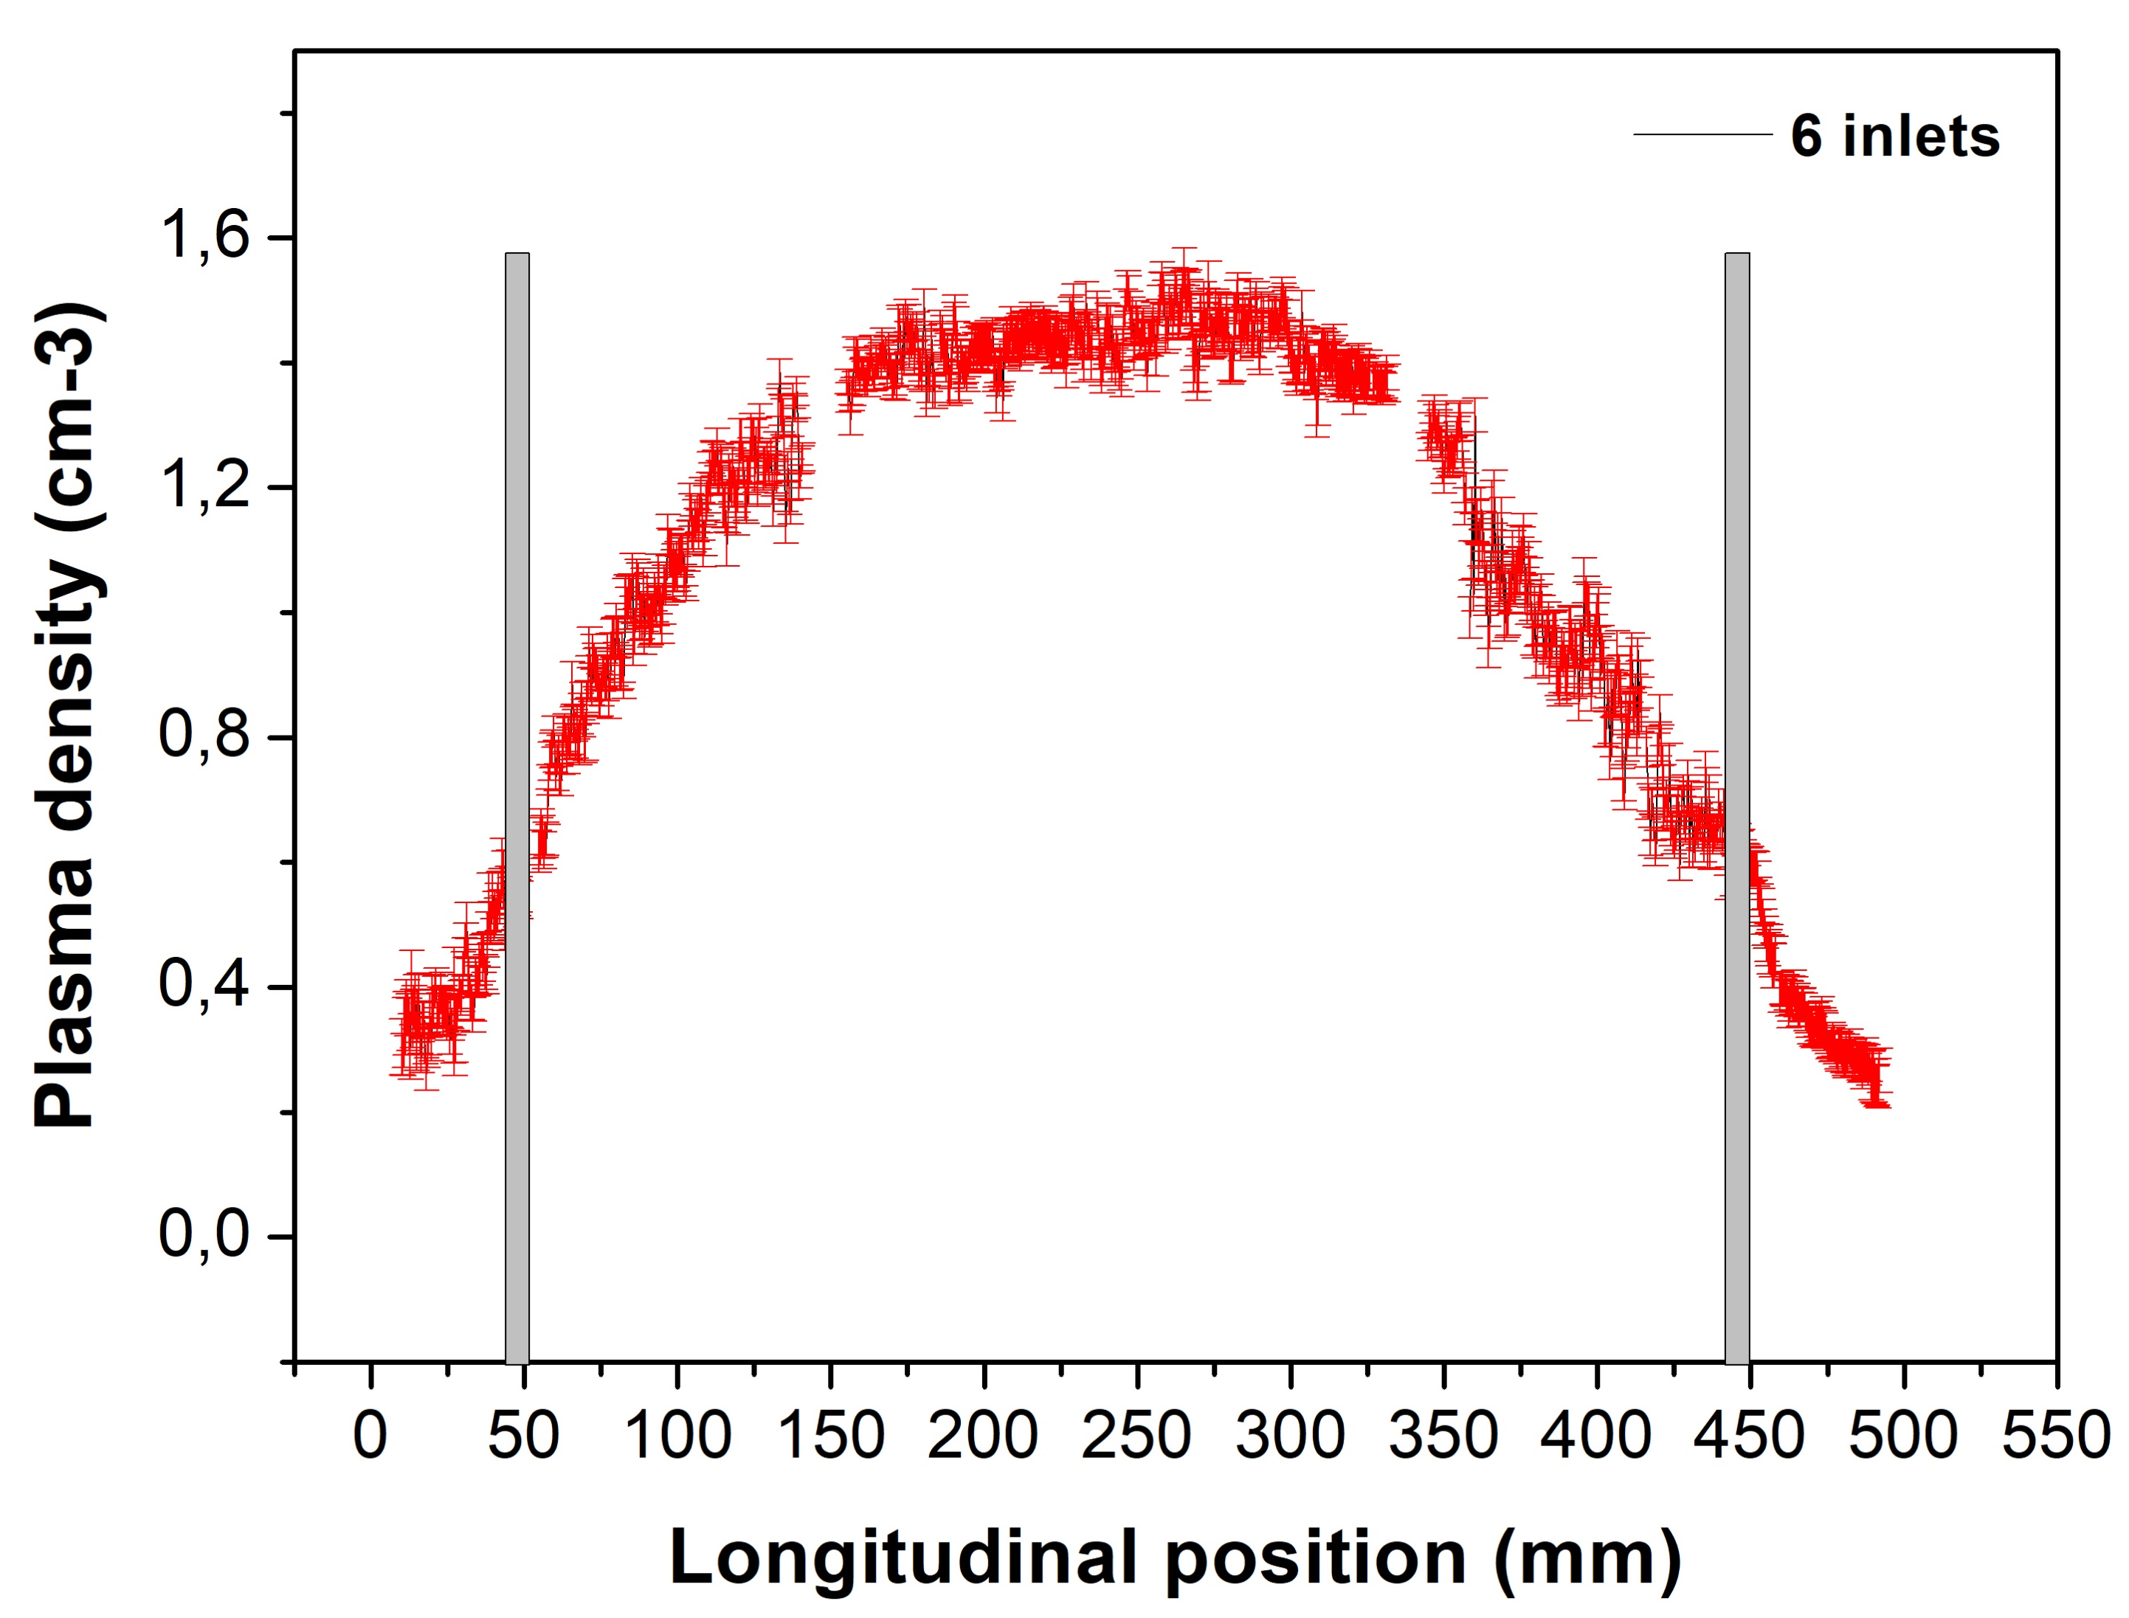
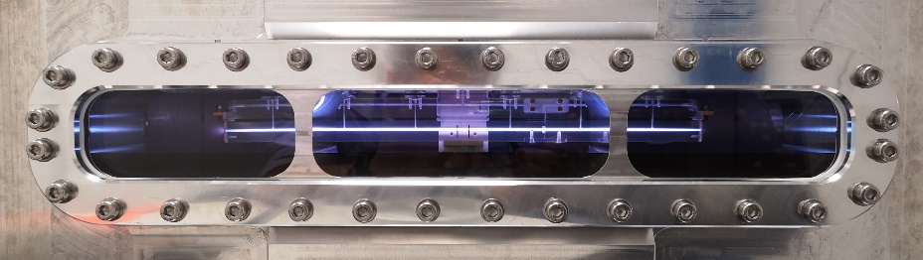
Plasma accelerating module – Plasma ramps control
10 cm
20 cm
55%
40cm
inlet
80
60
60
40
6x1mm inlets to feed te plasma channel
10 cm long internal ramps to match the beam
20 cm long uniform electron distribution
55% density decreasing in 10 cm long rmps
A. Biagioni | TDR Review committee 25-26 November 2024

Slide 8
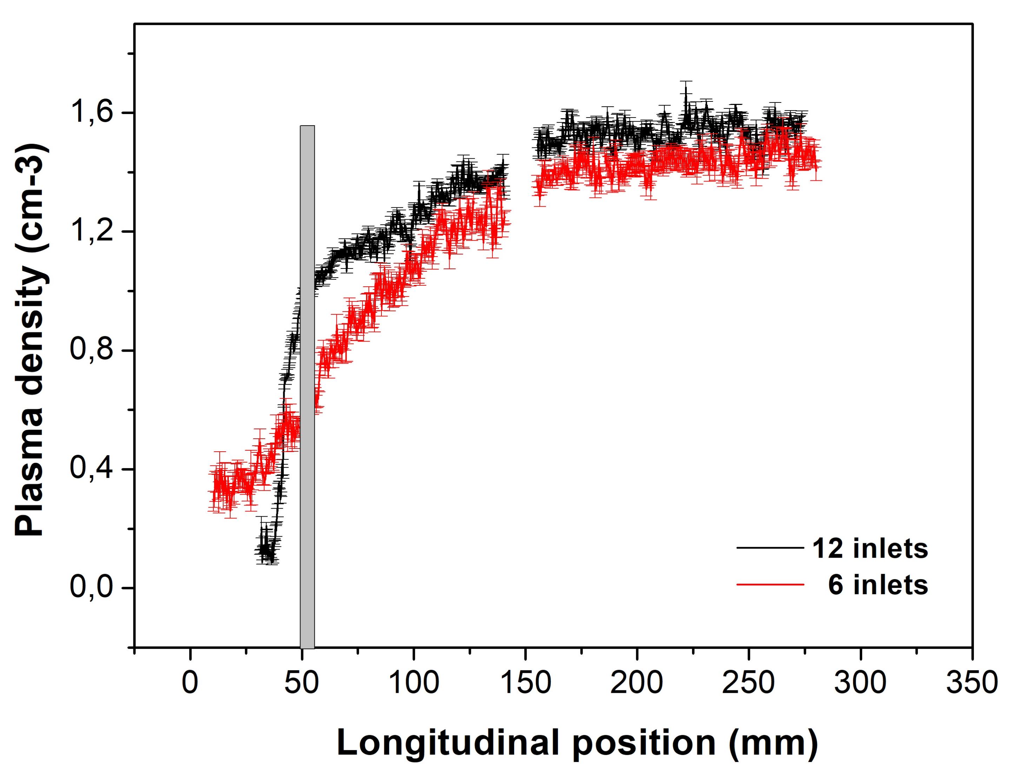
Plasma accelerating module – Plasma ramps control
Half-capillary
New inlets
10 cm
32%
15
25
35
25
80
25
35
12x1mm inlets to feed te plasma channel injectors of constant diameter and progressively closer together
32% density decreasing in 10 cm long internal ramps (with respect to 55% of the previous geometry)
20 cm long uniform electron distribution
32% density decreasing in 10 cm long rmps
Internal ramps can be controlled to make the matching with the beam

Slide 9
Plasma accelerating module – TDR readness
Plasma accelerating module(61%) | Technical design (83%) | Writing (40%)
10.1 Introduction | 100% | 100%
10.2 Plasma module design
10.2.1 Plasma sources | 70% | 60%
10.2.2 HV-sources for plasma creation | 100% | 100%
10.2.3 Plasma discharge stabilizaiton | 100% | 100%
10.3 Plasma chamber design | 20% | 20%
10.3.1 Focusing and extraction systems | Beam physics
10.3.2 Capillary supports and handling | 70% | 0%
10.4 Vacuum pumping system | 60% | 30%
10.5 Diagnostics
10.5.1 Plasma diagnostics | 100% | 50%
10.5.1.1 Stark broadening technique | 100% | 100%
10.5.1.2 Interferometric techniques | 100% | 0%
10.5.2 Beam diagnostics | Beam diagnostics
10.6 High repetition rate plasma sources | 80% | 80%
10.7 Future developments
10.7.1 Segmented capillary | 100% | 0%
10.7.2 All-in-one capillary | 100% | 0%
10.7.3 APL collimator system | 70% | 0%
10.8 Plasma module safety system | 80% | 0%

Slide 10
Thank you for your attention
A. Biagioni | TDR Review committee 25-26 November 2024

Slide 11
EuPRAXIA-PP Consortium
Coordinator
11

Slide 12
Acknowledgements
EuPRAXIA Preparatory Phase
This project has received funding from the European Union’s Horizon Europe research and innovation programme under Grant Agreement No. 101079773. It is supported by in-kind contributions by its partners and by additional funding from UK and Switzerland.
EuPRAXIA Doctoral Network
This project has received funding from the European Union´s Horizon Europe research and innovation programme under grant agreement no. 101073480 and the UKRI guarantee funds.
EuAPS
This publication has been made with the co-funding of European Union Next Generation EU.

Slide 13
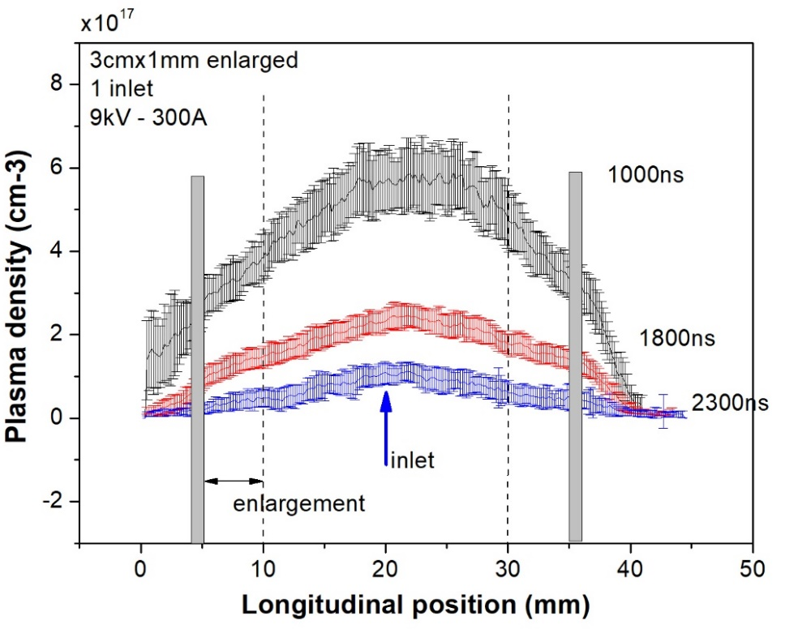
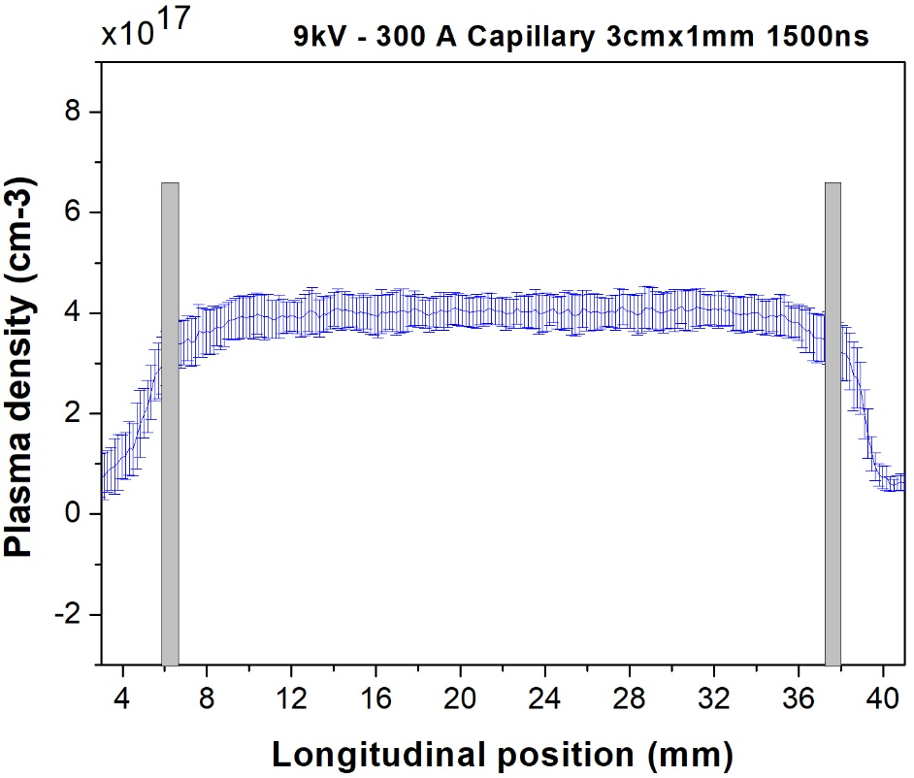
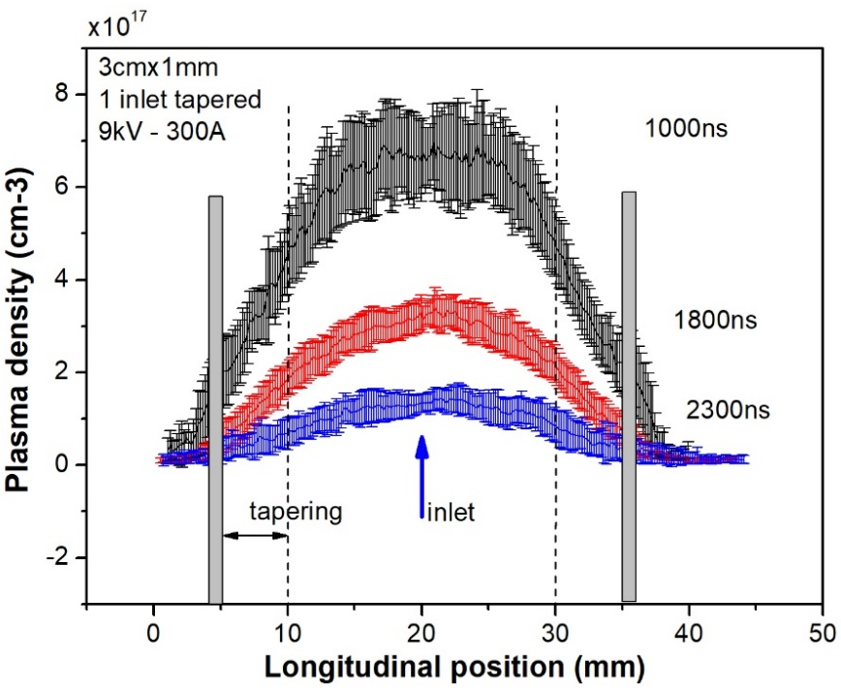
2022_Study on the longitudinal density profile
Test on channel shaping allow us to modify and control the longitudinal profile
Cigar-shape
inlet
Laser trigger and
Cigar-shape capillary

Slide 14
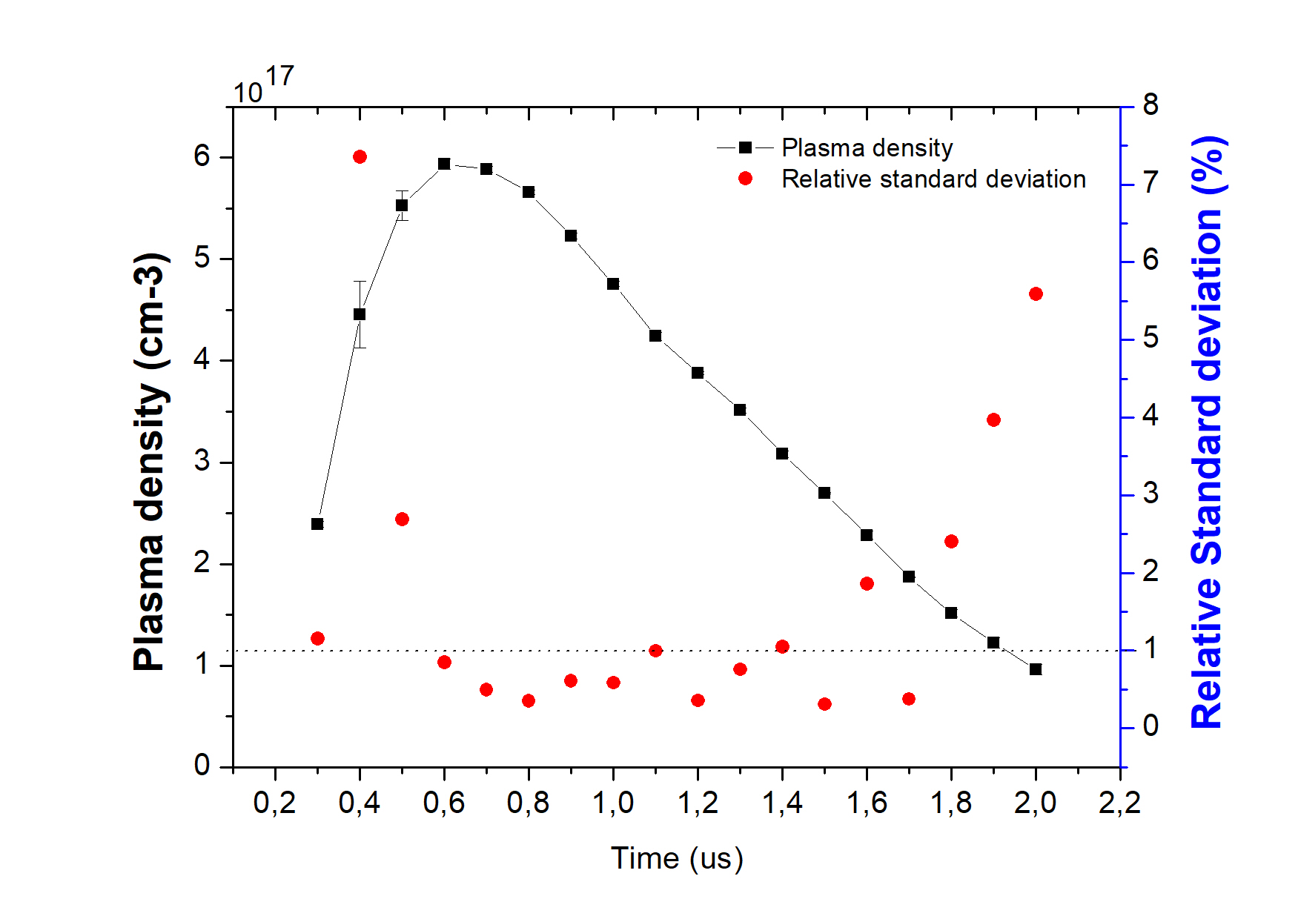
2022_Study on the longitudinal density profile
Savitzky–Golay filter
Higher voltages (18-20kV)

