Slide 1
Darkside Masterclass
Instruction – Excel Part A
Dipartimento di Fisica e Astronomia, Catania,
3 Dicembre 2024

Slide 2
Purpose
Analysis via Excel event display for 3 different events (Ev): number 4, number 474, number 19383
You can move between these events selecting the corresponding tab (see the bottom of your excel file)
Final goal: learn how to reconstruct the position (x,y,z,r) of the particle and when to reject an event (based on the position).

Slide 3
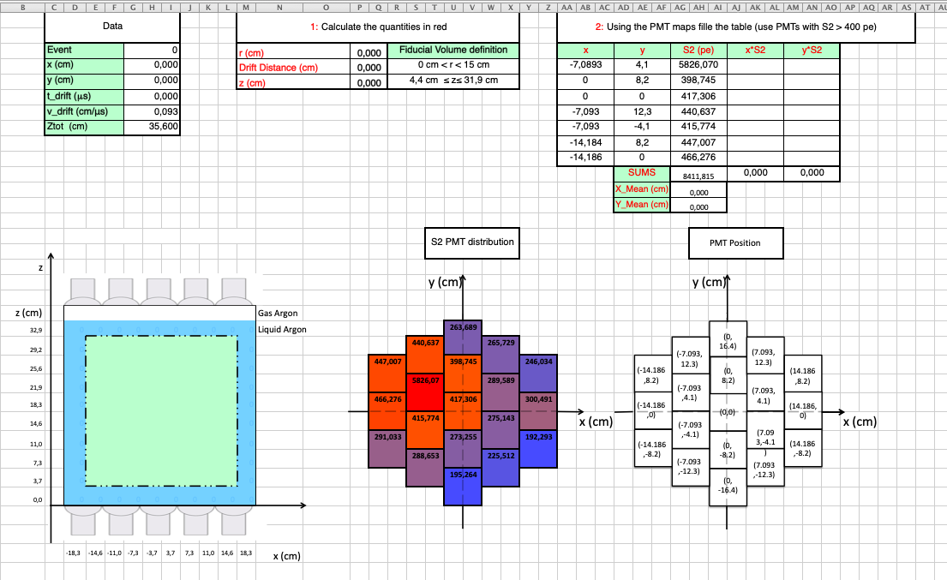
Excel View

Slide 4
Excel View
PART 1:
Calculate the radius (r) and the z position of the particle
Does this event have to be rejected?

Slide 5
Excel View
PART 2:
To be done only if the event has NOT been rejected in PART 1
Calculate the x and y position of the particle and compare them with the original Data

Slide 6
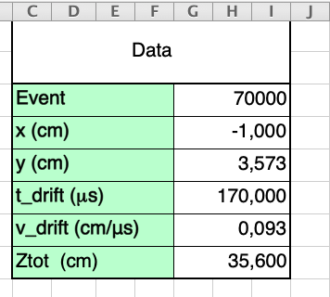
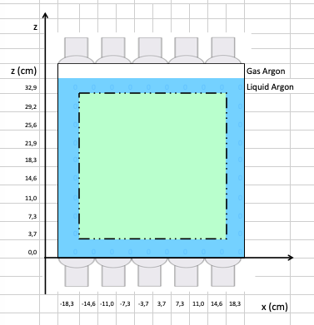
PART 1
You will start with the following data:
The number (ID) of the event
x position of the particle in the TPC in centimetre (cm)
y position of the particle in the TPC in cm
Time between S1 and S2 in microsecond (μs=10⁻⁶ s)
Velocity of an electron in Liquid Ar in cm/μs
Total height of the TPC in cm
z
y
Ztot
(0,0)
(0,0)
x

Slide 7
PART 1
To calculate the radius (r), which means the distance from the center in x and y of the TPC, you simply use the Pythagorean theorem:
r=
x
y
Which, translate in excel is:
=SQRT(G7^2+G8^2)
Where G7 and G8 correspond to excel cells containing the value of the x and y position, as you can see from the screenshot
You can insert them in your excel formula by simply clicking on the respective cells
Play the Video

Slide 8
PART 1
To calculate the z axis, you can then apply the following formula:
Space (Drift distance)= Velocity (v_drift) * time (t_drift)
The drift distance is not equal to z, indeed it has been calculated starting from the t_drift = t_{S2} – t_{S1} , which means top – bottom
We can then get the final z position in our
frame of reference:
z = Ztot - Drift distance
Play the Video
Drift
distance
.
Ztot
z
When you finished, you can see the x-z position highlighted in a yellow square

Slide 9
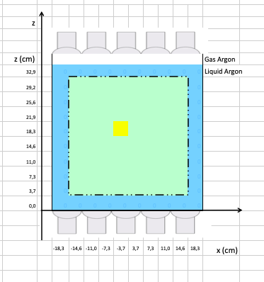
PART 1
Considering then the fiducial volume, expressed in r and z positions and highlighted in the screenshot, and with the help of the green square
highlighted in the TPC,
you have to decide to
reject or not this event.
The event has to be in between the value of r and z. Why?
As you can notice, both from the z-x plot and, in particular directly from the r (3,71 cm) and z (19,79 cm) value of the example, this event has to be accepted.

Slide 10
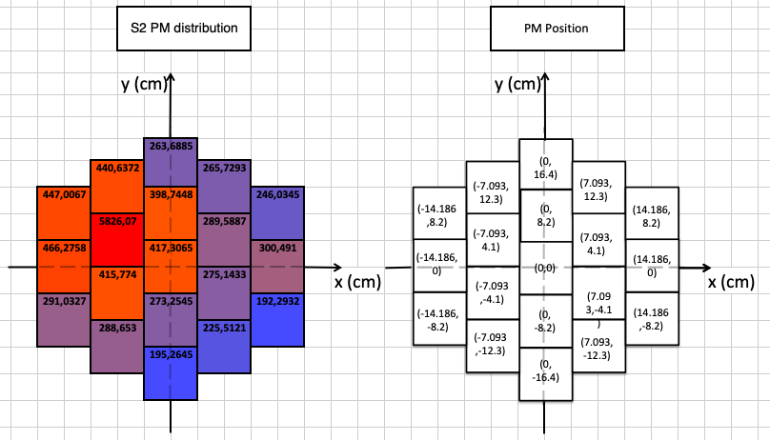
PART 2
If the event has been accepted in PART 1, otherwise skip
Now we can see how to get an approximation of the x and y position (in PART 1 given), starting from the S2 charge distribution in the top PhotoMultipliers (PMs) of the TPC (on the left in the screenshot) expressed as a number of photon electrons (pe)
PMs position in our x-y frame of reference (cm)

Slide 11
PART 2
We can then perform a weighted average in both x and y between the 7 PM with the highest number of photons in S2, using as weight (w) the number of photonelectrons (pe)
position *w
x_{PM1}* pe_{PM1}+x_{PM2}* pe_{PM2} + x_{PM3}* pe_{PM3} + x_{PM4}* pe_{PM4} + x_{PM5}* pe_{PM5} + x_{PM6}* pe_{PM6} + x_{PM7}* pe_{PM7}
X_mean=
pe_{PM1}+pe_{PM2}+pe_{PM3}+pe_{PM4}+pe_{PM5}+pe_{PM6}+pe_{PM7}
Σw
Σw== SUMS
Play the Video
The same for the y position

