Slide 1
ANTIMATTER MEETING
Status of the antideuteron analysis in Bologna

Slide 2
THE MAIN GOAL OF THE ANALYSIS
The goal of this analysis is to find the antideuterons in the AMS-02.
To quantify the antideuterons in cosmic rays, the flux calculation is needed. If any event has been detected, the flux formula is used to calculate an upper limit and constrain the theoretical models.
The flux of a particle in the i-th rigidity bin is calculated using the following :
Number of counted event
A strong selection is needed to identify antideuterons
$$Φ\left(R_{i}\right)= \frac{N_{i}}{T A_{i} ∆R_{i} Ω}$$
Solid angle
Exposure time
Rigidity bin width
Larger bin leads to a lower flux limit (but less precise in Rigidity)
Acceptance accounting both selection and geometrical effects
Corrected acceptance $A_{i}= \frac{ε_{data}}{ε_{MC}} A_{sel}$
Data/MC correction in the efficiencies
If is far from unity your MC isn’t correctly simulating the detector response

Slide 3
STANDARD SELECTION
The following selection has been applied to the events:
IsPhysicsTrigger
IT PatternY: L2 & (L3|L4) & (L5|L6) & (L7|L8)
IT Chisquare Y < 10
IT $\frac{σ_{Z(IT)}}{Z_{IT}}<0.1$
IT NhitsY > 5
IT Nhits XY > 3
Fiducial Volume (TOF & TRD & IT)
TRD NHitsOnTrack > 10
TRD LikelihoodRatio e/p > 0.8
TRD LikelihoodRatio p/He < 0.3
RICH: Mask(HasRich)
RICH: HasAdditionalData
RICH: NHitsUsed > 2
RICH: RingGeomTest
RICH: NPMTsRing > 2
RICH: $\left|\frac{β_{RICH}−β_{TOF}}{β_{RICH}}\right|<0.1$ (NaF only)
RICH: $\frac{{PhotoElectrons}_{measured}}{{PhotoElectors}_{expected}}<3$ (agl only)
(only NaF & agl range)
TOF: NβClusters = 4
TOF: ChiSquareCoo < 4
TOF: TotalCluster(onTime+OffTime) < 2
TOF: $\left|\frac{Z_{utof}−Z_{ltof}}{Z_{utof}}\right|<0.2$ (only TOF range)

Slide 4
STANDARD SELECTION
TOF Charge asymmetry selection
Change in the MC model?
We are not selecting a pure sample!
TOF range
NaF range
agl range

Slide 5
SAMPLES DEFINITION
In the TOF analysis range I have started to further clean the sample using Machine Learning techniques, from the TMVA package implemented in ROOT.
Signal and background sample:
Creating samples of 50000 events each (25000 for ML training and 25000 for testing) from the proton MC ntuples
/storage/gpfs_ams/ams/groups/AMS-Italy/ntuples/v1.1.0/Pr.B1236/pr.pl1phpsa.0550.4_00/
Signal:
$0.5< β_{TOF}<0.8$
$R_{rec}>0$
$0.7< m_{tof}<1.4$
Background:
$0.5< β_{TOF}<0.8$
$R_{rec}<0$
$m_{tof}>0$ (all charge confused)
pi-
pi+
Bkg Composition:
98.8% pions
1% kaons
0.09% antiprotons
Very few higher mass events
p
pbar
background
signal
TOF range
Image (for illustration purposes) taken from MC P
/storage/gpfs_ams/ams/groups/AMS-Italy/ntuples/v1.1.0/Pr.B1236/pr.pl1.05100.6_02/
Samples have been created from a different MC P to have more statistic in the negative sample

Slide 6
VARIABLES IN THE TRAINING
The variables used in the training are Inner Tracker variables for which the data and MC are not so far away.
I looked for variables that have less dependence on rigidity/velocity, otherwise the ML algorithm can learn the mass and would apply a mass cut.
$0.7< β<0.75$
Protons
MC protons
$0.75< β<0.8$
Protons
MC protons
$0.7< β<0.75$
GBLNoMS (data P)
GBL (data P)
$0.7< β<0.75$
GBLNoMS (MC P)
GBL (MC P)
$0.8< β<0.85$
Protons
MC protons
$0.85< β<0.9$
Protons
MC protons
$0.8< β<0.85$
GBLNoMS (data P)
GBL (data P)
$0.8< β<0.85$
GBLNoMS (MC P)
GBL (MC P)
Example: NClusterXside, IT, Layer2, 1cm from track
Example: ChisquareX for IT, with and without MS correction

Slide 7
VARIABLES IN THE TRAINING
The variables used in the training are Inner Tracker variables for which the data and MC are not so far away.
I looked for variables that have less dependence on rigidity, otherwise the ML algorithm can learn the mass and would apply a mass cut.
Variable used:
N° 1 ChisquareX (IT)
N°7 PartialR asymmetries (L2-L8)-> ${Partial R asymmetry}_{i}= \frac{{PartialR}_{i} −R_{rec}}{R_{rec}}$
N°7 NCluster (IT), Side X, 1mm (L2-L8)
N°7 NCluster (IT), Side X, 1cm from Track (L2-L8)
N°7 NCluster (IT), Side X, 2cm from Track (L2-L8)
N°7 NCluster (IT), Side Y, 1mm (L2-L8)
N°7 NCluster (IT), Side Y, 1cm from Track (L2-L8)
N°7 NCluster (IT), Side Y, 2cm from Track (L2-L8)
NTotalCluster (IT), SideX, 1mm (sum on L2-L8)
NTotalCluster (IT), SideX, 1cm (sum on L2-L8)
NTotalCluster (IT), SideX, 2cm (sum on L2-L8)
NTotalCluster (IT), SideY, 1mm (sum on L2-L8)
NTotalCluster (IT), SideY, 1cm (sum on L2-L8)
NTotalCluster (IT), SideY, 2cm (sum on L2-L8)
56 variables

Slide 8
BOOSTED DECISION TREES
Decision trees are a common technique used to solve classification (and regression) problems.
They are based on one-variable rectangular cut in a multidimensional variable space.
Starting from an initial sample, a rectangular splits it into two “leaves”.
Each leaf is evaluated as signal-like (if composed mostly by signal events) or background-like.
The leaves can be split again using another one-dimensional cut until and “ending condition” is reached.

Slide 9
BOOSTED DECISION TREES
Decision trees are a common technique used to solve classification (and regression) problems.
They are based on one-variable rectangular cut in a multidimensional variable space.
Starting from an initial sample, a rectangular splits it into two “leaves”.
Each leaf is evaluated as signal-like (if composed mostly by signal events) or background-like.
The leaves can be split again using another one-dimensional cut until and “ending condition” is reached.

Slide 10
BOOSTED DECISION TREES
Decision trees are a common technique used to solve classification (and regression) problems.
They are based on one-variable rectangular cut in a multidimensional variable space.
Starting from an initial sample, a rectangular splits it into two “leaves”.
Each leaf is evaluated as signal-like (if composed mostly by signal events) or background-like.
The leaves can be split again using another one-dimensional cut until and “ending condition” is reached.

Slide 11
BOOSTED DECISION TREES
Decision trees are a common technique used to solve classification (and regression) problems.
They are based on one-variable rectangular cut in a multidimensional variable space.
Starting from an initial sample, a rectangular splits it into two “leaves”.
Each leaf is evaluated as signal-like (if composed mostly by signal events) or background-like.
The leaves can be split again using another one-dimensional cut until and “ending condition” is reached.

Slide 12
BOOSTED DECISION TREES
The Boosted algorithm creates many trees (a forest) starting from the training sample.
For each tree a weight is calculated as related to its separation power. This weight is used to weight the sample for the next tree and for the final output of the BDT.
Weigths $w_{i}$
Weigths $w_{i}$
…
The final prediction y(x) of the BDT is obtained as a weighted-sum of each individual response.
$$y\left(x\right)=\sum_{j=1}^{Ntrees}{β_{j} y_{j}(x)}$$
Individual response of the j tree
The calculation of $β$ depends on the boosting algorithm and is related to the weight $w_{i}$

Slide 13
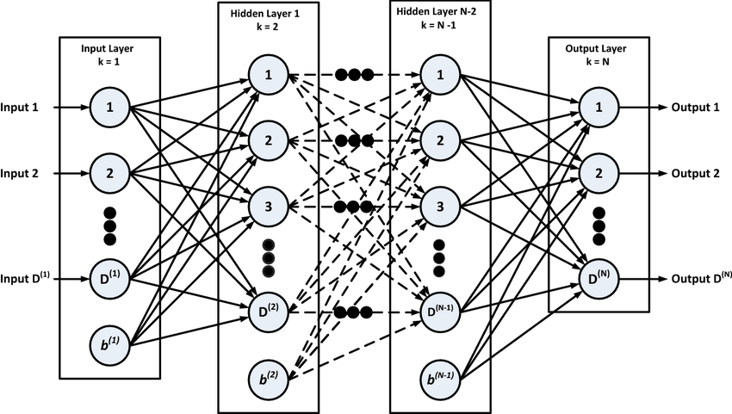
MULTILAYER PERCEPTRON
“An artificial neural network (ANN) is a model inspired by the structure and function of biological neural networks in animal brains.”
There is a plenty of ANNs that can be used for a plethora of different purposes. The ANNs can be summarized as composed by nodes and link between them. The node structure of the ANN and represents the “storage of information” and the links are functions connecting the various nodes, related to some parameters (weight and biases typically).
One of the most common used is the MultiLayer Perceptron (MLP). Is an ANN organized in several layers fully connected: it means that each node of a certain layer is connected to every node of the previous layer.
Between the input layer and the output layer there are the hidden layers.
Supposing a layer is composed by N nodes and receives K input values, it can be summarized as the following:
$$f^{l}=σ^{l}(W^{l} u+ b^{l})$$
Values stored in the layer l
(N values for N nodes)
Bias vector (K elements)
Weight matrix NxK
Activation function
(acts on a linear combination of input and bias)
Inputs from previous layer (K)

Slide 14
DEEP NEURAL NETWORK
If there are more than 1 hidden layer, the ANN is also called Deep Neural Network (DNN).
A Deep Neural Network (DNN) can be used in the following way:
The DNN learns features from input data to distinguish between two classes (Supervised Training). The parameter of the DNN are set.
Another dataset, different from the training one, is used to test the DNN performances (testing phase).
The DNN can process other inputs.
The DNN has a complicated structure that allows it to learn many features. It can reach high performances in the classification, also using lot of variables in the training phase. A more complicated structure implies a higher computational effort needed in the training phase.

Slide 15
BDT AND DNN COMPARISONS
AUC = Area Under the Curve
ROC = Receiver Operating Characteristic
First layer
Second layer
Output layer
DNN tested (ActivationFunction|Nodes , ActivationFunction|Nodes , … , ActivationFunction):
DNN1->Layout= SIGMOID|50, SIGMOID|50, LINEAR
DNN2->Layout= SIGMOID|50, SIGMOID|50, SIGMOID|25, LINEAR
DNN3->Layout= SIGMOID|500, SIGMOID|500, SIGMOID|250, SIGMOID|125, LINEAR
DNN4->Layout= SIGMOID|500, SIGMOID|500, SIGMOID|250, SIGMOID|250, SIGMOID|125, LINEAR
Additional informations (for experts ;) ):
->ErrorStrategy=SUMOFSQUARES
->LearningRate=0.0001
->BatchSize=500
->TrainingMethod: BP
->No weight decay
->No regularization
->ADAM Optimizer
ROC:
BDT tested:
BDT1 Ntrees = 800
BDT2 Ntrees = 400
BDT3 Ntrees = 200
BDT4 Ntrees = 100
BDT5 Ntrees = 50
AUC:
0.961
0.961
0.960
0.960
0.822
0.810
0.808
0.798
0.793
DNNs perform better than BDTs
Additional informations (for experts ;) ):
->No pruning
->AdaBoost boosting
->Separation: Gini index

Slide 16
BDT PERFORMANCE

Slide 17
BDT AND DNN COMPARISONS
← (On the left): Response distribution for training and test samples, to show the separation power of the networks.
As Luca suggested: it could be useful to look at the variable ranking of the BDTs, to understand from which variables then DNN can acquire more information.
← 20-56 Ranking of variables for BDT1 (with 800 trees).
The NCluster variables are the most useless.
New Training with the other 8 variables remaining:
The DNNs acquire more information from the most powerful variables?
AUC: 0.96
AUC: 0.739

Slide 18
DNN PERFORMANCE
No overfitting in the DNN training.
No regularization needed.

Slide 19
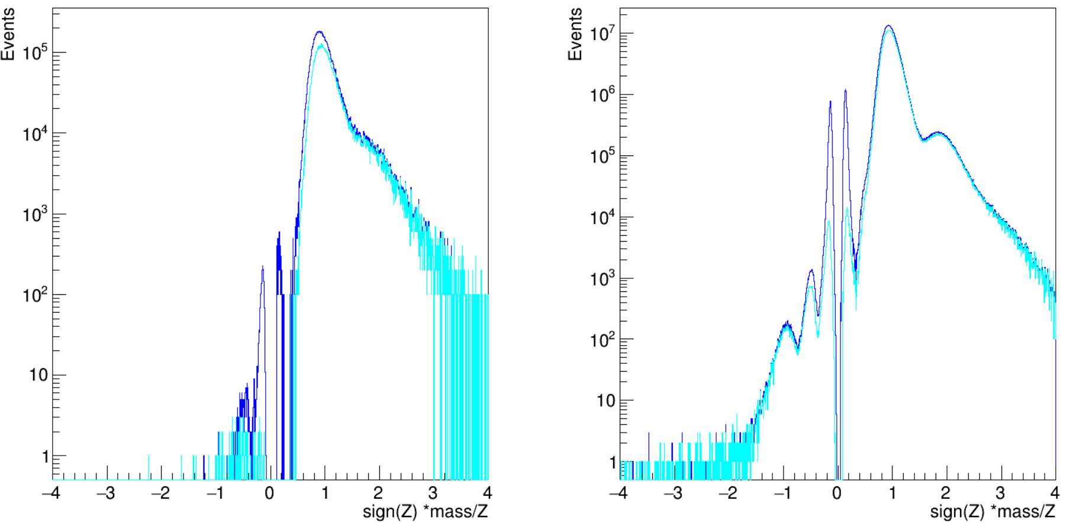
DNN PERFORMANCE ON DATA
The DNN4 has been applied on data, in the TOF range.
Proton peak suppressed
Proton peak a bit suppressed
Cut value: rejected BDT Respose < 0.6082
Pre DNN
After DNN
Pions suppressed
Pions rejected
Pre DNN
After DNN
$$0.3< β<0.5$$
β outside training range
$$0.5< β<0.8$$
A huge effect on rejecting pions, an inefficiency on protons and a small effect on high mass tail.
Is it learning rigidity from the MS correction in the ChisquareX of the IT?

Slide 20
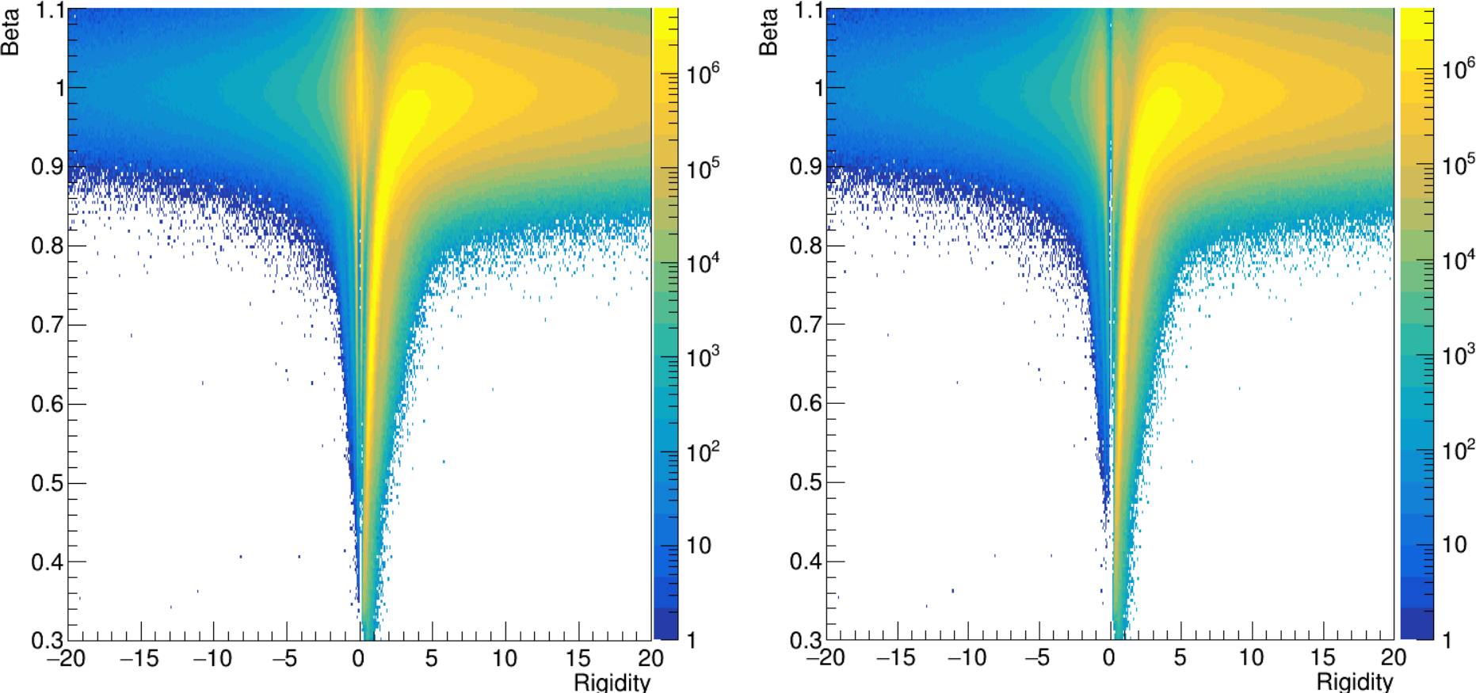
DNN PERFORMANCE ON DATA
The DNN4 has been applied on data, in the TOF range.

Slide 21
RECURRENT NEURAL NETWORK
The Recurrent Neural Network (RNN) is a kind of NN in which is present a temporal sequence in the algorithm. For each timestep the network is updated according to the input and to the previous configuration.
From PDG
At the step t the network can be defined as:
Bias vector
$$h_{t}=g_{h}(Wx_{t}+Vh_{t−1}+b)$$
Weighting the input vector x using the matrix W
Updating the network using the matrix V and the previous step
$$y_{t}= g_{o}(Uh_{t})$$
Calculating the output using the updated network and the matrix U
The RNNs are mainly used to treat temporal sequences of data, but they can also used on a huge number of variables, if they are “packed in blocks” mimicking a temporal sequence in the input.
However, in temporal sequences both long-term and short-term features can be present. The RNNs are not particularly suited to learn efficiently the long-term ones.

Slide 22
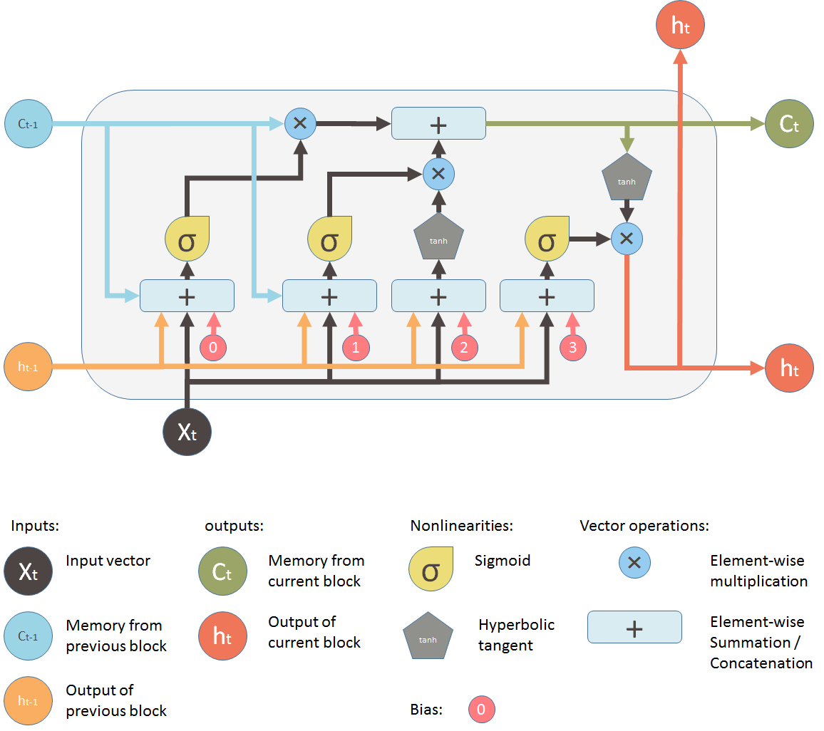
LONG SHORT-TERM MEMORIES
The simple RNN are not suited to learn efficiently long-range features in time (long-term memory). The Long Short-Term Memory is a RNN designed to avoid this problem.
LSTM block (step t):
To hold long-term memory, the LSTM has a context.
The short-term memory remains embedded in the hidden state.
The LSTM scheme is based on four gates:
the forget gate $f_{t}$ controls how much of the previous state $c_{t−1}$ should be kept or forgotten;
the present context ${\tilde{c}}_{t}$ combine the input $X_{t}$ and previous hidden state $h_{t−1}$ information to upgrade the current state $c_{t}$
the input gate $i_{t}$controls how much of the present context ${\tilde{c}}_{t}$ should propagate to the current state $c_{t}$
the output gate $o_{t}$ controls how much of the current state should be propagate in the current hidden state $h_{t}$

Slide 23
LONG SHORT-TERM MEMORIES
The simple RNN are not suited to learn efficiently long-range features in time (long-term memory). The Long Short-Term Memory is a RNN designed to avoid this problem.
LSTM block (step t):
The forget gate $f_{t}$ controls how much of the p$revious state c_{t−1}$ should be kept or forgotten.
$$f_{t}= σ\left(W^{f} x_{t}+ V^{f}h_{t−1}+b^{f}\right)→f_{t}⊗c_{t−1}$$
$$W^{f},V^{f},b^{t}$$
$$weight matrices and bias vector associated to forget gate$$

Slide 24
LONG SHORT-TERM MEMORIES
The simple RNN are not suited to learn efficiently long-range features in time (long-term memory). The Long Short-Term Memory is a RNN designed to avoid this problem.
LSTM block (step t):
The input gate $i_{t}$controls how much of the present context ${\tilde{c}}_{t}$ should propagate to the current state $c_{t}$.
$$i_{t}= σ\left(W^{i} x_{t}+ V^{i}h_{t−1}+b^{i}\right)→i_{t}⊗{\tilde{c}}_{t}$$
$$W^{i},V^{i},b^{i}$$
$$weight matrices and bias vector associated to input gate$$

Slide 25
LONG SHORT-TERM MEMORIES
The simple RNN are not suited to learn efficiently long-range features in time (long-term memory). The Long Short-Term Memory is a RNN designed to avoid this problem.
LSTM block (step t):
The present context ${\tilde{c}}_{t}$ combine the input $X_{t}$ and previous hidden state $h_{t−1}$ information to upgrade the current state $c_{t}$.
$${\tilde{c}}_{t}=tanh\left(W^{c} x_{t}+ V^{c}h_{t−1}+b^{c}\right)$$
$$W^{c},V^{c},b^{c}$$
$$weight matrices and bias vector associated to present context gate$$

Slide 26
LONG SHORT-TERM MEMORIES
The simple RNN are not suited to learn efficiently long-range features in time (long-term memory). The Long Short-Term Memory is a RNN designed to avoid this problem.
LSTM block (step t):
The current state $c_{t}$ is updated combining the forget gate $f_{t}$, the input gate $i_{t}$, and the present context gate ${\tilde{c}}_{t}$
$$c_{t} =f_{t}⊗c_{t−1}+i_{t}⊗{\tilde{c}}_{t}$$
Deciding how much information from the present context add in the long-term memory propagation
Deciding how much information forget from the previous state when propagating the long-term memory info.

Slide 27
LONG SHORT-TERM MEMORIES
The simple RNN are not suited to learn efficiently long-range features in time (long-term memory). The Long Short-Term Memory is a RNN designed to avoid this problem.
LSTM block (step t):
The output gate $o_{t}$ controls how much of the current state should be propagate in the current hidden state $h_{t}$:
$$o_{t}=σ\left(W^{o} x_{t}+ V^{o}h_{t−1}+b^{o}\right)→ h_{t}=o_{t} ⊗tanh⁡(c_{t})$$
$$W^{o},V^{o},b^{o}$$
$$weight matrices and bias vector associated to output gate$$
Updated the hidden state, the LSTM can calculate the output:
$$y_{t}= g_{o}(Uh_{t})$$

Slide 28
GATED RECURRENT UNIT
The Gated Recurrent Unit (GRU) is a simplified version of the LSTM, that doesn’t allow to propagate the context vector. It’s able to obtain the same performance on long sequences, requiring less computational resources. It’s functioning based on two gates, the reset gate $r_{t}$ and the update gate $z_{t}$.
GRU block (step t):
$$reset gate: r_{t}=σ\left(W^{r} x_{t}+ V^{r}h_{t−1}+b^{r}\right)$$
$$update gate: z_{t}=σ\left(W^{z} x_{t}+ V^{z}h_{t−1}+b^{z}\right)$$
$$new context: \tilde{h_{t}}=tanh\left(W^{h} x_{t}+ V^{h}(r_{t} ⊗h_{t−1})+b^{h}\right)$$
$W^{r},V^{r},b^{r}$, $W^{z},V^{z},b^{z}$, $W^{h},V^{h},b^{h}$
$$weight matrices and bias vector associated to the gates$$
t
t-1
t
The update of the hidden status is calculated as the following:
$h_{t} =z_{t}⊗\tilde{h_{t}}+(1−z_{t})$ $⊗$ $h_{t−1}$

Slide 29
ALL RNNs USED
I have decided to use GRU and LSTM because they are able to learn long-term sequences: if a variable isn’t important for the training, then it will be forgotten from these two networks. This technique is used at LHC for jet reconstruction, when you have a lot of variables.
To use the LSTM, RNNs and GRU I have divided the input variables in 8 sequential steps of 7 variables each.
Step 1
Step 2
Step 3
Step 4
Step 5
Step 6
Step 7
Step 8
Chisquare X
NTotalCluster X 1mm
NTotalCluster X 1cm
NTotalCluster X 2cm
NTotalCluster Y 1mm
NTotalCluster Y 1 cm
NTotalCluster Y 2cm
PartialR Asymmetry L2
PartialR Asymmetry L3
PartialR Asymmetry L4
PartialR Asymmetry L5
PartialR Asymmetry L6
PartialR Asymmetry L7
PartialR Asymmetry L8
NclusterX 1 mm L2
NclusterX 1 mm L3
NclusterX 1 mm L4
NclusterX 1 mm L5
NclusterX 1 mm L6
NclusterX 1 mm L7
NclusterX 1 mm L8
NclusterX 1 cm L2
NclusterX 1 cm L3
NclusterX 1 cm L4
NclusterX 1 cm L5
NclusterX 1 cm L6
NclusterX 1 cm L7
NclusterX 1 cm L8
NclusterX 2 cm L2
NclusterX 2 cm L3
NclusterX 2 cm L4
NclusterX 2 cm L5
NclusterX 2 cm L6
NclusterX 2 cm L7
NclusterX 2 cm L8
NclusterY 1 mm L2
NclusterY 1 mm L3
NclusterY 1 mm L4
NclusterY 1 mm L5
NclusterY 1 mm L6
NclusterY 1 mm L7
NclusterY 1 mm L8
NclusterY 1 cm L2
NclusterY 1 cm L3
NclusterY 1 cm L4
NclusterY 1 cm L5
NclusterY 1 cm L6
NclusterY 1 cm L7
NclusterY 1 cm L8
NclusterY 2 cm L2
NclusterY 2 cm L3
NclusterY 2 cm L4
NclusterY 2 cm L5
NclusterY 2 cm L6
NclusterY 2 cm L7
NclusterY 2 cm L8
The RNNs have many input and it’s possible to have only one final output (many-to-one) or an output for each step (many-to-many). For my purposes, only one final output is obtained (many-to-one configuration) for the classification.

Slide 30
RNNs LAYOUT
DNN tested (ActivationFunction|Nodes , ActivationFunction|Nodes , … , ActivationFunction):
LSTM1->Layout=10|7|8, RESHAPE|FLAT, DENSE|64|RELU, DENSE|1|LINEAR
LSTM2->Layout=20|7|8, RESHAPE|FLAT, DENSE|64|RELU, DENSE|1|LINEAR
GRU1 ->Layout=10|7|8, RESHAPE|FLAT, DENSE|64|RELU, DENSE|1|LINEAR
RNN ->Layout=10|7|8, RESHAPE|FLAT, DENSE|64|RELU, DENSE|1|LINEAR
Additional informations (for experts ;) ):
->ErrorStrategy=SUMOFSQUARES
->LearningRate=0.0001
->BatchSize=100
->MaxEpoch = 20
->TrainingMethod: BP
->Weight decay = 0.01
->ADAM Optimizer
N time steps
Variables for each step
Number of internal layer nodes of the network
Reshape layer
RNN/LSTM/GRU layer
Dense (fully connected) layer
Classification output
Nnodes x 8 timestep -> output(Nx8)
(8N)-> output(64)
(Nx8)-> output(8N)

Slide 31
RNNs PERFORMANCES
Equal performance means the long-term memory effects are negligible(?)
Consistency checks are needed (OnGoing)
AUC:
0.958
0.959
0.958
0.958
Performance similar to the DNNs
No overfitting
The results can be affected on the input assembly (in which way the variables are put together as blocks and in the block sequence).

Slide 32
ER CODICIONE
I have started to write the analysis code from the beginning, to be updated on a gitlab repository for antimatter analyses.
My
Open
Repository
Towards
Antimatter in
Cosmic rays using
Computational
Intelligence
Currently on testing phase
Suggestions for a future using:
If u want to create your branch, please call it “MortacciDe<YourName>”
BACKUP NAME:
AnCo (Antimatter Code)

