Slide 1
SEARCHING FOR ANTIDEUTERONS
STATUS OF THE DBAR ANALYSIS IN BOLOGNA
francesco.dangelo13@unibo.it
AMS-Italy meeting – Bologna – 27/11/2024

Slide 2
ANTIDEUTERONS IN COSMIC RAYS
Cosmic antideuterons are produced in collision between propagating primary cosmic rays and the interstellar medium.
Detecting them and modeling their production in fundamental for the Dark Matter indirect search: secondary antideuterons are suppressed at low kinetic energies, while Dark Matter ones are not.
BESS Collaboration, PRL, 132, 131001 (2024)
BESS Collaboration, PRL, 132, 131001 (2024)
Experimental data
Prediction
francesco.dangelo13@unibo.it
AMS-Italy meeting – Bologna – 27/11/2024
2

Slide 3
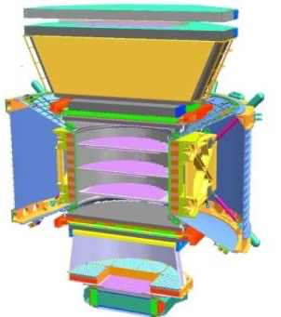
GOALS OF THE ANALYSIS
Search for heavy antideuterons in cosmic rays with the Alpha Magnetic Spectrometer
L1
TRD
The TRD helps with the particle identification.
UTOF
L2
L3-L4
|Z| is reconstructed using both the TOF and the Inner Tracker.
Tracker
L5-L6
L7-L8
The Rigidity is reconstructed using the Inner Tracker and the magnet (and also the sign of Z).
LTOF
The β is reconstructed using the TOF (0.3 < β < 0.8) and the RICH (NaF 0.75 < β < 0.99 and aerogel β > 0.96) in three independent samples.
RICH
L9
ECAL
francesco.dangelo13@unibo.it
AMS-Italy meeting – Bologna – 27/11/2024
3

Slide 4
SEARCHING FOR ANTIDEUTERONS WITH AMS-02
BESS Collaboration
PRL, 132, 131001 (2024)
spectrum
The quantity of a certain cosmic ray specie observed is calculated using the following flux formula :
Upper limit
$$Φ\left(R_{i}\right)= \frac{N_{i}}{T_{i} A_{i} ∆R_{i} }$$
$N_{i}$Number of counted signal events
$∆R_{i}$Rigidity bin width
$A_{i}$acceptance
$T_{i}$ Exposure time
This formula can be used to calculate a spectrum (such as antiprotons) or can be used to put an upper limit if nobody has been observed (such as antideuterons).
The rigidity bin width can be enlarged to obtain lower the limit, losing spectral information (such as antideuterons).
francesco.dangelo13@unibo.it
AMS-Italy meeting – Bologna – 27/11/2024
4

Slide 5
SEARCHING FOR ANTIDEUTERONS WITH AMS-02: EVENT SELECTION
Find the number of good antideuterons is one of the most difficult thing of the analysis.
It means identify few events in more than ten billions. A tight standard selection has been applied to clean the sample from bad reconstructed events, but it’s not enough. A more advanced selection is required (applying Machine Learning algorithms).
$$Φ\left(R_{i}\right)= \frac{N_{i}}{T_{i} A_{i} ∆R_{i}}$$
IsPhysicsTrigger
Fiducial Volume
RTI selection
TRD NHitsOnTrack > 10
TRD LikelihoodRatio e/p > 0.8
TRD LikelihoodRatio p/He < 0.3
TOF: NβClusters = 4
TOF: ChiSquareCoo < 4
TOF: TotalCluster(onTime+OffTime) < 2
TOF: $\left|\frac{Z_{utof}−Z_{ltof}}{Z_{utof}}\right|<0.2$ (TOF sample only)
IT PatternY: L2 & (L3|L4) & (L5|L6) & (L7|L8)
IT Chisquare Y < 10
IT $\frac{σ_{Z(IT)}}{Z_{IT}}<0.1$
IT NhitsY > 5
IT Nhits XY > 3
RICH: NHitsUsed > 2 (only NaF and agl samples)
RICH: RingGeomTest (only NaF and agl samples)
RICH: NPMTsRing > 2 (only NaF and agl samples)
Standard selection
francesco.dangelo13@unibo.it
AMS-Italy meeting – Bologna – 27/11/2024
5

Slide 6
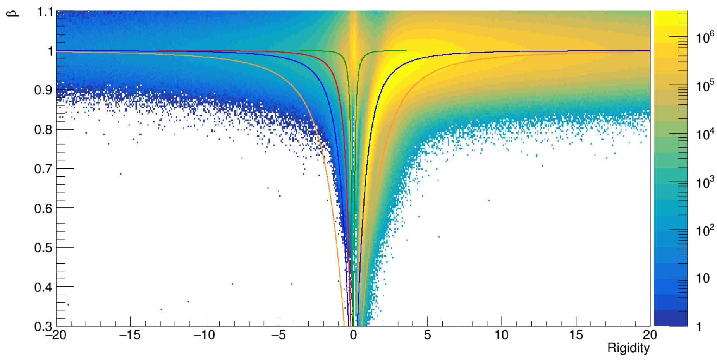
SEARCHING FOR ANTIDEUTERONS WITH AMS-02: EVENT SELECTION
$$\overline{P}$$
K$−$
$$π−$$
$$π+$$
$$P$$
$$\overline{D}$$
$$D$$
TOF range
After the standard selection
francesco.dangelo13@unibo.it
AMS-Italy meeting – Bologna – 27/11/2024
6

Slide 7
SEARCHING FOR ANTIDEUTERONS WITH AMS-02: EVENT SELECTION
In 12.5 ys of data, we have in the TOF range, with $0.3< β<0.8$:
TOF range
After the standard selection
$0.3< β<0.8$
861.5 millions of protons
32.4 millions of deuterons
12.2 millions of pi+
7.9 millions of pi-
42 265 K-
12446 antiprotons
270 antideuterons (probably background)
$$mass= \frac{ZR}{γβ}$$
francesco.dangelo13@unibo.it
AMS-Italy meeting – Bologna – 27/11/2024
7

Slide 8
SEARCHING FOR ANTIDEUTERONS WITH AMS-02: EVENT SELECTION (DNN-TOF)
We started to apply Machine Learning algorithms to try to further clean the TOF sample.
We did a first attempt using a Deep Neural Network (DNN), based on Inner Tracker (IT) variables. We have trained the DNN using the MC of protons, starting with events in the TOF samples.
MC Protons, TOF analysis range:
We have chosen the protons as signal sample.
We started considering two kind of backgrounds:
a wrong charge background composed by events with the wrong sign of the charge;
a wrong mass background composed by events where the mass in bad reconstructed (too high)
Signal: protons
Wrong sign background:
all negatives (98.8 % pions)
Wrong mass background
For statistical reasons, we enlarged the training samples to lie in the $0.5< β<0.9$ range
francesco.dangelo13@unibo.it
AMS-Italy meeting – Bologna – 27/11/2024
8

Slide 9
SEARCHING FOR ANTIDEUTERONS WITH AMS-02: EVENT SELECTION (DNN-TOF)
Choosing the IT variables
-> loose R dependence
-> agreement between data and MC
$$0.7< β<0.75$$
Protons
MC protons
56 Variable used:
N° 1 ChisquareX (IT) NO MS, GBL
N°7 PartialR asymmetries (L2-L8)
N°7 NCluster (IT), Side X, 1mm (L2-L8)
N°7 NCluster (IT), Side X, 1cm from Track (L2-L8)
N°7 NCluster (IT), Side X, 2cm from Track (L2-L8)
N°7 NCluster (IT), Side Y, 1mm (L2-L8)
N°7 NCluster (IT), Side Y, 1cm from Track (L2-L8)
N°7 NCluster (IT), Side Y, 2cm from Track (L2-L8)
NTotalCluster (IT), SideX, 1mm (sum on L2-L8)
NTotalCluster (IT), SideX, 1cm (sum on L2-L8)
NTotalCluster (IT), SideX, 2cm (sum on L2-L8)
NTotalCluster (IT), SideY, 1mm (sum on L2-L8)
NTotalCluster (IT), SideY, 1cm (sum on L2-L8)
NTotalCluster (IT), SideY, 2cm (sum on L2-L8)
$$0.85< β<0.9$$
Protons
MC protons
francesco.dangelo13@unibo.it
AMS-Italy meeting – Bologna – 27/11/2024
9

Slide 10
SEARCHING FOR ANTIDEUTERONS WITH AMS-02: EVENT SELECTION (DNN-TOF)
The DNNs performances have been evaluated using the ROC curve:
Adding L1 in the analysis -> ONGOING
TOF range
$0.5< β<0.9$
DNN with wrong mass background
DNN with wrong charge background
Pions
Eff 98%
Pions
Eff 34%
High mass
Eff 34%
Pbar
eff 87%
High mass
Eff 76%
Pbar
eff 90%
Blind region
Protons
eff 89%
Deuterons
eff 78%
Blind region
Protons
eff 86%
Deuterons
eff 92%
TOF range
$0.5< β<0.8$
TOF range
$0.5< β<0.8$
francesco.dangelo13@unibo.it
AMS-Italy meeting – Bologna – 27/11/2024
10

Slide 11
SEARCHING FOR ANTIDEUTERONS WITH AMS-02: EVENT SELECTION (DNN-AGL)
$$π−$$
$$e^{+} e^{−}$$
$$P$$
We have chosen the protons as signal sample.
We have chosen the wrong mass background composed by events where the mass in bad reconstructed (too high)
$$\overline{P}$$
K$−$
$$π+$$
$$\overline{D}$$
Adding L1 in the analysis -> ONGOING
signal
$$D$$
background
DNN with wrong mass background
The DNNs performances have been evaluated using the ROC curve:
Low mass
Eff 76%
High mass
Eff 20%
Pbar
eff 85%
Blind region
Protons
eff 97%
Deuterons
eff 75%
AGL range
$0.95< β<0.99$
AGL range
$0.95< β<0.99$
francesco.dangelo13@unibo.it
AMS-Italy meeting – Bologna – 27/11/2024
11

Slide 12
SEARCHING FOR ANTIDEUTERONS WITH AMS-02: EXPOSURE TIME
$$Φ\left(R_{i}\right)= \frac{N_{i}}{T_{i} A_{i} ∆R_{i}}$$
The exposure time has been calculated selecting al the seconds used in the analysis, according to a Real Time Information (RTI) selection.
Each second has been weighted using its livetime fraction.
The exposure time has been calculated using the Max IGRF cutoff, using 30° view.
R > 26 GV
T = $2.55 {10}^{8}$ s
Is not in SAA
Livetime Fraction > 0.5
AMS Zenit < 40°
RTI selection
12.5 years data:
First event: May 2011
Last event: Nov 2023
francesco.dangelo13@unibo.it
AMS-Italy meeting – Bologna – 27/11/2024
12

Slide 13
SEARCHING FOR ANTIDEUTERONS WITH AMS-02: ACCEPTANCE
$$Φ\left(R_{i}\right)= \frac{N_{i}}{T_{i}{ A}_{i} ∆R_{i} }$$
The acceptance describes the ability of the detector to record particles.
MC generation plane: ${l^{2}=3.9 x 3.9 m}^{2}$
1: Selection acceptance of the detector: accounts for the selection used to detect particles $A_{sel}=\frac{N_{accepted}}{N_{generated}} π l^{2}$
2: Correpted acceptance of the detector: accounts for the differences between data and MC.
$N_{accepted}$ = events passing a certain selection in the MC
$N_{generated}$ = events generated in the MC
Corrected acceptance $A_{i}= \frac{ε_{data}}{ε_{MC}} A_{sel}$
$$\frac{ε_{data}}{ε_{MC}}=\prod_{\begin{aligned}i \\ subdetector\end{aligned}}{\frac{ε_{data, i}}{ε_{MC, i}}}$$
1. Standard selection acceptance
2. Standard selection Corrected acceptance
ONGOING
francesco.dangelo13@unibo.it
AMS-Italy meeting – Bologna – 27/11/2024
13

Slide 14
SEARCHING FOR ANTIDEUTERONS WITH AMS-02: EFFICIENCIES
The acceptance is calculated using the MC. To calculate the acceptance “on the data” we need to correct the selection acceptance, using the efficiency ratio between data and MC.
It accounts for the difference between data and MC, so when the MC is not perfectly simulating the detector response.
$$Φ\left(R_{i}\right)= \frac{N_{i}}{T_{i}{ A}_{i} ∆R_{i} }$$
Data/MC correction in the efficiencies
Corrected acceptance $A_{i}= \frac{ε_{data}}{ε_{MC}} A_{sel}$
$$\frac{ε_{data}}{ε_{MC}}=\prod_{\begin{aligned}i \\ subdetector\end{aligned}}{\frac{ε_{data, i}}{ε_{MC, i}}}$$
ONGOING
Still a lot of secondaries
L1 is needed
francesco.dangelo13@unibo.it
AMS-Italy meeting – Bologna – 27/11/2024
14

Slide 15
MODELING THE ANTIDEUTERONS PRODUCTION
Antideuterons are expected to be produced in collisions between primary CRs propagating through the galaxy, and the ISM.
To estimate this secondary production, we had decided to follow the path below:
Propagation models
Pbar XS
Tune an analytical model on the data
Antiproton prediction
Cross section data on pbar
Cross section data on dbar
COALESCENCE MODEL
Galprop/HelMod
Comparison with CR data
Dbar XS
Tune an analytical model on the data
Antideuteron prediction
francesco.dangelo13@unibo.it
AMS-Italy meeting – Bologna – 27/11/2024
15

Slide 16
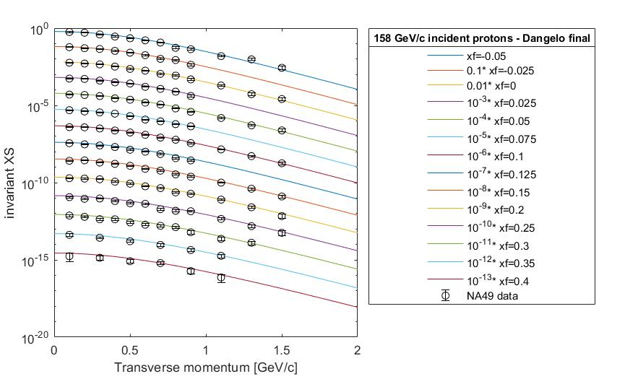
MODELING THE ANTIDEUTERONS PRODUCTION
We have used the available data on pbar production cross section to fit an analytical model to calculated the pbar production in CRs.
Propagation models
Pbar XS
Tune an analytical model on the data
Antiproton prediction
Cross section data on pbar
Cross section data on dbar
COALESCENCE MODEL
Galprop/HelMod
Comparison with CR data
Dbar XS
Tune an analytical model on the data
Example: comparison between the model and the NA49 data on pp collisions
Antideuteron prediction
francesco.dangelo13@unibo.it
AMS-Italy meeting – Bologna – 27/11/2024
16

Slide 17
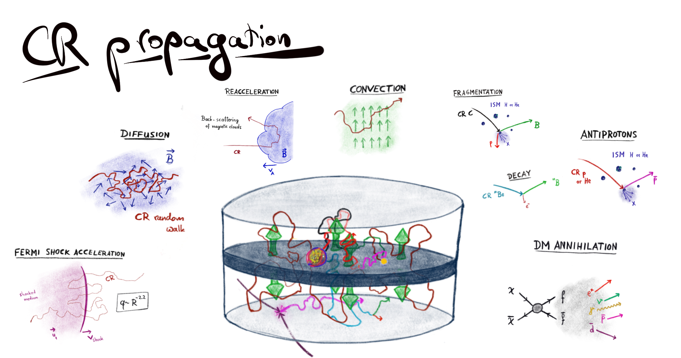
MODELING THE ANTIDEUTERONS PRODUCTION
We used the propagation model described in M. J. Boschini et al 2020 ApJS 250 27 and the framework Galprop/HelMod to predict the antiproton flux at the ISS.
The model can be used also to propagate the antideuterons in the Galaxy.
Propagation models
Pbar XS
Tune an analytical model on the data
Antiproton prediction
Cross section data on pbar
Cross section data on dbar
COALESCENCE MODEL
Galprop/HelMod
Comparison with CR data
Dbar XS
Tune an analytical model on the data
Antideuteron prediction
francesco.dangelo13@unibo.it
AMS-Italy meeting – Bologna – 27/11/2024
17

Slide 18
MODELING THE ANTIDEUTERONS PRODUCTION
We compared the predicted flux with the AMS data on the antiprotons Phys. Rep. 894, 1 (2021).
Propagation models
Pbar XS
Tune an analytical model on the data
Antiproton prediction
Cross section data on pbar
Cross section data on dbar
COALESCENCE MODEL
Galprop/HelMod
Comparison with CR data
Dbar XS
Tune an analytical model on the data
Antideuteron prediction
D’Angelo, Masi, Oliva - IL NUOVO CIMENTO 47 C (2024) 302
francesco.dangelo13@unibo.it
AMS-Italy meeting – Bologna – 27/11/2024
18

Slide 19
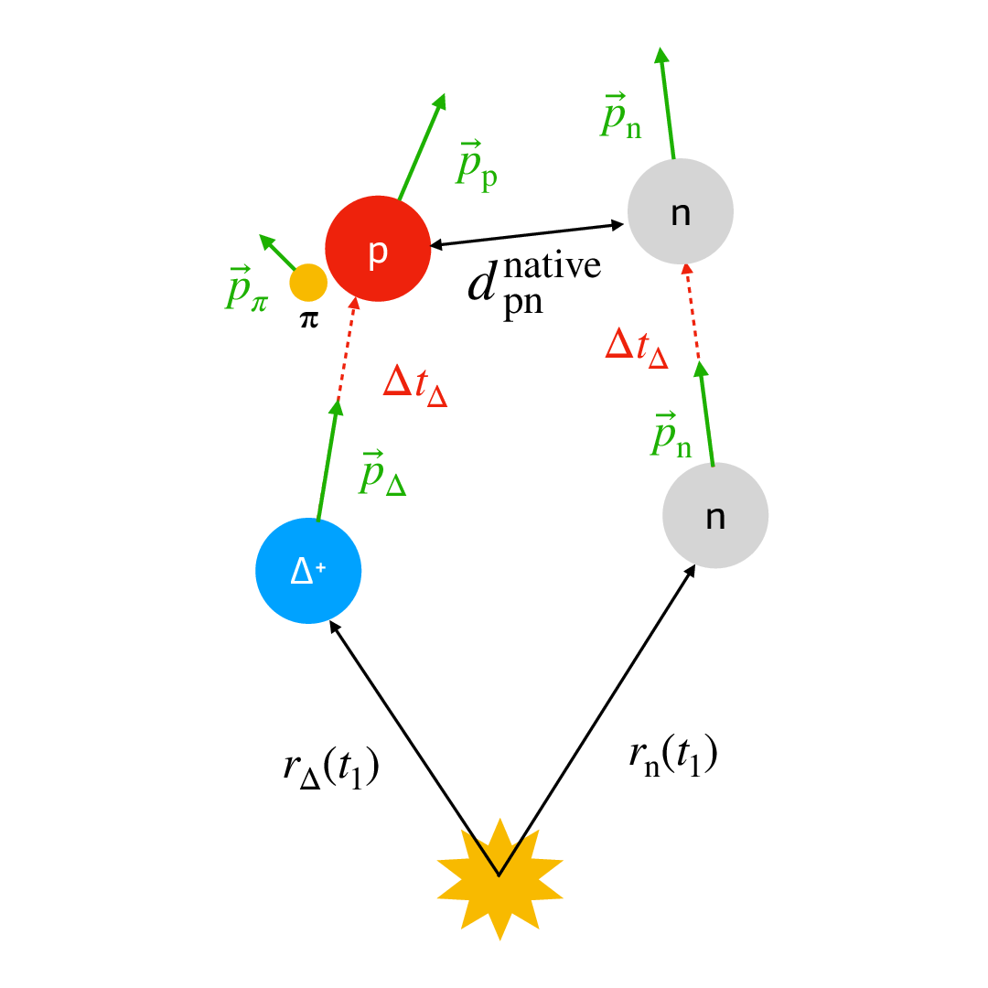
MODELING THE ANTIDEUTERONS PRODUCTION
If two antinucleons are produced near enough in coordinate and momentum space, they can merge and form an antideuterons.
The parameters of the coalescence model are tuned on dbar data.
Propagation models
Pbar XS
Tune an analytical model on the data
Antiproton prediction
Cross section data on pbar
$$\overline{d}$$
The antinucleon spectra is calculated using the pbar production cross section
Cross section data on dbar
COALESCENCE MODEL
Galprop/HelMod
Comparison with CR data
Dbar XS
Tune an analytical model on the data
Antideuteron prediction
COMING SOON
francesco.dangelo13@unibo.it
AMS-Italy meeting – Bologna – 27/11/2024
19

Slide 20
MODELING THE ANTIDEUTERONS PRODUCTION
The whole picture allows us to predict the secondary dbar production and compare with the experimental bound we will calculate with AMS (adding to the plot on the right the AMS data and our antideuteron prediction).
BESS Collaboration, PRL, 132, 131001 (2024)
Propagation models
Cross section data on pbar
Pbar XS
Tune an analytical model on the data
Antiproton prediction
COALESCENCE MODEL
Comparison with CR data
Cross section data on dbar
Galprop/HelMod
Dbar XS
Tune an analytical model on the data
Antideuteron prediction
COMING SOON
francesco.dangelo13@unibo.it
AMS-Italy meeting – Bologna – 27/11/2024
20

Slide 21
SUMMARY
Antideuterons search in on-going, using Machine Learning algorithm to suppress the background.
Training classificators using MC events is very difficult: we don’t have enough statistics when creating the background samples.
Using the IT alone is difficult to clean further the samples. Furthermore, using ML algorithms based on the TRD variables can improve our analysis.
L1 is needed in the analysis.
We have started to cleaning the agl range using DNNs.
Efficiencies correction calculations in ongoing.
We have an analytical model to predict the antiproton secondary production in cosmic collision. It’s the starting point to predict the antideuterons using a coalescence model.
francesco.dangelo13@unibo.it
AMS-Italy meeting – Bologna – 27/11/2024
21

