Slide 2
Contents
Introduction
Prototypes with industry
Preparing series production: the cavity example
Series production better than prototypes

Slide 3
Contents
Introduction
Prototypes with industry
Preparing series production: the cavity example
Series production better than prototypes

Slide 4
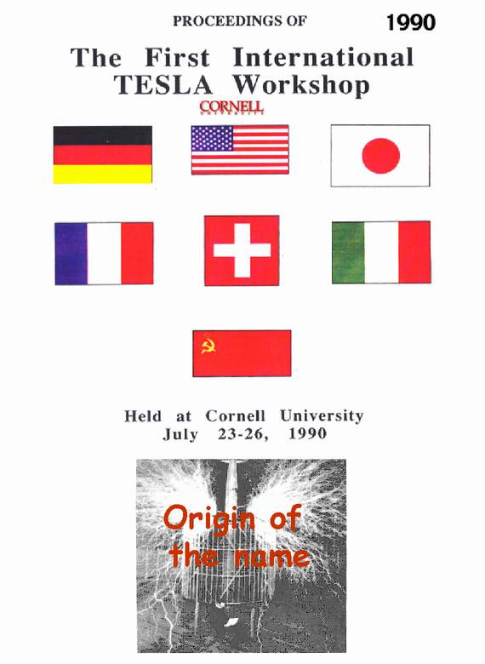
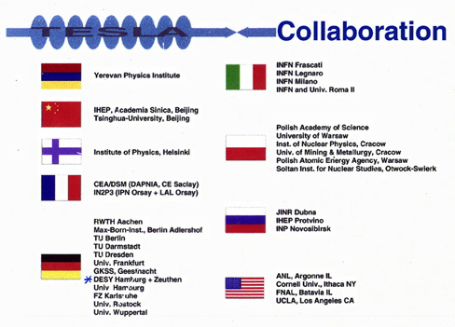
Eu-XFEL by-product of TESLA
The European XFEL has been the by-product of TESLA, the Superconducting Linear Collider developped since 1990 by a large International Collaboration
as in 1992

Slide 5
The goals of the TESA Mission
Basic goals on SRF Technology
  Increase gradient by a factor of 5: from 5 to 25 MV/m
    Push cavity performances close to the physical limit, understanding practical limits
    Set all the required quality control for reproducibility and industrial production
  Make possible pulsed operation: Lorentz force detuning
    Combine SRF and mechanical engineering in cavity design
    Develop efficient Modulators and Klystrons
    Develop new ancillaries: slow and fast tuners, couplers
  Reduce cost per MV by a factor 20: to make the LC feasible
    New cryomodule concept for cryolosses, cost and filling factor (for real estate gradient)
    All subsystems designed for large scale production
    Reliability and quality control as a general guideline
Basic goals on Machine Design
  Design a Linear Collider based on the Cold Linac peculiarities
  Maximize Luminosity and optimize cost for a given plug power
  Design and quote major subsystems: DR, Positron Source, BDS, etc.
  Put all together in a consistent TDR, including cost estimation

Slide 6
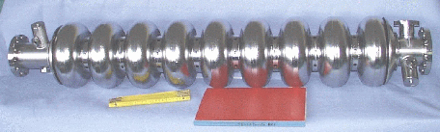
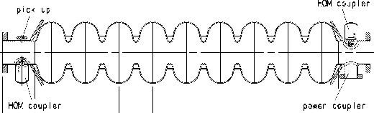
First Steps of the TESLA Game
Major contributions from: CERN, Cornell, DESY, CEA-Saclay, INFN-LASA
9-cell, 1.3 GHz
TESLA cavity parameters
R/Q | 1036 | W
E_{peak}/E_{acc} | 2.0
B_{peak}/E_{acc} | 4.26 | mT/(MV/m)
Δf/Δl | 315 | kHz/mm
K_{Lorentz} | ≈ -1 | Hz/(MV/m)²

Slide 7
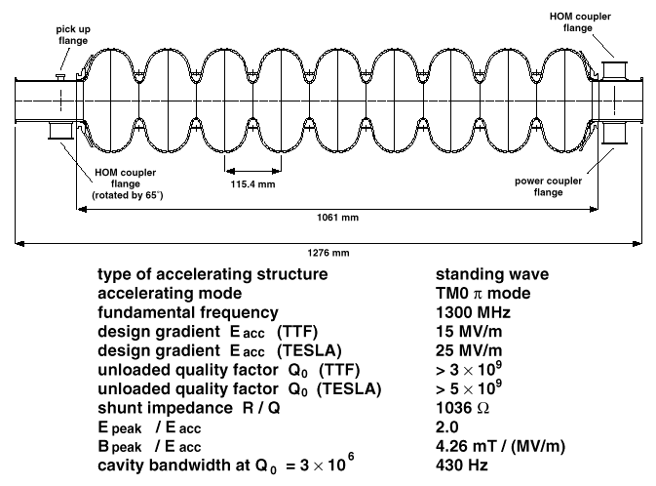
TESLA cavity design and rules

Slide 8
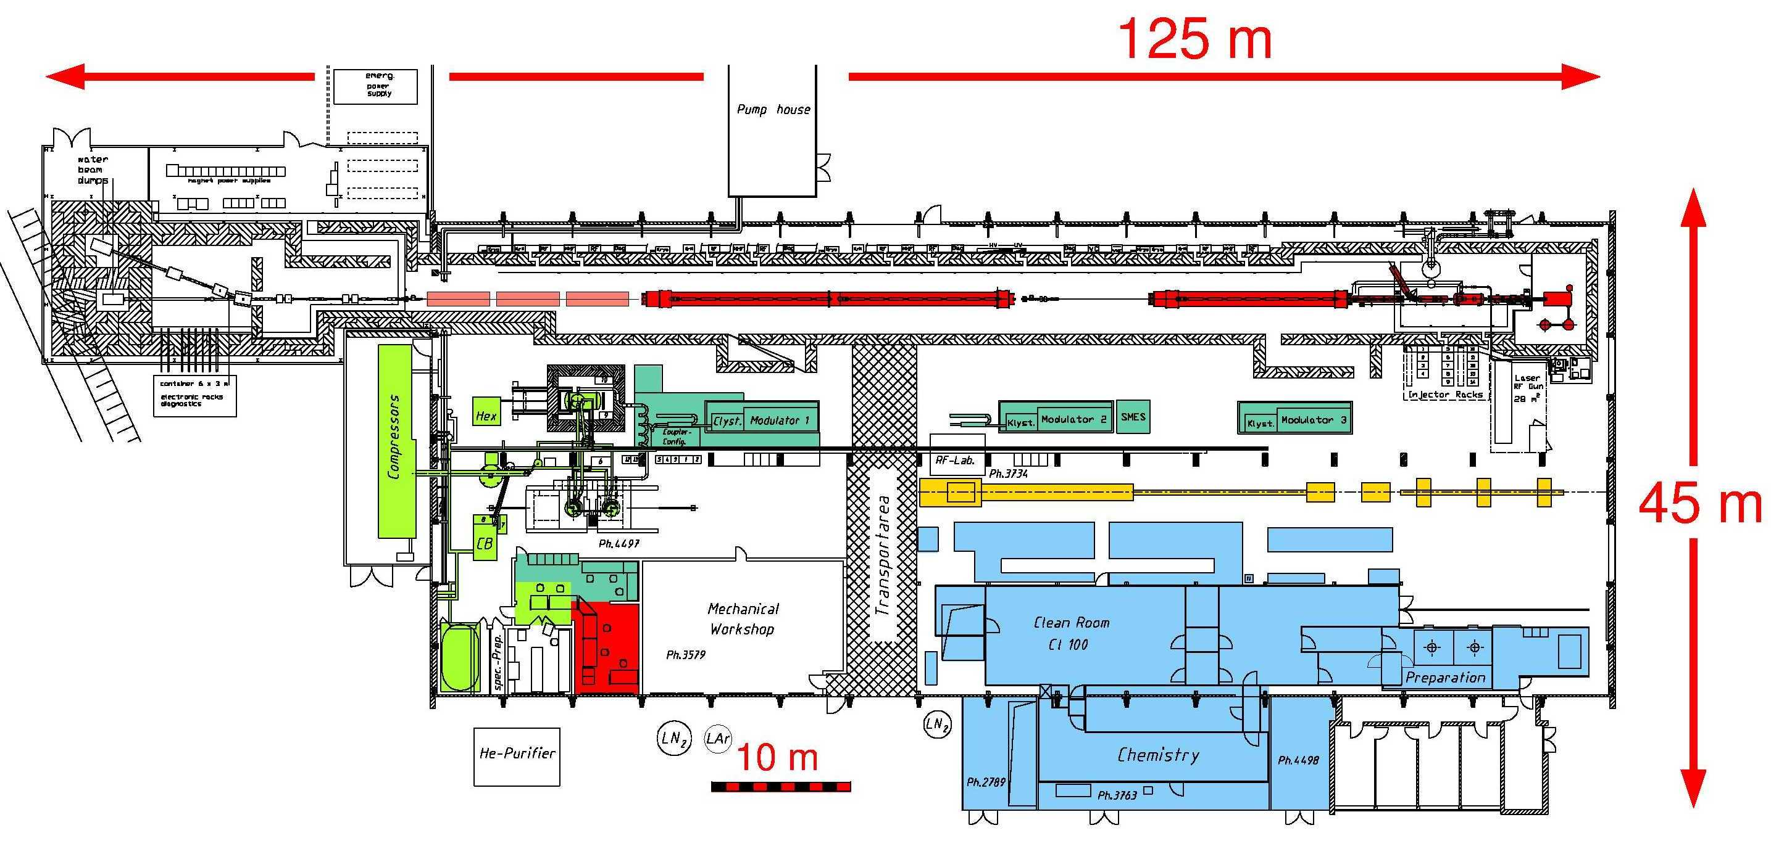
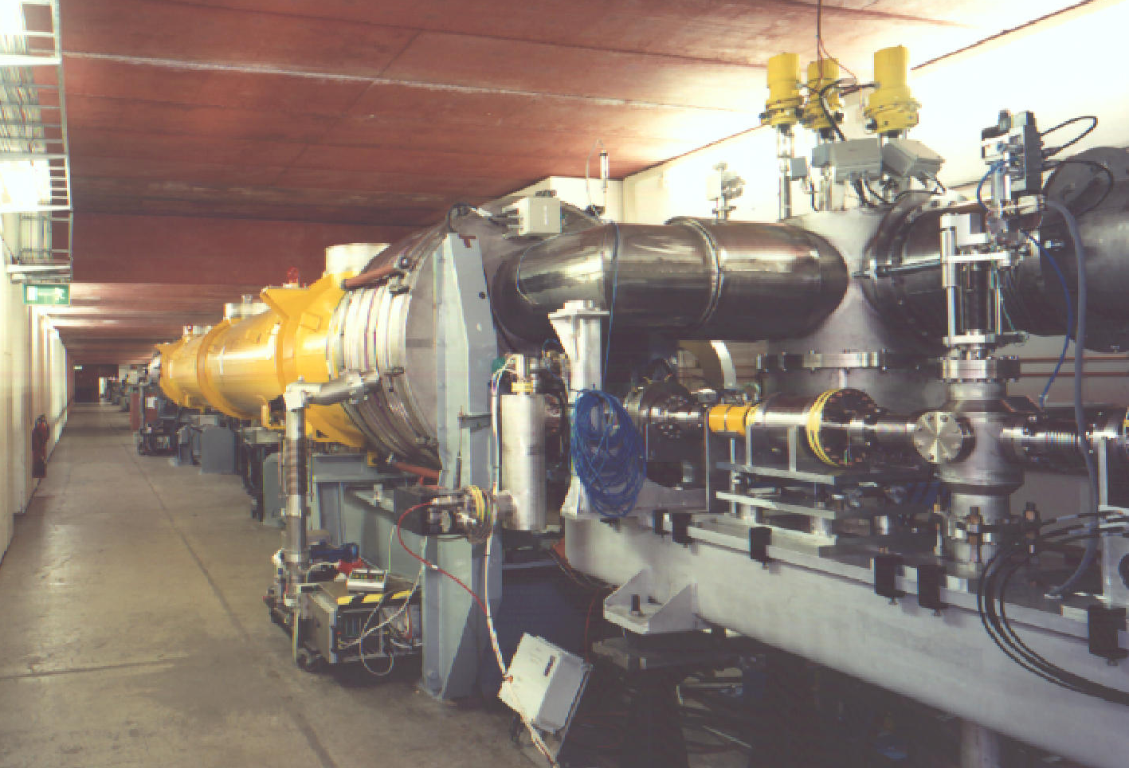
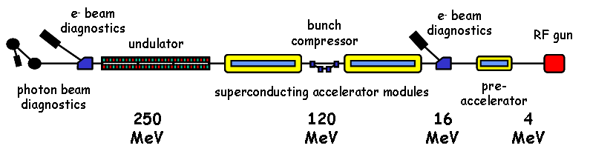
TTF: a new infrastructure at DESY
TTF as operated for SASE FEL

Slide 9
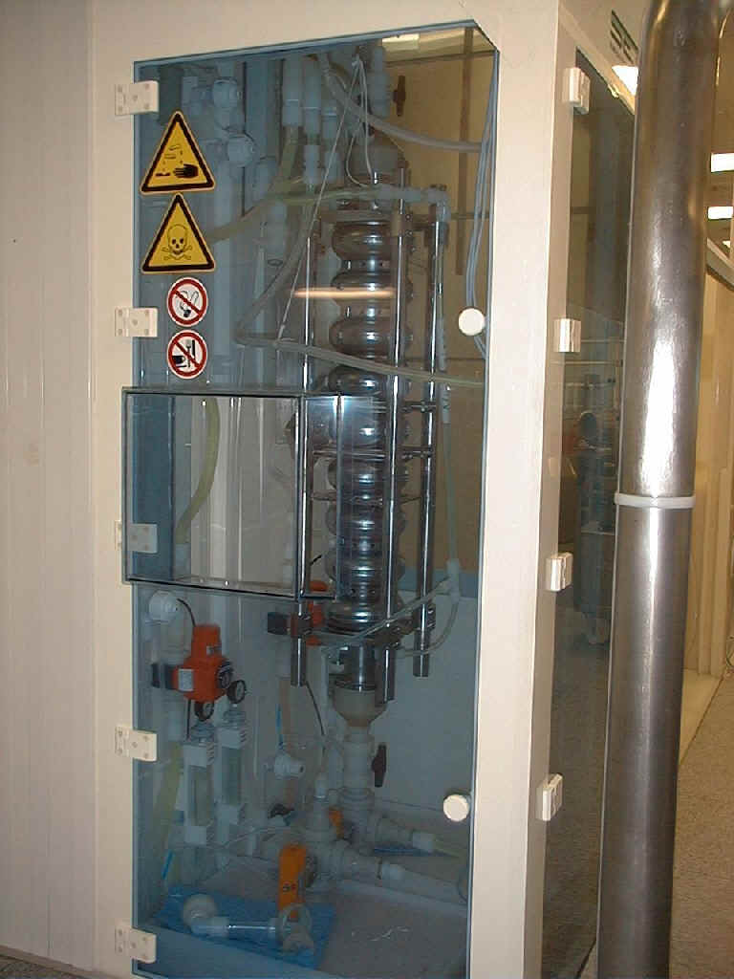
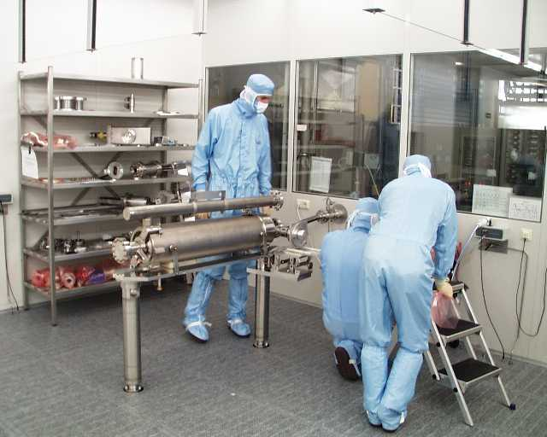
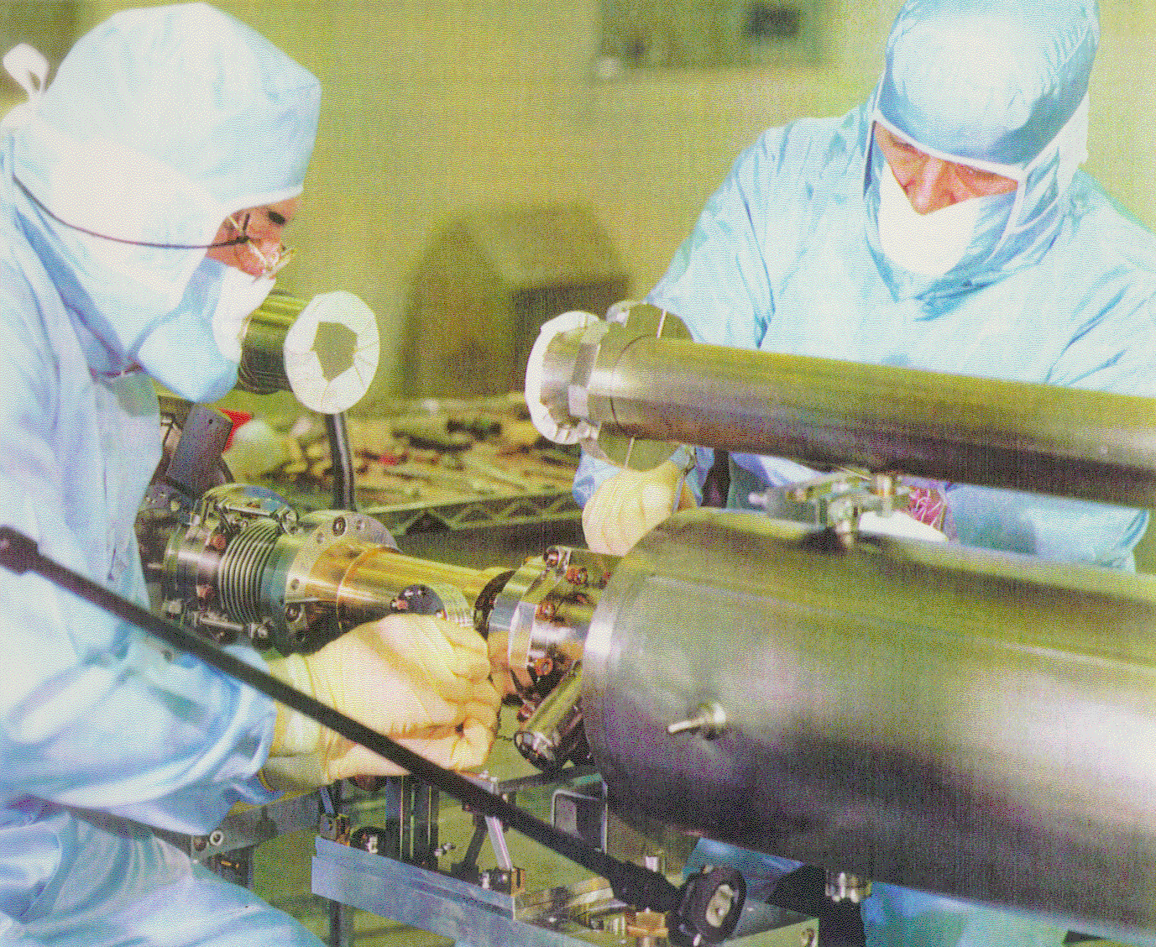
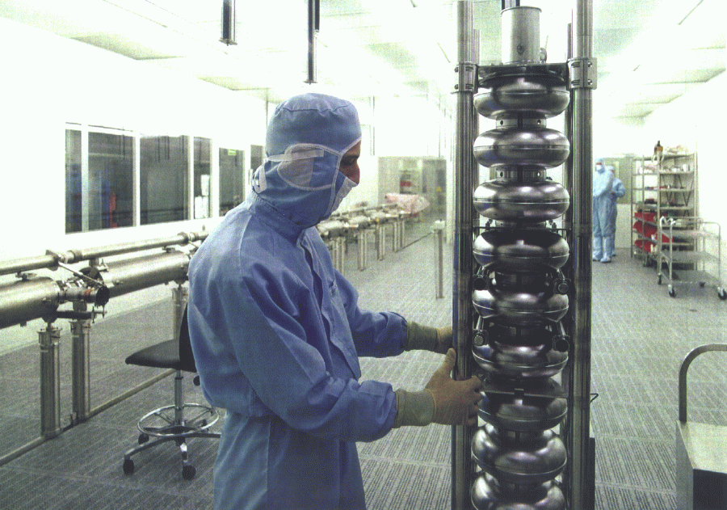
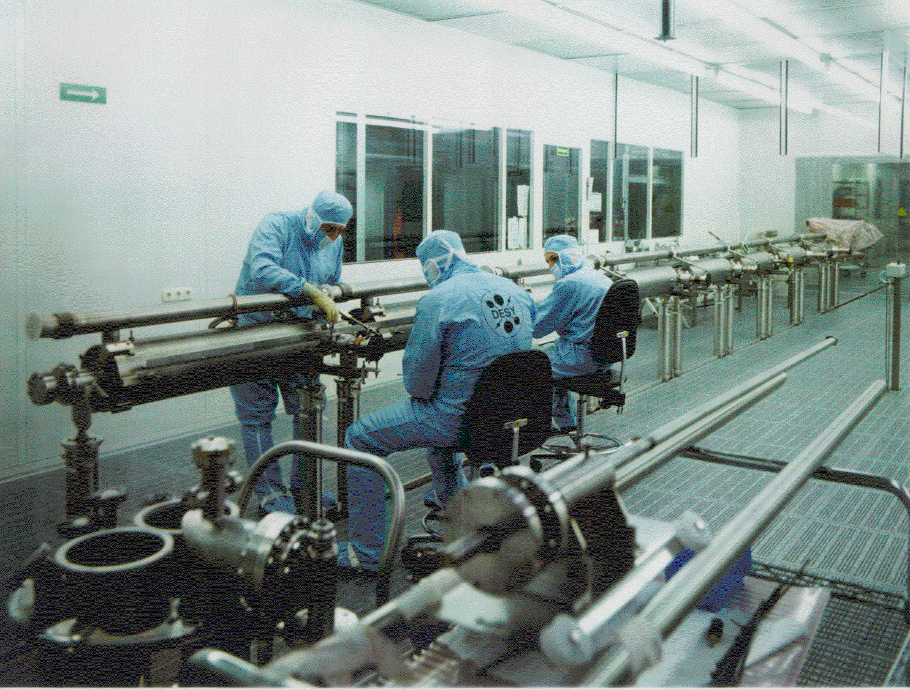
Preparation of TESLA Cavities

Slide 10
Contents
Introduction
Prototypes with industry
Preparing series production: the cavity example
Series production better than prototypes

Slide 11
The way to improve SRF Performances
In parallel with the machine design, all major TESLA sub-components have been conceived, designed and protopyped for TTF.
Most of the process has been performed in strict collabotration with industry.
Concerning SRF cavities, all the technology already mastered by industry have been further improved with the help of Labs experience. All the mechanical fabrication done in industry.
The acquisition of an EB Welding machine at DESY had the strong opposition by the Director Biorn Wiik
The matured experience on the Niobium welding has been transferred directly from Labs to industry
Clean room operation and special surface treatments were developped at the DESY infrastructure and promptly tranferred to Industry

Slide 12
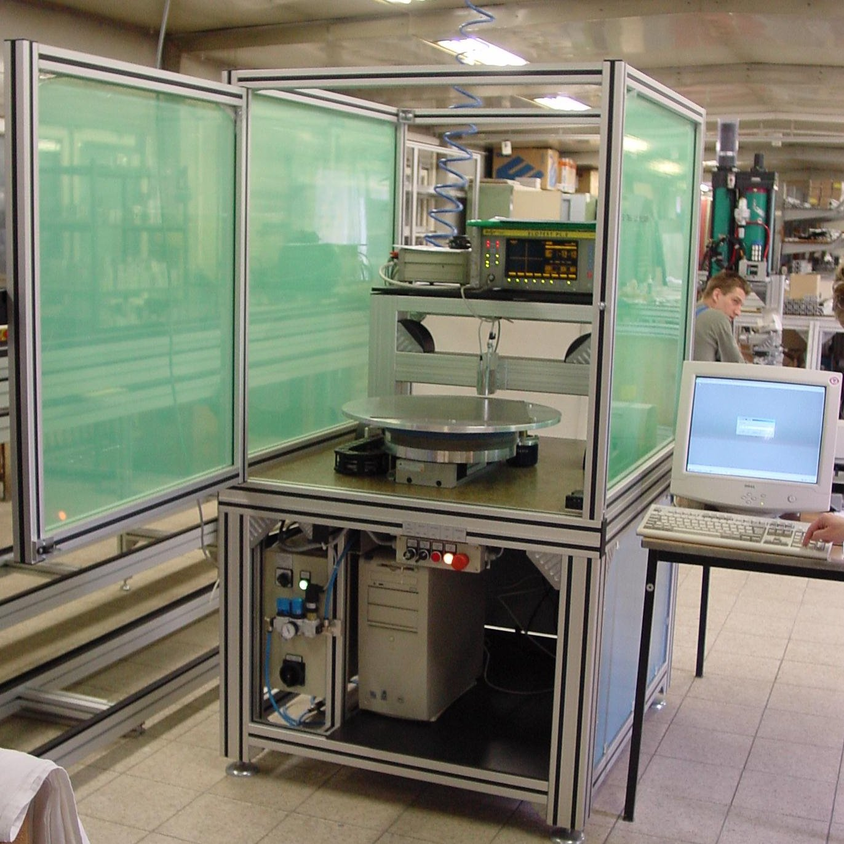
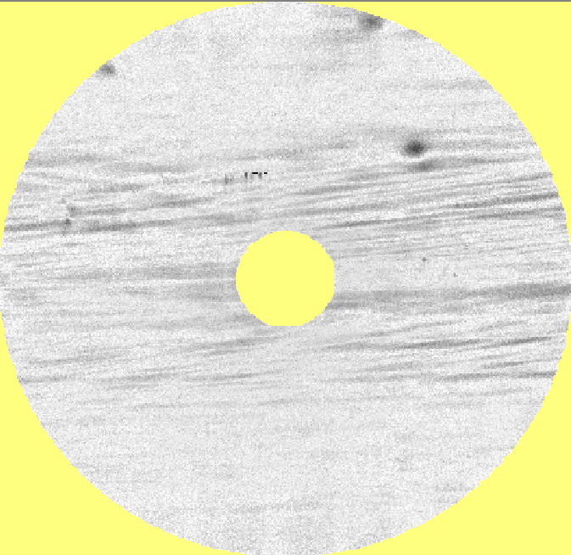
Eddy Current Scanner for Nb Sheets
Scanning results
Rolling marks and defects are visible on a niobium disk to be used to print a cavity half-cell.
Surface analysis is then required to identify the inclusions

Slide 13
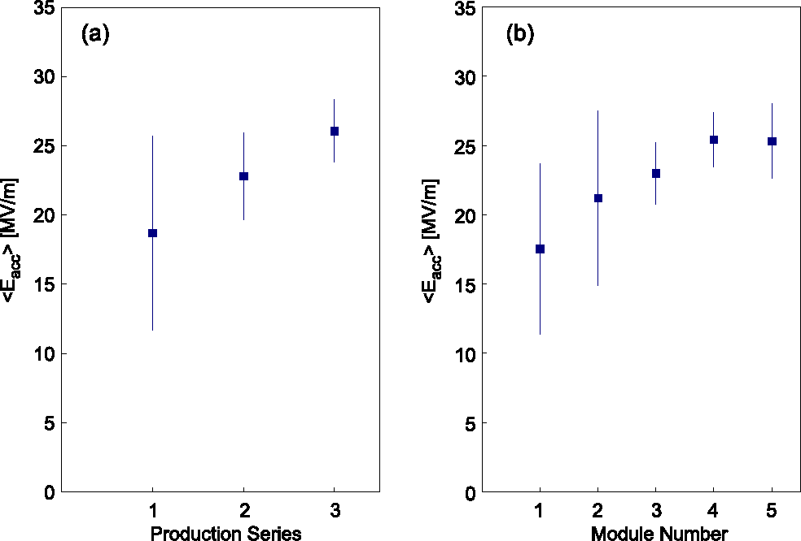
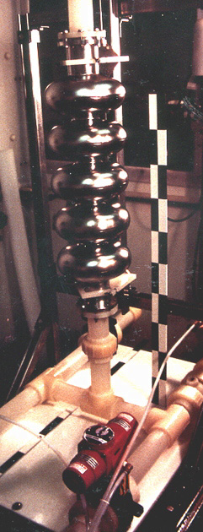
Learning curve with BCP
BCP = Buffered Chemical Polishing
3 cavity productions from 4 European industries: Accel, Cerca, Dornier, Zanon
Cornell
1995
<E_{acc}> @ Q₀ ≥ 10¹⁰
<E_{acc}> @ Q₀ ≥ 10¹⁰
at Q = few 10⁹
<2001>
<1999>
<1997>
Improved welding
Niobium quality control
Module performance in the TTF LINAC
5-cell

Slide 14
3rd cavity production with BCP
Still some field emission at high field
Q-drop above 20 MV/m not cured yet
AC67 discarded (cold He leak)
TESLA original goal
Vertical CW tests of naked cavitis

Slide 15
Further Improvement with EP
EP (Electro-Polishing) developed at KEK by Kenji Saito (originally by Siemens)
Coordinated R&D effort: DESY, KEK, CERN, CEA-Saclay & INFN LASA
9-cell EP cavities from 3rd production
EP at Nomura Plating (Japan) by KEK
1400 °C heat treatment
AC76: just 800 °C annealing
TESLA 800 specs:
35 MV/m @ Q₀ = 5 × 10⁹
Vertical CW tests of naked cavitis

Slide 16
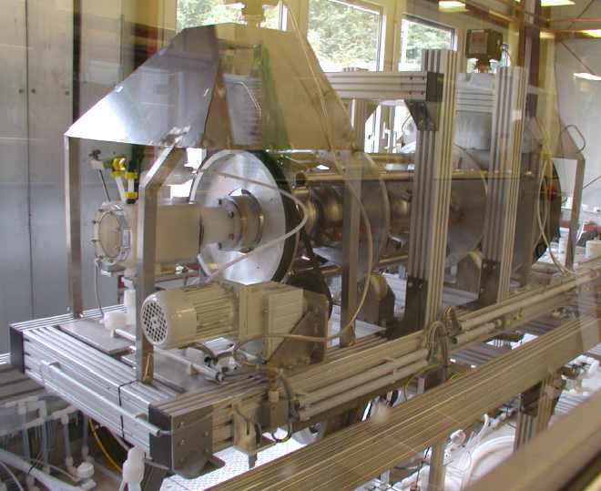
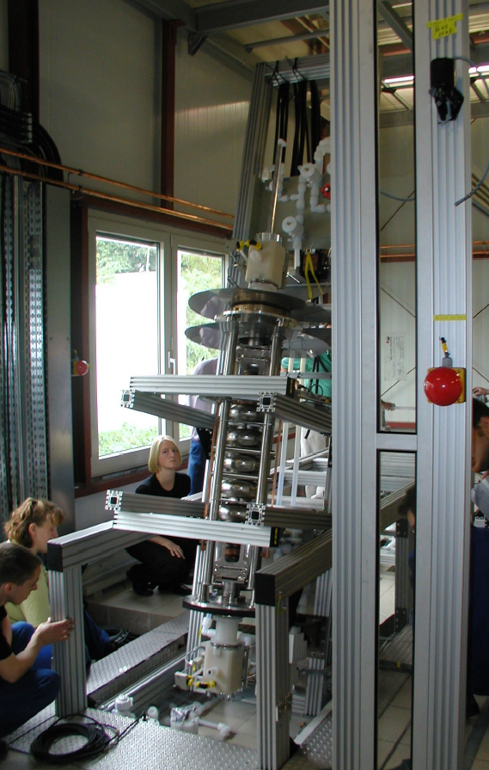
EP at DESY from the KEK Experience

Slide 17
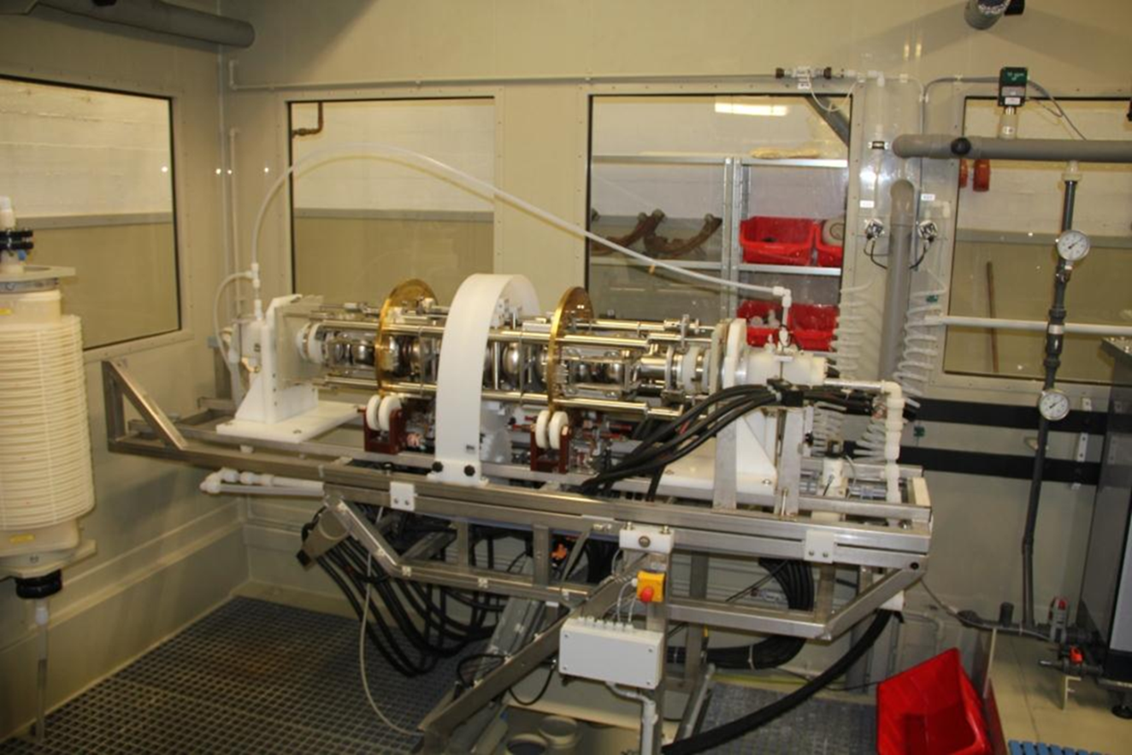
EP system at RI

Slide 18
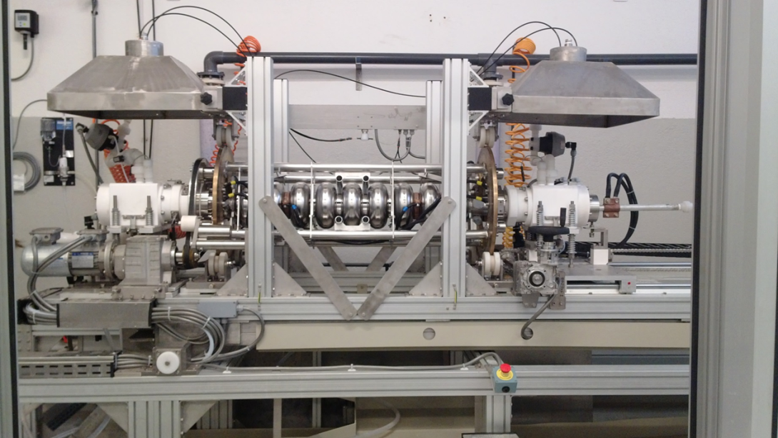
EP system at Zanon
Courtesy EZ

Slide 19
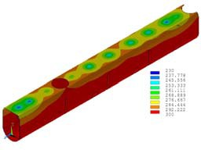
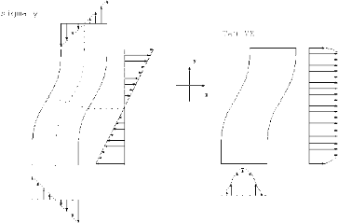
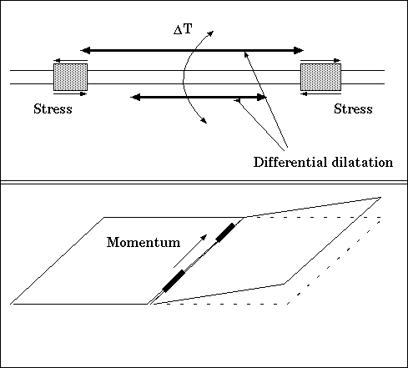
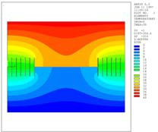
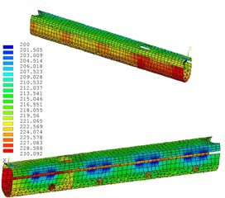
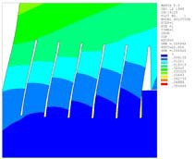
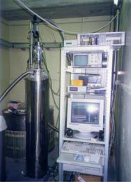
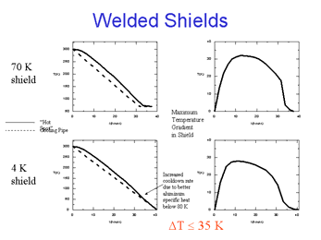
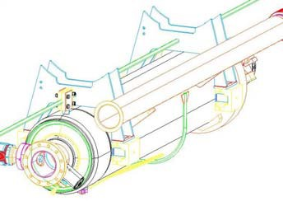
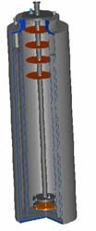
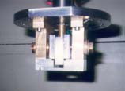

Not Just Cavities: From Prototype to Cry 3
Extensive FEA modeling (ANSYS™) of the entire cryomodule
Transient thermal analysis during cooldown/warmup cycles,
Coupled structural/thermal simulations
Full nonlinear material properties
Detailed sub-modeling of new components and Laboratory tests
Finger-welding tests at ZANON
Cryogenic tests of the sliding supports at INFN-LASA

Slide 20
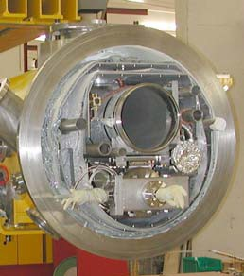
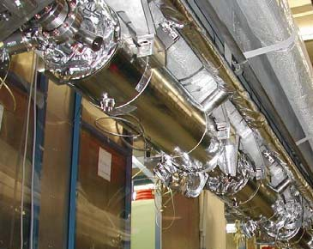
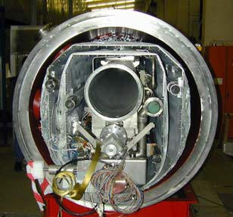
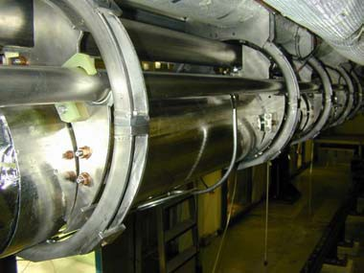

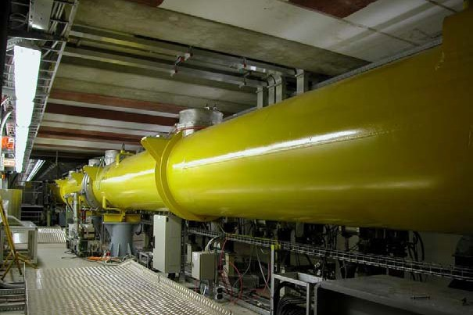
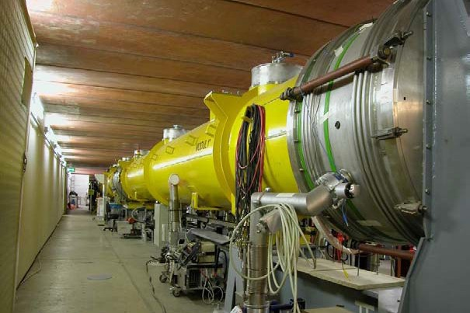
Cryomodule Evolution in TTF-II
ACC 5
ACC 4
ACC 3
ACC 2
ACC 1
RF gun
800 MeV
400 MeV
120 MeV
4 MeV
ACC 4 & ACC 5
ACC 2 & ACC 3
ILC Acc. Workshop
16 August 2005

Slide 21
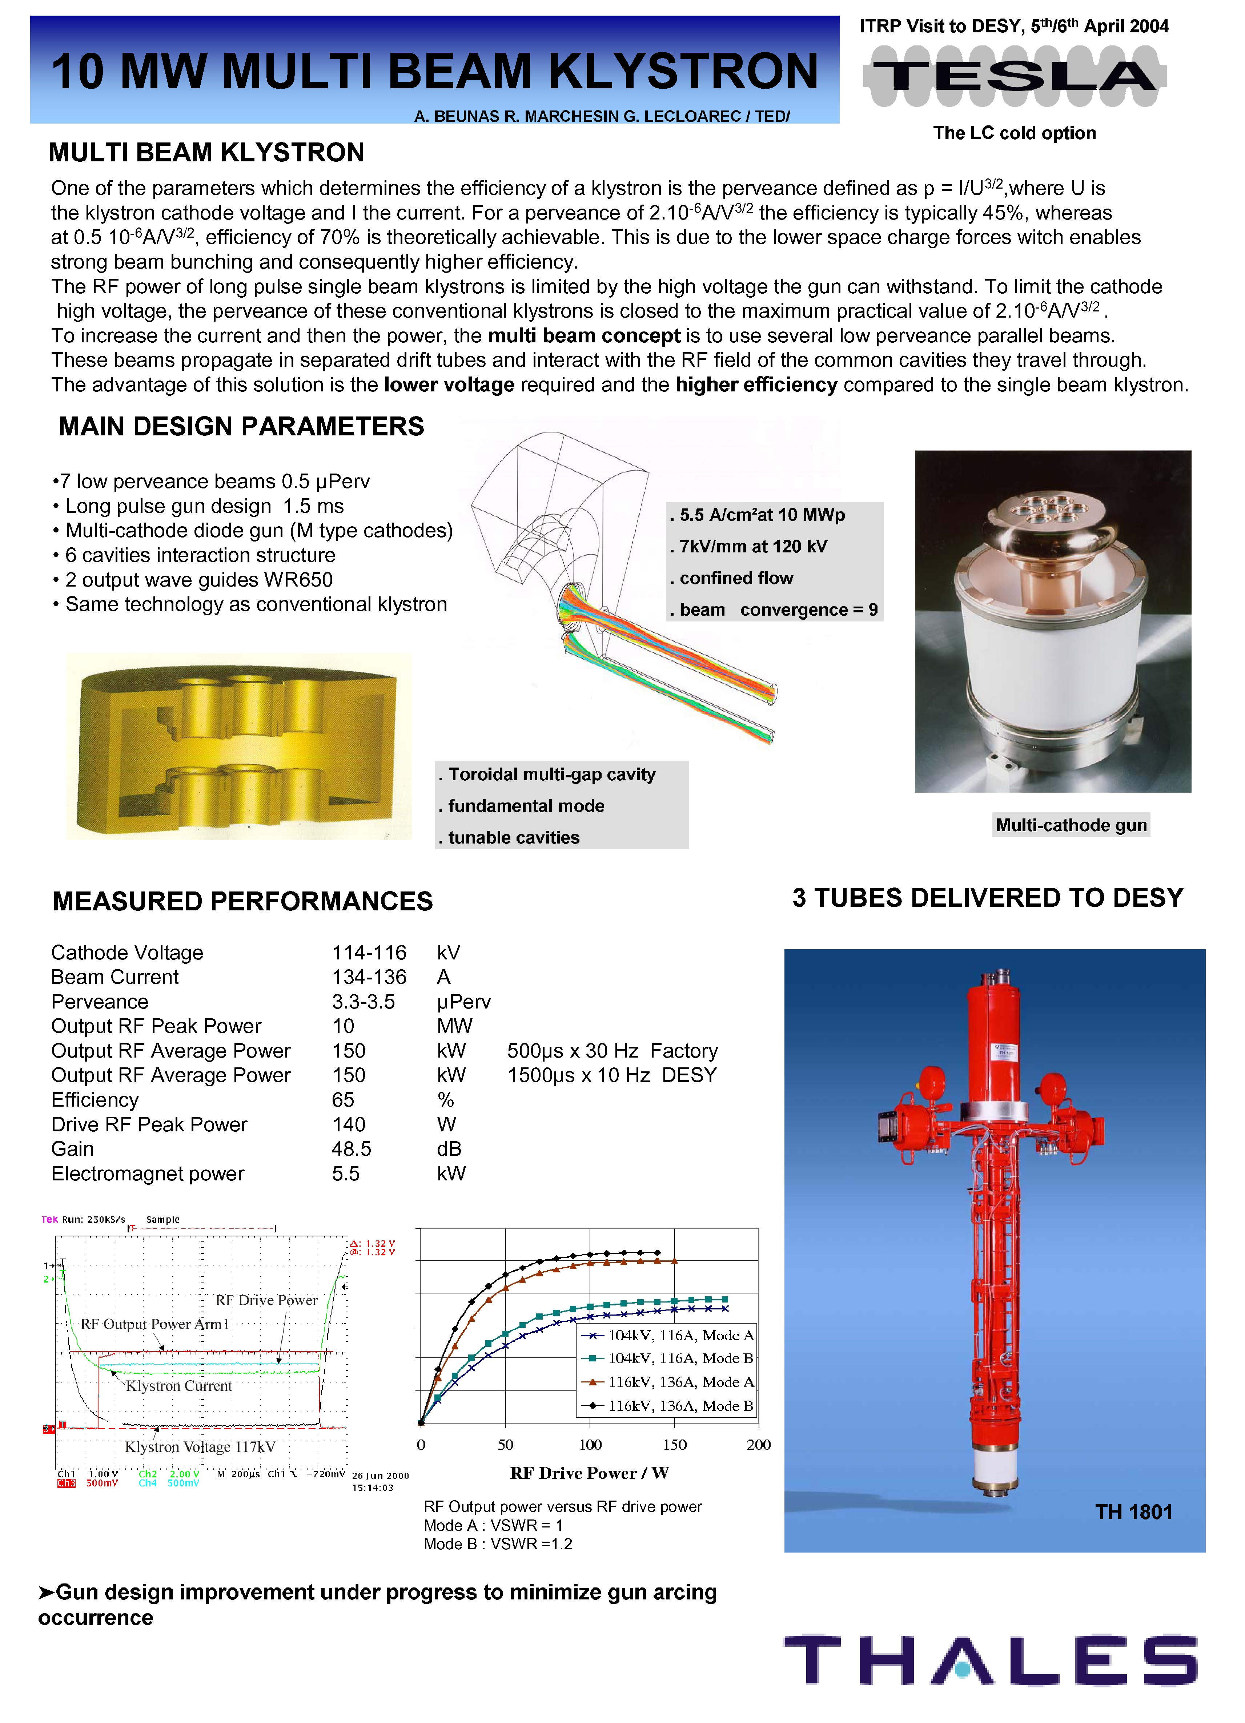
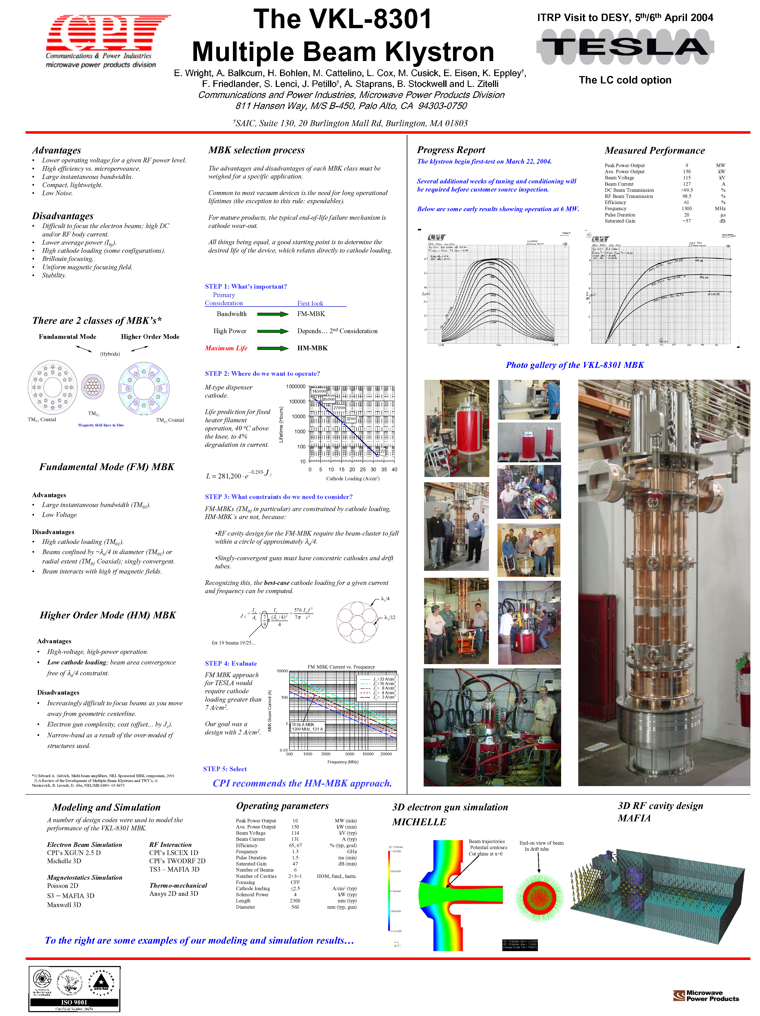
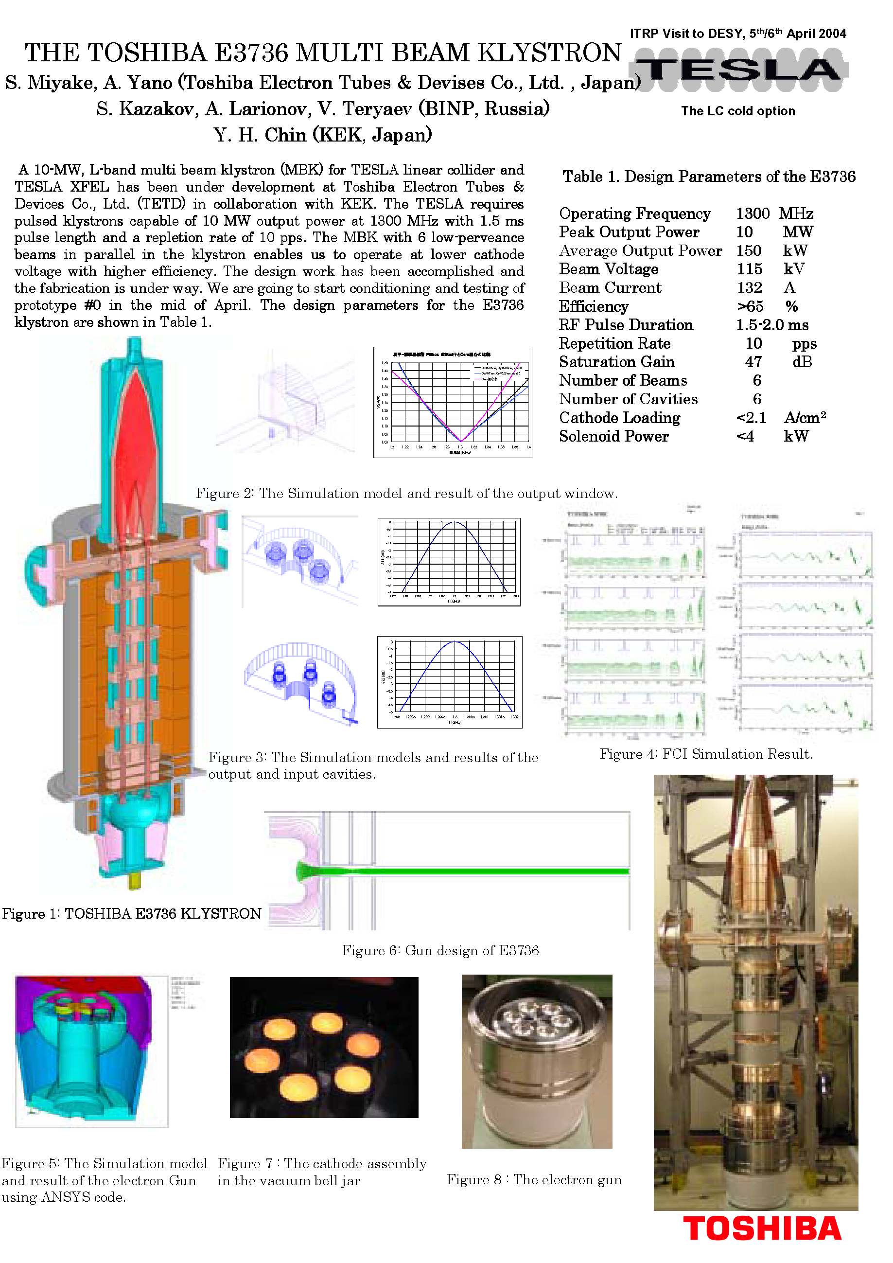
10 MW Klystrons Developped by Industry

Slide 22
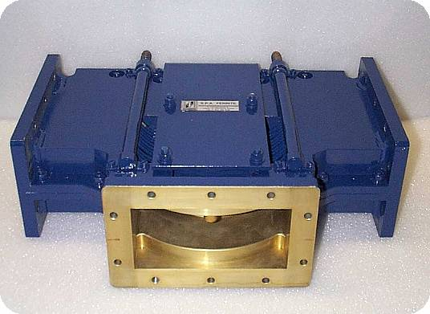
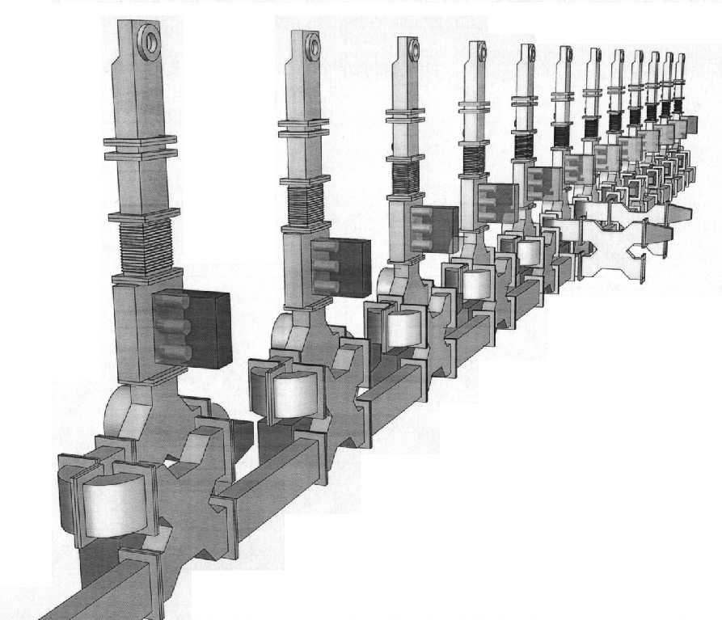
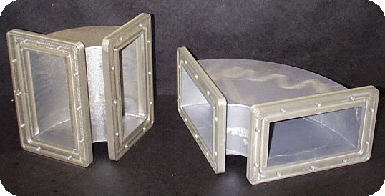
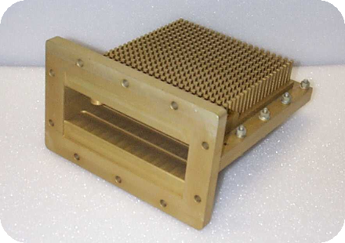
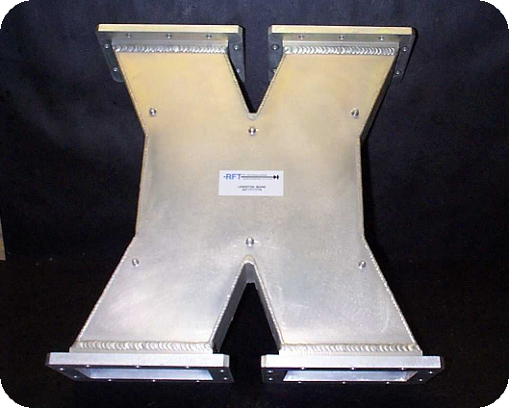
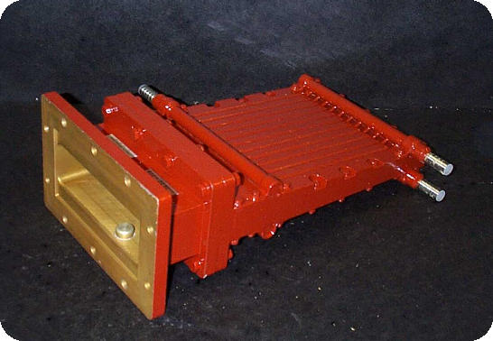
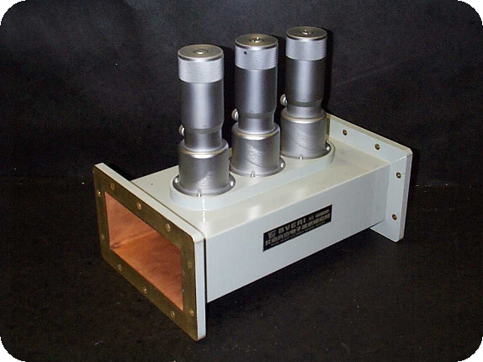
RF Waveguide Components @ 1.3 GHz
3 Stub Tuner (IHEP, Bejing, China)
E and H Bends (Spinner)
Circulator (Ferrite)
Peak Power = 0.4 MW
Peak Power = 2 MW
Hybrid Coupler (RFT, Spinner)
RF Load (Ferrite)
RF Load (Ferrite)
Peak Power = 5 MW
Peak Power = 1 MW

Slide 23
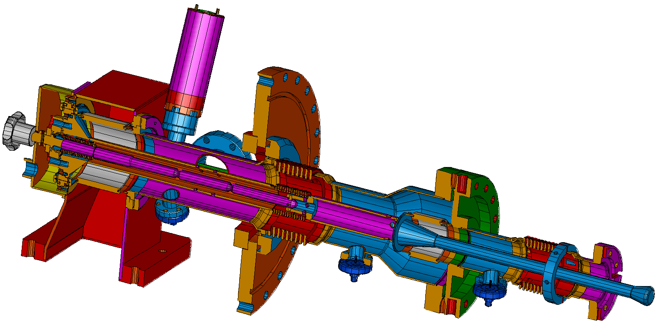
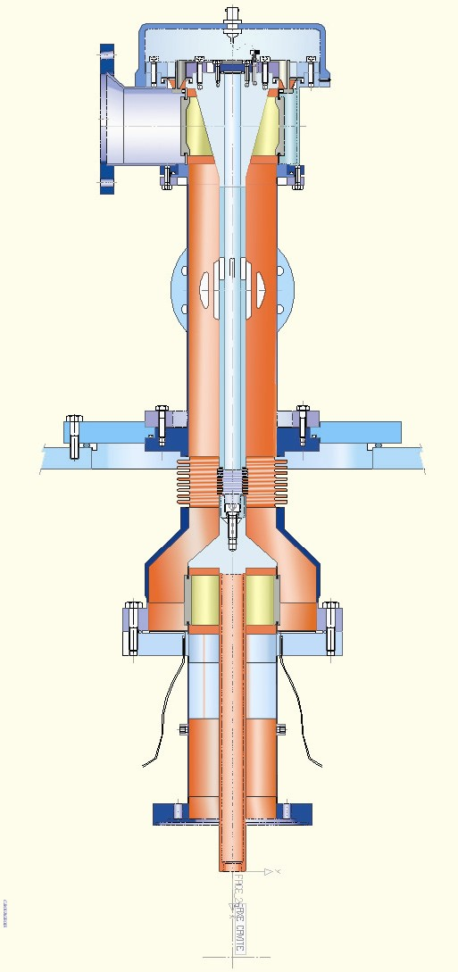




Ancillaries: Coupler R&D at LAL-Orsay
Alternative Designs
TTF III Design
High Power Coupler Test Stand
Clean room assembly

Slide 24




Ancillaries: Cavity Tuners
The Saclay Tuner in TTF
The INFN Blade-Tuner
Successfully operated with superstructures

Slide 25
RF Distribution: the TESLA RF Unit
1 klystron for 3 accelerating modules, 12 nine-cell cavities each
vector modulator
MBK Klystron
DAC
circulator
DAC
Mechanical tuner
(frequency adj.)
and piezo-electric tuner
(Lorentz force compensation)
stub tuner (phase & Qext)
Low
Level
RF System
coaxial coupler
cavity #1
cavity #12
vector sum
pickup signal
ADC
accelerator module 1 of 3
ADC
vector demodulator

Slide 26
Pulse Transformer Modulator Layout

Slide 27

New QC tools in 4th Production
© V. Singer

Slide 28



TESLA Technical Design Report: March 2001
As in the TDR
Updated tunnel cross section

Slide 29






Industrial Studies for TESLA TDR & E-XFEL

Slide 30


Cavity Fabrication Industrial Studies
Production Plan for 20,000 cavities

Slide 31



TTF2 as XFEL Injector Prototype
e⁻ beam
BC3 BC2
RF-GUN
ACC5 ACC4 ACC3 ACC2 ACC1
500 MeV

Slide 32

Outstanding Results with module # 5
6 cavities exceed 30 MV/m
1 cavity shows field emission at high field
1 cavity is quenching at 25 MV/m
5 Hz Test limited to demonstrate 25 MV/m module

Slide 33




TESLA/XFEL Milestones
July 1990 – 1° International TESLA Workshop @ Cornell University
February 1992 – 1° TESLA Collaboration Board Meeting @ DESY
March 1993 - “A Proposal to Construct and Test Prototype Superconducting RF Structures for Linear Colliders”
March 1995 -TESLA Test Facility Linac Design Report
SASE FEL included in TESLA → TTF 2
May 1996 – first beam at TTF1
March 2001 – TESLA Technical Design Report with XFEL. First SASE-FEL Saturation at TTF
July 2002 – from the German Science Council: Two independent projects: TESLA X-FEL and TESLA LC
February 2003 –TESLA X-FEL proposed as an European Facility, 50% funding from Germany
June 2004 – TTF II: First beam accelerated
August 2004 – TESLA Technology chosen for ILC
June 2007 – European XFEL Project Starts
Infrastructure
@ DESY in Hall 3
TTF I
TTF II
TESLA Collider
TESLA X-Ray FEL

Slide 34
TTF: 10 years of experience
Taking into account all data from 1995
E_{acc} = ½ E_{surf}

Slide 35
Contents
Introduction
Prototypes with industry
Preparing series production: the cavity example
Series production better than prototypes

Slide 36
European XFEL Cavity Production - 1
At the end of the long prequalification process (TTF, FLASH, ILC,…)
Ettore Zanon, EZ & Research Instruments, RI
were contracted at the end 2010 to produce each
8 Cavities for infrastructure rump/up and qualification
  4 Dummy CVs (DCV), 4 Reference CVs (RCV)
280 XFEL type series cavities (first 8 are PCV)
12 ILC HiGrade cavities
Additional 120 cavities allocated end 2012 to each companiy
Nb & NbTi supplied by DESY
Production precisely following detailed specifications which also include the exact definition of infrastructure to be used (build to print)
Final treatment after main EP: final EP for RI / flash BCP for EZ

Slide 37
European XFEL Cavity Production - 2
No performance guaranty by the vendors, i.e. the risk of unexpected low gradient or field emission is taken over by XFEL/DESY (responsibility for re-treatment).
Goal: average usable XFEL gradient 23.6 MV/m at Q₀=1x10¹⁰, X-Rays <1x10⁻²mGy/min
First series cavities (PCV) to be delivered end 2012 – begin 2013
All cavities to be delivered till end 2014 – begin 2015
Delivery rate: about 8 CVs/week (4/each vendor)
Supervision of the CV production: DESY & INFN/LASA

Slide 38

Treatments as from Experience on Prototype

Slide 39









e-Documentation in EDMS - Data Bank
Fabrication
EDMS
Cavity-DB
Document
Phys. Part
Files
Inspection sheet
Data
Statistical analysis
Inspection sheets for QM documentation
Fabrication structure. Subassembly parts related. Procedure related
All XFEL SC cavity documents (specifications, inspection sheets, meeting minutes, PED data etc.) recorded in EDMS
EZ and RI have access to documents and data (to relevant only)

Slide 40






PED Activities and TUEV Control
Test piece (TP) is composed by 2 cell with helium vessel, without end groups, representing all pressure bearing parts and welds. It is built using exactly the same manufacturing methods and welding parameters that will be later used for production. Two EBW machines/company. Then two test pieces had been built.

Slide 41
Good performance of reference cavities
8 RCVs: acceptance test successful
D.Reschke, A.Sulimov, D.Kostin

Slide 42

Major Infrastructures at EZ & RI
2 EBW (Electron Beam Welding) plants, equipped with cryo-pumps
ISO 7 and ISO 4 Clean Rooms with cleaning and rinsing facility
UPW (Ultra Pure Water - 18 MΩ·cm) production system (>3000 l/h)
HPR (High Pressure Rinsing – 100 bar) apparatus
800 °C and 120 °C ovens operating with High Vacuum.
Cavity Tuning Machine, CTM, provided by DESY
RF tests set up (for HalfCell, DumbBells and EndGroups), provided by DESY
US (Ultra Sonic) cleaning baths
Complete chemical processing plants (EP, BCP or both)
Cavity internal visual inspection systems

Slide 43

Special Equipments installed in Industry

Slide 44


CTM cavity tuning machine and HAZEMEMA
DESY developed, build and delivered to both companies a cavity tuning machine CTM and equipment for RF measurement on half cells, dumb-bells and end groups HAZEMEMA
CTM and HAZEMEMA installed at RI
CTM in installation at EZ

Slide 45



Cavity Infrastructure Layout at EZ
Building layout: clean rooms ISO10, ISO7, ISO4, US and BCP treatment, 120ºC baking, 800ºC oven, EBW, tuning machine etc.

Slide 46




Examples of EZ Infrastructure (courtesy of EZ)
New EBW machine
New oven for 800ºC treatment
Borescope for optical inspection

Slide 47




Examples of EZ Infrastructure (courtesy of EZ)
US cleaning and BCP in ISO 10 clean room
ISO 4 installed in the new building
The UPW (Ultra Pure Water) production system

Slide 48

Deep Defect Analysis Capability @ Labs - 1
Topographical defects at the welding seams

Slide 49

Deep Defect Analysis Capability @ Labs - 2
Etching pits: EBSD with strain maps via grain reference orientation deviation (GROD)

Slide 50

Deep Defect Analysis Capability @ Labs - 3
Dangerous surface defects generated by bad HPR (Hihg Pressure Water rinsing)

Slide 51
Contents
Introduction
Prototypes with industry
Preparing series production: the cavity example
Series production better than prototypes

Slide 52
1.3 GHz E-XFEL cavities «as received»
EP
BCP
RI
EZ
RI
EZ

Slide 53




As Received Maximum Gradient
200 W P_{for} limit

Slide 54


As Received Usable Gradien
23.6 MV/m
Include operations spec
  Q₀ ≥ 1×10¹⁰
  FE threshold (X-ray)
→ Usable Gradient

Slide 55

As Received Usable Gradient
Include operations spec
  Q₀ ≥ 1×10¹⁰
  FE threshold (X-ray)

Slide 56
Final performance: Eacc
Total after 313 retreatments performed on 237 of the 831 cavities
Before:
E max 31.4 ± 6.8 [MV/m]
(RI): E max 33.0 ± 6.5 [MV/m])
(EZ): E max 29.8 ± 6.6 [MV/m])
After:
E max 33.0 ± 4.8 [MV/m]
(RI): E max 34.7 ± 4.4 [MV/m])
(EZ): E max 31.5 ± 4.9 [MV/m])
Before:
E usable 27.7 ± 7.2 [MV/m]
(RI): E usable 29.0 ± 7.3 [MV/m])
(EZ): E usable 26.4 ± 6.6 [MV/m])
After:
E usable 29.8 ± 5.1 [MV/m]
(RI): E usable 31.2 ± 5.2 [MV/m])
(EZ): E usable 28.6 ± 4.8 [MV/m])

Slide 57
Final performance: Q0
Total after 313 retreatments performed on 237 of the 831 cavities
Before :
Q0 @ 4 MV/m 2.15 ± 0.32 [1.10¹⁰]
(RI): Q0 @ 4 MV/m 2.11 ± 0.32 [1.10¹⁰])
(EZ): Q0 @ 4 MV/m 2.18 ± 0.32 [1.10¹⁰])
After:
Q0 @ 4 MV/m 2.23 ± 0.34 [1.10¹⁰]
(RI): Q0 @ 4 MV/m 2.21 ± 0.34 [1.10¹⁰])
(EZ): Q0 @ 4 MV/m 2.26 ± 0.33 [1.10¹⁰])
Before:
Q0 @ 23.6 MV/m 1.31 ± 0.26 [1.10¹⁰]
(RI): Q0 @ 23.6 MV/m 1.29 ± 0.24 [1.10¹⁰])
(EZ): Q0 @ 23.6 MV/m 1.34 ± 0.28 [1.10¹⁰])
After:
Q0 @ 23.6 MV/m 1.37 ± 0.25 [1.10¹⁰]
(RI): Q0 @ 23.6 MV/m 1.34 ± 0.22 [1.10¹⁰])
(EZ): Q0 @ 23.6 MV/m 1.41 ± 0.26 [1.10¹⁰])

Slide 58
E-XFEL experience on cavity production rate
2013
2014
2015
EZ cavity production udated on May 6th, 2015

Slide 59


Vertical TEST Infrastructure at DESY
Multiple vertical tests started in Feb 2013 (IFJ-Pan & DESY)
2 independent cryostats and RF stations for six 4-cavity inserts
Parallel commissioning of inserts + vertical tests on series cavities
New software for vertical tests
  no Second Sound, no T-Mapping at AMTF

Slide 60

XFEL cavities: verticat test rate

Slide 61

Effect of HPR after transportation: E_{acc}

Slide 62
Effect of HPR after transportation: Q₀

Slide 63
EP vs BCP: average E_{acc} and Q₀ /mounth
31 April 2015
Final BCP
Final EP

Slide 64

E-XFEL: Usable Installed Voltage

Slide 65

XFEL definition of usable gradient

Slide 66
Some consideration on the series production
Industry, once trained, is doing as well as the lab behind
Results obtained are very close to those available more than 13 years ago, the time of the ITRP
  Results depend on the technology applied
  The complete cycle in Industry improves the yield, but not dramatically
The possibility of a second treatment is still mandatory to improve the yield
  HPR is usually sufficient, flash BCP can be required, EP is excluded (HT installed)
  Second treatment is improving the yield, both for high field and field emission

Slide 67
Reference for CW after LCLS II
After XFEL, EZ & RI produced all the 1.3 GHz cavities for LCLS II, including final treatment and Nitrogen doping
All the cryomodules, modified for CW, are now produced in China by Wuxi, originally with IHEP supervision
DOE sbuscribed the high nominal value for the cavity Qo (as promissed by the succesfull application of the nitrogen doping) but doubled the cryoplant: just in case
Costing of XFEL was succesfully based on industrial studies performed by experienced companies
New large Projects should consider a very similar approach
Cavity packadge, criomodule and ancillaries are going together

Slide 68


Thank you for your attention

