Slide 1

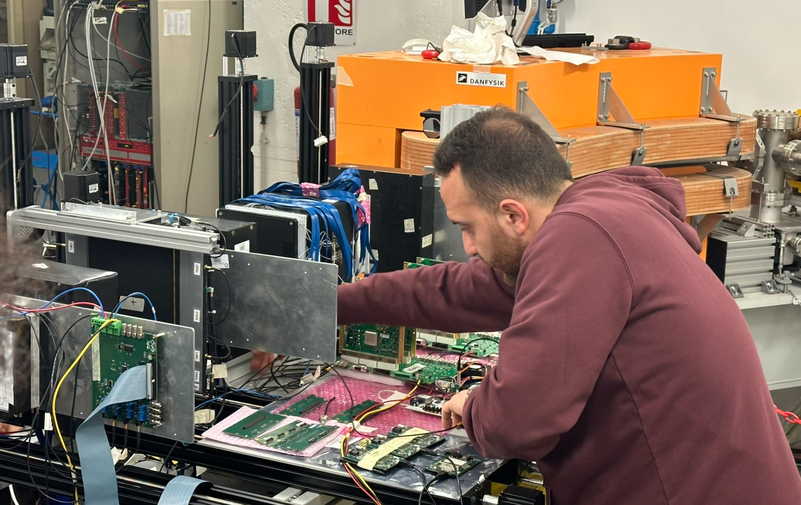
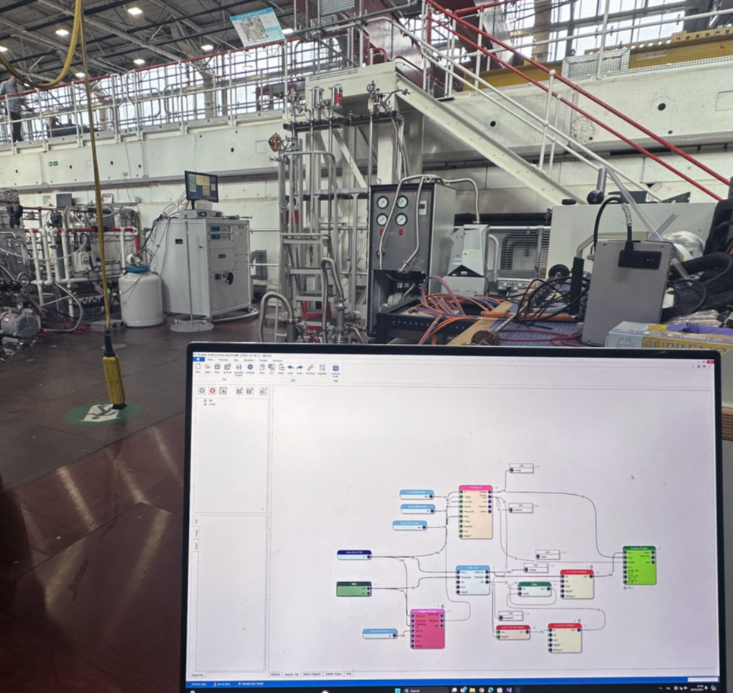
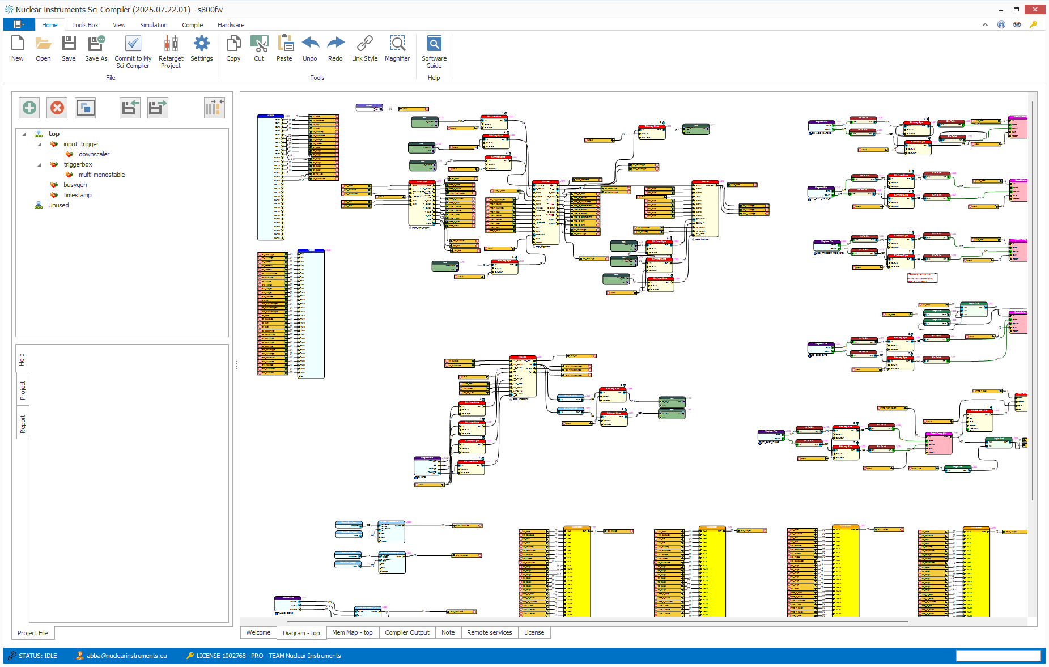
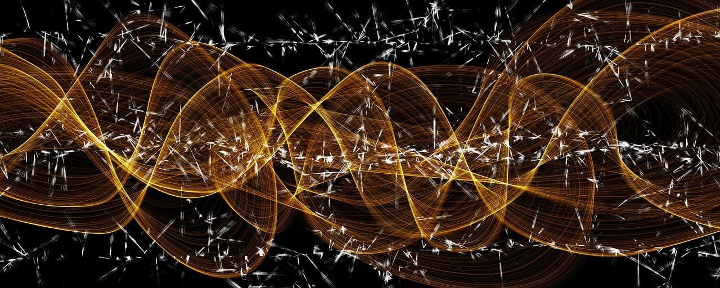
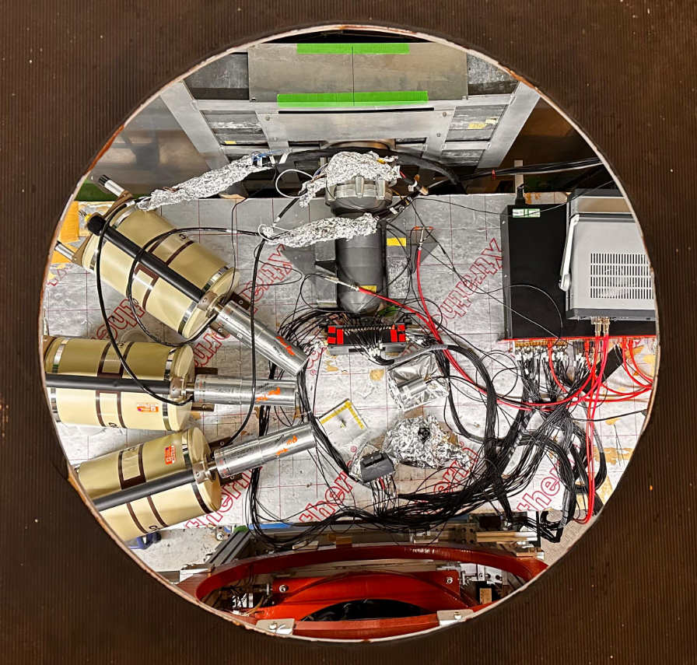

Sci-Compiler: A Flexible Tool for Designing Complex Multi-Channel Readout Systems
A. Abba
F. Caponio
S. Carsi
D. Bianchi
V. Arosio
M. Petruzzo
C. Tintori
L. Colombini
M. Bianchini
V. Bottiglieri
Y. Venturini
A. Cusimano
Notes:
Today, we're diving into the world of Sci-Compiler, an ingenious tool that's revolutionizing the way we create, manage, and deploy firmware for cutting-edge scientific research. Whether you're a physicist seeking to unravel the mysteries of the cosmos, a medical researcher on the cusp of a new discovery, or an engineer designing the next generation of detectors, Sci-Compiler is your gateway to turning complex hardware into a symphony of synchronized signals and data.

Slide 2
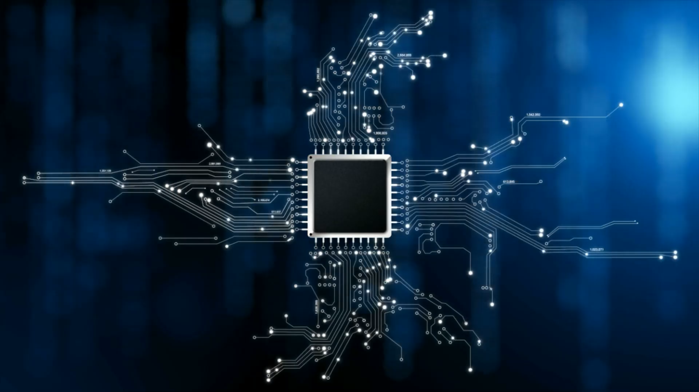
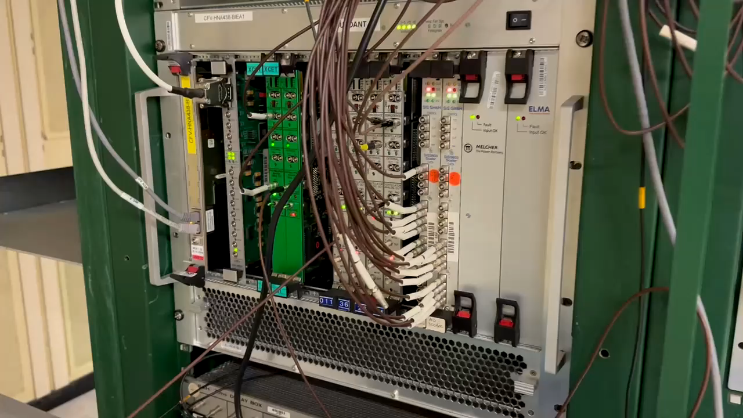
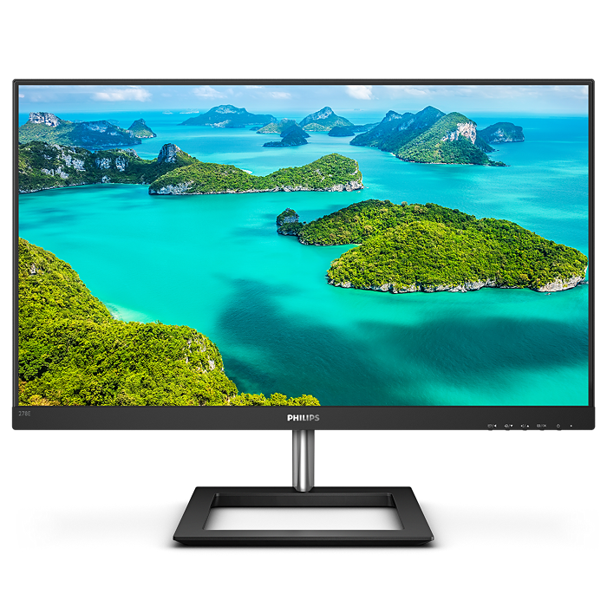
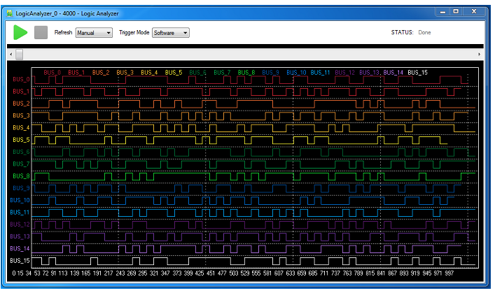
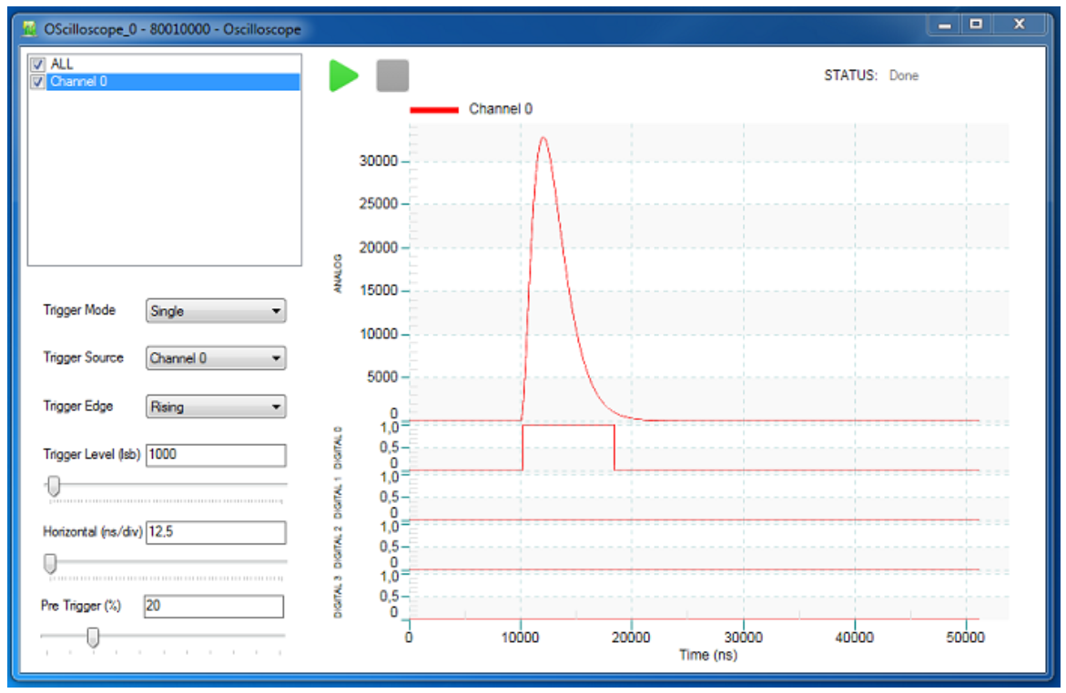
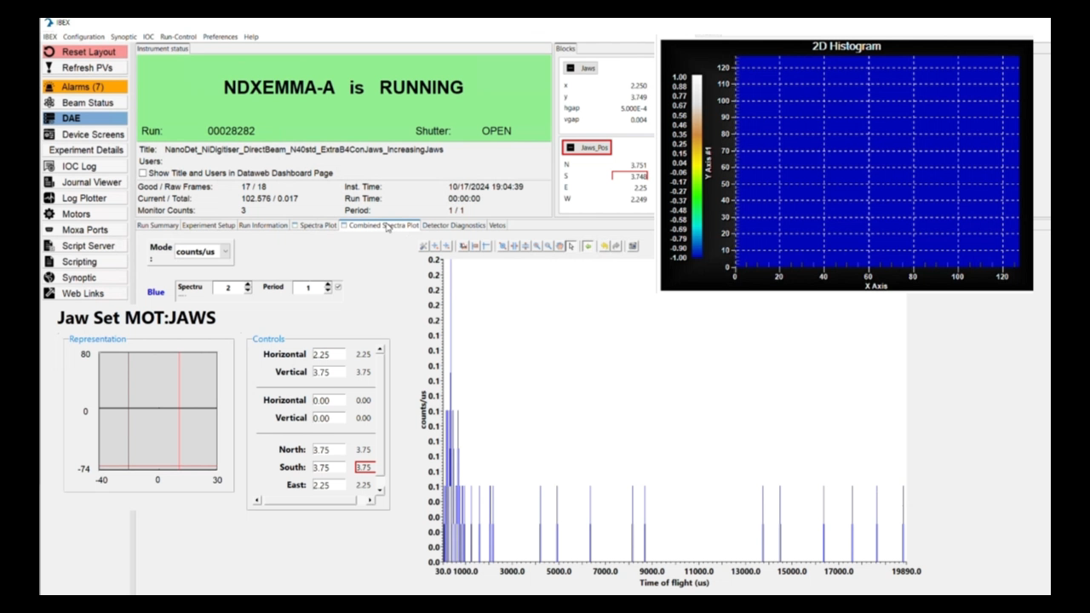
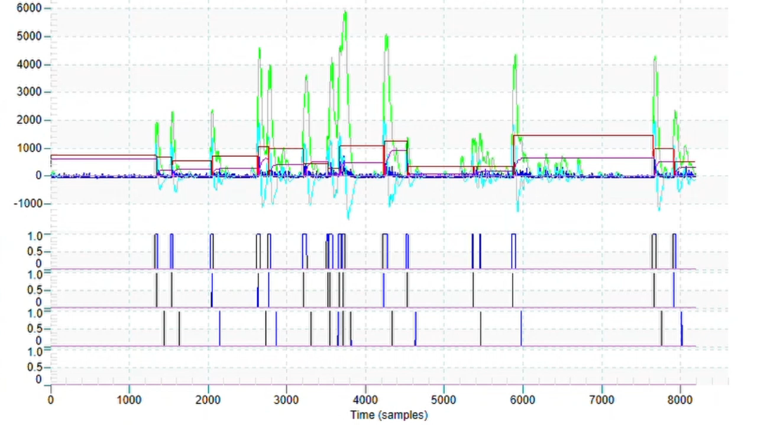
Notes:
In the last 60 years of physics experiments traditional solution to implement trigger logic and readout systems involve the usage of several function specific modules connected each other with cables. The system function is indeed defined by the kind of module used (for coincidence, delay, digitizer, oscilloscope, tdc) and the way they are interconnected. The large number of cables and the vendor specific module configuration made quite complex the debug and maintaining of complex system with a large number of channels

Slide 3
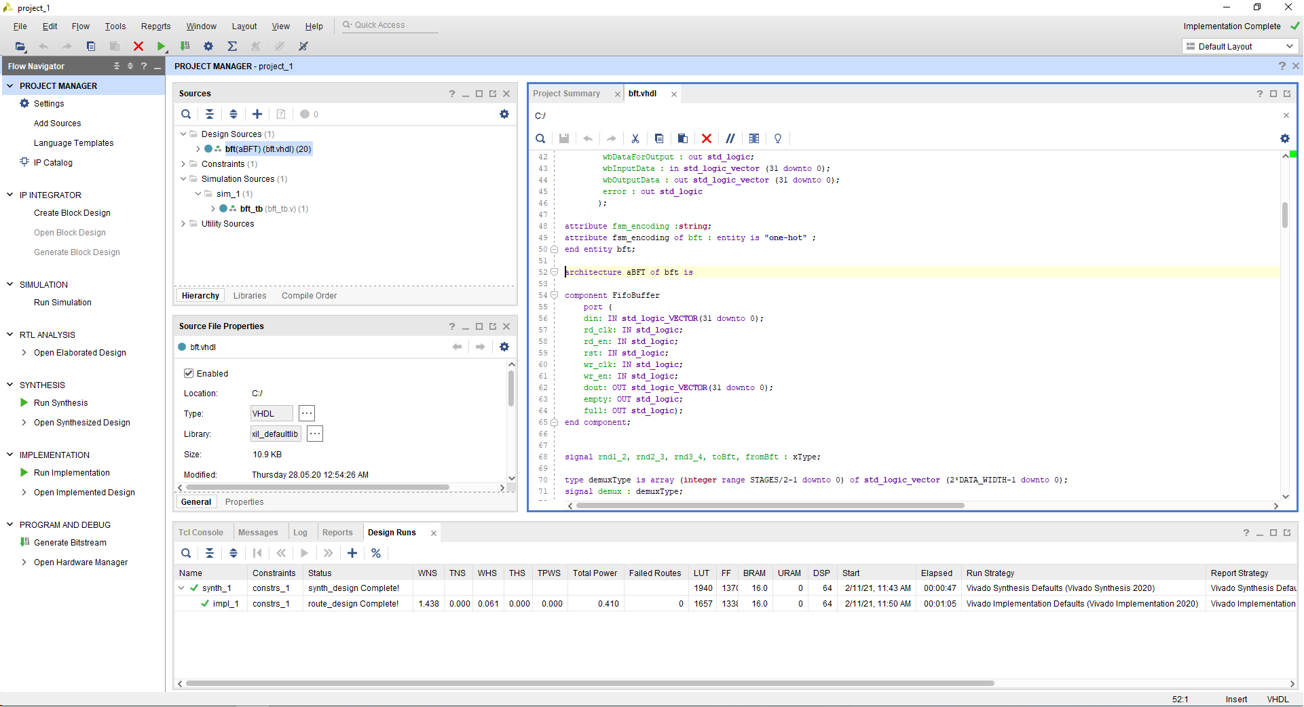
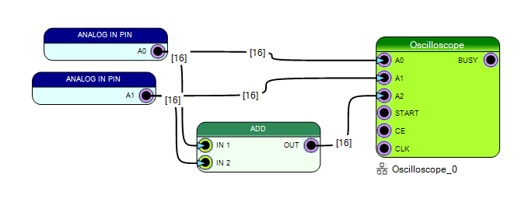
From Concept to Creation: SciCompiler Brings Your Ideas to Life
Design as easily as sketching your ideas – no need to learn complex languages like VHDL or Verilog; SciCompiler takes care of it for you.
Develop with block diagram
Notes:
Design firmware for FPGAs demands proficiency in specialized programming languages such as VHDL or Verilog, coupled with an in-depth understanding of the electronic circuits that materialize when the FPGA compiler transforms the human-designed firmware into a machine-configurable file, known as a bitstream. Typically, users articulate their desired logic functions or algorithms through code; however, the compiler's output more closely resembles an intricate electronic circuit rather than traditional software. This complexity significantly steepens the learning curve for those looking to harness the full potential of FPGA devices.

Slide 4
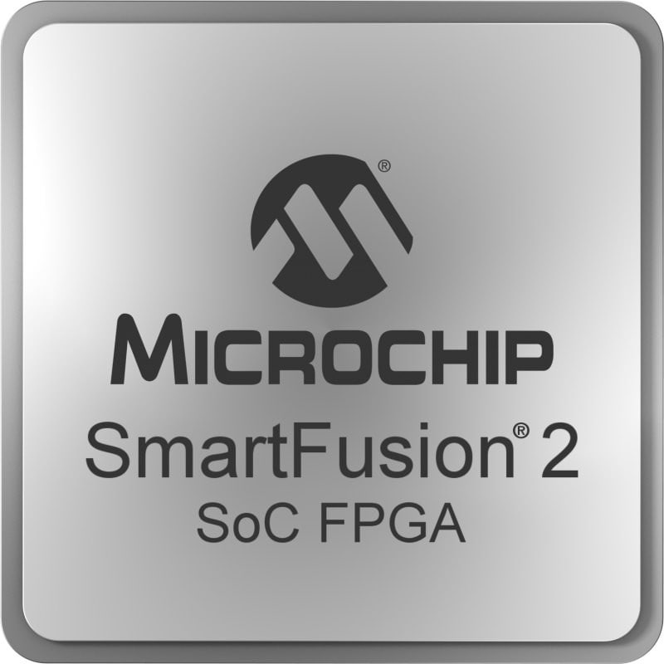
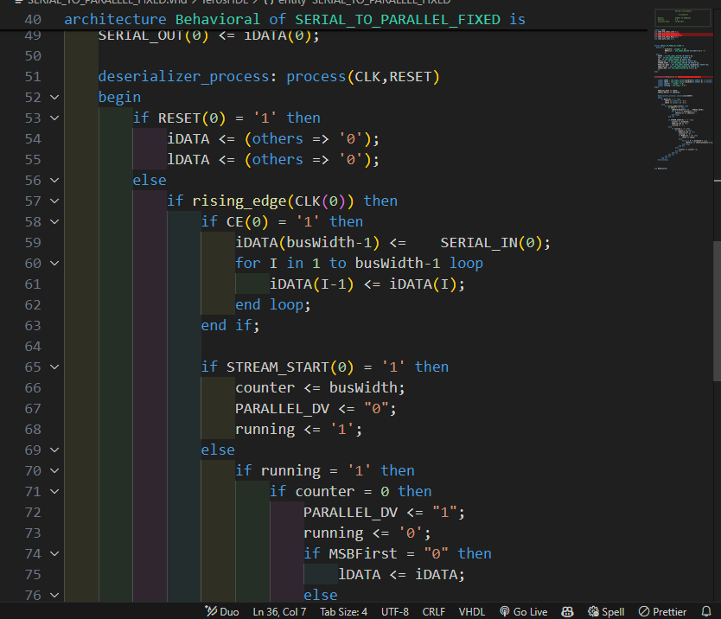

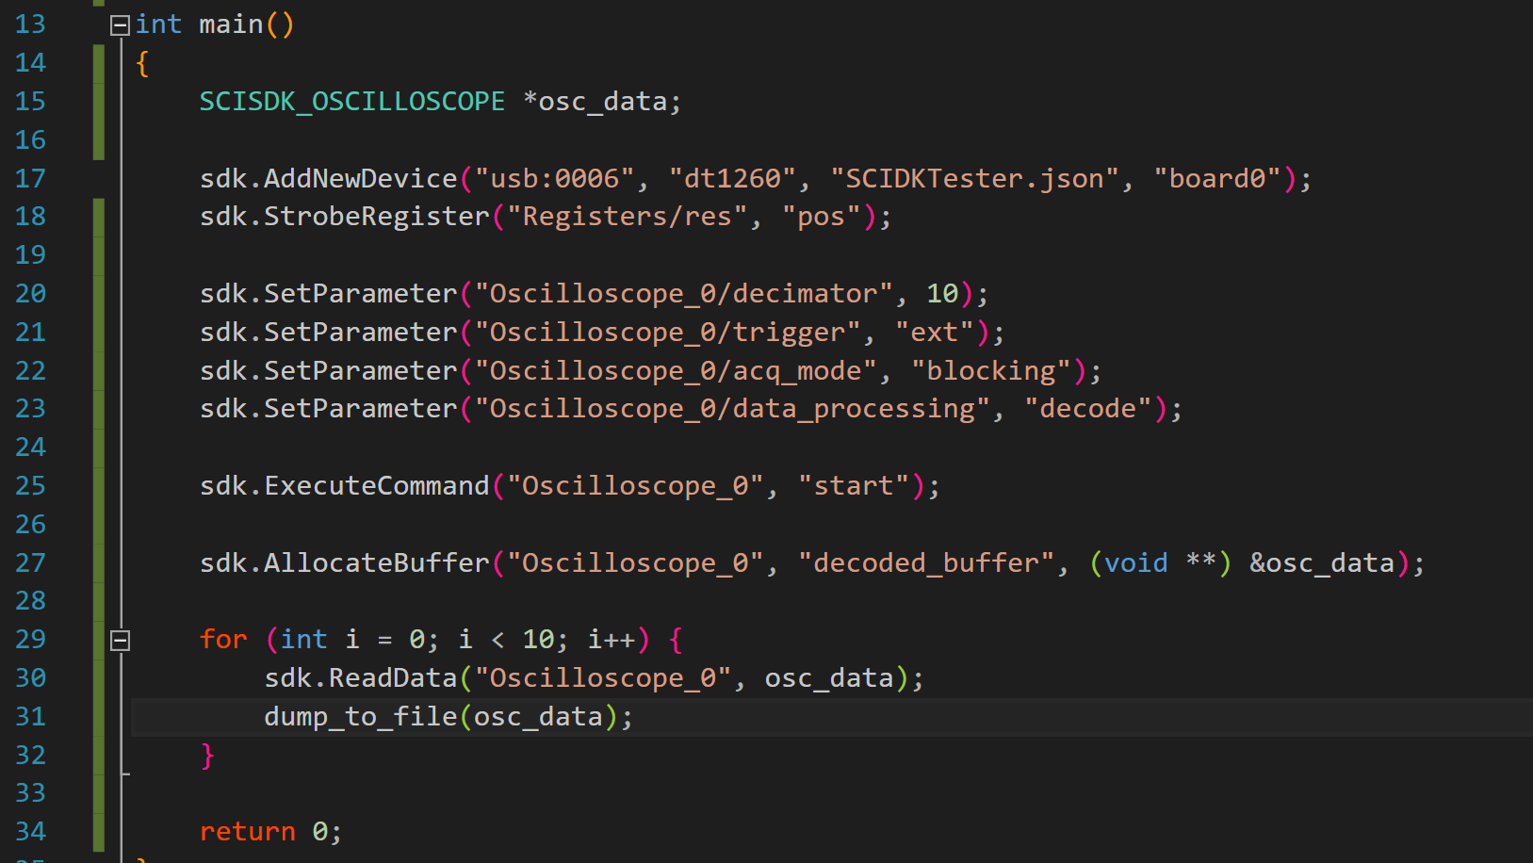
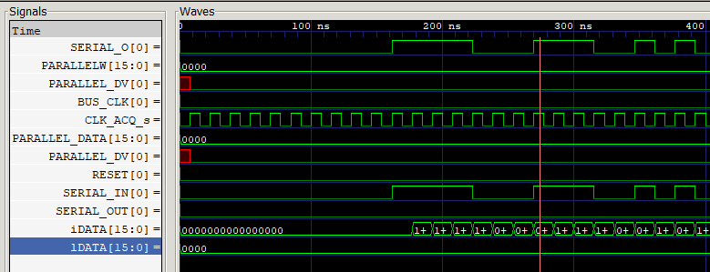
Sci-Compiler generate for you firmware and software
READOUT UI
SIMULATE
WINDOWS AND LINUX SDK
FIRMWARE
Notes:
Design firmware for FPGAs demands proficiency in specialized programming languages such as VHDL or Verilog, coupled with an in-depth understanding of the electronic circuits that materialize when the FPGA compiler transforms the human-designed firmware into a machine-configurable file, known as a bitstream. Typically, users articulate their desired logic functions or algorithms through code; however, the compiler's output more closely resembles an intricate electronic circuit rather than traditional software. This complexity significantly steepens the learning curve for those looking to harness the full potential of FPGA devices.

Slide 5
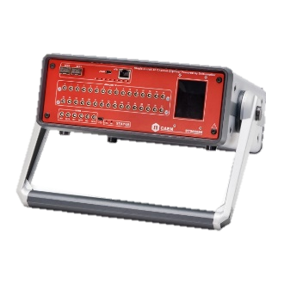
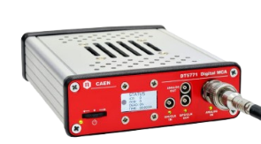
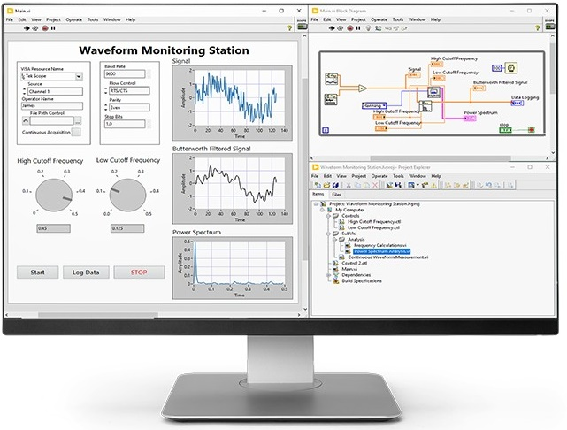
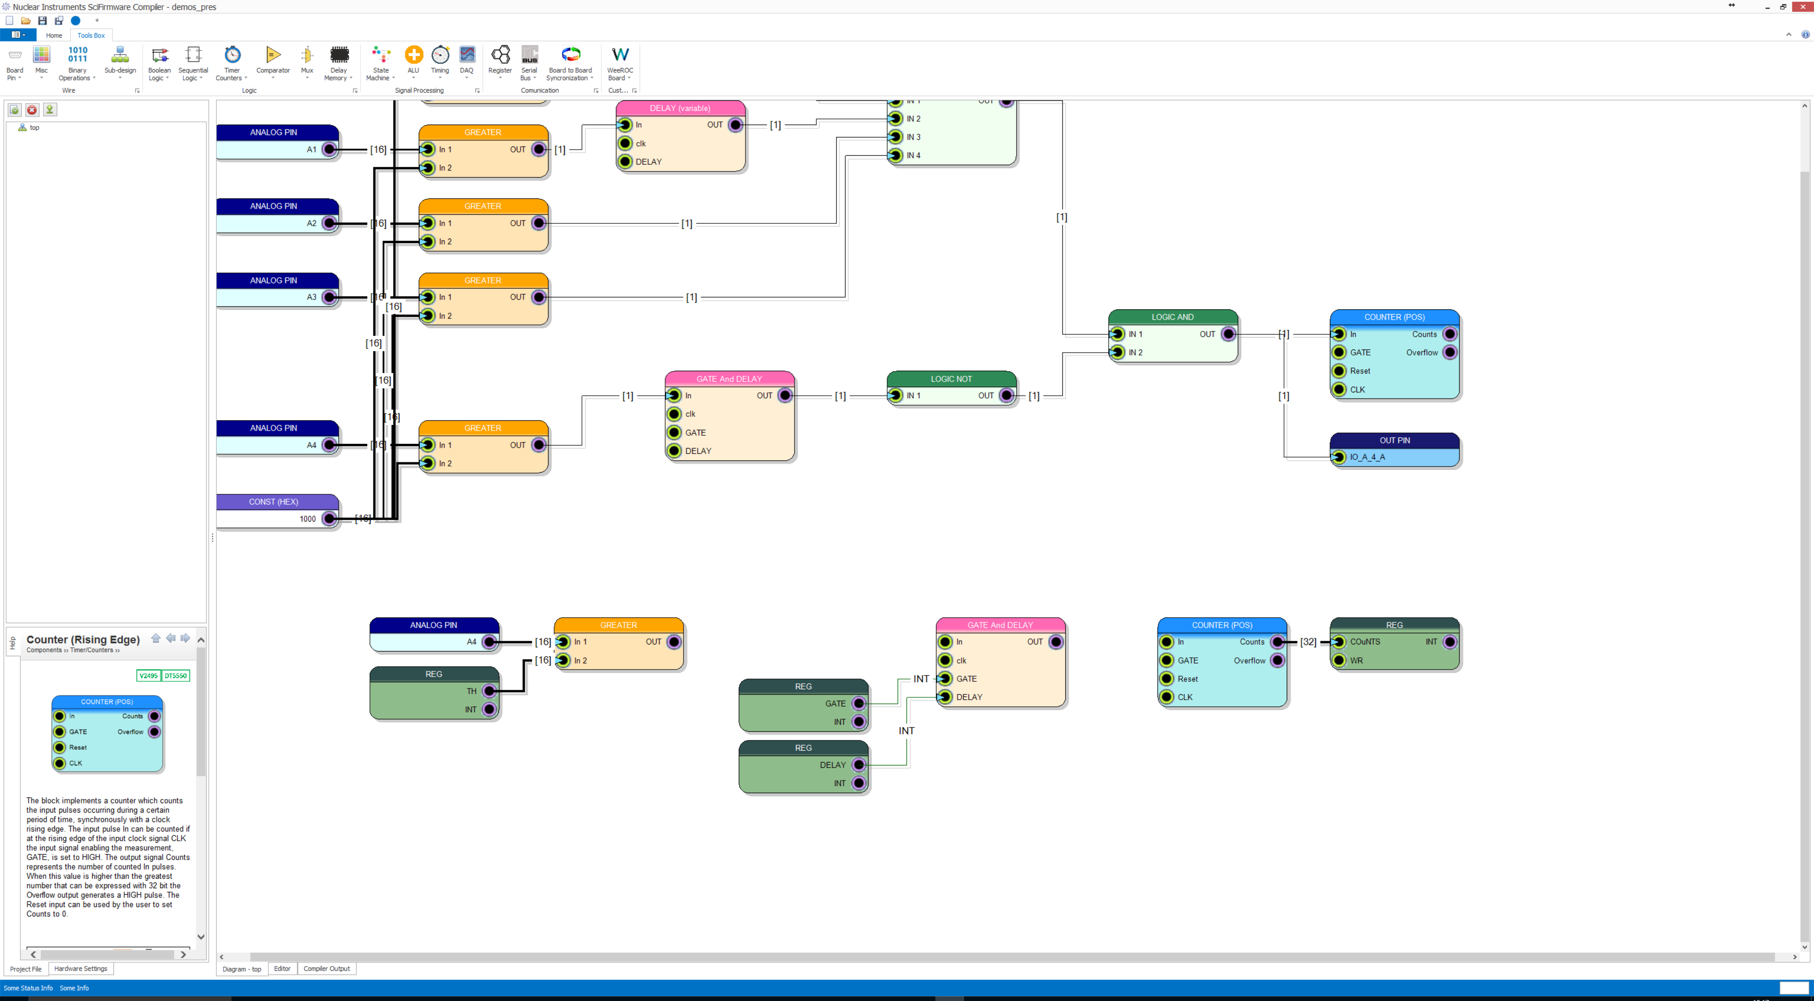
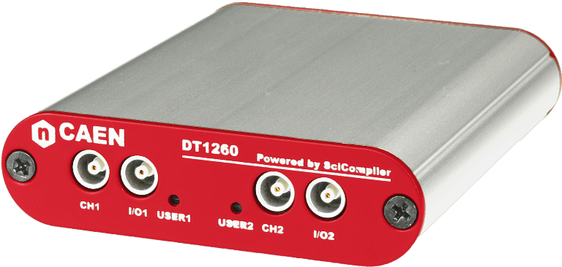
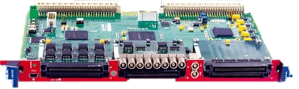
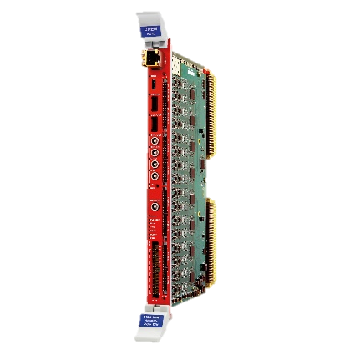
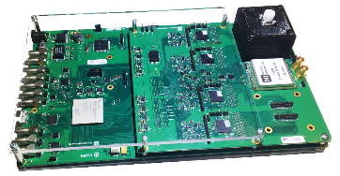
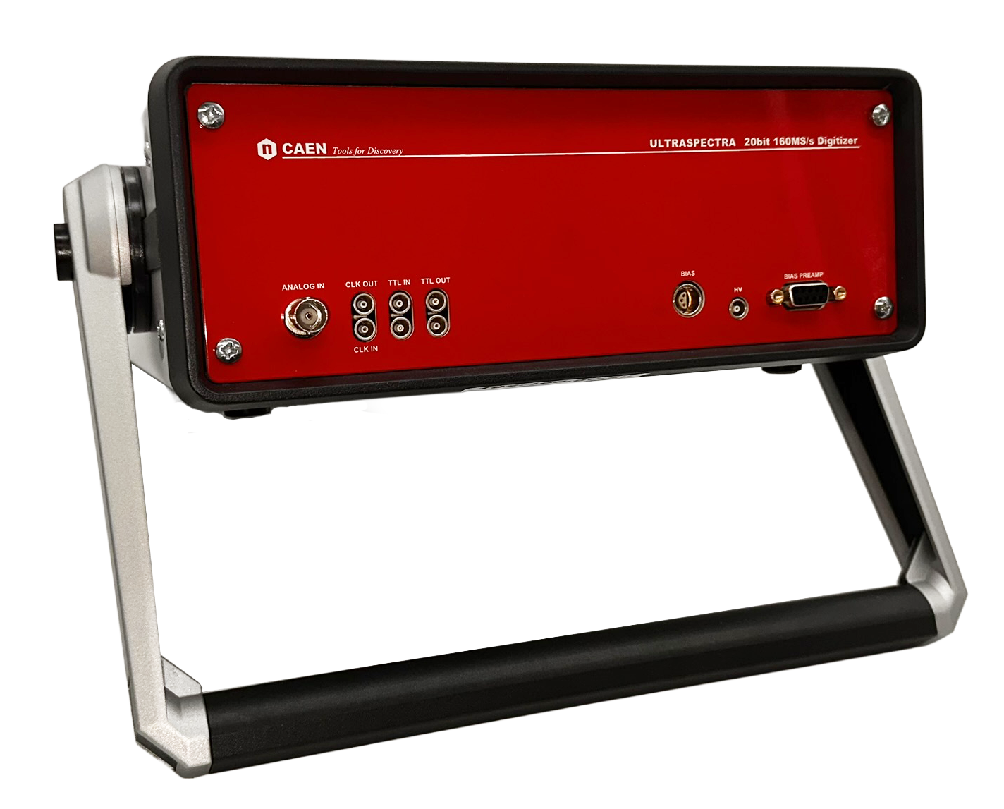
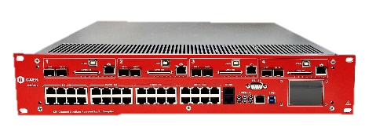

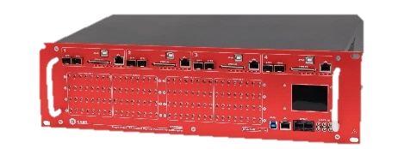
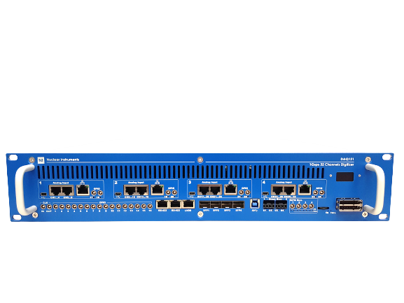
NI/CAEN Solution: OpenFPGA digitizers + SciCompiler firmware generator
DT5571
DT5560
DT1260
V2495
SCICOMPILER
OPENFPGA
HARDWARE PLATFORMS
V2730
V2740/5
DT550W
20 bit !!
R5560
DAQ 121 / DAQ 122
12/14 bit – 1 Gsps
32 channels
Notes:
CAEN and Nuclear Instruments have pioneered a transformative solution that accelerates the transition from traditional electronics to FPGA based readout and processing systems. Together, we've unveiled a new generation of digitizers featuring open FPGAs. These digitizers are designed with the end-user in mind, offering the flexibility to reconfigure firmware with ease through our groundbreaking Sci-Compiler software, which utilizes intuitive visual programming. Users can concentrate solely on crafting their unique algorithms via a block diagram interface, while Sci-Compiler seamlessly translates this design into a functional bitstream, effectively bridging the gap between concept and execution.

Slide 6
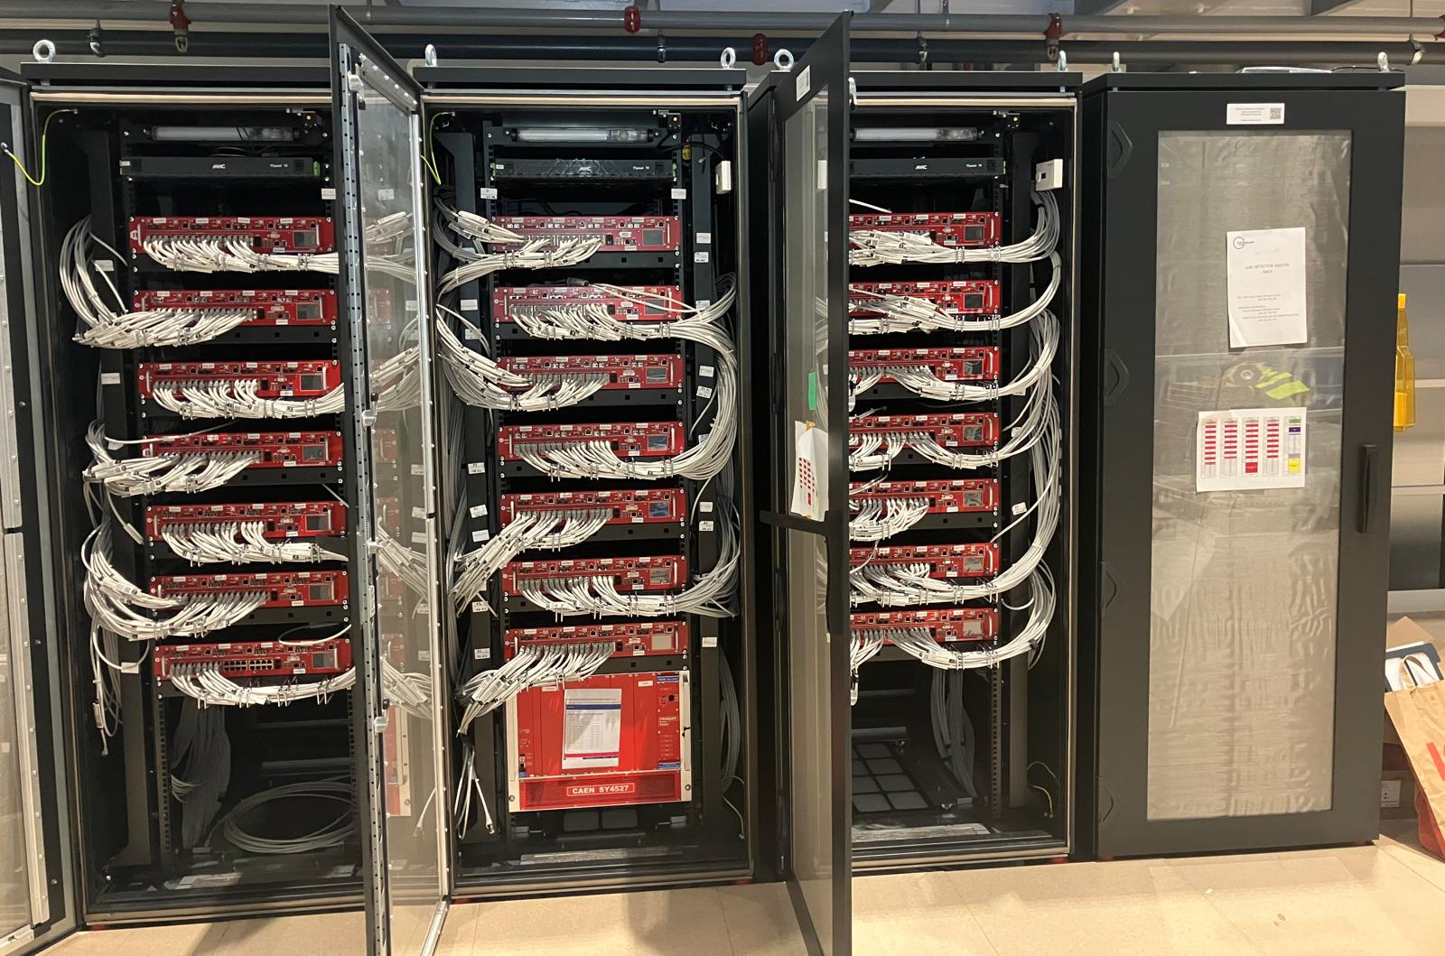
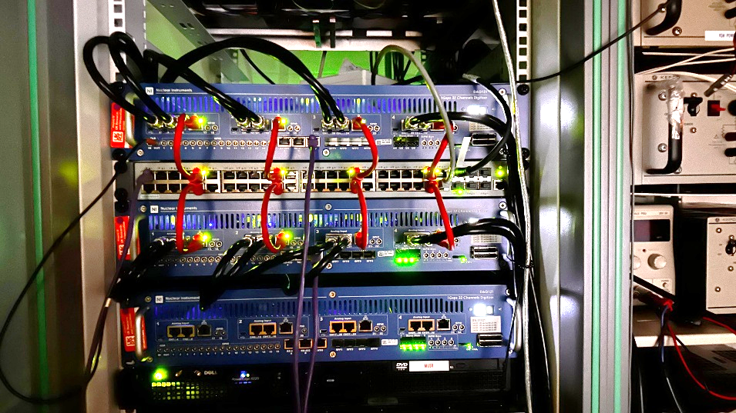
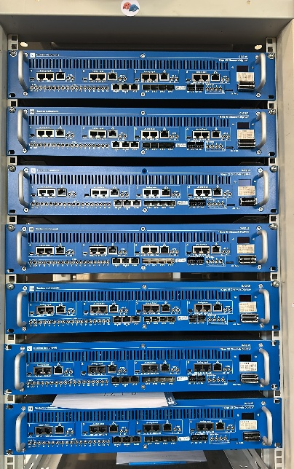
Large Scale Experiments read-out system based on Sci-Compiler devices
ISIS HiFI – DAQ 121
LOKI SANS @ ESS, developed by UKRI – ISIS – R5560
ISIS SuperMUSR – DAQ 121
Notes:
The European Spallation Source has strategically embraced the capabilities of the R5560 module, enhanced by the versatility of SciCompiler, to the data acquisition systems for a suite of their instruments. These include the likes of LOKI, BIFROST, MIRACLES, and VESPA, each a cornerstone in their exploration of neutron science.
At the heart of this technological symphony is the R5560 with a firmware that has been tailored using SciCompiler to meet the intricate demands of neutron instrumentation.
You can see the straw tubes testing system, the digitizer rack and the validation test results on LARMOR, ISIS performed last year.

Slide 7
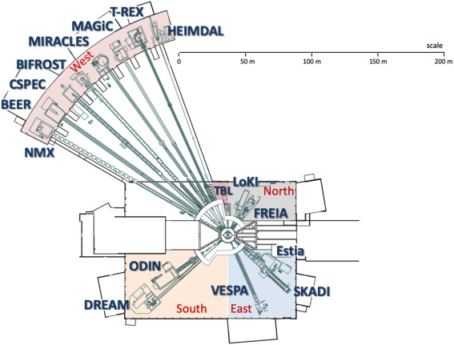
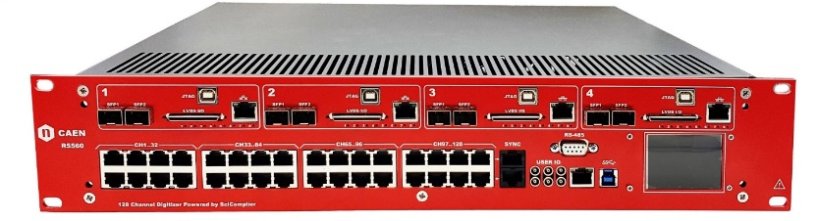

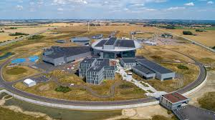



(ESS) LOKI, BIFROST, MIRACLES, CSPEC, VESPA more than 10K channels
BEAM MONITOR
Notes:
The European Spallation Source has strategically embraced the capabilities of the R5560 module, enhanced by the versatility of SciCompiler, to the data acquisition systems for a suite of their instruments. These include the likes of LOKI, BIFROST, MIRACLES, and VESPA, each a cornerstone in their exploration of neutron science.
At the heart of this technological symphony is the R5560 with a firmware that has been tailored using SciCompiler to meet the intricate demands of neutron instrumentation.
You can see the straw tubes testing system, the digitizer rack and the validation test results on LARMOR, ISIS performed last year.

Slide 8
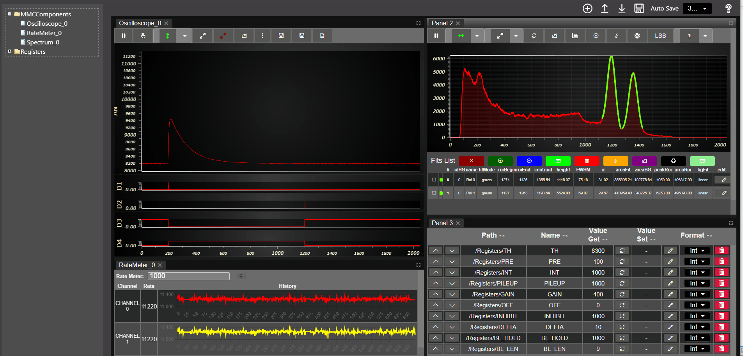
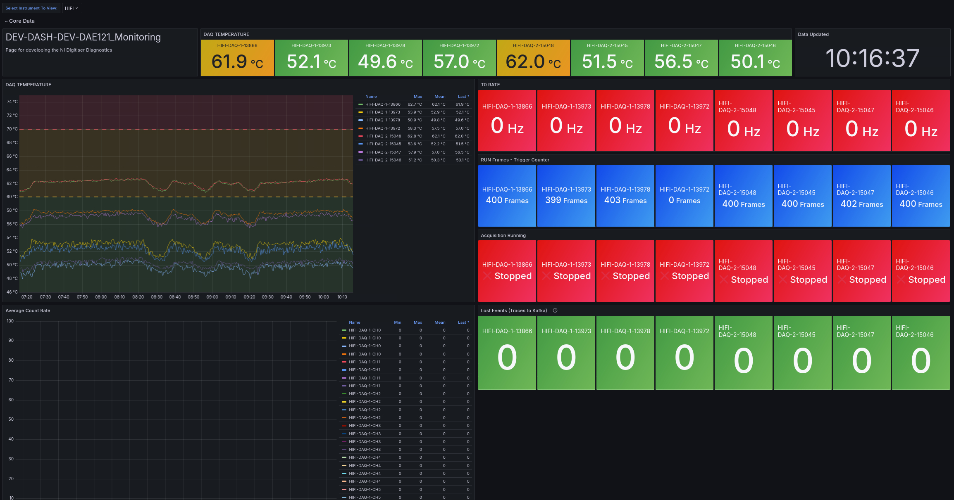
Real-time monitor and SCADA integration
On-board signal probe with web interface
Influx DB connector (GRAFANA MONITOR)
On-board EPICS server
On-board UPCUA server
Notes:
The European Spallation Source has strategically embraced the capabilities of the R5560 module, enhanced by the versatility of SciCompiler, to the data acquisition systems for a suite of their instruments. These include the likes of LOKI, BIFROST, MIRACLES, and VESPA, each a cornerstone in their exploration of neutron science.
At the heart of this technological symphony is the R5560 with a firmware that has been tailored using SciCompiler to meet the intricate demands of neutron instrumentation.
You can see the straw tubes testing system, the digitizer rack and the validation test results on LARMOR, ISIS performed last year.

Slide 9
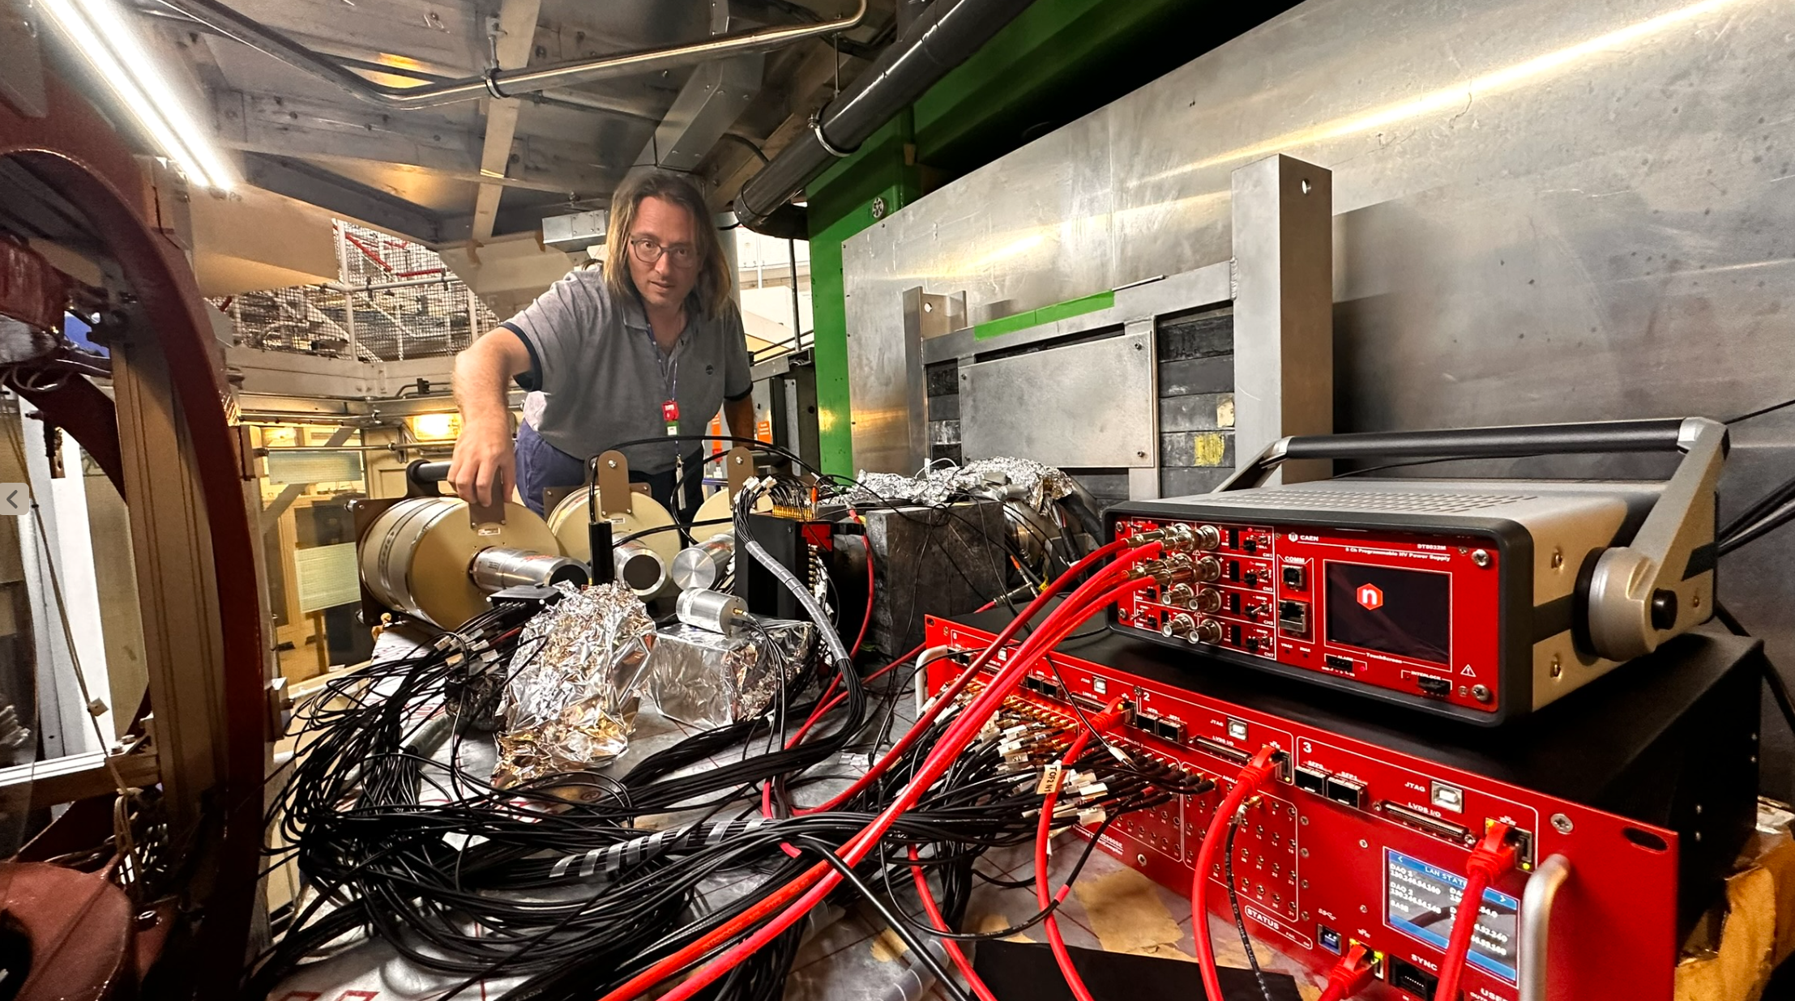





ISIS Fiber Hodoscope CHNET MAXI
Massimiliano Clemenza - UNIMIB
32X + 32Y scintillating fiber
9 Germanium detector readout with online spectrum
calculation
4x4 Scintillator matrix readout
2 neutron monitor with PSD real-time processing
Readout using R5560SE digitizer
Installed and test on CRONOS ISIS detector
Germanium Detectors
Hodoscope
Neutron Monitor
4x4 Scintillator Matrix
Notes:
Let's pivot to practical, real-world applications where SciCompiler has been utilized effectively. A prime example is 'Ardesia', an X-ray spectrometer developed by the Politecnico di Milano. Leveraging SciCompiler, the team was able to develop firmware capable of high-rate X-ray spectroscopy.
The instrument at the core of these tests was the DT5560. This particular hardware was chosen for its compatibility and ability to handle the demands of high-rate data acquisition. The firmware developed via SciCompiler for the DT5560 demonstrated remarkable performance: the system was tested to nearly 2.7 million counts per second; despite these high count rates, the spectrometer maintained a good resolution and a deadtime near to 0.

Slide 10
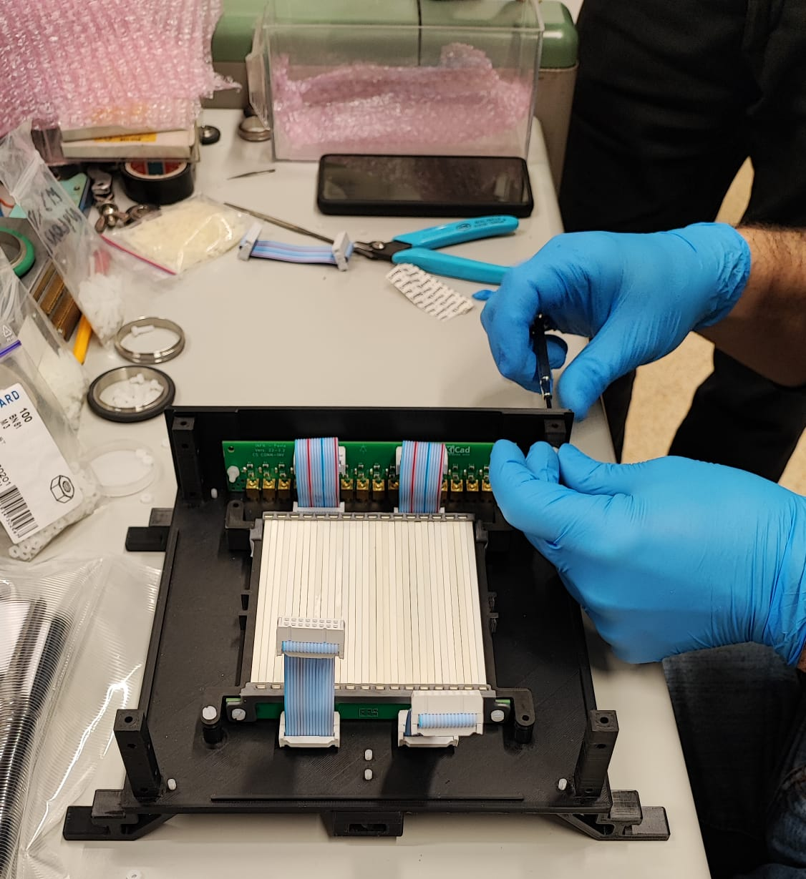
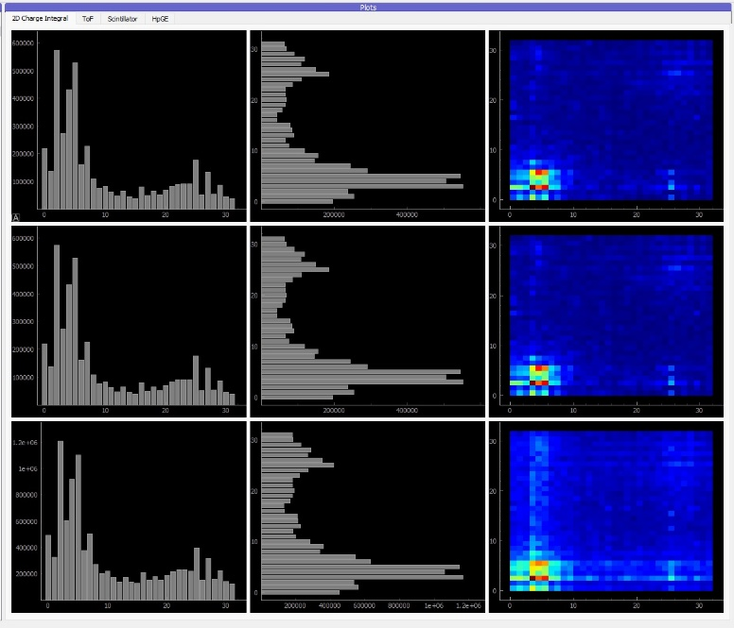
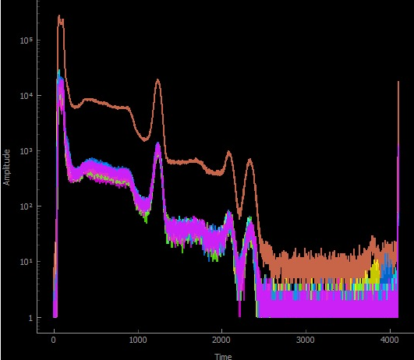
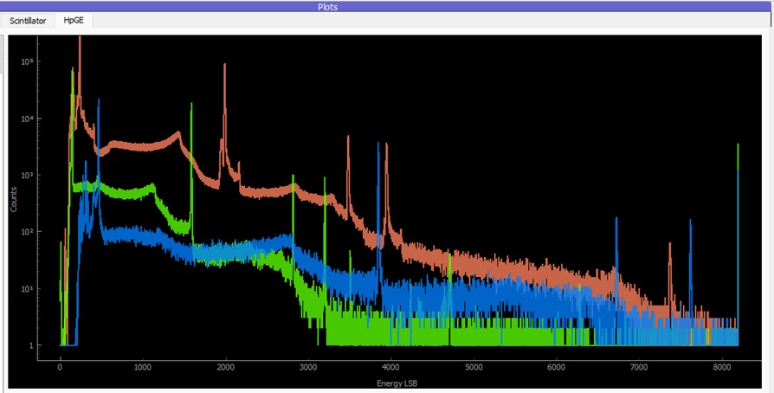
ISIS Fiber Hodoscope CHNET MAXI
Massimiliano Clemenza - UNIMIB
32X + 32Y scintillating fiber
9 Germanium detector readout with online spectrum
calculation
4x4 Scintillator matrix readout
2 neutron monitor with PSD real-time processing
Readout using R5560SE digitizer
Installed and test on CRONOS ISIS detector
Notes:
Let's pivot to practical, real-world applications where SciCompiler has been utilized effectively. A prime example is 'Ardesia', an X-ray spectrometer developed by the Politecnico di Milano. Leveraging SciCompiler, the team was able to develop firmware capable of high-rate X-ray spectroscopy.
The instrument at the core of these tests was the DT5560. This particular hardware was chosen for its compatibility and ability to handle the demands of high-rate data acquisition. The firmware developed via SciCompiler for the DT5560 demonstrated remarkable performance: the system was tested to nearly 2.7 million counts per second; despite these high count rates, the spectrometer maintained a good resolution and a deadtime near to 0.

Slide 11
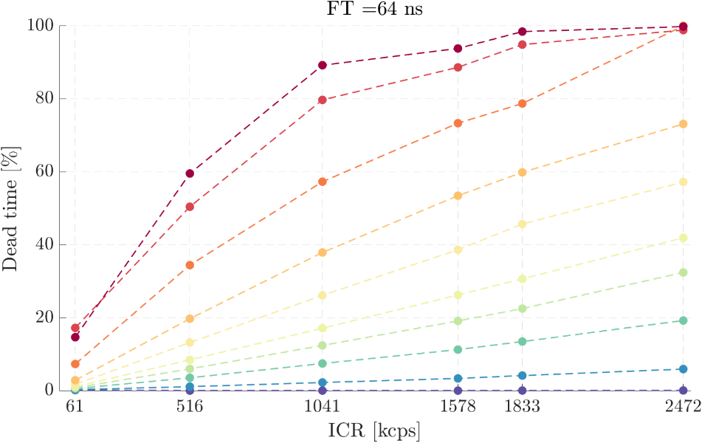
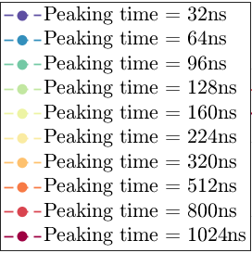
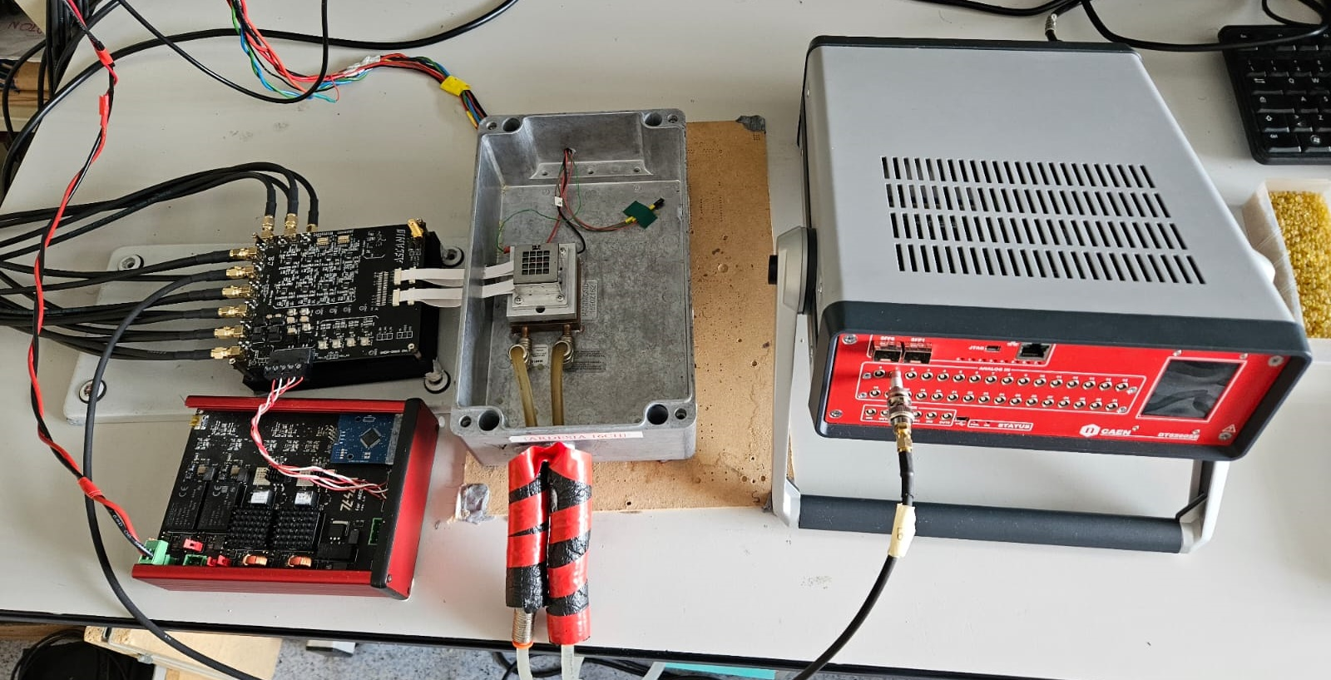
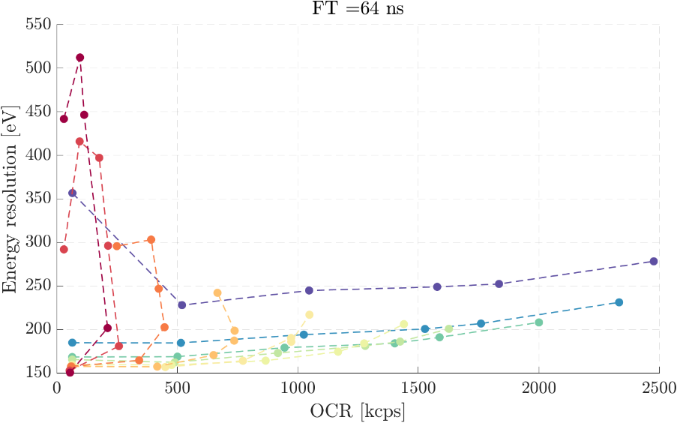
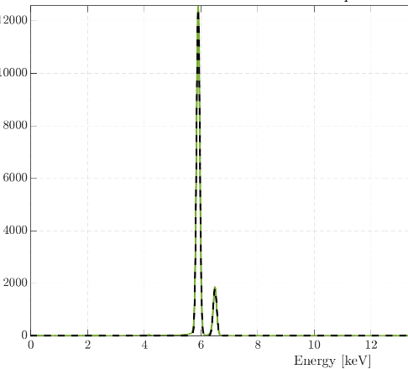


Ardesia 16 channels SDD read-out
SDD (Silicon Drift Detector) matrix 4x4 detector
Front end: 4 channel Cube ASIC designed at PoliMI
Achieving high throughput with minimal dead time
Good energy resolution.
Fe⁵⁵ Spectrum
1% dead time, 250 eV @ 2.5 Mcps OCR
7% dead time, 230 eV @ 2.4 Mcps OCR
19% dead time, 200 eV @ 2 Mcps OCR
Notes:
Let's pivot to practical, real-world applications where SciCompiler has been utilized effectively. A prime example is 'Ardesia', an X-ray spectrometer developed by the Politecnico di Milano. Leveraging SciCompiler, the team was able to develop firmware capable of high-rate X-ray spectroscopy.
The instrument at the core of these tests was the DT5560. This particular hardware was chosen for its compatibility and ability to handle the demands of high-rate data acquisition. The firmware developed via SciCompiler for the DT5560 demonstrated remarkable performance: the system was tested to nearly 2.7 million counts per second; despite these high count rates, the spectrometer maintained a good resolution and a deadtime near to 0.

Slide 12





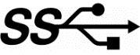




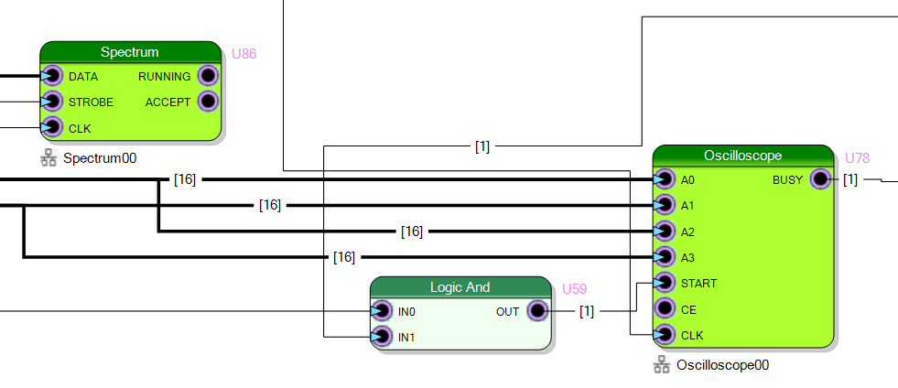
Open-FPGA Board architecture
Primary function of a firmware:
ADC/DAC
MEMORY
I/O
Control the board acquisition process
FRAMEWORK
Processing data
CONFIGURATION
READOUT
Transfer data to and from readout PC/Server
USER DEFINED
PROCESSING LOGIC
Sci-Compiler lets the developer think only about the core algorithm — everything else, from framework to readout, is handled automatically with high-level abstraction blocks.
Notes:
Let's clarify the division of the firmware in each open hardware card. The firmware is partitioned into two primary components: the framework and the processing logic.
The framework acts as the backbone of the card, expertly handling the ADC and D to A, signal acquisition for both analog and digital inputs, memory management, and communication. It supports various communication protocols such as Ethernet, USB, or optical links, showcasing its versatile connectivity options.
In essence, the framework is designed to manage the entire board seamlessly and transparently from the user's perspective. Users are not burdened with the intricacies of framework configuration; instead, they can dedicate their focus entirely to the development of their unique processing algorithms within the processing logic component.
This is where Sci-Compiler steps in. It intelligently molds the framework to conform to the user's block diagram design. By doing so, Sci-Compiler bridges the gap between complex hardware management and the user's need for a tailored processing logic. It ensures that the user's algorithm is perfectly integrated within the hardware, functioning optimally within the predefined system architecture.
This division not only optimizes the development workflow but also significantly reduces the time from concept to deployment, making it an efficient tool for innovators and researchers alike.

Slide 13







SciCompiler: ip integrator software
IP – Virtual Instruments
USER DESIGN
BUILDER ENGINE
Notes:
SciCompiler is integrated with a vast library of virtual instrument IPs, streamlining the firmware development process. Users design their firmware visually with a block diagram, which SciCompiler then expertly converts into VHDL code. It proceeds to compile the project utilizing industry-standard tools from Xilinx or Intel and seamlessly downloads the compiled firmware directly to the FPGA.

Slide 14









Examples of what you can do with Sci-Compiler
REALTIME FFT
COMPLEX TRIGGER LOGIC
PHA
PSD
SUB-ns TOF TDC
NEUTRON IMAGING
REALTIME IIR-FIR FILTER
REALTIME STATISTICS
Notes:
Sci-Compiler is a versatile tool designed to enhance scientific research and data analysis. Let's delve into some practical examples of what Sci-Compiler can do for us.
Imagine performing Pulse Height Analysis (PHA) with unparalleled precision. Sci-Compiler integrates a trapezoidal filter, charge integration and peak detection. Not only that, but it also allows the incorporation of user-custom algorithms, offering flexibility to meet specific experimental needs.
In the realm of trigger logic, complexity is a common hurdle. Sci-Compiler elegantly converts intricate trigger sequences into a single-board, diagram-based design. This simplifies the setup without compromising the sophistication of your logic systems.
Now, consider the real-time calculation of Pulse Shape Discrimination. Sci-Compiler does this using multiple algorithms that analyze both exponential tails, commonly found in scintillators, and rise time, essential for Helium-3 detectors. This functionality is critical for instantaneous analysis, which is essential in many advanced scientific applications.

Slide 15



Sci-Compiler generates firmware
Limited parallelism
High delay (ms)
Full parallelism
Low delay (ns)
DAQ
Other VPL (like Labview) generate code for CPU
running inside DAQ computer
Generate FPGA firmware that «runs» directly inside the DAQ
Notes:
Sci-Compiler is very different from other visual programming software such as Labview. Labview typically generates software that runs on the PC in which the DAQ is inserted, processing data in near real-time. The DAQ is limited to digitizing the data, while it is the acquisition PC's CPU that processes them. Sci-Compiler generates firmware that directly processes the data within the DAQ in strict real-time. This means that it can fully exploit the parallelism of the FPGA, with a computing capacity much higher than that of the PC, and have delays in producing the processing result on the scale of nanoseconds rather than milliseconds as happens with software running on a PC.

Slide 16






High Speed Digitizer
Sci-Compiler Firmware
DT5571
FE
TRIGGER
QDC
SPECTRUM
ADC
200 Msps
Notes:
Sci-Compiler is very different from other visual programming software such as Labview. Labview typically generates software that runs on the PC in which the DAQ is inserted, processing data in near real-time. The DAQ is limited to digitizing the data, while it is the acquisition PC's CPU that processes them. Sci-Compiler generates firmware that directly processes the data within the DAQ in strict real-time. This means that it can fully exploit the parallelism of the FPGA, with a computing capacity much higher than that of the PC, and have delays in producing the processing result on the scale of nanoseconds rather than milliseconds as happens with software running on a PC.

Slide 17
High Speed Digitizer
THRESHOLD
14 bit
EDGE
DETECTOR
DELAY
(INT TIME)
ADC
COMPARATOR
1 sample/clock cycle
RESET
ACC
REGISTER
LATCH
SPECTRUM
Notes:
Sci-Compiler is very different from other visual programming software such as Labview. Labview typically generates software that runs on the PC in which the DAQ is inserted, processing data in near real-time. The DAQ is limited to digitizing the data, while it is the acquisition PC's CPU that processes them. Sci-Compiler generates firmware that directly processes the data within the DAQ in strict real-time. This means that it can fully exploit the parallelism of the FPGA, with a computing capacity much higher than that of the PC, and have delays in producing the processing result on the scale of nanoseconds rather than milliseconds as happens with software running on a PC.

Slide 18



High Speed Digitizer
DAQ
Nuclear Instruments
DAQ 121 - DAQ 122
1 Gsps, 32 channel, 12/14 bit
JESD IP
RX
14 bit
4x12 GHz
14 bit
FE
ADC
JESD 204B
14 bit
CAEN V2730 - 500 Msps, 32 channel, 14 bit
CAEN V2751 - 1 Gsps, 16 channel, 14 bit
14 bit
250 MHz
1 GHz
CLOCK
GENERATOR
250 MHz
Notes:
Sci-Compiler is very different from other visual programming software such as Labview. Labview typically generates software that runs on the PC in which the DAQ is inserted, processing data in near real-time. The DAQ is limited to digitizing the data, while it is the acquisition PC's CPU that processes them. Sci-Compiler generates firmware that directly processes the data within the DAQ in strict real-time. This means that it can fully exploit the parallelism of the FPGA, with a computing capacity much higher than that of the PC, and have delays in producing the processing result on the scale of nanoseconds rather than milliseconds as happens with software running on a PC.

Slide 19

High Speed Digitizer
8 Channels module
Clock Generator/Distributor
FPGA ( Zynq Ultrascale+ SoC)
ADC 1 Gsps – 14 bit
Notes:
Sci-Compiler is very different from other visual programming software such as Labview. Labview typically generates software that runs on the PC in which the DAQ is inserted, processing data in near real-time. The DAQ is limited to digitizing the data, while it is the acquisition PC's CPU that processes them. Sci-Compiler generates firmware that directly processes the data within the DAQ in strict real-time. This means that it can fully exploit the parallelism of the FPGA, with a computing capacity much higher than that of the PC, and have delays in producing the processing result on the scale of nanoseconds rather than milliseconds as happens with software running on a PC.

Slide 20
High Speed Digitizer: Serial data link JED204.B
Analog to Digital Converter
Tx Application Layer
Data
Framing
Frame Lane Alignment Symbol Generator
8/10b Encoder
Serializer
Tx Driver
Parallel data
14 bit
@ 1 GHz
Serial Link
Rx Application
Data
Deframing
Frame Lane Alignment Logic
8/10b Decoder
Deserializer
Rx Receiver
4x14 bit
@ 250 MHz
Parallel data
Notes:
Sci-Compiler is very different from other visual programming software such as Labview. Labview typically generates software that runs on the PC in which the DAQ is inserted, processing data in near real-time. The DAQ is limited to digitizing the data, while it is the acquisition PC's CPU that processes them. Sci-Compiler generates firmware that directly processes the data within the DAQ in strict real-time. This means that it can fully exploit the parallelism of the FPGA, with a computing capacity much higher than that of the PC, and have delays in producing the processing result on the scale of nanoseconds rather than milliseconds as happens with software running on a PC.

Slide 21



High Speed Digitizer: Parallel data decoding
1 GHz
SAMPLE 0
SAMPLE 1
SAMPLE 2
SAMPLE 3
Serial Link
JESD RX
Sample 0
Sample 1
Sample 2
Sample 3
250 MHz
Notes:
Sci-Compiler is very different from other visual programming software such as Labview. Labview typically generates software that runs on the PC in which the DAQ is inserted, processing data in near real-time. The DAQ is limited to digitizing the data, while it is the acquisition PC's CPU that processes them. Sci-Compiler generates firmware that directly processes the data within the DAQ in strict real-time. This means that it can fully exploit the parallelism of the FPGA, with a computing capacity much higher than that of the PC, and have delays in producing the processing result on the scale of nanoseconds rather than milliseconds as happens with software running on a PC.

Slide 22

High Speed Digitizer: FPGA clock speed limit
Programmable FPGA architecture limits maximum clock speed
Modern FPGA optimized designed may operate in the range 250 – 400 MHz
Congestion in the device reduce maximum speed
Safe margin must be considered for “open hardware” configurable application
Notes:
Sci-Compiler is very different from other visual programming software such as Labview. Labview typically generates software that runs on the PC in which the DAQ is inserted, processing data in near real-time. The DAQ is limited to digitizing the data, while it is the acquisition PC's CPU that processes them. Sci-Compiler generates firmware that directly processes the data within the DAQ in strict real-time. This means that it can fully exploit the parallelism of the FPGA, with a computing capacity much higher than that of the PC, and have delays in producing the processing result on the scale of nanoseconds rather than milliseconds as happens with software running on a PC.

Slide 23




High Speed Digitizer: Parallel QDC implementation
NI-DAQ 122
Sci-Compiler Firmware
TRIGGER
TRIGGER
QDC
SPECTRUM
FE
ADC
CAEN DT2730
TRIGGER POSITION
250 M
4 x 14 bit
1G x 14 bit
Notes:
Sci-Compiler is very different from other visual programming software such as Labview. Labview typically generates software that runs on the PC in which the DAQ is inserted, processing data in near real-time. The DAQ is limited to digitizing the data, while it is the acquisition PC's CPU that processes them. Sci-Compiler generates firmware that directly processes the data within the DAQ in strict real-time. This means that it can fully exploit the parallelism of the FPGA, with a computing capacity much higher than that of the PC, and have delays in producing the processing result on the scale of nanoseconds rather than milliseconds as happens with software running on a PC.

Slide 24




High Speed Digitizer: Parallel QDC implementation
NI-DAQ 122
Sci-Compiler Firmware
TRIGGER
TRIGGER
QDC
SPECTRUM
FE
ADC
CAEN DT2730
TRIGGER GATE
Notes:
Sci-Compiler is very different from other visual programming software such as Labview. Labview typically generates software that runs on the PC in which the DAQ is inserted, processing data in near real-time. The DAQ is limited to digitizing the data, while it is the acquisition PC's CPU that processes them. Sci-Compiler generates firmware that directly processes the data within the DAQ in strict real-time. This means that it can fully exploit the parallelism of the FPGA, with a computing capacity much higher than that of the PC, and have delays in producing the processing result on the scale of nanoseconds rather than milliseconds as happens with software running on a PC.

Slide 25
High Speed Digitizer: Parallel QDC implementation
THRESHOLD
COMPARATOR
Trigger
Gate
THRESHOLD
COMPARATOR
ENCODER
THRESHOLD
Trigger
Position
COMPARATOR
THRESHOLD
COMPARATOR
EDGE
DETECTOR
Trigger
ToT

Slide 26
High Speed Digitizer: Parallel QDC implementation
TRIGGER
ACC. RESET
ACC
REGISTER
PHASE 0
LATCH
TRG GATE 0
RISE EDGE DET
SET
FF
PARTIAL
ACC RESULT
COUNTER
INT TIME
FALL EDGE DET
RESET
DELAY
PHASE 0
INTEGRATOR 0
TRG GATE 0
PHASE 0
INTEGRATOR 1
TRG GATE 0
LATCH
PHASE 0
INTEGRATOR 2
QDC RESULT
TRG GATE 0
PHASE 0
INTEGRATOR 3
TRG GATE 0
TRIGGER
COUNTER
INT TIME
DELAY

Slide 27

High Speed Digitizer: Parallel QDC implementation

Slide 28

High Speed Digitizer: Parallel trapezoidal implementation
FAST
SHAPER
ZERO
CROSS
PRE
ADC
SLOW
SHAPER
BASELINE
RESTORER
-
ENERGY
SAMPLING
SPECTRUM

Slide 29


High Speed Digitizer: Parallel trapezoidal implementation

Slide 30


High Speed Digitizer: Parallel trapezoidal implementation
DT9000 → 5 Gsps
upcoming digitizer family
High-Energy Physics
Particle tracking in collider experiments
Radiation-hard sensors for extreme environments.
Nuclear Physics & Fusion
Neutron detection and spectroscopy.
Monitoring of intense radiation fields in fusion reactors.
Medical Physics
Dosimetry for radiotherapy and proton therapy (high precision and radiation hardness).
Real-time monitoring of therapeutic beams.
Space & Astrophysics
Radiation monitoring in satellites and space missions.
Detection of cosmic rays and solar particle events.
Industrial & Security Applications
Beam diagnostics in accelerators and synchrotrons.
Non-destructive testing using radiation.
Radiation monitoring in nuclear facilities.
Diamond Detector

Slide 31

High Speed Digitizer: Parallel trapezoidal implementation
DT9000 → 5 Gsps upcoming digitizer family
8ns FWHM
Ultra Fast signal response
Diamond Detector
Fast digitizer and new processing algorithms

Slide 32



High Speed Digitizer: Parallel trapezoidal implementation
5 Gsps

Slide 33


High Speed Digitizer: Parallel trapezoidal implementation

Slide 34

High Speed Digitizer: Parallel trapezoidal implementation
Resolution comparison at different sampling rate and constant shaping time for 20ns decay signal from diamond detector
Am²⁴¹ – 59 keV line

Slide 35


Sci-Compiler TM signals
Time Multiplexed signal

Slide 36


Sci-Compiler TM signals

Slide 37



Sci-Compiler TM signals
Sub-sample interpolator

Slide 38






(ISIS) Realtime PSD on GS20 scintillator and Nanoparticles detectors
DAQ 121, 1 GSPS 12 bits Advanced DSP
Innovative Neutron detectors test beam with good gamma/neutron separation
Reatime PSD SciCompiler Firmware
Notes:
SciCompiler has been used by IRSN to readout He3 position sense tubes to estimate in real-time neutron interaction point using center of mass algorithm calculated on the signal amplitude on the two sides of the tubes.

Slide 39

(ISIS) Realtime PSD on GS20 scintillator and Nanoparticles detectors
Notes:
SciCompiler has been used by IRSN to readout He3 position sense tubes to estimate in real-time neutron interaction point using center of mass algorithm calculated on the signal amplitude on the two sides of the tubes.

Slide 40


(ISIS) Realtime PSD on GS20 scintillator and Nanoparticles detectors
220 ns Latency
Up to 50 Mcps
NEUTRON BEAM
ISIS DAE
DAQ 121 Real Time Processor
Notes:
SciCompiler has been used by IRSN to readout He3 position sense tubes to estimate in real-time neutron interaction point using center of mass algorithm calculated on the signal amplitude on the two sides of the tubes.

Slide 41


RFX Neutron Monitor
Scientific goals
Neutron measurement → direct indicator of fusion reaction rate and fusion power
Requires accurate neutron/gamma discrimination (PSD)
Geometry and installation
3 scintillator-based detectors installed below the vacuum vessel.
Modular shielding: borated polyethylene (outer layer) + lead (inner layer).
Scintillators
EJ276D (25×25×100 mm, plastic):
  Fast response, excellent n/γ discrimination.
  Efficient for fast neutrons, but no spectral information (H-scattering).
LaCl₃ (Ø1” × 1”):
  Provides spectral information (discrete energy peak).
  Fast signals (~50 ns), but poor n/γ discrimination → requires advanced algorithms.
Readout
  All crystals coupled to SiPMs.
Experimental requirements
  Typical discharge: 1 s duration.
  Average count rate ~1 kHz, with short spikes (100 µs – 1 ms).
  Detectors must follow rapid neutron bursts from magnetic reconnection events.
Notes:
SciCompiler has been used by IRSN to readout He3 position sense tubes to estimate in real-time neutron interaction point using center of mass algorithm calculated on the signal amplitude on the two sides of the tubes.

Slide 42



RFX Neutron Monitor
Detector system
Three scintillator crystals
Each read by SiPM arrays (4×4)
Arrays divided into 4 groups with 2 SiPM, summed analogically
Signals sampled by NI DAQ121
Acquisition
Full waveform readout (128 samples @ 1 ns).
Standard PSD methods
Traditional n/γ PSD algorithms tested → ineffective for LaCl₃.
FFT-based method
Compute FFT for each event.
Evaluate ratio:
Provides reasonable separation
Notes:
SciCompiler has been used by IRSN to readout He3 position sense tubes to estimate in real-time neutron interaction point using center of mass algorithm calculated on the signal amplitude on the two sides of the tubes.

Slide 43
RFX Neutron Monitor: Firmware
ADC 0
ADC 1
ADC 2
TOTAL SUM OF ARMONICS
FFT
ADC 3
>TH
SUM >30th ARMONICS
ADC 4
ADC 5
ADC 6
Digitizer
ADC 7
Notes:
SciCompiler has been used by IRSN to readout He3 position sense tubes to estimate in real-time neutron interaction point using center of mass algorithm calculated on the signal amplitude on the two sides of the tubes.

Slide 44






Integrated development system
Simulate & Generate
Firmware
Visual Firmware Debug
RESOURCE EXPLORER
Data Readout
Notes:
Sci-Compiler is a comprehensive suite composed of three interrelated tools, each serving a pivotal role in the workflow of firmware generation and data acquisition.
First, we have the SciCompiler itself. This is the core engine where the design and generation of firmware take place transforming your block diagrams into real, executable firmware for your hardware.
Next in our toolkit is the Resource Explorer. Consider this the diagnostician of the suite. The Resource Explorer is instrumental during the debugging phase
Lastly, SciSDK, which stands for Sci-Compiler Software Development Kit. This library is essential for data readout

Slide 45


Integrated simulation
Save your time → Compile can require hours, simulation few seconds
Simpler debug → You can inspect any net and signal
Better test coverage → You can insert critical signal to check how firmware perform
Notes:
SciCompiler is not only a tool for firmware generation but also a powerful simulation platform. It enables users to simulate the generated code, which offers a multitude of benefits for the development and debugging process.
Time Efficiency: Traditional compilation, especially for complex designs, can be a time-consuming process, often requiring several hours to complete. SciCompiler's simulation feature, however, can execute in a matter of seconds. This rapid turnaround saves valuable time, allowing for more iterations and faster progress in the development cycle.
Streamlined Debugging: With the ability to simulate the code, debugging becomes a far simpler task. SciCompiler allows for the inspection of any net or signal within the design. This granular level of control and visibility means that potential issues can be identified and resolved with greater ease.
Enhanced Test Coverage: A crucial aspect of firmware development is test coverage. SciCompiler's simulation capability enables the insertion of critical signals to test how the firmware will perform under specific conditions. This means that you can simulate edge cases and challenging scenarios, ensuring that the firmware is robust and reliable before deployment.

Slide 46


Integrated simulation
Generate analog signal to replace ADC data stream
Write script to simulate
Register RW
Notes:
SciCompiler incorporates a comprehensive detector emulator, a sophisticated tool that generates test signals, or stimuli, simulating the behavior of real detectors connected to the firmware inputs.
Firmware ADC input can be replaced in simulation with different data sources:
Data Sequences: Users can load sequences of data previously gathered from real acquisitions or software simulations. This feature is particularly useful for replaying real-world scenarios or testing the firmware's response to known conditions.
Signal Generation: For more dynamic testing, users can rely on the built-in signal generator (detector emulator). This component is capable of simulating various signal shapes, such as exponential decay or pulse signals, as well as more complex features like spectra, Poissonian temporal distributions, pileup effects, and noise..
Users have the option to write simple scripts in VBA. These scripts can simulate configuration register accesses, allowing users to mimic the way the firmware would be interacted with in the readout software.

Slide 47

Integrated simulation
Notes:
The output of the simulation can be graphically visualized or dumped on file.

Slide 48




Resource Explorer: Debugging tool
Notes:
Turning our attention to the Resource Explorer, this is a simply graphical software that serves as the window into the firmware's soul. With its intuitive graphical user interface, the Resource Explorer enumerates all the endpoints embedded within the firmware. The true power of the Resource Explorer lies in its ability to interact with these endpoints. Whether it's performing a readout of data or configuring settings, all of this can be done directly within the interface. And the most striking feature? All this functionality is at your fingertips without writing a single line of code.

Slide 49













SCI-SDK: Multi-platform device indipendent readout library
Available open source on GitHUB
https://github.com/NuclearInstruments/SCISDK
Works on: Windows, Linux
Compatible with Raspberry PI
Available on: PIP, NPM, and APT (for Ubuntu) and ANT (java)
Works inside Jupyter Lab, pre installed on new instruments
Documentation and examples available here:
https://nuclearinstruments.github.io/SCISDK/
Notes:
SciSDK stands as the gateway for data acquisition from all compatible open hardware boards. This library is a testament to the open-source community, as it is freely available on GitHub for anyone to use, modify, and distribute.
The accessibility of SciSDK is one of its strongest features. It is cross-platform, with availability for both Windows and Linux systems. Runs event on Raspberry PI. For Windows users, it is distributed as compiled binaries in the form of releases on GitHub. Linux users, specifically those using Ubuntu, can conveniently install it via the apt package manager.
In Python, a wrapper for the library is provided on PyPI, ensuring easy integration into Python projects. Similarly, Node.js users can find the package on npm, and the Java community can access it through Ant.
Diving deeper into the architecture of SciSDK, we find it is composed of several layers:
At the base, we have the Hardware Abstraction Layer (HAL), which utilizes device-specific libraries to perform low-level memory accesses on the instrument.
Above HAL, there are drivers that facilitate the interaction with endpoints generated by SciCompiler. These drivers are crucial as they decode the data into a usable form.
The firmware manager is an intelligent component that identifies the available endpoints in the firmware and instantiates the corresponding drivers to interact with them.
Moreover, the library's versatility is highlighted by its compatibility with a plethora of programming languages and environments, including Python, C, C++, C#, VB.NET, LabVIEW, Node.js, Java, CERN's Root, and MATLAB..

Slide 50



SCI-SDK: Multi-platform device indipendent readout library
Just enter in your terminal to start using SciSDK
pip install scisdk
Notes:
Utilizing SciSDK within LabVIEW allows users to leverage the advanced data processing and analysis power of custom firmware, generated with Sci-Compiler, while benefiting from LabVIEW's intuitive drag-and-drop interface and its vast library of pre-built functions and subroutines. This integration is particularly advantageous for engineers and scientists who are accustomed to LabVIEW's environment but wish to extend their system's capabilities with sophisticated, tailor-made firmware.

Slide 51


SCI-SDK: Multi-platform device indipendent readout library
Board0
sdk.ReadData(“board0:/Oscilloscope_0”)
sdk.ReadData(“board1:/Spectrum_0”)
Board1
Board2
Notes:
Utilizing SciSDK within LabVIEW allows users to leverage the advanced data processing and analysis power of custom firmware, generated with Sci-Compiler, while benefiting from LabVIEW's intuitive drag-and-drop interface and its vast library of pre-built functions and subroutines. This integration is particularly advantageous for engineers and scientists who are accustomed to LabVIEW's environment but wish to extend their system's capabilities with sophisticated, tailor-made firmware.

Slide 52






Remote Compile Service based on My SCI-Compiler Cloud
Design entry with SciCompiler
Upload project on the cloud
Remote Compile on MyCaen
Notes:
SciCompiler introduces an innovative solution to overcome the challenges of lengthy compilation times and the substantial disk space required for FPGA compiler installations. This is achieved through a service known as remote customization.
The concept is straightforward yet powerful. Instead of compiling projects locally on your own machine, SciCompiler allows you to send your project to a dedicated CAEN server. This server is optimized for FPGA compilation tasks. By utilizing remote compilation, you save on both the computational resources of your local machine and the disk space that would otherwise be consumed by the installation of a full-fledged FPGA compiler. This process is handled entirely within the SciCompiler environment, providing a seamless experience. You continue to work on your designs locally, and with just a few clicks, you can offload the heavy lifting of compilation to the remote server. he transmission of your project to the CAEN server is secured, ensuring that your proprietary designs are protected

Slide 53





Remote Compile Service based on My SCI-Compiler Cloud
Download the firmware compiled
Install the firmware on the device
Notes:
SciCompiler will notify you that the compilation process is complete. This notification can happen within the SciCompiler interface or on MyCAEN. Within the SciCompiler environment, you will have the option to download the newly compiled firmware. With the firmware downloaded, SciCompiler facilitates the programming of the target device.

Slide 54

DT5571
DT5560
DT1260
DAQ121 – 1 Gsps 32 channels – 12 bit
DAQ122 – 1 Gsps 32 channels – 14 bit
V2495
SCICOMPILER
OPENFPGA
HARDWARE PLATFORMS
(COMPATIBLE WITH ESS & ISIS READOUT)
V2730
V2740/5
DT550W
20 bit !!
R5560
Notes:
SciCompiler supports a diverse array of open FPGA boards, catering to a wide range of applications and performance requirements. The compatibility spectrum includes boards varying from single-channel modules to those offering up to 128 channels per module. This variety ensures that whether you're dealing with small-scale experiments or large, complex systems, there's a board that fits the need.
The sampling rates of these boards are just as varied, ranging from 65 MSPS (Mega-Samples Per Second) to a robust 500 MSPS. This range allows for precise selection based on the temporal resolution and signal speed required for your specific detector

