Slide 2

Measuring Ion Dynamics in the
Core of European DEMO:
A Design Space Exploration for Collective Thomson Scattering
J. Flocken, S. B. Korsholm, J. Rasmussen
Technical University of Denmark, Dept. of Physics, Lyngby, Denmark
e-mail: jlafl@dtu.dk
Notes:
Few words about yourself

Slide 3
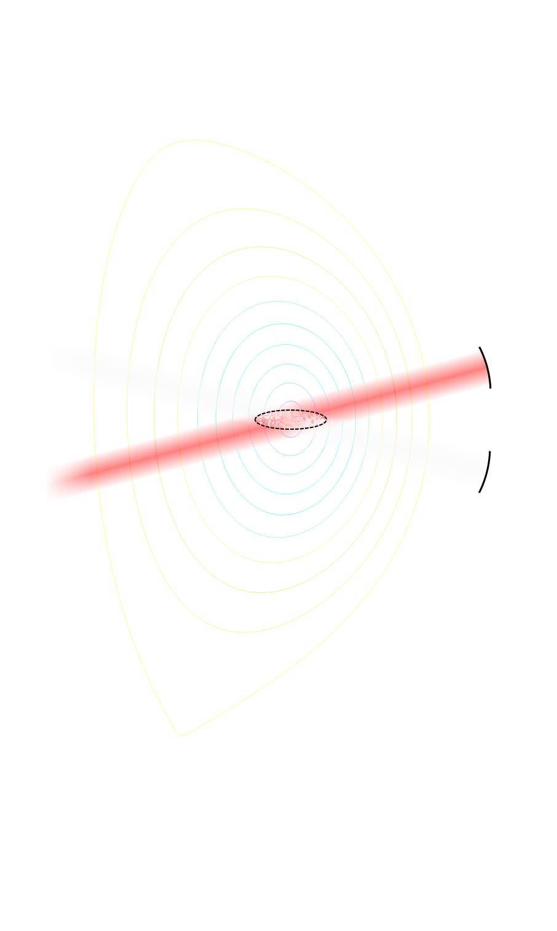



Collective Thomson Scattering (CTS)
Probe radiation scatters off electron fluctuations
Collective effects for $α_{S}≔\frac{1}{\left|{\overset{⃑}{k}}_{s}−{\overset{⃑}{k}}_{i}\right|λ_{D}}≫1$
$↪$ ion properties define scattered spectrum
Sensitive to:
  ion temperature
  (projected) bulk velocity
  relative ion abundance
  fast ion velocity distribution
Local measurement
Probe
$${\overset{⃑}{k}}_{i}$$
$${\overset{⃑}{k}}_{s}$$
Receiver
Notes:
current study:
P ~ 1MW
X-mode, sub-harmonic
$T_{i}$, $v_{i}$, $n_{α}$
$f_{P}$, $β_{R}$, $r_{M}$, $N_{frq}$

Slide 4
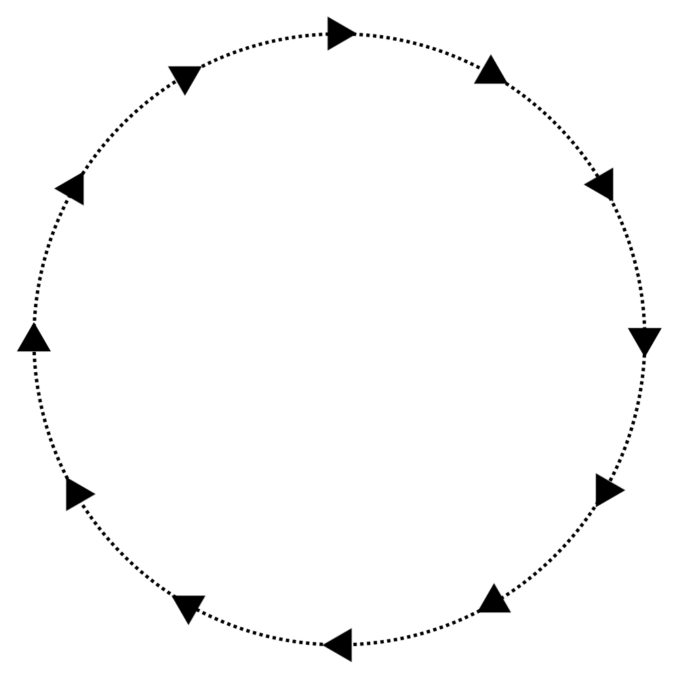
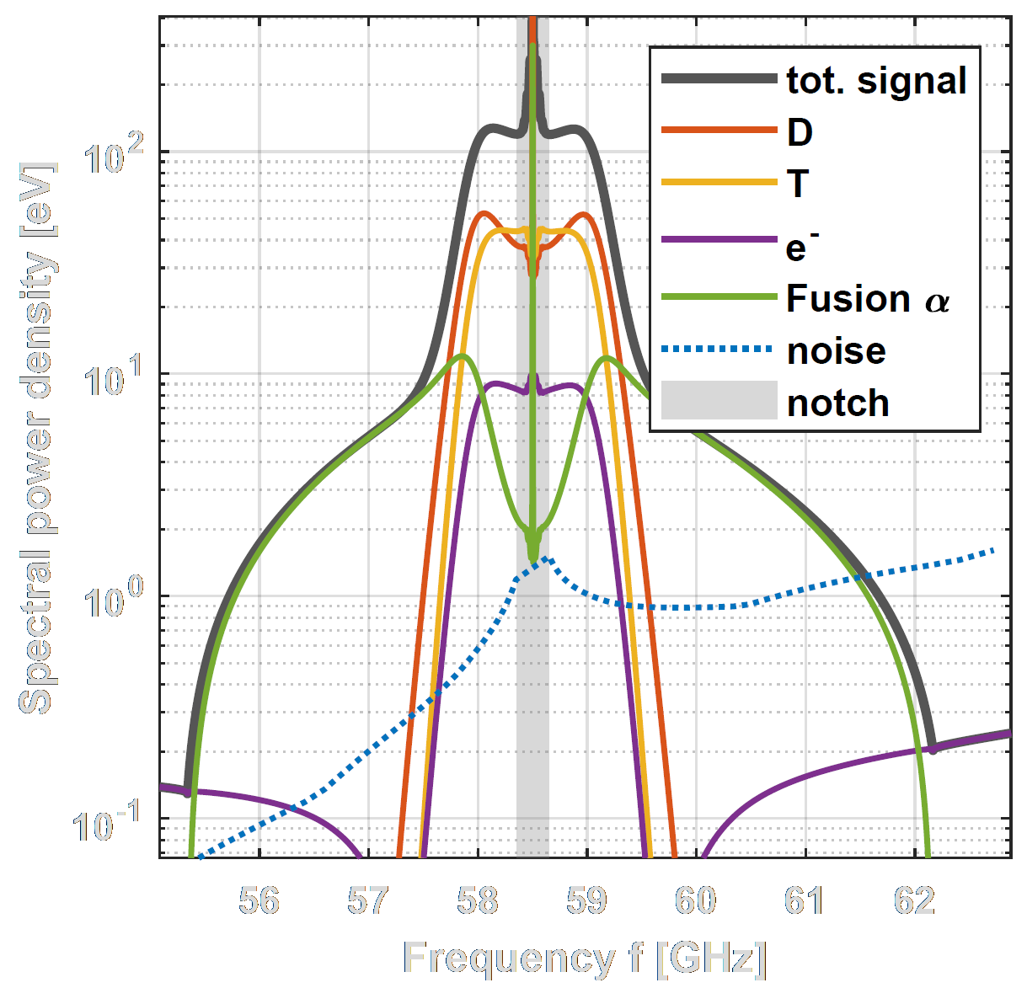
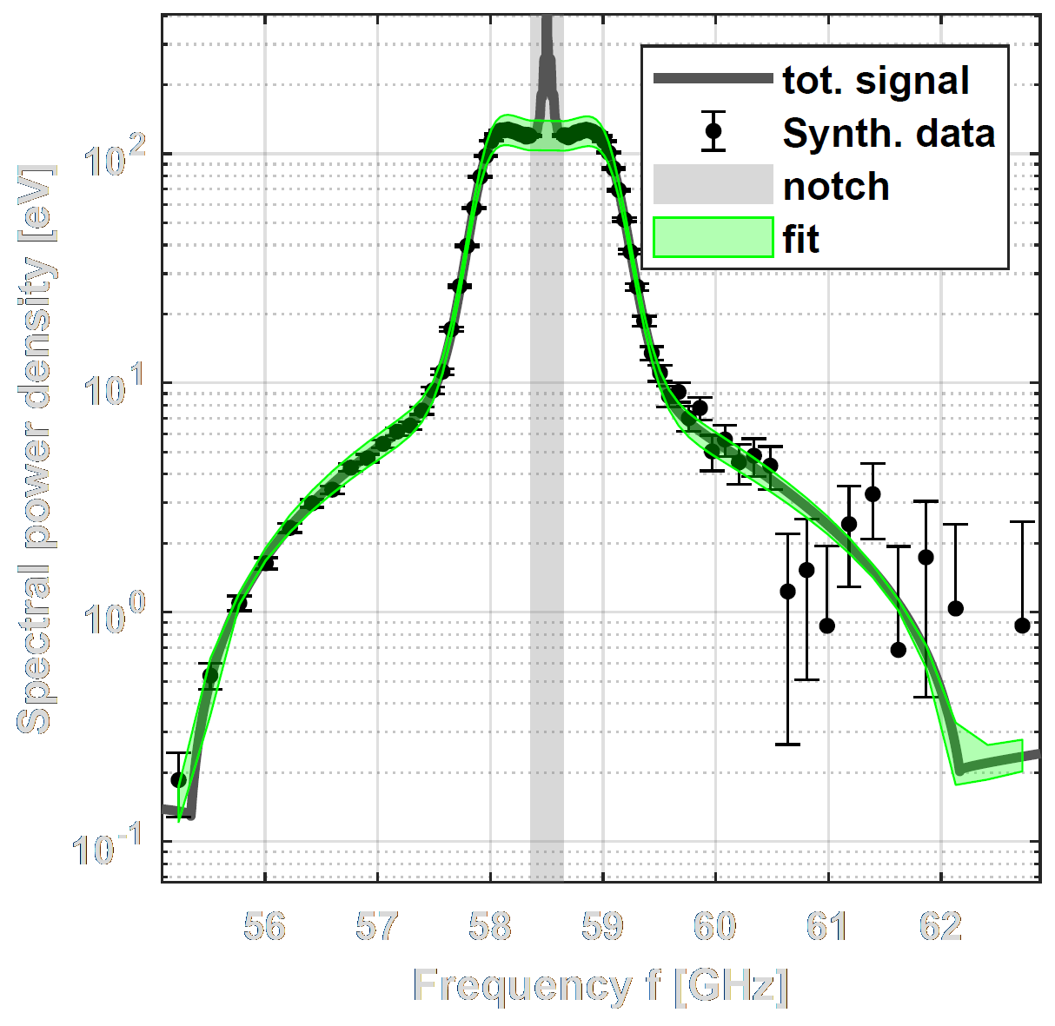
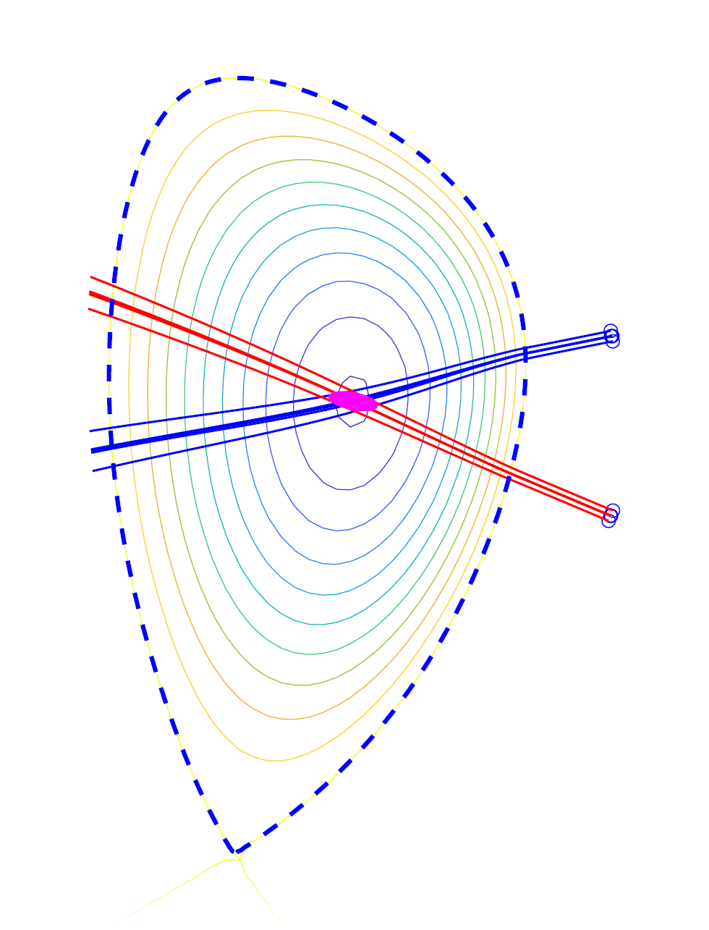
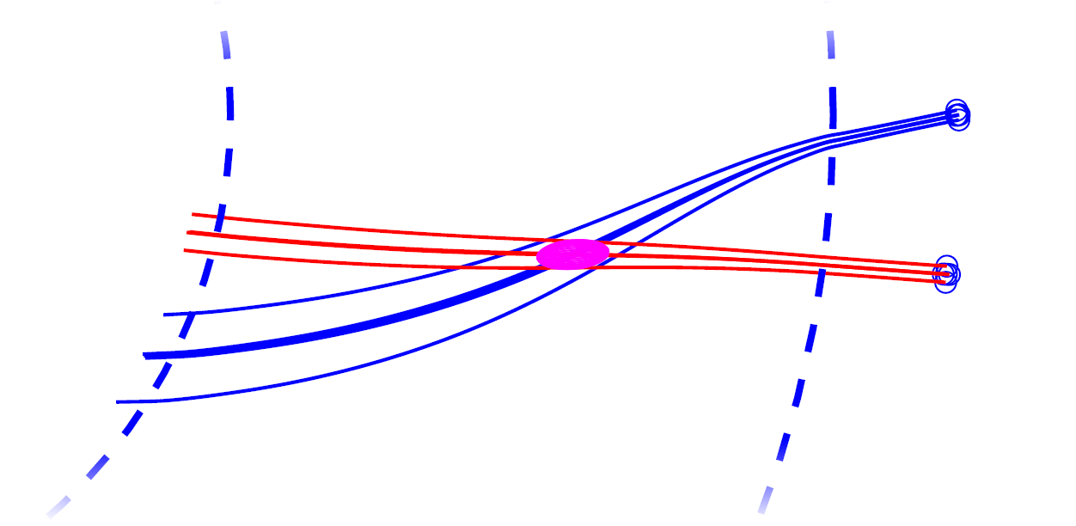
Optimisation framework
Ray tracing:
Find scattering geometry
New parameter of interest
Repeat for different values of parameter of interest
Input parameters
Reference configuration
Forward modelling: Calculate scattered spectrum
Update value of parameter of interest to the one with best measurement quality
Measurement quality
Adding noise & Inverting synthetic data
Repeat N_{fit} times
Notes:
Parameters of interest:
$f_{P}$, $β_{R}$, $r_{M}$, $N_{frq}$

Slide 5
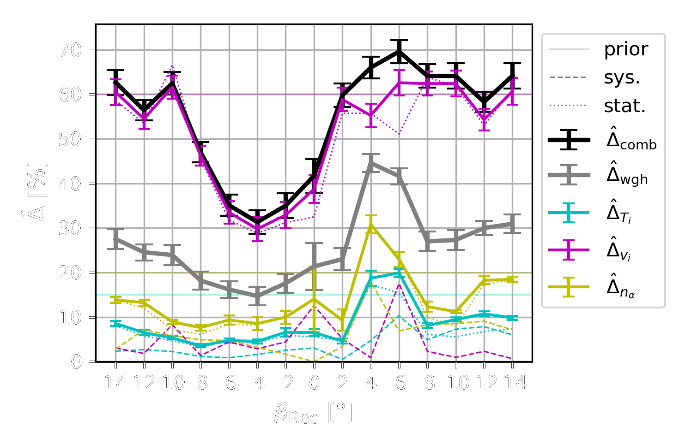
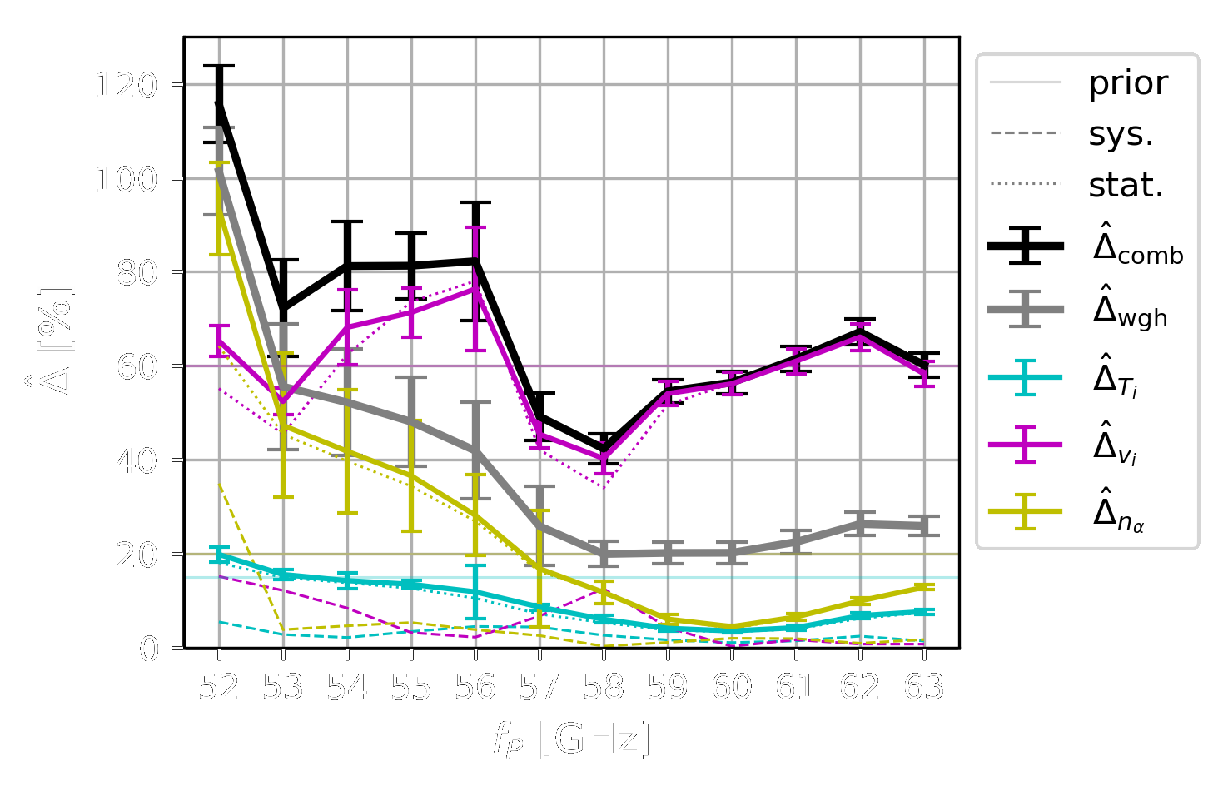
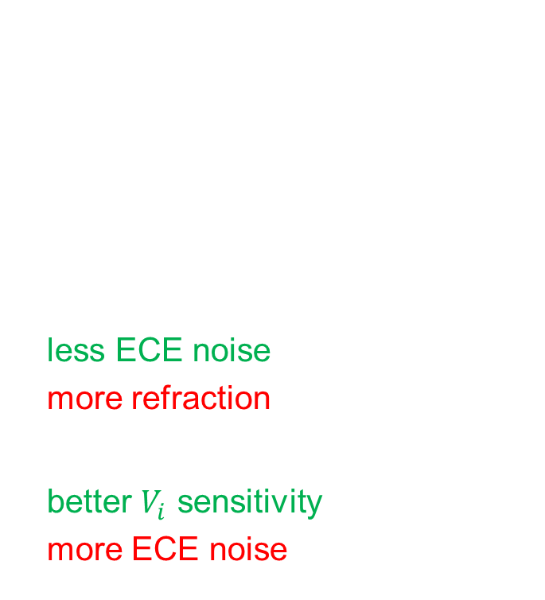
Preliminary results
Relative measurement errors ${\hat{Δ}}_{X}$ weighted by prior uncertainties to get ${\hat{Δ}}_{wgh}$
Key trade-offs:
Lower frequencies mean
less ECE noise, but also
more refraction
More parallel view means
better $V_{i}$ sensitivity, but also
more ECE noise
Notes:
T_{int} = 0.5s

Slide 6

Conclusions
CTS is viable as a core diagnostic for DEMO
Proof of principle for optimisation procedure
Current optimal setup uses probe frequency of ~58.5 GHz
and slightly oblique receiver
$⇒$ achieves accuracies of ${\hat{Δ}}_{T_{i}}\sim 5\%$, ${\hat{Δ}}_{V_{i}}\sim 30\%$ and ${\hat{Δ}}_{n_{α}}\sim 8\%$
Next steps:
  Improve realism (edge turbulence, variable scenario, ...)
  Consider machine integration
  Beyond DEMO: Apply optimisation procedure to other machines

Slide 7
Questions?
This work has been carried out within the framework of the EUROfusion Consortium, funded by the European Union via the Euratom Research and Training Programme (Grant Agreement No 101052200 — EUROfusion). Views and opinions expressed are however those of the author(s) only and do not necessarily reflect those of the European Union or the European Commission. Neither the European Union nor the European Commission can be held responsible for them.

Slide 10
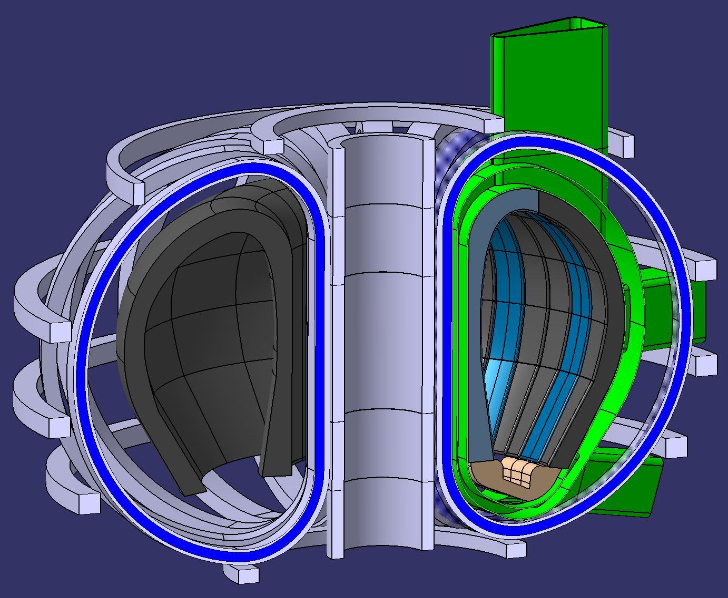

EU DEMO: Fusion Reactor Conditions
Large tokamak, ITER-like
4.4 T magnetic field on axis
$\sim$ 30 keV core temperature
Designed for single operational scenario
$↪$ little variation between discharges
Extreme neutron irradiation
Limited diagnostics access
(breeding blanket)
M. Kannamüller et al., DEMO LAR – Transforming the
2D design point in 3D CAD models (12/11/2024)
Notes:
mention new baseline

