Slide 1




Status of the high-resolution magnetic proton recoil neutron spectrometer for SPARC
Shon Mackie
MIT Plasma Science and Fusion Center
M. Dalla Rosa², J. L. Ball¹, J. Carmichael³, C. Wink¹, X. Wang¹, S. Colombi², D. Rigamonti⁴, G.P.A. Berg⁵, P. Raj³, M. Tardocchi⁴, J. Frenje¹, J. Rice¹ ,
R. A. Tinguely¹
[1]
[2]
[3]
[5]
[4]
This work is funded by Commonwealth Fusion Systems under RPP031

Slide 2
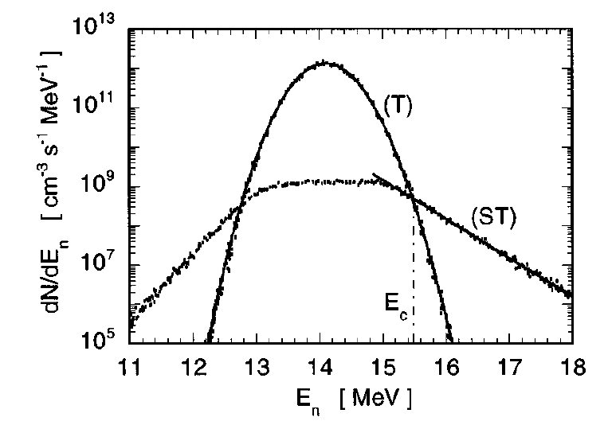
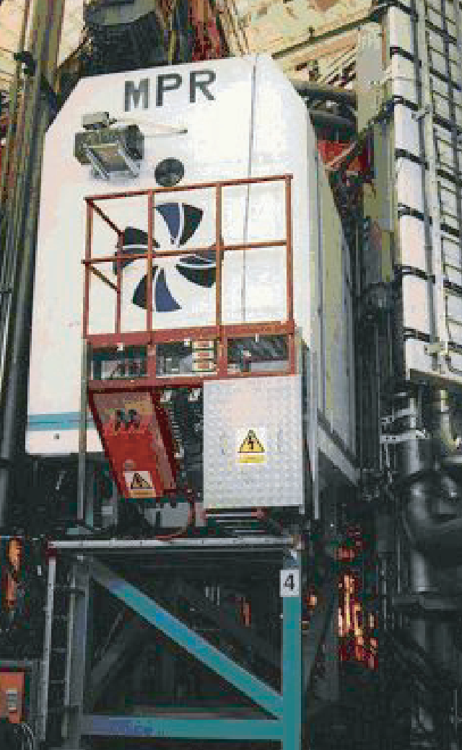
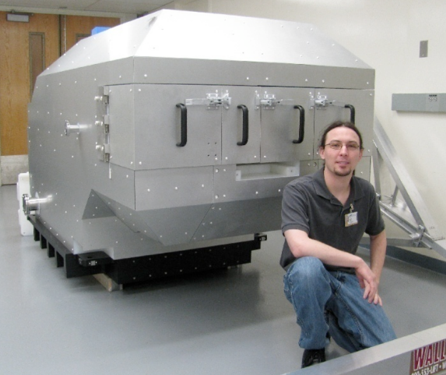
Neutron spectrometry will probe SPARC burning plasmas
Neutron emission spectra encode information about the kinetic distributions of fuel ions, enabling diagnosis of critical plasma parameters¹ such as:
  Fusion power (distinguish thermonuclear vs. suprathermal fusion)
  Fuel ion temperature, composition, and density
  Nonthermal ion distributions generated via RF and alpha heating
SPARC’s core plasma will be diagnosed by a Magnetic Proton Recoil (MPR) neutron spectrometer
  MPR technique was developed at JET in the 90s, employed to great effect at NIF and OMEGA^{1,2}
  The Ferrari of Neutron Spectrometers⁴
Simulated neutron spectrum due to thermal bulk
and suprathermal alpha knock on tail in ITER³
¹L. Giacomelli, et al. Advanced Neutron Diagnostics for JET and ITER Fusion Experiments
²D. Casey, et al. The magnetic recoil spectrometer for measurements of the absolute neutron spectrum at OMEGA and NIF
³L. Ballabio, G. Gorini, J. Kallne. Alpha particle knock-on signature in neutron emission of DT plasmas
⁴M. Tardocchi, Private Communication
MRS pre-installation at NIF
MPR installed at JET

Slide 3
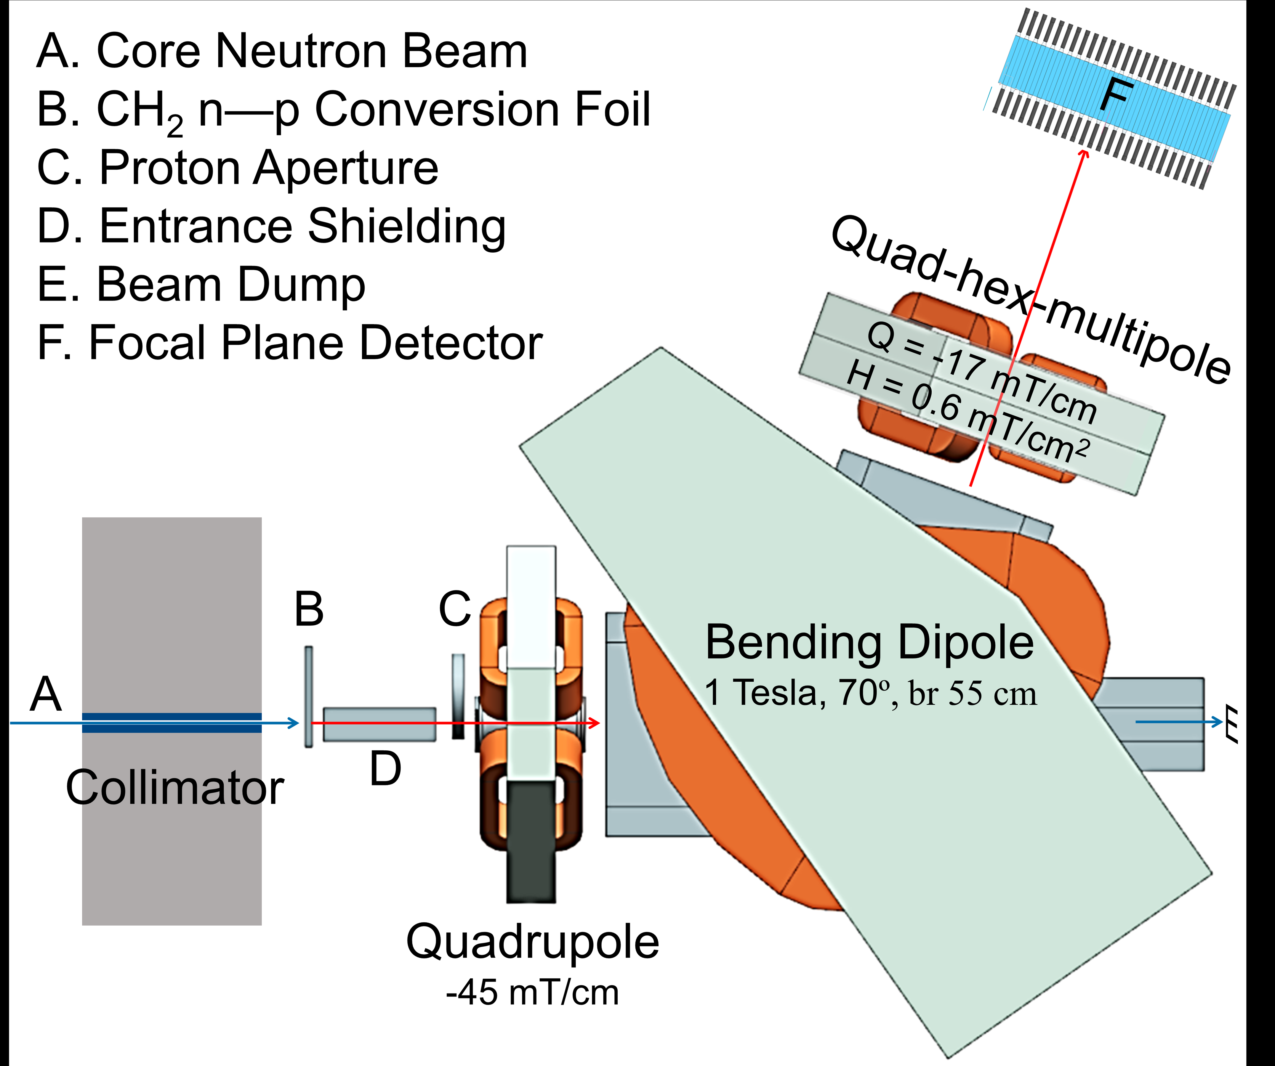
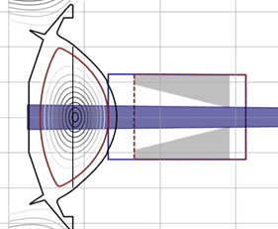
Principle of Magnetic Proton Recoil neutron spectrometers
Collimated neutrons hit thin plastic foil, scattering protons
Forward scattered protons selected by aperture to enter a magnetic ion optical beamline which disperses by energy
Hodoscope detector array placed in ion optical focal plane measures position-space proton distribution
Spatial distribution of protons is directly related to the incident neutron spectrum by well-known physics
Hodoscope Detector Array
Conversion foils
Core Neutrons
To Beam Dump
Proton apertures
NOT TO SCALE

Slide 4
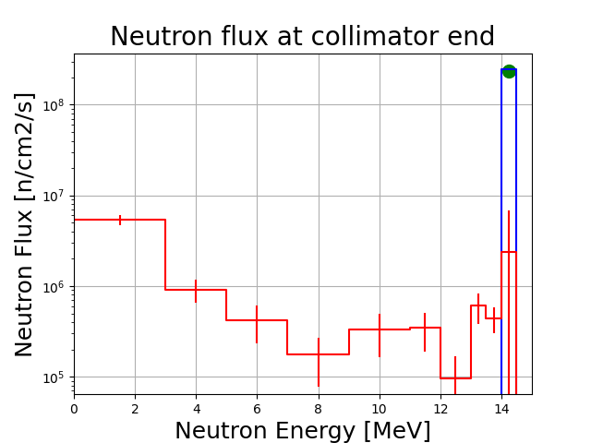
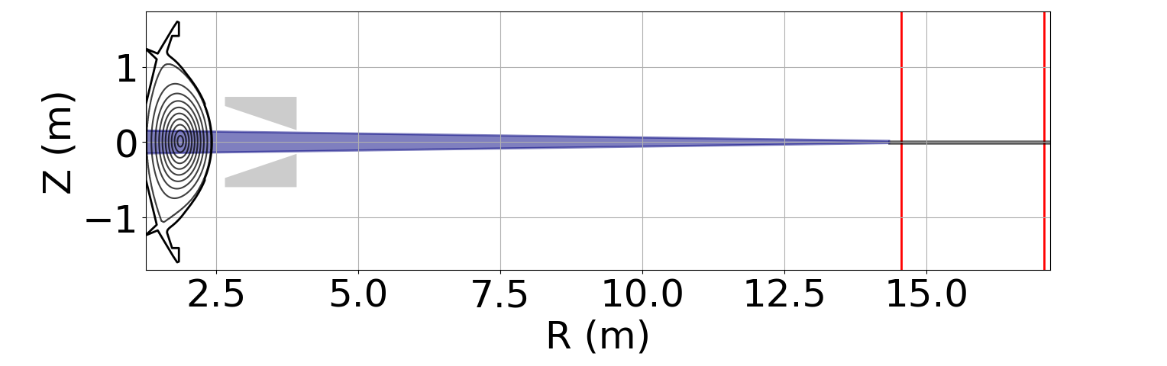
Unobstructed, collimated line of sight enables high quality measurements of neutron emissions from reactor core
MPR constitutes the midplane line of sight of the poloidal neutron camera, synergistically unlocking sophisticated spatial, spectral, and temporal studies of fusion reactions
  More details on the neutron camera detectors provided by J.L. Ball and A. Celora today after lunch
OpenMC neutron transport simulations validate analytic model of optical neutron transport and attenuation
MPR Field of View and Attenuating Materials
Analytic transport
model agrees with
OpenMC direct flux
In-port shielding
accommodates FOV
MPR Window
50 um*
Direct
Indirect
Indirect flux >10 MeV
<1% direct flux
Port flange
5 mm*
Air
12 m*
*preliminary values

Slide 5
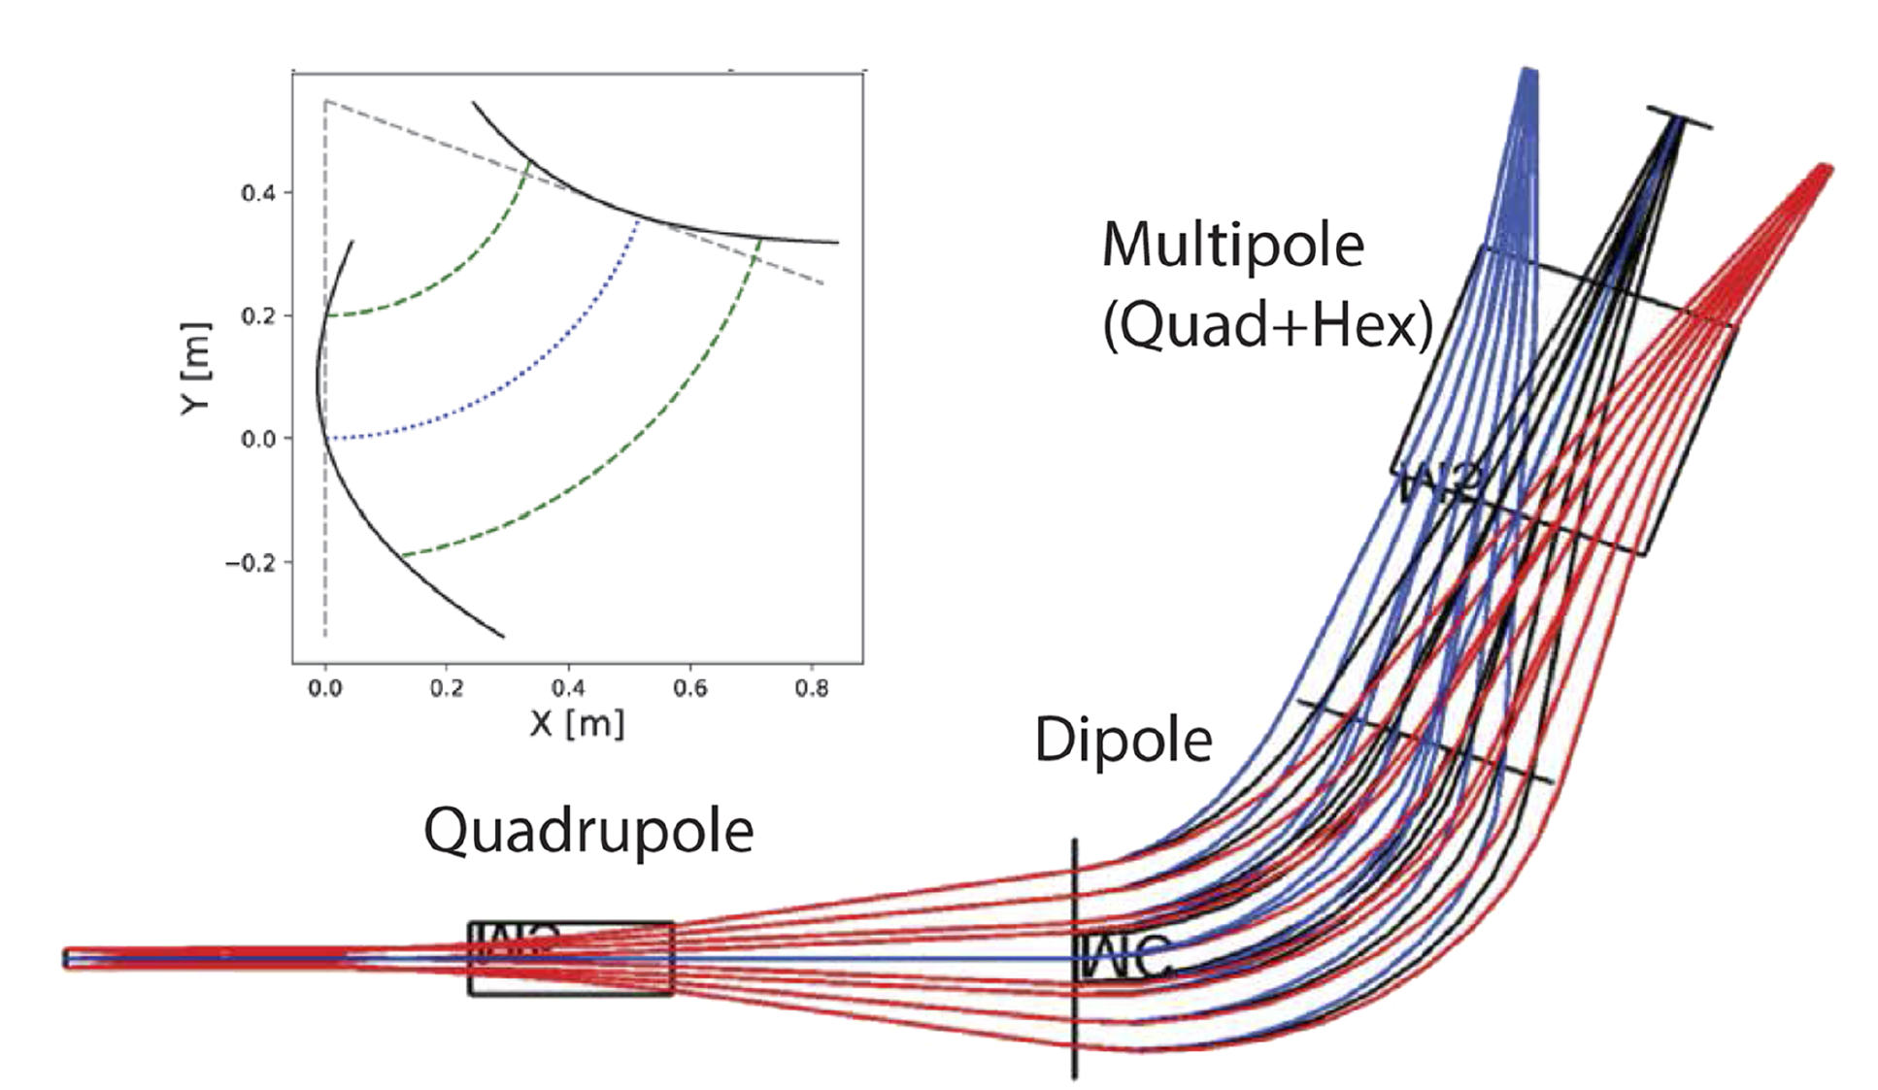
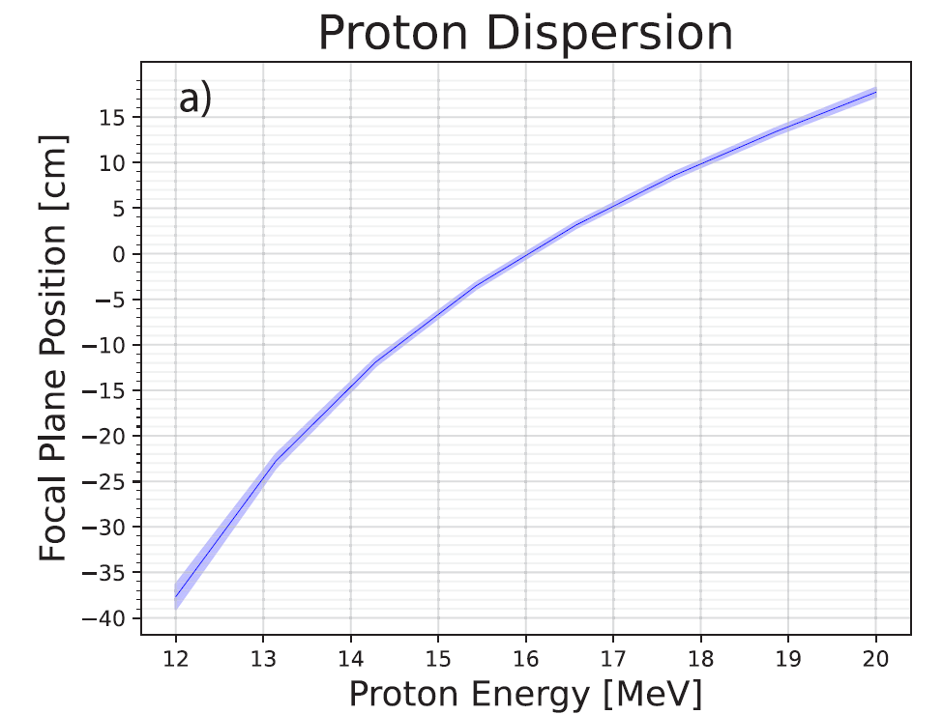

Electromagnetic beamline has been optimized to deliver unprecedented resolution and flexibility¹
3 magnet beamline has been designed using COSY INFINITY to achieve ${δE}/{E_{0}}<0.7\%$
Electromagnetic design gives tunable proton energy sensitivity up to 20 MeV
Reference Energy | Dipole Field | Proton Spectral Range | Ion Optical Energy Resolution
2.5 MeV | 0.4 T | [1.9, 3.1] MeV | 20 keV
14 MeV | 1.0 T | [10.5, 17.5] MeV | 88 keV
16 MeV | 1.1 T | [12.0, 20.0] MeV | 124 keV
0.75E₀
E₀
1.25E₀
¹S. Mackie et al. Ion Optical design of the magnetic proton recoil neutron spectrometer for the SPARC tokamak

Slide 6
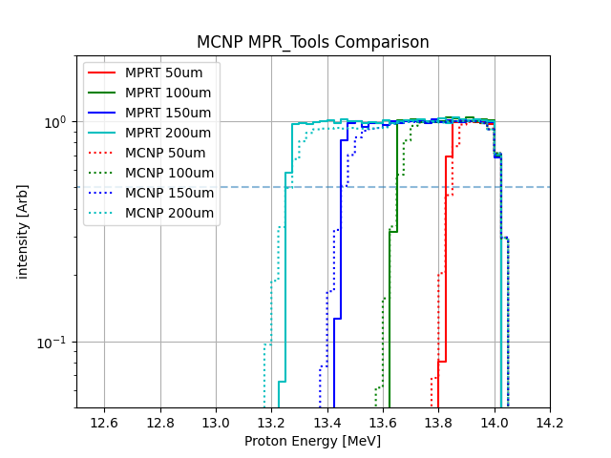
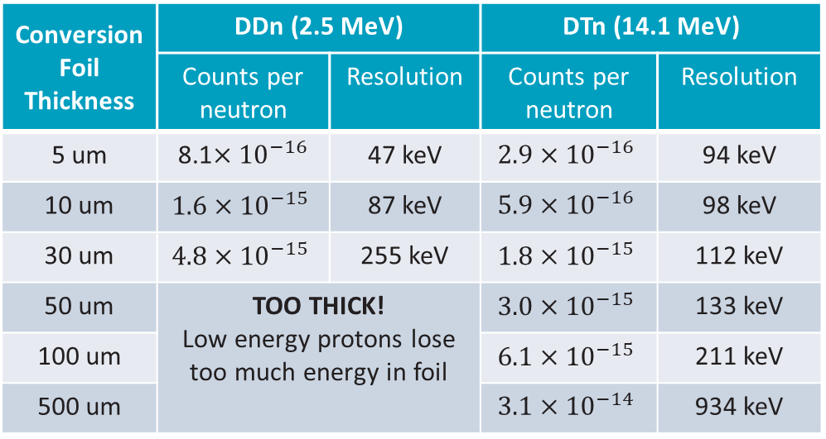
Conversion geometry controls MPR sensitivity and resolution
Conversion Foil Thickness | DDn (2.5 MeV) |  | DTn (14.1 MeV)
 | Counts per neutron | Resolution | Counts per neutron | Resolution
5 um | 8.1$×{10}^{−16}$ | 47 keV | $$2.9×{10}^{−16}$$ | 94 keV
10 um | $$1.6×{10}^{−15}$$ | 87 keV | $$5.9×{10}^{−16}$$ | 98 keV
30 um | $$4.8×{10}^{−15}$$ | 255 keV | $$1.8×{10}^{−15}$$ | 112 keV
50 um | TOO THICK! Low energy protons lose too much energy in foil |  | $$3.0×{10}^{−15}$$ | 133 keV
100 um |  |  | $$6.1×{10}^{−15}$$ | 211 keV
500 um |  |  | $$3.1×{10}^{−14}$$ | 934 keV
Instrument sensitivity and resolution are inherently at odds
Rotary foil mechanism enables shot-to-shot selection of foil geometry
Custom, lightweight Monte Carlo response function code developed and benchmarked against MCNP
  https://github.com/shonmackie/MPR_Tools

Slide 7
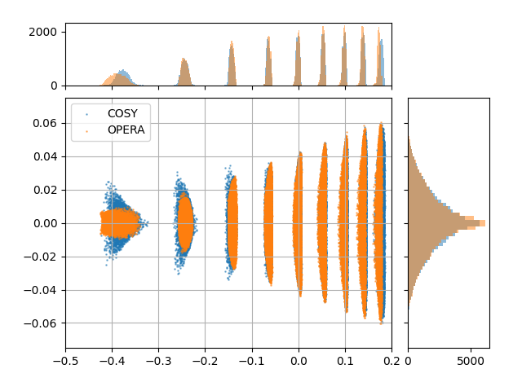
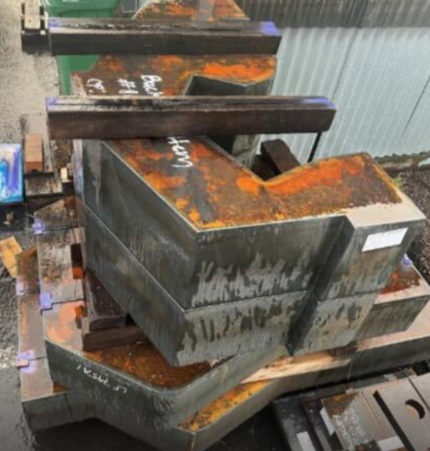
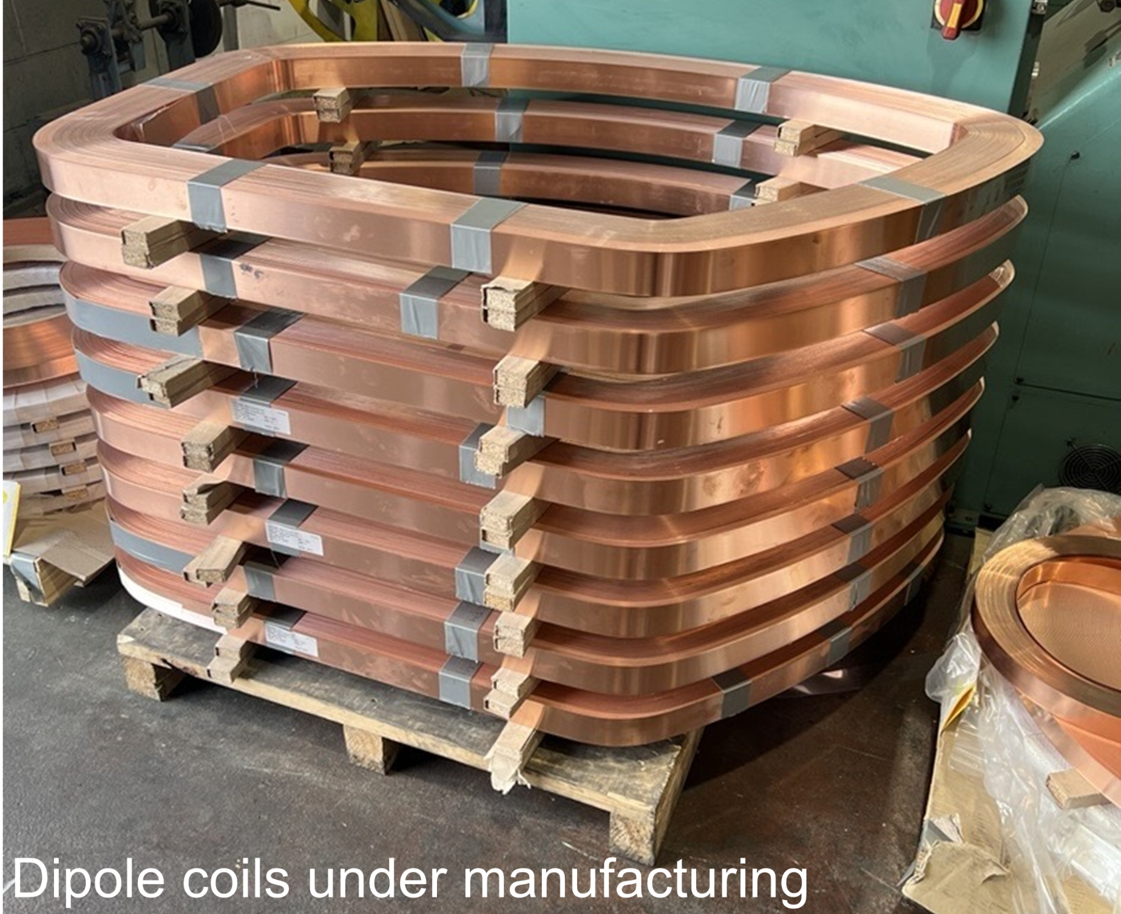
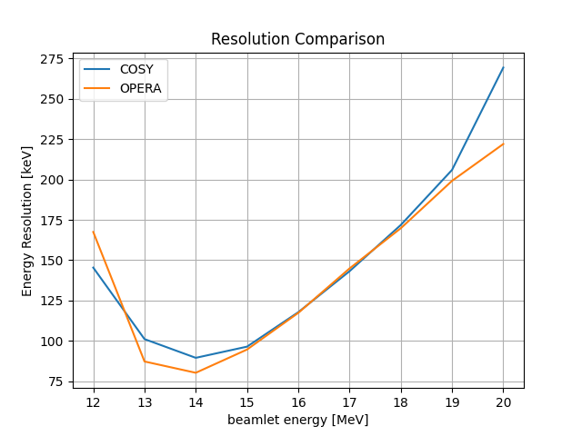
The magnets are being manufactured to specification
Excellent agreement between idealized ion optical calculations and finite element model of manufacturing design
Engineering parameters:
  16,600 kg total mass
  15.1 kW max power draw
  21 L/min cooling water
Focal plane proton images
Resolution as function of energy

Slide 8
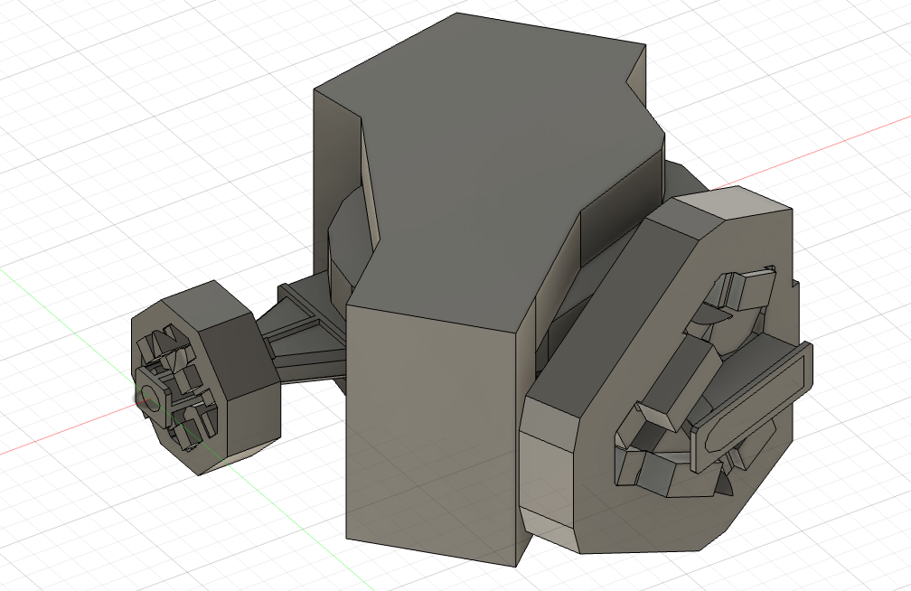
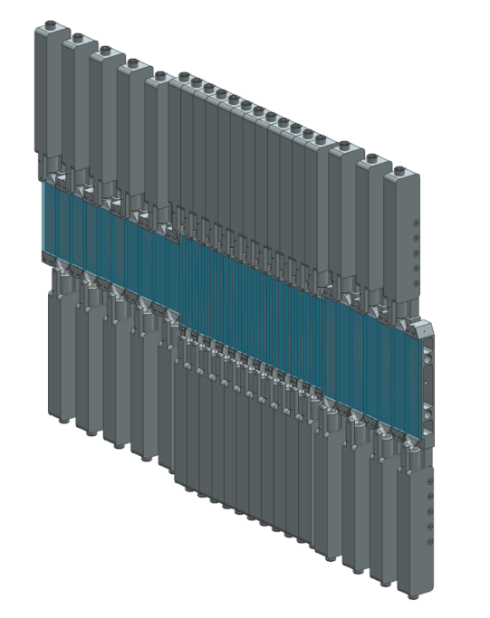
Background radiation on the hodoscope is manageable
Hodoscope detectors designed to maximize Signal-to-Background Ratio (SBR)
  More detailed discussion of hodoscope detector development coming up next from M. Dalla Rosa
A high fidelity OpenMC model of the spectrometer and neutron lab space has been implemented to study background levels
Accounting for Background subtraction, PSD and detection efficiency gives average SBR of 10-10,000 across the hodoscope
  Pessimistic estimate – no radiation shielding included in model
CSG model of MPR magnets and
vacuum chamber (X. Wang)
Hodoscope
assembly

Slide 9
SPARC’s MPR is on track to deliver high quality measurements across experimental campaigns
High resolution neutron spectrometer will diagnose key plasma parameters relevant to understanding the burning plasma state
Designed to maximize flexibility to meet a variety of experimental needs:
  Electromagnetic design measures neutron energies from 1-20 MeV
  Swappable conversion foil enables shot-to-shot selection of resolution vs sensitivity
Ongoing work:
  Vendor is working hard to deliver beamline by end of 2025/early 2026
  Hodoscope shielding design and signal processing routines are being refined to improve Signal to Background Ratio

Slide 10
Backup Slides

Slide 11
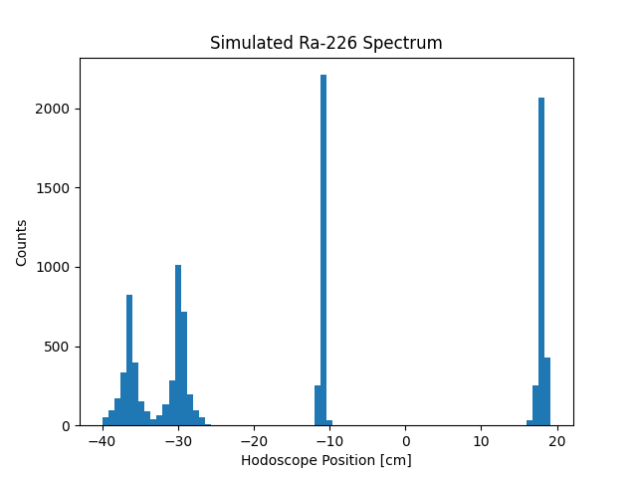
Ab initio response function calculation gives independently calibrated measure of neutron production
MPR response function can be precisely calculated from first principles based on physics of elastic n,p scattering and proton transport through magnetic field
Calibration boils down to characterization of as-built components
Ra-226 alpha source planned to verify beamline’s ion optical performance
5.5 MeV
7.7 MeV
4.8 MeV
4.6 MeV

Slide 12
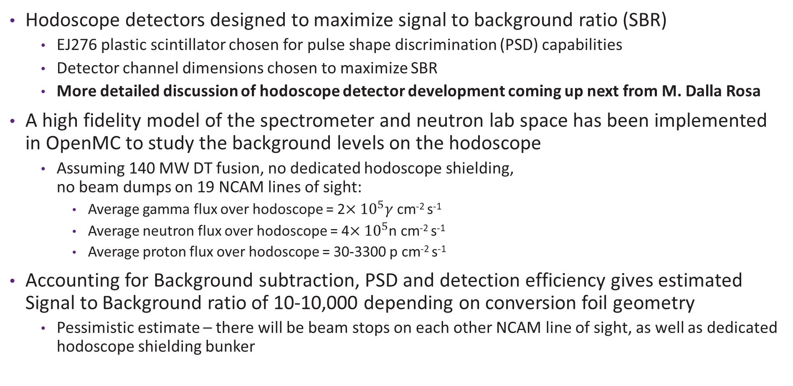
Background radiation on the hodoscope is manageable
Hodoscope detectors designed to maximize signal to background ratio (SBR)
  EJ276 plastic scintillator chosen for pulse shape discrimination (PSD) capabilities
  Detector channel dimensions chosen to maximize SBR
  More detailed discussion of hodoscope detector development coming up next from M. Dalla Rosa
A high fidelity model of the spectrometer and neutron lab space has been implemented in OpenMC to study the background levels on the hodoscope
  Assuming 140 MW DT fusion, no dedicated hodoscope shielding,
  no beam dumps on 19 NCAM lines of sight:
    Average gamma flux over hodoscope = 2$×{10}^{5}γ$ cm⁻² s⁻¹
    Average neutron flux over hodoscope = 4$×{10}^{5}$n cm⁻² s⁻¹
    Average proton flux over hodoscope = 30-3300 p cm⁻² s⁻¹
Accounting for Background subtraction, PSD and detection efficiency gives estimated Signal to Background ratio of 10-10,000 depending on conversion foil geometry
  Pessimistic estimate – there will be beam stops on each other NCAM line of sight, as well as dedicated hodoscope shielding bunker

