Slide 1




Study of in-vacuum discharges with X-rays at the High Voltage Padova Test Facility
International Conference on Diagnostics For Fusion Reactors: the Burning Plasma Era (ICFRD2025)
Varenna, Villa Monastero, 01-05 September 2025
F. Caruggi, S. Cancelli, A. Celora, G. Croci, A. De Lorenzi, G. Grosso, F. Guiotto, L. Lotto, A. Muraro, T. Patton, N. Pilan, O. Putignano, M. Tardocchi
f.caruggi@campus.unimib.it

Slide 2
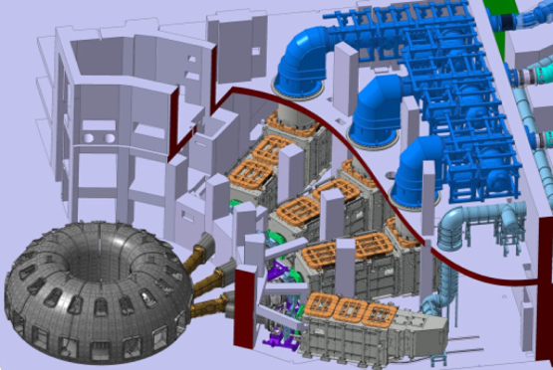
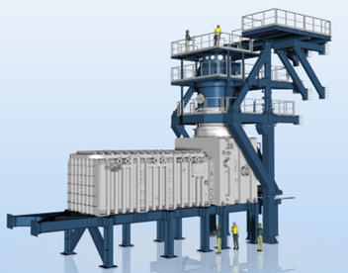
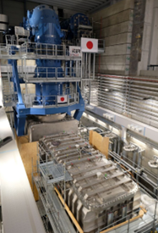
Context: ITER, MITICA
External heating system for ITER: Neutral Beam Injector.
  Energy through acceleration and neutralization of negative ion beam up to 1 MeV (40 A, 3600 s).
MITICA, in the commissioning phase in Padova, Italy, is the full-scale prototype of the NBI.
  Source, accelerator and neutralizer.
  Critical issue in accelerator: electrical discharges and vacuum breakdown.

Slide 3
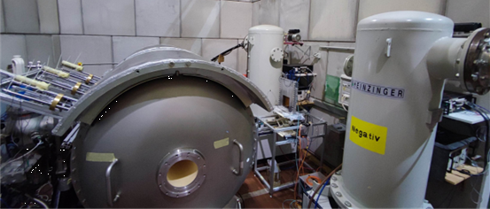
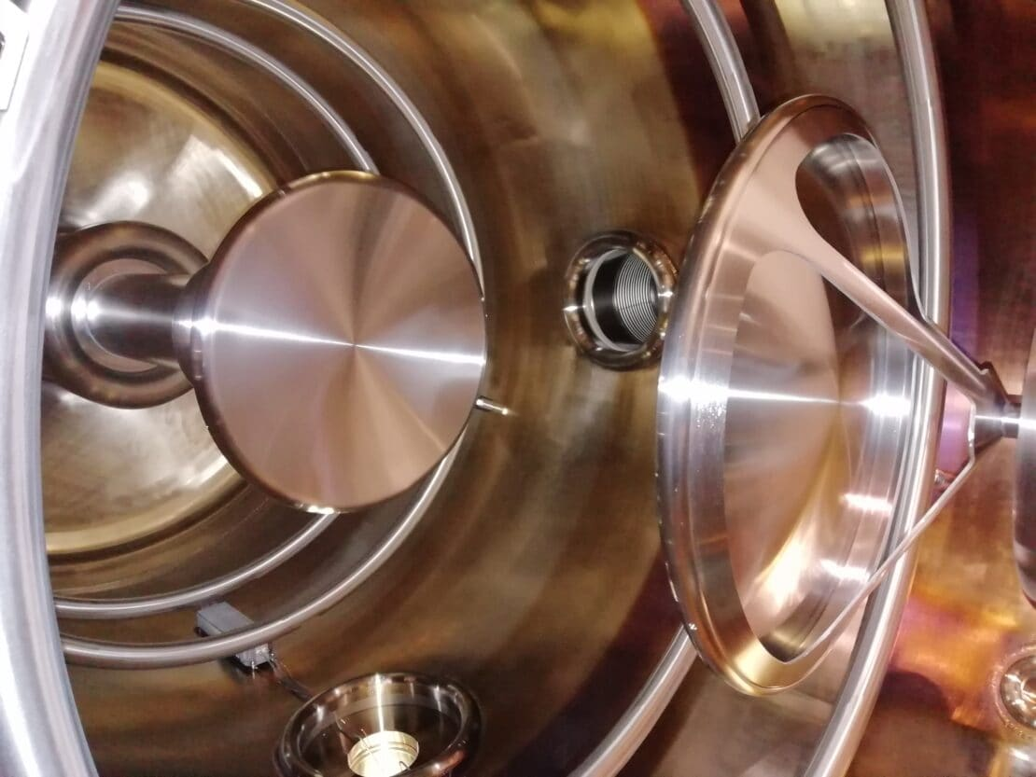
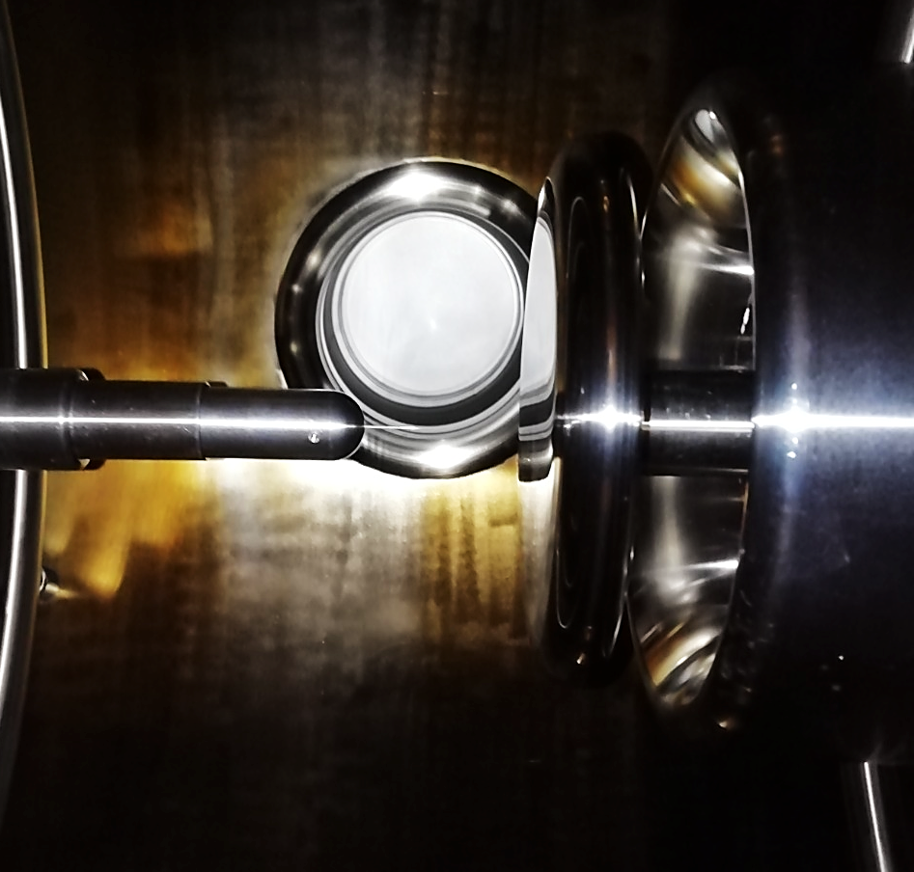
Experimental facility: HVPTF
High Voltage Padova Test Facility: experiment in support of MITICA.
  Study of electrical discharges in vacuum and phenomenology of vacuum breakdowns.
  Vacuum vessel (2 m³), two electrodes with voltage differences up to 800 kV_{DC}
  Conditioning experiments, to improve the vacuum gap resistance to breakdown events.
  Diagnostics installed to study electrical signals + emissions from the chamber (cameras, X-ray detectors)

Slide 4
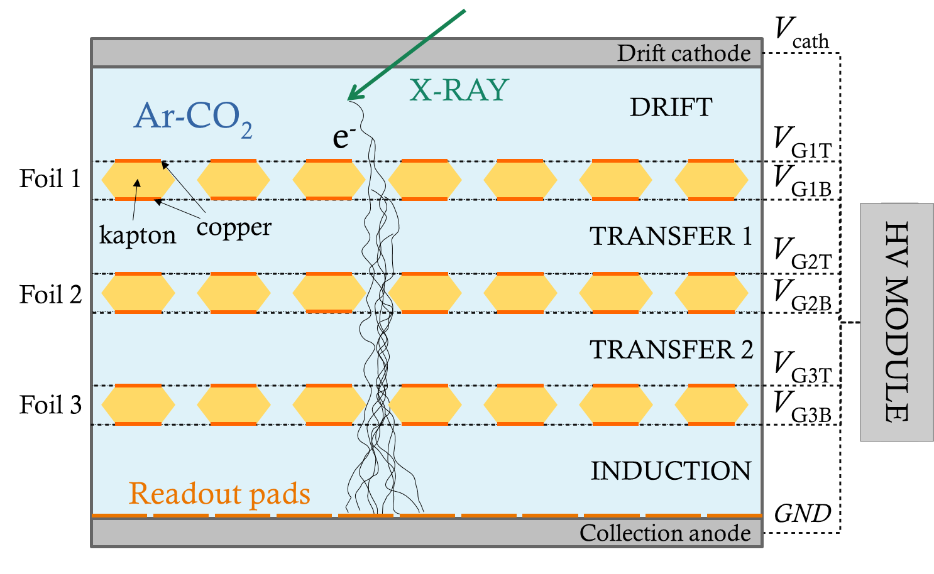
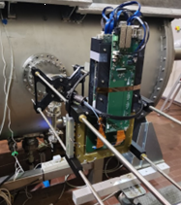
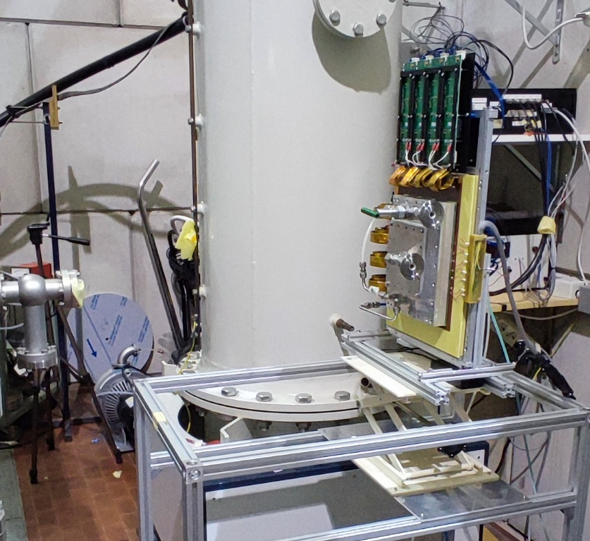
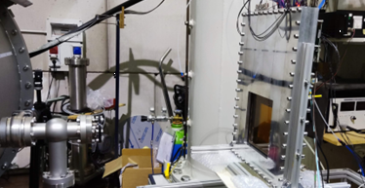
Instruments: GEM detectors
Gaseous radiation detector employing GEM foils, developed at CERN since 1997.
Readout: combination of ASICs and FPGAs.
  All-digital acquisition chain, collaboration with Nuclear Instruments.
  Single photon counter with great time resolution.
  Segmented anodes for spatial reconstruction, good spatial resolution.
  Time-over-Threshold converted to energy of the incoming radiation, decent energy resolution.
Different prototypes installed at HVPTF

Slide 5
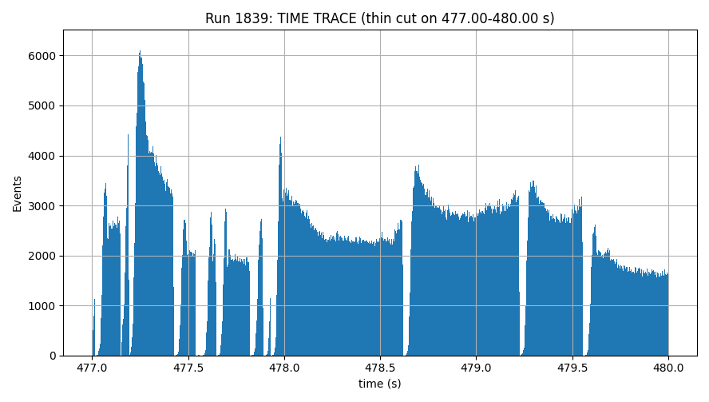
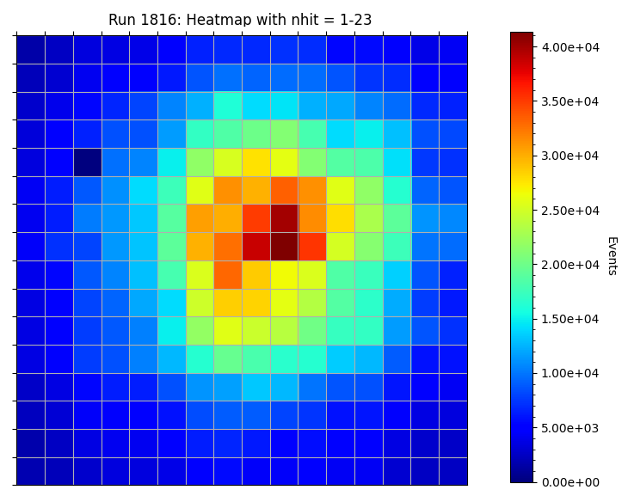
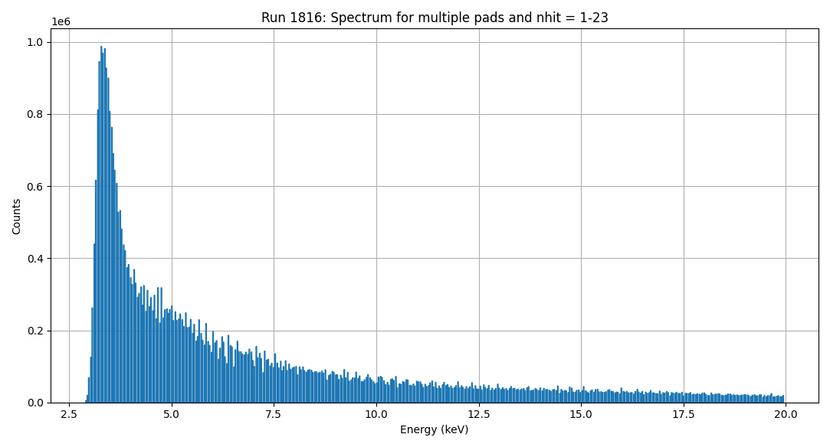
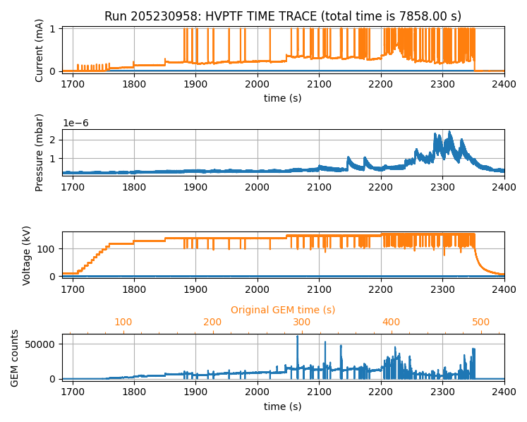
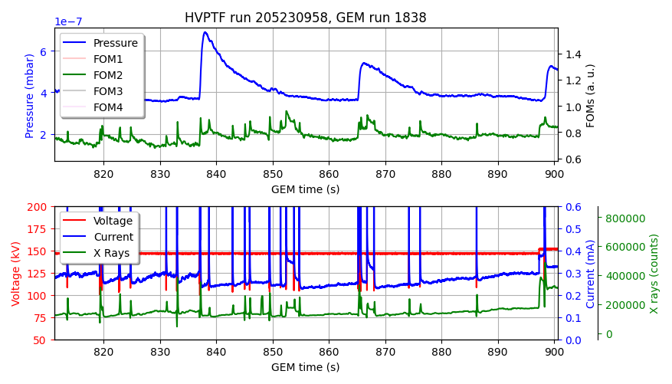
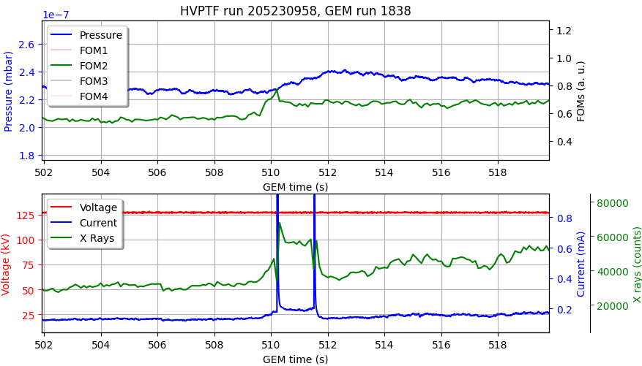
Experimental: first studies
First analyses aimed at testing the capabilities of the GEM detectors for HVPTF.

Slide 6
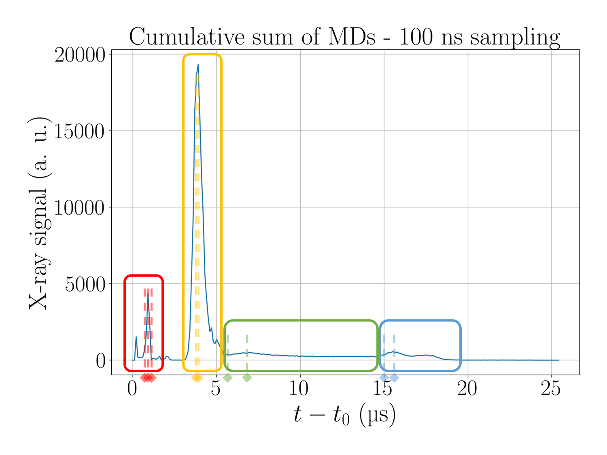
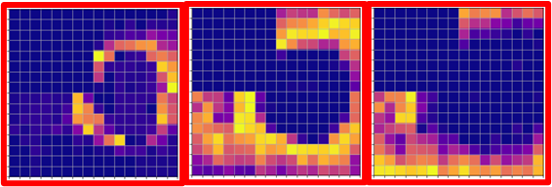
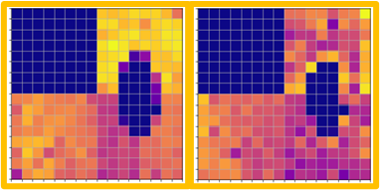
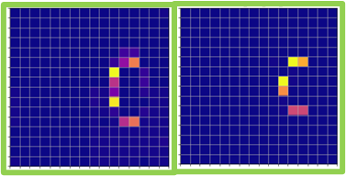
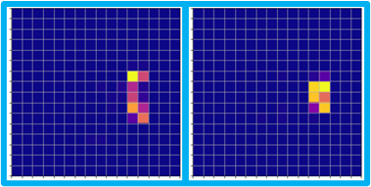
Experimental: micro-discharges
The micro-discharges were studied in more detail, mainly focusing on needle-plane electrode conditioning runs.
  Accurate analysis of the micro-scale phenomena thanks to the GEM capabilities.
  High consistency in the pattern of the X-ray emissions.
  Different results for different geometries.

Slide 7
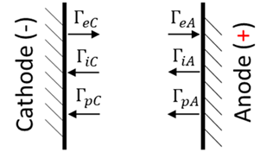
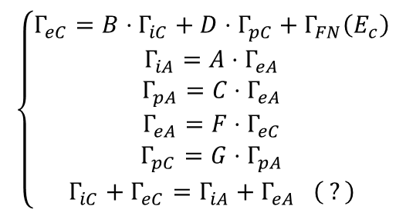
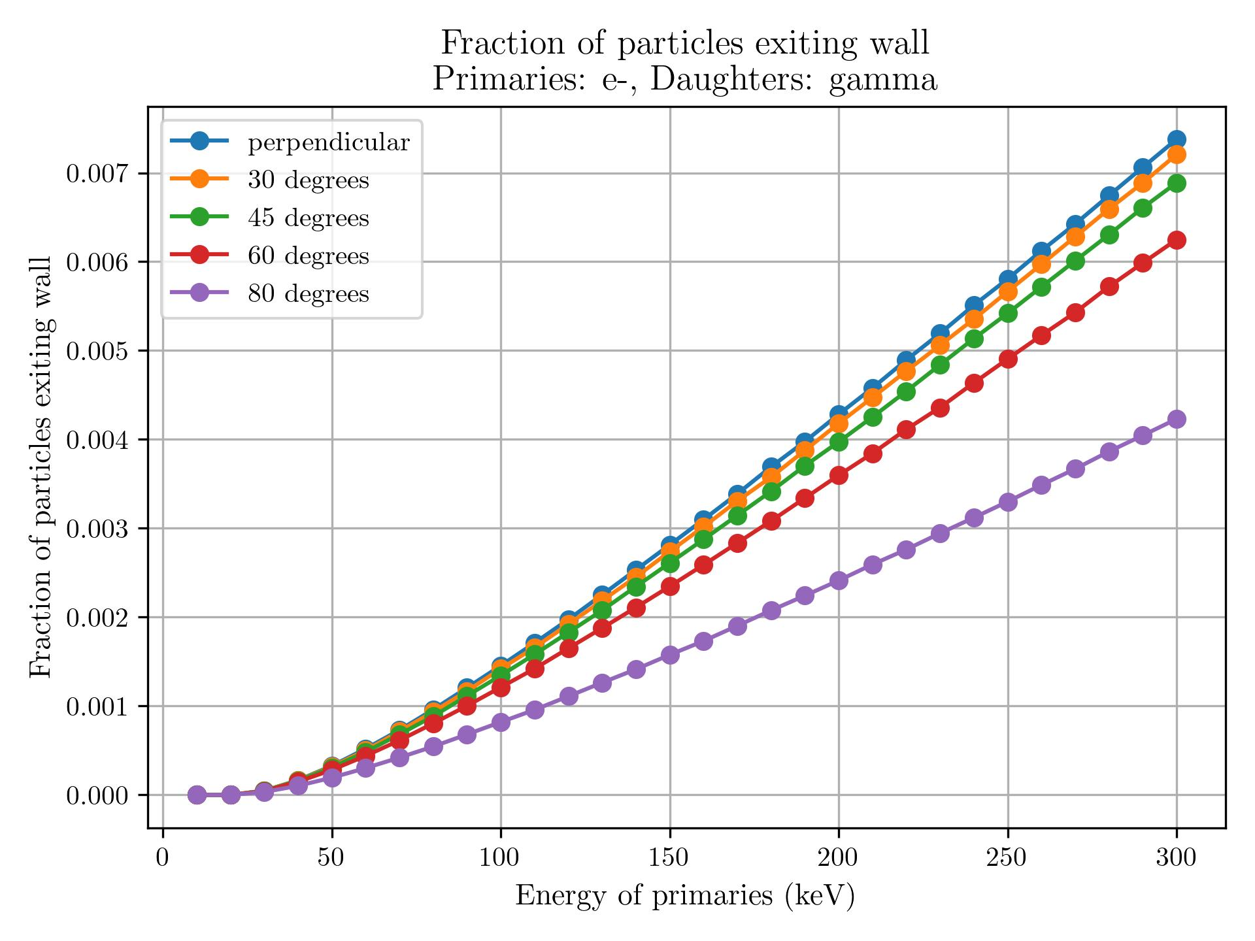
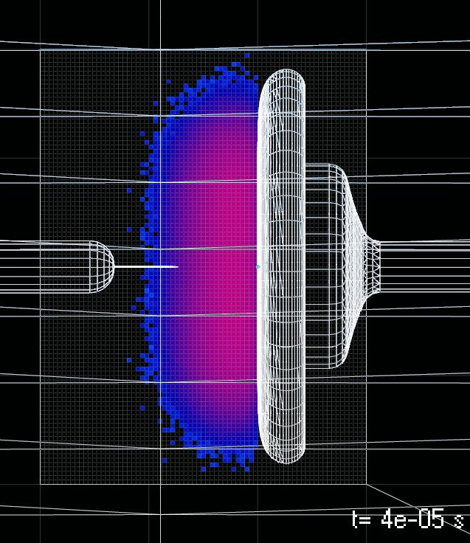
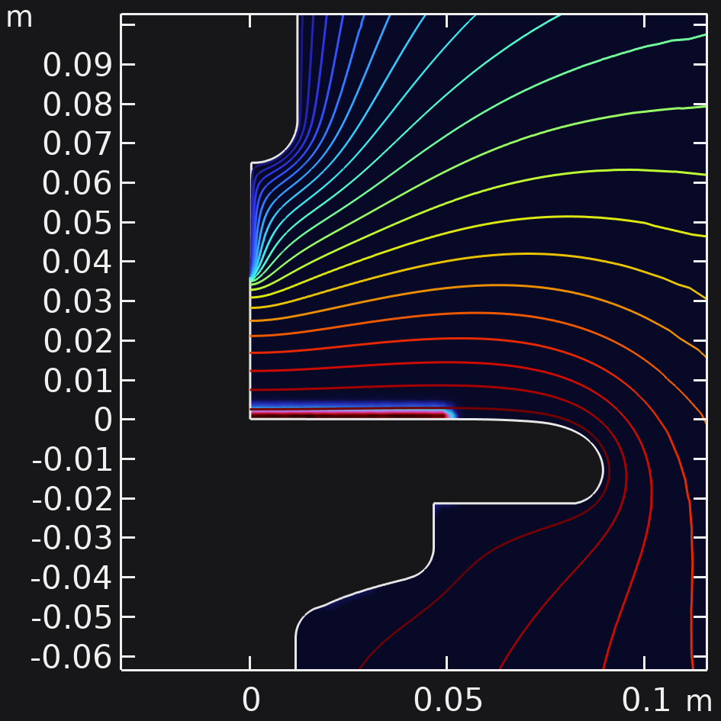
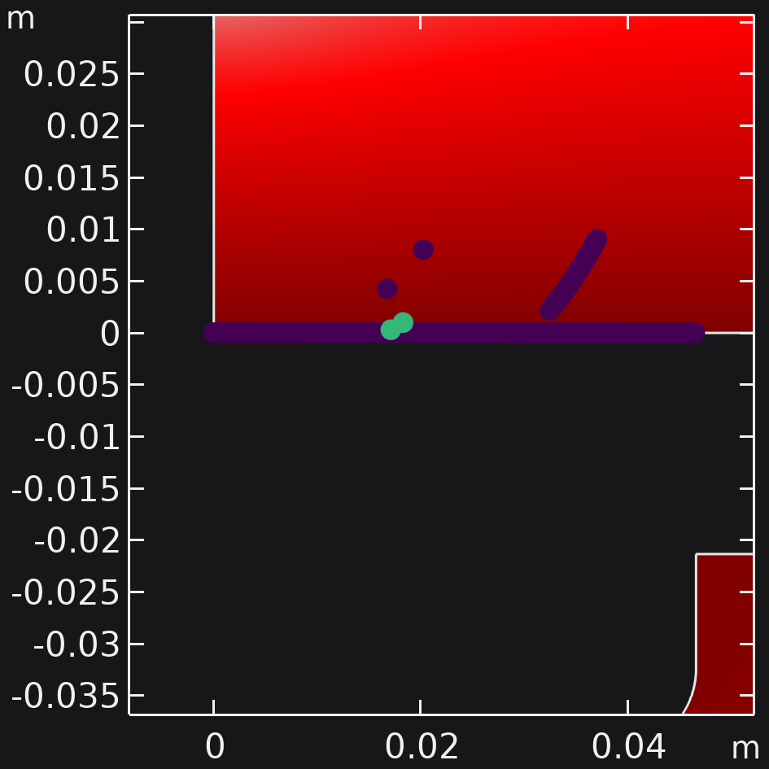
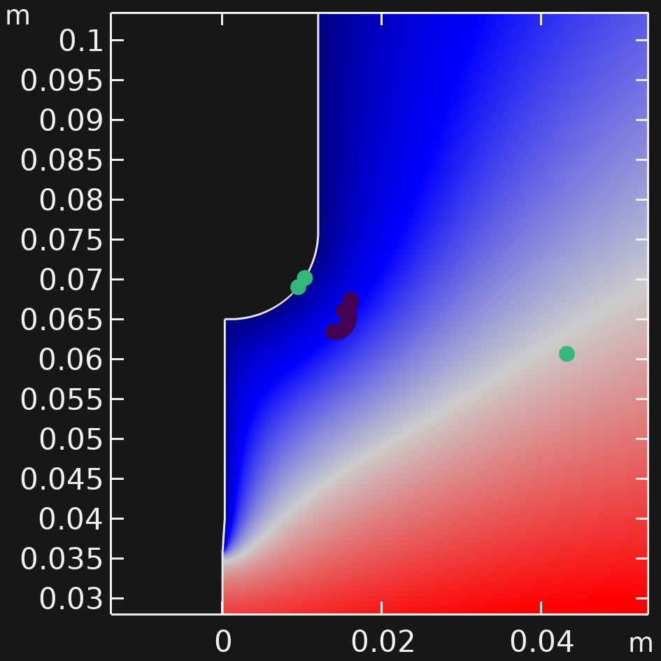
Theory: model and simulations
Model considering the dynamics of electrons, ions and photons in the geometry of HVPTF, with production of secondaries both at the surfaces of the electrodes and in the gap in between.
Subdivision in simpler components, modeled separately.
  Production of secondaries Geant4, SRIM.
  Gas desorption from the surfaces Molflow.
Effects combined in single COMSOL Multiphysics simulation.
  Electron-ion dynamics in the field.
  Secondaries produced according to the simulations.
  Pressure profile in time from gas desorption.

Slide 8
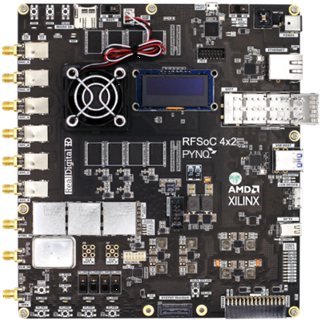
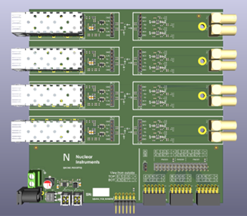
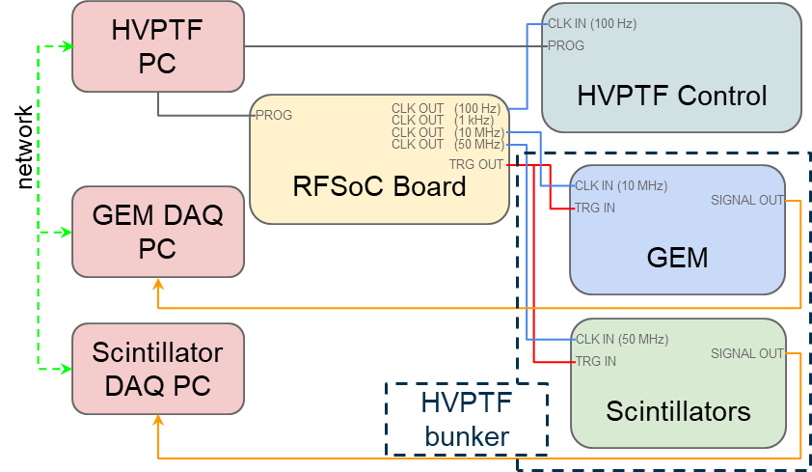
Synchronization system
System for synchronization and control of the diagnostics.
Physical components to generate and distribute the clock and trigger signals for each diagnostics.
  AMD XILINX RFSoC 4x2 with custom firmware.
  Electro-optical converters for signals, to avoid grounding issues.
Software developed to manage and control the data acquisition procedures on different PCs.
  Finite state machine logic on each acquisition PC.
  Server-client structure over the network for communication and centralized control.

Slide 9
Conclusions
The issue of discharges and breakdowns in vacuum could impact negatively the capabilities of the Neutral Beam Injector for ITER.
  More studies and modeling for discharges in vacuum are beneficial to the whole
GEM detectors have proven to be a good instrument for X-ray studies in the HVPTF environment.
  This can be an aid for the development of their capabilities as diagnostics for fusion machines as well.
The implementation of the synchronization system will help with additional studies and experimental measurements in HVPTF.
  The same concept of clock and trigger generation via FPGAs could be a cheaper and more manageable alternative with respect to others.

Slide 10
Thank you for the attention
Special thanks to all contributors and co-workers from participating institutions

