Slide 1

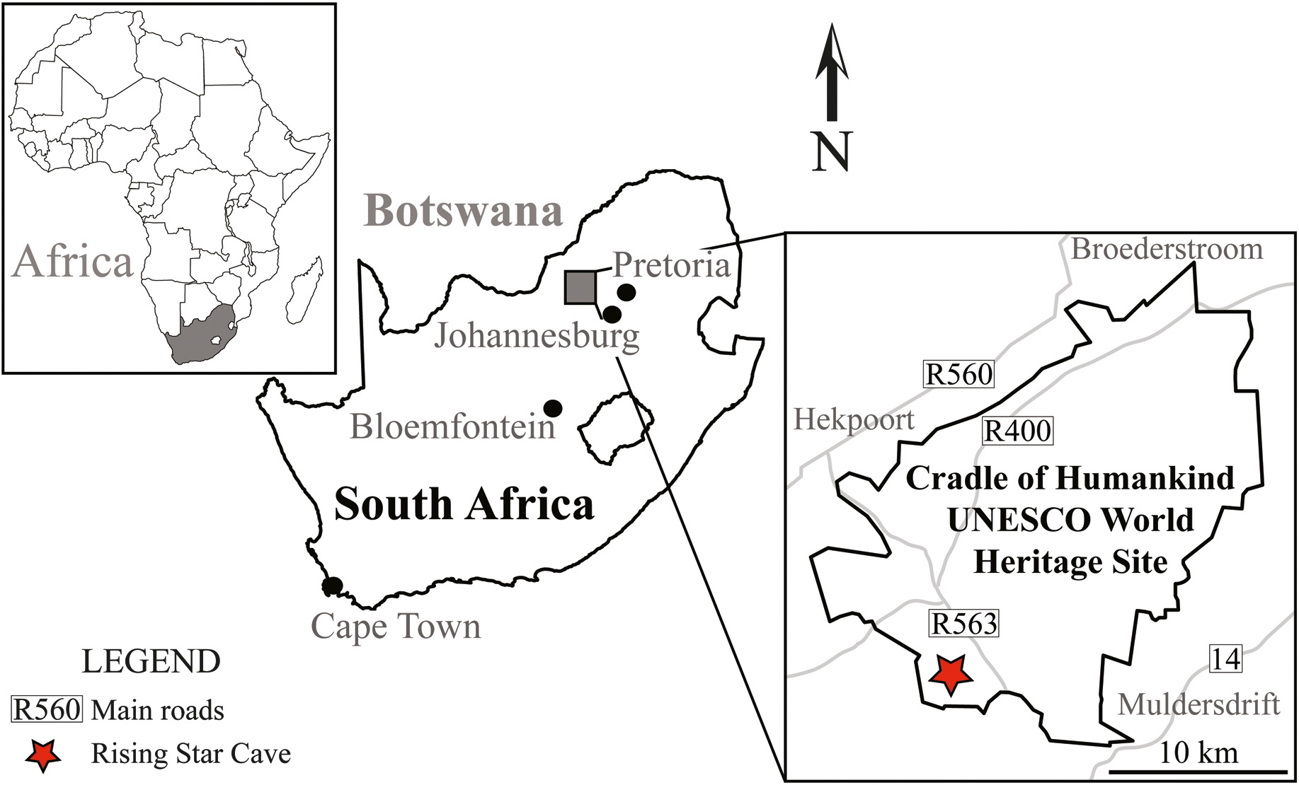
Muography in COHWHS
The MUSTAR Project
M. Bruschi - INFN Bologna (ITALY)

Slide 2
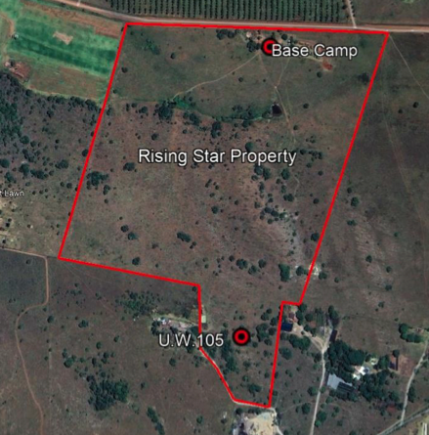
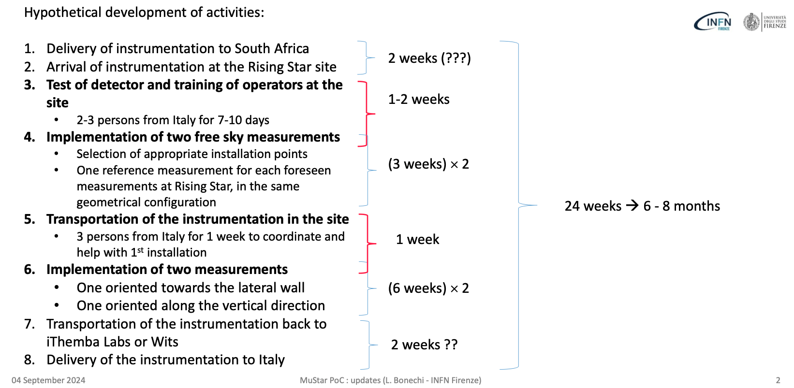
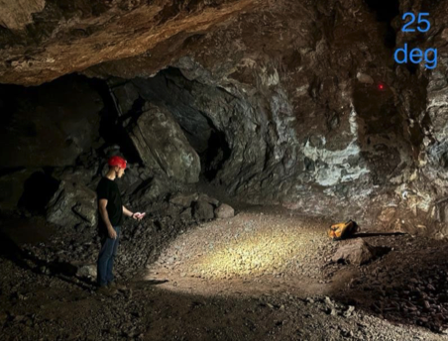
MuStar PoC Timeline

Slide 3
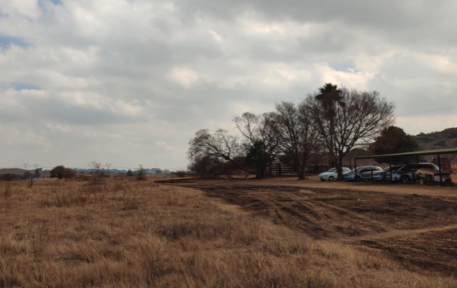
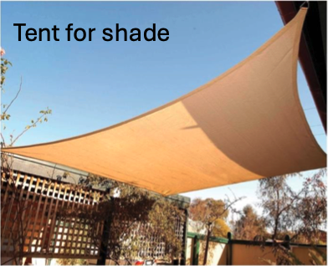
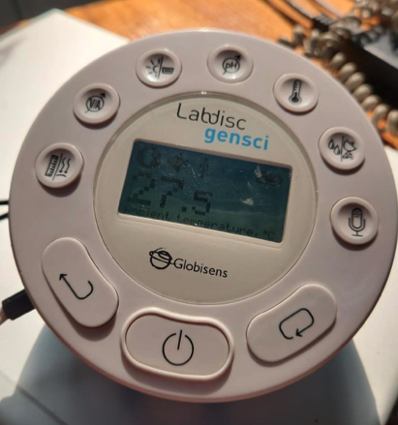
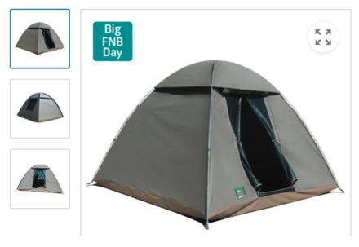
Status of different activities
Shipment Firenze-Johannesburg
  ATA Carnet Paperwork in advanced phase
  Pete Jones will be the reference for this operation in Johannesburg
Preparation of the site
  Day/night Temperature excursion measurement
  Preparation of the free sky measure
    Tent
  Transportation on site to #105
  Installation in the cavern
  Infrastructures (Internet, cables, UPS ...)
Team that will follow the detector operations
  How to organize the knowledge transfer
Precision area mapping (LIDAR Digital Surface Model)

Slide 4
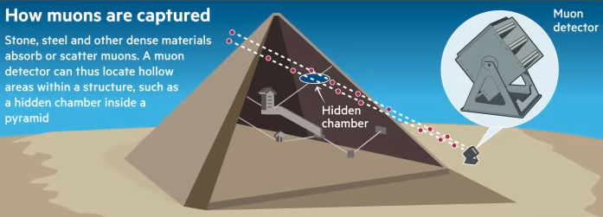
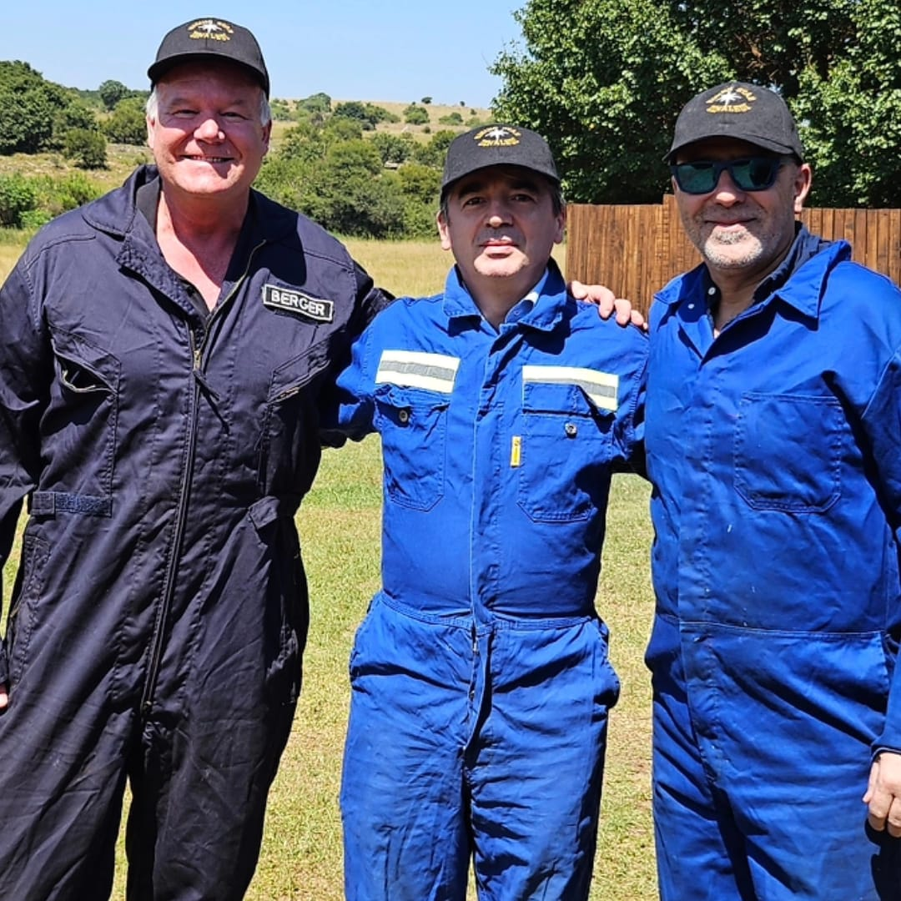
Decisions & Actions
Data Management:
o Action: Lorenzo and Luna to propose:
§ Data collection methods and storage
§ Data access protocols and permissions
§ Backup and security measures
12. Risk Management:
o Action: Dirk to propose:
§ Potential risks and mitigation strategies
§ Emergency contact numbers and procedures
13. Timeline and Milestones:
o Action: Marco to propose a detailed timeline after consulting all parties, including key milestones and deliverables.
14. Budget and Funding:
o Action: Marco to propose an overview of budget allocation, funding sources, and financial tracking after consulting all parties.
15. Memorandum of Understanding (MoU):
o Action:
§ INFN and National Geographic: Draft existing and submitted last August to Dr. Debora Trein (Nat Geo)
§ INFN and ITHEMBA LABS
  Expired in September
  Updated with MUSTAR
  Signed in the next future in Rome

Slide 5
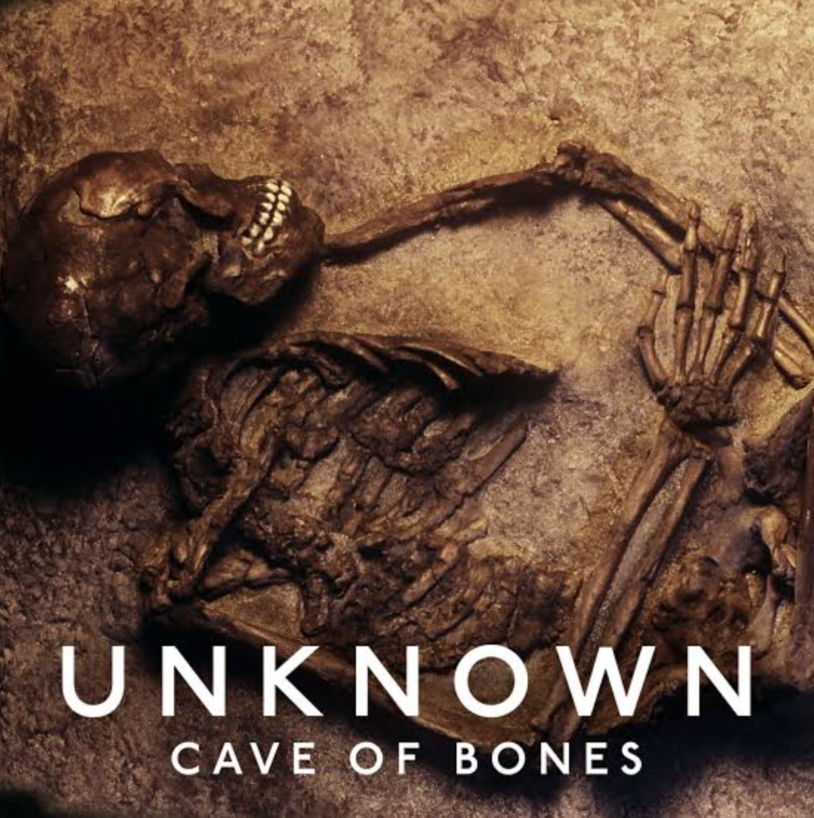
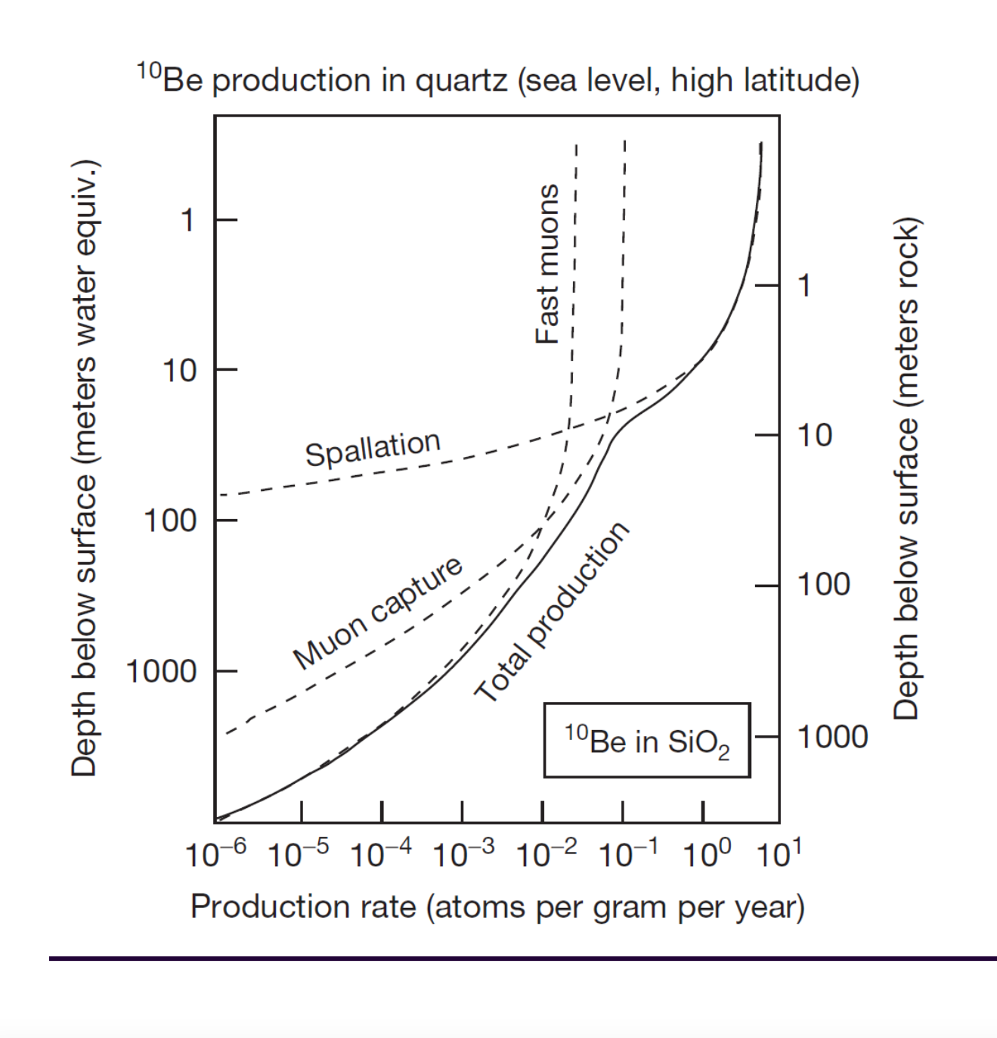
Final remarks
In general the preparation of the PoC at #105 is proceeding reasonably well
MoU signing
  critical path: the MoUs must be signed in order we can start
  Should a couple of days meeting be organized in order to finalize all this paper work ?
  Any idea which helps in speeding up this phase is wellcome
Video Documentary on the measures at #105
  It could provide a great advertisement to our project
  How can we organize this?
The activity of the GeoDating group is progressing well
  Muon Radiography data will help in territory dating
  Probably also measurements of cosmic neutron fluxes will help in geodating
  Next GeoDating meeting : Thursday November 14th at 16:00 CET

Slide 6
Backup

Slide 7
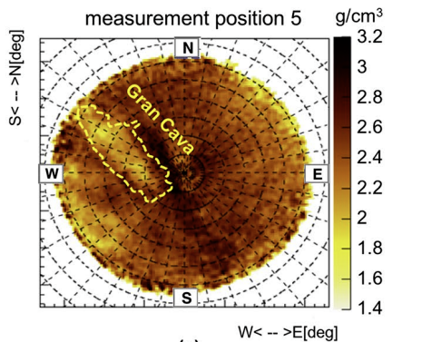
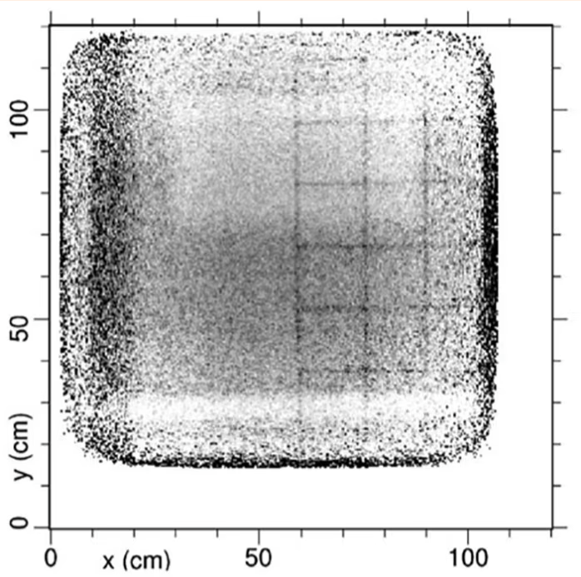
The principle of muography
Natural Imaging Agents
  Unlike X-rays that require a source, muons are naturally and abundantly available.
  Muons lose energy and get absorbed or deflected when passing through matter.
Capturing Shadows
  Detectors placed on opposite sides of an object capture muons after they pass through.
  Areas with denser material (like metals or rock) absorb more muons, casting a 'shadow' on the detector.
Creating an Image
  By measuring the number of muons passing through different parts of the object, a 2D (or 3D using more detectors) image can be constructed.
  Helps in revealing the internal structure without physically opening the object.
  Needs comparison with MonteCarlo simulations
Example of muography inside the Temperino mine (Tuscany) by the Florence group(INFN and Uni.)
Areas of lower (hidden caves) or higher densities materials are visible
More about this in the following

Slide 8
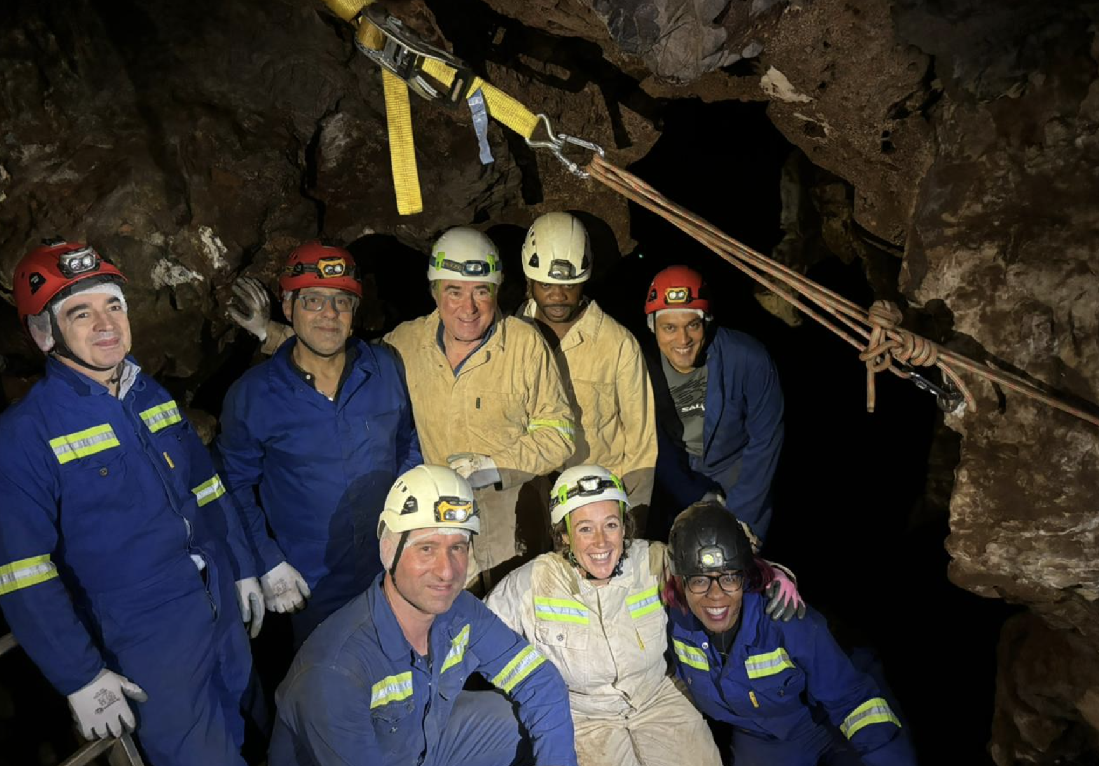

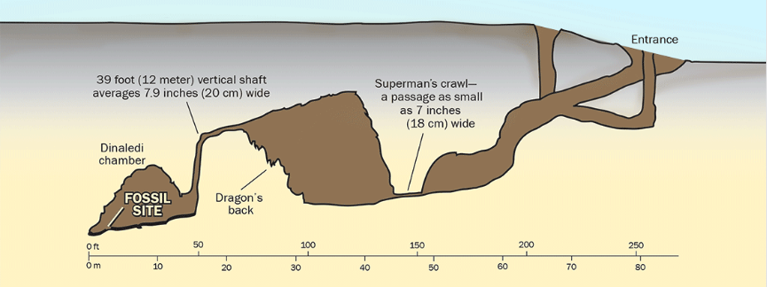
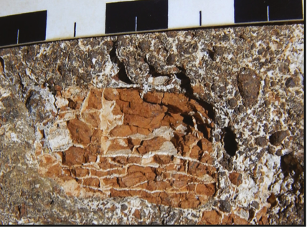
Proposed experiments with Muon Imaging in COHWHS
POC: Muography of the RS site 105
  appropriate position
  ideal for an initial muographic experiment
    These first results will have already a big scientific impact
Exploring for alternative access points to the Rising Star subsystem
  hypothesis based on the discovery of numerous remains of Naledi man in the cave system
  Presently hardly accessible
  The Rising Star subsystem floor sits at 30-35m depth good for MI
  Positioning the detectors in different areas in the cave could be used to discover any spaces or passages that are now sealed off from the main chambers
Muon tomography to inspect blocks of fossil bearing breccias
  Present imaging used conventional computed tomography or higher energy synchrotron imaging, both of which are expensive modalities and expose fossils to higher doses of radiation which may affect some studies

