Slide 1
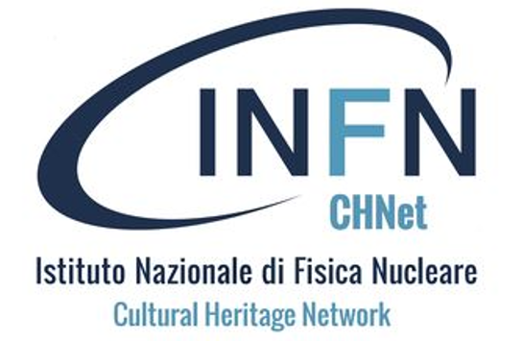
Riunione annuale CHNet: attività nodo LNGS
Stefano Nisi, Responsabile Nodo CHNet_LNGS
Università Sapienza, Roma- 27 novembre 2024

Slide 2
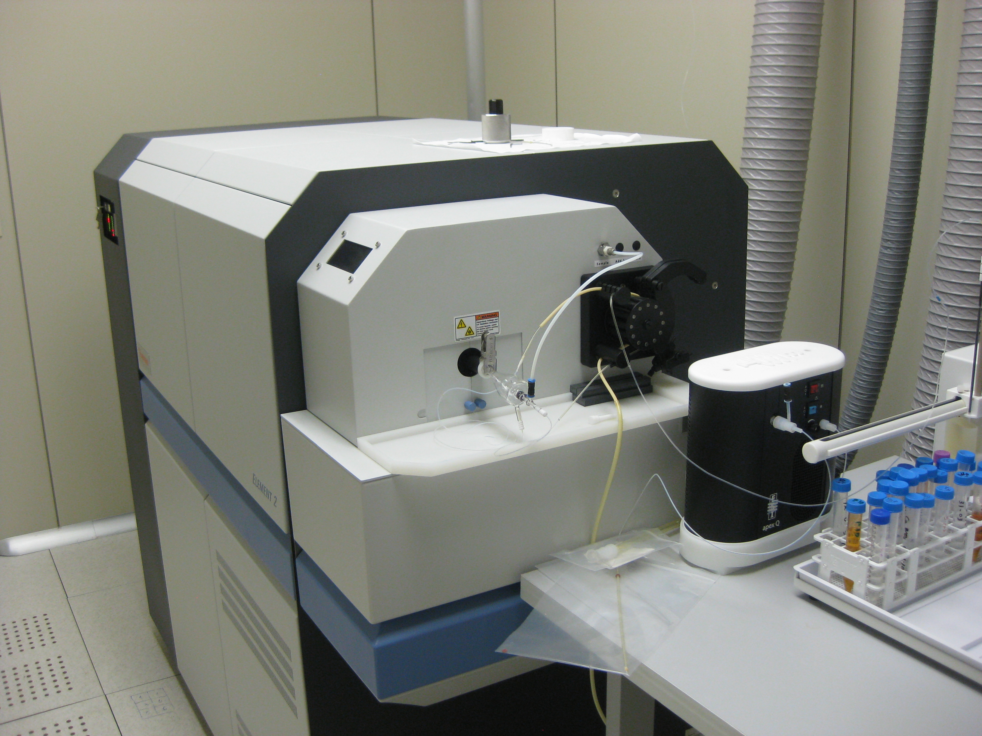
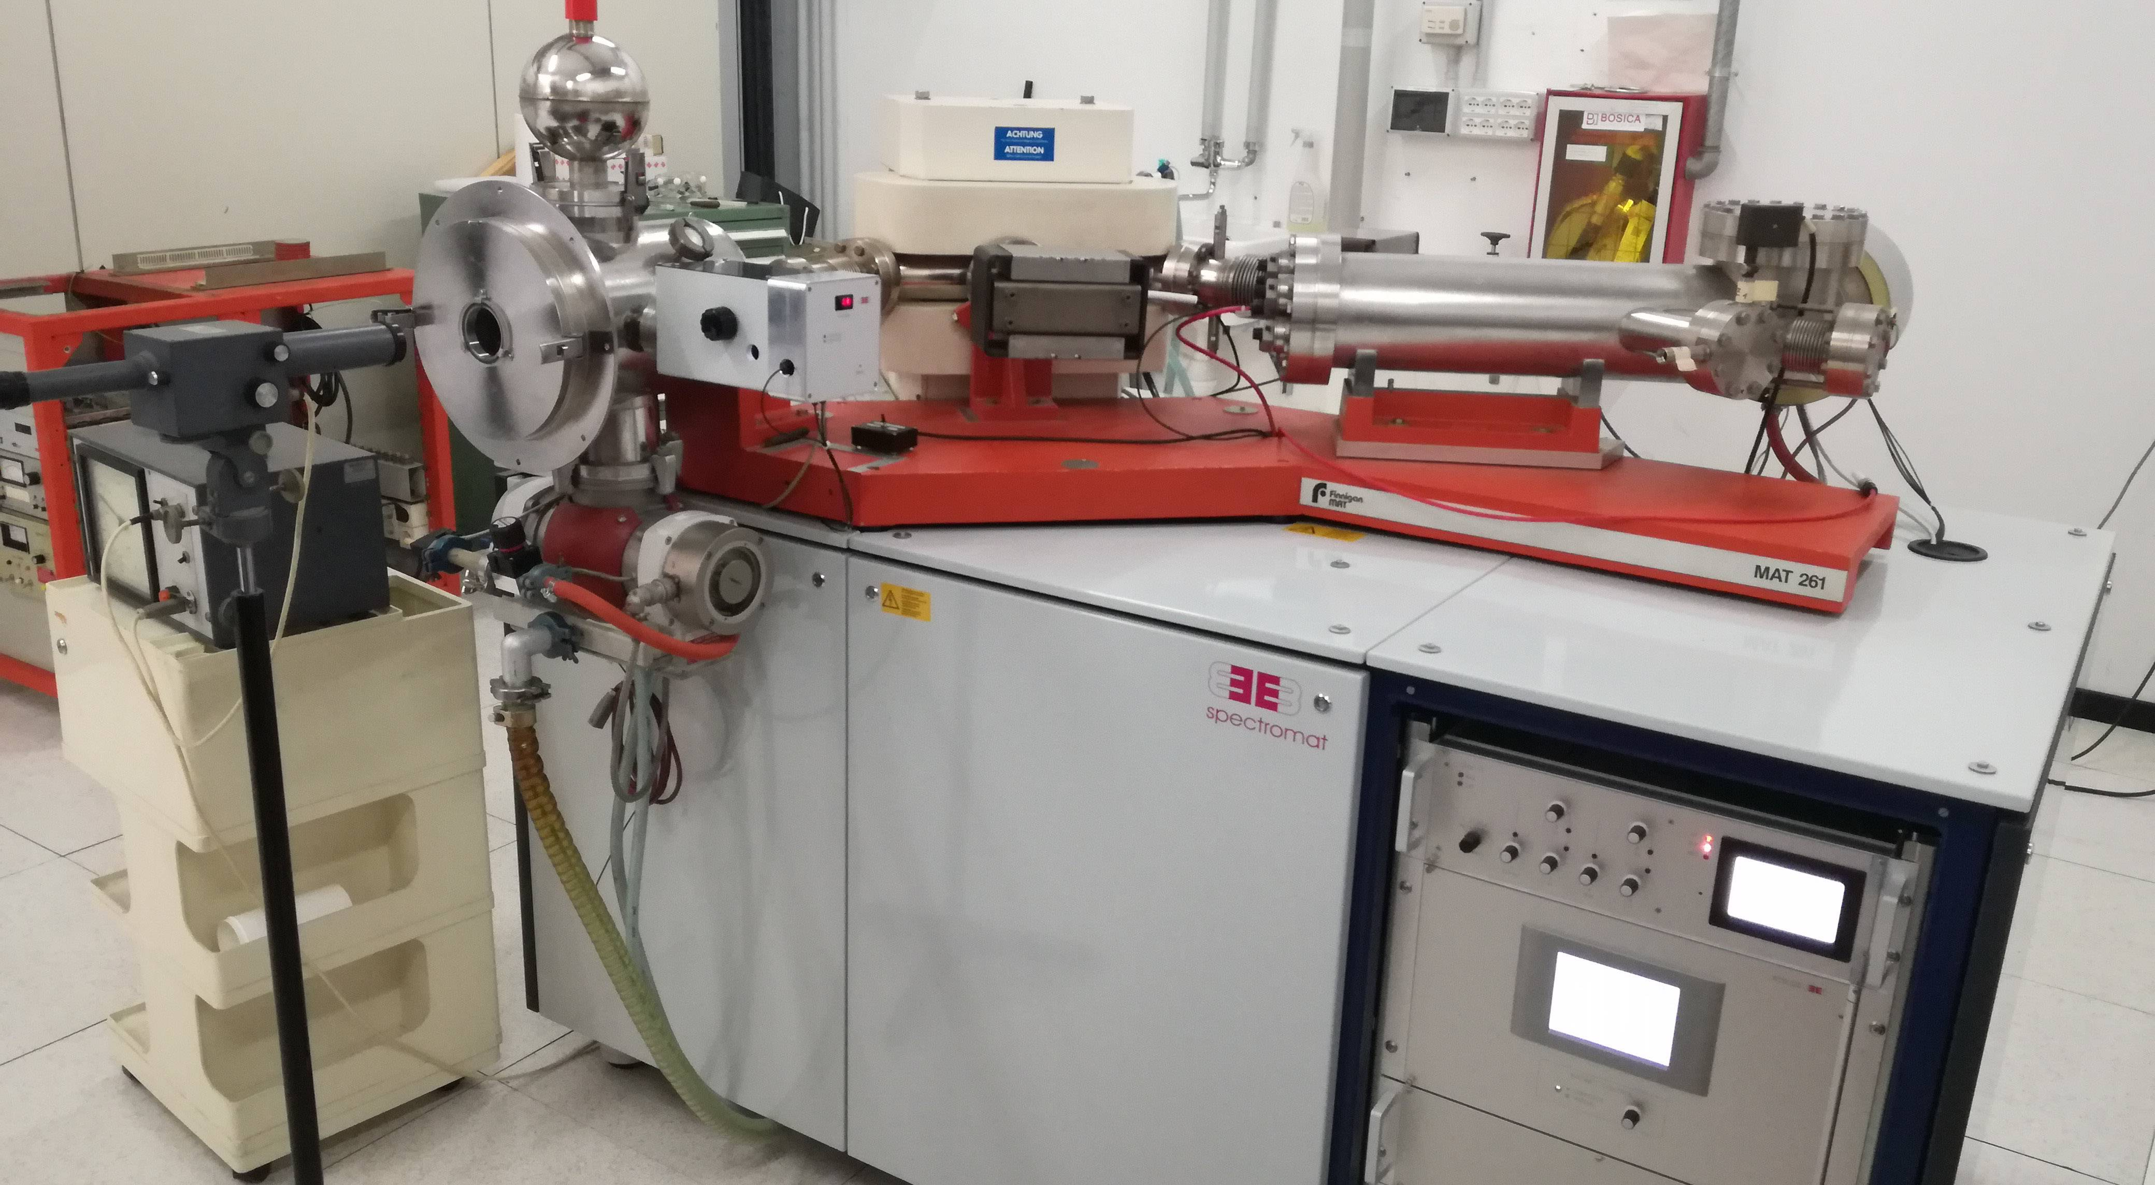
Servizi offerti dal nodo CHNet_LNGS
Analisi della composizione elementale degli elementi in traccia mediante ICP-MS
Misura precisa dei rapporti isotopici degli elementi pesanti con spettrometria di massa con sorgente a ionizzazione termica.

Slide 3
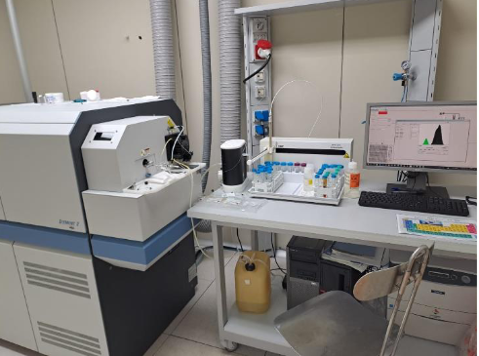
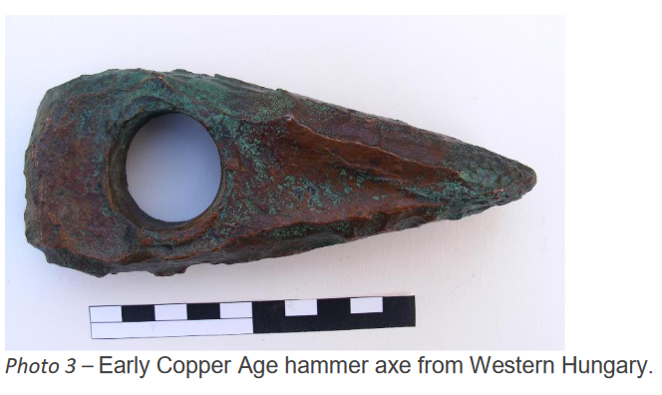
Progetti: Iperion HS 2020-2024
Project Title*
Trace element analysis of Late Neolithic and Copper Age copper artefacts from Hungary
User Group Leader*
Dr. Zsuzsanna Siklós, Eötvös Loránd University, Institute of Archaeological Sciences
The aim of the project was to investigate the chemical compositional and trace element analysis of
malachite and copper artefacts from the Late Neolithic to Late Copper Age (4700-3000/2800 cal BCE)
from the area of present-day Hungary in order to determine the provenance of the raw material. The
measurements complemented the recent lead isotope measurements, which together allowed us to
reconstruct the provenance of the raw material of these objects.

Slide 4
Trace element analysis of Late Neolithic and Copper Age copper artefacts from Hungary
Conference presentations:
Siklósi, Zs. – M. Virág, Zs. – Villa, I. M. – Nisi, S. – Mozgai, V. – Bajnóczi, B. – Kraus, D. – Szilas, G.:
Traces of local copper metallurgy in the Copper Age of the Carpathian Basin – interpreting the
transmission of metallurgical technology at the 29th annual meeting of the European Association of
Archaeologists (30 August – 2 September 2023) in Belfast
Siklósi, Zs. – M. Virág, Zs. – Bondár, M. – Villa, I. M. – Nisi, S. – Mozgai, V. – Bajnóczi, B. – Kraus, D.:
The provenance of the Middle and Late Copper Age copper artefacts of the Carpathian Basin at the 20th
UISPP World Congress in Timişoara (September 5-9, 2023)
Siklósi, Zs. – Nisi, S. – Villa, I. M. – Mozgai, V. – Bajnóczi, B. – M. Virág, Zs.: At the meeting of two worlds
The chemical composition of copper artefacts and the provenance of their raw material from the Copper
Age of the Carpathian basin. Archeo.Metalli/Archaeo.Metals (Ag, Pb, Cu) Napoli – Gran Sasso, Italy,
September 13-14, 2023
Published article:
Siklósi, Zs., Villa, I. M., & Nisi, S. (2023). The provenance of a forgotten Copper Age spectacle spiral
pendant. In A. Király (Ed.), From tea leaves to leaf-shaped tools. Studies in honour of Zsolt Mester on
his sixtieth birthday (pp. 297–311). Lithic Research Roundtable & Institute of Archaeological Sciences,
ELTE Eötvös Loránd University, Budapest, Hungary. https://doi.org/10.23898/litikumsi02a14

Slide 5
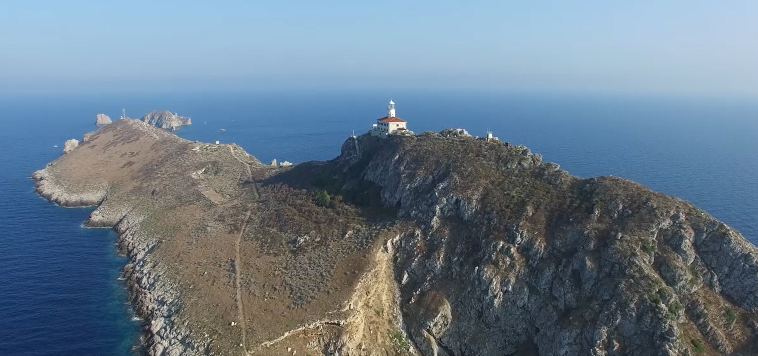
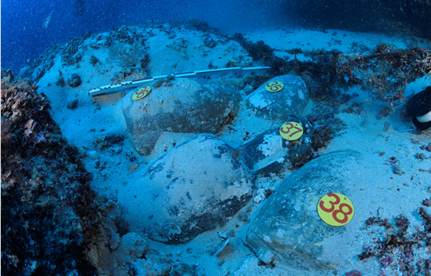
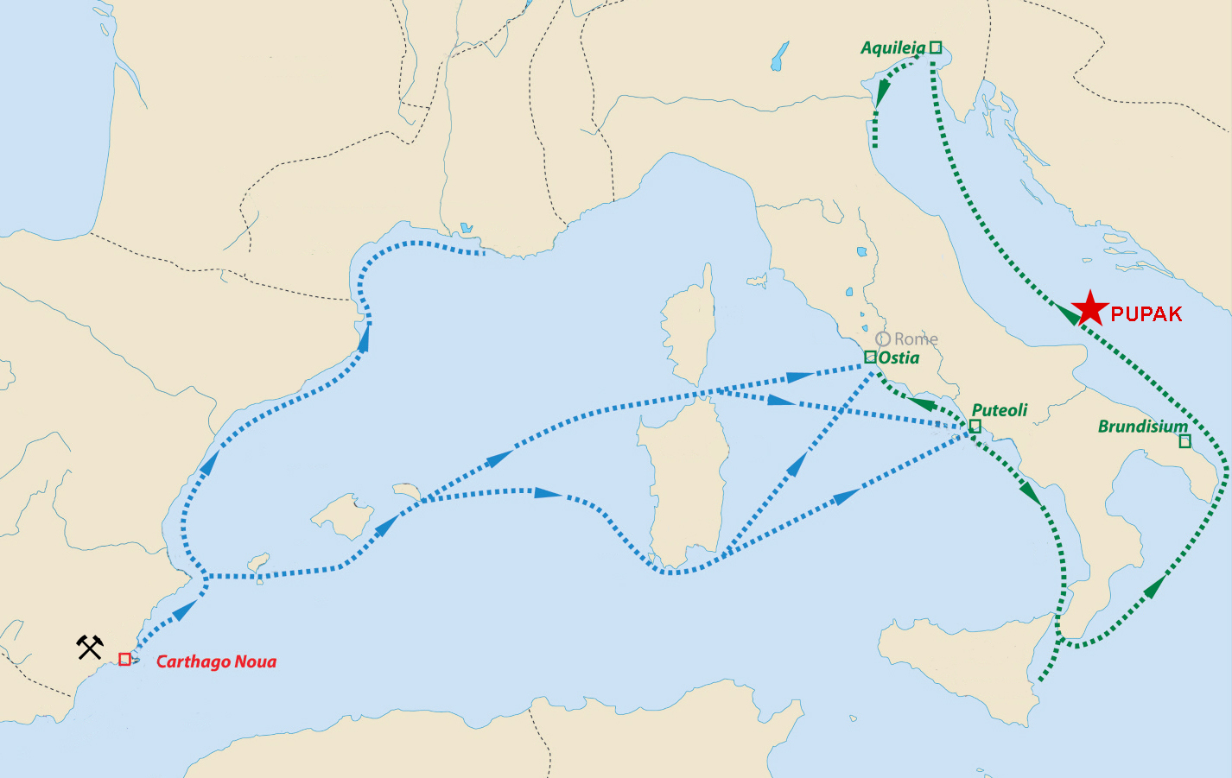
Progetti: Iperion HS 2020-2024
Project Title*
Archaeometric analysis of shipwreck remains at the Pupak shallows, Croatia
User Group Leader*
Jurica Bezak , Croatian Conservation Institute, Department for Underwater Archaeology
Most significant in terms of novelty and scientific potential is the discovery of the first wreck from Roman times in the Croatian undersea carrying a cargo of lead ingots. A comprehensive scientific interpretation of this shipwreck is greatly hampered by the presence of six more shipwrecks scattered in the underwater surrounding the shallow. Such circumstances to a considerable extent make it difficult to precisely associate the discovered material to a specific shipwreck.

Slide 6
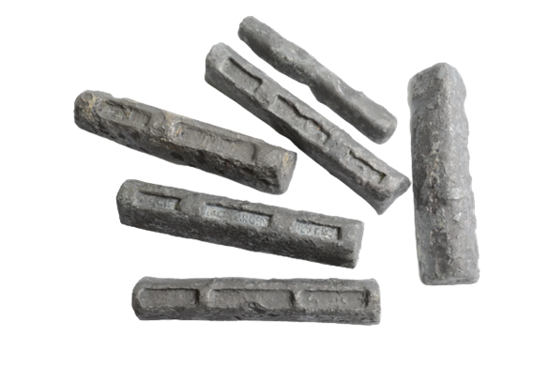
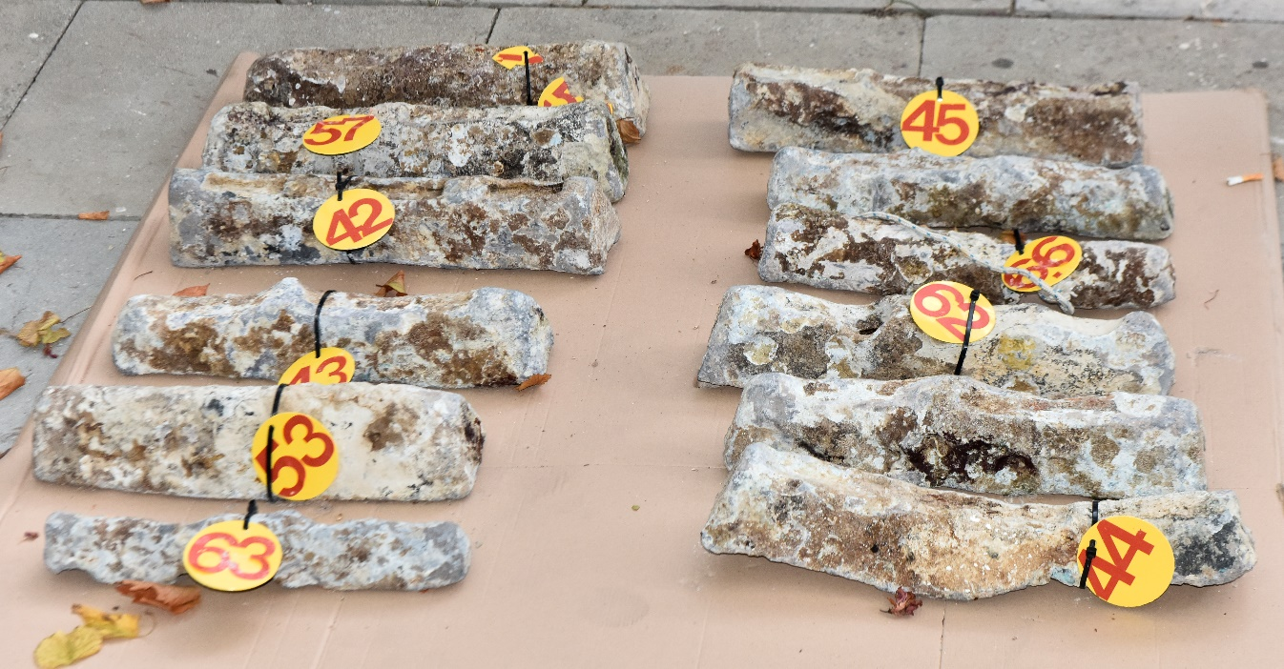
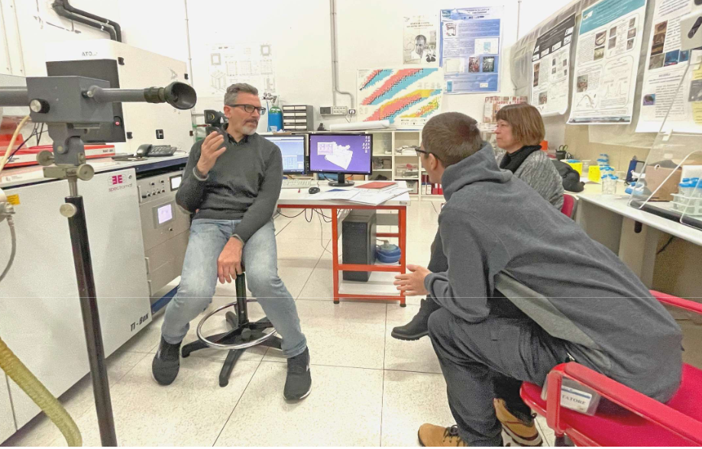
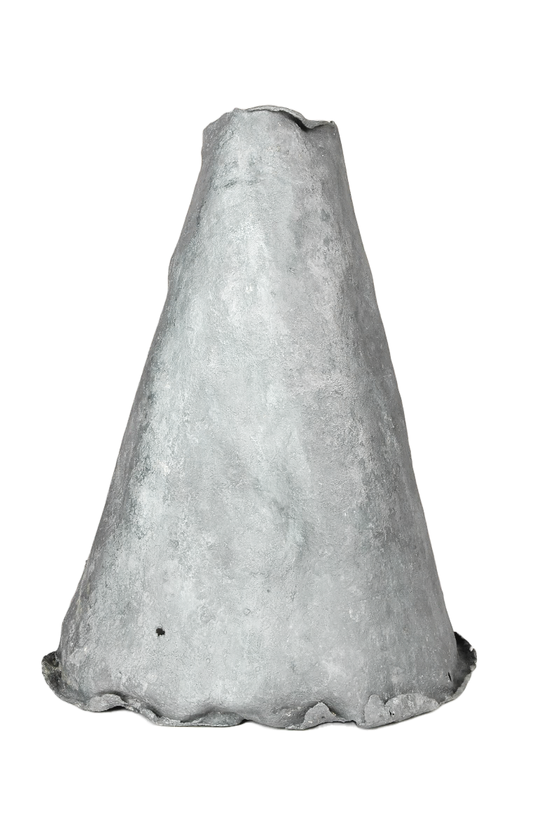
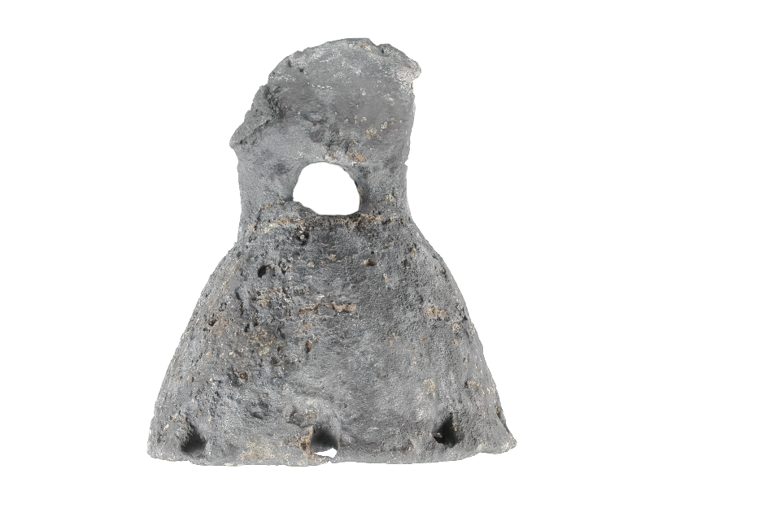
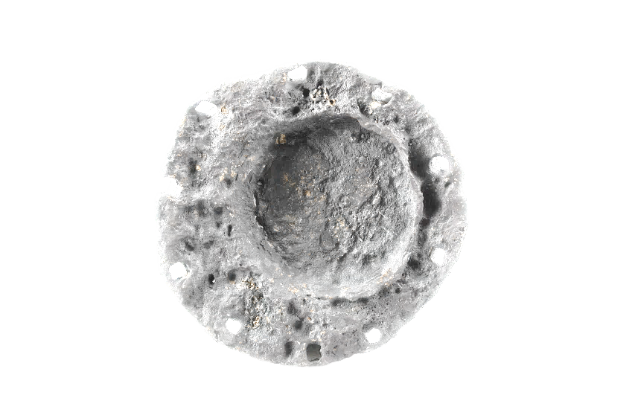
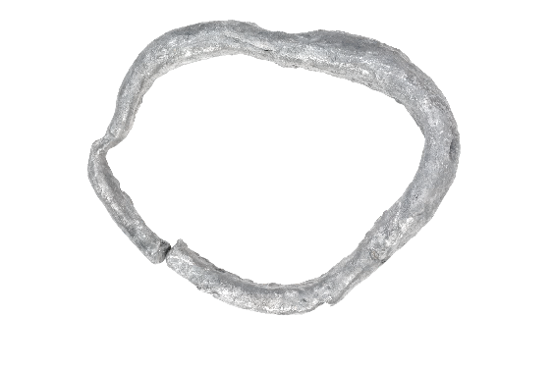
The lead ingots from the Pupak shallows site
Archaeometric analysis of shipwreck remains at the Pupak shallows, Croatia
The discovery of this shipwreck is of great significance because, until now, only 3 Roman lead ingots, found as isolated finds, have been documented in the Croatian undersea. Judging by the number of documented finds of cargo, amphorae were the main part of the load, while the lead ingots were secondary. During the research of the site, so far 25 lead ingots have been found. Their number provides evidence that the lead ingots were part of a mixed commercial cargo. They were not part of the ship's stores that served for repairs of leaks, anchors lead stocks, hull sheathing or sounding weights during navigation.

Slide 7
²⁰⁸Pb/²⁰⁶Pb
Tutti i lingotti sono raggruppati in due cluster
Tutti i campioni che non appartengono ai cluster sono attrezzature di navigazione
Solo un paio di questi campioni hanno stessa provenienza dei lingotti: riparazioni a bordo
Tre campioni di attrezzature sono compatibili con aree minerarie del nord Europa sfruttate solo in periodi storici più recenti: probabilmente appartengono a naufragi successivi: datazione ¹⁴C
²⁰⁷Pb/²⁰⁶Pb

Slide 8
Progetti: Iperion HS 2020-2024
Project Title*
The metal sources used by the Nabatean and parallel kindoms
User Group Leader*
Yehudit Harlavan, Geological Survey of Israel, Tel Aviv University
Applying lead isotopes and geochemical tracers in studying metal artefacts has been widely used since the 1970s. In this approach, the lead isotope data is compared with published lead isotope data of ore deposits from provenance areas to point to the potential source/s of the artefacts. For the current study, we determined the lead isotope and chemical elemental compositions of 20 lead/copper/bronze-based artefacts from two archaeological sites in Israel, which are parallel to both the Nabataean Kingdom and the Roman period in Israel.

Slide 9
L’uso delle monete nella Magna Grecia

Slide 10
L’uso delle monete nella Magna Grecia

Slide 11
L’uso delle monete nella Magna Grecia

Slide 12
Personale
I LNGS non hanno personale dedicato in maniera specifica alle attività sui beni culturali e questo rappresenta un grande limite per coltivare possibili collaborazioni
Stefano Nisi: responsabile nodo CHNet_LNGS
Francesco Ferella: assegnista LNGS
Isabella Ercoles: dottoranda Sapienza

Slide 13
Divulgazione: Sharper, PID, PCTO…
https://archeometalli.sites.lngs.infn.it/

Slide 14
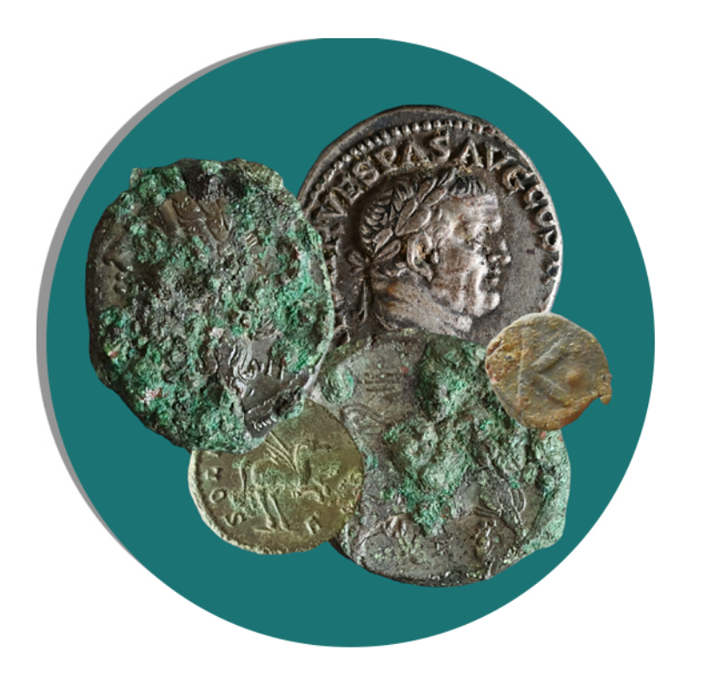
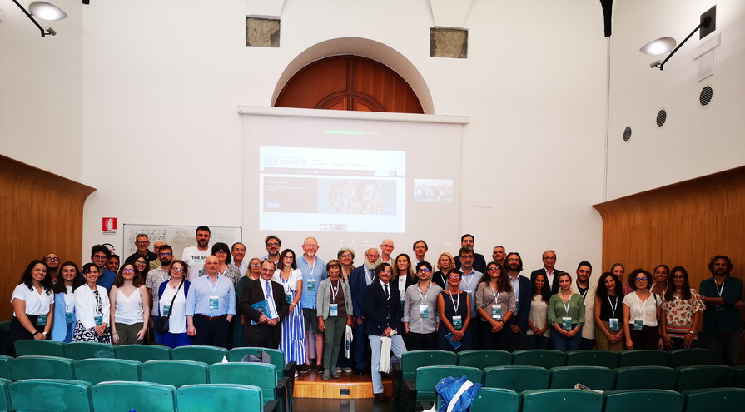
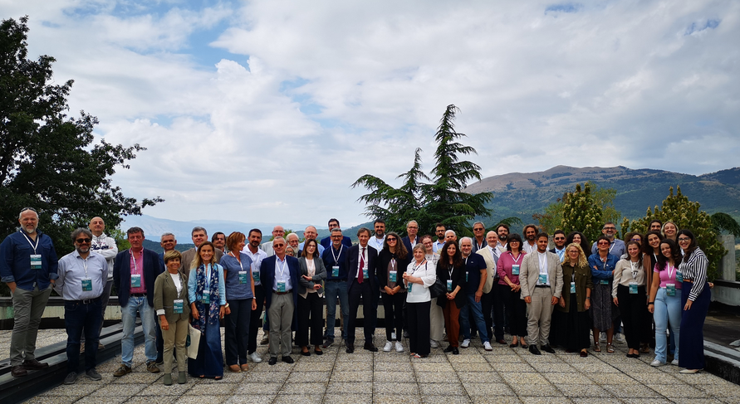
Archeo.Metalli
Due momenti della conferenza: a destra nell’aula Pietro Piovani presso il Dipartimento di Studi Umanistici dell'Università degli Studi di Napoli Federico II; sotto presso le aree esterne dei LNGS

Slide 15
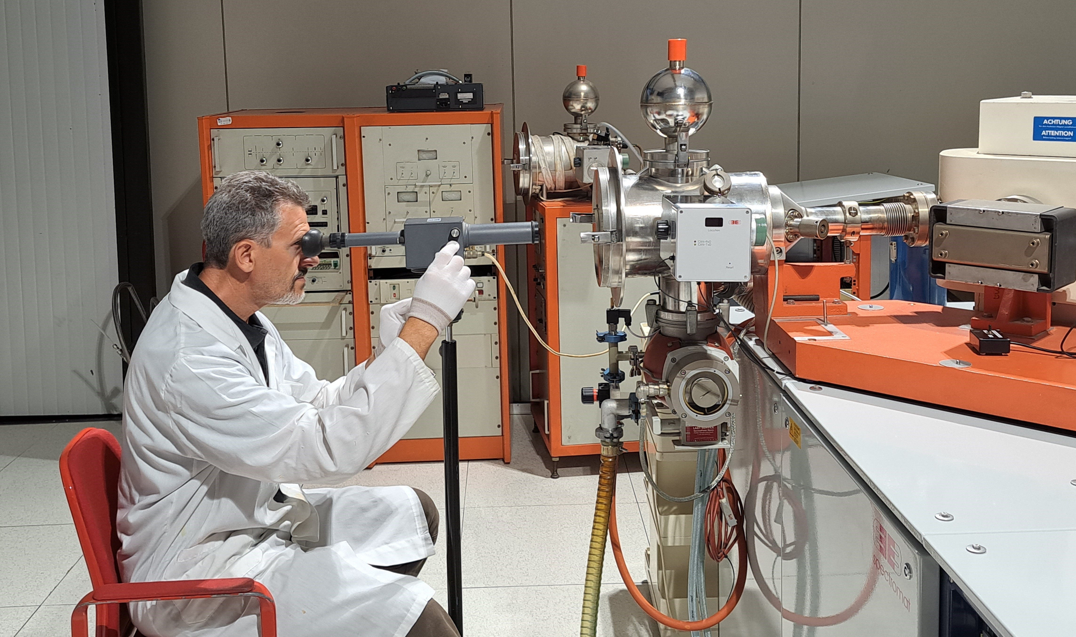
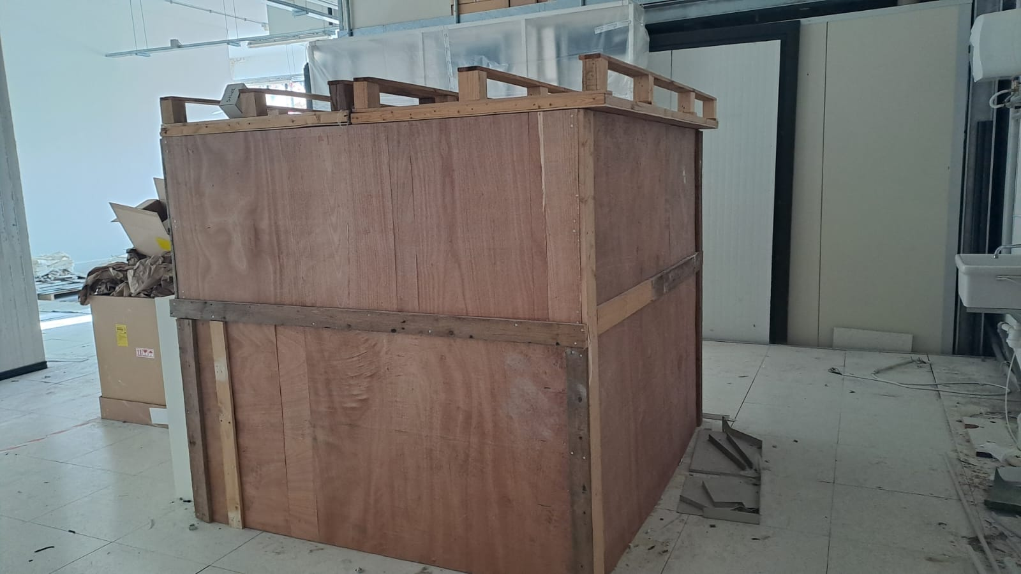
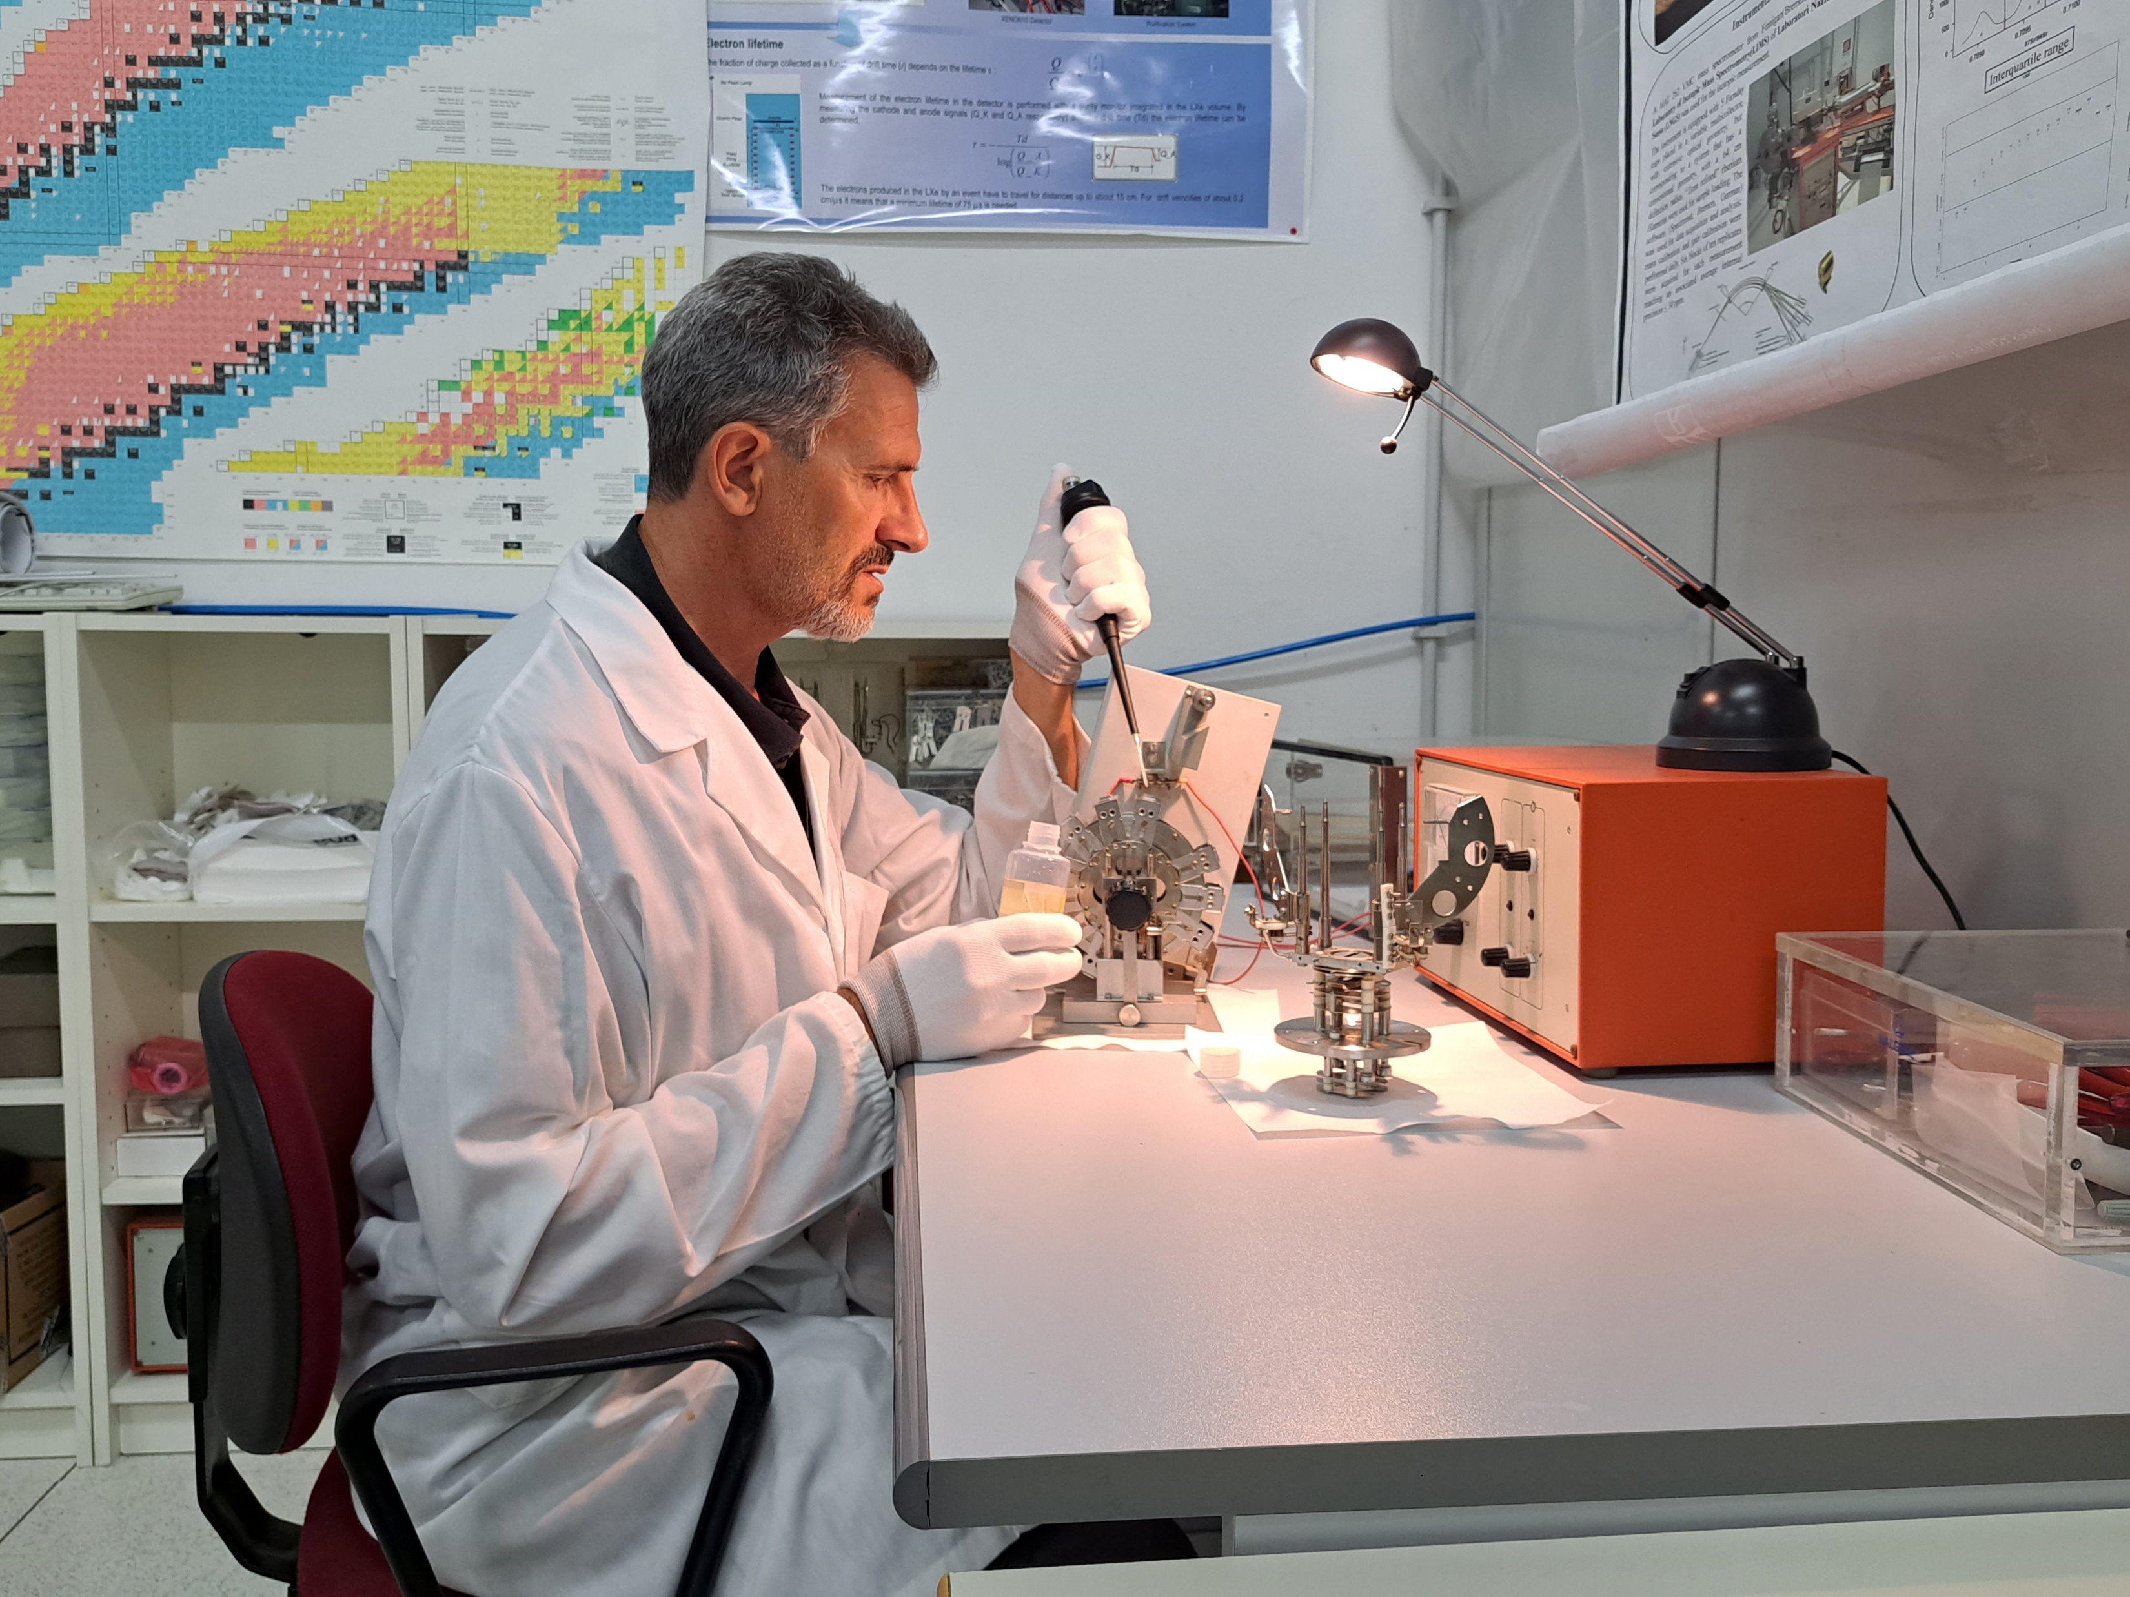
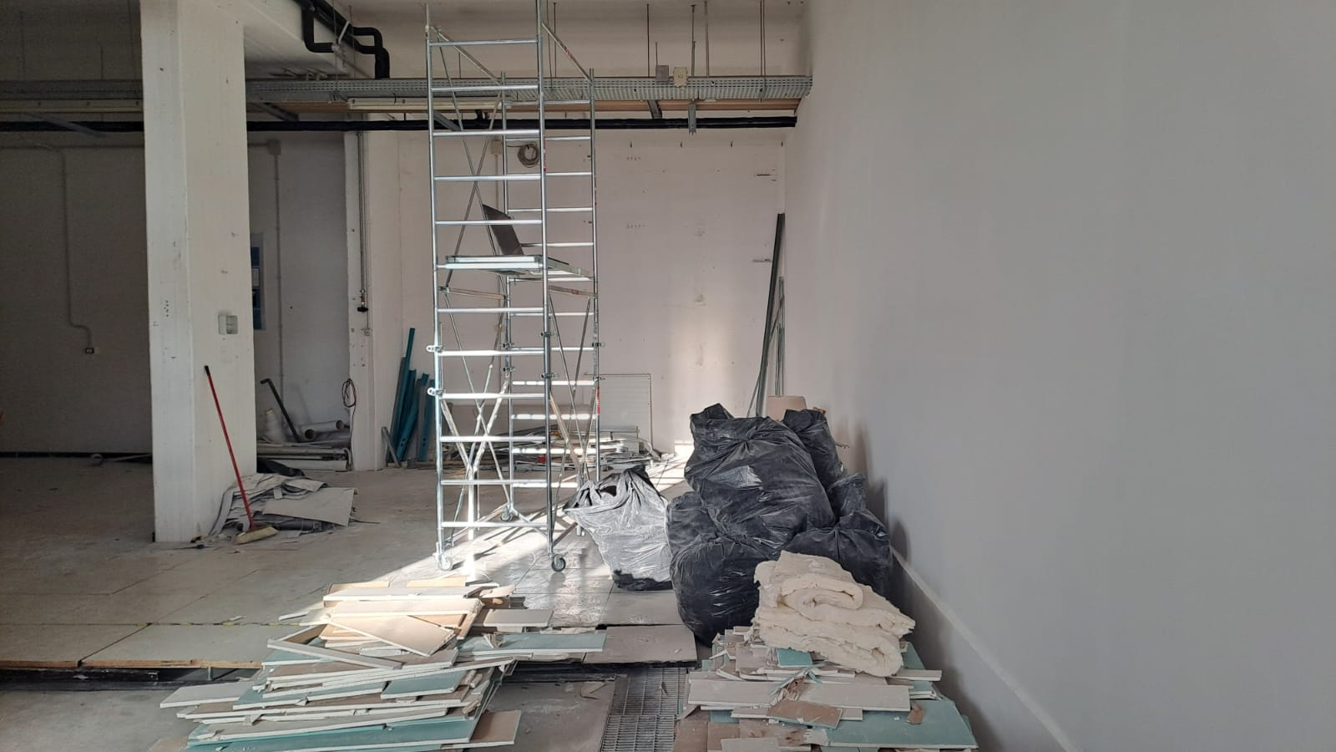
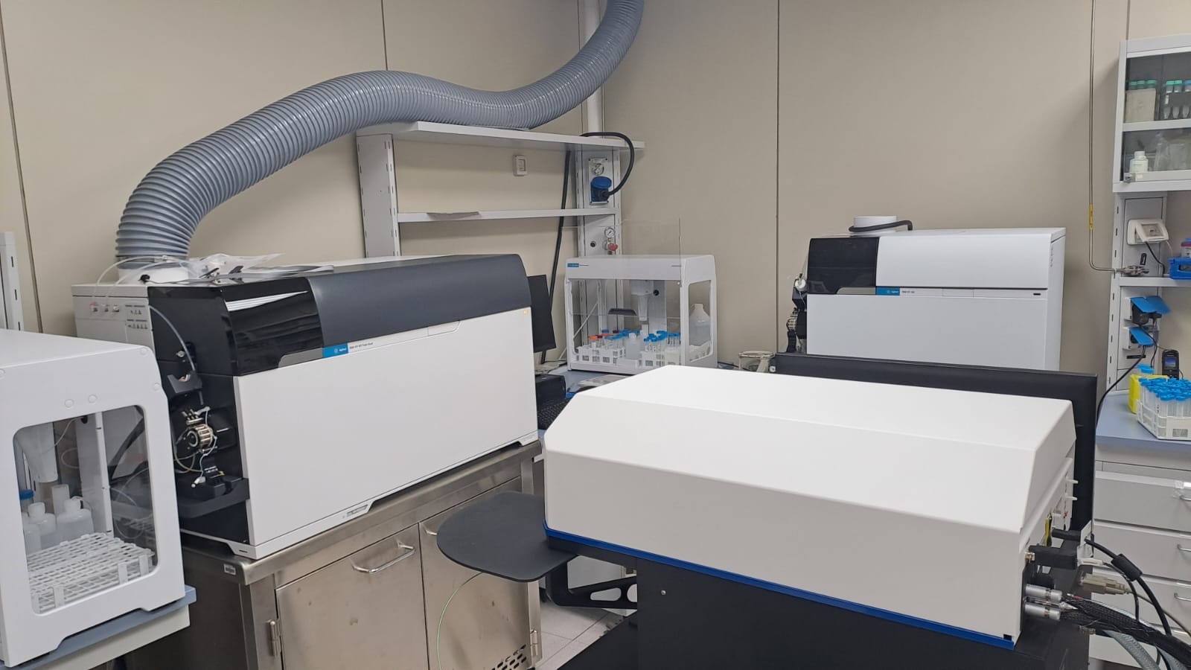
Passato: fino maggio 2023
Presente
Futuro: Settembre 2025
Costruzione di un laboratorio dedicato alla Misura dei Rapporti Isotopici (TIMS) ed estensione della Camera Bianca per ospitare i tre ICP-MS

Slide 16
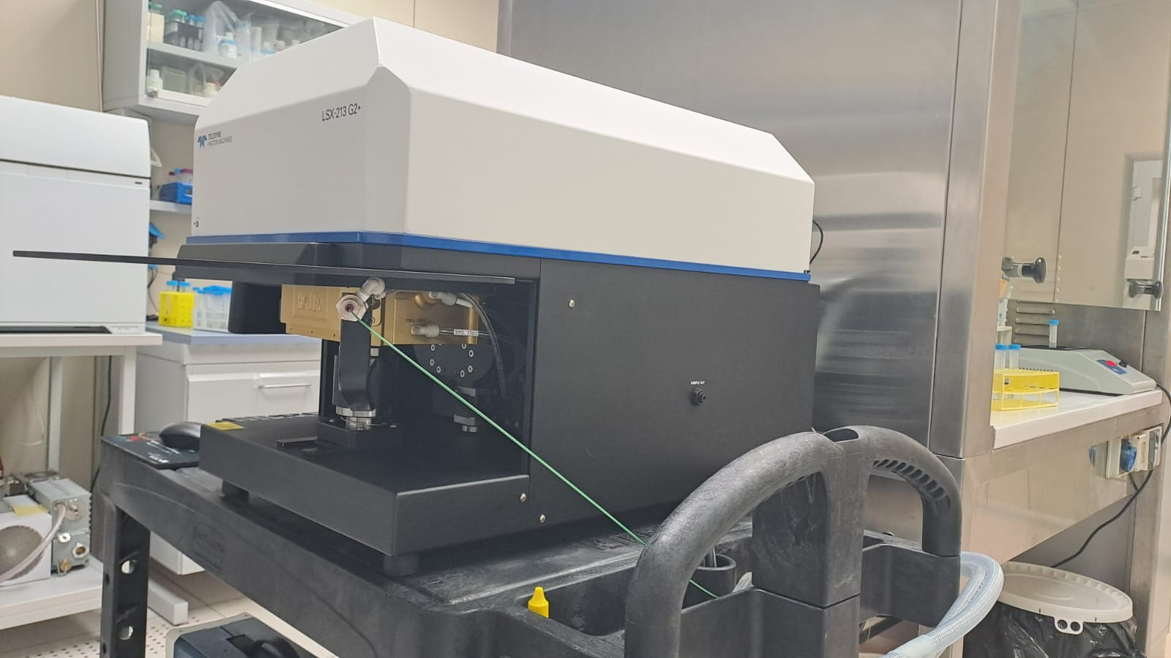
Sistema Laser ablation accoppiato allo spettrometro QQQ-ICP-MS
Questo sistema permette la misura della composizione elementale diretta di campioni solidi tramite un fascio laser di dimensioni variabili tra 4 e 200 um che svolge la funzione di campionatore. Lo spettrometro di massa rileva composizione ed elementi in traccia presenti nel campione. La strumentazione è dotata di software per imaging superficiale o profili di profondità.

Slide 17
Grazie per l’attenzione

