Slide 1
Quantum Gravity and TQFTs:
A New Chapter in a Troubled Love Story
Matteo Bruno
j./w. Eugenia Colafranceschi, Fabio M. Mele, Carlo Rovelli

Slide 2
Program
Historical overview (of our interest)
Topological Quantum Field Theory
Atiyah’s Axioms
The Lego game
Quantum Gravity
Spin foam, or state sum model
3D General Relativity is Topological
Atiyah-like axioms for Spin foam
The importance of combinatory
The Refinement limit
1968 – Ponzano-Regge model to quantize 3d gravity
1988 – E.Witten introduces TQFT in supersymmetry
1988 – M.Atiyah provides a set of axioms for TQFT
1989 – E.Witten proves TQFT can compute knot invariants
1990 – E.Witten shows 3d quantum gravity is a TQFT
1992 – V.Tuarev and O.Viro revise the Ponzano-Regge model, giving a combinatorial definition for 3d TQFT
1992 – H.Ooguri proves the two quantizations are actually the same
1993 – C.Rovelli proves the same results comes out in LQG
90’s – developing models for 4d quantum gravity inspired by TQFT, e.g. Spin Foam models, State Sum models, Categorical construction by J.Barret, L.Crane, L.Freidel, C.Rovelli…
2012 – C.Rovelli and M.Smerlak provides axioms for Spin Foam and discuss the Refinement limit
Quantum Gravity and TQFTs
1

Slide 3
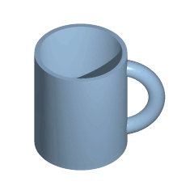
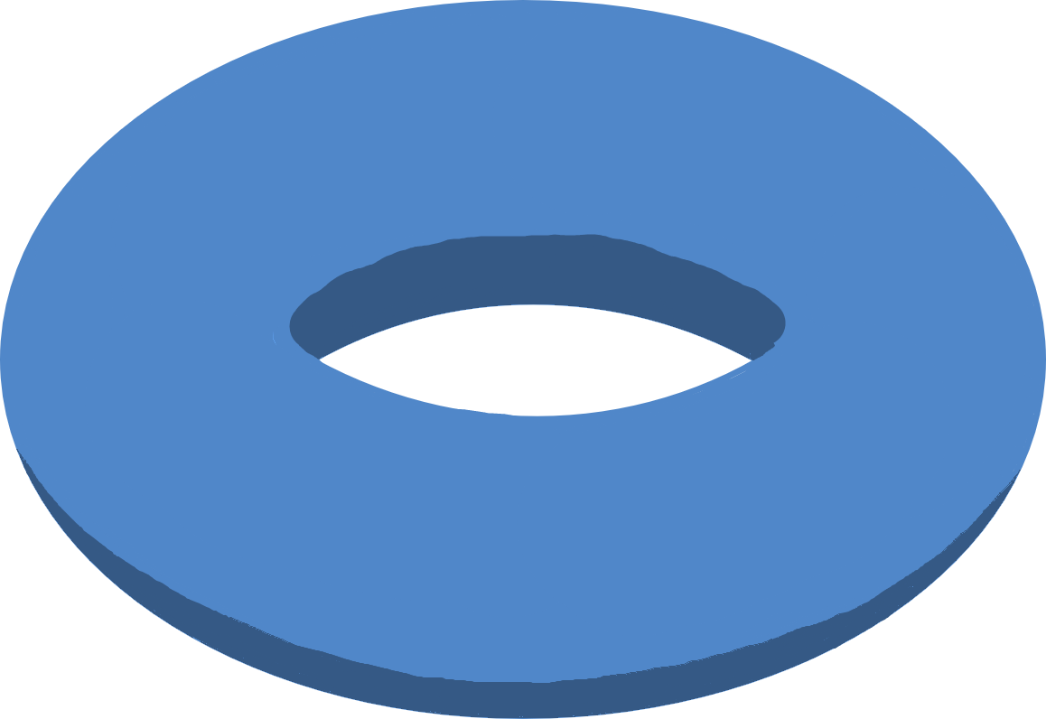
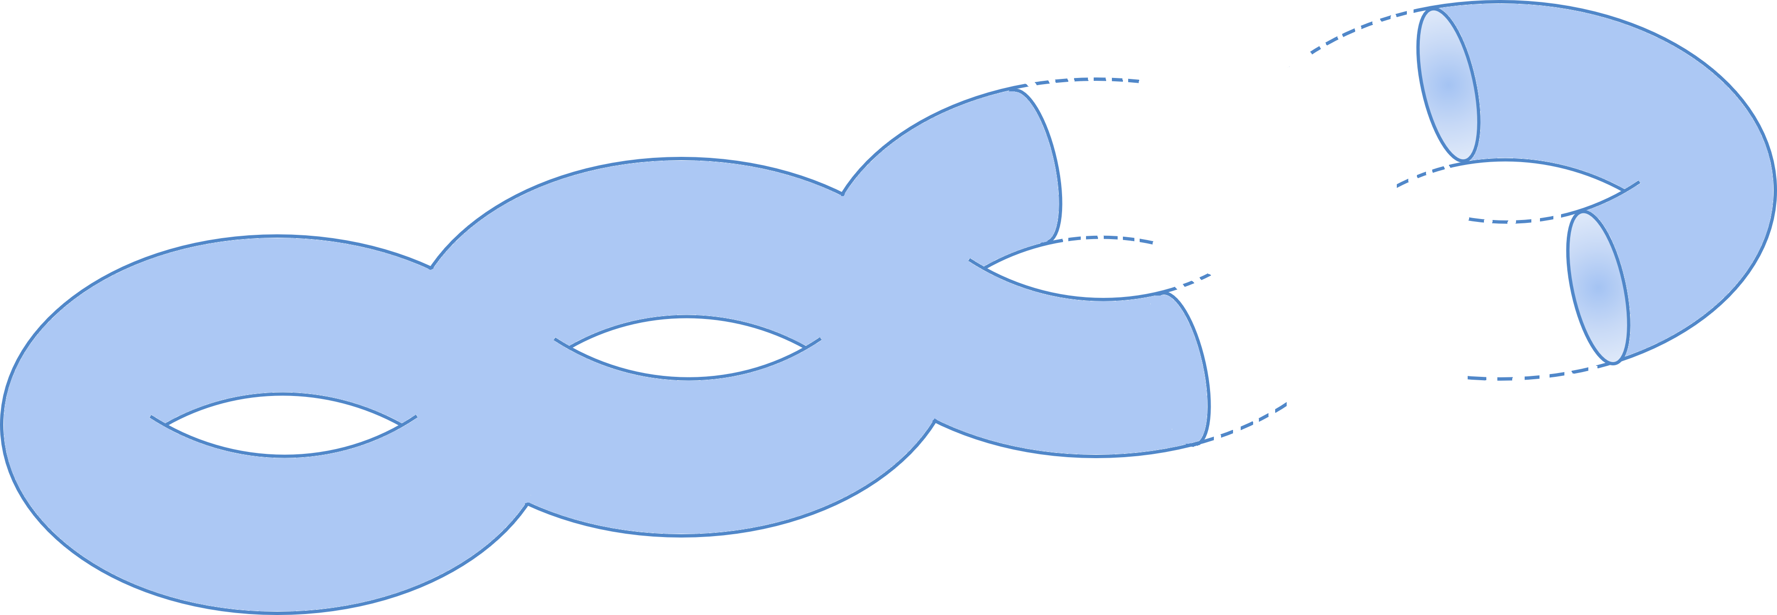
What a topology!
Topological (smooth) manifold: a space that locally looks like $ℝ^{d}$
Two manifolds have the same topology if they can be deformed continuously into each other.
There exists a classification of topological manifold? No! Just in dimension 2.
Closed surfaces have the same topology iff they have the same number of holes (genus)
genus $0$
genus $1$
…
genus $g$
Quantum Gravity and TQFTs
1

Slide 4
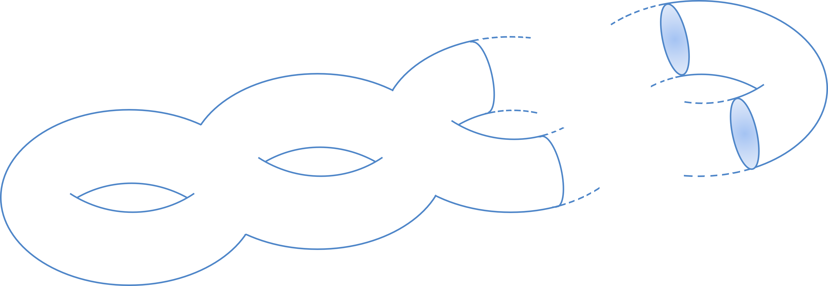
Topological Quantum Field Theory
The idea
The smooth manifold is the space on which the theory leaves.
There is no length nor curvature. (Main difference w.r.t. the usual field theories which leave on Minkowski spacetime)
Framework is similar to General Relativity. The gravitational field leaves on a smooth manifold and it induces a notion of length and curvature (linked to the distribution of matter via Einstein Field Equation)
The physical observables depend only on global properties, namely the topology.
No local degrees of freedom.
e.g.
TQFT on surfaces with genus $g$ ($2d$ TQFT)
$$⟨0\left|𝒪\right|0⟩=f_{𝒪}(g)$$
$$g$$
Quantum Gravity and TQFTs
2

Slide 5
Topological Quantum Field Theory
Atiyah’s axioms
A d-dimensional TQFT is a map $"→"$ from oriented smooth manifolds to vector spaces that associate
To a $(d−1)$-dimensional closed manifold $B$, a Hilbert space $H_{B}$
To a $d$-dimensional manifold $M$ with boundary $∂M=B$ a vector $Z\left(M\right)∈H_{B}$
$$B→H_{B}$$
$$M→Z\left(M\right)∈H_{∂M}$$
Such that
$B_{1}⊔B_{2}→H_{B_{1}⊔B_{2}}=H_{B_{1}}⊗H_{B_{2}}$ (Factorization)
$\overline{B}→H_{\overline{B}}=H_{B}^{∗}$ (Duality)
$M=M_{1}∪_{B}M_{2}→Z\left(M\right)=⟨Z\left(M_{2}\right),Z\left(M_{1}\right)⟩$ for $∂M_{1}=B_{1}⊔B, ∂M_{2}=\overline{B}⊔B_{2}$ (Gluing)
$Z\left(B×I\right)=𝕀_{H_{B}}$ (Identity)
$H_{∅}=ℂ, Z\left(∅\right)=1$ (Normalization)
Quantum Gravity and TQFTs
3

Slide 6
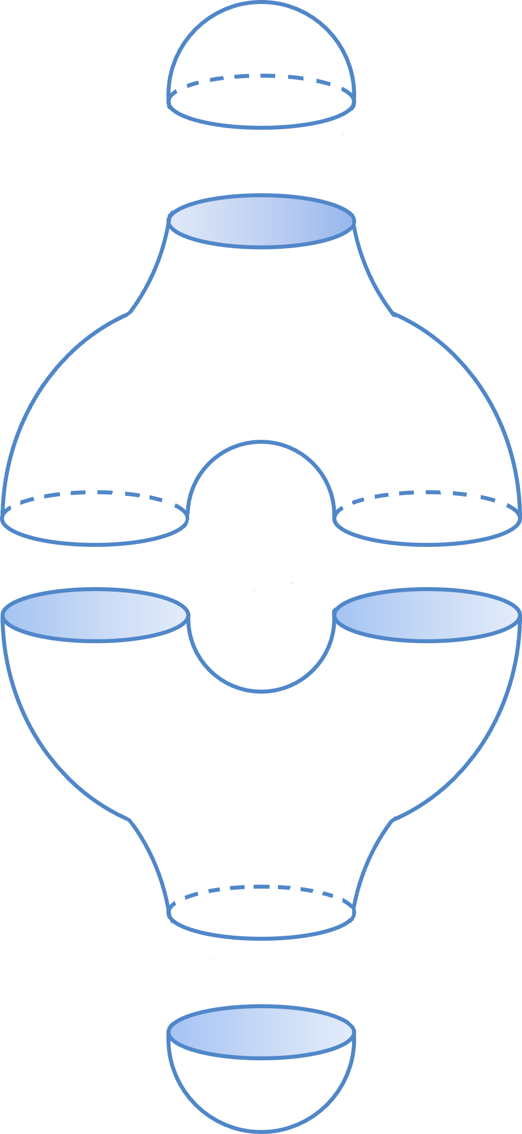
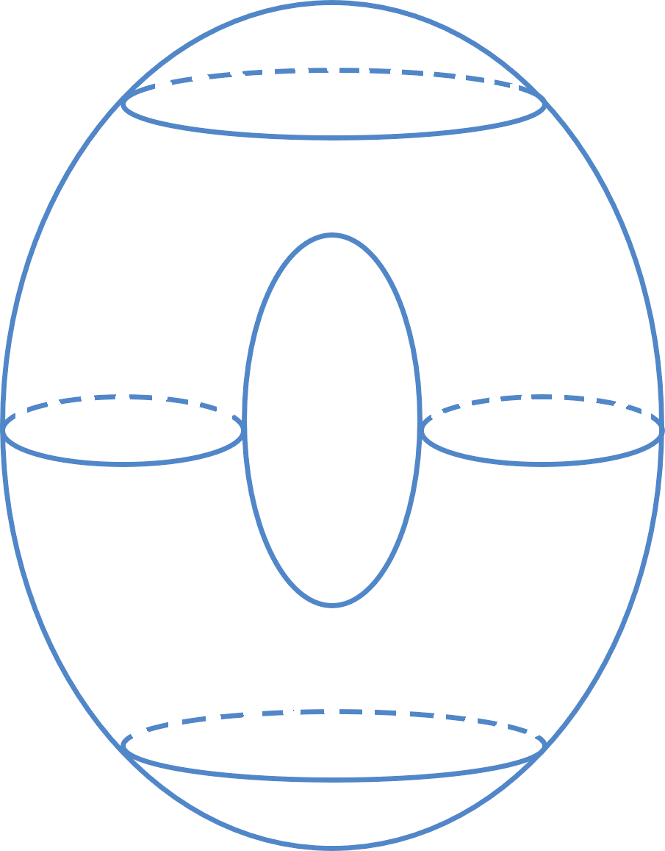
Topological Quantum Field Theory
The Lego game
$Z\left(M\right)∈H_{{\overline{B}}_{1}}⊗H_{B_{2}}=End\left(H_{B_{1}},H_{B_{2}}\right)$ if $∂M={\overline{B}}_{1}⊔B_{2}$. If $B_{1}=B_{2}=∅,$then $Z\left(M\right)∈ℂ$
Every manifold $M$ is associated with a linear operator between the Hilbert spaces of the boundary components
$$ℂ$$
$$ℂ$$
$$H_{S^{1}}$$
$$H_{S^{1}}⊗H_{S^{1}}$$
$$H_{S^{1}}$$
$$ℂ$$
$$ℂ$$
Quantum Gravity and TQFTs
4

Slide 7
A useful tool – Triangulation!
Let’s try to do some computation
A surface can be decomposed into triangles
We can use it to compute topological invariants!
Euler characteristic $χ(Δ_{M})=V−E+F$
A triangulation $Δ_{M}$ on $M$ induces a triangulation on its boundary $Δ_{∂M}=∂Δ_{M}$
Every smooth manifold can be triangulated! Of course not with triangles!
Generalization to $d$-dimension of triangles as “fundamental cell”: $d$-simplex
$$∙$$
$0$-simplex
$1$-simplex
$2$-simplex
(triangle)
$3$-simplex
(tetrahedron)
…
Quantum Gravity and TQFTs
5

Slide 8
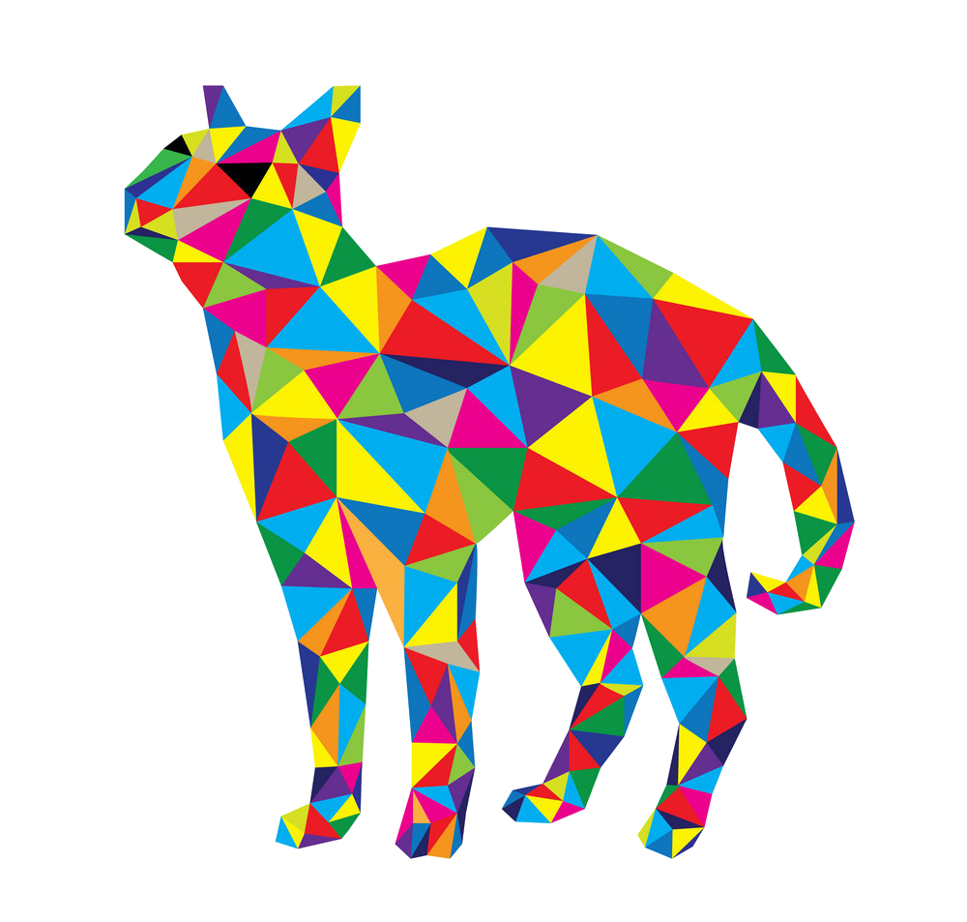
Spin foam and state sum models
Let’s try to quantize gravity
Idea! – Triangulate the smooth manifold $M$ on which the field theory leaves. (Like a coarse-graining or a regulator)
Computing the partition function enriching the triangulation with a colouring $σ$ that depends on the field theory
To each coloured d-simplex we associate an amplitude $A\left( \right)∈ℂ$
$$Z\left(M\right)=\sum_{Δ}{𝓌_{Δ}}\sum_{σ}{\prod_{s}{A\left(σ\left(s\right)\right)}}$$
Usually we consider a $"truncated"$ theory in which the triangulation is fixed
Quantum Gravity and TQFTs
6

Slide 9
Spin foam and state sum model
Incredibly it works!
For TQFTs (as 3d quantum gravity), the partition function $Z$ computed via spin foam is independent of the triangulation or is renormalizable and gives the same result by computing Feynman’s path integral
This is because TQFTs do not have local degrees of freedom
Refinement limit
4d quantum gravity is not a TQFT hence we need something to read the local degrees of freedom
The limit passes through finer and finer triangulations, make the theory able to «read» the local degrees of freedom
…
Quantum Gravity and TQFTs
7

Slide 10
Axioms for Spin Foam models
Atiyah’s axioms and quantum gravity - Table
A d-dimensional truncated spin foam model is a map $"→"$ that associated triangulations to “vector objects”
Topological data
Combinatorial data
Model
Algebraic data
$$B^{d−1}, ∂B=∅$$
$$Δ_{B}$$
$$→$$
$$H_{Δ_{B}}$$
$$M^{d}$$
$$Δ_{M}$$
$$→$$
$$Z\left(Δ_{M}\right)$$
With properties
$${Δ_{B}}_{1}⊔{Δ_{B}}_{2} →H_{{Δ_{B}}_{1} }⊗H_{Δ_{B_{2}}}$$
$$Δ_{\overline{B}}→H_{Δ_{B}}^{∗}$$
$$Δ_{M_{1}}∪_{Δ_{B}}Δ_{M_{2}}→\left\langle Z\left(Δ_{M_{2}}\right),Z\left(Δ_{M_{1}}\right)\right\rangle$$
$$H_{∅}=ℂ, Z\left(∅\right)=1$$
Quantum Gravity and TQFTs
8

Slide 11
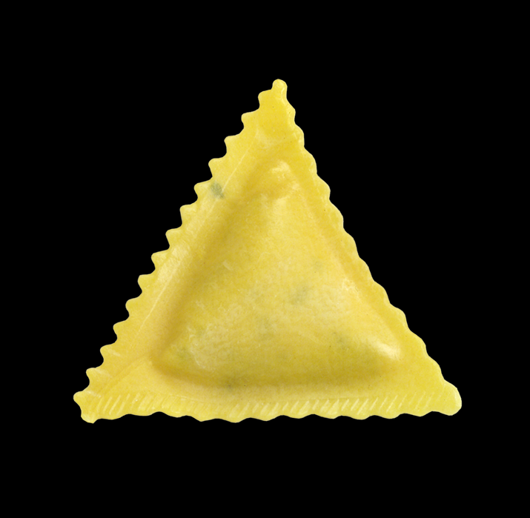
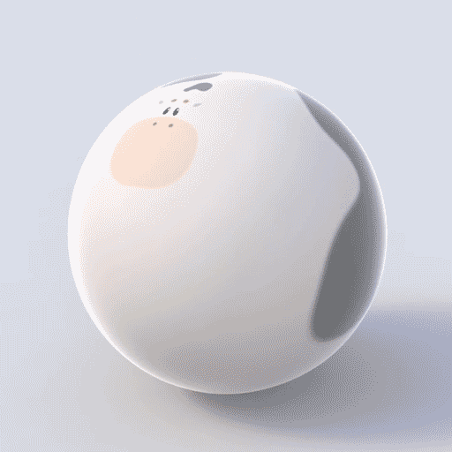
Axioms for Spin Foam models
No identity
In these axioms there is no identity
Topological identity (cylinder): $M∪_{∂M}\left(∂M×I\right)≅M$ as operator on Hilbert space $Z\left(B×I\right)=𝕀_{H_{B}}$
gluing
diffeomorphism
No triangulation identity:
A triagulation of the cylinder $Δ_{∂M×I}$ such that $Δ_{M}∪_{∂M}Δ_{∂M×I}=Δ_{M}$does not exists
(A raviolo is topologically a sphere)
gluing
(As well as this cow)
Quantum Gravity and TQFTs
9

Slide 12
Axioms for Spin Foam models
The Refinement limit
On the set of triangulations $𝒯_{Δ_{∂M}}^{M}$ of $M$ with fixed boundary triangulation $Δ_{∂M}$, there exists an ordering $≤$.
$$Z: 𝒯_{Δ_{∂M}}^{M}→H_{Δ_{∂M}};$$
$$Δ↦Z(Δ)$$
Then, $Z$ is like a sequence and we can perform the limit $\lim_{Δ→∞}{Z\left(Δ\right)=:Z^{∞}\left(M,Δ_{∂M}\right)}$
…
$$Δ→∞$$
$$Z$$
$$Z$$
$$Z$$
$$Z^{∞}\left(M,Δ_{∂M}\right)$$
…
Quantum Gravity and TQFTs
10

Slide 13
Axioms for Spin Foam models
Properties of the the limit
Suppose the limit $\lim_{Δ∈𝒯_{Δ_{∂M}}^{M}}{Z\left(Δ\right)}=Z^{∞}\left(M,Δ_{∂M}\right)∈H_{Δ_{∂M}}$ exists
$Z^{∞}$ satisfy the gluing:
$Z^{∞}\left(B×I, Δ_{B}⊔Δ_{B}\right)$ is a projector:
$Ran\left(Z^{∞}\left(B×I, Δ_{B}⊔Δ_{B}\right)\right)$ not depend on the triangulation:
$$Z\left(M_{1}∪_{B}M_{2},Δ_{B_{1}}⊔Δ_{B_{2}}\right)=\left\langle Z^{∞}\left(M_{1},Δ_{\overline{B}}⊔Δ_{B_{2}}\right),Z^{∞}\left(M_{2},Δ_{B_{1}}⊔Δ_{B}\right)\right\rangle$$
$$\left\langle Z^{∞}\left(B×I, Δ_{B}⊔Δ_{B}\right),Z^{∞}\left(B×I, Δ_{B}⊔Δ_{B}\right)\right\rangle =Z^{∞}\left(B×I, Δ_{B}⊔Δ_{B}\right)$$
$$Ran\left(Z^{∞}\left(B×I, Δ_{B}⊔Δ_{B}\right)\right)≅Ran\left(Z^{∞}\left(B×I, {Δ′}_{B}⊔{Δ′}_{B}\right)\right)$$
Quantum Gravity and TQFTs
11

Slide 14
Axioms for Spin Foam models
Properties of the the limit
We can identify all the $H_{Δ_{B}}$ associated to the same $B$! $H_{Δ_{B}}≅H_{Δ_{B}^{′}}≅Ran\left(Z^{∞}\left(B×I, Δ_{B}⊔Δ_{B}\right)\right)=:H_{B}$
$Z^{∞}\left(M,Δ_{∂M}\right)$ is independent of the boundary triangulation
The Refinement limit defines a $Z^{∞}:M↦Z^{∞}\left(M\right)∈H_{∂M}$
and associate to $B↦H_{B}$
moreover, $B↦H_{B}$satisfies factorization and duality
$Z^{∞}$ satisfies gluing and $Z^{∞}\left(B×I\right)=𝕀_{H_{B}}$
The Refinement limit defines a TQFT
Quantum Gravity and TQFTs
12

Slide 15
Conclusion
Spin Foam admits an axiomatic formulation in which the set of axioms emulates the Atiyah axioms for TQFT with the addition of a combinatorial data (triangulation)
There exists an higher structure for this set of axioms, making the theory analogous to a once-extended TQFT
The Refinement limit can be performed and, if exists, it defines a TQFT
Thank you for your attention
Quantum Gravity and TQFTs
13

