Slide 1





Precision test of fundamental physics with matter-wave interferometers
Nicola Poli
Dipartimento di Fisica e Astronomia & LENS
Università degli Studi di Firenze, Italy
nicola.poli@unifi.it
TICTOC
GRAV
Monday 10th February 2025
Notes:
1) Many thanks for the opportunity to present to you TICTOCGRAV project.
2) Exploring gravity with ultra-cold Cadmium and Strontium optical clocks and atom interferometers.
3) My name is Nicola Poli and the host institution I choose for this project is LENS laboratories.

Slide 2
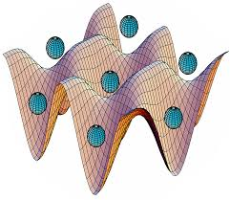
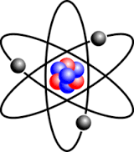
Atomic Clocks & Gravimeters
TIME
GRAVITY
Optical atomic clocks
Atom interferometers (gravimeters/gradiometers)
internal d.o.f., electronic states
external d.o.f., momentum states
hν
׀e›
k_{eff}
g
eV
׀g›
μeV
T
T
relative precision <10⁻²⁰
relative precision < 10⁻¹¹ g
Table-top, low-energy experiments, high precision

Slide 3
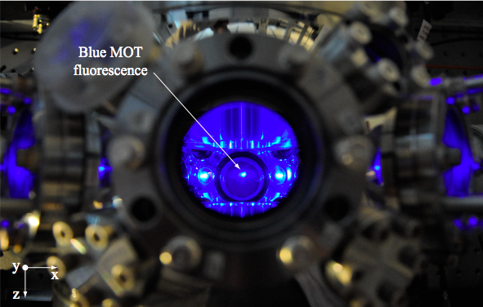
Ultracold Sr atoms
10⁶ Sr atoms @ 1 mK
Notes:
Applicazioni incredibili che oggi fanno uso della relativita’

Slide 4


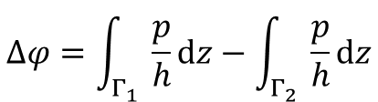
Interference of matter waves
Young’s double-slit experiment
free
evolution
detection
S₁
Γ₁
source
Γ₂
preparation
S₂
$$∆φ=\int_{Γ_{1}}{\frac{p}{h}dz}−\int_{Γ_{2}}{\frac{p}{h}dz}$$
splitting
recombination
Matter Wave Interferometry = art of coherently splitting, reflecting, and recombining matter waves
A. D. Cronin, J. Schmiedmayer, D. E. Pritchard, Rev. Mod. Phys. 81, 1051 (2009)

Slide 5
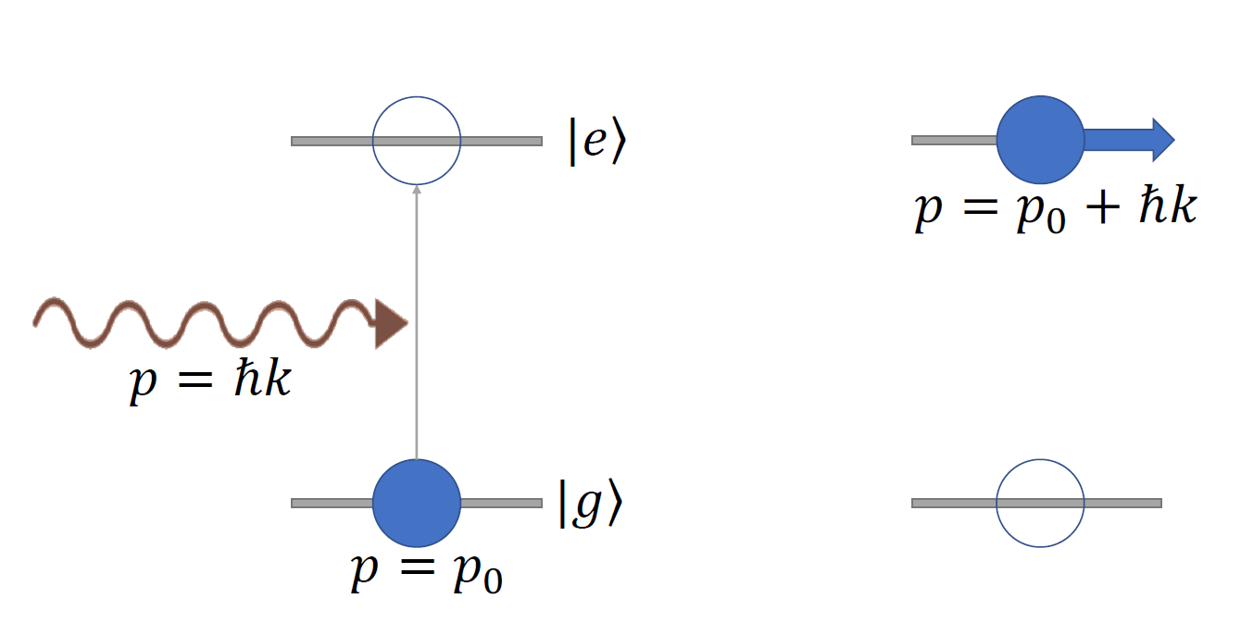
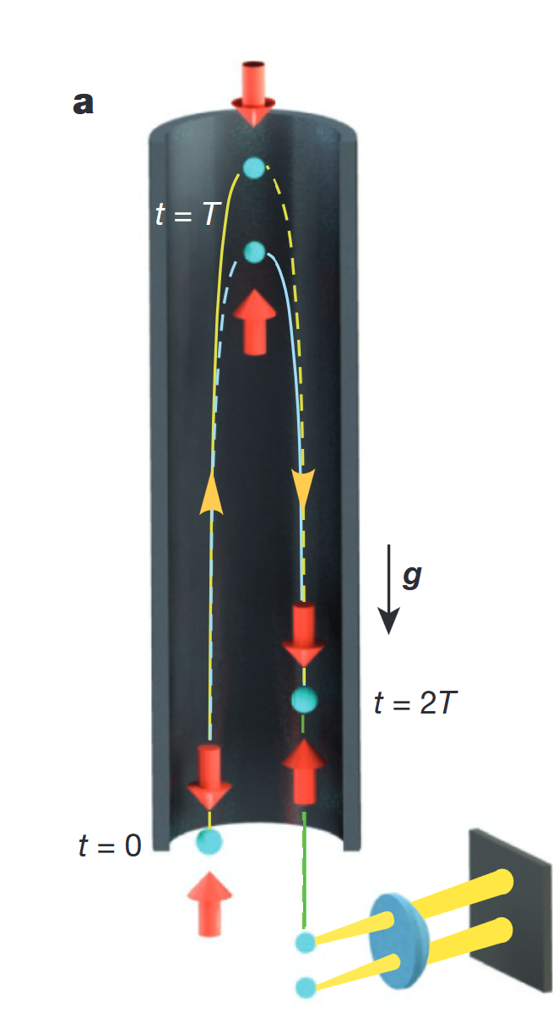


Atom Interferometers
light matter wave
|g,p₀›
$$ω$$
|e,p₀+hk›
$$∆φ=φ_{1}−φ_{2}$$
|e, p₀+hk>
|g,p₀›
T
T
SPLIT
REFLECT
RECOMBINE
Atomic fountains

Slide 6
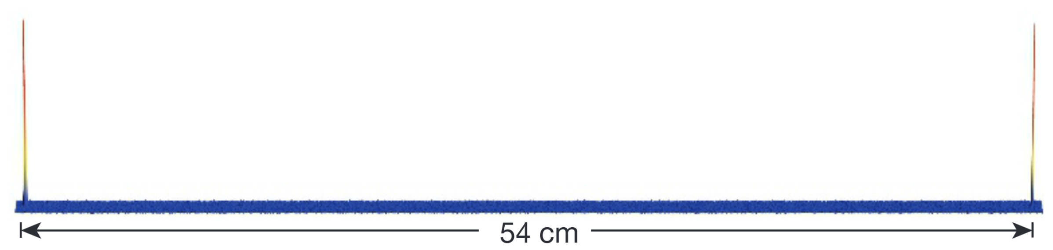
Atom Interferometers
light matter wave
|g,p₀›
$$ω$$
|e,p₀+hk›
$$∆φ=φ_{1}−φ_{2}$$
54 cm
|e, p₀+hk>
|g,p₀›
T
T
SPLIT
REFLECT
RECOMBINE
half-meter wave packet separation
T. Kovachy et al Nature 528, 530 (2015)

Slide 7
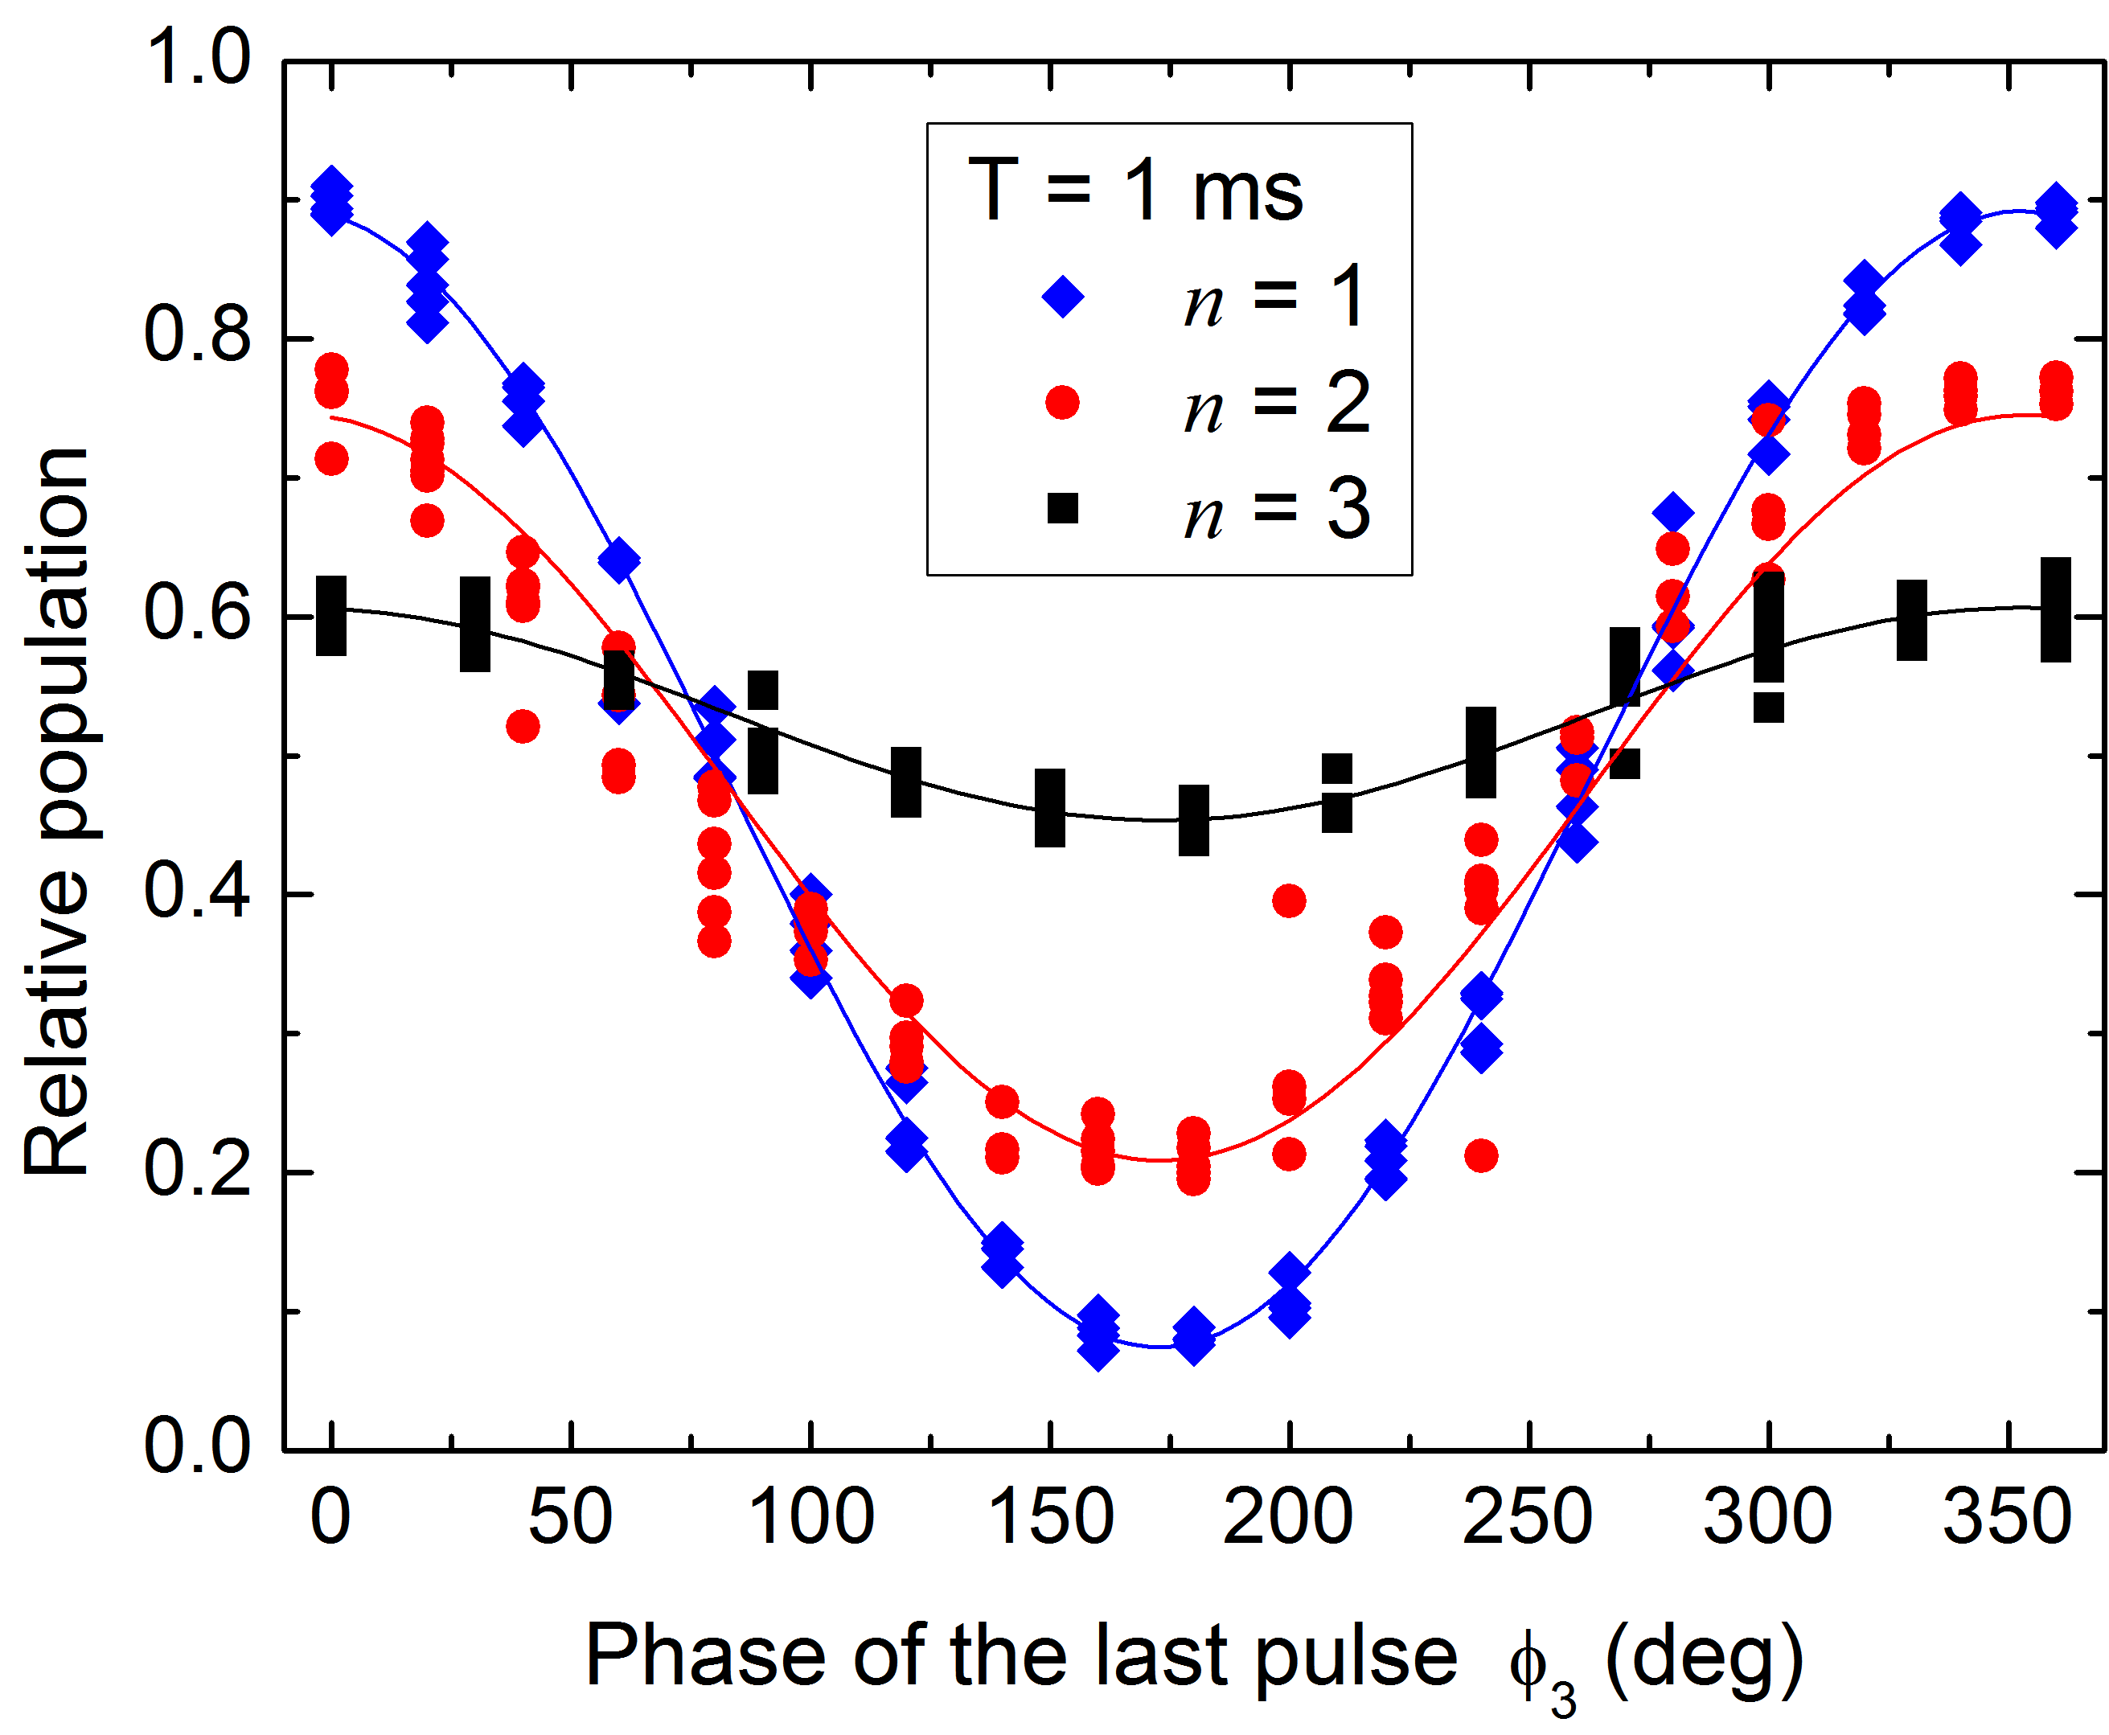
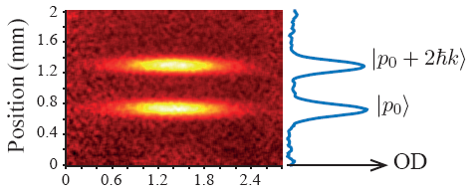
Atom Interferometers
light matter wave
|g,p₀›
$$ω$$
|e,p₀+hk›
$$∆φ=φ_{1}−φ_{2}$$
|e, p₀+hk>
|g,p₀›
T
T
SPLIT
REFLECT
RECOMBINE

Slide 8
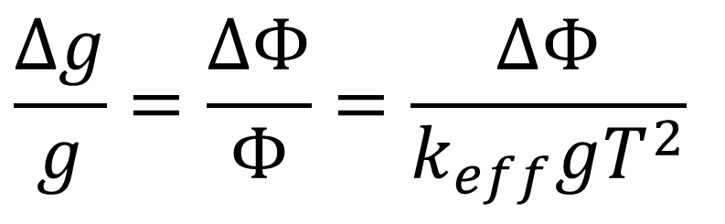



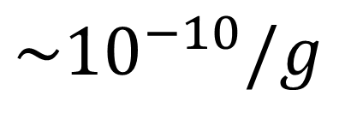
Atom Interferometers - Gravimeters
light matter wave
|g,p₀›
|e,p₀+hk›
$$ω$$
g
|e, p₀+hk>
|g,p₀›
T
T
SPLIT
REFLECT
RECOMBINE
Sensitivity
$$\sim 1 mrad$$
$$\frac{Δg}{g}=\frac{ΔΦ}{Φ}=\frac{ΔΦ}{k_{eff}gT^{2}}$$
$$\sim {10}^{−10}/g$$
$\sim 107 m$⁻¹
$$\sim 1 s$$
Rb, Cs, …

Slide 9
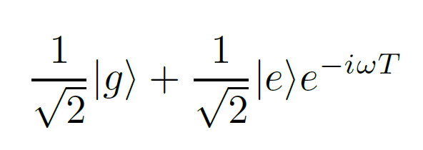

Atom Interferometers
light matter wave
|g,p₀›
|e,p₀+hk›
$$ω$$
g
|e, p₀+hk>
|g,p₀›
T
T
SPLIT
REFLECT
RECOMBINE
Sensitivity
$$\sim 1 mrad$$
$$\frac{Δg}{g}=\frac{ΔΦ}{Φ}=\frac{ΔΦ}{k_{eff}gT^{2}}$$
$$\sim {10}^{−10}/g$$
$\sim 107 m$⁻¹
$$\sim 1 s$$
Rb, Cs, …

Slide 10
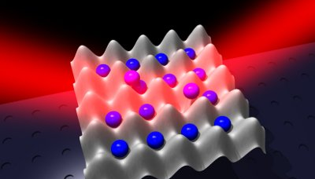
Imaging Optical Frequencies
NICOLA.POLI@UNIFI.IT
10

Slide 11
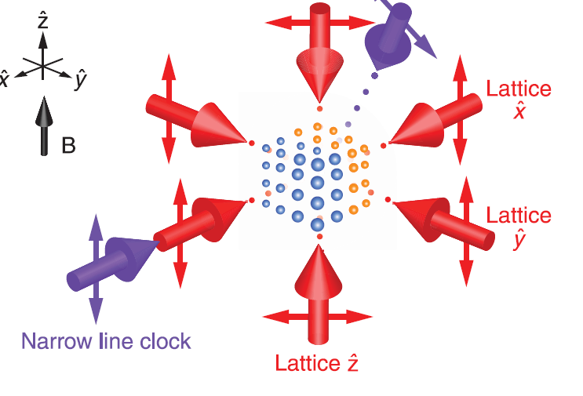
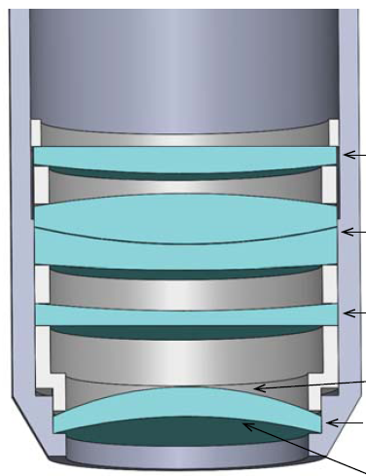
Imaging Optical Frequencies
3D lattice clock
@JILA
⁸⁷Sr
Fermi Gas
NICOLA.POLI@UNIFI.IT
11

Slide 12
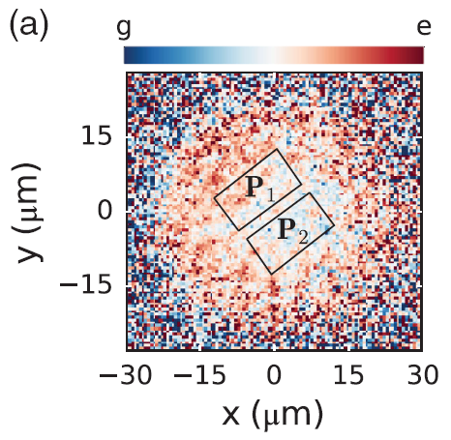
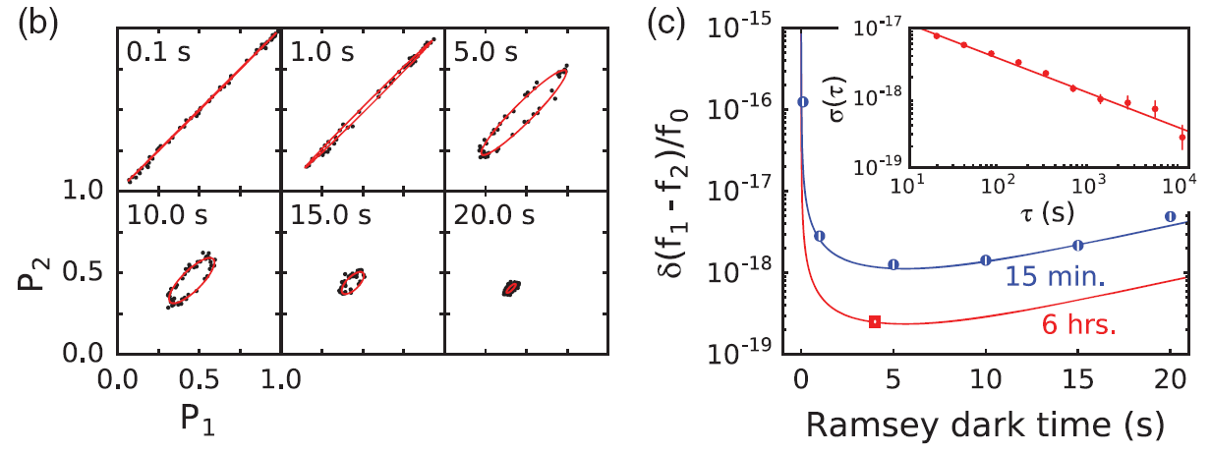
Gravitational Red Shift
Imaging Optical Frequencies
G. E. Marti, R. B. Hutson, A. Goban, S. L. Campbell, N. Poli, J. Ye, "Imaging optical frequencies with 100 μHz precision and 1.1 μm resolution", Phys. Rev. Lett. (2018)
2,5 10⁻¹⁹
Notes:
Applicazioni incredibili che oggi fanno uso della relativita’

Slide 13

Gravitational Red Shift
10 μm
Δν/ν = 10 ⁻²¹
Δν/ν = 10 ⁻²²
λ_{dB} ≈ 1 μm @ 1nK
Notes:
Come dicevo precedentemente la realta’ che ci circonda e’ a quattro dimensioni, anche se su la scala di velocita’ di tutti i giorni non ci accorgiamo di queste piccolissime variazioni. Oggi con i moderni orologi e’ possibile misurare queste piccolissime variazioni dello spazio tempo anche a velocita’ piccolissime.
Un secondo effetto, stavolta di relativita’ generale
piccola scala cioe’ per velocita’ piccole e perCome vi dicevo effetti di

Slide 14
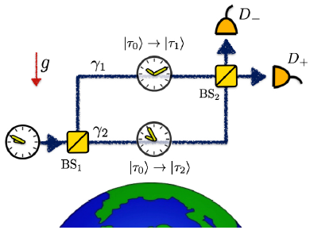
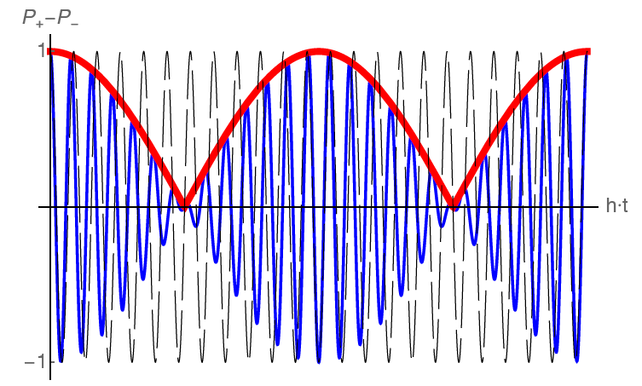
Quantum Interference of Clocks
Observe gravity induced “decoherence” in clock interferometers
  Quantum superposition of clocks in different locations
  (h = height difference)
h
  Dephasing introduced by differential time dilation in the two different paths γ₁ and γ₂
T
(T=time)
  Interferometer contrast loss
  Decoherence induced by “which path” information from clock state
M. Zych et al. Nature Commun. 2(505), 1498 (2011)
NICOLA.POLI@UNIFI.IT
14
Notes:
1) As a third objective, there is the realization for the first time of quantum interference of clocks located in different gravitational potential.
2) The goal of this experiment is to observe de-coherence phenomena induced by the different time dilation on the two entangled clocks that are Red Shifted due to the different height,
3) The principle of the experiment is actually drawn in the proposal article by the group of C.Brukner
4) the idea is to create a quantum superposition of clocks in two different locations, let the two entangled clock to evolve in different potential, and then recombine in a standard interferometer.
5) What we expect, by calculating the standard effect on the classical trajectories is a relative dephasing of the two clocks showing off as a reduction in coherence at a certain time.
6) I think it is very important to perform this kind of experiments since in this case the quantum superposition we can create is of the order of meters and this is exactly the regime in which we may start to observe a deviation from the classical way of applying correction on the classical trajectories.
7) This, in turn, might give better insight into the quantum to classical transition in composite macroscopic objects

Slide 15
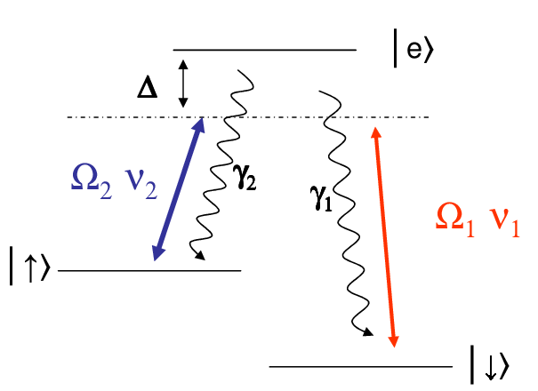



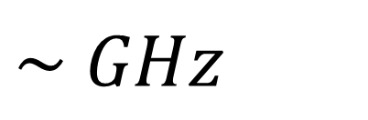
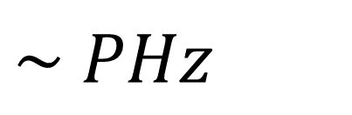
Two Photons (Bragg-Raman) – Single photon
$$\sim { PHz}^{}$$
$$\sim { GHz}^{}$$

Slide 16
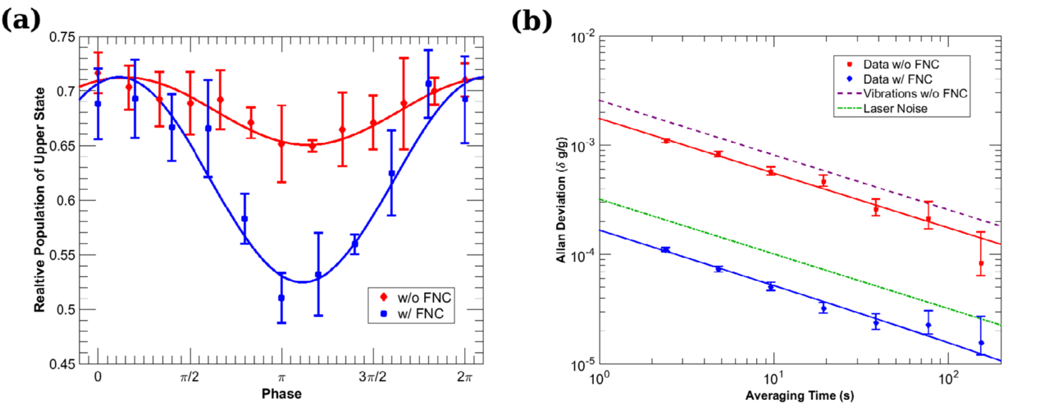


Single-Photon Interferometry with Strontium Atoms
Clock Gradiometer Sr – 698 nm
τ = 160 s
$${{}_{}^{3}P}_{0}$$
׀e,hk›
Single photon
(momentum states
+ electronic states)
430 THz
$${{}_{}^{1}S}_{0}$$
׀g,0›
Clock Gravimeter Sr – 698 nm
L. Hu et al., Phys. Rev. Lett. 119 263601 (2017)
100 m tower experiments on Sr clock interferometry
AION (UK), MAGIS (USA), …
L. Hu et al., Class. Quantum Grav. 37 014001 (2020)
NICOLA.POLI@UNIFI.IT
16

Slide 17
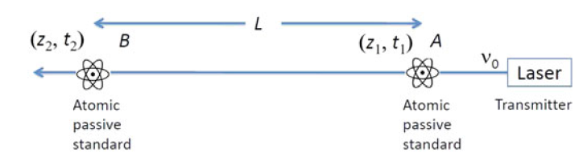
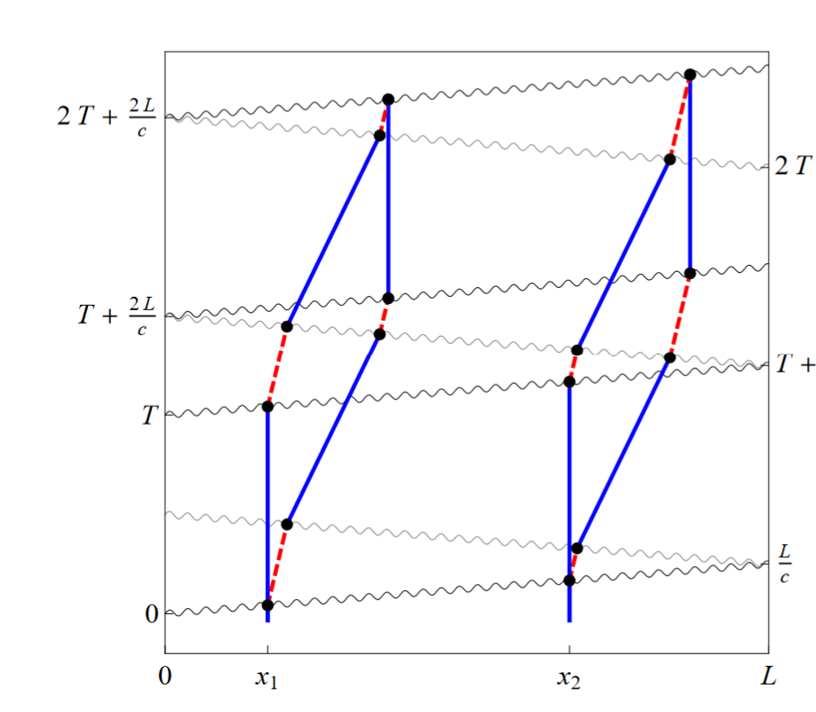
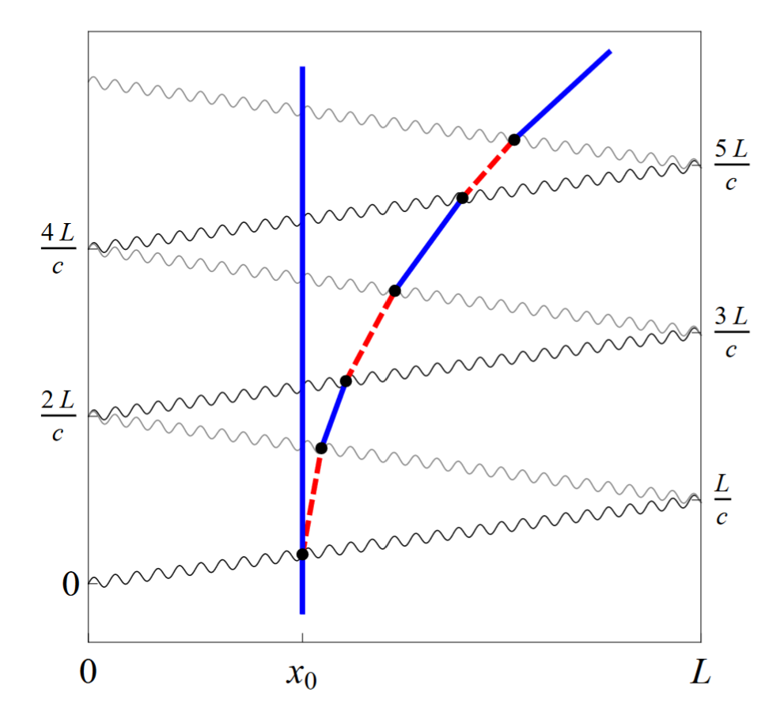
Single-Photon Interferometry with Strontium Atoms
τ = 160 s
$${{}_{}^{3}P}_{0}$$
A new GW Detector
׀e,hk›
430 THz
$${{}_{}^{1}S}_{0}$$
׀g,0›
N. Yu, M. Tinto, Gen. Relativ. Gravit. 43, 1943 (2011)
LMT with strontium clock transition
P. W. Graham, et al. Phys. Rev. Lett. 110, 171102 (2013)
NICOLA.POLI@UNIFI.IT
17
Notes:
1) While it is almost certain that at some level, quantum correction to Gravity must appear, there is no a unified view on how to apply these corrections either on the scale at which these corrections must appear.
2) So, the problem of unification of the two theories is still open and it is highly possible that answers will come from experiments.
3) The main goal of TICTOCGRAV experiment is to start to address this problem experimentally, studying the interplay between gravity and quantum mechanics with the best quantum sensors to date, namely optical atomic clocks and atom interferometers
4) Thanks to the advance in A.M.O. physics, in this system we realize a full coherent control of matter waves, both of the internal degrees of freedom such as spin states (both electronic, nuclear spin) and complete control of the motion of the atom center of mass, down to quantum level.
5) In all these sensors we actually rely on in interference of matter-waves to perform time and gravity measurements, and interference is the best witness of quantum-ness.
6) Moreover, these systems are generally low energy, small in size, but with the at the highest precision
7) to give you an example of the precision of modern optical lattice clock (done by stabilizing a laser to an atomic transition), has approached the level of 10-18 in fractional frequency stability. and we currently working to explore the next digit in relative accuracy.
Now at this level, it means that we are capable of detecting the relative position between two atoms at rest sitting at two different heights with respect to the geoid of only 1 mm though frequency measurements at this precision.
8) In the case of atom interferometers as gravimeters and gravity gradiometers, the precision at the level of 10-11 ms2 allows performing measurements give the access to perform measurements for example of gravitational constant G at the level of 100 ppm.

Slide 18
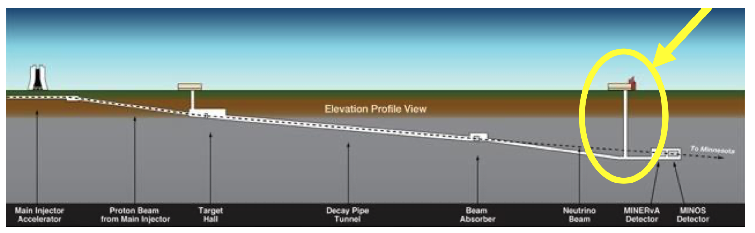
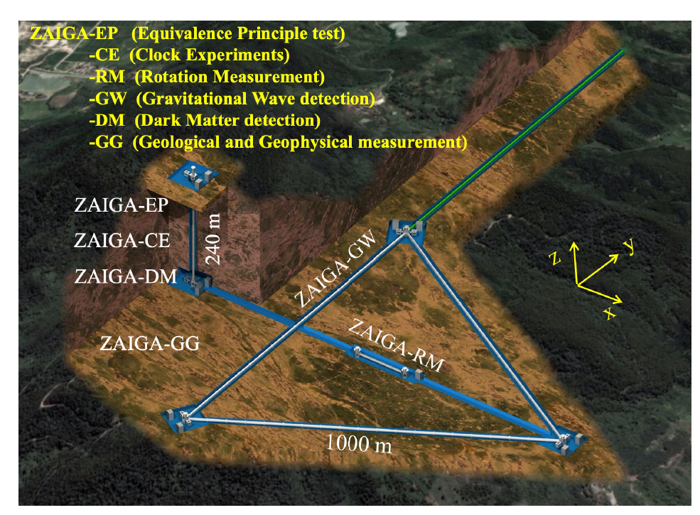
Large Scale Atom Interferometers
MAGIS 100 (Fermilab - USA)
ZAIGA ( Wuhan, CHN)
O. Buchmueller et al. Contemporary Physics, 64(2), 93–110 (2023)
NICOLA.POLI@UNIFI.IT
18

Slide 19
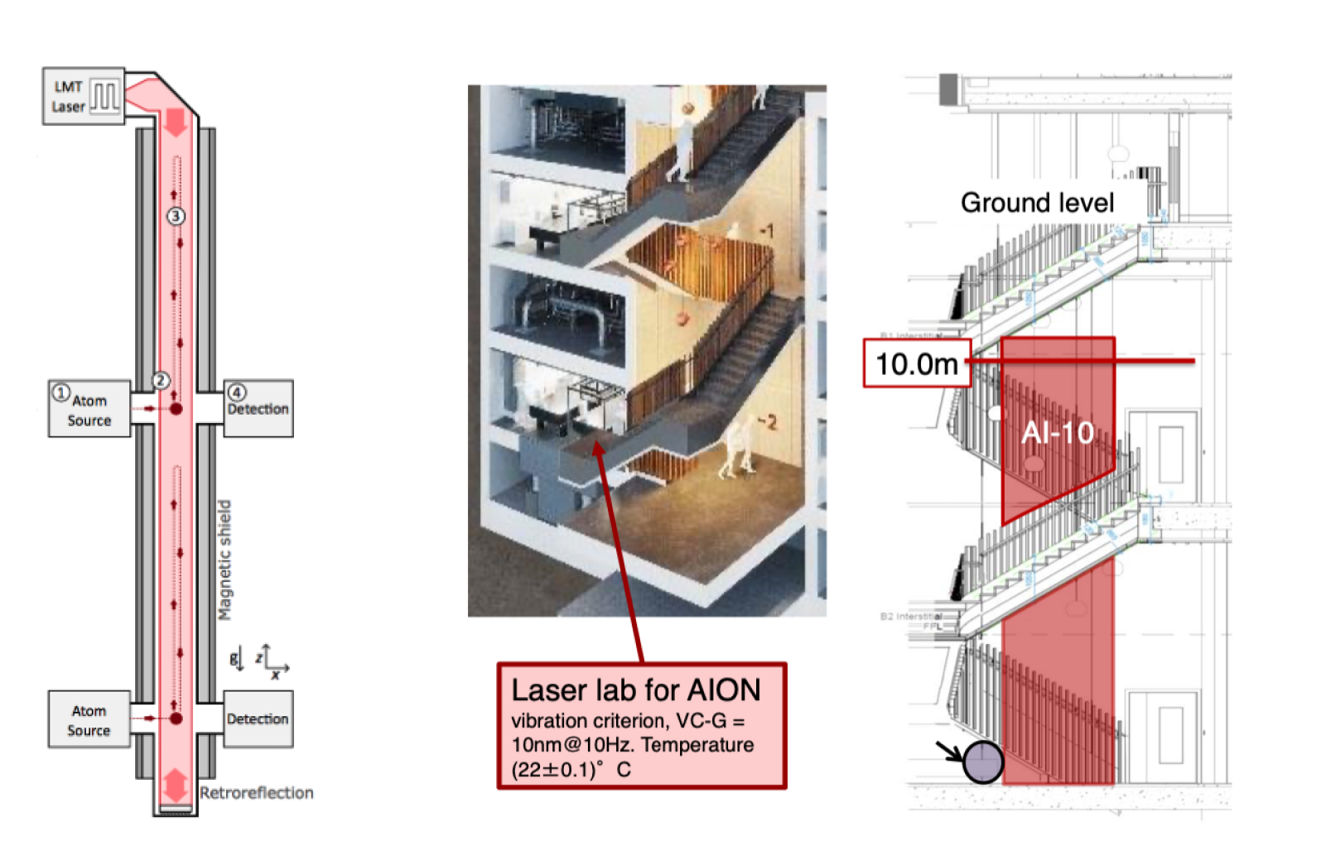
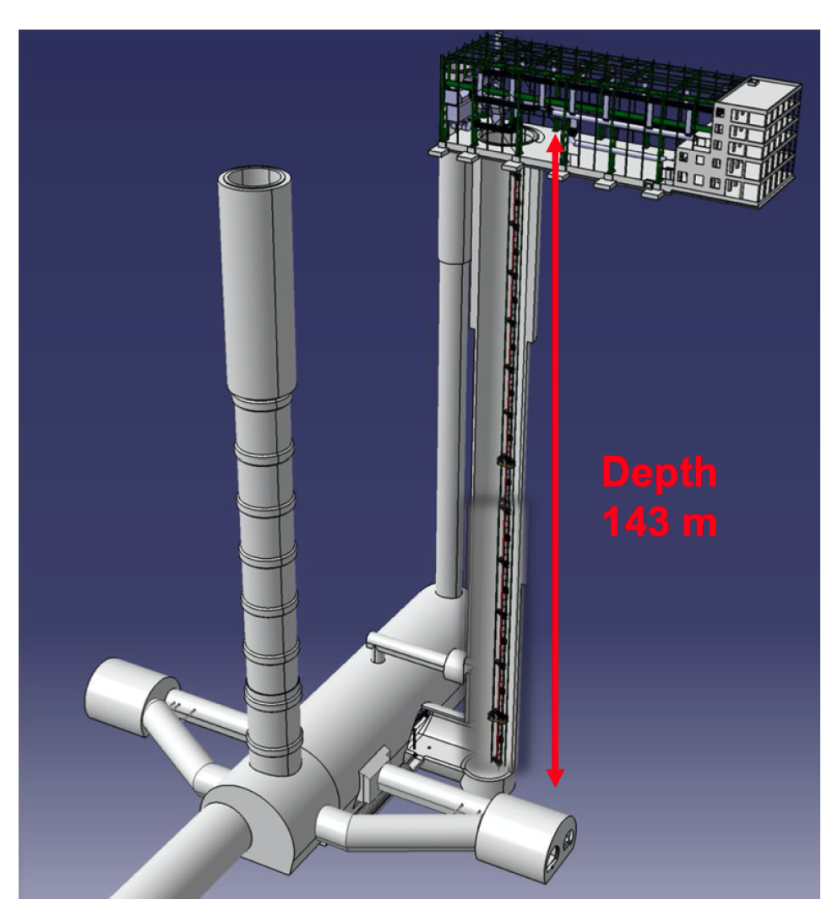
Large Fountains
AION-10 (Oxford, UK)
O. Buchmueller et al. Contemporary Physics, 64(2), 93–110 (2023)
AION 100 (CERN, CH)
NICOLA.POLI@UNIFI.IT
19

Slide 20
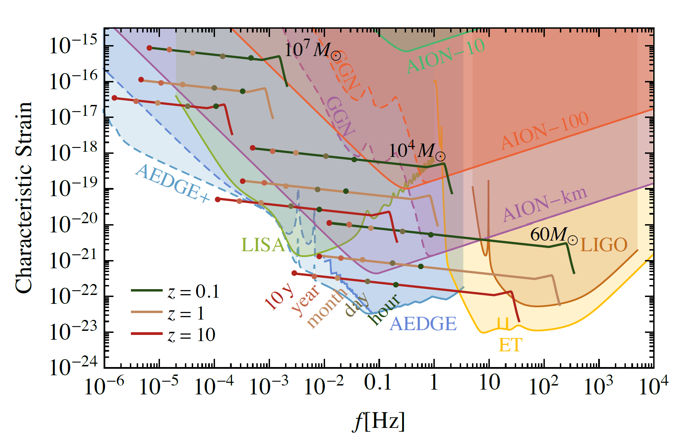
Gravitational waves
Mid freq. band (0.01 – 1) Hz
O. Buchmueller et al. Contemporary Physics, 64(2), 93–110 (2023)
NICOLA.POLI@UNIFI.IT
20

Slide 21
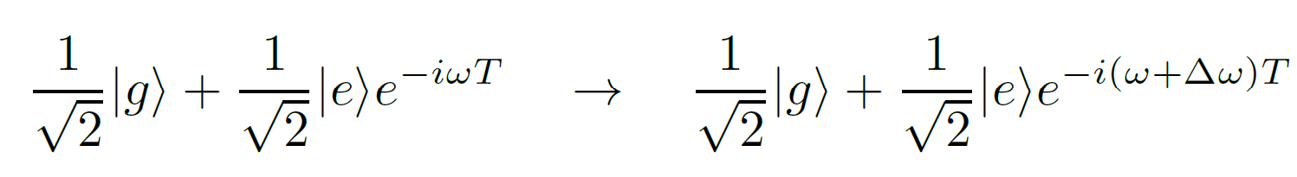
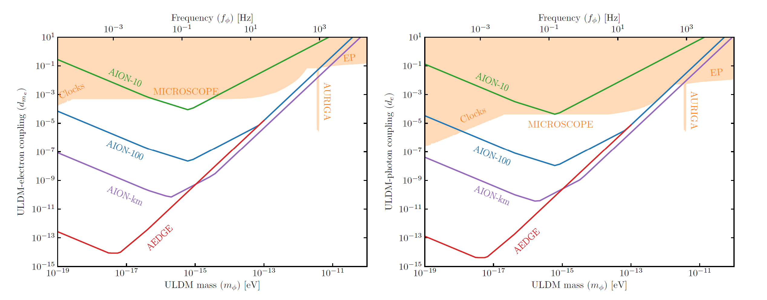
Dark Matter Search
O. Buchmueller et al. Contemporary Physics, 64(2), 93–110 (2023)
NICOLA.POLI@UNIFI.IT
21

Slide 22
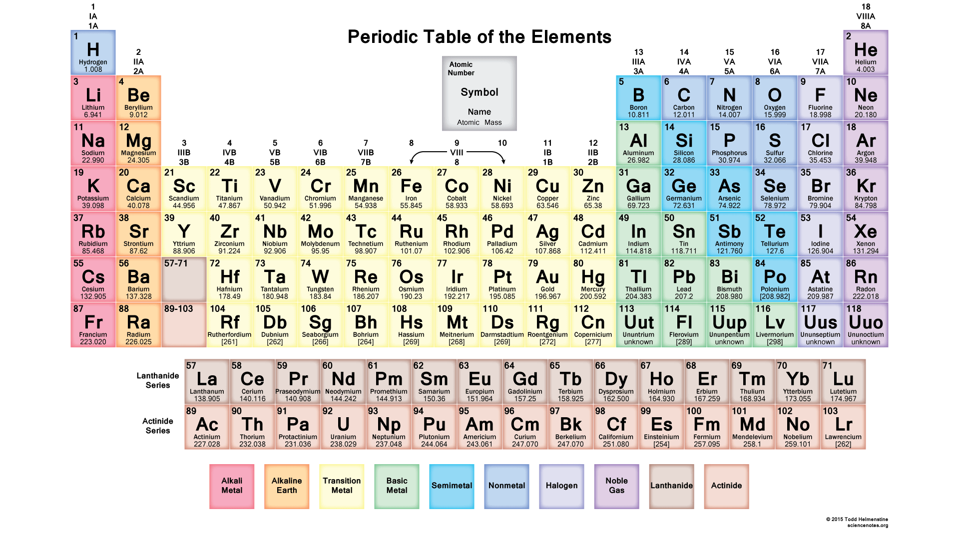
Clock Interferometry Candidates
NICOLA.POLI@UNIFI.IT
22

Slide 23
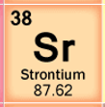
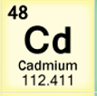
Simultaneous Cd-Sr Interferometer
Similar atomic level structure
- 2:1 transition frequency ratio
¹P₁
- Low sensitivity to blackbody shift (Cd!)
³P₁
cooling
326nm
689nm
³P₀
- Very low sensitivity to B & E fields
229nm
461nm
332nm
- Presence of clock transitions
698nm
¹S₀
clock
- Fermions and bosons available
Fundamental Physics Tests
Weak equivalence principle
Non-classical time dilation effects
Spin-Gravity Coupling
J. N. Tinsley and N. Poli, “Exploring Gravity with Ultra-cold Cadmium and Strontium Optical Clocks and Bragg Interferometers,” in ECAMP 13 (2019)
J. N. Tinsley et al., "Prospects for a simultaneous atom interferometer with ultracold cadmium and strontium for fundamental physics tests”, Proceedings Volume 12016, Optical and Quantum Sensing and Precision Metrology II, 1201602 (2022)
NICOLA.POLI@UNIFI.IT
23

Slide 24
Quantum Interference of Clocks
  Interferometer contrast modulation
(h*T)_{Sr}= 21 m s
(h*T)_{Cd}= 10 m s
Full revival for h=2 m, time T = 5 - 10 s
Sr as “contrast reference”, observe on Cd faster contrast decay
π/2
π/2
π/2
π/2
NICOLA.POLI@UNIFI.IT
24
Notes:
1) while this a quite challenging condition to be satisfied it is important to notice that by using two different species it might not be necessary to wait for full revival, as a matter of fact, we could use Sr as a reference and observe on Cd the faster contrast decay.
2) this differential scheme for the proposed experiment, might also in reject common sources of technical decoherence
3) for this experiment there are several challenges as to realize a trap for the both atoms in the superposition of states with the same optical potential. Here we can inherit what has been done in atomic clocks community and use traps at magic wavelength
4) in particular for Cd It is necessary to develop high-power UV light sources for efficient trapping.

Slide 25
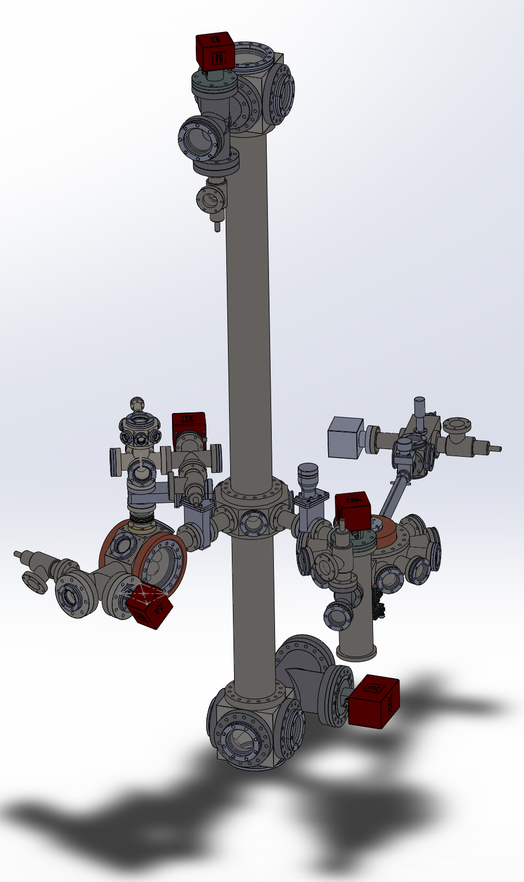
Cd-Sr Interferometry Chamber
- 2m fountain for Cd & Sr
- Cd & Sr loaded from slowed atomic beams in separated MOT
- Optical dipole traps to transfer the atoms at the center of the fountain tube
S. Bandarupally, PhD thesis
25
NICOLA.POLI@UNIFI.IT
25

Slide 26
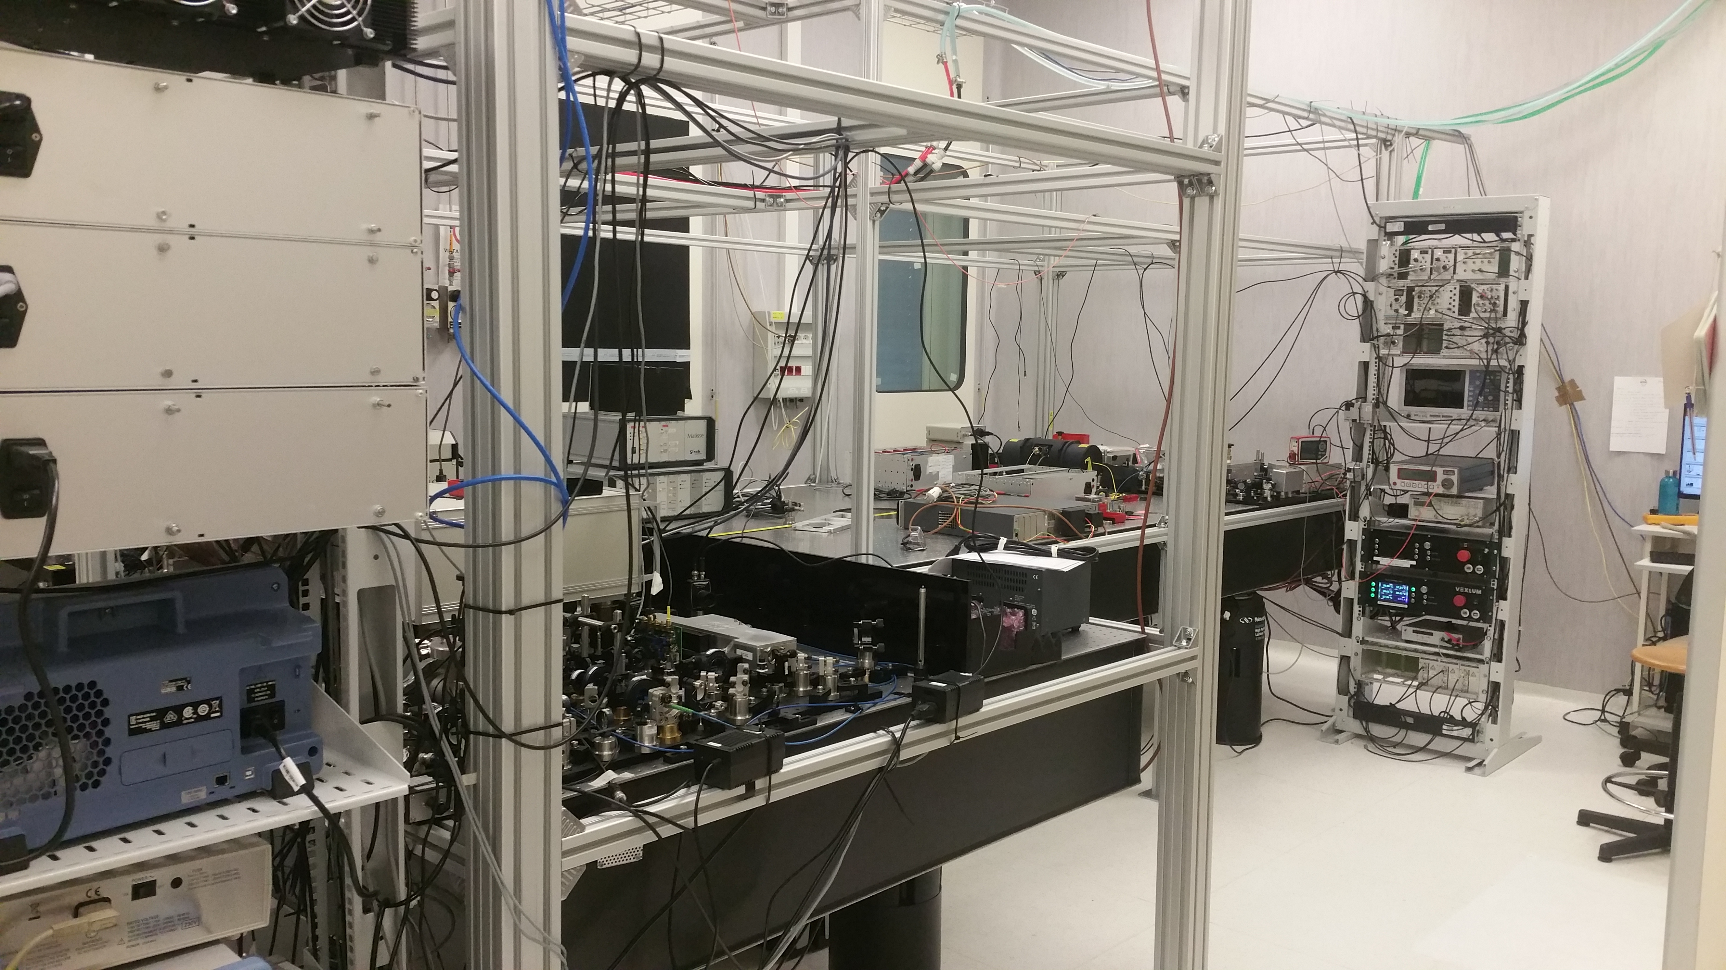
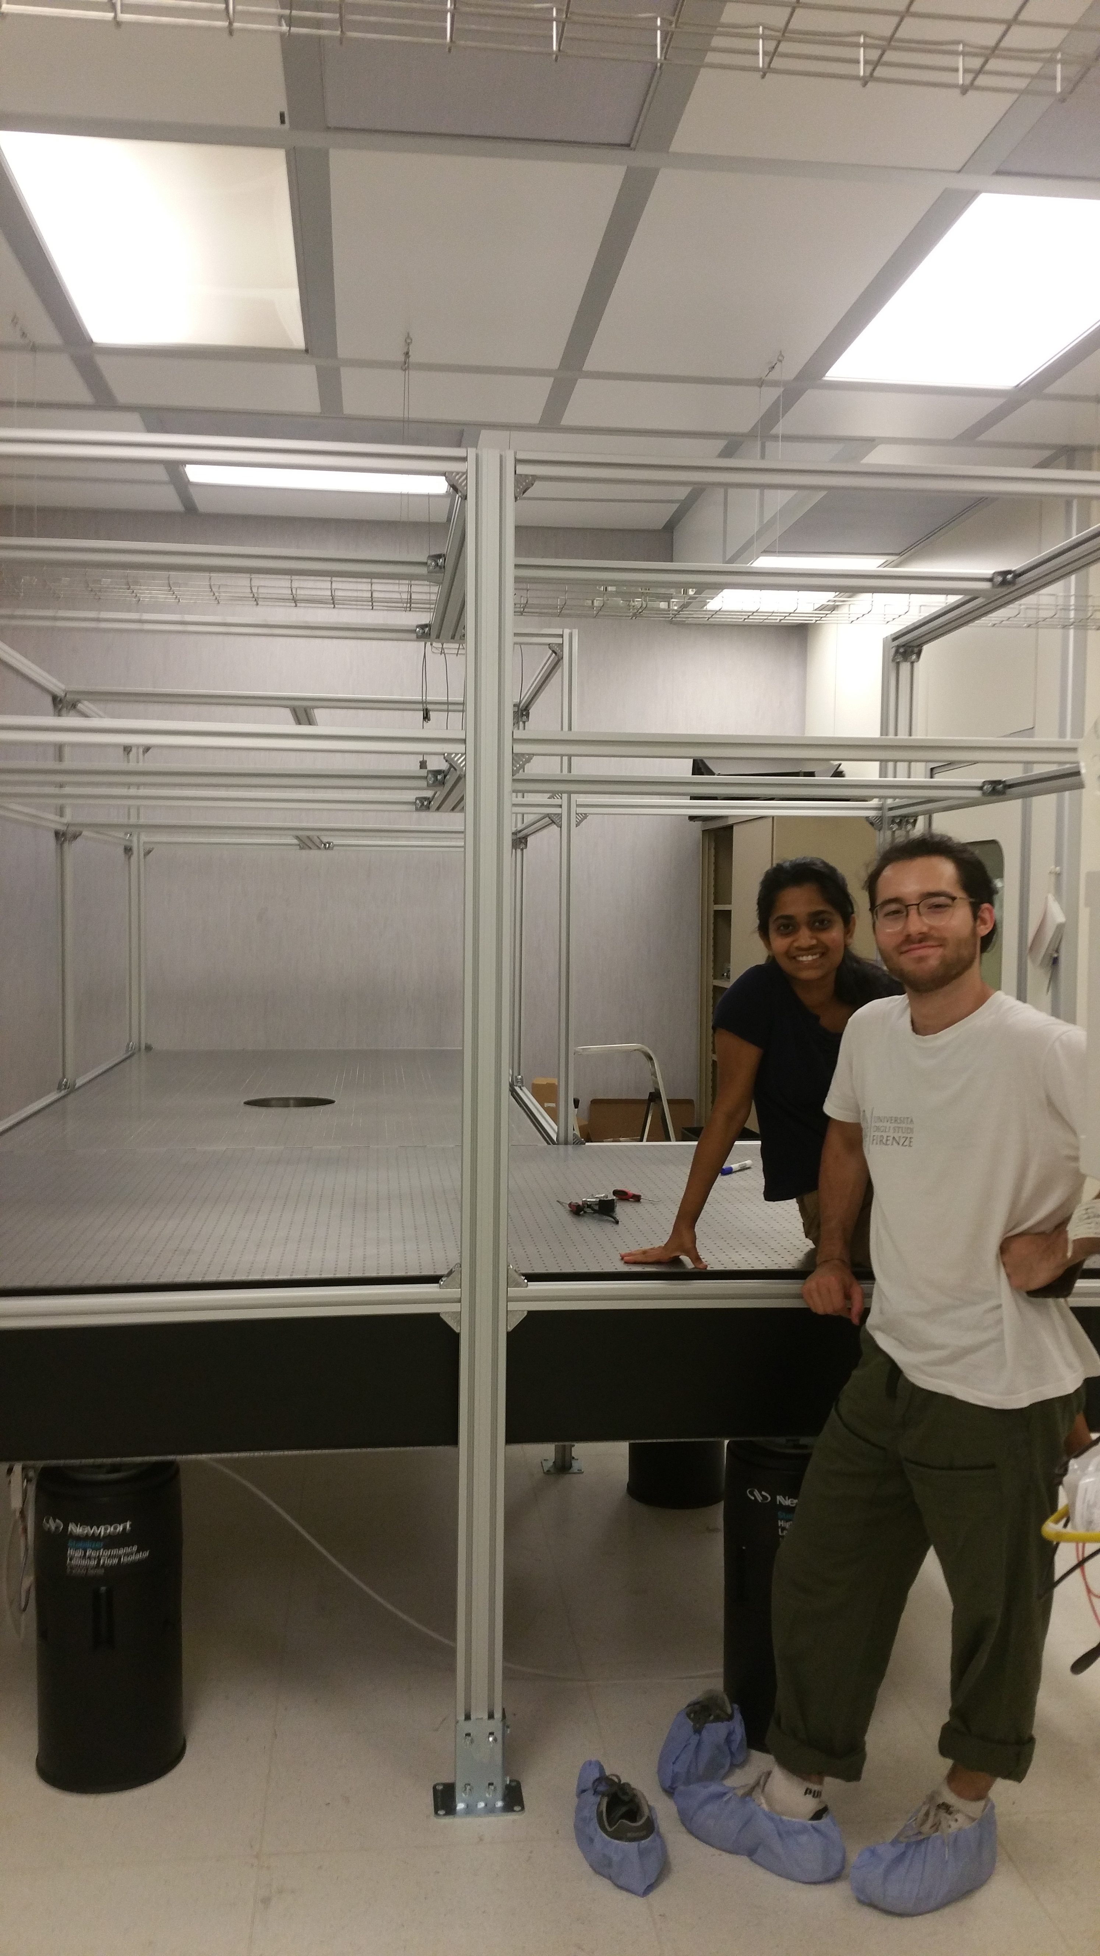
Cd-Sr Lab
NICOLA.POLI@UNIFI.IT
26
Notes:
Here a picture of the optical table in clean room, with the hole hosting the atomic fountain, and our laser systems.

Slide 27
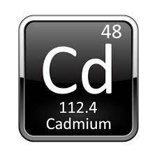
Cadmium Properties
Interesting possibilities for atomic physics study
¹⁰⁶Cd | 1.25%
¹⁰⁸Cd | 0.89%
¹¹⁰Cd | 12.47%
¹¹¹Cd | 12.80%
¹¹²Cd | 24.11%
¹¹³Cd^{(*)} | 12.23%
¹¹⁴Cd | 28.75%
¹¹⁶Cd^{(*)} | 7.51%
6 bosons (I=0)
2 fermions (I=1/2)
^{(*)} long lifetime
Cold collisional physics
Degenerate gas production
Quantum information
Favourable wavelength ratio of main optical cooling & spectroscopy transitions
NICOLA.POLI@UNIFI.IT
27

Slide 28
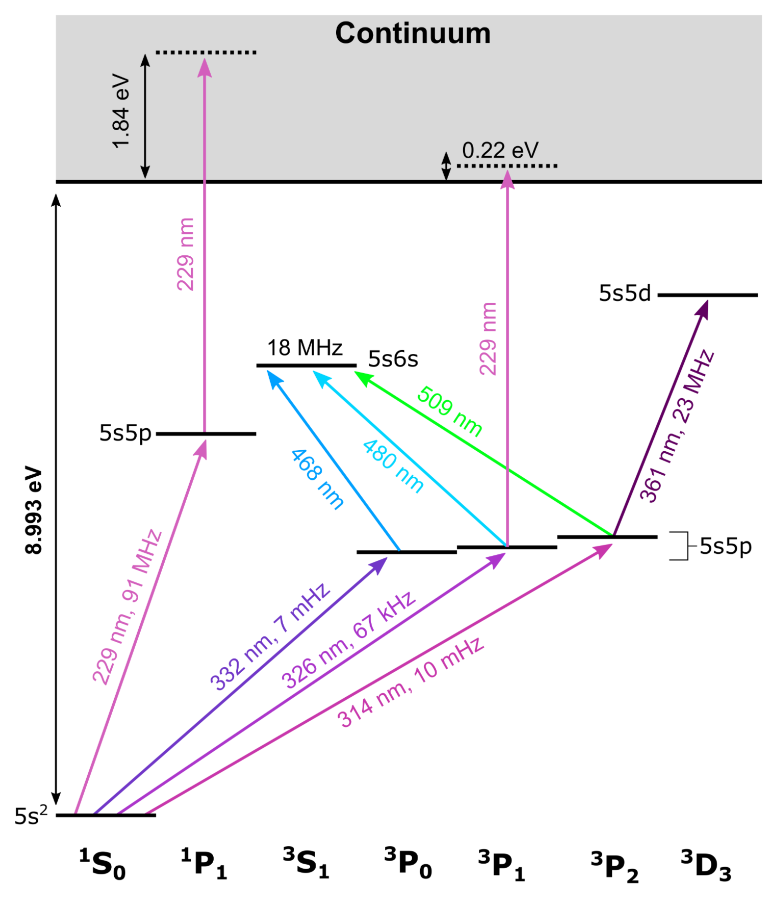
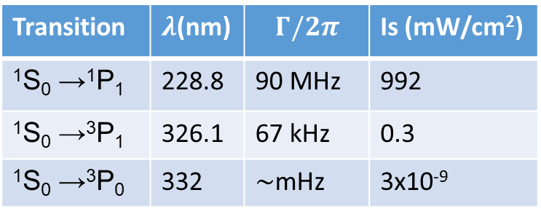
Cooling and trapping Cadmium
Challenges
  High magnetic field gradient
  Photoionisation
  Limited power
  Vacuum damage
Advantages
  Huge scattering force
  Small stopping distance
  229
Challenges
  Small scattering force
  Low capture velocity
  326
Advantages
  High power available
  Low Doppler temperature
Transition | $λ$(nm) | $$Γ/2π$$ | Is (mW/cm²)
¹S₀ →¹P₁ | 228.8 | 90 MHz | 992
¹S₀ →³P₁ | 326.1 | 67 kHz | 0.3
¹S₀ →³P₀ | 332 | $∼$mHz | 3x10⁻⁹
C. Monroe, H. Katori, K. Gibble, S. Truppe

Slide 29
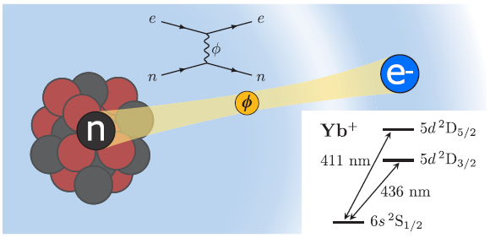
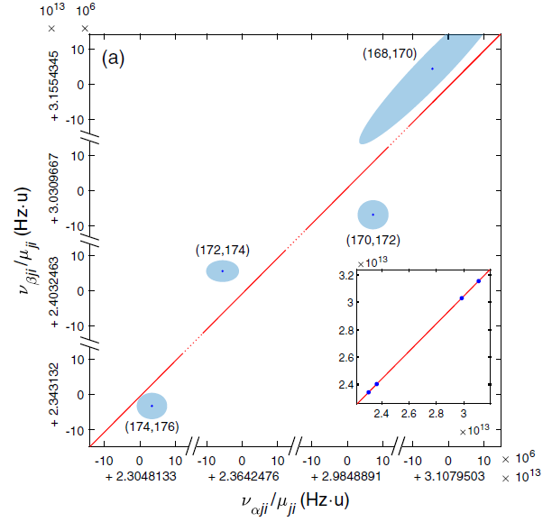
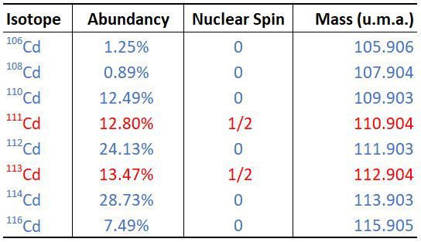
Probing New Long-Range Interactions by Spectroscopy
Non linearity in King’s plot
I.Counts "Evidence for Nonlinear Isotope Shift in Yb+ Search for New Boson", Phys Rev Lett 125, 123002 (2020)
C. Delaunay, R. Ozeri, G. Perez, and Y. Soreq, Probing atomic Higgs-like forces at the precision frontier, Phys. Rev. D 96, 093001 (2017).
NICOLA.POLI@UNIFI.IT
29

Slide 30
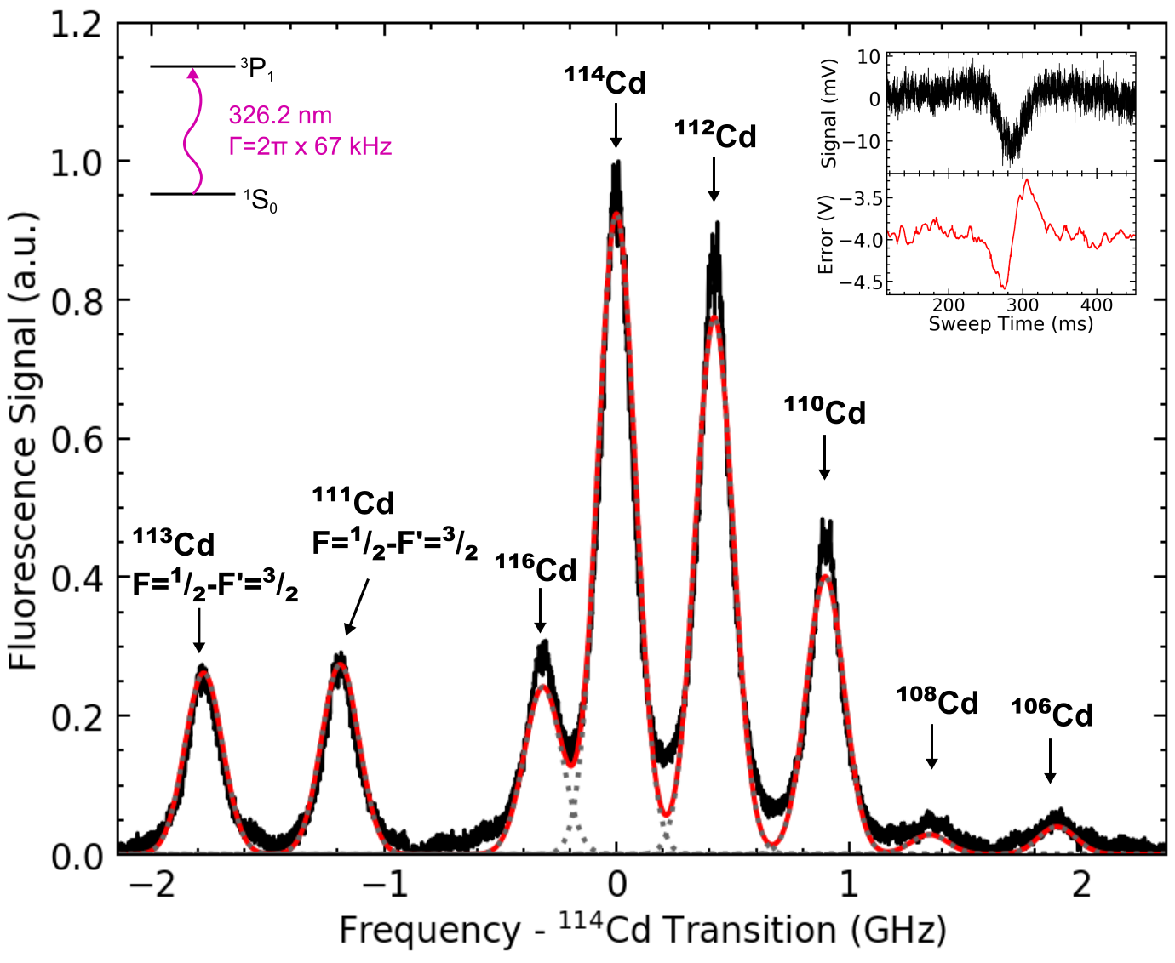
Cd Beam Spectroscopy at 326 nm
Spectroscopy and error signal from the atomic beam
Possibility for high-precision isotope shift measurements ->> King’s Plots
S. Manzoor, et al. "High-power, frequency-quadrupled UV laser source resonant with the ¹S₀-³P₁ narrow intercombination transition of cadmium at 326.2 nm", Optics Letters 47 (10), 2582-2585 (2022)
30
NICOLA.POLI@UNIFI.IT
30

Slide 31
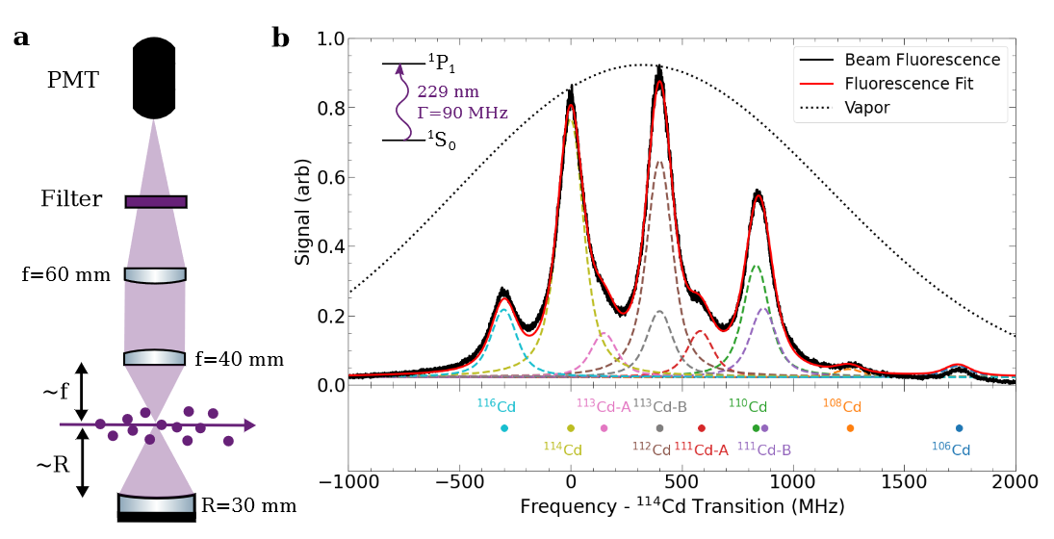
Cadmium Atomic Beam Spectroscopy
J. N. Tinsley, et al. "Watt-level blue light for precision spectroscopy, laser cooling and trapping of strontium and cadmium atoms", Optics Express 29, 25462-25476 (2021)
B. Ohayon New Journal of Physics 24 123040 (2022)
S. Hofsäss Phys. Rev. Research 5, 013043 (2023)
NICOLA.POLI@UNIFI.IT
31

Slide 32
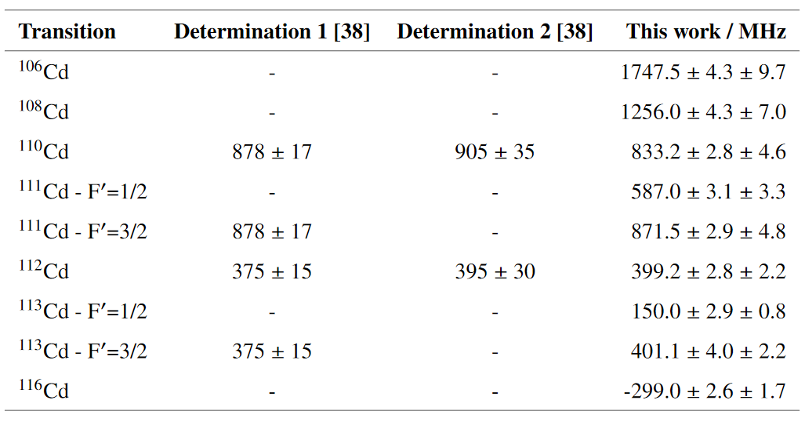

Cadmium Isotopic Shifts
J. N. Tinsley, et al. "Watt-level blue light for precision spectroscopy, laser cooling and trapping of strontium and cadmium atoms", Optics Express 29 (16), 25462 (2021)
NICOLA.POLI@UNIFI.IT
32

Slide 33
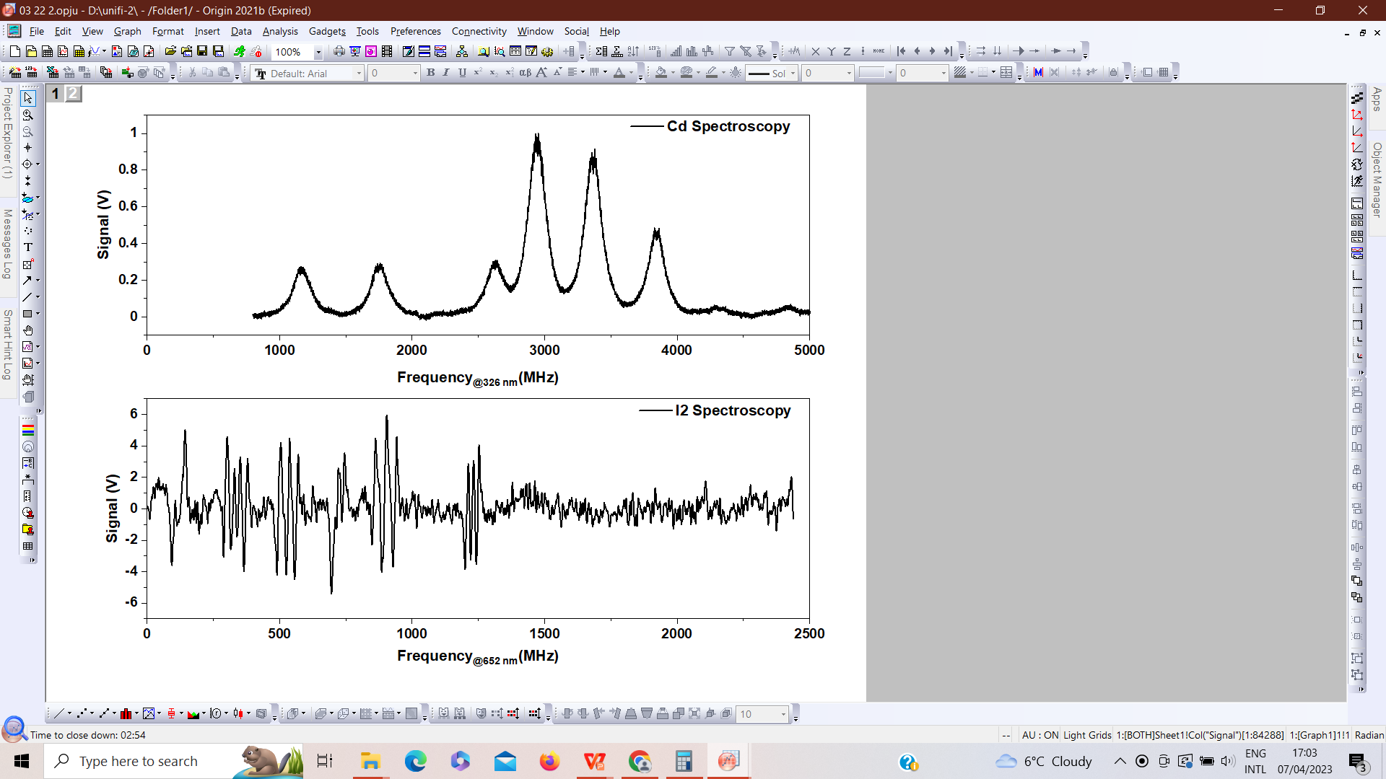
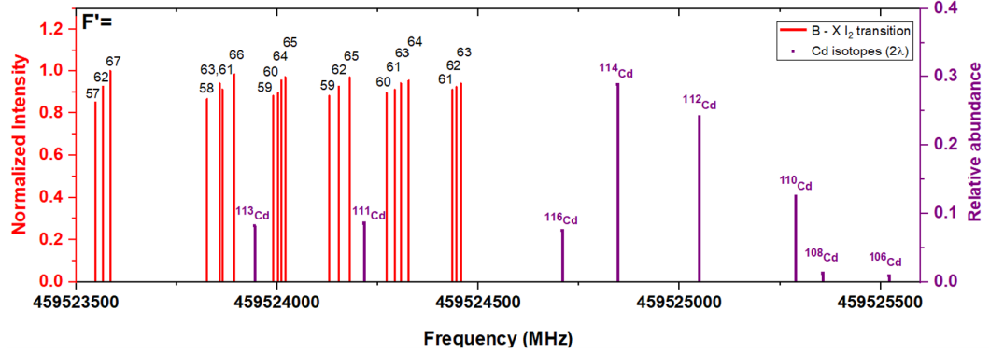

Precision spectroscopy of Iodine Molecule
Cd Spectrum @ 326 nm
I2 spectrum @ 652 nm
S. Manzoor et al., Opt. Express 32, 44683- 44693 (2024)
NICOLA.POLI@UNIFI.IT
33

Slide 34


Hyperfine parameters determination
S. Manzoor et al., Opt. Express 32, 44683- 44693 (2024)
NICOLA.POLI@UNIFI.IT
34

Slide 35


Cooling and trapping Cadmium
S. Bandarupally et al. J. Phys. B: At. Mol. Opt. Phys. 56 185301 (2023)
NICOLA.POLI@UNIFI.IT
35
Notes:
The science chamber has just come to us, we will start baking and assembling it and in the next few months if we are lucky we will be able to see something.
Our Cd MOT chamber design is based on some simulations carried out by my collegues, so go find them if you have any technical question, I’m sure they will be happy to give you answers.
I’ll give you the general idea.
Let’s start saying that cadmium MOTs have already been realized. With respect to the historical approach, with 326 and 229 being used in the same chamber, we designed a two-stage colling and trapping.
So 229 is good to slow atoms because of its large scattering force; a 229 mot is feasible, but it requires high magnetic field gradients to compensate for the scattering (we’re talking about tens of watts coils). Not to mention the damage that a 229 mot could cause on the vacuum parts.
That’s why we preferred to design a 3d MOT on the 326 transition. Cooling in this case is associated with a lower doppler temperature with respect to the 229.It’s true that the 326 transition has a small scattering force, but we can overcome this limitation with the watt-level power we have at disposal.
So, basically the 229 is used just at the beginning of the loading to slow the atoms; we confine them in a 2d 229 mot for very short times, limiting the period when ionization can occur; and then apply a little 229 push beam.
At this point, atoms start diverge, moving towards the 326 mot, which has a rather small capture velocity;

Slide 36


Cooling and trapping Cadmium
NICOLA.POLI@UNIFI.IT
36
Notes:
The science chamber has just come to us, we will start baking and assembling it and in the next few months if we are lucky we will be able to see something.
Our Cd MOT chamber design is based on some simulations carried out by my collegues, so go find them if you have any technical question, I’m sure they will be happy to give you answers.
I’ll give you the general idea.
Let’s start saying that cadmium MOTs have already been realized. With respect to the historical approach, with 326 and 229 being used in the same chamber, we designed a two-stage colling and trapping.
So 229 is good to slow atoms because of its large scattering force; a 229 mot is feasible, but it requires high magnetic field gradients to compensate for the scattering (we’re talking about tens of watts coils). Not to mention the damage that a 229 mot could cause on the vacuum parts.
That’s why we preferred to design a 3d MOT on the 326 transition. Cooling in this case is associated with a lower doppler temperature with respect to the 229.It’s true that the 326 transition has a small scattering force, but we can overcome this limitation with the watt-level power we have at disposal.
So, basically the 229 is used just at the beginning of the loading to slow the atoms; we confine them in a 2d 229 mot for very short times, limiting the period when ionization can occur; and then apply a little 229 push beam.
At this point, atoms start diverge, moving towards the 326 mot, which has a rather small capture velocity;

Slide 37


Cooling and trapping Cadmium
NICOLA.POLI@UNIFI.IT
37
Notes:
The science chamber has just come to us, we will start baking and assembling it and in the next few months if we are lucky we will be able to see something.
Our Cd MOT chamber design is based on some simulations carried out by my collegues, so go find them if you have any technical question, I’m sure they will be happy to give you answers.
I’ll give you the general idea.
Let’s start saying that cadmium MOTs have already been realized. With respect to the historical approach, with 326 and 229 being used in the same chamber, we designed a two-stage colling and trapping.
So 229 is good to slow atoms because of its large scattering force; a 229 mot is feasible, but it requires high magnetic field gradients to compensate for the scattering (we’re talking about tens of watts coils). Not to mention the damage that a 229 mot could cause on the vacuum parts.
That’s why we preferred to design a 3d MOT on the 326 transition. Cooling in this case is associated with a lower doppler temperature with respect to the 229.It’s true that the 326 transition has a small scattering force, but we can overcome this limitation with the watt-level power we have at disposal.
So, basically the 229 is used just at the beginning of the loading to slow the atoms; we confine them in a 2d 229 mot for very short times, limiting the period when ionization can occur; and then apply a little 229 push beam.
At this point, atoms start diverge, moving towards the 326 mot, which has a rather small capture velocity;

Slide 38


Imaging DUV - 2D MOT
NICOLA.POLI@UNIFI.IT
38
Notes:
The science chamber has just come to us, we will start baking and assembling it and in the next few months if we are lucky we will be able to see something.
Our Cd MOT chamber design is based on some simulations carried out by my collegues, so go find them if you have any technical question, I’m sure they will be happy to give you answers.
I’ll give you the general idea.
Let’s start saying that cadmium MOTs have already been realized. With respect to the historical approach, with 326 and 229 being used in the same chamber, we designed a two-stage colling and trapping.
So 229 is good to slow atoms because of its large scattering force; a 229 mot is feasible, but it requires high magnetic field gradients to compensate for the scattering (we’re talking about tens of watts coils). Not to mention the damage that a 229 mot could cause on the vacuum parts.
That’s why we preferred to design a 3d MOT on the 326 transition. Cooling in this case is associated with a lower doppler temperature with respect to the 229.It’s true that the 326 transition has a small scattering force, but we can overcome this limitation with the watt-level power we have at disposal.
So, basically the 229 is used just at the beginning of the loading to slow the atoms; we confine them in a 2d 229 mot for very short times, limiting the period when ionization can occur; and then apply a little 229 push beam.
At this point, atoms start diverge, moving towards the 326 mot, which has a rather small capture velocity;

Slide 39

DUV 2D MOT - Cadmium
MOT signals
Doppler background
NICOLA.POLI@UNIFI.IT
39
Notes:
The science chamber has just come to us, we will start baking and assembling it and in the next few months if we are lucky we will be able to see something.
Our Cd MOT chamber design is based on some simulations carried out by my collegues, so go find them if you have any technical question, I’m sure they will be happy to give you answers.
I’ll give you the general idea.
Let’s start saying that cadmium MOTs have already been realized. With respect to the historical approach, with 326 and 229 being used in the same chamber, we designed a two-stage colling and trapping.
So 229 is good to slow atoms because of its large scattering force; a 229 mot is feasible, but it requires high magnetic field gradients to compensate for the scattering (we’re talking about tens of watts coils). Not to mention the damage that a 229 mot could cause on the vacuum parts.
That’s why we preferred to design a 3d MOT on the 326 transition. Cooling in this case is associated with a lower doppler temperature with respect to the 229.It’s true that the 326 transition has a small scattering force, but we can overcome this limitation with the watt-level power we have at disposal.
So, basically the 229 is used just at the beginning of the loading to slow the atoms; we confine them in a 2d 229 mot for very short times, limiting the period when ionization can occur; and then apply a little 229 push beam.
At this point, atoms start diverge, moving towards the 326 mot, which has a rather small capture velocity;

Slide 40

DUV 2D MOT - Cadmium
MOT signals
Doppler background
NICOLA.POLI@UNIFI.IT
40
Notes:
The science chamber has just come to us, we will start baking and assembling it and in the next few months if we are lucky we will be able to see something.
Our Cd MOT chamber design is based on some simulations carried out by my collegues, so go find them if you have any technical question, I’m sure they will be happy to give you answers.
I’ll give you the general idea.
Let’s start saying that cadmium MOTs have already been realized. With respect to the historical approach, with 326 and 229 being used in the same chamber, we designed a two-stage colling and trapping.
So 229 is good to slow atoms because of its large scattering force; a 229 mot is feasible, but it requires high magnetic field gradients to compensate for the scattering (we’re talking about tens of watts coils). Not to mention the damage that a 229 mot could cause on the vacuum parts.
That’s why we preferred to design a 3d MOT on the 326 transition. Cooling in this case is associated with a lower doppler temperature with respect to the 229.It’s true that the 326 transition has a small scattering force, but we can overcome this limitation with the watt-level power we have at disposal.
So, basically the 229 is used just at the beginning of the loading to slow the atoms; we confine them in a 2d 229 mot for very short times, limiting the period when ionization can occur; and then apply a little 229 push beam.
At this point, atoms start diverge, moving towards the 326 mot, which has a rather small capture velocity;

Slide 41



Cd 332 nm & Sr 698 nm Clock Atom Interferometry Lasers
Requirement of high power (> 1 W) and narrow linewidth (Hz level)
M. Chiarotti et al. Phys. Rev. X Quantum 3, 030348 (2022)
41
NICOLA.POLI@UNIFI.IT
41

Slide 42

LMT Fidelity – Developed Laser
Can apply this to the measured laser noise
Using the Rabi frequency expected from the measured power (w = 5 mm)
Unpublished
High finesse cavity @ 332 nm
for UV-DUV lasers frequency stabilization
M. Chiarotti et al. Phys. Rev. X Quantum 3, 030348 (2022)
Notes:
Relative sensitivity which is the product of LMT order and W parameter proportional to the fidelity this has been somehow observed in the clock interferometer

Slide 43
Conclusions
Clock Atom interferometers (Cd & Sr atoms)
Fundamental physics tests
Quantum interference of clocks

Slide 44






GROUP PHOTO
Mauro Chiarotti
Jonathan Tinsley
Shamaila Manzoor
Paul Robert
Michele Sacco
Satvika Bandarupally
Nicola
Poli
POST-DOC & STUDENT POSITIONS AVAILABLE!
NICOLA.POLI@UNIFI.IT

