Slide 1

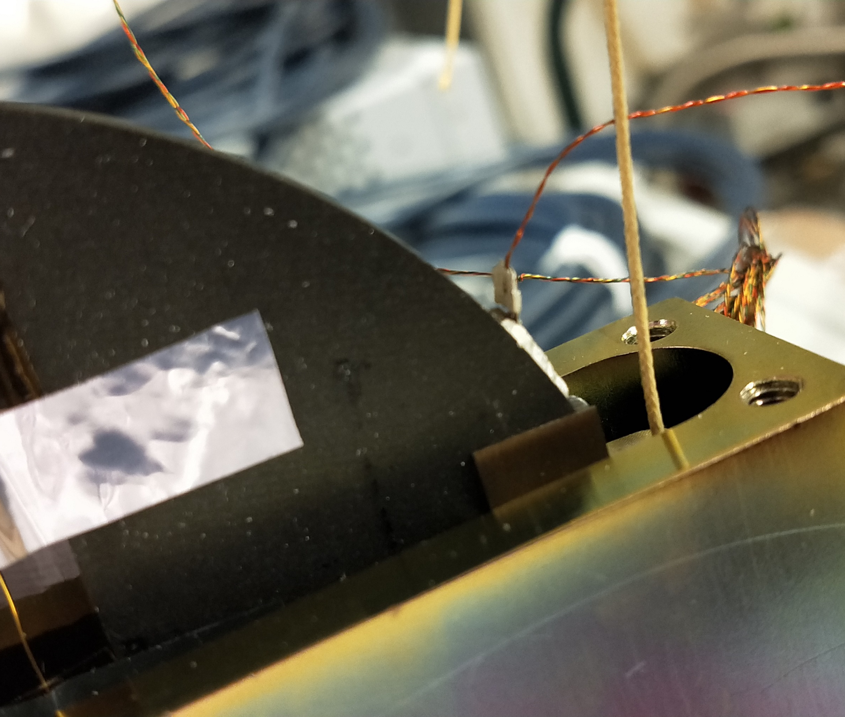


The Archimedes Experiment: a way for exploring the Vacuum-Gravity Interaction
Paola Puppo (INFN Roma)
on behalf of the Archimedes collaboration
The Low-Energy Frontiers of Particle Physics
10–12 Feb 2025 INFN-LNF Frascati (RM)

Slide 2
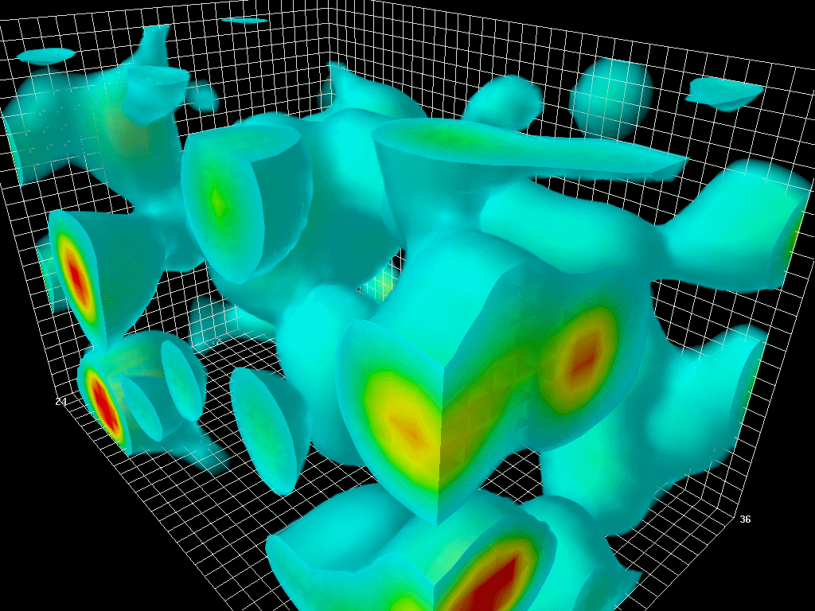
Scientific motivations and goal of the experiment
Does vacuum fluctuations interact with gravity?
Does the vacuum stress gravitates?
Does vacuum weighs?
The theoretical understanding and experimental evidences are still not completely satisfactory
We can already put interesting upper limit, for instance:
Dark photon (see E. Calloni talk)
P. Puppo - The Low-Energy Frontiers of Particle Physics 10–12 Feb 2025 INFN-LNF Frascati (RM)

Slide 3
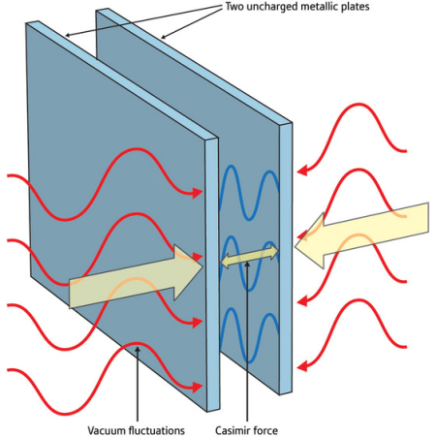
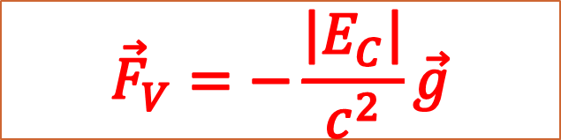


General Information on Archimedes
The vacuum weight
The Casimir effect is one of the macroscopic manifestations of vacuum fluctuations.
If the vacuum «weighs» then there is a force, directed upward, equal to the weight of the modes expelled from the cavity. In analogy with the Archimedes force[*].
$${\vec{F}}_{V}=−\frac{\left|E_{C}\right|}{c^{2}}\vec{g}$$
Gravitational field
$$\vec{g}$$
E_{c} :Casimir Energy
[*] G. Bimonte, E. Calloni, G. Esposito, L. Rosa – Physical Review D 76, 025008 (2007) – DOI: 10.1103/PhysRevD.76.025008
$${\vec{F}}_{V}$$
3
P. Puppo - The Low-Energy Frontiers of Particle Physics 10–12 Feb 2025 INFN-LNF Frascati (RM)

Slide 4


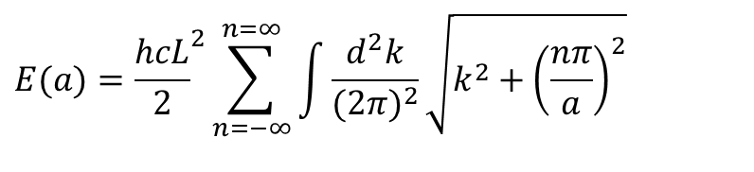
The Casimir effect is derived considering the zero point e.m. energy contained in a casimir cavity, i.e. in the volume defined by two perfectly reflecting parallel plates
L
a
If the plates are perfectly reflecting, the modes that can oscillate must have discrete wavenumbers on horizontal axes k_{y} = nπ/a while all values are allowed for k_{x} e k_{z}
z
y
x
$$E(a)={\frac{hcL}{2}}^{2}\sum_{n=−∞}^{n=∞}{\int{\frac{d^{2}k}{(2π)^{2}}}}\sqrt{k^{2}+{\left(\frac{nπ}{a}\right)}^{2}}$$
$$∞$$
4
P. Puppo - The Low-Energy Frontiers of Particle Physics 10–12 Feb 2025 INFN-LNF Frascati (RM)

Slide 5
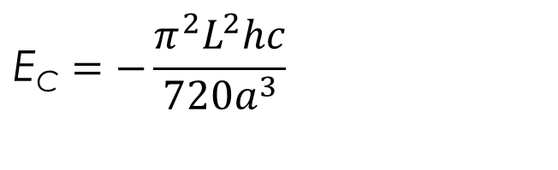
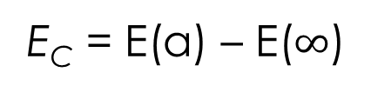
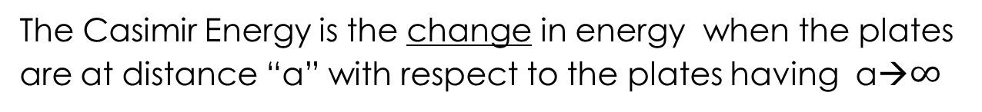
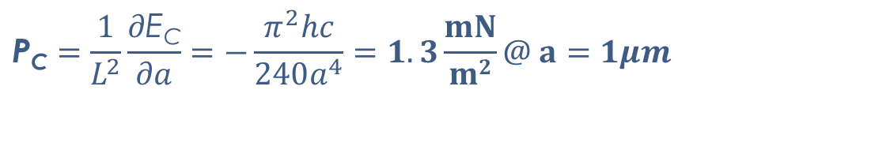
The Casimir Energy is the change in energy when the plates
are at distance “a” with respect to the plates having a→$∞$
E_{C} = E(a) – E($∞$)
$$\text{E}\text{C}=−\frac{π^{2}L^{2}hc}{720a^{3}}$$
Casimir Energy
$$\text{P}\text{C}=\frac{1}{L^{2}}\frac{∂\text{E}\text{C}}{∂a}=−\frac{π^{2}hc}{240a^{4}}=1.3\frac{mN}{m2}@ a=1μm$$
CASIMIR PRESSURE
First prediction: Casimir 1948
First measure (force): Sparnay 1956
Presently tested (force) with an accuracy of 0.5% (Mohideen: 2005)
P. Puppo - Vacuum Fluctuations at Nanoscale and Gravitation: theory and experiments – Orosei – May 2019
5

Slide 6
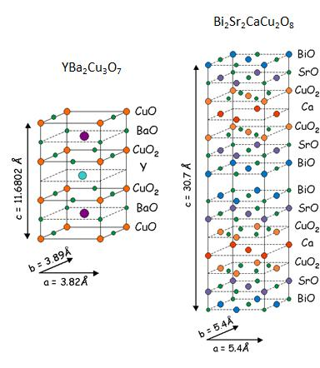
How to measure the vacuum weigth?
The idea is to modulate the vacuum energy of a rigid Casimir cavity by changing the reflectivity of the plates with time
Use high Tc layered superconductors as natural multi Casimir-cavities.
YBCO, BSCO, GdBCO… behave as natural multi-layer Casimir cavities.
A transition from normal to superconducting state and vice versa can be induced by the modulation of the temperature of a superconductor.
Profit of the fact that in normal state the plane that will become superconducting is a very poor conductor.
→ high variation of Casimir energy at the transition
Expected upward force 5 10⁻¹⁶ N
6
P. Puppo - The Low-Energy Frontiers of Particle Physics 10–12 Feb 2025 INFN-LNF Frascati (RM)

Slide 7
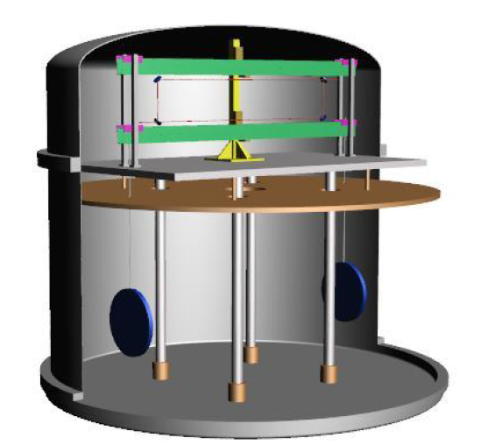
The measurement Strategy
T
High Sensitivity Balance: arm center of mass and suspension point must be well positioned (within 4μm)
Temperature modulation around Tc
Quiet environment: low human activity(Newtonian noise) and low seismic noise
Interferometric Readout
7
P. Puppo - The Low-Energy Frontiers of Particle Physics 10–12 Feb 2025 INFN-LNF Frascati (RM)

Slide 8
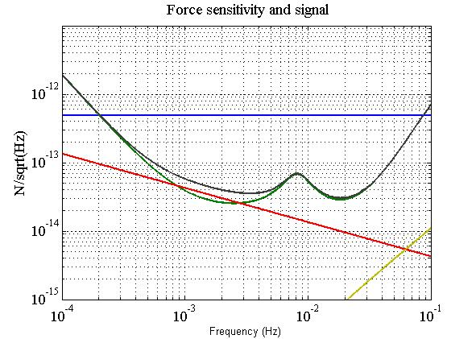
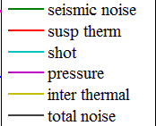
Expected signal and sensitivity
High Sensitivity Balance
Temperature modulation around Tc
Seismically quiet place for the experiment site
The modulation frequency value is chosen where the sensitivity is the best.
Limited by : thermal noise and seismic noise
P. Puppo - Vacuum Fluctuations at Nanoscale and Gravitation: theory and experiments – Orosei – May 2019
8

Slide 9
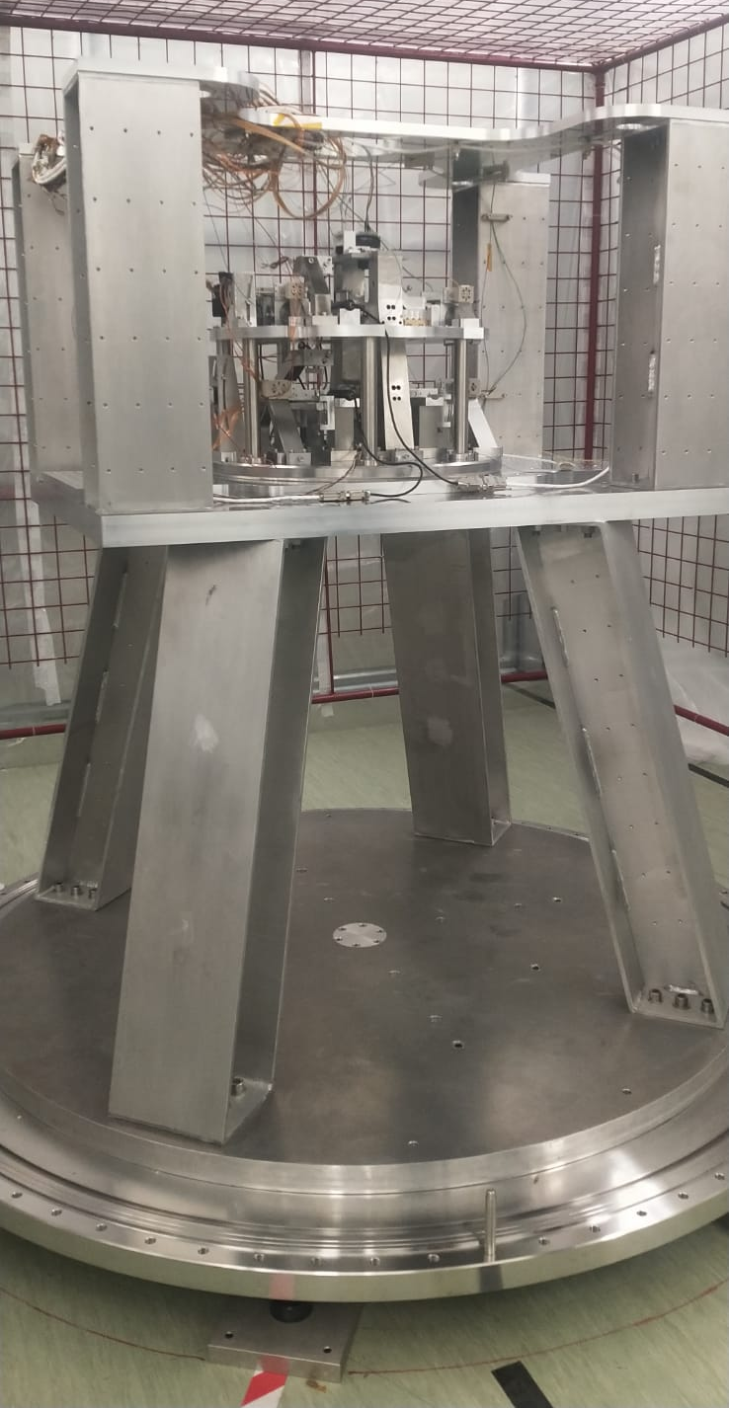
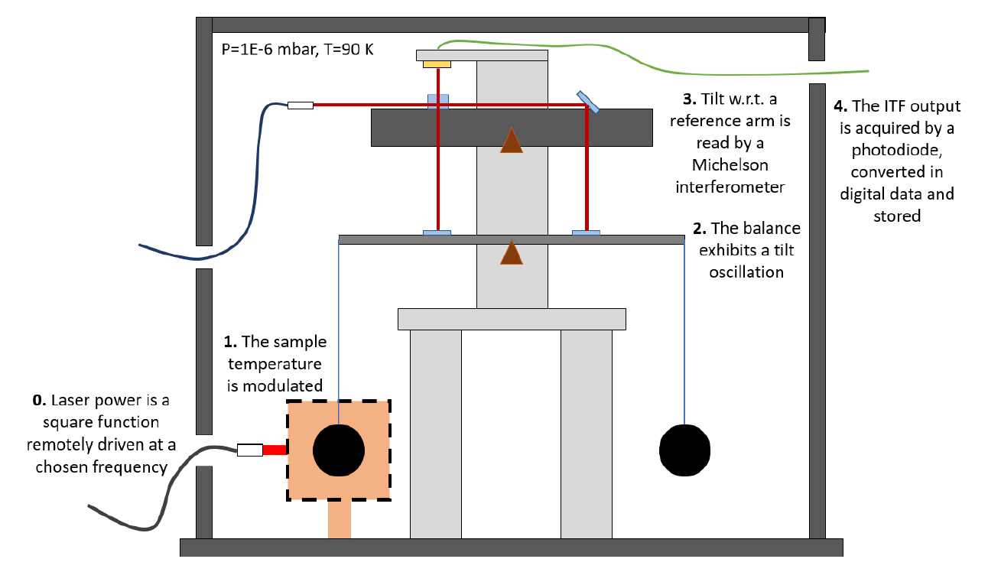
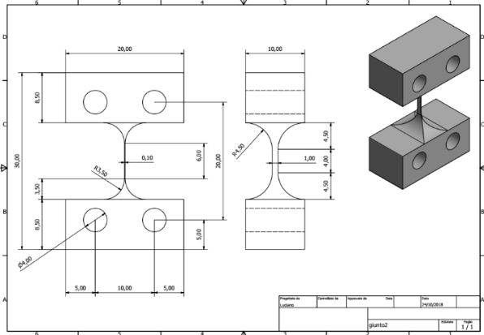
The BALANCE
The balance is suspended with very soft flexural joints
→ High frequency noise lowered and hence locking on the interferometer is possible
Arm tilt readout with a Michelson Interferometer
The ITF output on the photodiode and converted in digital signal
Temperature modulation system
Joints
9
P. Puppo - The Low-Energy Frontiers of Particle Physics 10–12 Feb 2025 INFN-LNF Frascati (RM)

Slide 10
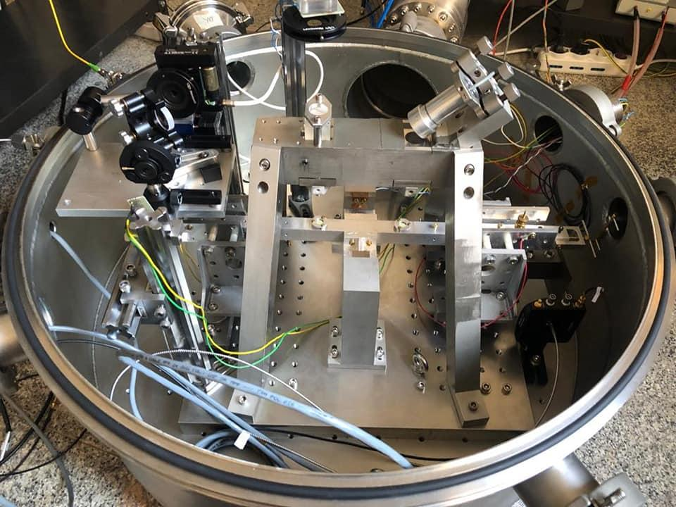
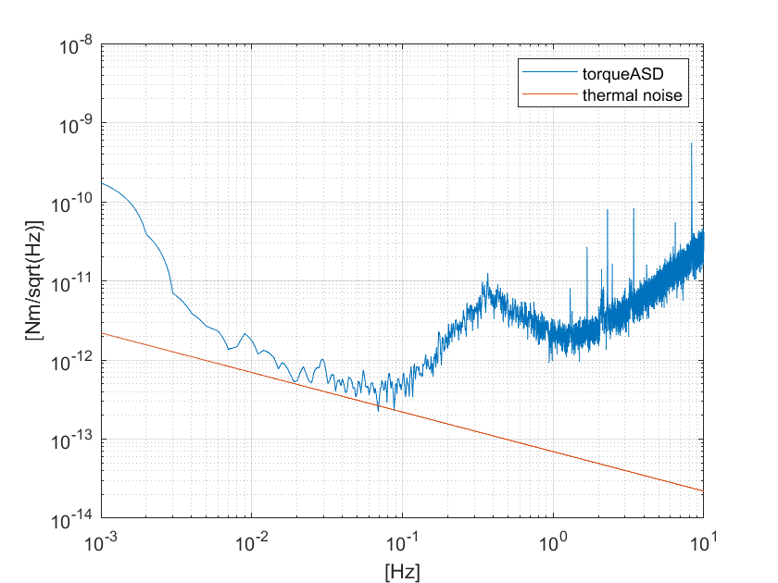
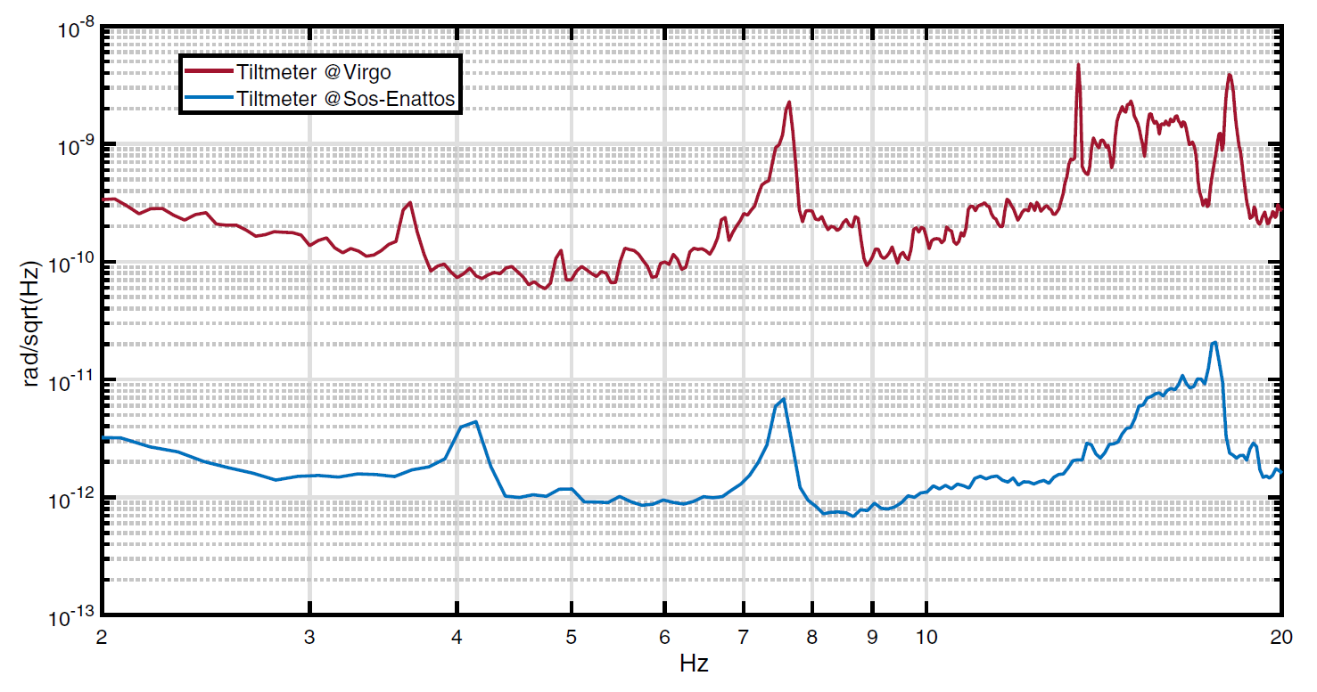
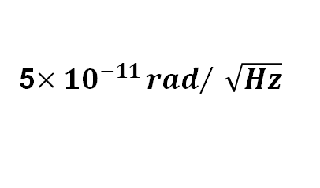
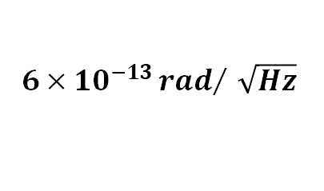
A prototype of balance was built to test every component and find the best optic-mechanical configuration for the final balance.
See E. Calloni presentation
for details
Tilt measurement comparison between Virgo gravitational wave interferometer (Cascina, Pisa) and Sos Enattos (Sardinia) sites.
Most sensitive tiltmeter in the world in the frequency band from 2 Hz to 20 Hz.
Preliminary
Prototype sensitivity in torque is limited by thermal noise.
5$×{10}^{−11}{rad}/{\sqrt{Hz}}$
$$6×{10}^{−13}{rad}/{\sqrt{Hz}}$$
https://doi.org/10.1140/epjp/s13360-021-01993-w

Slide 11
The data acquisition system and storage
Sampling at 25 kHz;
ITF Control loop with a feedback bandwidth of 200mHz performed with a system hardware of National Instruments;
Data storage in definition;

Slide 12
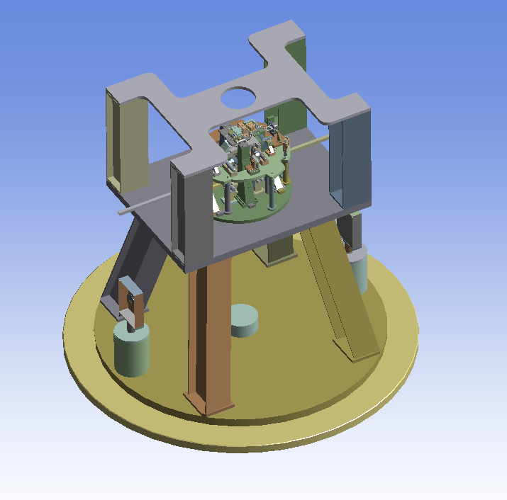
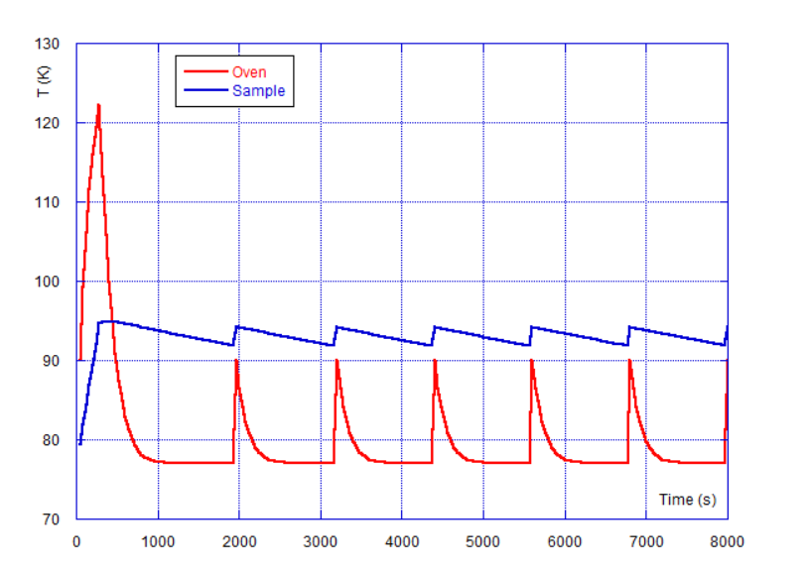
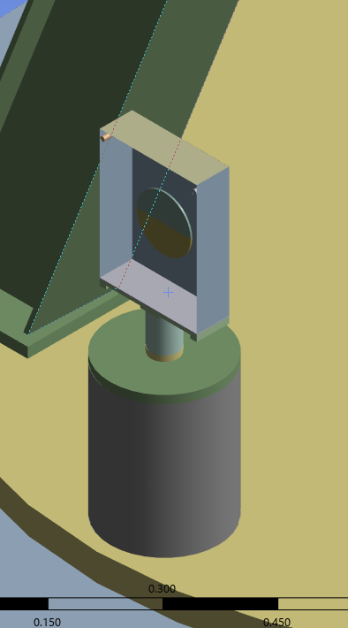
THERMAL MODULATION
The thermal modulation must be performed by radiative exchange between sample and an oven which surrounds it.
Requirements: Frequency modulation 10mHz
Temperature modulation 2K
YBCo, GdBCO, BSCO sample 20cm diam
Tc (90K-100K)
Modulation frequency and its amplitude around T_{c} depend on
the thermal properties of the materials.
A finite element study is important for the geometry definition
and the material choice.
Arm
Wires
Example
of FEM result
Sample
Oven
The experimental chamber is kept at the liquid nitrogen temperature and act as thermal bath.
P. Puppo - The Low-Energy Frontiers of Particle Physics 10–12 Feb 2025 INFN-LNF Frascati (RM)

Slide 13
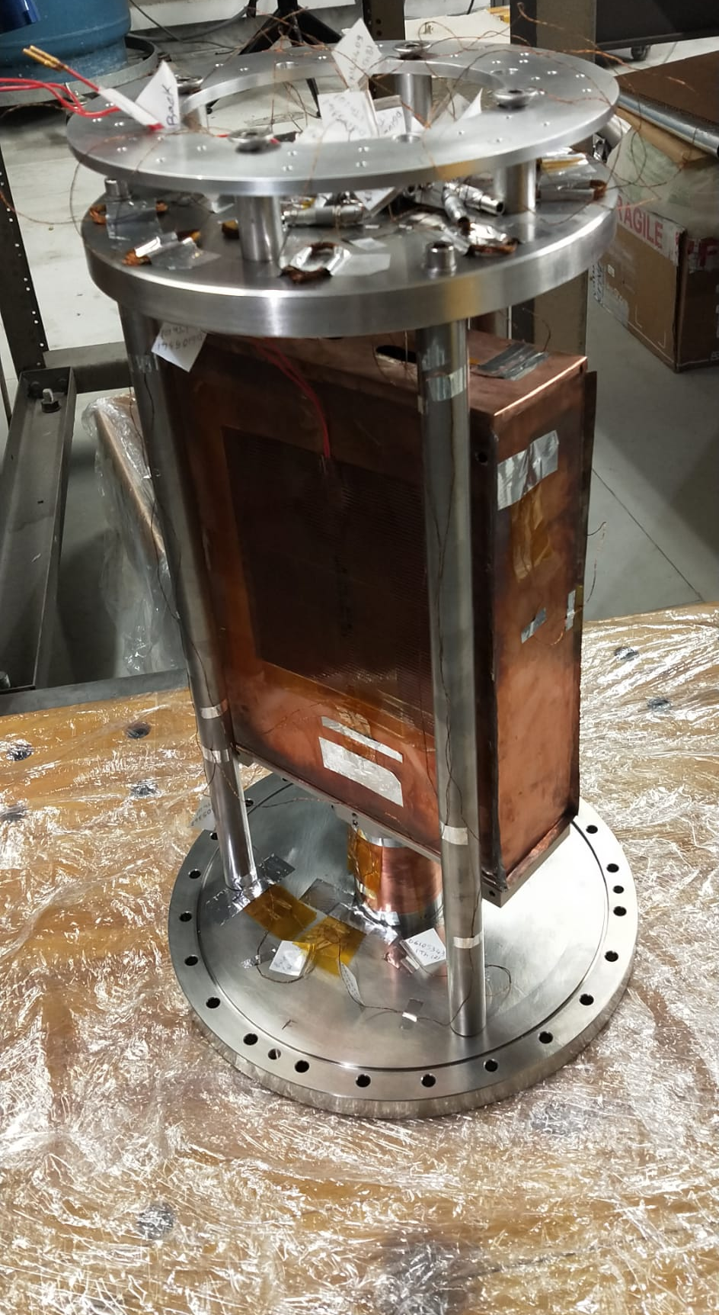
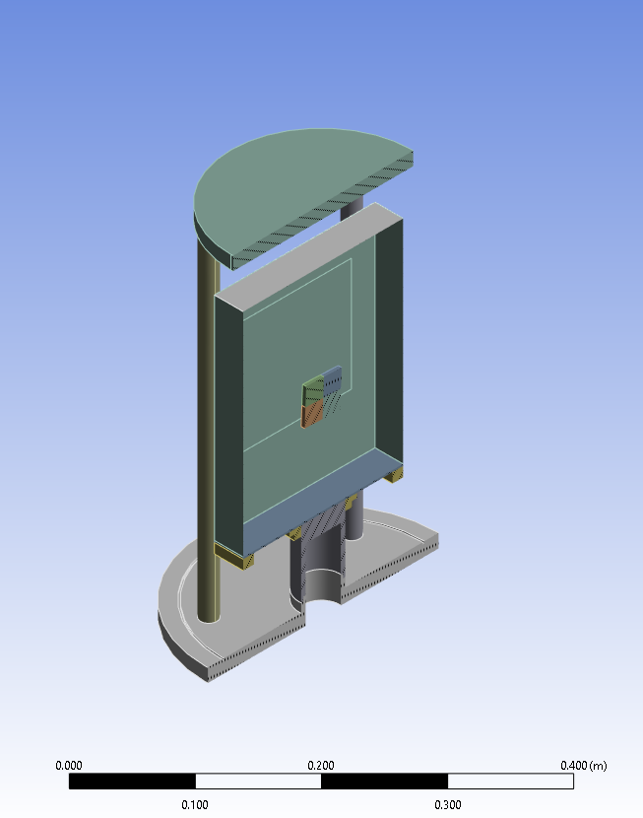
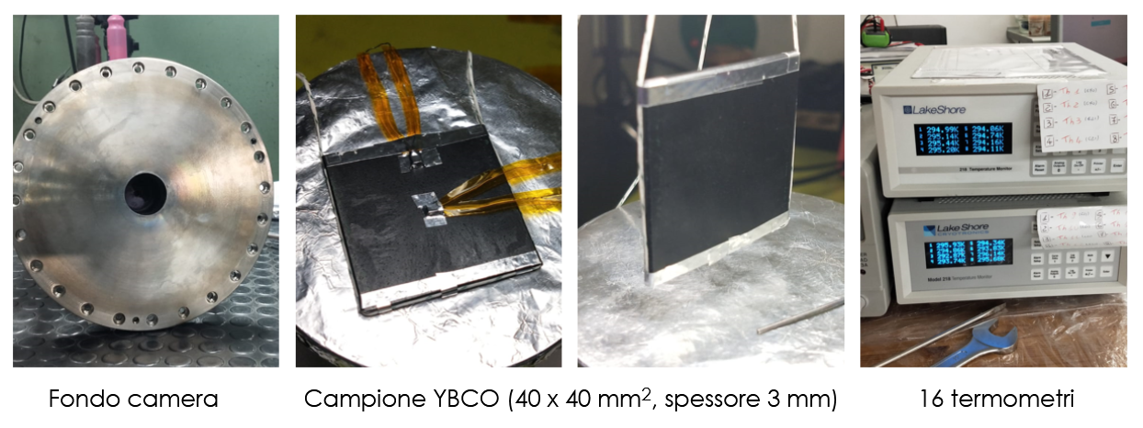
Small scale test
Oven and Heater
YBCo sample (4cmX4cmX2mm), 40g
Oven: OFHC copper – thin walls
P. Puppo - The Low-Energy Frontiers of Particle Physics 10–12 Feb 2025 INFN-LNF Frascati (RM)

Slide 14
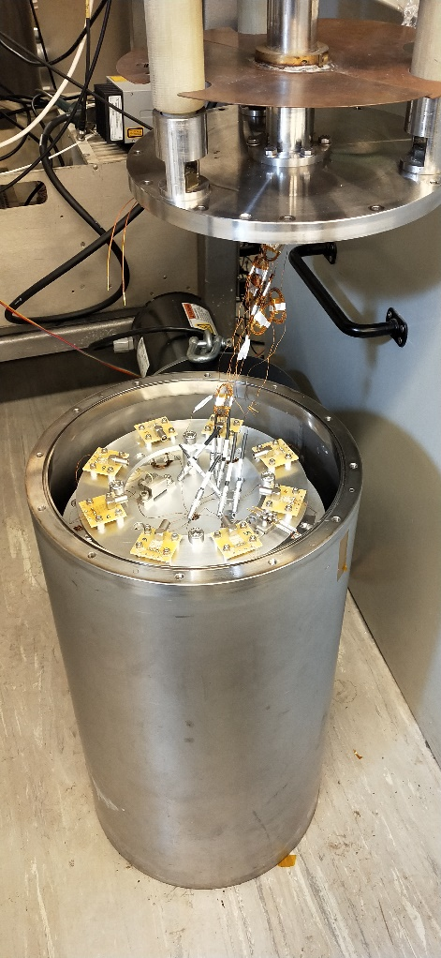
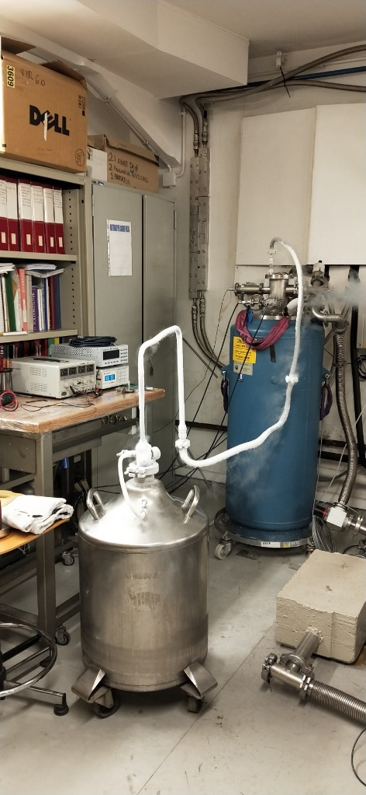
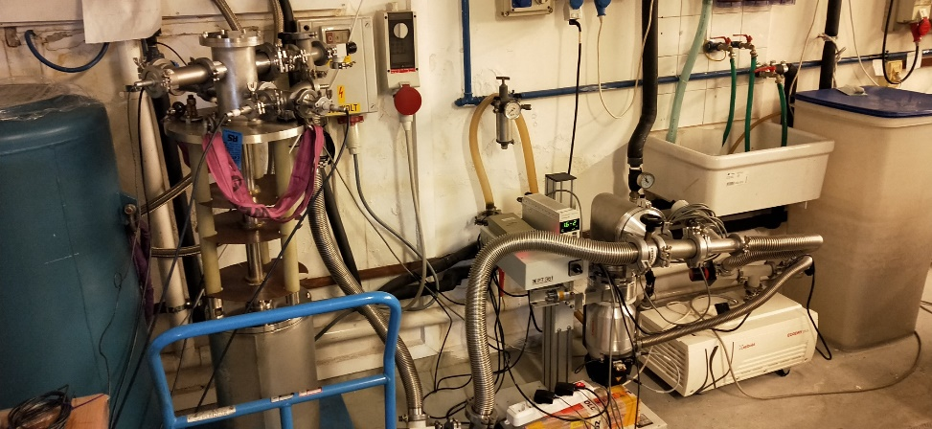
Cooling Setup
liquid nitrogen cryostat
experimental chamber
In the oven support there is the liquid
nitrogen→ direct contact with thermal bath
P. Puppo - The Low-Energy Frontiers of Particle Physics 10–12 Feb 2025 INFN-LNF Frascati (RM)
vacuum system

Slide 15
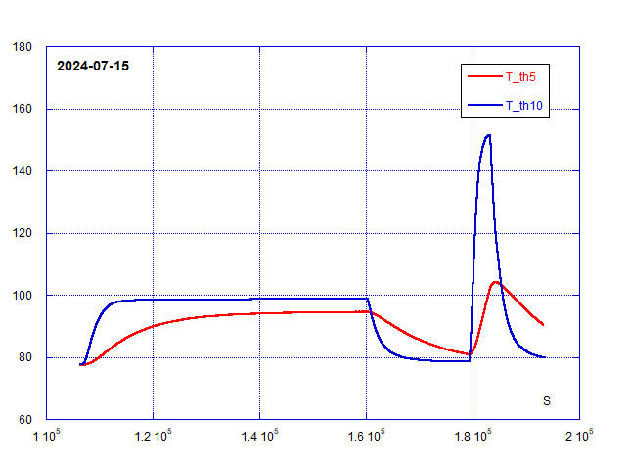
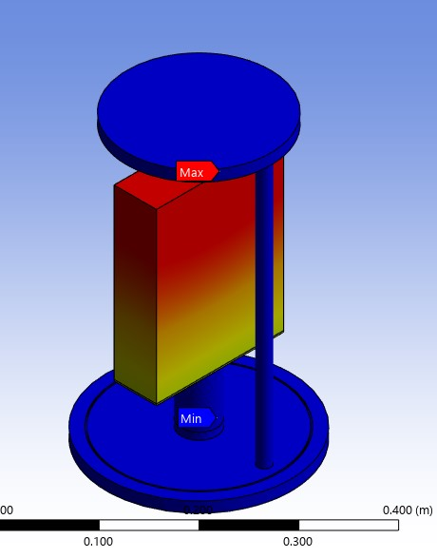
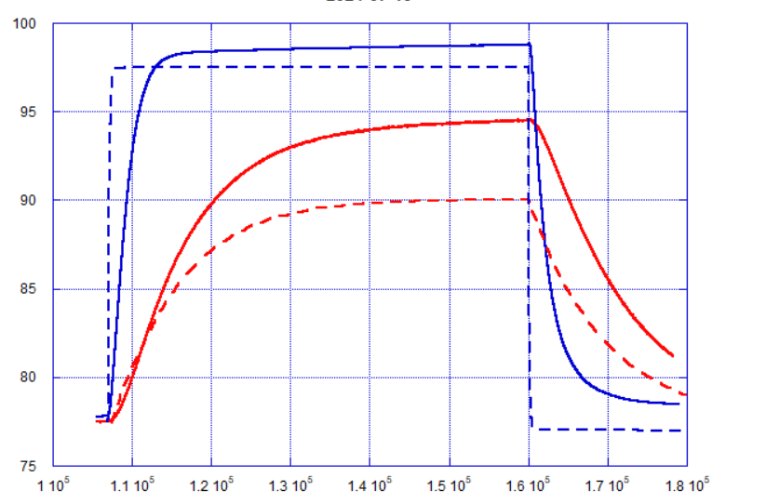
Cooling Tests Example
Oven
K
Sample
P=10 W
Heated Oven
P=1 W
K
Oven
Sample
Comparison with
FEM (--)
without optimization
Cooling cycles with different heating powers
on the Oven.
Example with 1W heating power performed
on middle 2024
s
P. Puppo - The Low-Energy Frontiers of Particle Physics 10–12 Feb 2025 INFN-LNF Frascati (RM)

Slide 16
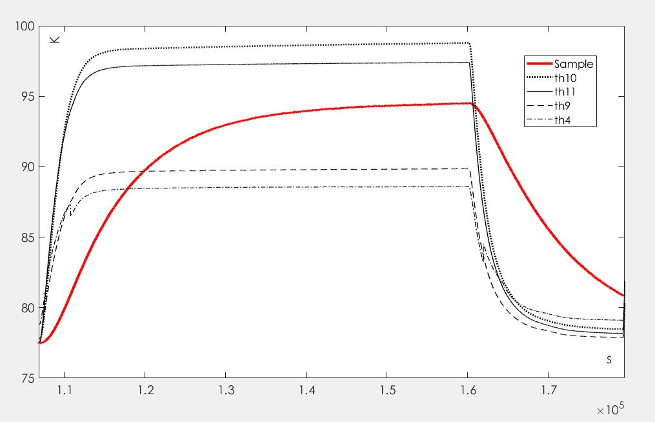
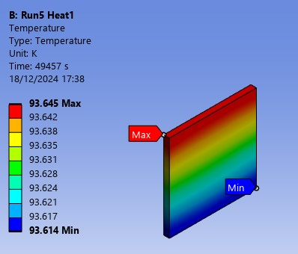
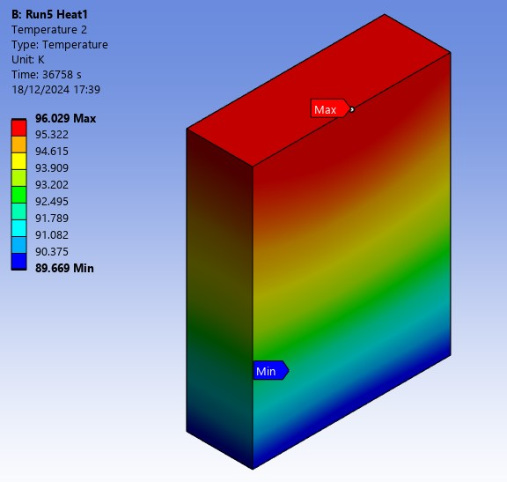
Data analysis
Two Temp sensors on the Sample (negligible gradient) - Red
Four Temp sensors on the Oven (Black curves – see the gradient)
P. Puppo - The Low-Energy Frontiers of Particle Physics 10–12 Feb 2025 INFN-LNF Frascati (RM)

Slide 17
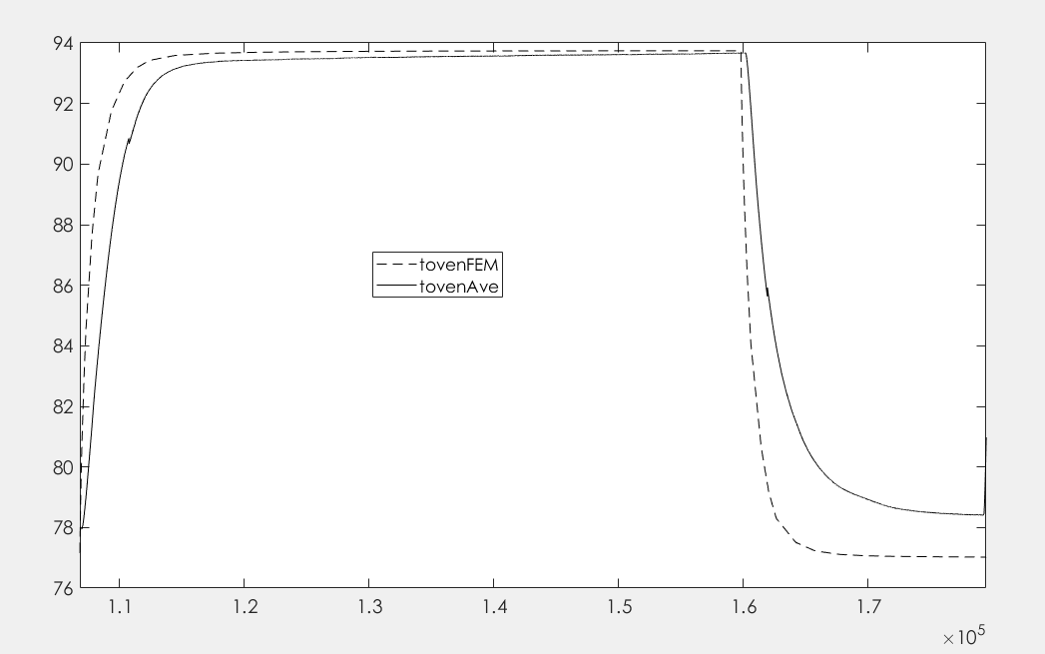

Residual Thermal Resistance
Heating Tau_{Oven}=2201 s (heating and cooling phases)
→ Residual Thermal Resistance (k_{c})
23 W\m²\K
$$τ=\frac{M_{oven}C_{copper}}{k_{c}}=\text{Tau}\text{Oven}$$
Conduction
Cooling
Kc included in the FEM
Good agreement obtained
Oven measured temperature
FEM estimation with thermal resistance
k_{c}
Heating
P. Puppo - The Low-Energy Frontiers of Particle Physics 10–12 Feb 2025 INFN-LNF Frascati (RM)

Slide 18
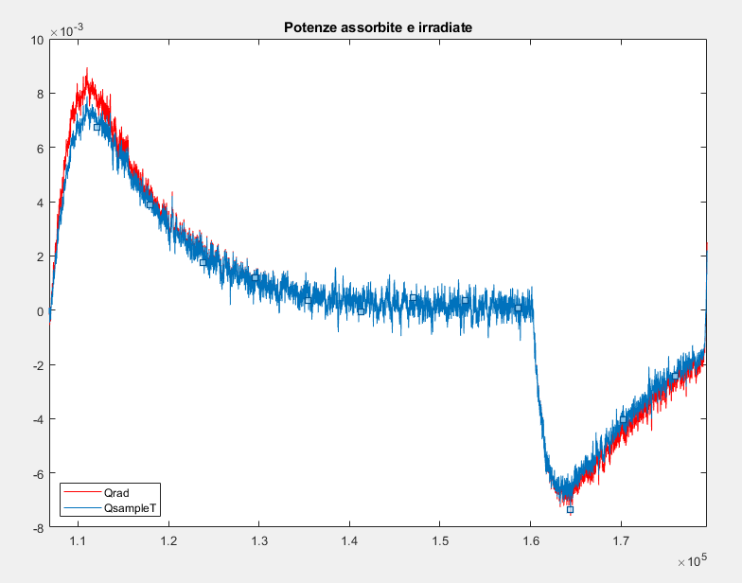

Emissivity estimation (ε=1)
$$P_{sample}=M_{YbCo}C_{YbCo }\left(T\right)\frac{dT_{sample}}{dt} \left[W\right]$$
$$P_{radiation}=2 ε σ S \left(T_{sample}^{4}−T_{oven}^{4}\right) \left[W\right]$$
P_{sample}
P_{rad}
The agreement between P_{sample} and P_{rad} indicates that the data interpretation is correct

Slide 19
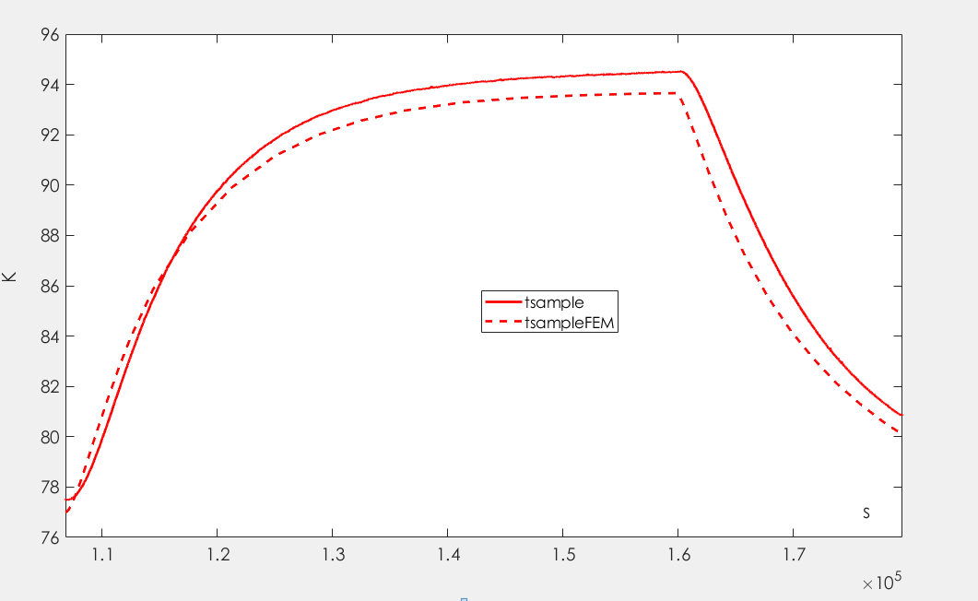
Sample
Sample thermal properties and radiative exchange
in agreement with the simulation

Slide 20
Comments
Agreement between data and FEM simulation (model validation)
The modulation frequency is <10 mHz, so some improvements are
implemented:
Use of a radiator
Change of sample geometry

Slide 21
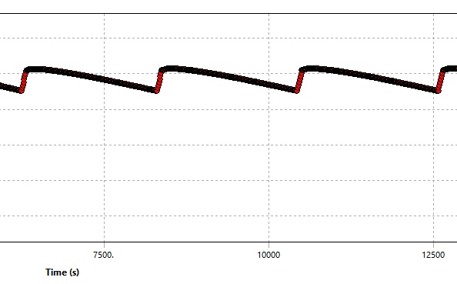
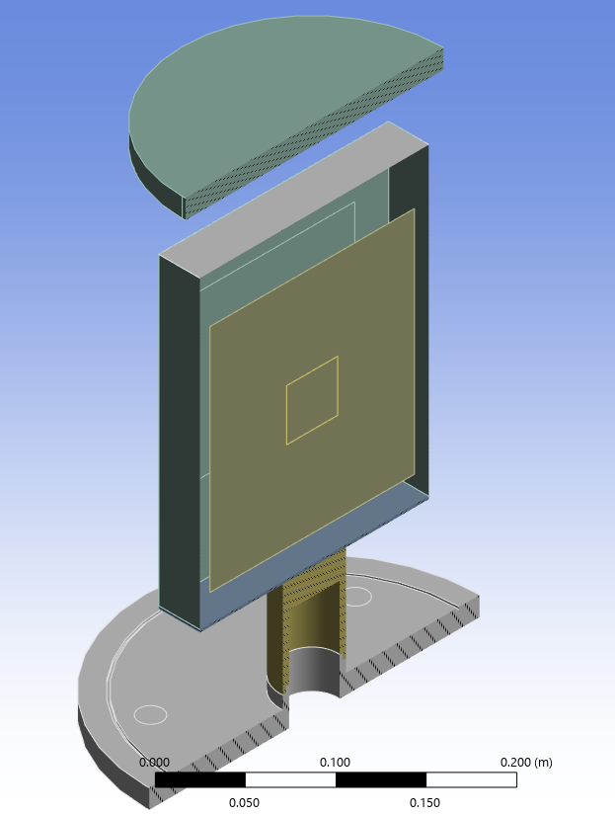
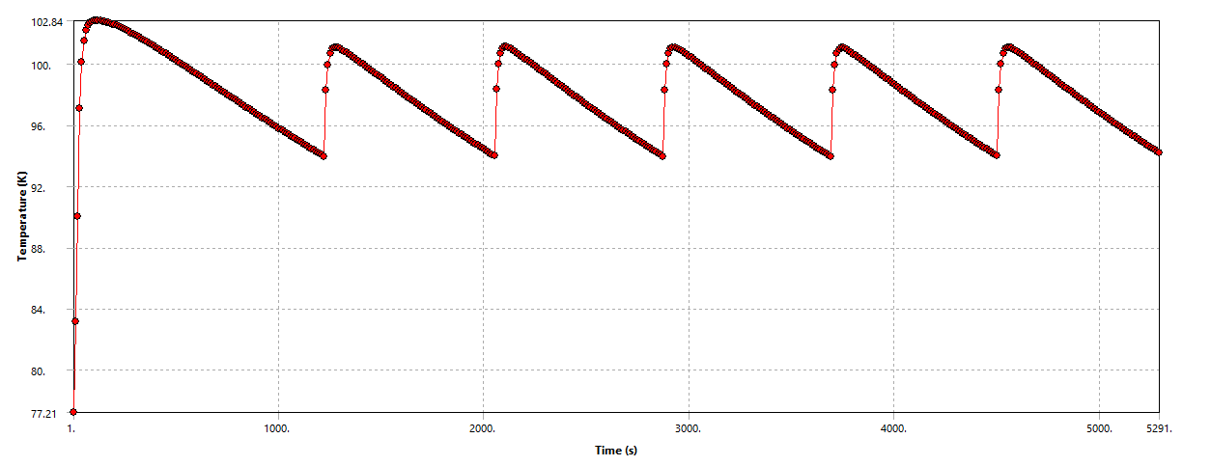
With a radiator (thin OFHC foil)
from 0.5 to 1.5 mHz
NO Radiator
Radiator
Sample tau=680s
With Radiator

Slide 22
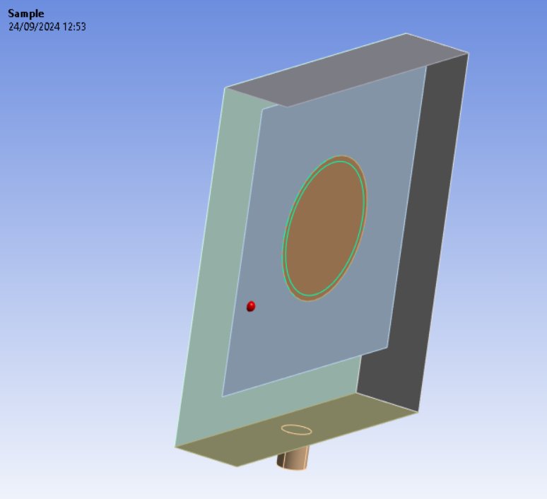
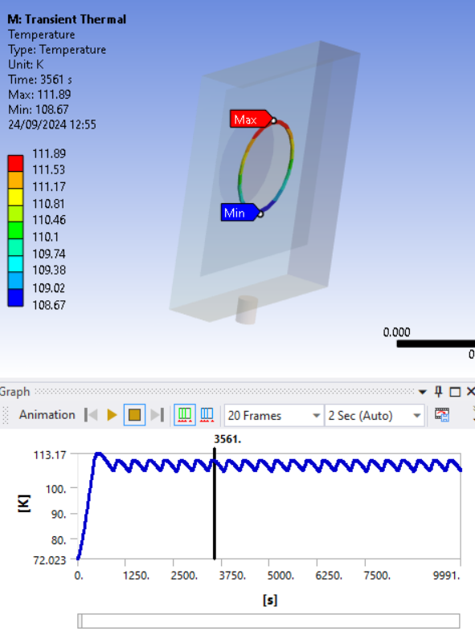
Oven
ring sample
radiator
cold finger
BSCCO ring sample Graphite radiator
R_{in} = 92 mm 400x400 mm 500x100 mm P = 10 W
R_{out} = 100 mm thickness = 0.1 mm thickness = 0.1 mm
V = 20·10³ mm³
Modulation of temperature between 107 K and 110 K of a few hundreds of s.

Slide 23
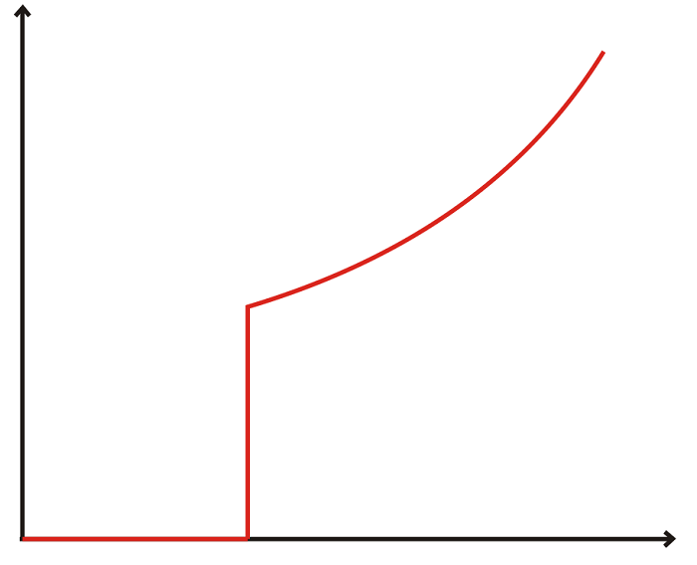
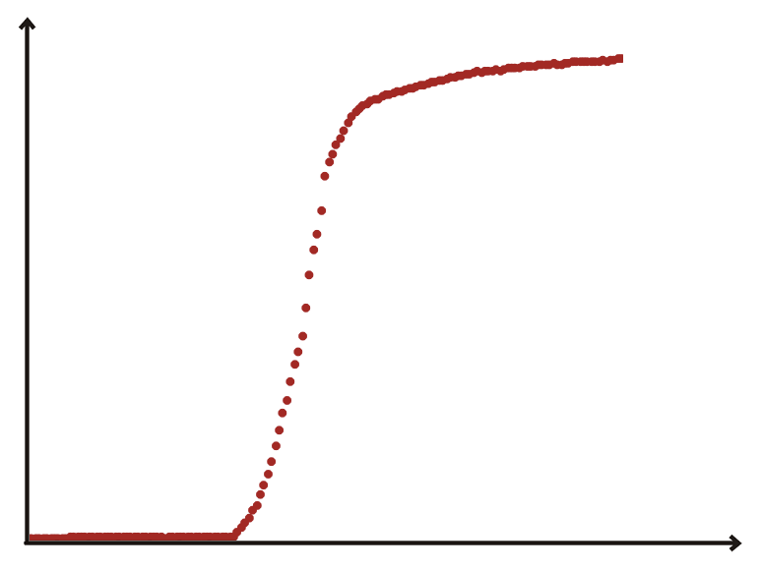
SAMPLES
R
T_{C} T
Ideal superconductor
real superconductor
Requirements:
T_{C} > 80 K and ΔT_{C} 2 K
Large mass > 200 g → samples with a 10 cm diameter
From the electrical resistance as a function of temperature plot it is possible to obtain information on the first requirement.
Also, these plots will let us understand the quality of a sample and if a certain degree of dis-uniformity exits in it.
R
ΔT_{C}
T_{C} T

Slide 24
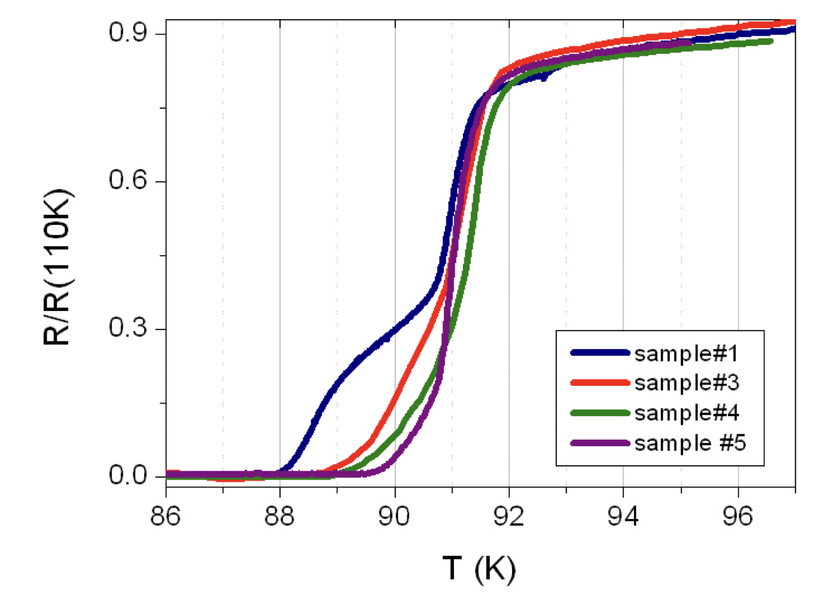
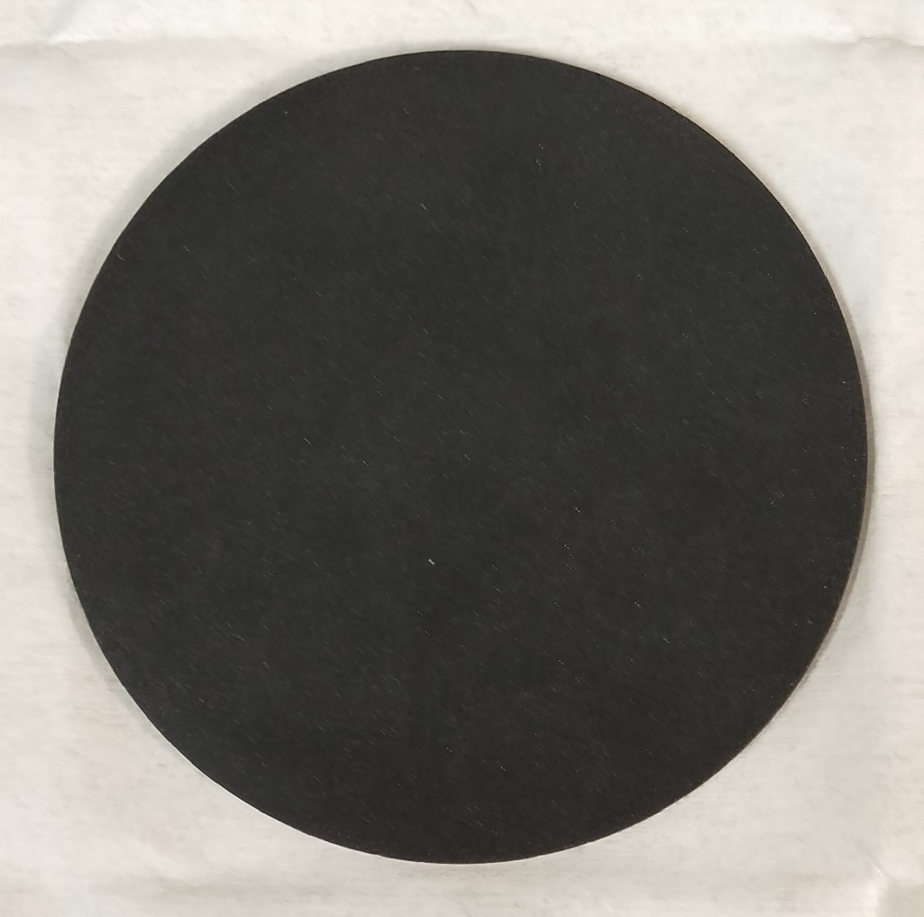
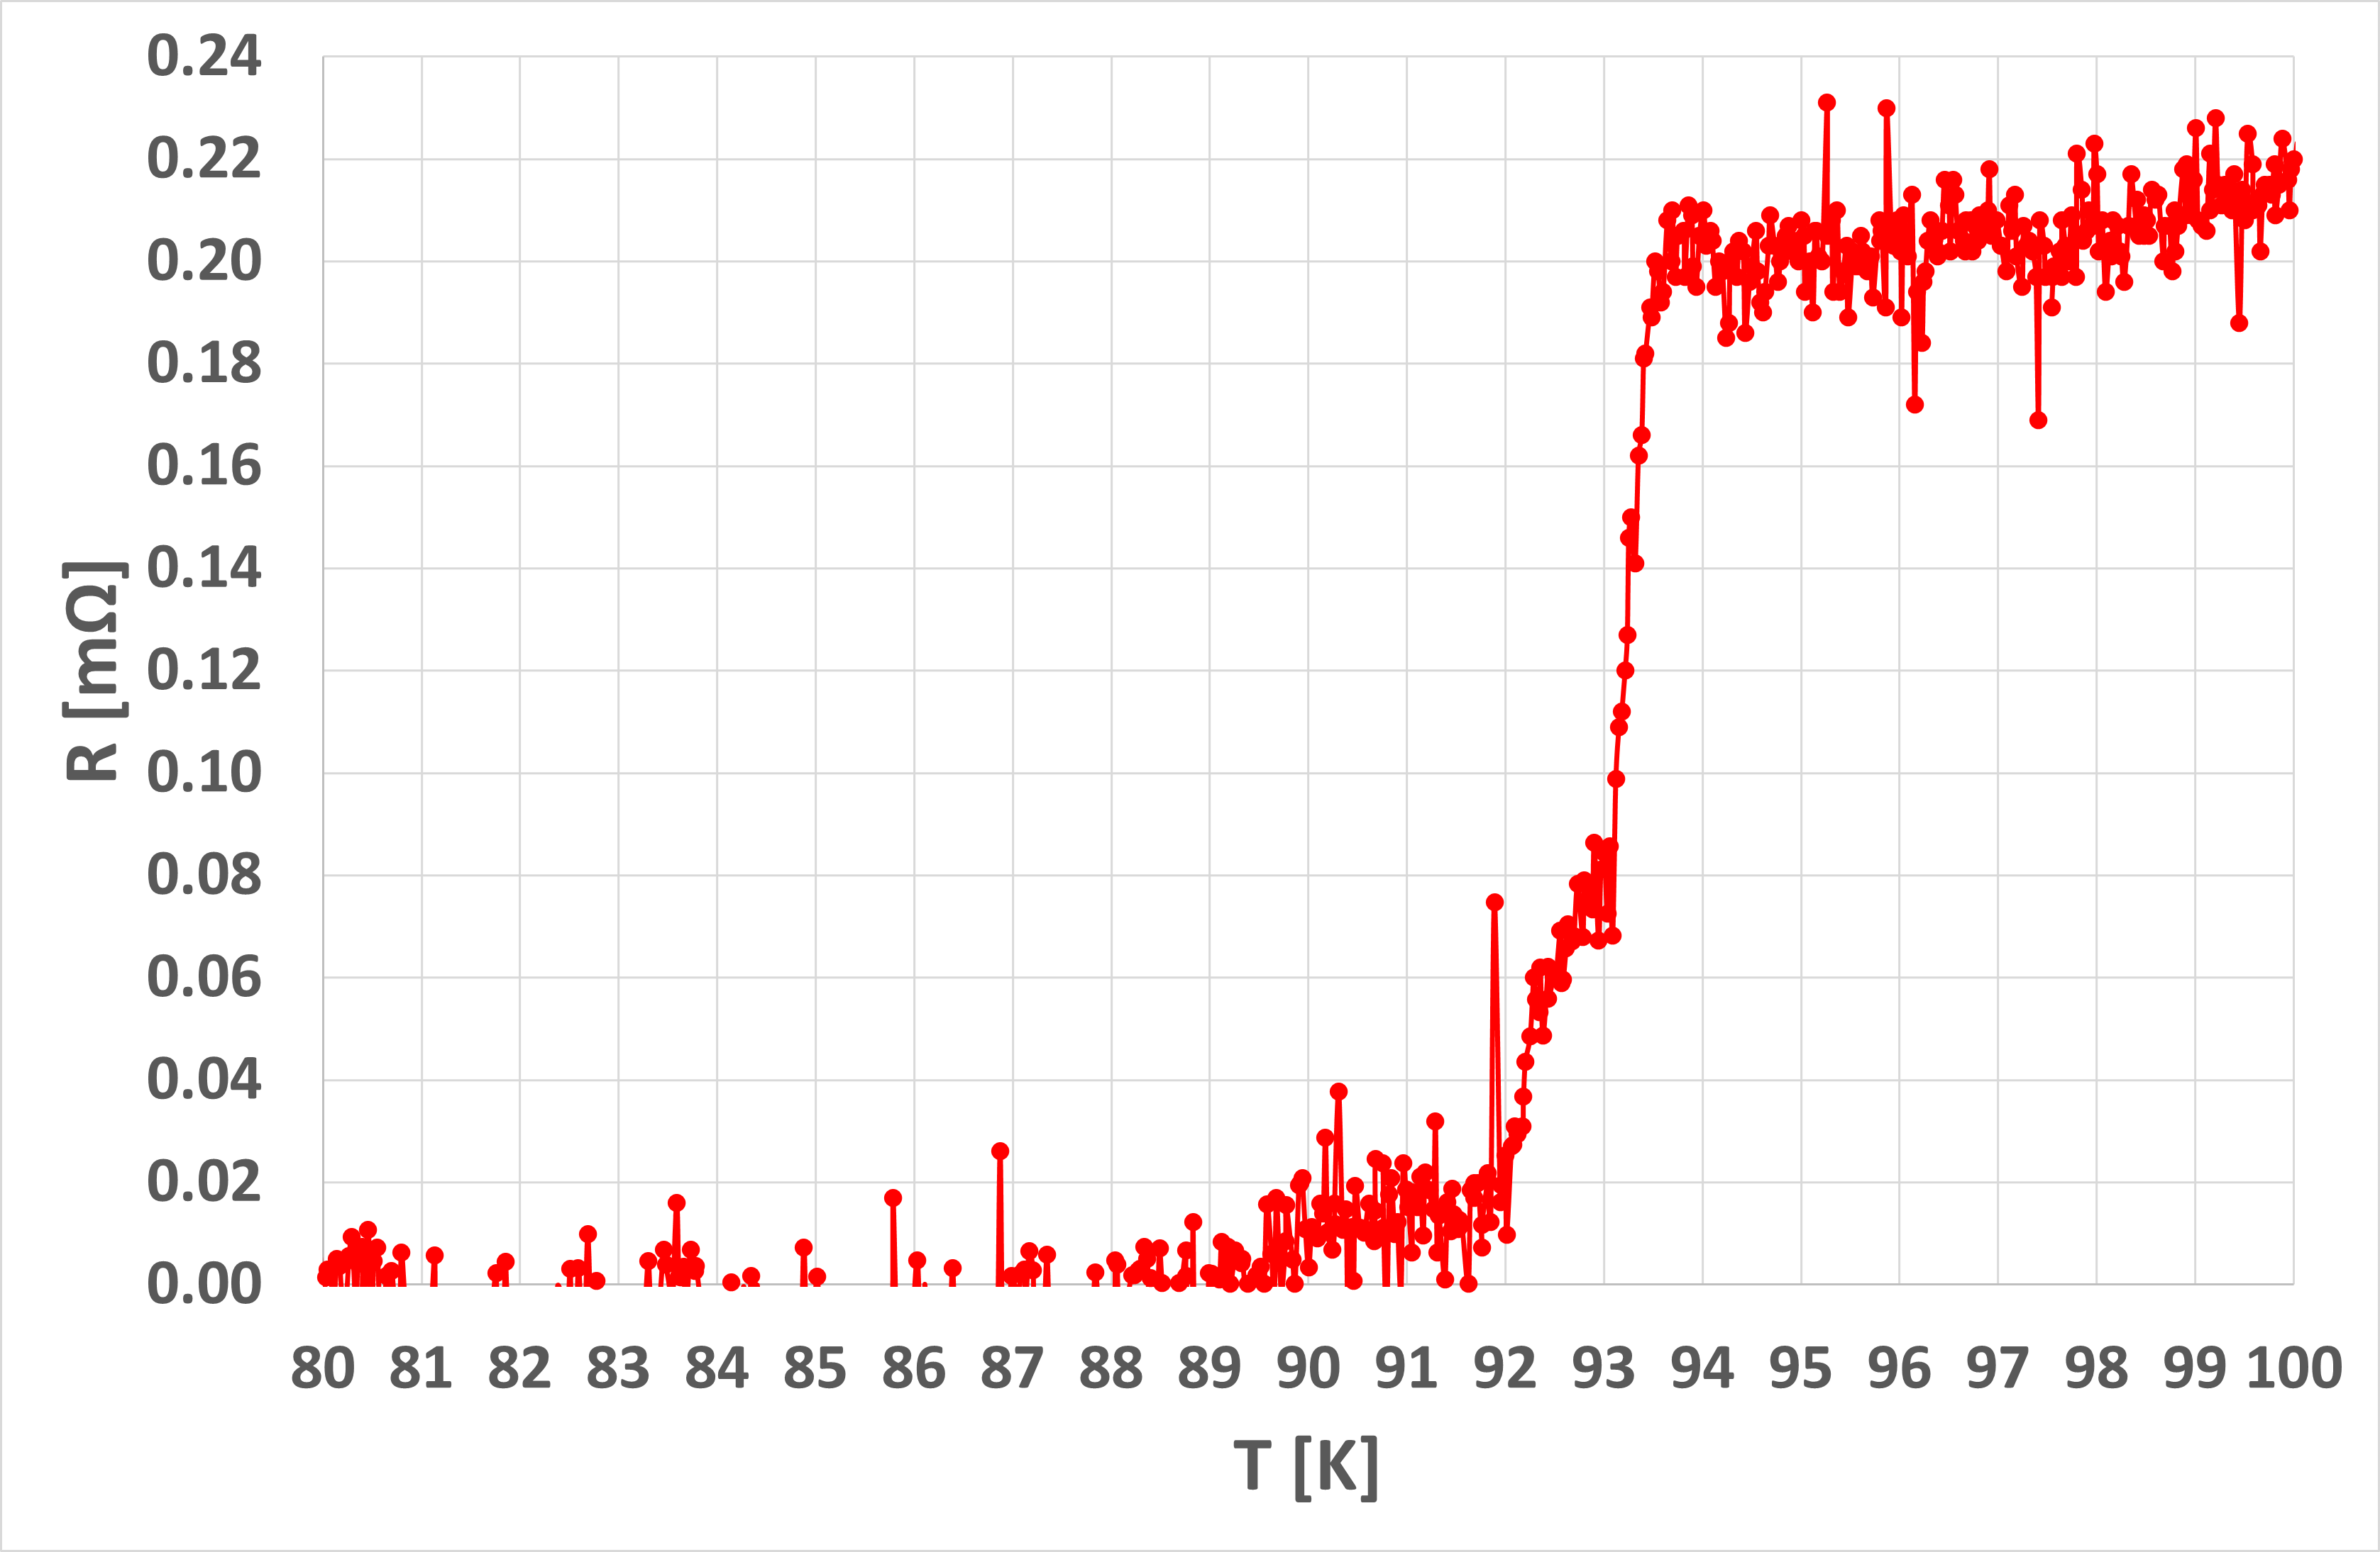








 | FRAGMENTS OF A DISC | ENTIRE DISC
Sintered YBCO Sintered YBCO discs were prepared in different sintering conditions (temperature, oxidation) in order to maximise T_{C} and reduce ΔT_{C} (CAN Superconductors).
crystalline GdBCO/Ag Single-domain melt-textured bulk pieces (CAN Superconductors).
T_{c} : 89.5 K
ΔT_{c}: 4.0 K
’’double’’ transition
diameter: 100mm
thickness: 3 mm
mass: ~ 124 g
(like sample#3)
diameter: 100mm
thickness: 4 mm
mass: ~ 213 g
courtesy of Dr Daniela Stornaiuolo
work in progress
courtesy of Dr Daniela Stornaiuolo

Slide 25

CRYOSTAT
Vacuum/Insulation Chamber
company: Fantini Sud S.p.A. (Italy)
material: steel
height , diameter: 3240 mm , 2730 mm
mass: 8100 kg
Nitrogen Chamber
company: Fantini Sud S.p.A. (Italy)
material: steel
height , diameter: 2003 mm , 2400 mm
mass: 6100 kg
Experimental Chamber
company: L.M.P. Amicuzi (Italy)
material: steel
height , diameter: 1780 mm , 2000 mm
mass: 3500 kg
The cryostat consists of three chambers.
The Experimental Chamber, that will hosts
the balance, will be completely submerged
in liquid Nitrogen inside the Nitrogen Chamber.
The volume of liquid Nitrogen in the tank is
approximately 4000 l.
An Aluminium screen around the Experimental Chamber ensures good thermal uniformity even with low liquid Nitrogen level.
Given a thermal input of about 2W/m², the evaporation time of liquid Nitrogen is estimated
to be about 5 months.
In the Insulation Chamber a vacuum (~10⁻⁶ mbar) will be created to isolate the system from the outside.

Slide 26




Superinsulation system of the Second Chamber
Cryotest of the first and second chamber
Third and second chamber

Slide 27










ARCHIMEDES
Archimedes is an INFN-funded fundamental physics experiment that searches for small weight variations induced by quantum vacuum fluctuations.
It is the first experiment to be installed in the Sar-Grav laboratory, in the area of the disused Sos Enattos mine near Lula (Nu, Sardinia). The SarGrav laboratory has both surface and underground facility, and is dedicated to the research on gravitational waves, gravitational physics and geophysics.
Archimedes will work in the frequency range from 5 mHz to 10 mHz and the signal will be limited by seismic and thermal noise.
Thanks to the unique geological properties of Sardinia and the low population density, Sos Enattos area is an excellent site to host experiments that require very low seismic noise levels. Working at cryogenic temperatures (cryostat) reduces the thermal noise.

Slide 28

CONCLUSIONS
Archimedes is an experiment conceived to shed light on the discussed interaction between the gravitational field and the vacuum fluctuations.
The measurement must be performed using an extremely sensitive balance and modulating the temperature of superconductors at very low frequencies (about tens of mHz) and with amplitude of a few K.
The experiment will work at cryogenic temperature and in a seismically quiet site
An upgraded thermal modulation system have been set up and first promising results were obtained
The results of the simulations support the mechanically isolated system, composed of a ring sample (GdBCO or BSCCO) in thermal contact with a radiator, that exchanges heat only with its thermal bath whose temperature is modulated by the screen that surrounded this system.

Slide 29








SOME REFERENCES
doi: 10.1103/PhysRevB.106.134502
doi: 10.1103/PhysRevD.90.022002
https://www.scientificamerican.com/article/how-much-does-nothing-weigh/
Physics 2020, 2, 1–13; doi:10.3390/physics2010001
https://www.facebook.com/archimedes.experiment/

Slide 30

The Low-Energy Frontiers of Particle Physics
10–12 Feb 2025 INFN-LNF Frascati (RM)

