Slide 1
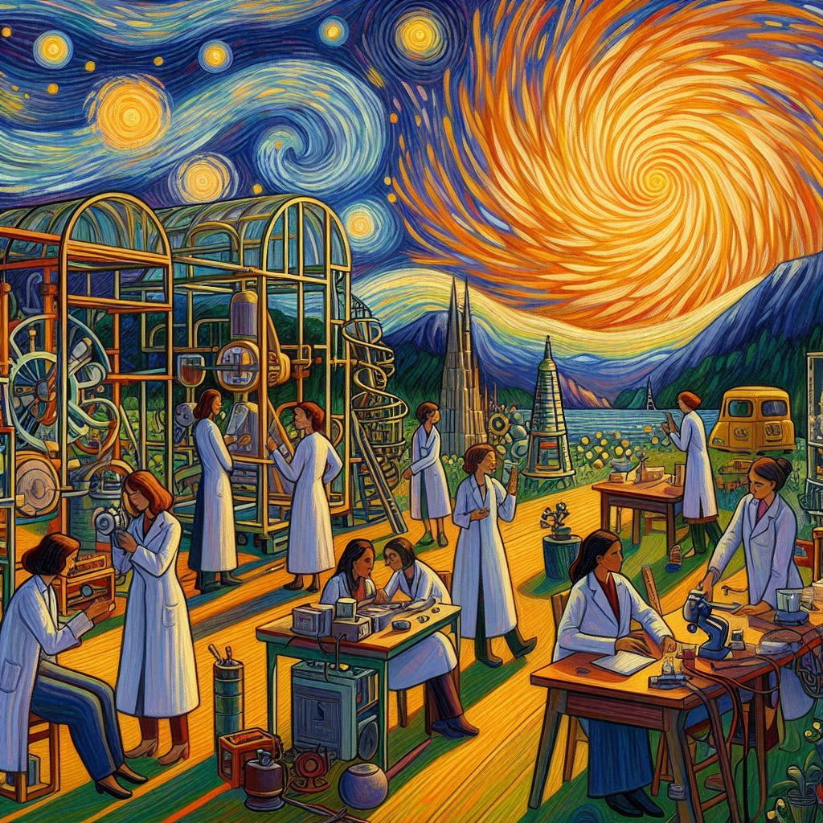
I've
Low-Energy Frontier of Particle Physics
"Low-Energy Frontier of Particle Physics in the style of Paul Gaugin"
Made with Microsoft Copilot
Dmitry Budker
Helmholtz Institute, Johannes Gutenberg University, Mainz & UC Berkeley
LNF Workshop, Frascati, February 10, 2025

Slide 2
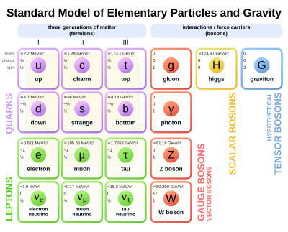
https://en.wikipedia.org/wiki/Physics_beyond_the_Standard_Model
Notes:
The standard model works well, but the “Elefant-in-the-room” questions force us to look beyond the SM

Slide 3
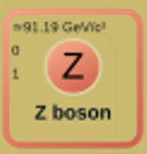
Beyond
BSM
BBSM
‘
‘
https://en.wikipedia.org/wiki/Physics_beyond_the_Standard_Model
Notes:
BSM: retain the rules; add new fields/particles
BBSM: beyond QFT (CPT, spin-statistics)
Frontiers: Energy, Intensity (precision);
Low energy: BSM may not need high energy!

Slide 4
Looking for BSM phenomena
Traditional particle physics
“Tabletop” AMO physics (parity violation, EDM)
Astrophysics
Gravitational waves
Direct detection of Dark Matter
New forces ( = indirect detection of Dark Matter)
?

Slide 5
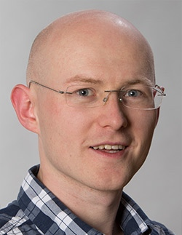
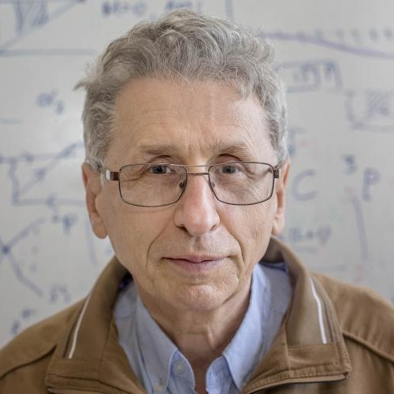
The latest catalogs of EXOTIC potentials
Previous catalogs:
J. E. Moody and F. Wilczek, Phys. Rev. D 30, 130 (1984)
B. A. Dobrescu and I. Mocioiu, J. High Energy Phys. 11 (2006)

Slide 6
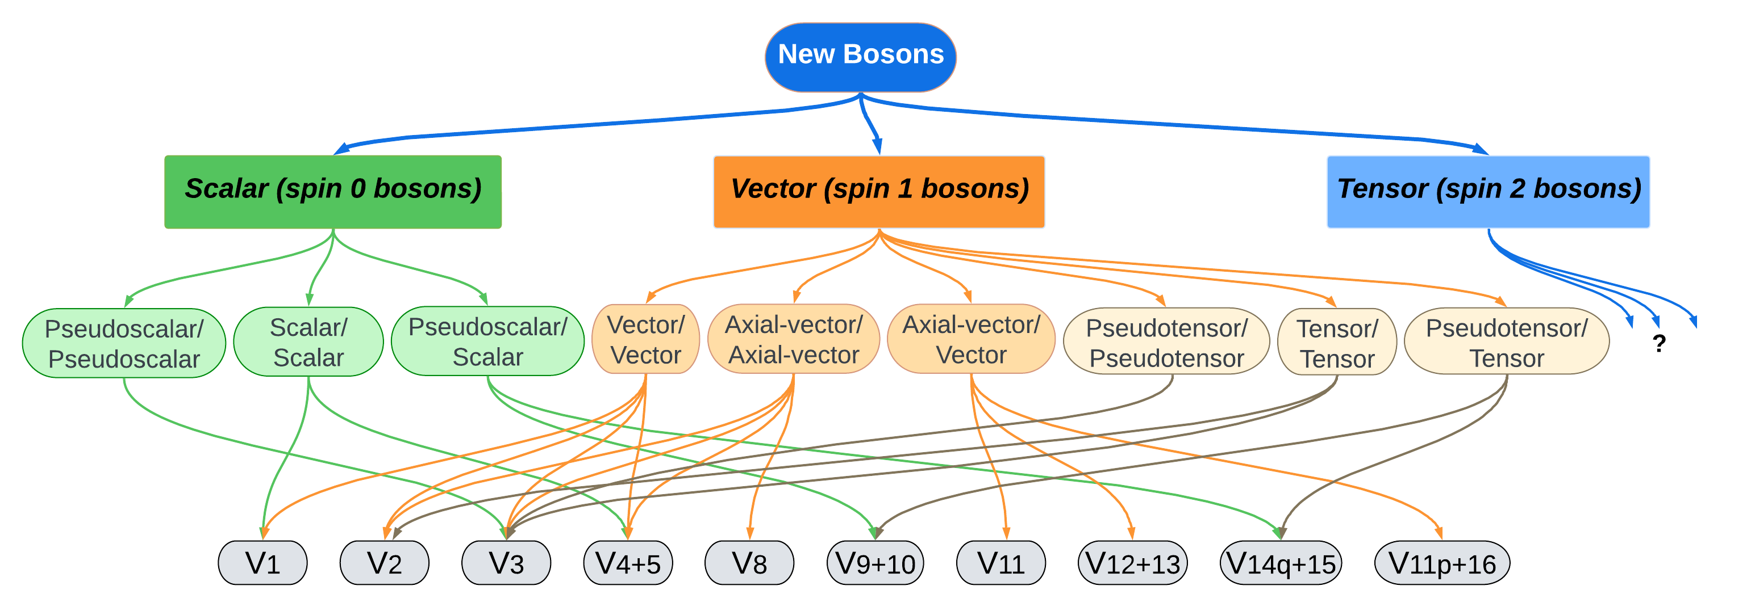
arXiv:2408.15691 Rev. Mod. Phys. under review
Dr. Lei Cong
Dr. Wei Ji
Dr. Yevgeny Stadnik

Slide 7
One example of a PV fifth-force search

Slide 8
arXiv:2205.07222
Science Advances 9, eade0353 (2023)
Dr. Min Jiang, USTC
P-odd, T-even
Dr. Wei Ji, HI Mainz
Notes:
Spin Amplifier for Particle PHysIcs REsearch (SAPPHIRE)

Slide 9
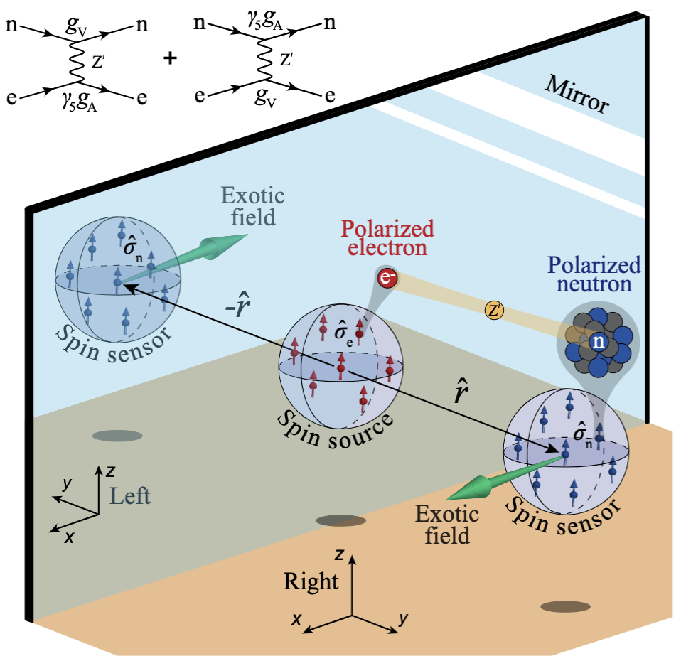
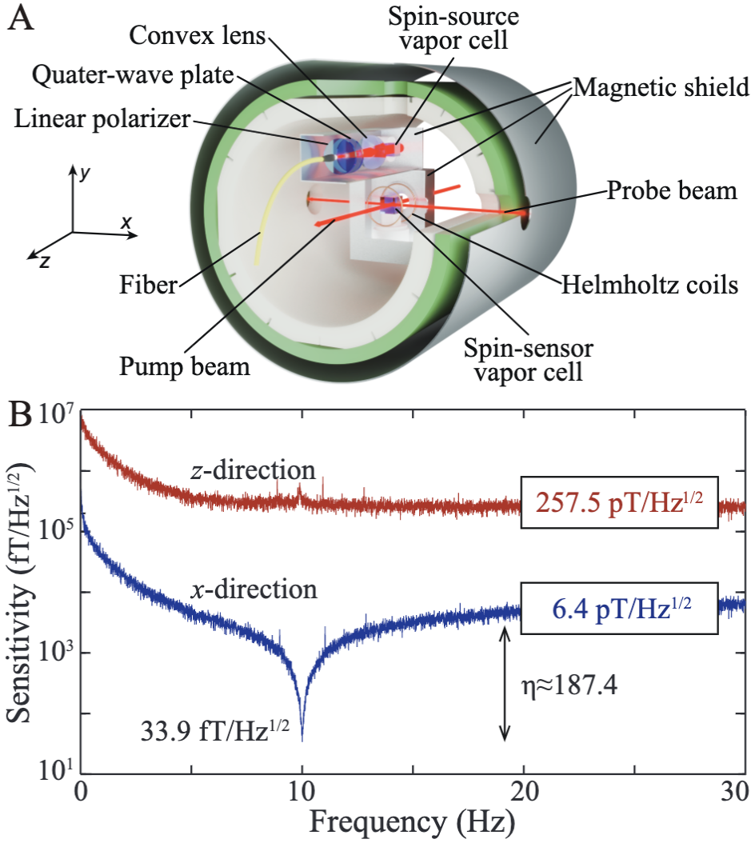
arXiv:2205.07222
Science Advances 9, eade0353 (2023)

Slide 10
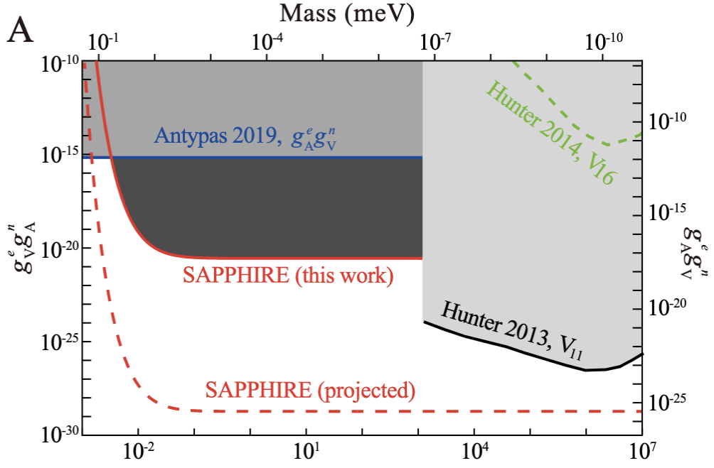
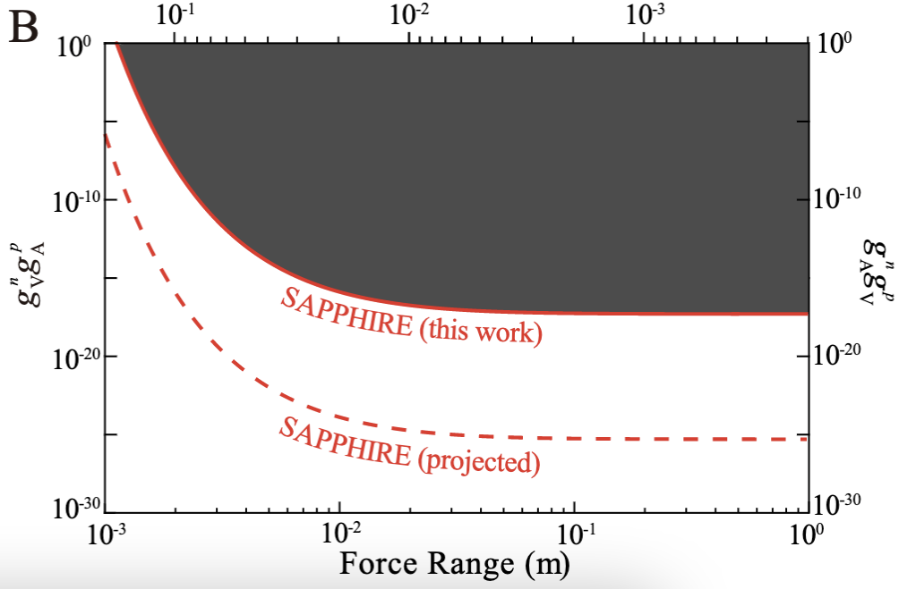
arXiv:2205.07222
Science Advances 9, eade0353 (2023)
Electron-neutron couplings
Proton-neutron couplings
Notes:
These results have already been improved by 4 OOM: better spin source (SS magnet), better magnetometer K-He-3 by the group of Kai Wei Beihang Labs Hangzhou

Slide 11
Results “around the corner” (a small selection)

Slide 12
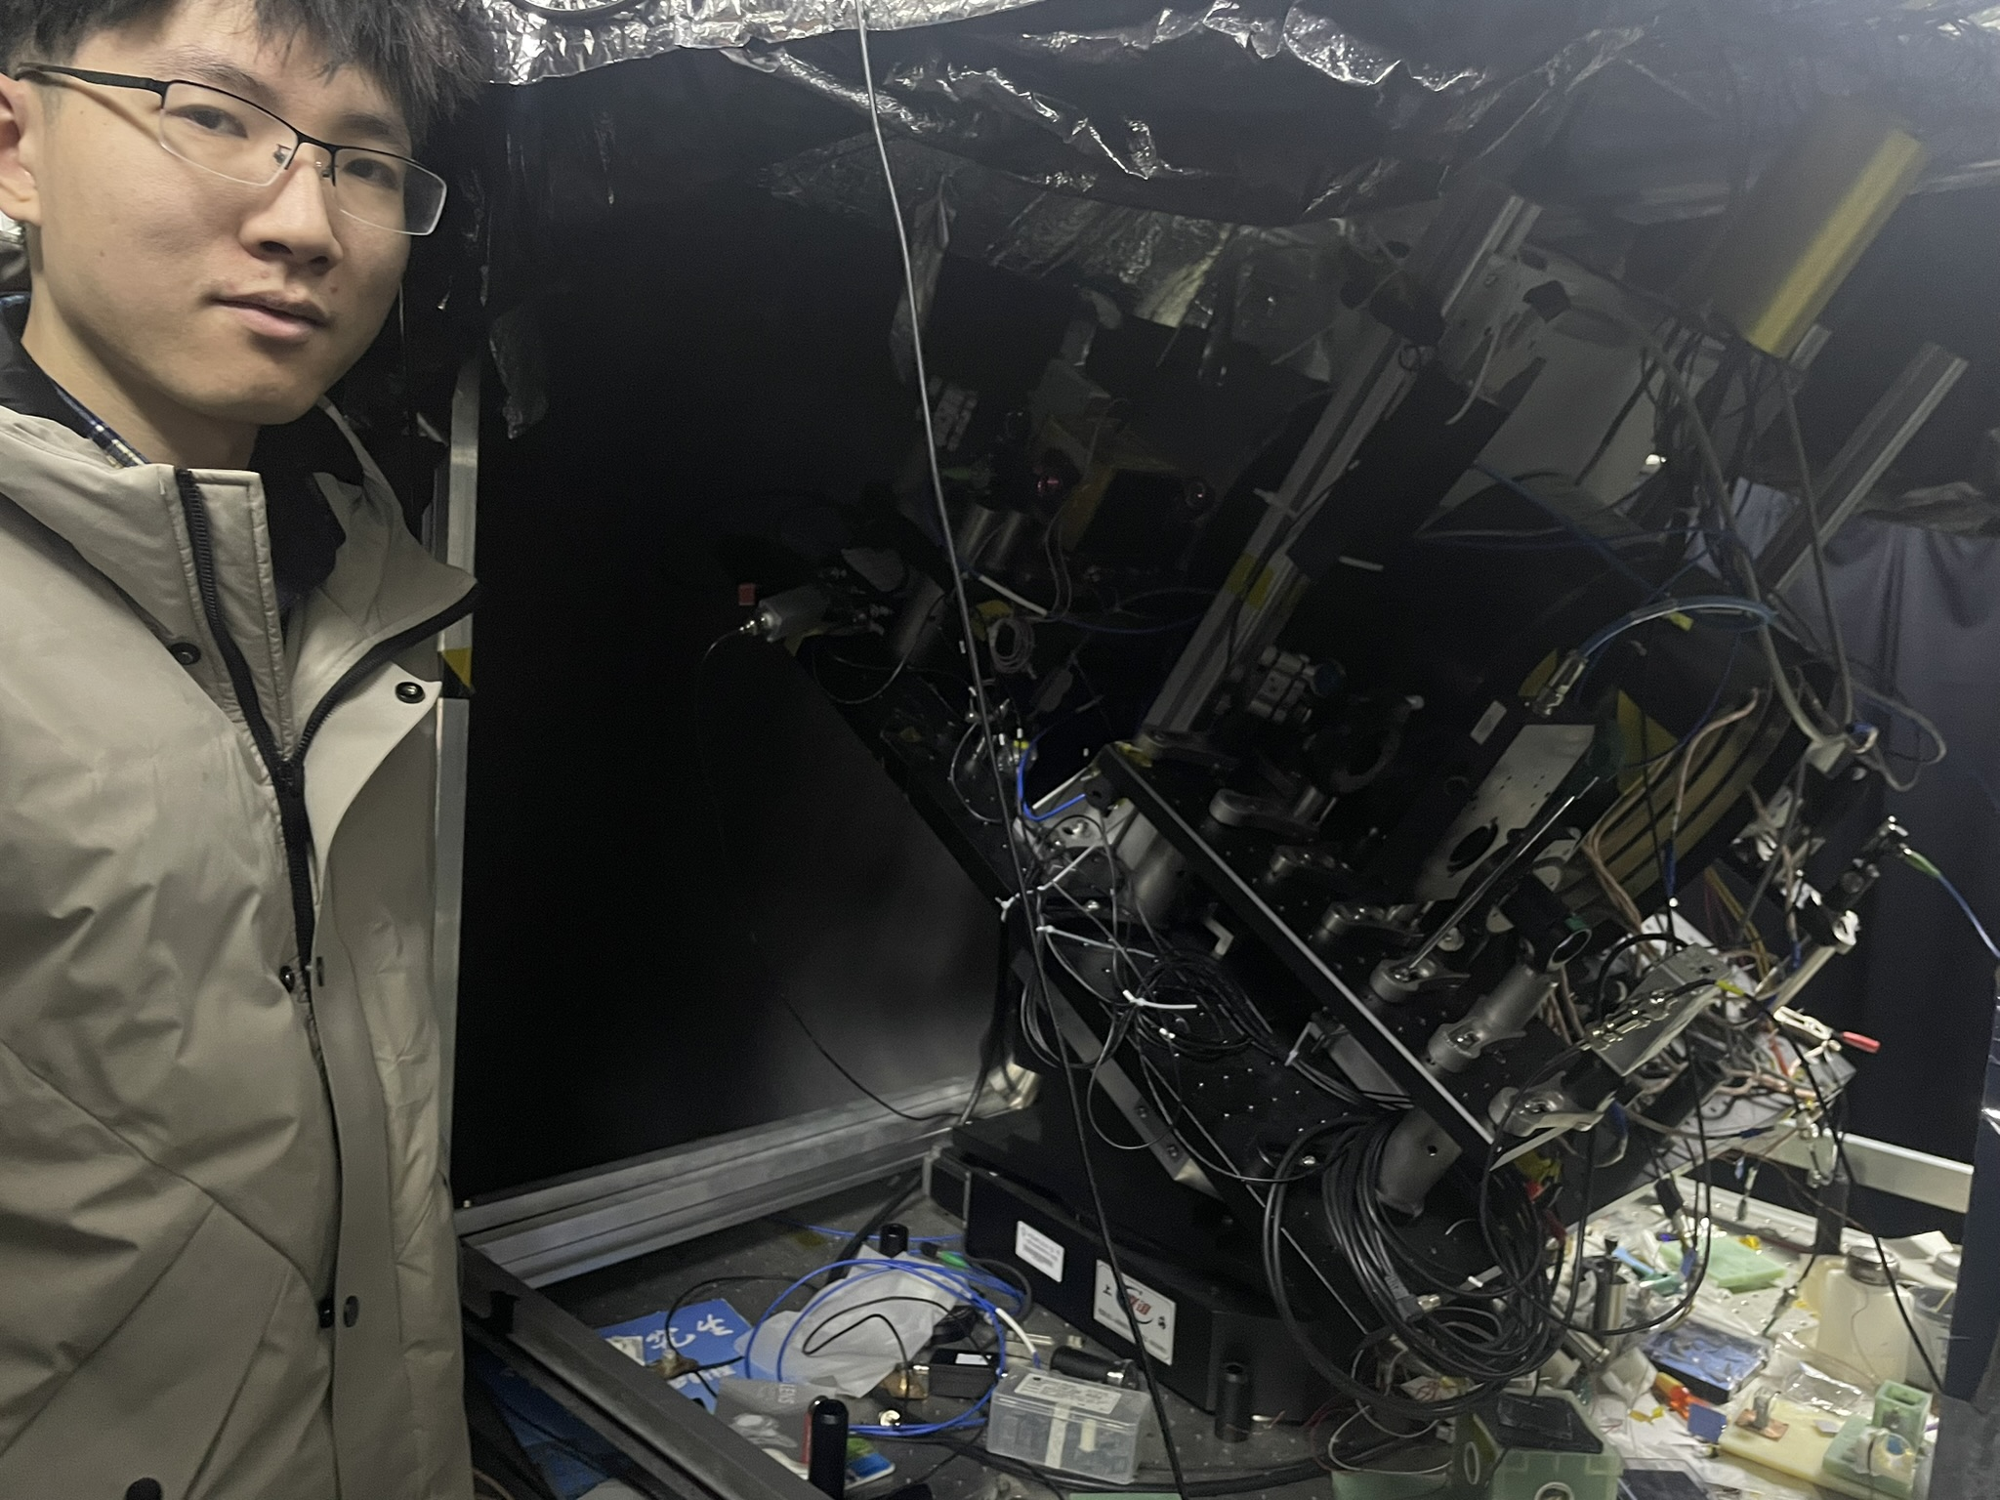
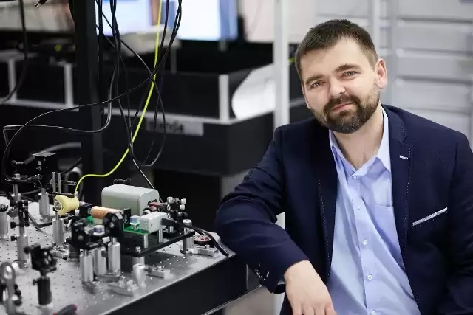
“Spin-gravity”
Violates everything!
Pioneering work by ➞
We use zero-field NMR
Molecular comagnetometry
Monopole-dipole interactions
Derek Jackson Kimball
“Spin-gravity” search @ USTC
Jagiellonian Prof. Szymon Pustelny Piotr Put
University
Gary Centers
Notes:
GDM

Slide 13
Long-range spin-dependent PV interactions
Molecular PV with NMR (chiral and achiral molecules)

Slide 14
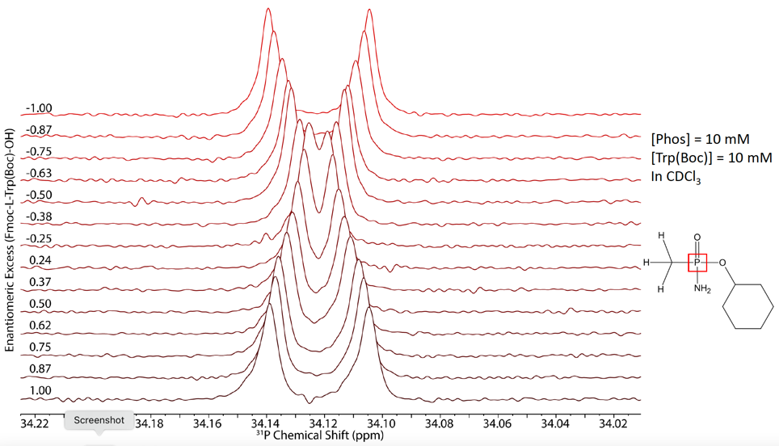
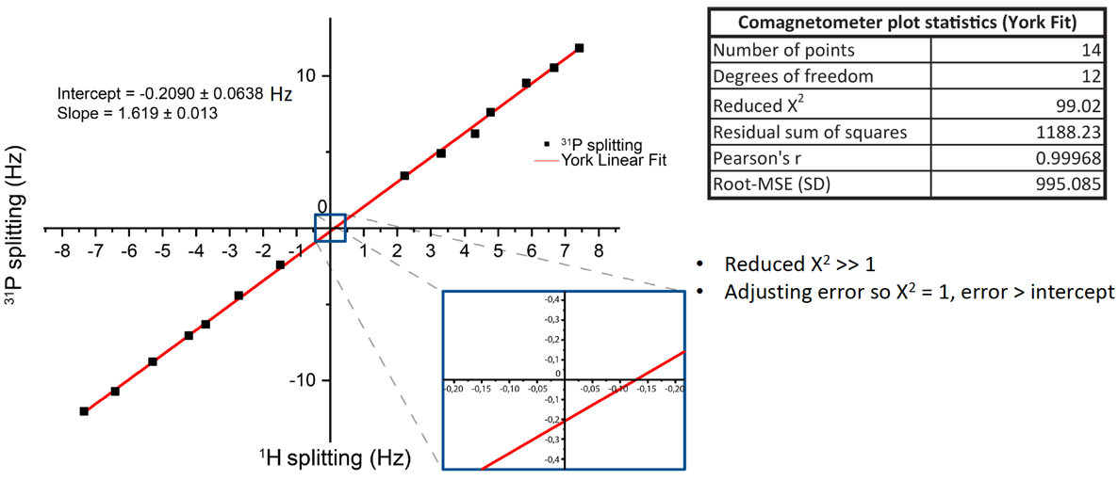
An optimistic roadmap from here
¹³C/¹H $→$ ³¹P/¹H $→$ ??/¹H
PNC shift $∝Z2A2/3$: ~10 nHz ~µHz ~mHz
arxiv: 2412.20997 (2024)
Collaboration @ ELCH:
Rudolf Pietschnig
Denis Kargin
Robert Berger
Kostantin Gaul (now @Mainz)
Collaboration @ MPIP:
Manfred Wagner
Tanja Weil
Another effort: ¹⁰³Rh (ACAC)
M. Sabba (M. Levitt’s group, SOTON)
Danila Barskiy Erik Van Dyke

Slide 15
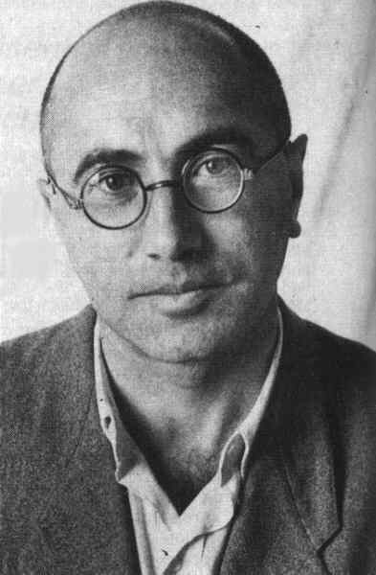
P-even J-coupling: ~13 kHz
P-odd: $J^{\left(1\right),PNC}≈−3 mHz$
Possible modification to CeNTREX EDM expt
Projected S/N~100 in 3.5 h
Systematics under control with multiple reversals
²⁰⁵Tl¹⁹F and ²⁰³Tl¹⁹F
Nuclear anapoles
Ya. B. Zel’dovich
Notes:
Nuclear anapole moments were predicted by Zel’dovich in the same 1959 paper where he predicted APV

Slide 16
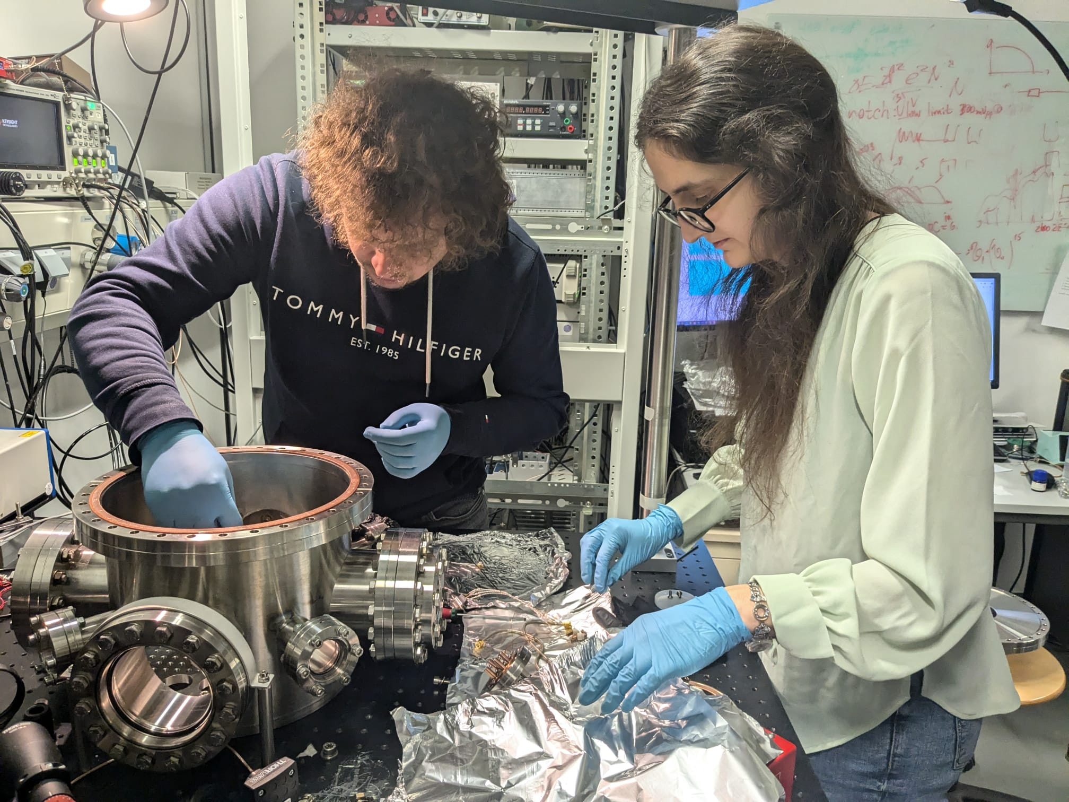
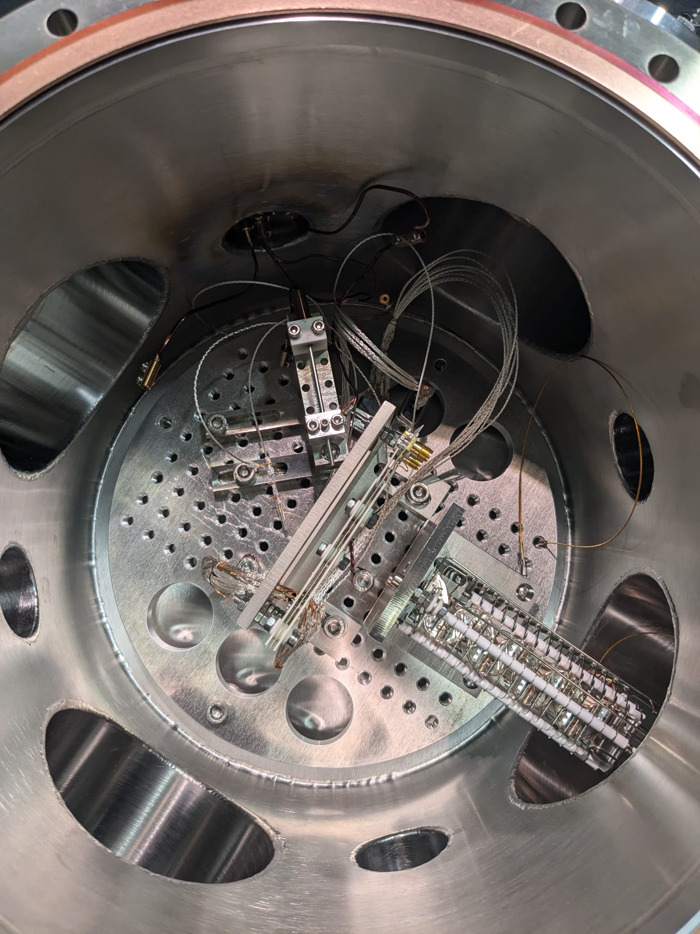
Antimatter On A Chip (AMOC)
Co-trapping of positrons, antiprotons, and eventually antihydrogen away from CERN
Notes:
Collaboration with Hartmut Häffner @ Berkeley

Slide 17
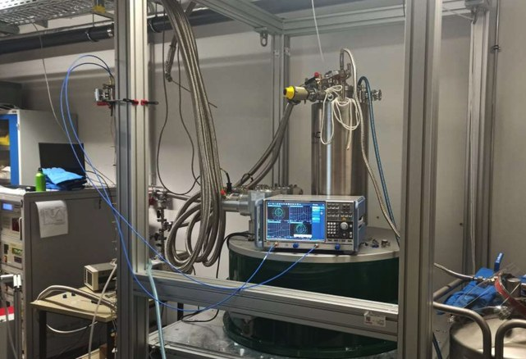
Detection of MHz-GHz Gravitational Waves with GravNet
© Kristof Schmieden
Bonn, Mainz, Frascati, …
SC cavities; strong magnets
Fixed frequency (use GW chirp)
Global network
Single-photon detection
Supported by ERC
GravNet prototype
CASPEr Mainz
14.1 T magnet
© Kristof Schmieden

Slide 18
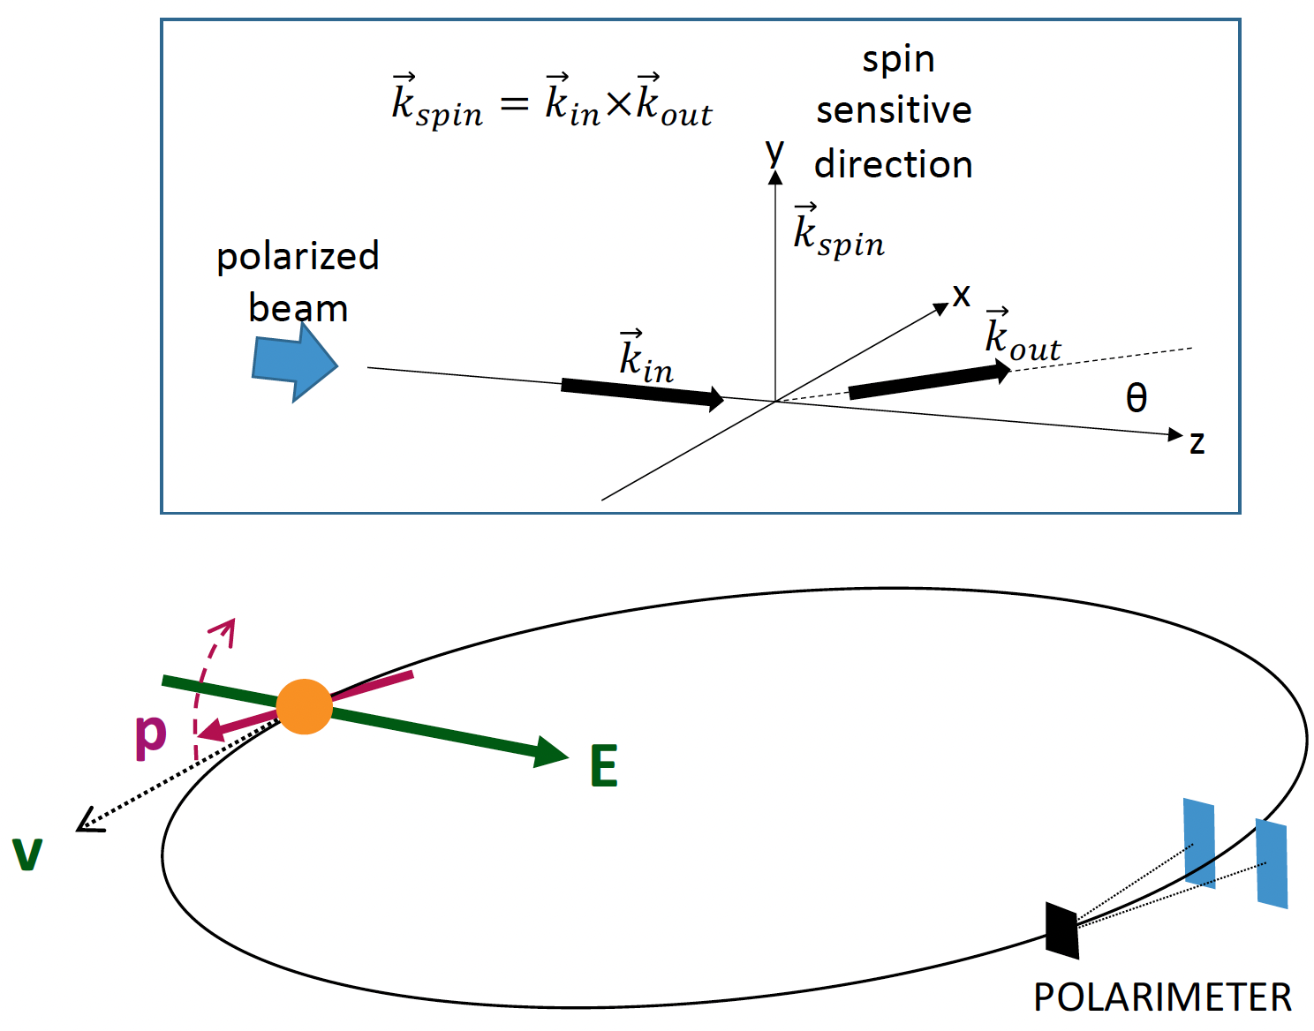
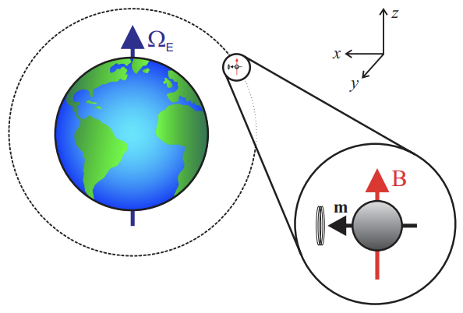
Further on up the road…
(anti)proton EDM @ 10⁻²⁹ e∙cm
Gamma Factory @ CERN
Gravity Probe Spin
Notes:
No time to discuss…
Gravity Probe Spin: Lense-Thirring (frame dragging) and de Sitter (geodetic precession); are these effects the same for classical gyroscopes and quantum spins?

Slide 19
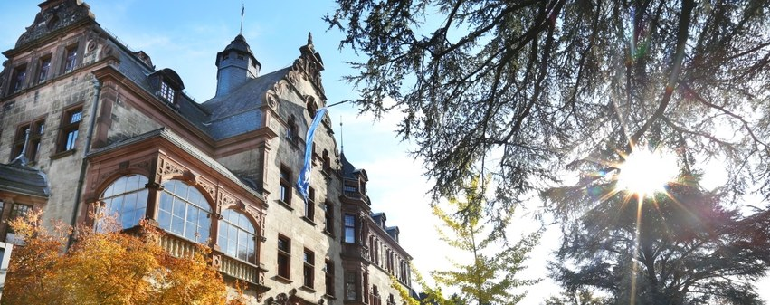
WEH seminar: “Parity Violation in Molecules”
March 30 – April 1, 2026
Physikzentrum, Bad Honnef, Germany

Slide 20
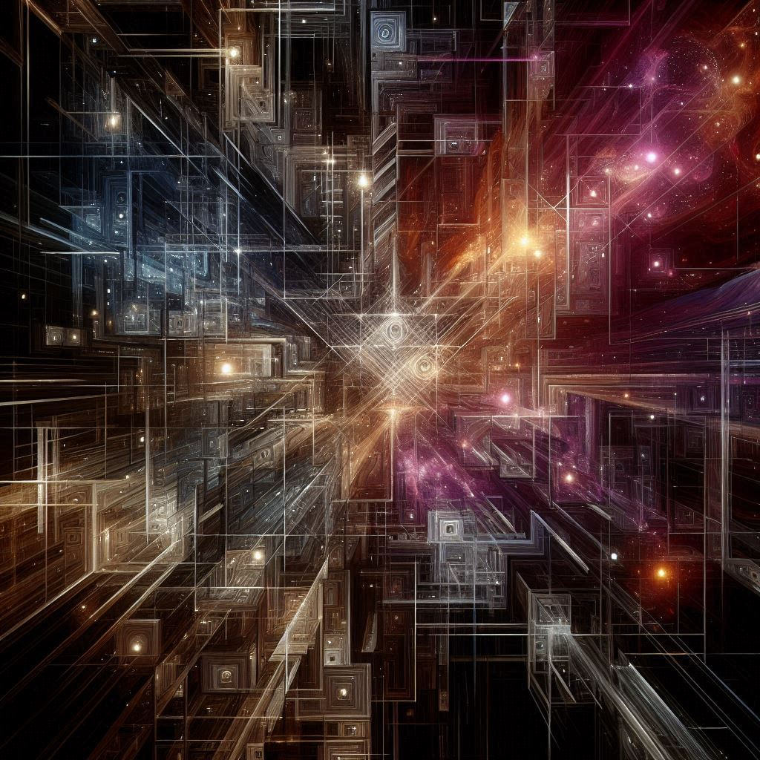
Waiting for approval: “Dark Intersections” school
August 2-7, 2026 (tentatively)
Physikzentrum, Bad Honnef, Germany
Ferromagnetic He-3
Rydberg atoms
Single-photon microwave detectors
High Frequency Gravitational Waves
…
"Dark Intersections"
Made with Designer. Powered by DALL·E 3.

Slide 22
What can DM be ?
Ultralight bosonic particles
Axions (pseudoscalar)
ALPs (pseudoscalar)
Dilatons (scalar)
Vector particles
Antiquark Nuggets (AQN)
Millicharged particles
Not even particles
A gross misunderstanding of gravity (MOND, …) ???
Proca MHD (finite photon mass) ☹?
Black holes, dark planets, interstellar gas, … ☹?
WIMPS ☺
Relaxions (mixed)

Slide 23
What can DM be ?
Ultralight bosonic particles
Axions (pseudoscalar)
ALPs (pseudoscalar)
Dilatons (scalar)
Vector particles
Antiquark Nuggets (AQN)
Millicharged particles
Not even particles
A gross misunderstanding of gravity (MOND, …) ???
Proca MHD (finite photon mass) ☹?
Black holes, dark planets, interstellar gas, … ☹?
WIMPS ☺
Relaxions (mixed)
Bosonic fields oscillate at the Compton frequency
☞ apparent oscillation of fundamental constants

Slide 24
A lot is going on in UBDM searches…
Both direct and indirect

Slide 25
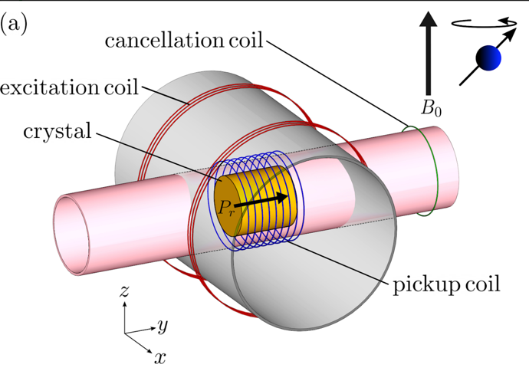
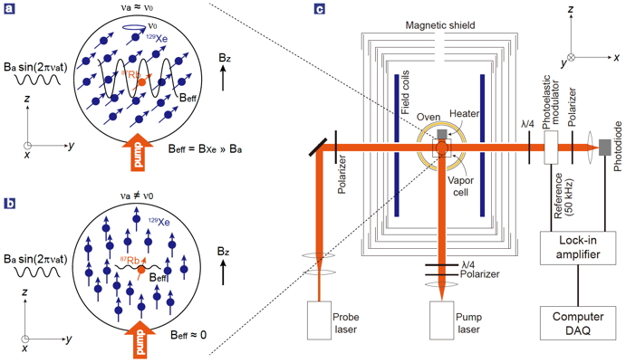
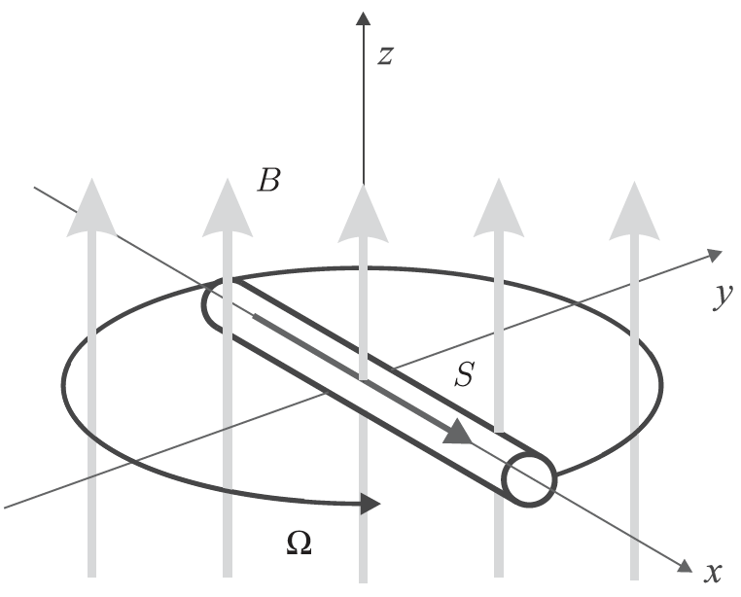
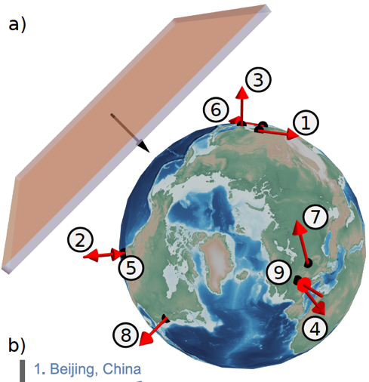
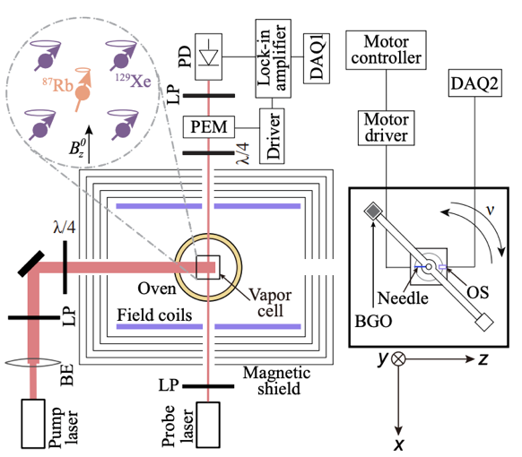
Searching for Ultralight Bosonic (and other) DM
NMR (CASPEr)
Spin-based sensors for DM: masers, spin amplifiers
Spin-based sensors for fifth-force searches (single NV, cells)
GNOME, clock networks, hybrid networks
Gravimeters
Atomic spectroscopy
Antimatter
Levitated magnets
Notes:
These are just a few examples!

Slide 26
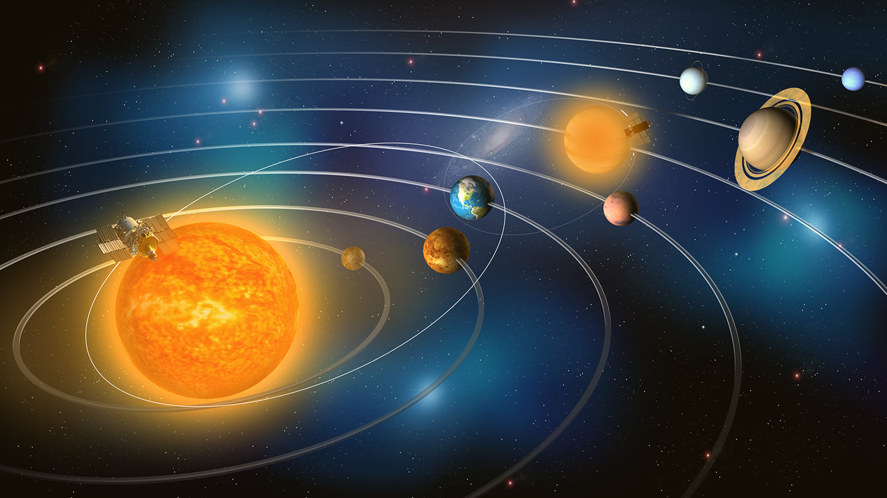
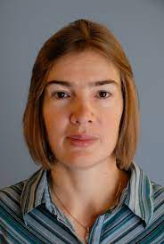
arXiv:2408.10324

