Slide 1
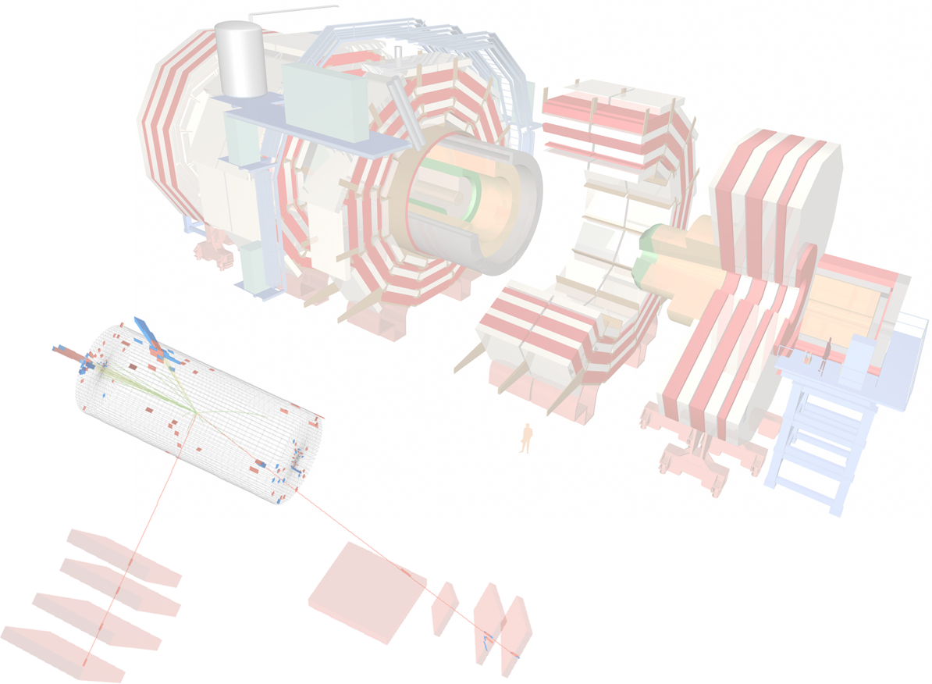
Highlights from CMS physics results …with a Naples bias
Luca Lista
INFN - Napoli

Slide 2
Group responsibilities
Detector
Pigi: RPC Project Manager
Salvatore: RPC Technical Coordinator
Camilo: DPG convener (2012)
Electroweak: Z incl. cross section, W/Z paper
Ended, JHEP published in October (Michele, Francesco, Annapaola, Luca)
Single top
Orso, Mario, Luca, Oktay jumping in
Luca: new convener in 2012, member of TOPLHCWG
new postdoc in 2012
Orso and Mario will compete next year!
Higgs: H→ZZ→2l2q
Annapaola, Francesco, Sabino
Exotica: Heavy Charged Stable Particles
Camilo
Statistics tools, PAT: Annapaola
Statistics committee: Luca, Conferene committee: Pigi

Slide 3
Electroweak Physics

Slide 4
Z→ll inclusive cross section
Isolated dilepton pairs with p_{T}>20 (μ), 25 GeV (e) and η within trigger fiducial region. Mass range: 60 < m_{ll} < 120 GeV
Fit simultaneously yield and efficiencies using different dilepton categories (μμ)
Cut and count analysis using tag & probe efficiencies (ee)
Z→μ⁺μ⁻
13728 ± 121

Slide 5
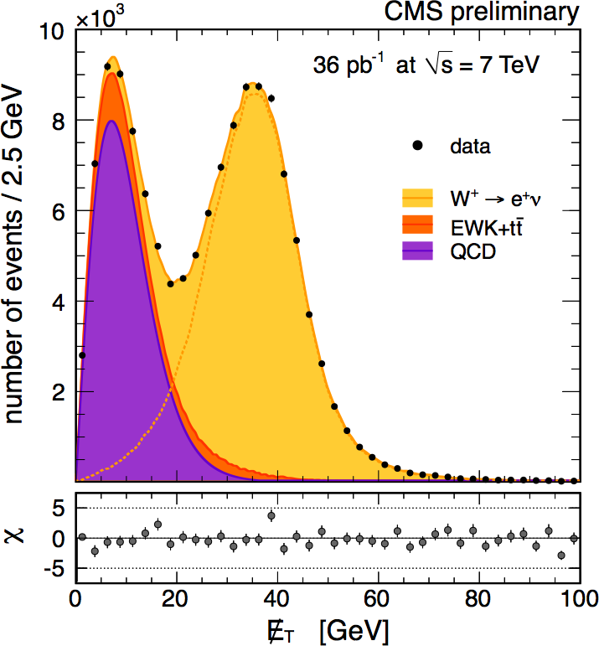
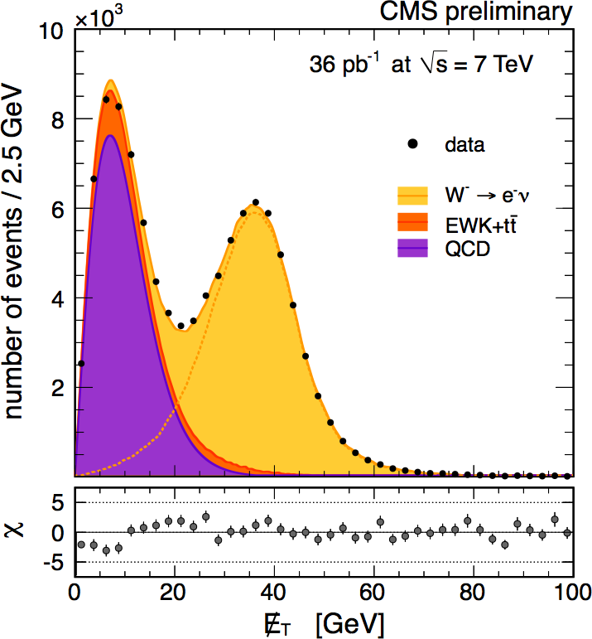
W⁺ and W⁻ production
W⁺→l⁺ν
W⁻→l⁻ν
W production is charge asymmetric at LHC
Asymmetry is ~1.4, not 2, due to sea quark contribution
All analysis ingredients are data driven
Fit separately positive and negative lepton missing E_{T} spectra to extract σ(W⁺) and σ(W⁻)
Alternatively, fit simultaneously the total yield and ratio to extract σ(W±) and σ(W⁺)/σ(W⁻)
In the ratio several uncertainties cancel
Fixed templates
W→μν
84091 ± 291
56666 ± 240
Parameterized shapes
W→eν
81268 ± 302
54703 ± 249
JHEP 10 (2011) 132 published end of Oct.

Slide 6
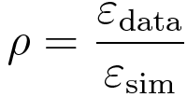
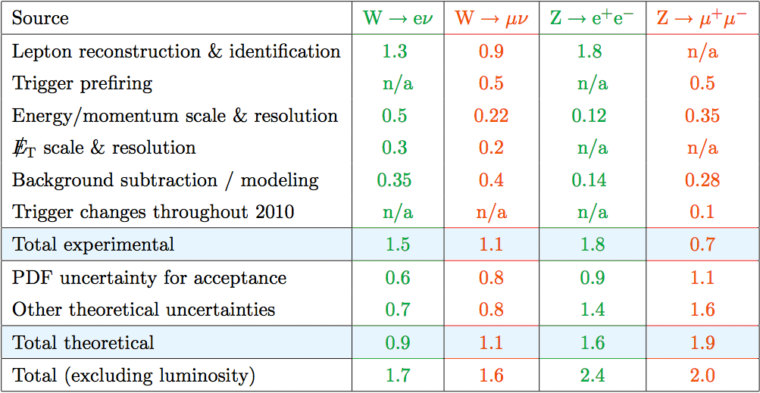
Systematic uncertainties
Data-driven methods to determine efficiencies, background and signal shapes allow to reduce experimental uncertainties
Lumi. uncert.:
4%
Uncert. propagated from Z T&P to W p_{T}/η spectrum
CMS-DP-2011-002

Slide 7
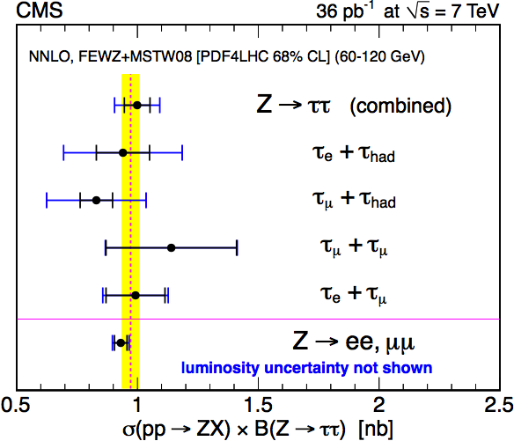
Comparison with theory
W→lν
Z→ll
syst.
stat.
lumi.
Good agreement with theoretical predictions
Systematic uncertainty dominates

Slide 8
Comparison with theory
σ(W)/σ(Z)
σ(W⁺)/σ(W⁻)
Ratios are not affected by luminosity uncertainty
W⁺/W⁻ potentially sensitive to PDF, W/Z has precise prediction

Slide 9
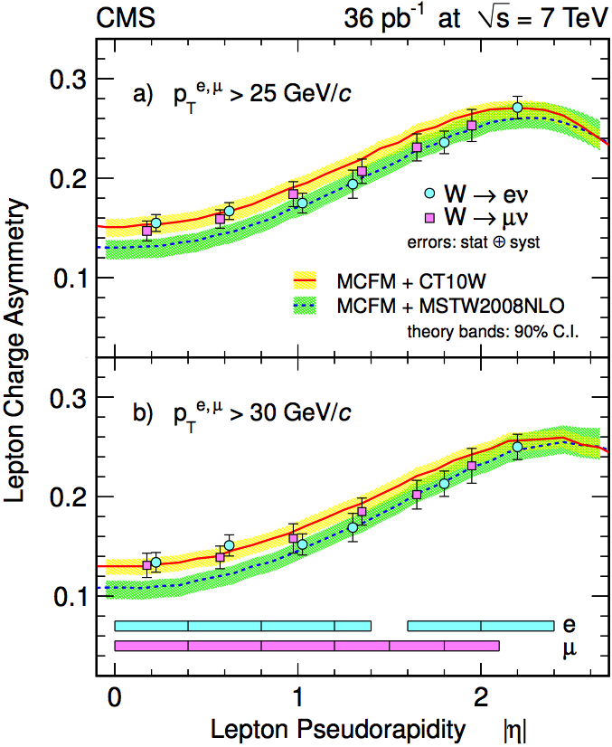
W charge asymmetry
W⁺/W⁻ charge asymmetry vs η measured for both e and μ with 36pb⁻¹
Updated with 234pb⁻¹ with muons only
Similar selection to inclusive cross section analysis
Signal yield from isolation variable fit (shape independent on η)
Two p_{T} thresholds (25, 30 GeV) to probe different phase space regions
Charge mis-id: 0.1(barrel)-0.4(endcap)% for electrons, <10⁻⁴ for muons
Statistical uncertainty: ~3%
Systematic uncertainties (~3%), limited by the size of Drell-Yan control samples
Separate efficiency estimates for + and − leptons
p_{T} scale and resolution
Background and signal modeling
JHEP04 (2011) 050

Slide 10
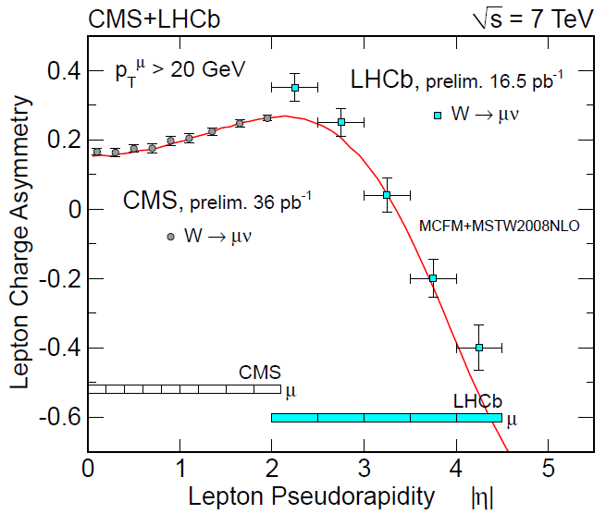
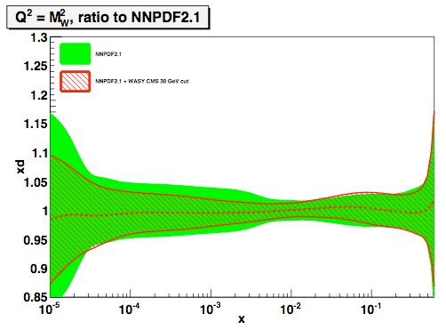
CMS ad LHCb measurements
CMS results already improve d,u,d,u,s quark PDFs by >40% in the range 10⁻³ < x < 10⁻² !!!
CMS complementary w.r.t. LHCb

Slide 11
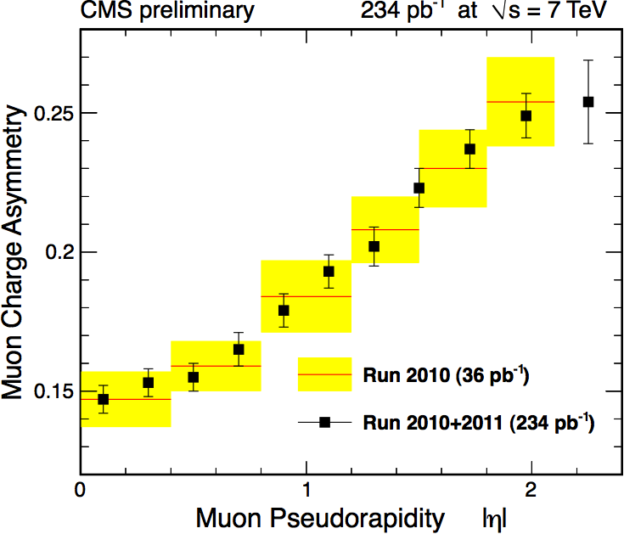
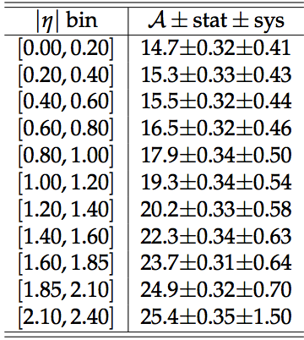
Asym. with 234 pb⁻¹ (muons)
Improved uncertainties with larger statistics and control samples
Largest uncertainties: DY contamination (MC estimate), eff. (+/−) ratio, muon p_{T} scale
CMS PAS EWK-11-005

Slide 12
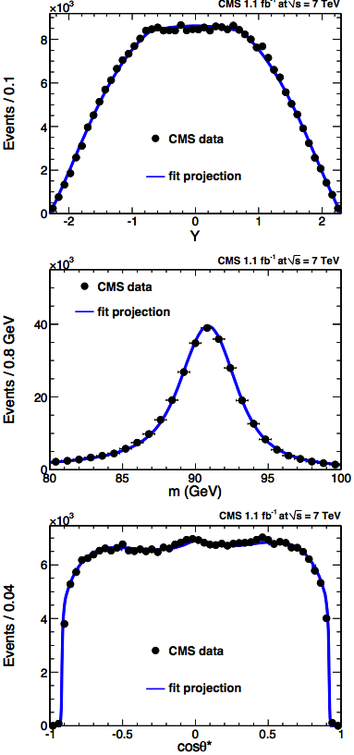
sin²θ_{W} measurement with 1.1fb⁻¹
The full decay information, including cosθ*, Y and s=m_{ll}² of the dimuon pairs, used to determination sin²θ_{W} using a complete triple-differential fit model built
Collins-Soper frame adopted for cosθ*
Potential fit extension to beyond-SM couplings
LO prediction + CTEQ6 PDF used as signal fit model
The following parton level diff. cross section has to be combined with proper PDF contributions:
Largest uncertainties: PDF, resolution and alignment, LO model (QCD), FSR
Phys. Rev. D 84, 112002 (2011)

Slide 13
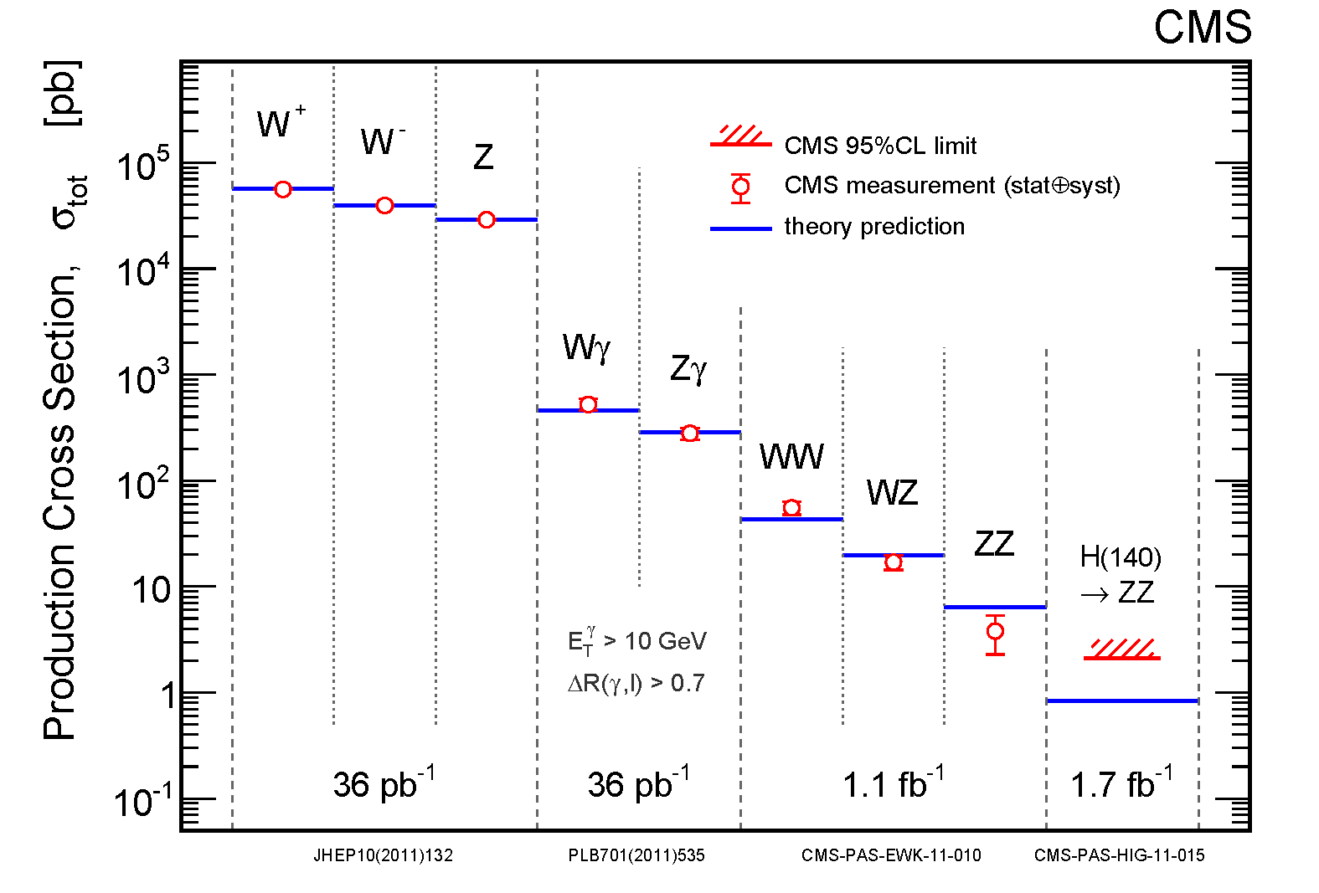
EWK summary

Slide 14
Top physics

Slide 15
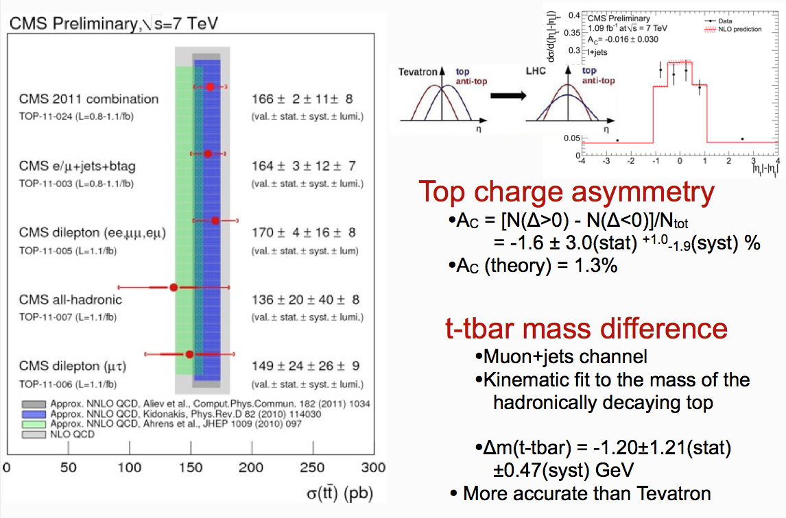
Top quark properties
tt cross section

Slide 16
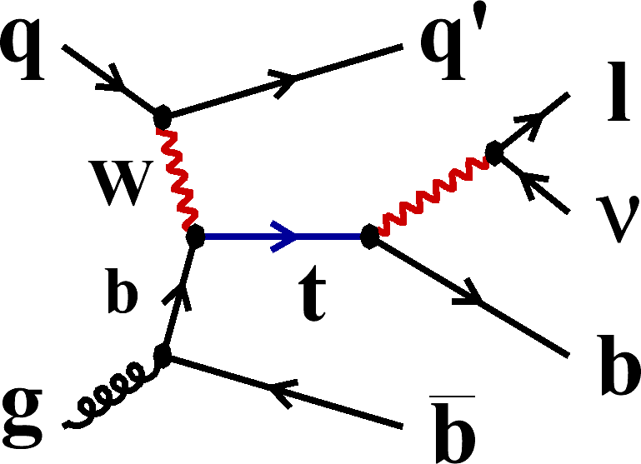
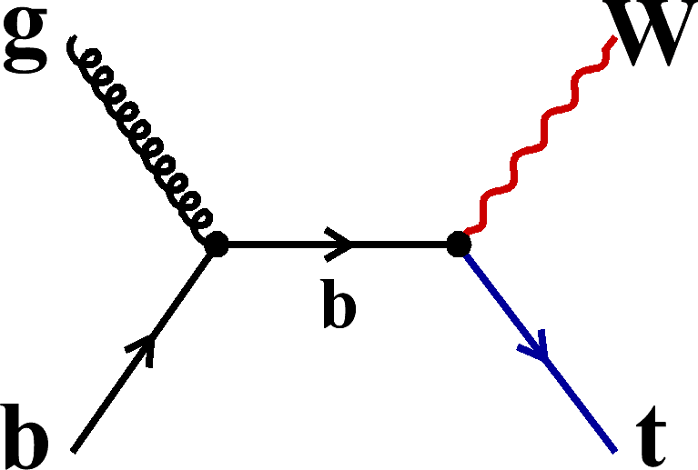
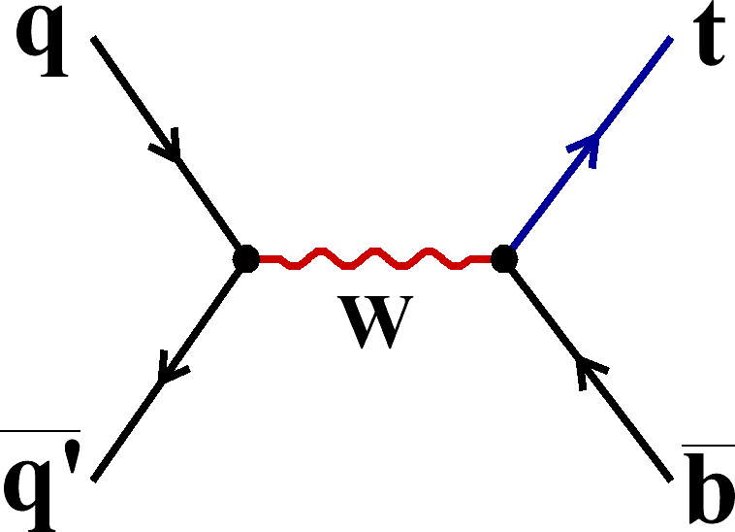
Single top production
t-channel
associated Wt production
s-channel
Allows a |V_{tb}| measurement
Search for non-SM phenomena
Search W’ or H+ (Wt or s-chan. signature)
Search for FCNC, e.g. ug → t

Slide 17
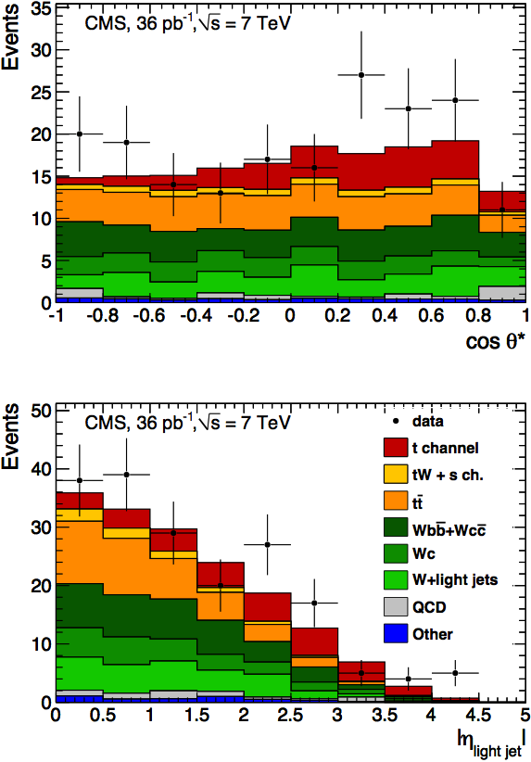
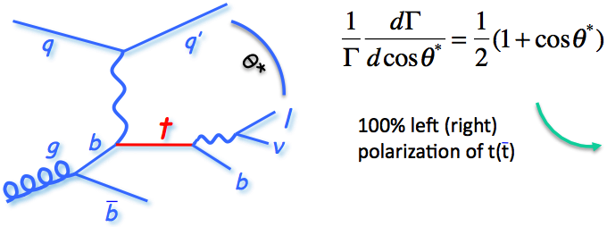
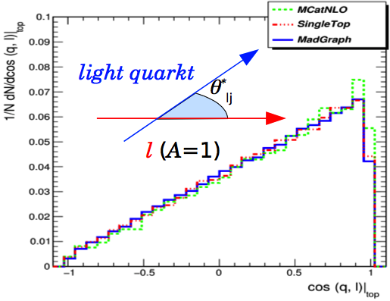
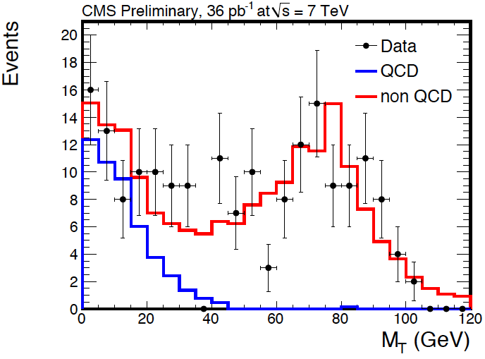
Background estimate from data
QCD veto cut

Slide 18
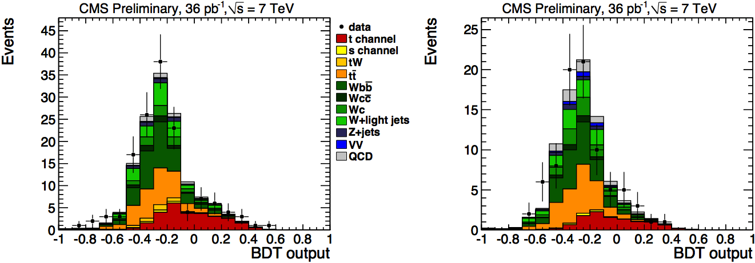
Signal extraction
Complementary approaches adopted:
2D maximum likelihood method (cosθ*, |η_{lq}|)
Multivariate analysis (Boosted Decision Trees)
Phys. Rev. Lett. 107 (2011) 091802
muons
electrons
CMS (36pb⁻¹), update in progress!
Compare to: ATLAS (0.7fb⁻¹) :
ATLAS-CONF-2011-101

Slide 19
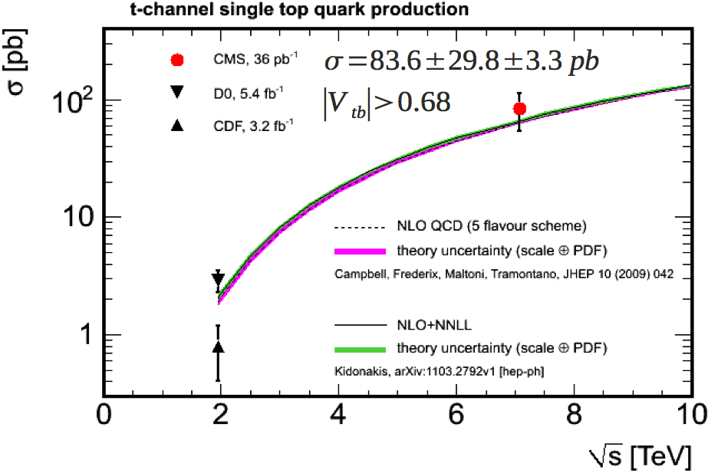
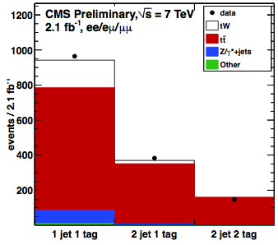
Tevatron vs LHC
t-channel single-top
tW single-top
CMS PAS TOP-11-022
σ_{tW} = 22⁺⁹₋₇pb (2.7σ significance), never measured at Tevatron
SM: σ_{tW} = 15.6pb
s channel for next year (ATLAS limit: 5×SM so far…)

Slide 20
Searches for new Physics

Slide 21
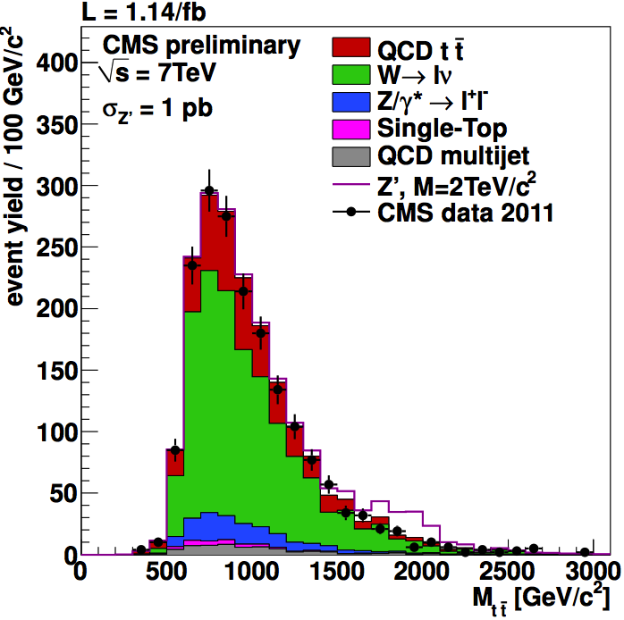
Heavy resonances

Slide 22
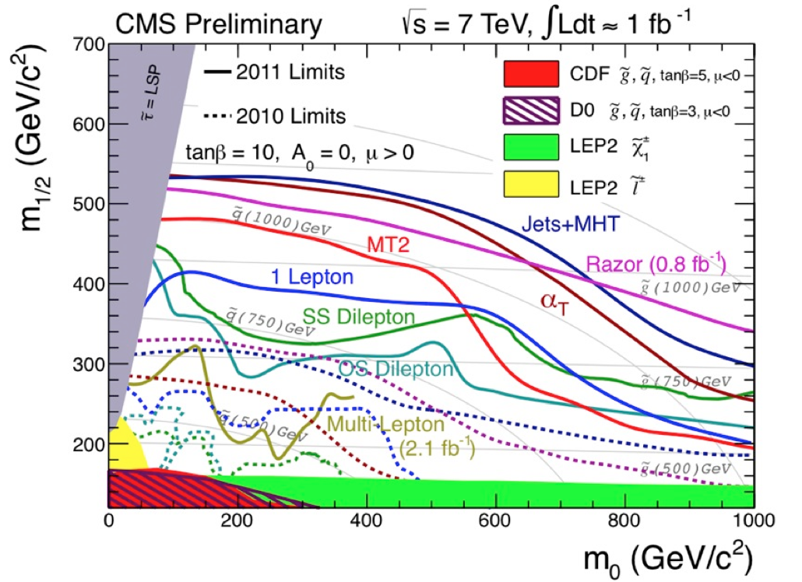
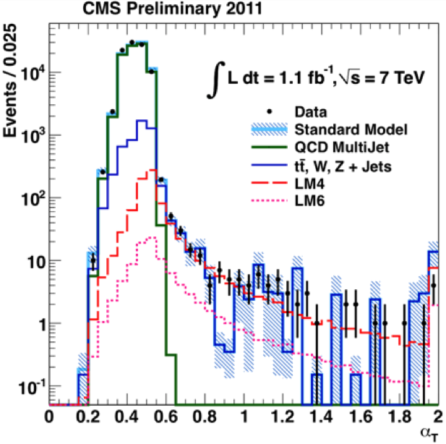
Super-Symmetry

Slide 23
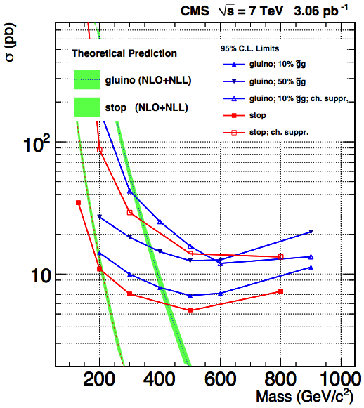
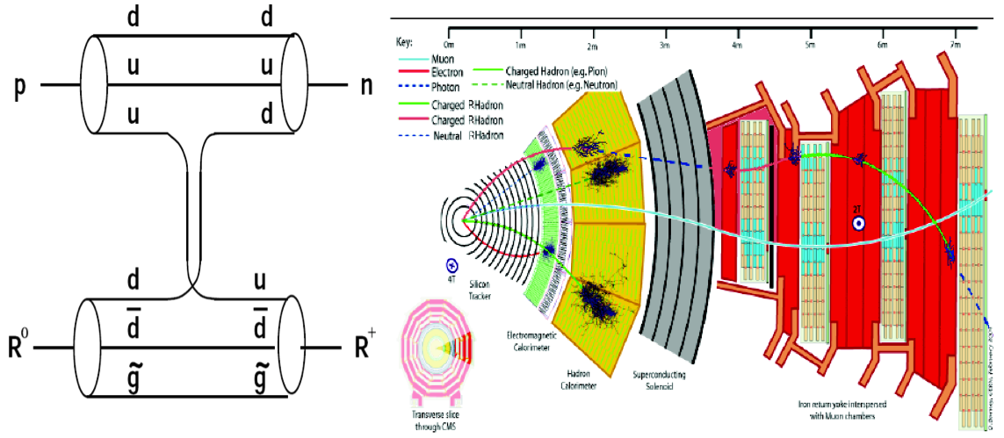
Heavy Stable Charged Particles
May flip their charge while crossing the detector
Significant effort for simulation of time response
Update in progress with larger data samples
J. High Energy Phys. 03 (2011) 024

Slide 24
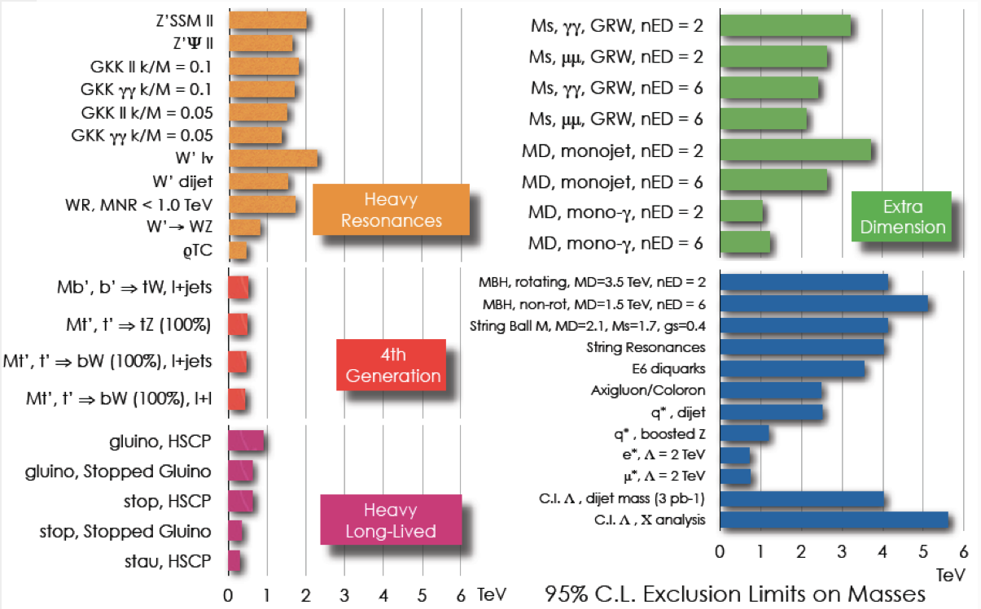
Exotica searches

Slide 25
Heavy ions

Slide 26
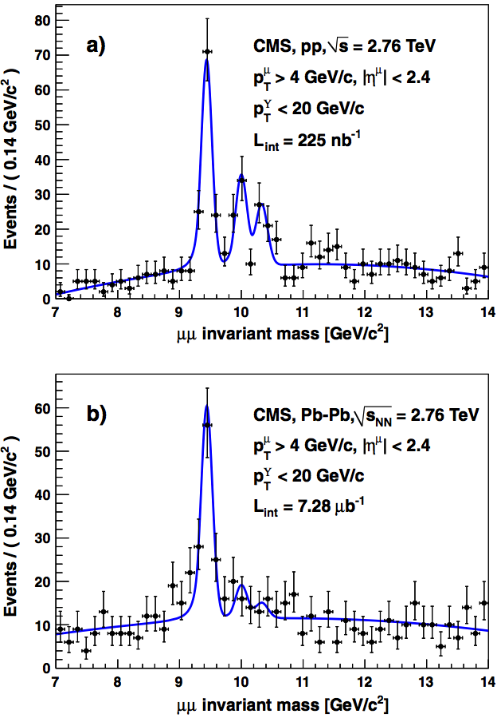
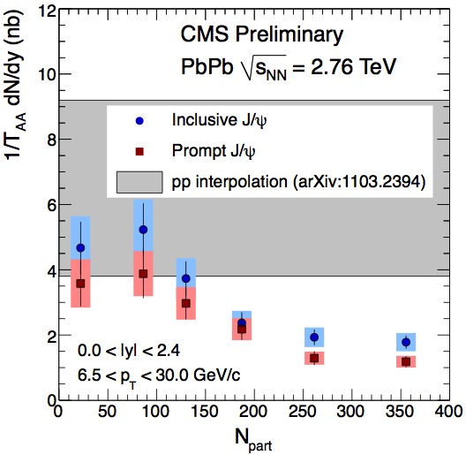
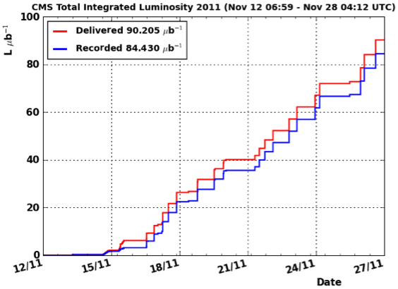
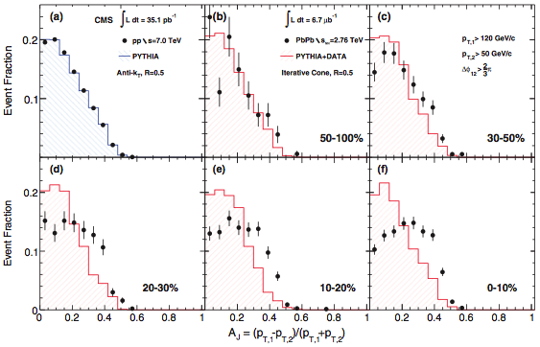
Heavy ions results
Being updated…

Slide 27
Search for the SM Higgs boson

Slide 28
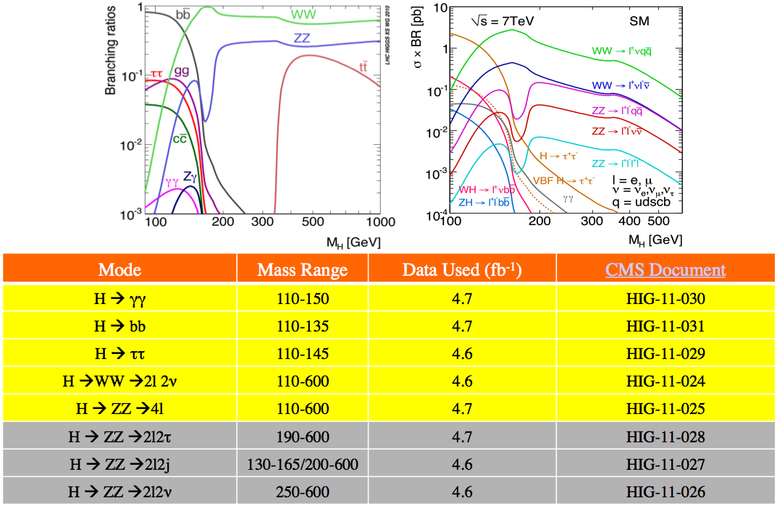
Higgs search channels

Slide 29
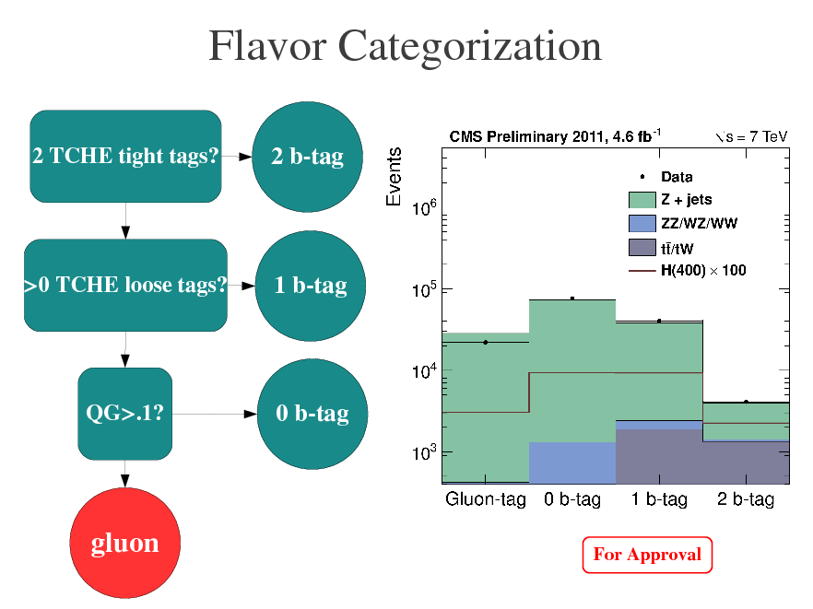
H→ZZ→2l2j strategy

Slide 30
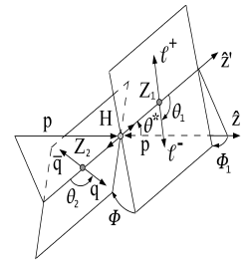
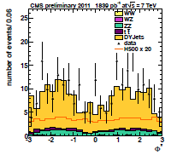
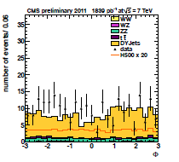
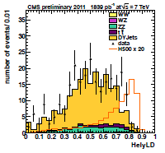
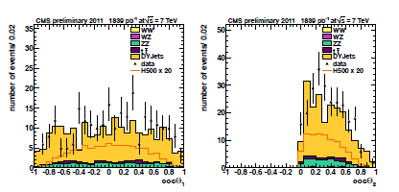
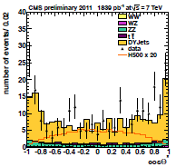
Angular Discriminant
Kinematics of the event described univocally by 5 helicity angles, combined in a LD.
Exploit spin info which is manifest in angular correlations.
Cut on LD is a function of diboson reconstructed mass and depend on the btag category.

Slide 31
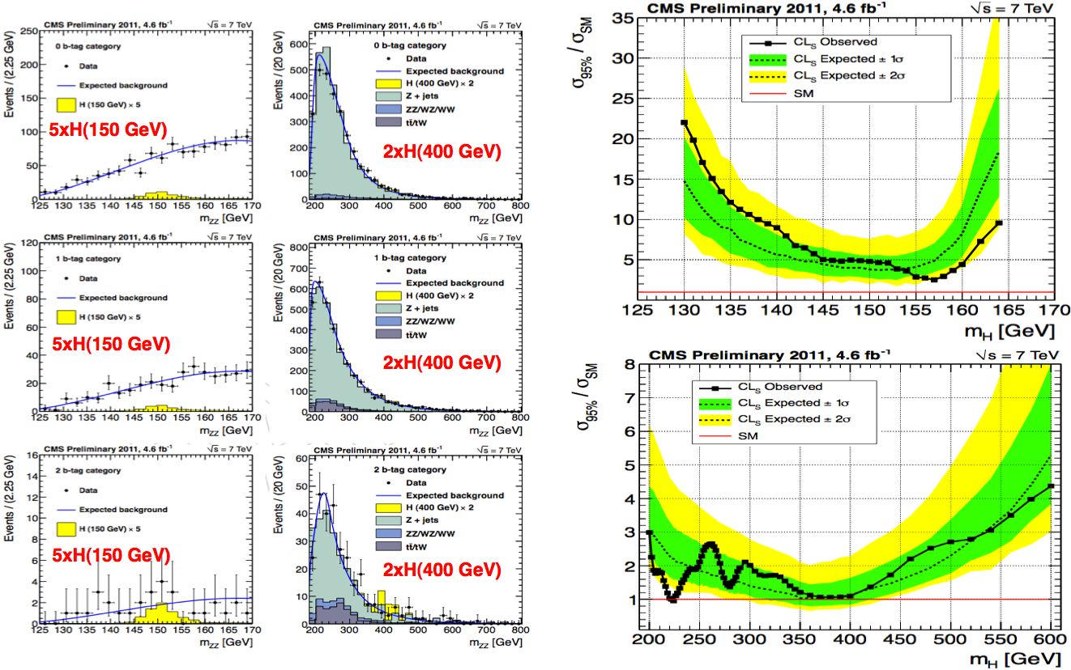
Results and upper limit

Slide 32
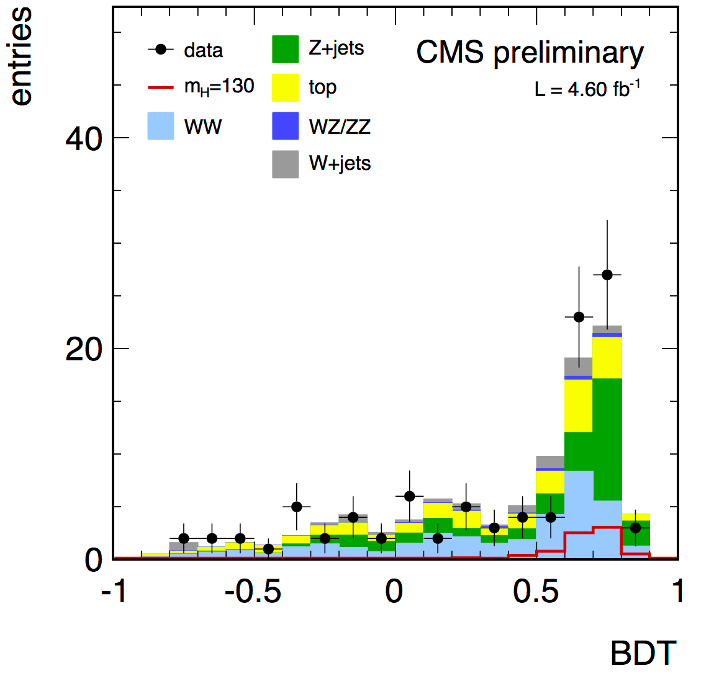
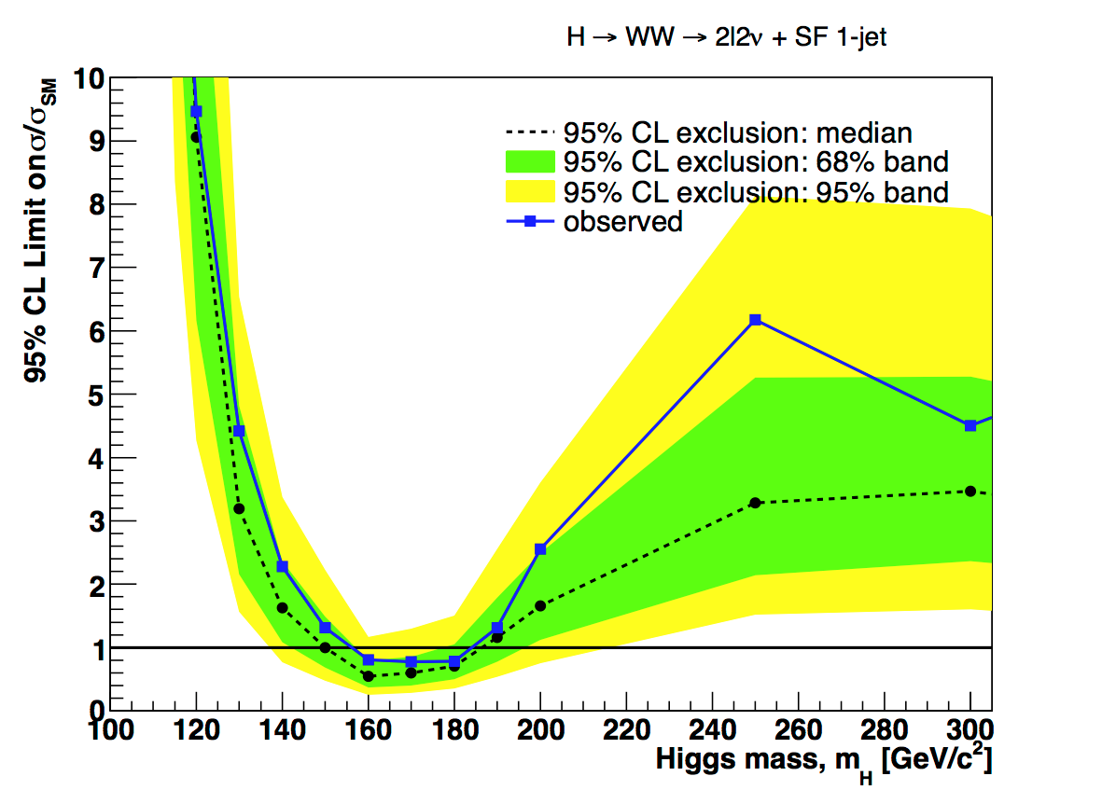
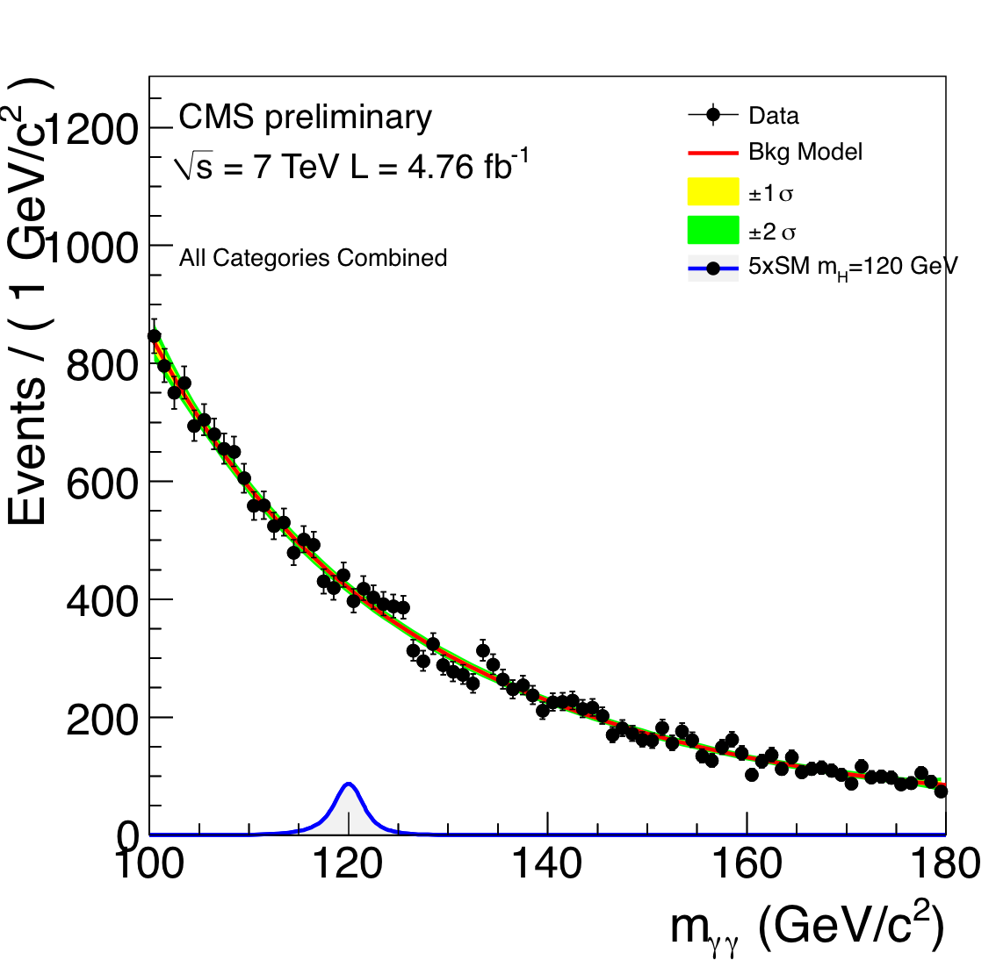
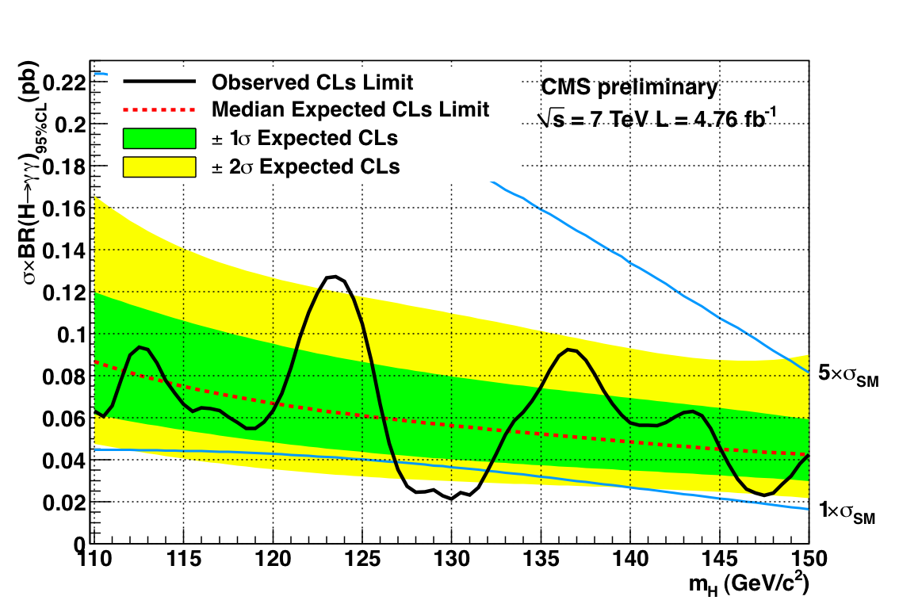
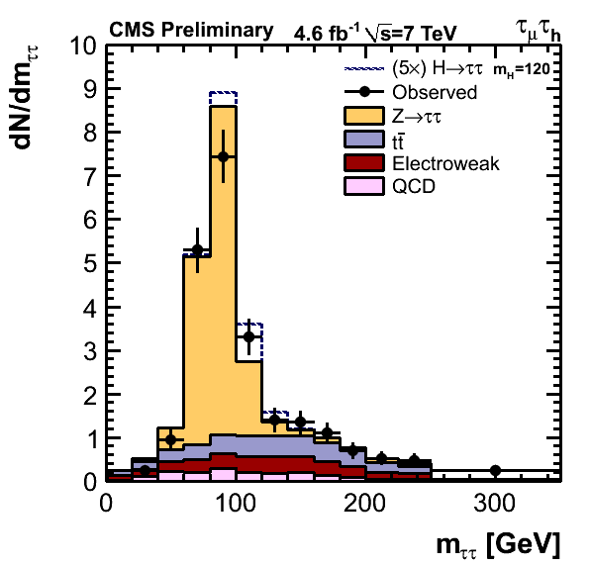
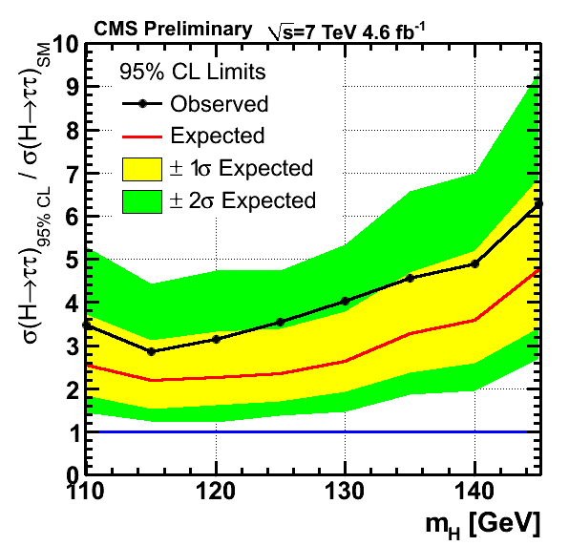
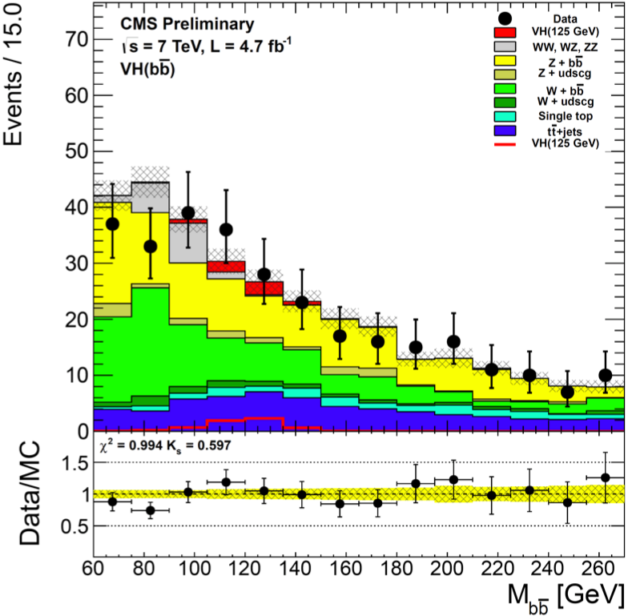
Low mass sensitive channels
WW
γγ
ττ
bb
4l

Slide 33
CMS combined limit on σ/σ_{SM}

Slide 34
Higgs mass 95% CL exclusion

Slide 35
CLs of Higgs signal hypothesis

Slide 36
Cross section “measurement”

Slide 37
Channel comparison
Best fit σ/σ_{SM} of the various channels.
Excess quite consistently seen in all individual channels ±1σ in the low mass region.

Slide 38
“Hints” or fluctuation?

Slide 39
“Hints” or fluctuation?
Note:
p-value is the probability to have at least the observed fluctuation if there is only background,
not
the probability that there is only background given the observed fluctuation!

Slide 40
Conclusion
Fantastic results from CMS thanks to excellent LHC performances
No signal of new Physics so far
Not much space left for “minimal” SuSy
Hints of Higgs boson signal don’t yet allow to establish presence or exclusion
Stay tuned for next year!
… and finally a bit of sociology →

Slide 41
Bloggers’ combination
viXra.org, reported by A Quantum Diaries Survivor

Slide 42
Higgs comparison from FB
ATLAS vs CMS comparison, circulated on FB

Slide 43
LA MIA E’ CLASSE FANTOCCI, IL SUO E’ C…

