Slide 1
SUPERCONDUCTING MAGNET THEMES PhD on Accelerator Physics @ Sapienza University
Lucio ROSSI
Milano University and INFN LASA
lucio.rossi@mi.infn.it
Stefania FARINON
INFN Genova
stefania.farinon@ge.infn.it
THESE SLIDES ARE MOSTLY TAKEN FROM LAST YEAR PRESENTATION BY L.ROSSI

Slide 2
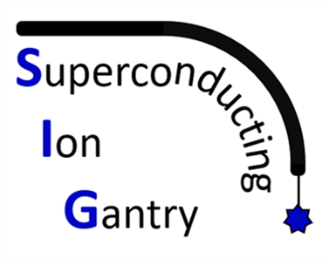
Outline
SC magnets for the Muon Collider
SC magnets for medical applications
SC magnets for high energy physics

Slide 3
General information
The thesis locations can be:
Milano, at the LASA Laboratory of University and INFN
Genova, at the Physics Department
To get more information you can contact (but many more people are involved):
Stefania Farinon stefania.farinon@ge.infn.it
Lucio Rossi lucio.rossi@mi.infn.it
Marco Statera marco.statera@mi.infn.it
As mentioned by G.Cavoto, two related courses will be offered:
Design of superconducting magnets (S.Farinon)
Applied Cryogenics (R.Musenich)

Slide 4
SC magnets for the Muon Collider

Slide 5
The Muon Collider
The Muon Collider represents a rising hope for an energy-frontier collider, offering both high energy and high precision.
Its design is entirely dictated by the muon lifetime, which is just 2.2 μs at rest, and the critical need for rapid and efficient cooling!
Fast and efficient cooling of muons is essential to transform a "cloud of particles" into a cold, focused beam. The cooling cell is the most critical component of the accelerator—without cooling, there are no muons to collide. The cooling process works by absorbing energy in all directions and then restoring energy in a single direction. This requires: Efficient absorbers, Large-acceptance RF cavities, Strong, very large-acceptance superconducting magnets for focusing
Short intense proton bunches produce muons that are captured
6D - Ionization cooling of muon in matter
Acceleration to collision energy
Collision

Slide 6
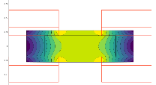
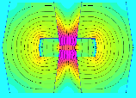
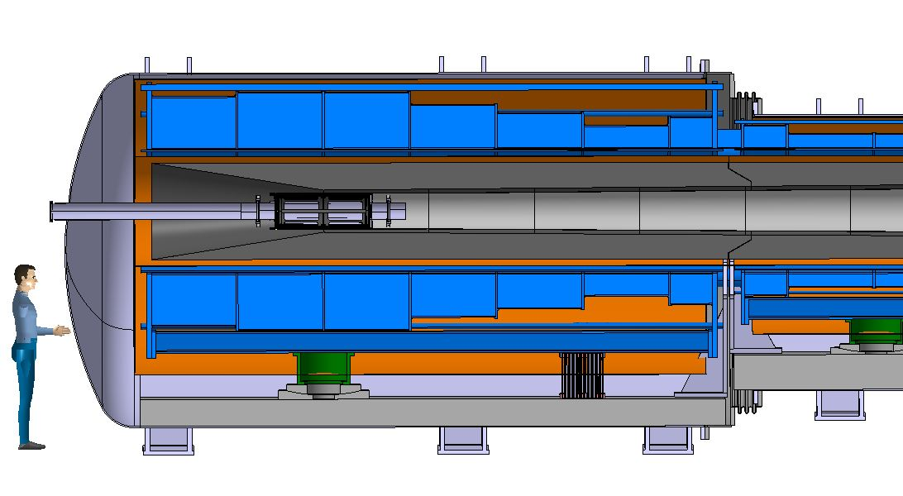
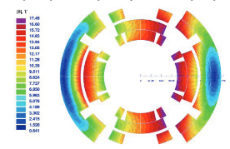
Muon collider magnets
NC ±1.8 T, 400 Hz 100 mm x 30 mm
20 T, 200 mm
Radiation heat load ≈ 5…10 kW
Radiation dose: 80 MGy
SC < 10T
100 mm x 30 mm
SC dipole
NC dipole
NC dipole
SC dipole
RCS
> 40 T, 60 mm
16 T peak, 160 mm
Radiation heat load ≈ 5 W/m
Radiation dose ≈ 20…40 MGy
6

Slide 7
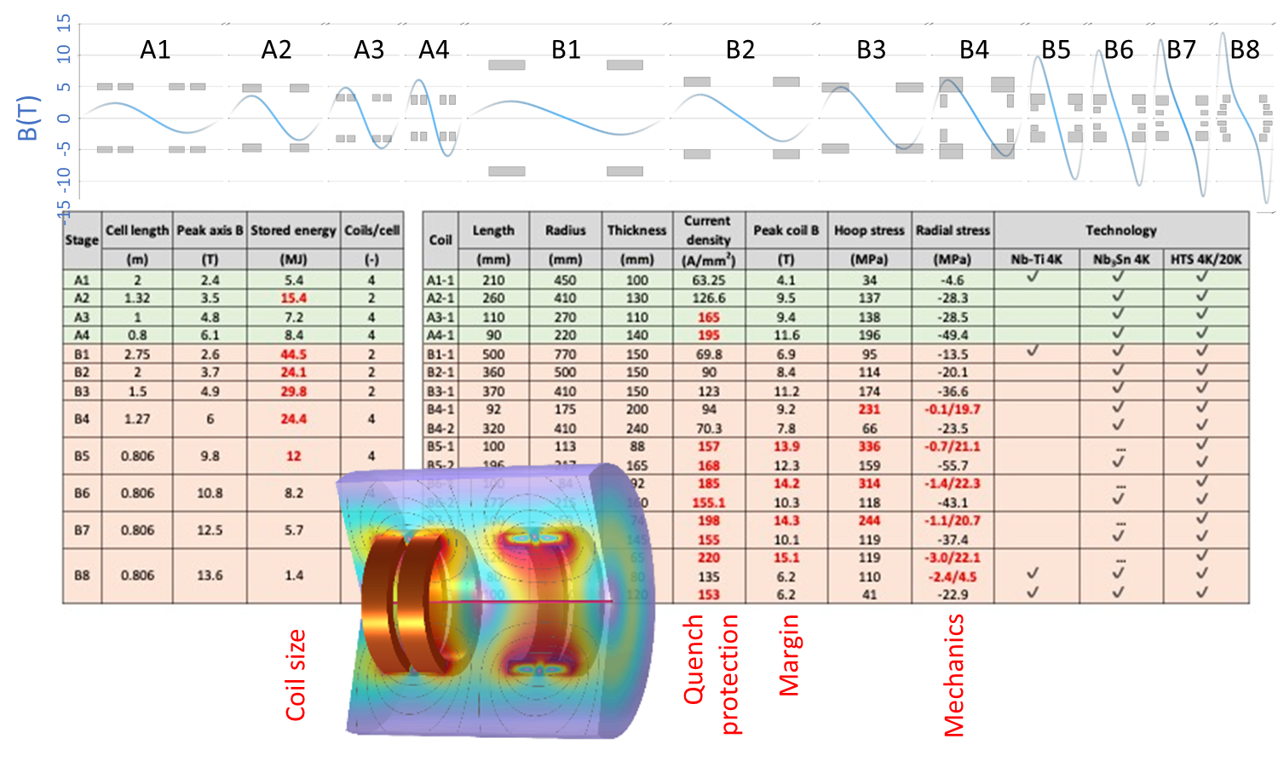
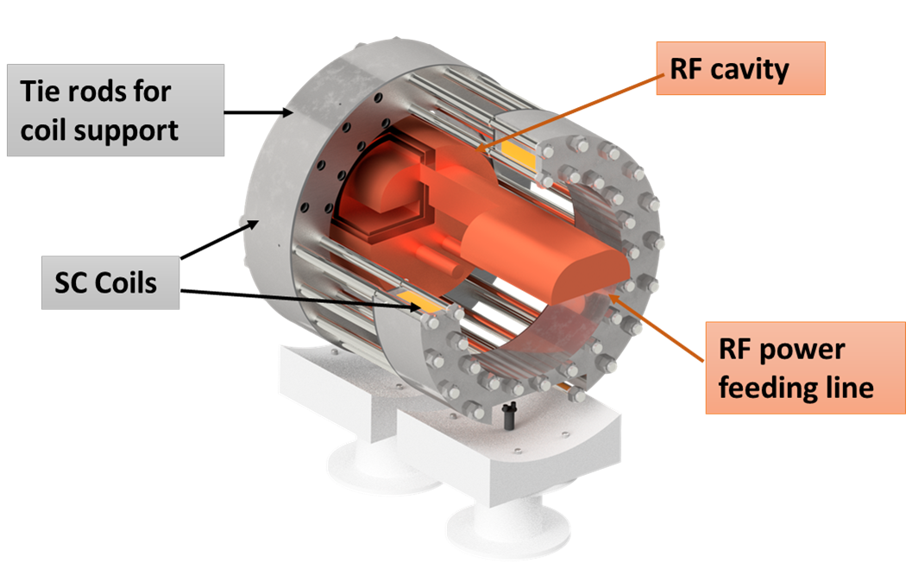
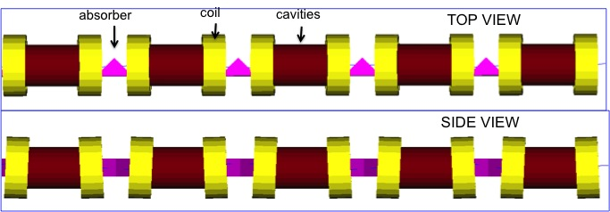
6D Cooling Cells (HTS @ 20 K)
Facility under design at LASA lab 7 T splice coil in HTS, cryogen-free, for RF cavity test

Slide 8
Collider Magnets Requirements

Slide 9
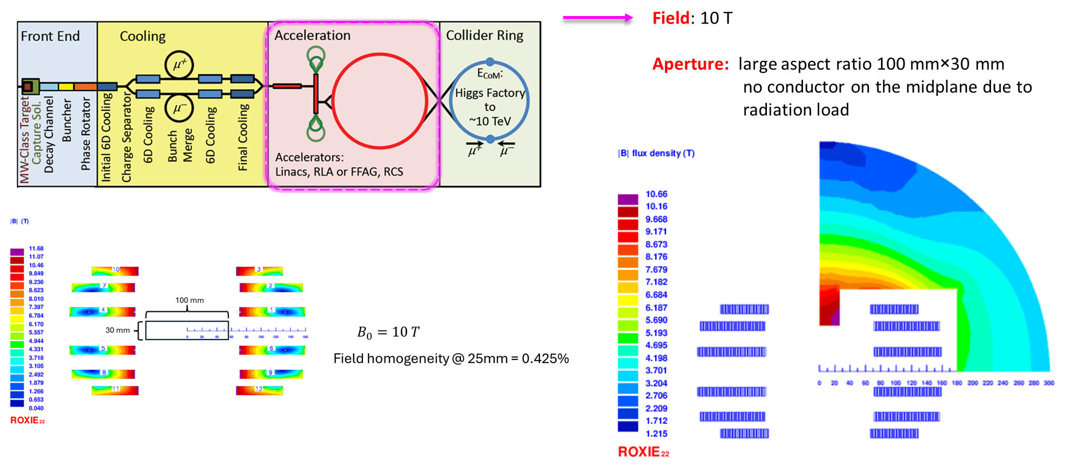
Accelerator magnets

Slide 10
SC magnets for medical applications

Slide 11
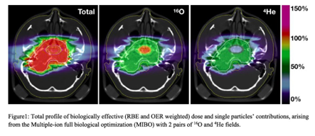
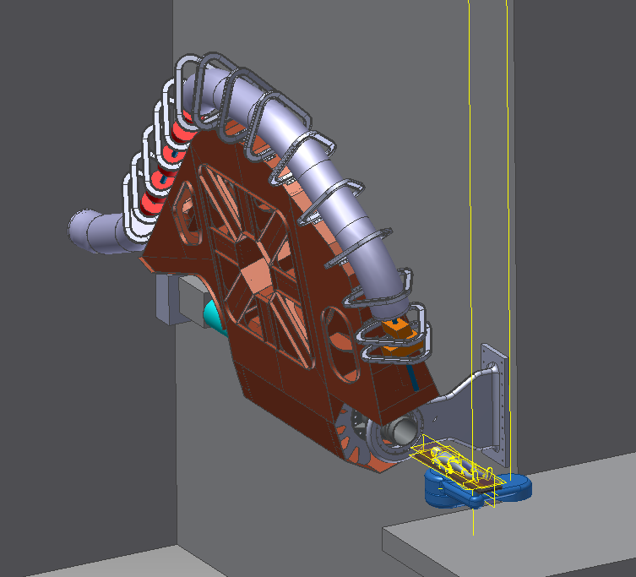
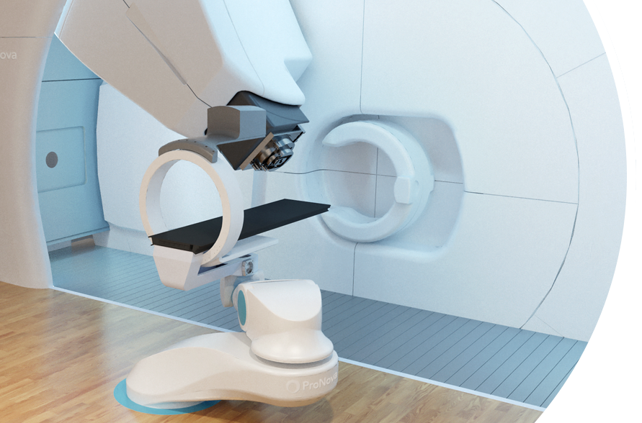
What’s next for particle therapy?
Multiple ions delivered with light-weighted Gantry
Rotatable gantry allows non-coplanar irradiation, enhancing effectiveness
Treatment rooms equipped with patient imaging
Dose Delivery and Range Verification Systems able to adapt online the dose delivered
Ion gantry @ Himac (JP)
Gantry and imaging system of a proton therapy center
Sketch of the ion gantry in the treatment room

Slide 12
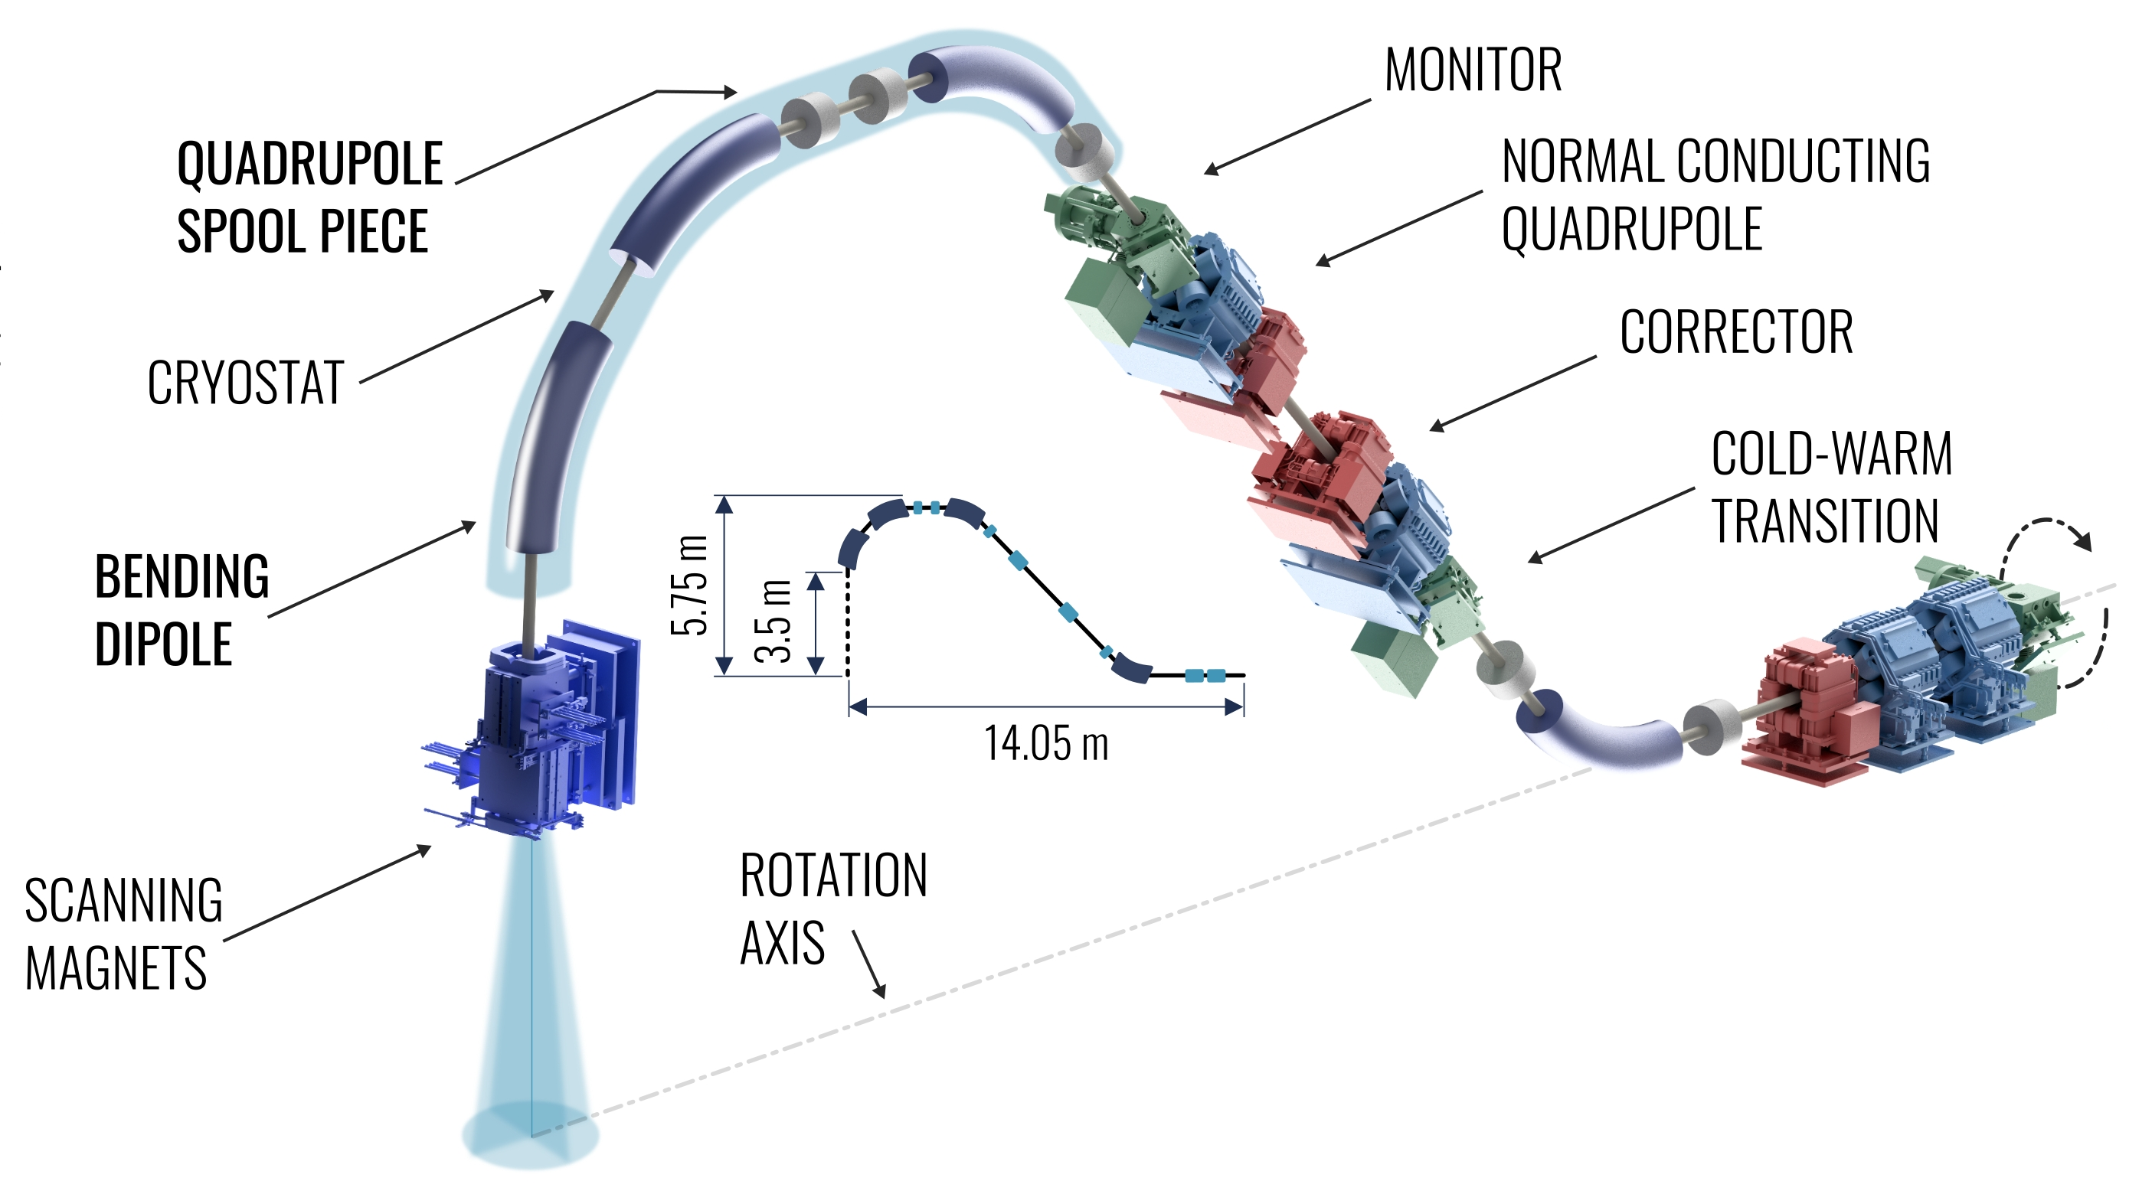
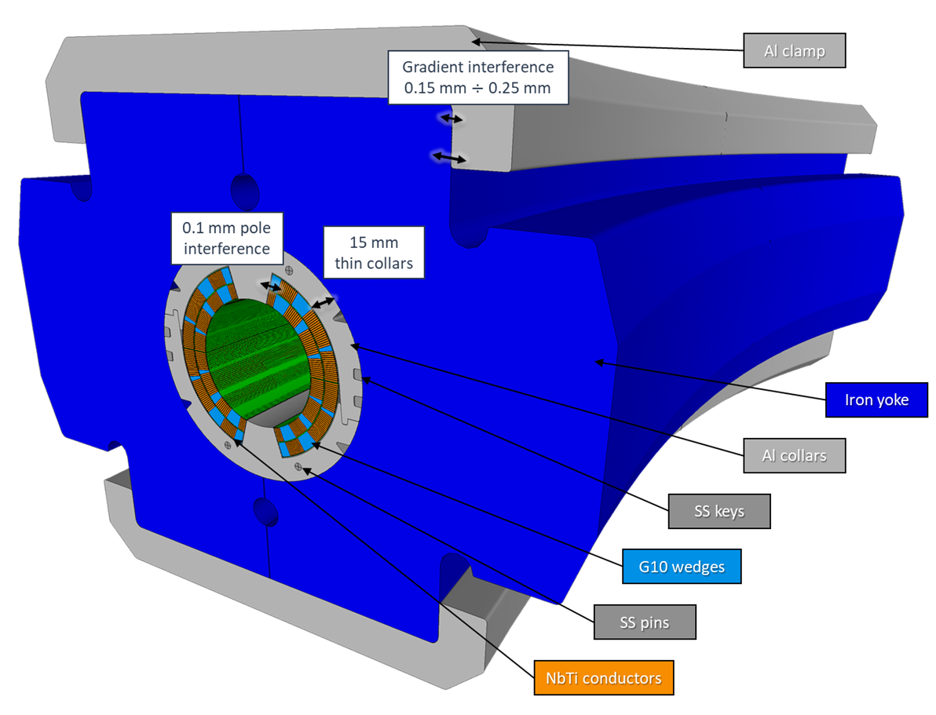
SIG WP2
Design, construction and test of a curved superconducting demonstrator magnet (SDM-c) for ion gantries
Main demo. magnet params
NbTi superconducting Rutherford cable
Cos-θ coils
Pure dipolar field: 4 T
Bore diameter: 80 mm
Small curvature radius: 1.65 m (Challenge #1)
Angular sector: 30°
High field ramp-rate: 0.15 T/s - 0.4 T/s (Challenge #2)
Compatible with conduction cooling (no LHe) but no optimization (Challenge #3)

Slide 13
HITRIplus WP8 – Superconducting magnet design

Slide 14
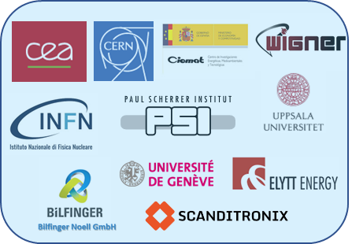
I.FAST WP8 – Innovative superconducting magnets

Slide 15
SC magnets for high energy physics

Slide 16
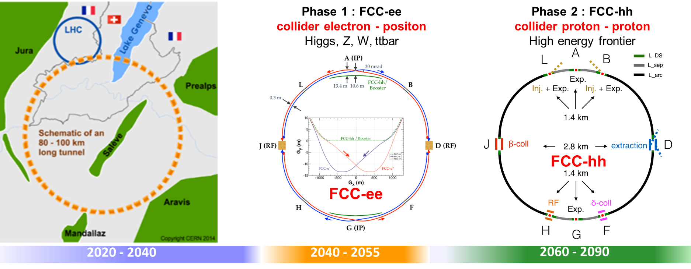
The FCC integrated program

Slide 17
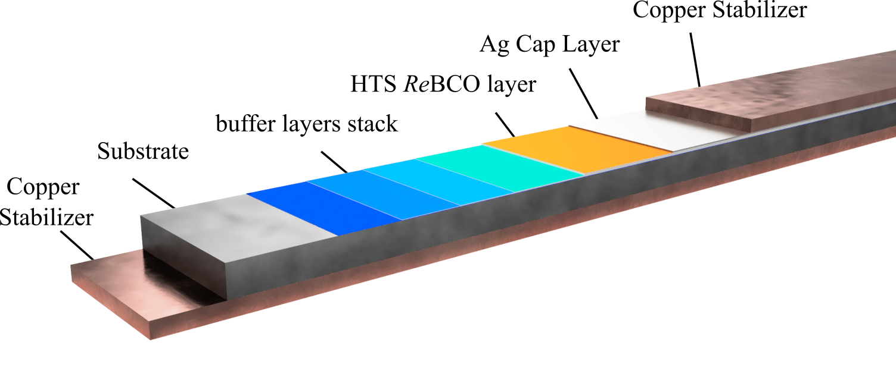
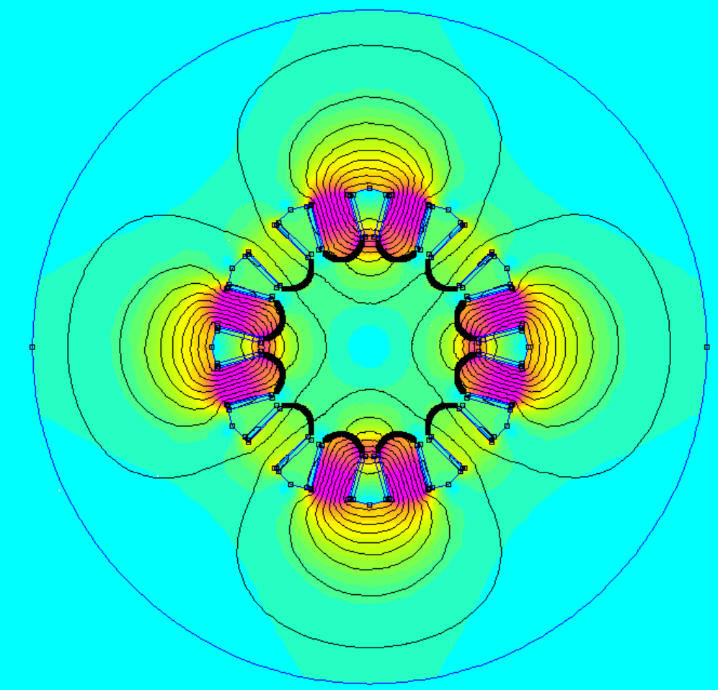
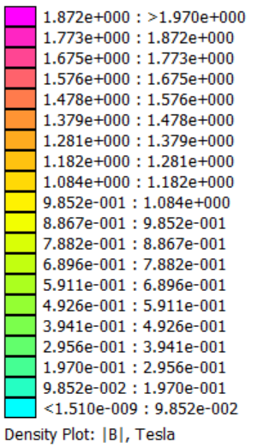
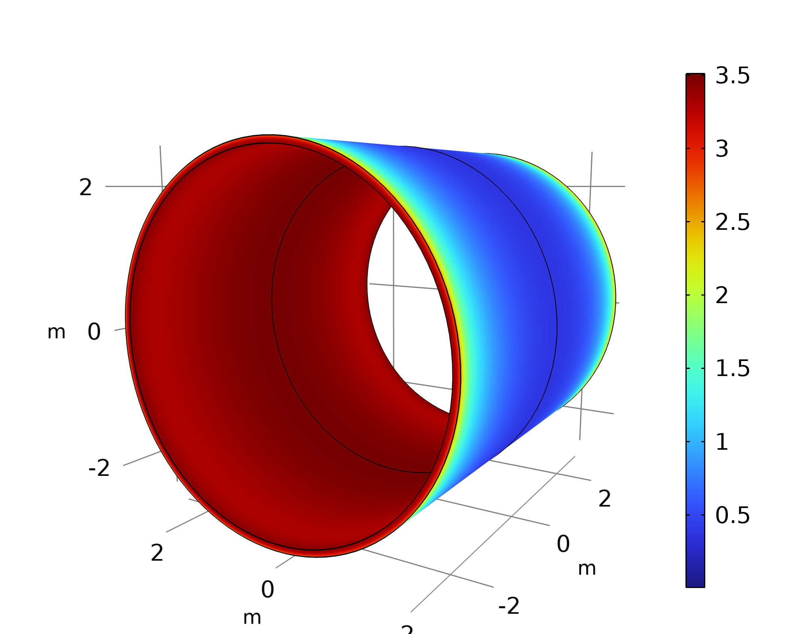
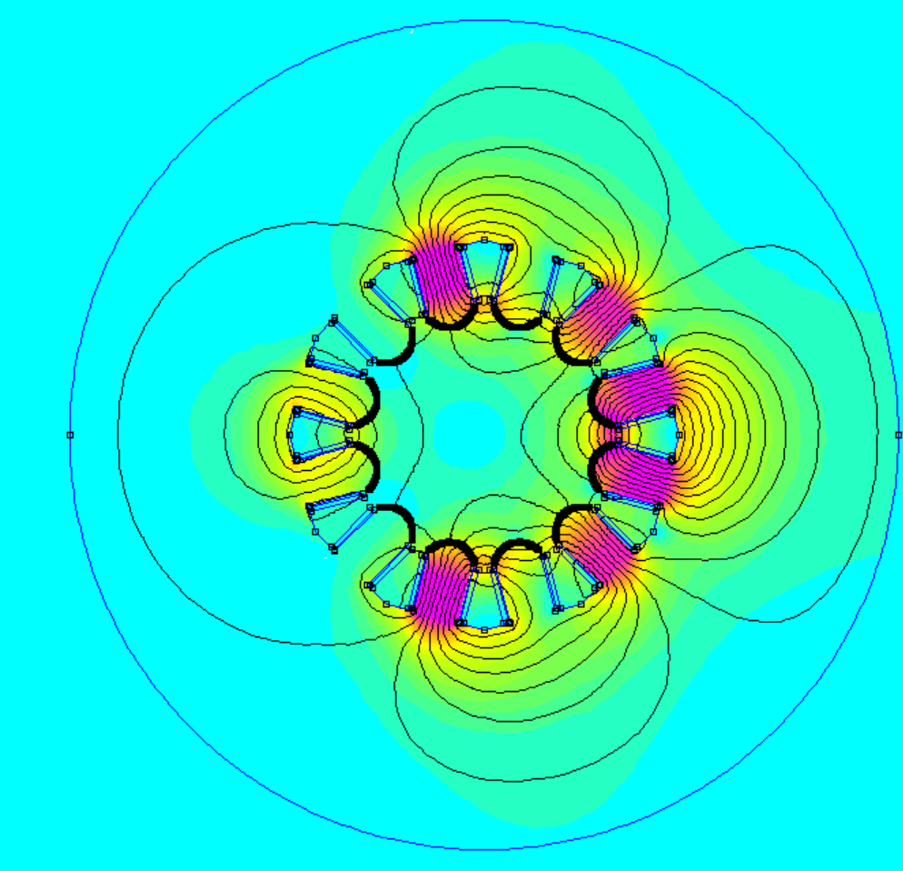
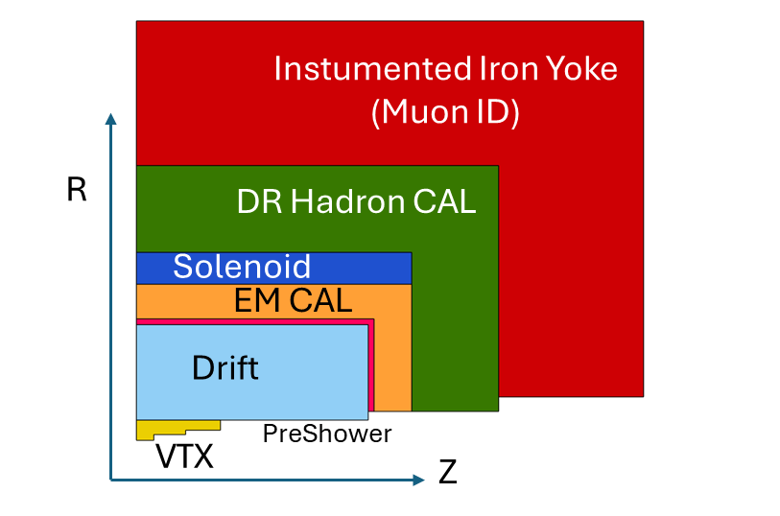
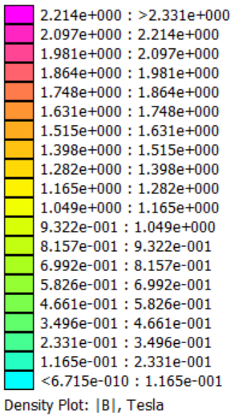
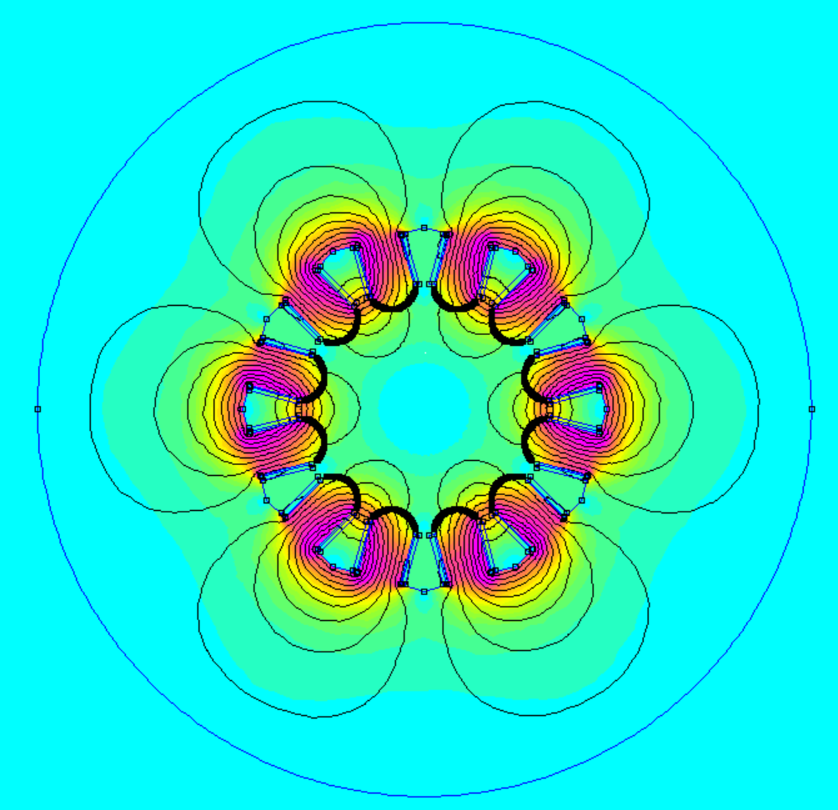
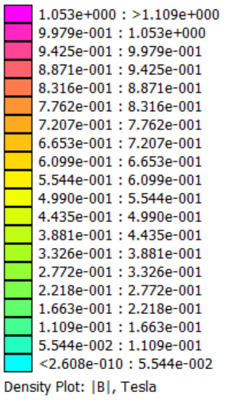
FCC-ee magnets
3T HTS solenoid for the IDEA detector
HTS superferric combined function quadrupole and sextupole magnet
Quadrupole
Combined mode
Sextupole

Slide 18
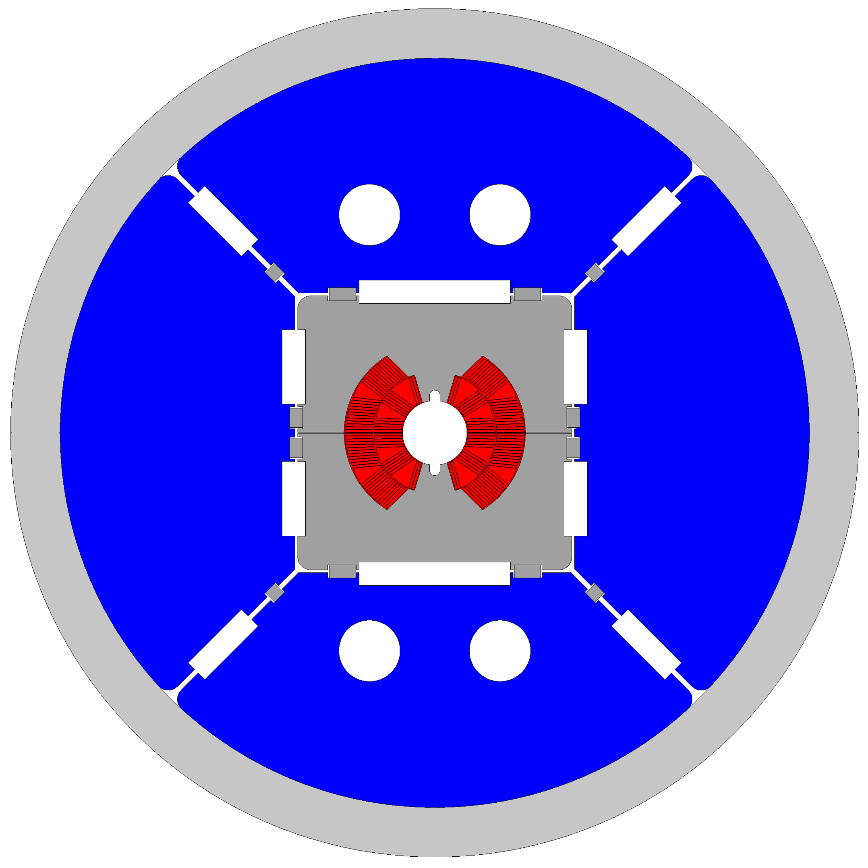
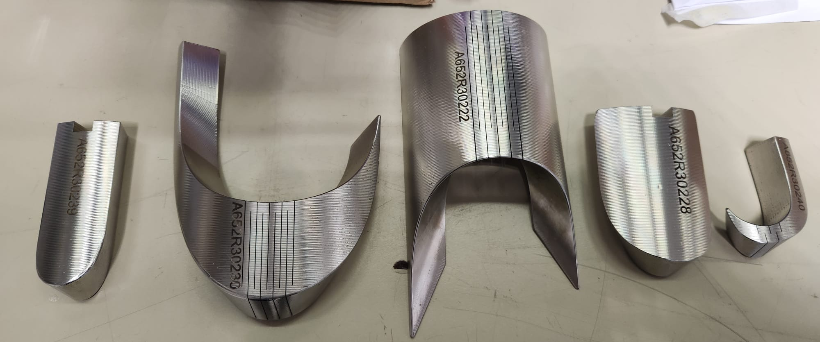
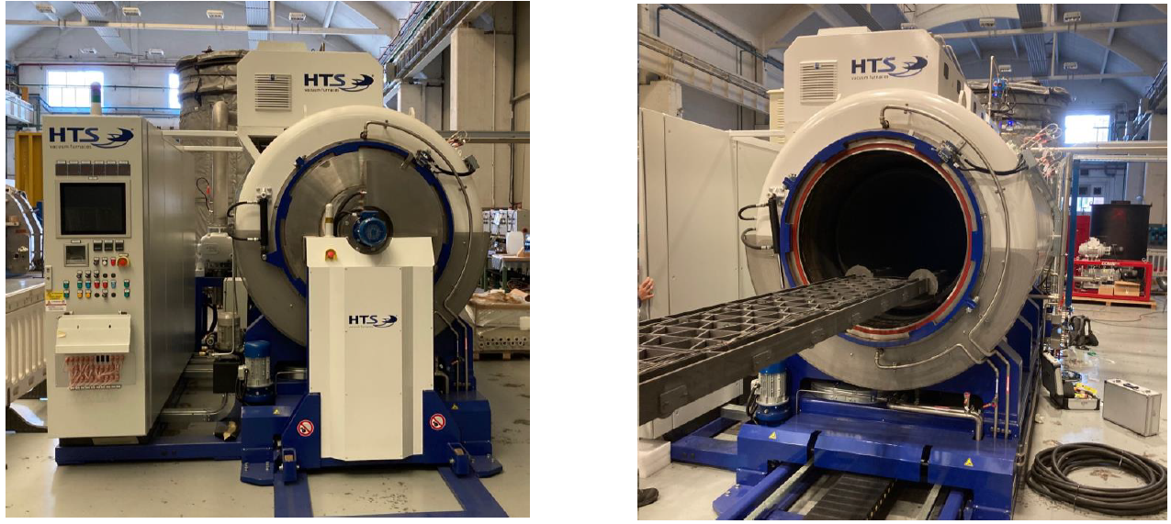
FCC-hh magnets
The FalconD project involves the development and construction of a short model Nb₃Sn dipole with the following specifications:
Single aperture with an inner bore of 50 mm.
2-layer cos-theta coil, providing a bore field of 12 T at 1.9 K.
Mechanical assembly using bladder & key technology.
The total coil length is 1.5 m.
SS end spacers
Furnace for coil heat treatments

Slide 19
Thanks for the attention

