Slide 1
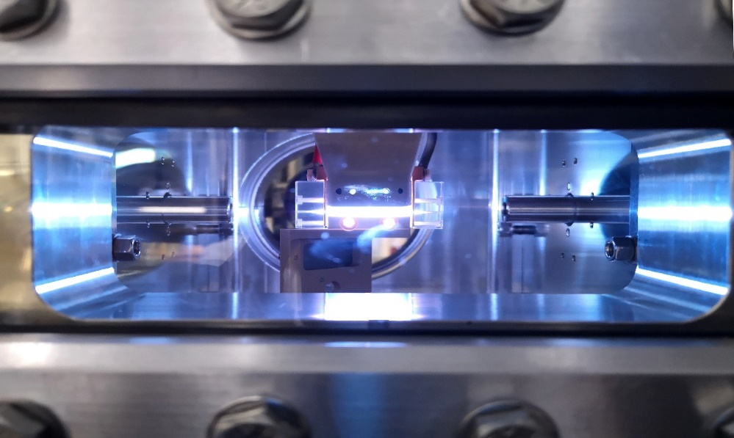
Plasma_lab
Plasma diagnostics for plamsa-based accelerators
Biagioni, L.Crincoli,
R. Demitra,
G. Costa, M. Anania
Laboratori Nazionali di Frascati
INFN
Angelo.Biagioni@lnf.infn.it

Slide 2
Outline
Motivations
Plasma-based accelerators
Plasma lenses
Plasma sources
Gas-filled discharge capillary
Experimental setup
Plasma sources characterization
Angelo.Biagioni@lnf.infn.it

Slide 3
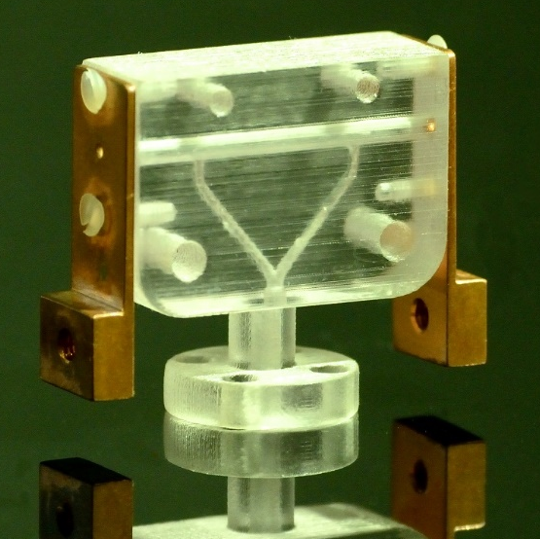
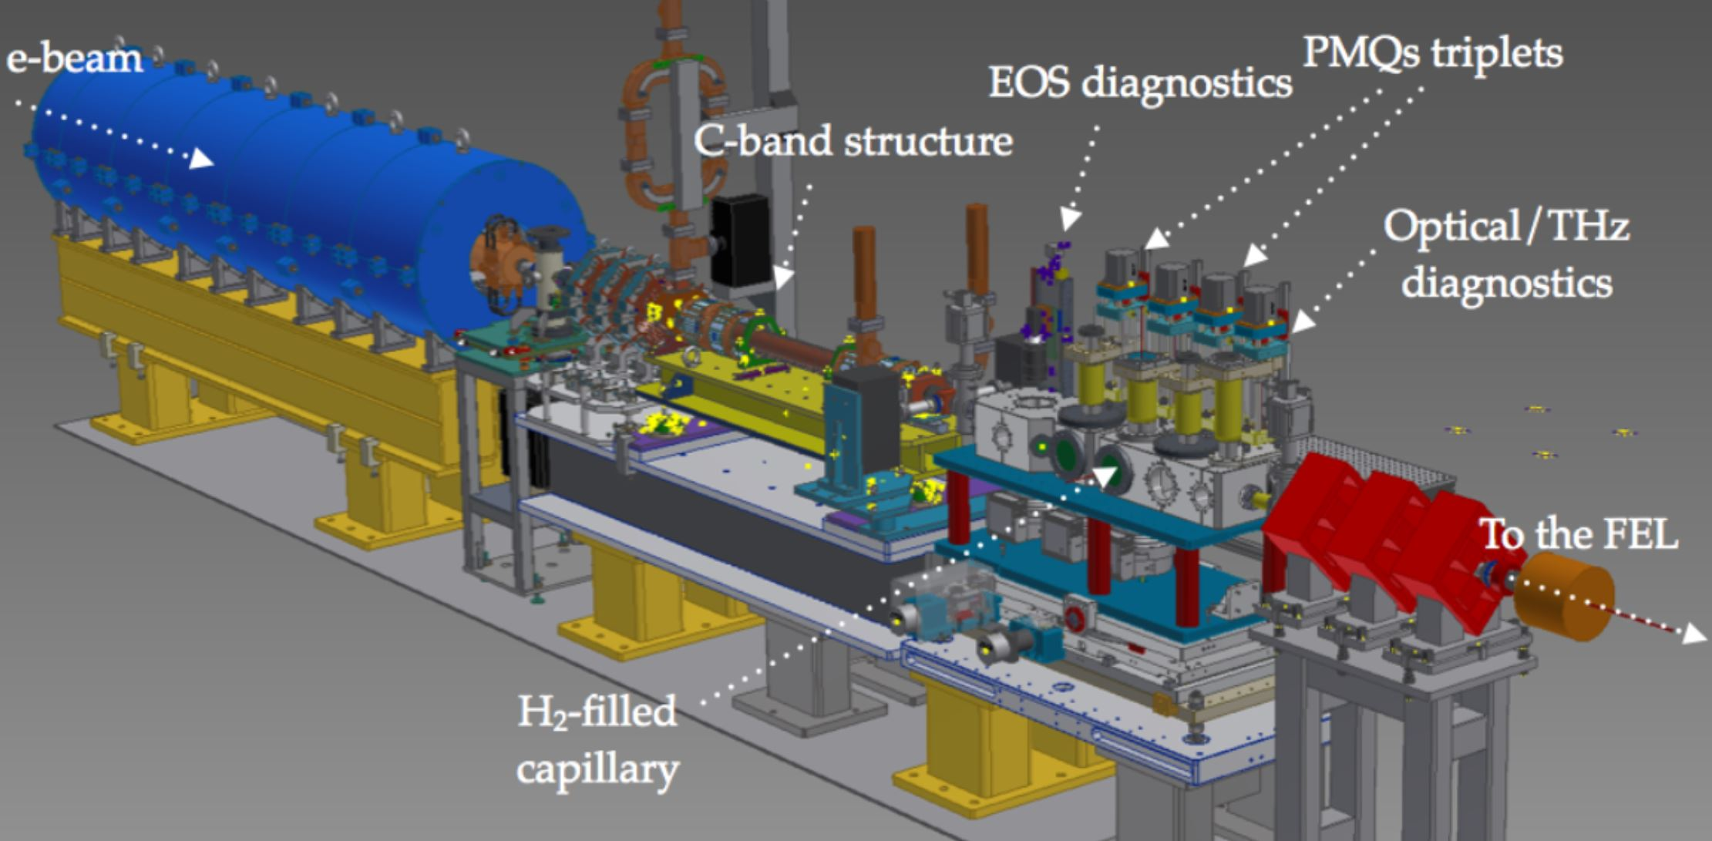
Plasma-based accelerators
Driver bunch
Witness bunch
Driver bunch
Witness bunch
RF-based accelerators MV/m
Plasma-based accelerators GV/m
Angelo.Biagioni@lnf.infn.it

Slide 4
Plasma-based accelerators
Driver bunch
λp
Witness bunch
Plasma density measurement
represents a crucial point to
implement plasma-based
devices:
Accelerators
Plasma lens
Linear regime (nb < np)
Weakly NL regime (nb = np)
Non-linear regime (nb>>np)

Slide 5
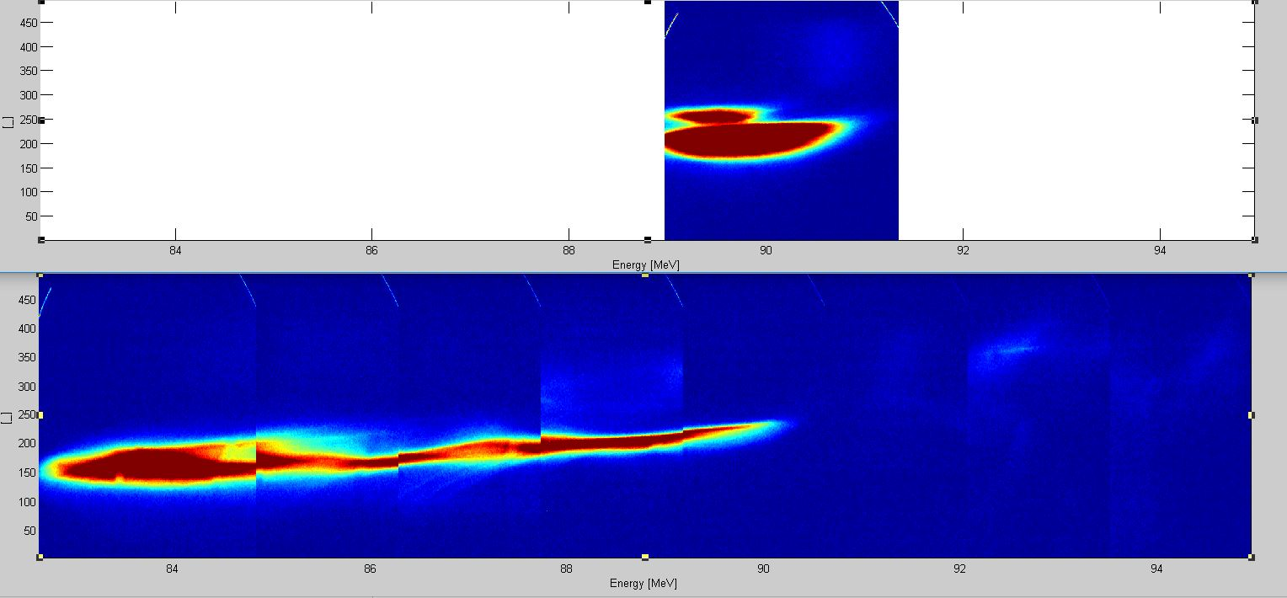
First results
Plasma capillary
No Plasma
Witness
3 cm
Driver
3 MeV
7 MeV
Witness
Driver
With Plasma
Plasma obtained at 12kV-310 A
Electron density 10¹⁵ cm⁻³
λp ~ 1050 um
By using a 3cm long capillary, an accelerating gradient of 800 MV/m has been obtained, which should be compared to 20-30 MeV of conventional accelerating system

Slide 6
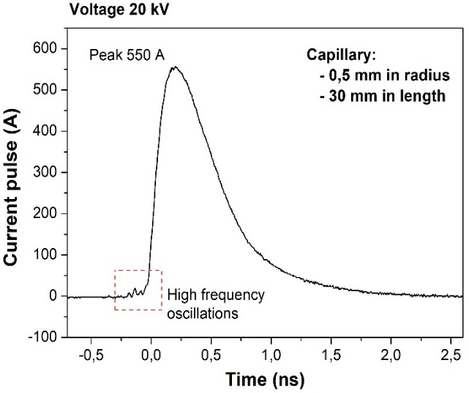
Experimental set-up
Capillary shapes:
Length (Energy)
Radius (Density)
Timing:
Valve opening time
Voltage delay time
Trigger of ICCD camera
Spectrometer:
Grating
Optical alignment
Camera timing:
Delay time
Gate time
Angelo.Biagioni@lnf.infn.it

Slide 7
Plasma sources: gas-filled discharge capillary
3cmx1mm
20cmx1mm
two inlets
Plasma source characterization means to study the plasma behaviour as a fuction of many parameters: discharge voltage, position and number of the gas inlets, plasma channel shape and so on, that in turn will affect the quality of the accelerated beam
10cmx1mm
single inlet

Slide 8
Plasma characterization: density measurements
Stark broadening method
By using the Stark broadening method to measure
the plasma density, we obtain the below result:
the larger is the Balmer line (Δλ), the higher is the
electron density of plasma
Electrode shadow
Plasma channel
Plasma
plume
Balmer Beta line B_{β} due to transitions from the
outer orbit n=4 to the orbit n=2
Angelo.Biagioni@lnf.infn.it

Slide 9
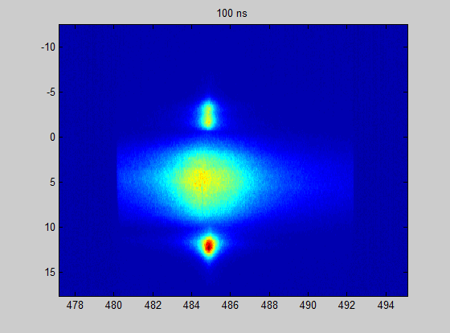
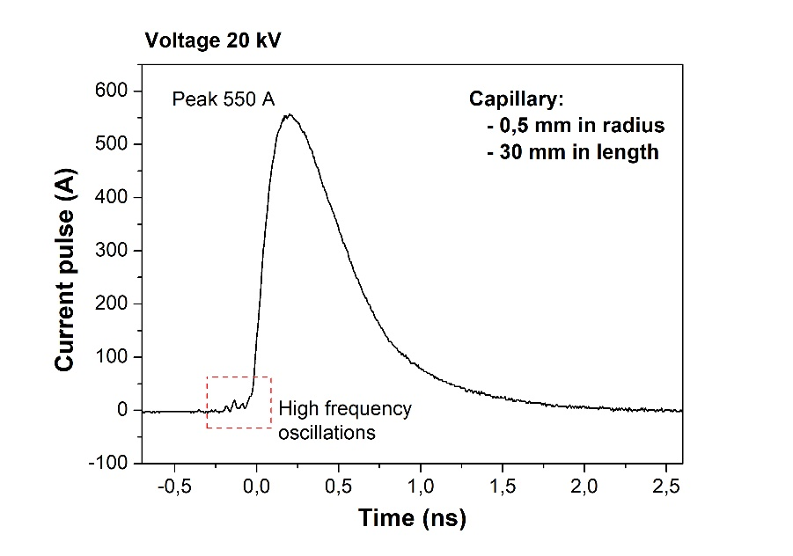
Density measurements
Plasma density inside and outside the capillary will change during the current pulse: such a behaviour it is very important to select when inject the electron bunch
Position (mm)
Balmer β line
Δλ
Capillary
Electrode
Plasma
channel
Plasma plume
λ (nm)
Angelo.Biagioni@lnf.infn.it

Slide 10
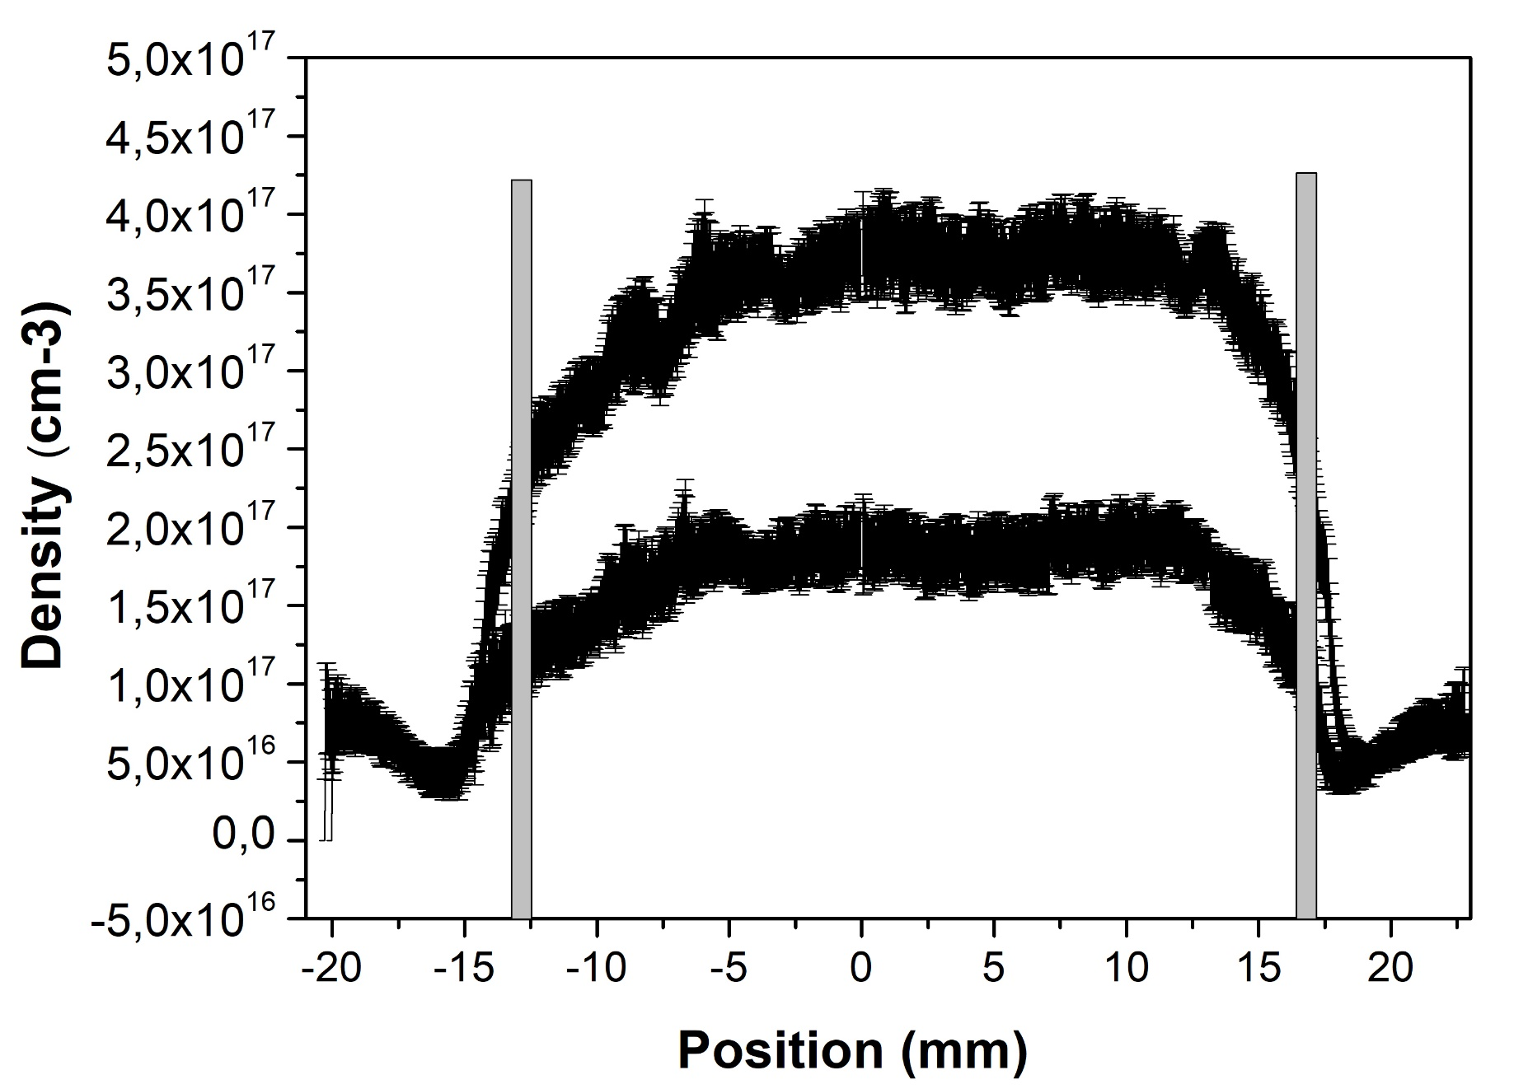
inlets
Stability 5-7%
800 ns
Uniformity
50%
20 mm
1200 ns
Plumes
10-15mm
30 mm
Capillary 3cmx1mm 2 inlet NO SPACERS
13 kV - 300 A
Pressure 300 mbar

Slide 11
Laser triggering
Gas injection
Lens to change
the focal spot
Vacuum chamber Plasma_lab
+
Capillary 5cmx1mm Minimum breakdown voltage depends on the neutral gas pressure
By using a laser beam to trigger the discharge :
Minimum voltage
Stability shot-to-shot
Plasma current
Timing jitter
Plasma light
Laser
100 mJ
11 ns
100 um
Spectrometer
ICCD

Slide 12
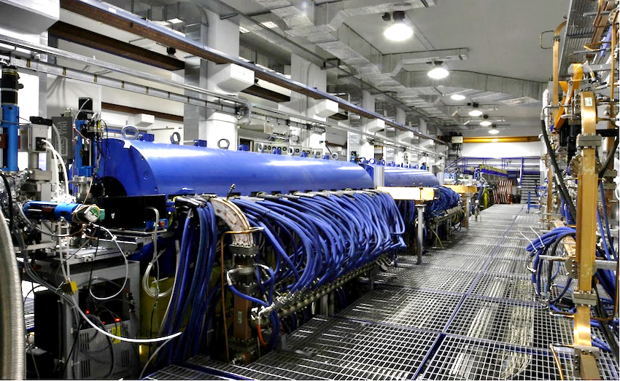
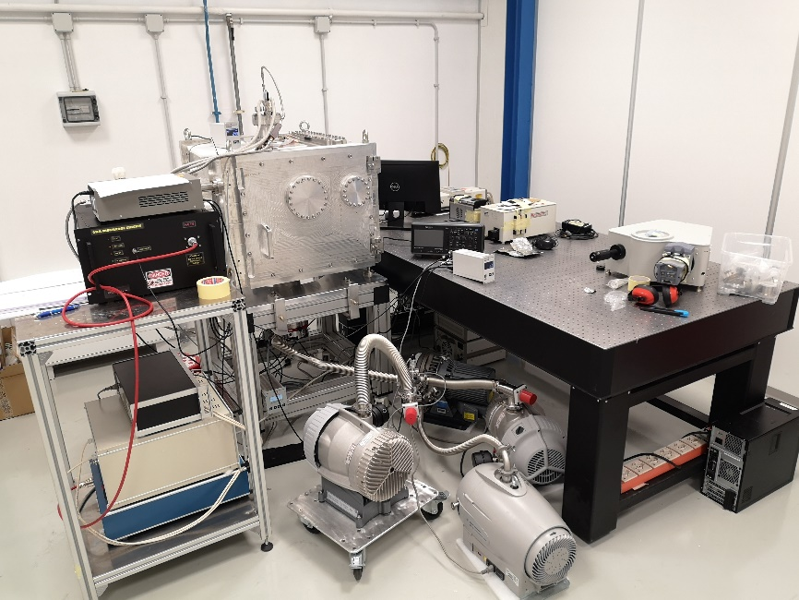
Plasma_lab experience
Sparc_lab accelerator
New Plasma lab
How to use the experimental setup to produce plasmas inside capillaries with different shapes: length and radius
How to implement the optical system and set ICCD camera parameters to make the spectrographic analysis
How to make the data processing to obtain the plasma densities to characterize our plasma sources

Slide 13
Thank you
for your attention

