Slide 1


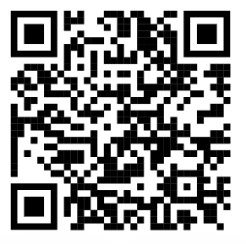

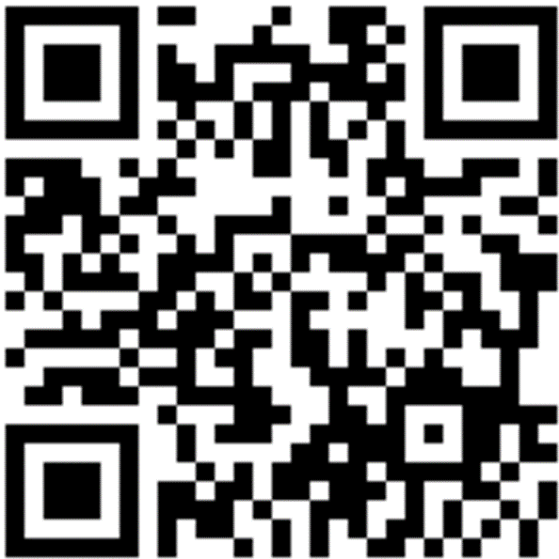
CH4rLiE
Associate Professor. Dr. Daniele Dondi
Director in Laboratory of Radiation Chemistry and EPR Spectroscopy
Department of Chemistry, University of Pavia, 27100, Italy.
Thursday, October 28th, 2024

Slide 2
EXPERIMENTS
Prepared a Nickel metal pyrolysis boat for large scale pyrolysis.
Earlier the pyrolysis sample boat was small and only 120mg of sample can only be loaded for safety and effective pyrolysis. Now with the Nickel boat around 500mg of sample can loaded in single charging. Prepared 2g of Z5 and Z10 lignin 20% pyrolyzed sample.
The pyrolyzed sample was tested for Ni metal with Ni-DMG complex text and ammonia test. There was no nickel found in the pyrolyzed sample.

Slide 3
Z5-Lignin 20% pyrolyzed with Nickel boat 500mg batch
Carbon content-14.4%

Slide 4
Z5-Lignin 20% pyrolyzed with Nickel boat 750mg loading
Carbon content-14%

Slide 5
Z10-Lignin 20% pyrolyzed with Nickel boat 500mg batch
Carbon content-16.9%

Slide 6
Acknowledgement
Thank you

