Slide 1


Perspectives in High Charge State ECR Ion Source Development and Scope
IMP
L. Sun
Institute of Modern Physics, CAS, 730000, Lanzhou, China
PIBHI’25, April. 7~9, 2025, Acitrezza, Italy

Slide 2
Outline
The Driving Forces in ECRIS Development
Review the previous development history
Perspectives in ECRISs
Towards physics frontier
Towards ion beam intensity frontier
Scope and Summary
Notes:
Needs: SHE, CEE, HIAF
HCI production: metallic beams with CAFe-2 (LECR5 & SECRAL 3), Uranium beam with HIRFL@SECRAL-I & SECRAL-II
New Techniques towards intense beams: HTO, Vlasov launcher, 2-frequency AG, Biased probe + AG effect
HIAF requirements in long range, FECR

Slide 3
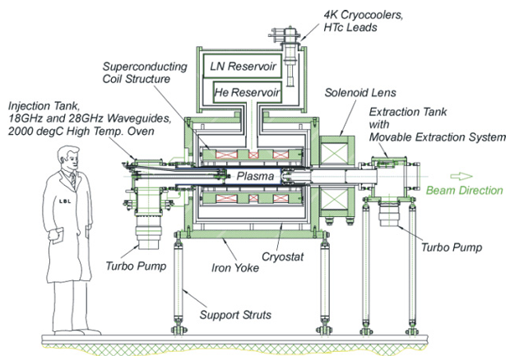
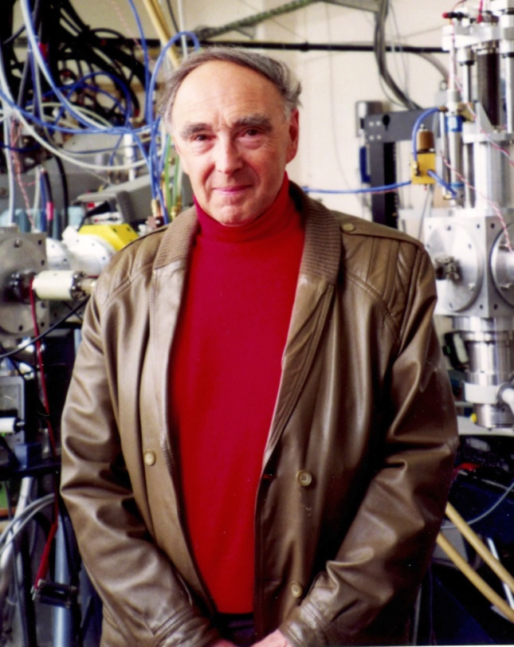
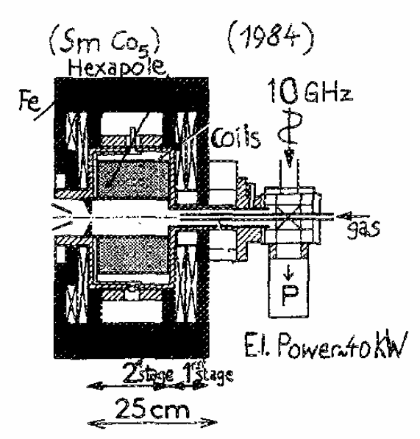

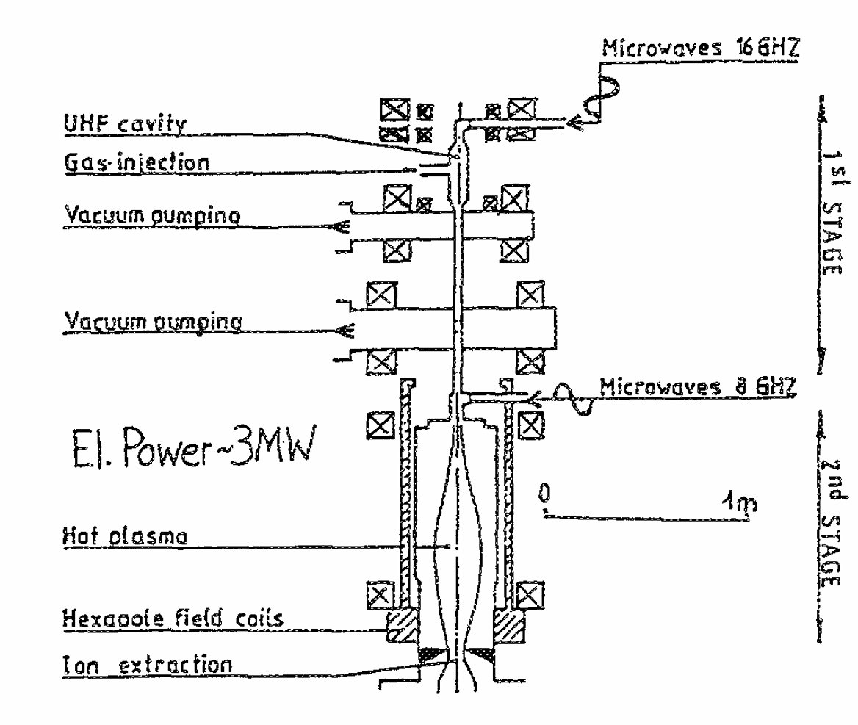
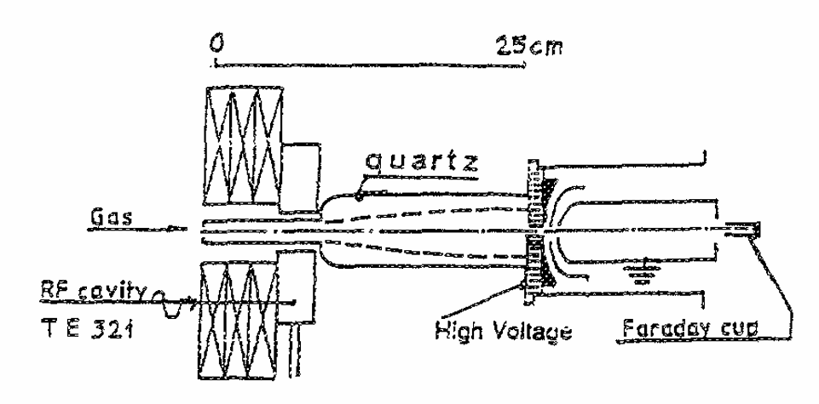
ECRIS Development
ECRIS is a great machine
3rd G.
2nd G.
1st G.
VENUS (2003)
Caprice (1984)
Geller’s Scaling Laws:
I(q) α B_{ecr}² ∼ ω_{rf}²
Q_{opt} ∼ log ω_{rf}³
origin
SuperMAFIOS (1974)
Scaling laws guiding
(merged with techniques)
1st ECRIS (1965)
Notes:
Needs: SHE, CEE, HIAF
HCI production: metallic beams with CAFe-2 (LECR5 & SECRAL 3), Uranium beam with HIRFL@SECRAL-I & SECRAL-II
New Techniques towards intense beams: HTO, Vlasov launcher, 2-frequency AG, Biased probe + AG effect
HIAF requirements in long range, FECR

Slide 4
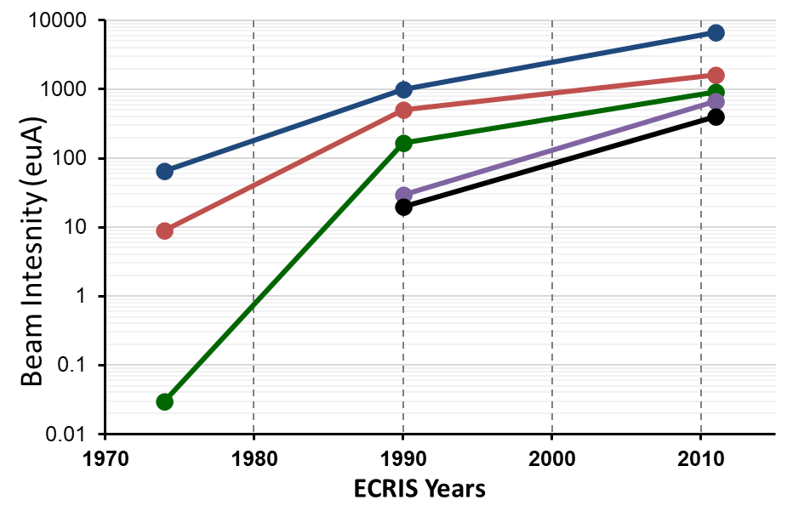
ECRIS Development
~15 years continuous developments for high performance 2nd G. ECRIS:
High-B mode
Double frequency
Frequency fine tuning
Biased disk
Al chamber
Afterglow
Gas-mixing
Coaxial coupling
Direct WG coupling
Micro-oven tech.
…
ECRIS used on Cyclotron
Worldwide enthusiasm on ECRIS
O⁶⁺
Bi³¹⁺
U³⁴⁺
Ar¹¹⁺
Xe²⁷⁺
More than 20 years continuous R&D:
SC-magnet for ECRIS
HTO Tech.
ECR plasma physics
…
ECRIS used on Linac
Notes:
Needs: SHE, CEE, HIAF
HCI production: metallic beams with CAFe-2 (LECR5 & SECRAL 3), Uranium beam with HIRFL@SECRAL-I & SECRAL-II
New Techniques towards intense beams: HTO, Vlasov launcher, 2-frequency AG, Biased probe + AG effect
HIAF requirements in long range, FECR

Slide 5
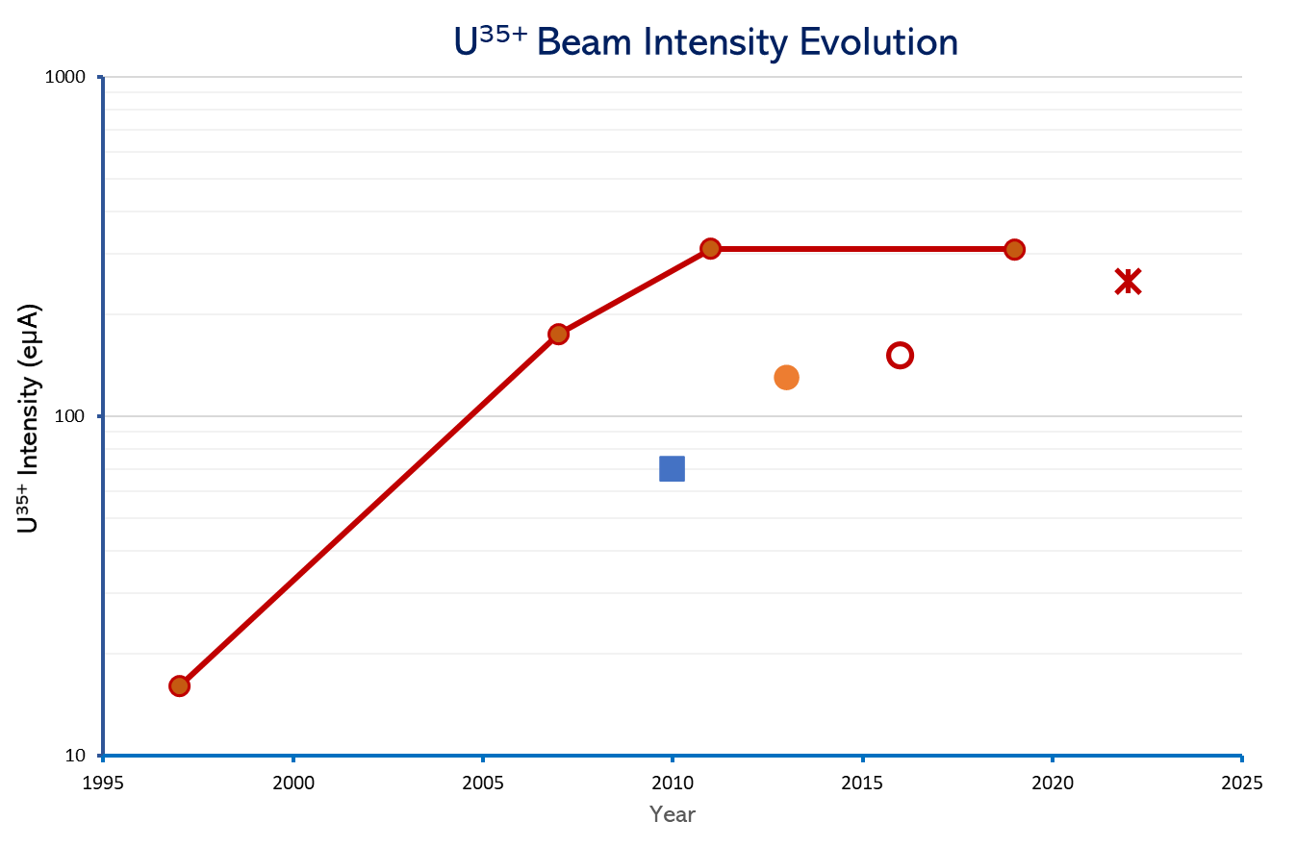
ECRIS Development
28 GHz SECRAL-II
(IHO + UO₂)
+ miro-channel chamber
28 GHz VENUS
(HTO + UO₂)
28 GHz SECRAL-II
(IHO + UO₂)
28 GHz SCECRIS/RIKEN
(HTO + UO₂)
28 GHz VENUS
(oven + URe₂ alloy)
28 GHz SCECRIS/RIKEN
(Sputtering)
24 GHz SECRAL
(Sputtering)
18 GHz SuSI
(Sputtering)
High Intensity U³⁵⁺
Reliable oven >1800℃
High performance ECRIS
14.5 + 10 GHz AECR-U
(oven + URe₂ alloy)
HTO: High temperature resistor heating oven, IHO: Inductive heating oven
Notes:
Needs: SHE, CEE, HIAF
HCI production: metallic beams with CAFe-2 (LECR5 & SECRAL 3), Uranium beam with HIRFL@SECRAL-I & SECRAL-II
New Techniques towards intense beams: HTO, Vlasov launcher, 2-frequency AG, Biased probe + AG effect
HIAF requirements in long range, FECR

Slide 6
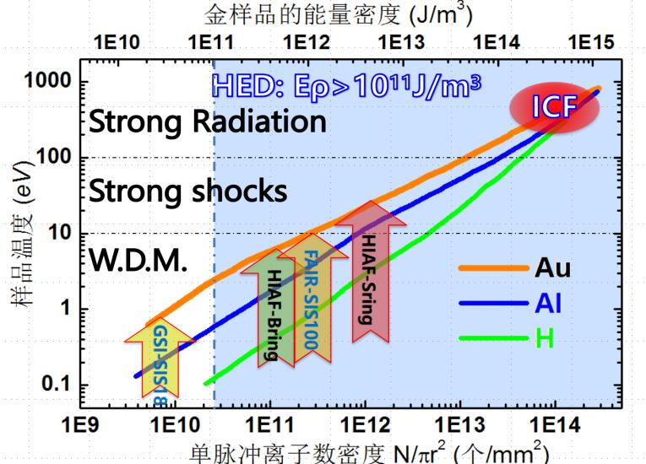
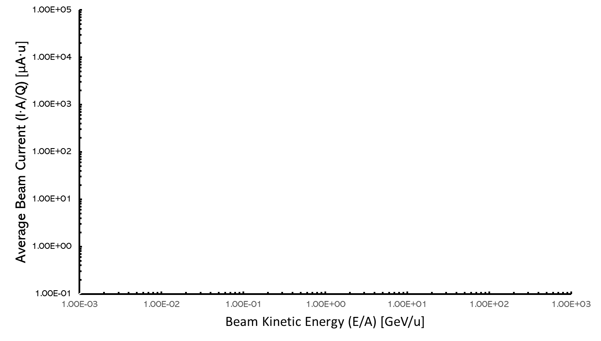
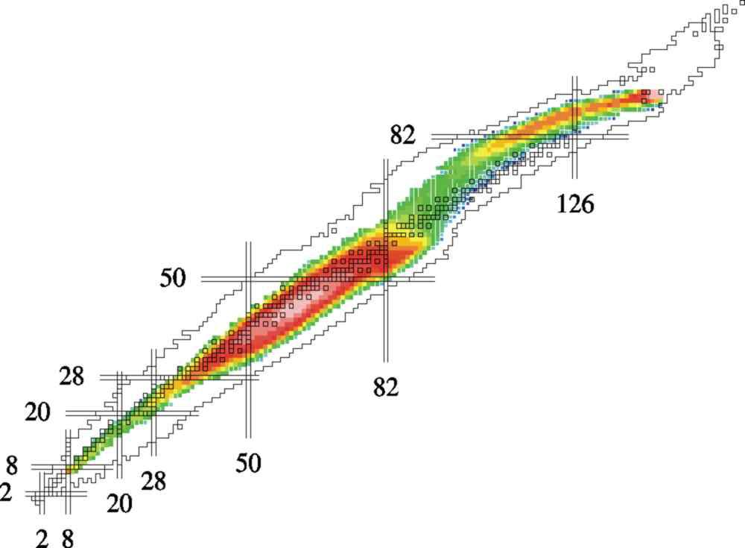
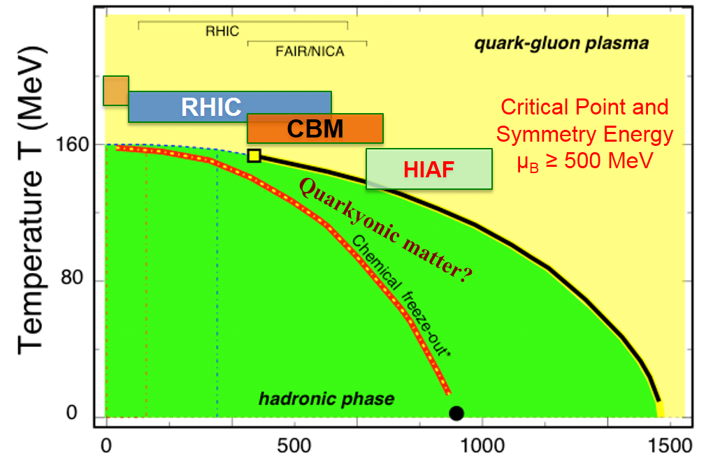
ECRIS Supported Physics Frontier
HEDM
HEDP→ ICF
Nuclear physics
Heavy ion application
QCD
Notes:
Needs: SHE, CEE, HIAF
HCI production: metallic beams with CAFe-2 (LECR5 & SECRAL 3), Uranium beam with HIRFL@SECRAL-I & SECRAL-II
New Techniques towards intense beams: HTO, Vlasov launcher, 2-frequency AG, Biased probe + AG effect
HIAF requirements in long range, FECR

Slide 7
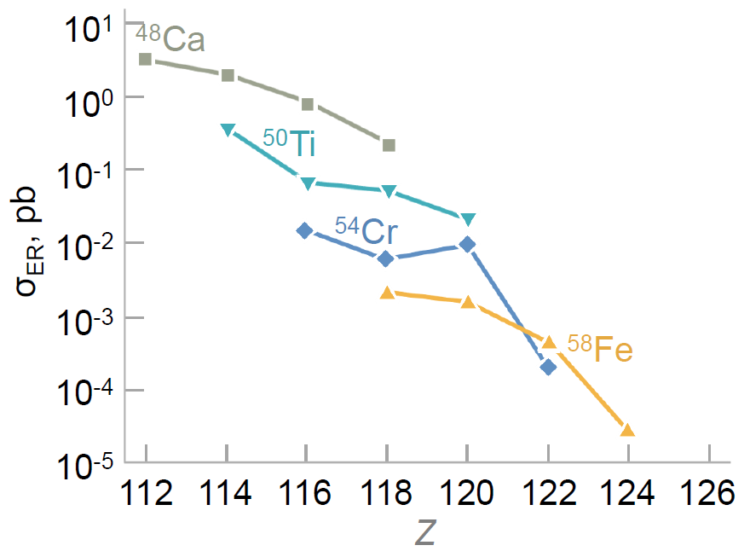
ECRIS Supported Physics Frontier
Z>118 synthesis: σ<10 fb
Need beams: >10²⁰ ions/cm²
New element:
High intensity 10~20 pμA
High power target
Intense highly charged medium Z ion beams
G. Adamian, N. Antonenko, A. Bezbakh, and R. Jolos, Physics of Particles and Nuclei, Vol. 47, No. 3, pp. 387–455 (2016)
Notes:
Needs: SHE, CEE, HIAF
HCI production: metallic beams with CAFe-2 (LECR5 & SECRAL 3), Uranium beam with HIRFL@SECRAL-I & SECRAL-II
New Techniques towards intense beams: HTO, Vlasov launcher, 2-frequency AG, Biased probe + AG effect
HIAF requirements in long range, FECR

Slide 8
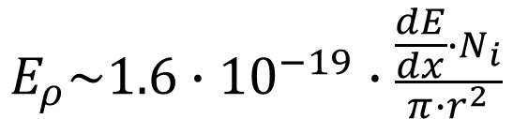
ECRIS Supported Physics Frontier
$$E_{ρ}\sim 1.6∙{10}^{−19}∙\frac{\frac{dE}{dx}∙N_{i}}{π∙r^{2}}$$
HEDP
Heavier Ions（Z²）
Higher Intensity（I_{q}）
Efficient Acc.：Higher Q
Intense highly charged heavy ion beams
Notes:
Needs: SHE, CEE, HIAF
HCI production: metallic beams with CAFe-2 (LECR5 & SECRAL 3), Uranium beam with HIRFL@SECRAL-I & SECRAL-II
New Techniques towards intense beams: HTO, Vlasov launcher, 2-frequency AG, Biased probe + AG effect
HIAF requirements in long range, FECR

Slide 9
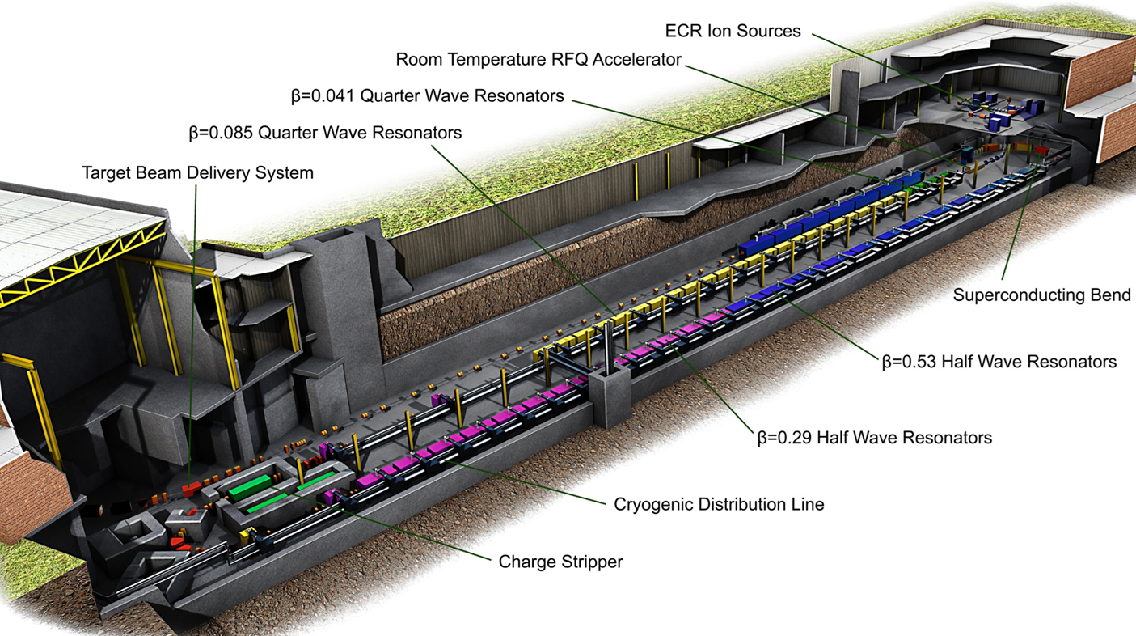
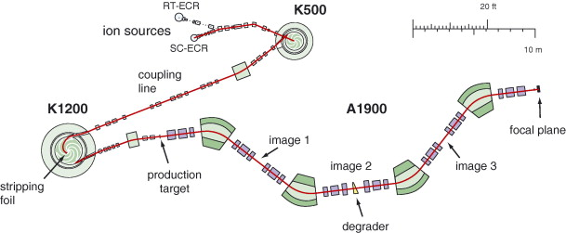
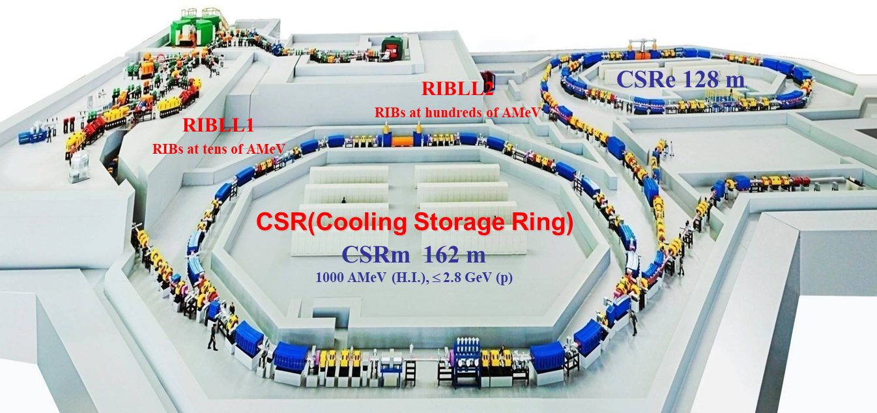
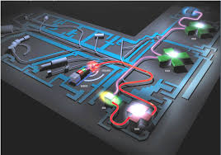
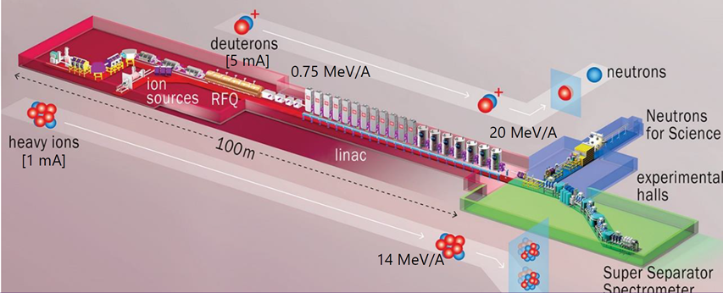
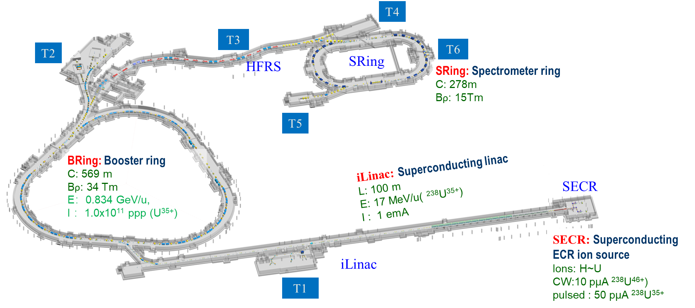
Towards Heavy Ion Beam Frontier
NSCL-CCF
FRIB
HIRFL
SPIRAL1
SPIRAL2
HIAF
Notes:
Needs: SHE, CEE, HIAF
HCI production: metallic beams with CAFe-2 (LECR5 & SECRAL 3), Uranium beam with HIRFL@SECRAL-I & SECRAL-II
New Techniques towards intense beams: HTO, Vlasov launcher, 2-frequency AG, Biased probe + AG effect
HIAF requirements in long range, FECR

Slide 10
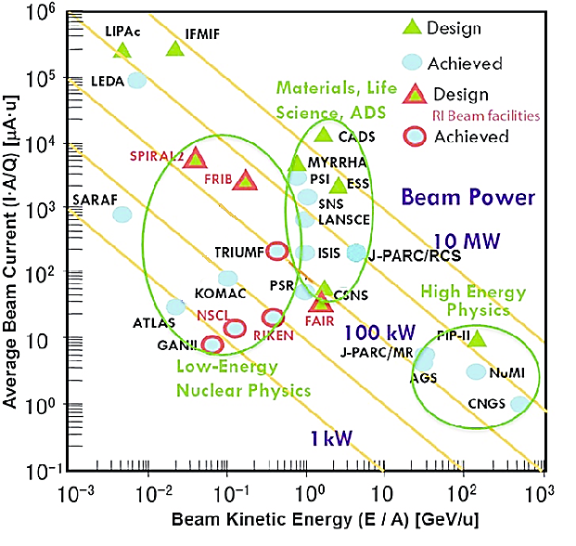
Towards Heavy Ion Beam Frontier
HIAF/CW
Heavy ion beam power frontier
FRIB
HIAF/pulsed
(CW beam)
Heavy ion beam
energy frontier
(pulsed beam)
Notes:
Needs: SHE, CEE, HIAF
HCI production: metallic beams with CAFe-2 (LECR5 & SECRAL 3), Uranium beam with HIRFL@SECRAL-I & SECRAL-II
New Techniques towards intense beams: HTO, Vlasov launcher, 2-frequency AG, Biased probe + AG effect
HIAF requirements in long range, FECR

Slide 11
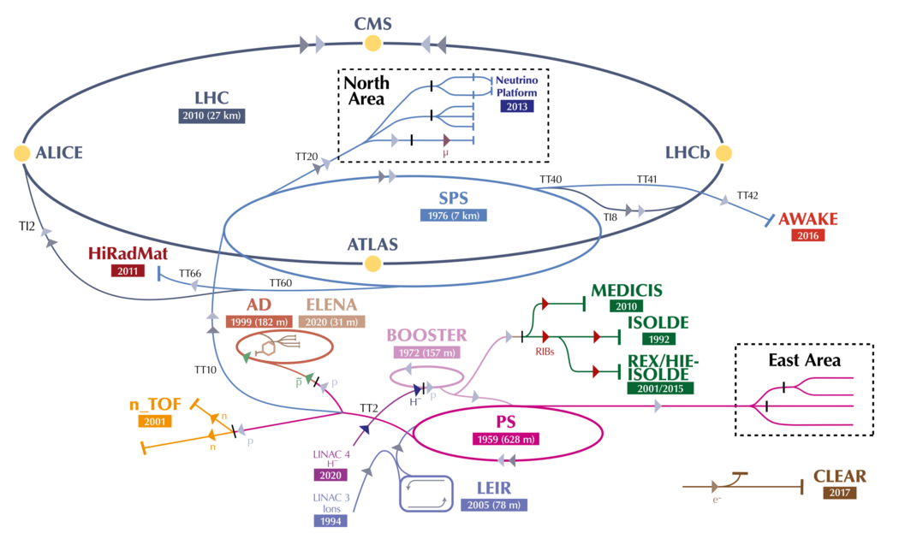
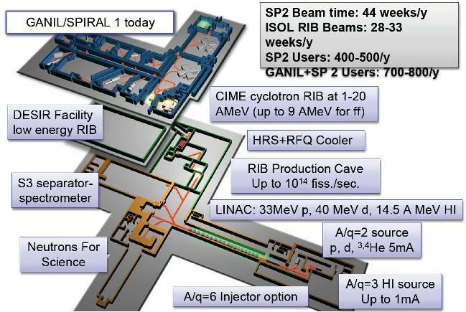
Scope: Historical Questions
LHC
SPIRAL2
1.0 emA Pb²⁷⁺/ 0.4 ms@10 Hz
1.0 emA Ar¹²⁺/ CW
Notes:
Needs: SHE, CEE, HIAF
HCI production: metallic beams with CAFe-2 (LECR5 & SECRAL 3), Uranium beam with HIRFL@SECRAL-I & SECRAL-II
New Techniques towards intense beams: HTO, Vlasov launcher, 2-frequency AG, Biased probe + AG effect
HIAF requirements in long range, FECR

Slide 12
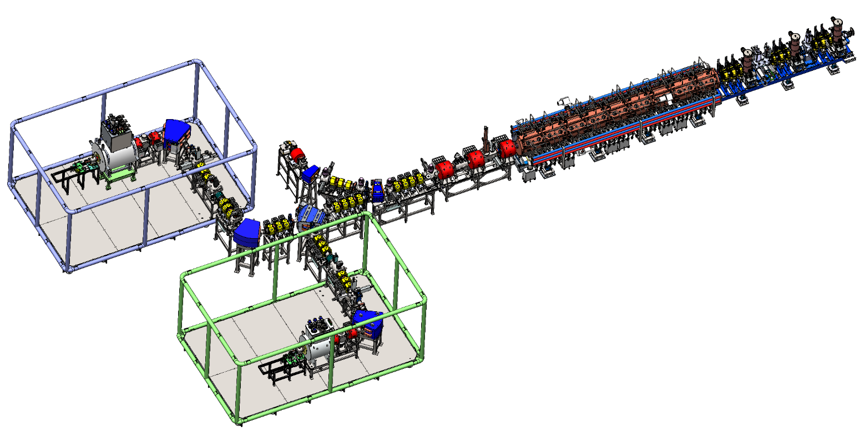
Scope: New Challenges
pulsed: 28 pμA U³⁵⁺
1 ms@3 Hz
CW: >10 pμA U⁴⁶⁺
HIAF Front-end
pulsed: 50 pμA U³⁵⁺
>1 ms@3 Hz
CW: >14 pμA U⁴⁶⁺
Ion Sources:
Mission:
Capacity to produce intense ion beams
New Methods to intense pulsed beams
Macro and micro stability: days—ms—μs

Slide 13
Scope: Key Issues
Higher Q, I_{q}=
Higher P_{rf}
B
M
P
E
Magnetic confinement
Intense beam extraction
Effective μW heating
Plasma feeding

Slide 14
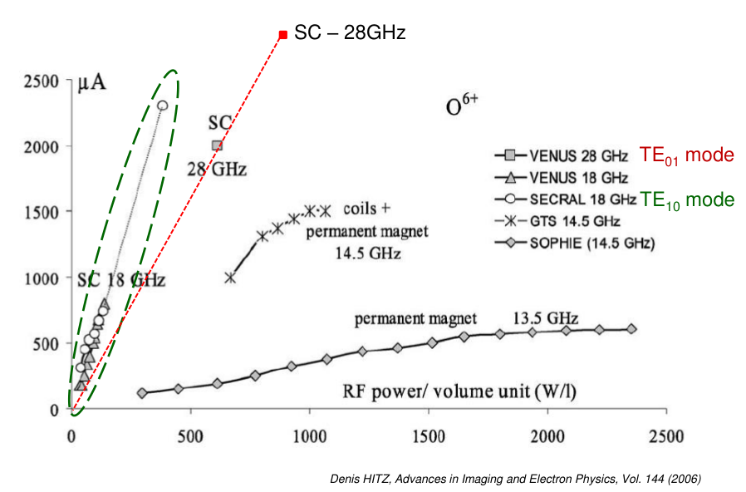
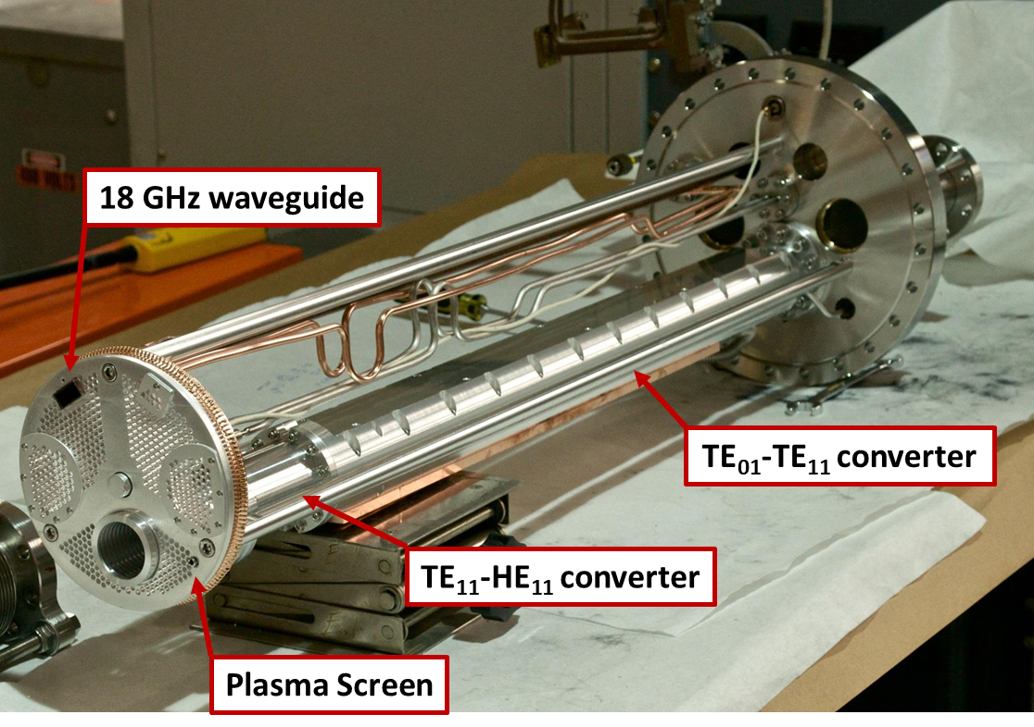
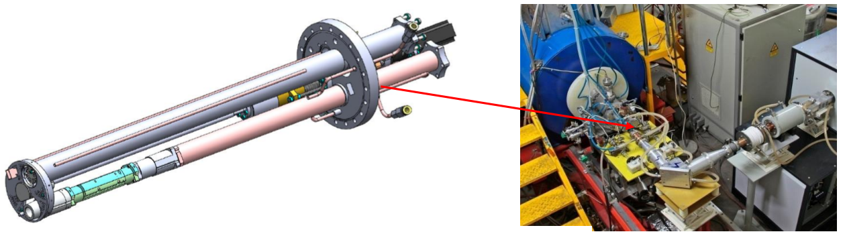
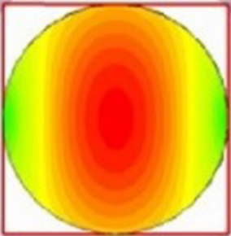
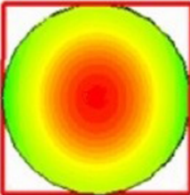
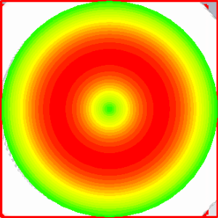
Scope 1: Microwave Heating Efficiency
Efficient microwave heating
VENUS Tests--2013
C. Lyneis@ICIS’13
Denis HITZ, Advances in Imaging and Electron Physics, Vol. 144 (2006)
TE11
HE11
Microwave coupling?
Microwave Launching?
TE01
See Wang’s talk
L. Sun@ICIS’15

Slide 15
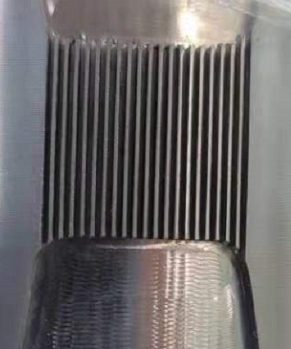
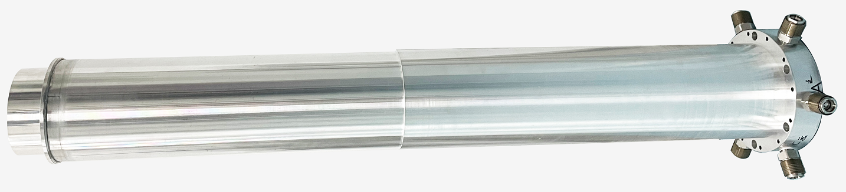
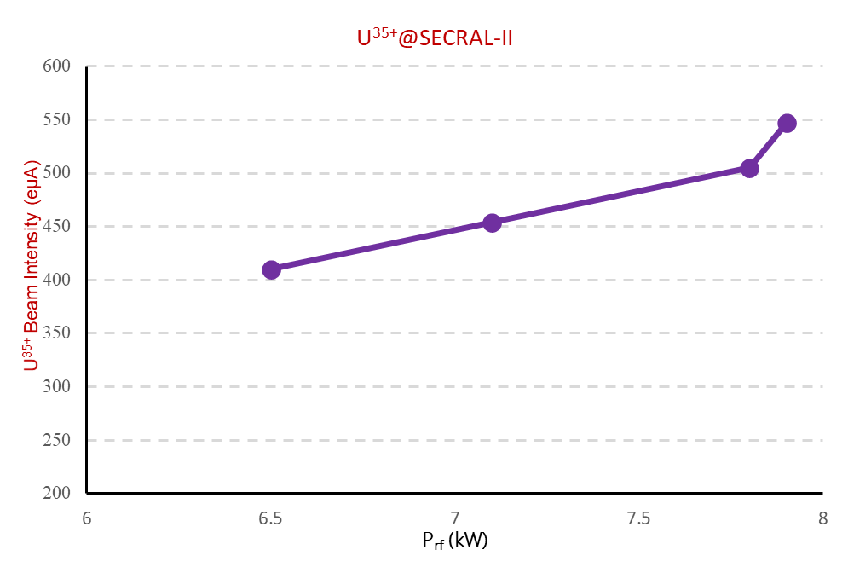
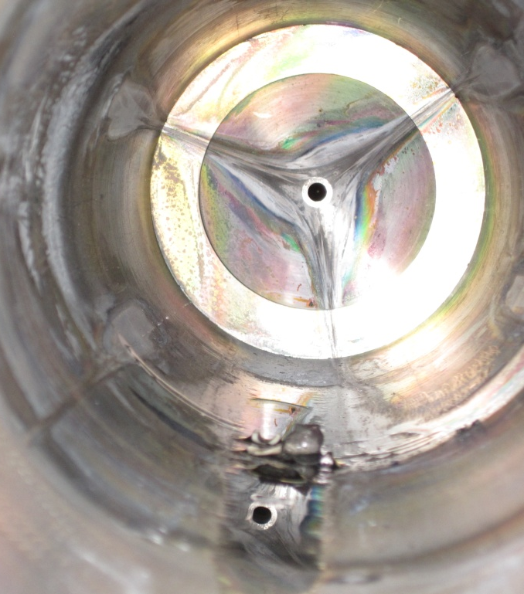
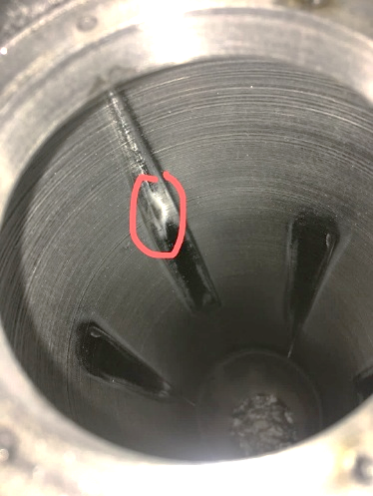
Scope 2: Plasma Chamber Cooling
Efficient Cooling
I_{q} ∝ P_{rf}
Micro-channel to mitigate the 10 MW/m² heat sink risk
Risk 1
Server etching marks after continuous high power Ar beam operation
Will that work at 20 MW/m² or 30 MW/m² ?
Risk 2

Slide 16
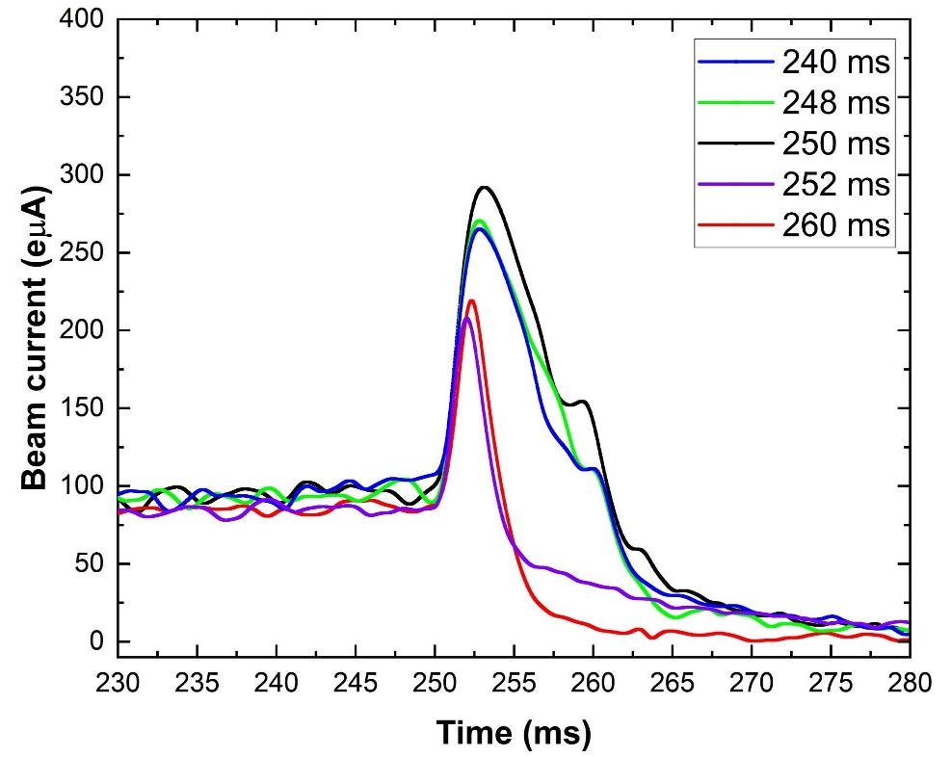
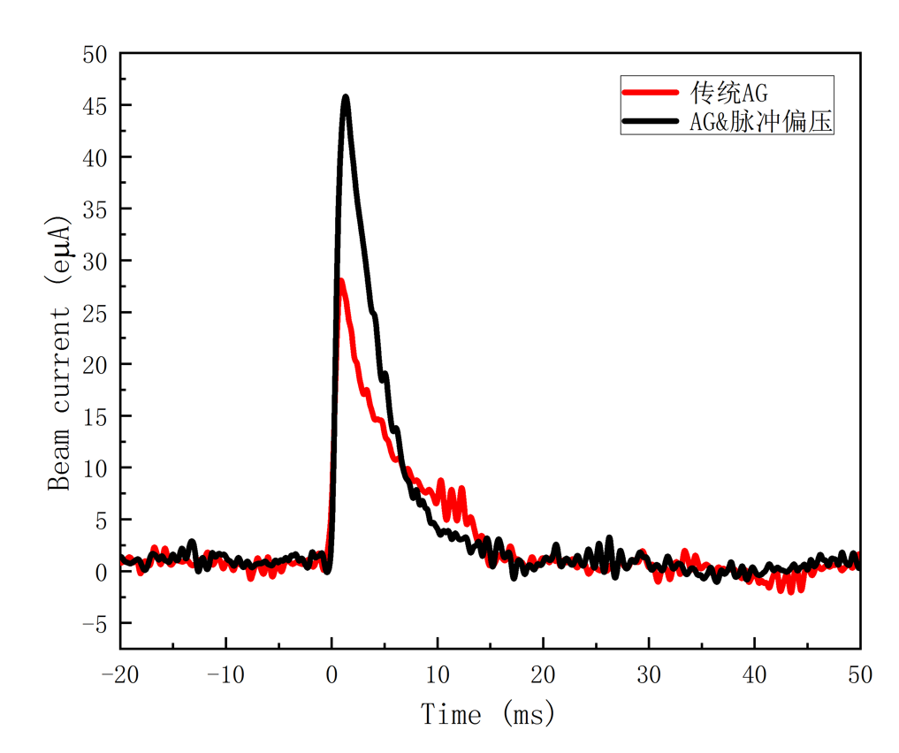
Scope 3: Pulsed Beam Production
Efficient pulsed beam production
Xe³⁴⁺
AG+BD
AG
Afterglow
Double frequency control pulse peaks and length
Afterglow + pulsed biased-disk
Accumulate more particles for higher beam pulse peaks
PHYS. REV. ACCEL. BEAMS 25, 063402 (2022)
Recent results in 2024

Slide 17
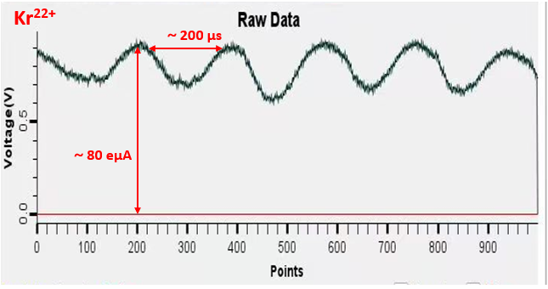
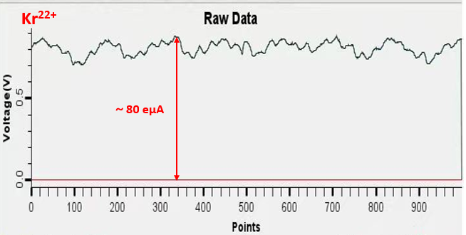
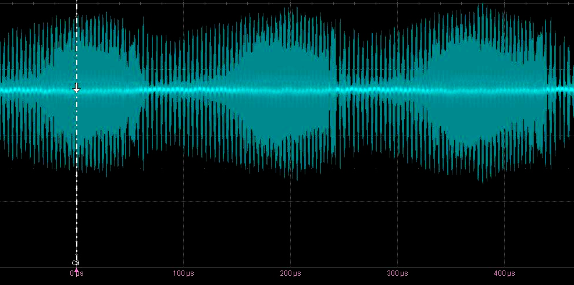
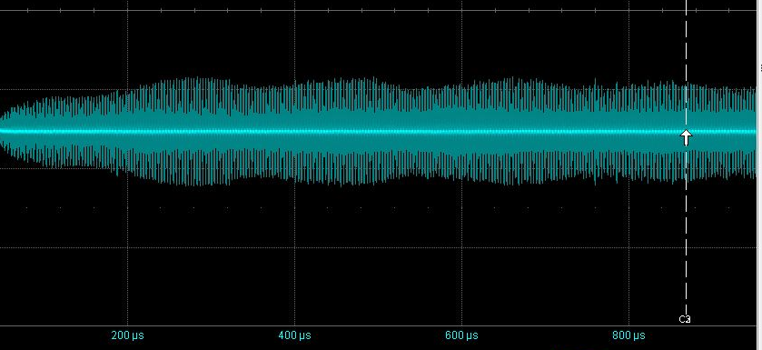
Scope 4: “New” Instabilities
New Instabilities: μs scale and strong impact to beam acceleration
Faraday cup signal after analyzing magnet
Phase probe signal after SFC
Parameter optimization

Slide 18
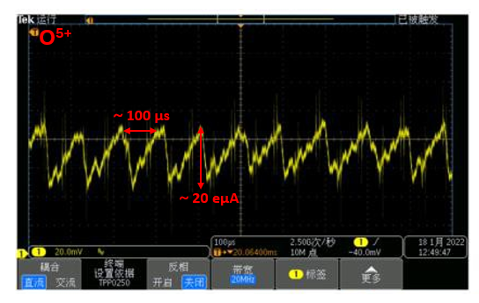
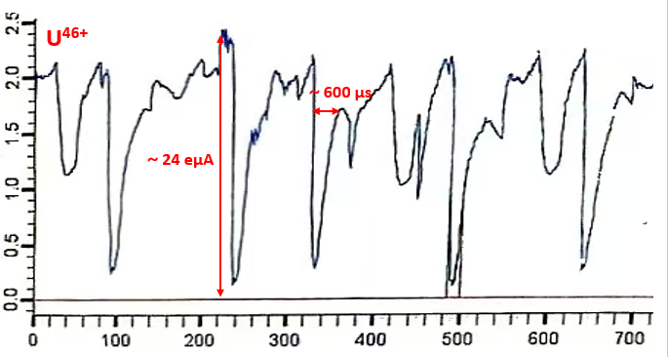
Scope 4: “New” Instabilities
New Instabilities: μs scale and strong impact to beam acceleration
SSC-LINAC-SECRAL-I
SESRI-LECR5
Why & How?
Triggered even at B_{min}/B_{ecr} ~ 0.6, which is much lower than the threshold for electron cyclotron instabilities
Sensitive to microwave power and gas pressure, but not to magnetic field
Driven by the so-called “drift wave instabilities” which arise from density gradient and cover a full regime of few tens of Hz to few hundreds of kHz ^{1, 2} ?
1. Experimental investigation of plasma instabilities by Fourier analysis in an electron cyclotron resonance ion source, Phys. Rev. Accel. Beams 21, 093402, (2018)
2. Observations of parametric drift wave instabilities in an electron cyclotron resonance ion source, Plasma Phys. Control. Fusion 62 105013, (2020)

Slide 19
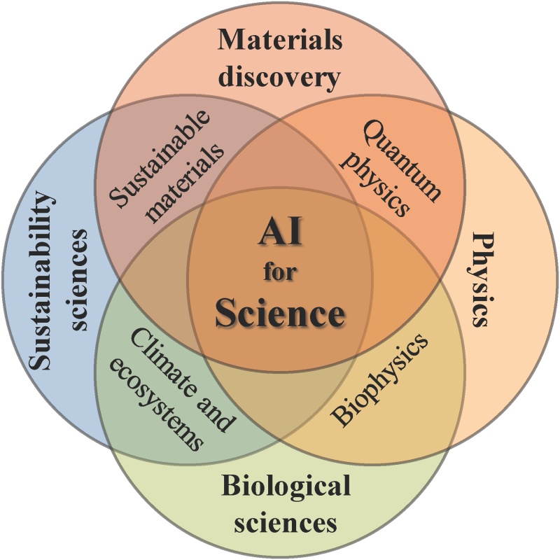
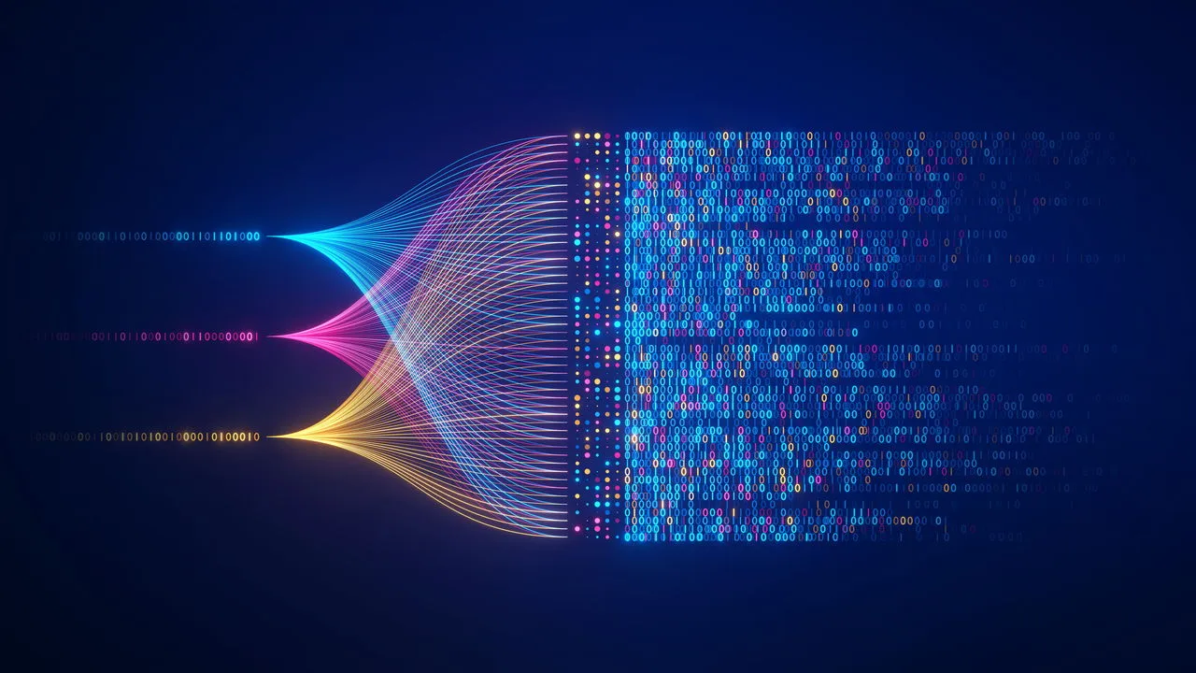
Scope 5: AI for ECRIS Science
ECRIS
iECRIS

Slide 20
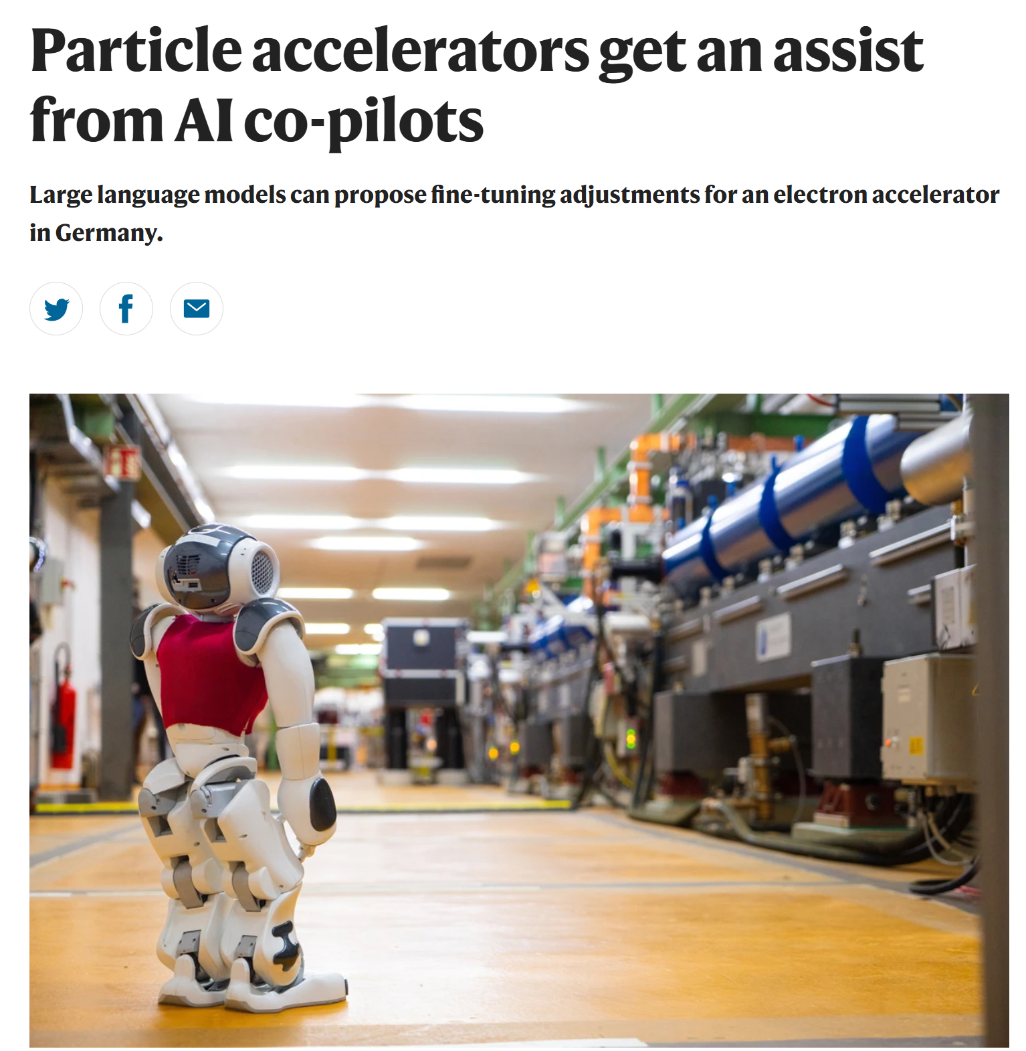
Scope 5: AI for ECRIS Science
AI for ECR ion source Technology
Higher performance
Ion source design
Better reliability, stability
Refined Scaling Laws
More efficient optimization
Intellectual operation
Nature 637, 521 (2025)
Probably, we need to define the motivation of AI for ECRISs

Slide 21
Summary
Heavy ion related physics and application stimulating the vitality of ECRISs
New challenges and questions are emerging in the high performance ECRISs
ECRISs are in the hands of the 4th generation ECRIS sourcerors. What would be the highlighted topics:
4th generation sources
New physics and technologies
AI system development

Slide 22


