Slide 1
VENUS operation and HCI beams for superheavy element production at LBNL
Damon Todd and Janilee Benitez
Lawrence Berkeley National Laboratory
09 April 2025

Slide 2
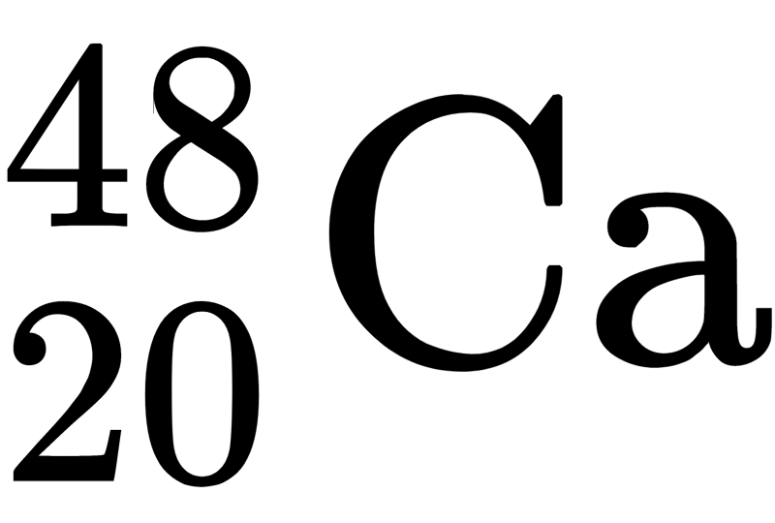
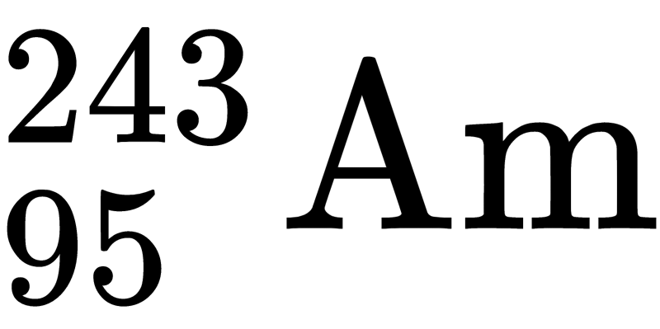
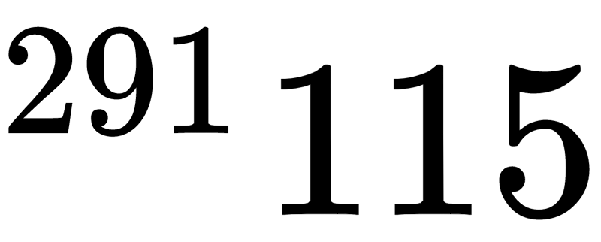
Recent superheavy element discoveries
immediately lose a few neutrons and later decay
beam
target
Notes:
^{48}_{20}\mathrm{Ca}
A short history of recent superheavy element discoveries.
High current 48Ca on heavy targets
If you have a hammer, all problems look like a nail

Slide 3
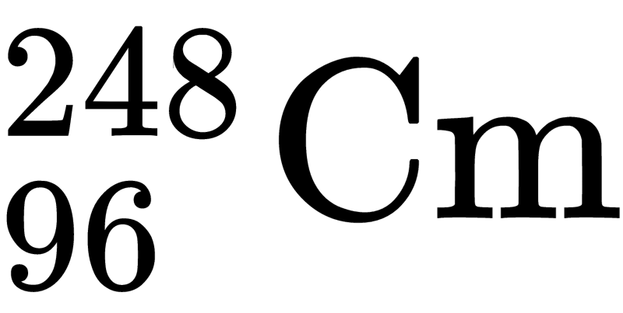
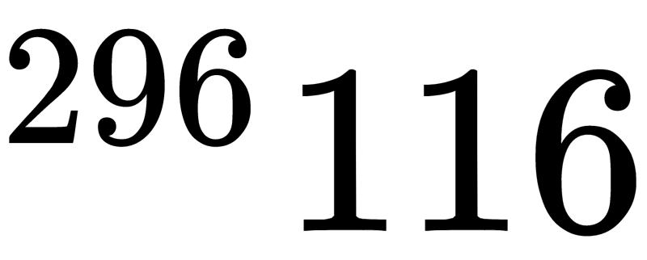
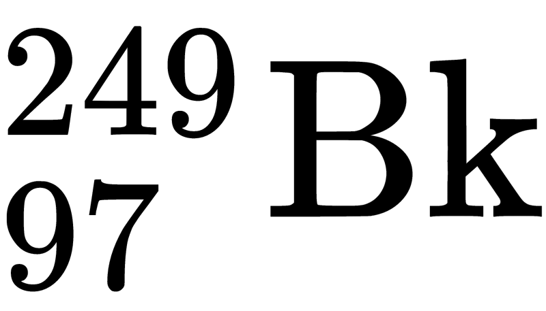
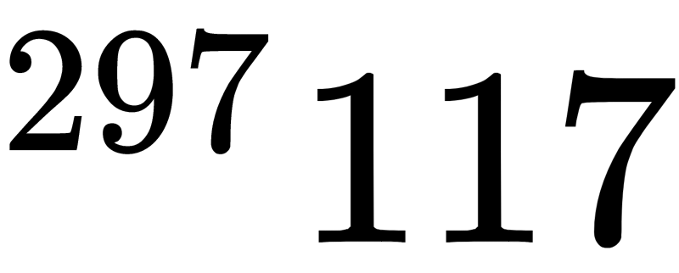
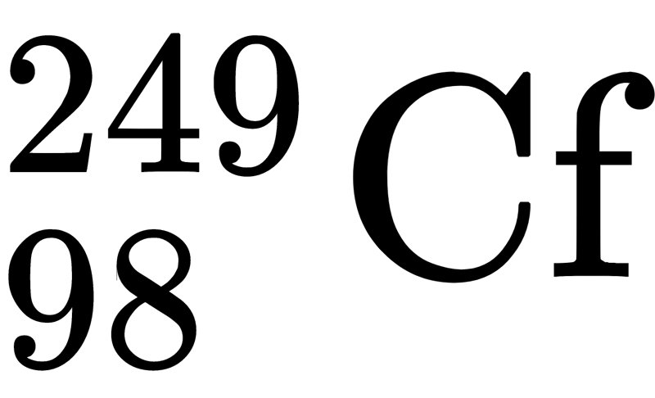
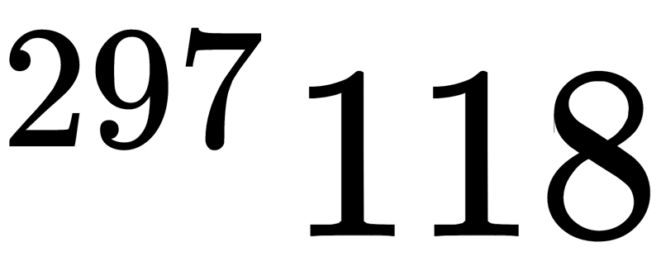
Recent superheavy element discoveries
beam
Notes:
^{48}_{20}\mathrm{Ca}
A short history of recent superheavy element discoveries.
High current 48Ca on heavy targets
If you have a hammer, all problems look like a nail

Slide 4
Recent superheavy element discoveries
Typical beam needs:
Current: as close to ∞ as possible (typically 1-2 pμA is satisfactory)
Energy: 5-6 MeV/u
beam
Notes:
^{48}_{20}\mathrm{Ca}
A short history of recent superheavy element discoveries.
High current 48Ca on heavy targets
If you have a hammer, all problems look like a nail

Slide 5
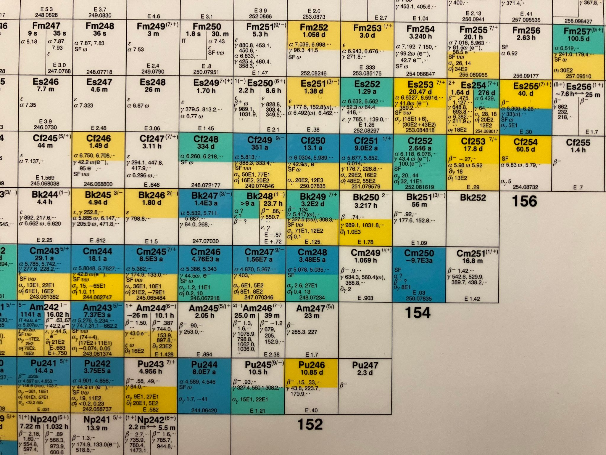
Limit in target atomic number
120???
119???
118
proton number
117
116
115
Notes:
Es, next, has <mg produced per year in 253 (21 day half life). Things get worse as you c

Slide 6
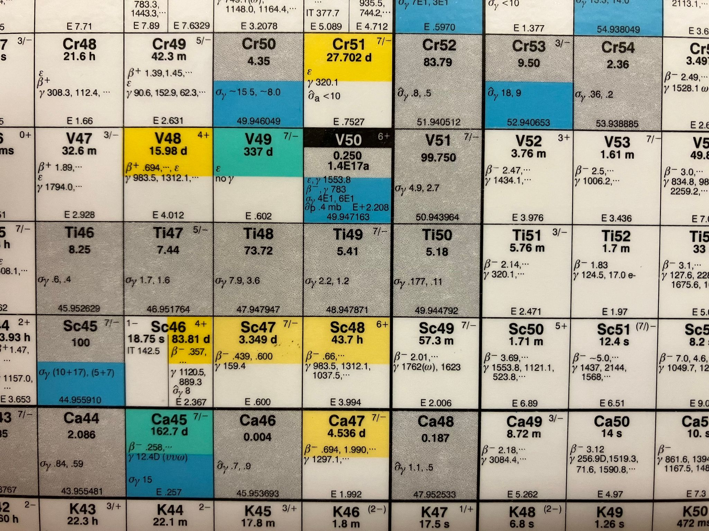
Increasing atomic number of projectiles
Increase
beam proton number
Notes:
Es, next, has <mg produced per year in 253 (21 day half life). Things get worse as you c

Slide 7
Limit in target atomic number
Dubna: ??Cr on ?? → ??
RIKEN: ⁵¹V on Cm → 119
LBNL: ⁵⁰Ti on Cf → 120
Increase
beam proton number
(expectation to continue with heavier beams after)
Notes:
Es, next, has <mg produced per year in 253 (21 day half life). Things get worse as you c

Slide 8
One way to get metal into an ECR ion source: ovens
ECR plasma
oven crucible
metal gas
metal
add heat

Slide 9
One way to get metal into an ECR ion source: ovens
ECR plasma
oven crucible
metal gas
metal
Improve by aiming
add heat

Slide 10
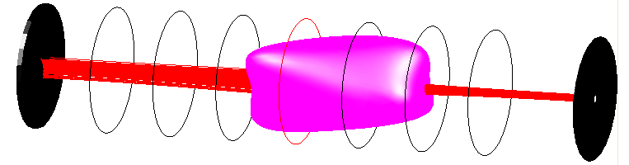
One way to get metal into an ECR ion source: ovens
ECR plasma
oven crucible
metal gas
metal
Improve by aiming
Improve more by aiming better
add heat

Slide 11
Side question: what are we measuring when using metal in ovens??
Ion
gauge
ECR plasma
biased disk
oven
extraction
source chamber

Slide 12
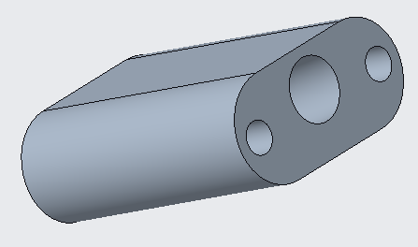
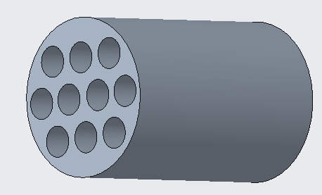
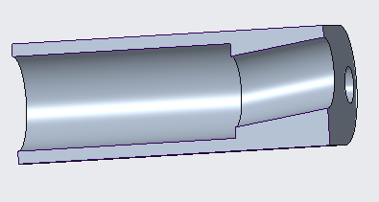
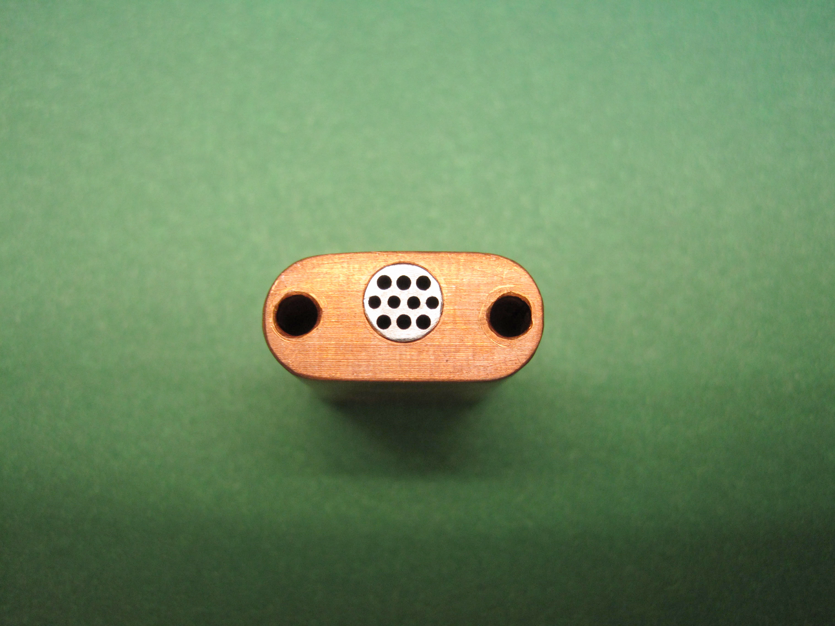
Low-temperature oven used for ⁴⁸Ca beams from VENUS
Conductively heated
Operating temperature for calcium: ~600°C
Maximum operating temperature: ~700°C
Results:
Delivery of continuous, 1-2 pμA ⁴⁸Ca¹¹⁺ by cyclotron
Consumption: ~0.5 mg/hr (>$300k/g)
Stainless insert:
8.5 mm long
5.6 mm diameter

Slide 13
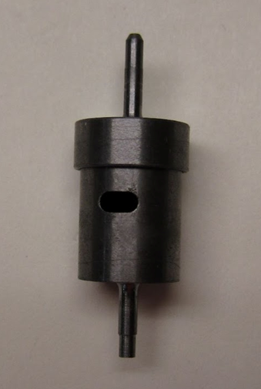
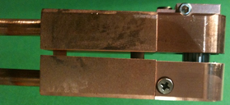
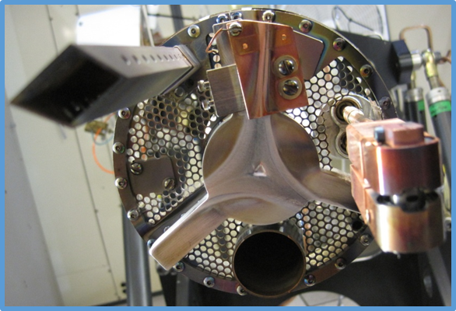
Reaching higher temperatures: resistive oven
Resistive ovens:
Custom-made (Ta, W, and Re)
Thickness ~0.25 mm
Volume ~0.3 cm³
T > 2000 °C
I

Slide 14
Reaching higher temperatures: resistive oven
B
Resistive ovens:
Custom-made (Ta, W, and Re)
Thickness ~0.25 mm
Volume ~0.3 cm³
T > 2000 °C
I
F

Slide 15
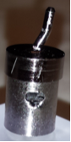
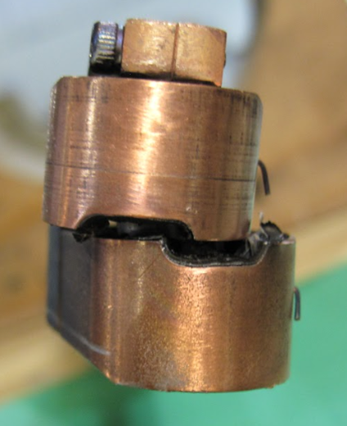
Reaching higher temperatures: resistive oven
B
Resistive ovens:
Custom-made (Ta, W, and Re)
Thickness ~0.25 mm
Volume ~0.3 cm³
T > 2000 °C
I
Inside VENUS, reliable temperatures reached are typically ≲ 1500 °C, dictated largely by hot metal chemistry
F

Slide 16
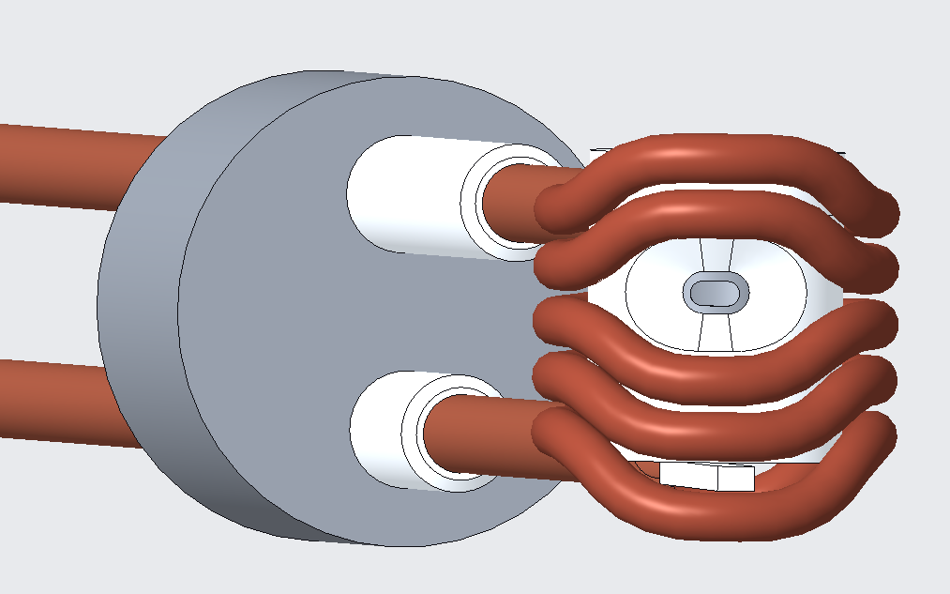
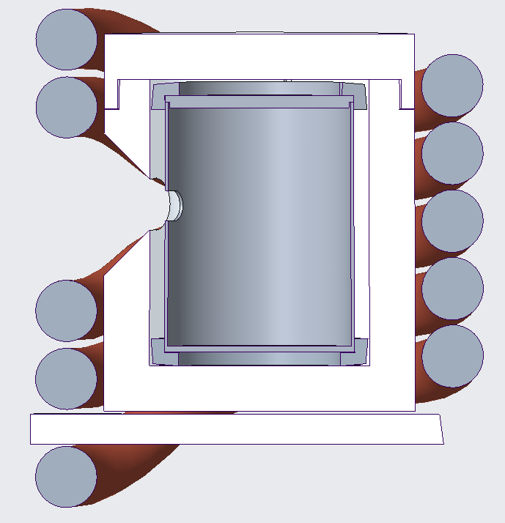
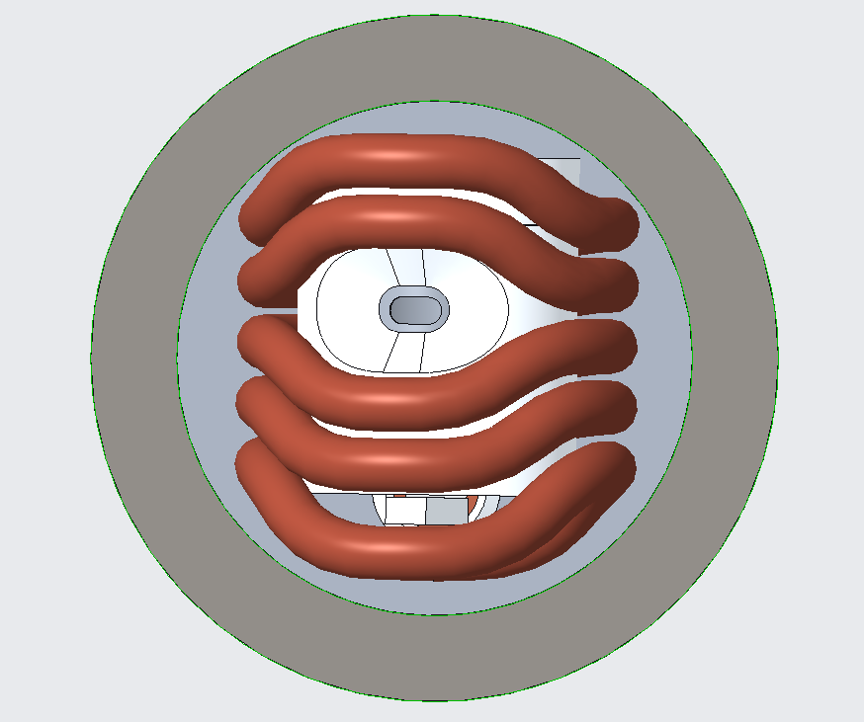
Vertical inductive oven concept
20.7 mm
24 mm
must fit through 38.1-mm-diameter port
Supported by insulating rod

Slide 17
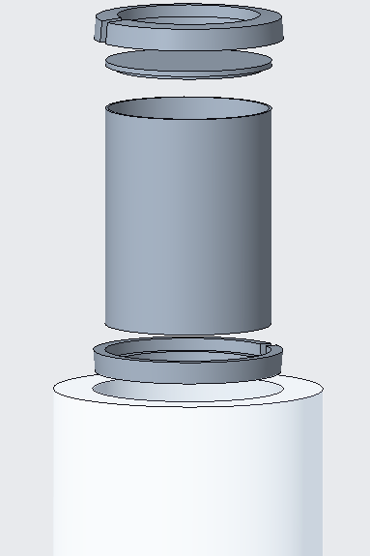
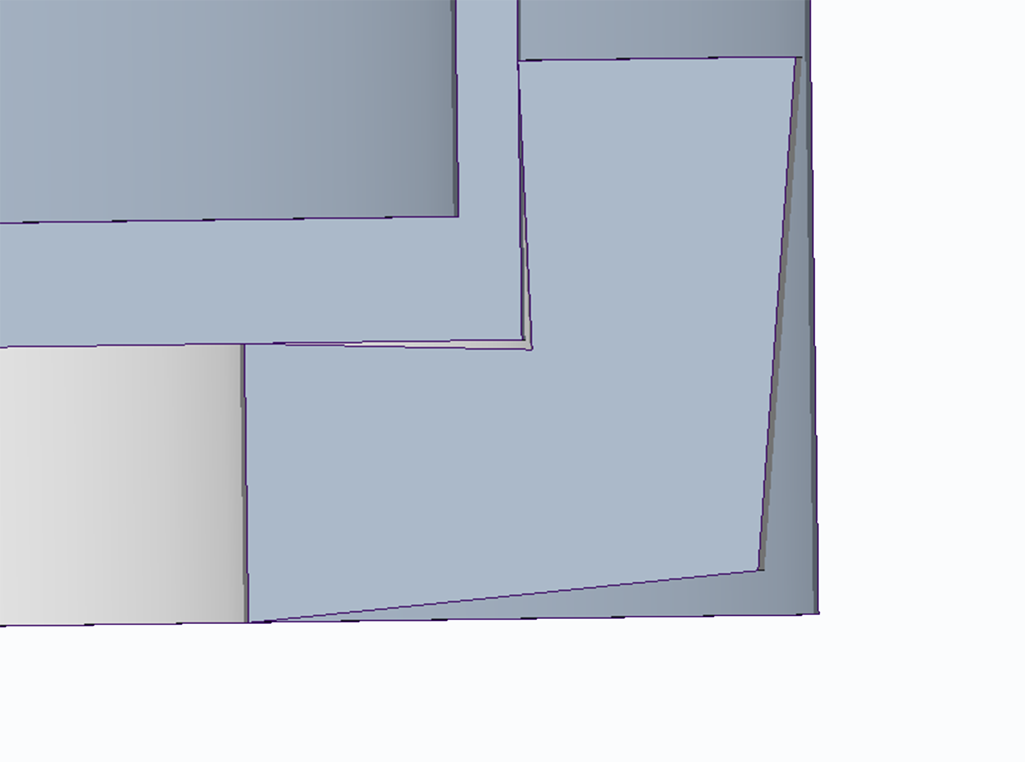
Oven exploded view
Support ring
Lid
Susceptor
Susceptor
Point-like contact
Support ring
Insulator
Insulator

Slide 18
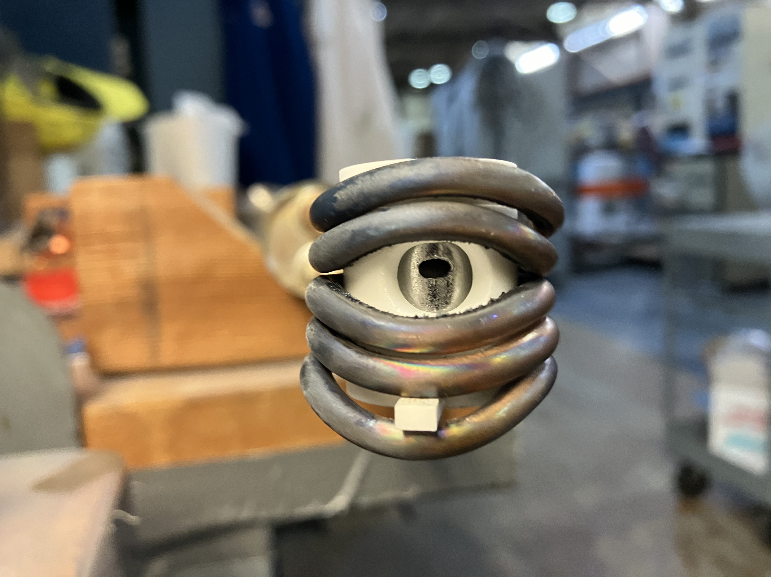
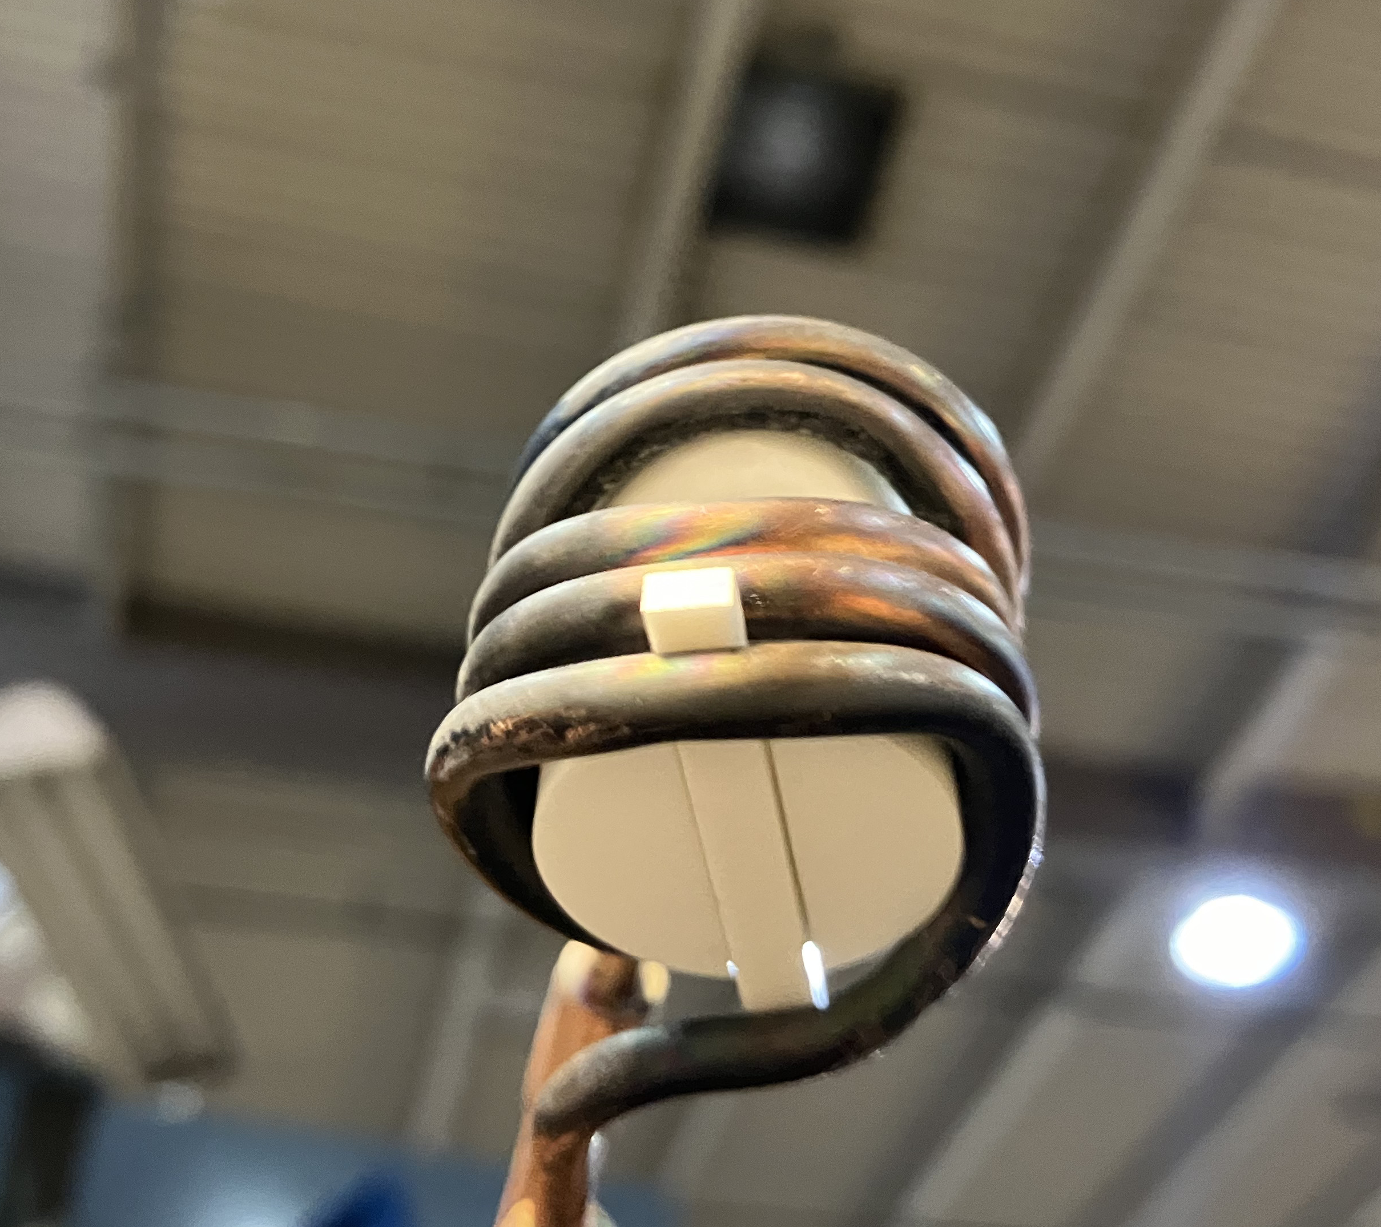
Inductive oven
Front view
Bottom view

Slide 19
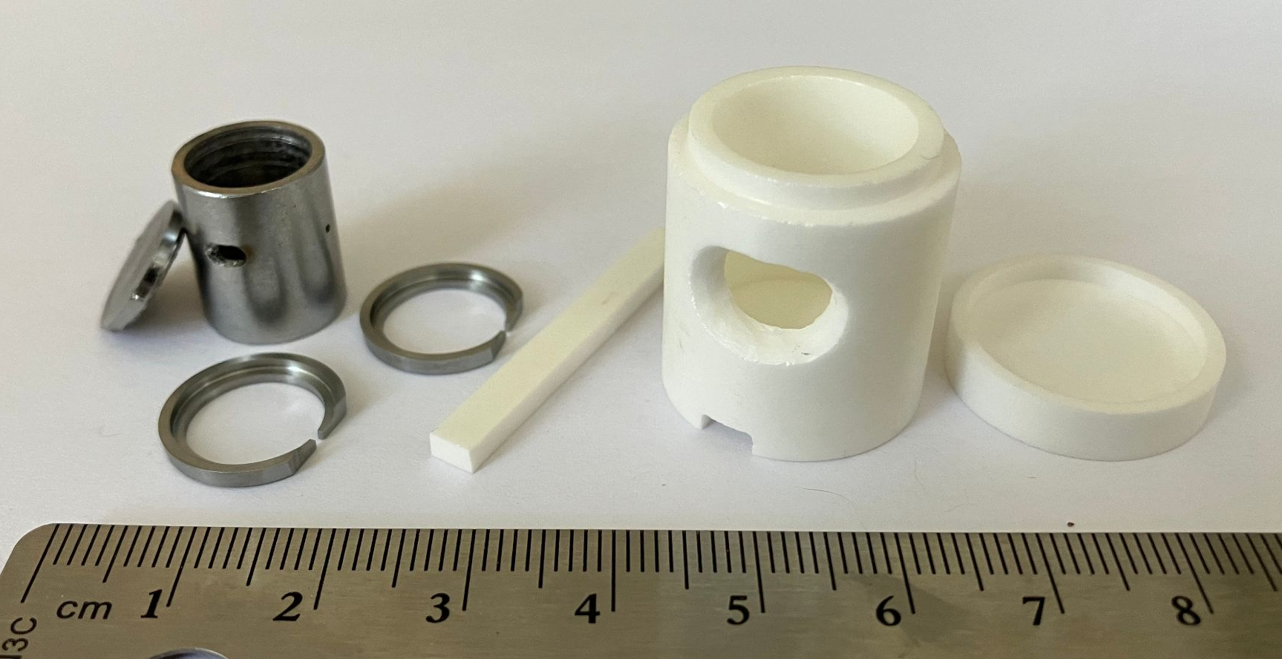
Current inductive oven inner parts
Susceptor:
1.1-mm-thick molybdenum (skin depth = 0.26 mm @ 200 kHz)
Finally replaced first susceptor after >75 days running ⁵⁰Ti
Insulators:
Yttria-stabilized zirconia
Must be replaced after each run (typically 10 days)

Slide 20
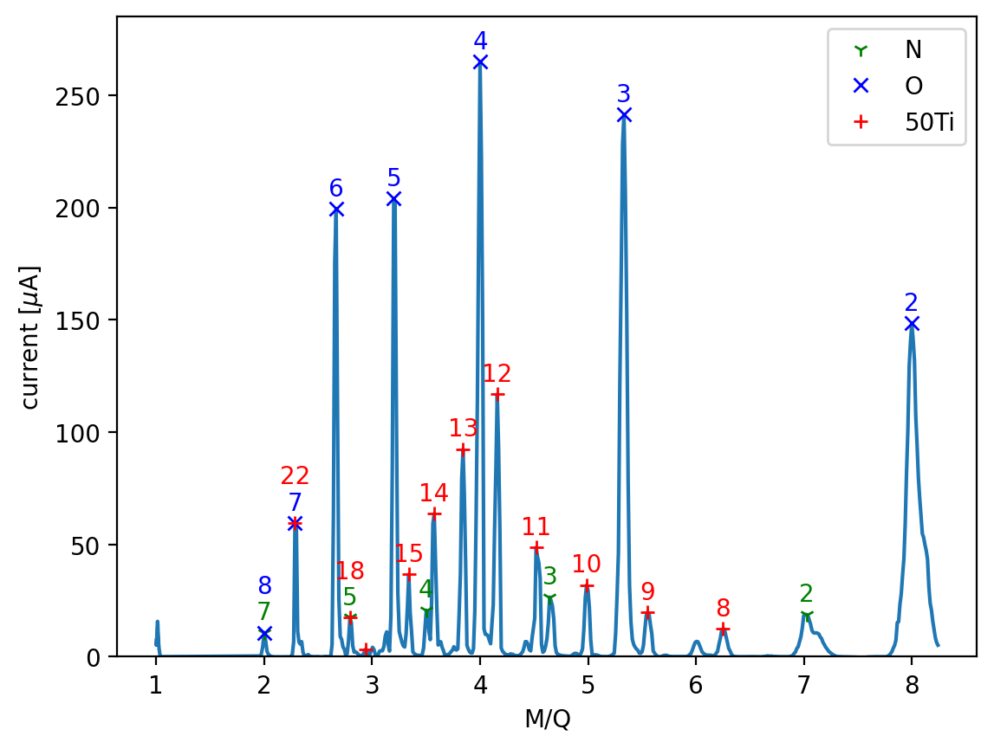
Typical operation
Operation for >100 μA ⁵⁰Ti¹²⁺ beams::
Inductive power: 800-1000 W of ~175 MHz
Consumption: 2.5 – 5.0 mg/hr
Capacity: ~1.2 g, or 11-20 days
Run time: Up to 10 days straight (so far)
Refill time: ~4 hours to back on target
Sources settings:
~10⁻⁷ mbar injection pressure
~700 W of 18 GHz RF (no 28 GHz)
Standard 18 GHz fields::
B_{ECR} = 0.64 T
B_{ext} ~ B_{radial} ~ 1.2 T
B_{inj} ~ 1.8 T
B_{min} ~ 0.39 T
Notes:
No temperature diagnostics in VENUS
Oven reached >2000 ℃ in test stand

Slide 21
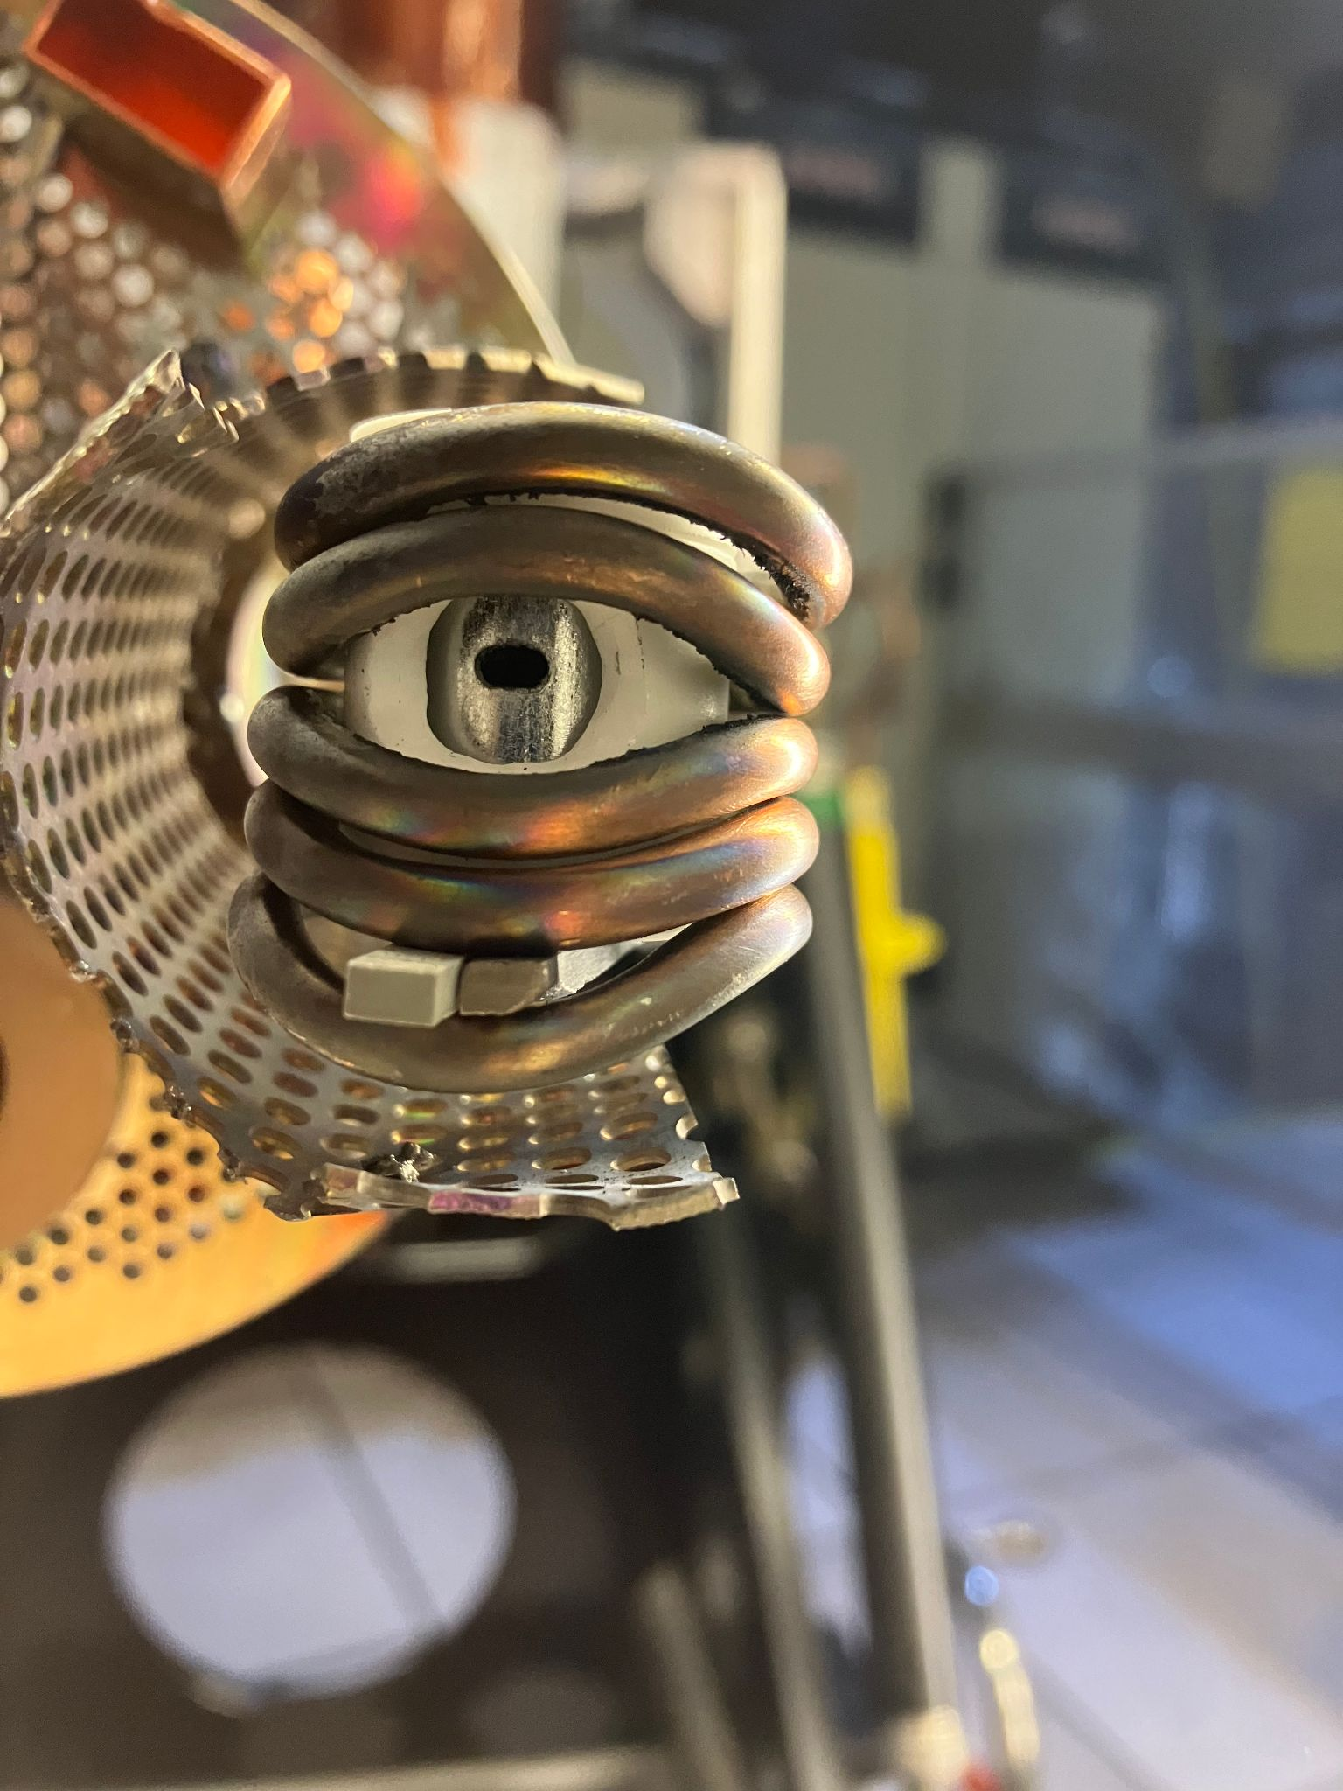
Two primary superheavy element projectile beams
⁴⁸Ca¹¹⁺
From VENUS low-temperature oven:
Typically 60-100 μA
Consumption: ~0.5 mg/hr (~0.7% to experimenters)
From Cyclotron:
Typically 16-22 μA (1.45-2 pμA)
⁵⁰Ti¹²⁺
From VENUS inductive oven:
Typically 100-150 μA
Consumption: 2.5-5.0 mg/hr (~0.07% to experimenters)
From Cyclotron:
Typically 15-24 μA (1.25-2 pμA)

Slide 22
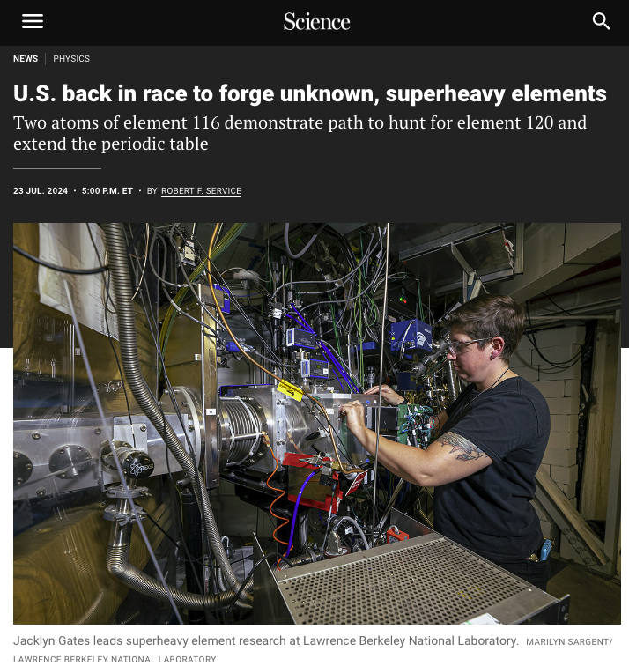
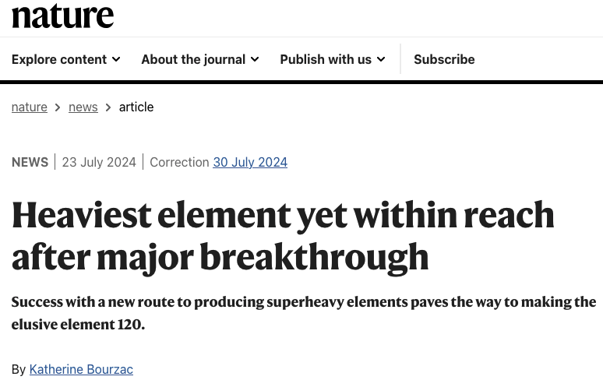
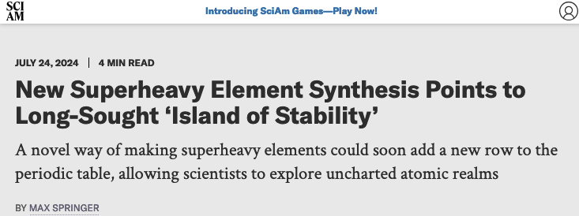
Success: Two atoms of element 116 from 22 days of running

Slide 23
Two primary superheavy element projectile beams
⁴⁸Ca¹¹⁺
From VENUS low-temperature oven:
Typically 60-100 μA
Consumption: ~0.5 mg/hr
From Cyclotron:
Typically 16-22 μA (1.45-2 pμA)
⁵⁰Ti¹²⁺
From VENUS inductive oven:
Typically 100-150 μA
Consumption: 2.5-5.0 mg/hr
From Cyclotron:
Typically 15-24 μA (1.25-2 pμA)

Slide 24
Two primary superheavy element projectile beams
⁴⁸Ca¹¹⁺
From VENUS low-temperature oven:
Typically 60-100 μA
Consumption: ~0.5 mg/hr
From Cyclotron:
Typically 16-22 μA (1.45-2 pμA)
⁵⁰Ti¹²⁺
From VENUS inductive oven:
Typically 100-150 μA
Consumption: 2.5-5.0 mg/hr
From Cyclotron:
Typically 15-24 μA (1.25-2 pμA)

Slide 25
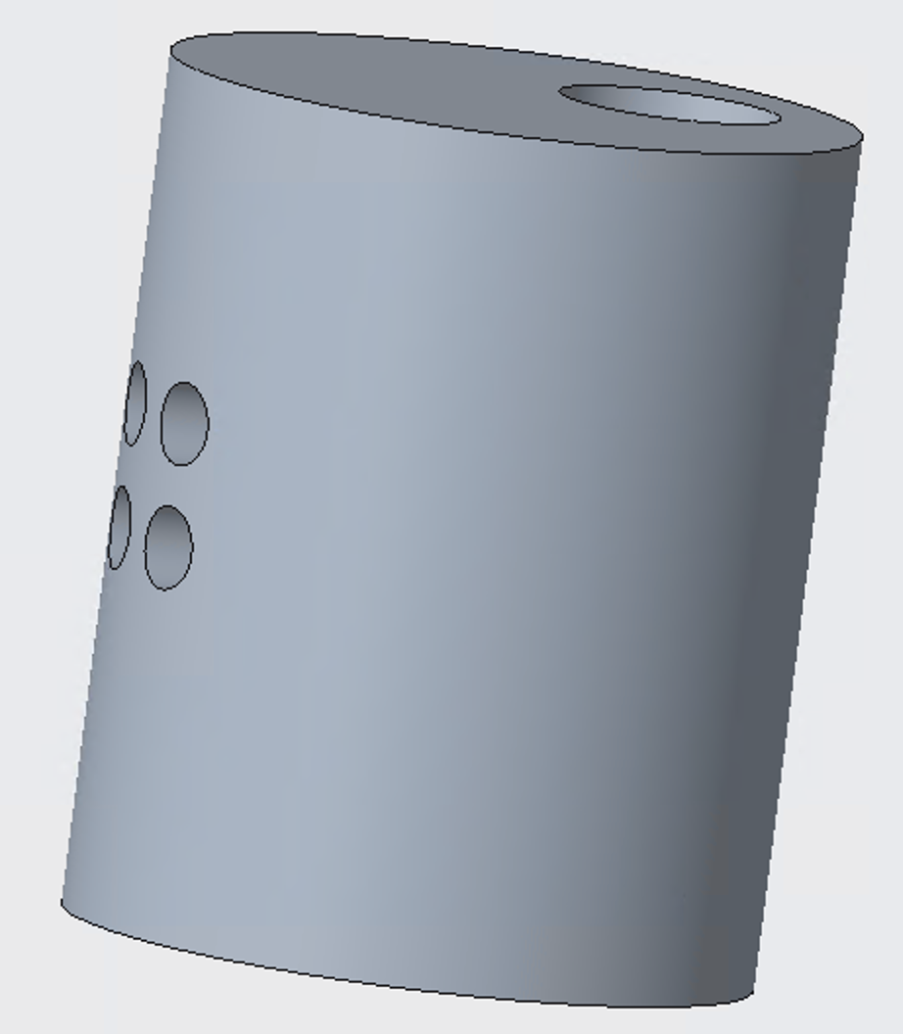
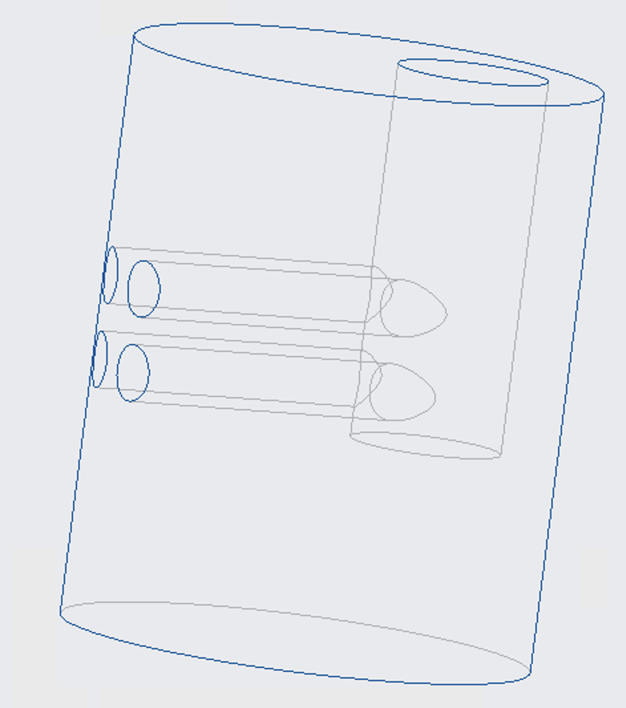
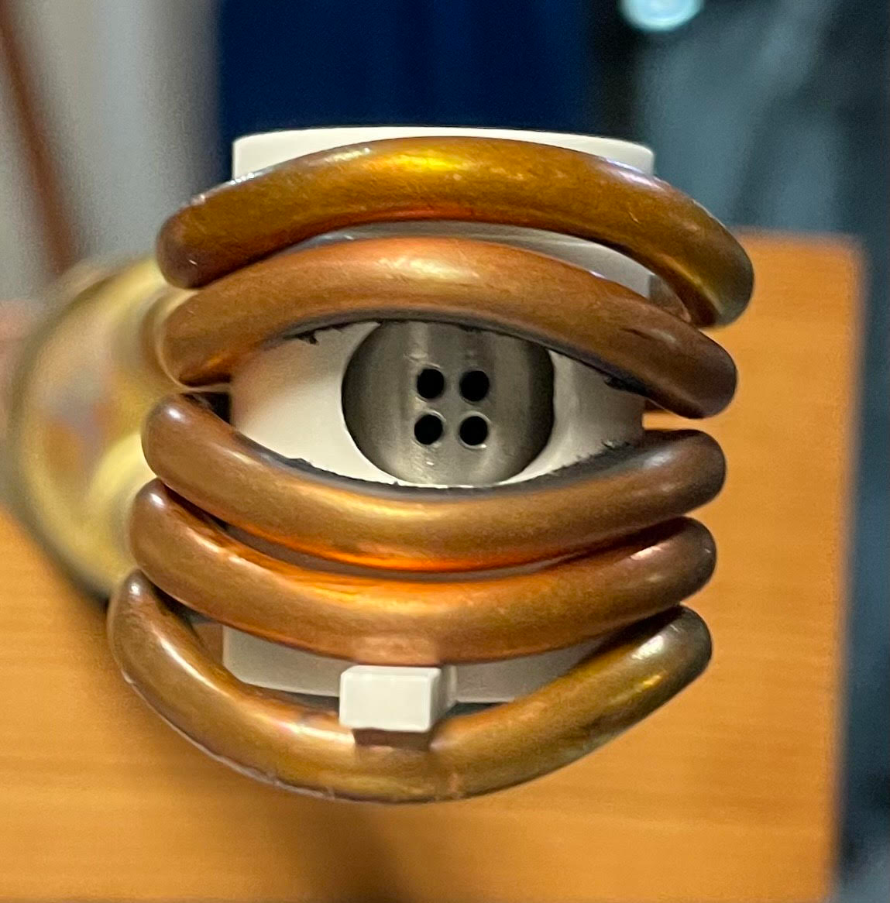
An aiming inductive oven, proof of concept
Produced over 100 eμA ⁴⁸Ti¹²⁺
Clearly not aligned correctly
New design will lead to better alignment

Slide 26
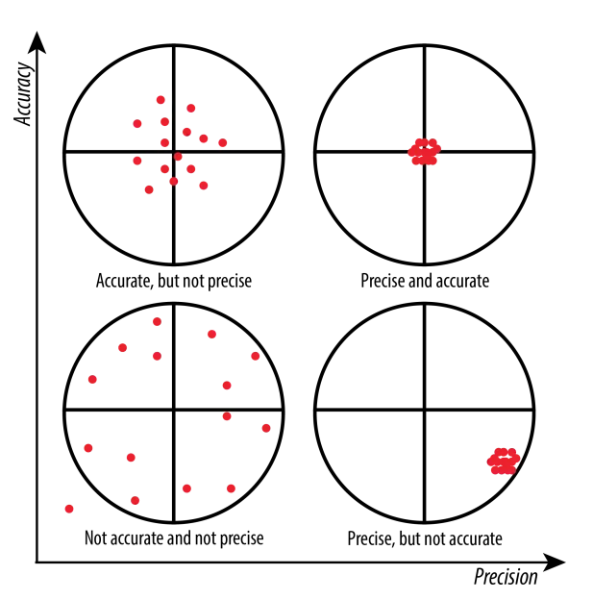
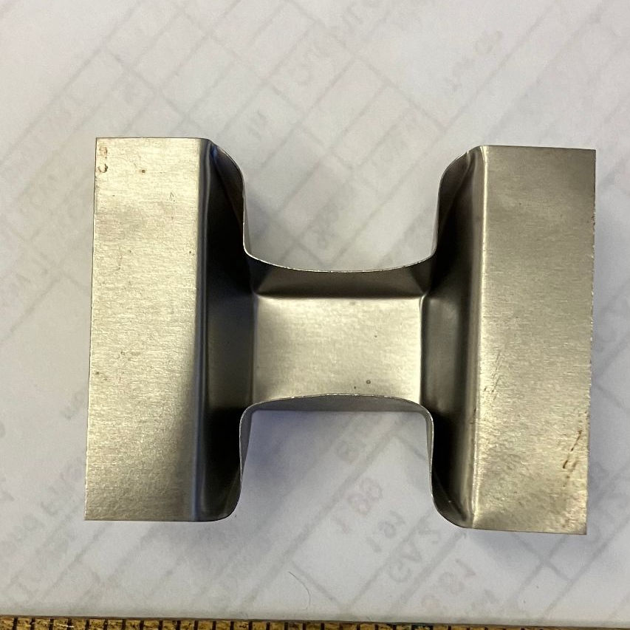
Precision and accuracy
accuracy
boat oven
precision

Slide 27
Thank you!

Slide 28
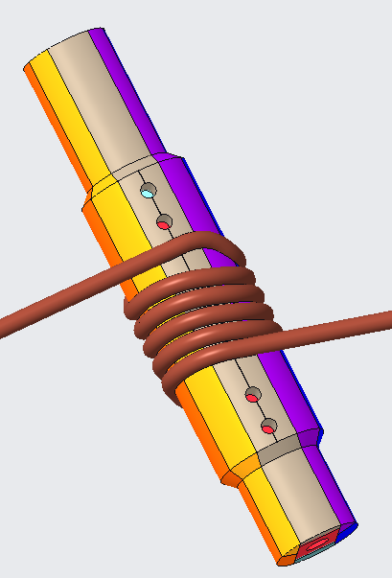
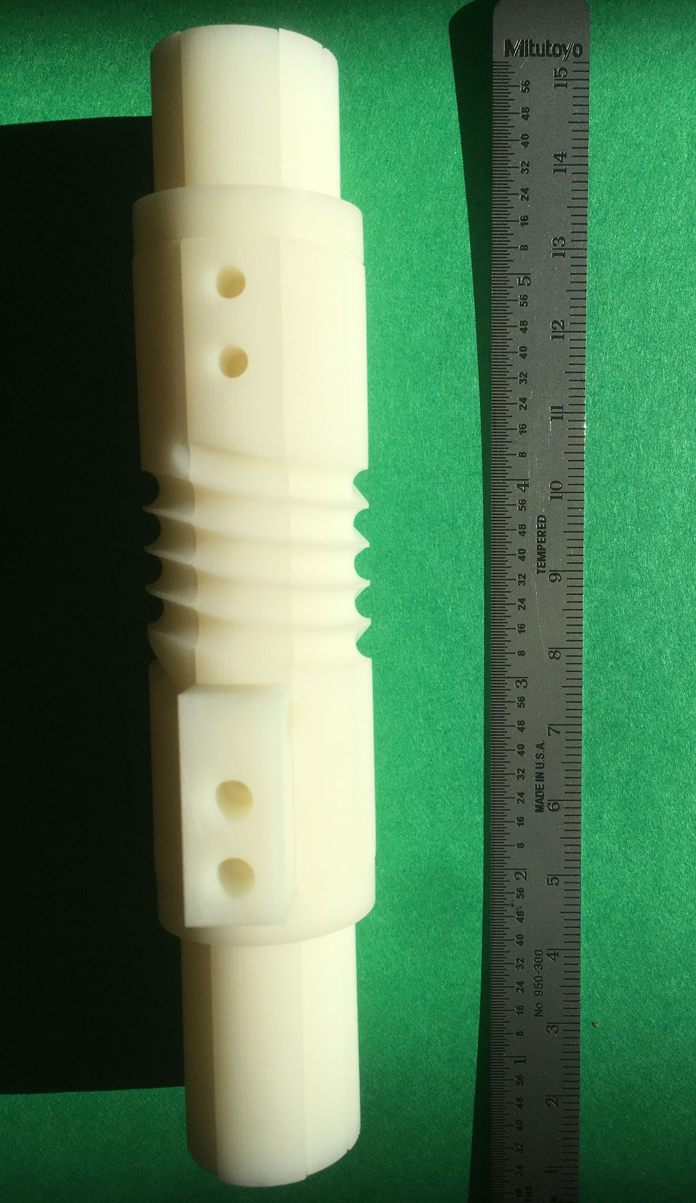
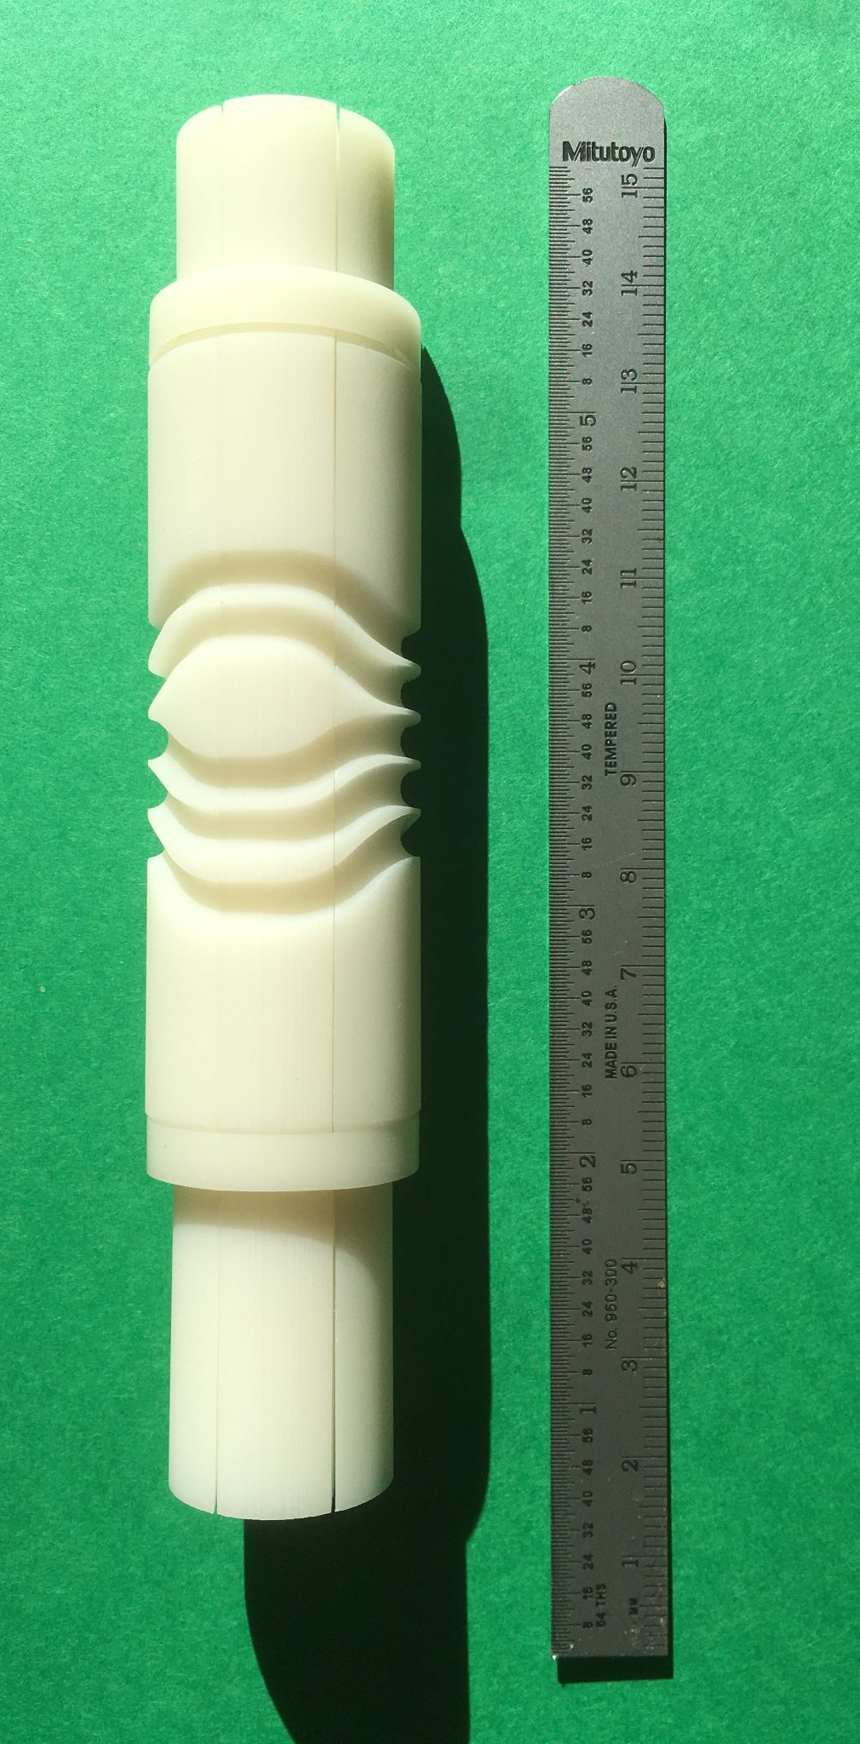
3D printed fixture for 4-mm-diameter/0.4-mm-wall-thickness copper tubing
Design
3D printed form

Slide 29
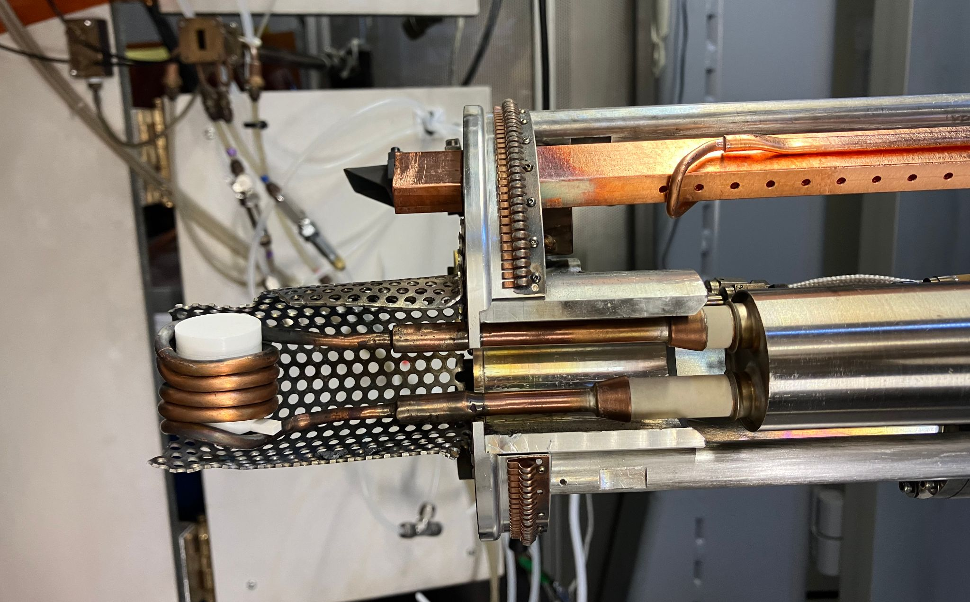
Safety catch

Slide 30
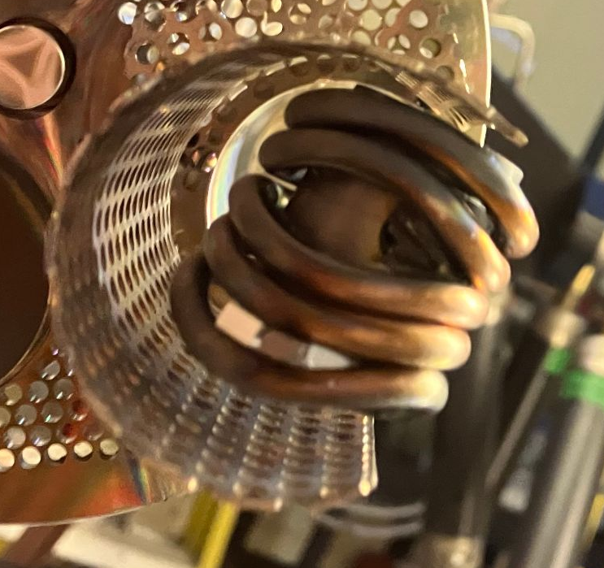
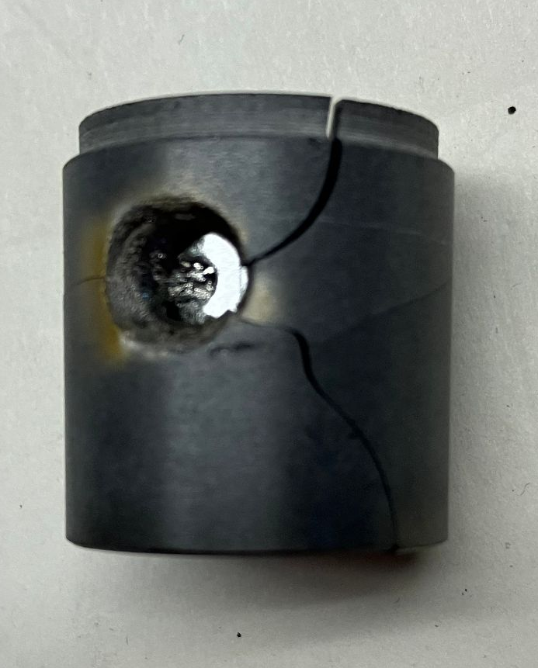
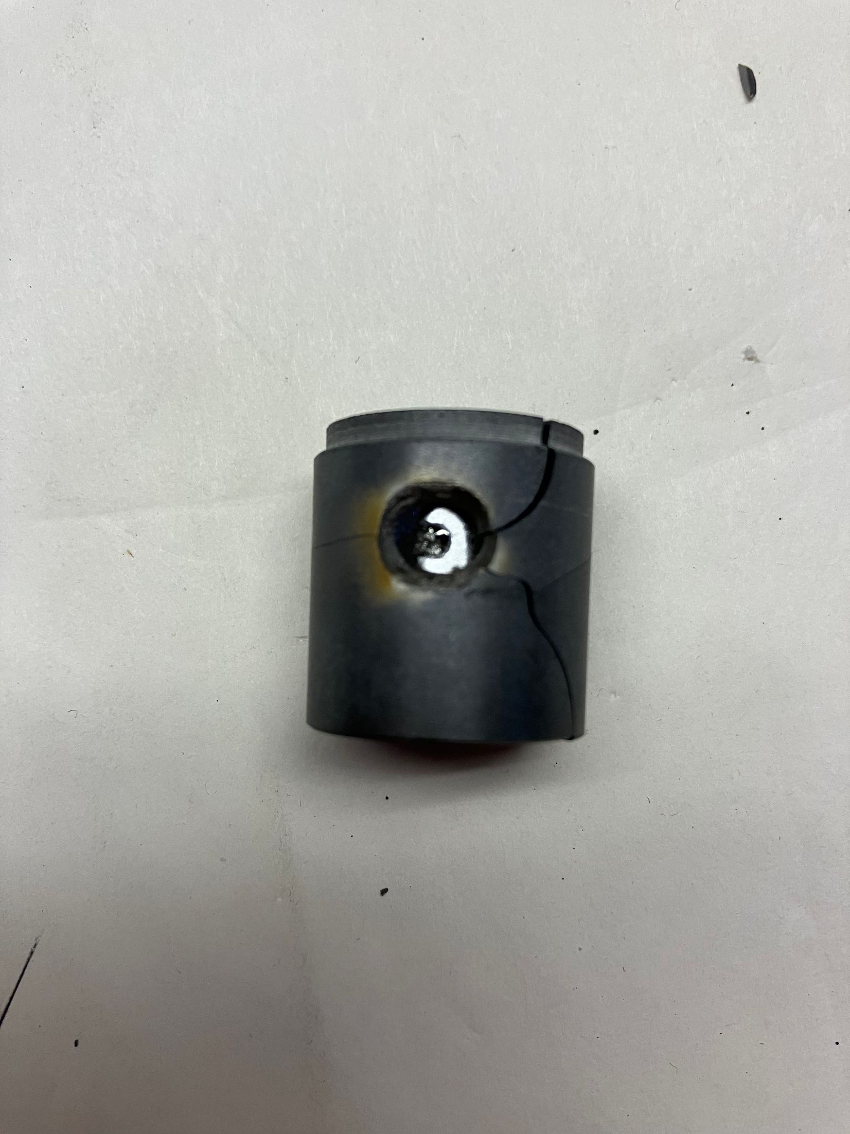
Early problems: rotations → clogs
Insulator relative to coil
Susceptor relative to insulator

Slide 31
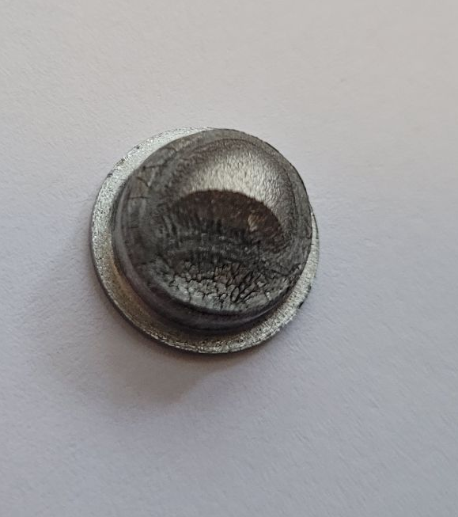
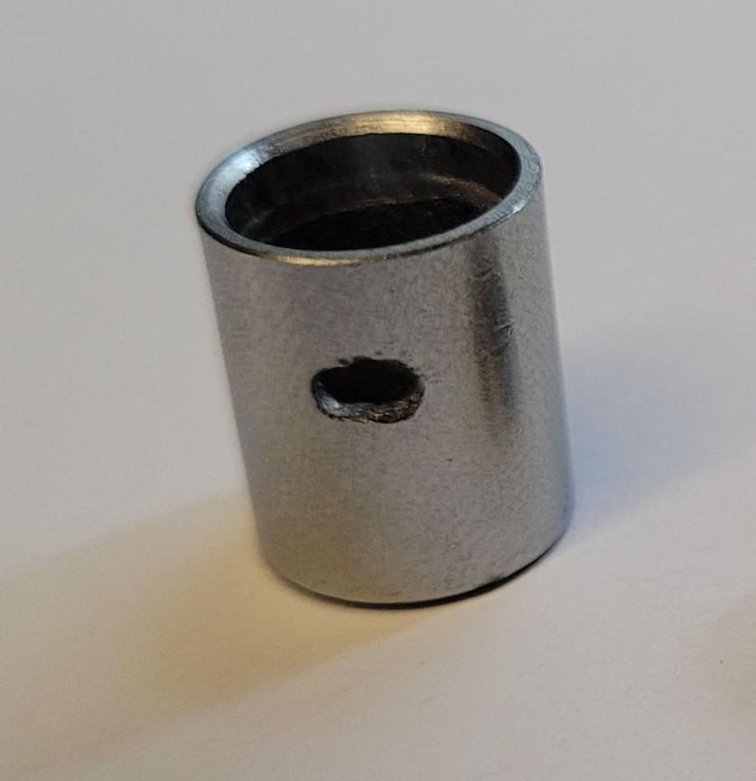
Susceptor after runs
Titanium solidifies on ends -> ends are cooler than body (potential problem for “aiming” solution for horizontal ovens??)
Higher temperature body prevents clogging!
Same susceptor and lid have been used for all cyclotron runs (>40 days)

Slide 32
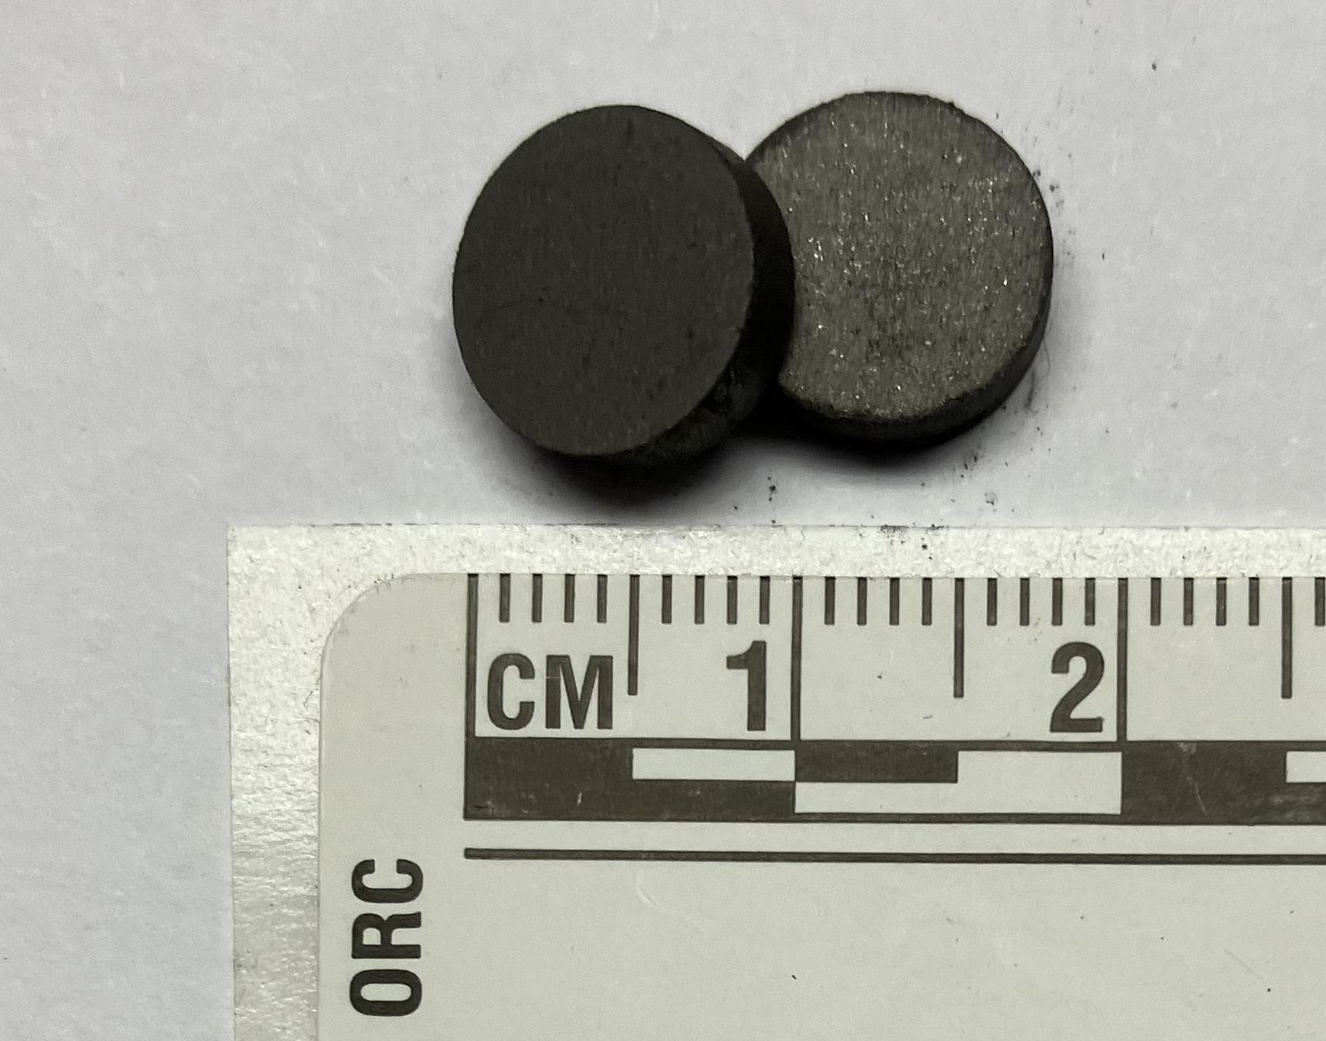
⁵⁰Ti pellets

Slide 33

Susceptor after runs
Yosemite’s Half Dome

Slide 34
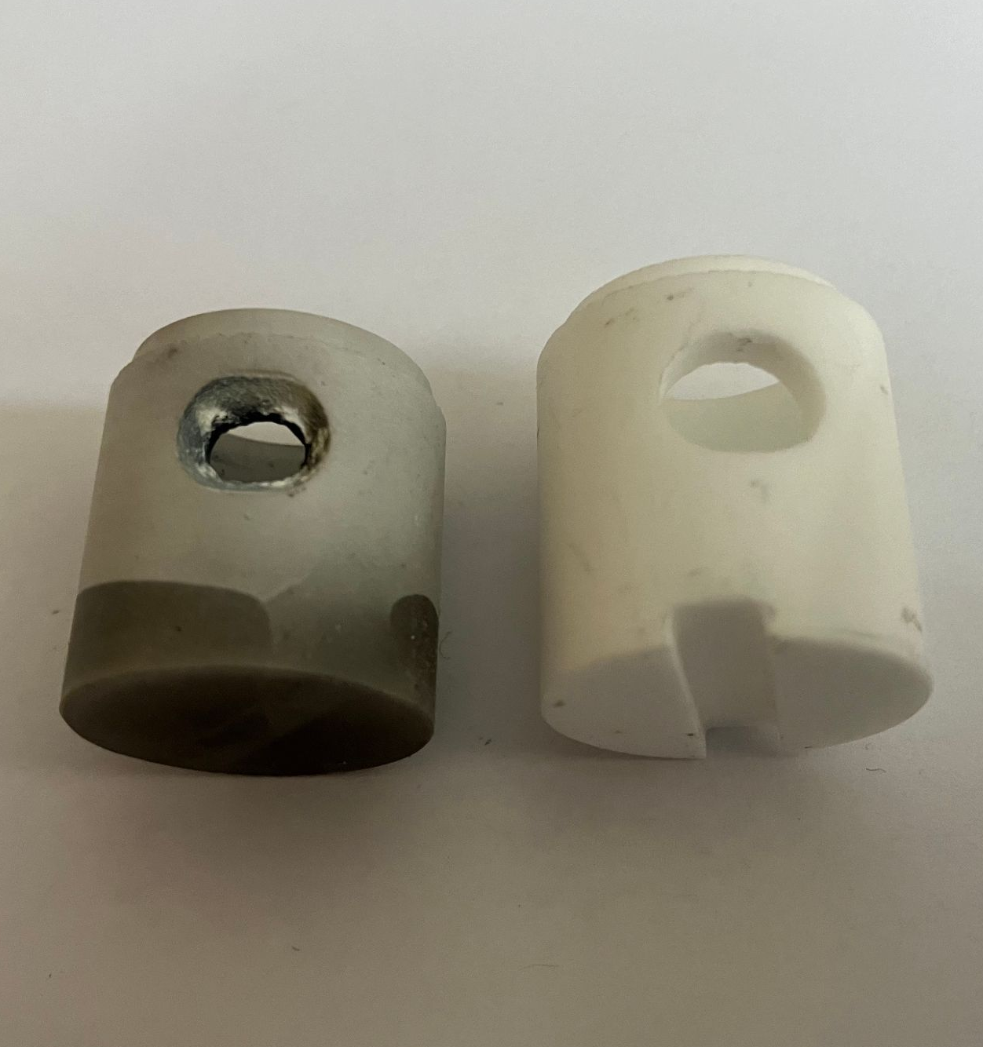


Solutions to rotations
Original
New
Insulator relative to coil
Susceptor relative to insulator
Solution: slotted insulator body preserves
alignment using support post
Solution: thin molybdenum strips jammed
between insulator and susceptor

