Slide 1
Wednesday, 09 April 2025
Morning round table I (8:30 – 10:30)
Beam reliability, reproducibility and stability issues
T. Nagatomo (RIKEN) HCI Beam Production and Challenges at RIKEN
L. Sun (IMP-CAS) Production of intense highly charged metallic ion beams for routine operation
D. Todd (LBNL) VENUS operation and HCI beam production for SHE in LBNL

Slide 2
HCI Beam Production and Challenges at RIKEN
T. Nagatomo
on behalf of Ion Source Team, RIKEN Nishina Center

Slide 3
Toward U³⁵⁺ beam of 300μA ~ 1 month stable
・P (28 GHz +18 GHz) ~ 4 kW
・Much UO₂ consumption rate > 10 mg /h
・Emittance growth due to I_{ext} ~ 10 mA (Space charge ? Plasma meniscus?)
・Beam intensity instability due to much metal vapor
・X-ray heat load increase
・Ion beam extraction system improvements

Slide 4
Beam intensity instability due to metal vapor
In the case of V-beam supply for the SHE of 119

Slide 5
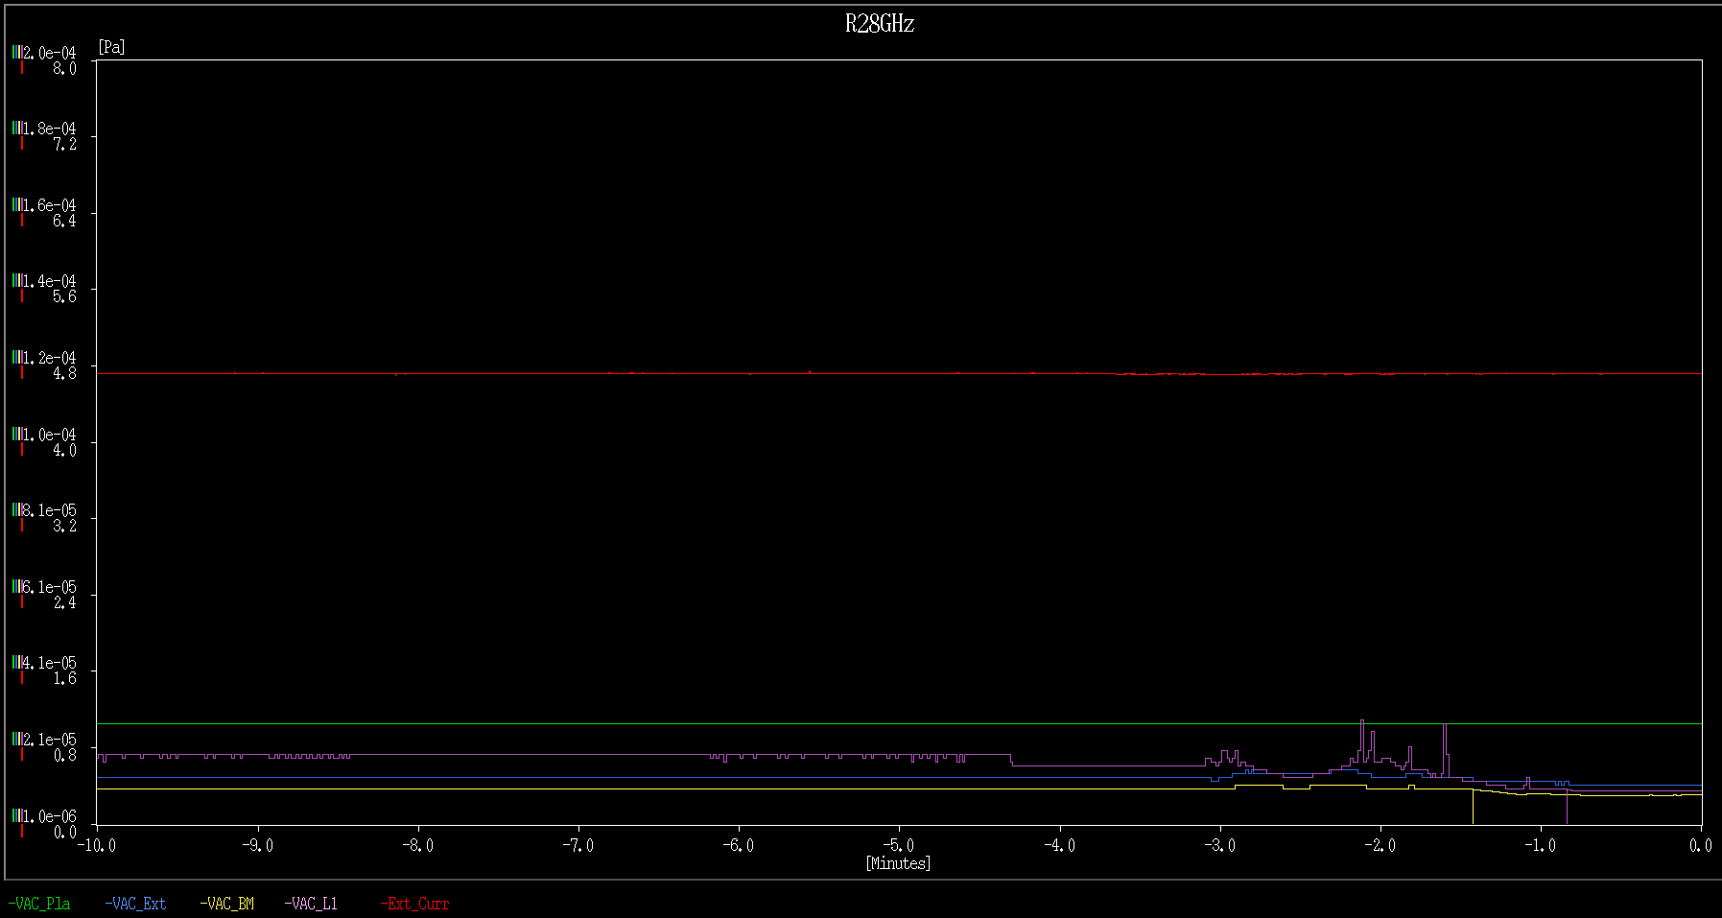
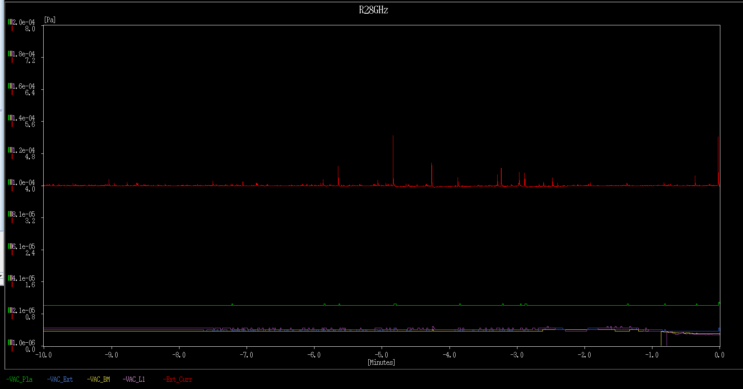
V sample filling +
Plasma chamber cleaning
54.6 days
3.0 mg/h (4.0 g total)
1st FC
2nd FC
(before RFQ)
29 days
4.0 mg/h (4.0 g total)
Days
1 min
1 mA
I_{drain} = 4.0 mA
I_{drain} = 4.0 mA
Fluctuation in beam intensity ~ a few %.
This spike causes an intensity reduction of > 10%

Slide 6
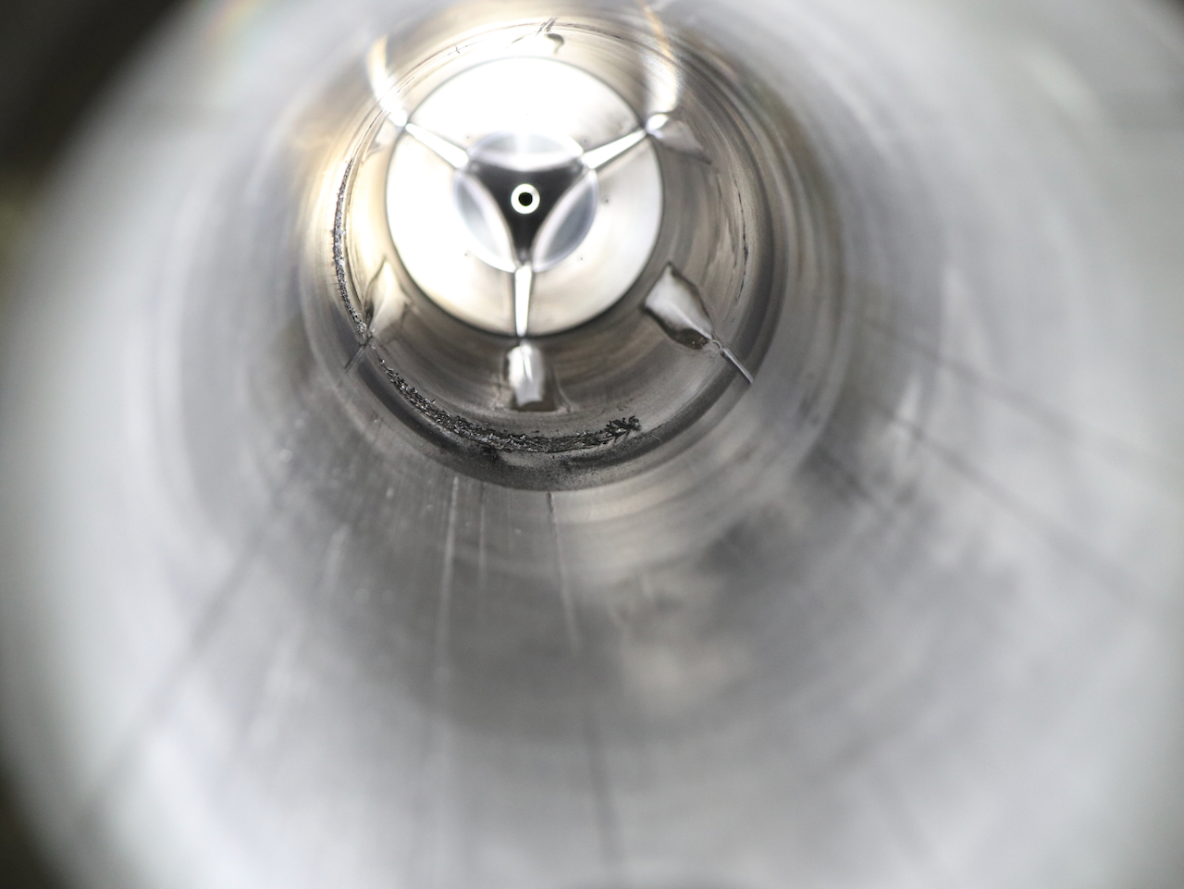
I_{drain} = 4.0 mA
Fluctuation in beam intensity ~ a few %.
Flake-shaped
Metal
1 min
1 mA
I_{drain} = 4.0 mA
Typical Deposition of the vanadium sample
After another long run with
the consumption rate ~ 5.2 mg/h (Total 4.2 g)
This spike causes a reduction in beam intensity of more than 10%.

Slide 7
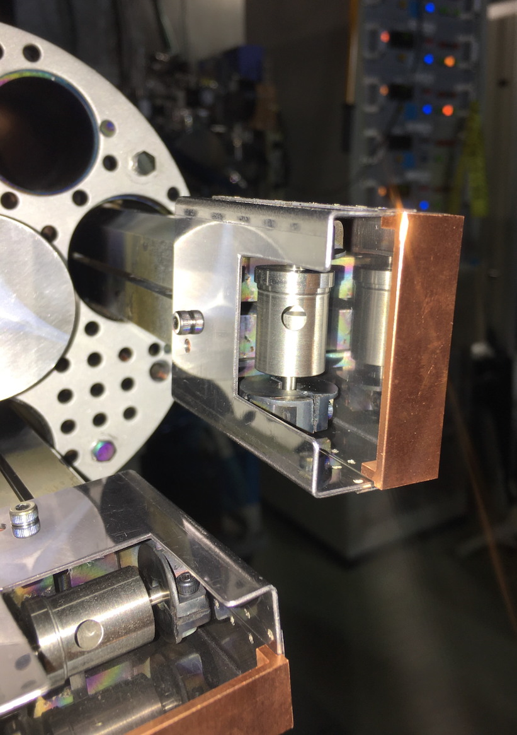
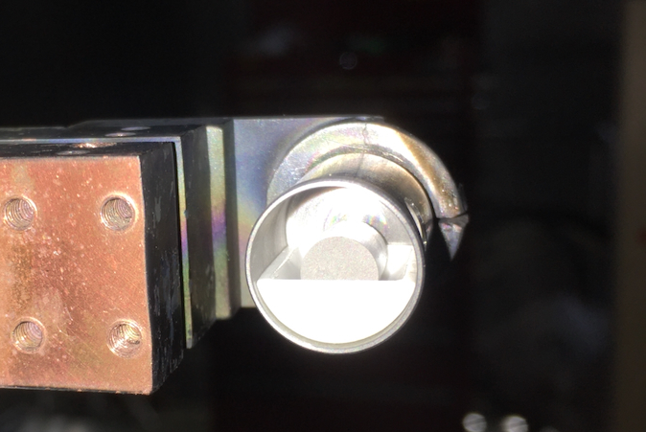
Anti-Deposition Shield (AD Shield)
To ECR Zone
A boat-shaped ceramic crucible was fabricated to direct the aperture into the ECR zone

Slide 8
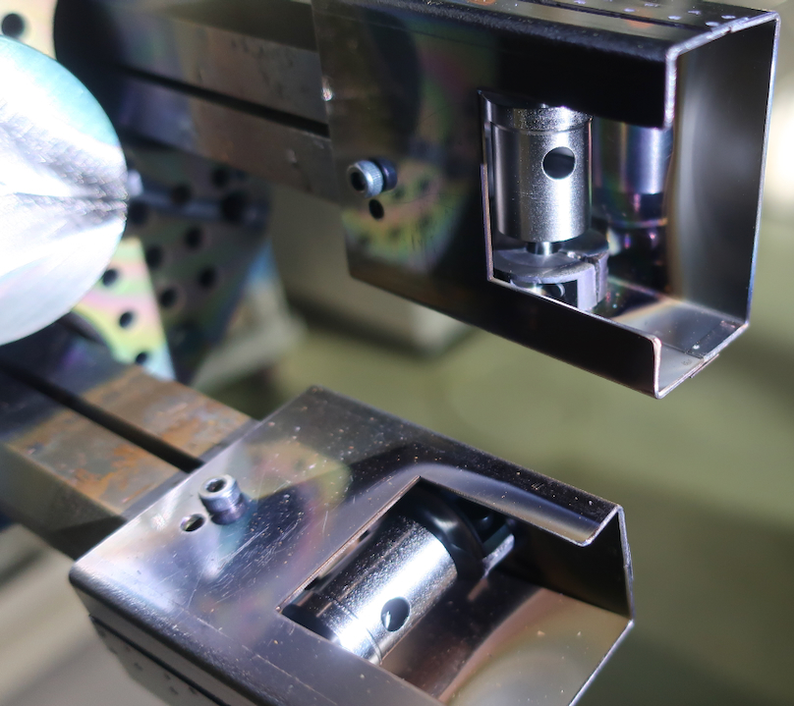
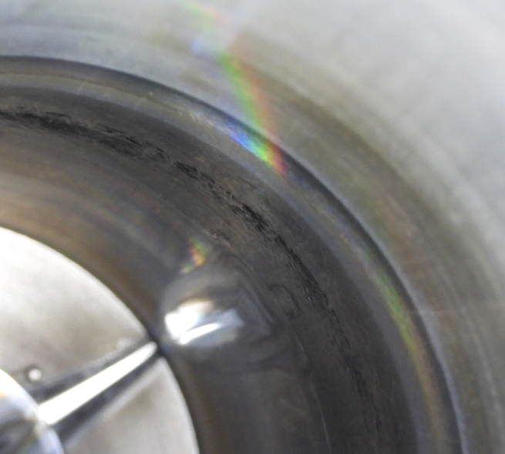
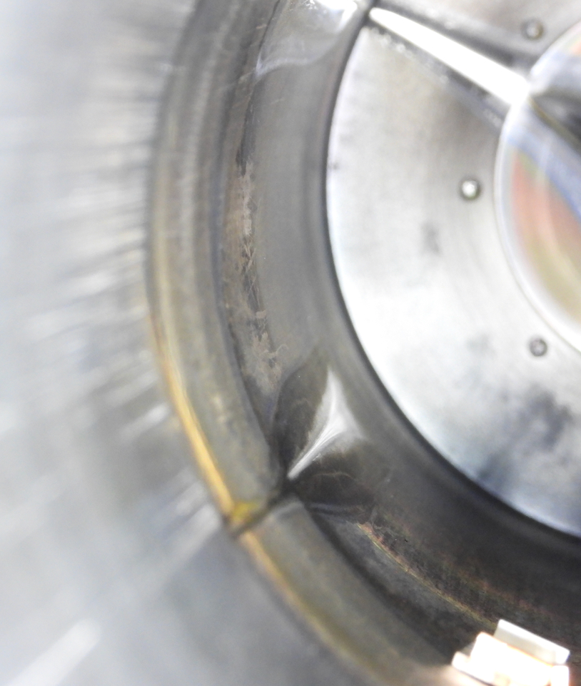
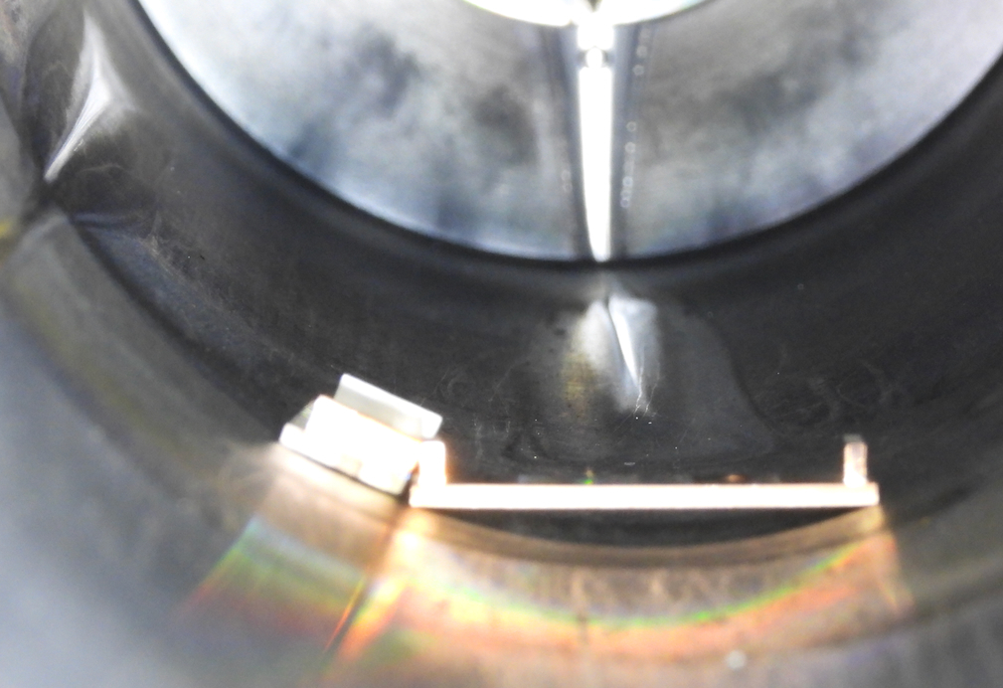
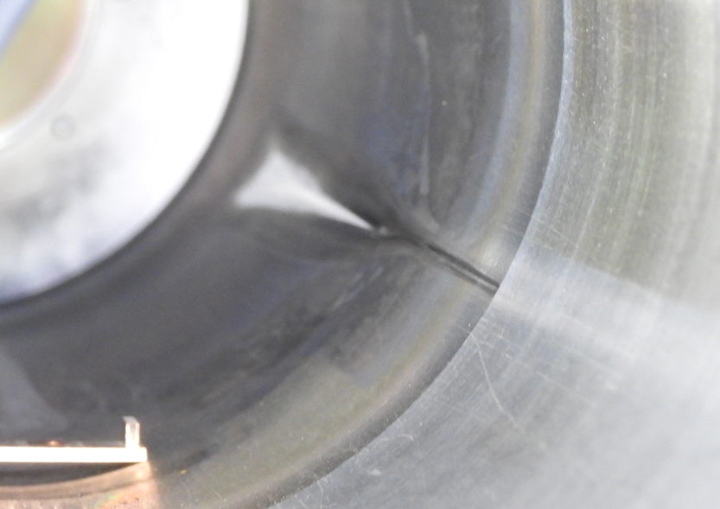
With
AD
Sheilds
(~2.4 g )
w/o AD Sheilds
(after ~4.2 g consumption)

Slide 9
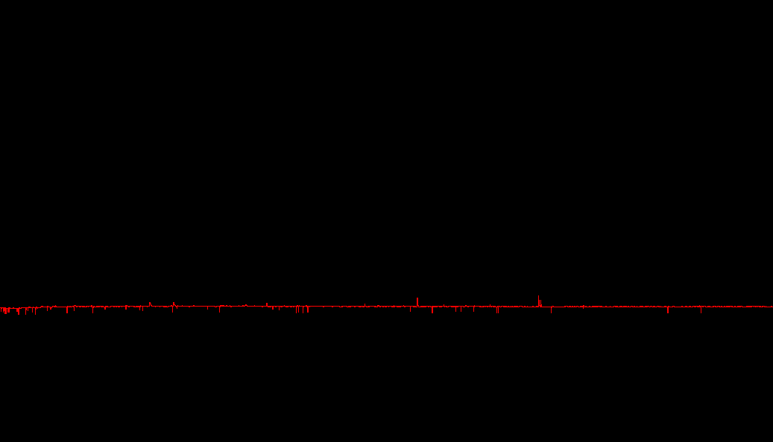
Comparison of I_{dain} without and with AD shield
1 min
1 min
1 mA
1 mA
I_{drain} = 4.0 mA
I_{drain} = 3.4 mA
w/o AD Sheilds
(after 4.2 g total consumption)
with AD Sheilds
(after 2.4 g total consumption)

Slide 10
Beam intensity instability due to metal vapor
・Beam reduction was caused by sudden evaporation of flake-shaped metal deposits inside the chamber wall when the plasma touch them.
・This test was not achieved same consumption level (total 4g).
However, AD shield has the potential to suppress instantaneous

Slide 11
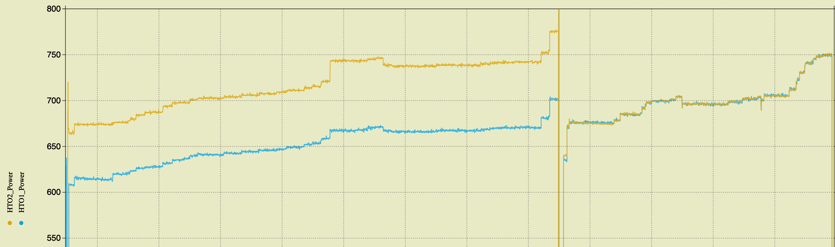
800
700
600
HTO1, 2
(same power)
OVEN
Heating
Power (w)
HTO2
HTO1
V sample filling
Plasma chamber Cleaning
Days

Slide 12
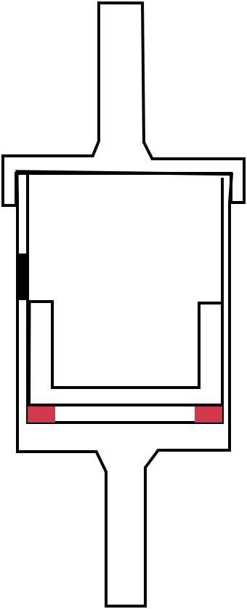
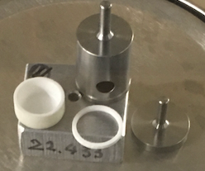
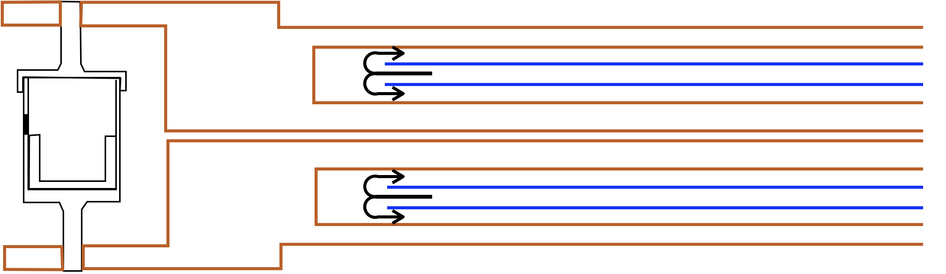
Temperature distribution in the crucible is uneven, especially noticeably lower at the bottom, lid and upper area of the aperture.
It is considered that the sample accumulates and or deposits in the lower temperature area.
Ceramic
ring
Cooling water (25 degrees C)

Slide 13
X-ray heat loading

Slide 14
X-ray heat load
X ray heat load on the cryostat
Is expected as 4-10 W !!

Slide 15
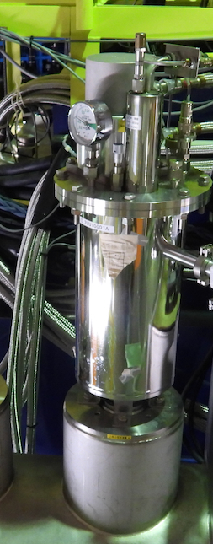
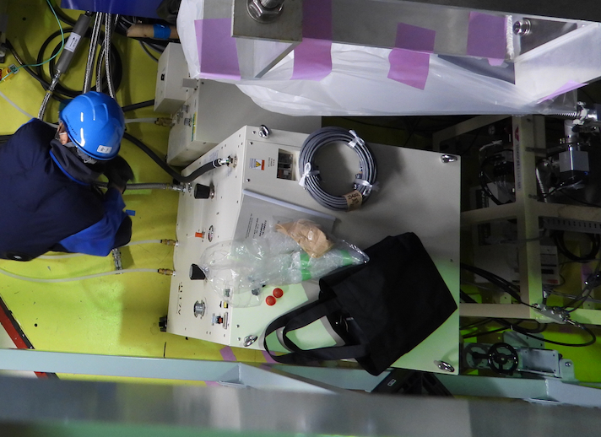
Extremely high-power GM-JT ( > 8 W @ 4 K)
Two compressors were used, the smaller (E77-A) for GM and the larger (J117V) for the JT circuit.
Already installed in RIKEN 28G-Hz SC-ECRIS for RIBF (R28G-S)
GM-JT (RJT-100, SHI Cryo. Group)

Slide 16
X-ray heat loading
・Extremely high-power GMJT (RJT-100) was developed by SHI Cryo. Group.
・Cooling power of > 8 W @ 4 K
・RJT-100 was already installed in R28G-S and in operation.

Slide 17
Ion beam extraction system improvements

Slide 18
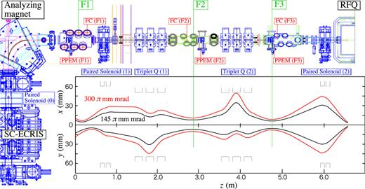
Modification of Extraction System
・F1 – Sol1 - Q11Q22Q33 – F2 – Q21Q22Q33 – F3 – Sol2 – RFQ
・The optical path between F2 and F3 is determined to match the acceptances of the RFQ.
・From F1 to F2, Combination of Sol1 and Triplet Q can absorb some focus shift.
・ A significant increase in beam intensity significantly affects the beam focusing at F1.
There is a significant possibility that the Sol 1-TQ combination will not be able to handle the situation.

Slide 19
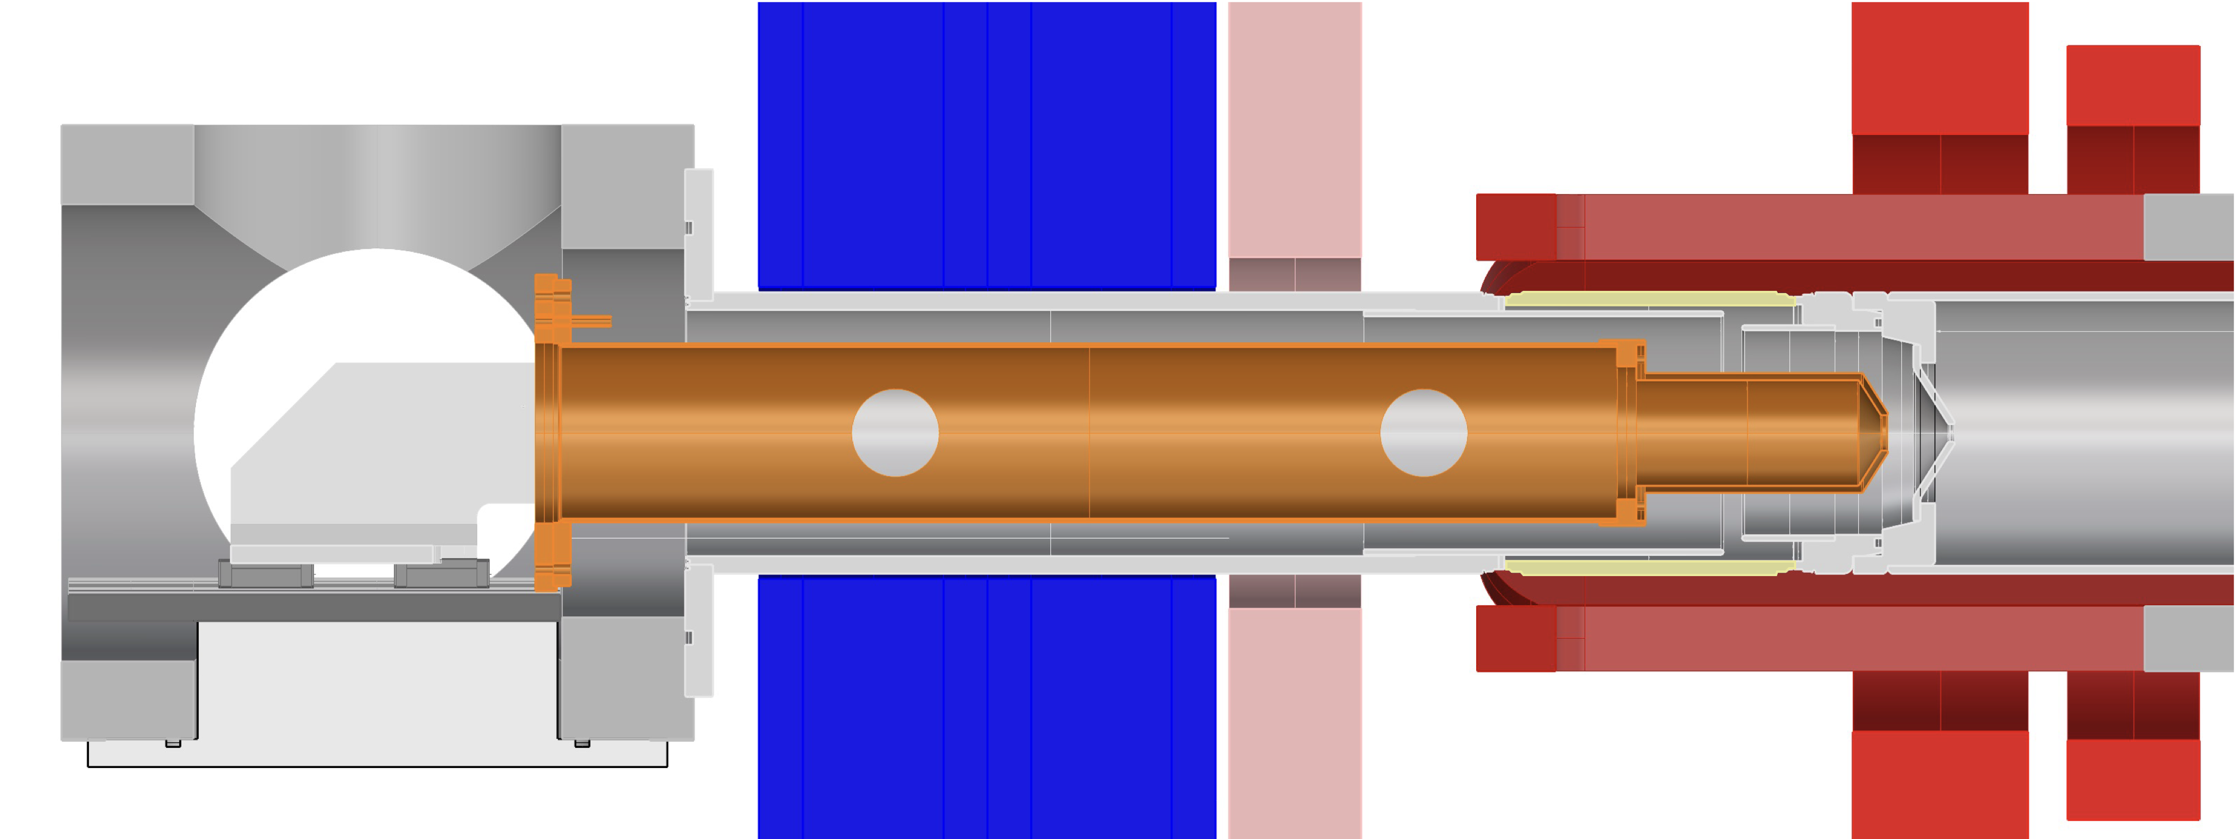
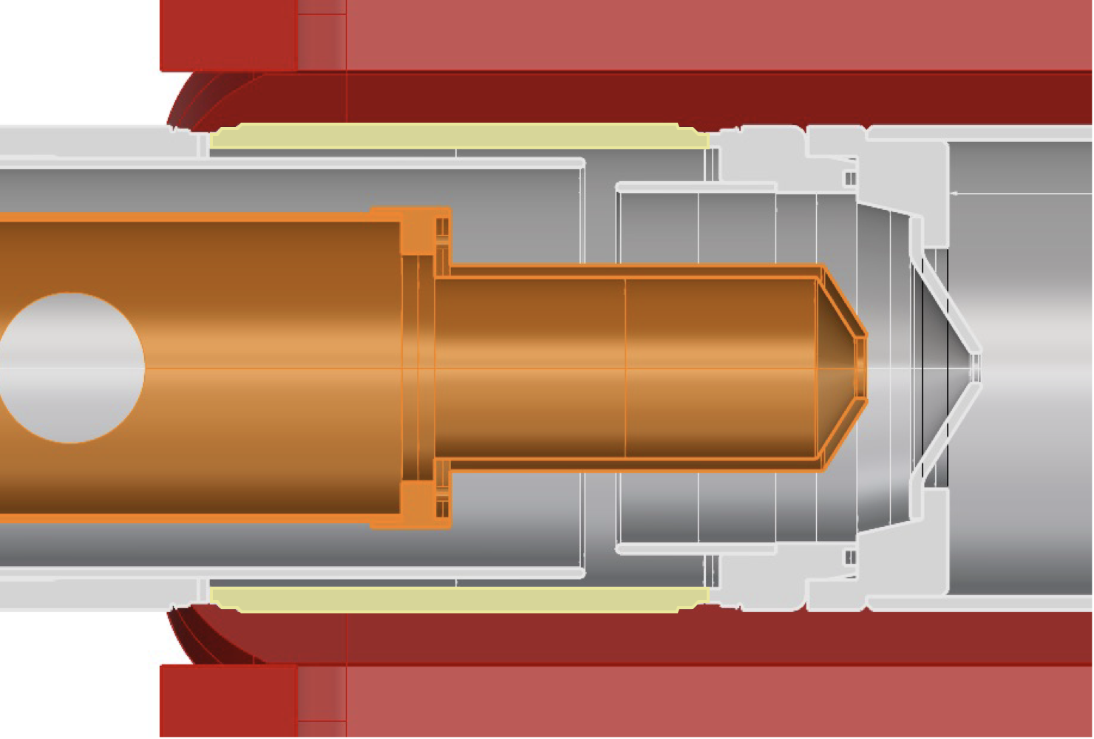
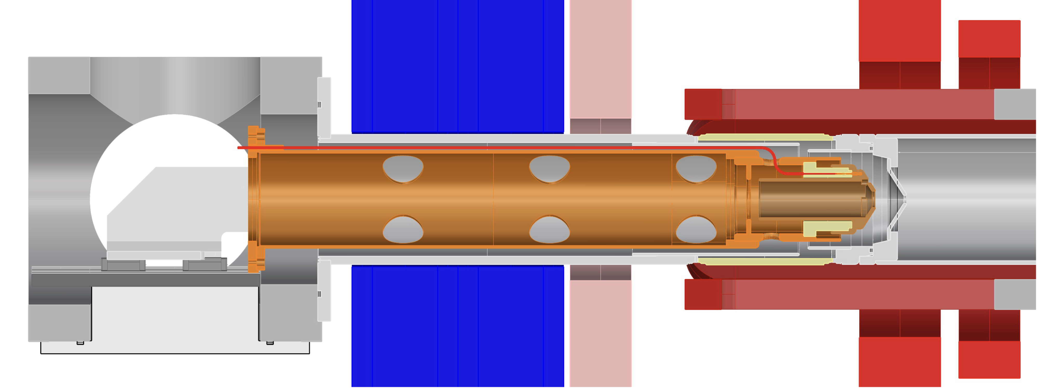
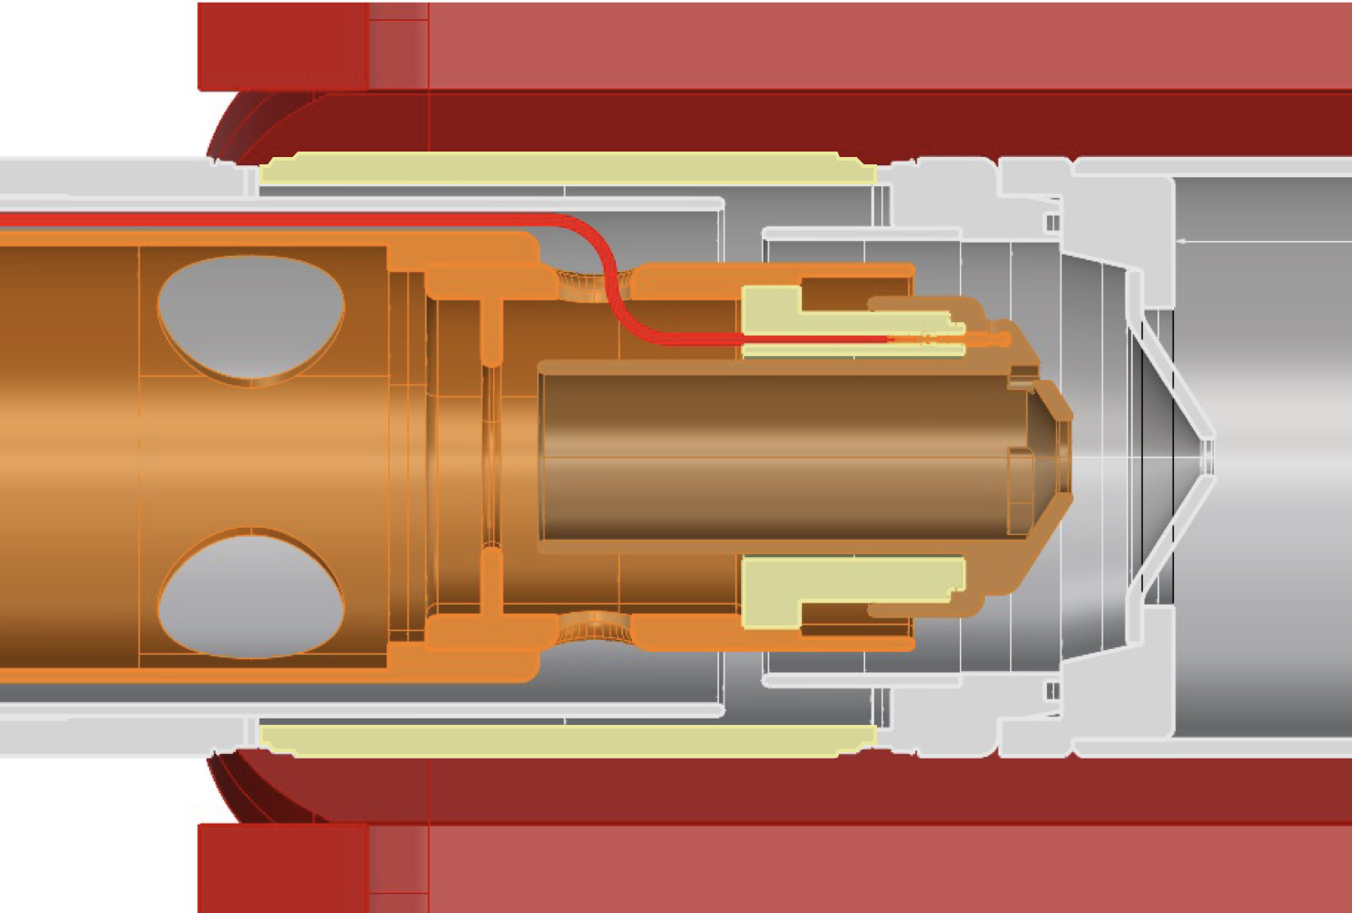
Ext. HV
GND
Ext. HV
GND
Ext. Sol.
Previous
Setups
Insulator
Insulator
Ext. HV
GND
Ext. Sol.
Modified
Setups
(1st Step)
Neg. HV
Insulator
500
250
・Previously, optics adjustment by grounded puller electrode position change and Ext. Sol.
・Modified electrode to allow -30 kV to be applied to the end of the puller.
・500-mm space following the Ext.Sol. → Additional lenses are being designed.
・FC and profile measurement devices is plan to install the following chamber.
Need new
or good ideas

Slide 20
Pepper-pot type Emittance meter at First diagnostic chamber
Optical flow method automatically tracks beam spots as the distance changes
→ Improved measurement accuracy, especially angular resolution
Morita et.al., ICIS2023
Estimated beam profile
Observed X-Y
y(mm)
y(mm)
1405 mm
upstream
x(mm)
x(mm)
With Good resolution!
The estimation accuracy of the transverse phase space distribution upstream of the analyzing magnet has been dramatically improved.
→ Expected to be able to measure changes in emittance with increasing beam intensity and Iext

Slide 21
Ion beam extraction system improvements
・To deal with the change in focus due to the increase in beam intensity, the extraction system is being modified.
An electrode capable of applying -30 kV at the tip of the puller were fabricated and installed.
Additional beam optics devices (e.g., lenses) are being designed.
・Improved angular resolution of the PPEM so that the transverse phase space distribution can be predicted before the analyzer.

Slide 22
Summary
◎：OK
○：could be OK
△：in progress
Toward uranium 35+ beam 300μA
○Beam intensity instability due to metal vapor
◎X-ray heat load
△Ion beam extraction system improvements
＋Cooling system upgrade of Plasma Chamber

Slide 23
Beam intensity instability due to metal vapor
・Beam reduction was caused by sudden evaporation of flake-shaped metal deposits inside the chamber wall when the plasma touch them.
・This test was not achieved same consumption level (total 4g).
However, AD shield has the potential to suppress instantaneous
X-ray heat loading
・Extremely high-power GMJT (RJT-100) was developed by SHI Cryo. Group.
Cooling power of > 8 W @ 4 K
・RJT-100 was already installed in R28G-S and is in operation.
Ion beam extraction system improvements
・To deal with the change in focus due to the increase in beam intensity, the extraction system is being modified to apply -30 kV at the end of the puller.
・Additional beam optics devices (e.g., lenses) are being designed.→ We need new good ideas
・Improved angular resolution of the PPEM so that the transverse phase space distribution can be predicted before the analyzer.

Slide 25
I_{drain}
Start
I_{drain} = 4.0 mA
Fluctuation in beam intensity ~ a few %.
I_{drain}
1 min
End
1 mA
I_{drain} = 4.0 mA
This spike causes a reduction in beam intensity of more than 10%.

Slide 26
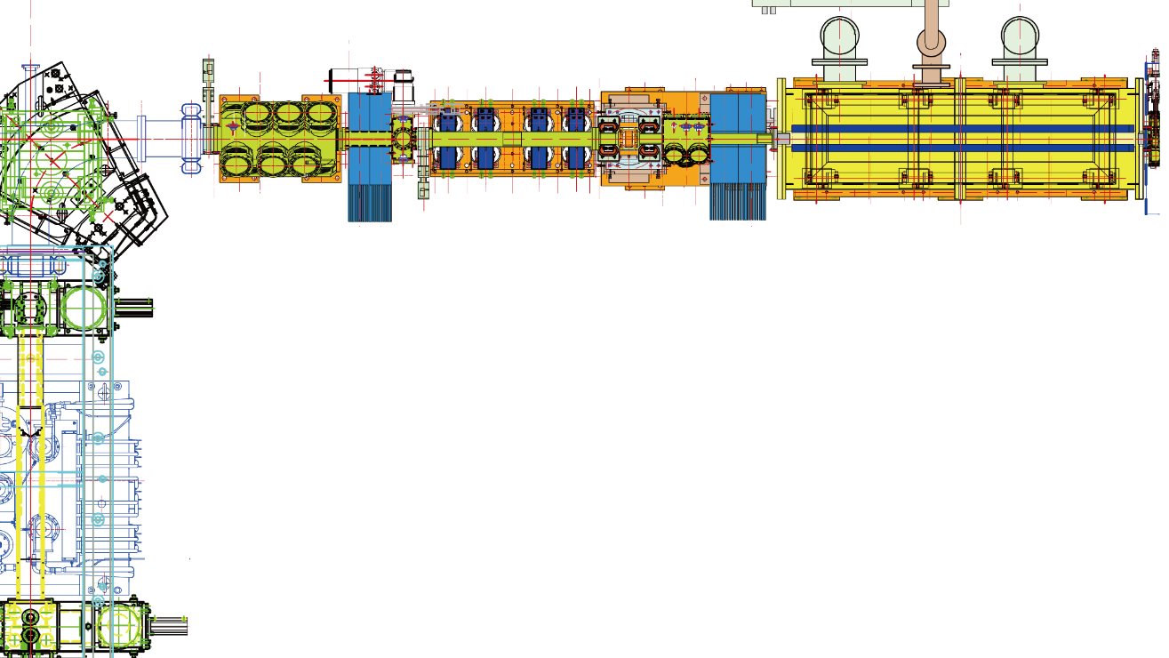
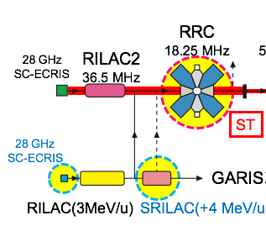
RIKEN 28-GHz ECRISs for RILAC II and RILAC
SC-ECRIS（RILAC II）and LEBT
RFQ
Q magnet
Faraday
cup
Paired Solenoid
Paired Solenoid
SC-ECRIS
Analyzing magnet
3 m
SC-ECRIS（RILAC）and LEBT

