Slide 1


Production of intense highly charged metallic ion beams for routine operation
IMP
L. Sun, W. Lu
Institute of Modern Physics, CAS, 730000, Lanzhou, China
PIBHI’25, April. 7~9, 2025, Acitrezza, Italy

Slide 2
Outline
General info on Metallic Ion Beams at IMP
Metallic Ion Beams Operation at IMP
Operation Status
Operation for compact ion sources
Operation for SHE
Operation with refractory metallic ion beams
Operation stability
Summary
Notes:
Needs: SHE, CEE, HIAF
HCI production: metallic beams with CAFe-2 (LECR5 & SECRAL 3), Uranium beam with HIRFL@SECRAL-I & SECRAL-II
New Techniques towards intense beams: HTO, Vlasov launcher, 2-frequency AG, Biased probe + AG effect
HIAF requirements in long range, FECR

Slide 3
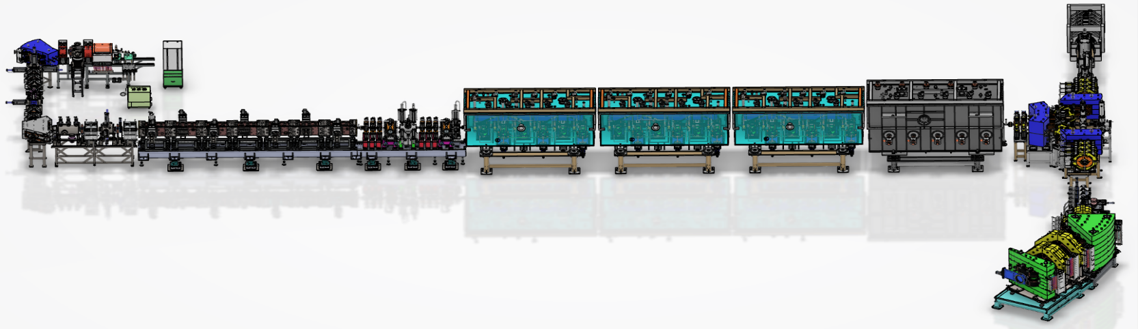
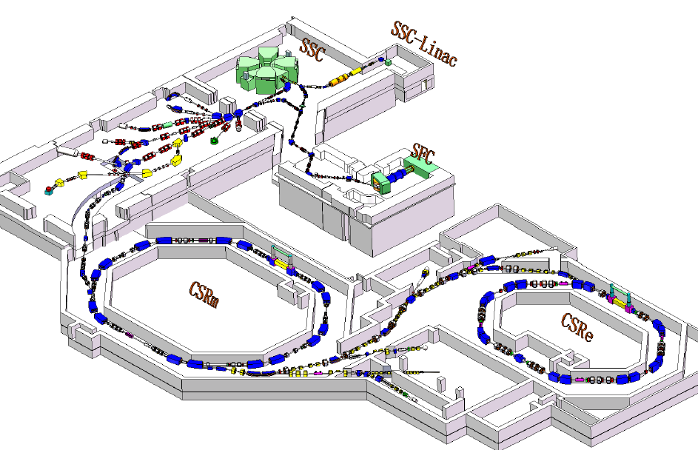
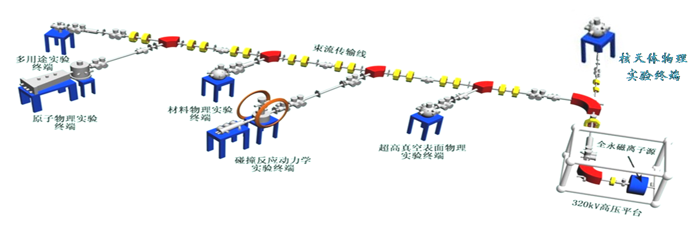
General Info: Facilities
28 GHz SECRAL-I
18 GHz LECR5
HIRFL
14 GHz LECR3
24 GHz SECRAL-II
CAFE2
320 kV HV Platform
14 GHz LAPECR2
Notes:
Needs: SHE, CEE, HIAF
HCI production: metallic beams with CAFe-2 (LECR5 & SECRAL 3), Uranium beam with HIRFL@SECRAL-I & SECRAL-II
New Techniques towards intense beams: HTO, Vlasov launcher, 2-frequency AG, Biased probe + AG effect
HIAF requirements in long range, FECR

Slide 4
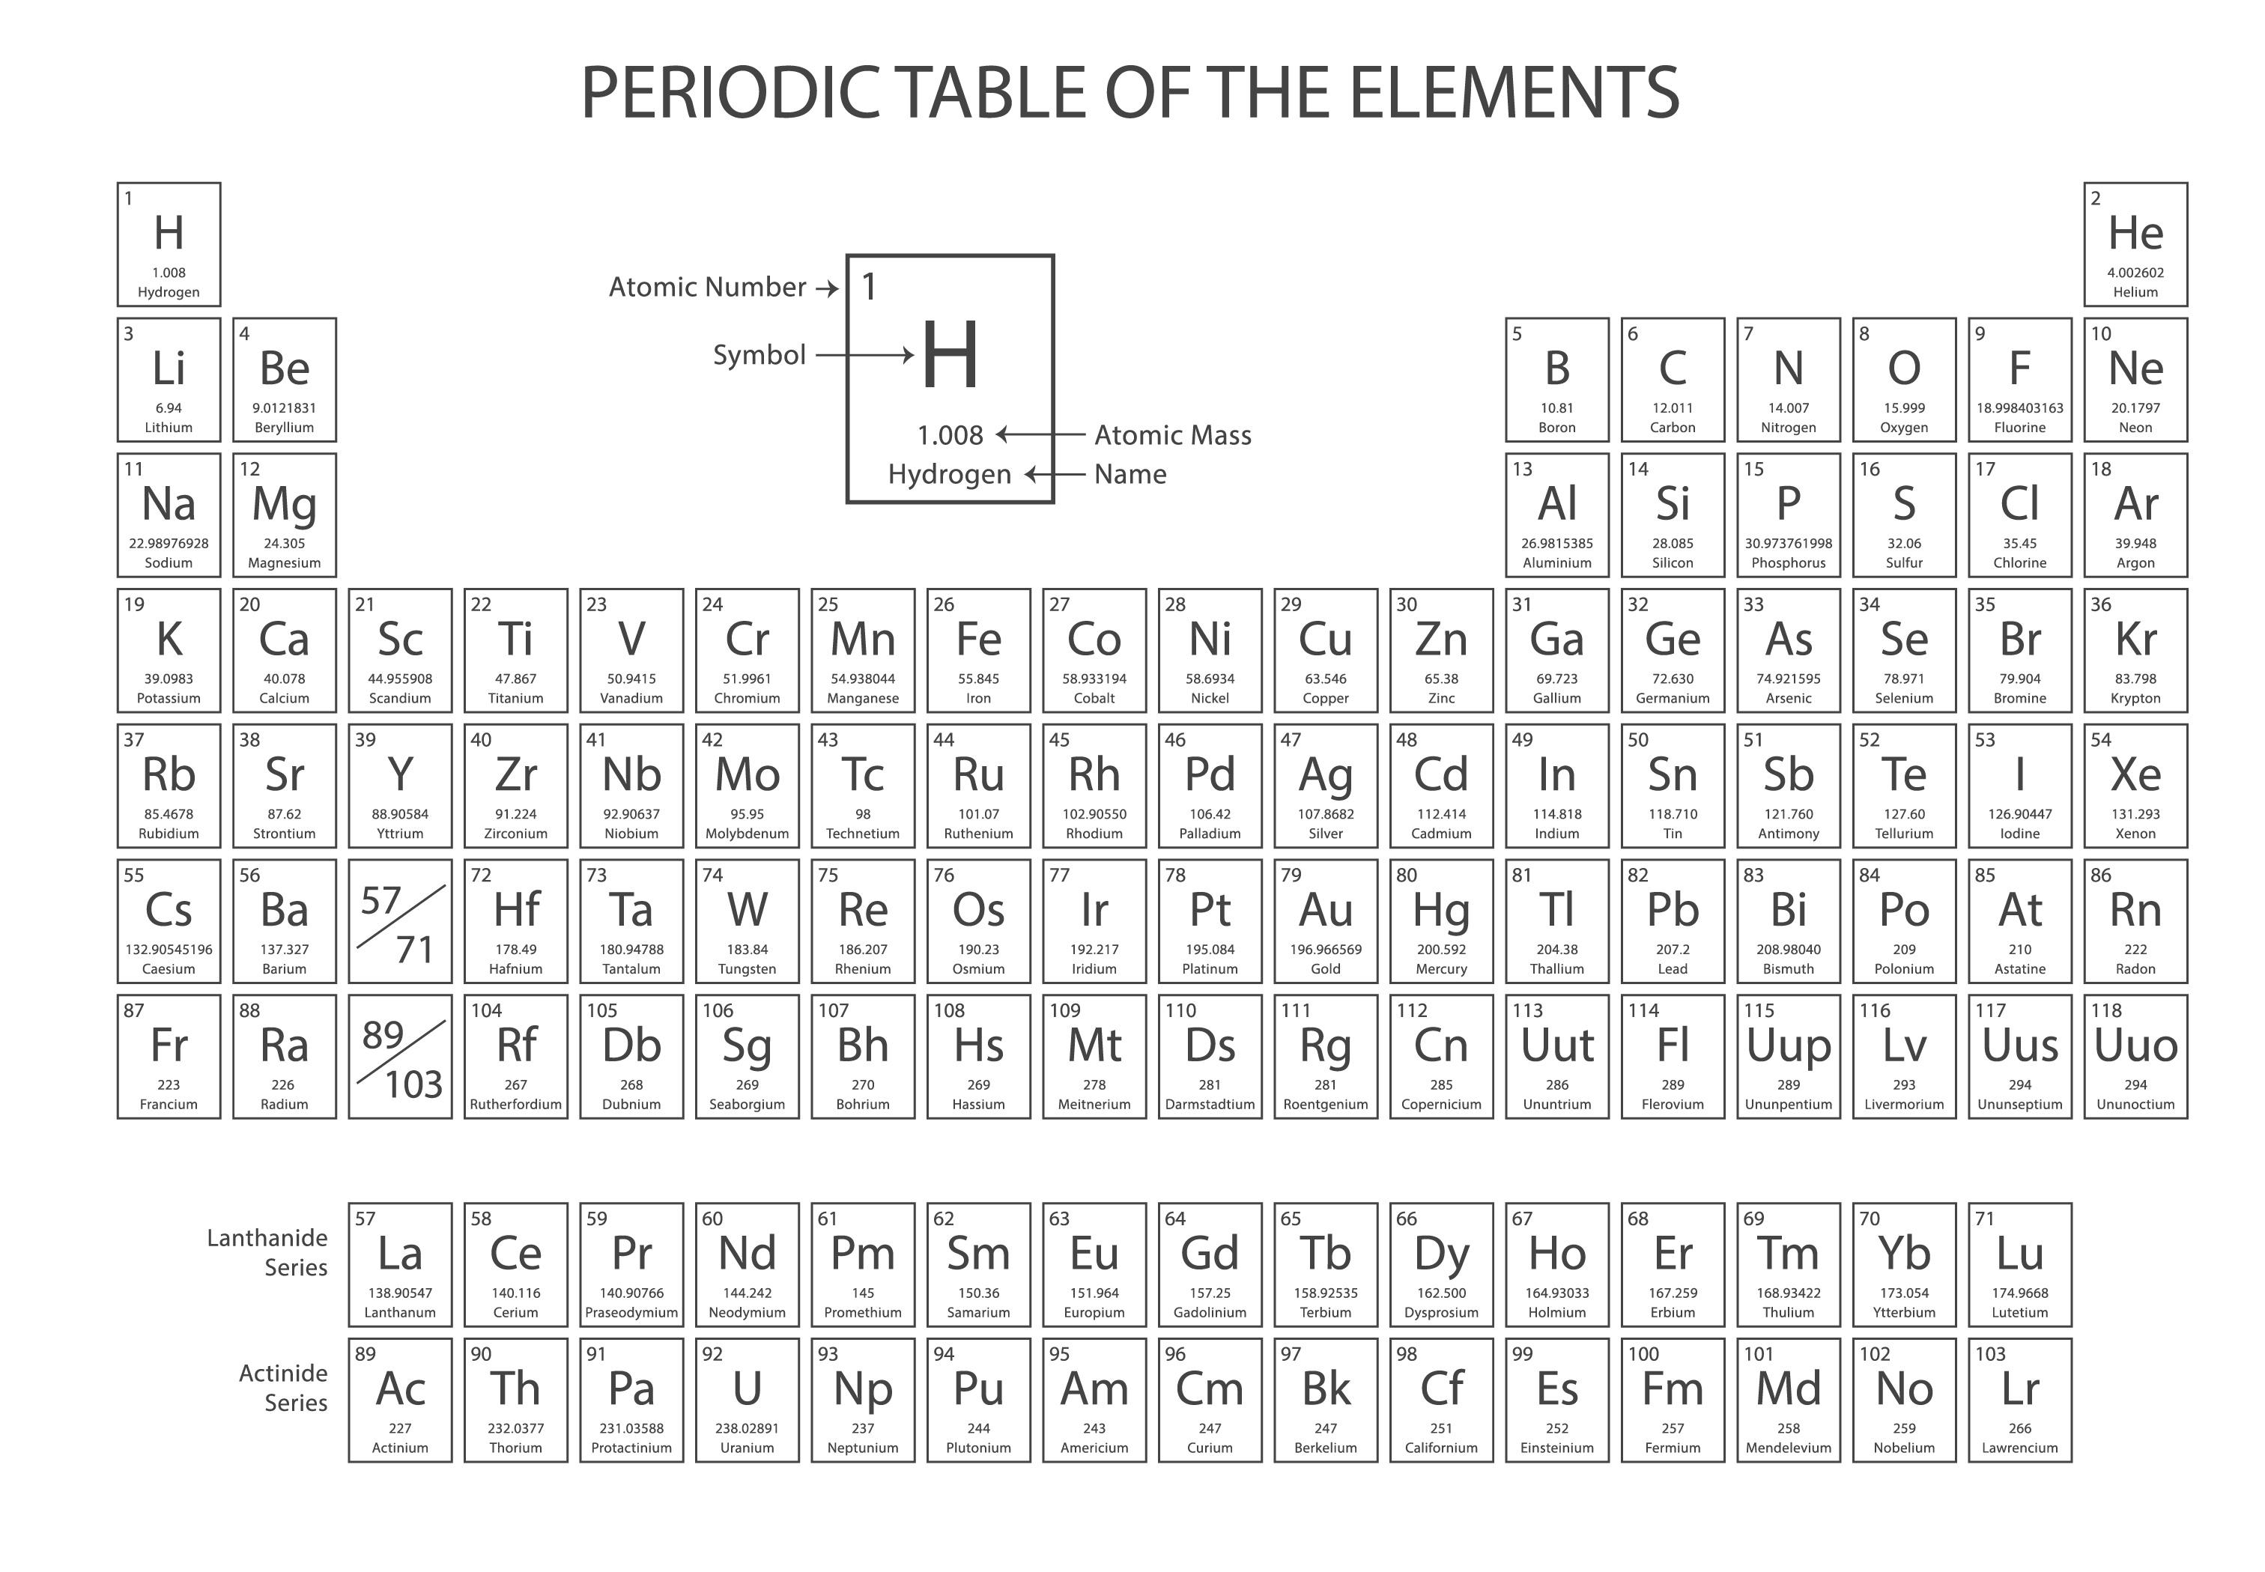
General Info: Ion Beam List
Ion beams produced at IMP
:Gas
:OVEN
:MIVOC
:Sputtering
Notes:
Needs: SHE, CEE, HIAF
HCI production: metallic beams with CAFe-2 (LECR5 & SECRAL 3), Uranium beam with HIRFL@SECRAL-I & SECRAL-II
New Techniques towards intense beams: HTO, Vlasov launcher, 2-frequency AG, Biased probe + AG effect
HIAF requirements in long range, FECR

Slide 5
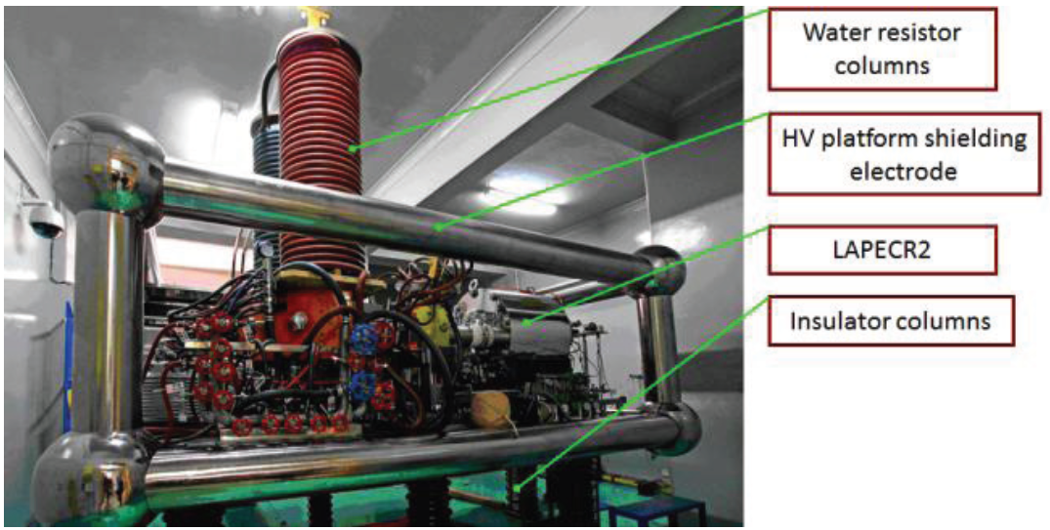
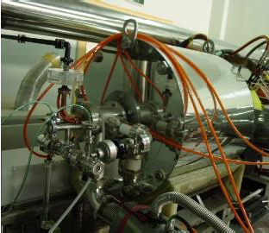
Status: Operation with Compact Ion Source
Ion current （eμA） | Material used | LAPECR2 （14.5 GHz <0.75 kW） 2006-2022
#Mn¹¹⁺ | MnO₂ | 14
*Fe¹³⁺ | C₁₀H₁₀Fe | 18
*Ni¹³⁺ | C₁₀H₁₀Ni | 35
*Ni¹⁷⁺ | C₁₀H₁₀Ni | 10
#Au³⁰⁺ | Au | 5.3
#Au³⁵⁺ | Au | 3
#Bi²⁸⁺ | Bi | 45
#Bi³³⁺ | Bi | 12
#Eu²³⁺ | Eu | 17
#Eu³³⁺ | Eu | 5
**U²⁵⁺ | U | 11
**U³¹⁺ | U | 4
* MIVOC
**Sputtering
#Conventional oven
Recently a refined design IHO is applied
Notes:
Needs: SHE, CEE, HIAF
HCI production: metallic beams with CAFe-2 (LECR5 & SECRAL 3), Uranium beam with HIRFL@SECRAL-I & SECRAL-II
New Techniques towards intense beams: HTO, Vlasov launcher, 2-frequency AG, Biased probe + AG effect
HIAF requirements in long range, FECR

Slide 6
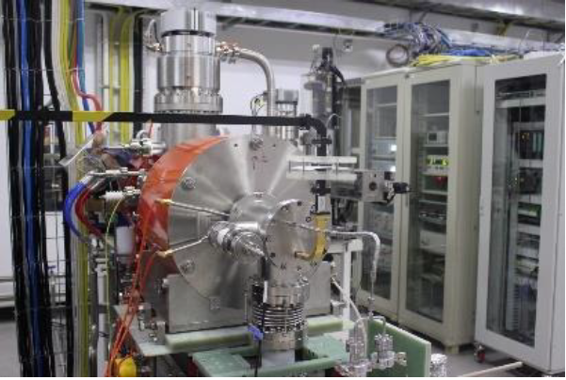
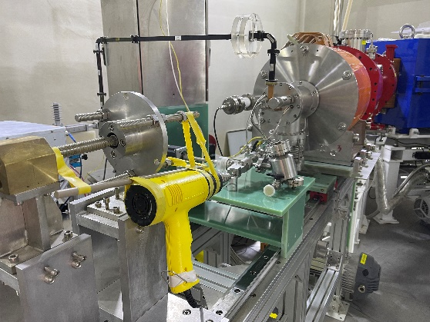
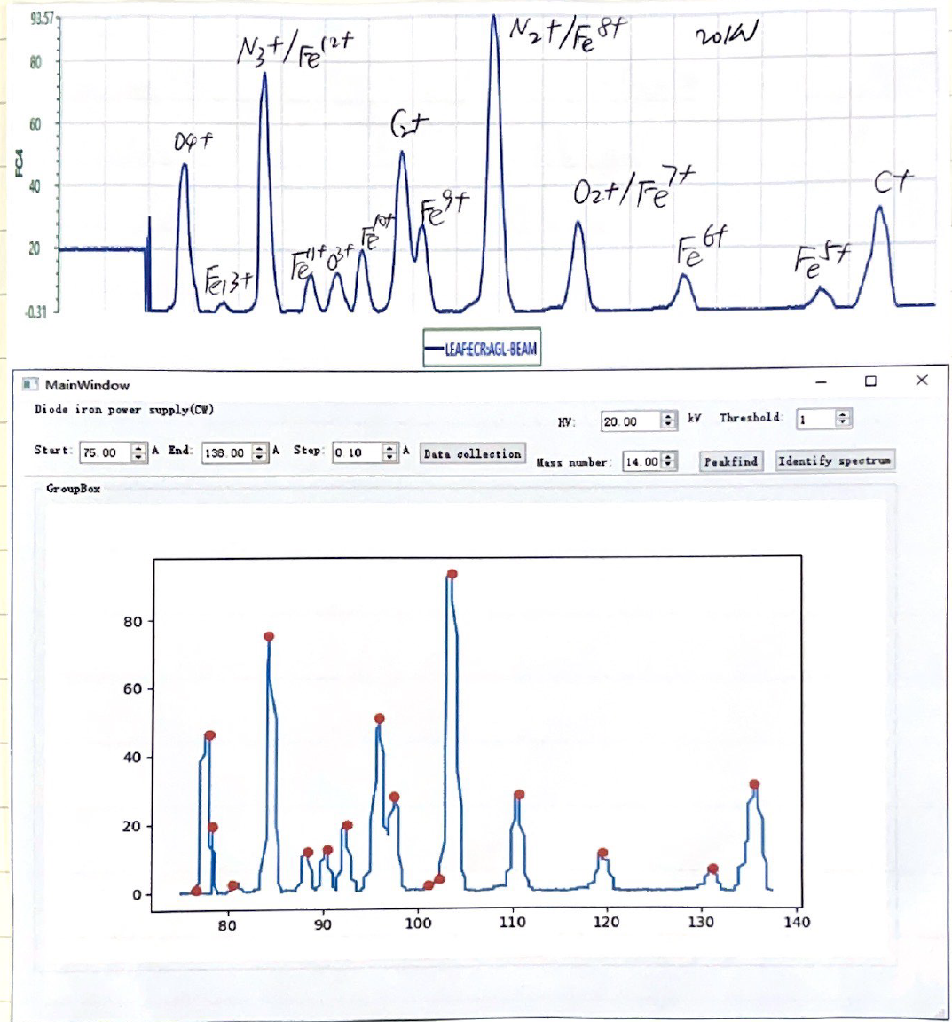
Status: Operation with Compact Ion Source
Limited by the space at source injection
MIVOC
Sputtering
Small resistor oven
Ion current （eμA） | LAPECR3 （14.5 GHz <0.75 kW） 2023
*Fe⁶⁺ | ~10
*Fe⁹⁺ | ~30
*Fe¹⁰⁺ | ~20
*Fe¹¹⁺ | ~10
* MIVOC
Notes:
Needs: SHE, CEE, HIAF
HCI production: metallic beams with CAFe-2 (LECR5 & SECRAL 3), Uranium beam with HIRFL@SECRAL-I & SECRAL-II
New Techniques towards intense beams: HTO, Vlasov launcher, 2-frequency AG, Biased probe + AG effect
HIAF requirements in long range, FECR

Slide 7
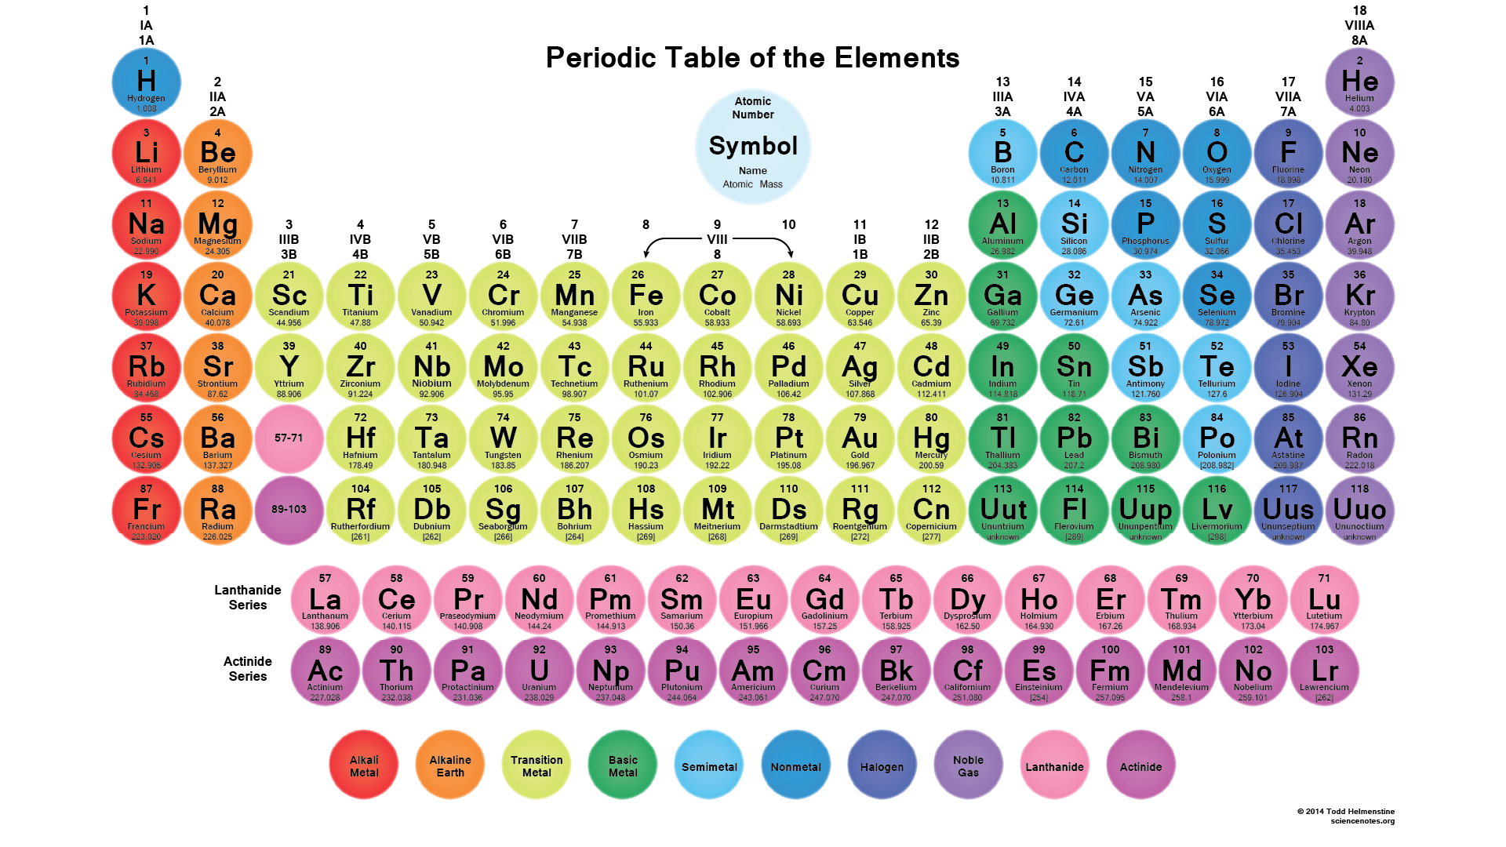
Status: Operation for SHE
Stable neutron rich projectile
119
⁵⁴Cr+²⁴³Am→²⁹⁷119*→²⁹⁴119+3n
⁵⁵Mn+²⁴⁴Pu→²⁹⁹119*→²⁹⁶119+3n
⁵¹V+²⁴⁸Cm→²⁹⁹119*→²⁹⁶119+3n
⁵⁰Ti+²⁴⁹Bk→²⁹⁹119*→²⁹⁶119+3n
⁴⁵Sc+²⁴⁹Cf→²⁹⁴119*→²⁹¹119+3n
120
⁵⁵Mn+²⁴³Am→²⁹⁸120*→²⁹⁵120+3n
⁵⁸Fe+²⁴⁴Pu→³⁰²120*→²⁹⁹120+3n
⁵⁴Cr+²⁴⁸Cm→³⁰²120*→²⁹⁹120+3n
⁵⁰Ti+²⁴⁹Cf → ²⁹⁹120*→²⁹⁶120+3n
A worldwide Research Campaign

Slide 8
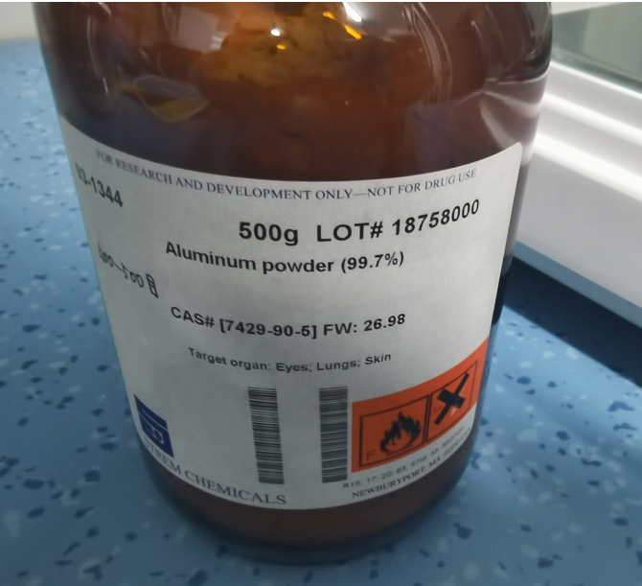
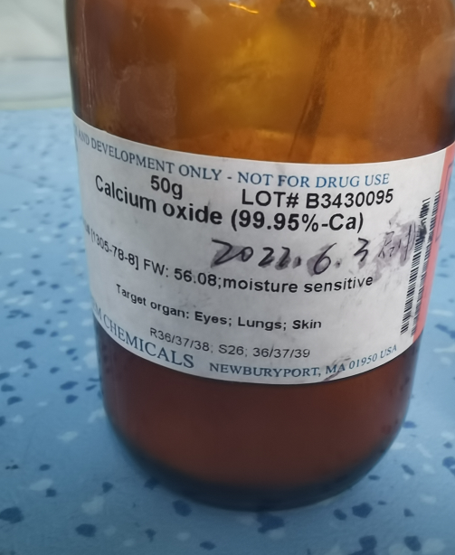
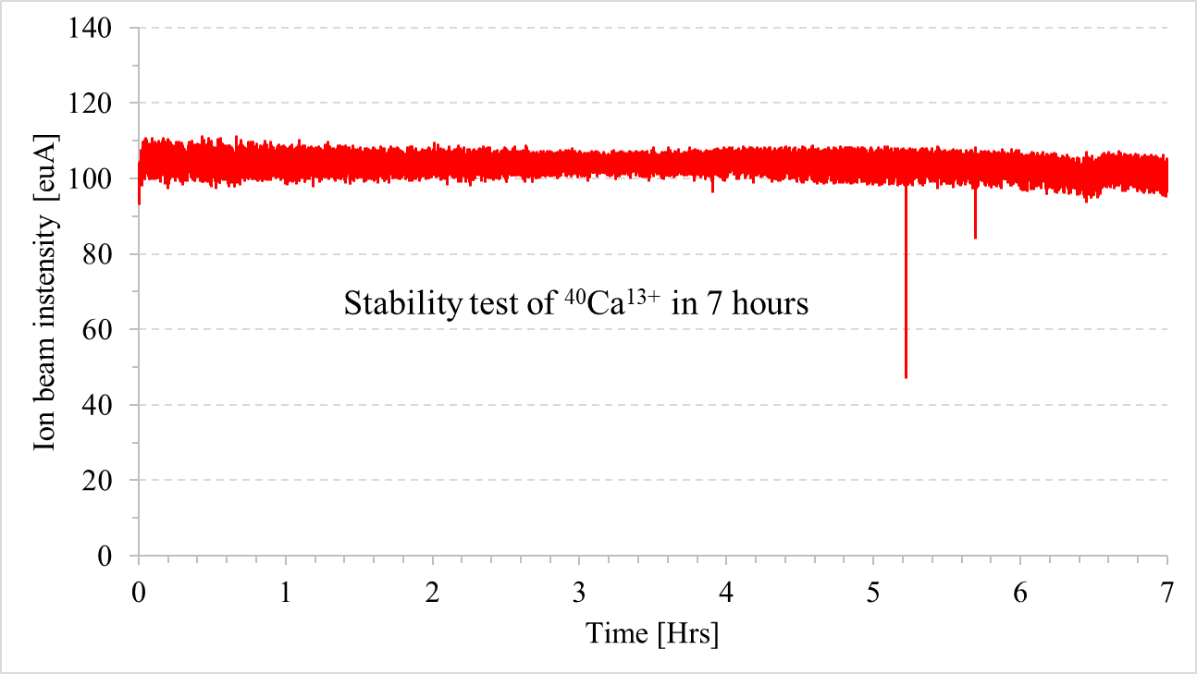
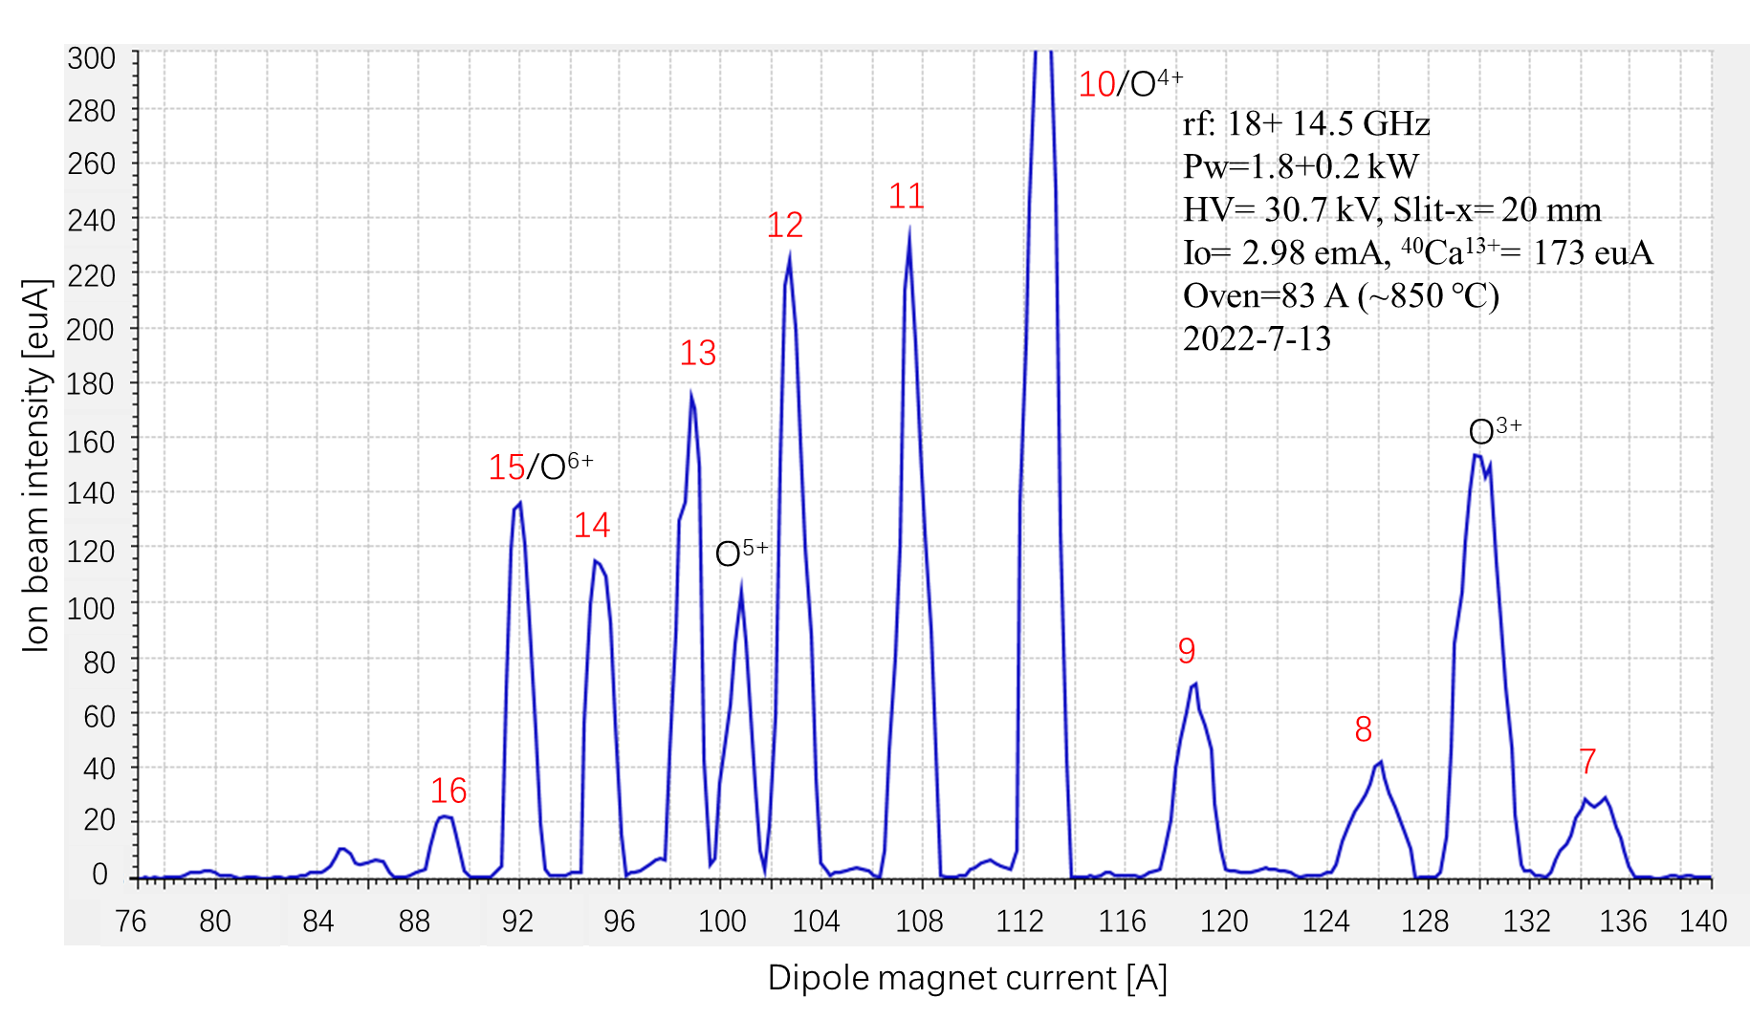

Status: Operation for SHE
$$3CaO+2Al→3Ca+{Al}_{2}O_{3}$$
Ion current （eμA） | 18+14 GHz/2 kW 2023
Ca¹¹⁺ | 235
Ca¹²⁺ | 225
Ca¹³⁺ | 173
Ca¹⁴⁺ | 115
Ca¹⁶⁺ | 65
Ca¹⁸⁺ | 18
Ca¹⁹⁺ | 1.5
[1]. W. Lu, H. Y. Ma, C. Qian, et.al. Nuclear Instruments and Methods in Physics Research A 1062 (2024) 169207

Slide 9
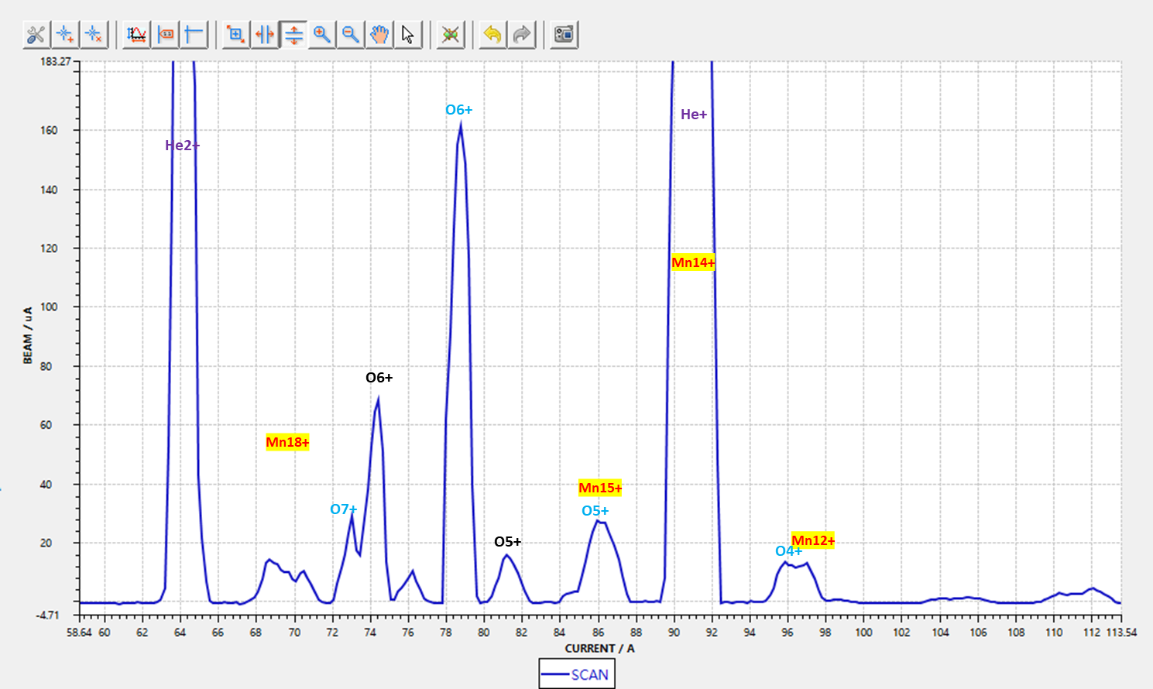
Status: Operation for SHE
Target ion: ⁵⁵Mn¹⁷⁺
M/q= 3.235
Supporting gas: ⁴He
very difficult to get high charge state!

Slide 10
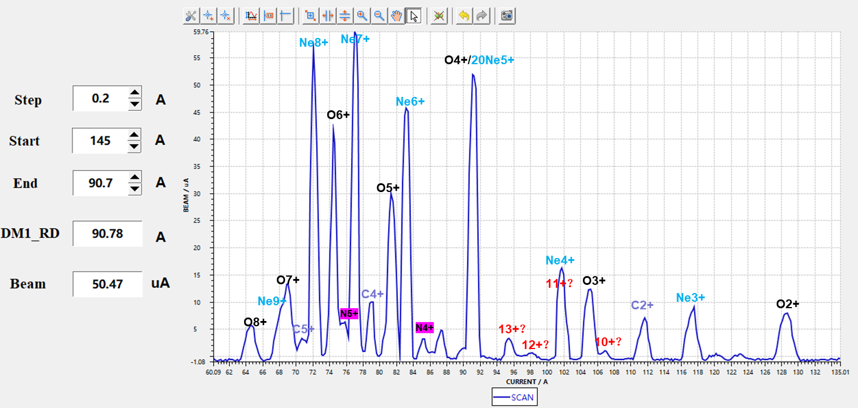
Status: Operation for SHE
Supporting gas: ²⁰Ne
even difficult to get medium charge state!

Slide 11
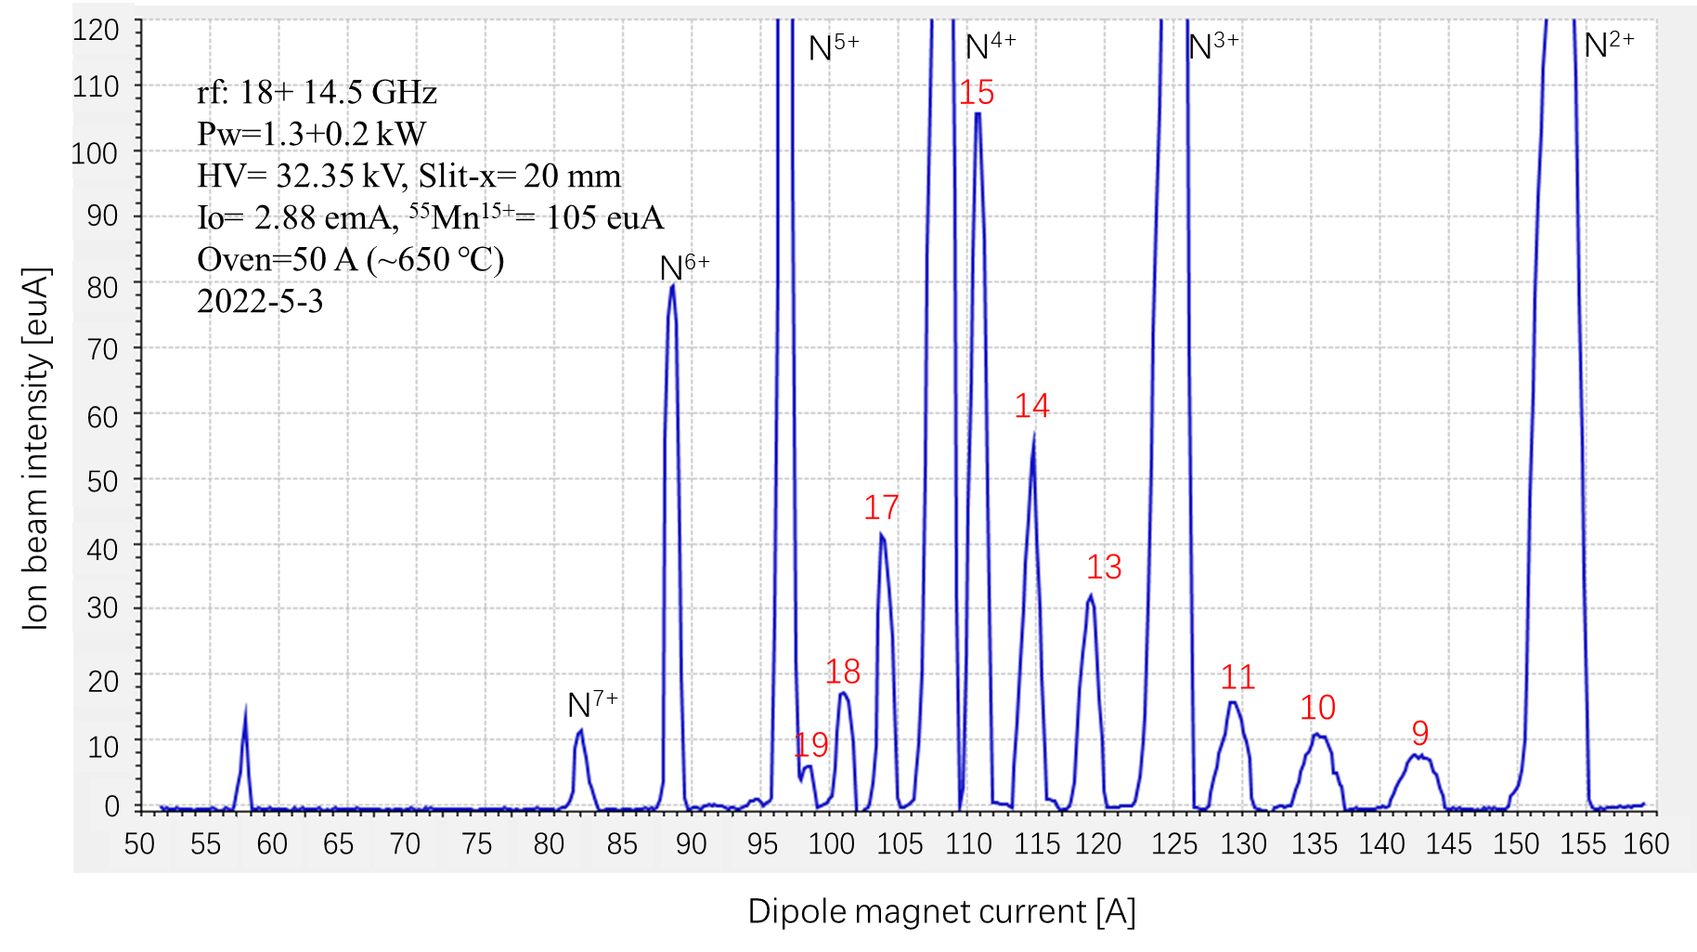
Status: Operation for SHE
Supporting gas: ¹⁴N
stable Mn¹⁷⁺ produced

Slide 12
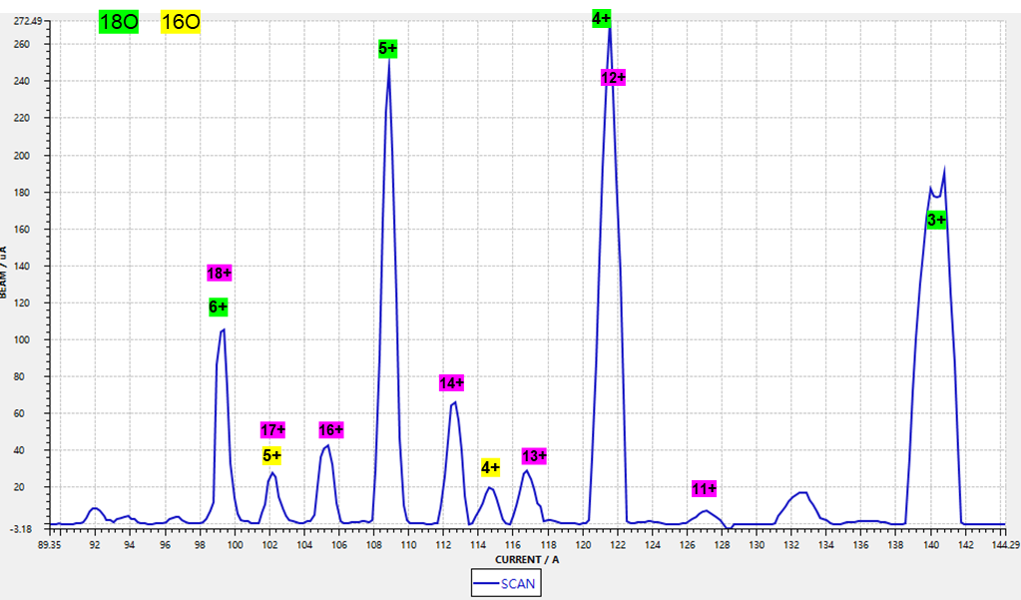
Status: Operation for SHE
Target ion: ⁵⁴Cr¹⁷⁺
M/q= 3.176
Supporting gas: ¹⁸O
difficult to avoid the influence of ¹⁶O⁵⁺

Slide 13
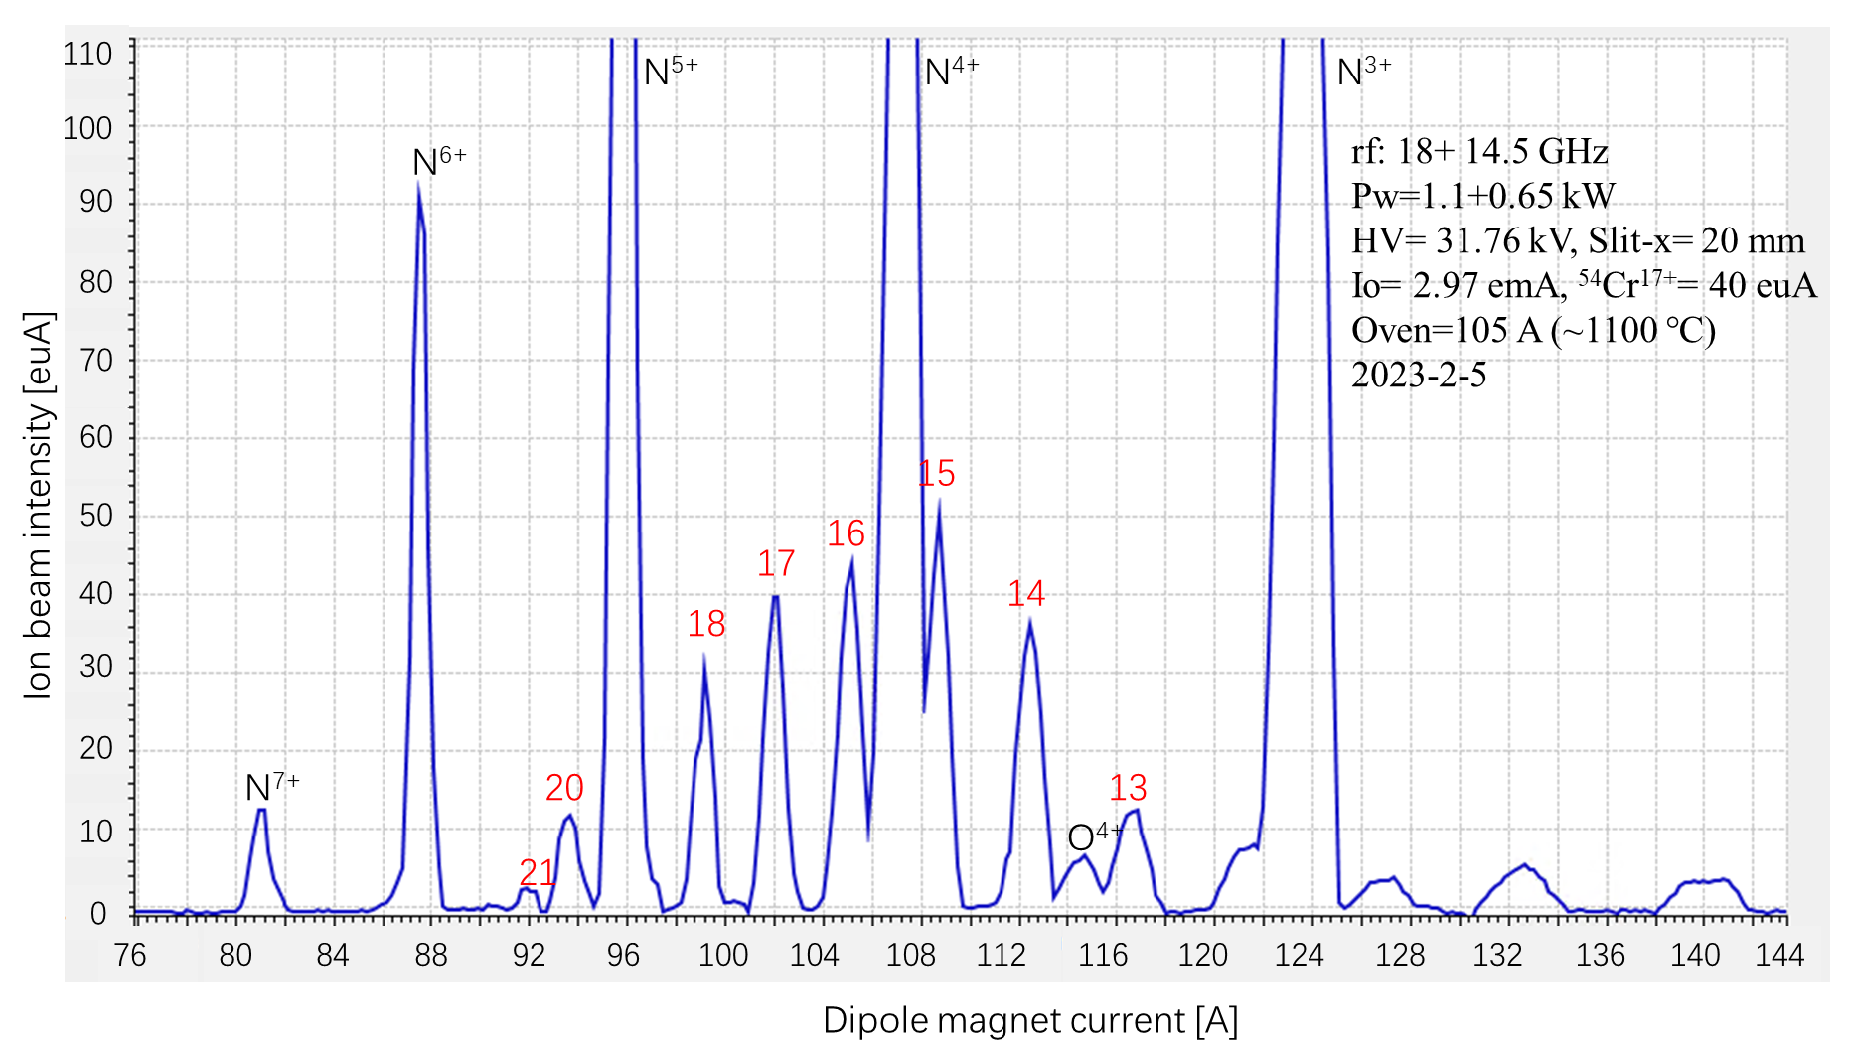
Status: Operation for SHE
Supporting gas: ¹⁴N₂
stable Cr¹⁷⁺ produced

Slide 14
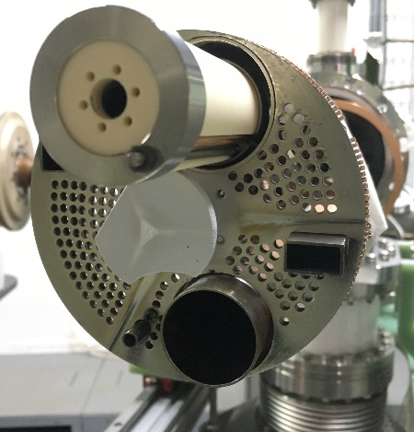
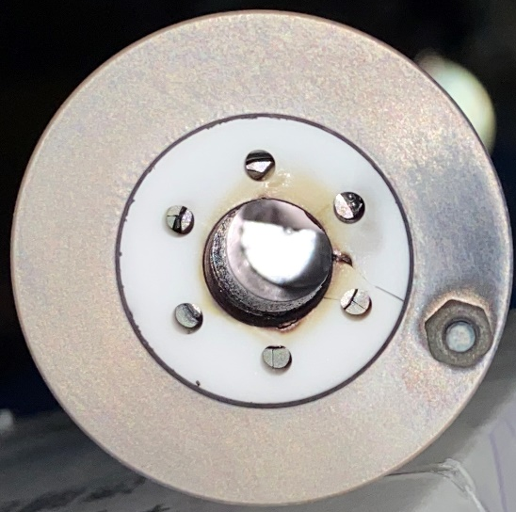
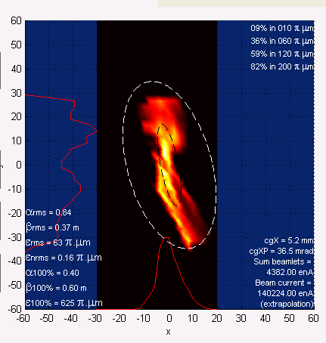
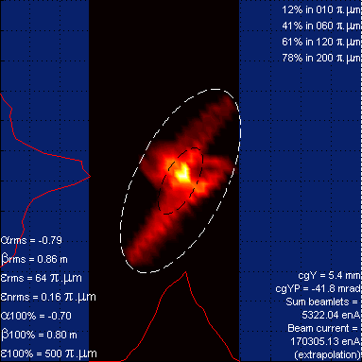
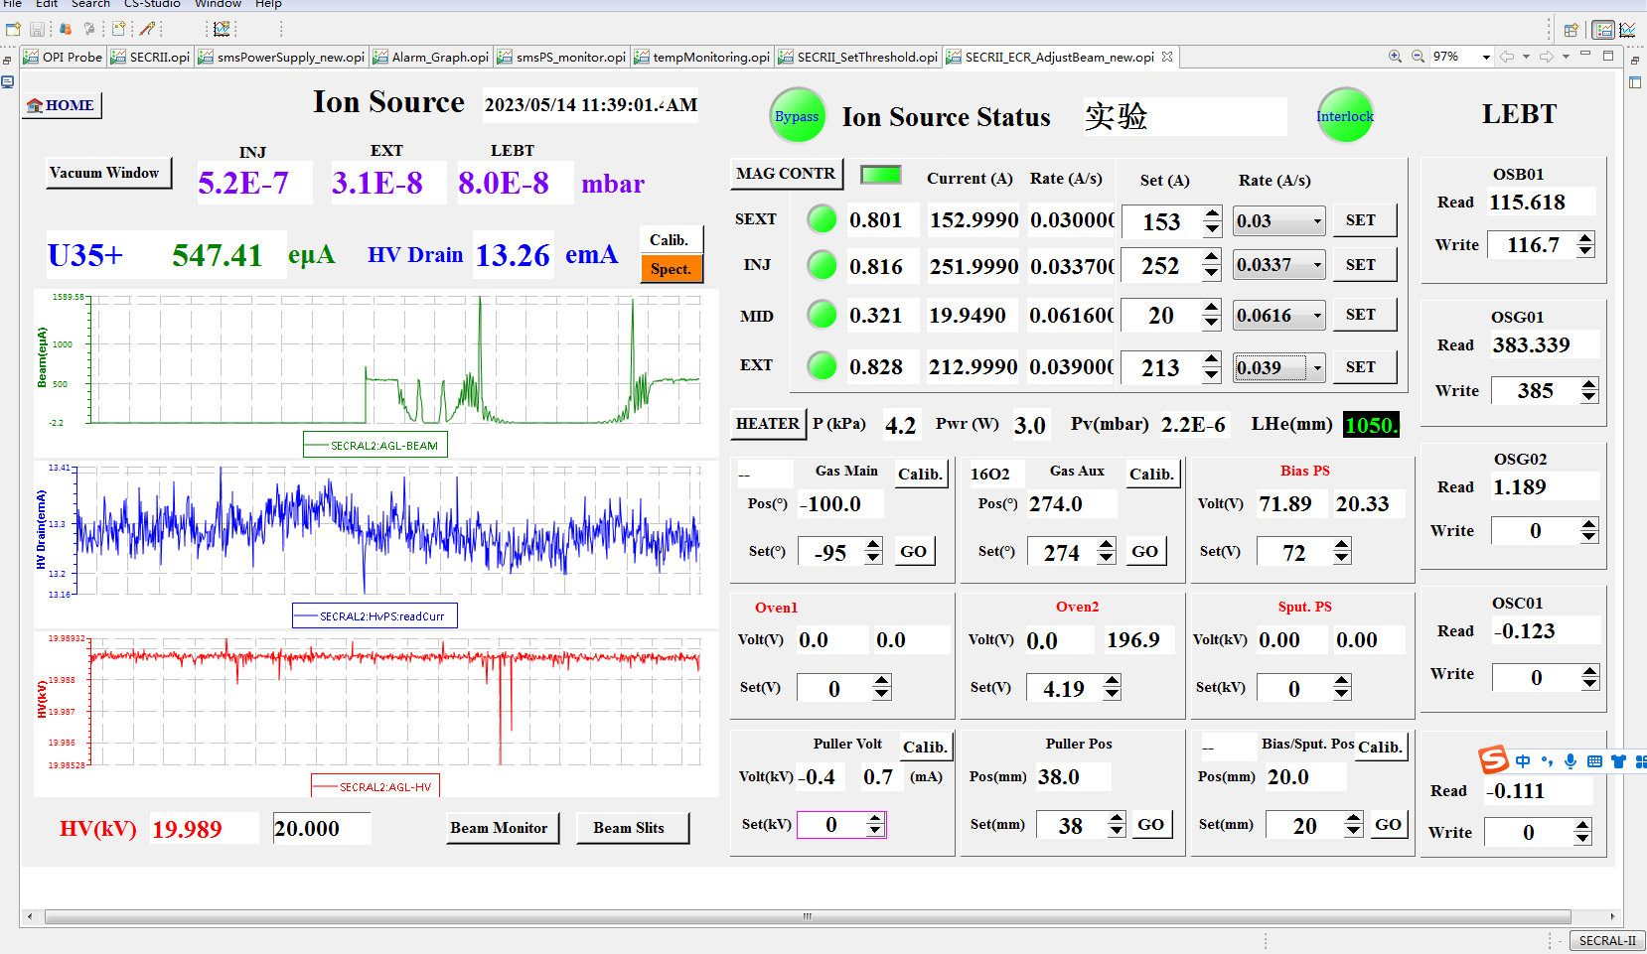
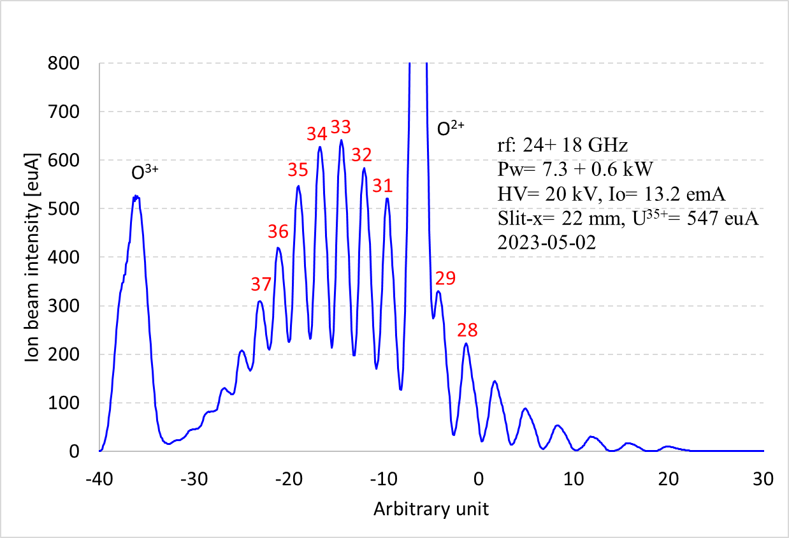
Status: Operation with Refractory Metal Ion Beams

Slide 15
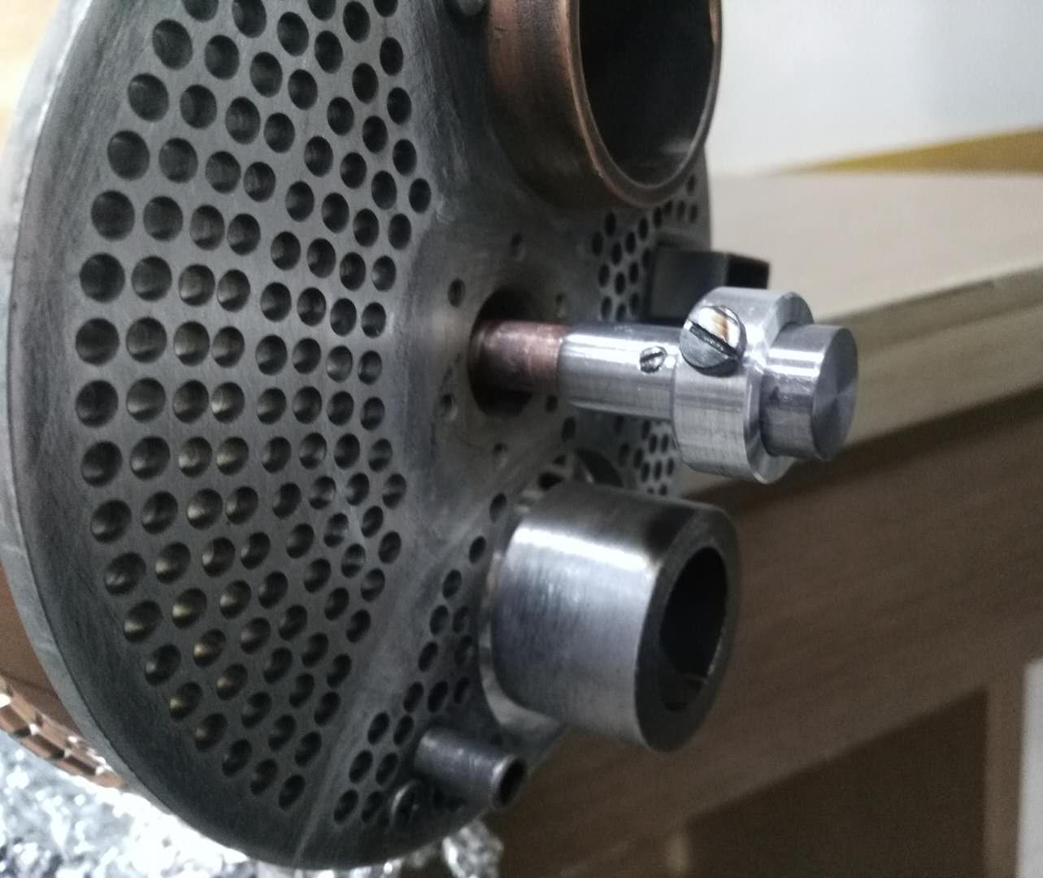
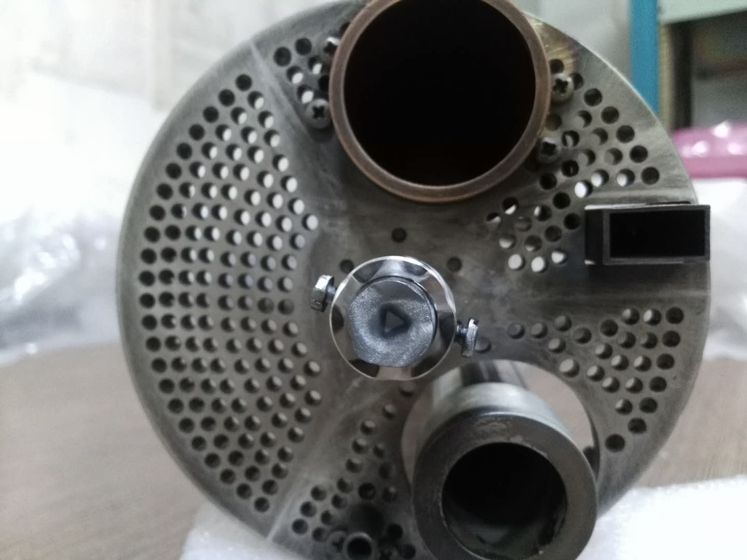
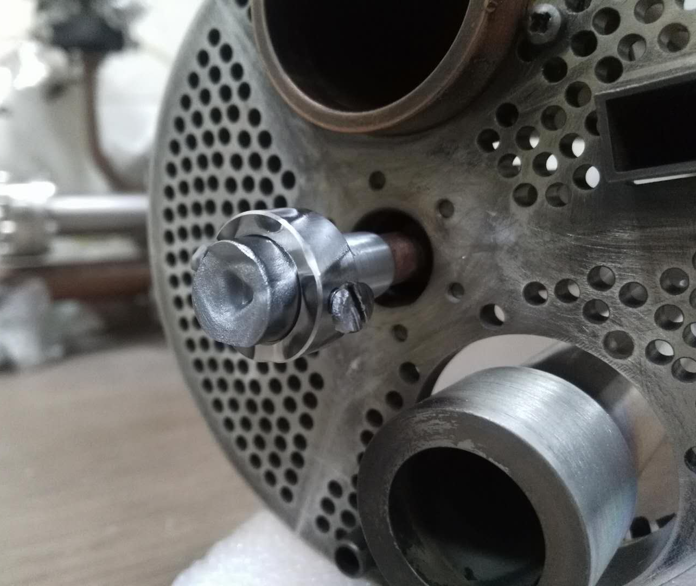
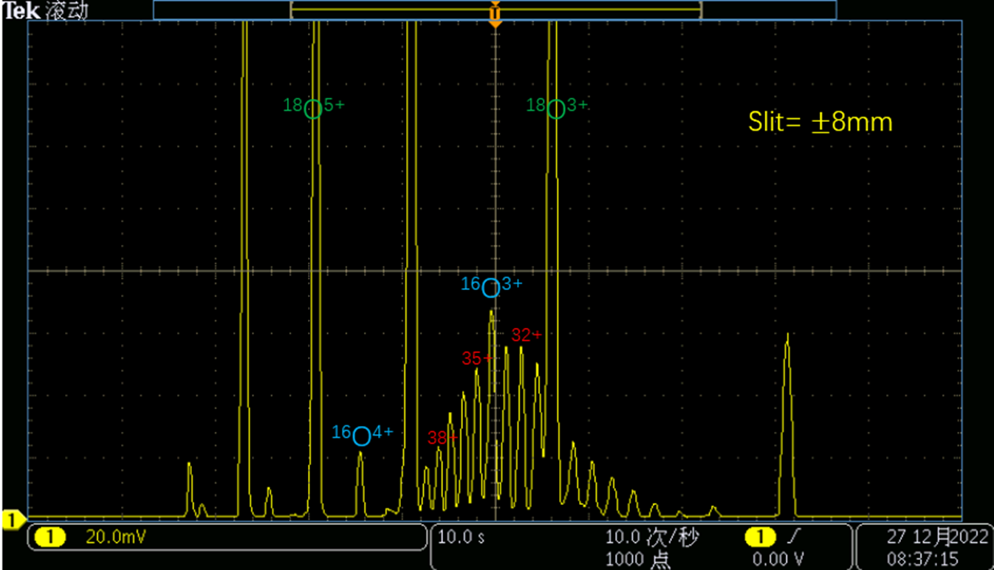
Status: Operation with Refractory Metal Ion Beams
Ta rod
RF: 24+ 18 GHz
Total rf Power: 2-3 kW
Extraction voltage: 12-20 kV
Drain current: 4-6 emA
Slit-x= 16 mm, Slit-y= 40 mm
Bias Voltage: -3~-6 kV
Ta^{31/35/38+}= 30-50 euA
Consumption rate: 5-8 mg/h
Ionization rate: 5-7 %
2018-present

Slide 16
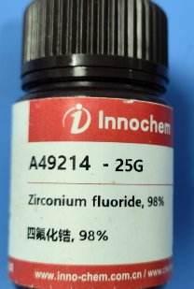
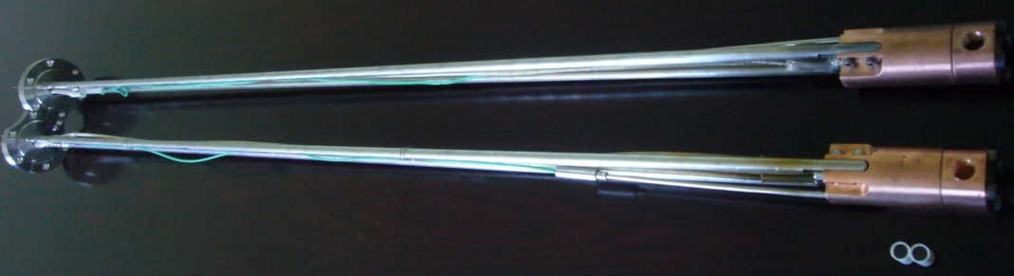
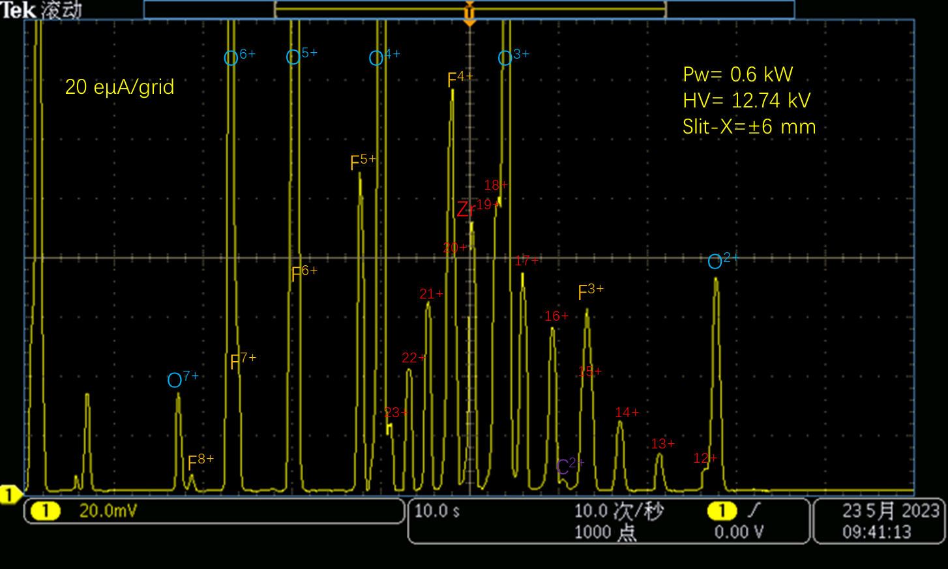
Status: Operation with Refractory Metal Ion Beams
Cartridge heating oven
Material: ZrF₄
Rf: 18 GHz
Pw= 0.5-0.6 kW
HV= 12.74 kV, Io= 3-4 emA
Slit-x= 12 mm
⁹⁴Zr¹⁹⁺= 50-100 euA
Oven temp.: ~460 ℃
Consumption rate: 3-4 mg/h
2023-5

Slide 17
Status: Operation Long-term Stability
2022-18+18 GHz-Ta³⁵⁺

Slide 18
Status: Operation Long-term Stability
2024-Single 18 GHz-Fe¹⁷⁺

Slide 19
Summary
Metallic ion beams production is a special topic for ECRIS
Diverse methods employed for routine operation
These remain challenging
High intensity routine operation
Reasonable consumption rate
Long-term stability
Rare/expensive isotope ion beam
Refractory metallic ion beam reliable operation

Slide 20


